Slide 1
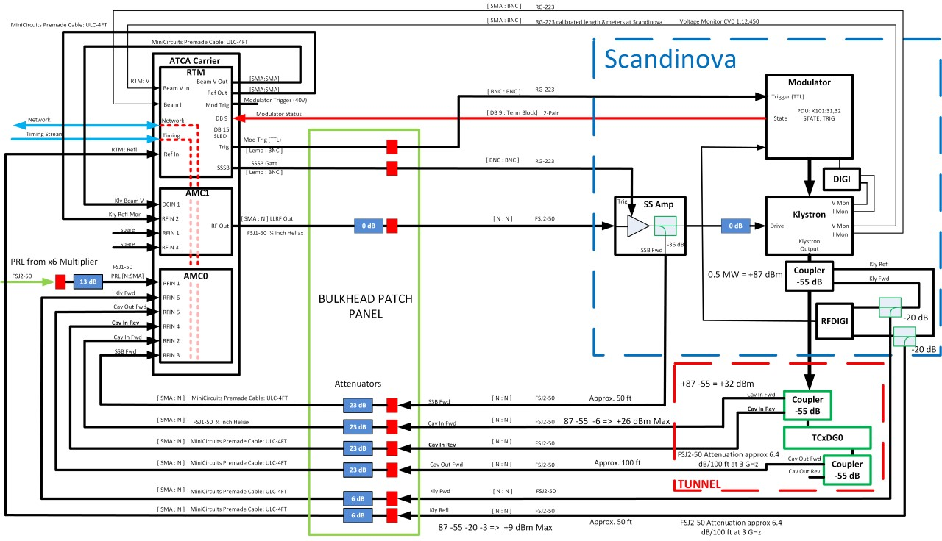
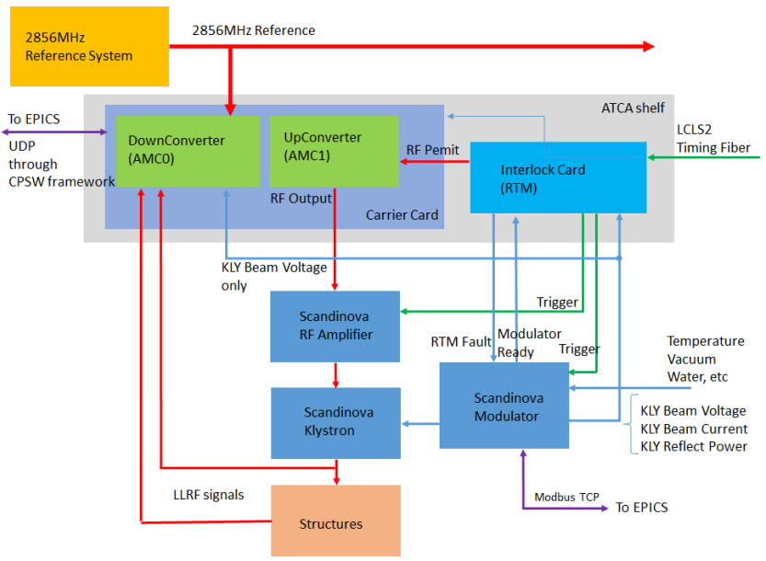
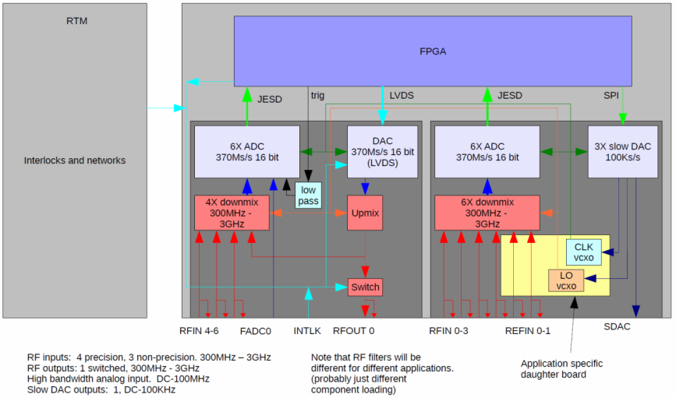
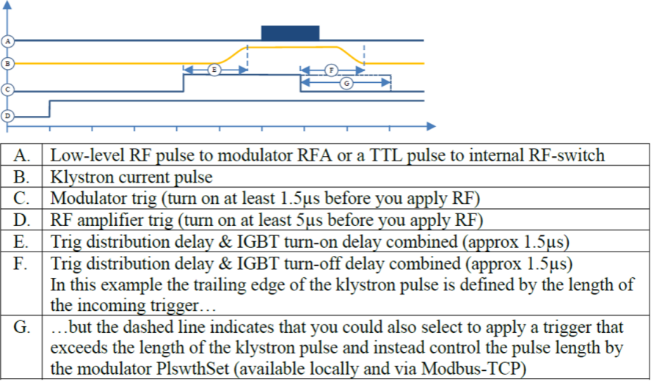
This work was supported by the LCLS-II project and the U.S. Department of Energy, contract DE-AC02-76SF00515
LLRF CONTROLS OF THE S-BAND TRANVERSE DEFLECTOR CAVITY FOR LCLS-II
N. Ludlow, J. Sikora, V. Dolghashev, E. Williams
SLAC National Accelerator Laboratory, USA
System Overview
The S-band Transverse Deflector (STCAV2) is a 2856 MHz deflecting cavity used for longitudinal beam diagnostics, such as, absolute electron bunch length, slice energy spread, and vertical slice emittance
The LLRF controls utilize the SLAC ATCA-based LLRF platform which has been successfully deployed for other beam operations
The high-power RF consists of a Solid-State Amplifier, modulator and a klystron supplied by ScandiNova Systems AB.
The Solid-State Amplifier is driven with a RF pulse at 2856 MHz at a repetition rate of 120 Hz at input power of less than 10 mW and the Klystron outputs 400 kW or less.
The ScandiNova systems send interlock controls and signals back to the ATCA Rear Transition Module (RTM)
LLRF System
The ATCA-based system consists of two advanced mezzanine cards (AMC cards) which plug into a carrier card that contains an FPGA for all signal processing, handling of timing/triggers, interface to RTM and communication with EPICS
An external 2856 MHz reference is provided to the downconverter which down mixes to IF of 85 MHz
85 MHz was chosen as the IF frequency because it is (5/21)*(Clock Frequency). Using non-IQ sampling demodulation scheme in the FPGA to help increase linearity in the demodulation
The ADCs are driven by a 357 MHz sampling clock and feed the 16-bit digitized measurement into the digital demodulator
Communication between the ADCs and the FPGA utilize the GTX receivers within the FPGA and use the JESD204B protocol.
The DAC used in up-conversion uses 16 bits of LVDS
The downconverter can also read the klystron beam voltage through a DC ADC channel with a high sampling rate for diagnostics and correlation with other beamline parameters such as beam position monitors
Specification | Value
Phase Noise | <0.2 deg (rms)
Amplitude Noise | <0.1%
Phase Drift | 1 ps/minute
Amplitude Drift | <0.1% (1min) (2 degree C)
RF Channel Bandwidth | >10 MHz
RF Channel Resolution | 16 bits
Non-Linearity | 0.1 degrees for 6 dB change
Modulator Voltage Readback | 14 bits

