Slide 1
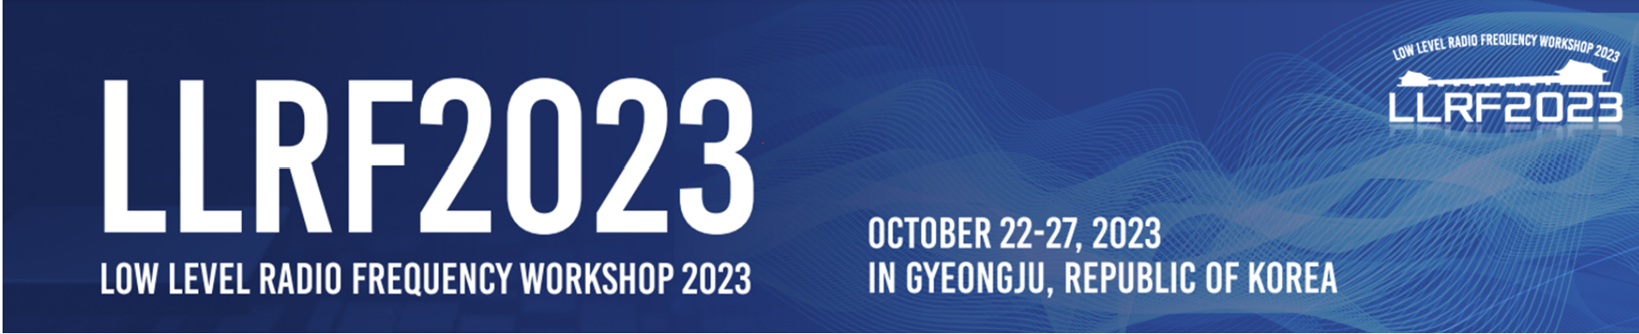
LLRF Algorithms for Superconducting Cavities in SHINE
X.F. Huang, Y.B. Zhao, X. Zheng, Z.G. Zhang, K. Xu,
S.J. Zhao, H.R. Jiang, W.F. Yang, H. Wu, H.L. Wu, Y.C Yu
Shanghai Advanced Research Institute. CAS
2023.10.25

Slide 2
Outline
1 Overview of LLRF algorithms
2 Microphonics Studies
3 Microphonics Suppression

Slide 3
1.1 Control Algorithms
Amplitude / phase Control Loop:
1, GDR/SEL modes
2, PI algorithm
Digital Frequency Control Loop
slow tuning:
1, PI algorithm
fast tuning:
1, PI algorithm
2, microphonics suppression
Others
1, conditioning
2, online measurement
3, monitoring/interlock
The framework of Low-level RF control system

Slide 4
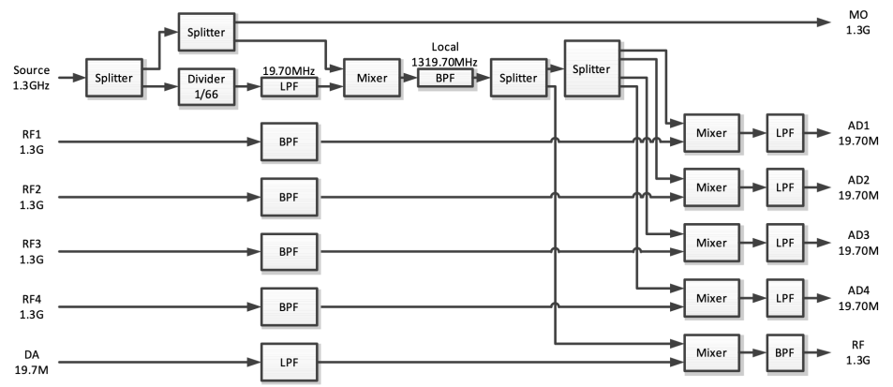
1.2 Sampling Module
The reference signal is 1.3GHz.
ADC clock: 108.33MHz (1300/12)
DAC clock: 108.33MHz (1300/12)
IF： 19.7MHz (1300/66)
LO：1319.7MHz
Sampling scheme：non-IQ (2/11)
1.3GHz LLRF front-end signal flow chart

Slide 5
1.3 Two-Driven Modes
GDR Mode：
Two modes have already been used in SHINE, such as vertical test and horizontal test.
SEL Mode：

Slide 6
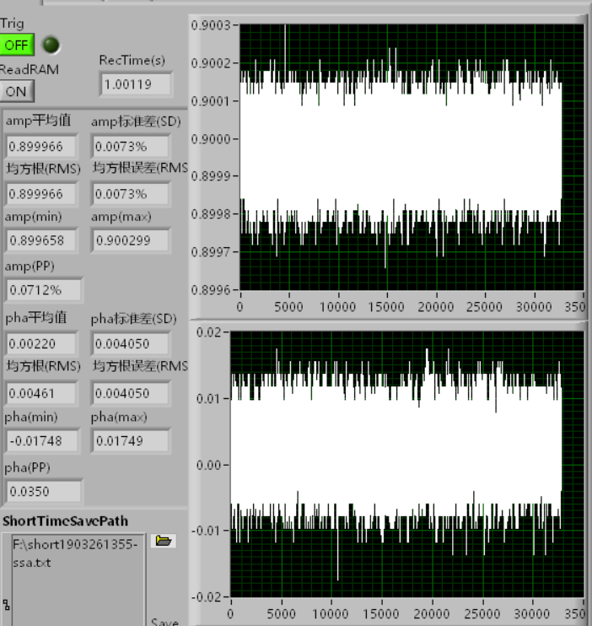
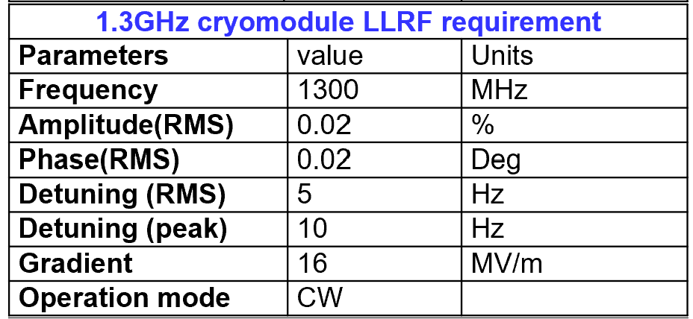
1.4 A&P Algorithm
The objective of operational stability:
The stability of LLRF itself without SSA and cavity:
Amplitude stability <0.01%(rms)， Phase stability <0.01deg(rms)
This stability meets operational goals.

Slide 7
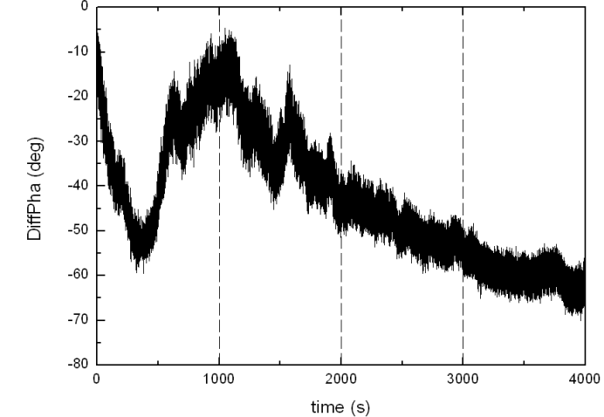
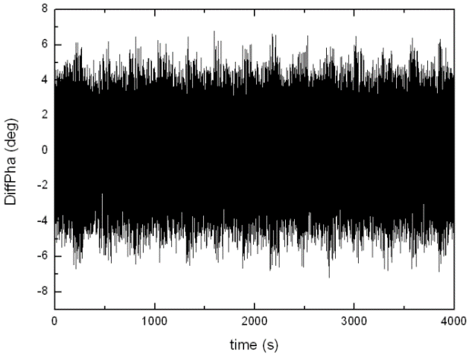
1.5 Digital Frequency Control Loop
The Scheme design of frequency control loop
PID OFF
PID ON
Fast tuning:
When the PID controller is turned off,
the phase fluctuation is about 70 deg.
When the PID controller is turned on,
the phase fluctuation is reduced to +/- 6 deg.
The PID algorithm is effective in suppressing slow changes in frequency.
The Phase difference between forward signal and cavity signal in one hour

Slide 8
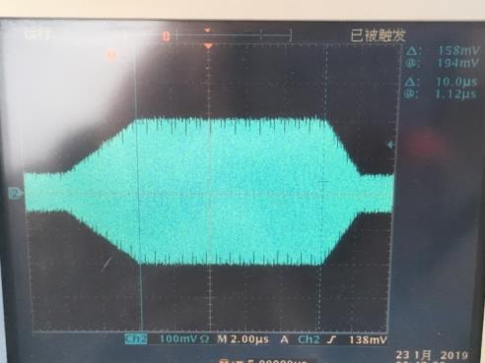
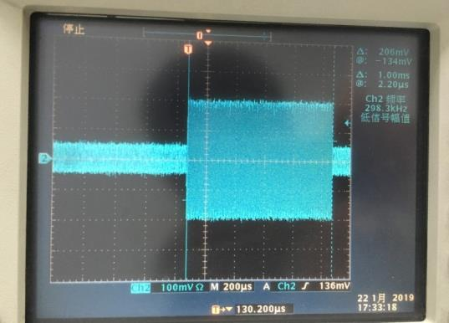
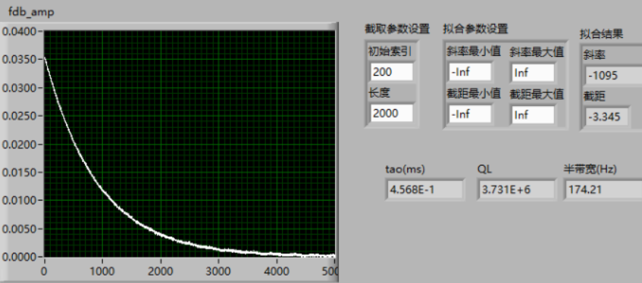
1.6 Auxiliary
Pulse Conditioning
Repetition frequency:
0.1Hz – 200kHz
Duty: 1-100%
Rise/Falling edge:
Programmable
1us Pulse
1ms Pulse
Q_{L} measurement
Record time: 1us – 20s
Linear fitting

Slide 9
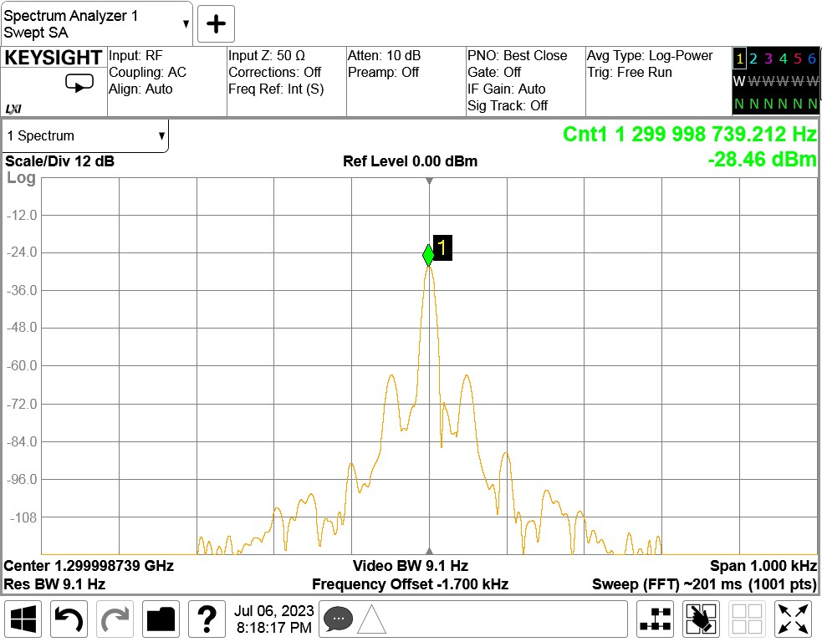
2.1 Microphonics Studies
Where is 50Hz sideband?
Main signal source: NONE
LLRF output: NONE
The pickup from the cavity: Measured
The on-site vibration sensor: Measured
What is the vibration source at 50Hz?
50Hz
50Hz microphonics measured at cavity signal
Conditions:
Stable environment:
8# cavity located at the end of a cryomodule,
far away from cryogenic valves
Small cavity input power: ~ 50W

Slide 10
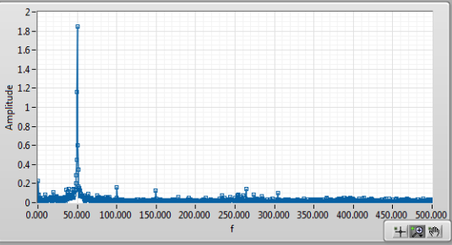
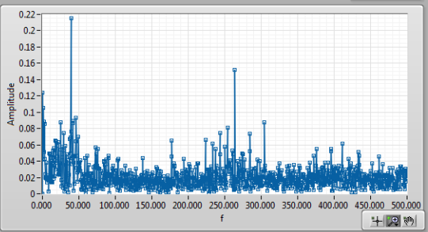
2.2 Microphonics Studies
Pump on
Pump off
Measured vibration spectrum when the vacuum pump is on and off
The vibration is introduced into the cryomodule through the bellows from the vacuum pump in the tunnel .

Slide 11
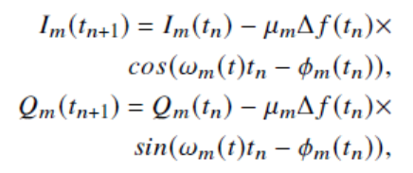
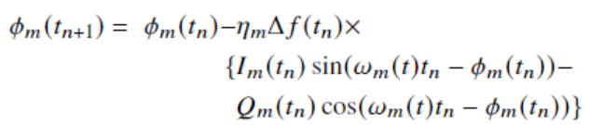
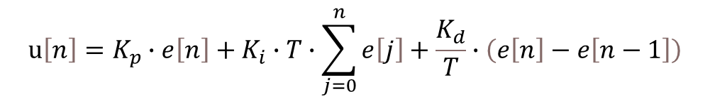
3.1 Microphonics Suppression
Our designed control loop includes PI (Proportional-Integral) and ANC (Active Noise Control) control, as shown in the following block diagram.
Incremental PID algorithm：
$$u\left[n\right]=K_{p}∙e\left[n\right]+K_{i}∙T∙\sum_{j=0}^{n}{e\left[j\right]}+\frac{K_{d}}{T}∙\left(e\left[n\right]−e\left[n−1\right]\right)$$
Narrow Bandwidth ANC: (A.Bellandi, et al., LINAC2022, THPOPA21)

Slide 12
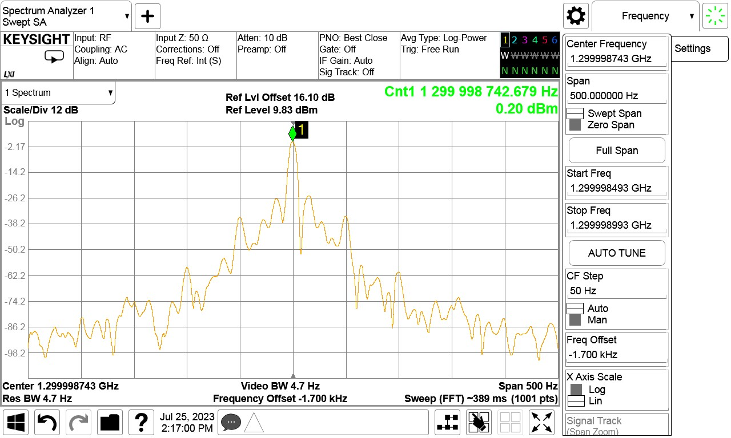
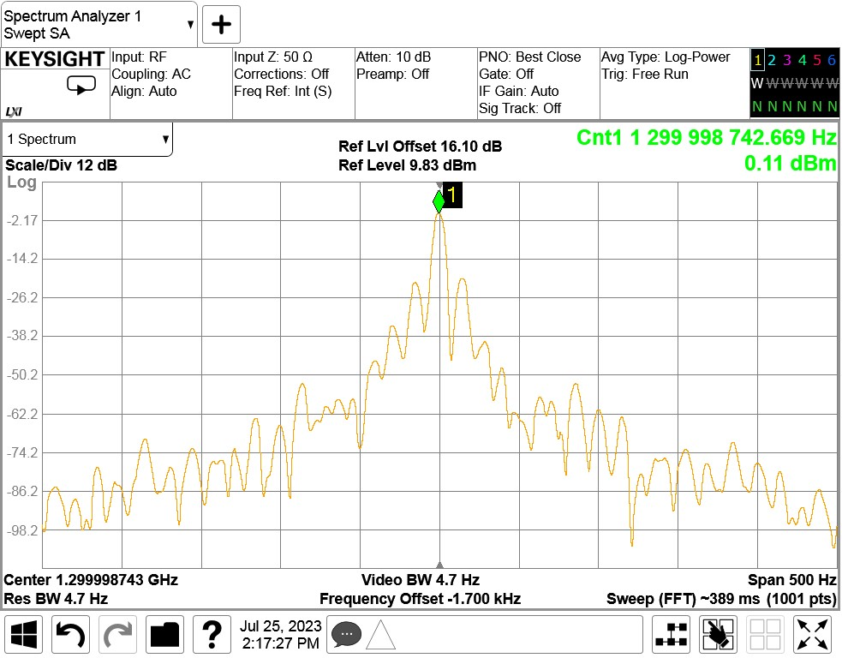
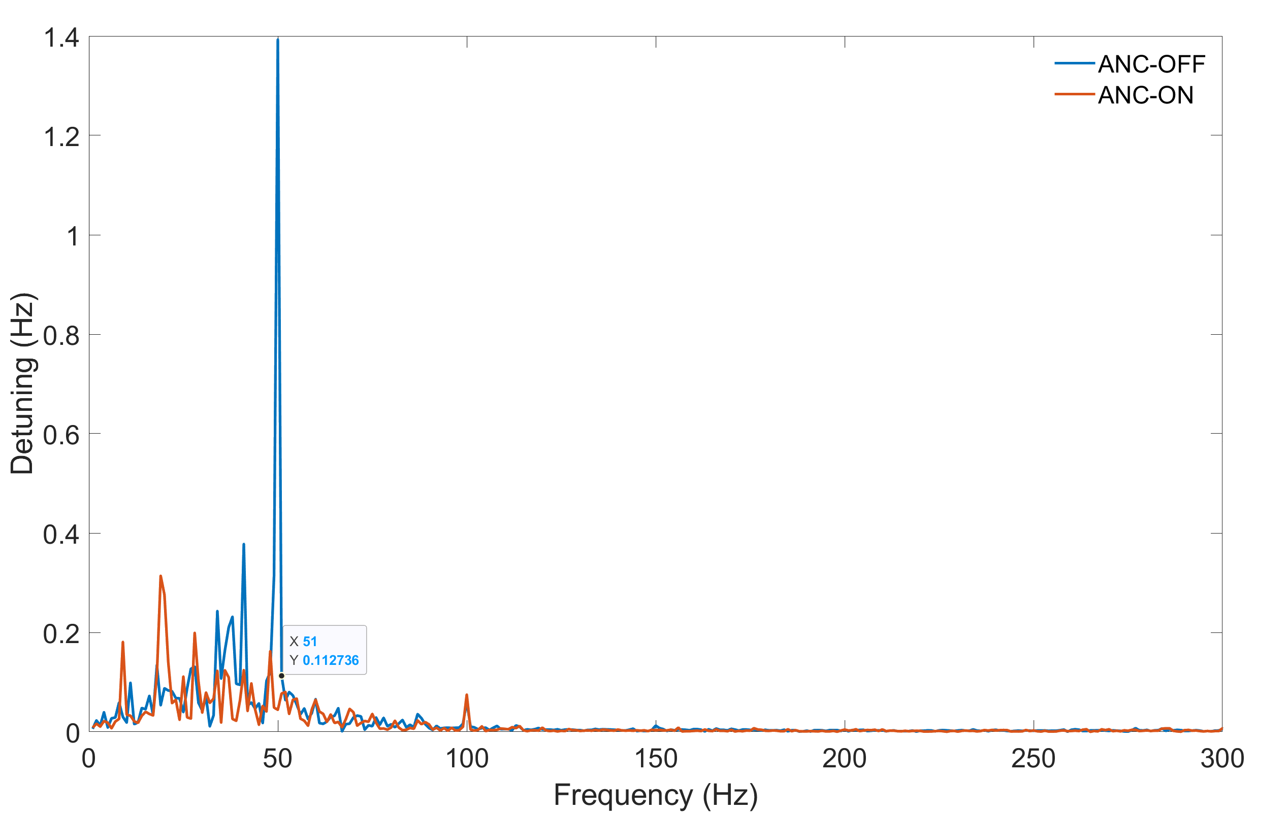
3.2 Microphonics Suppression
ANC OFF
ANC ON
Detuning Spectrum
Suppression experiment:
Subject: 8# cavity in the Cryomodule
Cavity incident power: 1kW.
Operating in GDR operating mode with a closed-loop frequency control.
50Hz sideband: -38dB (ANC Off), -50dB(ANC On)
With ANC algorithm, 50Hz noise is obviously suppressed.

Slide 13
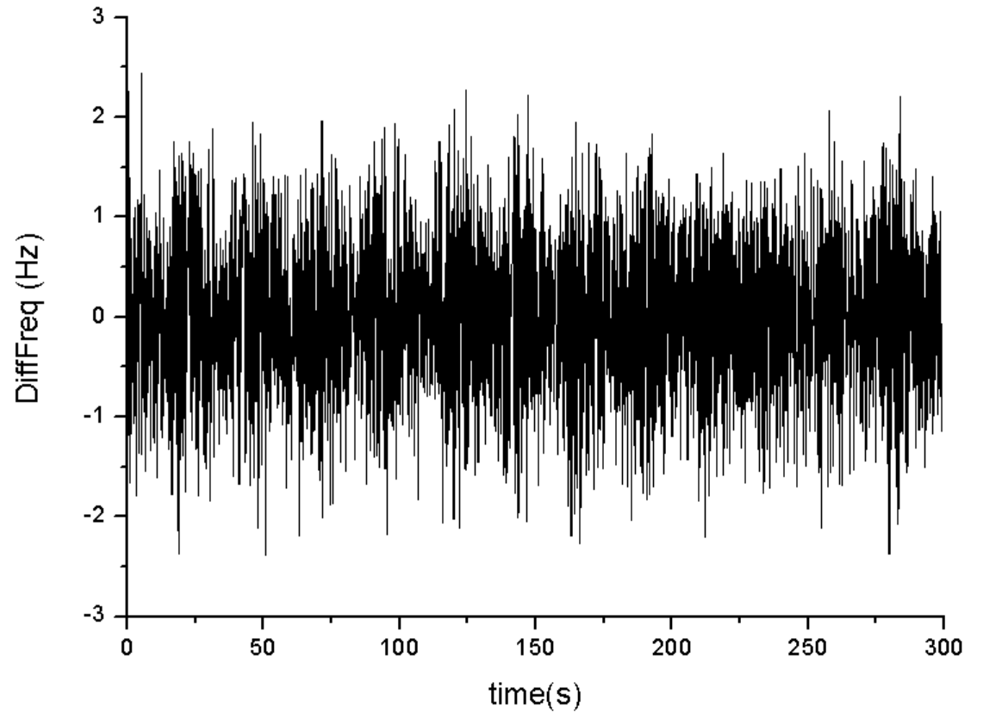
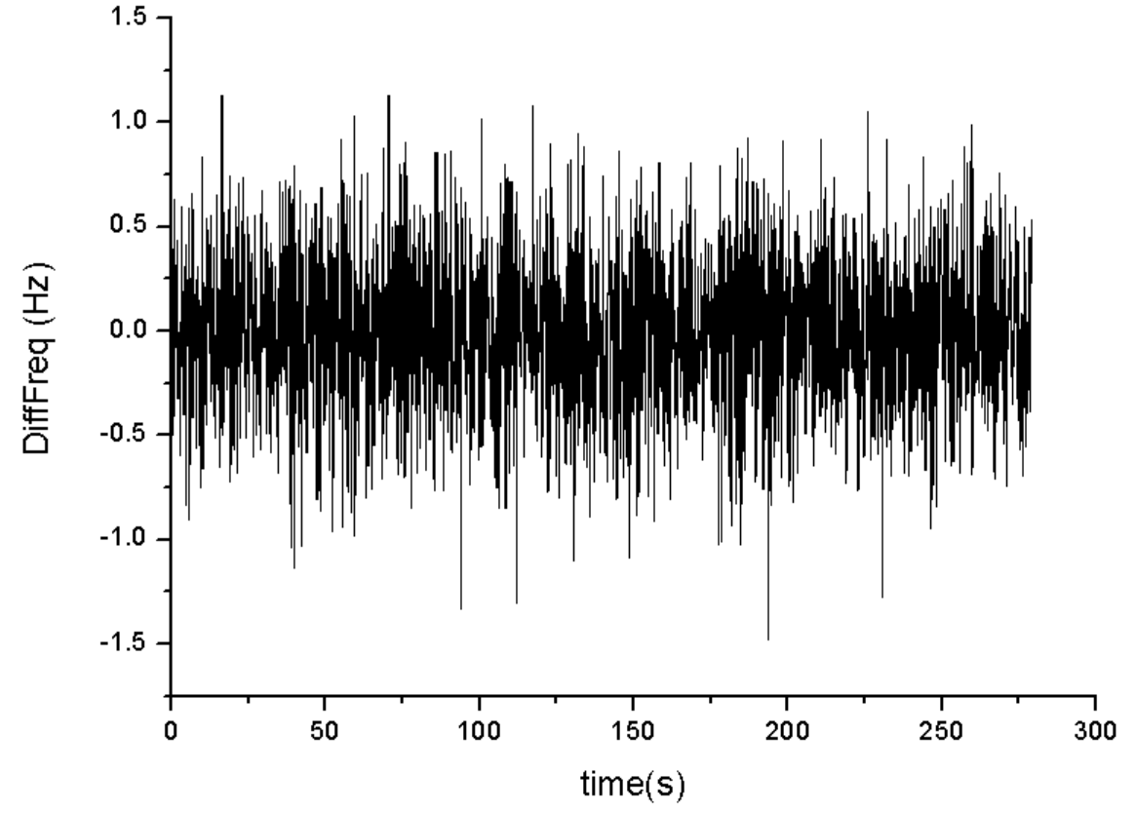
3.3 Microphonics Suppression
Detuning distribution
Detuning in 5min (ANC Off)
Detuning in 5min (ANC On)
Suppression experiment:
Subject: 8# cavity in the Cryomodule
Cavity incident power: 1kW.
Operating in GDR operating mode.
Peak detuning: ~40% reduction with ANC ON.
With ANC algorithm, the peak detuning is obviously reduced.

Slide 14
Conclusions & Outlook
LLRF algorithms has been implemented in CW operation
  Two operation mode: GDR, SEL
  The LLRF stability without SSA and cavity:
    Amplitude stability (rms): <0.01%
    Phase stability (rms): <0.01deg
Microphonics noise has been successfully compensated
  Algorithm: PI + ANC
  Cavity peak detuning is reduced by 40%.
In the near future, LLRF will be tested in more cavities.
  More complicated environment
  More events

Slide 15
Thank you for your attention!

