Slide 1
An Intra-pulse feedforward algorithm for improving
pulsed microwave stability
Reporter: JIAWEI HAN
Author: Jiawei Han, Hongli Ding, Jinfu Zhu, Haokui Li, Xiwen Dai, Jiayue Yang, Weiqing Zhang
2022-10-24
1
Notes:
Good morning, everyone. I am from Institute of Advanced Science Facilities, Shenzhen,chaina . It’s my pleasure to be here today to present my report on An Intra-pulse feedforward algorithm for improving pulsed microwave stability.

Slide 2
Contents
1 Motivation
2 Model and algorithm
3 Automation software and verification
4 Conclusion and future work
Notes:
This is the table of contents for this report. Build propose

Slide 3
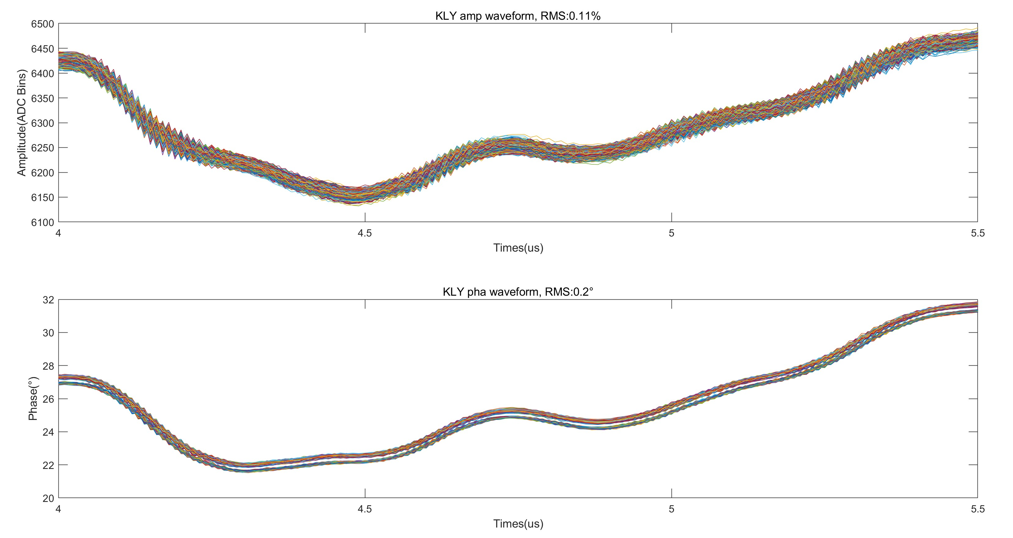
1 Motivation
In the pulse operation process of the Dalian Coherent Light Source (DCLS) linear accelerator, the klystron plays an important role in the microwave system.
During operation in DCLS, we found that there is obvious jitter between adjacent microwaves output by klystron.
Before algorithm execution
Figure1 DCLS
delamination phenomenon
After algorithm execution
Figure2 Jitter between adjacent microwaves
Figure3 Purpose
Notes:
Figure 1 is the Dalian Coherent Light Source，and In the pulse operation process of it，the klystron plays an important role in the microwave system.
During operation in DCLS, we found that there is obvious jitter between adjacent microwaves output by klystron.
Figure 2 shows the Jitter between adjacent microwaves .
This result the Amplitude and phase bad stability of klystron output microwave, which is 0.11%/0.2 degrees.
Our intention is to find a kind of feed-forward algorithm, by which we can reduce the jitter within the pulse
just like Figure3. so we can improve the stability.

Slide 4
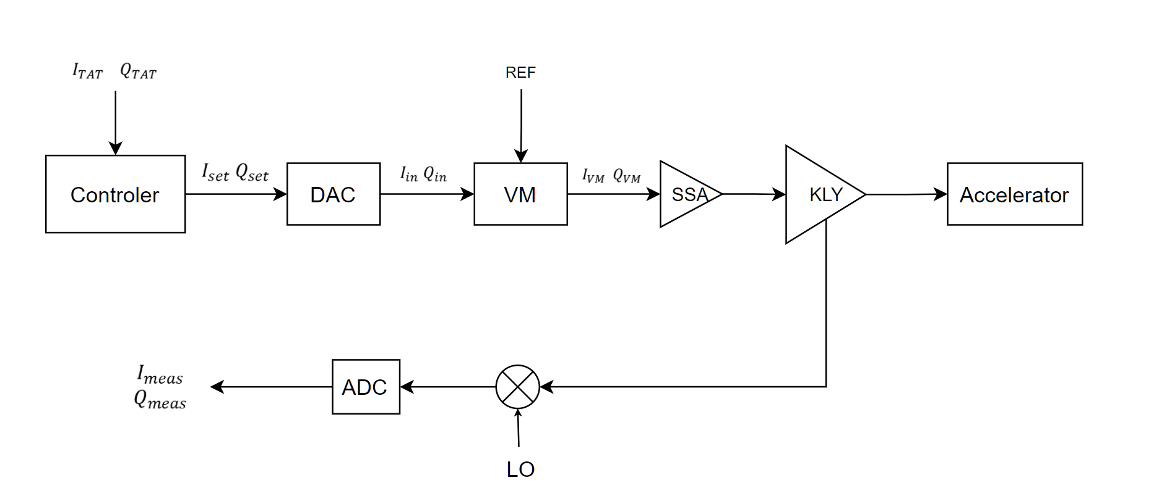
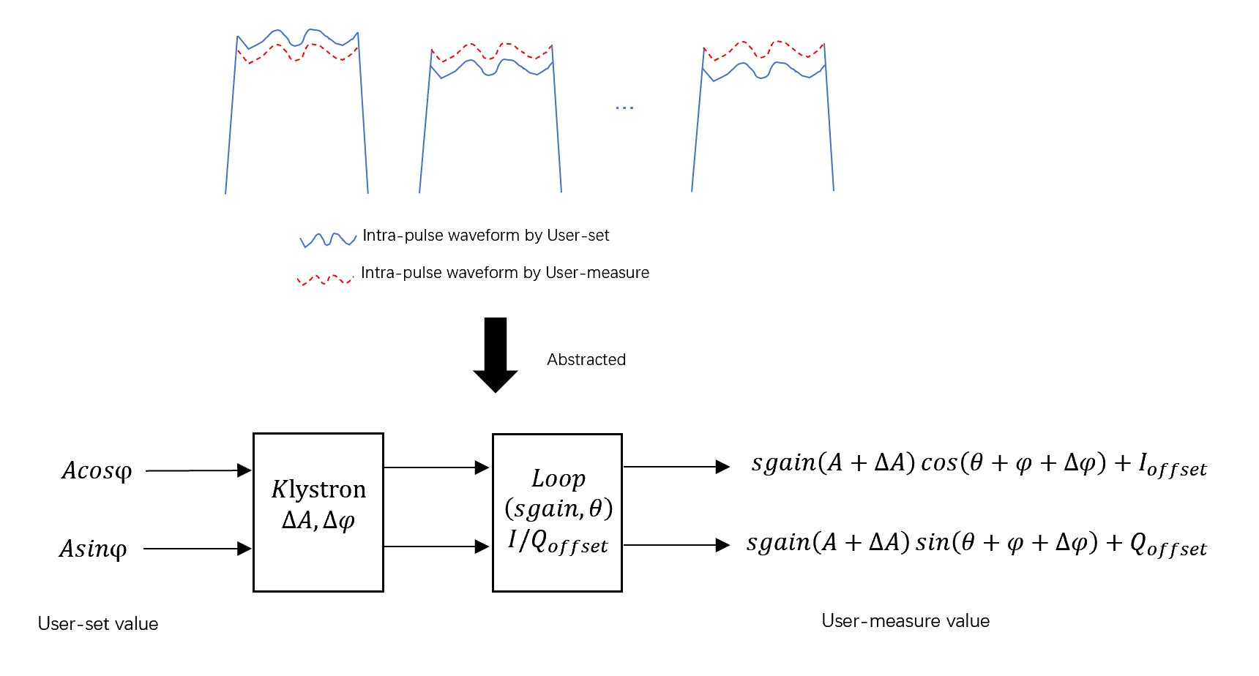
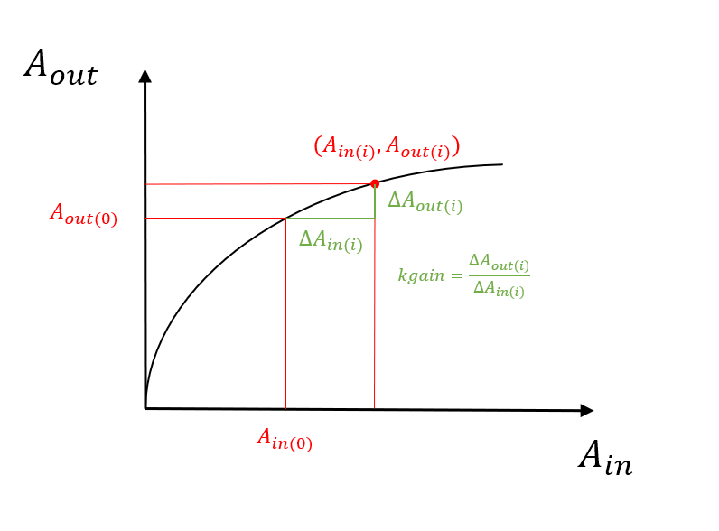
2.1 Model expression of the problem
Klystron small-scale linear and amplitude phase jump model: Physical process → Abstract model → mathematical expression.
Figure3 The abstract model of the entire loop physical process
Figure1 The physical process from LLRF excitation to measurement
Figure4 The mathematical expression of abstract models
Figure2 The klystron input-output curve
Notes:
Then, We built the Klystron small-scale linear and amplitude phase jump model.
Those pictures show the Model building. From Physical process to our Abstract model ,and then to the mathematical expression.
Figure 1 shows the physic messsare loop . user set the value , through controller, DAC vm ssa kly and then get the messared value.
The klystron normalized input and output curve is shown in Figure 2 , WE define kgain is equal to derlt AOUT devided by derlt AIN
Figure3 is The abstract model of the entire loop physical process.
And then we get The mathematical expression of our abstract model like Figure4.

Slide 5
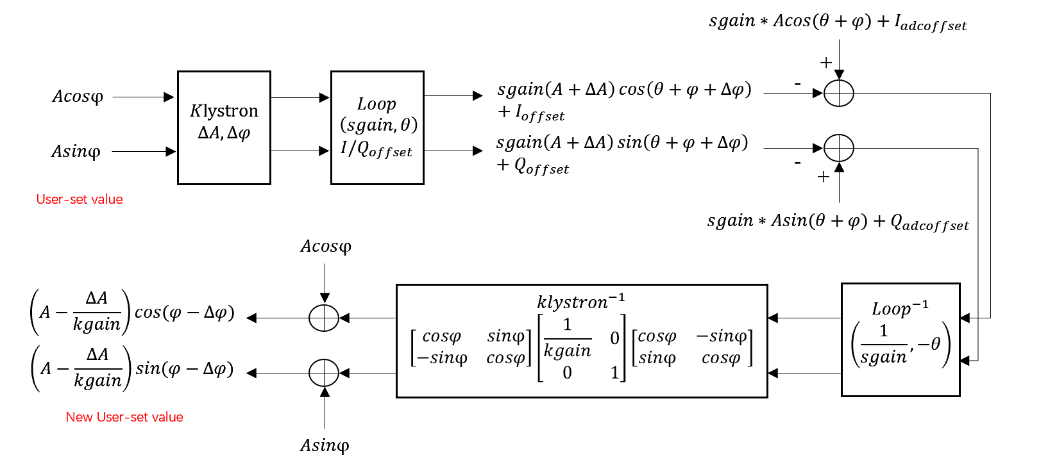
2.2 Intra-pulse feedforward algorithm
To solve the problem of klystron amplitude and phase jump in a small-scale linear amplitude and phase jump model, we designed an intra pulse feedforward algorithm.
Get the difference between the measured value and the expected value.
Inverse transformation of klystron small-scale linear and amplitude phase jump model.
Compensate for user input values.
Mathematical derivation of intra pulse feedforward algorithm
Notes:
To solve the problem of jitter in our model, we designed an intra pulse feedforward algorithm.
Get the difference between the measured value and the expected value.
Inverse transformation of klystron small-scale linear and amplitude phase jump model.
Compensate for user input values.

Slide 6
2.3 Key parameter of our algorithm
According to our model and algorithm, to suppress amplitude and phase jump, it is necessary to measure the loop phase shift($θ$), loop gain($sgain$) and $kgain$ parameters.
By fitting multiple sets of measured values and solving those matrix, the loop phase shift($θ$) loop gain($sgain$) and $kgain$ parameters can be obtained.
Notes:
According to our model and algorithm, to suppress the jitter, it is necessary to measure the loop phase shift($θ$), loop gain($sgain$) and $kgain$ parameters.
By fitting multiple sets of measured values and solving those matrix, the loop phase shift($θ$)， loop gain($sgain$) and $kgain$ parameters can be obtained

Slide 7
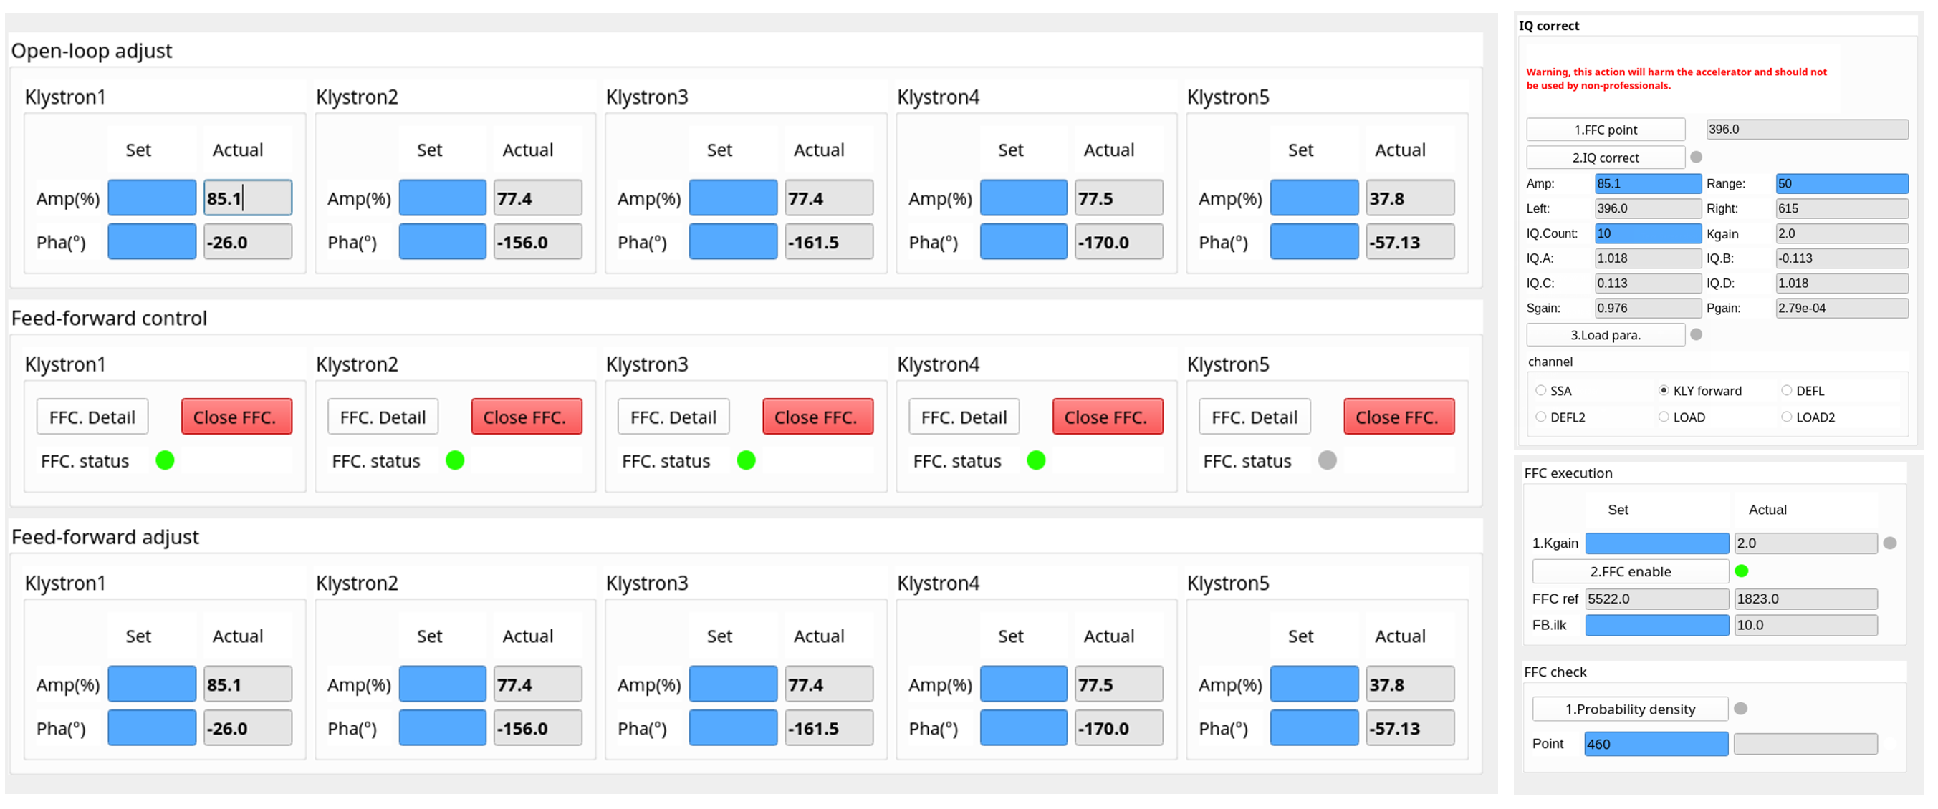
3.1 Automation application software
We created a user GUI application based on PyQt.
The main functions of the software include: LLRF excitation of amp/pha, calculation of key parameters, intra-pulse feedforward switch, etc.
Notes:
We created a user GUI application based on PyQt.
The main functions of the software include: LLRF excitation of amp/pha, calculation of key parameters, intra-pulse feedforward switch, etc.

Slide 8
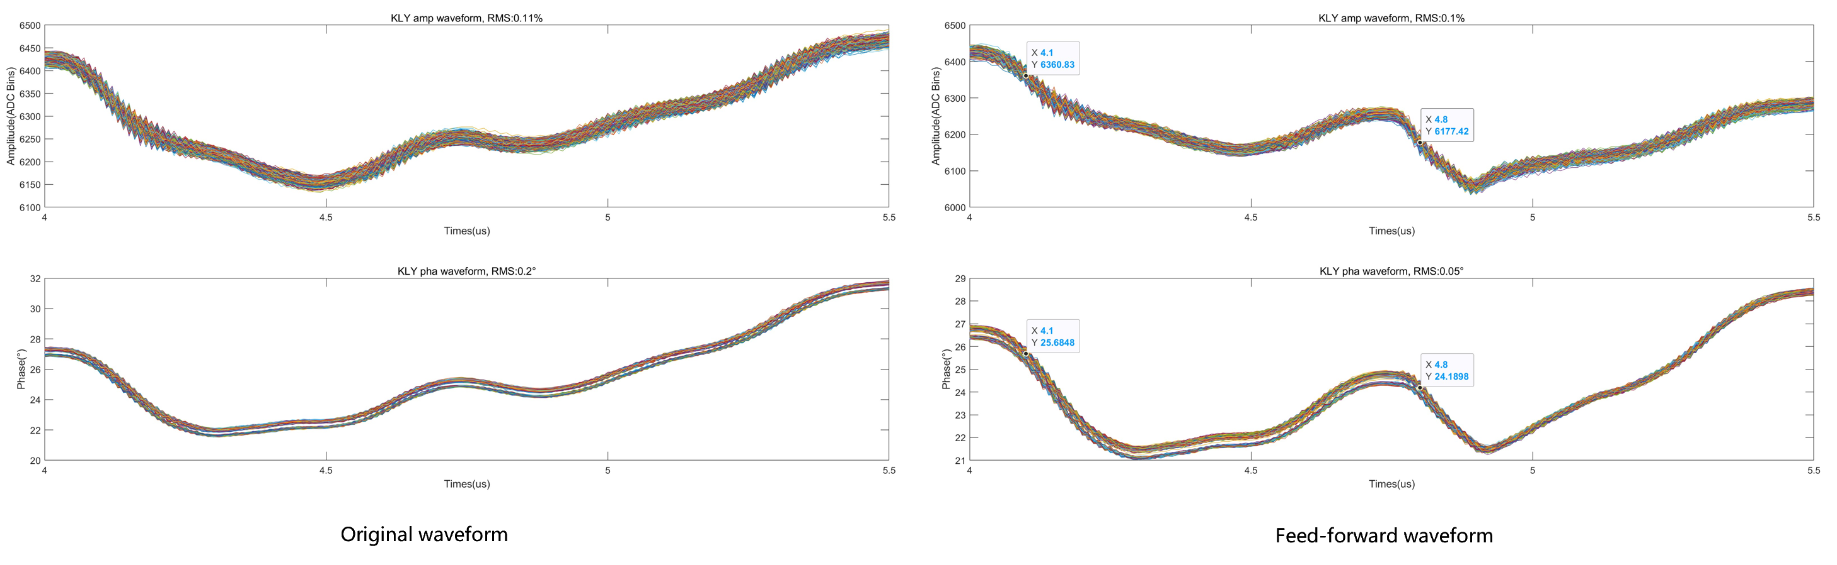
3.2 Experimental verification
This algorithm can effectively suppress the jitter between adjacent microwaves and improve the amplitude and phase stability (RMS) from 0.11%/0.2°to 0.1%/0.05°.
It can be seen from the figure that the phase layered jitter phenomenon of microwaves is significantly stronger than the amplitude layered jitter. Therefore, the improvement of microwave phase stability by the algorithm is far better than the improvement of microwave amplitude stability.
Notes:
This algorithm can effectively suppress the jitter between adjacent microwaves and improve the amplitude and phase stability (RMS) from 0.11%/0.2°to 0.1%/0.05°.
It can be seen from the figure that the phase layered jitter phenomenon of microwaves is significantly stronger than the amplitude layered jitter. Therefore, the improvement of microwave phase stability by the algorithm is far better than the improvement of microwave amplitude stability.

Slide 9
4 Conclusion and future work
We propose an intra-pulse feedforward algorithm based on klystron small-scale linear and amplitude phase jump model.
We developed user-level automation software that enables our feedforward algorithm.
Verification was carried out based on DCLS. The results show that our algorithm can effectively suppress the jitter between adjacent microwaves.
In the future, we will further accumulate theoretical and practical experience for the Shenzhen medium-energy high repetition rate X-ray free electron laser (S3FEL) device.
Notes:
In conclusion, I’d like to summarize the main points of my report.

Slide 10
THANKS
Thanks to Beijing Institute of High Energy Physics, Shanghai Institute of Higher Education, Lanzhou Institute of Modern Physics, Peking University, Tsinghua University and DESY
Notes:
That concludes my presentation. Thank you

