Slide 1
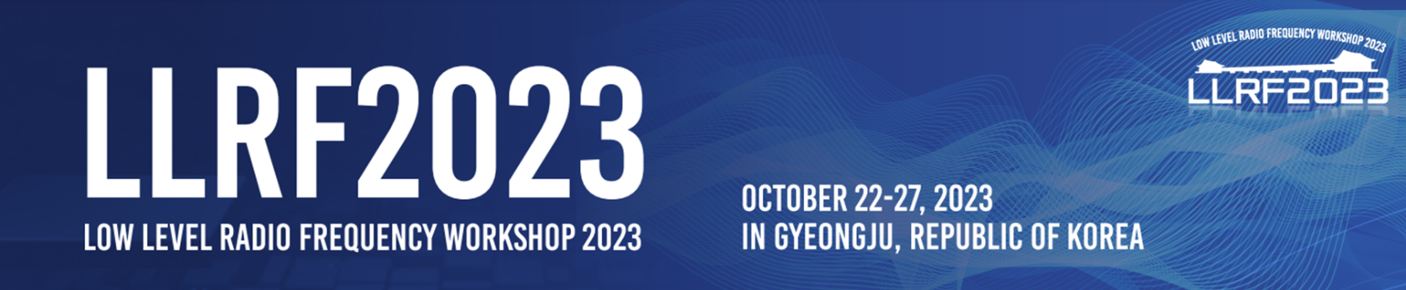

DESY lab talk
LLRF Workshop 2023
Julien Branlard, for the LLRF team
23.10.2023
Gyeongju, Republic of Korea
Notes:
12+3 mins

Slide 2
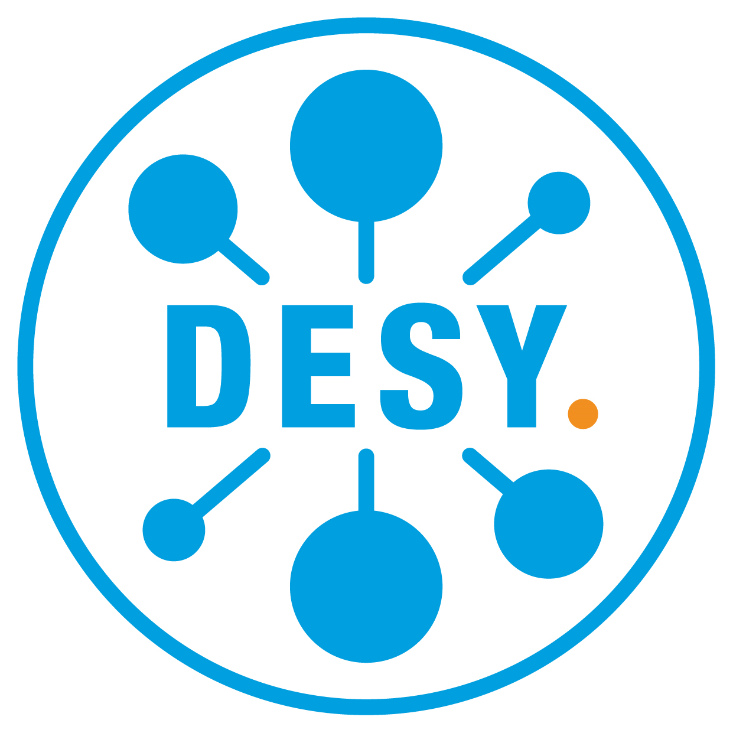
DESY strategy
(disclaimer) …at least my interpretation of it.
Pursuing the following high level goals
  Bio-Nanomaterials/Bio-Medical
  Exploration of matter and the universe
  Understanding the fundamental laws of nature
  Plasma acceleration
  Quantum Technologies
while
Pushing development on the following fields
  X-rays
  Laser
  Electrons
  Accelerators
  Detectors
  Computing
The following key words are becoming dominant in the management communications
Climate change
Energy supply
Sustainability
Digitalization
AI & Robotics
Autonomous operation
Big Data
International cooperation
Diversity
Cosmopolitan
For accelerators: develop new technologies (plasma acceleration) but keep a key role in FELs (FLASH / XFEL) and synchrotrons
Short term : FLASH 2020+ upgrade (2025-2026)
Mid term : Top priority set for PETRA IV upgrade (2030)
Mid term : Build a plasma wakefield accelerator (KALDERA) (2030)
Longer term : Prepare for new horizons with CW-XFEL (2035)

Slide 3

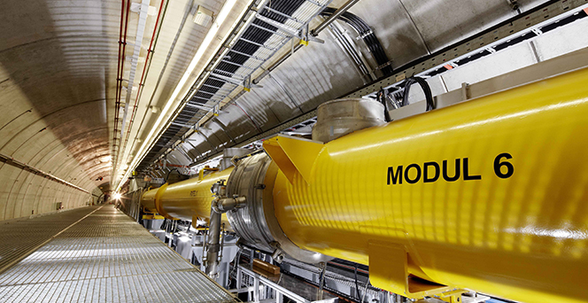
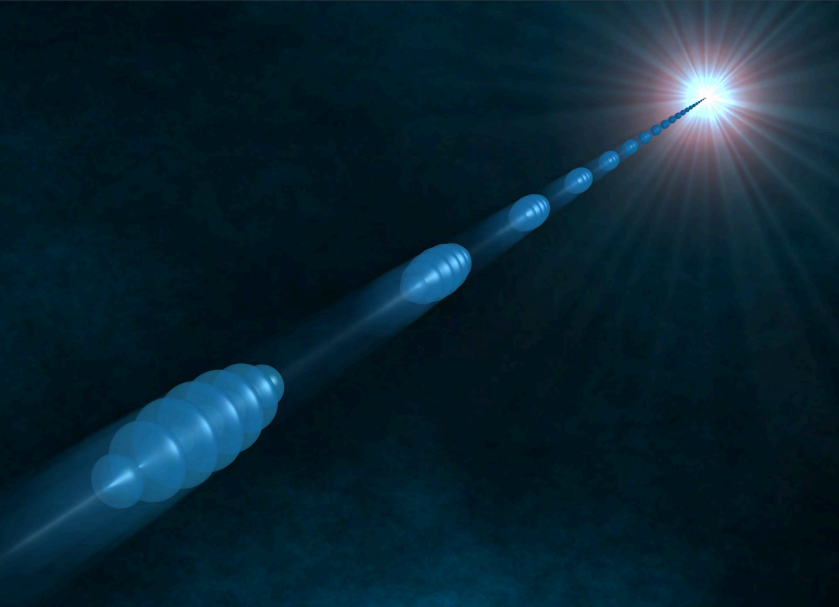
FLASH
Successive upgrades
Courtesy Christian Schmidt
Last year: 2022 shutdown
  ACC23 = 2 new cryomodules with cavities running
  on average at 28 – 29 MV/m
  New main oscillator
Demonstrated new energy 1.34 GeV
  increase from 1.3 GeV
  ACC45 : plan to place waveguide attenuators on
  2 cavities to lower field emission
  should help increase gradient 1.35 GeV
Next shutdown: Summer 2024 – Fall 2025
  FLASH 2020+ goal : provide external seeding
  LLRF:
    modernizing legacy monitoring system (new racks, VME → MTCA)
    improving RF reference distribution to bring benefit of new MO to end users
see next slide
photo: http://flash.desy.de
FLASH
2020+
Making FLASH brighter, faster and more flexible

Slide 4
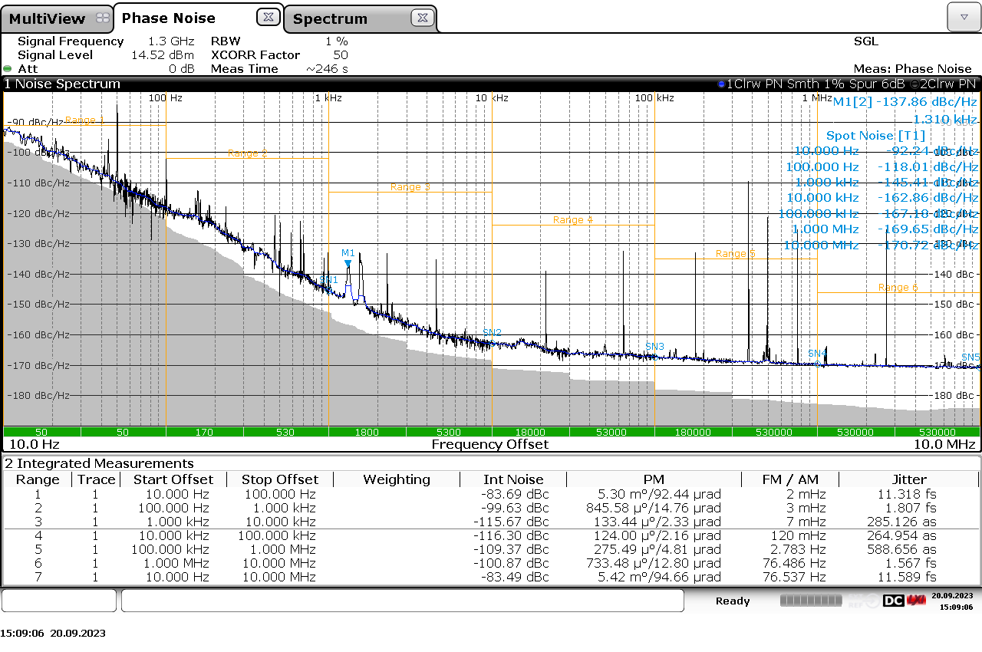
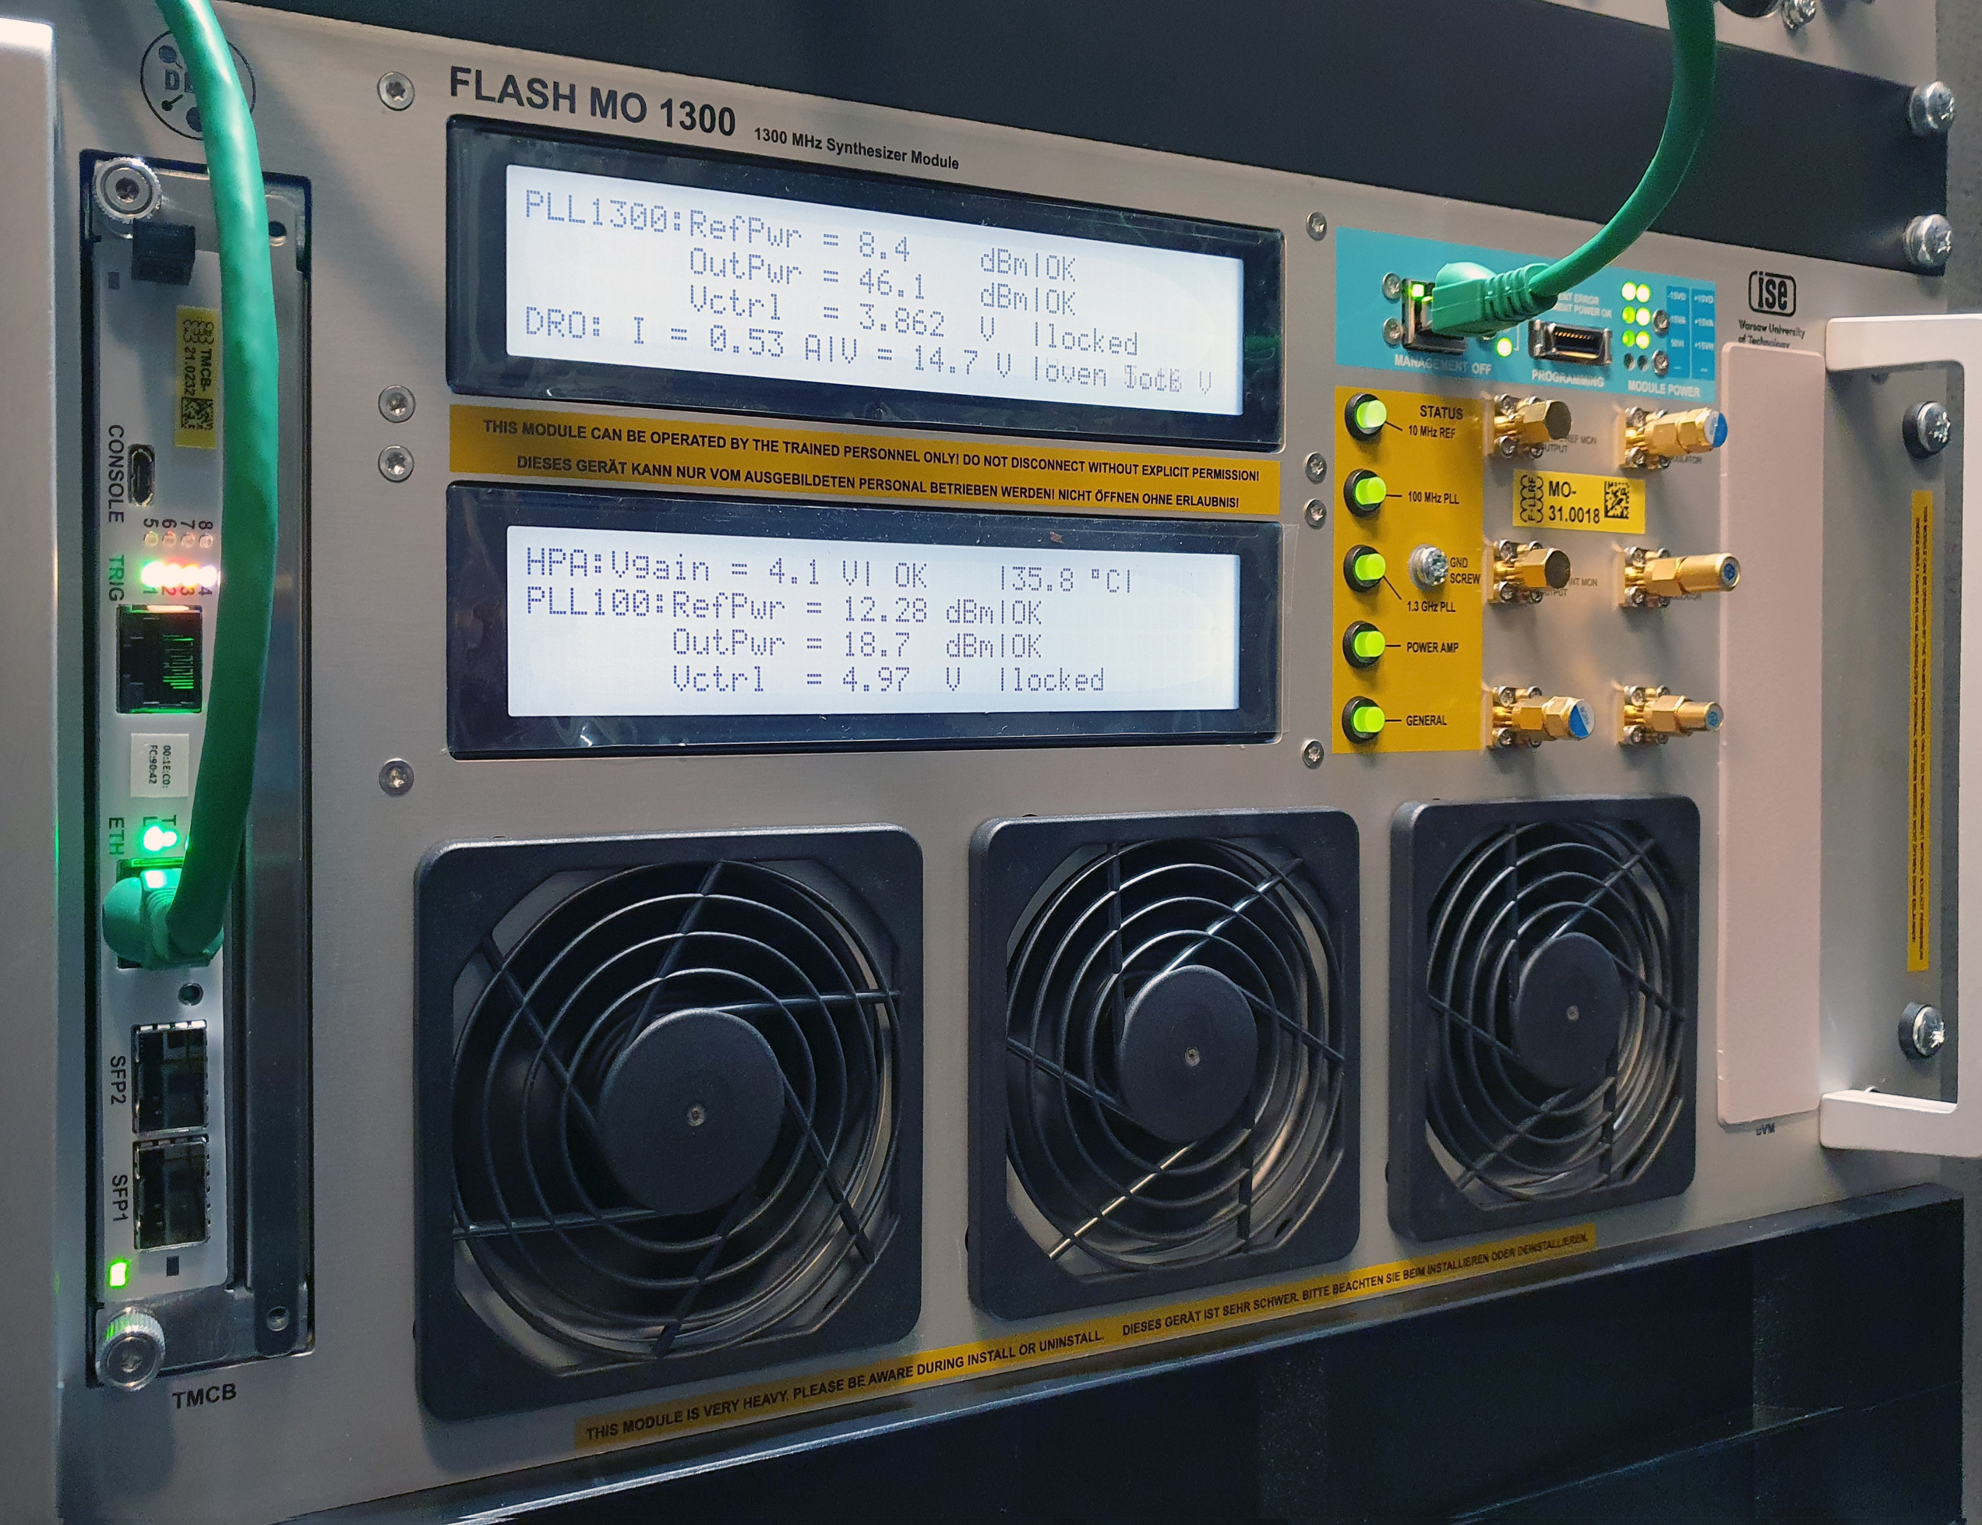



FLASH
Integrated jitter:
< 12 fs [10 Hz to 100 Hz]
< 1.8 fs [100 Hz to 1 kHz]
< 0.8 fs [1 kHz to 1 MHz]
R&D: Sub – 1fs (Femtosecond) reference
Under license from DESY
MO designed in collaboration with ISE, Poland
Courtesy Frank Ludwig & Heinz Pryschelski
- Improvement of integrated jitter from 38 fs to 1.8 fs [100Hz, 1MHz]
- fs-laser systems locked to the reference show significant improvement
KVG Quartz Crystal Technology GmbH
info@kvg-gmbh.de

Slide 5
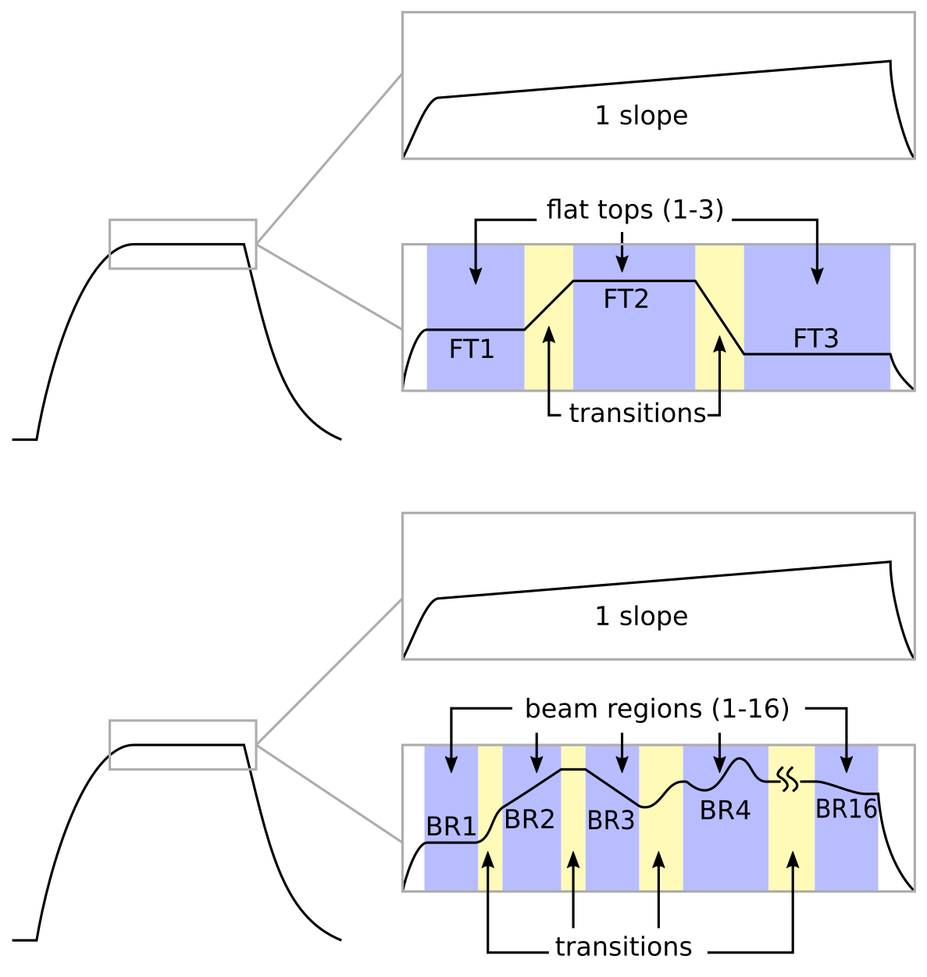
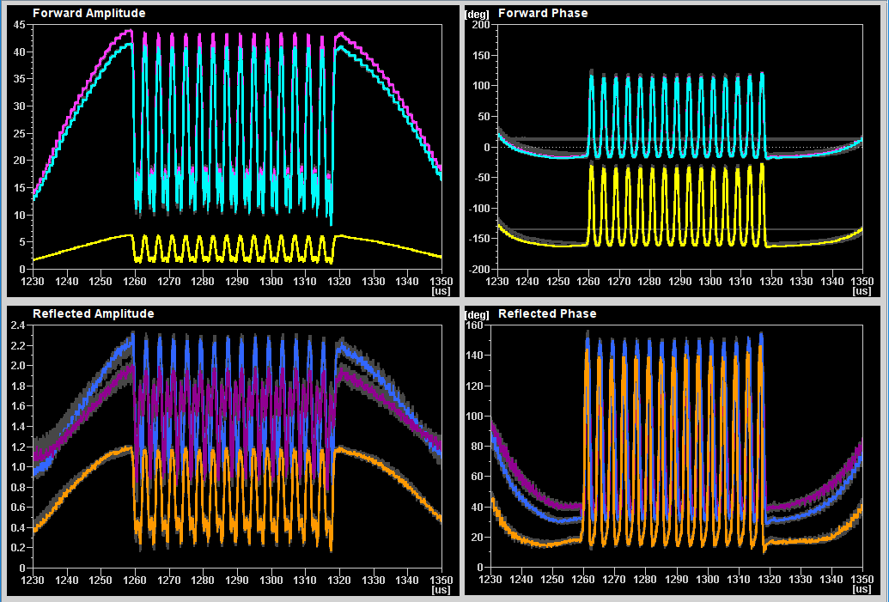
XFEL
On-going development and plan for next shutdown’s upgrade
On-going development
  Beam regions
Up to 16 independent beam regions
Can ALSO be used to modulate individual bunches
Tested up to 200 kHz (1.0 MV/m, 1.0 deg.)
250 kHz (0.5 MV/m, 0.5 deg.)
old
new

Slide 6
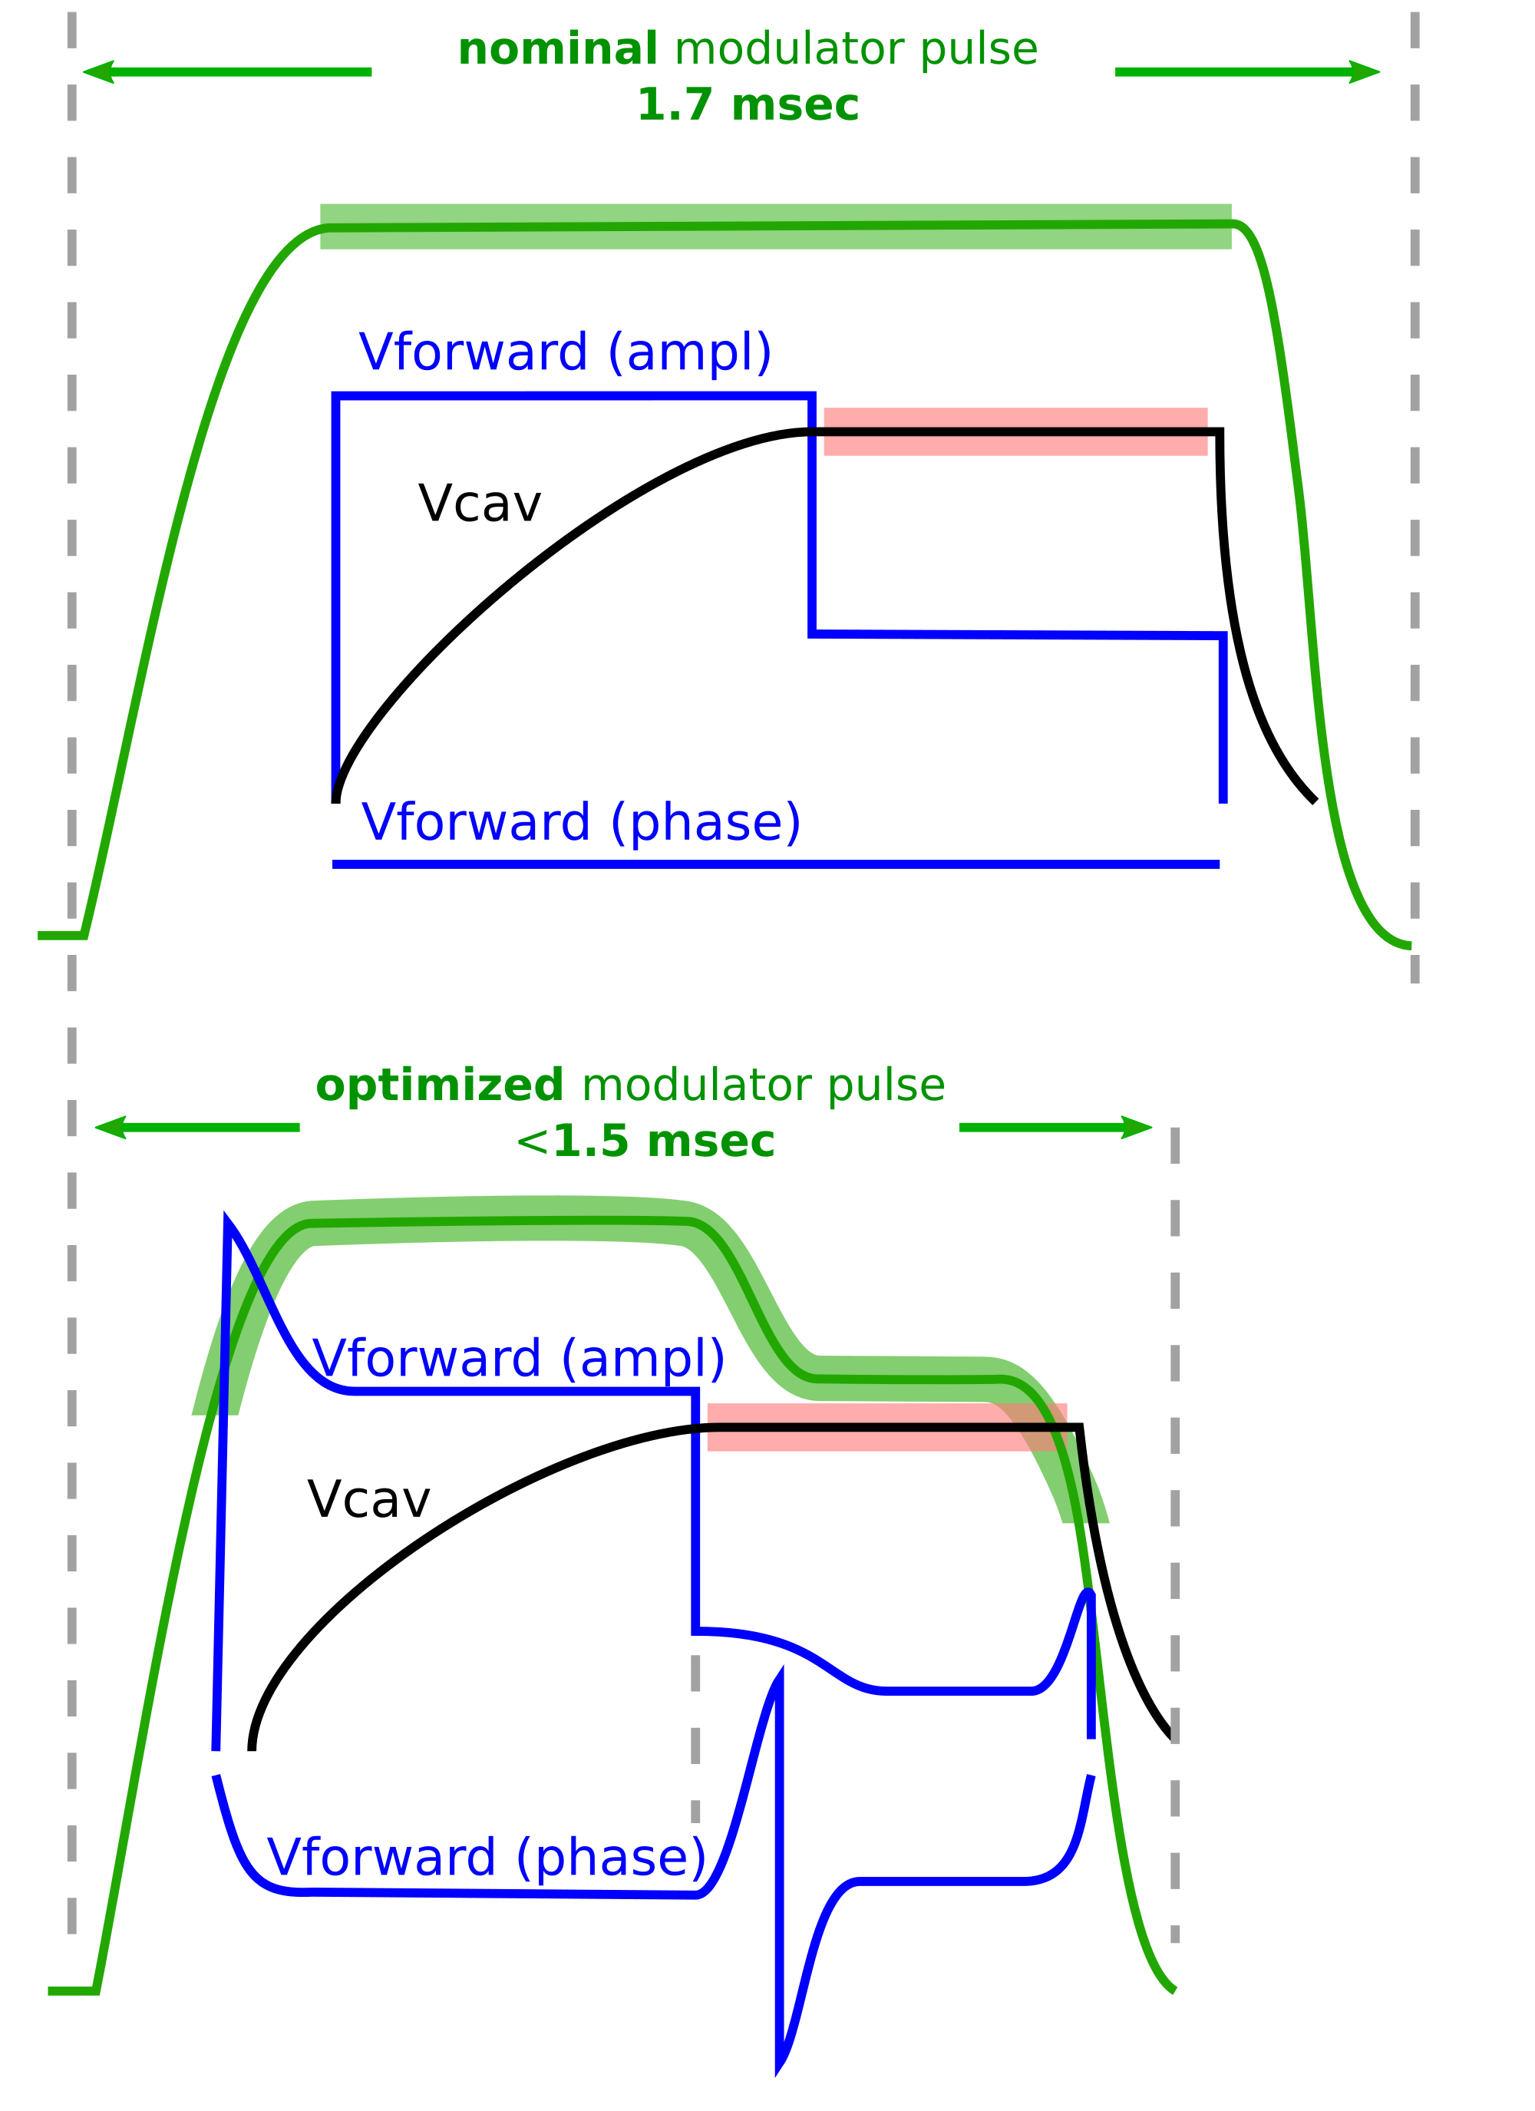
XFEL
On-going development and plan for next shutdown’s upgrade
On-going development
  Beam regions
  Energy saving initiative
  Online probe calibration
  Improved fault detection
Next shutdown: (6 months) Summer 2025 – Spring 2026
  Warm-up to double cryo safety valves + beam line upgrades
  LLRF:
    upgrade master oscillator (benefit from FLASH development)
    Partial MicroTCA upgrade (new ADCs, new main ctrl board)
Julien Branlard’s talk on Wed.
Mariusz Grecki’s talk on Tue.
Annika Eichler’s tutorial on Tue.
savings
savings

Slide 7
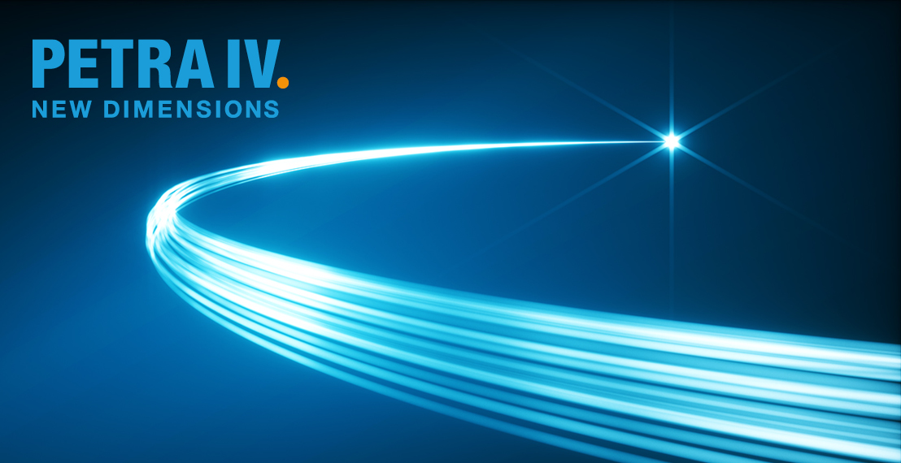
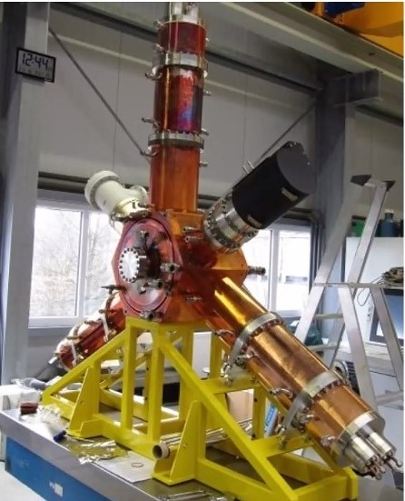
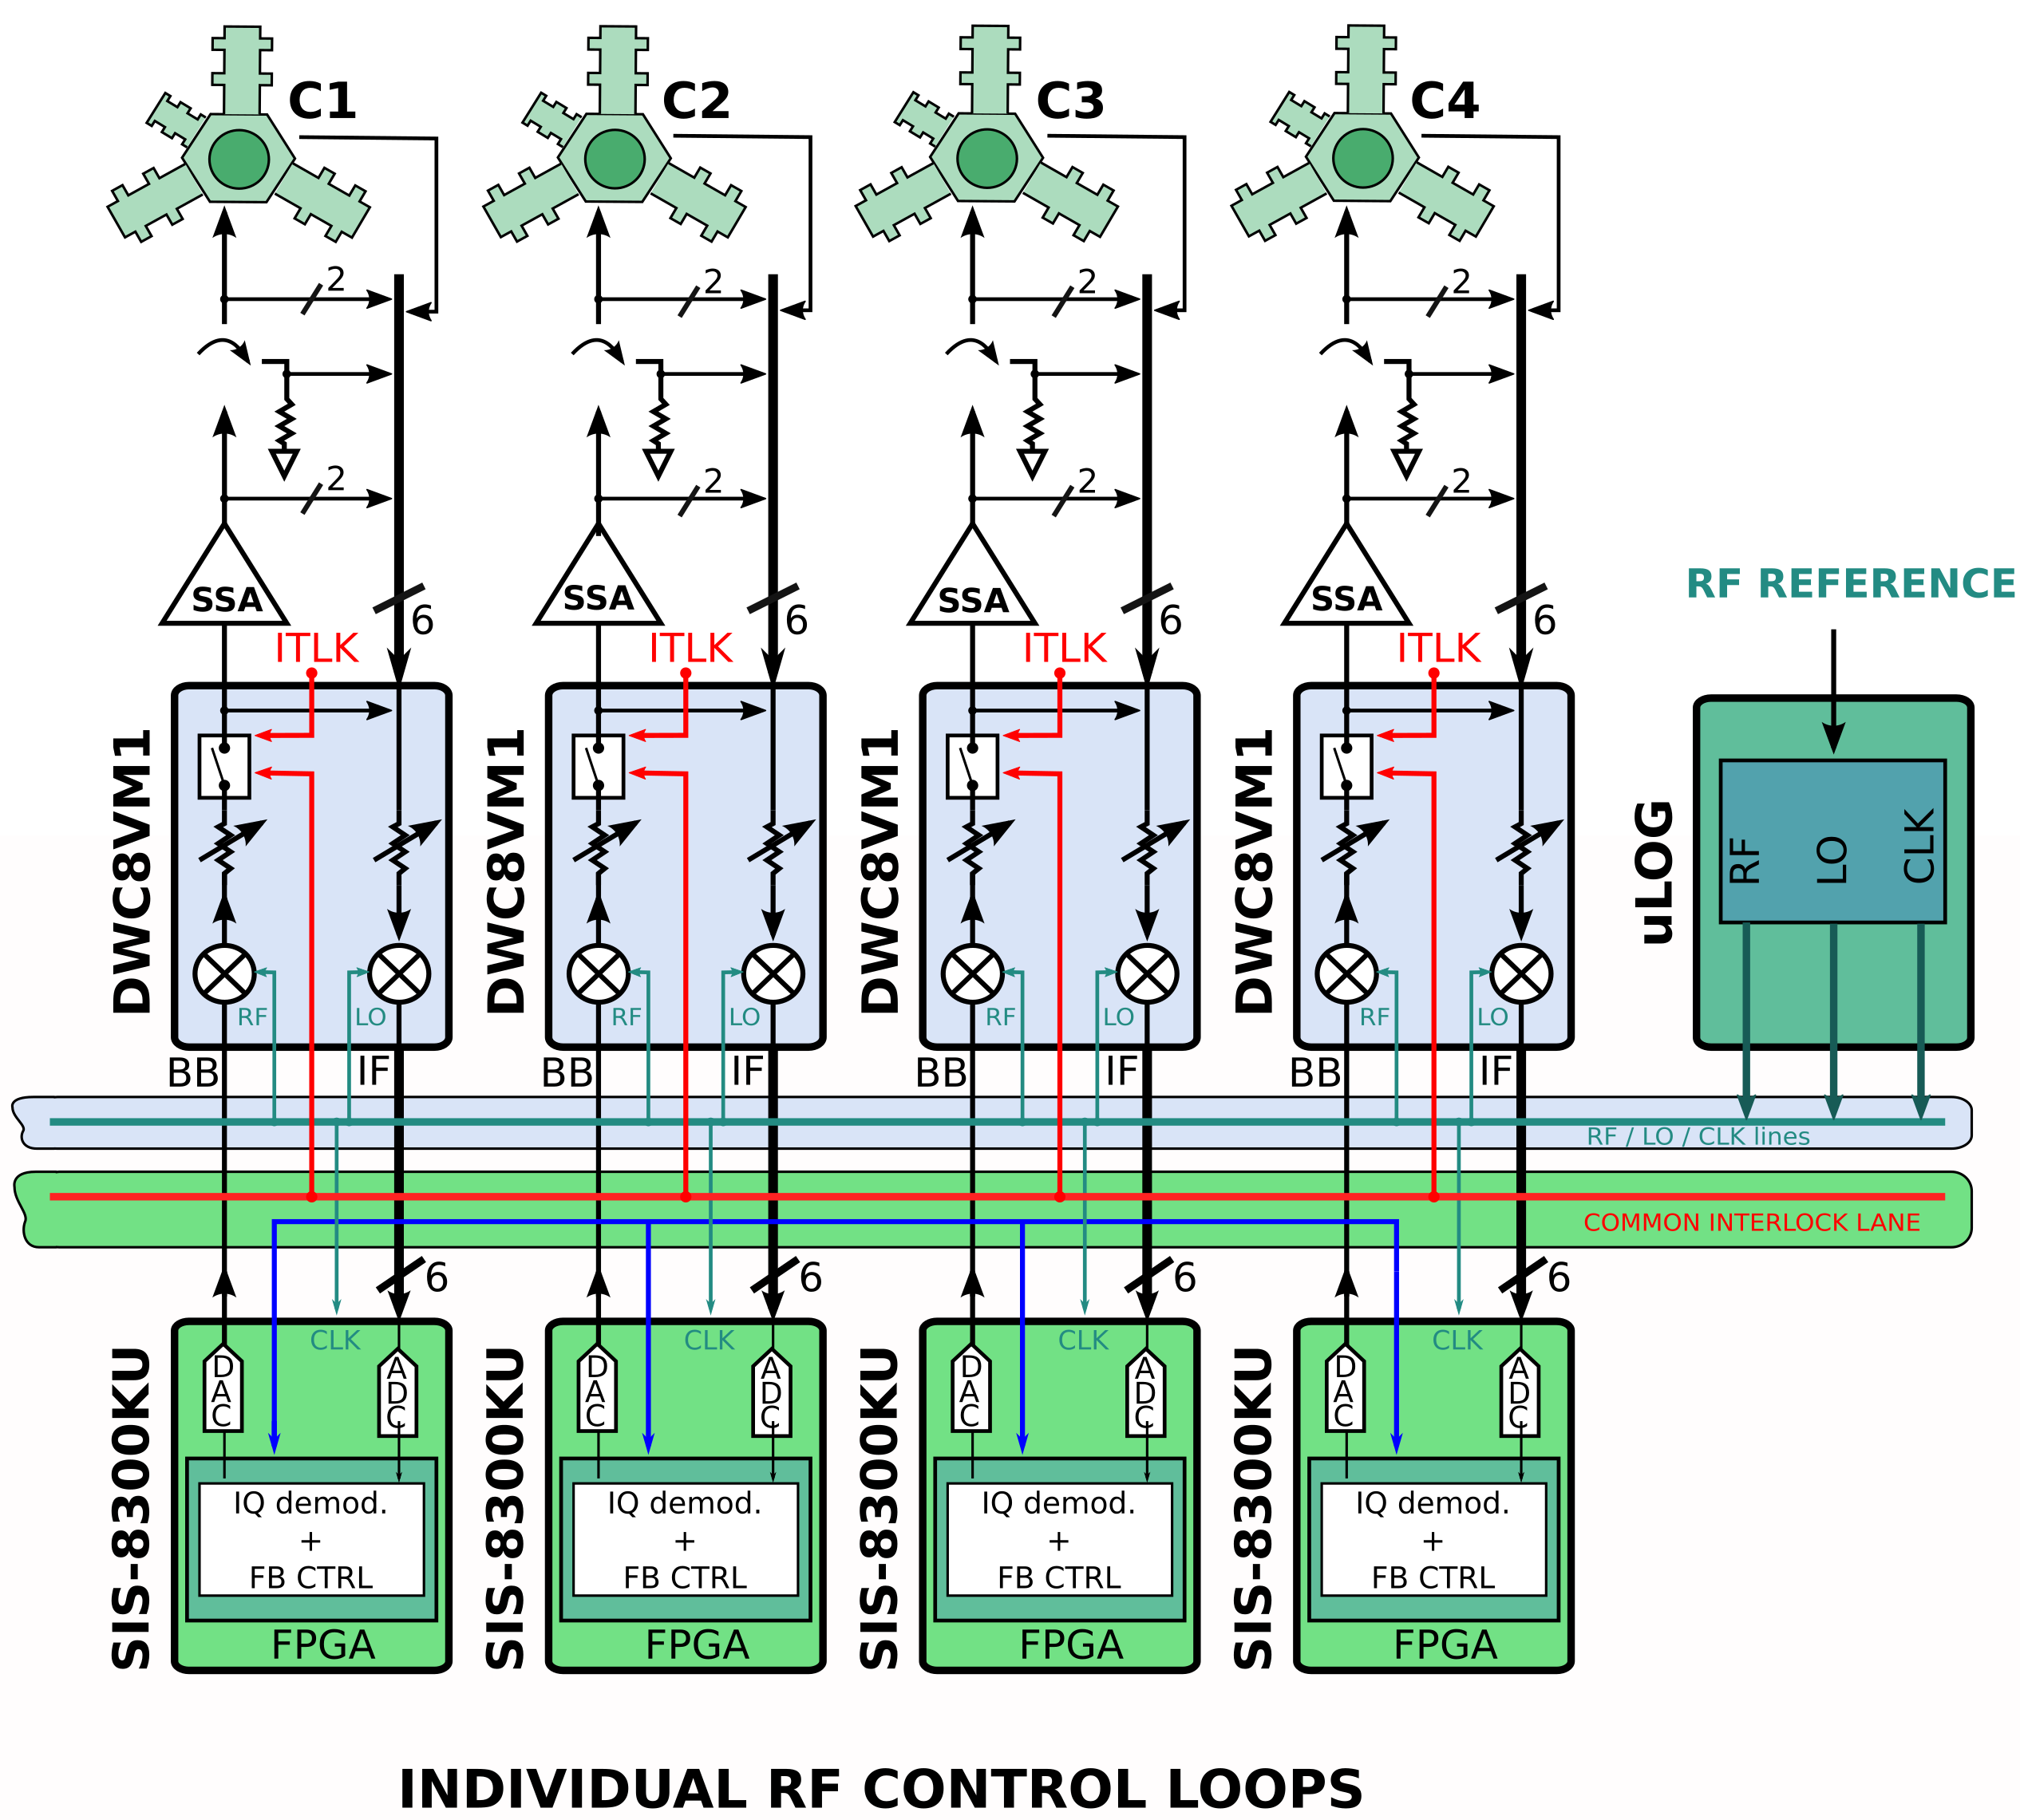
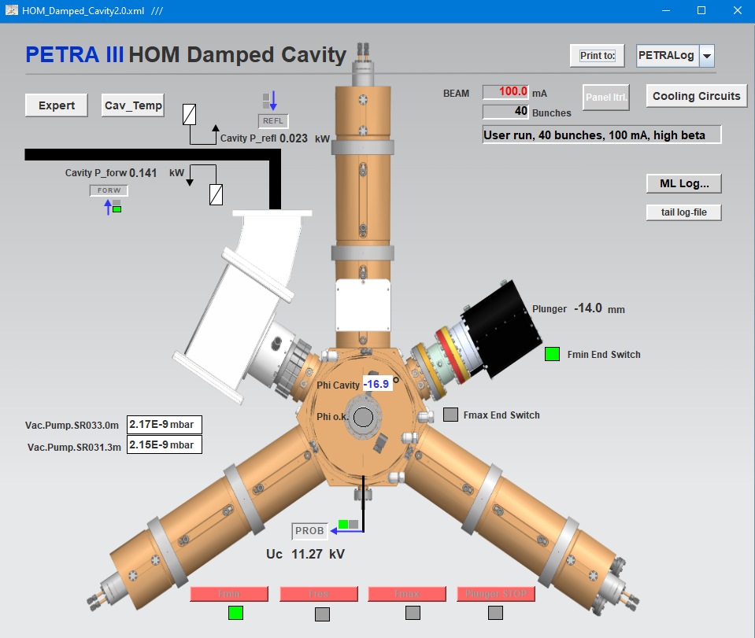
PETRA IV
~ 5 years but preparation work starts NOW
PETRA IV upgrade
  Achieve 10keV X-ray energies (approaching diffraction limit)
  Ideal source for 3D X-ray microscopy on nanometer scale
  Entire machine upgrade
  Including new LLRF (MicroTCA-based)
  24 cavities at 500 MHz
  24 cavities at 1.5 GHz
Preparation
  500 MHz test stand in operation
  New 500 MHz HOM-damped cavity
  installed and in operation at PETRA III
  with demonstrator LLRF system
4x single regulation loops
Courtesy Arvid Eislage

Slide 8
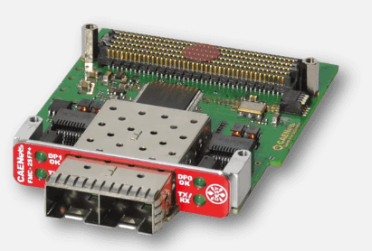
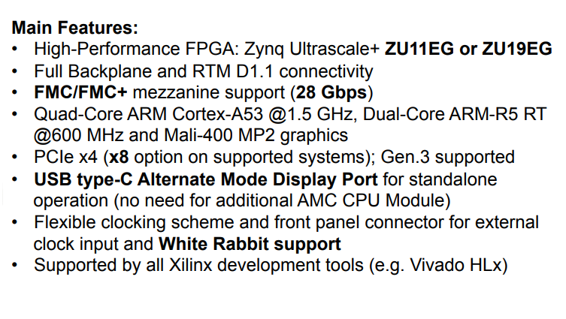
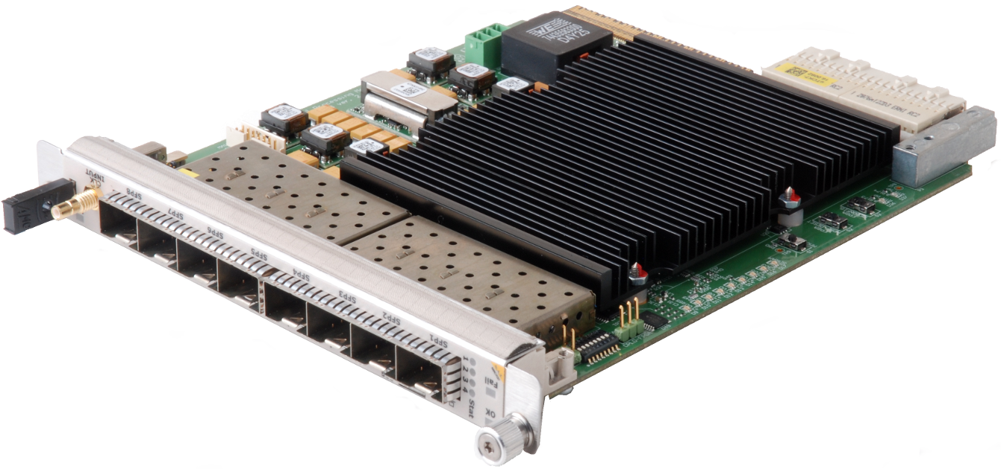
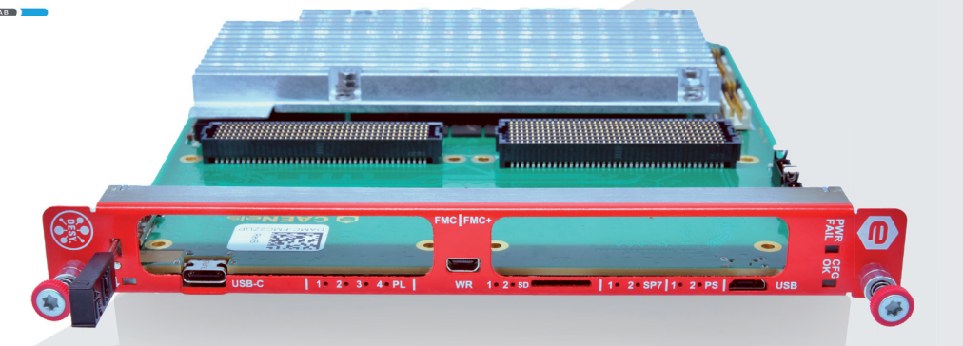
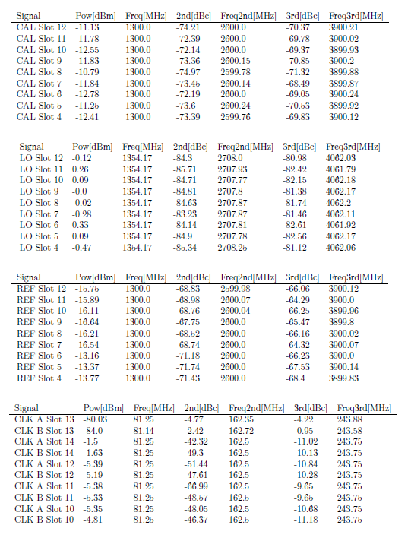
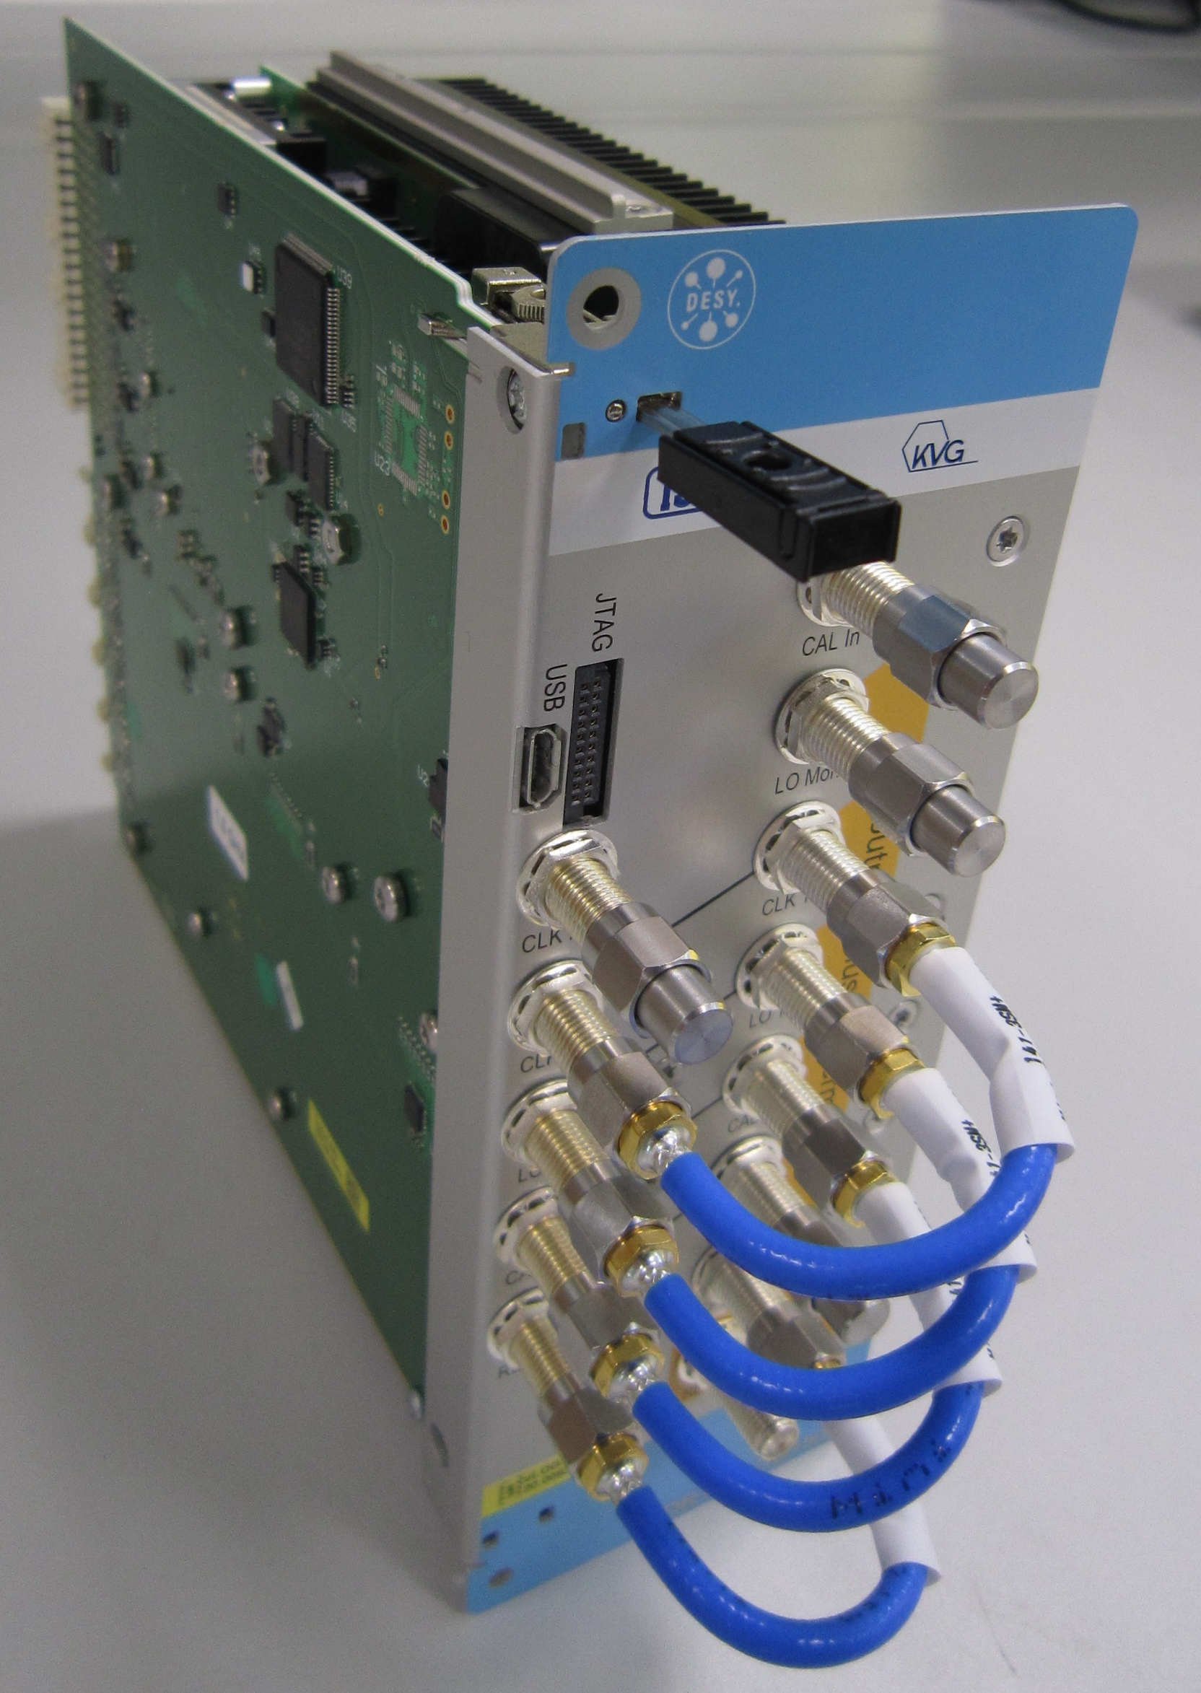
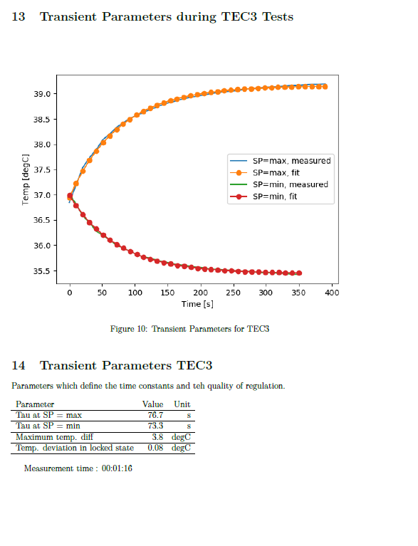
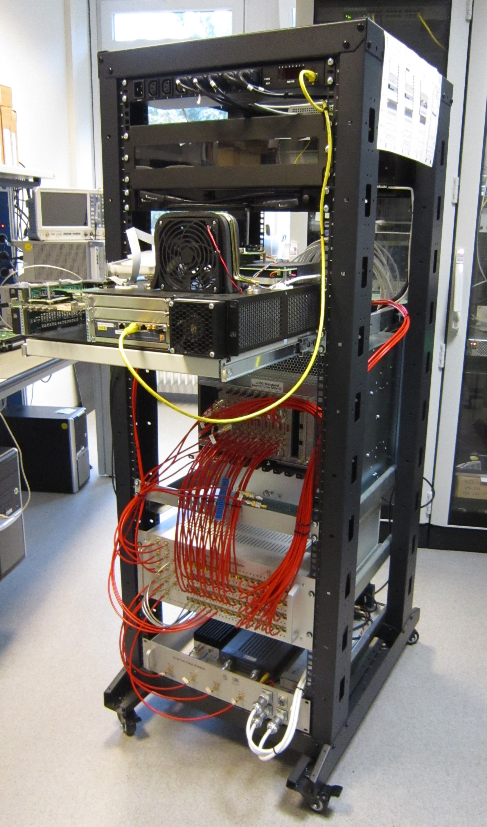
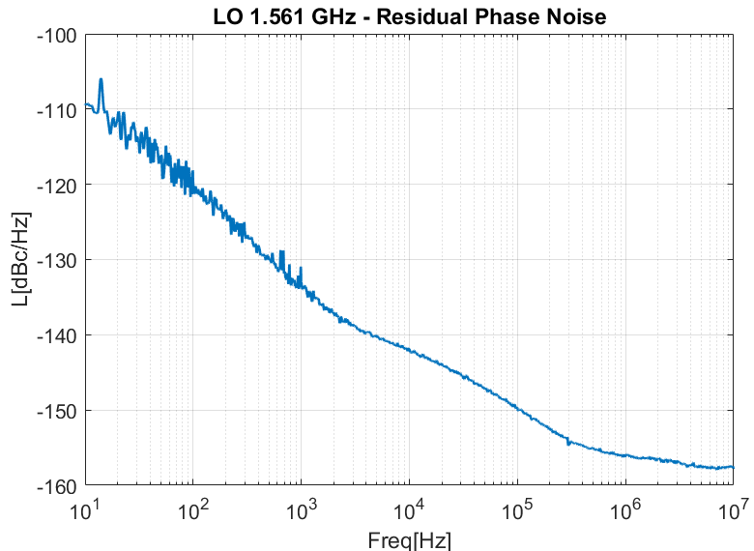
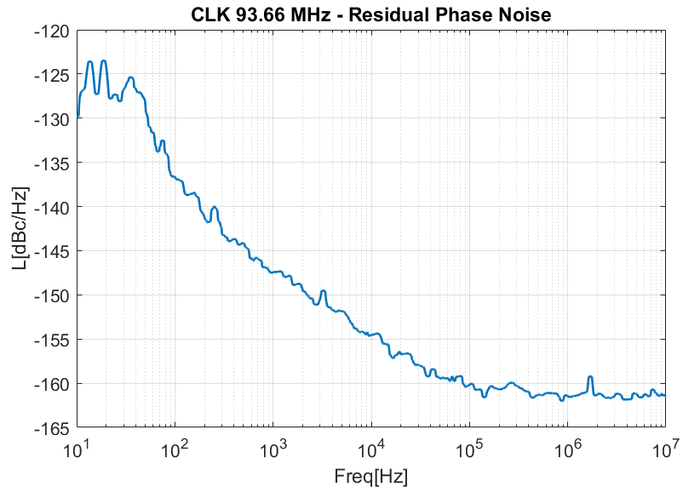
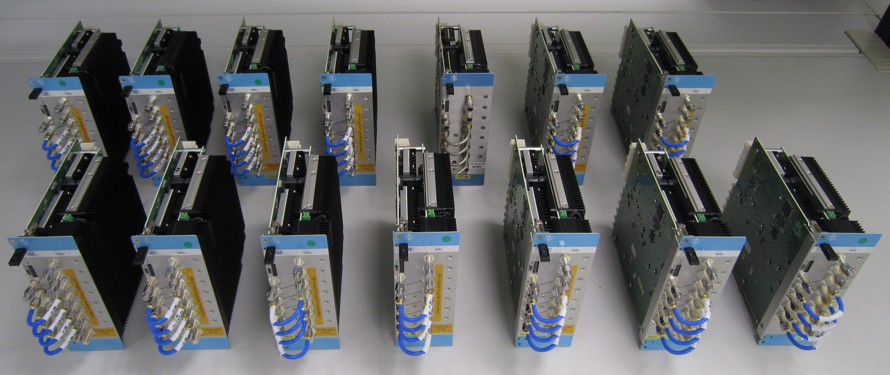
R&D
New MTCA developments for LLRF
ZUP + 2x FMC
TCK7
TCK7 → FMC2ZUP
SIS8300 → SIS3rd generation ADC
uLOG → uLOG next generation
  DESY licensed production to company KVG GmbH
  Production of 10x 1.3 GHz and 3x 1.5 GHz modules (HZB)
  Development of test stand to test each subcomponents
Courtesy Uros Mavric

Slide 9
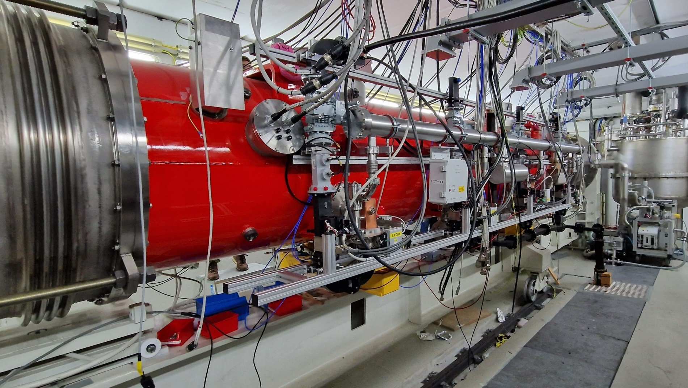
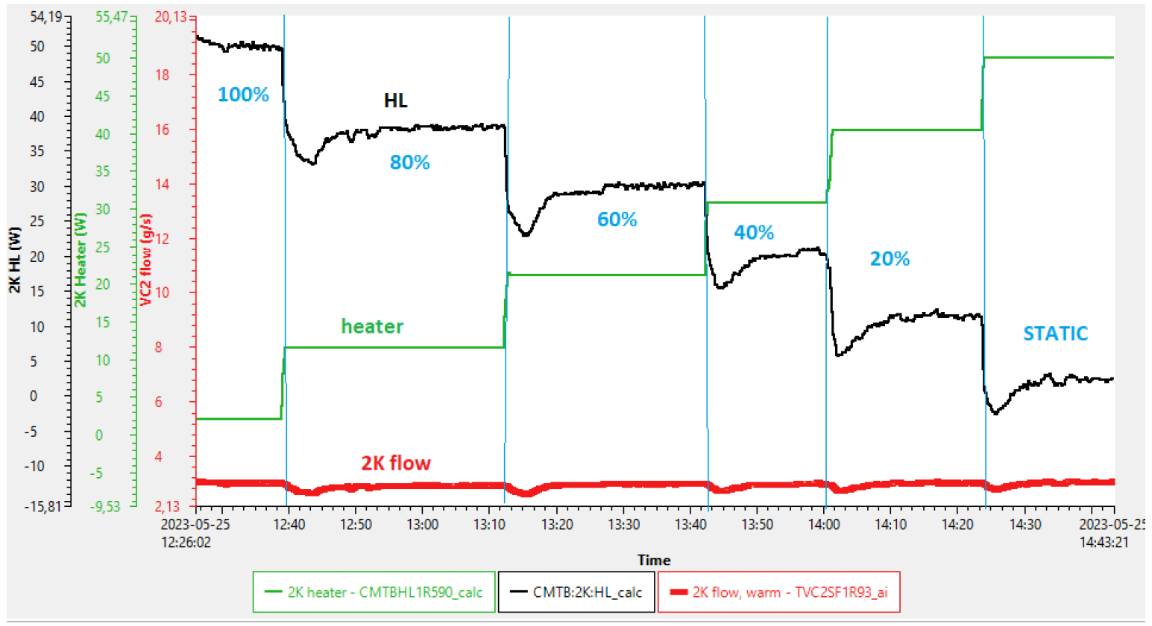
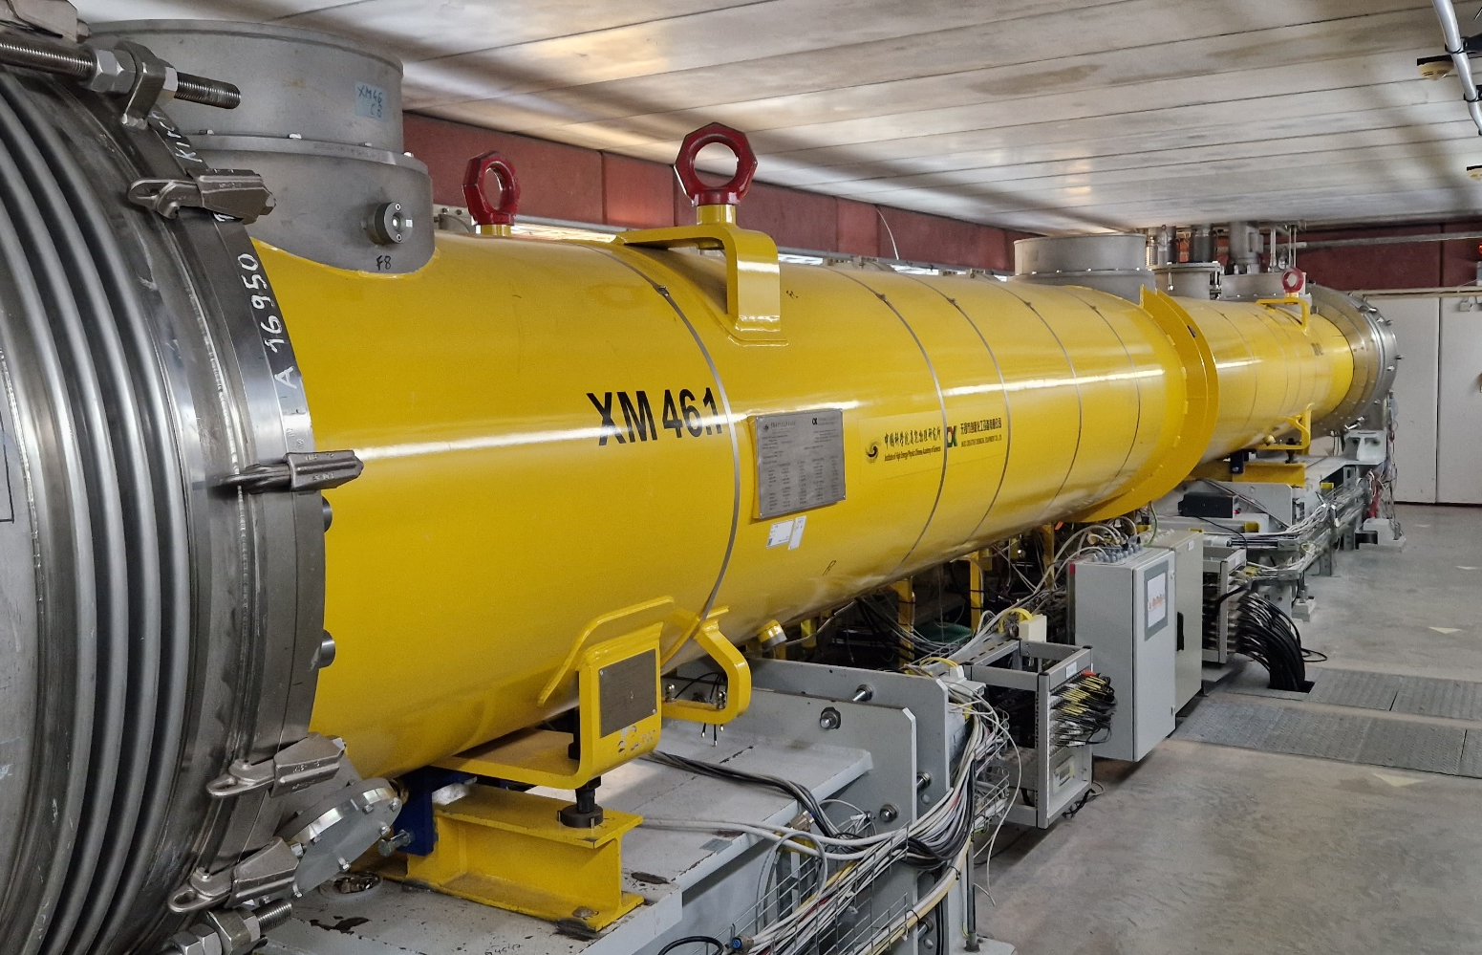
R&D
Continuous wave (CW) and Long Pulse (LP) R&D at XFEL
Two CW-capable tests stands
  Test of 3.9 GHz in CW at XATB1 (SSA)
  Test of 1.3 GHz in CW/LP at CMTB (IOT)
Development of a waveguide Q-tuner : goal is to extend Q_{L} tuning range (up to 1e8) w/o changing cryomodules
Dynamic heat load measurement as a function of duty cycle
CW test with 3.9 GHz module in XATB1
See Andrea Bellandi’s poster #71
CW tests with 1.3 GHz module in CMTB

Slide 10
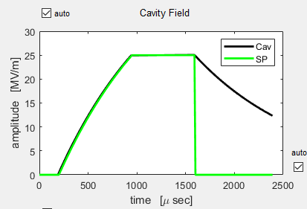
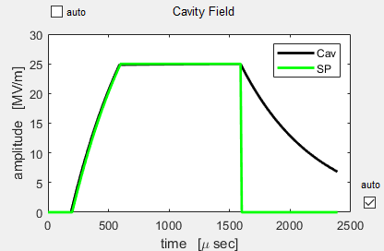
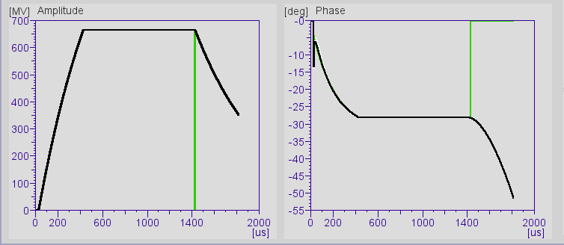
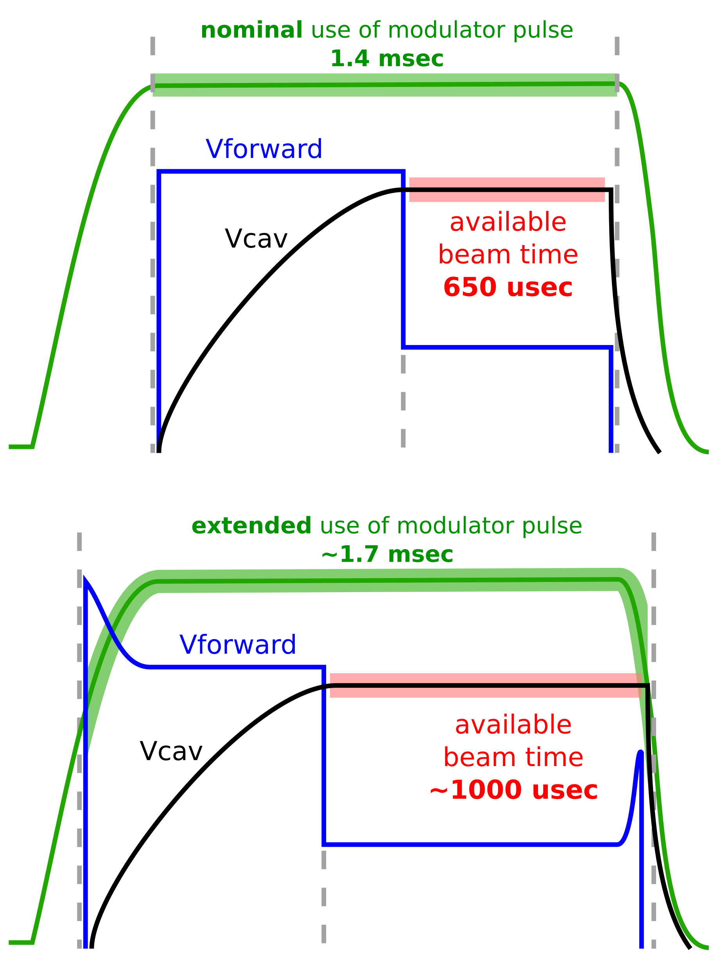
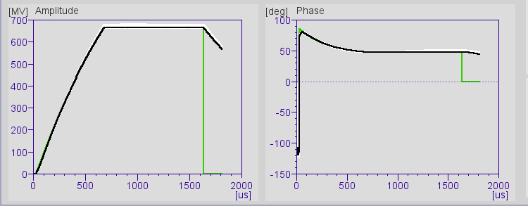
R&D
Continuous wave (CW) and Long Pulse (LP) R&D at XFEL
XFEL : can we increase the current 1.3 msec pulse to 2, 3 ms without changing the hardware ?
  Pulse stretching (affects read / write tables)
  Affects diagnostics (detuning, performance computation etc…)
  Tests at XFEL
T_{beam} = 650 usec
T_{beam} = 1000 usec
Sept 2021 : longer beam time by shortening fill time and lowering Q_{L} (4.6e6 → 2.5e6)
Q_{L} = 4.6e6
T_{fill} = 750 usec
Q_{L} = 2.5e6
T_{fill} = 400 usec
A13 665 → 1000 usec flat top
March 2022 : longer beam time by using extended modulator pulse
A10 665 → 970 usec flat top

Slide 11
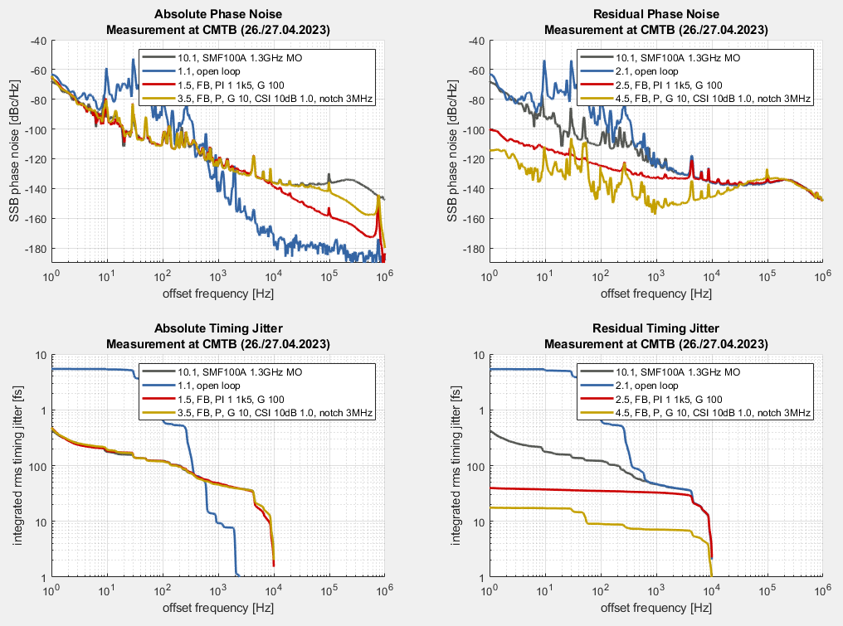
R&D
First results of CSI (Carrier Suppression Interferometer*) in a LLRF system
Out-of-loop absolute and residual phase-noise
Tested at CMTB
(CryoModule Test Bench)
Reference Generator:
SMF100A, 1.3GHz (R&S)
LLRF Detector:
Standard (-150 dBc/Hz)
CSI (-170 dBc/Hz)
Improved integrated jitter by the CSI
- Benefit on controller TBD
- Repeat with better main oscillator
- Repeat with better actuator (SSA)
Courtesy Matthias Hoffmann, Frank Ludwig
* L. Springer et al., "Phase Noise Measurements for L-Band Applications at Attosecond Resolution," in IEEE Transactions on Instrumentation and Measurement, vol. 71, pp. 1-7, 2022, Art no. 8003307, doi: 10.1109/TIM.2022.3170975.

Slide 12
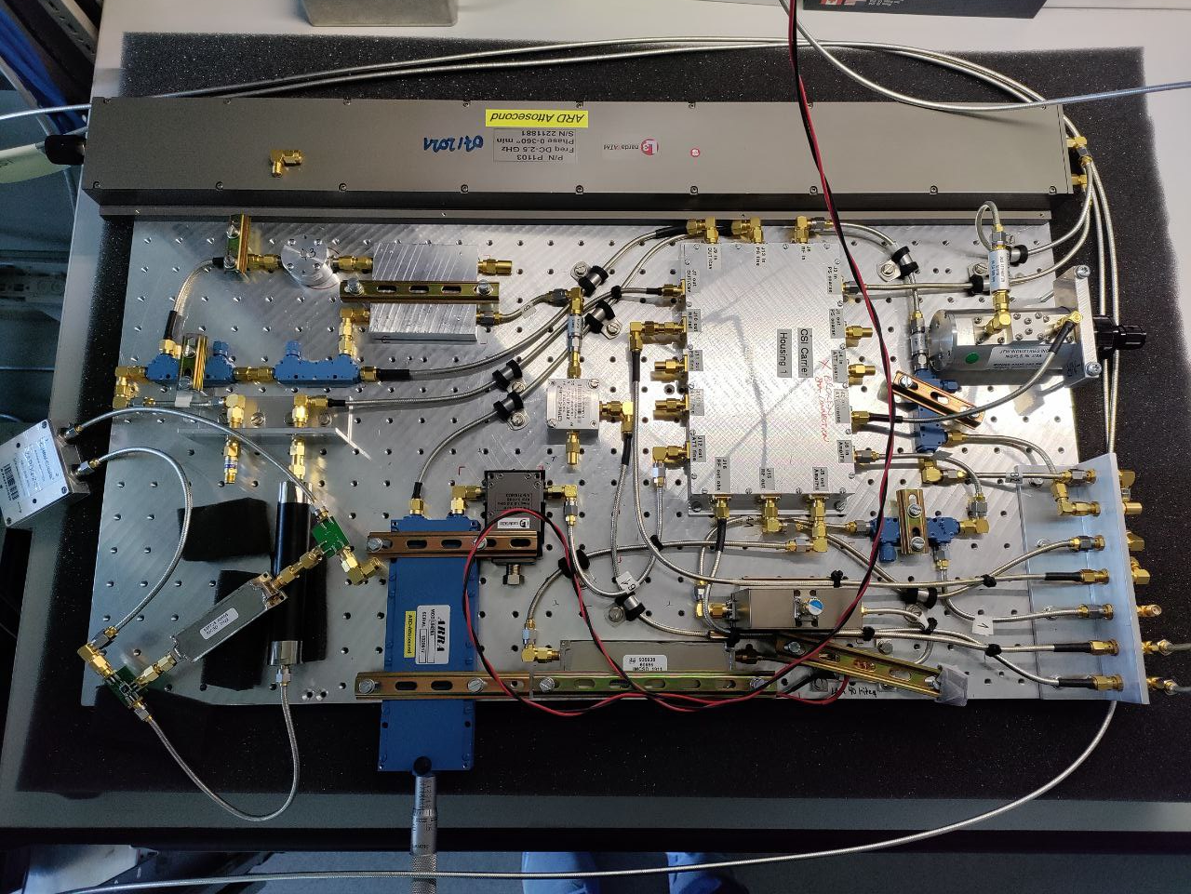
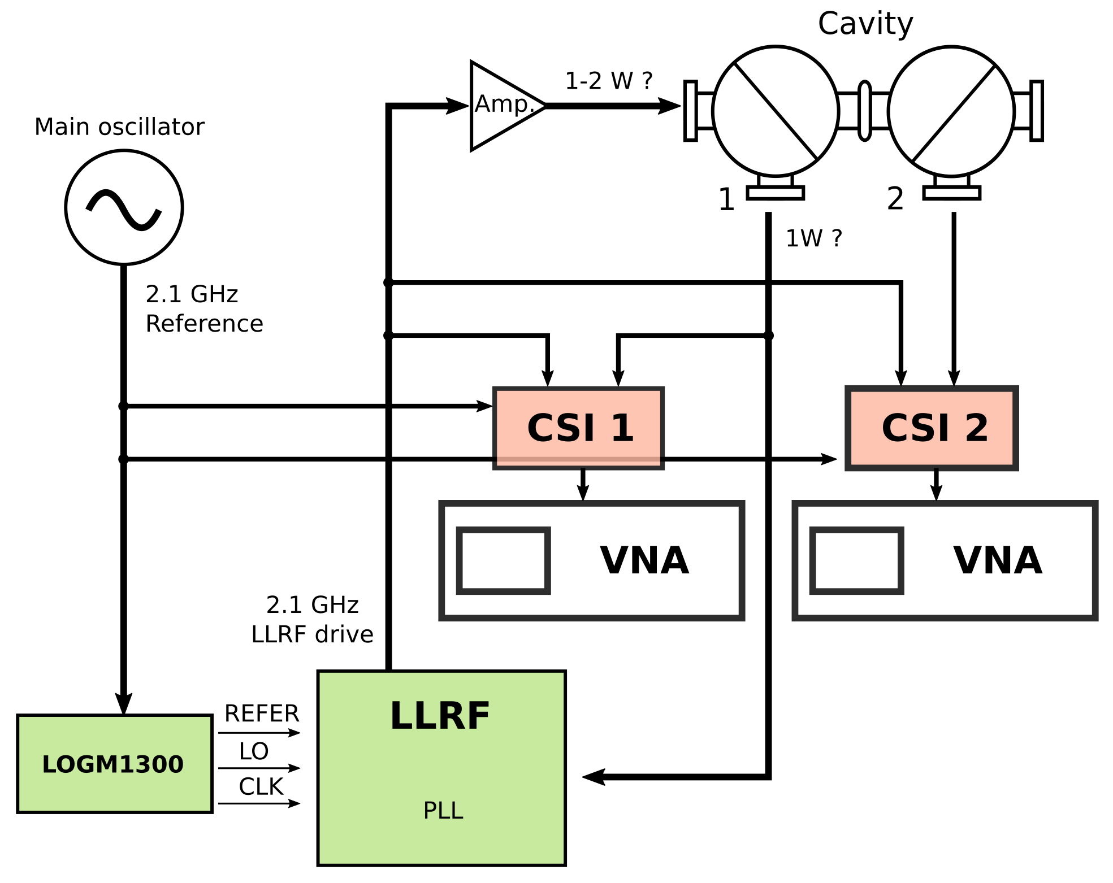
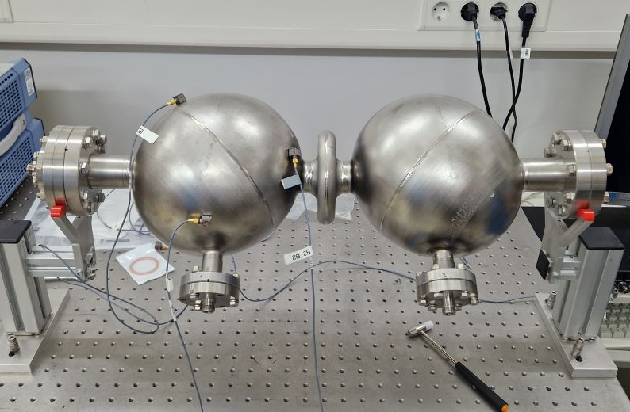
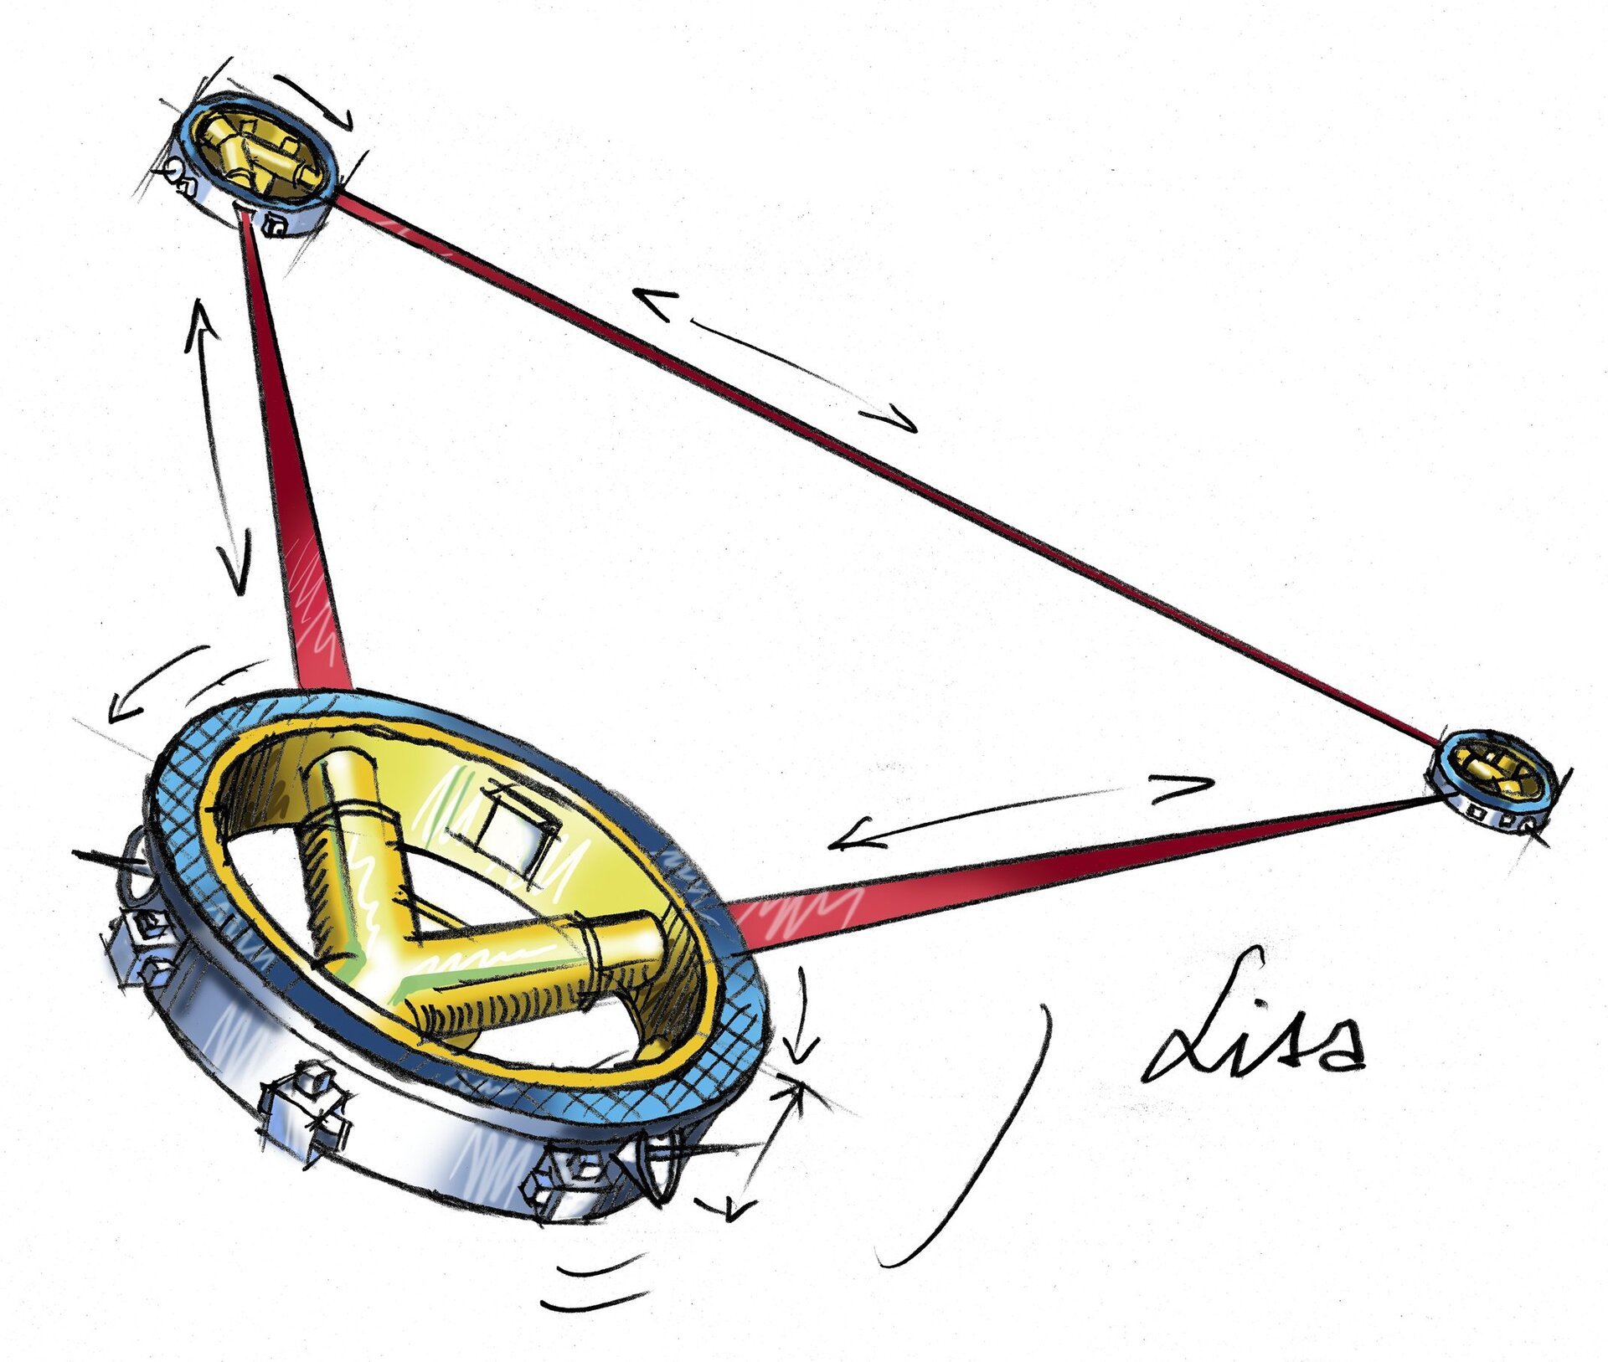
R&D
Gravitational waves
MAGO revival (Microwave Apparatus for Gravitational waves Observation)
  Pick up MAGO project (from early 2000) driven by CERN at the time
  Use binary cell SRF cavity as possible detector for gravitational waves
  LLRF in SEL combined with CSI to improve SNR
LISA (Laser Interferometer Space Antenna)
  Development of detector electronics (non-LLRF)
MAGO cavity at DESY
CSI setup
Courtesy Louise Springer
Image ESA

Slide 13



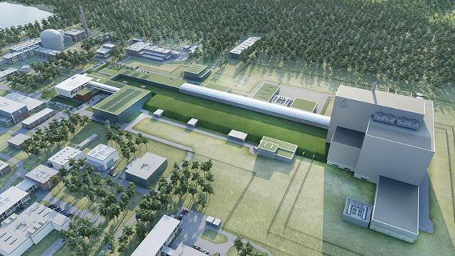
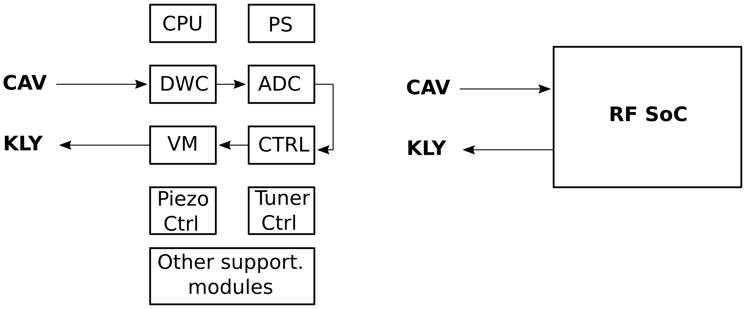

R&D
Examples of further HW / SW / FW development
New class of hardware : MicroTCA RF-SoC
  Main use at DESY is fast orbit FB for PETRA IV
  LLRF application (i.e. collaboration with SCK-CEN - MYRRHA)
SW / FW framework
  Continuing the open source initiative
  Deployment tool (1-click upgrade / roll back SW / FW)
  Effort in system-level integration / validation
Typical LLRF system architecture
System on a Chip LLRF architecture
image: https://www.sckcen.be/en
Burak Dursun’s invited talk on Thu.

Slide 14



R&D
Collaborations with universities towards higher LLRF reliability / availability
Fault Detection and Monitoring
  Continuous monitoring
  Real-time data collection
  History and trend of system performance
  Fault detection and notifications
  Predictive Maintenance
  Use of historical data to refine fault detection
  Integration with running accelerator (FLASH / XFEL)
  Implementation as HW monitors, FW module, Built-in software, External servers
Courtesy Gianluca Martino
Round table 1 : reliability and anomaly detection later today

Slide 15
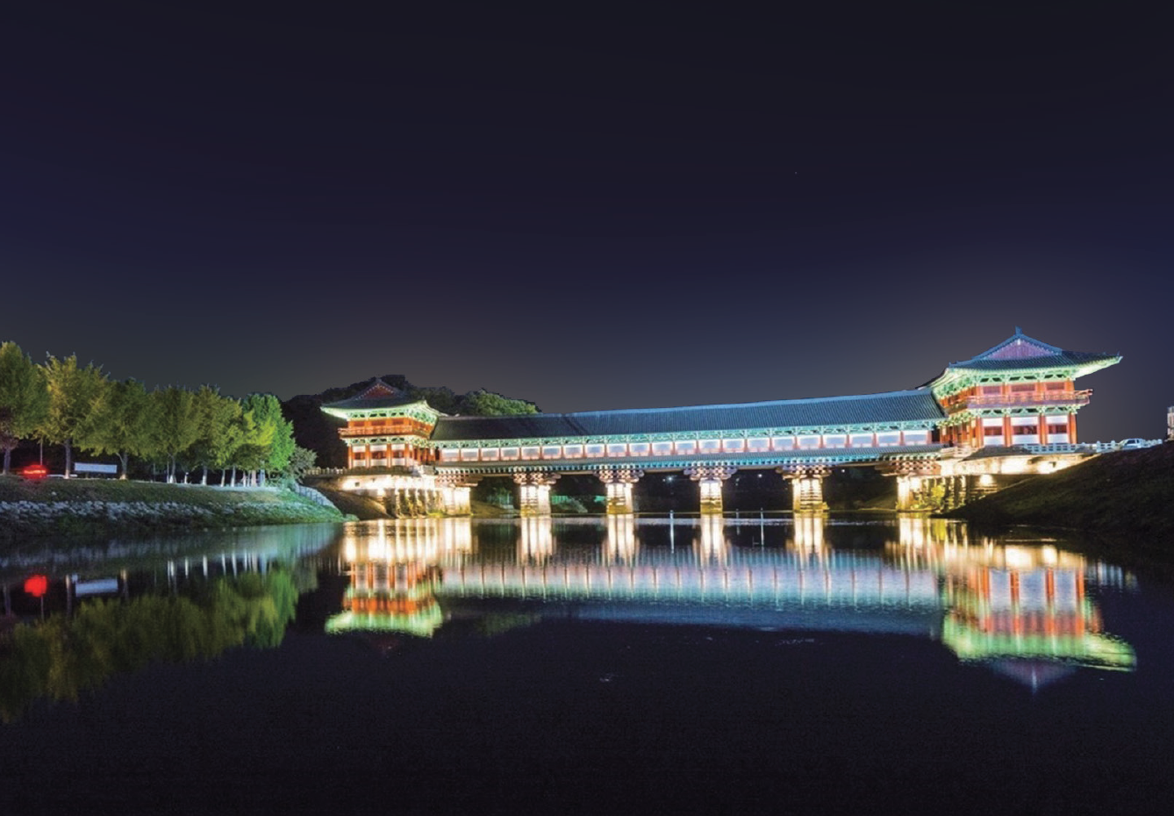

Thank you
감사합니다
gamsahabnida
Julien Branlard
MSK
julien.branlard@desy.de
+49 (0)40 8998 1599

