Slide 1
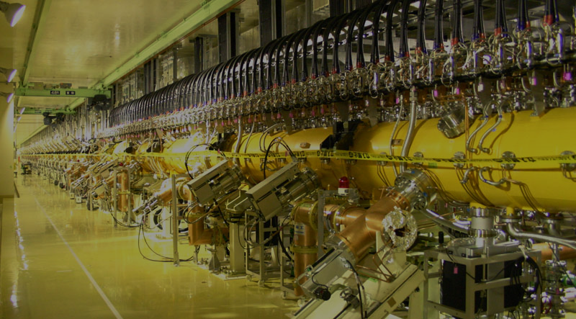
Present Status of J-PARC Linac LLRF System
LLRF2023 - Sep. 23, 2023 -
Kenta Futatsukawa^{(A)}, Cicek Ersin^{(A)}, Zhigao Fang^{(A)}, Yuji Fukui^{(A)}, Satoshi Mizobata^{(A)},
Yoshikatsu Sato^{(B)}, Shinichi Shinozaki^{(c)}
(A): High Energy Accelerator Research Organization (KEK) in Japan
(B): NAT in Japan
(c): Japan Atomic Energy Agency (JAEA) in Japan

Slide 2
Outlook
Introduction of J-PARC and J-PARC LINAC
Replacing digital feedback and feedforward system：
1st step: digitizer box for 324-MHz stations
μTCA.4 system at MEBT1
Beam loading compensation system
novel and superior adaptive beam loading compensation system calculated in the frequency domain
demonstration of beam loading compensation system for discrete beam with comb-like structure
Phase drift compensation system to suppress the variation of output momentum
Summary

Slide 3
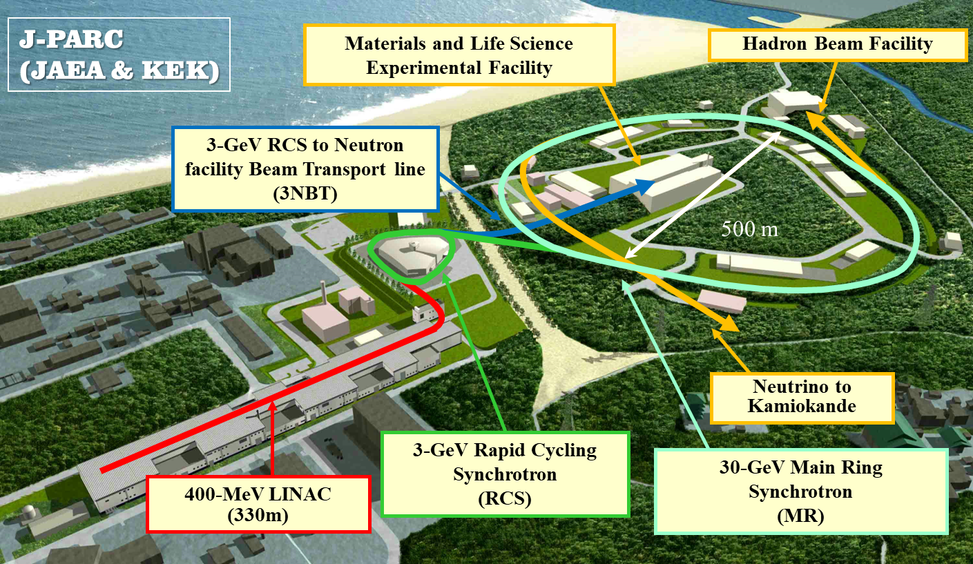
J-PARC & J-PARC LINAC
J-PARC (Japan Proton Accelerator Research Complex)
IS: H⁻ Ion Source
RFQ: Radio Frequency Quadrupole Linac
DTL: Drift Tube Linac (3 cavity modules)
SDTL: Separate-type Drift Tube Linac (16 cavity stations)
ACS: Annual Coupled Structure Linac (21 cavity stations)
※ all normal conducting cavities
required gradient stability :
±1% in amplitude,
±1 deg. in phase
J-PARC LINAC beam parameter
particles: H⁻ (negative hydrogen)
kinematic energy: 400 MeV
peak beam current: 50 mA
acceleration frequencies: 324 MHz / 972 MHz
pulse width: 500 μs (beam), ~650 μs (RF)
repetition: 25 Hz (except of ADS)
The beam load on the field gradient is large due to the acceleration of high-current beams. For the J-PARC LINAC, the performance of the beam load compensation contributes greatly to the stability of the field gradient.
macro-pulse structure
repetition：
25 Hz
intermediate-pulse structure
comb-like structure
frequency：
~1.23 MHz

Slide 4
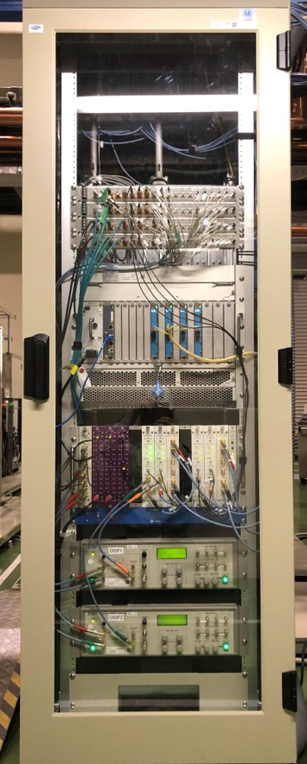
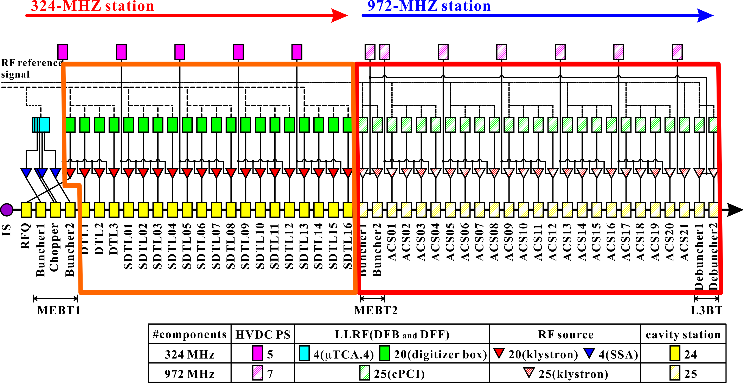
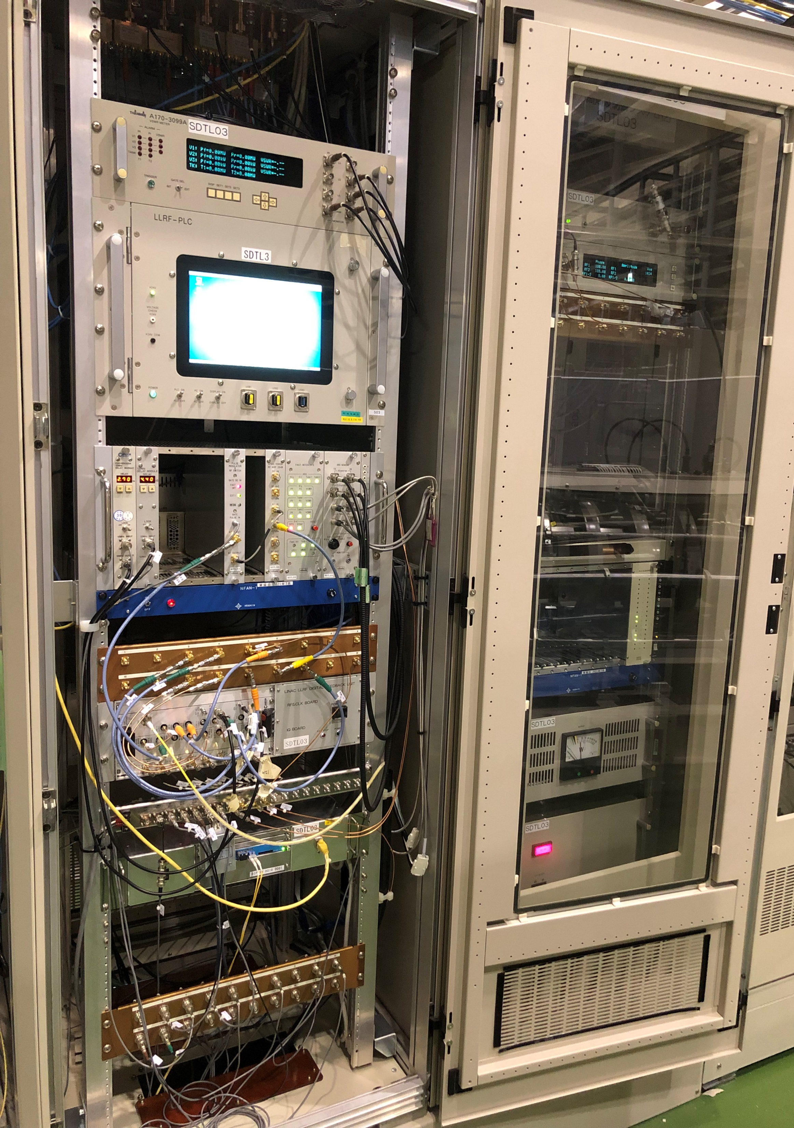
J-PARC LINAC LLRF system
summer shutdown of 2021
@ MEBT1
May 2020 @ SDTL02
Jan. 2020 @ SDTL12
μTCA.4 system
updated only digitizer
for MEBT1 B1-2, C1-2
@ RFQ, DTL1-3, SDTL01-16
μTCA.4 system
μTCA.4 system
updated only digitizer
old DFB&DFF system (cPCI)
PC + display with the touch panel function
NIM P.S.
cPCI analog module
digitizer box
chopper controller
The digital system of the 324-MHz LLRF system was completely updated until the summer shutdown of 2021. We are planning to replace the 324-MHz analog part to μRTM and eRTM boards of μTCA.4 and to develop the μTCA.4 system of 972-MHz stations.
summer shutdown of 2021
@ RFQ, DTL1-2
summer shutdown of 2020 @ DTL2, SDTL01-16

Slide 5
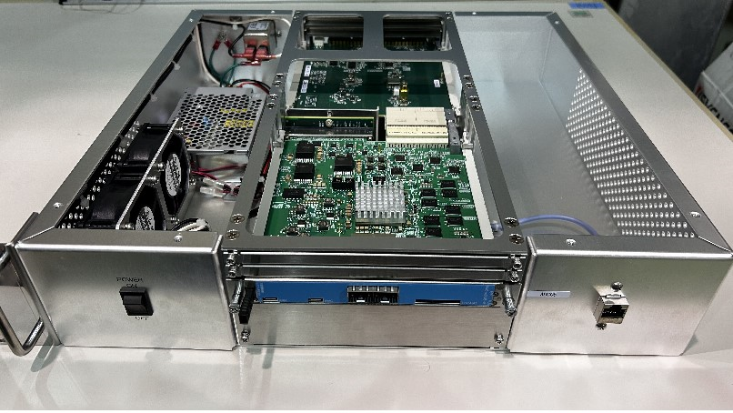
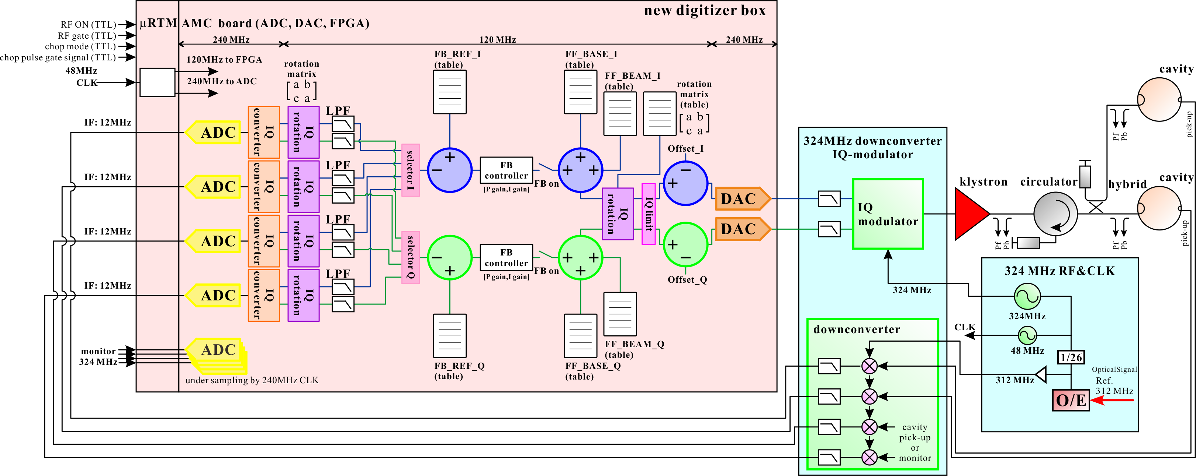
324-MHz DFB&DFF system: digitizer box
Comparison with cPCI system
increasing number of elements: 1024 → 4096 (or 8192)
increasing monitor points: before/after the PI controller, before rotation matrix
increasing flexibility in table inputs: FB_REF/FF_BASE/PI_GAIN/FF_BEAM/rotation matrix
μRTM board
AMC board
4 ch: 12-MHz IF sampling (utilizing downconverter of cPCI), 4 ch: direct sampling
The AMC board in digitizer box is same as the AMC board for 324-MHz μTCA.4 system to use the shelf.
5

Slide 6
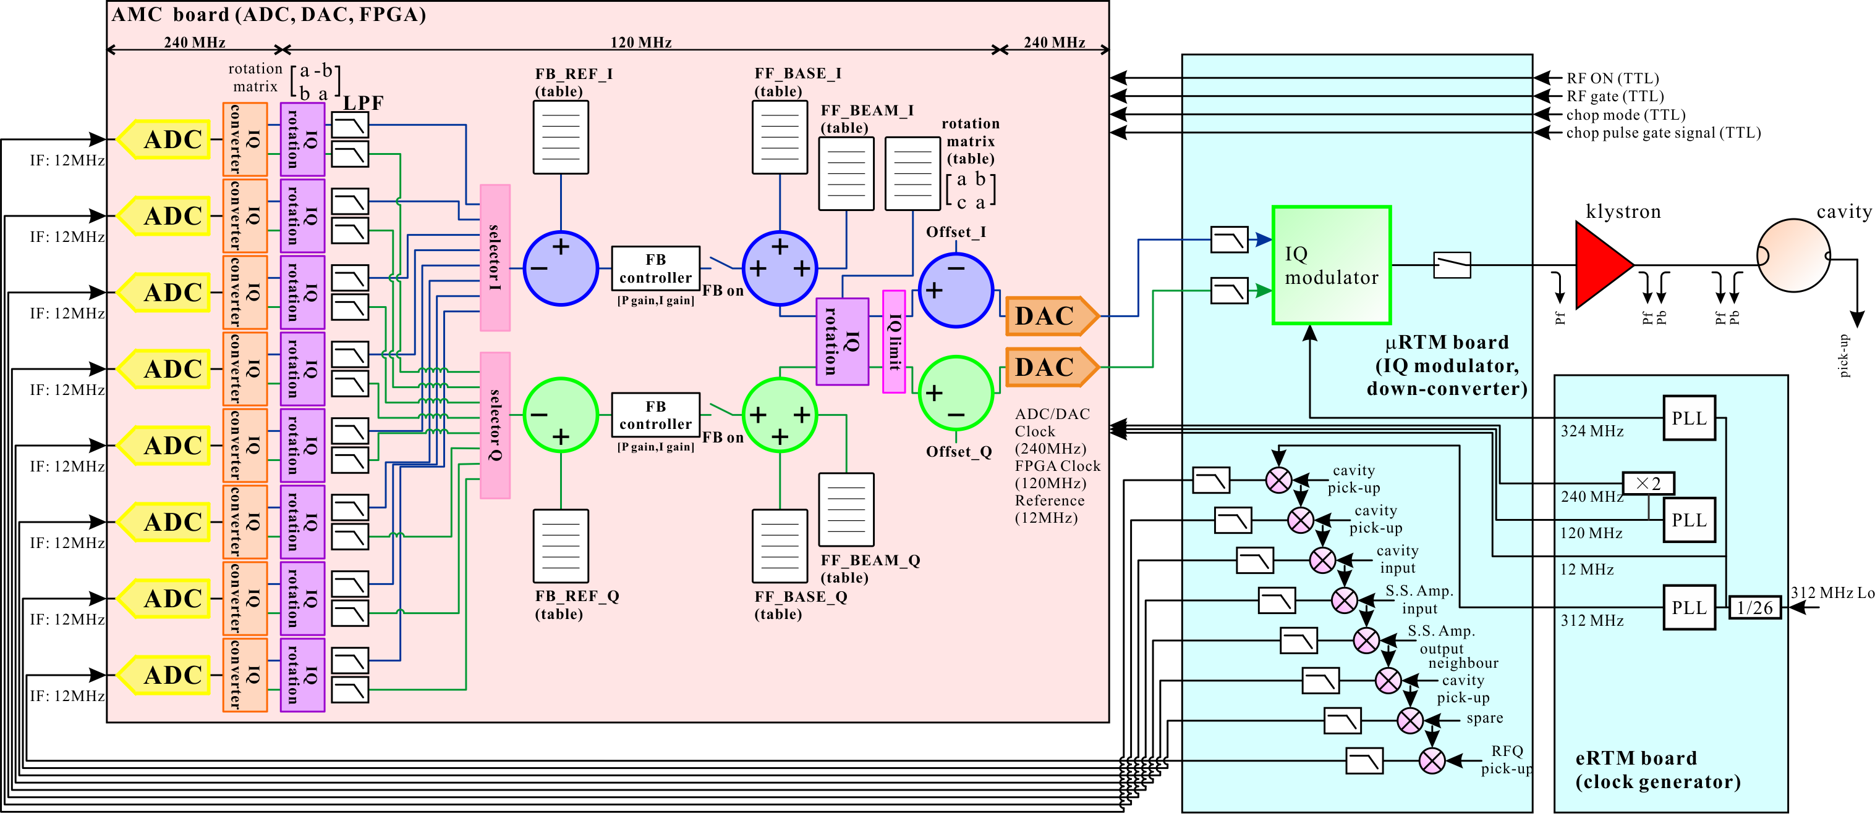
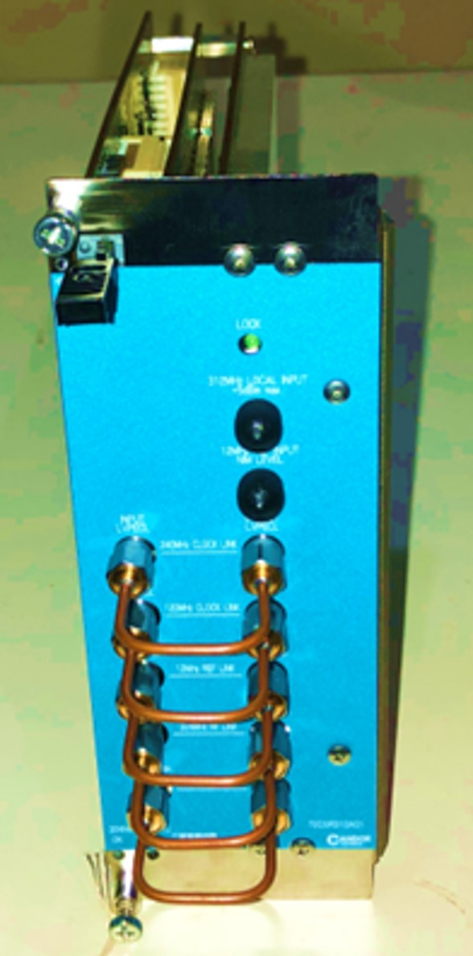
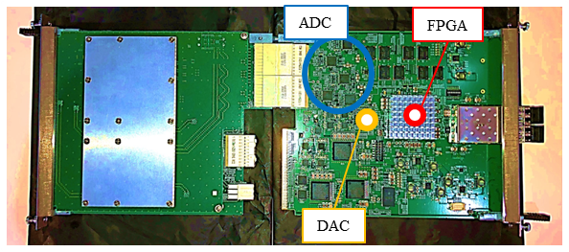
324-MHz DFB&DFF system: μTCA.4 system
eRTM board ： generating 312 MHz (LO), 324 MHz (RF), 12 MHz (reference), 120 MHz (FPGA clock), 240 MHz (ADC clock)
μRTM board ： implementing 8 ch down converter, 1 ch IQ modulator
→ 8 ch 12 MHz IF signals input to an AMC board
(digitizer box ： 4 ch 12 MHz IF, 4 ch 324 MHz RF(direct sampling)
6

Slide 7
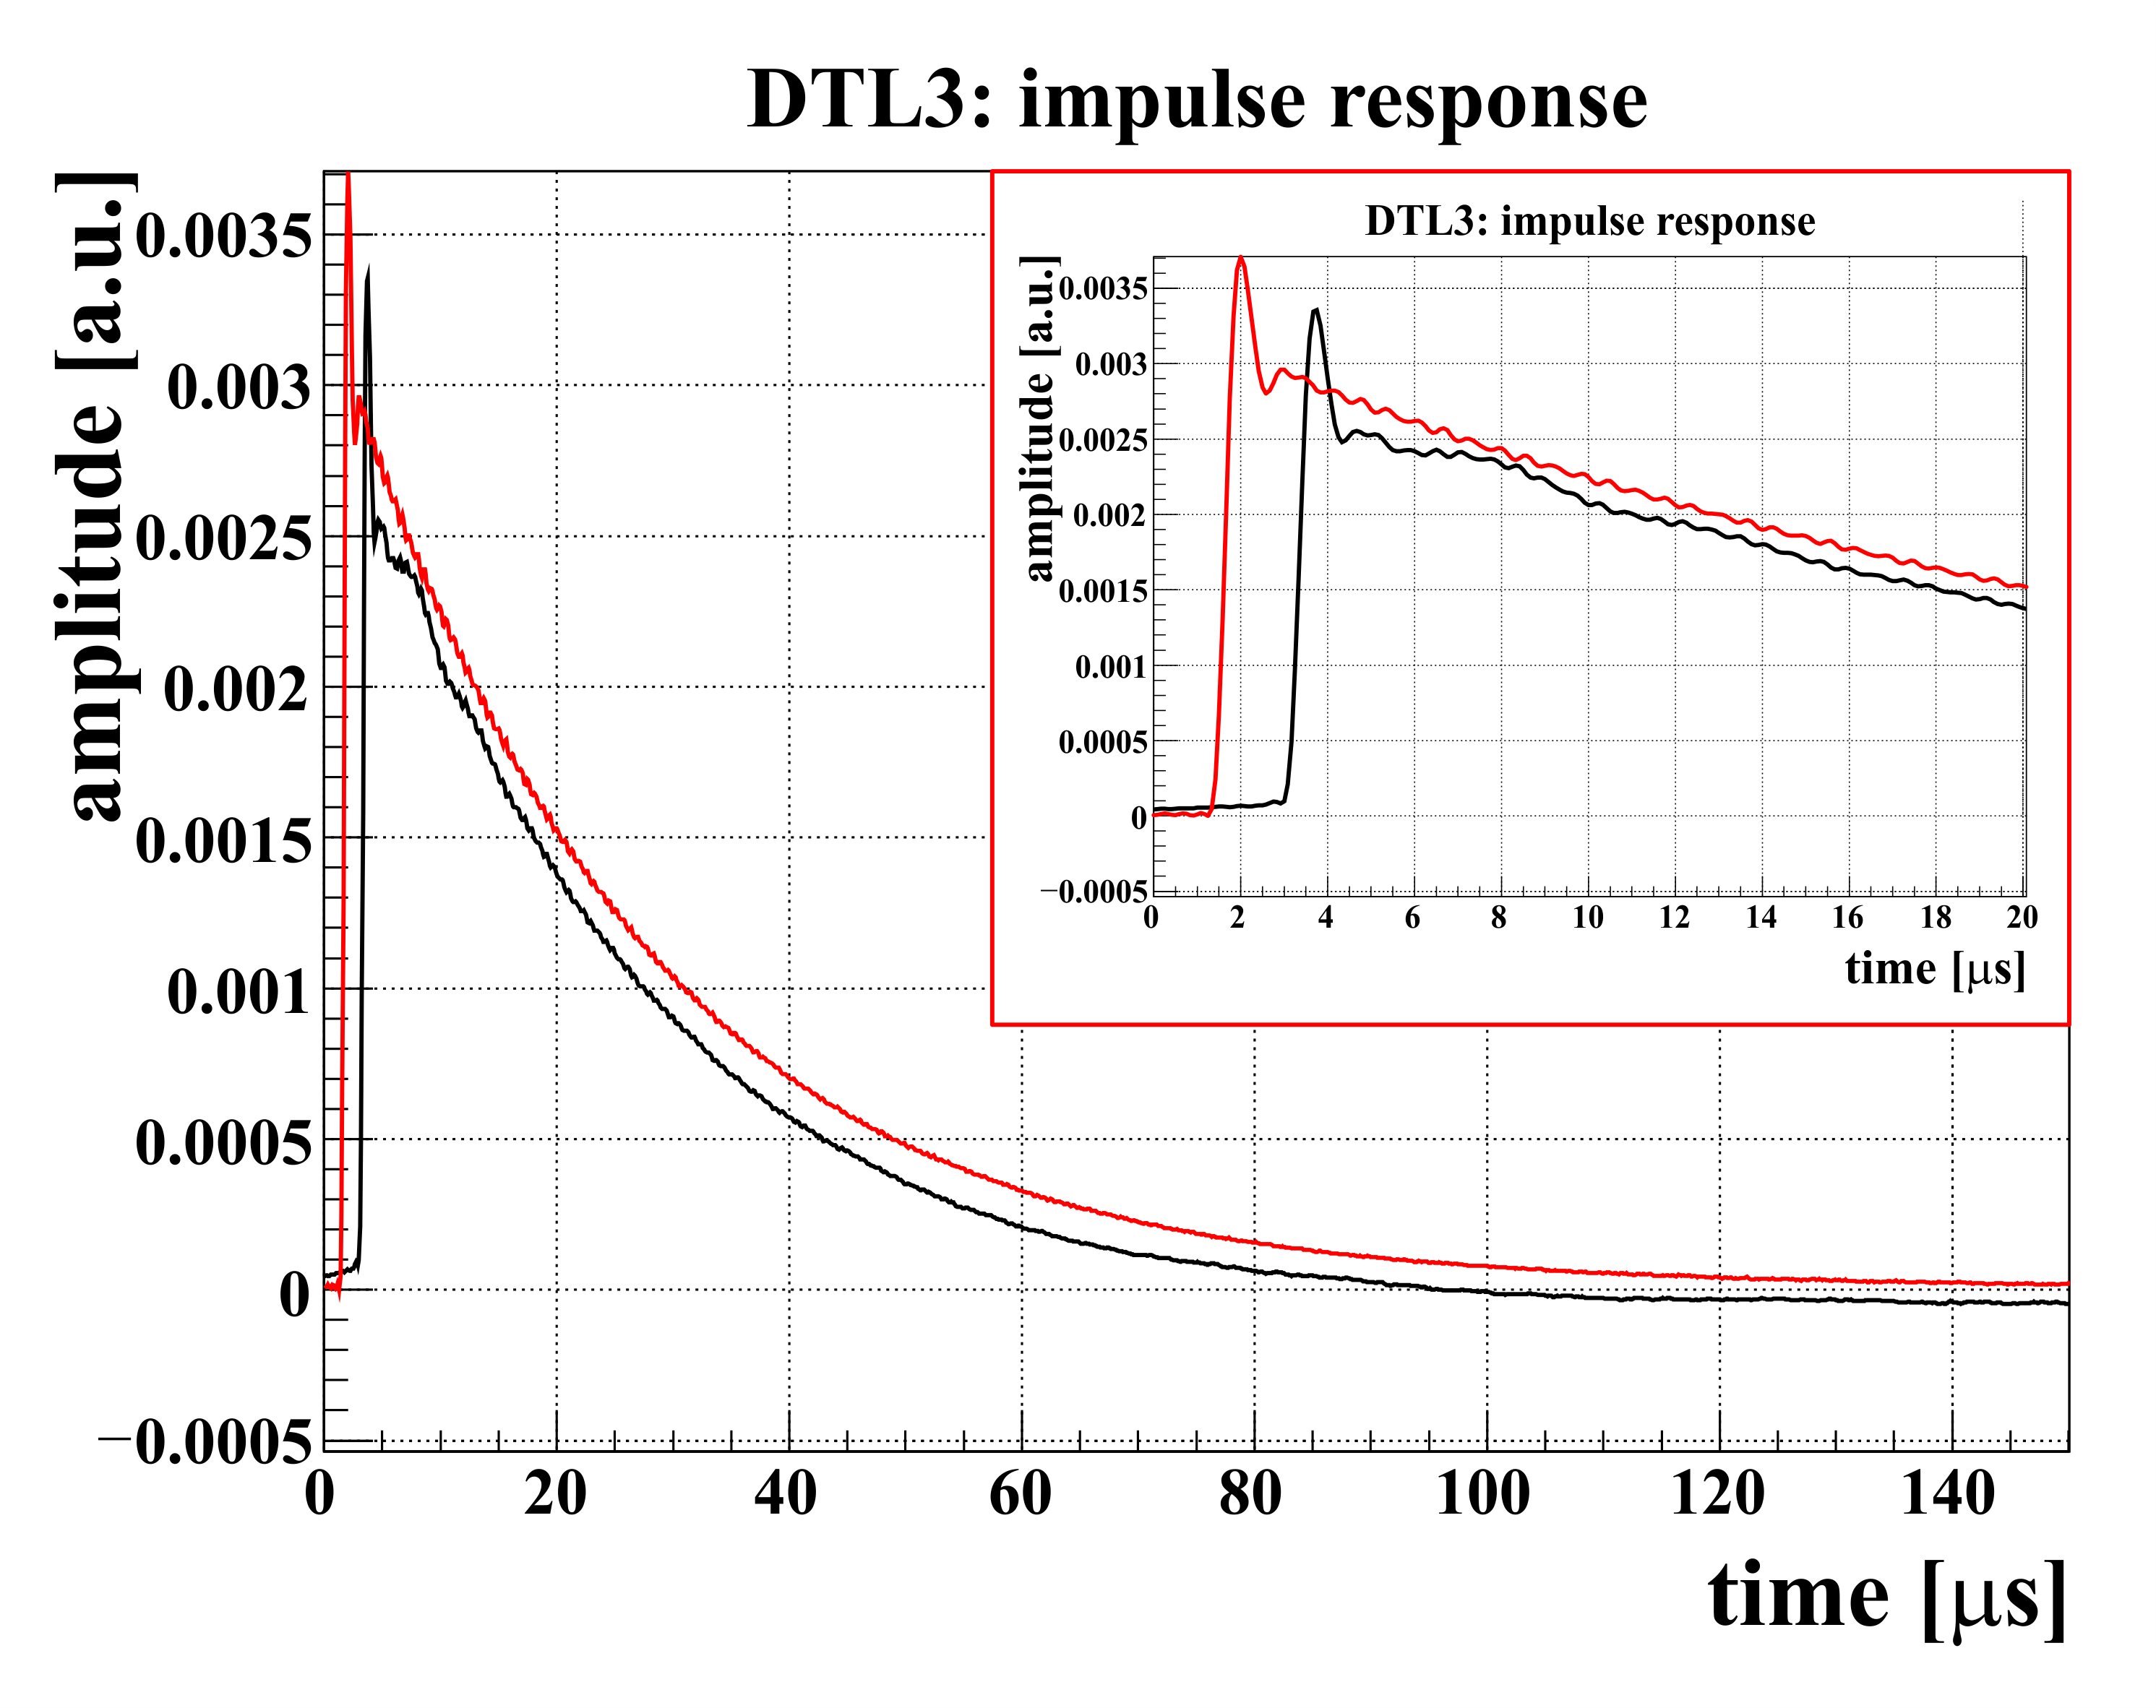
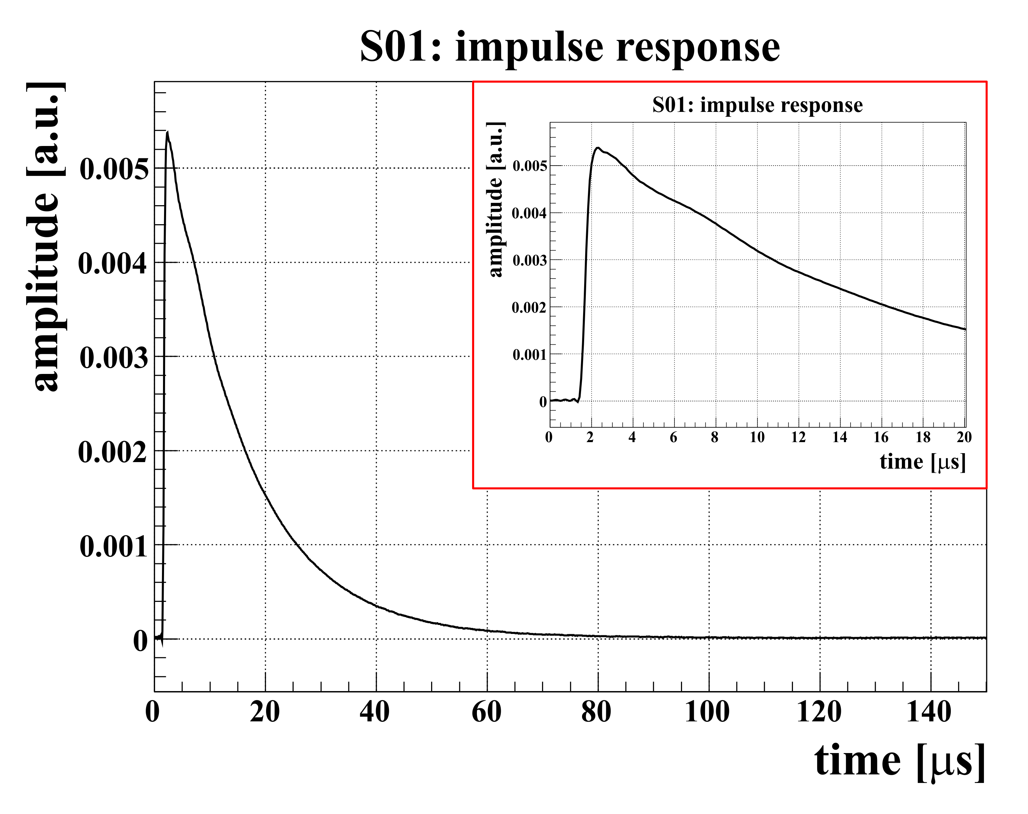
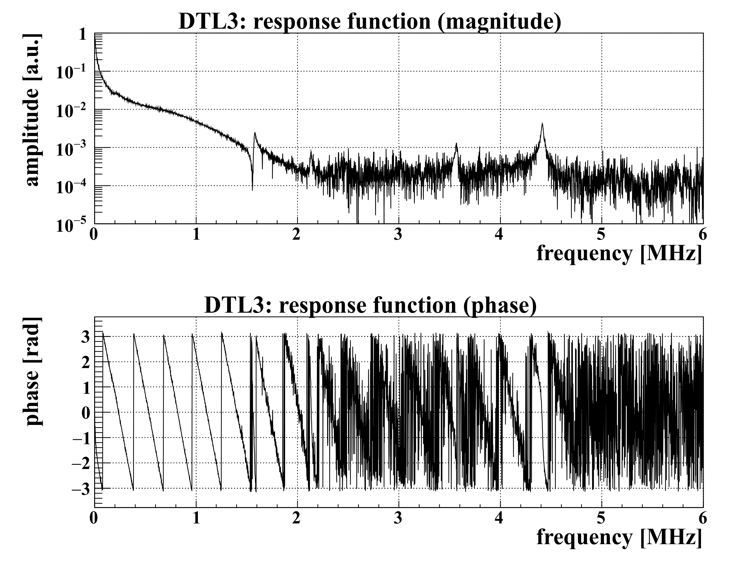
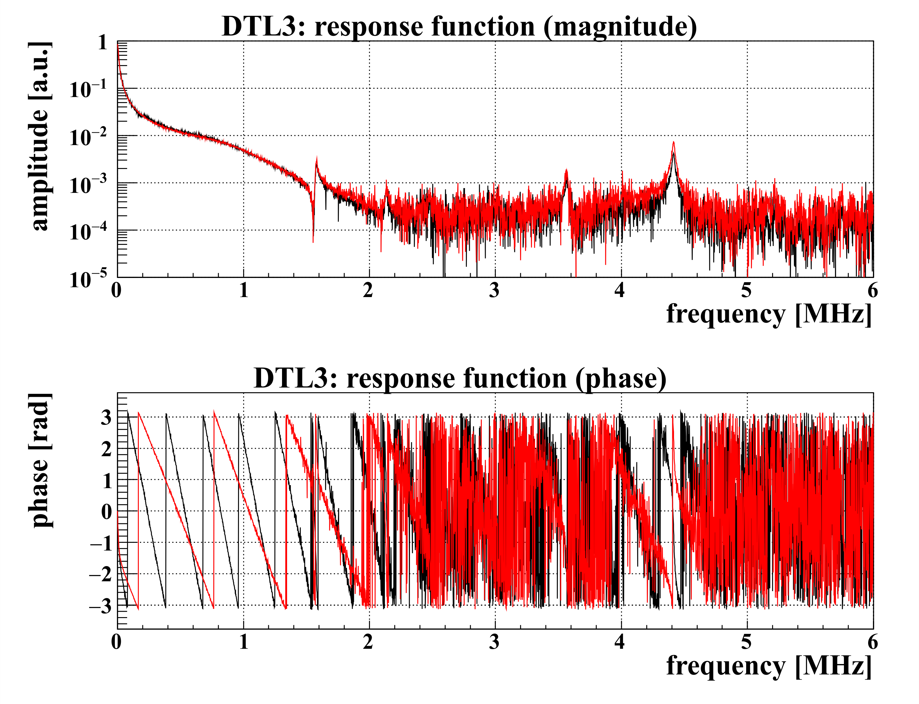
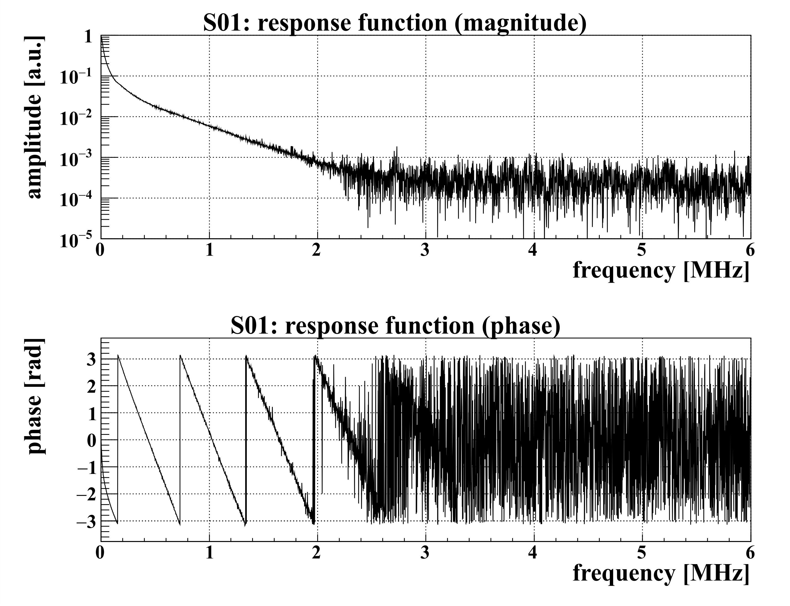
Beam loading compensation 1: transfer function
Firstly, we calculated the transfer function of our system to use the “actual time-domain measurement”.
DTL3
transfer function
→ impulse response
SDTL01
transfer function
→ impulse response
zoom
post coupler modes
zoom
delay：~3 μs
delay：~1.5 μs
The time delay amount of the impulse response for DTL3 was clearly larger than that for SDTL01.
→ For actual measurement, the estimated transfer function includes not only general RF device but also circuits in digital board.
The transfer function of DTL3 has a larger phase variation than that of SDTL01 at first measurement. → the time delay($e^{−sT}$) is larger
7
※ It is a problem of setting the delay amount of ADC on the digital board, and this issue has now been fixed.

Slide 8
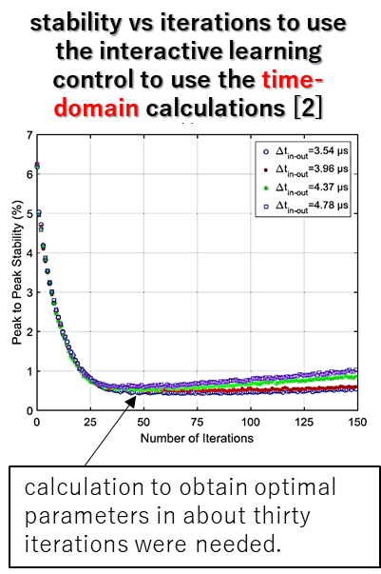
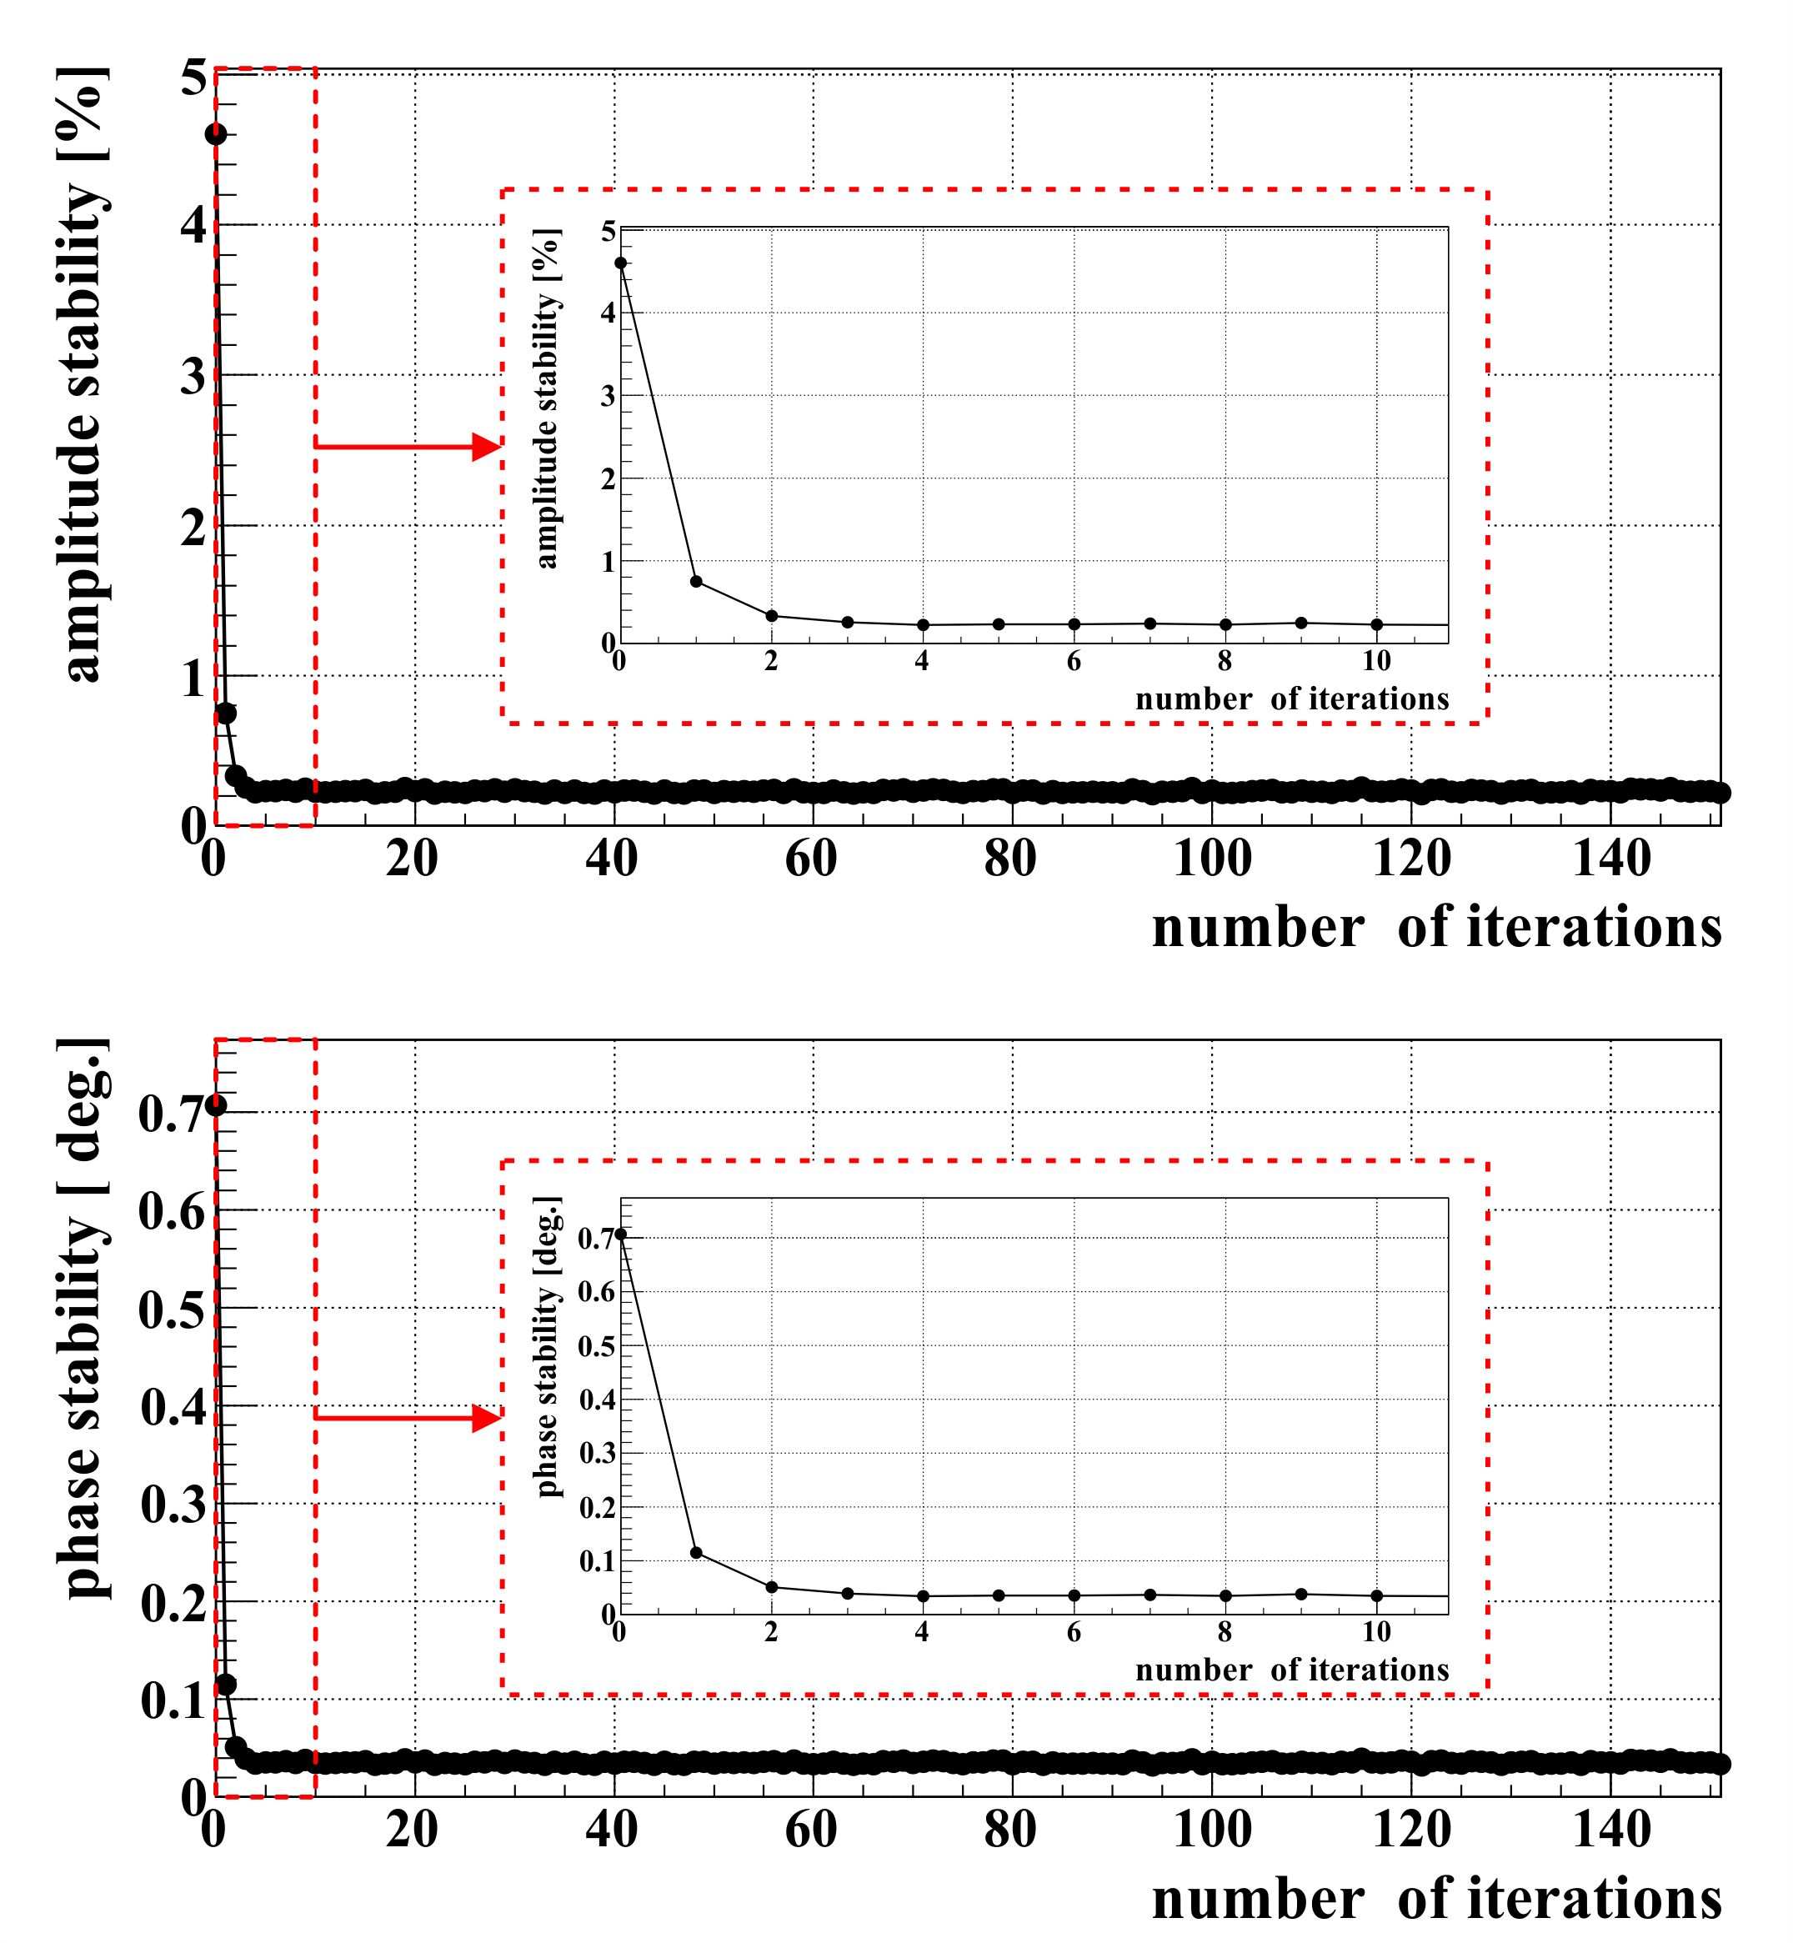
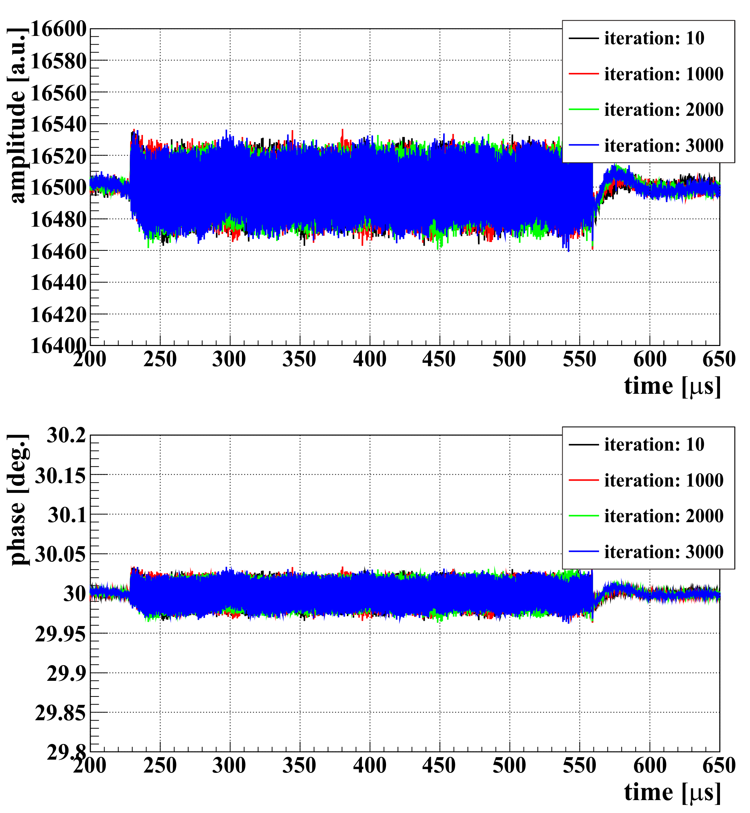
Beam loading compensation 1: field stability and iteration
The optimal parameters of beam loading correction (FF_BEAM) using the frequency-domain calculations are estimated
stability vs iterations [1]
RF waveform (MLF operation)
amplitude
intermediate-pulse structure
1.23-MHz components
amplitude
amplitude
±0.23% @50-mA beam
phase
calculating optimal parameters in a few iterations. (The reason why not once is due to the nonlinearity of the klystron)
phase
phase
±0.036 deg. @50-mA beam
[1] K. Futatsukawa, et al., J. Instrum., 17 (11) (2022), p. T11002
[2] S. Li, et al., Nucl. Instrum. Meth. A 945 (2019) 162612
8

Slide 9
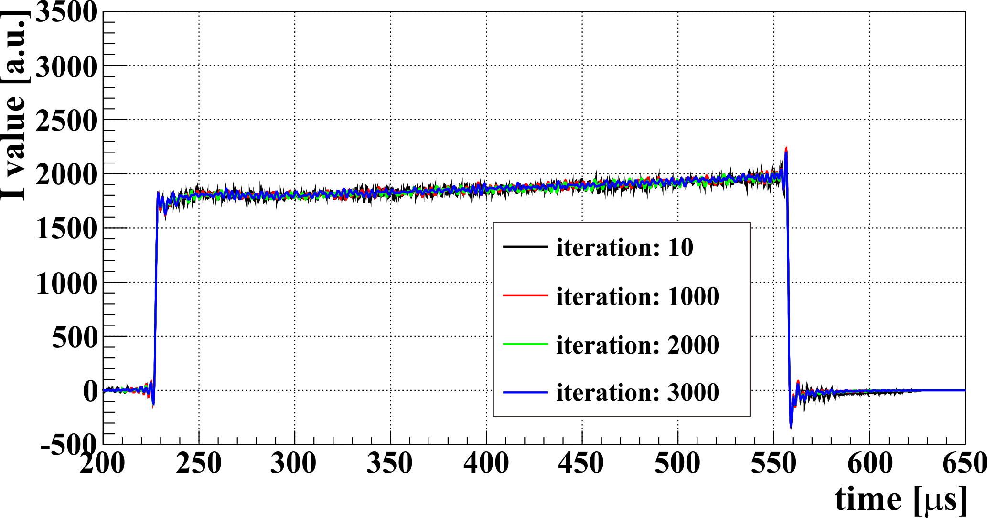
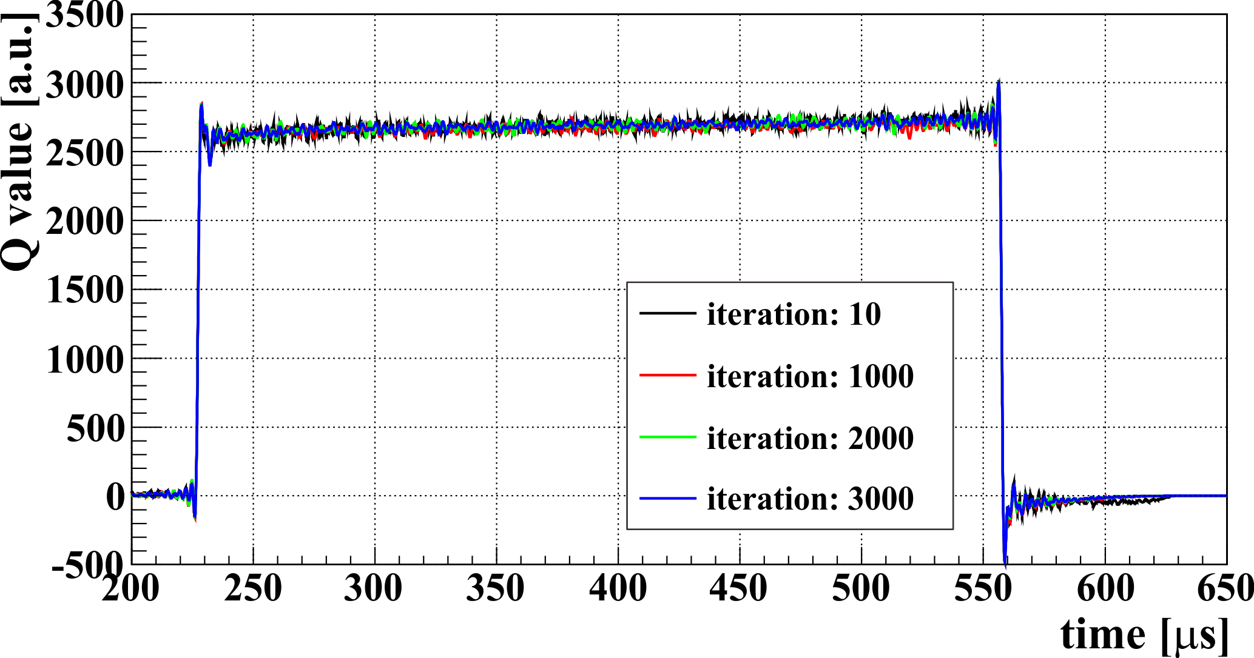
Beam loading compensation 1: accumulation of errors
Example of accumulation of errors
FF_BEAM parameters [1]
FF_BEAM：I
effect of brick-wall filter
Black：number of iterations = 10
Red：number of iterations = 500
FF_BEAM：Q
For example) if 𝑥′(𝑡) has noise 𝜎 that cannot be removed by the LPF, √𝑛 𝜎 of noise will be accumulated in the FF_BEAM parameters in 𝑛 iterations.
→ divergence after finite iterations
→ need to limit the number of iterations
There is no accumulation of errors in the FF_BEAM parameters after 3000 iterations.
expecting no divergence even after infinite iterations
no limit on number of iterations
[1] K. Futatsukawa, et al., J. Instrum., 17 (11) (2022), p. T11002
9

Slide 10
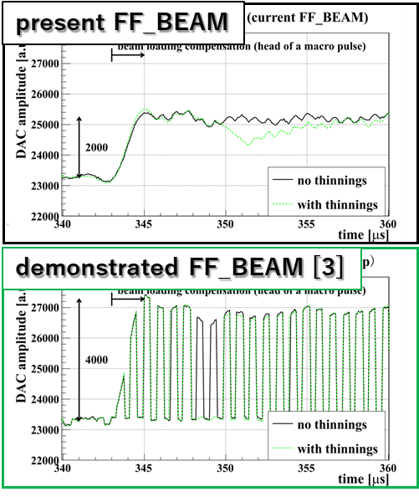
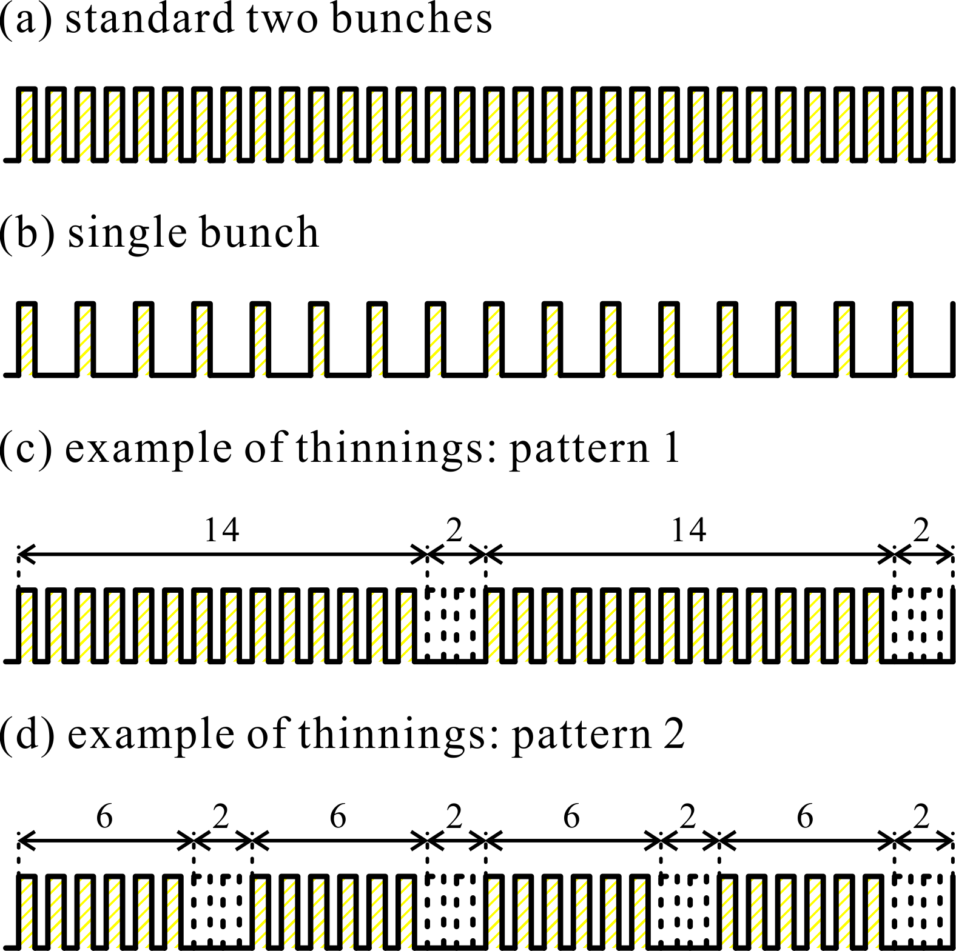
Beam loading compensation 2: discrete beam structure
The preset beam loading compensation system does not support the special intermediate pulse structure:
normally 2-bunch operation in RCS, but 1-bunch operation in RCS
certain intermediate pulses may be "thinned out" to adjust beam intensity
sometimes the intermediate pulse width is adjusted in order to adjust the beam intensity.
→ In particular, the thinning operation can significantly worsen the field stability of the cavity field.
→ High-frequent changes in the beam tests require automatic adapted beam loading compensation..
normal
amplitude
1 bunch
thinning
present FF_BEAM
worsen in thinning timing
demonstrated FF_BEAM [3]
→ suppressing worse
phase
intermediate pulse structure
FF_BEAM with comb-like
adapted to beam structure
thinning
DAC output
10
[3] K. Futatsukawa, et al., Nucl. Instrum. Meth. A 1047 (2023) 167778

Slide 11
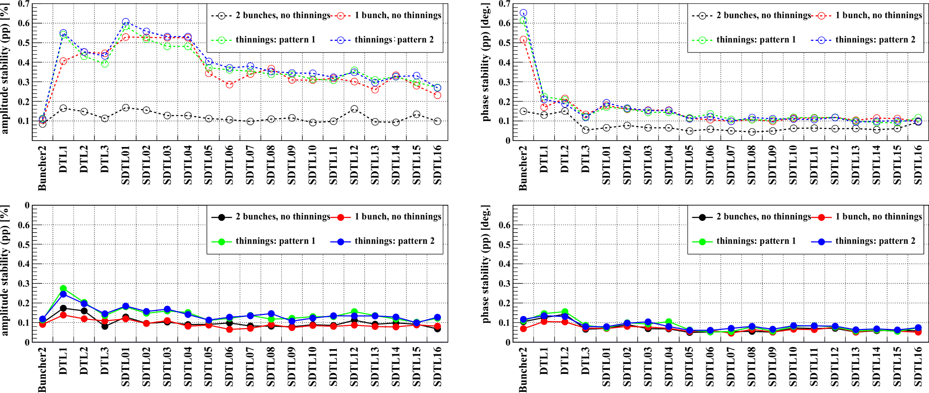
Beam loading compensation 2: field stability
amplitude
phase
beam current: 25 mA
present FF_BEAM
demonstrated FF_BEAM [3]
In the present beam loading compensation system, the stability of amplitude and phase (±0.5% and ±0.6 deg.) has deteriorated worse when the discrete beam parameters were changed. The demonstrated beam loading compensation system for discrete beam structure can significantly suppress the deterioration and achieve the stability of less than ±0.2% in amplitude and less than ±0.15 deg. in phase.
[3] K. Futatsukawa, et al., Nucl. Instrum. Meth. A 1047 (2023) 167778
11

Slide 12
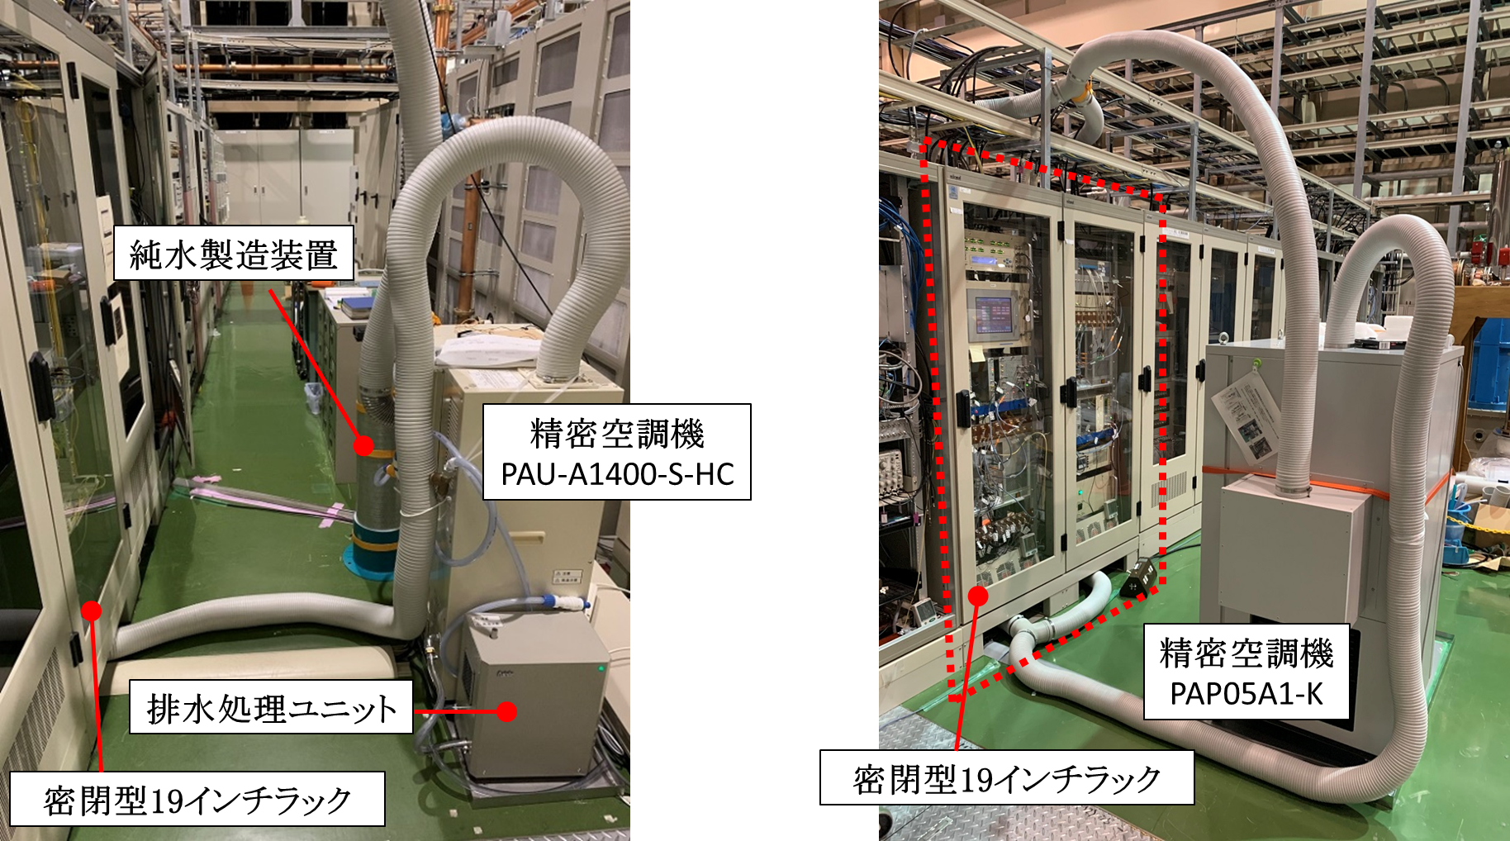
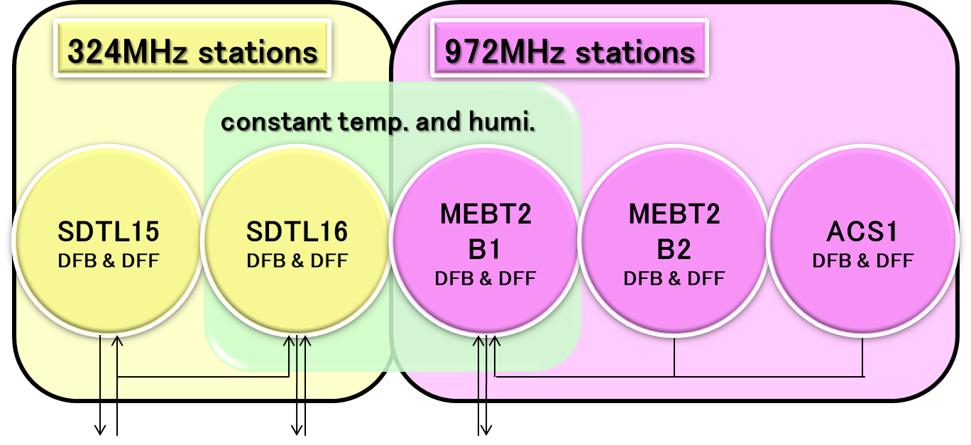
Phase drift correction: reference
We installed the four precision air conditioners and airtight 19” racks as the reference no having the phase drift.
reference
four racks:
RF reference distribution system
μTCA.4 system: MEBT1
downstream 324-MHz: SDTL16
upstream 972-MHz: MEBT2B1
pure water manufacturing device
PAU-A1400-S-HC
- MEBT1: 1 rack
airflow (m³/min) 4.8
cooling capacity (W) 1400
heating capacity (W) 2000
PAP05A1-K
- MEBT1C: 1 rack
- SDTL16/MEBT2B1: 2 racks / station
rated airflow (m³/min) 3~5
cooling & hearing capacity (W) 2300
cooling capacity (W) 1600
precision air conditioner
PAU-A1400-S-HC
We estimates the amount of phase drift by comparing the phase of the reference and neighboring cavities
precision air conditioner
PAP05A1-K
wastewater evaporator
airtight 19-inch rack
airtight 19-inch rack
12

Slide 13
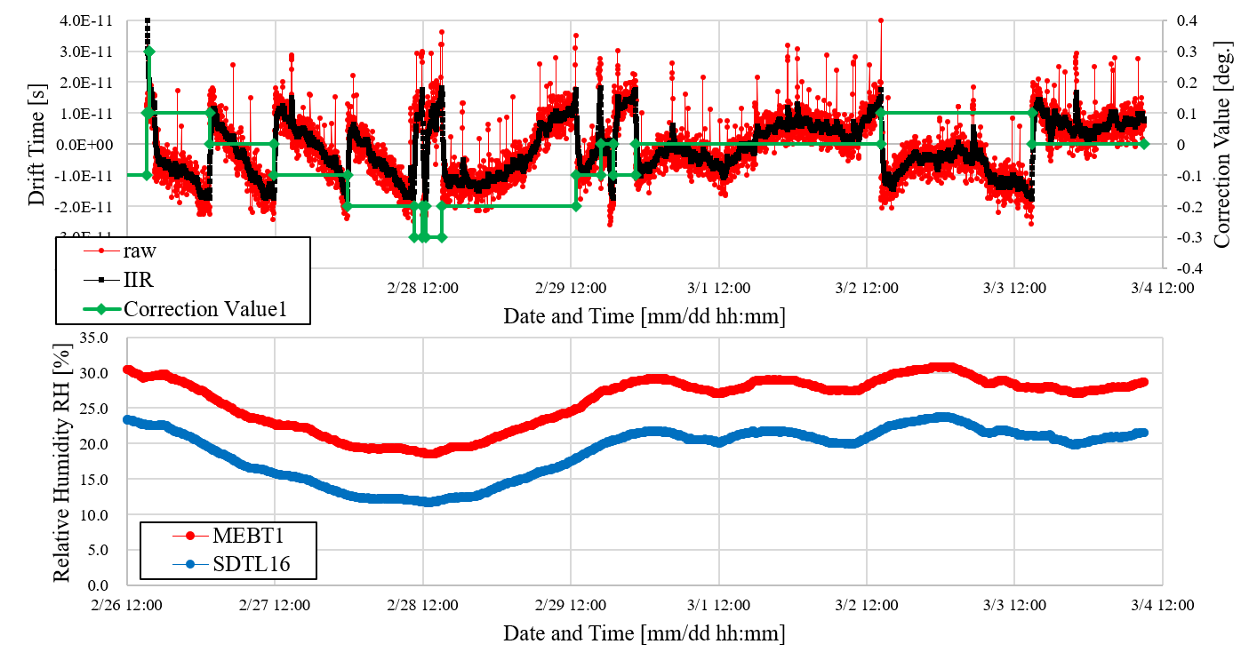
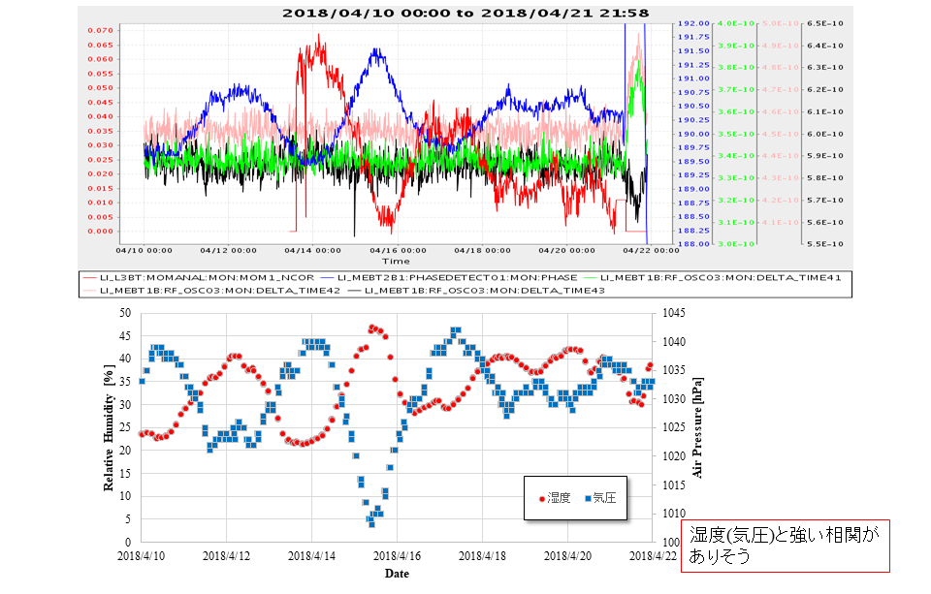
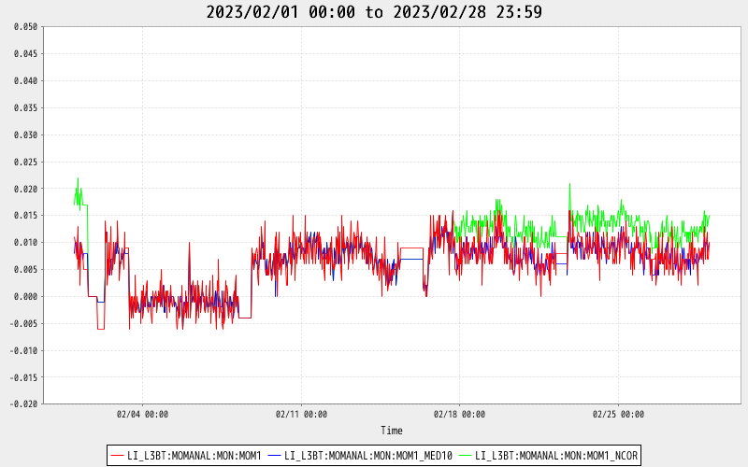
Phase drift correction: results
Phase Drift Correction
Long term stability of output momentum
raw data
data after LPF(IIR)
2018 (first time long-term measurement) [before correction]
0.1 deg. ~ 2.3E-10 s
Δp/p=0.07%
center momentum
correction values
2023/02/01-03/01
momentum correction was done
Δp/p=0.07%
The output momentum correction is carried out about 1 or 2 times per month. (the program is always on work.)
atmospheric
pressure
humidity
The all LLRF systems in the klystron galley environment are assumed to have the same amount of the phase drift, and the phase drift compensations are done when they vary by more than 0.075 deg. (0.1 deg. in figure) from the reference.
As the results of the phase drift compensation, the stability of the output momentum has improved enormously.
2023/02/01~2023/03/01
13

Slide 14
Summary
We are replacing the next generation digital feedback and feedforward system.
MEBT1: installed and operated μTCA.4 system
other 324-MHz stations: installed digitizer boxes and plan to replace with μTCA.4 system
972-MHz stations: developing new μTCA.4 system
We developed the beam loading compensation system.
adaptive beam loading compensation system calculated in the frequency domain
Calculate optimal parameters in a few iterations
no accumulation of errors in the FF_BEAM parameters
beam loading compensation system for discrete beam with comb-like structure
suppressing the deterioration when the beam condition such as thinning operation was changed
We developed the phase drift compensation system.
enormously improving the stability of the output momentum from LINAC.
14

Slide 15
Thank you for your attention

Slide 16
BACKUP

