Slide 1
ATF
Category:
Measurement and control
ID: 5
Low Level RF Workshop 2023
“Digital LLRF feedbacks development, implementation and test at KEK LUCX facility”
POPOV Konstantin
ARYSHEV Alexander
TERUNUMA Nobuhiro
24th October
2023

Slide 2
Presentation plan
ATF
Introduction into KEK LUCX facility and research motivation;
Digital Low-Level Radio Frequency feedback implementation technique;
Developed signal processing and feedback algorithm;
Experiments performed at KEK LUCX facility;
Summary and conclusion
2

Slide 3
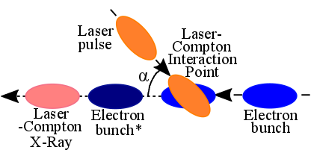
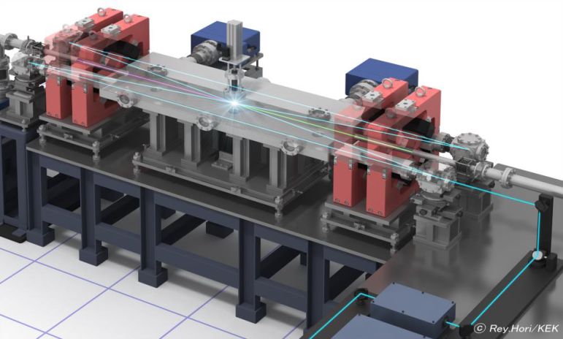
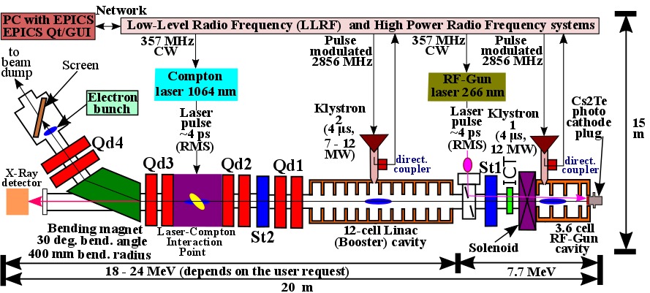
Laser-Compton X-Ray generation experiment at KEK LUCX facility
Figure 1: Laser-Compton backscattering geometry schematics
Figure 2: Schematics of the Laser-Compton X-Ray generation at KEK LUCX facility
Figure 18: KEK LUCX facility beamline schematics
Figure 3: KEK LUCX facility beamline schematic: Qd is the quadrupole doublet, St is the steering magnet
3

Slide 4
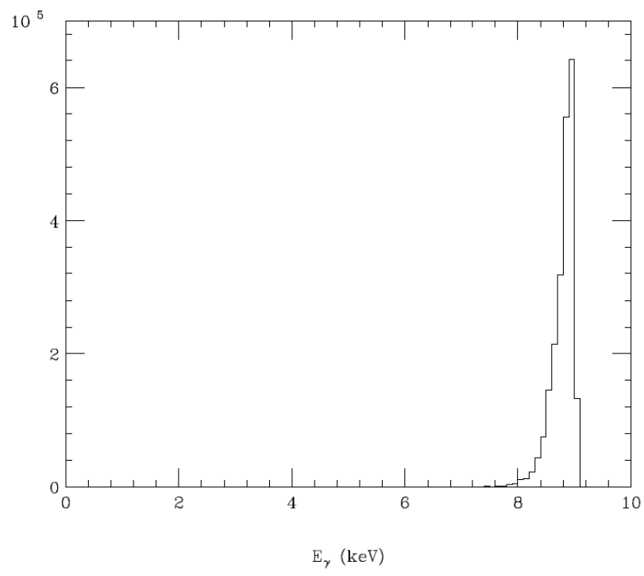
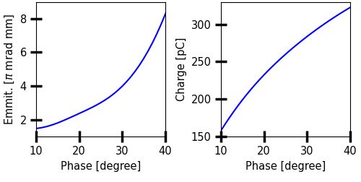
Research motivation
$$λ=1064 nm$$
$$E_{l}=\frac{h∙c}{λ}=$$
$$=1.165 eV$$
Detector is HyPix-3000
Energy band width(FWHM): ~4%
This pixel size is 100 $μ$m
x 100 $μ$m.
$$E=22.5 MeV$$
X-ray flux at the HyPix-3000:
11.83 photons/sec/pixel
This pixel size is 100um x 100um
Figure 4: Laser-Compton backscattering geometry schematics
Laser-Compton X-Ray bandwidth:
$$\frac{{dE}_{γ}}{E_{γ}}≈\sqrt{{\left(\frac{ε_{n}}{σ_{x}}\right)}^{4}+4∙{\left(\frac{dE}{E}\right)}^{2}}$$
X-Ray energy:
$$E_{γ}=4∙γ^{2}∙E_{l}$$
$$E_{γ}=9 keV$$
Figure 5: X-Ray energy distribution calculated at the X-Ray Detector location in CAIN (calculated by K. Sakaue and Y. Koshiba)
Motivation:
Stable accelerating field = stable beam parameters = stable laser-Compton X-Ray source at KEK LUCX facility
Goal:
Develop, implement and test a digital Low-Level Radio Frequency (LLRF) feedback for precise control of RF field at KEK LUCX facility
Figure 6: Bunch parameters: (a) is the norm. trans. emittance vs RF-Gun phase, (b) is the bunch charge vs RF-Gun phase
4

Slide 5
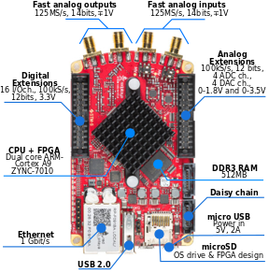
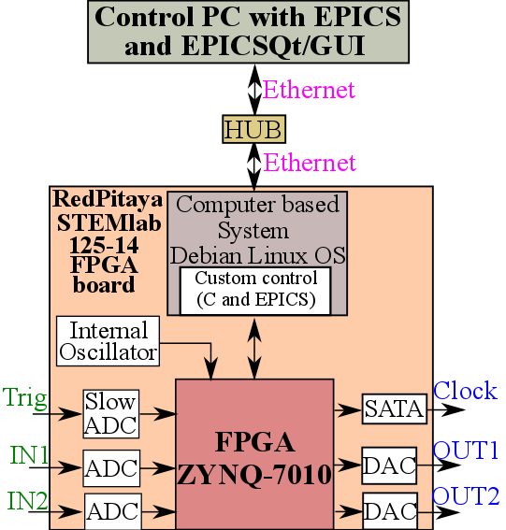
RedPitya STEMlab 125-14 FPGA board overview
Figure 7: RedPitaya STEMlab 125-14 FPGA board
Figure 8: Schematic of single RedPitaya STEMlab 125-14 FPGA board communication logic with PC
5

Slide 6
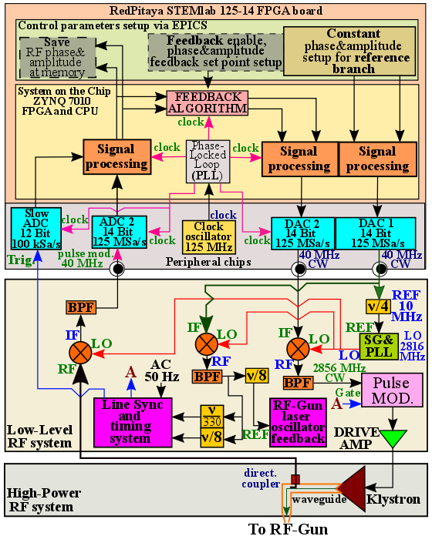
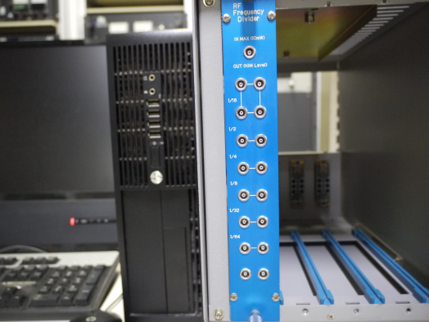
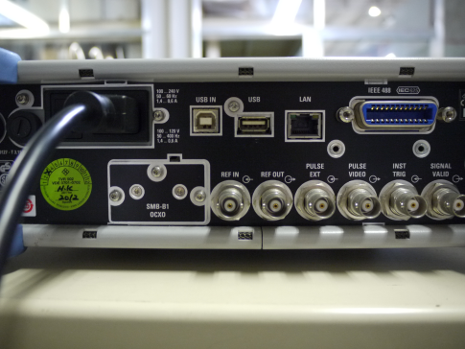
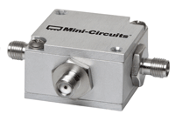
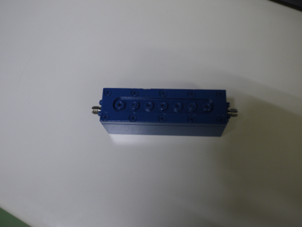
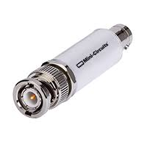
Digital Down Conversion (DDC)&Digital Up Conversion (DUC) technique
Figure 10: Frequency divider (1/4)
REF Input
Figure 11: 10 MHz REF Input (example)
Figure 12: RF-Mixer: Mini-circuits ZFM-4212+
Figure 13: 2856 MHz Band Pass Filter photo
Figure 14: 40 MHz
Band-Pass Filter
Figure 9: Schematic of DDC&DUC technique implementation into LLRF system
6

Slide 7
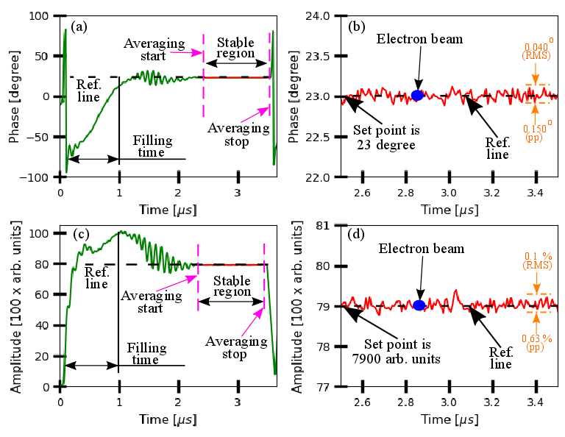
RF-Gun accelerating field waveform
Figure 15: RF-Gun RF field waveform: (a) and (b) are RF-Gun accelerating field phase and zoomed in stable region of the phase, (c) and (d) are RF-Gun accelerating field amplitude and zoomed in stable region of the amplitude
7

Slide 8
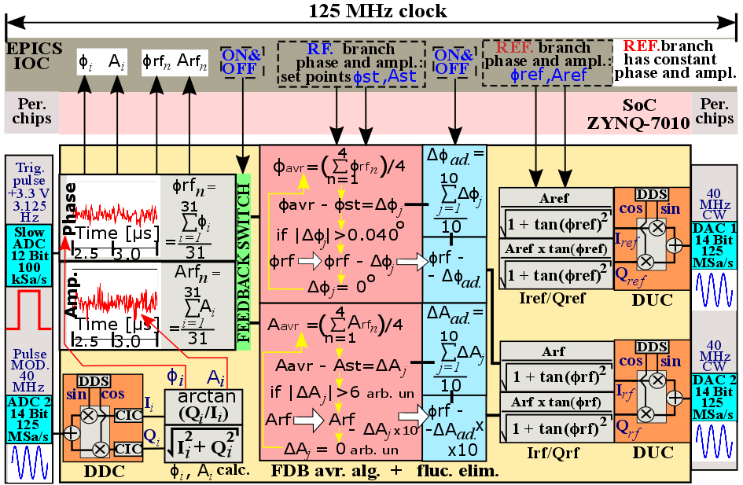
Signal processing and feedback algorithm
Figure 16: Block diagramm of the signal processing and feedback algorithm implemented into
the RedPitaya STEMlab 125-15 FPGA board
8

Slide 9
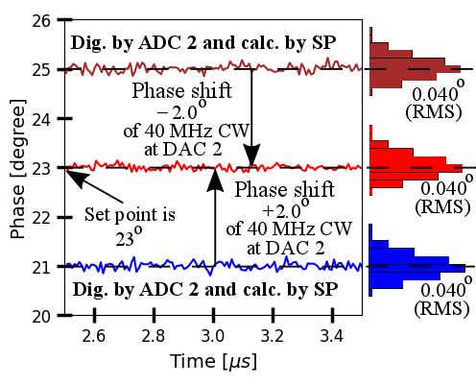
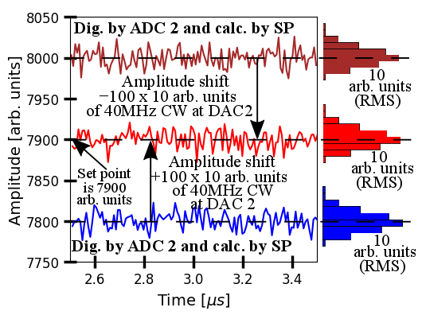
Signal processing and feedback algorithm: illustration example
Figure 17: Phase correction
illustration
Figure 18: Amplitude correction illustration
9

Slide 10
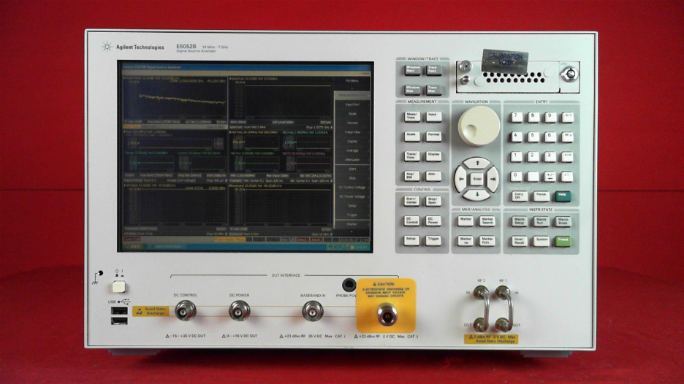
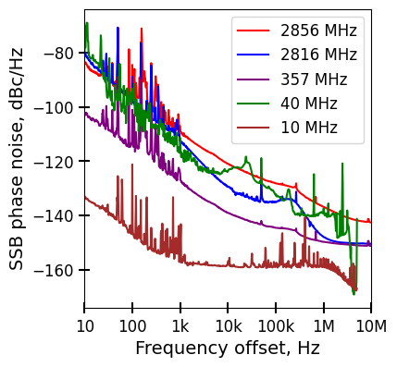
Experimental setup (RF-Gun cavity)
Figure 20: Keysight E5052B SSA
Figure 21: CW signals phase noise map
Figure 19: Experimental setup of the feedback performance for the RF-Gun cavity
10

Slide 11
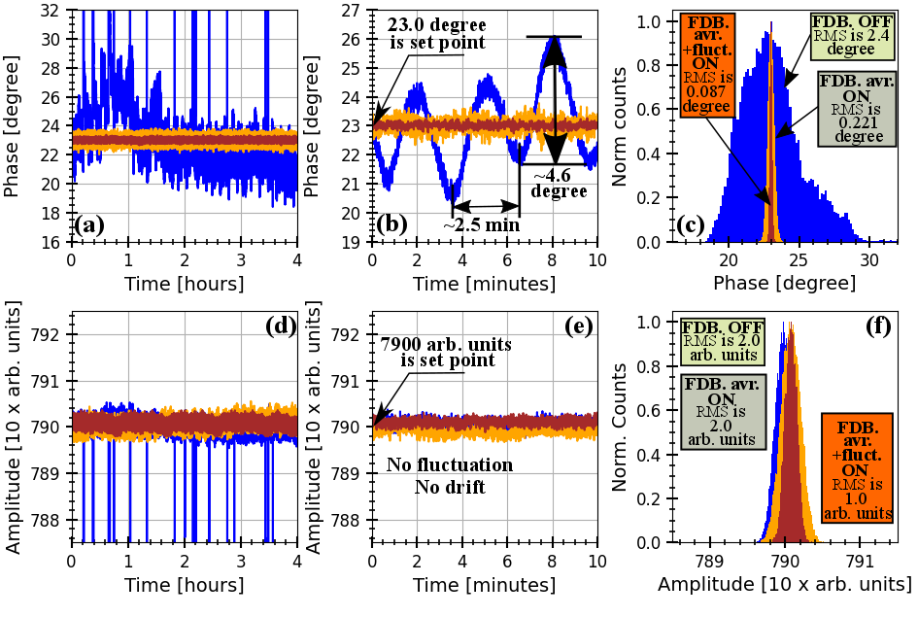
The feedback performance results (RF-Gun)
Figure 22: RF-Gun accelerating field stability experimental data (blue line is FDB OFF, orange line is FDB avr. ON,
red line is FDB avr. + fluct. elim ON): (a), (b) and (c) are RF-Gun phase stability during 4 hours, first 10 minutes
and histogram; (d), (e) and (f) are RF-Gun phase stability during 4 hours, first 10 minutes and histogram
11

Slide 12
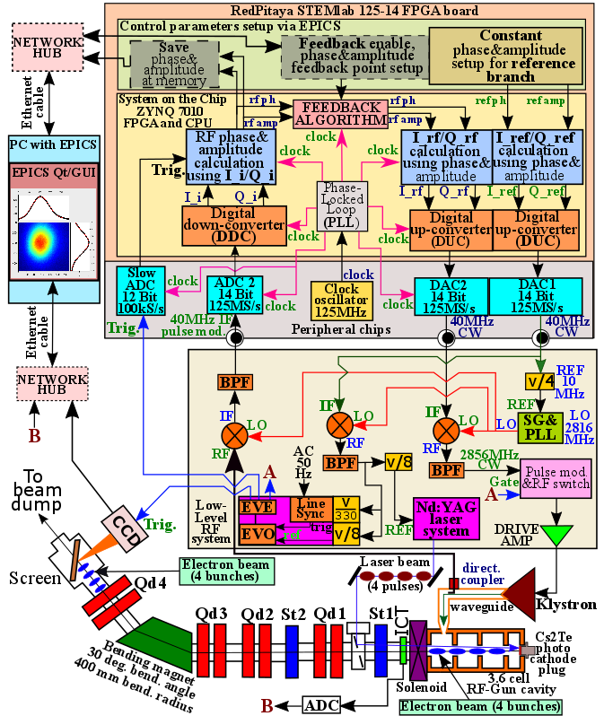
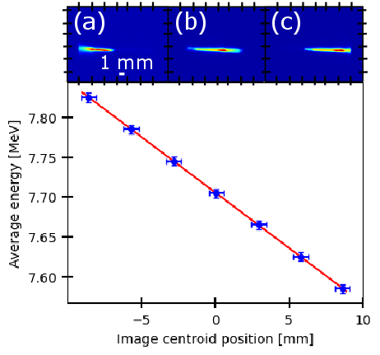
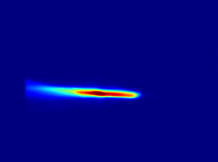
Experiment with electron beam: setup
Note:
$$FDB avr.$$
+
fluct. elim.
ON
Figure 24: Average energy vs image centroid position calibration curve (blue dots is exp. data and redline is linear fit)
1. Detect image
2. Fit with Gauss
3. Calculate horizontal dispersion at screen loc.
Figure 25: Typical image on screen measured by CCD
4. Use eq. 1
$η_{x}$ is 590 mm
$∆E=∆x∙E/η_{x}$ (1)
12
Figure 23: Experimental setup
$E$ is 7.7 MeV

Slide 13
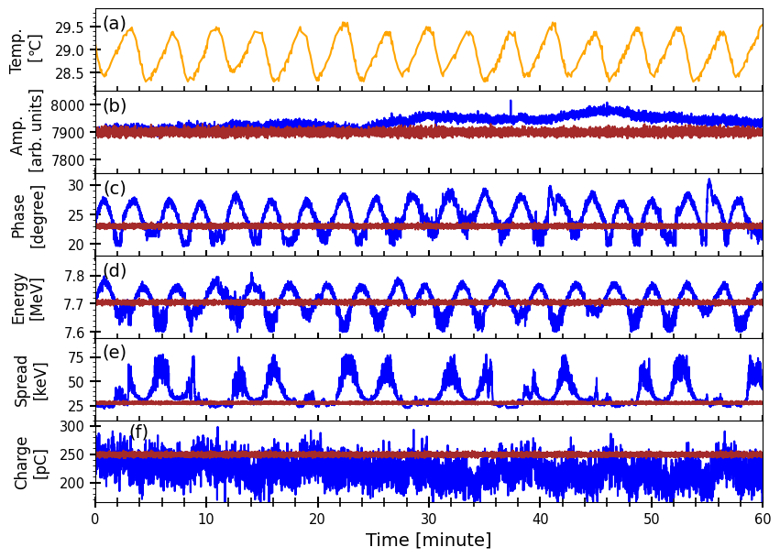
Experiment with electron beam: results
Figure 26: Experimental data (blue line is FDB. OFF and red line is FDB avr.+ fluct. elim. ON): (a) is the cavity surface temperature, (b) is the field amplitude, (c) is the field phase, (d) is the average energy, (e) is the energy spread,
(f) is the bunch charge vs time
13

Slide 14
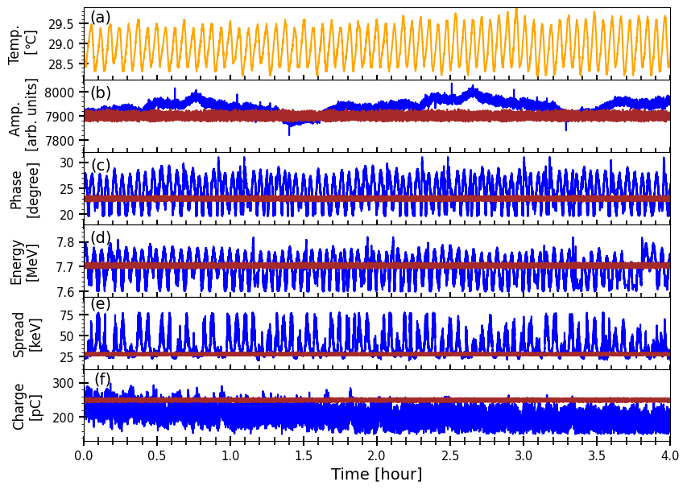
Experiment with electron beam: results
Figure 27: Experimental data (blue line is FDB. OFF and red line is FDB avr.+ fluct. elim. ON): (a) is the cavity surface temperature, (b) is the field amplitude, (c) is the field phase, (d) is the average energy, (e) is the energy spread,
(f) is the bunch charge vs time
14

Slide 15
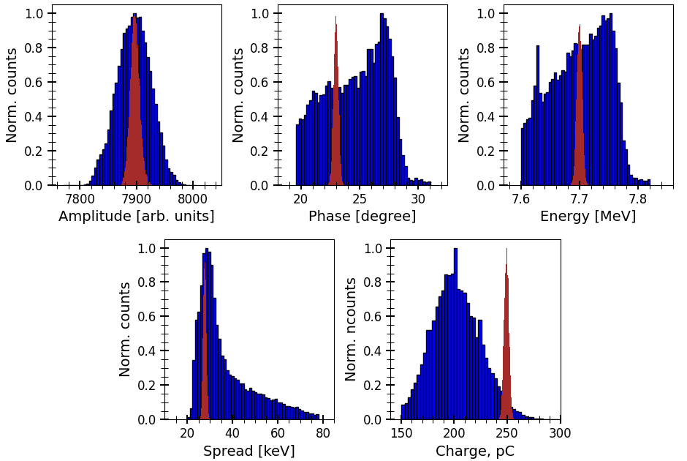
Experiment with electron beam: histograms
(a)
(b)
(c)
Pp is
254
arb.
units
Pp is
1.0 deg.
Pp is
21
keV
Pp is
50 arb.
units
Pp is
11.5 deg.
Pp is
220
keV
(d)
(e)
Pp is
5
keV
Pp is
15
pC
Pp is
58
keV
Pp is
148
pC
Figure 28: Experimental data (blue histogram is FDB. OFF and red histogram is FDB. avr + fluct. elim. ON):
(a) is the field amplitude, (b) is the field phase, (c) is the average energy, (d) is the energy spread, (e) is the bunch charge
15

Slide 16
Summary and conclusion
Table 1: Summary
Parameter | Value | Peak-to-peak stability with FDB. OFF | Peak-to-peak stability with FDB. avr. + fluct. elim. ON | OFF / ON
RF-Gun accelerating field amplitude, arb. units | 7900 | $254$ | $$50$$ | 5
RF-Gun accelerating field phase, degree | 23 | 11.5 | 1 | 11.5
Average energy, MeV | 7.7 | 0.220 | 0.021 | 10.5
Energy spread (RMS), keV | 25 | 58 | 5 | 11.6
Bunch charge, pC | 250 | 148 | 15 | 10.0
Conclusion:
Digital Low-Level Radio Frequency Feedback based on RedPitaya STEMlab 125-14 FPGA board was developed, implemented and tested at KEK LUCX facility. The phase and amplitude were stabilized 11.5 times and 5 times, respectively. As a result, beam average energy, energy spread and bunch charge stability was improved 10 times. As an optimistic prediction, laser-Compton X-Ray characteristics stability will be improved 10 times too.
16

Slide 17
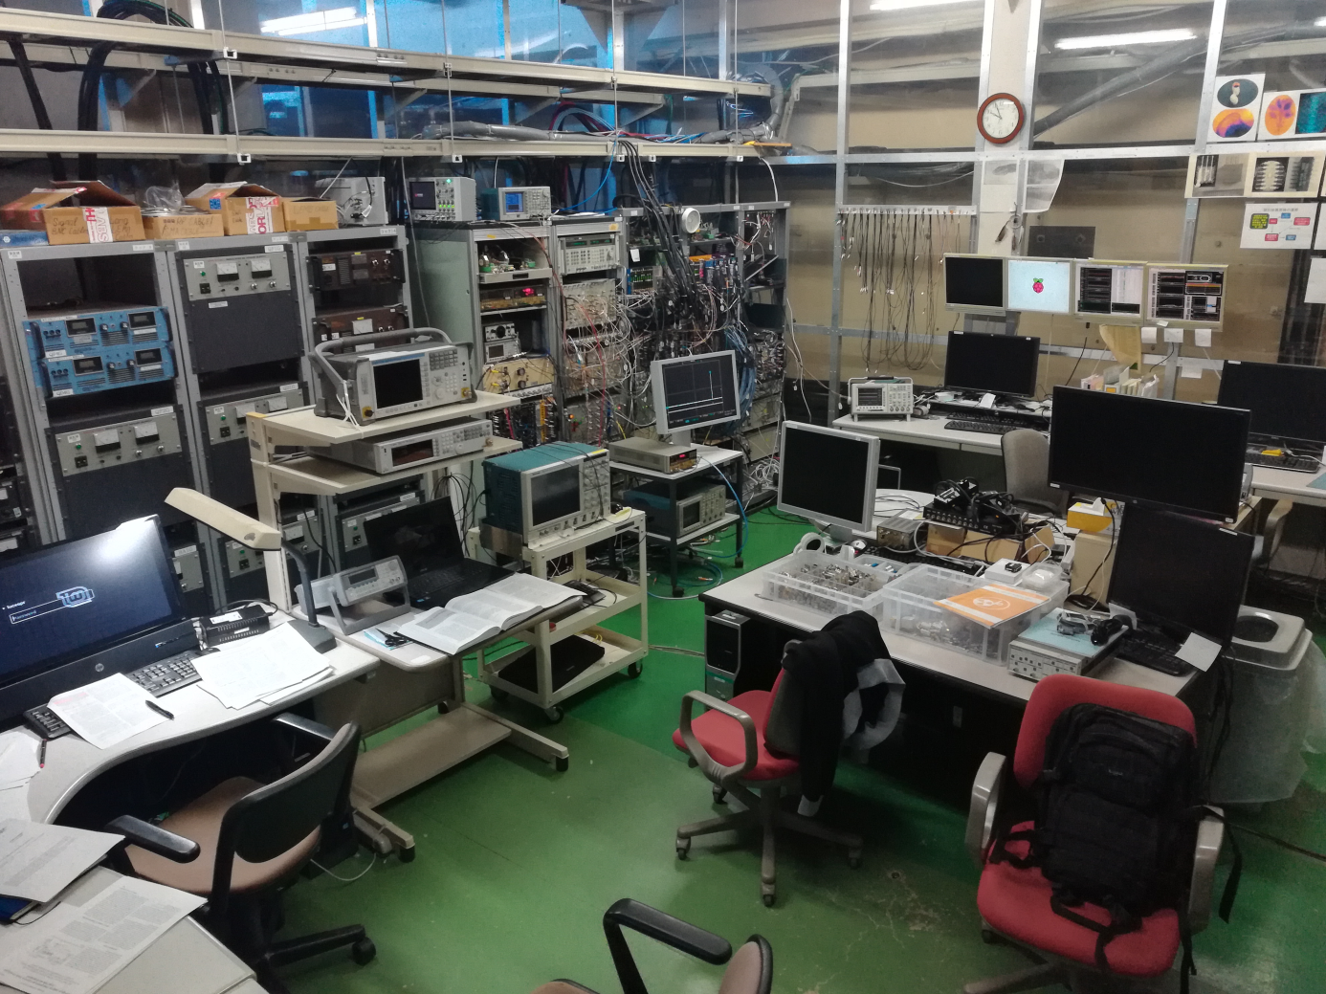
THANK YOU FOR ATTENTION!

Slide 19
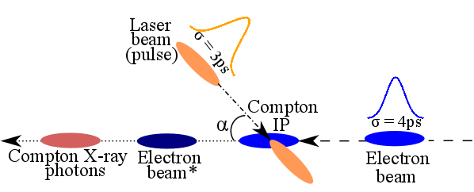
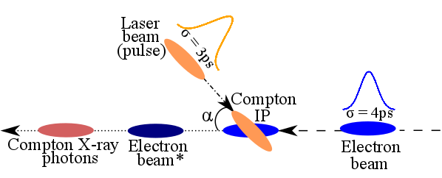
Electron beam parameters jitter influence on Compton X-ray photons parameters
Figure Bc.1.: Inverse Compton scattering phenomena.
Bad synchronization case. It means, feedback is turned OFF
Figure Bc.2.: Inverse Compton scattering phenomena.
Good synchronization case. It means, feedback is turned ON
Compton laser pulse (RMS) length at IP is equal to 3 ps.
Electron beam arrival time jitter is 1.1ps, while the bunch length is 4ps. So, 27.5% the bunch charge is lost because of time arrival jitter of electron bunch => Compton photons intensity is quarter less because of time arrival jitter of electron bunch.
Compton laser pulse (RMS) length at IP is equal to 3 ps.
Electron beam arrival time jitter is 100fs , while the bunch length is 4ps. As a conclusion, 3% of the bunch charge is lost because of time arrival jitter of electron bunch => Compton photons intensity is close to the ideal case.
Bc.1

