Slide 1
LCLS-II-HE Project Status
LLRF Workshop 2023
Andy Benwell, on behalf of the LCLS-II-HE LLRF Team
23 October, 2023

Slide 2
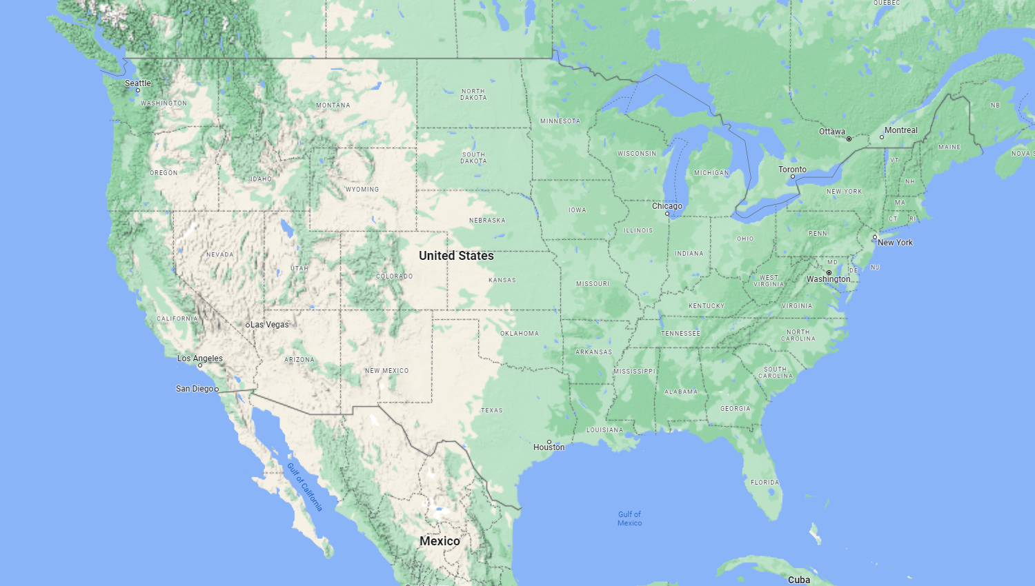
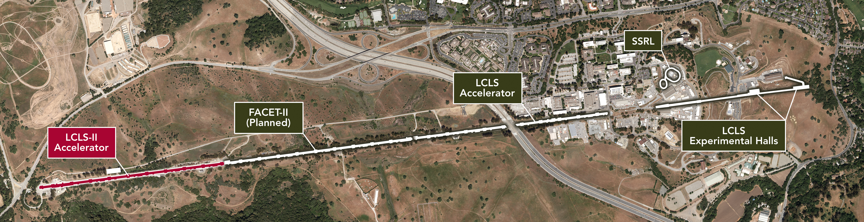
SLAC is extending the capability of its recently completed SRF Linac Coherent Light Source (LCLS-II) accelerator to keep it at the forefront of X-ray science.
Double the electron energy of the accelerator (4 ➔ 8 GeV)
  Extends X-ray energy range from 5 keV to 12.8 keV
Provide a dual source X-ray capability
  Delivers simultaneous soft X-ray and hard X-ray beams at high repetition rate
Provide specialized instrument for unique new source
  Delivers optimized measurement capabilities and enables science immediately after accelerator commissioning
LCLS-II-HE Upgrade @ SLAC

Slide 3
Outline
LCLS-II-HE Scope & Schedule
RF Systems Overview
Updates to HPRF
Updates to LLRF
LLRF System details
CM testing with the LCLS-II-HE LLRF system

Slide 4
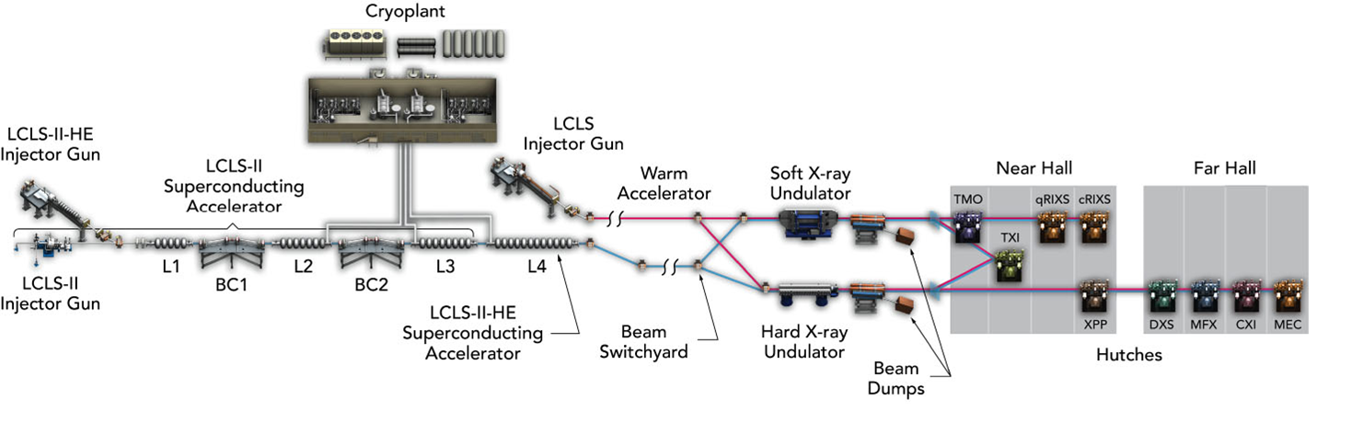
LCLS-II-HE Project Scope
Install 23 additional cryomodules (L4 Linac) to increase the LCLS-II accelerator energy to 8 GeV.
Install new cryogenic distribution system between Cryoplant-2 and the new L4 Linac.
Upgrade soft X-ray undulator for 8 GeV operation.
Upgrade the X-ray Pump Probe (XPP) instrument for MHz beam and data rates and upgrade the photon transport optics and beamline components through the Hard X-ray instruments.
For extended hard X-ray performance, develop conceptual design of a Low-Emittance Injector (LEI) including a tunnel design to support its construction. Also fund construction of a prototype high gradient SRF gun (30 MV/m cathode field) for the LEI.

Slide 5
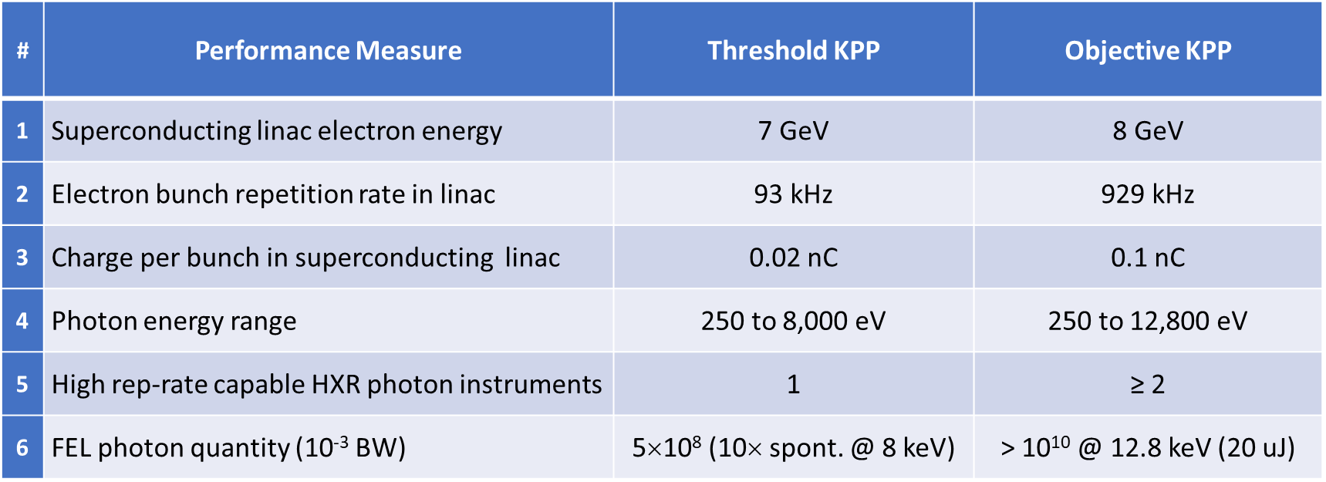
LCLS-II-HE Project Metrics

Slide 6
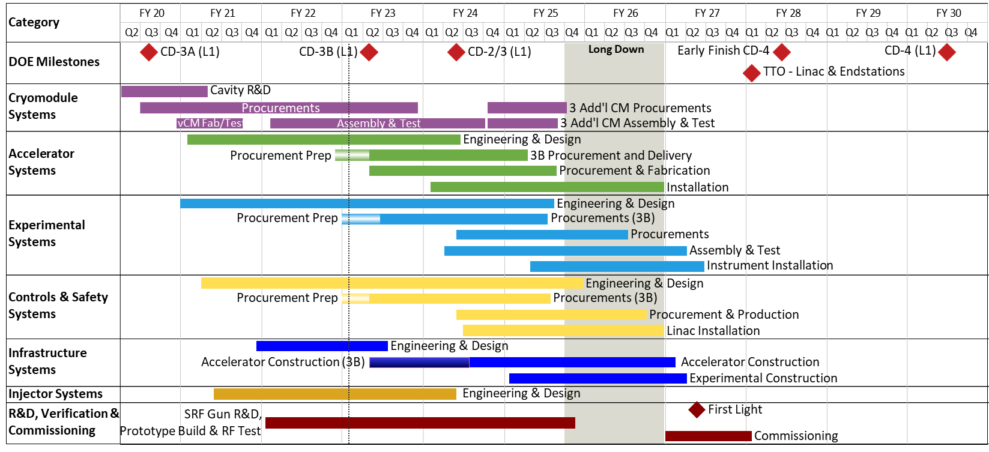
LCLS-II-HE Preliminary Schedule
CD-2/3 (L1)
We are here now
We have been here before ☺

Slide 7
RF Systems Overview
Section | # of CM | # of Cavities | Minimum Gradient [MV/m] | QL | SSA Power [KW]
L0 | 1 | 8 | 16.3 | 4.1e7 | 3.8
L1 | 2 | 16 | 13.6 | 4.1e7 | 3.8
L2 | 12 | 96 | 15.5 -> 16 | 4.1e7->6.0e7 | 3.8
L3 | 20 | 160 | 15.5 -> 16 | 4.1e7->6.0e7 | 3.8
L4 | 23 | 184 | 20.8 | 6.0e7 | 7.0
No major changes to RF control, but LLRF system must regulate higher gradient with higher loaded Q
  RF regulation at > 0.1 Hz remains the same
    0.01° RMS in phase
    0.01% RMS in amplitude
  RF regulation assumes
    < 1% beam current fluctuation
    < 10 Hz microphonic detuning
  Resonance Control regulation
    Piezo tuner setting accuracy < 1Hz
HE Linac changes
  L2 and L3 gradient increased
  L2 and L3 cavity QL increased
  L4 – new, with increased gradient

Slide 8
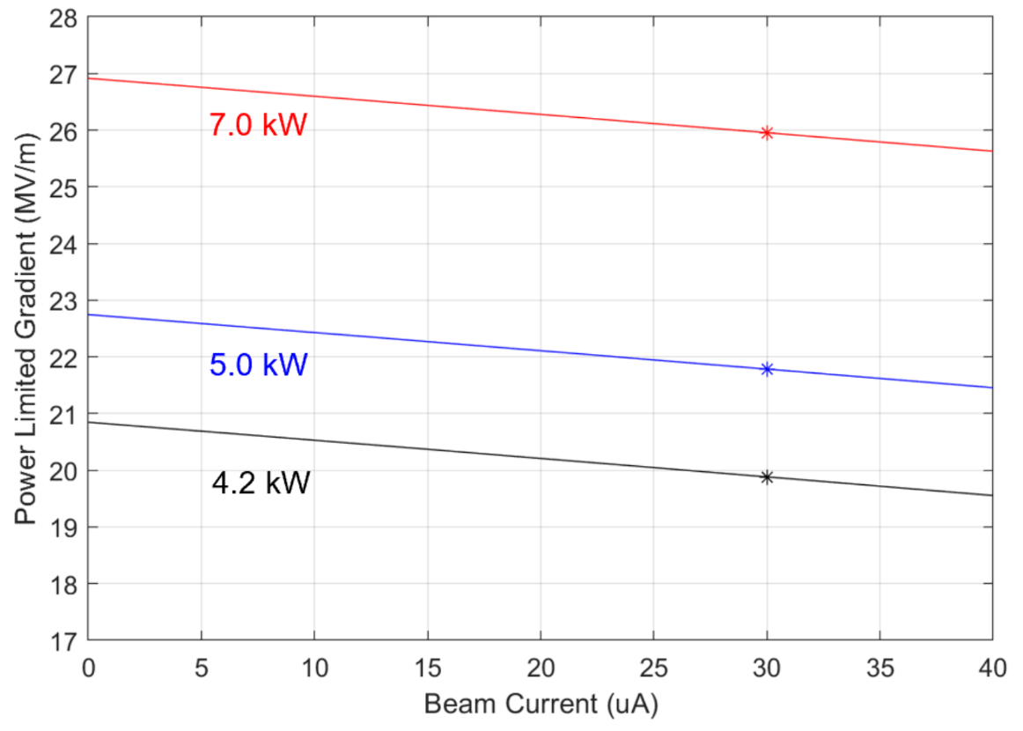
HPRF Source Selection
Single Cavity – Single Source architecture will be maintained from LCLS-II
  Keeps cavity field regulation as simplified as possible
RF Power requirements for LCLS-II-HE derived from cryomodule and beam configurations
  Qext adjusted to 6.0e7 (up from 4.1e7)
  Cavity peak detuning remains at 10 Hz
  30 µA Beam Current
  Assume 10% overhead for transmission loss
For the 20 HE CMs, 20.8 MV/m 5kW SSAs were considered, but 7 kW SSAs selected to meet gradient requirements

Slide 9
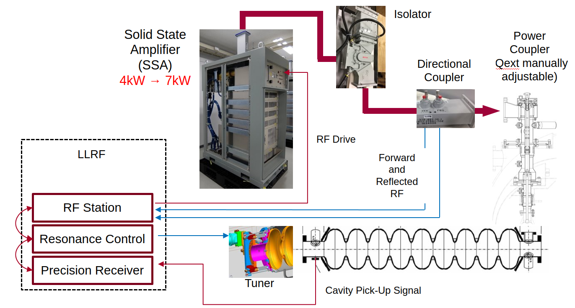
RF System transport and cavity regulation

Slide 10
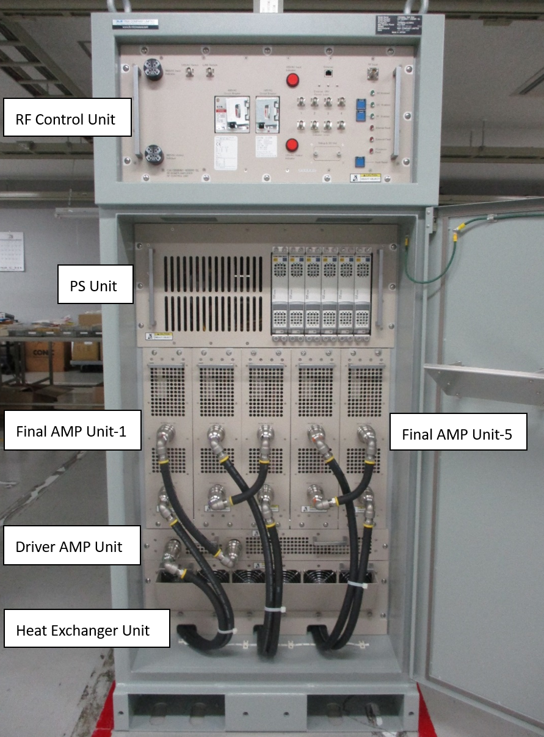
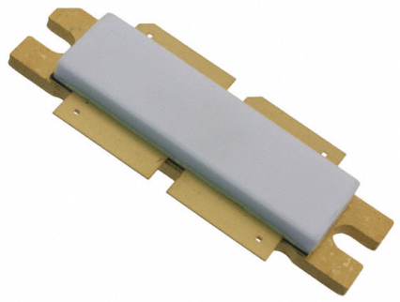
SSA Design Status
7 kW SSA
SSA vendor R&K was awarded funds for building 184 SSAs at 7 kW
18 prototype SSAs used for evaluation at SLAC and CM testing at partner laboratories
Slight architecture changes, but basic design is similar to LCLS-II
  Uses 10 new-generation LDMOS transistors
    max power ~ 700 W per transistor (up from 350W)
  New power supplies with higher estimated lifetime (MTBF)
  5 separate RF modules with 2 RF pallets each
  Same physical footprint
  Very similar controls interface
  Modbus TCP/IP
  Recognizable control registers

Slide 11
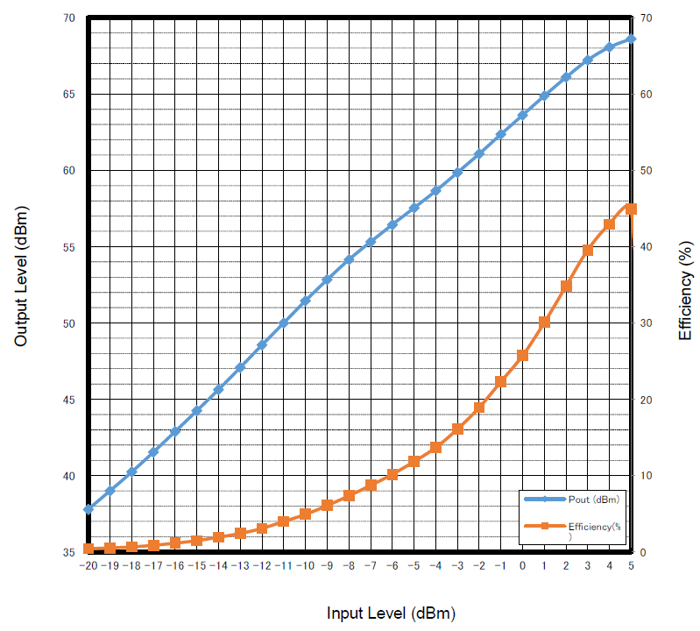
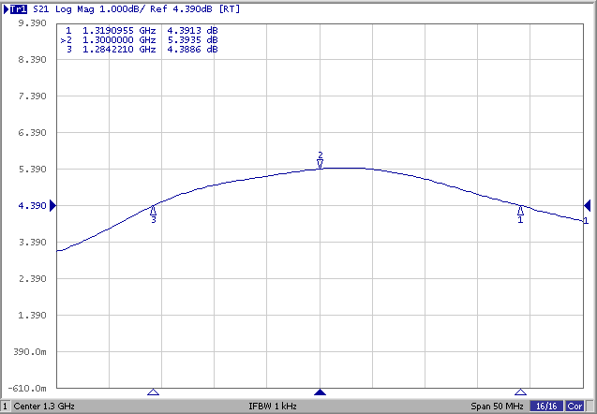
7 kW SSA Key Performance
  Phase vs frequency: linear within 5%
  Bandwidth at 7 kW > 1 MHz
  Efficiency > 40%
Gain & Efficiency
7 kW
1 dB Bandwidth
45%

Slide 12
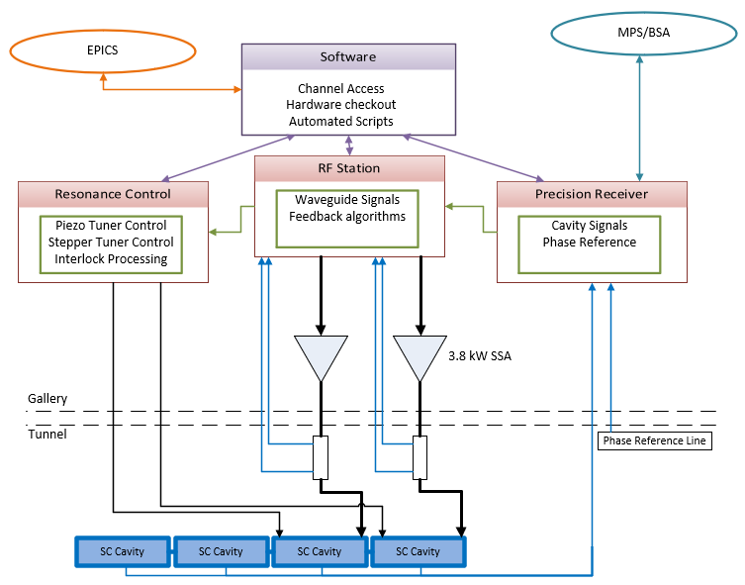
LLRF Systems Overview
Hardware/Firmware
  Precision Receiver Chassis (PRC)
    Exclusively for cavity signals
    Fiber communication for high Isolation necessary for 0.01°/0.01%
RF Station (RFS)
  Generates independent RF signal for 2 cavities
  Forward, Reverse and SSA Drive signals
  Detune frequency calculation, PI loop control
Resonance Control
  Piezo Tuner Control
  Stepper Motor Control
  Temperature Monitoring
  Interlock processing
Software
  Automated Scripting
    Cavity and SSA characterization
  Smooth transition between modes
  Channel Access
EPICS
  All control displays and waveform readouts
  Cavity control interface
  Modes of Operation
  Hardware health
Only minor LLRF system changes from LCLS-II

Slide 13
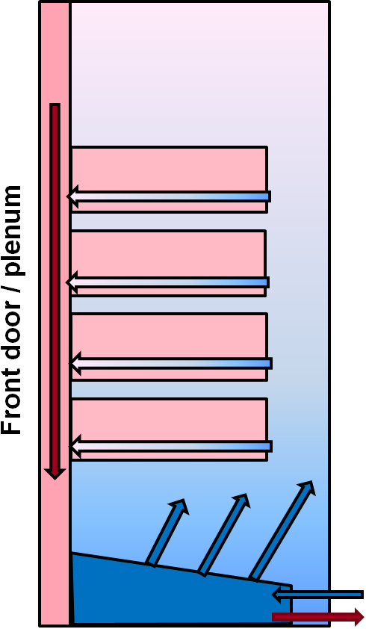
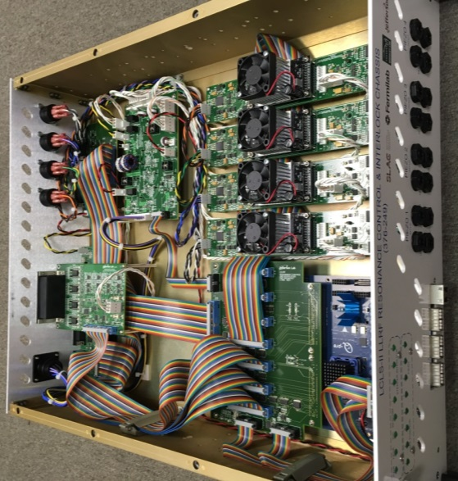
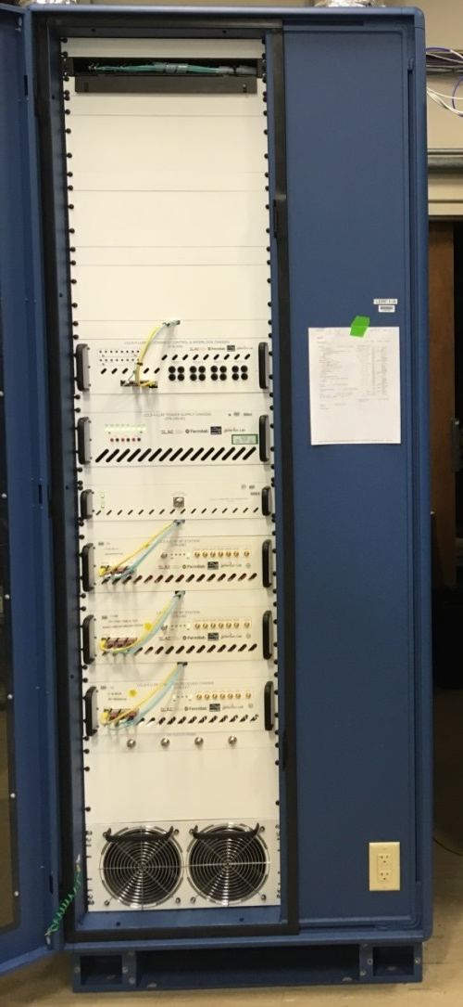
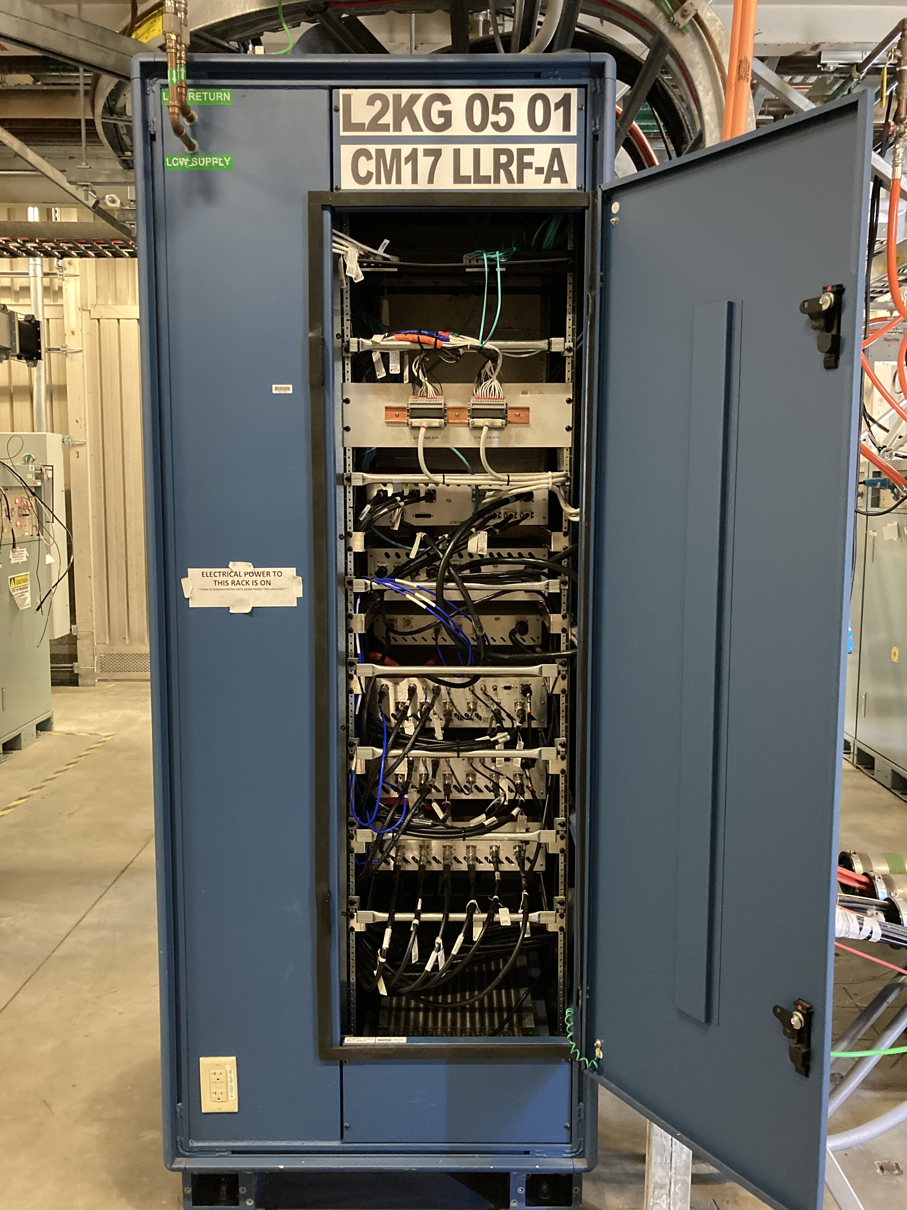
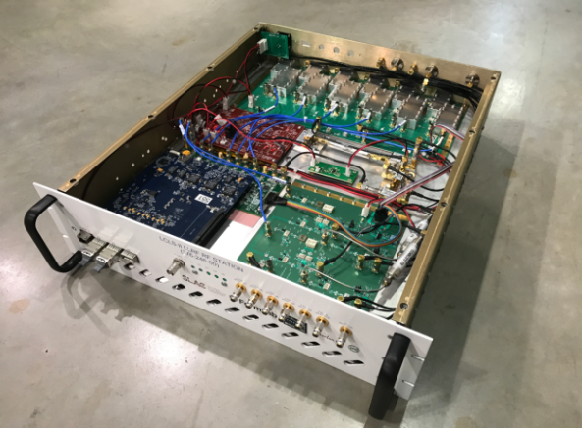
LCLS-II LLRF Hardware
Coupler/Stepper
Temperature
Resonance Control
Stepper tuner
driver
Power
FMC Breakout
Piezo tuner
drivers (x4)
Digital Carrier (FPGA)
Fiber links
RF Station
Power Board
Down
Converter
Digitizer
Digital Carrier
(FPGA)
Up
Converter

Slide 14
LLRF Systems Scale
  LCLS-II currently has 74 fully functional LLRF rack systems from sector 0 to 7
  HE will add 46 nearly identical racks from sector 7 to 10
  After yield, HE LLRF consists of:
    RF station chassis (x2) : 100
    Precision receiver chassis : 50
    Resonance control chassis : 50
    LO amplifier chassis : 50
    Power supply chassis : 50
    LLRF fiber patch panel : 50
SLAC now has a lot of experience
with building, testing and checking out the LCLS-II style LLRF system

Slide 15
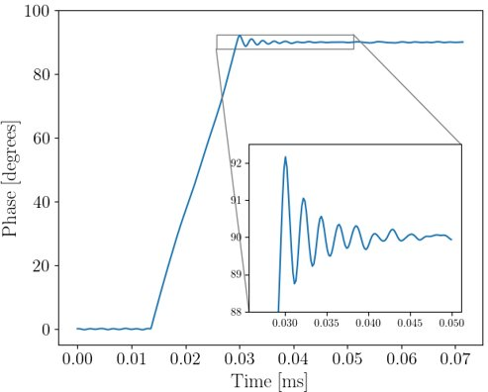
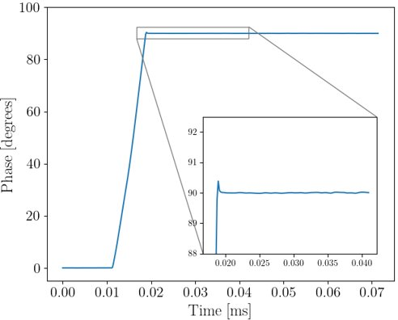
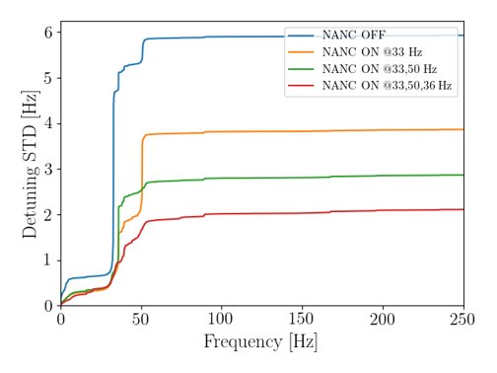
Firmware – Software tools
System characterization
  SSA, frequency tune, cavity and piezo tuner
Field Control
  Chirp, Pulsed, SEL raw, SEL, SELA, SELAP operation modes
  PI gain optimization
  Automatic mitigation for slow phase drifts (see talk by L.Doolittle)
Resonance Control
  Manual stepper motor operation
  Manual or feedback (Integral loop) piezo-tuner operation with low-pass filter
  Detune frequency waveform
  Forward power vs detune
  Microphonics compensation (ARC)
Waveforms
  Cavity, forward, reverse, drive, DAC
  Cavity bandwidth and detune
  FFTs
  Piezo tuner
  Phase Reference Line (PRL)
All new developments in support of LCLS-II commissioning are compatible with LCLS-II-HE

Slide 16
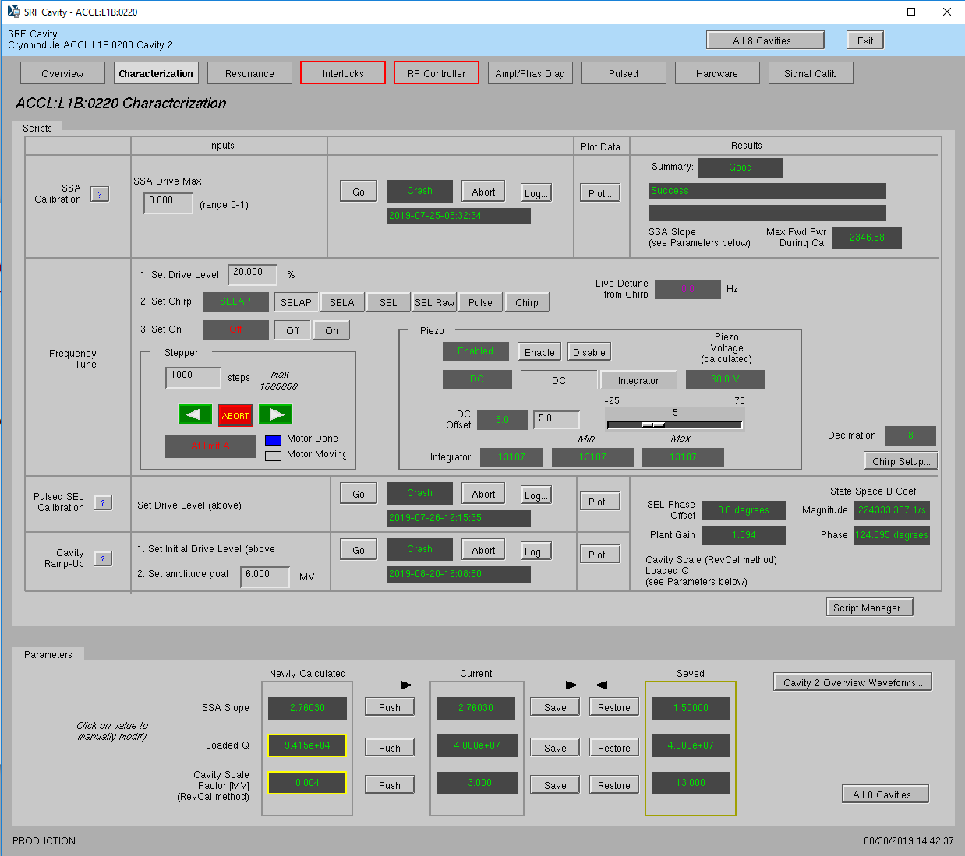
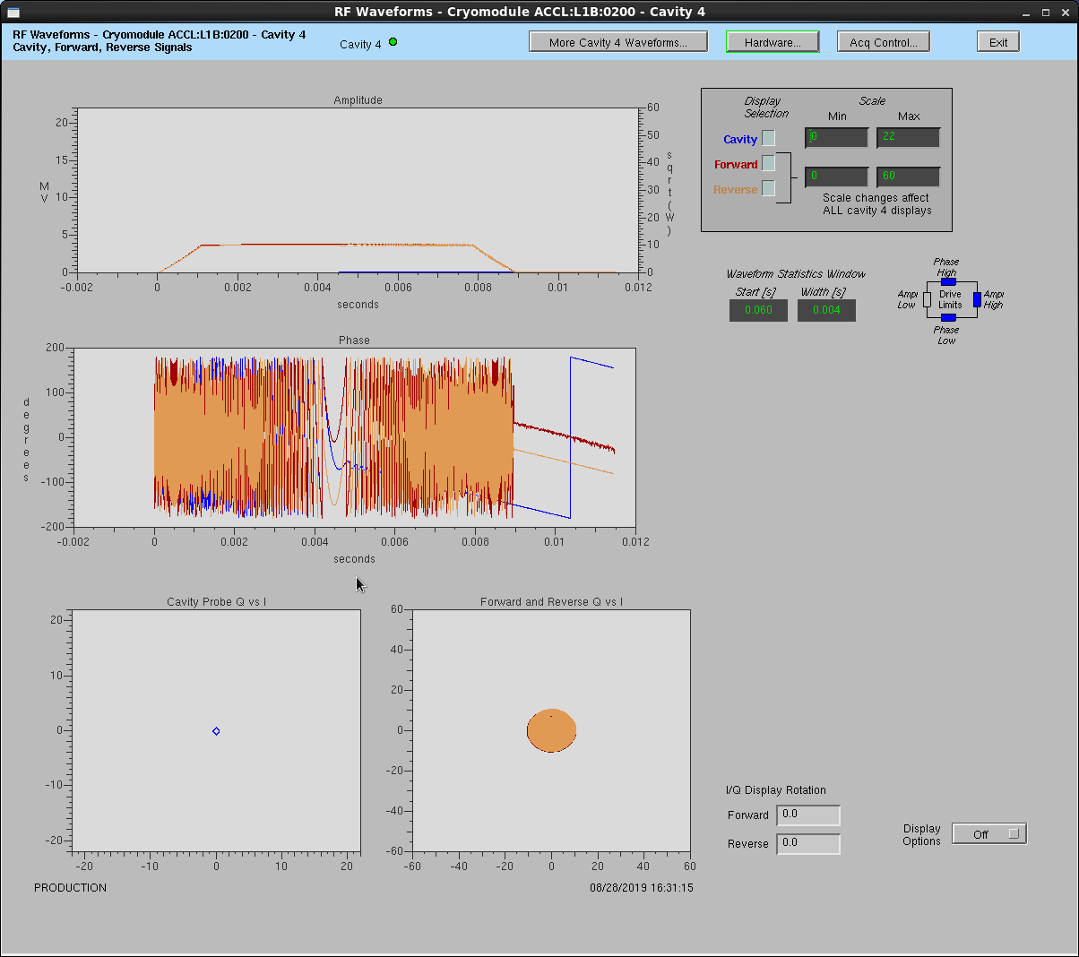
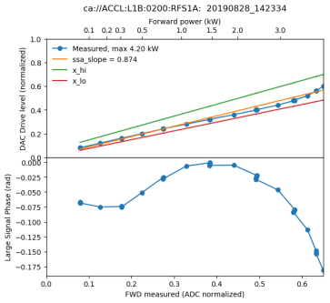
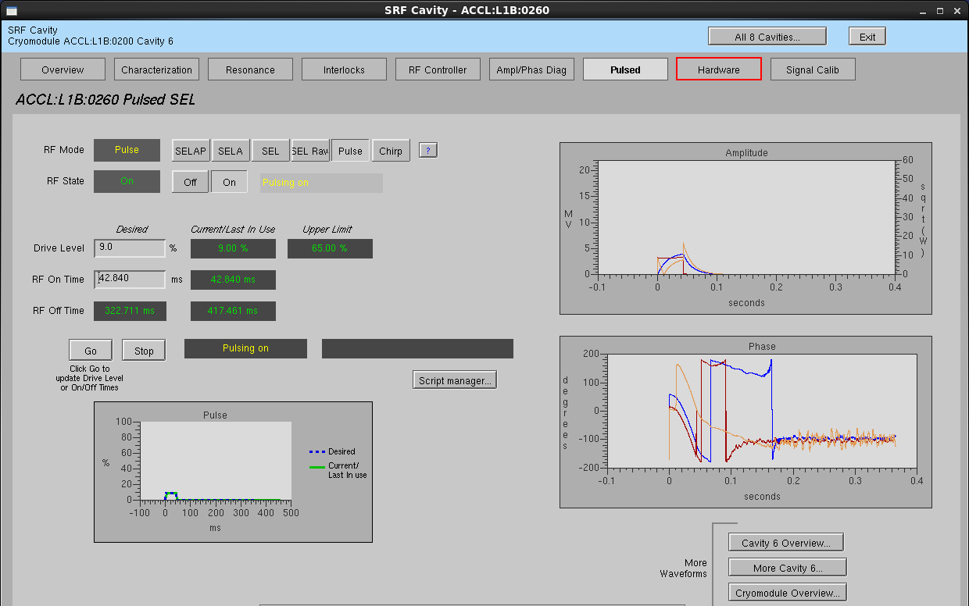
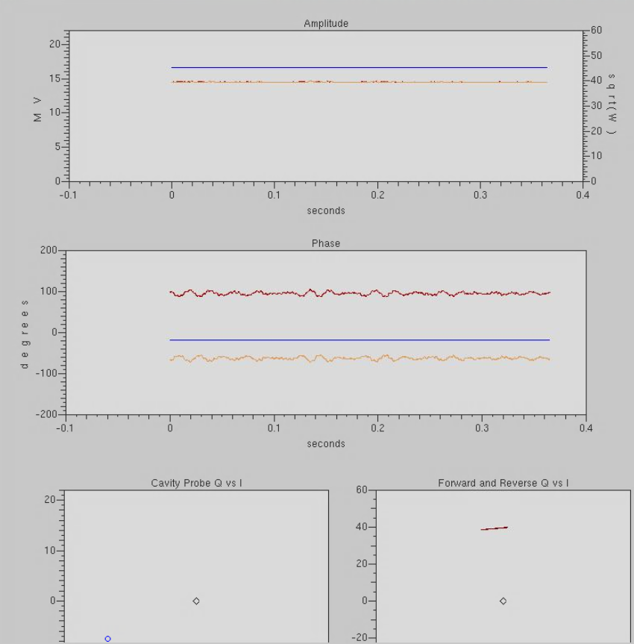
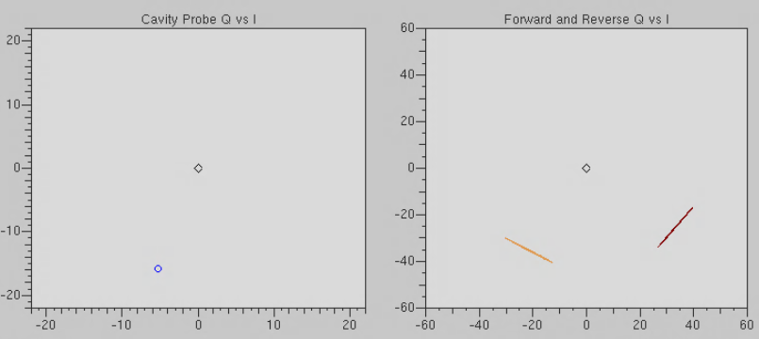
RF Cavity Setup & Control
4-Step Process
SSA calibration
Chirp detune scan
  Immediately “find” cavity and enter in SEL mode
  Enable piezo tuner response to center cavity at nominal frequency
Pulsed SEL calibration
  Measures loaded Q of cavity
  Calculates cavity scale factor, based on energy integration
Set to target field in SELAP mode
* Some user interfaces have been updated in production
Cavity Forward Reverse

Slide 17

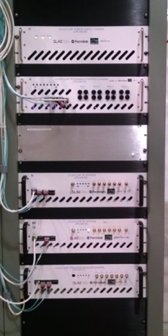
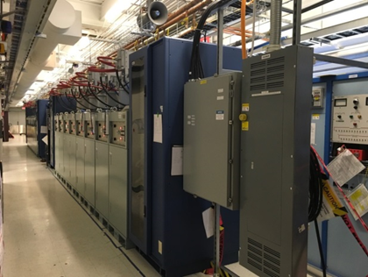
Learning from the Past
Practice for Commissioning of LLRF really began at Cryomodule test facilities
FNAL's CMTF and JLab's LERF used LCLS-II LLRF for testing CMs
These systems have been updated for LCLS-II-HE CM testing and are actively in use
Mandate has always been for the LLRF system to be as close to production as possible
  All modes of operation (SEL, SELAP, Pulsed)
  SSA and LLRF control
  User interfaces
  Calibration routines
  Tuning scripts
Cryomodules controlled by physicists, operators and LLRF experts
  Their feedback makes us stronger
Because of this, the LLRF controls system software and firmware were very mature for LCLS-II Commissioning
JLab LERF Gallery

Slide 18
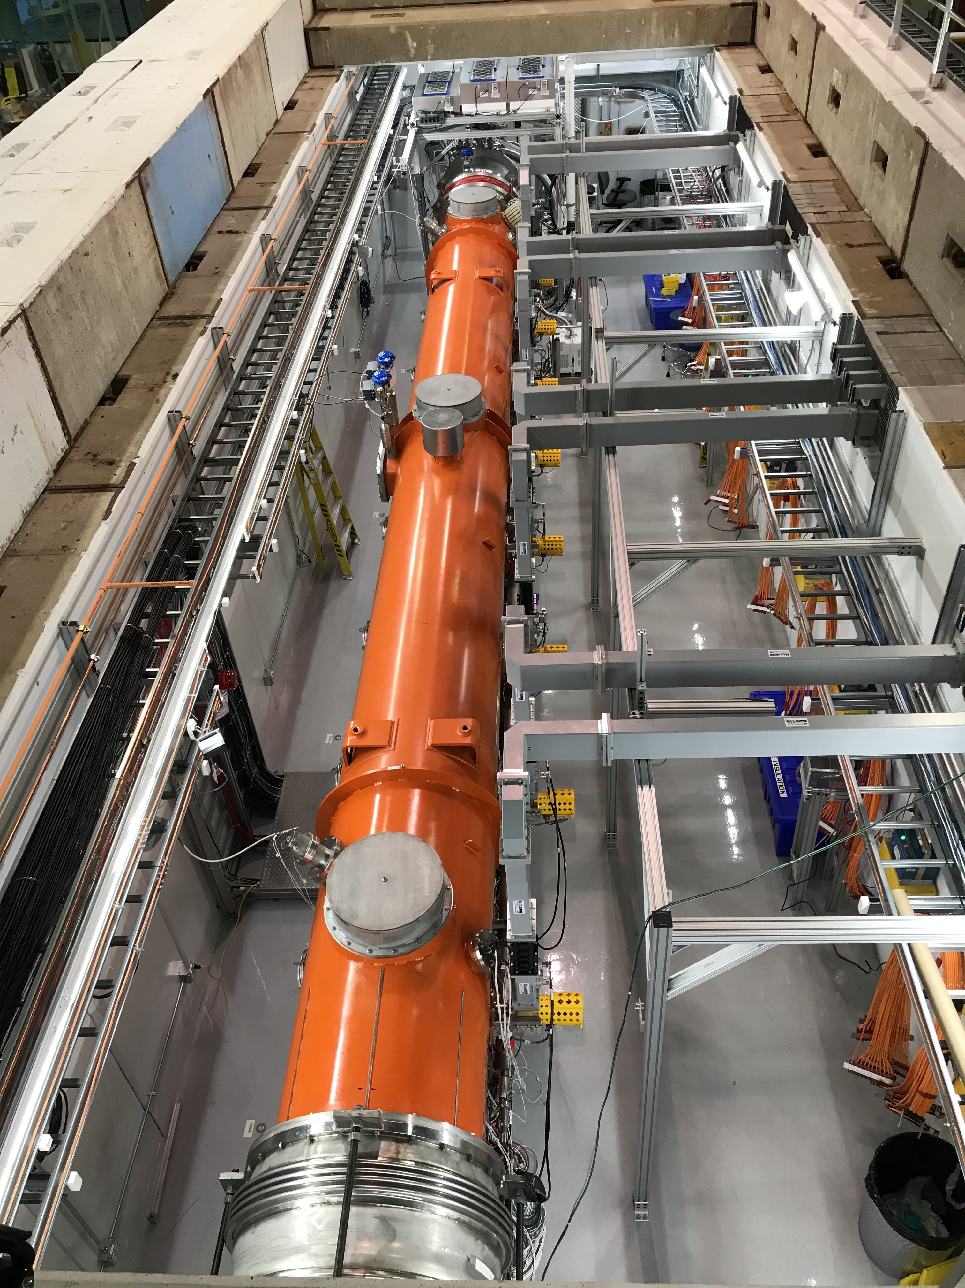
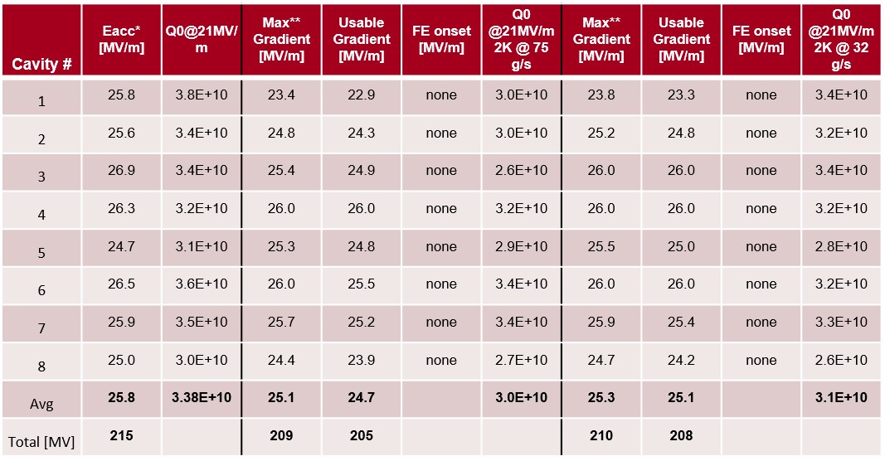
vCM Testing with LCLS-II LLRF in 2022
vCM performance was excellent:
  Exceeded Q₀ and voltage specifications
  World record 210 MV CW operation for 8 cavities
VTS
CM before plasma
CM after plasma
S. Posen et. al.

Slide 19
LLRF System Maturity
LCLS-II-HE LLRF is sufficiently mature and technically sound to meet all performance requirements
  HE is building on the success of LCLS-II, and inheriting all the designs and experience of LCLS-II
  LCLS-II LLRF has experience in numbers
    74 LLRF racks of hardware
    296 RFS/PRC/Resonance chassis
    74 LO amplifier chassis
    74 fiber patch chassis, power supply chassis
    Countless LLRF related components.
  LCLS-II LLRF has successfully complete all checkout tasks of the installed LLRF hardware
    LCLS-II LLRF has successfully complete software/firmware initialization for over 296 LLRF chassis over 300,000 times!

Slide 20
LLRF System Maturity
LCLS-II-HE LLRF is sufficiently mature and technically sound to meet all performance requirements
  The LCLS-II LLRF control system has been used by LLRF & SRF experts for cryomodule testing and accelerator operations
  LCLS-II has achieved 4 GeV of total stable voltage on SRF cavities July 7th 2022 (operated independently without beam)
    Turn on time of all cavities was < 3 hours
    Turn on time of all cavities now less than 20 minutes
  LCLS-II has achieved 3.6 GeV of stable beam on SRF cavities October 9th, 2022. LLRF calibration was measured with beam to have < 2% error
    160 cavities in L3 were phased in about 2 hours using LLRF features
  LCLS-II-HE vCM testing at FNAL validated the performance of the LCLS-II-HE LLRF system
    210 MV regulation achieved over 8 cavities

Slide 21
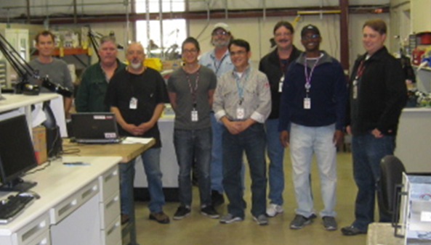
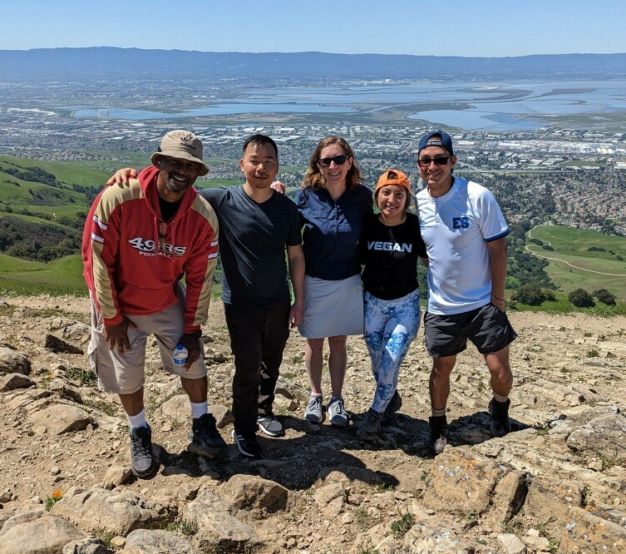
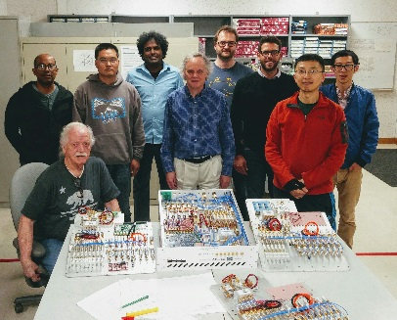
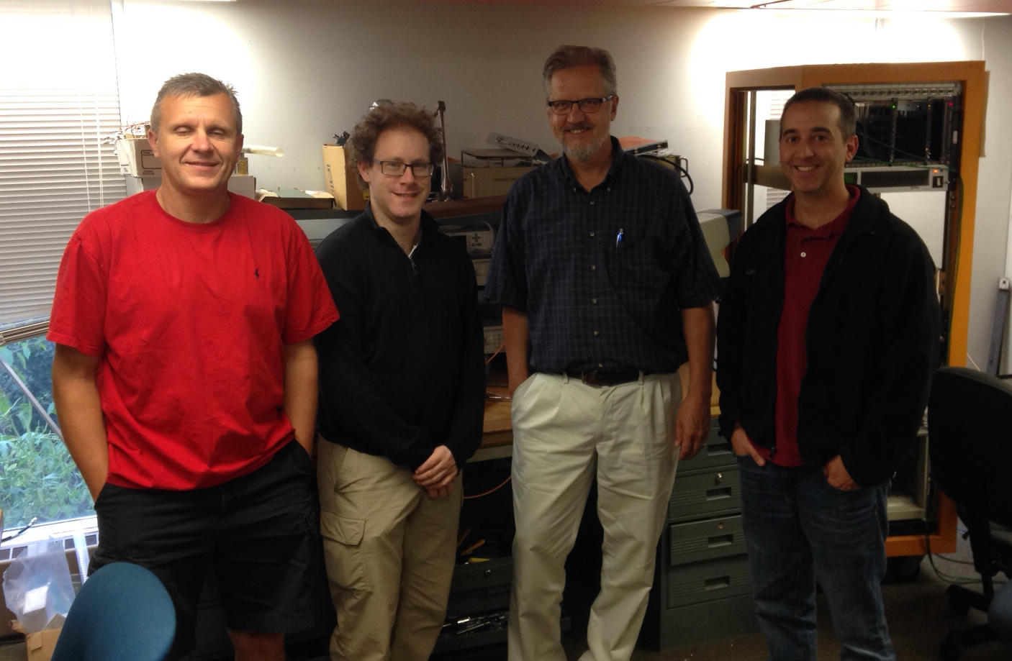
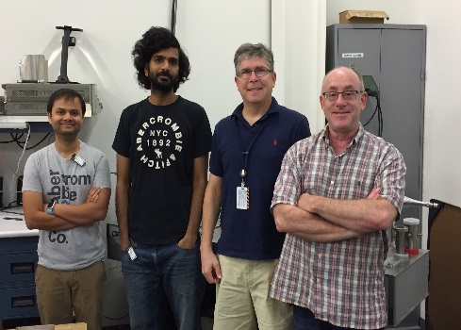
Thank you for your time
*not in photo
LCLS-II-HE is grateful to this ongoing LLRF collaboration for a high performing LLRF system
SLAC
A. Benwell
M. Boyes
G. Brown*
J. Diaz
S. Hoobler
R. Kelly
A. McCollough
P. Nguyen
M. Petree
A. Ratti*
D. Steele
LBNL
K. Campbell
Q. Du
M. Davidsaver*
L. Doolittle
J. Greer
G. Huang
S. Murthy*
C. Serrano
V. Vytla
Y. Xu
FNAL
B. Chase
E. Cullerton
J. Einstein
Dan Klepec
JLab
R. Bachimanchi
C. Hovater
O. Kumar
D. Seidman
Special thanks to the entire LCLS-II collaboration for all their hard work to make this possible!

Slide 22
Title of slide
감사합니다
6-7 September 2023 | LCLS-II-HE MAC Review of the Final Design Report | Fernanda G. Garcia

