Slide 1
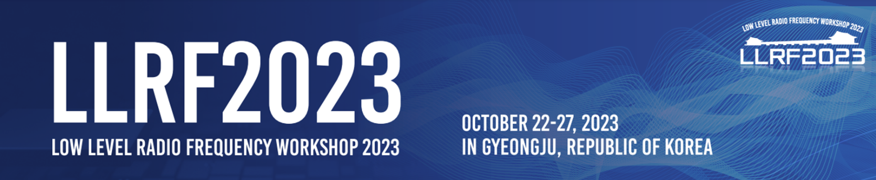

RF reference distribution and operation experiences in PAL-XFEL
Chang-Ki Min
on behalf of the PAL-XFEL team
Gyujin Kim, Jinyul Hu, Dongchul Shin, Seonghoon Jung, Inhyuk Nam, Changbum Kim, Hoon Heo, Heung-Sik Kang (PAL, POSTECH)
MSK group in DESY, Ingenieurbüro Gronefeld
Pohang Accelerator Laboratory

Slide 2
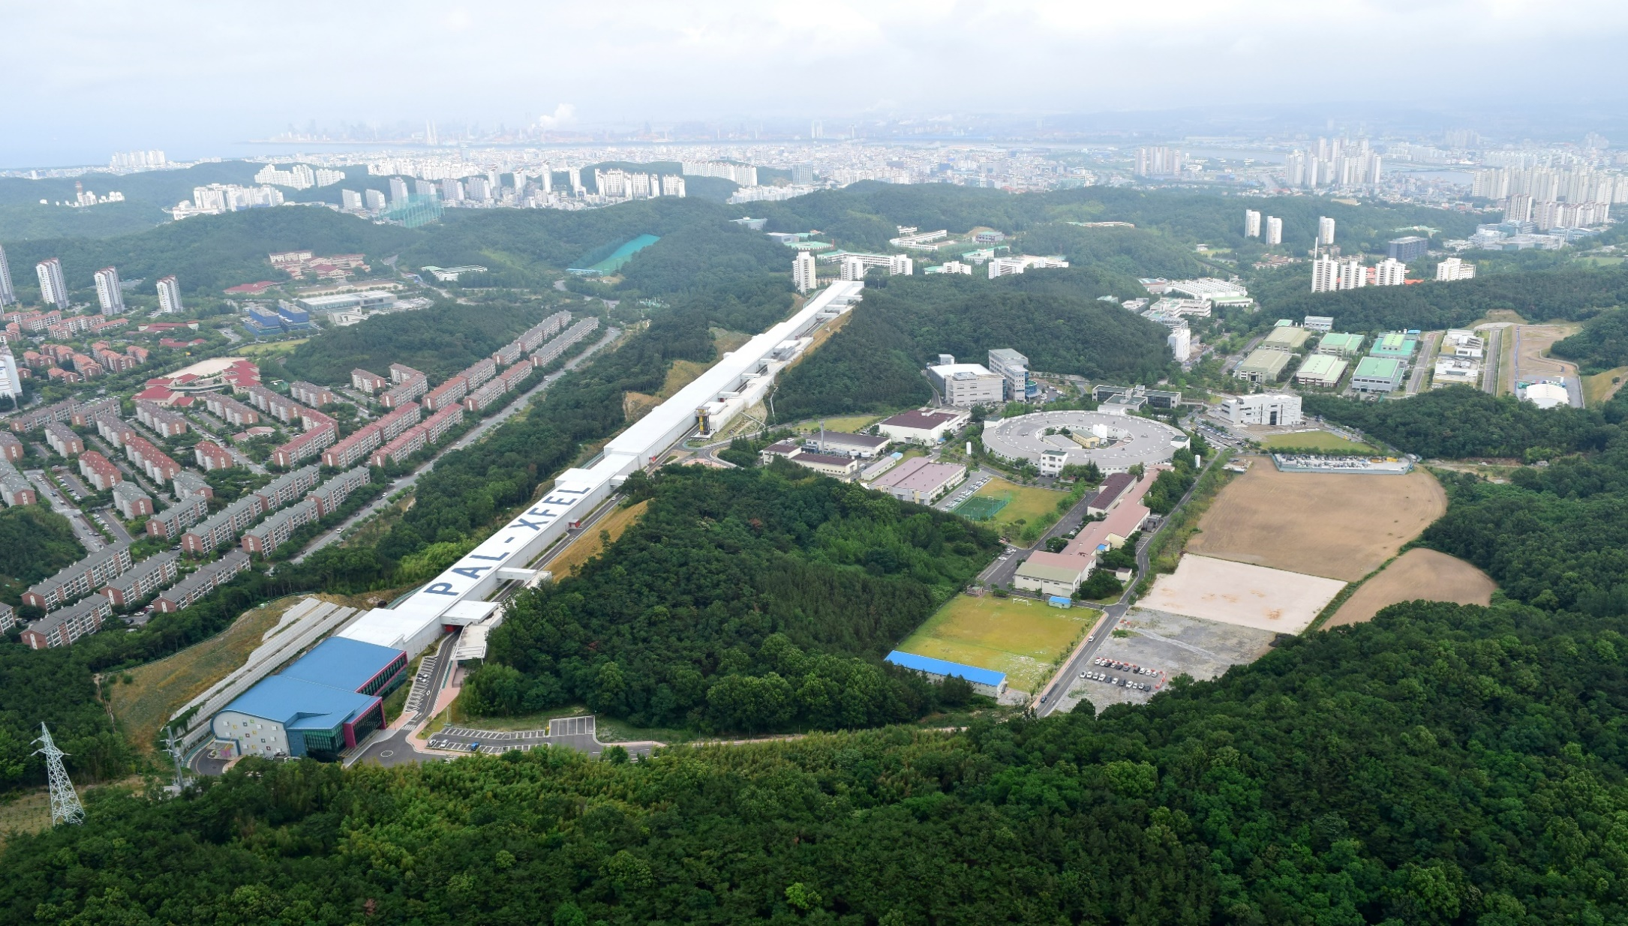
PAL-XFEL
2011 ~ 2015: Construction
2016: Commissioning
2017: User-service started
2019 : 60 Hz operation
: Hard X-ray self-seeding service
PLS-II
PAL-XFEL

Slide 3
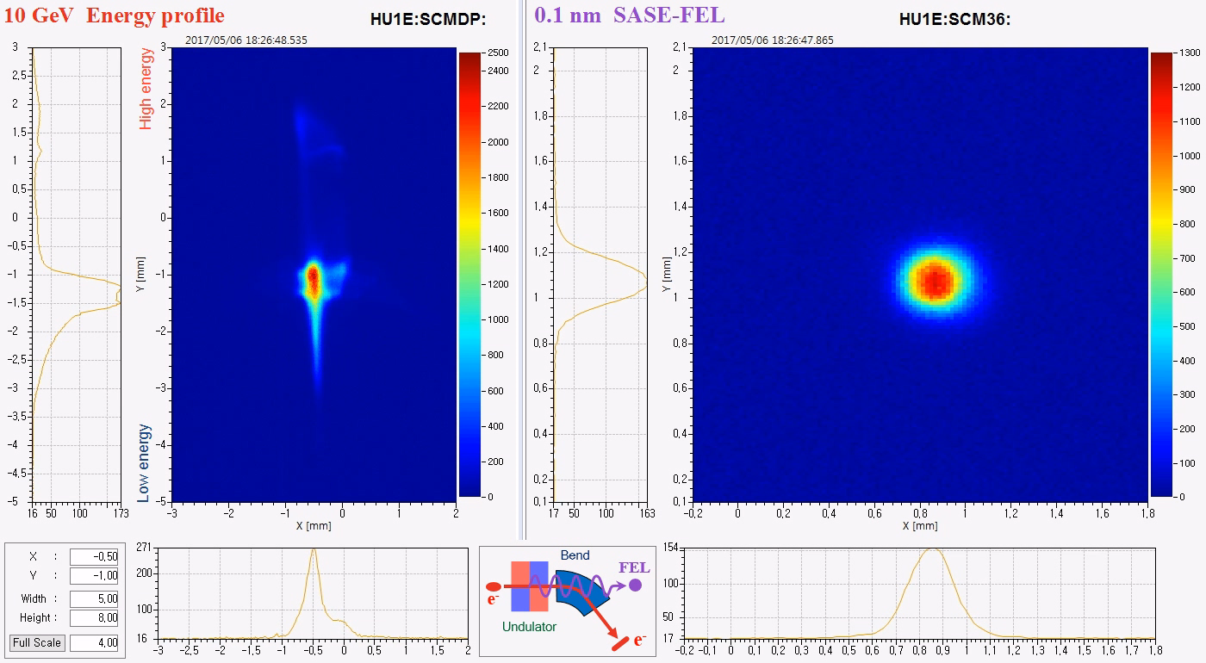
Outline
RF Timing dist. and Synchronization design and operation (~8 years)
Beam based feedback: Example, self-seeded operation mode
Beamline
- Additional phase control for laser system.
- Plan : Implementing optical timing

Slide 4
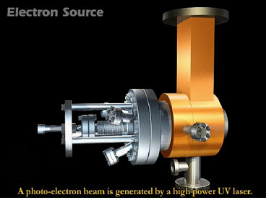
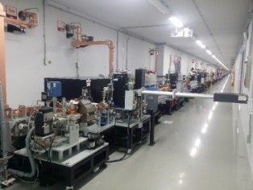
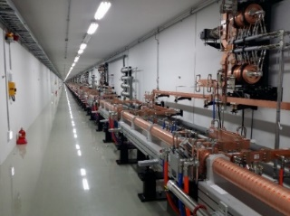
PAL-XFEL Parameters
30A
2 ps
200A
300fs
1kA
60fs
3kA
20fs
Self-seeding
  Main parameters
  e⁻ Energy 10 GeV -> 10.5 GeV
  e⁻ Bunch charge 20-200 pC
  Slice emittance < 0.5 mm mrad -> 0.3
  Repetition rate 60 Hz
  Pulse duration 10 fs – 100 fs
  Peak current 3 kA
  SX line switching DC (Phase-1)
  Kicker (Phase-2)
Undulator Line | HX1 | SX1
Photon energy [keV] | 2.5 ~ 12.8 -> 14.5 keV | 0.3 ~ 1.2
Beam Energy [GeV] | 4 ~ 10 -> 10.5 GeV | 3.15
Wavelength Tuning | energy | gap
Undulator Type | Planar, out-vac. | Planar
Undulator Period / Gap [mm] | 26 / 8.3 k = 1.87 | 35 / 9.0

Slide 5

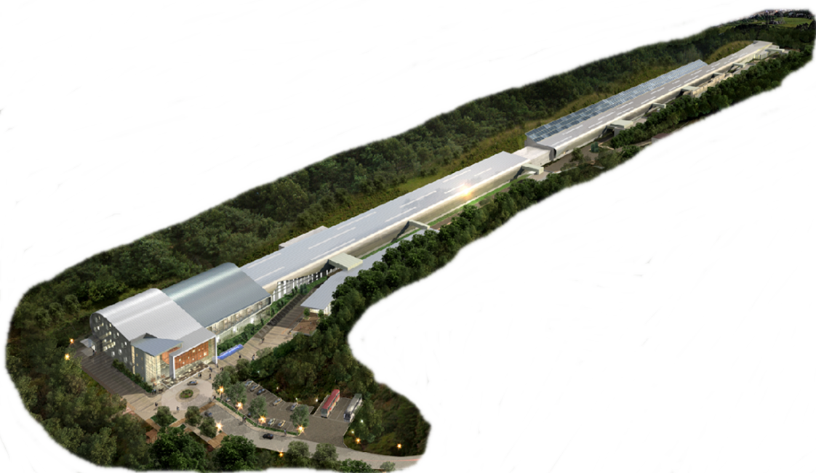
Femtosecond synchronization
Injector Laser
RF components
in Linac
Experimental Lasers
for soft X-ray
Experimental Lasers
for hard X-ray
And diagnostics
(bunch arrival time monitor)

Slide 6
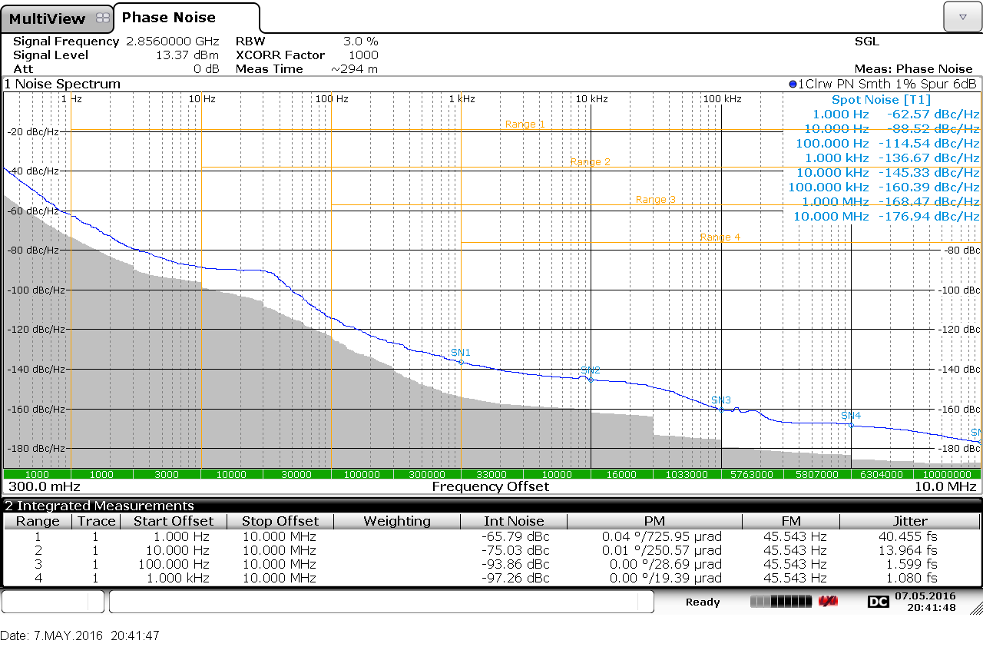
2.856 GHz phase noise
Integrated jitter (1 KHz~ 1 MHz) : ~0.8 fs
-160 dBc/Hz at 100KHz offset
-170 dBc/Hz at 1 MHz offset
1 kHz
100 kHz
-160dBc/Hz

Slide 7
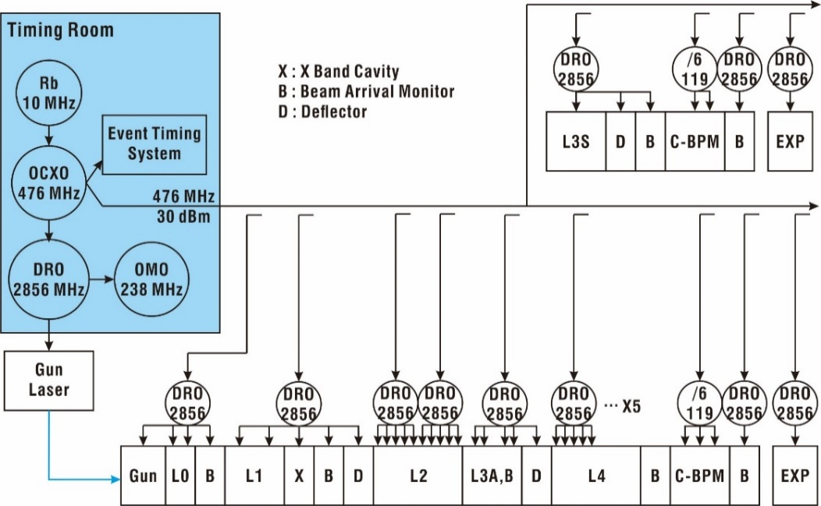
PAL-XFEL timing distribution (2.856GHz RF), ~1.5 km
Low phase noise timing source
(RF, Optical oscillators)
How slow
the Drift?
Drift compensation
Slow feedback
: energy, peakpower, etc

Slide 8
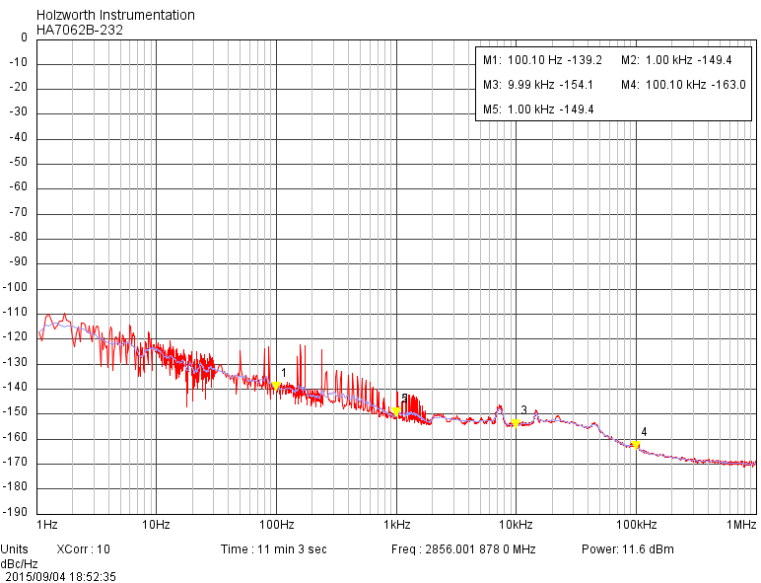
2.856 GHz phase noise
Integrated jitter (1 KHz~ 1 MHz) : ~0.8 fs
-160 dBc/Hz at 100KHz offset
-170 dBc/Hz at 1 MHz offset
476 MHz 2.856 GHz PLL
Performance
Integrated jitter (1 Hz~1MHz) : ~0.6 fs

Slide 9
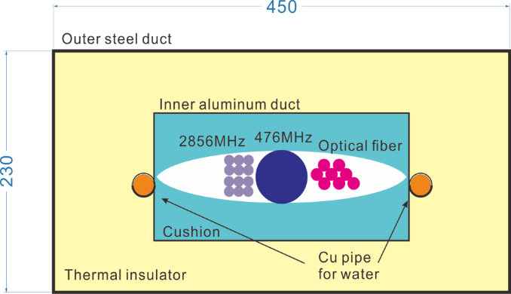
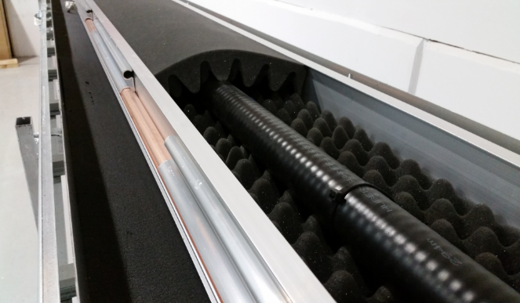
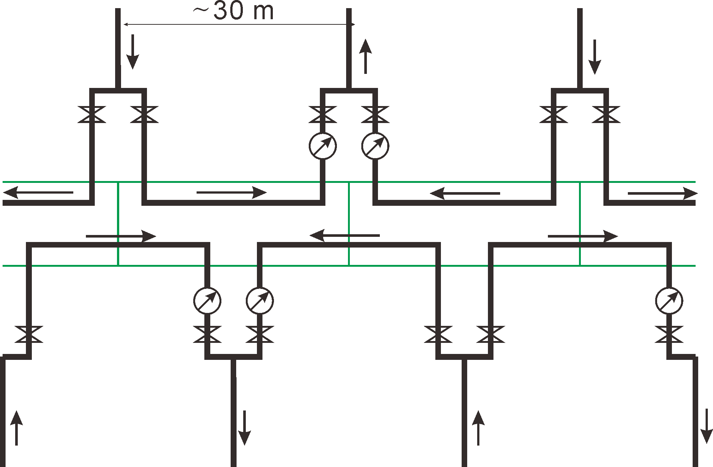
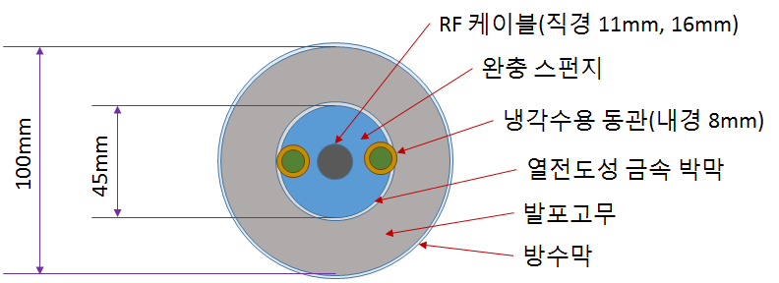
Temperature stabilization of RF Cables
Duct cross-section
With cover open
LCW flow diagram
RF cable
Cushion
Water tube
Metal sheet
Thermal
insulator
Cover
100
45
Temperature stability of Duct : 0.01℃/day

Slide 10
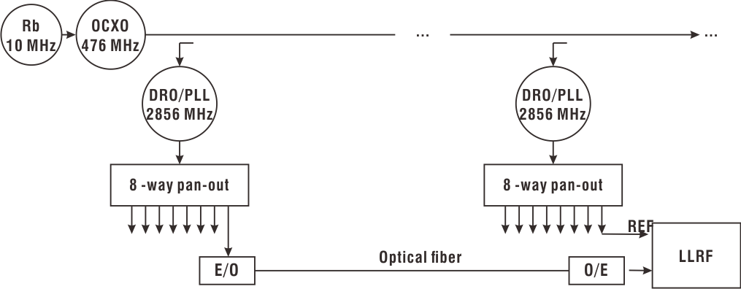
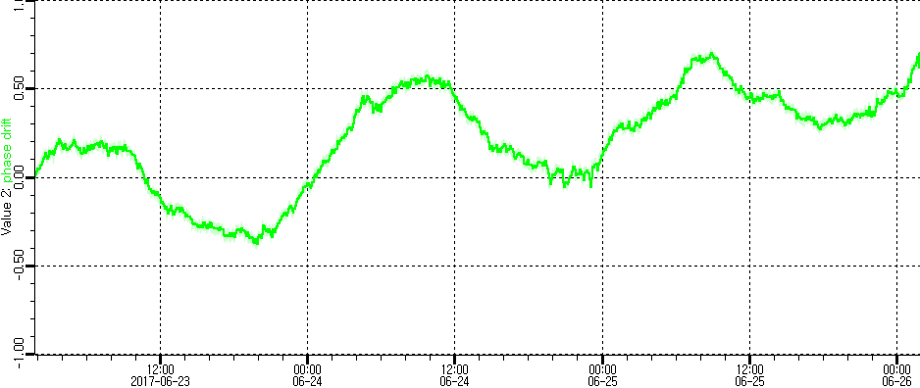
Phase Drift monitoring using drift-free optical link
~750 m
Libera Sync3
<10 fs rms jitter
~ 0.5 ps/day (corresponding to ~0.005℃)

Slide 11
Time scale of timing error in reference timing distribution
100 Seconds 10 minutes 1 hour 1day
10.2 fs RMS
14.8 fs RMS
24.8 fs RMS
275 fs RMS
Jitter (fs RMS)
Limited by
Measuement sensitivity
(~10fs RMS)
Time (Seconds)

Slide 12
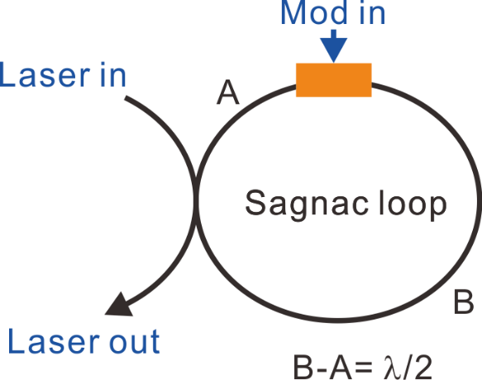
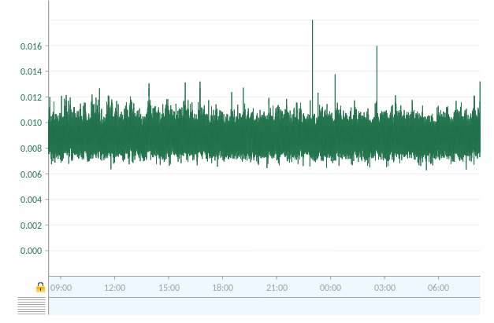
Photocathode gun - e⁻ bunch arrival jitter
Home-built sensitive phase detector
Between RF and optical laser
(2.856 GHz) (79.33MHz Ti:S)
Provides 10 fs level jitter
Gun RF amplitude stability
for one day
RF system adds ~10⁻⁴ amplitude jitter
~10 fs timing jitter
0.007~0.012% RMS

Slide 13
≈14 fs residual phase jitter from 1 Hz to 100 KHz
Out-of-loop measurement
Free running Ti:S
Phase Noise at 2.856 GHz (dBc/Hz)
Locked Ti:S
Residual
DRO
Measurement
noise floor
Offset Frequency (Hz)

Slide 14
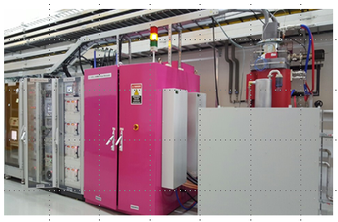
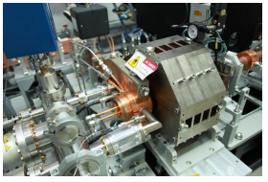
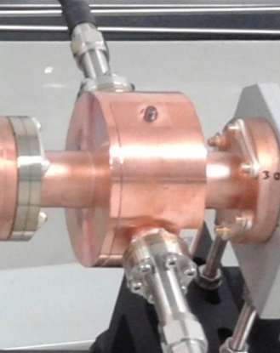
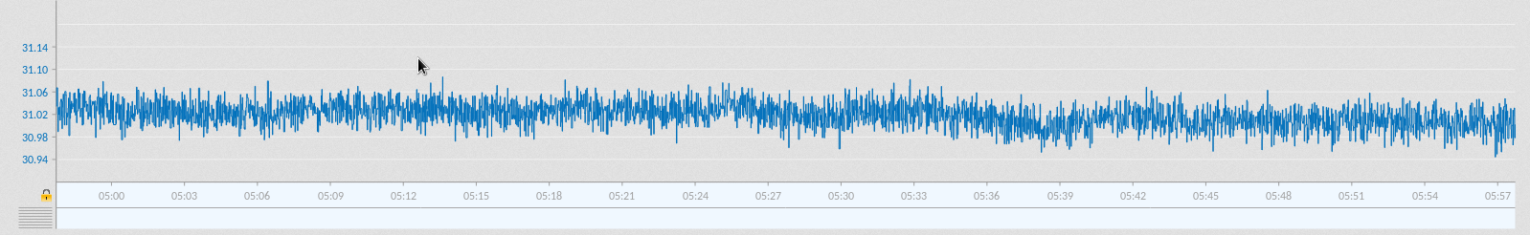
Machine stability : Beam arrival time jitter at gun
Klystron : operated in the saturated regime.
Modulator : 30 ppm CCPS-PFN type
Gun temperature change compensated by GUN-LLRF
GUN, ~11 fs rms
1hour

Slide 15
Linac beam based feedback

Slide 16
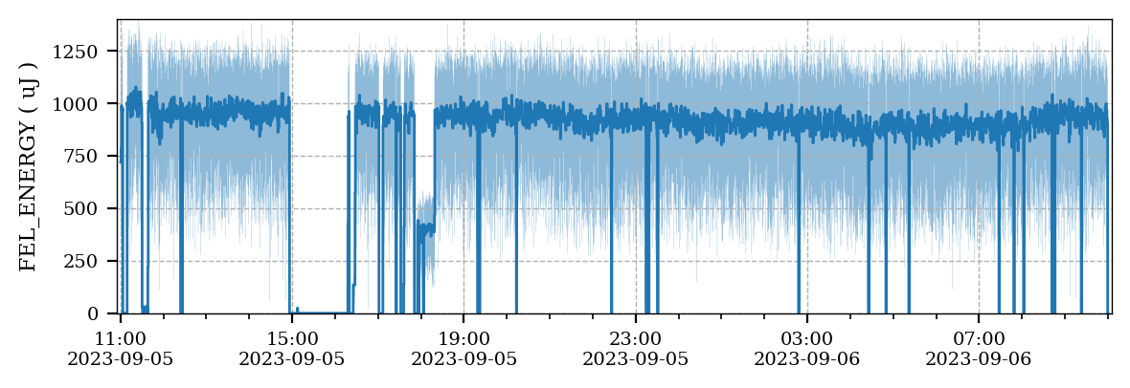
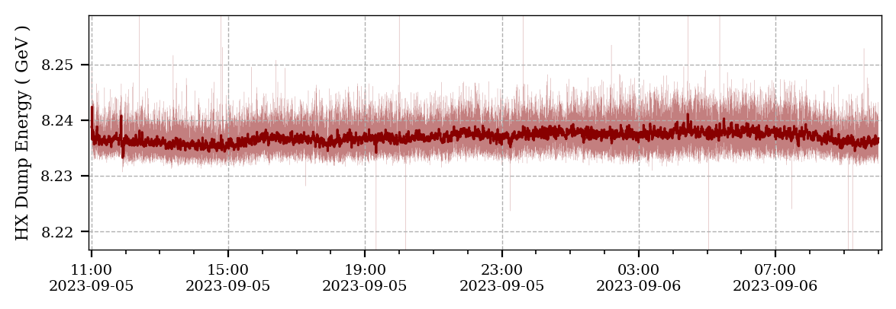
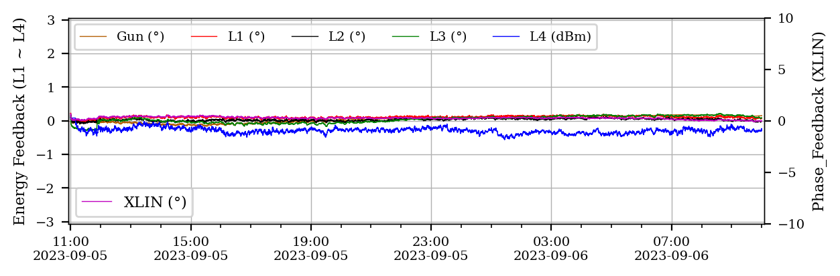
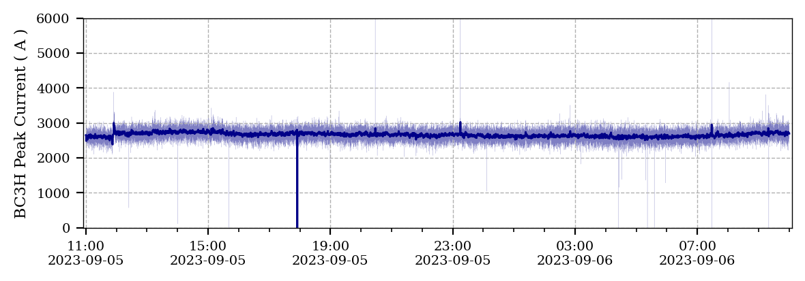
Self seeding FEL intensity stability

Slide 17
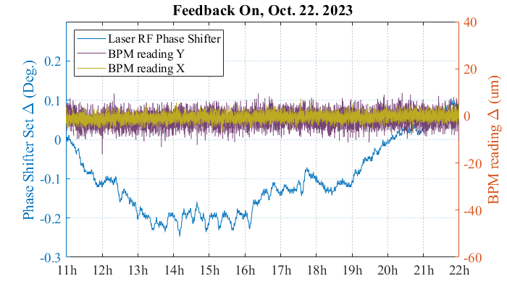
Gun phase, beam based feedback

Slide 18
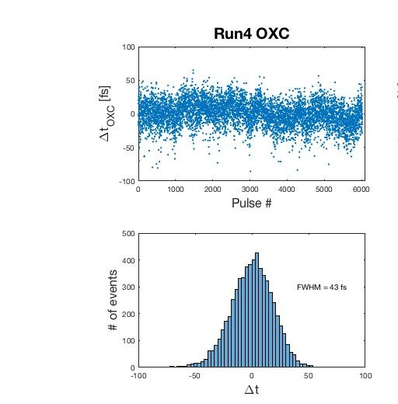
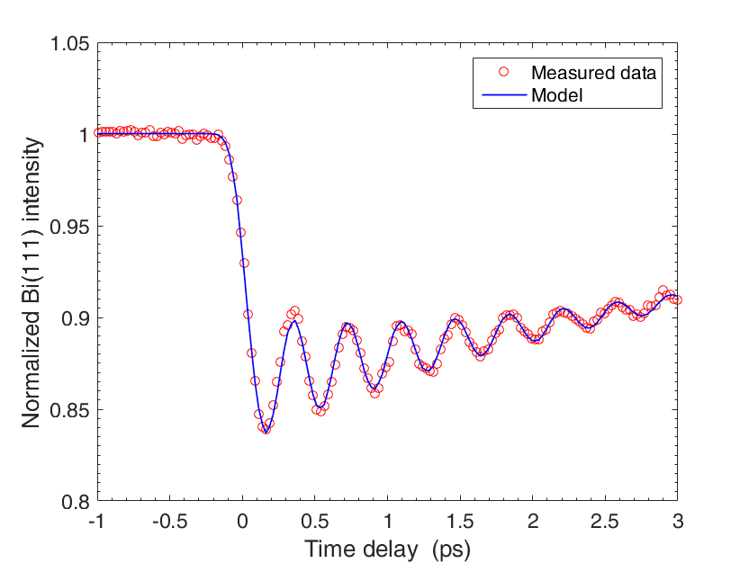
FEL timing jitter
Bi(111) Bragg diffraction intensity modulation
- No timing jitter correction
- Only slow time-drift correction
18.3 fs RMS

Slide 19
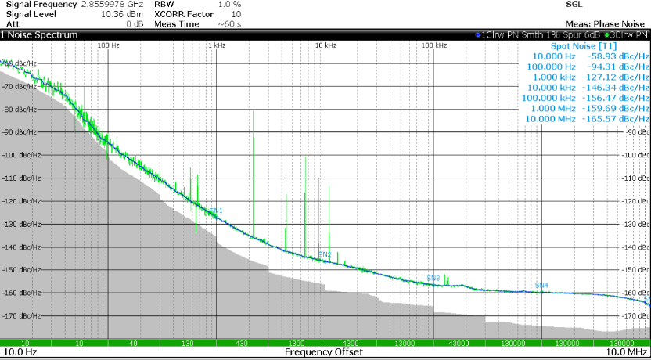
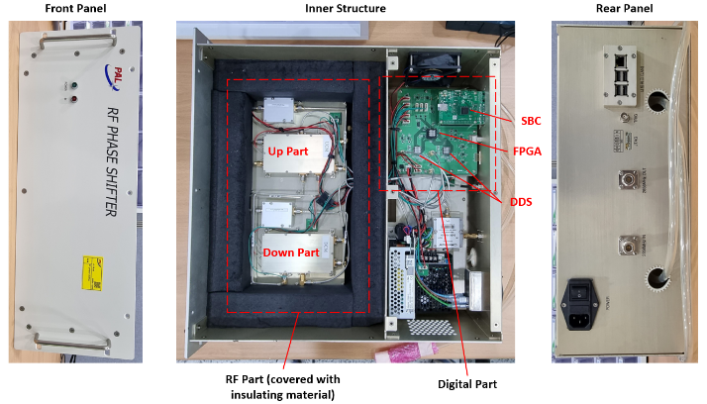
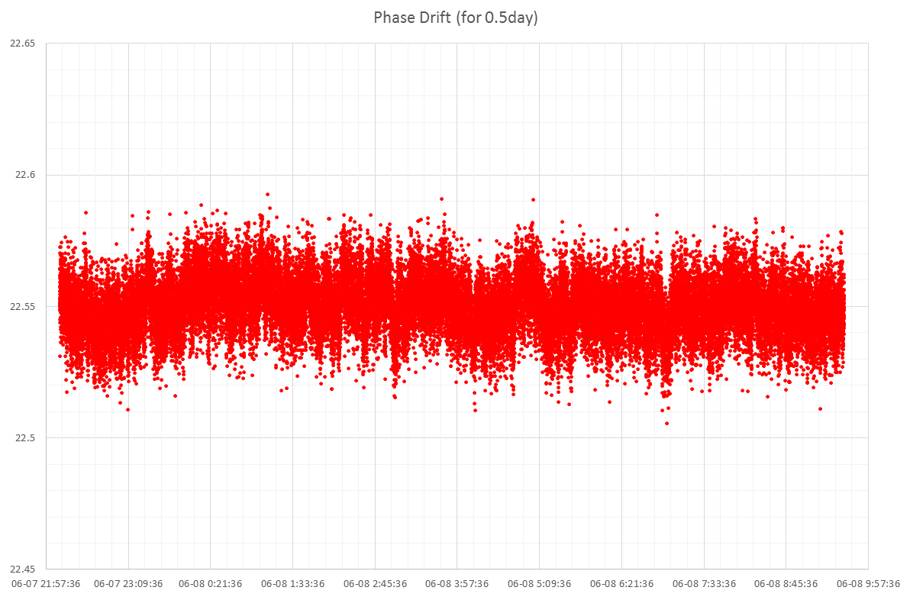
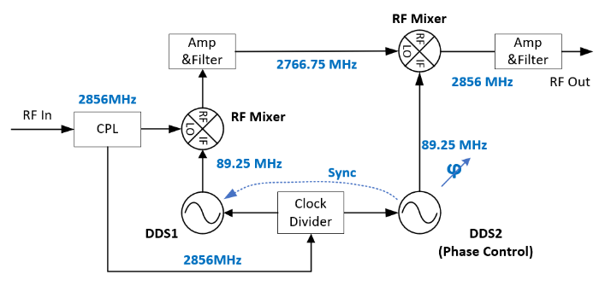
DDS phase shifter for laser
Pulse by pulse delay contorl of laser pulses
160dBc
<10 fs jitter & drift
with programmable delay time
10 fs rms
12 hour

Slide 20
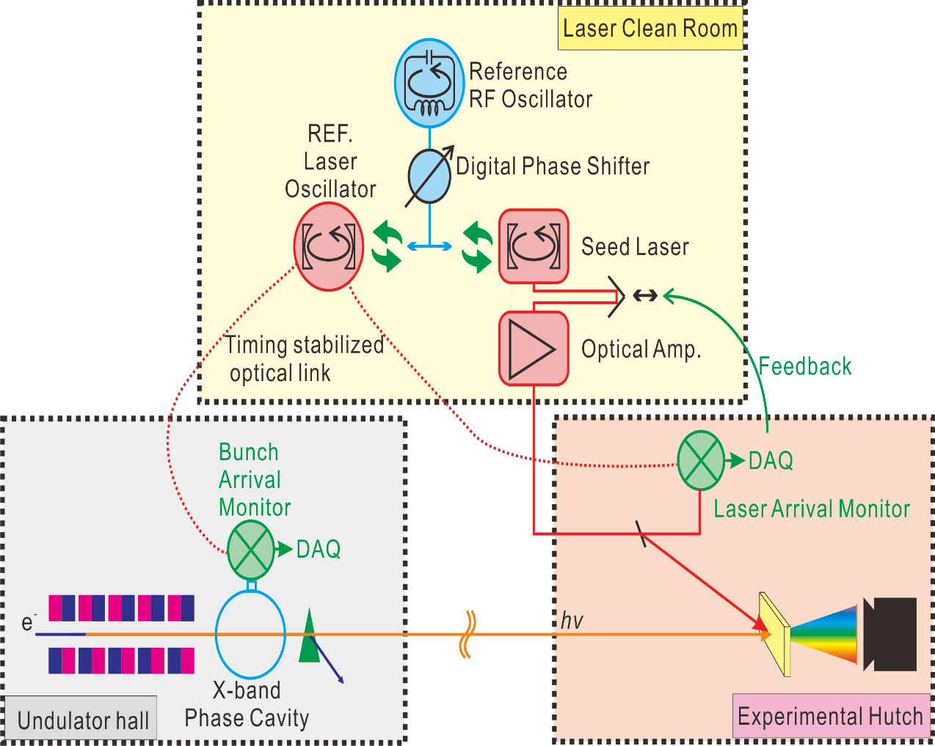
Pump probe delay control and jitter reduction plan

Slide 21
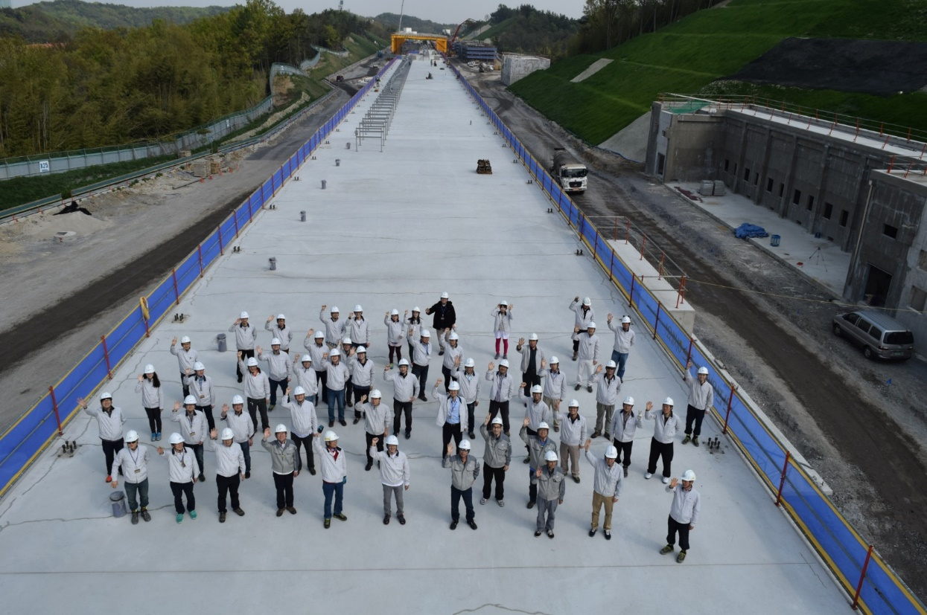

Thank you for your attention

Slide 22
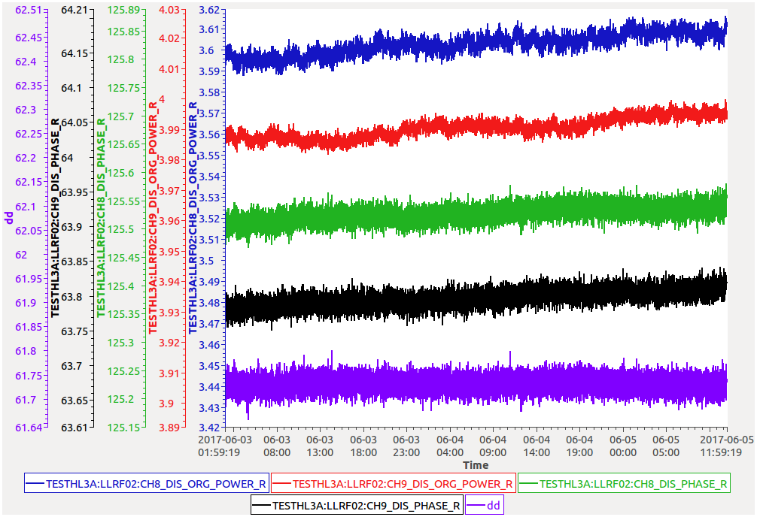
Optical timing test (Libera Sync 3, 2.2 km, 3days)
A : Libera Sync
amplitude
B : Reference
amplitude
A : Libera Sync
Phase
B : Reference
Phase
A -B
Phase drift
<10fs

