Slide 1
PAL e-LABs 빔 라인 업그레이드
성창규
2023. 03. 14

Slide 2
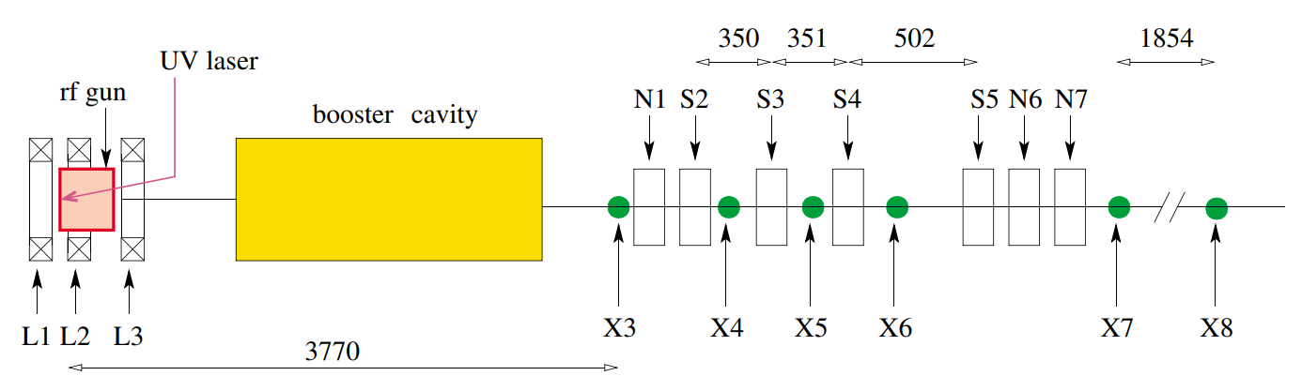
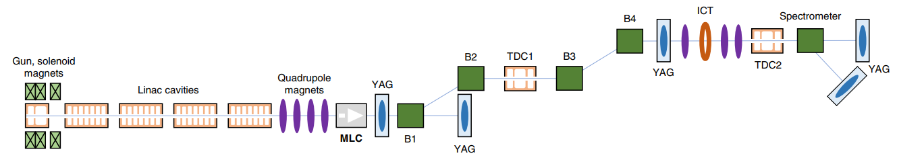
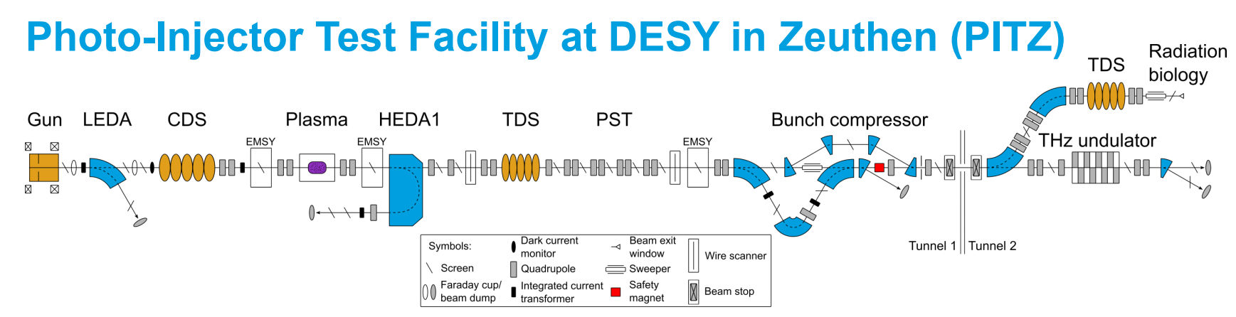
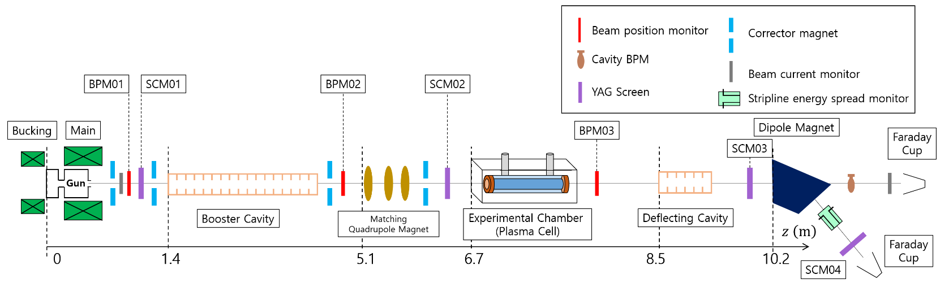
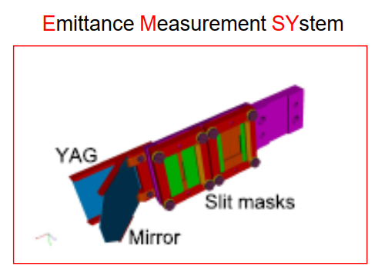
Photoinjectors 사례 조사
FNPL/NICADD
AWA
X: Diagnostic stations
X3: OTR + two multislit masks
X6: OTR only
PAL e-LABs
PITZ
VPP

Slide 3

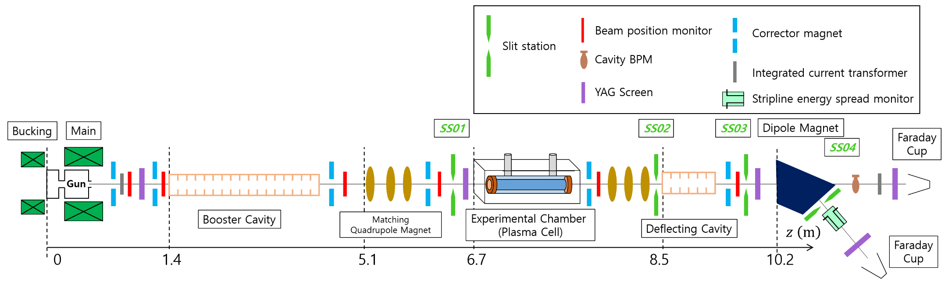
PAL e-LABs 빔 라인 업그레이드

Slide 4
빔 라인 업그레이드
현재 | 업그레이드 | 필요 장비 | 비고 | 예상 예산 (단위: 원)
3 BPM | 6 BPM | 3 stripline BPM + 3 MTCA digitizer |  | 1.2억 (120 M) (40M / 1 BPM + 1MTCA)
4 Corrector Magnet | 6 Corrector Magnet | 4 Magnet Power Supply (MPS) | 2 MPS (CM) + 2 MPS (QM) → (1 MPS = 1 CM / 1 MPS = 2 QM) Normal Quad Triplet | 4천만 (40 M) (10M / 1MPS)
3 Quad Magnet | 6 Quad Magnet
4 Screen Monitor | 5 Screen Monitor | 1 YAG + 1 CCD |  | 1백만 (1 M)
0 Slit Station | 4 Slit Station (SS) | 2 L-slit + 1 signle-slit + 2 YAG + 2 CCD | 1. L-shaped slit (준비완료/UNIST) 2. L-shaped slit + YAG (APL/LWFA) 3. Single slit (Hor.) (Slice E spread) 4. L-shaped slit + YAG (5D) | 4천만 (40 M) (15M / slit+YAG 10M / single-slit)
1 Bunch Compressor / 1 Undulator: 준비 완료 EEX line (double dogleg + 1 TDS): 1 RF Source + 4 DM: 먼 미래 혹은 불가능
순서 (전자빔 시운전 + APL 실험 + LWFA 실험 + 4D/5D PS 측정 실험 + FBT 실험 대비): 1 Slit Station (slit + YAG) → 3 BPM → 2 CM → 3 QM → 2 SS (Single-slit / slit+YAG) → 1 SCM or 3 BPM + 2 CM → 3 QM → 2 SS (slit + YAG) → 1 SS (single-slit) → 1 SCM |  |  |  | 총: 약 2억 (200 M)

