Slide 1




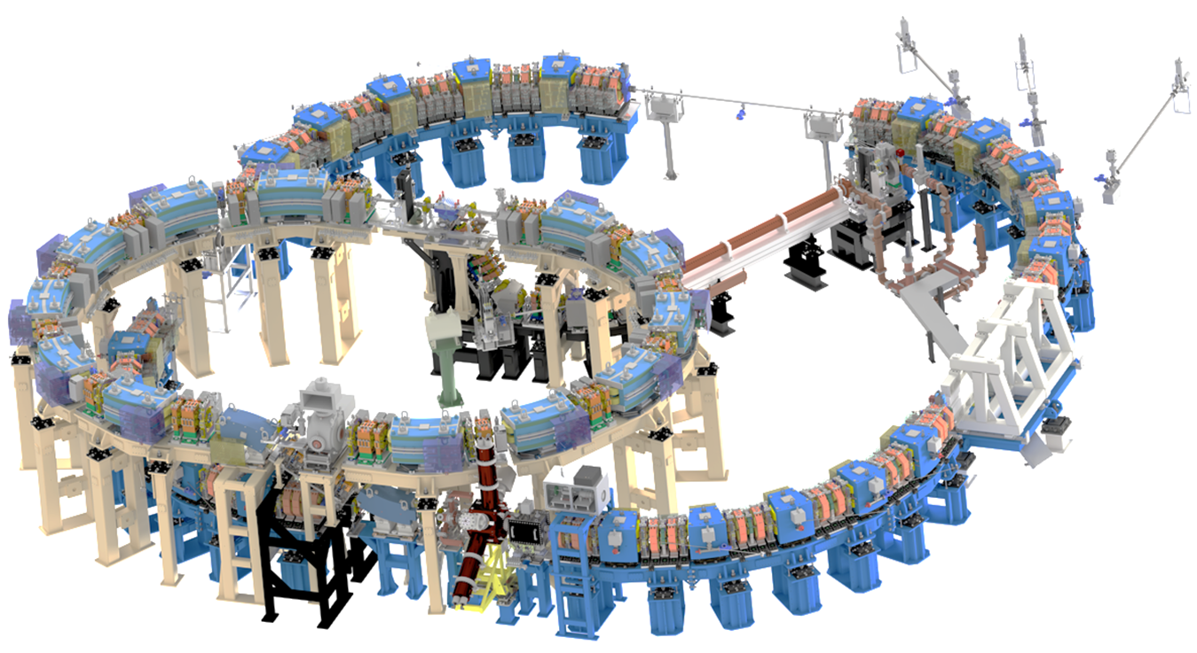
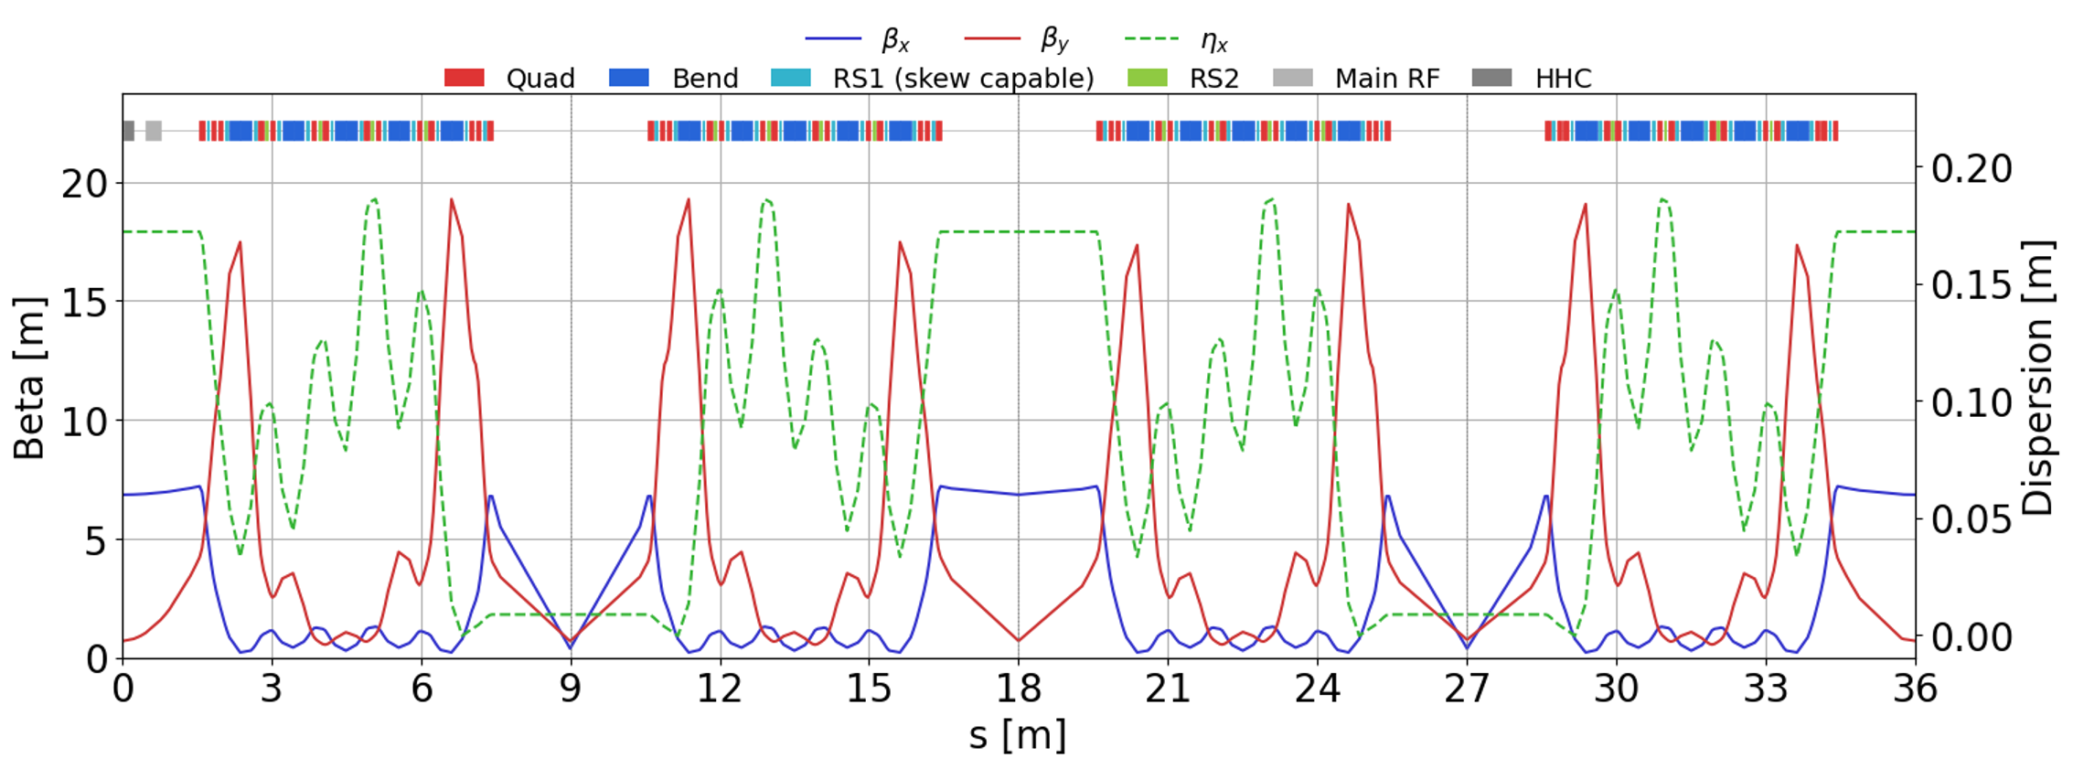
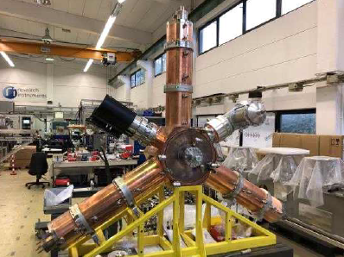
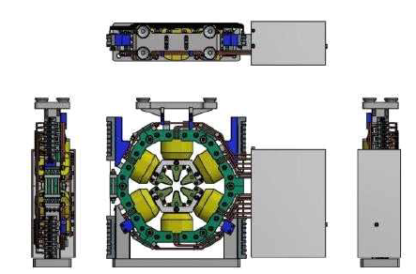
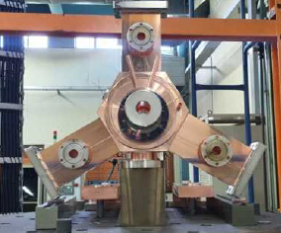
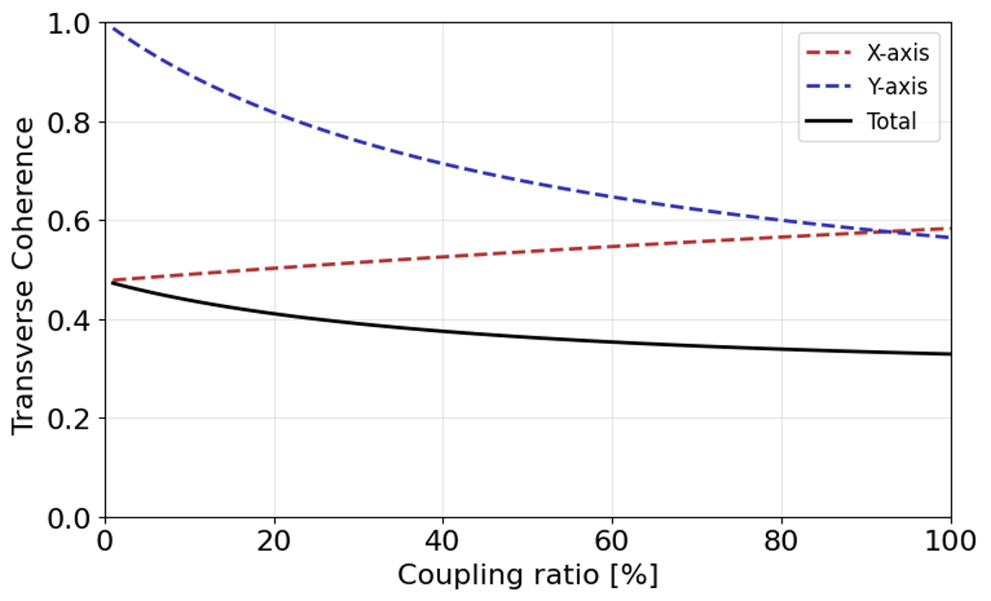
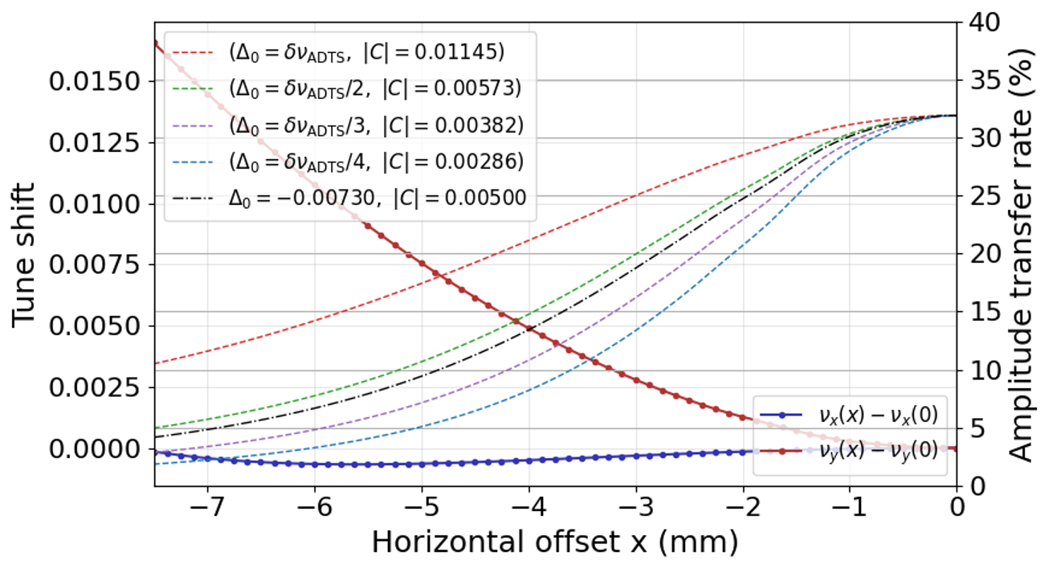
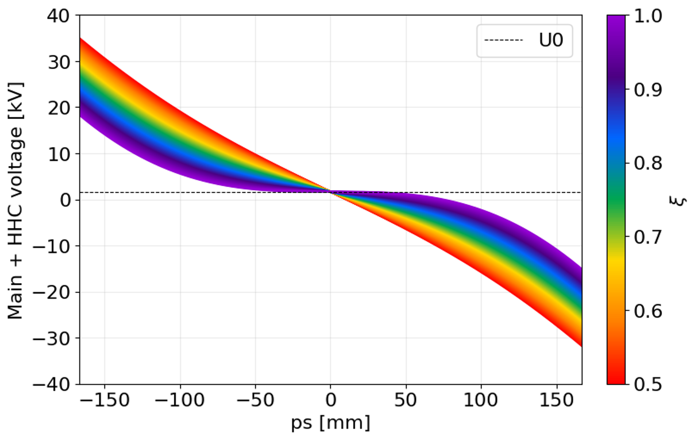
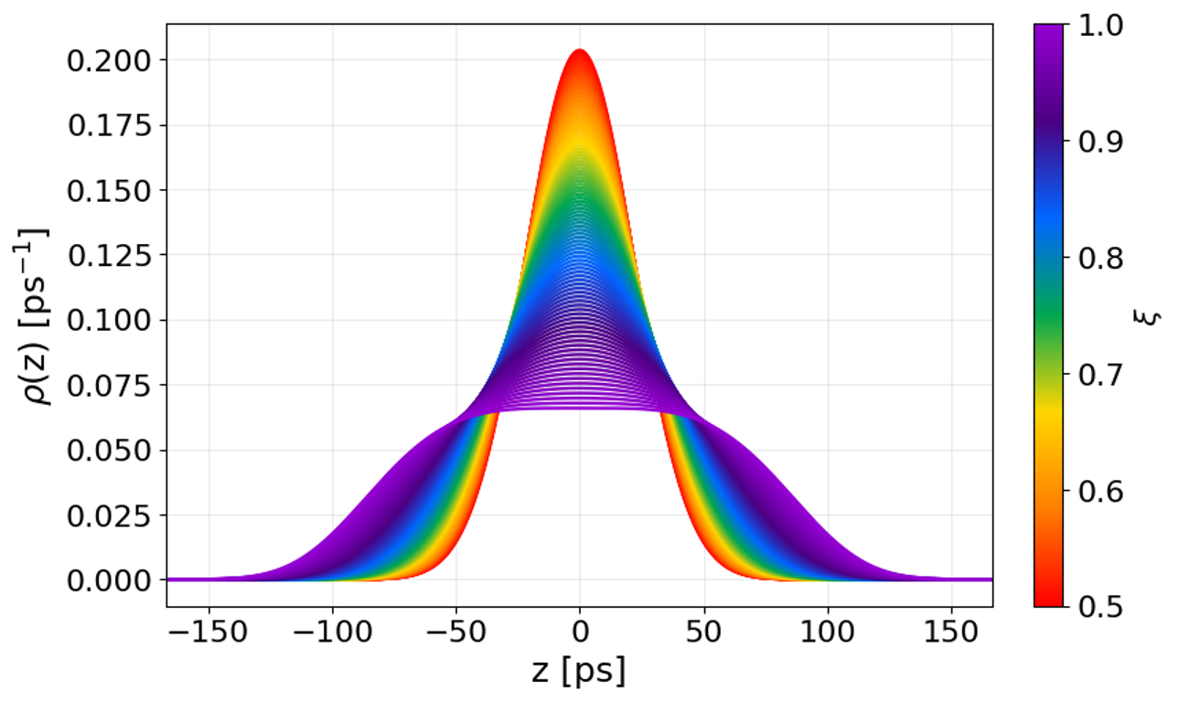
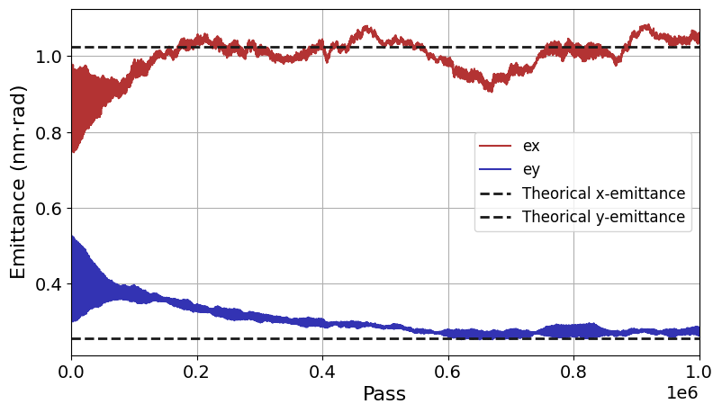
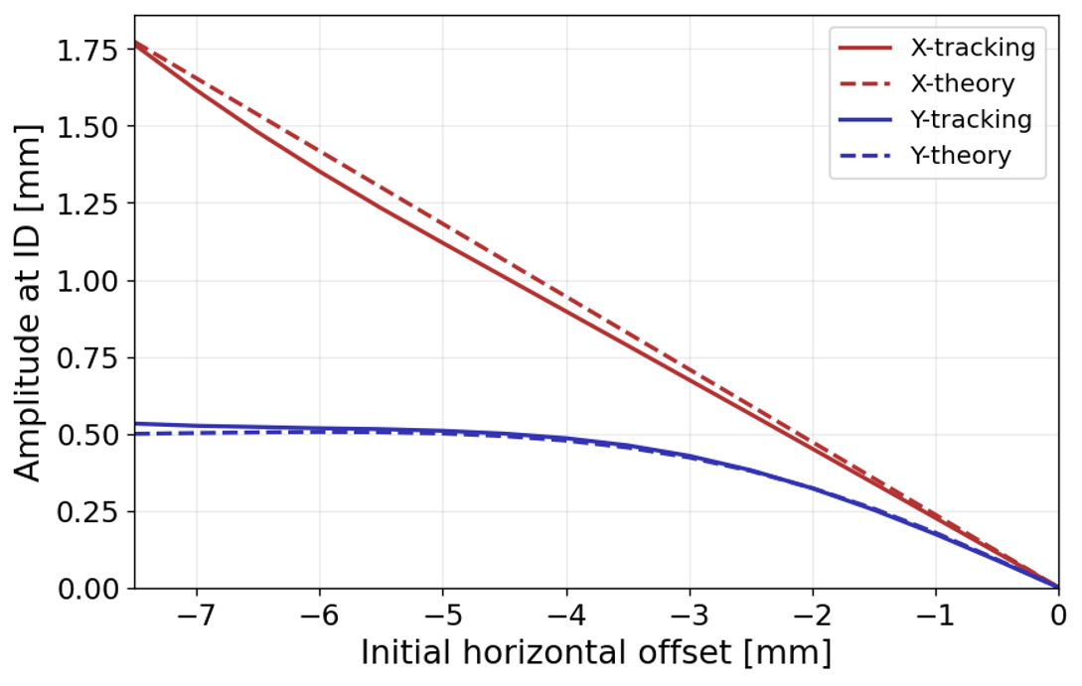
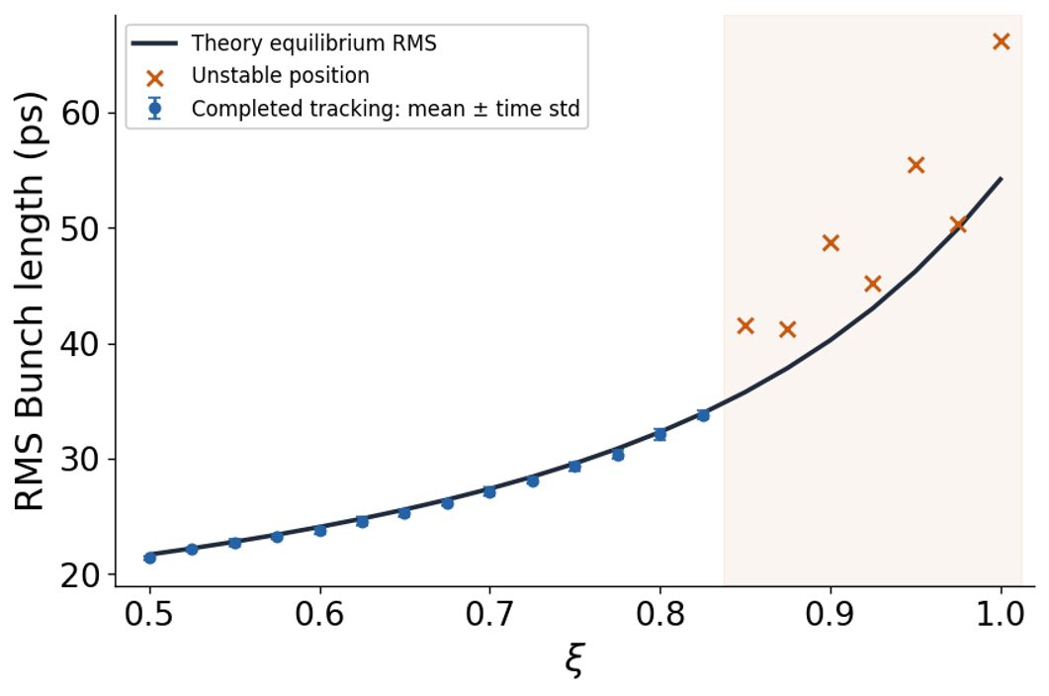
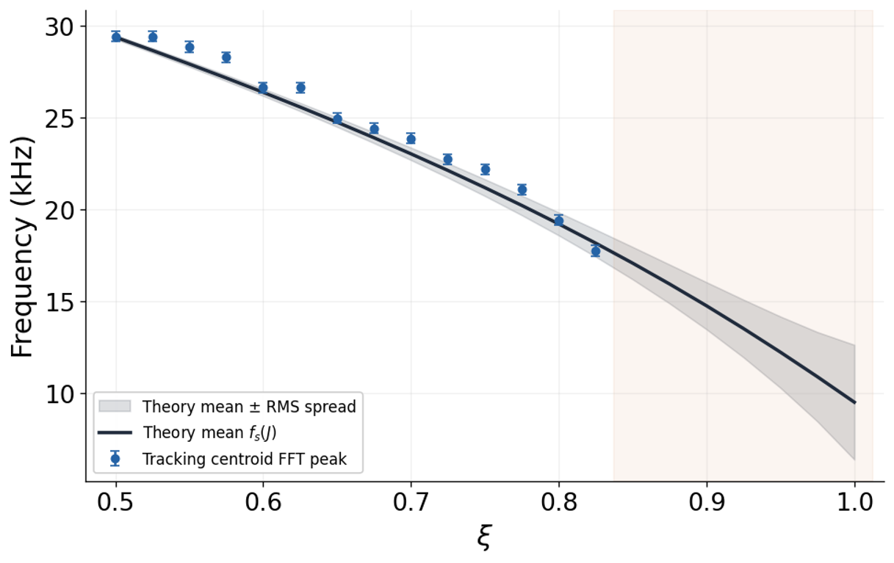
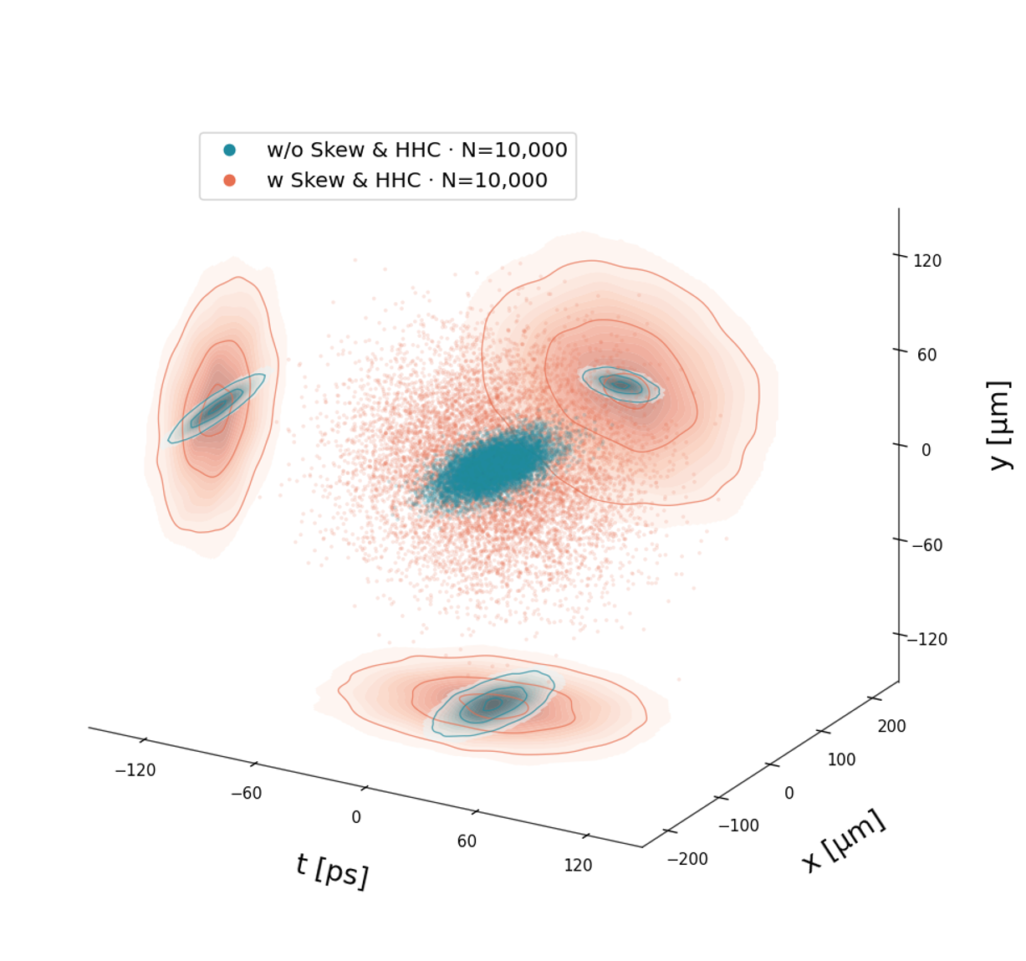
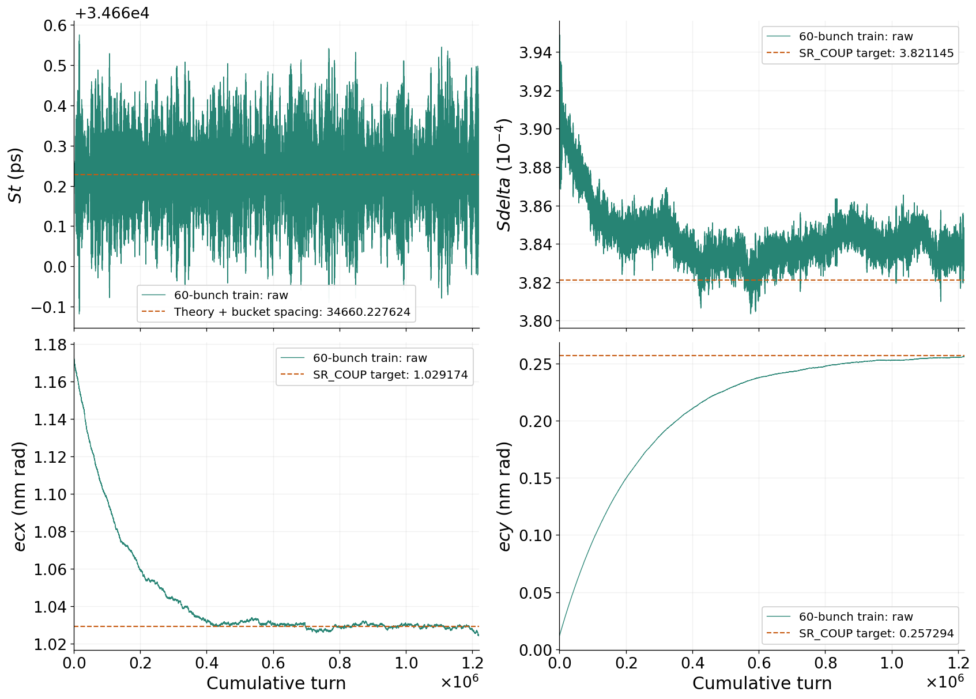
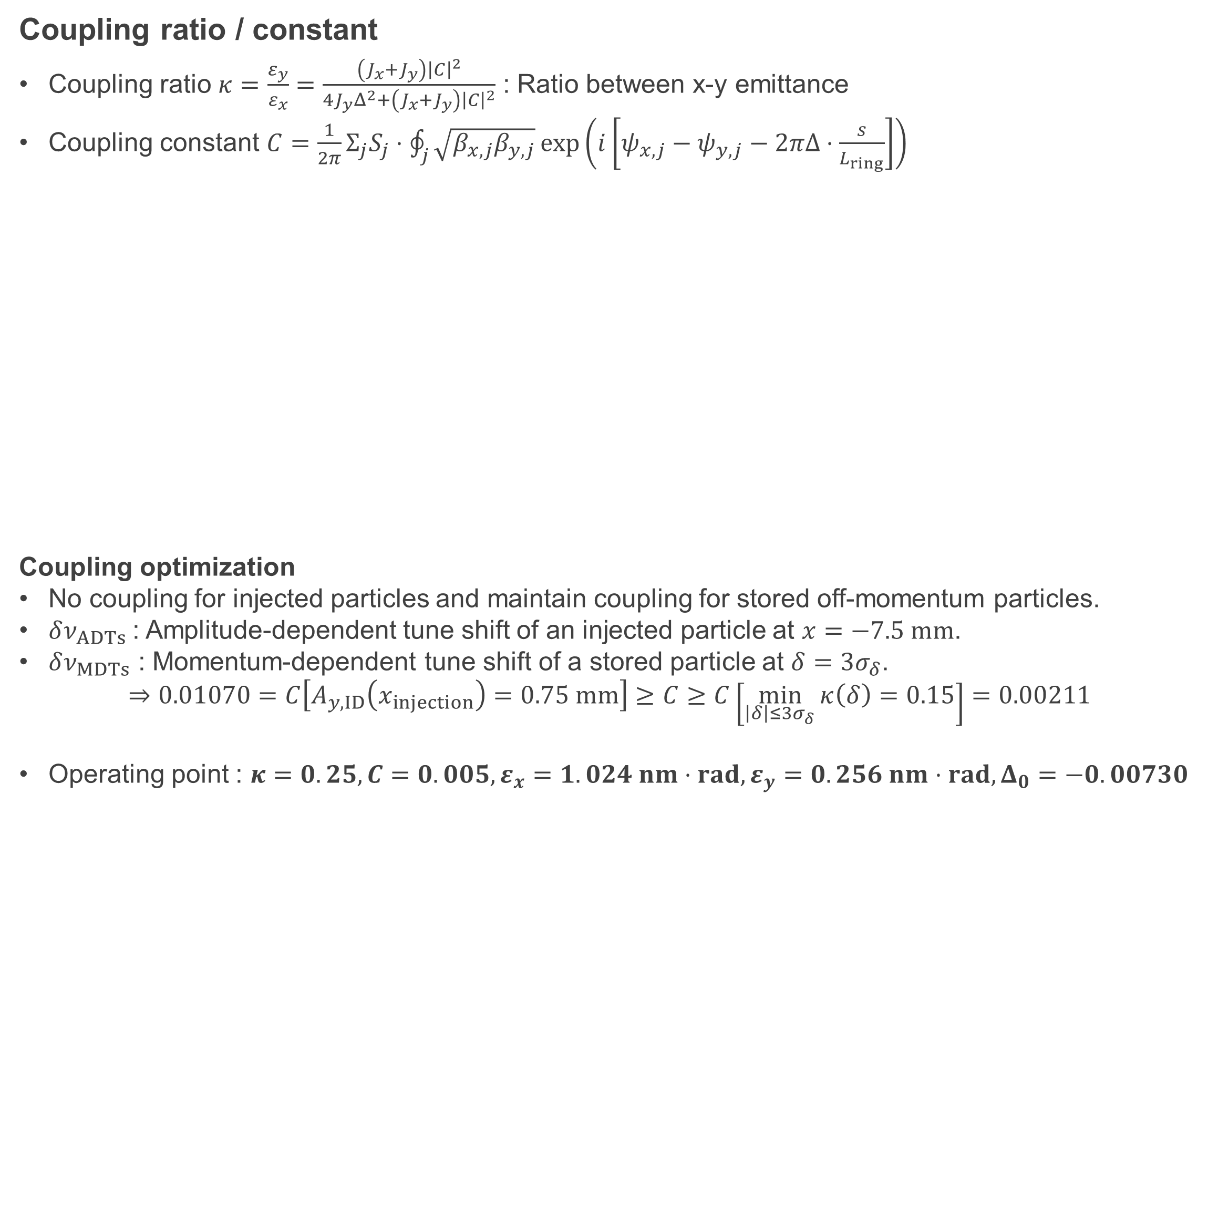
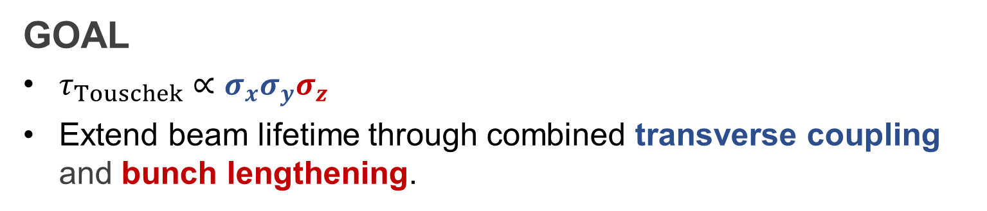
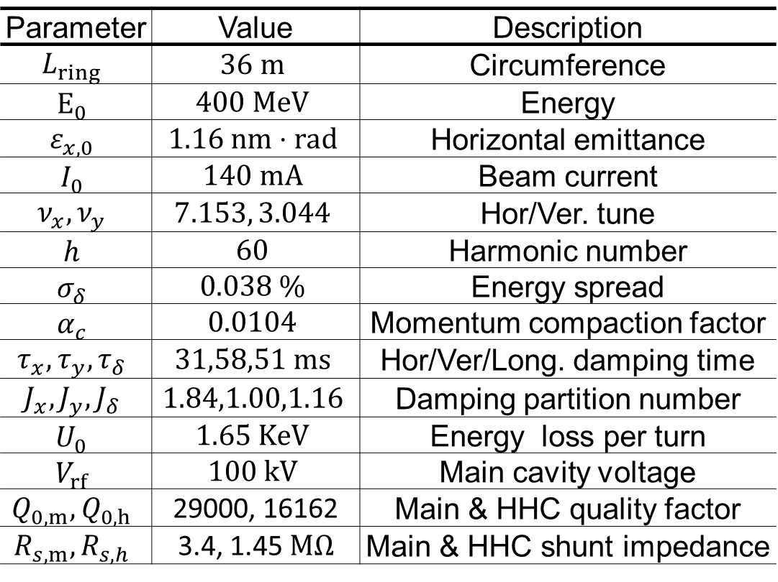
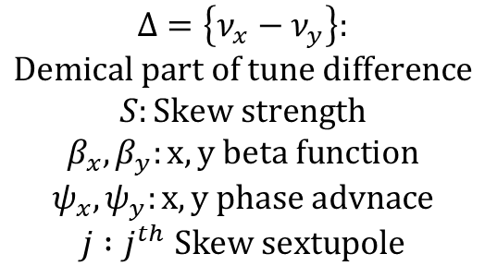
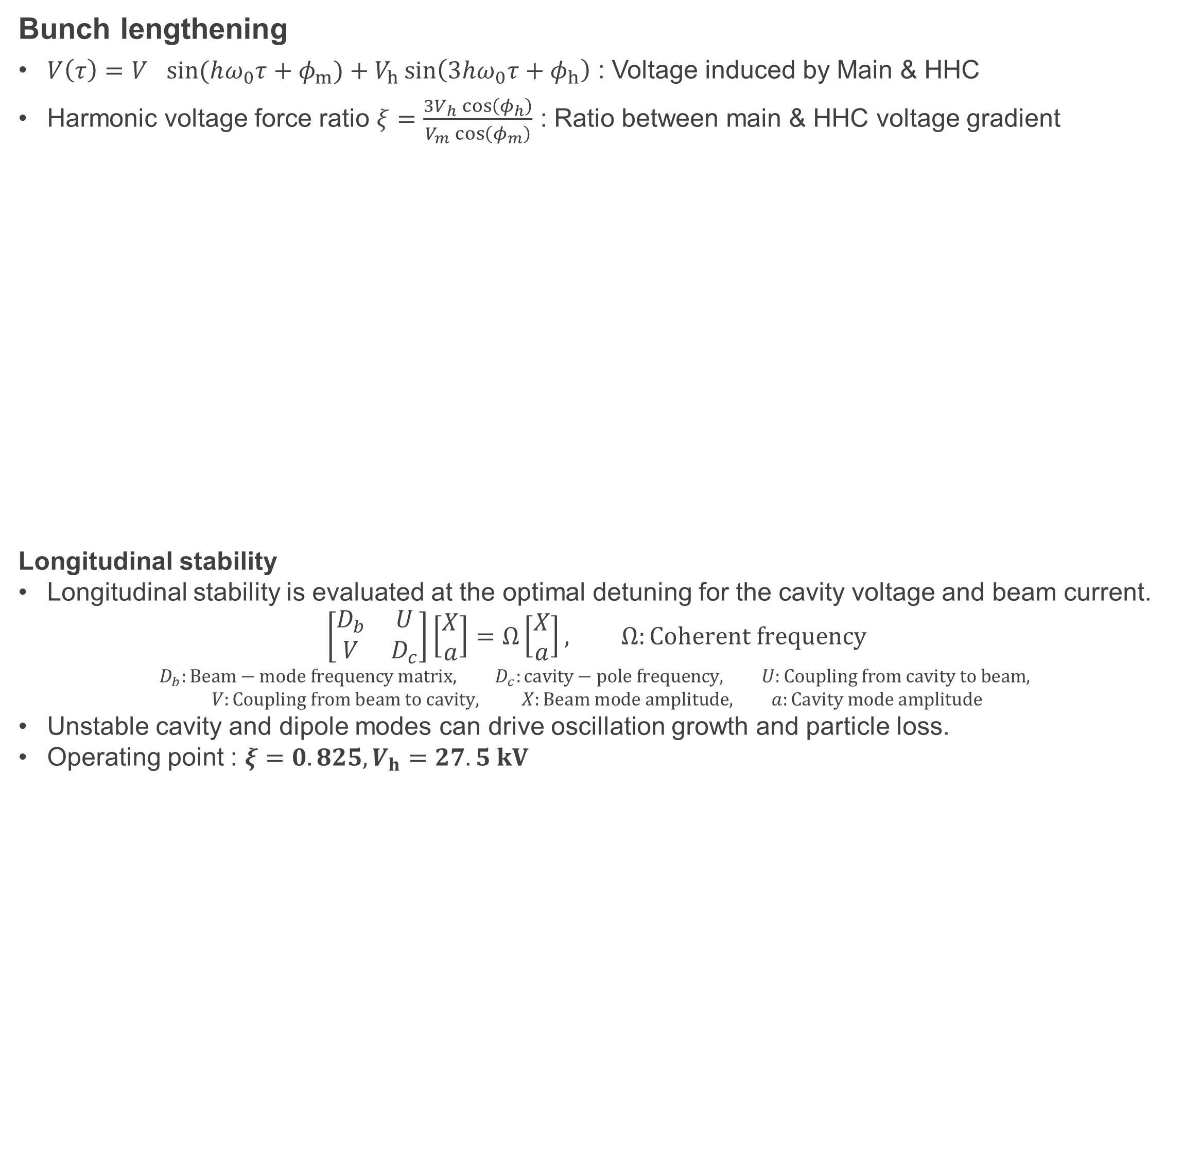
Operational Scenario for Enhancing the Touschek Lifetime of the PAL-EUV Storage Ring
Youngmin Park, Moses Chung*, POSTECH, Pohang, Korea.
Gyeongsu Jang, Juho Hong, Junho Ko, PAL, POSTECH, Pohang, Korea.
Abstract
The PAL-EUV storage ring operates with low-energy and low-emittance electron beams, resulting in a relatively short Touschek lifetime. This limits beam-current maintenance and stable operation of the storage ring. To mitigate this issue, this study investigates an operational strategy combining bunch lengthening with an active higher harmonic cavity (HHC) and transverse coupling control using skew quadrupole magnets. The effects of these parameters on the beam lifetime are evaluated to establish practical operating conditions for improving the Touschek lifetime and supporting stable PAL-EUV operation.
Introduction
Parameter | Value | Description
$$L_{ring}$$ | $$36 m$$ | Circumference
$$E_{0}$$ | $$400 MeV$$ | Energy
$$ε_{x,0}$$ | $$1.16 nm⋅rad$$ | Horizontal emittance
$$I_{0}$$ | $$140 mA$$ | Beam current
$$ν_{x},ν_{y}$$ | $$7.153, 3.044$$ | Hor/Ver. tune
$$h$$ | $$60$$ | Harmonic number
$$σ_{δ}$$ | $$0.038 \%$$ | Energy spread
$$α_{c}$$ | $$0.0104$$ | Momentum compaction factor
$$τ_{x},τ_{y},τ_{δ}$$ | $$31,58,51 ms$$ | Hor/Ver/Long. damping time
$$J_{x},J_{y},J_{δ}$$ | $$1.84,1.00,1.16$$ | Damping partition number
$$U_{0}$$ | $$1.65 KeV$$ | Energy loss per turn
$$V_{rf}$$ | $$100 kV$$ | Main cavity voltage
$$Q_{0,m},Q_{0,h}$$ | 29000, 16162 | Main & HHC quality factor
$$R_{s,m},R_{s,h}$$ | 3.4, 1.45 $MΩ$ | Main & HHC shunt impedance
PAL-EUV
Compact 400 MeV storage designed as a high-power EUV source.
Skew quadrupoles enable control of transverse coupling.
ALBA-type active higher harmonic cavity provides bunch lengthening.
Challenge
Short beam lifetime ~ 0.1 h
Skew: compatibility with dissonance injection and transverse coherence
HHC: Bunch lengthening and robinson instability
GOAL
$τ_{Touschek}∝σ_{x}σ_{y}σ_{z}$
Extend beam lifetime through combined transverse coupling and bunch lengthening.
Skew quadrupole
Higher Harmonic Cavity
$$Δ=\left\{ν_{x}−ν_{y}\right\}: \\ Demical part of tune difference$$
$$S:Skew strength$$
$$β_{x},β_{y}:x,y beta function$$
$$ψ_{x},ψ_{y}:x,y phase advnace$$
$$j :j^{th} Skew sextupole$$
Coupling ratio / constant
Coupling ratio $κ=\frac{ε_{y}}{ε_{x}}=\frac{\left(J_{x}+J_{y}\right){\left|C\right|}^{2}}{4J_{y}Δ^{2}+\left(J_{x}+J_{y}\right){\left|C\right|}^{2}}$ : Ratio between x-y emittance
Coupling constant $C=\frac{1}{2π}Σ_{j}S_{j}⋅\oint_{j}{\sqrt{β_{x,j}β_{y,j}}}\exp\left(i\left[ψ_{x,j}−ψ_{y,j}−2πΔ⋅\frac{s}{L_{ring}}\right]\right)$
Coupling optimization
No coupling for injected particles and maintain coupling for stored off-momentum particles.
$δν_{ADTs}$: Amplitude-dependent tune shift of an injected particle at $x=−7.5 mm$.
$δν_{MDTs}$ : Momentum-dependent tune shift of a stored particle at $δ=3σ_{δ}$.
$$⇒0.01070=C\left[A_{y,ID}\left(x_{injection}\right)=0.75 mm\right]≥C≥C\left[\min_{\left|δ\right|≤3σ_{δ}}{κ\left(δ\right)=0.15}\right]=0.00211$$
Operating point : $κ=0.25, C=0.005, ε_{x}=1.024 nm⋅rad, ε_{y}=0.256 nm⋅rad,Δ_{0}=−0.00730$
Bunch lengthening
$V\left(τ\right)=V_{}\sin{(hω_{0}τ+φ_{m})}+V_{h}\sin\left(3hω_{0}τ+φ_{h}\right)$ : Voltage induced by Main & HHC
Harmonic voltage force ratio $ξ=\frac{3V_{h}\cos\left(φ_{h}\right)}{V_{m}\cos\left(φ_{m}\right)}$ : Ratio between main & HHC voltage gradient
Longitudinal stability
Longitudinal stability is evaluated at the optimal detuning for the cavity voltage and beam current.
$$\left[\begin{matrix}D_{b} & U \\ V & D_{c}\end{matrix}\right]\left[\begin{matrix}X \\ a\end{matrix}\right]=Ω\left[\begin{matrix}X \\ a\end{matrix}\right], Ω:Coherent frequency$$
$$D_{b}:Beam−mode frequency matrix, D_{c}:cavity−pole frequency, U:Coupling from cavity to beam,$$
$$V:Coupling from beam to cavity, X:Beam mode amplitude, a:Cavity mode amplitude$$
Unstable cavity and dipole modes can drive oscillation growth and particle loss.
Operating point : $ξ=0.825, V_{h}=27.5 kV$
Results & Conclusion
Results & Conclusions
Compared with the reference condition (1% coupling, without HHC), the proposed operating conditions increase the longitudinal bunch length and effective transverse beam area by factors of approximately 2.2 and 4.5, respectively.
These improvements suggest a potential tenfold enhancement in the Touschek lifetime, based on the reduction in beam density.
This study provides a basis for defining practical operating conditions to improve the beam lifetime and support stable operation of the PAL-EUV storage ring.
Future Work
Vertical dispersion correction: Optimize the lattice to compensate for vertical dispersion introduced by skew quadrupole magnets, targeting zero vertical dispersion at the insertion device (ID).
RF voltage optimization: Extend the optimization beyond the present fixed main cavity voltage of 100 kV, exploring operation up to the design maximum of 250 kV.
Acknowlegement
Reference
Researches at PAL were supported in part by MSIT(RS-2022-00164805, Accelerator Application Support Project) and POSTECH.
1. T. Zhang, X. Huang, “Off-axis injection for storage rings with full coupling”, Physical Review Accelerators and Beams 21, 084002 (2018).
2. M. B. Alves, “Theoretical models for longitudinal coupled-bunch instabilities driven by harmonic cavities in electron storage rings”, Physical Review Accelerators and Beams 28, 034401 (2025).
*moses@postech.ac.kr

