Slide 1
Operational Scenario for Enhancing the Touschek Lifetime of the PAL-EUV Storage Ring
2026-10-16, Pohang, South Korea
Young Min Park
Division of Advanced Nuclear Engineering (DANE), POSTECH

Slide 2
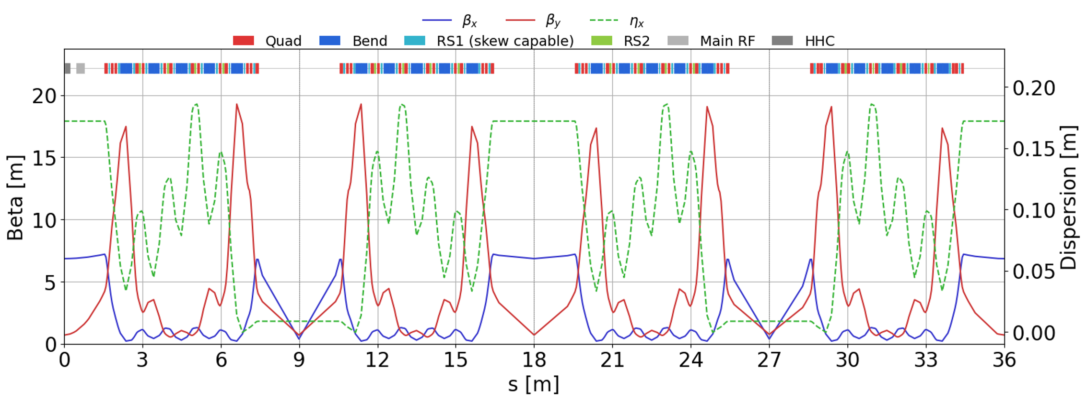
Introduction
PAL-EUV
Compact 400 MeV storage designed as a high-power EUV source.
Skew quadrupoles (RS1) enable control of transverse coupling.
Active higher harmonic cavity (HHC) provides bunch lengthening.
Challenge
Short touschek lifetime : ~ 0.1 h
Skew : Dissonance injection / Transverse coherence
HHC : Robinson Instability
2

Slide 3
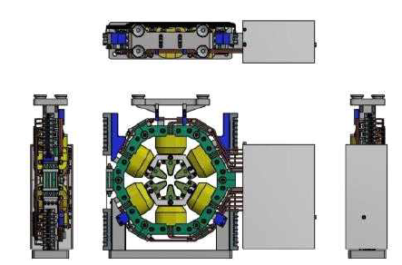
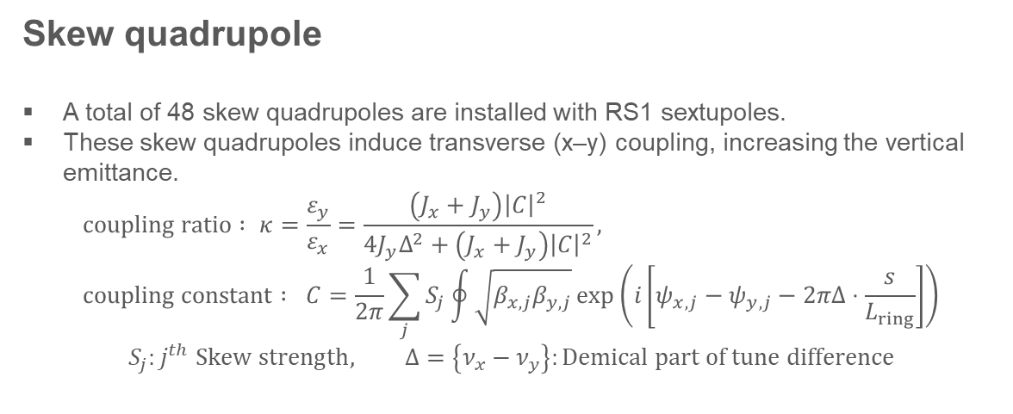
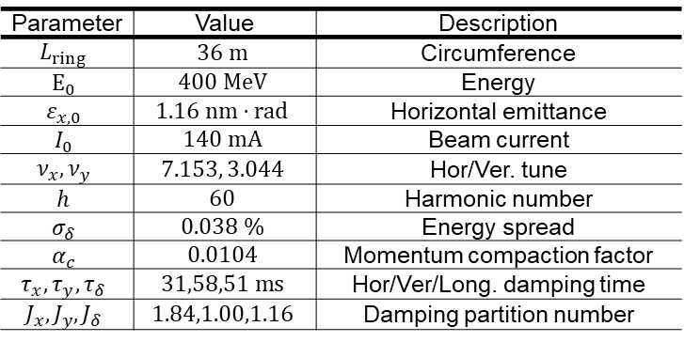
Skew quadrupole
Parameter | Value | Description
$$L_{ring}$$ | $$36 m$$ | Circumference
$$E_{0}$$ | $$400 MeV$$ | Energy
$$ε_{x,0}$$ | $$1.16 nm⋅rad$$ | Horizontal emittance
$$I_{0}$$ | $$140 mA$$ | Beam current
$$ν_{x},ν_{y}$$ | $$7.153, 3.044$$ | Hor/Ver. tune
$$h$$ | $$60$$ | Harmonic number
$$σ_{δ}$$ | $$0.038 \%$$ | Energy spread
$$α_{c}$$ | $$0.0104$$ | Momentum compaction factor
$$τ_{x},τ_{y},τ_{δ}$$ | $$31,58,51 ms$$ | Hor/Ver/Long. damping time
$$J_{x},J_{y},J_{δ}$$ | $$1.84,1.00,1.16$$ | Damping partition number
Skew quadrupole
A total of 48 skew quadrupoles are installed with RS1 sextupoles.
These skew quadrupoles induce transverse (x–y) coupling, increasing the vertical emittance.
$$coupling ratio : κ=\frac{ε_{y}}{ε_{x}}=\frac{\left(J_{x}+J_{y}\right){\left|C\right|}^{2}}{4J_{y}Δ^{2}+\left(J_{x}+J_{y}\right){\left|C\right|}^{2}}, \\ coupling constant : C=\frac{1}{2π}\sum_{j}{S_{j}\oint{\sqrt{β_{x,j}β_{y,j}}\exp\left(i\left[ψ_{x,j}−ψ_{y,j}−2πΔ⋅\frac{s}{L_{ring}}\right]\right)}}$$
$$S_{j}:j^{th} Skew strength, Δ=\left\{ν_{x}−ν_{y}\right\}:Demical part of tune difference$$
3

Slide 4
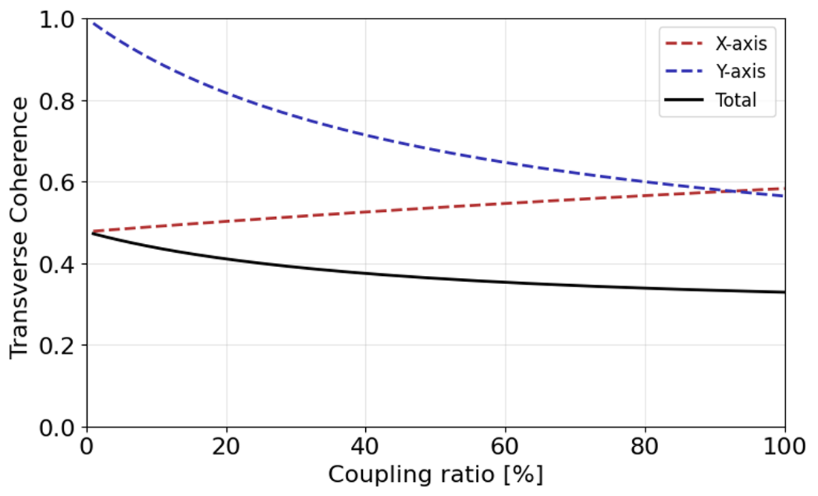
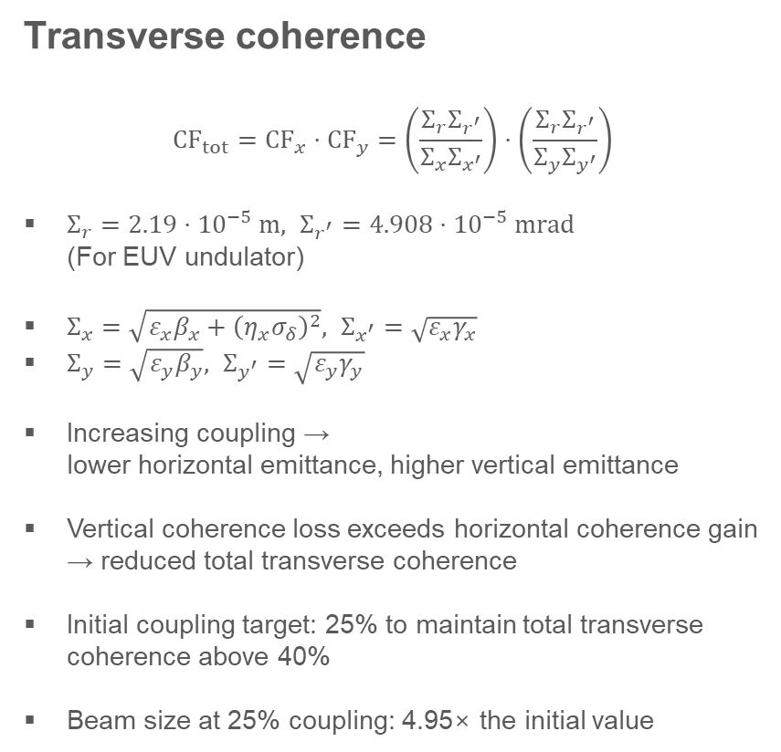
Coupling ratio
Transverse coherence
$${CF}_{tot}={CF}_{x}⋅{CF}_{y}=\left(\frac{Σ_{r}Σ_{r^{′}}}{Σ_{x}Σ_{x^{′}}}\right)⋅\left(\frac{Σ_{r}Σ_{r^{′}}}{Σ_{y}Σ_{y^{′}}}\right)$$
$Σ_{r}=2.19⋅{10}^{−5} m, Σ_{r^{′}}=4.908⋅{10}^{−5} mrad$
(For EUV undulator)
$Σ_{x}=\sqrt{ε_{x}β_{x}+{\left(η_{x}σ_{δ}\right)}^{2}}, Σ_{x^{′}}=\sqrt{ε_{x}γ_{x}}$
$Σ_{y}=\sqrt{ε_{y}β_{y}}, Σ_{y^{′}}=\sqrt{ε_{y}γ_{y}}$
Increasing coupling →
lower horizontal emittance, higher vertical emittance
Vertical coherence loss exceeds horizontal coherence gain → reduced total transverse coherence
Initial coupling target: 25% to maintain total transverse coherence above 40%
Beam size at 25% coupling: 4.95× the initial value
4

Slide 5
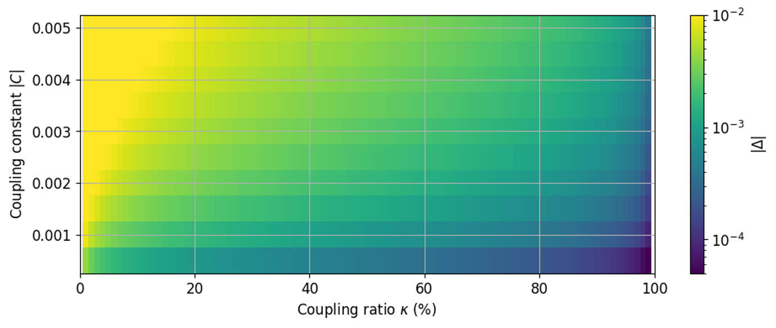
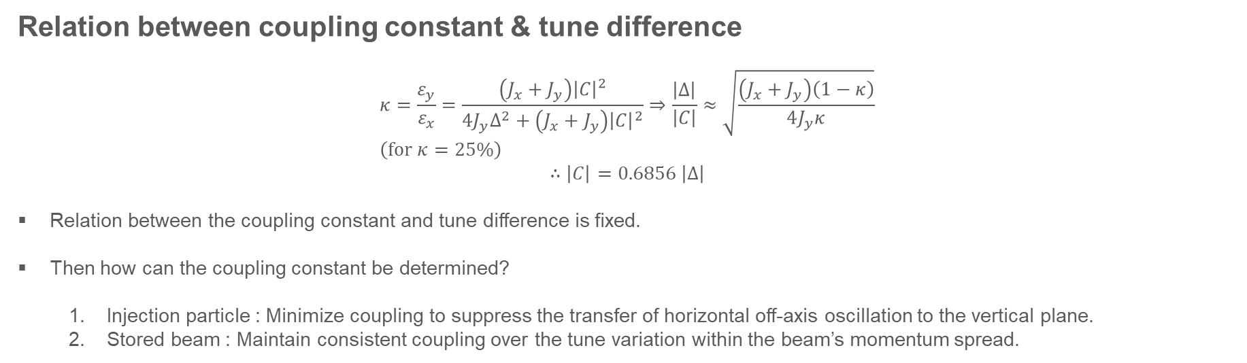
Coupling constant
Relation between coupling constant & tune difference
$$κ=\frac{ε_{y}}{ε_{x}}=\frac{\left(J_{x}+J_{y}\right){\left|C\right|}^{2}}{4J_{y}Δ^{2}+\left(J_{x}+J_{y}\right){\left|C\right|}^{2}}⇒\frac{\left|Δ\right|}{\left|C\right|}≈\sqrt{\frac{\left(J_{x}+J_{y}\right)\left(1−κ\right)}{4J_{y}κ}} \\ \left(for κ=25\%\right)$$
$$∴\left|C\right|=0.6856 \left|Δ\right|$$
Relation between the coupling constant and tune difference is fixed.
Then how can the coupling constant be determined?
  Injection particle : Minimize coupling to suppress the transfer of horizontal off-axis oscillation to the vertical plane.
  Stored beam : Maintain consistent coupling over the tune variation within the beam’s momentum spread.
5

Slide 6
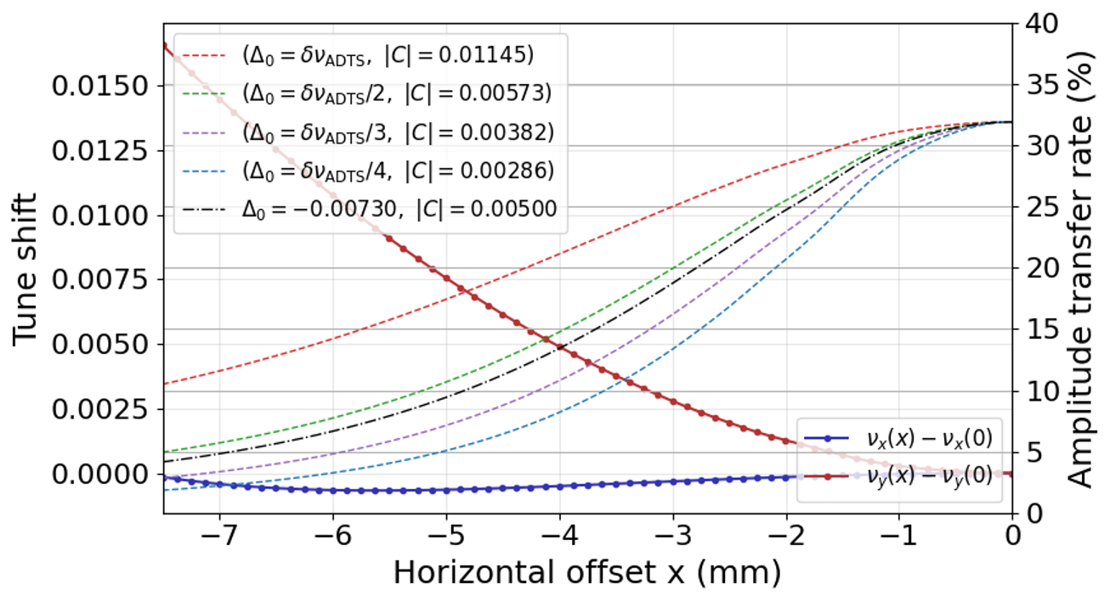
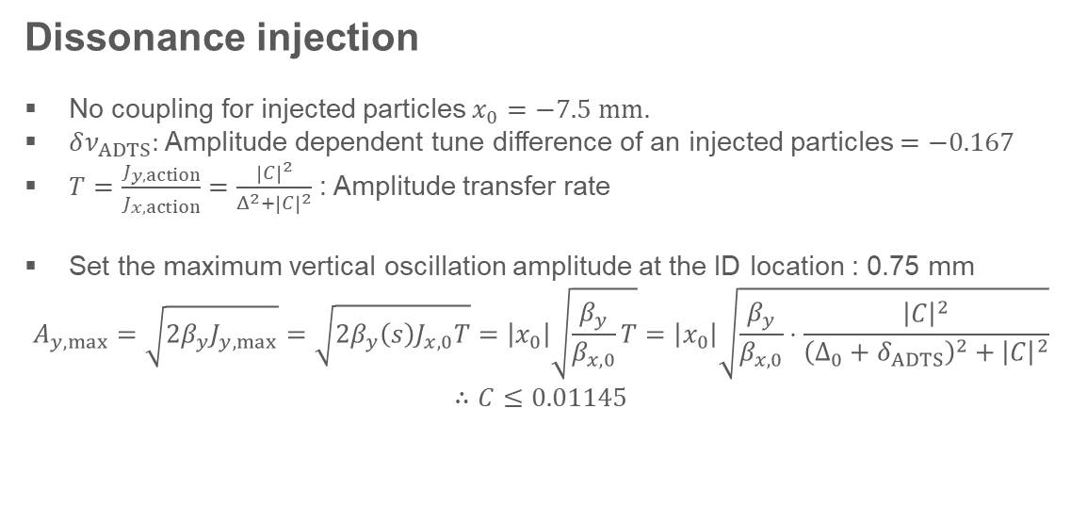
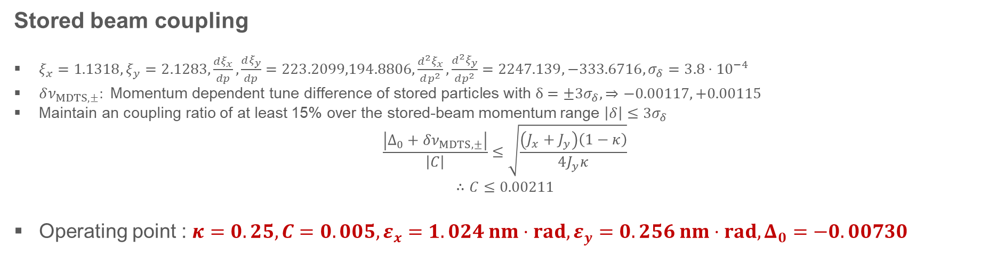
Coupling constant
Dissonance injection
No coupling for injected particles $x_{0}=−7.5 mm$.
$δν_{ADTS}:$ Amplitude dependent tune difference of an injected particles $=−0.167$
$T=\frac{J_{y,action}}{J_{x,action}}=\frac{{\left|C\right|}^{2}}{Δ^{2}+{\left|C\right|}^{2}}$ : Amplitude transfer rate
Set the maximum vertical oscillation amplitude at the ID location : 0.75 mm
$$A_{y,max}=\sqrt{2β_{y}J_{y,max}}=\sqrt{2β_{y}\left(s\right)J_{x,0}T}=\left|x_{0}\right|\sqrt{\frac{β_{y}}{β_{x,0}}T}=\left|x_{0}\right|\sqrt{\frac{β_{y}}{β_{x,0}}⋅\frac{{\left|C\right|}^{2}}{{\left(Δ_{0}+δ_{ADTS}\right)}^{2}+{\left|C\right|}^{2}}}$$
$$∴C≤0.01145$$
Stored beam coupling
$ξ_{x}=1.1318, ξ_{y}=2.1283,\frac{dξ_{x}}{dp},\frac{dξ_{y}}{dp}=223.2099,194.8806,\frac{d^{2}ξ_{x}}{dp^{2}},\frac{d^{2}ξ_{y}}{dp^{2}}=2247.139,−333.6716, σ_{δ}=3.8⋅{10}^{−4}$
$δν_{MDTS,±}: \text{Momentum}\text{ dependent tune }\text{difference}\text{ of }\text{stored particles with }δ=±3σ_{δ}, ⇒−0.00117, +0.00115$
Maintain an coupling ratio of at least 15% over the stored-beam momentum range $\left|δ\right|≤3σ_{δ}$
$$\frac{\left|Δ_{0}+δν_{MDTS,±}\right|}{\left|C\right|}≤\sqrt{\frac{\left(J_{x}+J_{y}\right)\left(1−κ\right)}{4J_{y}κ}}$$
$$∴C≤0.00211$$
Operating point : $κ=0.25, C=0.005, ε_{x}=1.024 nm⋅rad, ε_{y}=0.256 nm⋅rad,Δ_{0}=−0.00730$
6

Slide 7
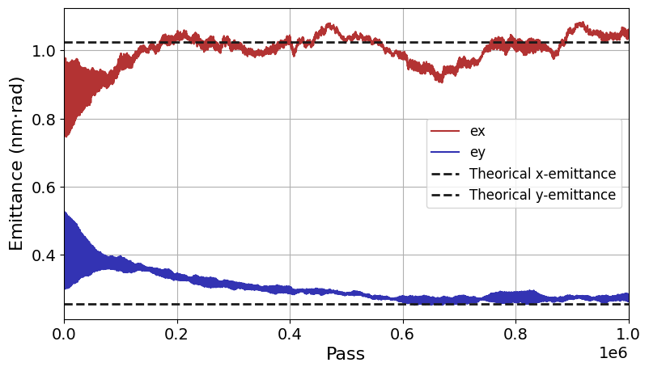
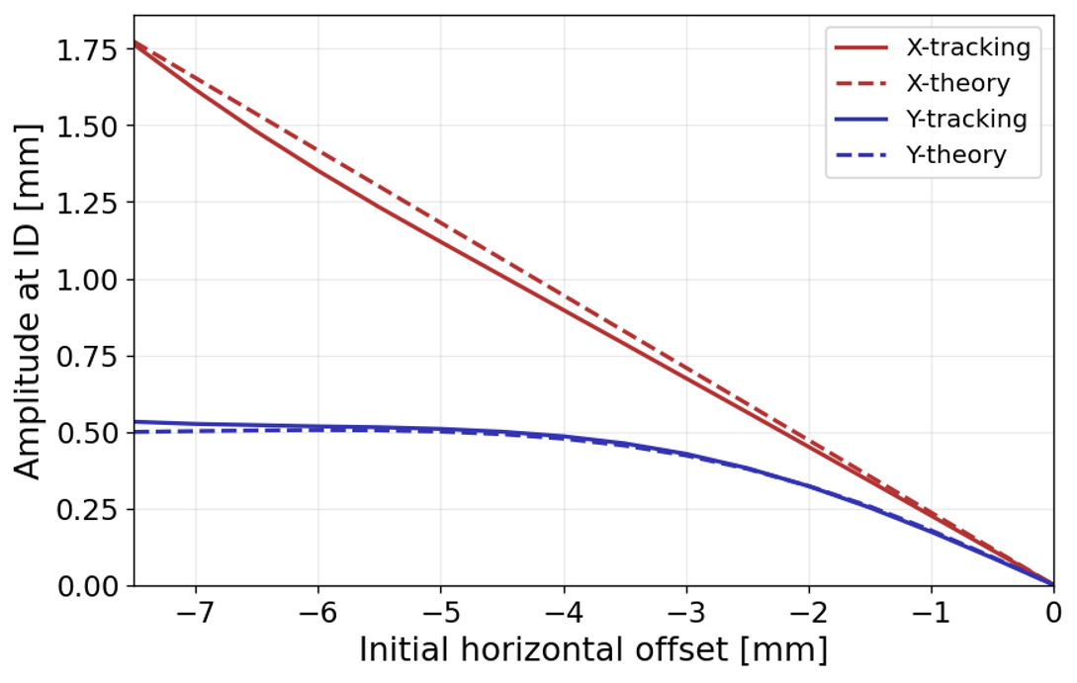
Results for x-y coupling
7

Slide 8
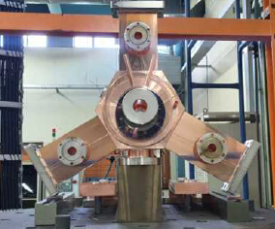
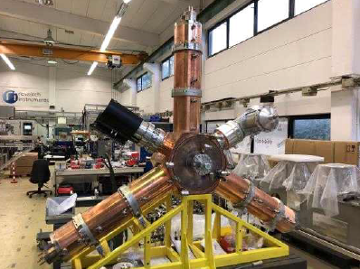
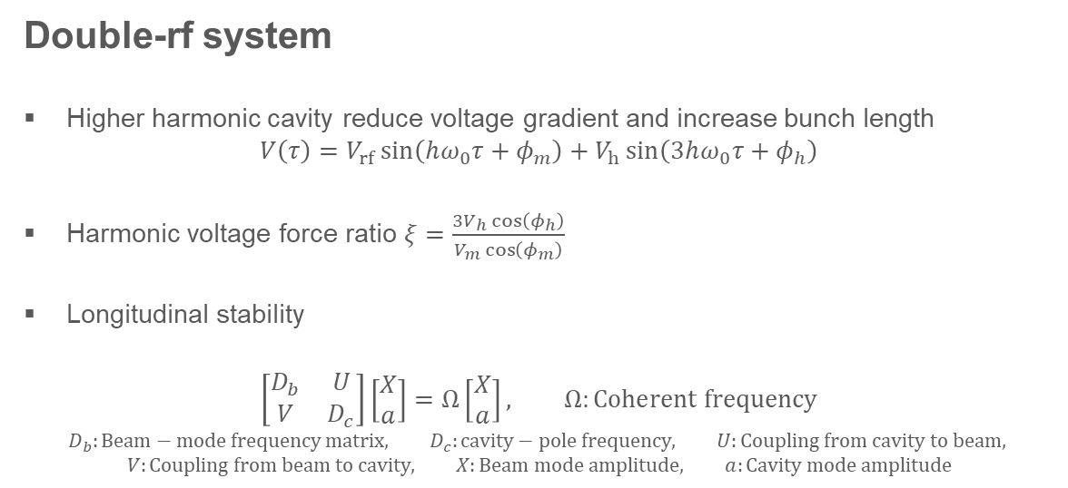
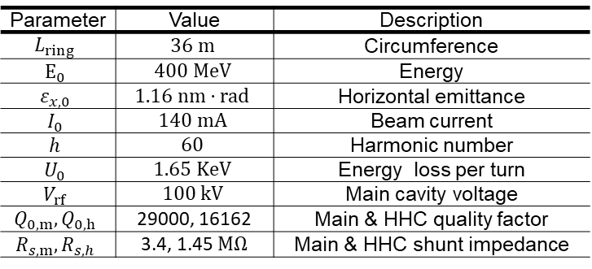
Harmonic cavity
Parameter | Value | Description
$$L_{ring}$$ | $$36 m$$ | Circumference
$$E_{0}$$ | $$400 MeV$$ | Energy
$$ε_{x,0}$$ | $$1.16 nm⋅rad$$ | Horizontal emittance
$$I_{0}$$ | $$140 mA$$ | Beam current
$$h$$ | $$60$$ | Harmonic number
$$U_{0}$$ | $$1.65 KeV$$ | Energy loss per turn
$$V_{rf}$$ | $$100 kV$$ | Main cavity voltage
$$Q_{0,m},Q_{0,h}$$ | 29000, 16162 | Main & HHC quality factor
$$R_{s,m},R_{s,h}$$ | 3.4, 1.45 $MΩ$ | Main & HHC shunt impedance
Double-rf system
Higher harmonic cavity reduce voltage gradient and increase bunch length
$$V\left(τ\right)=V_{rf}\sin\left(hω_{0}τ+φ_{m}\right)+V_{h}\sin\left(3hω_{0}τ+φ_{h}\right)$$
$\text{Harmonic voltage force ratio }ξ=\frac{3V_{h}\cos\left(φ_{h}\right)}{V_{m}\cos\left(φ_{m}\right)}$
Longitudinal stability
$$\left[\begin{matrix}D_{b} & U \\ V & D_{c}\end{matrix}\right]\left[\begin{matrix}X \\ a\end{matrix}\right]=Ω\left[\begin{matrix}X \\ a\end{matrix}\right], Ω:Coherent frequency$$
$$D_{b}:Beam−mode frequency matrix, D_{c}:cavity−pole frequency, U:Coupling from cavity to beam,$$
$$V:Coupling from beam to cavity, X:Beam mode amplitude, a:Cavity mode amplitude$$
8

Slide 9
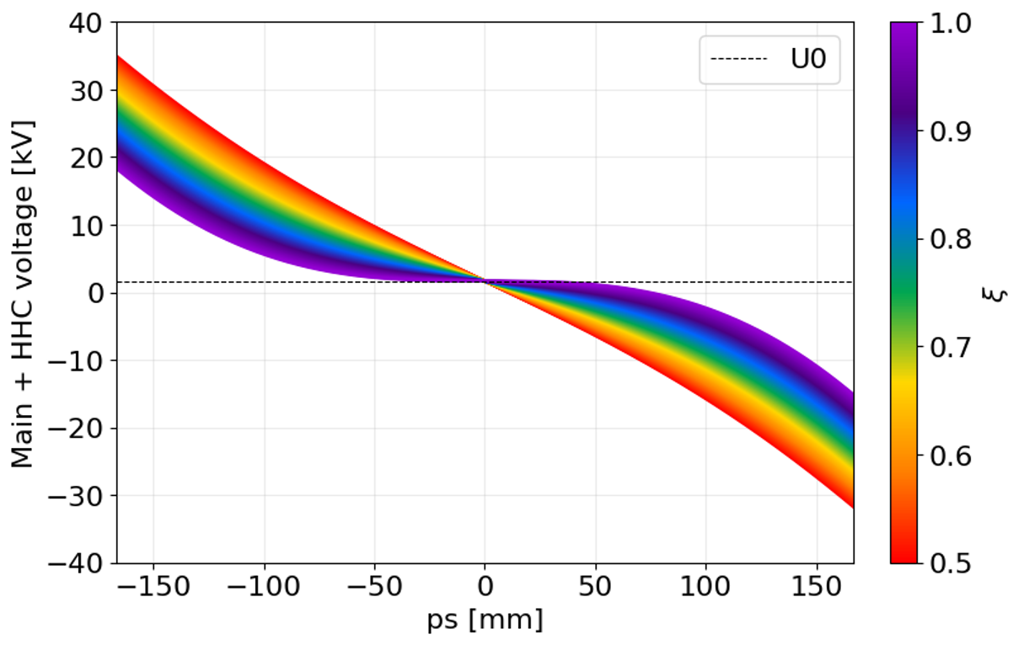
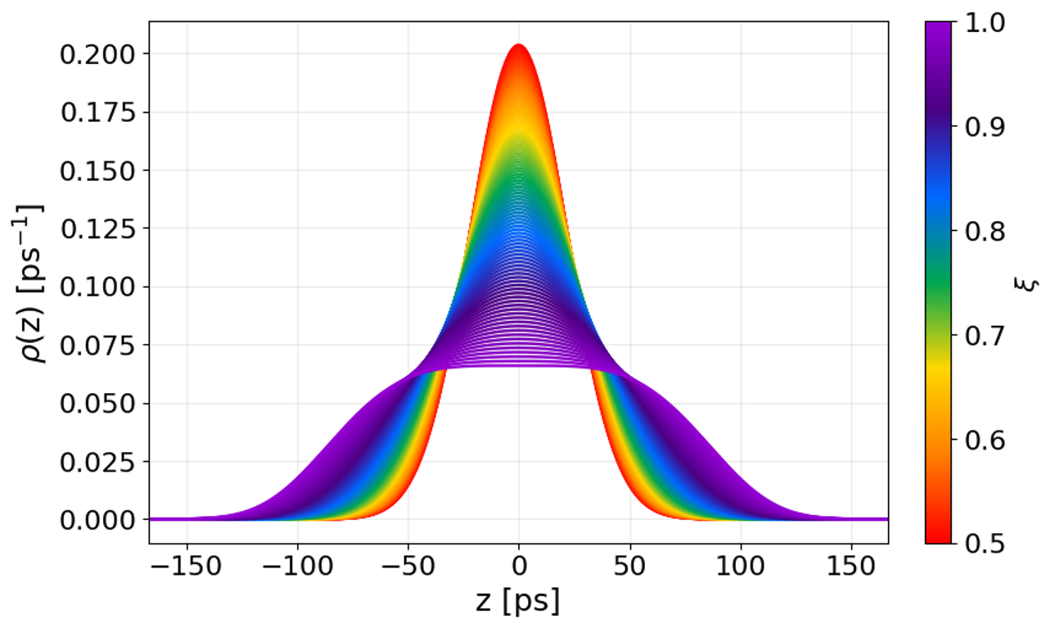
Harmonic cavity
9

Slide 10
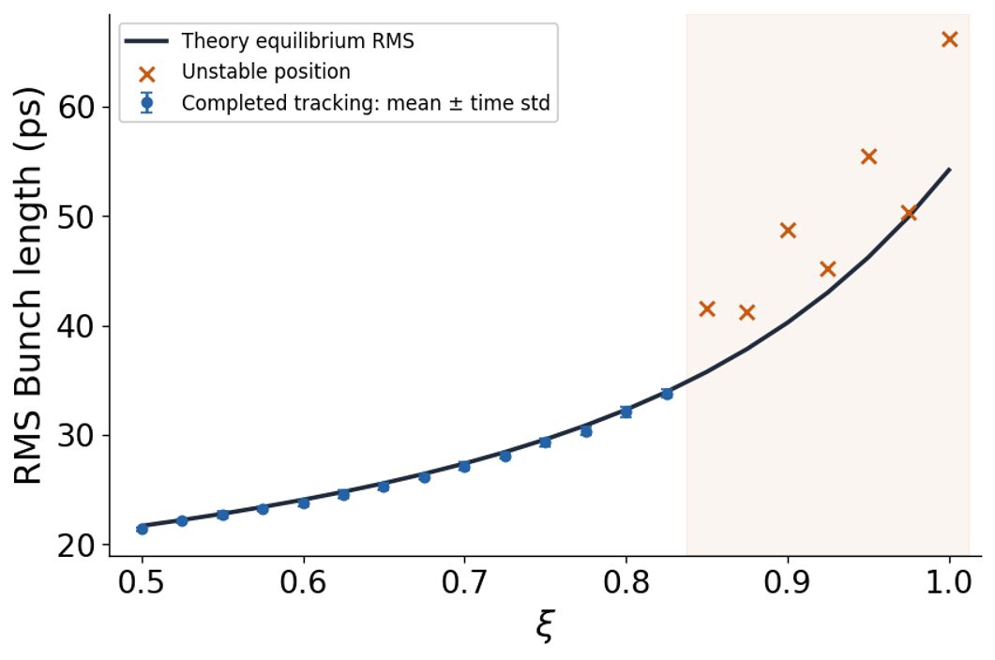
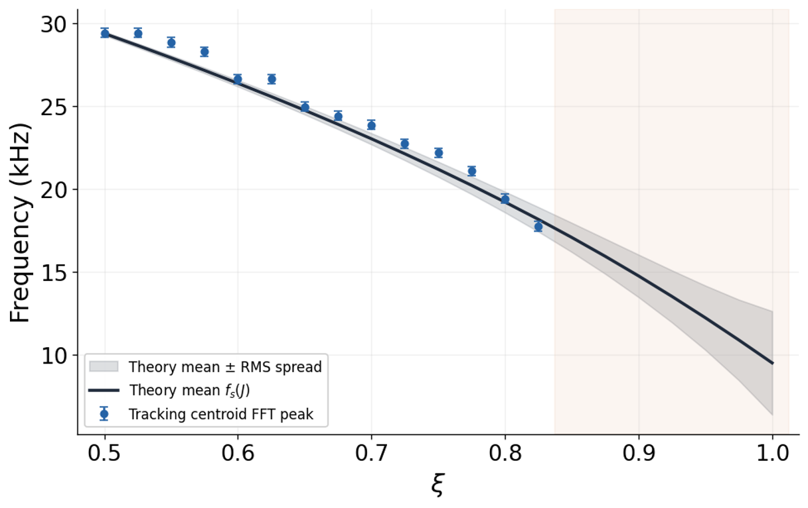

Longitudinal stability
Longitudinal stability
DC Robinson instability was the primary limitation on longitudinal stability
Operating point : $ξ=0.825, V_{h}=27.5 kV$
10

Slide 11
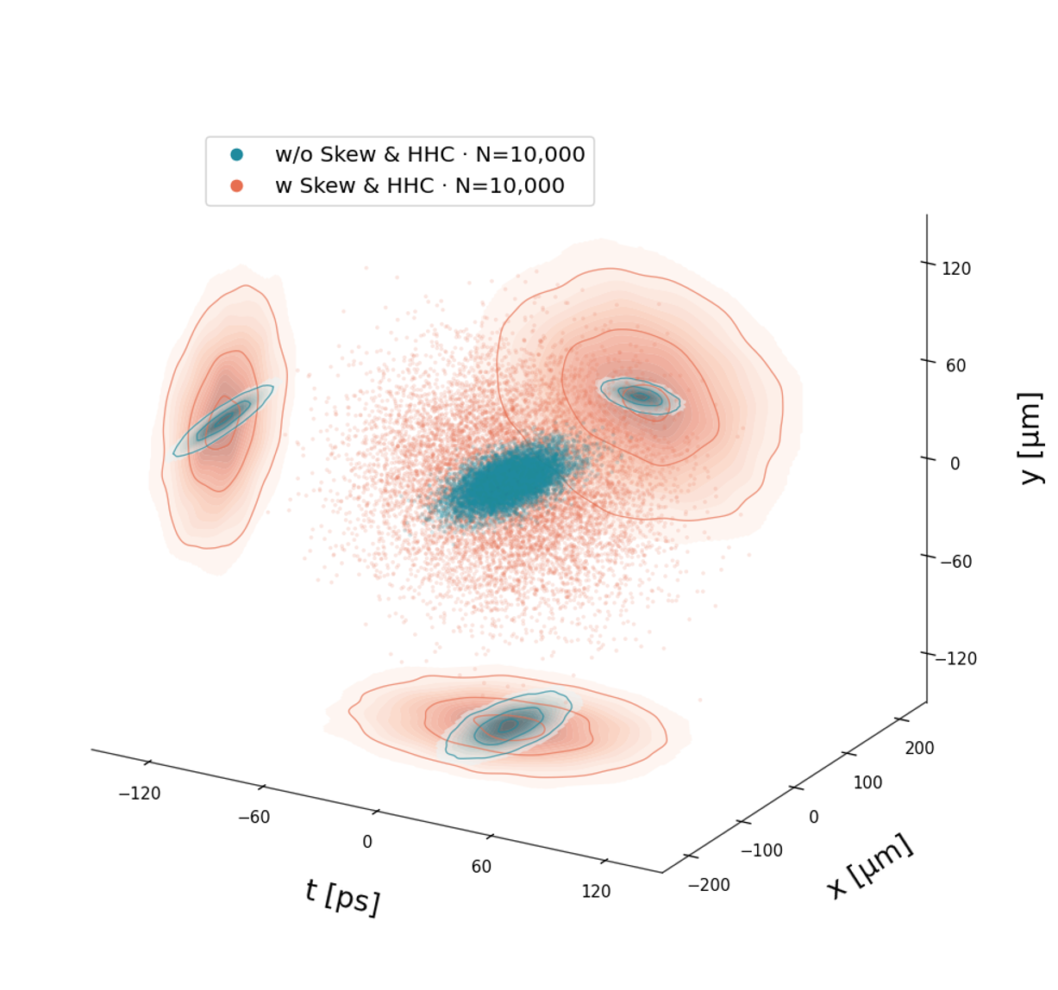
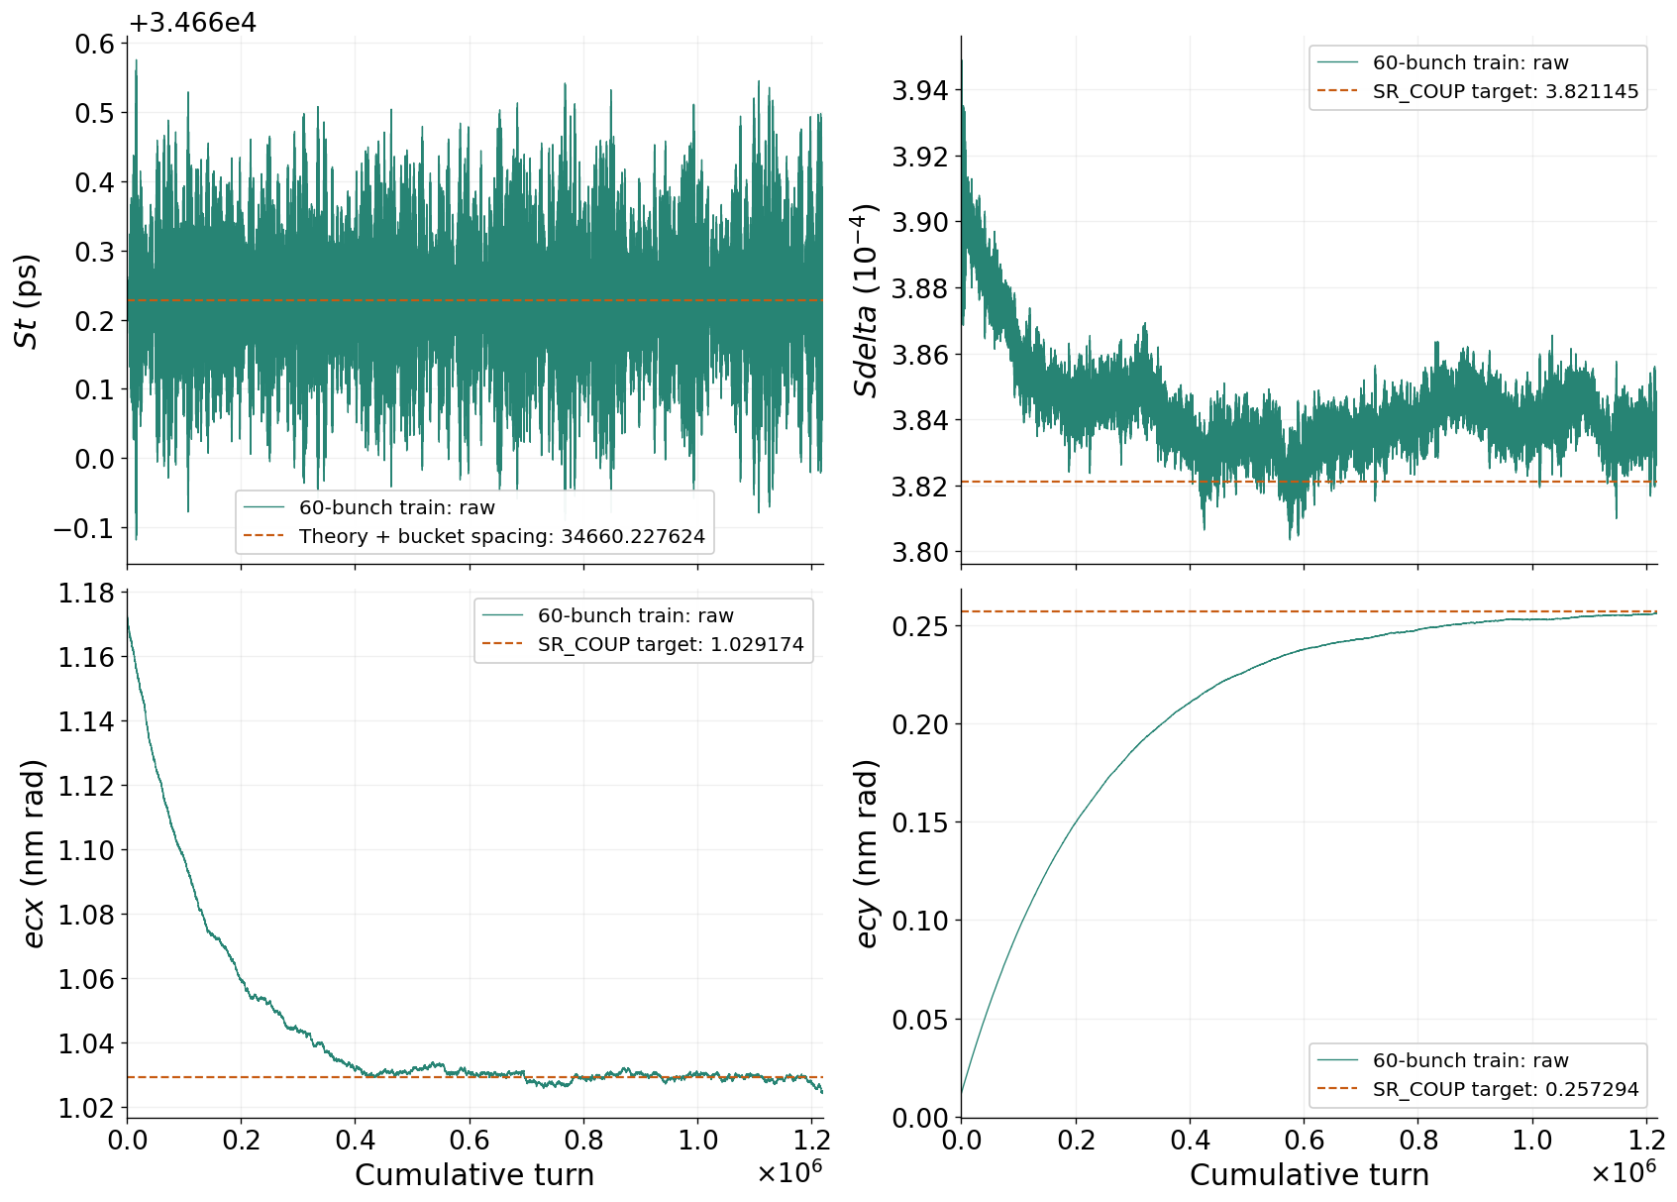
Results for both coupling & HHC
11

Slide 12
Summary and Future work
Results & Conclusions
Compared with the reference condition (1% coupling, without HHC), the proposed operating conditions increase the longitudinal bunch length and effective transverse beam area by factors of approximately 2.2 and 4.5, respectively.
These improvements suggest a potential tenfold enhancement in the Touschek lifetime, based on the reduction in beam density.
This study provides a basis for defining practical operating conditions to improve the beam lifetime and support stable operation of the PAL-EUV storage ring.
Future Work
Vertical dispersion correction: Optimize the lattice to compensate for vertical dispersion introduced by skew quadrupole magnets, targeting zero vertical dispersion at the insertion device (ID).
RF voltage optimization: Extend the optimization beyond the present fixed main cavity voltage of 100 kV, exploring operation up to the design maximum of 250 kV.
12

Slide 13
Thank you for your attention!
13

