Slide 1





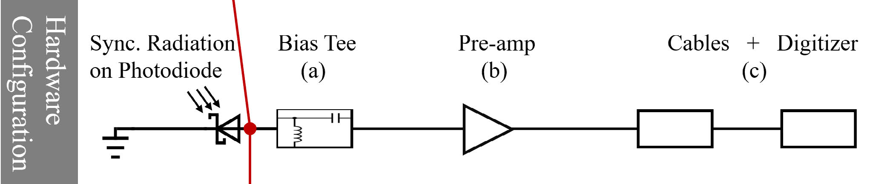
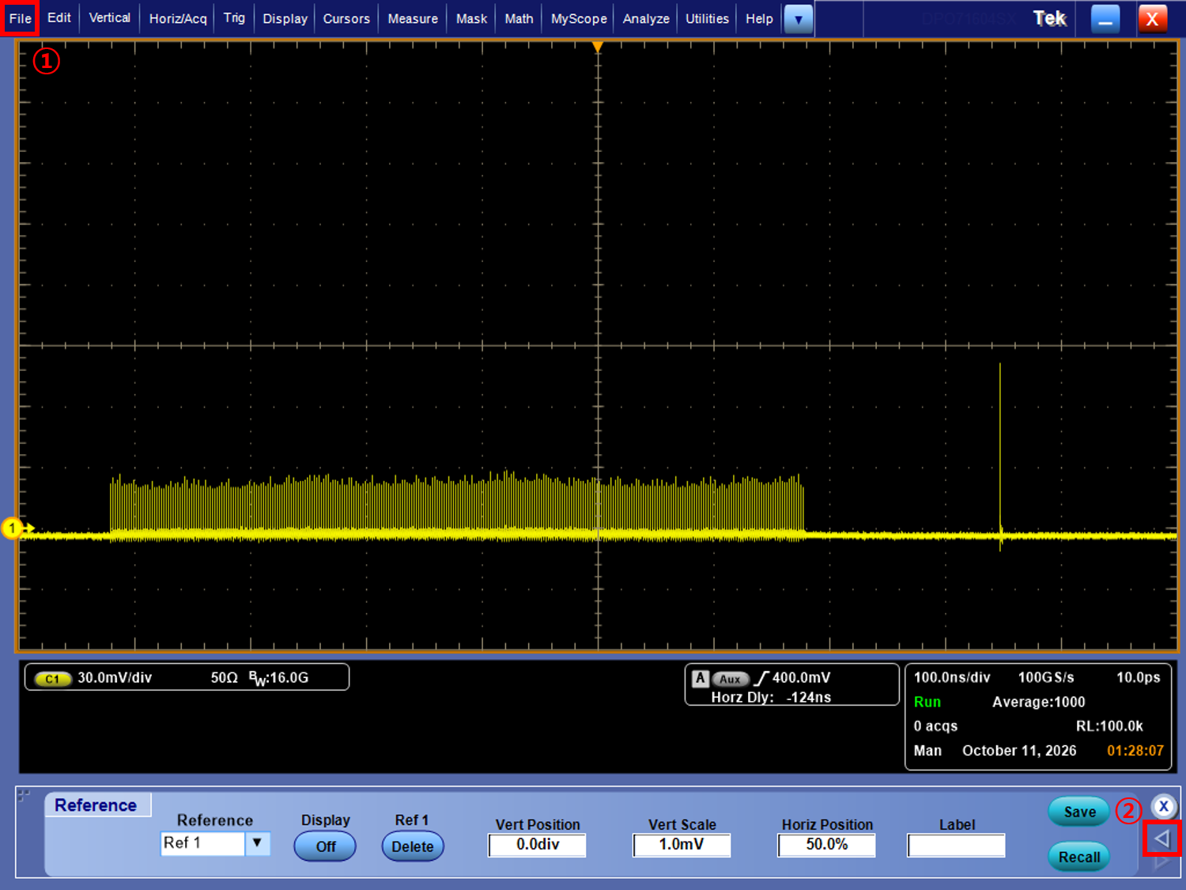
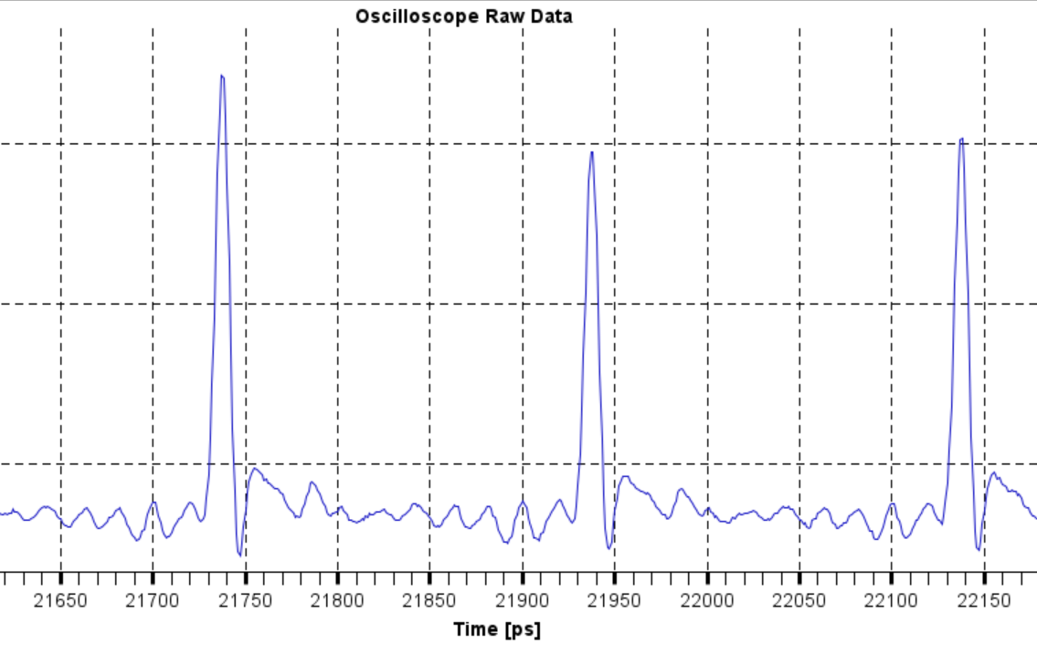
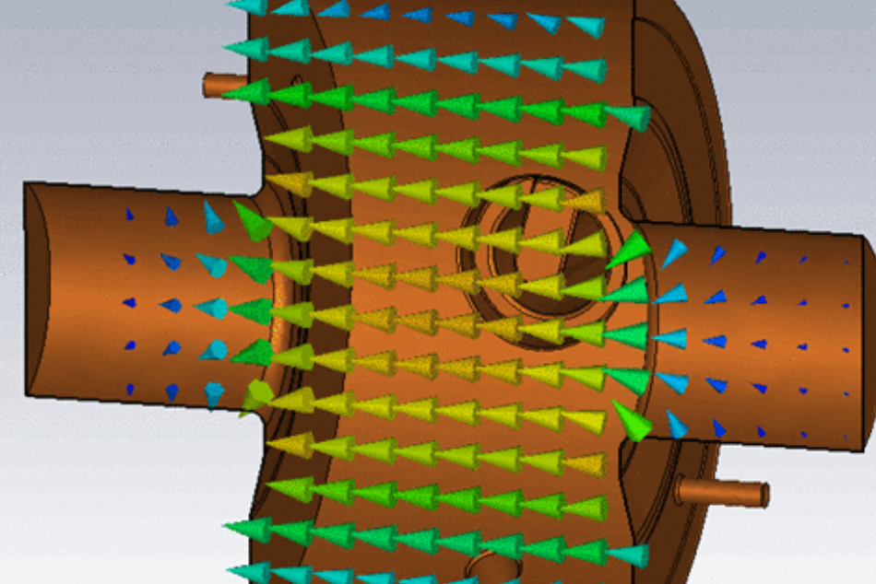
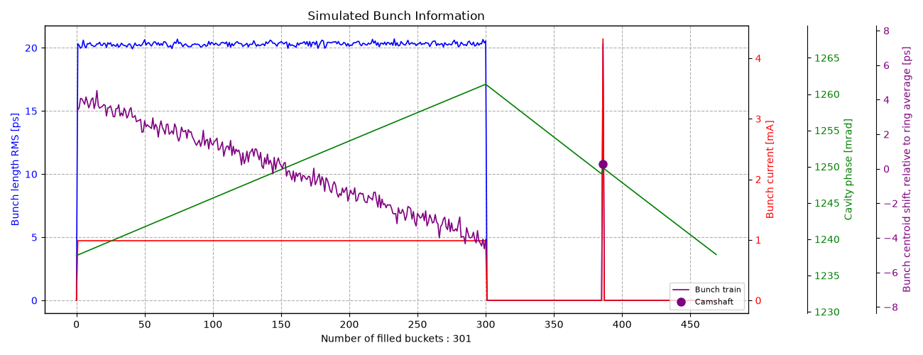
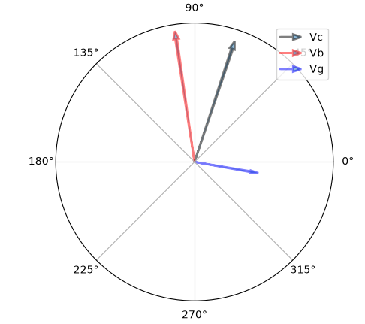
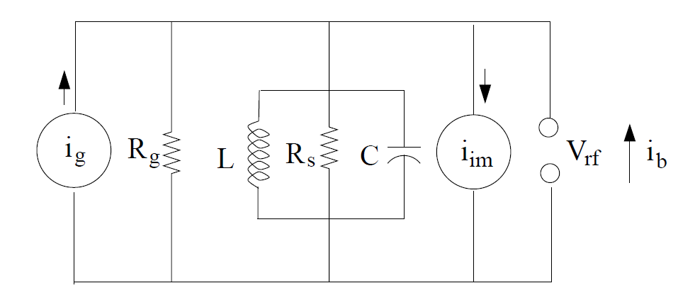
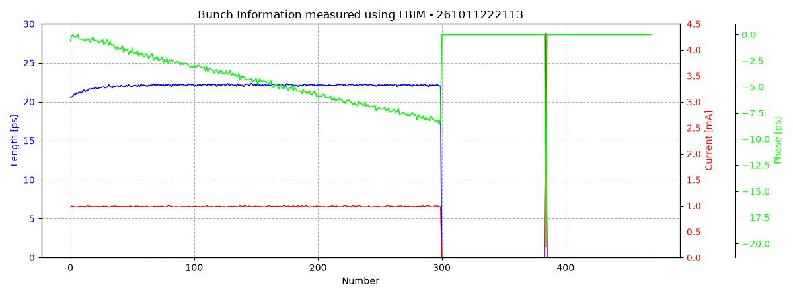
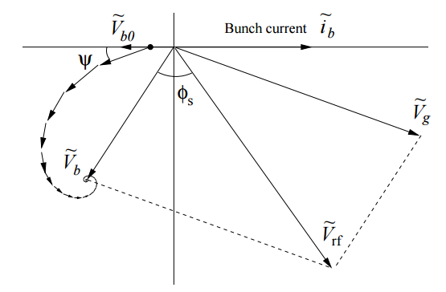


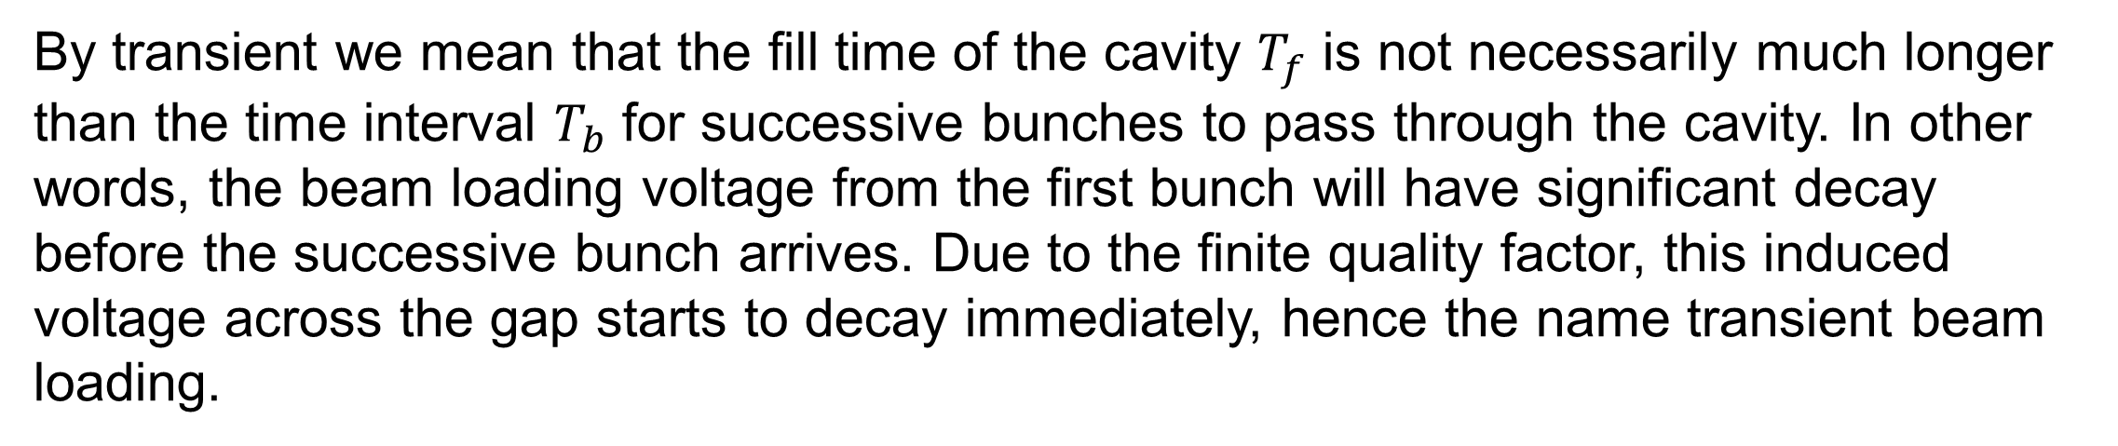

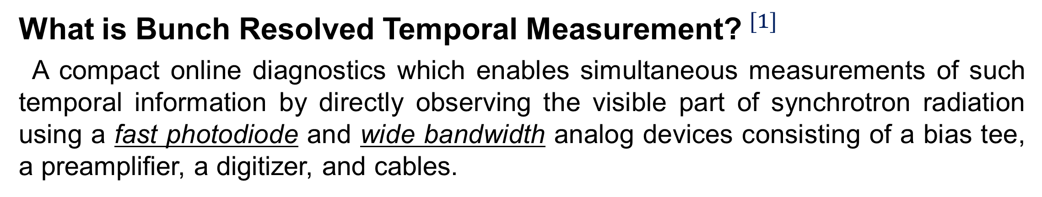
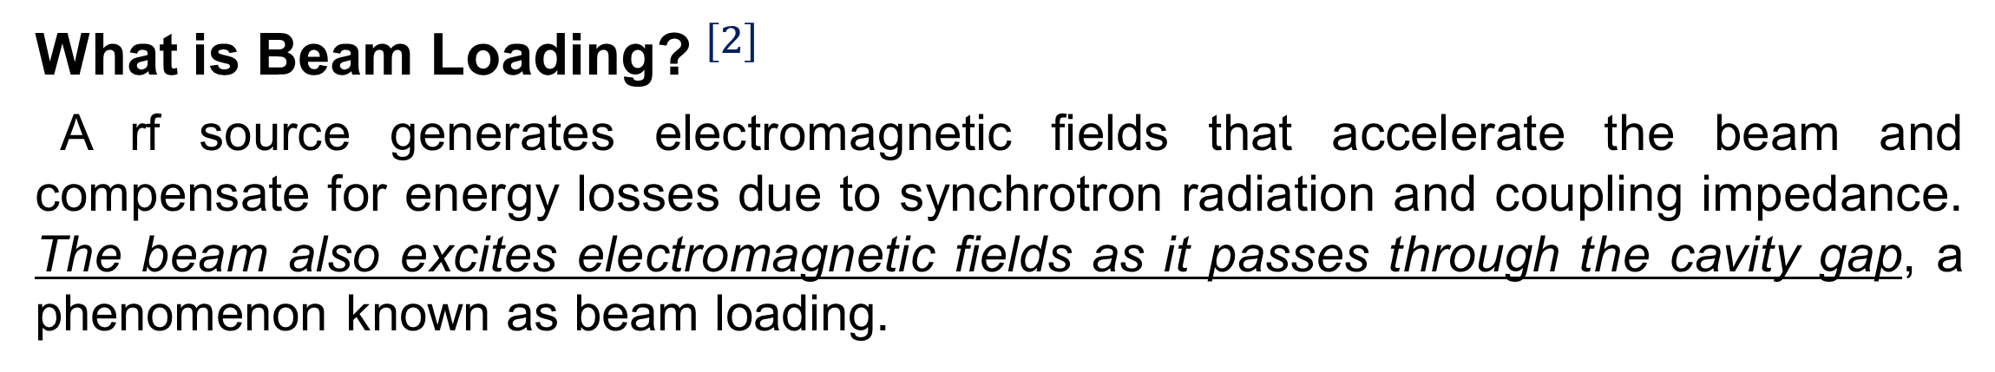
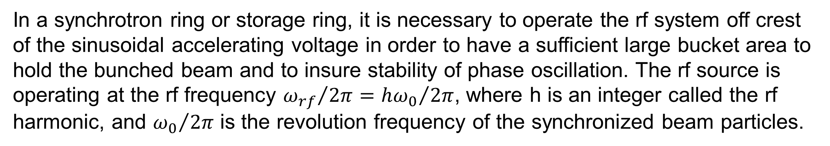
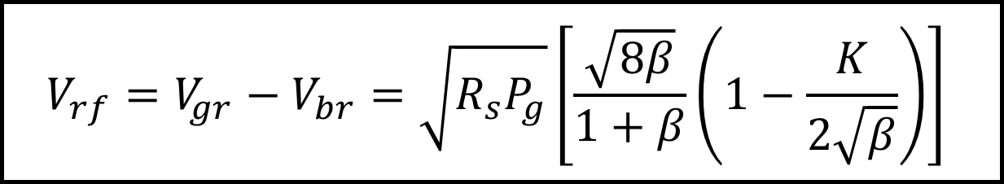

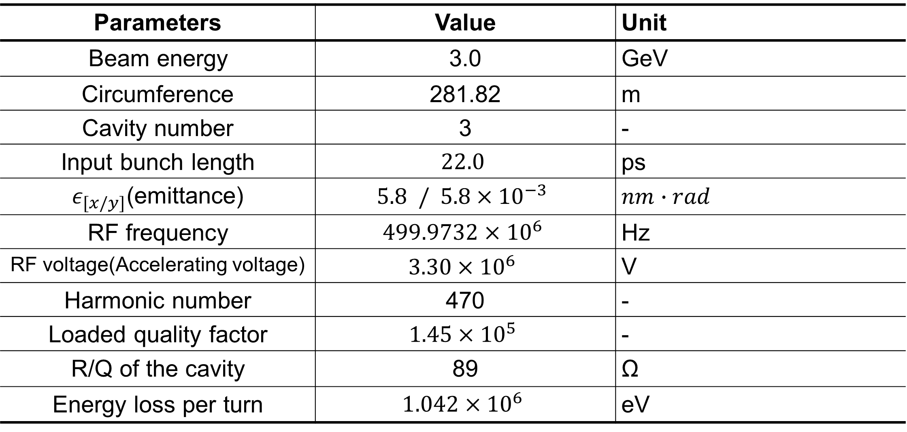
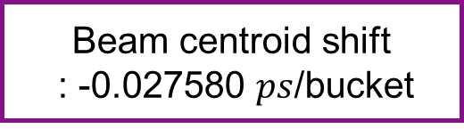
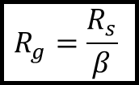
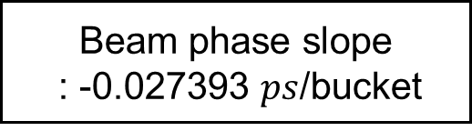
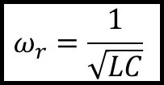
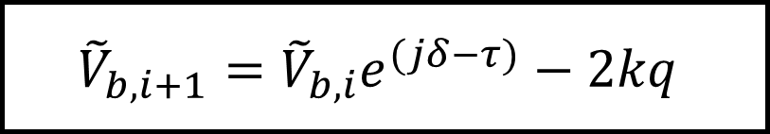
Study of Transient Beam Loading in the PLS-Ⅱ Storage Ring Using Bunch Resolved Diagnostics and mbtrack2 Simulations
Daon Lee, Department of Physics , Kangwon National University
Woojin Song, Jimin Seok, Pohang Accelerator Laboratory
Moses Chung, Department of Physics, POSTECH
Transient beam loading is a well known phenomenon in storage rings, where cavity fields excited by preceding bunches affect subsequent bunches and modify their longitudinal dynamics. Understanding this effect is important for various storage ring applications, including harmonic cavity operation aimed at extending beam lifetime and the optimization of Low-Level RF (LLRF) feedback To investigate transient beam loading at PLS-Ⅱ, simulations were performed using mbtrack2 with the PLS-Ⅱ storage ring parameters and filling pattern. To validate the simulation results, measurements were conducted using a Longitudinal Bunch Information Monitor (LBIM) installed at PLS-Ⅱ, which simultaneously measures the length, phase, and current of individual bunches using a fast photodiode and wideband electronics. The simulated bunch centroid shift along the bunch train was consistent with the measured bunch phase variation, supporting the interpretation that the observed displacement originates from the transient beam loading.
Motivation
Simulation Setup
What is Bunch Resolved Temporal Measurement?$^{[1]}$
A compact online diagnostics which enables simultaneous measurements of such temporal information by directly observing the visible part of synchrotron radiation using a fast photodiode and wide bandwidth analog devices consisting of a bias tee, a preamplifier, a digitizer, and cables.
PLS-Ⅱ Parameters
The PLS-Ⅱ storage ring parameters were implemented in mbtrack2, a Python based beam dynamics simulation code.
Parameters | Value | Unit
Beam energy | 3.0 | GeV
Circumference | 281.82 | m
Cavity number | 3 | -
Input bunch length | $$22.0$$ | ps
$ε_{[x/y]}$(emittance) | $$5.8 / 5.8×{10}^{−3}$$ | $$nm∙rad$$
RF frequency | $$499.9732×{10}^{6}$$ | Hz
RF voltage(Accelerating voltage) | $$3.30×{10}^{6}$$ | V
Harmonic number | 470 | -
Loaded quality factor | $$1.45×{10}^{5}$$ | -
R/Q of the cavity | 89 | Ω
Energy loss per turn | $$1.042×{10}^{6}$$ | eV
What is Beam Loading?$^{[2]}$
A rf source generates electromagnetic fields that accelerate the beam and compensate for energy losses due to synchrotron radiation and coupling impedance. The beam also excites electromagnetic fields as it passes through the cavity gap, a phenomenon known as beam loading.
Simulation results vs. PLS-Ⅱ results
(with rf feedback system)
In a synchrotron ring or storage ring, it is necessary to operate the rf system off crest of the sinusoidal accelerating voltage in order to have a sufficient large bucket area to hold the bunched beam and to insure stability of phase oscillation. The rf source is operating at the rf frequency ${ω_{rf}}/{2π={hω_{0}}/{2π}}$, where h is an integer called the rf harmonic, and ${ω_{0}}/{2π}$ is the revolution frequency of the synchronized beam particles.
Simulation Results
total current : 300.0$mA$ / bunch train : 0.9856$mA$, camshaft bunch : 4.320$mA$
- Image current
Range : 8.25ps
+ Beam
Beam centroid shift
: -0.027580 $ps$/bucket
By transient we mean that the fill time of the cavity $T_{f}$ is not necessarily much longer than the time interval $T_{b}$ for successive bunches to pass through the cavity. In other words, the beam loading voltage from the first bunch will have significant decay before the successive bunch arrives. Due to the finite quality factor, this induced voltage across the gap starts to decay immediately, hence the name transient beam loading.
E field
(ref. by Tetsuo ABE[KEK])
Equivalent Circuit
The rf system can be represented by an equivalent circuit.
The plot show the bunch centroid shift obtained from a particle tracking simulation using the uniform filling pattern shown in red.
Measured Results
total current : 300.081$mA$ / actual loaded fill pattern(camshaft=4.320$mA$)
generator
(power source)
$$R_{g}=\frac{R_{s}}{β}$$
rf cavity
$$ω_{r}=\frac{1}{\sqrt{LC}}$$
beam
$$V_{rf}=V_{gr}−V_{br}=\sqrt{R_{s}P_{g}}\left[\frac{\sqrt{8β}}{1+β}\left(1−\frac{K}{2\sqrt{β}}\right)\right]$$
Beam phase slope
: -0.027393 $ps$/bucket
Range : 8.19ps
Transient Beam Loading
Transient beam loading caused by gaps between bunches reduces the amplitude and shits the phase of the voltage induced by the bunches.
Summary & Conclusion
$${\tilde{V}}_{b,i+1}={\tilde{V}}_{b,i}e^{(jδ−τ)}−2kq$$
Transient beam loading occurs when gaps in the bunch filling pattern cause variations in the cavity voltage excited by preceding bunches, shifting the longitudinal equilibrium positions.
The bunch phase measured by LBIM, which provides information on individual bunches, agreed well with the simulated centroid shift along the bunch train.
fill time : $τ =\frac{ω_{r}}{2Q_{L}}∆t$
steady-state point
slip in phase : $δ =ω_{r}∆t$
Key Reference
[1] Hahn, Garam, et al. "Wideband diagnostics for online measurement of temporal information of beams in a storage ring." IEEE Transactions on Instrumentation and Measurement 73 (2023): 1-6.
[2] K. Y. Ng, Physics of Intensity Dependent Beam Instabilities. Singapore: World Scientific, 2005.
[3] Yamamoto, Naoto, Takeshi Takahashi, and Shogo Sakanaka. "Reduction and compensation of the transient beam loading effect in a double rf system of synchrotron light sources." Physical Review Accelerators and Beams 21, no. 1 (2018): 012001.
Daon Lee
lintad0409@kangwon.ac.kr
P: +82 010-6776-2850
Moses Chung
moses@postech.ac.kr
P: +82 010-2188-7986

