Slide 1
Vlasov Fokker-Plank Analysis of HHC for Bunch Lengthening
2026-08-14, Pohang, South Korea
Young Min Park
Division of Advanced Nuclear Engineering (DANE), POSTECH

Slide 2
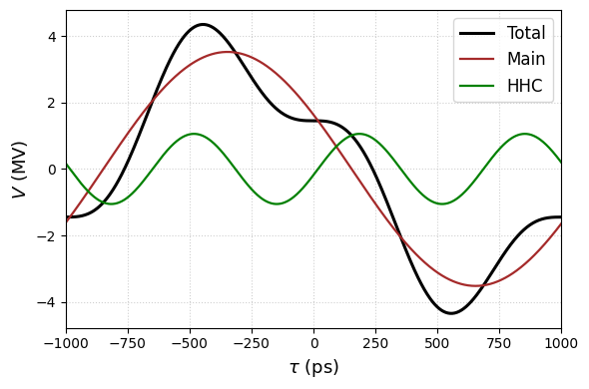
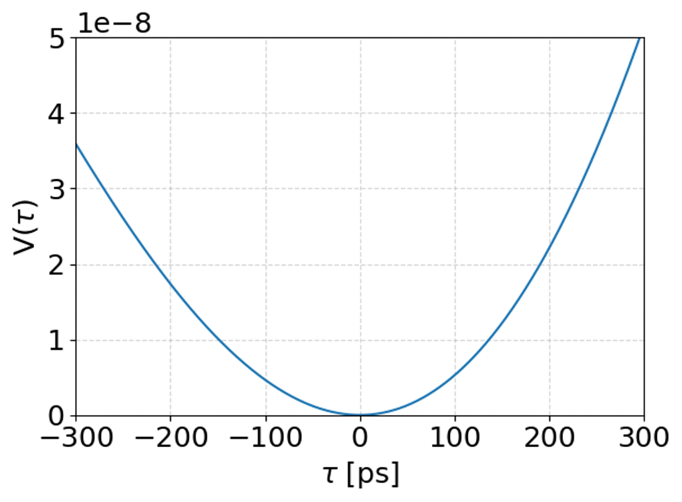
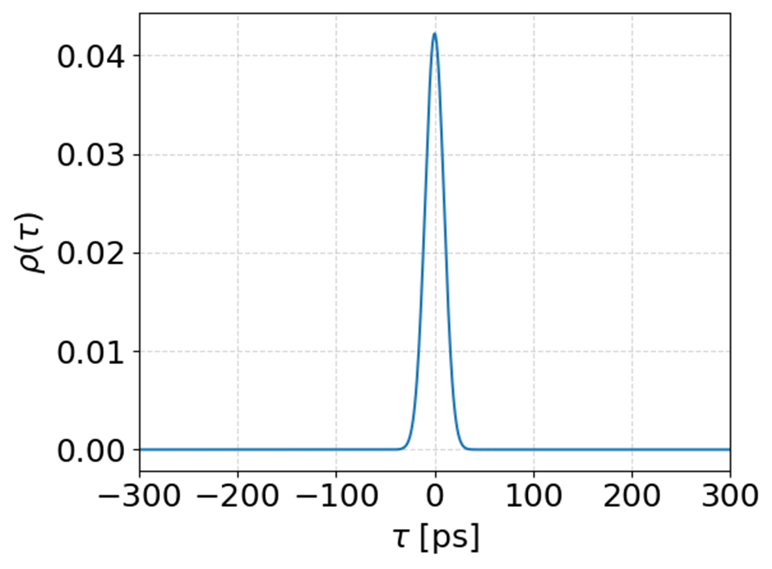
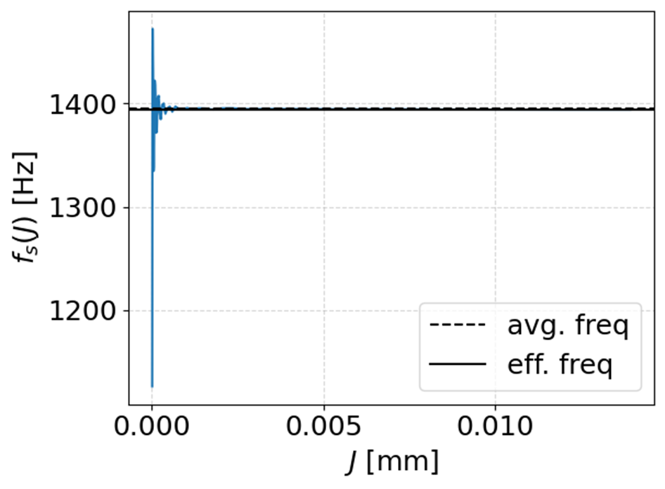
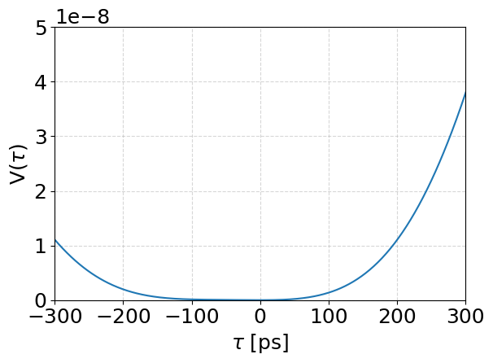
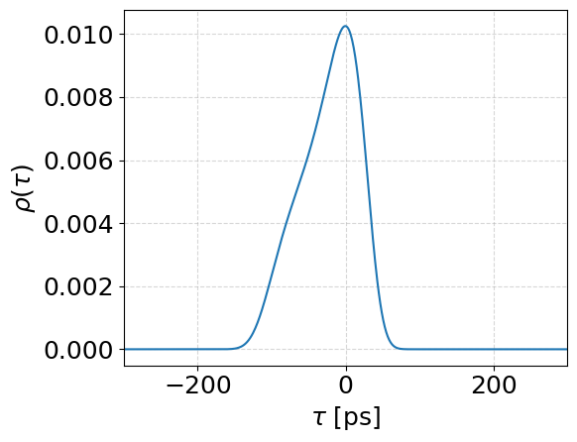
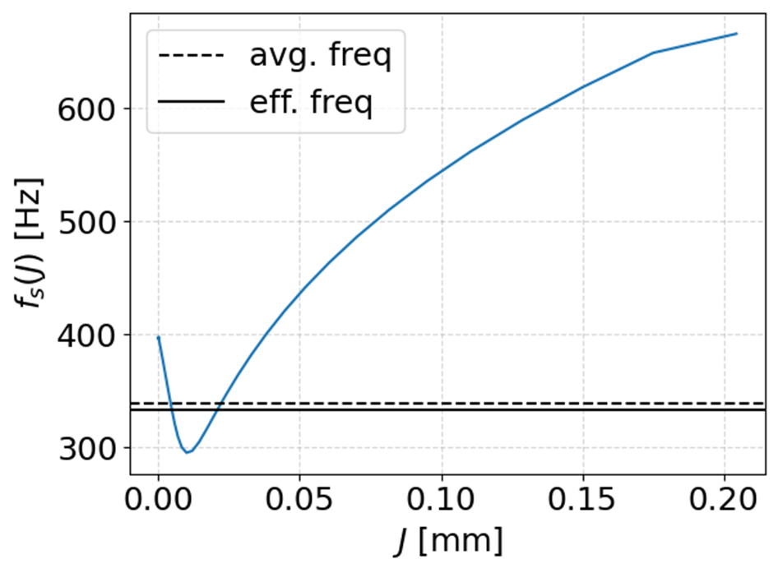


Intro
Single RF:
linear dynamics, quadratic potential, Gaussian bunch, constant synchrotron frequency
[1]
Double RF:
non-linear dynamics, arbitrary potential, non-Gaussian bunch, amplitude-dependent synchrotron frequency
Bunch lengthening
Higher harmonic cavity(HHC) reduce voltage gradient
Weak restoring force $→$bunch lengthening
$$V\left(τ\right)=V_{m}\sin\left(ω_{rf}τ+φ_{m}\right)+V_{h}\sin\left(mω_{rf}τ+φ_{h}\right)$$
$$V_{m,h} :Voltage of main\&HHC cavity, ω_{rf}:rf−frequency, τ:bunch−arrival time,$$
$$m:harmonic order, φ_{m,h} :phase of main\&HHC cavity$$
2
[1] A.Hofmann ,S.Myers, “Beam Dynamics in a Double RF System”, CERN ISR-TH-RF/80-26

Slide 3
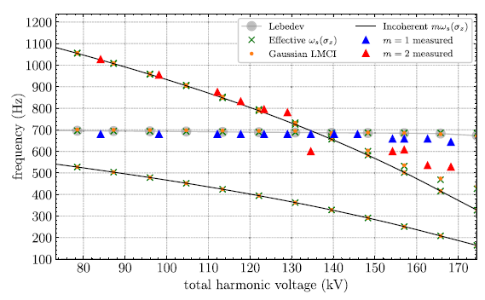
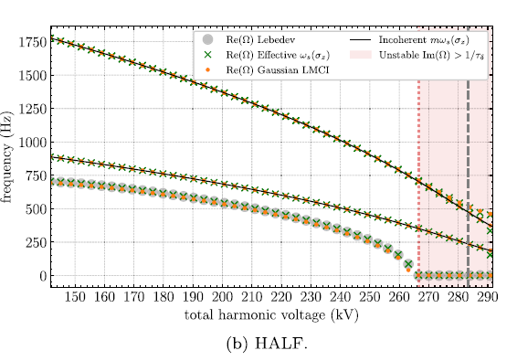
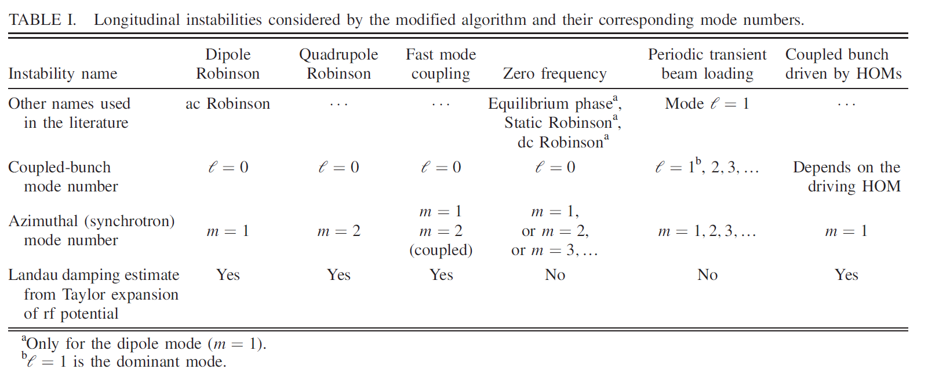
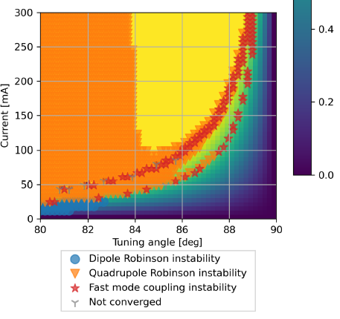
Intro
[1]
[2]
[1] M.B.Alves, “Theoretical models for longitudinal coupled-bunch instabilities driven by harmonic cavities in electron storage rings”, PRAB25
[2] A.Gamelin et al., “Semianalytical algorithms to study longitudinal beam instabilities in double rf systems”, PRAB25
3

Slide 4
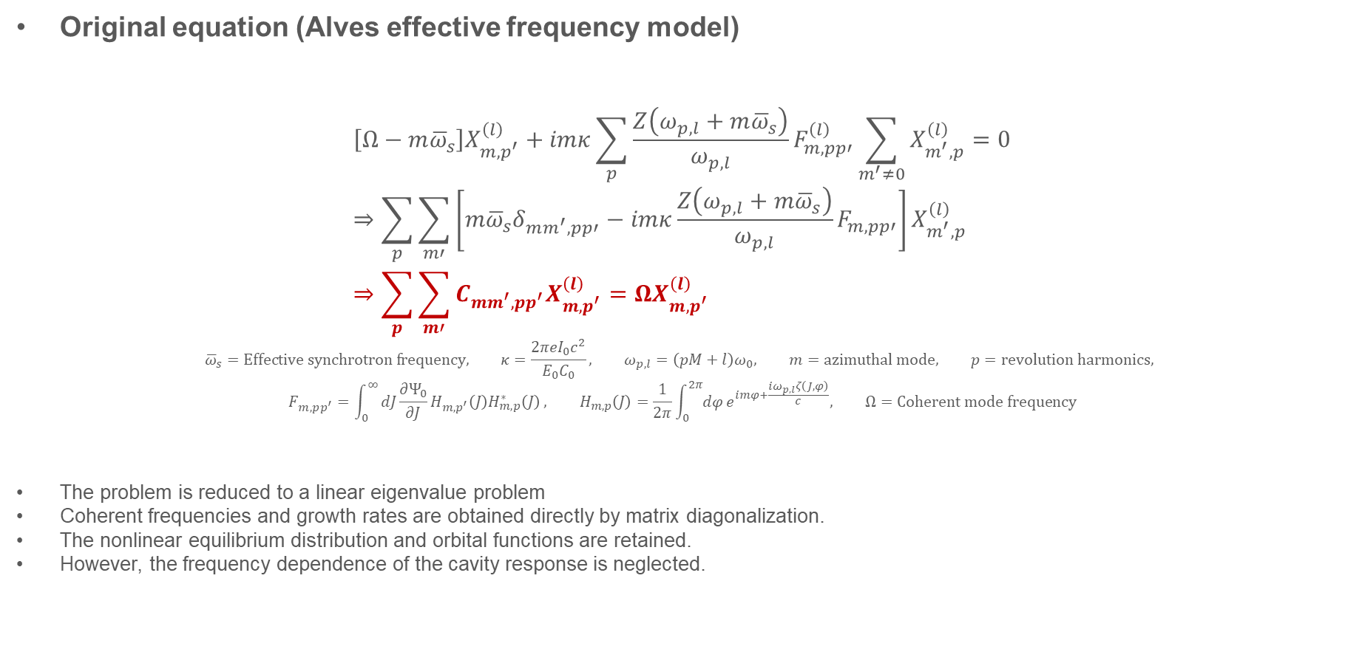
Theory
Original equation (Alves effective frequency model)
$$\left[Ω−m{\overline{ω}}_{s}\right]X_{m,p^{′}}^{\left(l\right)}+imκ\sum_{p}{\frac{Z\left(ω_{p,l}+m{\overline{ω}}_{s}\right)}{ω_{p,l}}F_{m,pp′}^{\left(l\right)}\sum_{m^{′}≠0}{X_{m^{′},p}^{\left(l\right)}}}=0 \\ ⇒\sum_{p}{\sum_{m′}{\left[m{\overline{ω}}_{s}δ_{mm^{′},pp′}−imκ\frac{Z\left(ω_{p,l}+m{\overline{ω}}_{s}\right)}{ω_{p,l}}F_{m,pp′}\right]}}X_{m^{′},p}^{\left(l\right)} \\ ⇒\sum_{p}{\sum_{m′}{C_{mm^{′},pp^{′}}X_{m,p^{′}}^{\left(l\right)}}}=ΩX_{m,p^{′}}^{\left(l\right)}$$
$${\overline{ω}}_{s}=Effective synchrotron frequency, κ=\frac{2πeI_{0}c^{2}}{E_{0}C_{0}}, ω_{p,l}=\left(pM+l\right)ω_{0}, m=azimuthal mode, p=revolution harmonics,$$
$$F_{m,pp^{′}}=\int_{0}^{∞}{dJ\frac{∂Ψ_{0}}{∂J}H_{m,p^{′}}\left(J\right)H_{m,p}^{∗}\left(J\right)}, H_{m,p}\left(J\right)=\frac{1}{2π}\int_{0}^{2π}{dφ}e^{imφ+\frac{iω_{p,l}ζ\left(J,φ\right)}{c}}, Ω=Coherent mode frequency$$
The problem is reduced to a linear eigenvalue problem
Coherent frequencies and growth rates are obtained directly by matrix diagonalization.
The nonlinear equilibrium distribution and orbital functions are retained.
However, the frequency dependence of the cavity response is neglected.
4

Slide 5
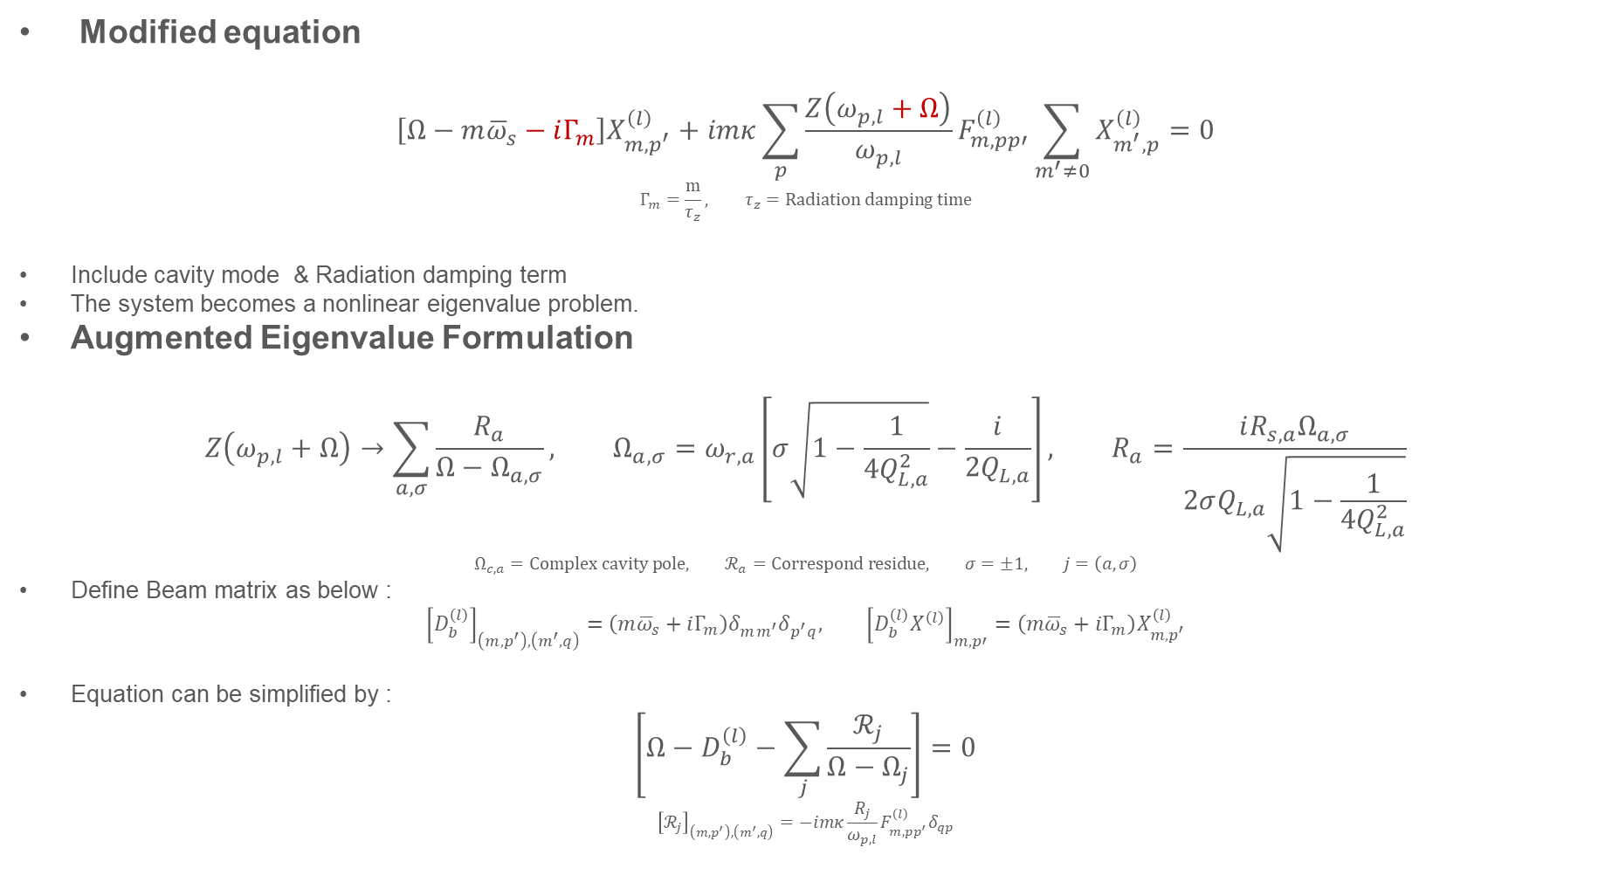
Theory
Modified equation
$$\left[Ω−m{\overline{ω}}_{s}−iΓ_{m}\right]X_{m,p^{′}}^{\left(l\right)}+imκ\sum_{p}{\frac{Z\left(ω_{p,l}+Ω\right)}{ω_{p,l}}F_{m,pp′}^{\left(l\right)}\sum_{m^{′}≠0}{X_{m^{′},p}^{\left(l\right)}}}=0$$
$$Γ_{m}=\frac{m}{τ_{z}}, τ_{z}=Radiation damping time$$
Include cavity mode & Radiation damping term
The system becomes a nonlinear eigenvalue problem.
Augmented Eigenvalue Formulation
$$Z\left(ω_{p,l}+Ω\right)→\sum_{a,σ}{\frac{R_{a}}{Ω−Ω_{a,σ}}}, Ω_{a,σ}=ω_{r,a}\left[σ\sqrt{1−\frac{1}{4Q_{L,a}^{2}}}−\frac{i}{2Q_{L,a}}\right], R_{a}=\frac{iR_{s,a}Ω_{a,σ}}{2σQ_{L,a}\sqrt{1−\frac{1}{4Q_{L,a}^{2}}}}$$
$$Ω_{c,a}=Complex cavity pole, ℛ_{a}=Correspond residue, σ=±1, j=\left(a,σ\right)$$
Define Beam matrix as below :
$${\left[D_{b}^{\left(l\right)}\right]}_{\left(m,p^{′}\right),\left(m^{′},q\right)}=\left(m{\overline{ω}}_{s}+iΓ_{m}\right)δ_{mm^{′}}δ_{p^{′}q}, {\left[D_{b}^{\left(l\right)}X^{\left(l\right)}\right]}_{m,p′}=\left(m{\overline{ω}}_{s}+iΓ_{m}\right)X_{m,p^{′}}^{\left(l\right)}$$
Equation can be simplified by :
$$\left[Ω−D_{b}^{\left(l\right)}−\sum_{j}{\frac{ℛ_{j}}{Ω−Ω_{j}}}\right]=0$$
$${\left[ℛ_{j}\right]}_{\left(m,p^{′}\right),\left(m^{′},q\right)}=−imκ\frac{R_{j}}{ω_{p,l}}F_{m,pp^{′}}^{\left(l\right)}δ_{qp}$$
5

Slide 6

Theory
Auxiliary variable
$${\left[ℛ_{j}\right]}_{\left(m,p^{′}\right),\left(m^{′},q\right)}=−imκ\frac{R_{j}}{ω_{p,l}}F_{m,pp^{′}}^{\left(l\right)}δ_{qp}→u_{j}^{\left(l\right)}⋅v_{j}^{T}$$
Let’s define auxiliary scalar variable $a_{j}^{\left(l\right)}$ as :
$$a_{j}^{\left(l\right)}=\frac{v_{j}^{T}X^{\left(l\right)}}{Ω−Ω_{j}}$$
Two equation can be derived :
$$D_{b}^{\left(l\right)}X^{\left(l\right)}+\sum_{j}{u_{j}^{\left(l\right)}a_{j}^{\left(l\right)}}=ΩX^{\left(l\right)}$$
$$v_{j}^{T}X^{\left(l\right)}+ρ_{j}^{\left(l\right)}a_{j}^{\left(l\right)}=Ωa_{j}^{\left(l\right)}$$
We can get augmented eigenvalue matrix :
$$\left[\begin{matrix}D_{b}^{\left(l\right)} & U^{\left(l\right)} \\ V^{\left(l\right)} & D_{c}^{\left(l\right)}\end{matrix}\right]\left[\begin{matrix}X^{\left(l\right)} \\ a^{\left(l\right)}\end{matrix}\right]=Ω\left[\begin{matrix}X^{\left(l\right)} \\ a^{\left(l\right)}\end{matrix}\right]→\text{Linear eigenvalue problem}$$
The dimension of matrix is $N_{p}⋅N_{m}+2N_{c}N_{p}$
(For example $m_{max}→±3, p→\left(−3,−1,1,3\right), N_{c}→2$, $40×40$ Matrix eigenvalue problem)
6

Slide 7
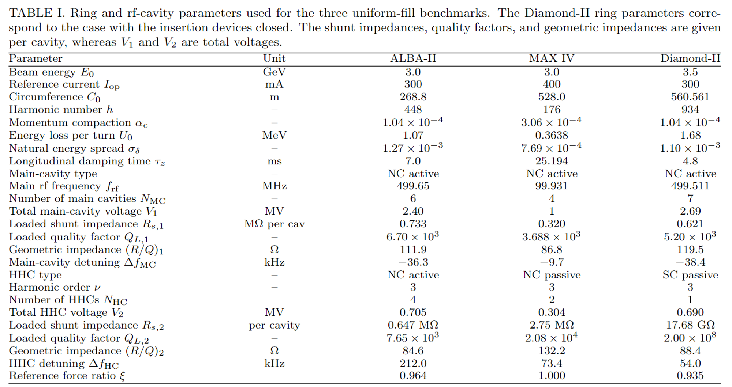
Test with other facilities
7

Slide 8
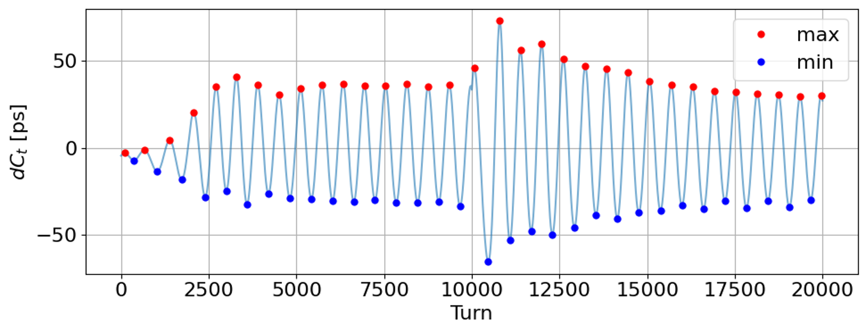
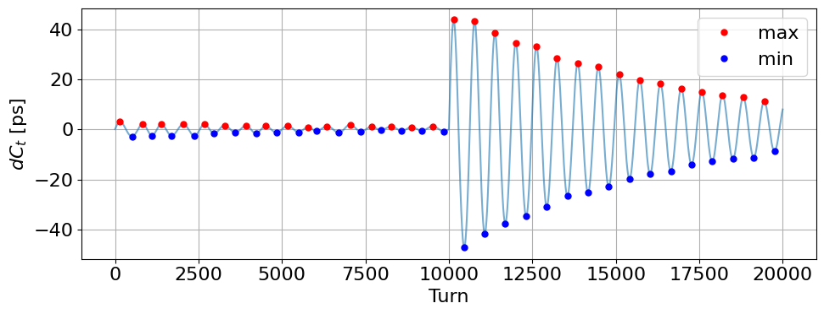
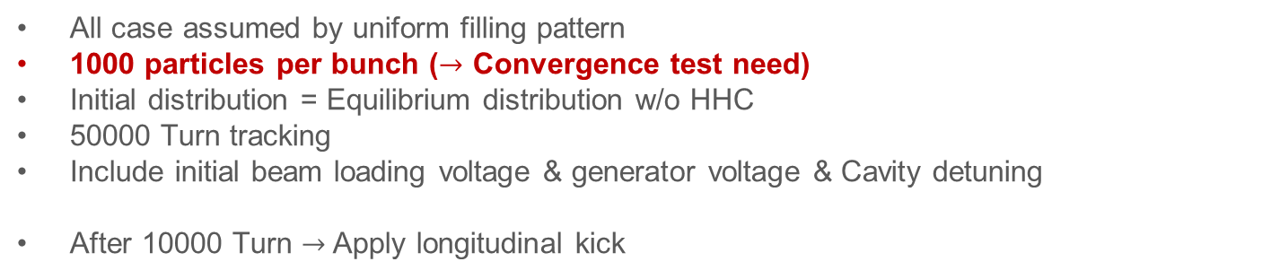
Tracking setup
Tracking with ELEGANT
All case assumed by uniform filling pattern
1000 particles per bunch ($→$ Convergence test need)
Initial distribution = Equilibrium distribution w/o HHC
50000 Turn tracking
Include initial beam loading voltage & generator voltage & Cavity detuning
After 10000 Turn $→$ Apply longitudinal kick
Growth
We can calculate growth & Damping rate
Damping
8

Slide 9
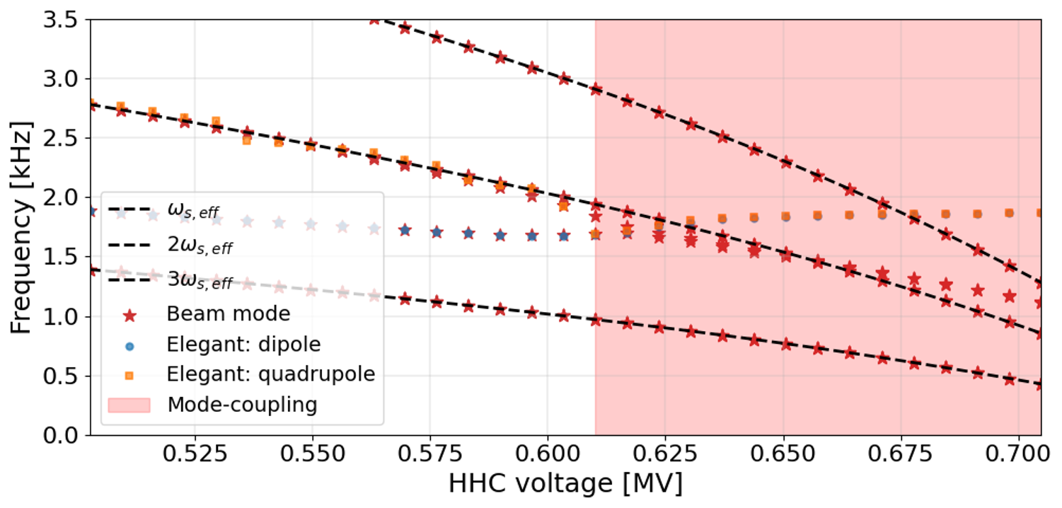
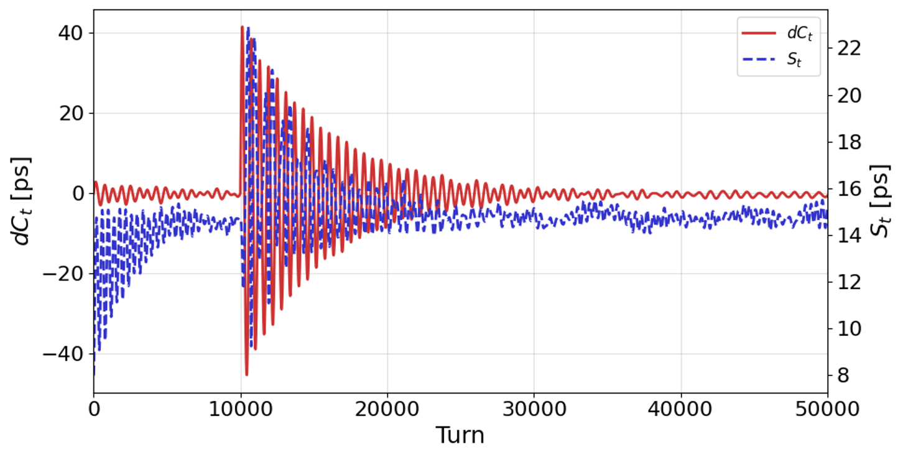
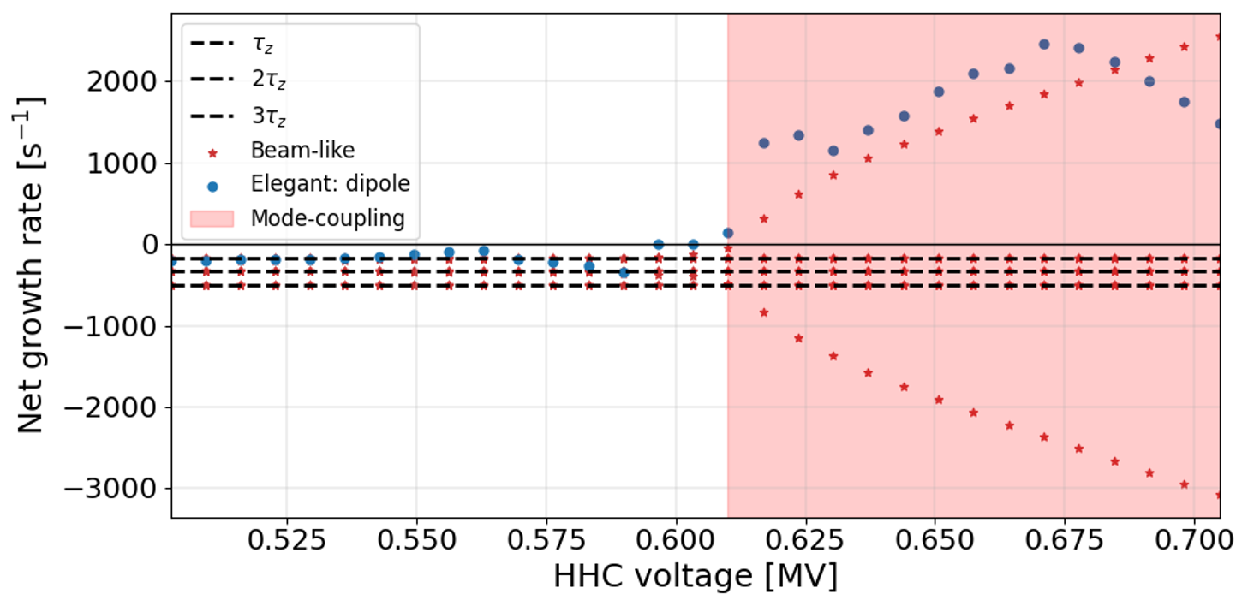
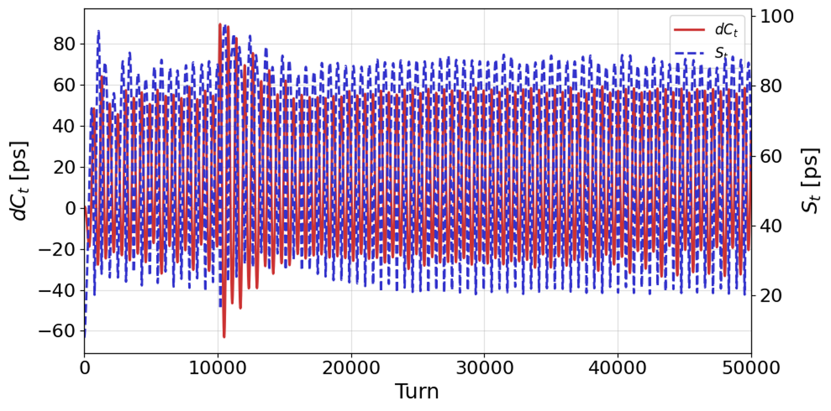
Dipole-Quadrupole mode coupling
ALBA-II
(100 mA)
9

Slide 10
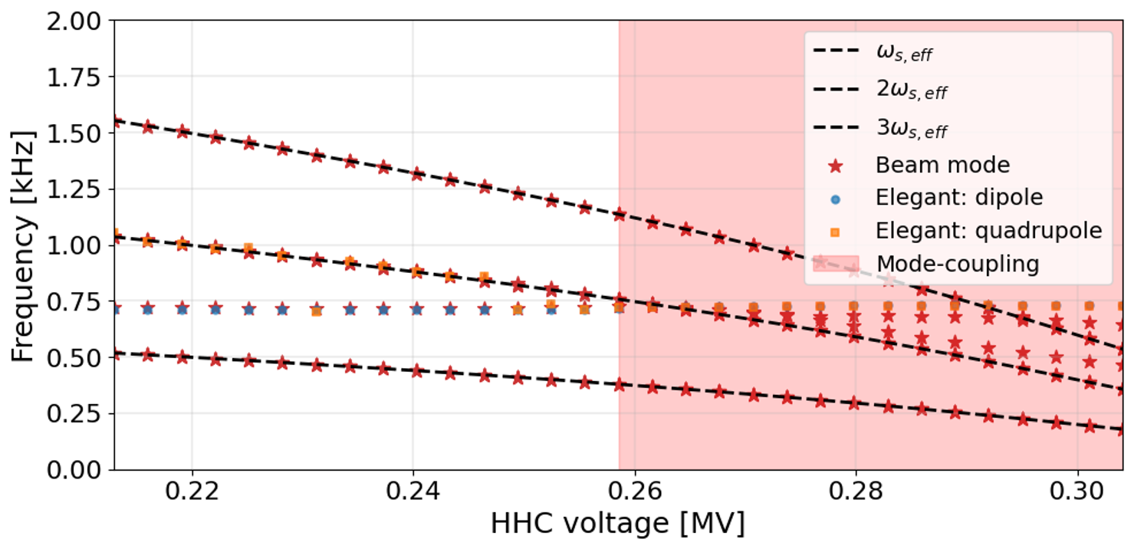
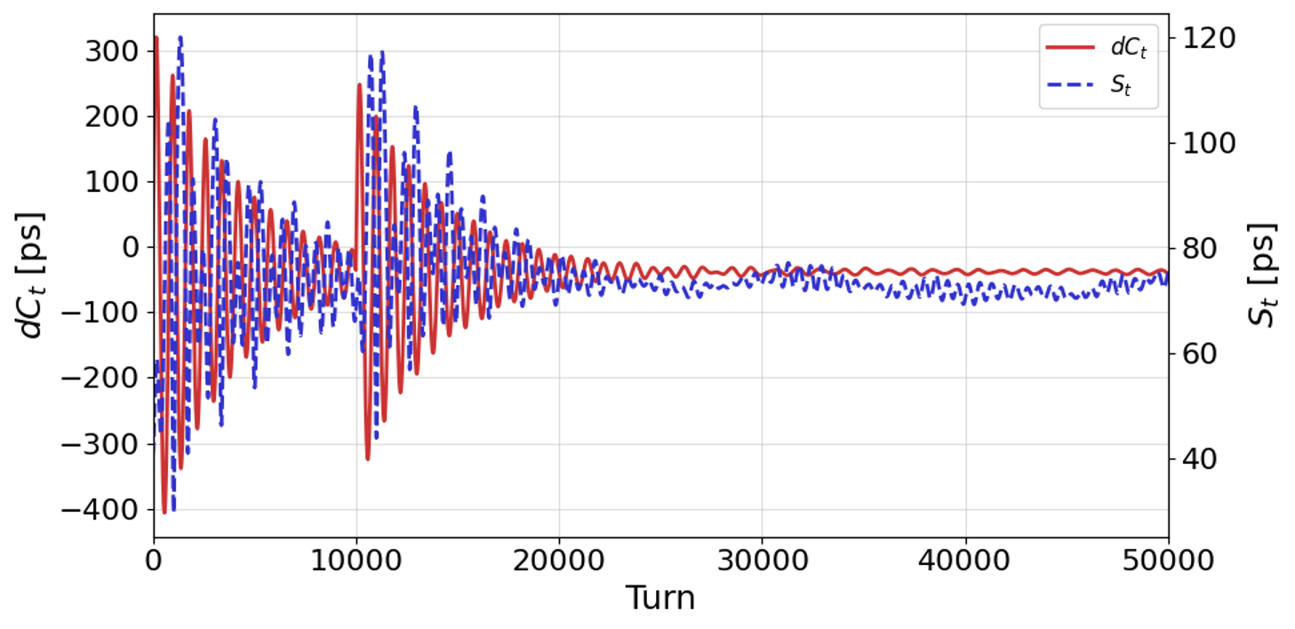
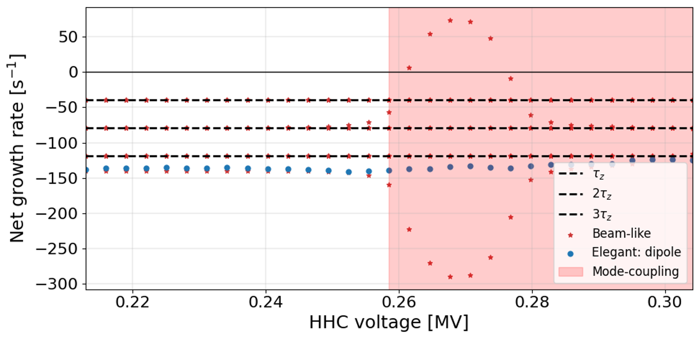
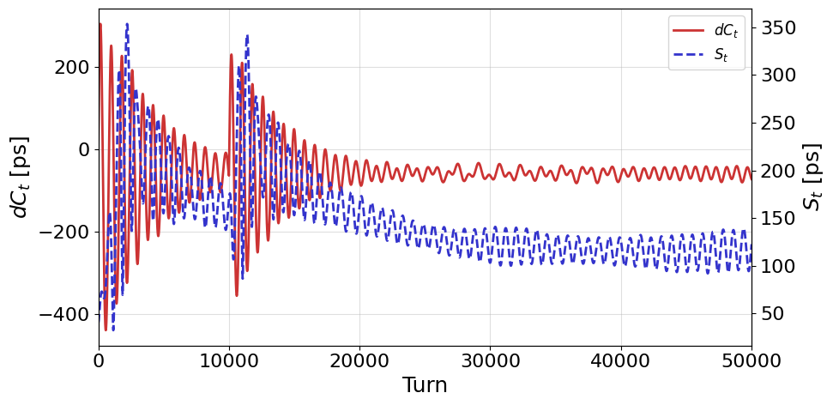
Dipole-Quadrupole mode coupling
Max-IV
10

Slide 11
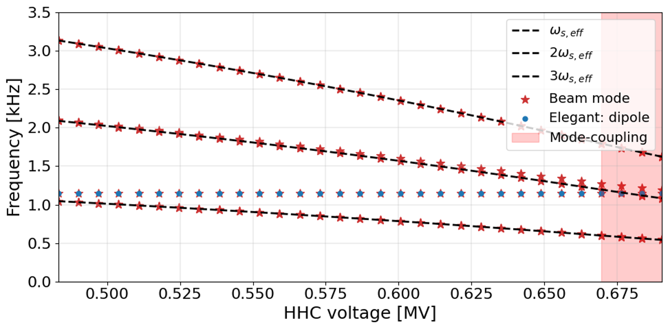
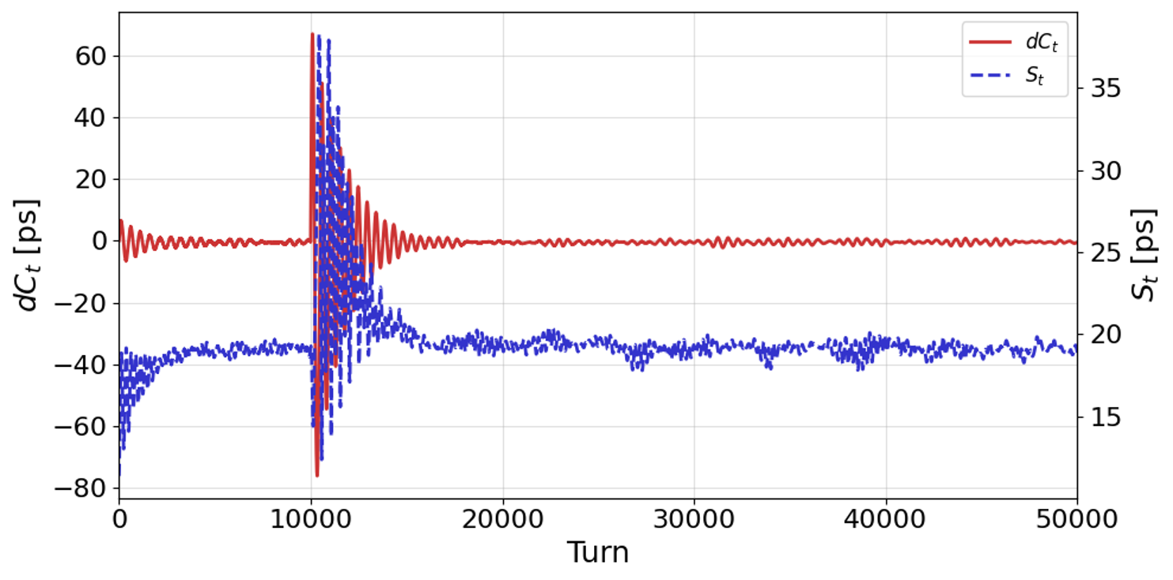
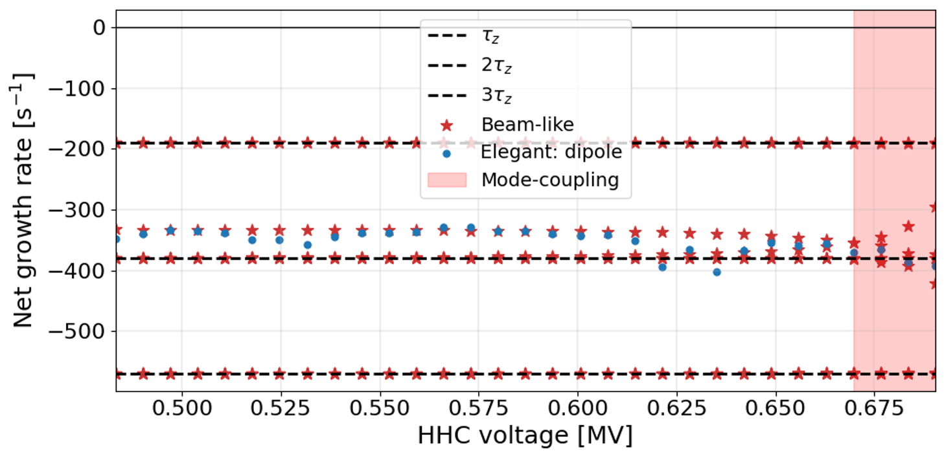
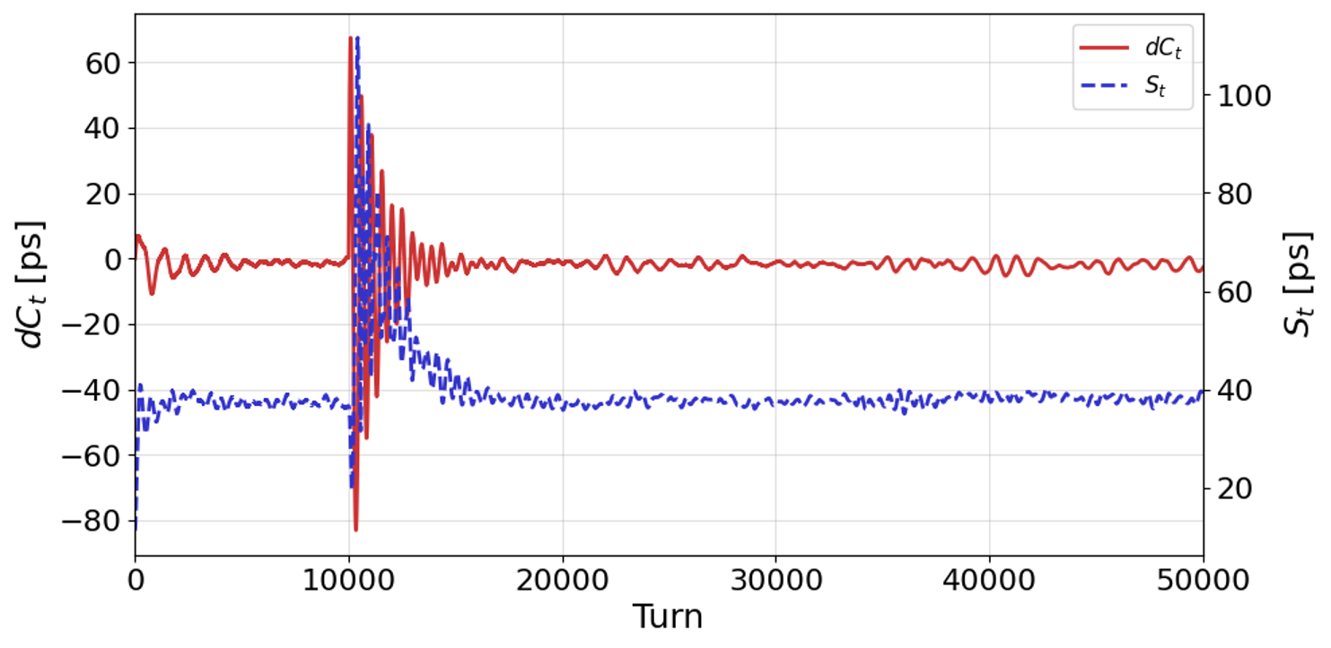
Dipole-Quadrupole mode coupling
Diamond
11

Slide 12
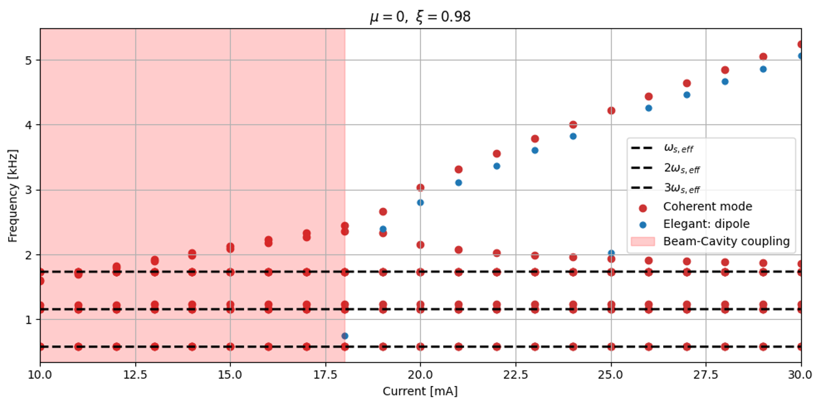
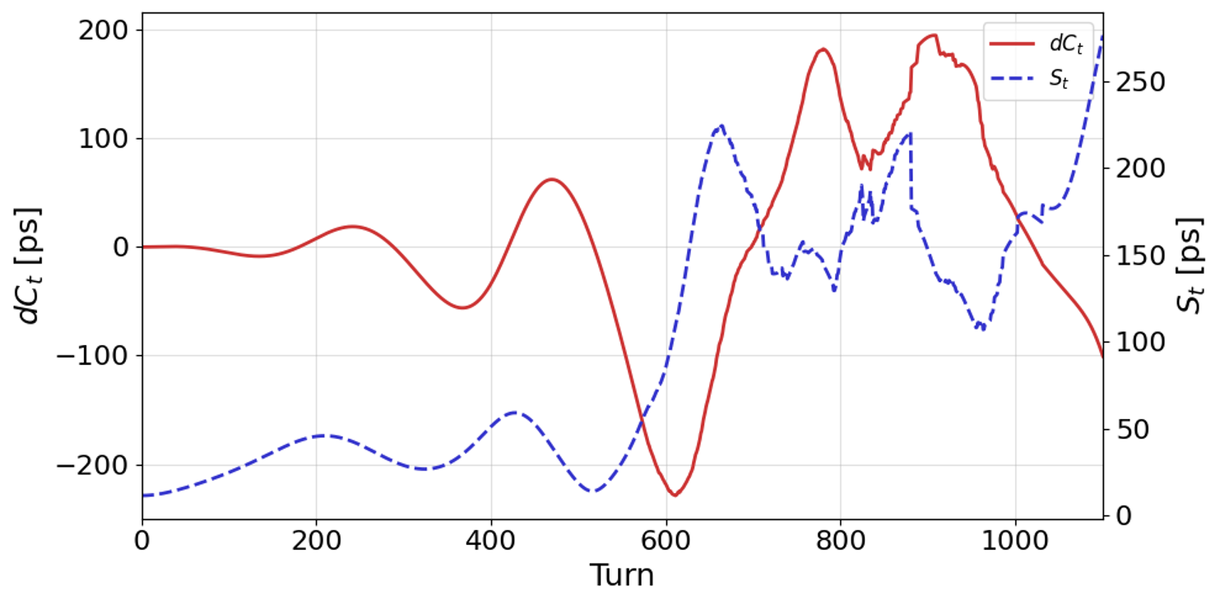
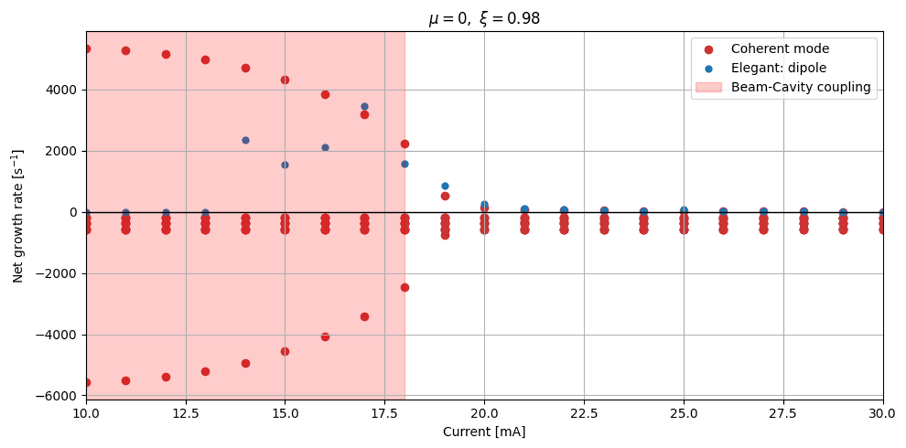
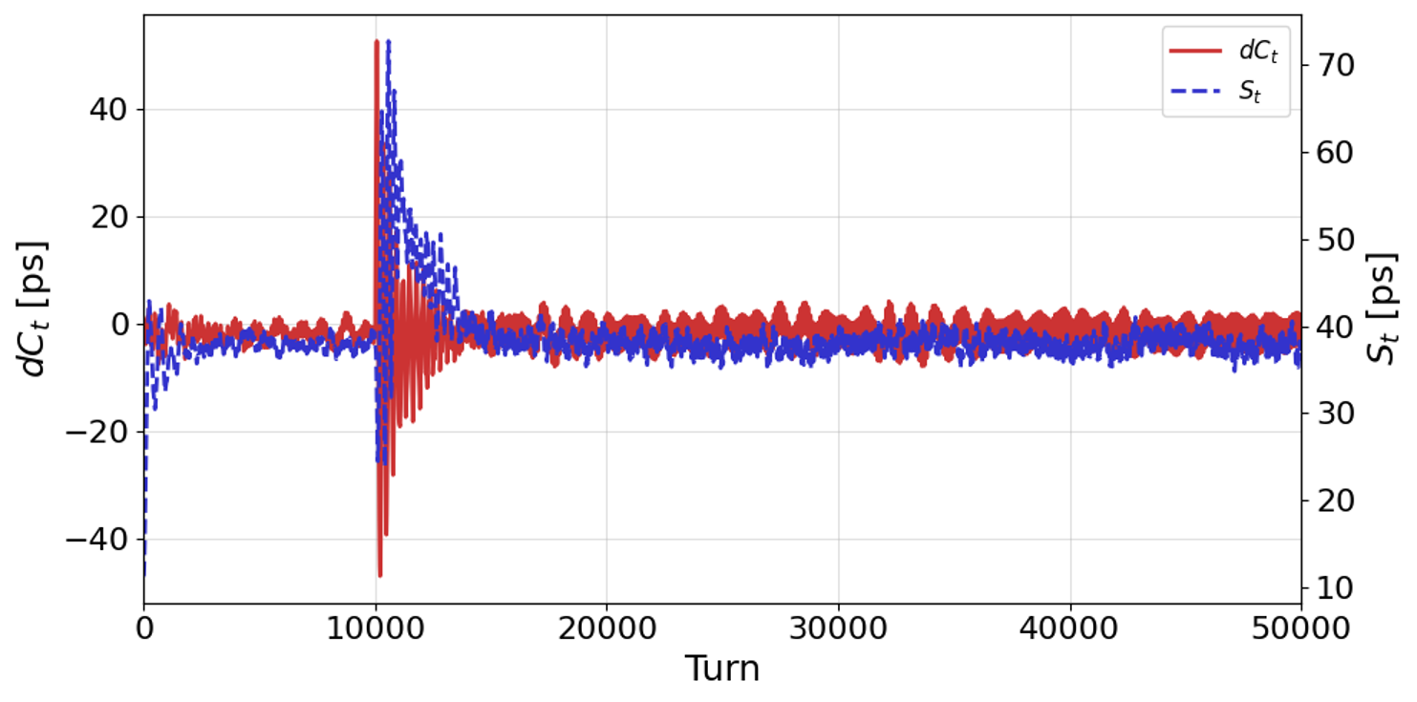
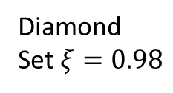
Low current cavity mode
Diamond
Set $ξ=0.98$
12

Slide 13
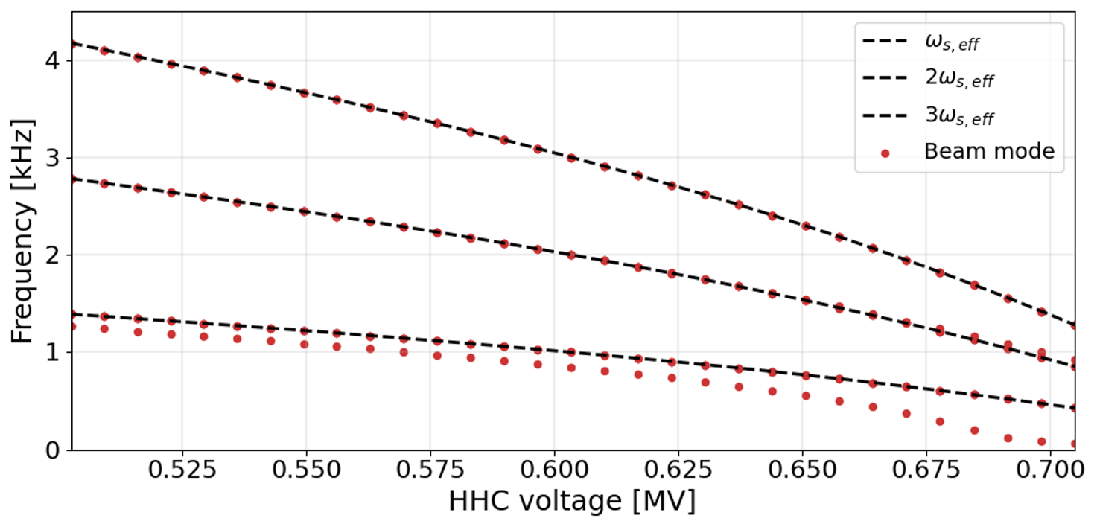
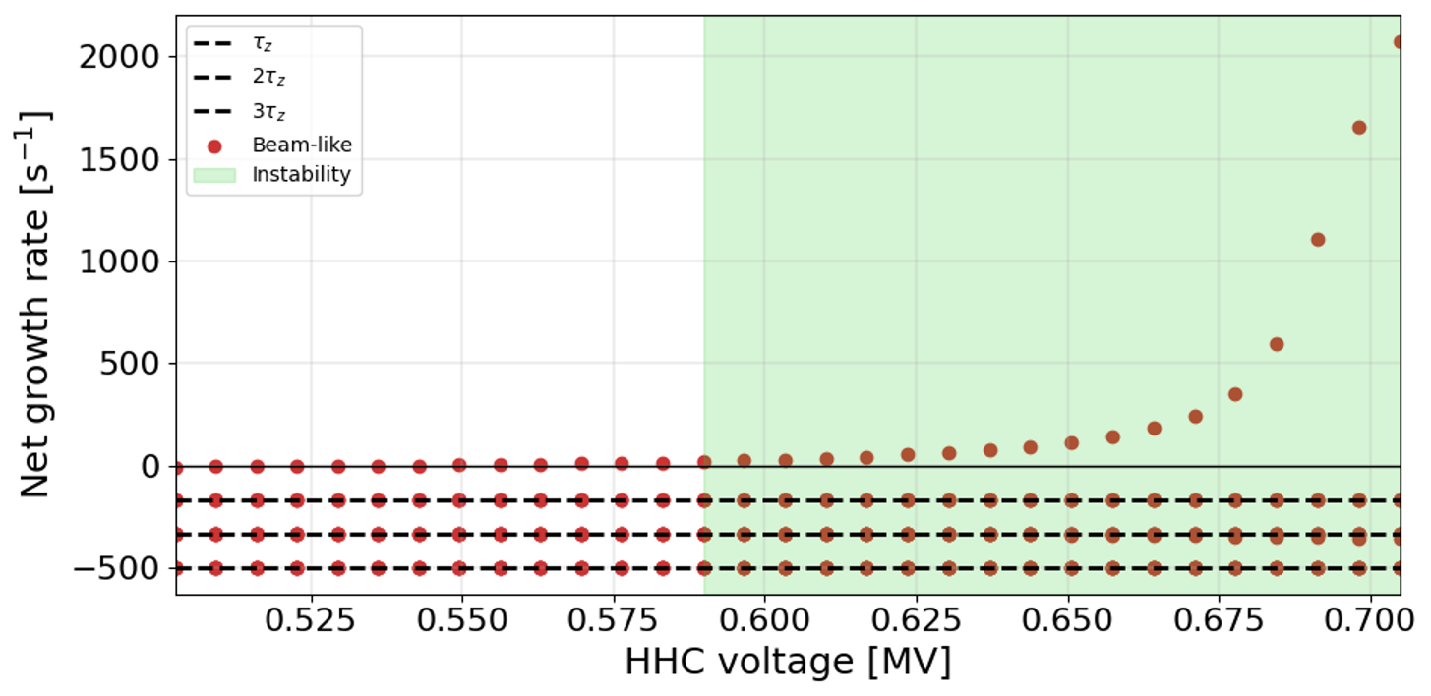
PTBL ($l=1$ Coupled Bunch Instability)
ALBA-II
(300 mA)
In progress …
13

Slide 14
Summary
Developed and solved a unified longitudinal instability equation capable of describing LMCI, PTBL, and cavity modes, covering the major instability phenomena that can occur in the longitudinal.
For dipole–quadrupole mode coupling, the coupled modes are rapidly excited after the instability onset, but quickly reach saturation and do not lead to significant beam loss.
For the low-current cavity mode, a small growth rate is observed before mode coupling, while the coupling leads to a rapid instability development accompanied by beam loss.
Further analysis is required for PTBL (CBI mode = 1) based on the tracking simulation results.
14

Slide 15
Thank you for your attention!
15

