Slide 1
Vertical emittance blow-up study with synchrotron sideband
Junha Kim

Slide 2
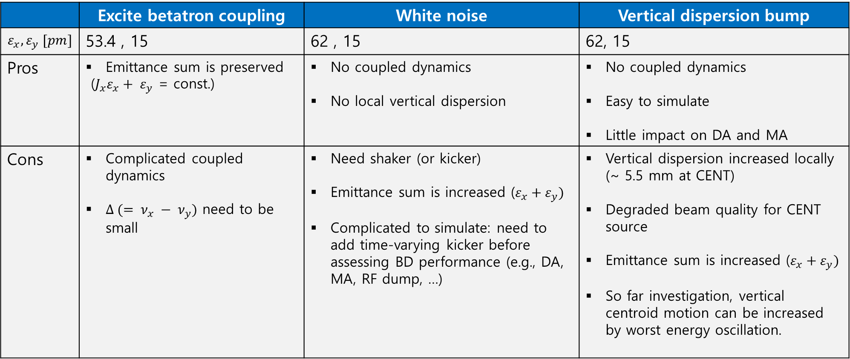
Vertical emittance blow-up methods
 | Excite betatron coupling | White noise | Vertical dispersion bump
$$ε_{x}, ε_{y} [pm]$$ | 53.4 , 15 | 62 , 15 | 62, 15
Pros | Emittance sum is preserved ($J_{x}ε_{x}+ ε_{y}$ = const.) | No coupled dynamics No local vertical dispersion | No coupled dynamics Easy to simulate Little impact on DA and MA
Cons | Complicated coupled dynamics $Δ (= ν_{x} − ν_{y})$ need to be small | Need shaker (or kicker) Emittance sum is increased ($ε_{x}+ε_{y})$ Complicated to simulate: need to add time-varying kicker before assessing BD performance (e.g., DA, MA, RF dump, …) | Vertical dispersion increased locally (~ 5.5 mm at CENT) Degraded beam quality for CENT source Emittance sum is increased ($ε_{x}+ε_{y})$ So far investigation, vertical centroid motion can be increased by worst energy oscillation.

Slide 3
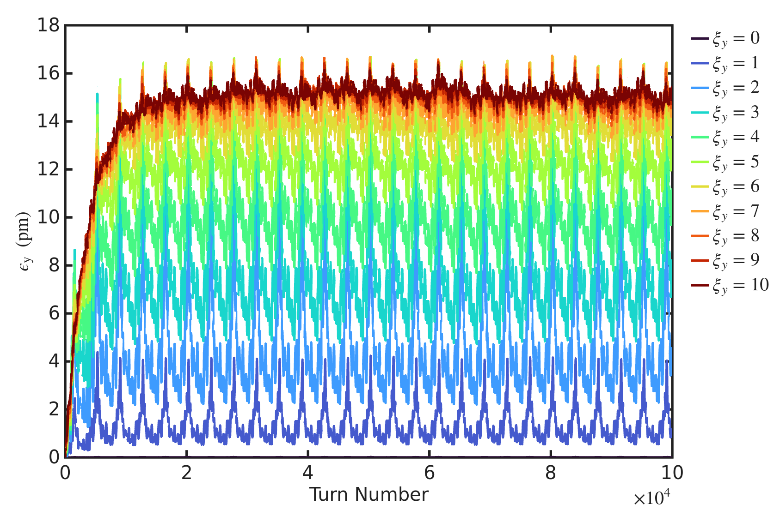
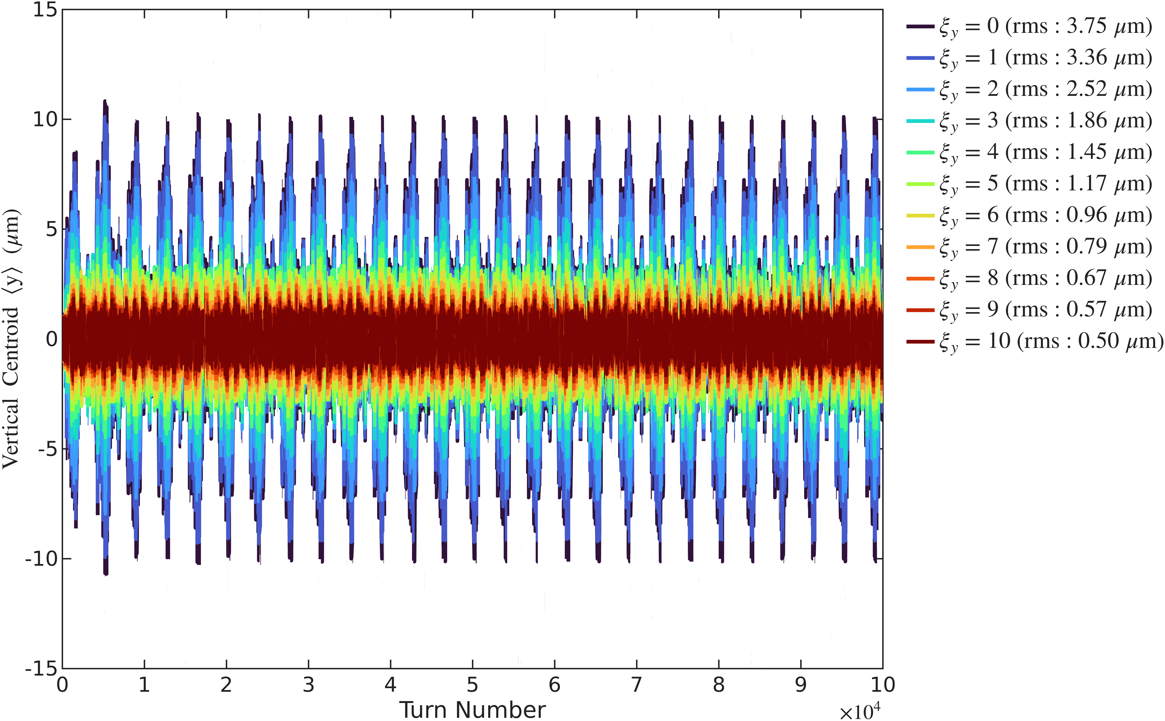
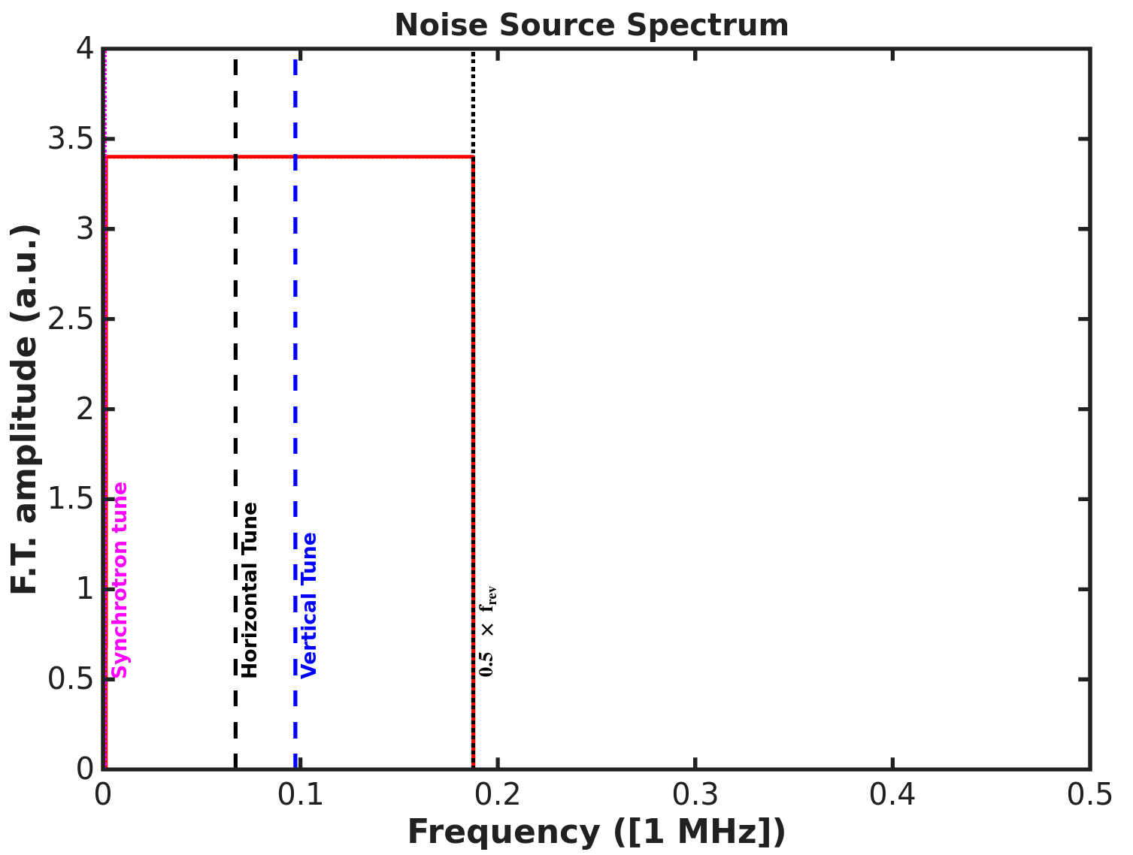
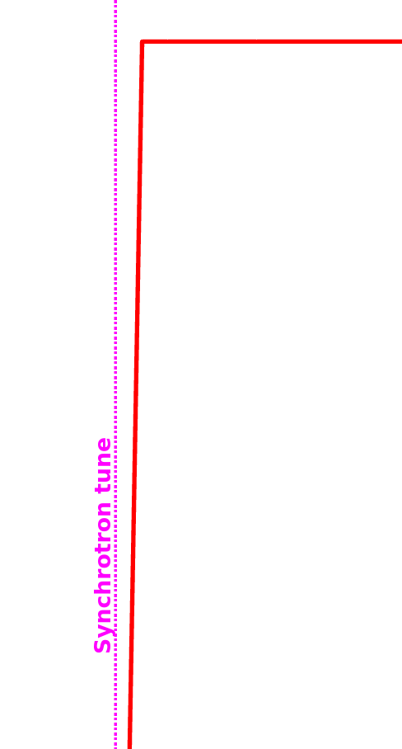
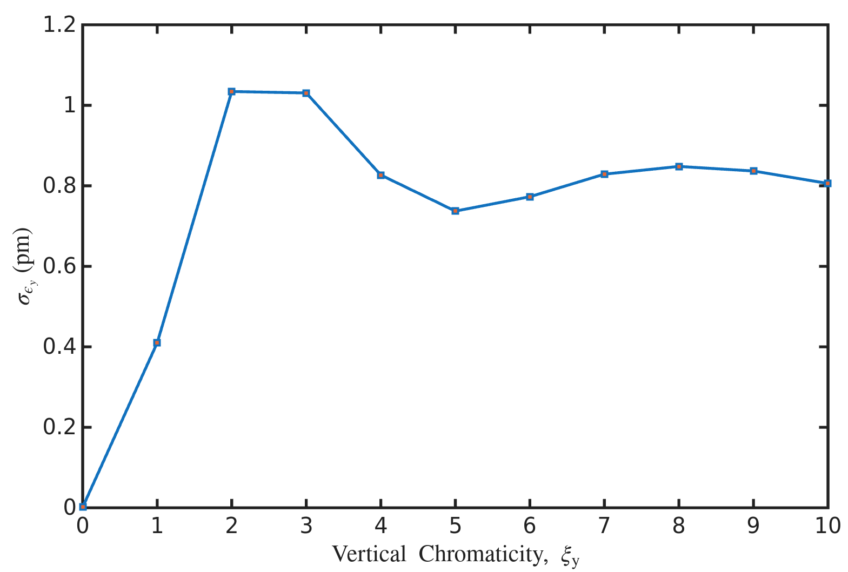
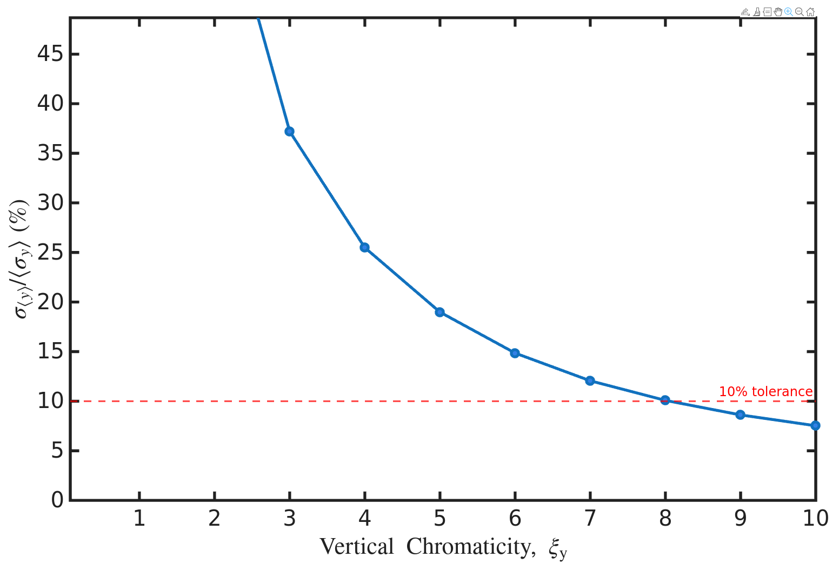
Korea-4GSR emittance blow up simulation settings and results
Results at middle of ID straight section ($ε_{y}=15pm$ ,Amp = 0.2$μrad$)
Vertical emittance blow-up is more effective at higher vertical chromaticity.
However, the vertical emittance fluctuates by about 0.8–1.0 pm, corresponding to 5.3–6.6%.

Slide 4
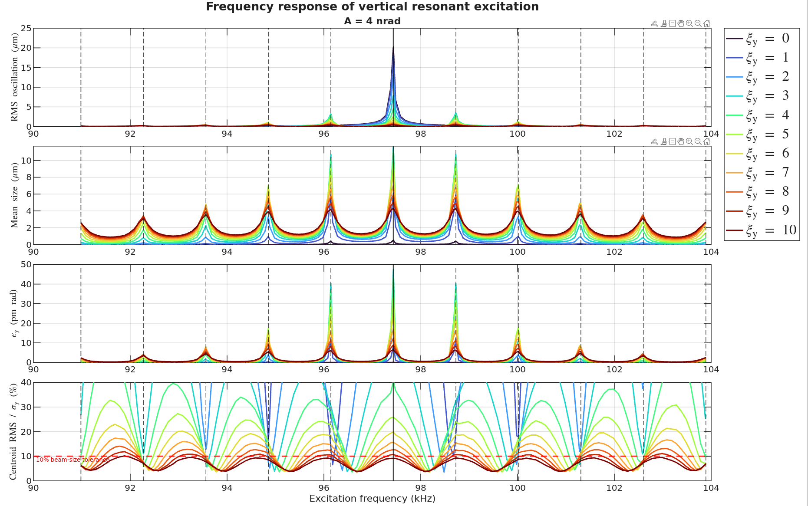
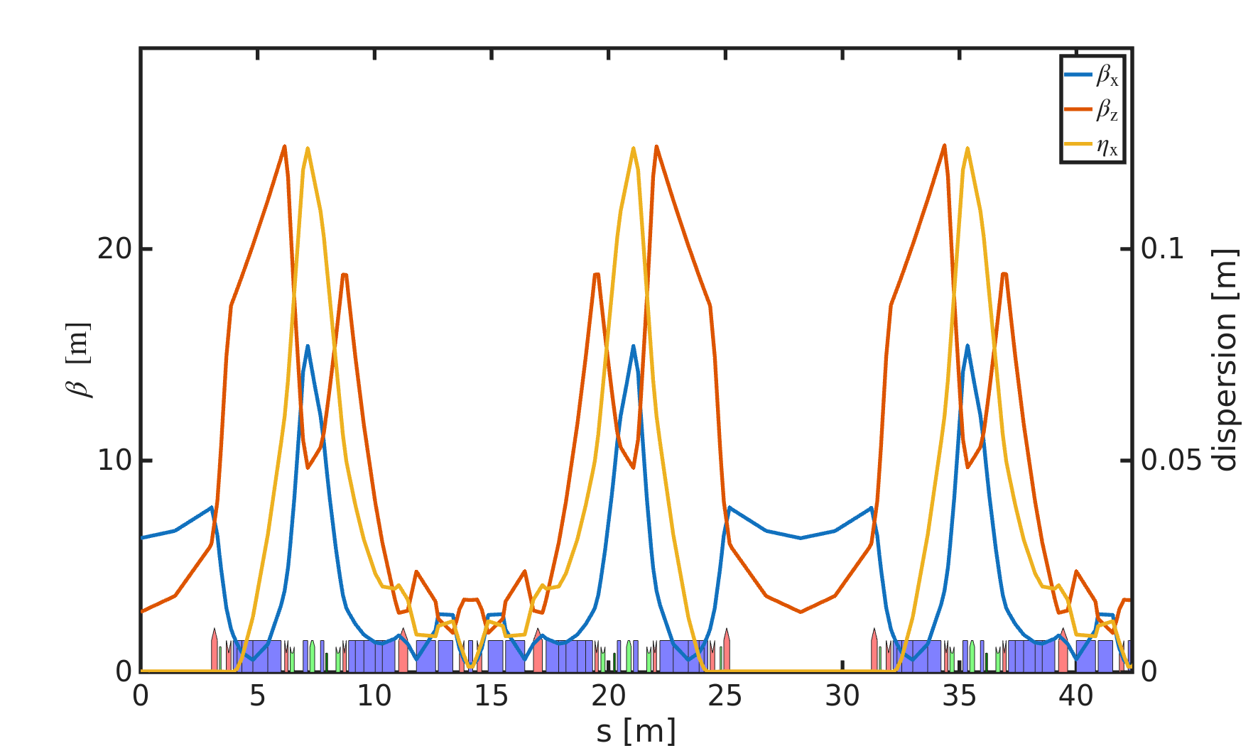
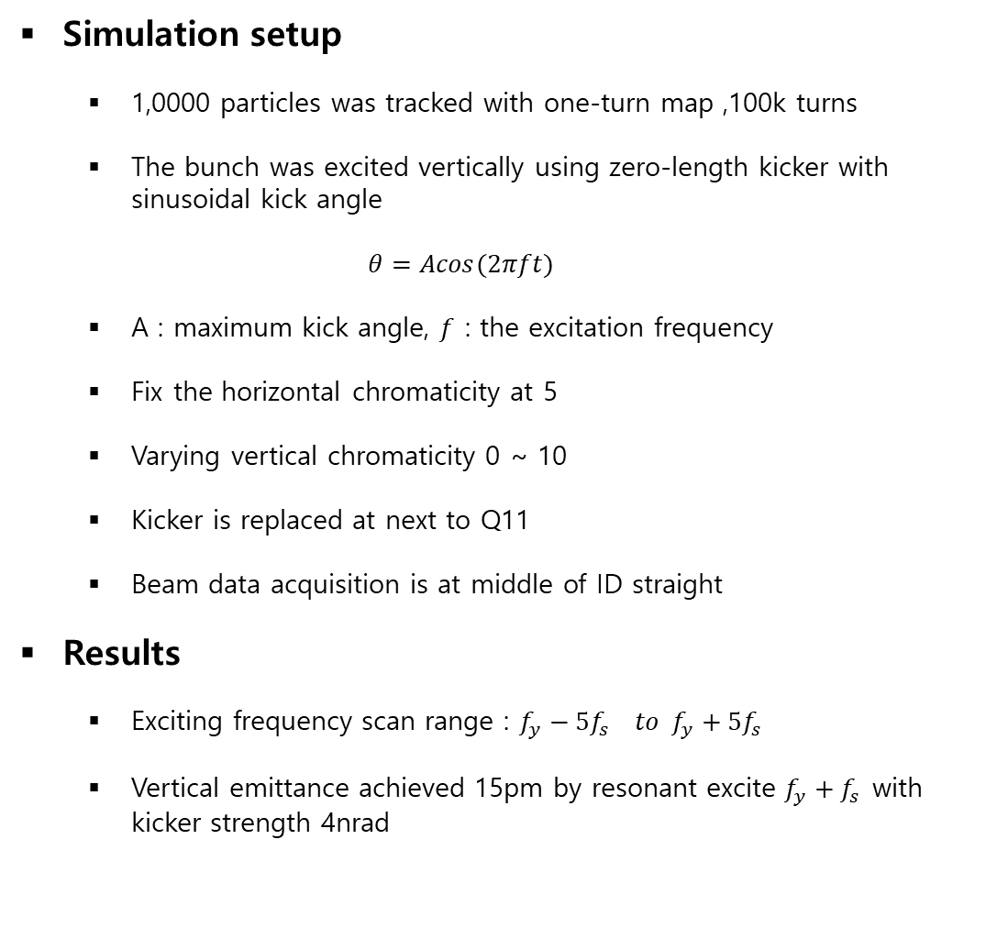
Emittance feedback for the KLS storage ring using PPRE
Simulation setup
  1,0000 particles was tracked with one-turn map ,100k turns
  The bunch was excited vertically using zero-length kicker with sinusoidal kick angle
  $$θ=Acos(2πft)$$
  A : maximum kick angle, $f$ : the excitation frequency
  Fix the horizontal chromaticity at 5
  Varying vertical chromaticity 0 ~ 10
  Kicker is replaced at next to Q11
  Beam data acquisition is at middle of ID straight
Results
  Exciting frequency scan range : $f_{y}−5f_{s} to f_{y}+5f_{s}$
  Vertical emittance achieved 15pm by resonant excite $f_{y}+f_{s}$with kicker strength 4nrad
Beam 관측
Kicker

Slide 5
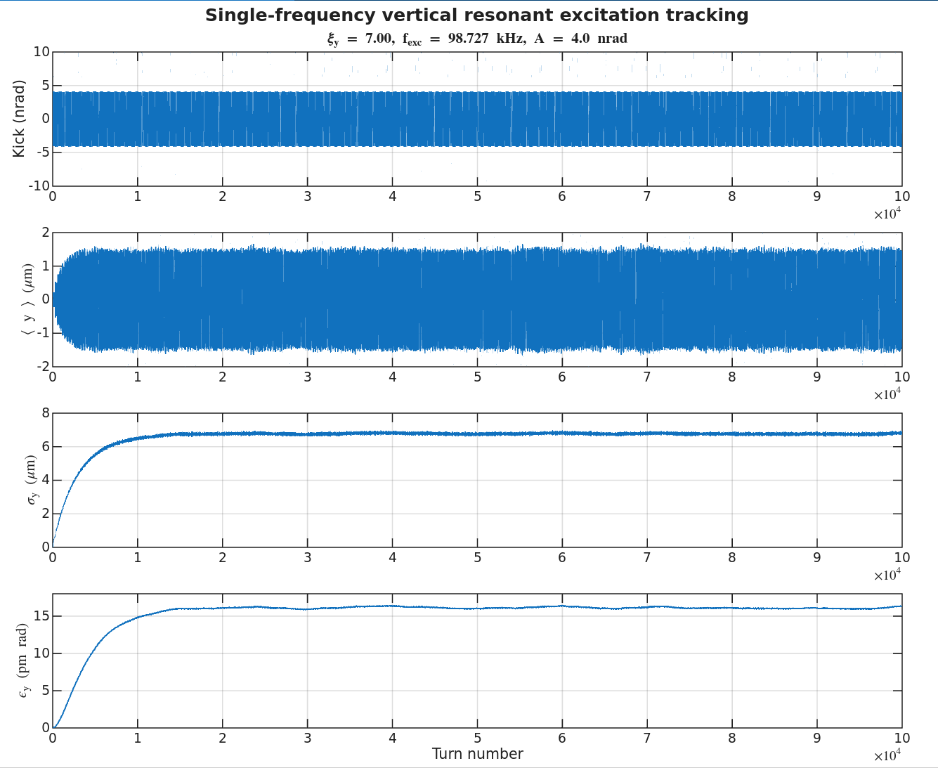
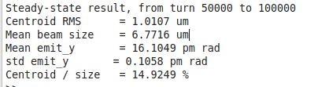
Emittance feedback for the KLS storage ring using PPRE
Results
  To analyze only the steady-state beam behavior, the data from 50,000 to 100,000 turns were used.
  The average vertical emittance was 16.1 pm, with a standard deviation of 0.1 pm.
  The centroid-to-beam-size ratio was 14.9%.

Slide 6
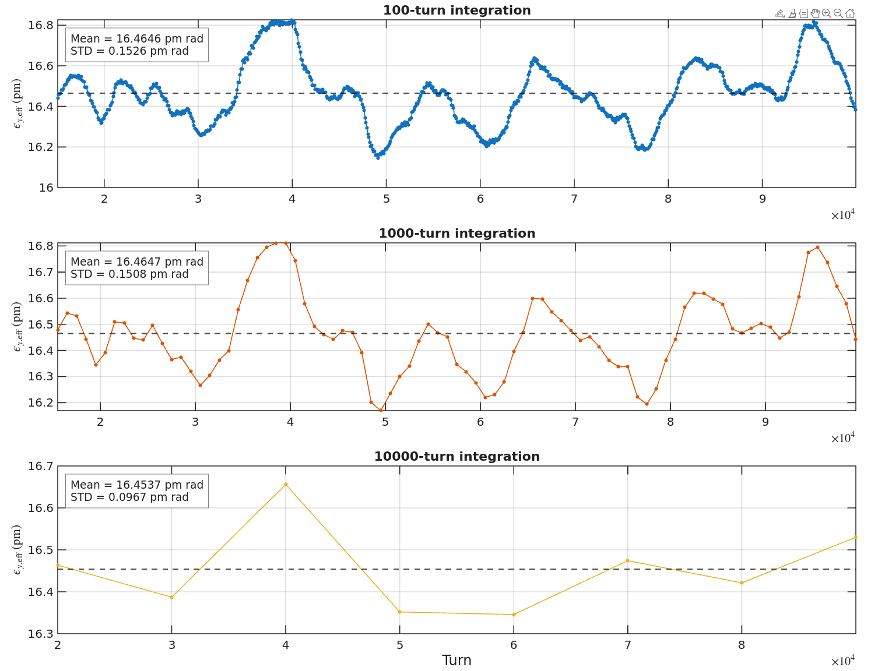
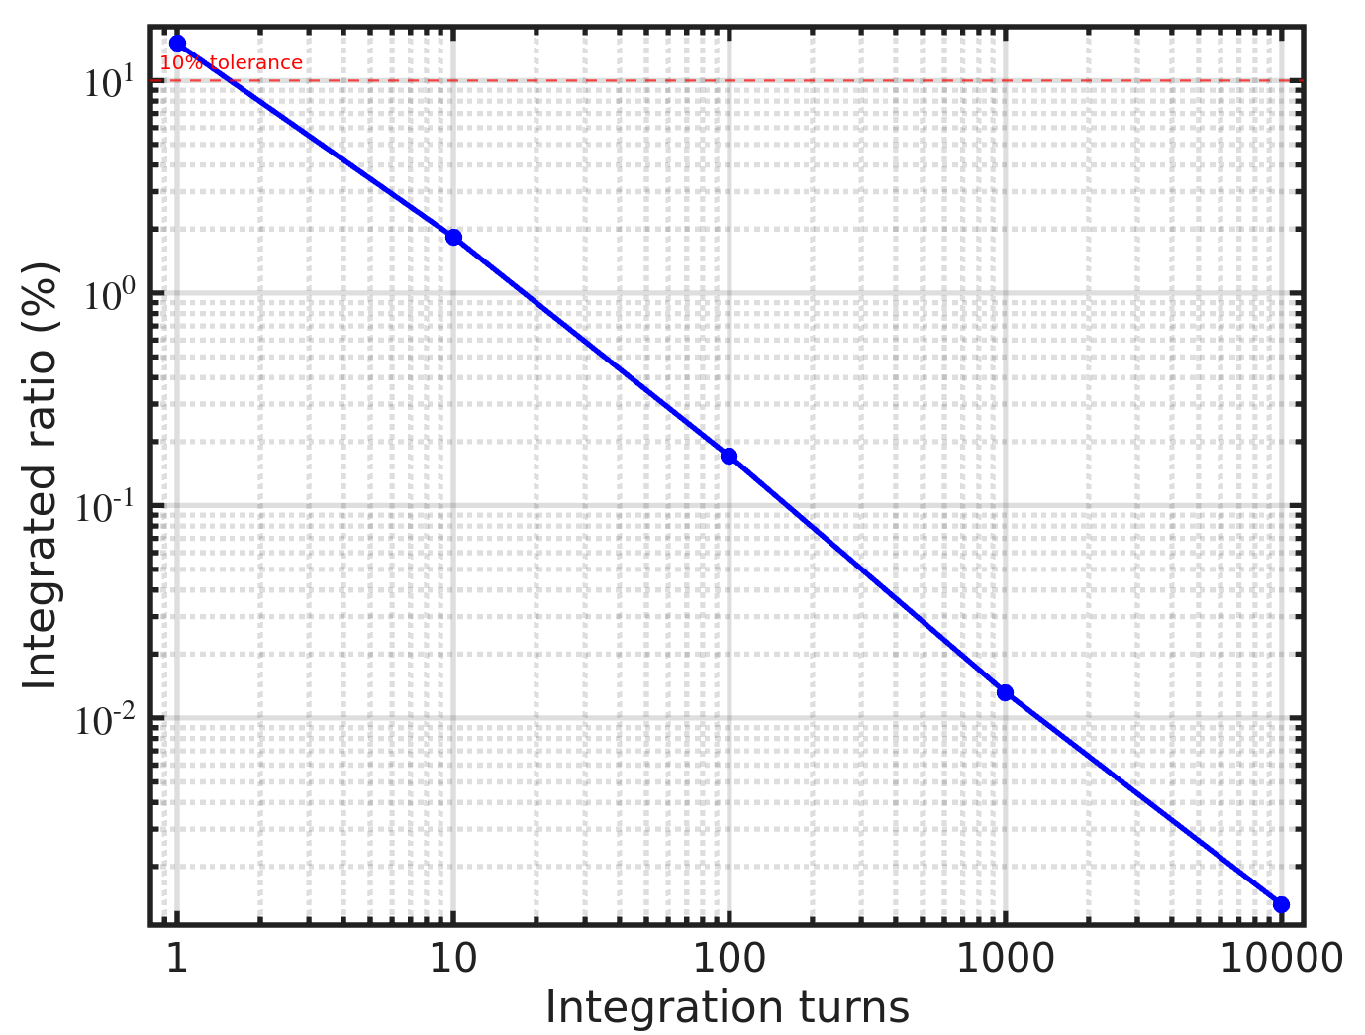
Calculation of Integrated emittance
Ratio = centroid std/ mean beam size

Slide 7
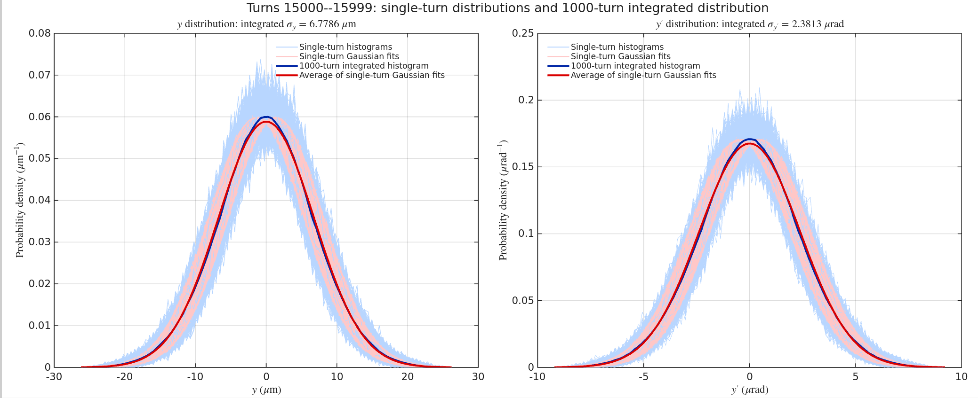

Calculation of Integrated emittance

Slide 8
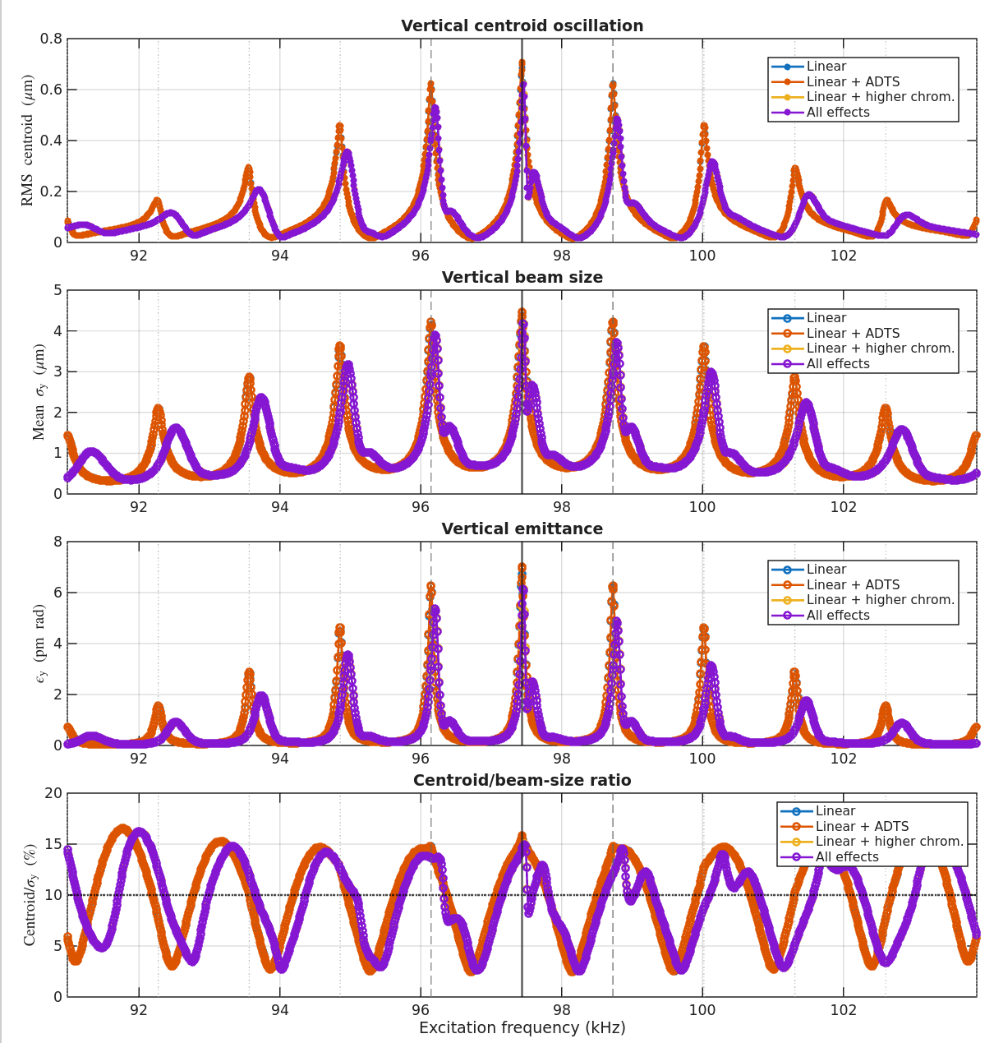
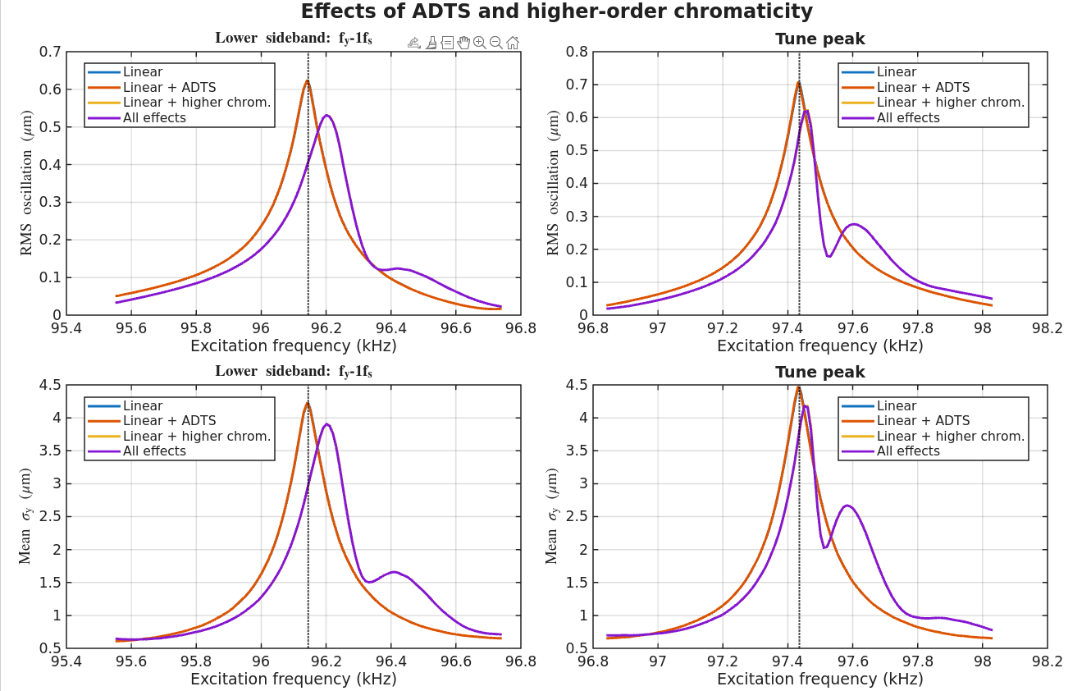
Effect of nonlinear terms (ADTS & higher order chromaticity)
Results
  The ADTS effect has a negligible impact on the sidebands because the kicker strength is too weak.
  However, higher-order chromaticity shifts the sideband peaks and broadens their bandwidth.

Slide 9
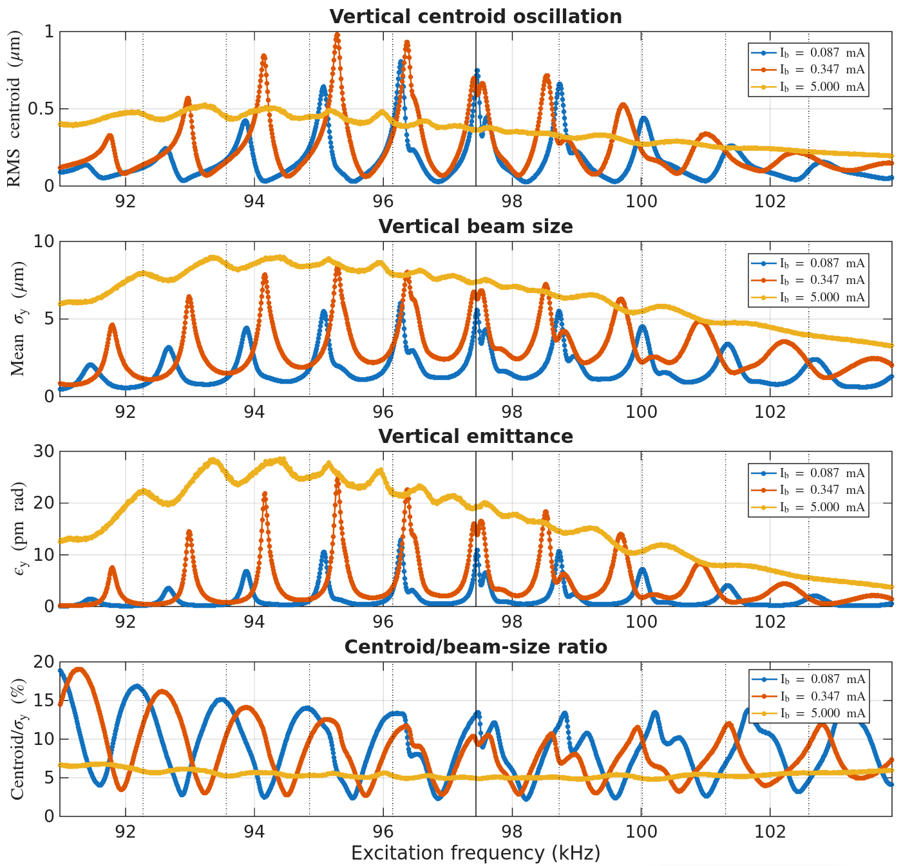
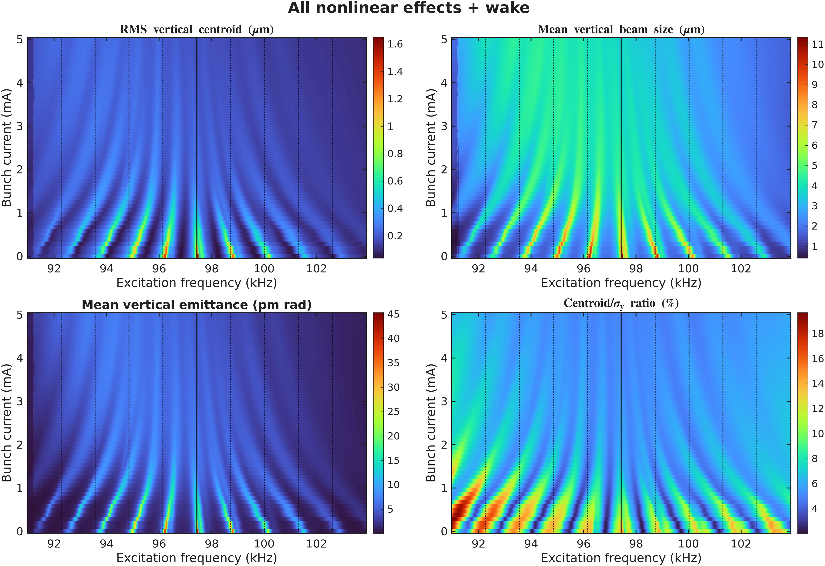
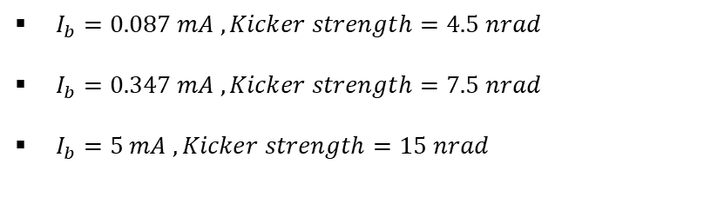
Effect of nonlinear terms (ADTS, higher order chromaticity, wake)
$I_{b}=0.087 mA , Kicker strength=4.5 nrad$
$I_{b}=0.347 mA , Kicker strength=7.5 nrad$
$I_{b}=5 mA , Kicker strength=15 nrad$

Slide 10
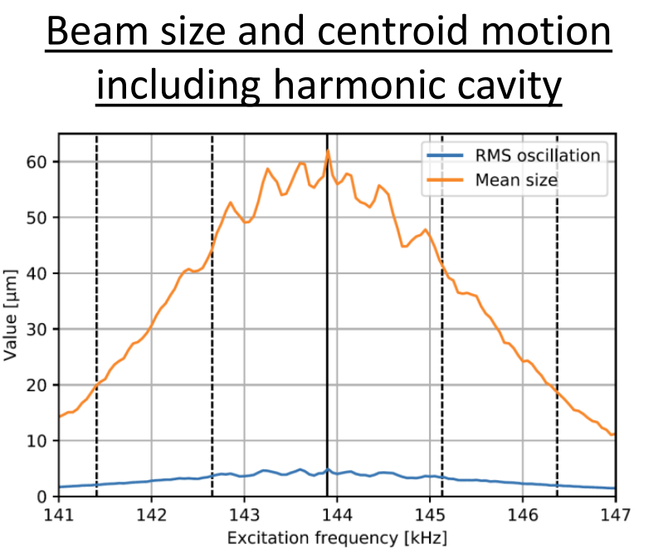
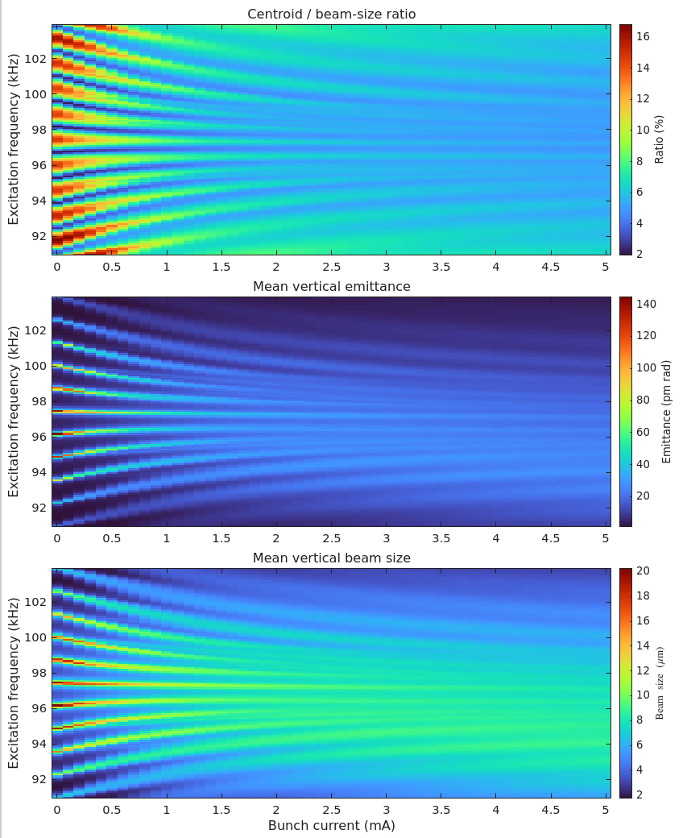
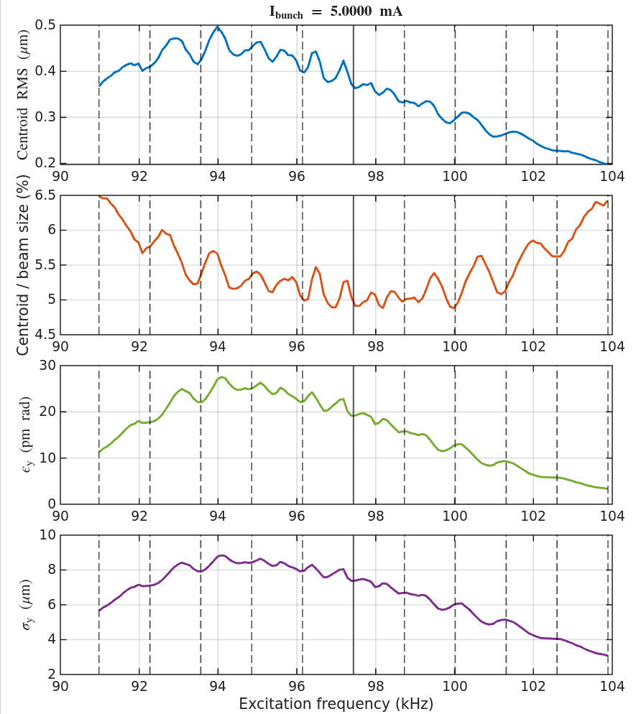
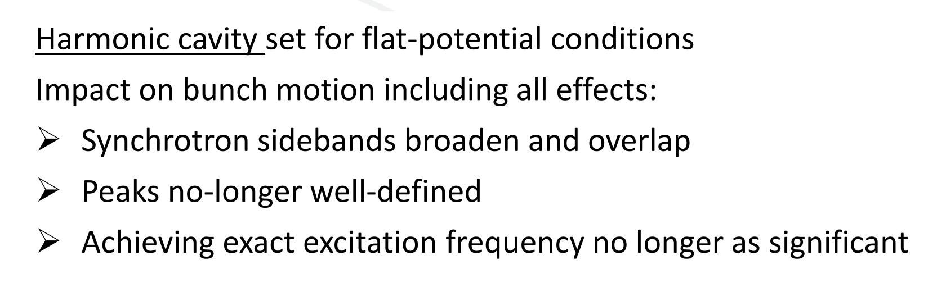
Investigation for Timing mode
Results
  Timing mode setting : 90 mA with 18 bunches, corresponding to 5 mA per bunch.
  A frequency-current 2D scan was performed for the centroid-to-beam-size ratio, vertical emittance, and beam size.
  For the 5 mA case, the synchrotron sidebands overlap and broaden. Therefore, selecting the exact excitation frequency is less critical.
  To achieve a vertical emittance of approximately 10–20 pm·rad, the first or second upper synchrotron sideband can be selected. If a larger emittance blow-up is required, the lower sideband region can be used.

Slide 11
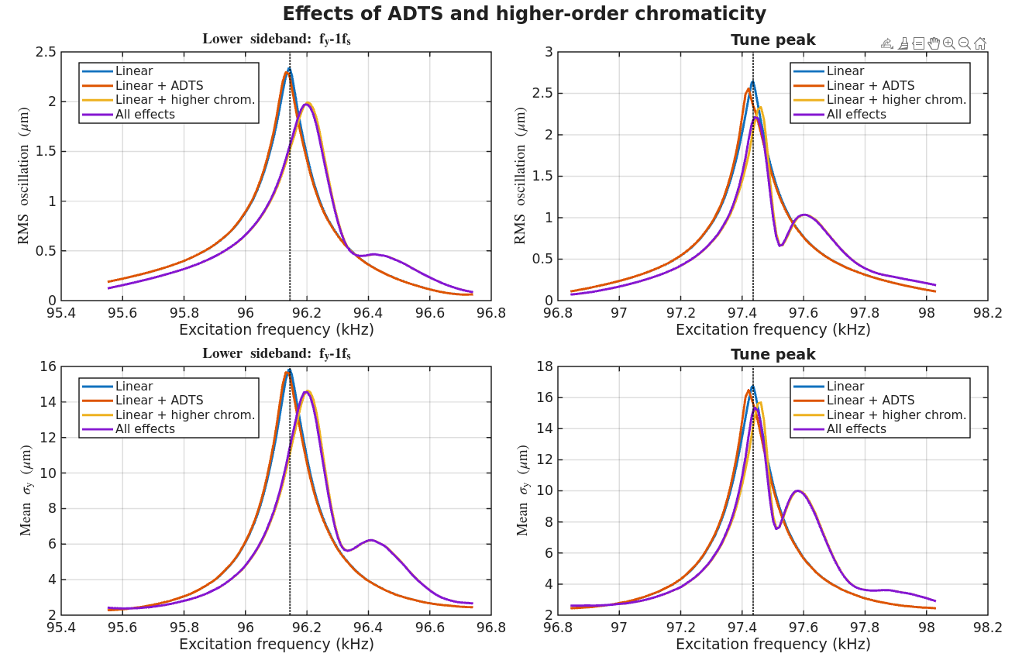
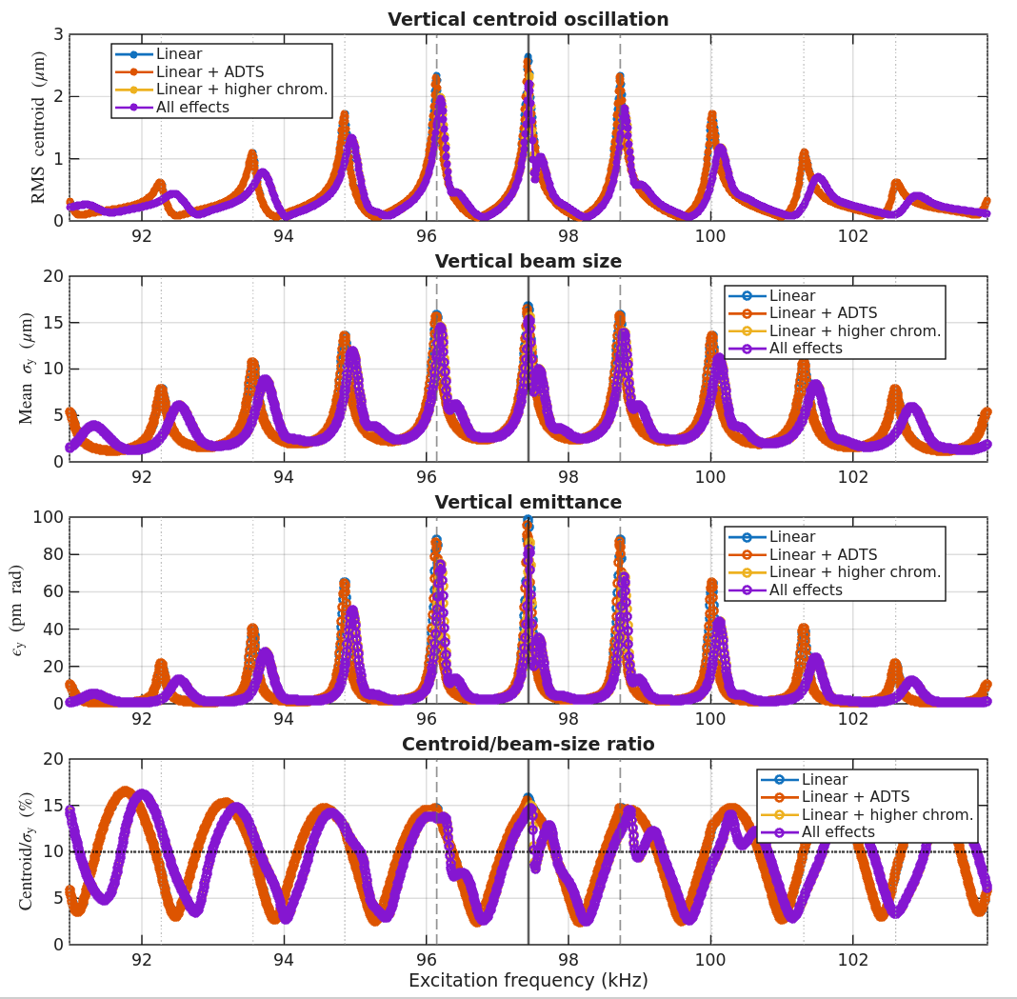
Effect of nonlinear terms for timing mode (ADTS & higher order chromaticity)
Results
  Overall, the results show a trend similar to the case with a 4 nrad kicker strength.
  The ADTS effect has a slightly larger impact on the sidebands, reducing the sideband amplitude and shifting the peaks.
  However, higher-order chromaticity shifts the sideband peaks more clearly and broadens their bandwidth.

Slide 12
Kicker strength with all nonlinear effect and wake field effect
Case 1 : 100mA brightness
Case 2 : 400mA brightness - without 3HC
Case 3 : 400mA brightness - with 3HC
Case 4 : Timing mode (90mA, 18 bunches)

Slide 13
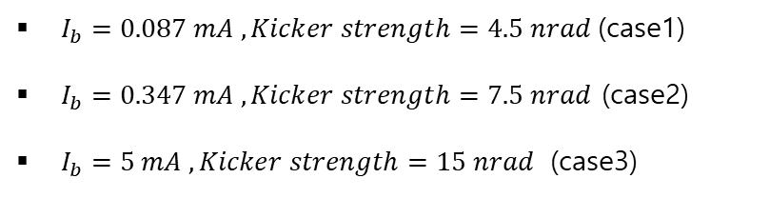
Effect of nonlinear terms (ADTS, higher order chromaticity, wake)
$I_{b}=0.087 mA , Kicker strength=4.5 nrad$(case1)
$I_{b}=0.347 mA , Kicker strength=7.5 nrad$ (case2)
$I_{b}=5 mA , Kicker strength=15 nrad$ (case3)

Slide 14
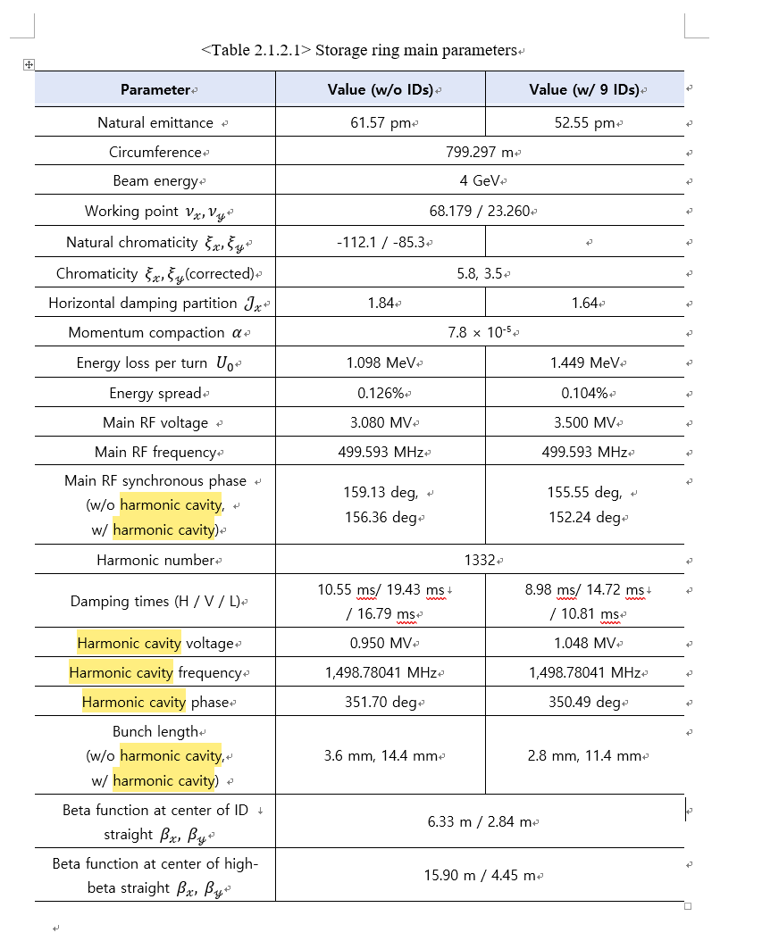
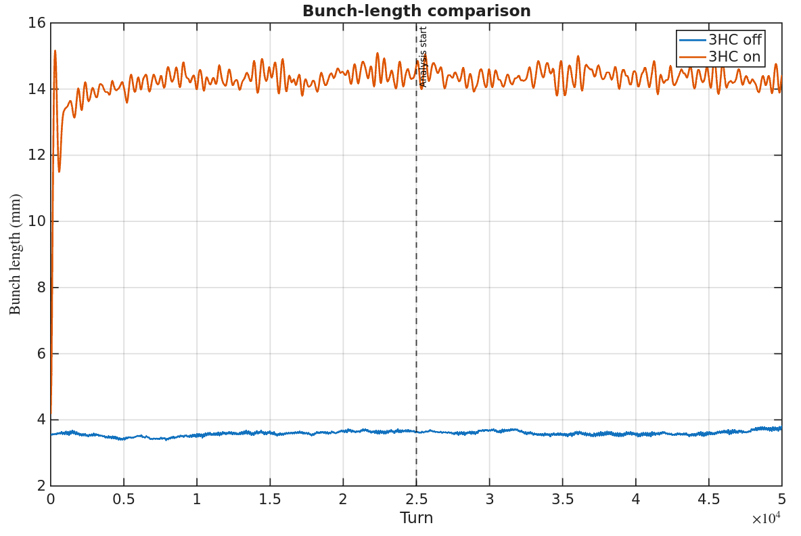
Bunch lengthening result with 3HC (one-turn map tracking)
Simulation setup
  1,000 particles was tracked with one-turn map ,50k turns
  3HC setting from KLS TDR
  3HC RF frequency : 1498.78MHz
  3HC voltage : 0.95 MV

Slide 15
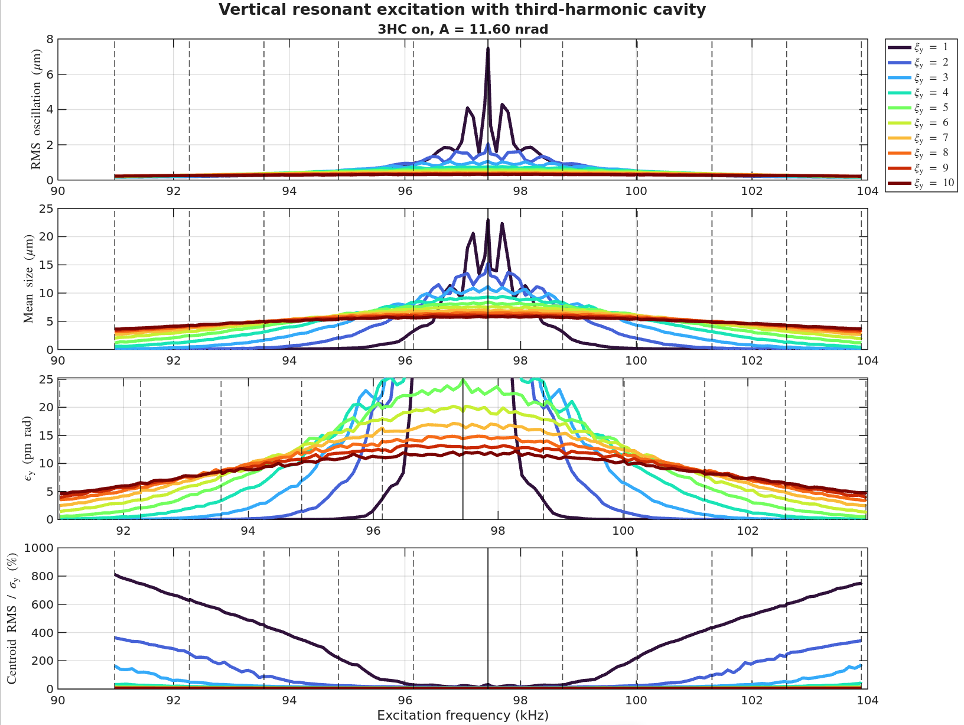
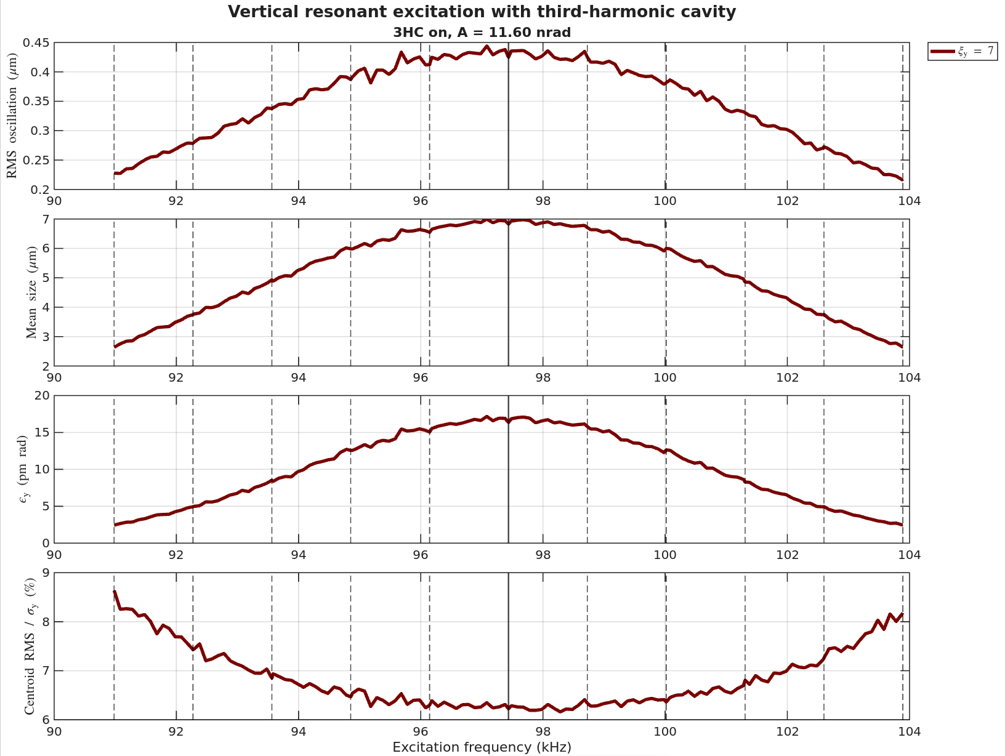
Frequency scan with 3HC (w/o wake & nonlinear effects)

Slide 16
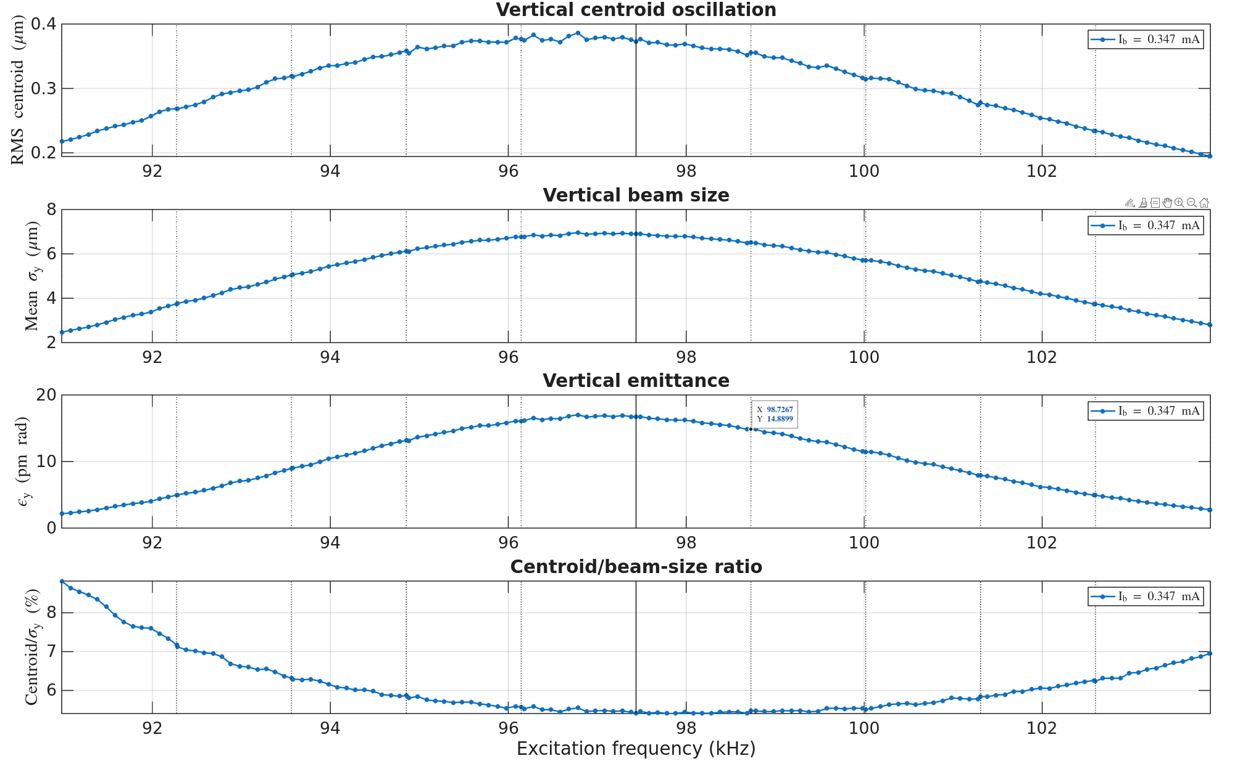
Frequency scan with 3HC (w/ wake & nonlinear effects)
Results
  Overall, the results show a trend similar to the case with timing mode simulation.
  The synchrotron tune was broaden by 3HC, therefore the resonance peak is overlapped.
  So the synchrotron tune shift and broaden effects are not significant effect with 3HC.

Slide 17
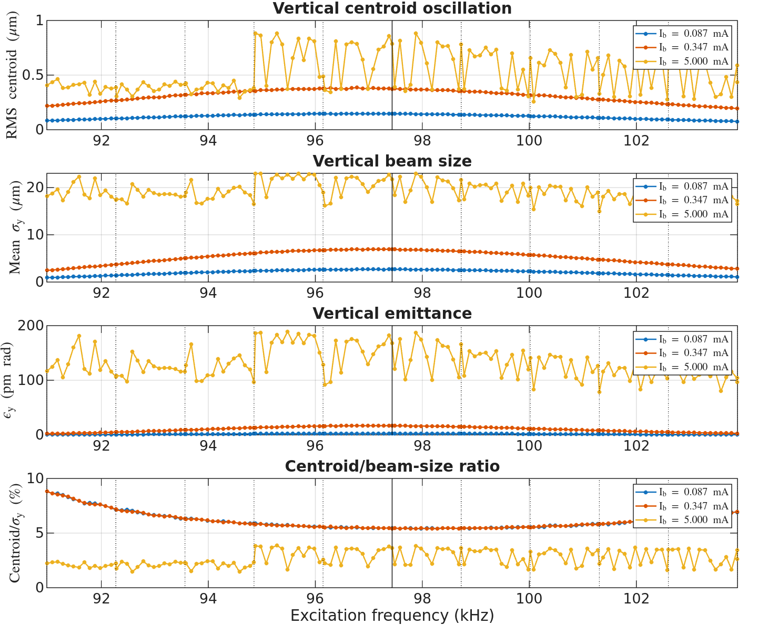
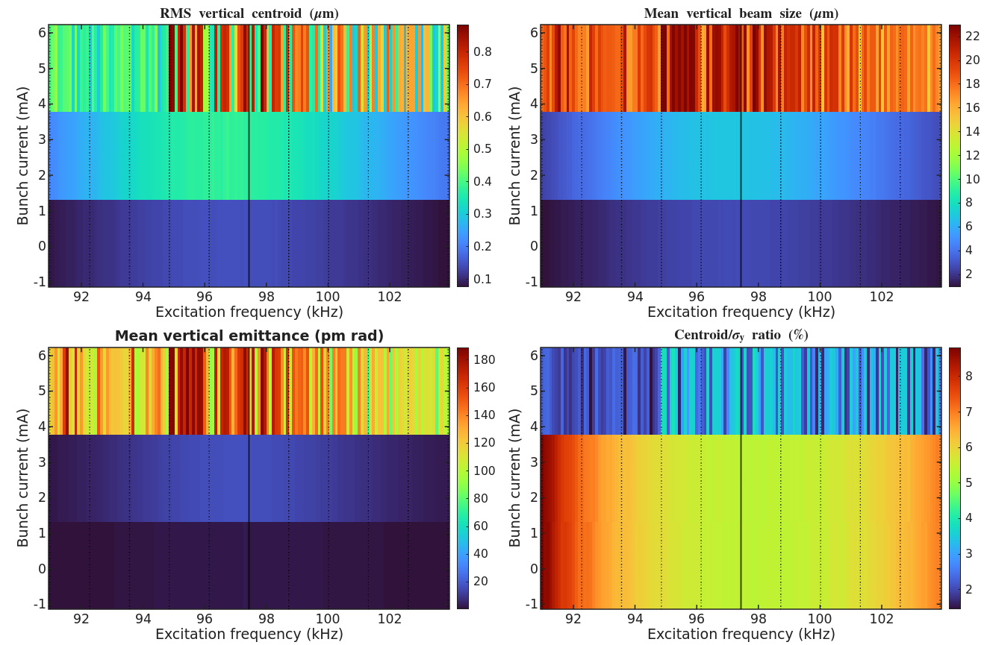
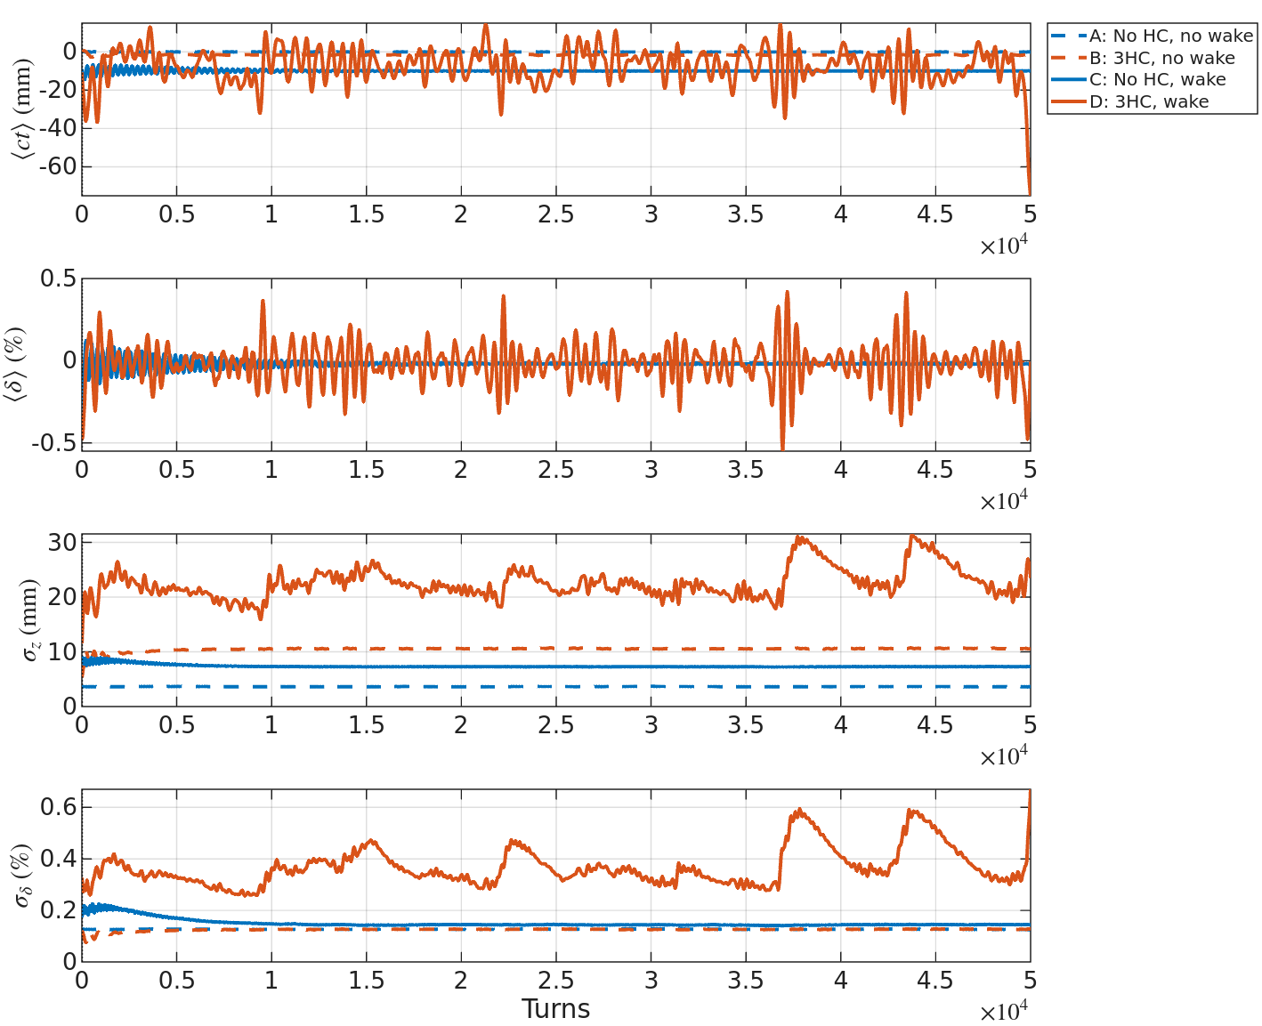
Frequency scan with 3HC in timing mode (w/ wake & nonlinear effects)
Results
  5mA에서 100mA, 400mA case와 달리 심한 fluctuation이 보임
  Turn에 따른 bunch length와 rms energy spread를 확인해보니 MWI 가 일어난 것으로 확인
  Simulation setting에서 bin 개수 : 50, particle 개수 : 10k로 설정하여 wake field가 상대적으로 강하게 들어간 것으로 보임

Slide 18
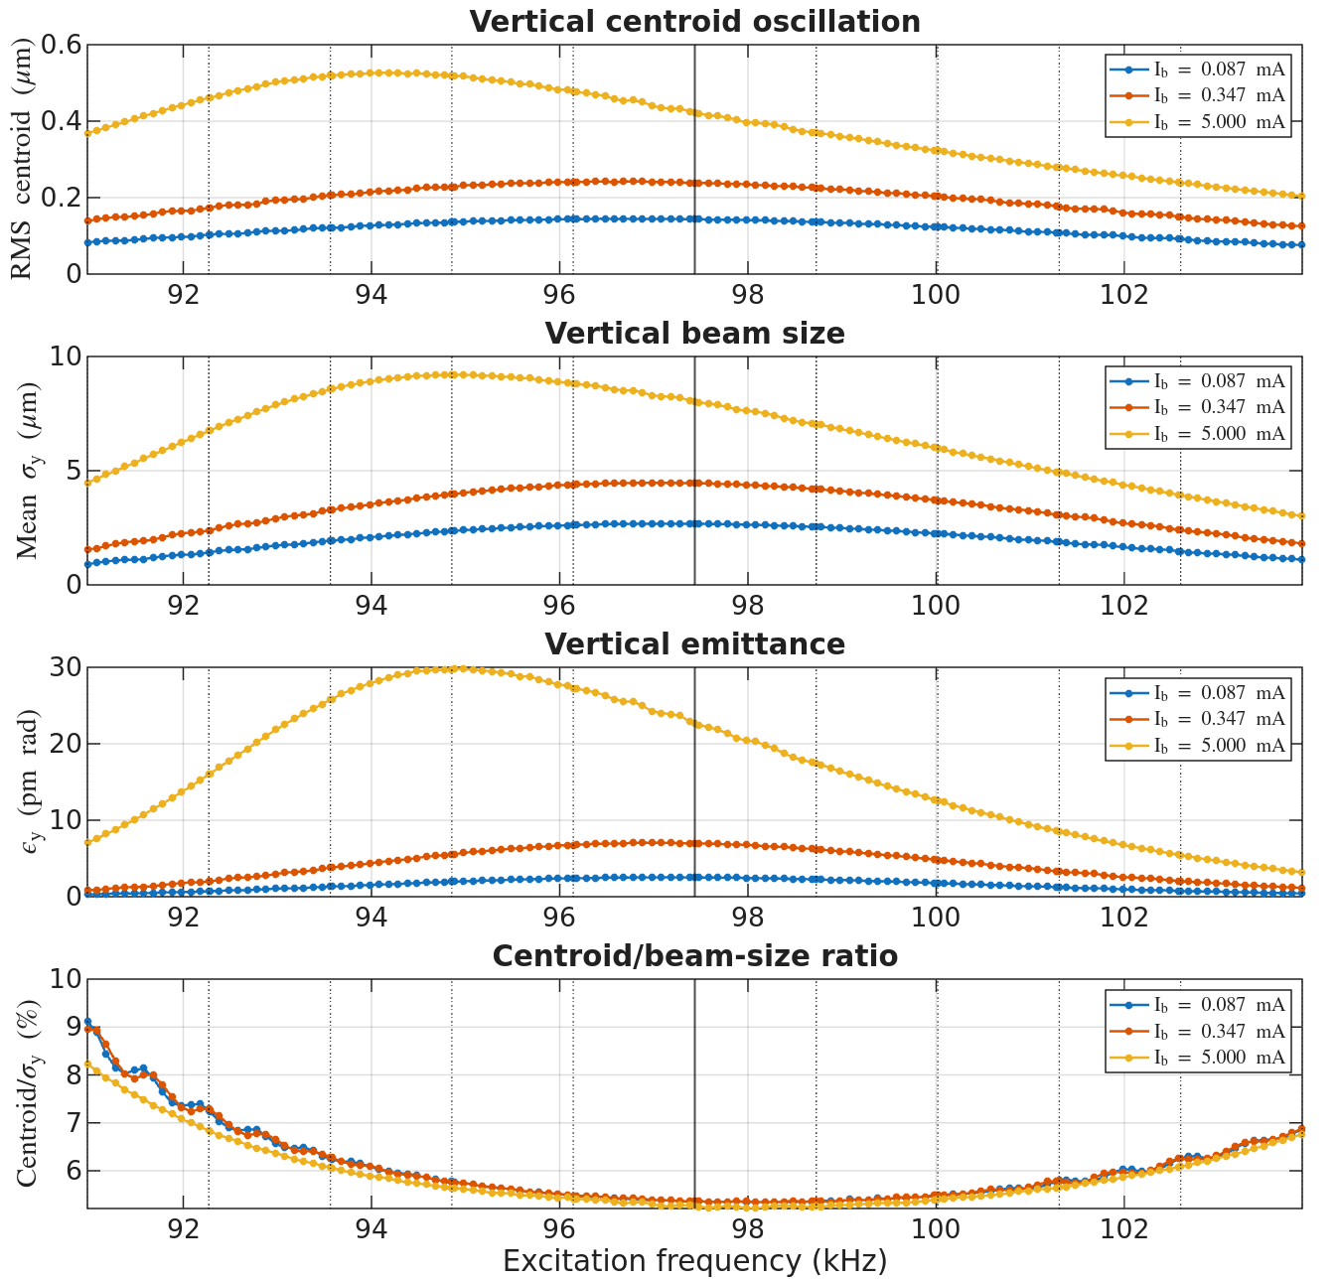
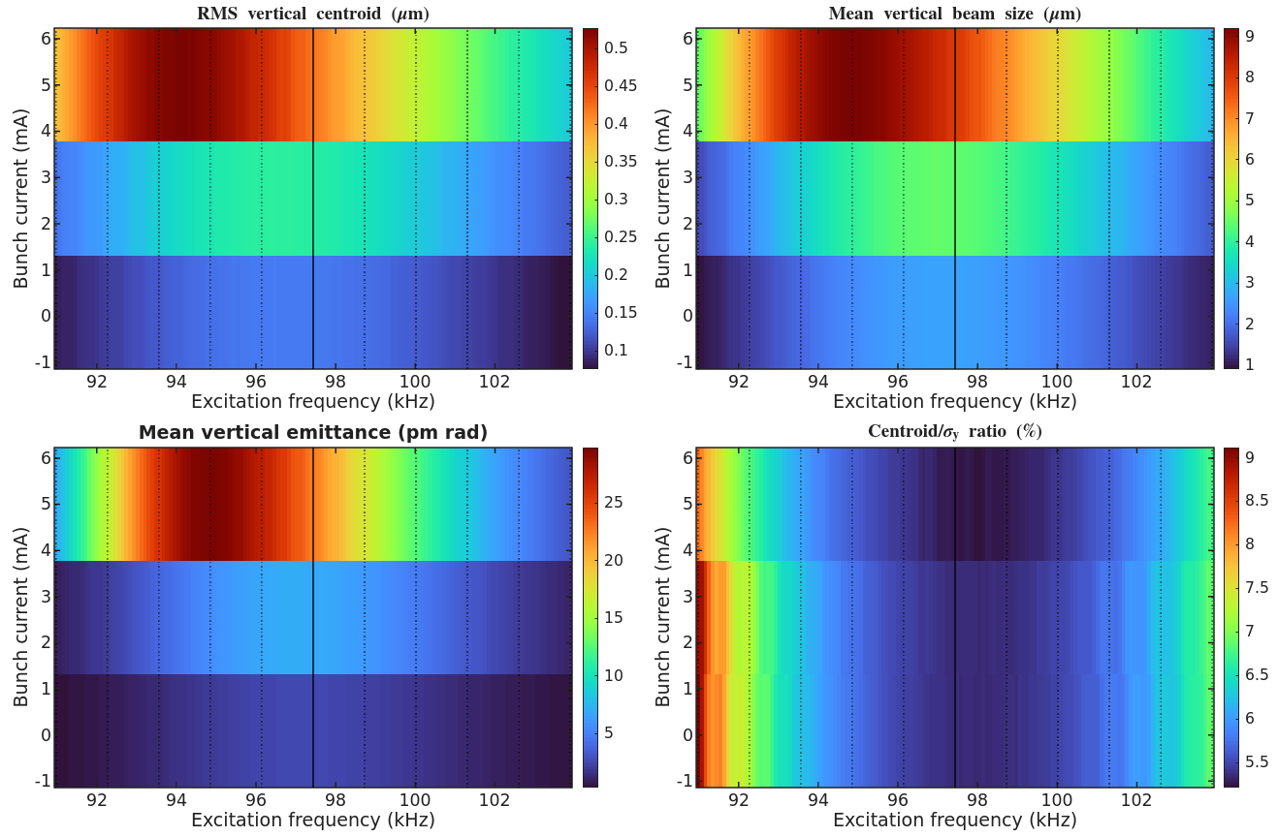
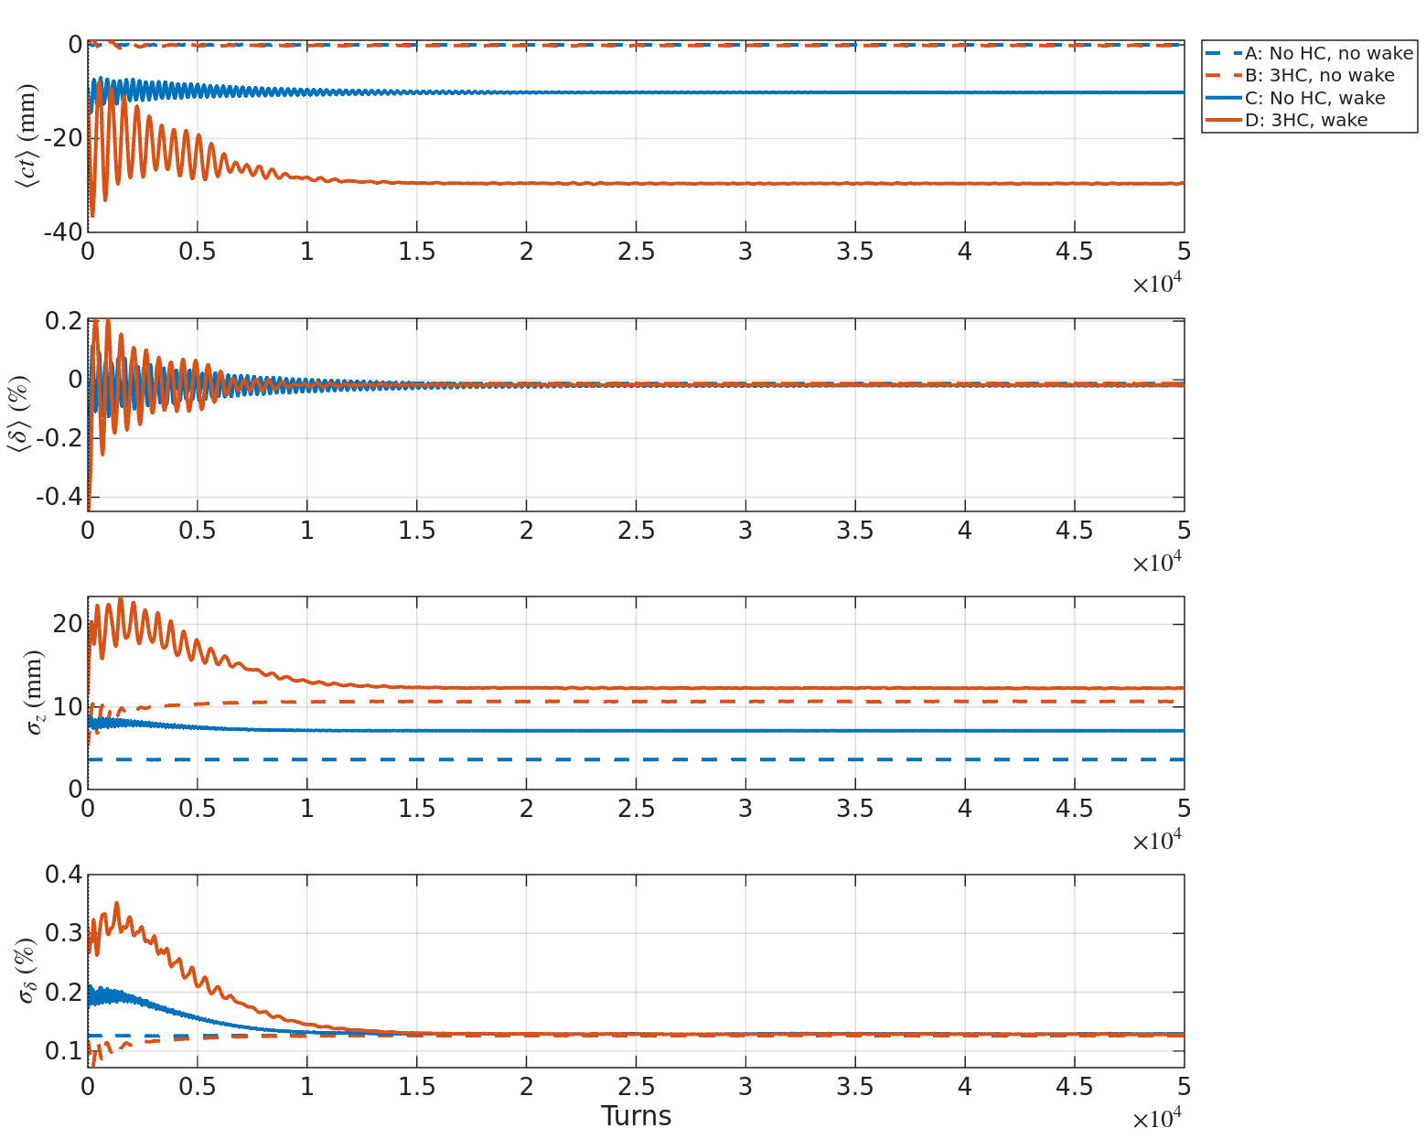
Frequency scan with 3HC in timing mode (w/ wake & nonlinear effects)
Results
  Simulation setting에서 bin 개수 : 400, particle 개수 : 100k로 설정하여 수행
  MWI 완화된 것 확인
  15nrad kick으로 vertical emittance 15pm~30pm 정도로 vertical emittance blowup 가능한 것으로 보임
Wake bin 개수 : 400, particle # : 100k

Slide 19
Kicker strength with all nonlinear effect and wake field
Case 1 : 100mA brightness => 4.5 nrad (10 pm)
Case 2 : 400mA brightness - without 3HC => 7.5 nrad (15 pm)
Case 3 : 400mA brightness - with 3HC => 11.6 nrad (15 pm)
Case 4 : Timing mode (90mA, 18 bunches) => 15 nrad (15~20 pm)

Slide 20
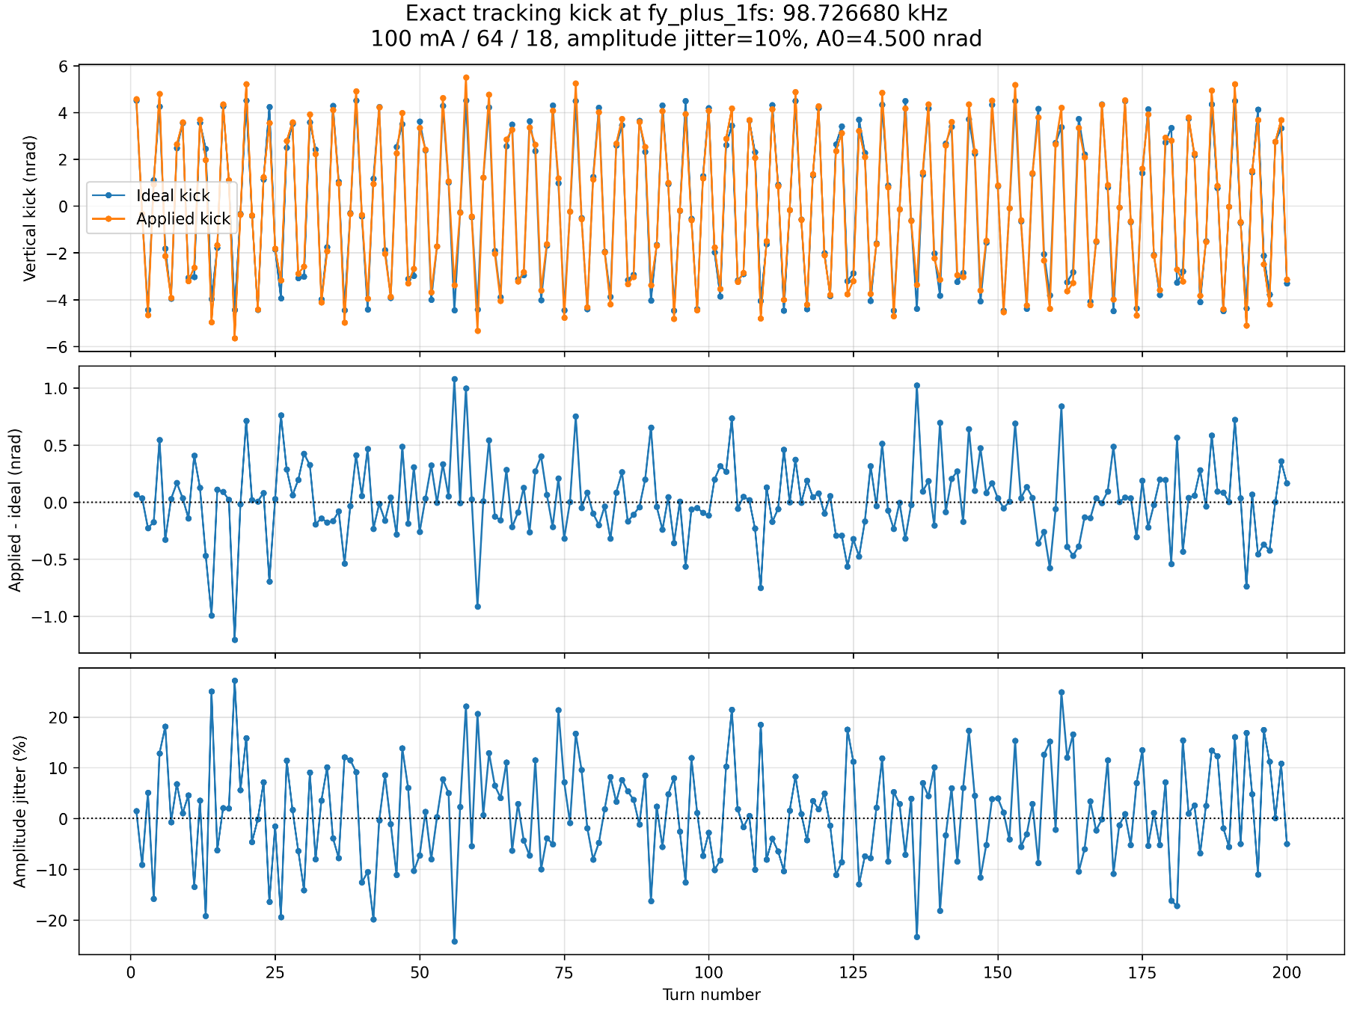
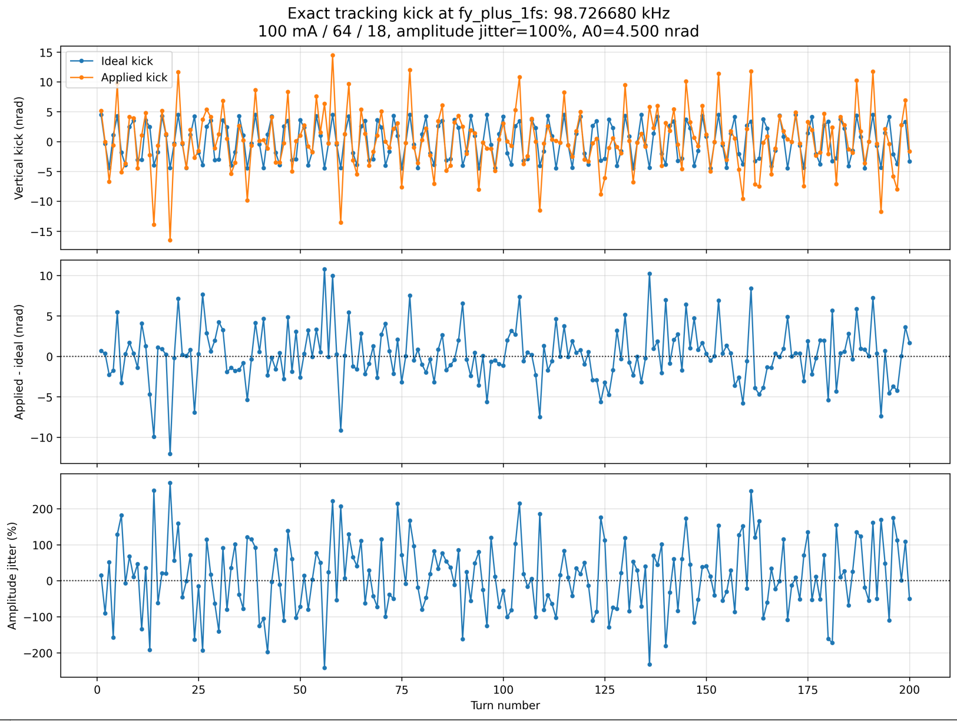
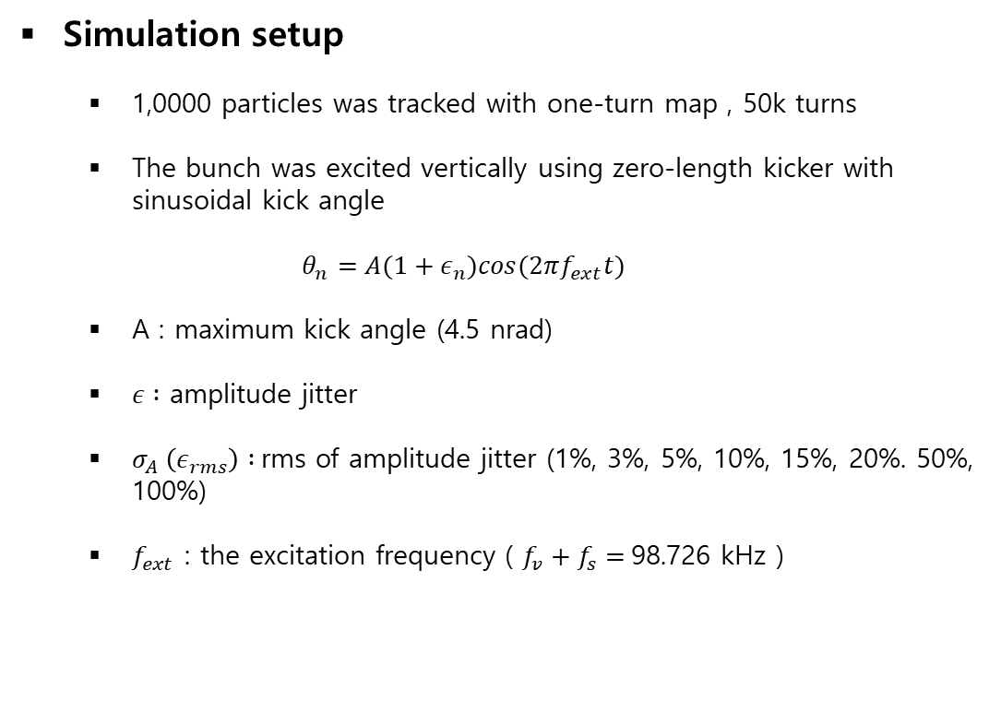
Study of Kicker strength jitter
Simulation setup
  1,0000 particles was tracked with one-turn map , 50k turns
  The bunch was excited vertically using zero-length kicker with sinusoidal kick angle
  $$θ_{n}=A(1+ε_{n})cos(2πf_{ext}t)$$
  A : maximum kick angle (4.5 nrad)
  $ε :$ amplitude jitter
  $σ_{A} \left(ε_{rms}\right) :$rms of amplitude jitter (1%, 3%, 5%, 10%, 15%, 20%. 50%, 100%)
  $f_{ext}$ : the excitation frequency ( $f_{v}+f_{s}=$98.726 kHz )

Slide 21
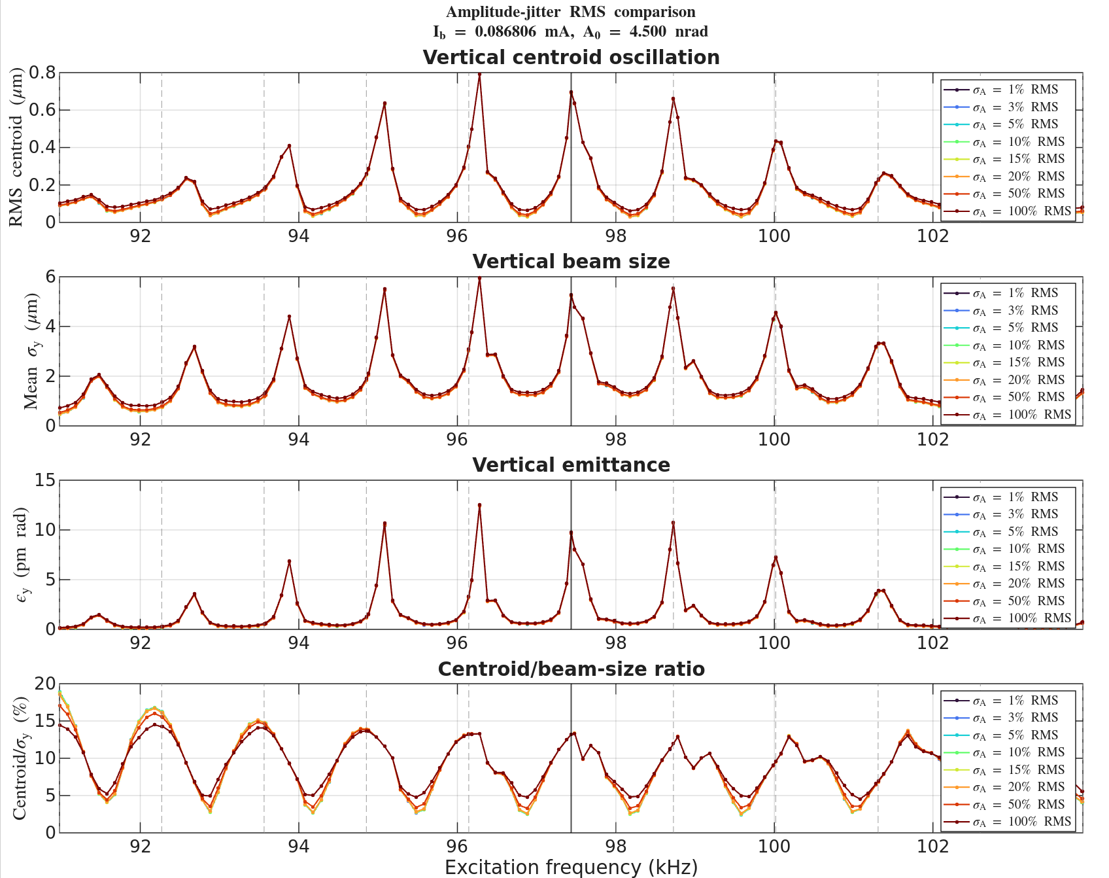

Study of Kicker strength jitter
  $θ_{n}=A\left(1+ε_{n}\right)cos\left(2πf_{ext}t\right)=θ_{0,n}(1+ε_{n})$
  $<ε_{n}> =0$, $σ_{A}=\sqrt{<ε_{n}^{2}>}$
  $J_{y}=\frac{1}{2}\left(\frac{y^{2}}{β_{y}}+β_{y}y^{′2}\right) ← y^{′}+θ$
  $J_{y}+ΔJ_{y}=J_{y}+β_{y}y^{′}θ+\frac{β_{y}θ^{2}}{2}$
  $<ΔJ_{y}>_{ε}= {<β}_{y}y^{′}θ_{n}>+ \frac{β_{y}}{2} θ_{0,n}^{2}\left(1+σ_{A}^{2}\right)$
  1턴 동안 Jitter 에 의해서 추가되는 효과 :
  $ε_{y,jitter}= <ΔJ_{y, jitter}>$ = $\frac{β_{y}}{2} θ_{0,n}^{2}σ_{A}^{2} →\frac{β_{y}A^{2}}{4}σ_{A}^{2}$
  A=4.5nrad, $β_{y}$=2.8, $σ_{A}=10\% \sim 100\%$, N = 50000턴
  $$\frac{{Nβ}_{y}A^{2}}{4}σ_{A}^{2} =0.007 pm \sim 0.7 pm$$

Slide 22
Thank you

Slide 23
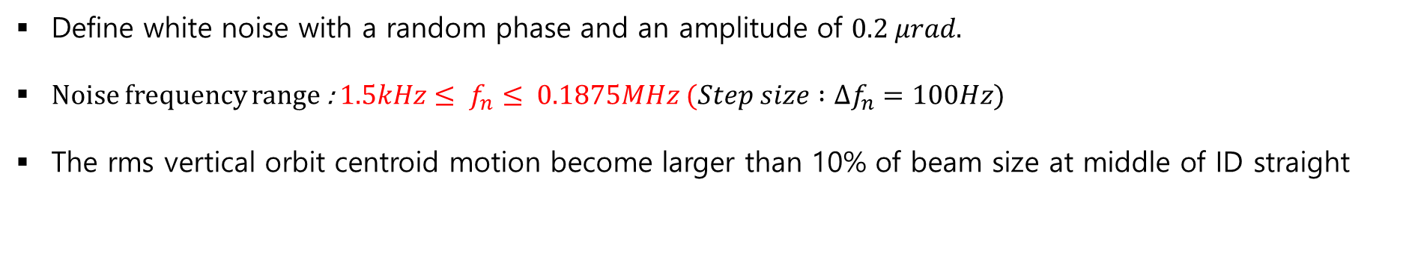
Korea-4GSR emittance blow up simulation settings and results
Results at middle of ID straight section ($ε_{y}=15pm$ ,Amp = 0.2$μrad$)
Define white noise with a random phase and an amplitude of $0.2 μrad.$
Noise frequency range : $1.5kHz≤ f_{n}≤ 0.1875MHz (Step size :Δf_{n}=100Hz$)
The rms vertical orbit centroid motion become larger than 10% of beam size at middle of ID straight

Slide 24
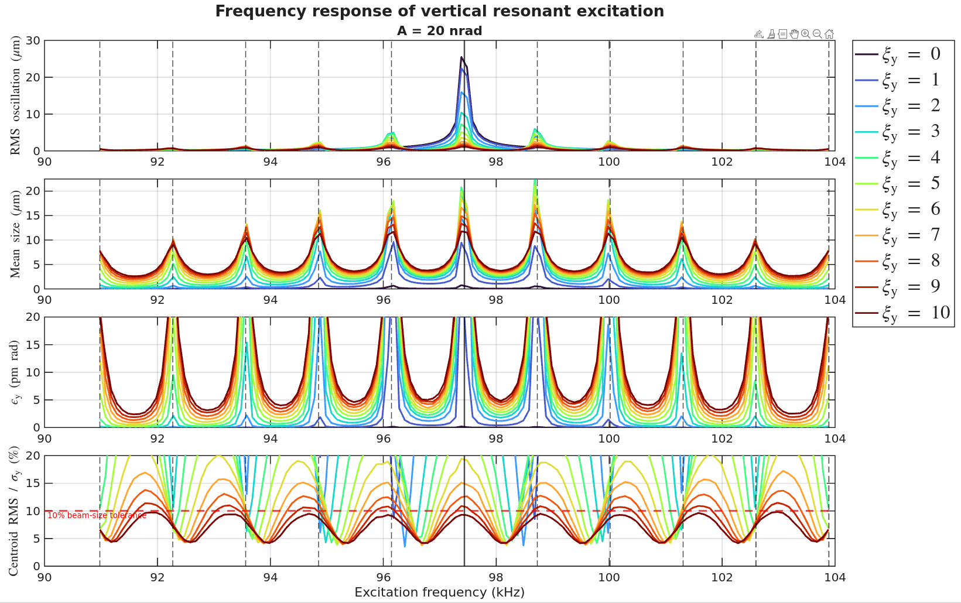
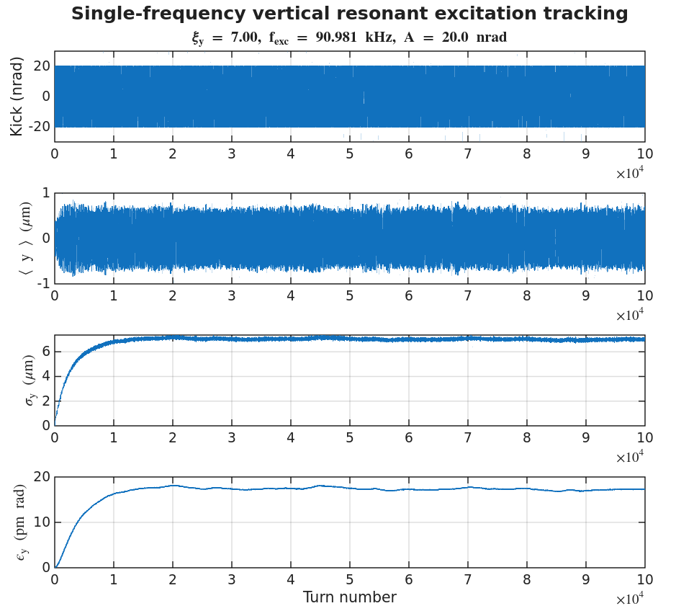
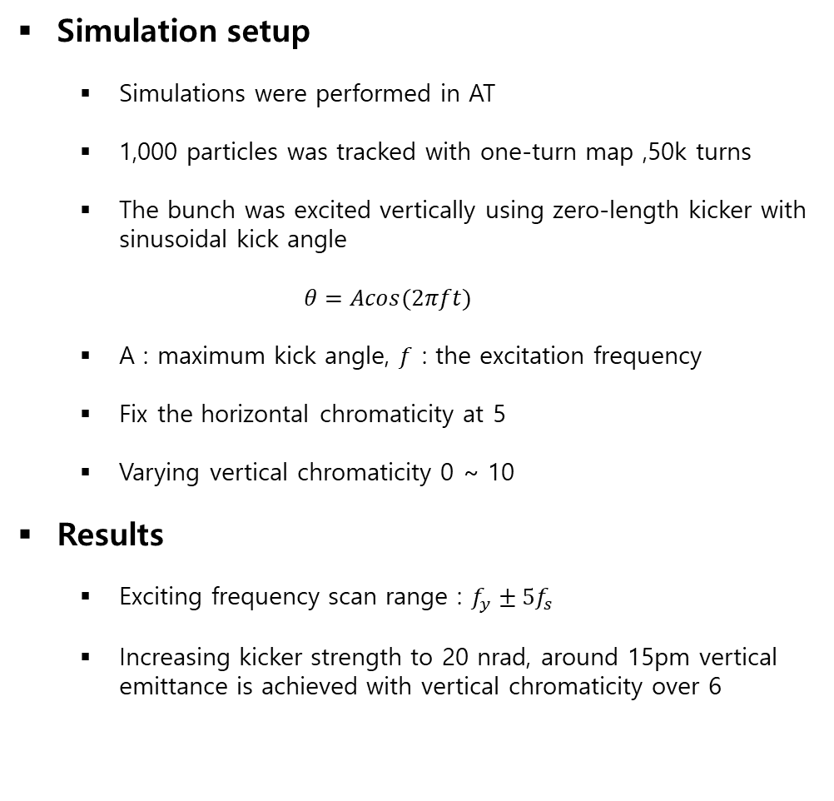
Emittance feedback for the KLS storage ring using PPRE
Simulation setup
  Simulations were performed in AT
  1,000 particles was tracked with one-turn map ,50k turns
  The bunch was excited vertically using zero-length kicker with sinusoidal kick angle
  $$θ=Acos(2πft)$$
  A : maximum kick angle, $f$ : the excitation frequency
  Fix the horizontal chromaticity at 5
  Varying vertical chromaticity 0 ~ 10
Results
  Exciting frequency scan range : $f_{y}±5f_{s}$
  Increasing kicker strength to 20 nrad, around 15pm vertical emittance is achieved with vertical chromaticity over 6

Slide 25
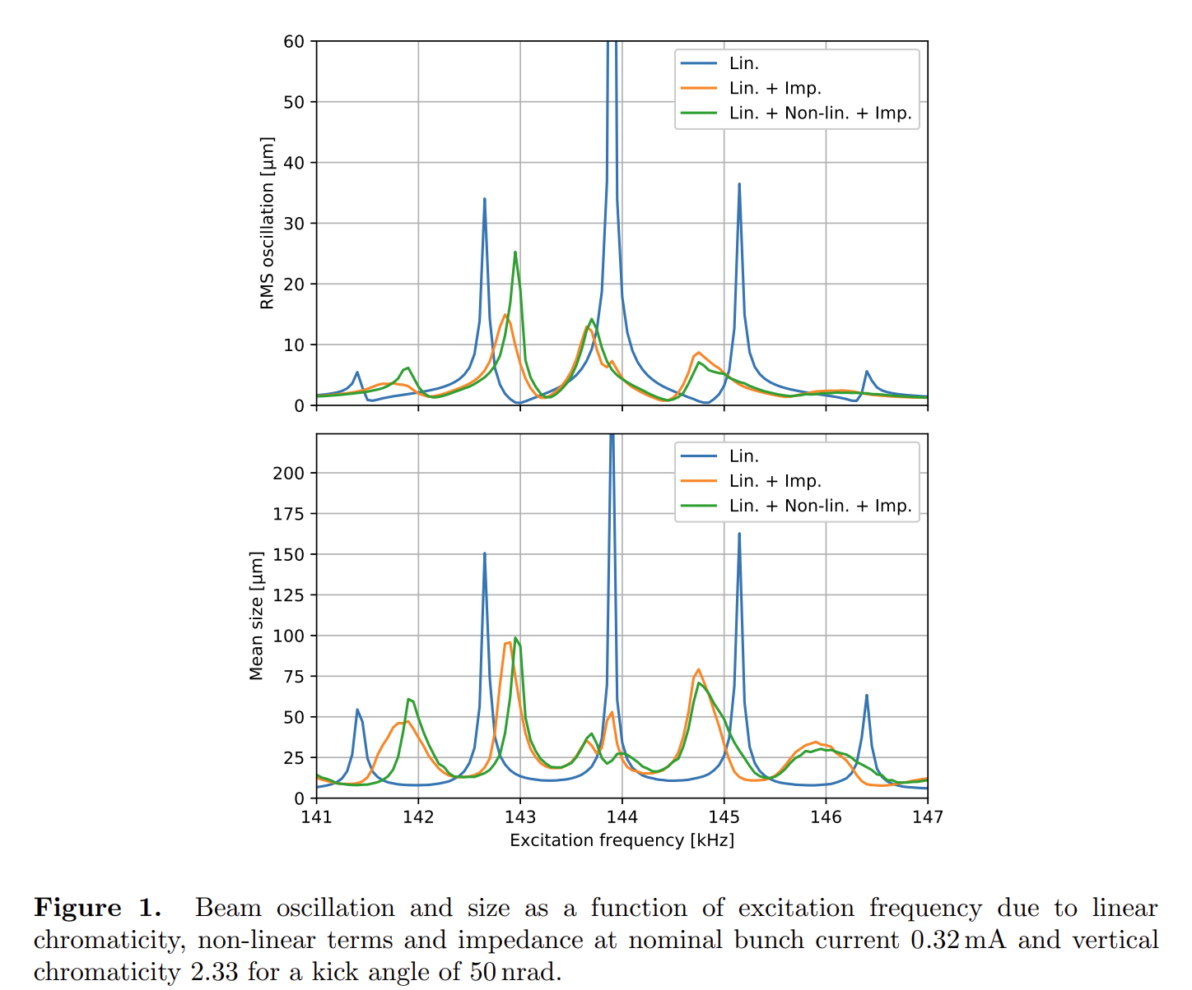
Emittance feedback for the Diamond-II storage ring using resonant excitation
Figure 1 shows the beam oscillation and size as a function of excitation frequency.
The symmetry of synchrotron sideband is broken by impedance and nonlinear terms.
The impedance widens and shifts sidebands closer to the betatron tune
Bunch current : 0.32mA
Vertical chromaticity : 2.33
Kick angle : 50 nrad

Slide 26
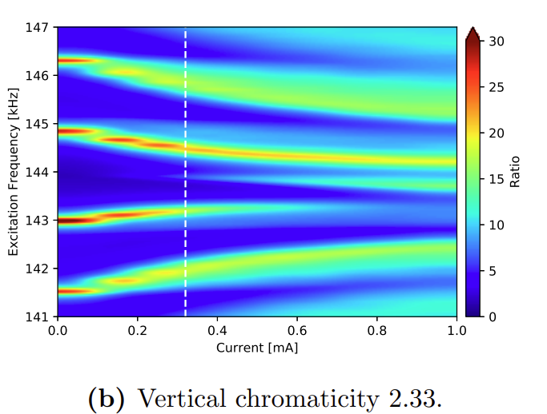
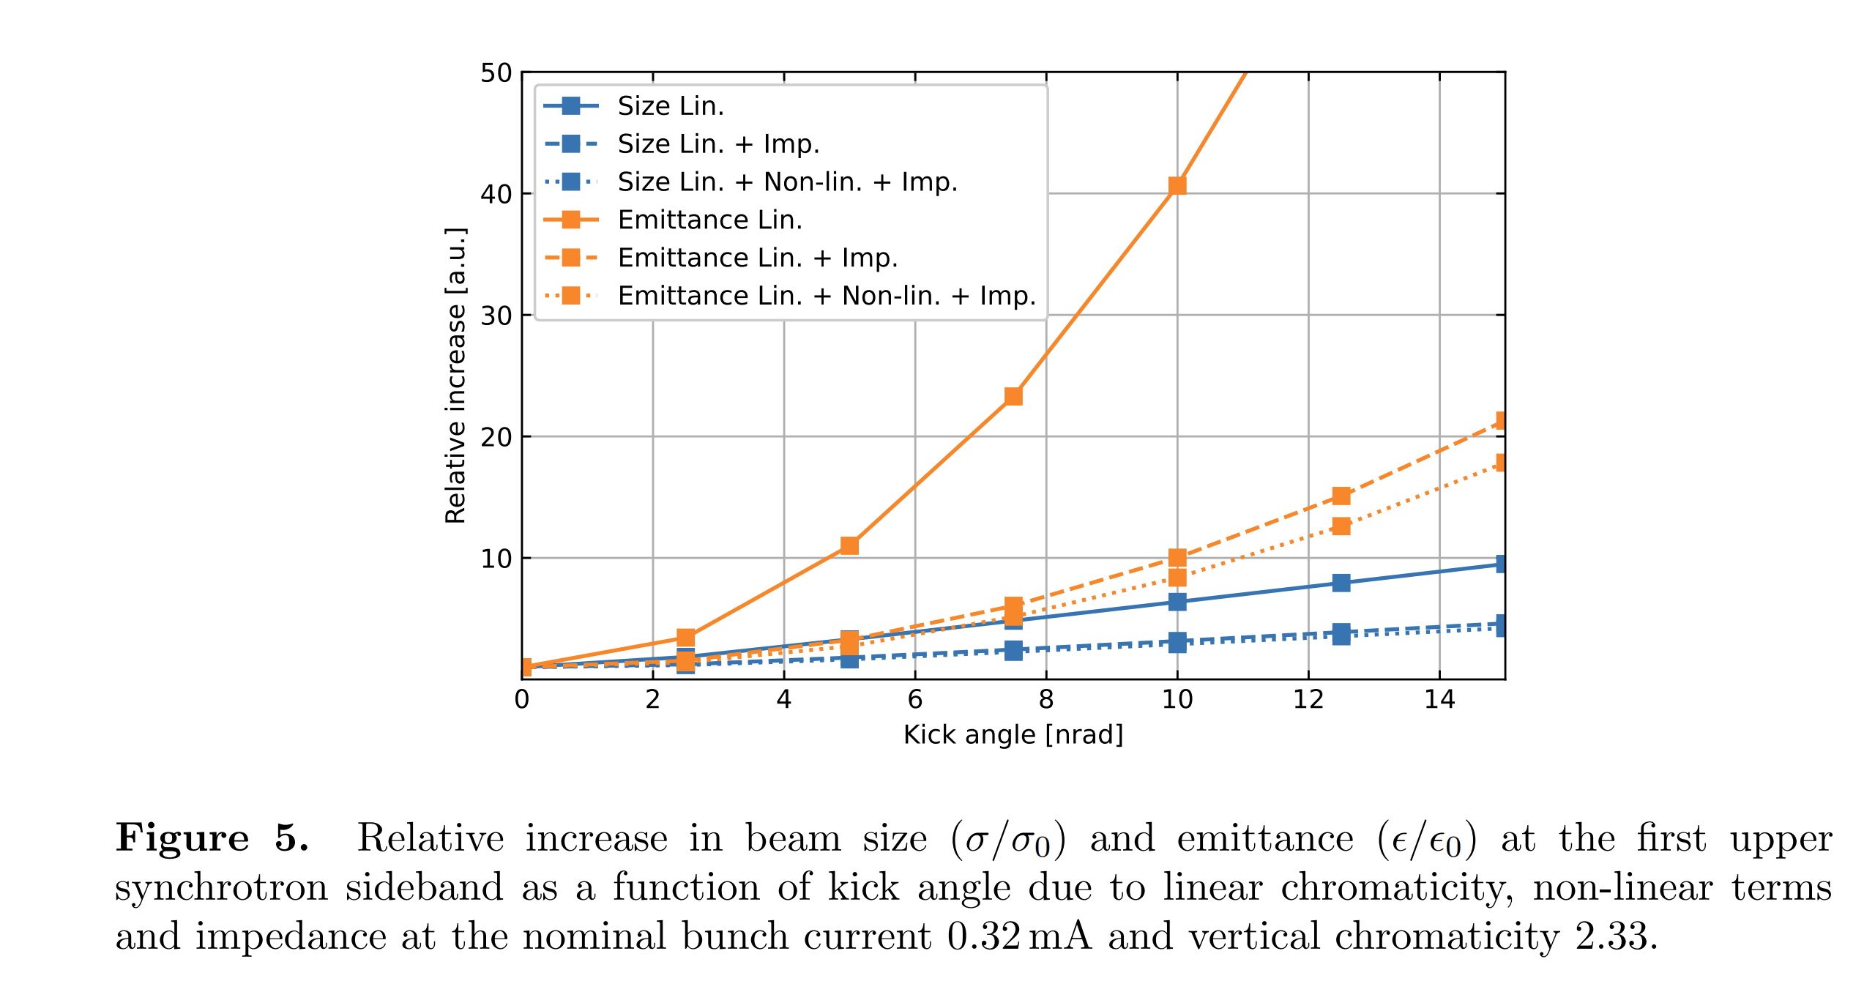
Emittance feedback for the Diamond-II storage ring using resonant excitation
Simulation setting
Excitation frequency : first upper synchrotron sideband
Current : 0.32mA
Vertical chromaticity : 2.33
Results
Emittance grows quadratically for small kick angles
Beam size grows linearly
The impedance has a significant effect on the growth rate
As the kick angle is increased to hundreds of nrad, ADTS starts to dominate, which causes the growth of the emittance to flat

Slide 27


Tracking with pyAT and wakefield
  Tracking results were cross-checked between MATLAB AT and pyAT.
  Since pyAT is better suited for wakefield simulations, further studies will be performed using pyAT.
From Dr. Seok

Slide 28


Slide 29


Tracking results
400mA / 64*18
100mA / 64*18
  Tracking data with wakefields show a trend similar to the Diamond-II simulation results.
  The synchrotron-frequency sidebands shift toward the betatron frequency.
  The sidebands become broader.

Slide 30
Tracking results
  Tracking data with wakefields show a trend similar to the Diamond-II simulation results.
  The synchrotron-frequency sidebands shift toward the betatron frequency.
  The sidebands become broader.

Slide 31


Tracking results

Slide 32


Slide 33


Slide 34



Slide 35



Kicker 위치 : ID 중앙
Kicker 세기 : 20nrad
Optimal excitation frequency : fy-5fs
Optimal vertical chromaticity : >6

Slide 36


Slide 37


Slide 38


Calculation of Integrated emittance
Turn-by-Turn emittance :
$$Σ_{tbt}= \left(\begin{matrix}<y−\overline{y}>^{2} & <(y−\overline{y})(y^{′}−\overline{y′})> \\ <(y−\overline{y})(y^{′}−\overline{y′})> & <{\left(y^{′}−\overline{y^{′}}\right)}^{2}>\end{matrix}\right)$$
$$ε_{y,tbt }=\sqrt{det⁡(Σ_{tbt})}$$
Integrated emittance (1~N) :
$$Σ_{1:N}=\frac{Σ_{1}+Σ_{2}+ ⋯Σ_{N}}{N}+\frac{1}{N}\sum_{t=1}^{N}{\left(μ_{t}−{\overline{μ}}_{N}\right){\left(μ_{t}−{\overline{μ}}_{N}\right)}^{T}} where μ_{t}=\left[\begin{matrix}\overline{y_{t}} \\ \overline{{y′}_{t}}\end{matrix}\right]$$
$$ε_{y,1:N }=\sqrt{\det{Σ_{1:N}}}$$

Slide 39

Calculation of Integrated emittance
Integrated emittance (1~N) :
$$Σ_{1:N}=\frac{Σ_{1}+Σ_{2}+ ⋯Σ_{N}}{N}+\frac{1}{N}\sum_{t=1}^{N}{\left(μ_{t}−{\overline{μ}}_{N}\right){\left(μ_{t}−{\overline{μ}}_{N}\right)}^{T}} where μ_{t}=\left[\begin{matrix}\overline{y_{t}} \\ \overline{{y′}_{t}}\end{matrix}\right]$$
$$ε_{y,1:N }=\sqrt{\det{Σ_{1:N}}}$$
$$Σ_{1:N}^{(1)}=\frac{1}{N} \sum_{t=1}^{N}{σ_{y,t}^{2}}+\frac{1}{N}\sum_{t=1}^{N}{\left(y_{t}−\overline{\overline{y}}\right) where \overline{\overline{y}} =\frac{1}{N}\sum_{t=1}^{N}{\overline{y_{t}}}}$$
$$Σ_{1:N}^{(4)}=\frac{1}{N} \sum_{t=1}^{N}{σ_{y′,t}^{2}}+\frac{1}{N}\sum_{t=1}^{N}{\left({y′}_{t}−\overline{\overline{y′}}\right) where \overline{\overline{y′}} =\frac{1}{N}\sum_{t=1}^{N}{\overline{{y′}_{t}}}}$$
$$Σ_{1:N}^{\left(2\right),(3)}=\frac{1}{N} \sum_{t=1}^{N}{σ_{yy^{′},t}}+\frac{1}{N}\sum_{t=1}^{N}{\left(y_{t}−\overline{\overline{y}}\right)\left({y′}_{t}−\overline{\overline{y′}}\right)}$$

Slide 40


Effect of nonlinear terms for timing mode (ADTS & higher order chromaticity)
100nrad kicker strength case

