Slide 1

2026-08-06, ZOOM
26.08.06
-updates
DAON LEE
2026 The Beam Diagnostics and Tomography Study

Slide 2
Outline
Ⅰ. Additional Diagonal Scan(ADS) Results
- Summary table(ADS)
Ⅱ. Multi-Screen Scan(MSS) Results
- Summary table(MSS)
- Back to the original scan with MENT
Ⅲ. Summary & Conclusion

Slide 3
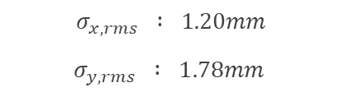



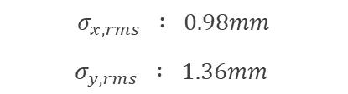

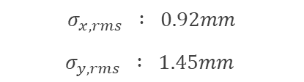


Simulation Set-Up
Macroparticles : 50,000 / Total particles : 3$×{10}^{8}$ (fix.)(on Space Charge)
$$K=$$
Initial beam
In Slit
①
$$σ_{x,rms} : 1.20mm$$
$$σ_{y,rms} : 1.78mm$$
$$t=0.034$$
,no masking
Low-Coupling
②
$$σ_{x,rms} : 0.92mm$$
$$σ_{y,rms} : 1.45mm$$
$$t=0.029$$
,masking
Coupling
③
$$σ_{x,rms} : 1.25mm$$
$$σ_{y,rms} : 1.76mm$$
$$t=0.29$$
,no masking
High-Coupling
④
$$σ_{x,rms} : 0.98mm$$
$$σ_{y,rms} : 1.36mm$$
$$t=0.24$$
,masking
3

Slide 4
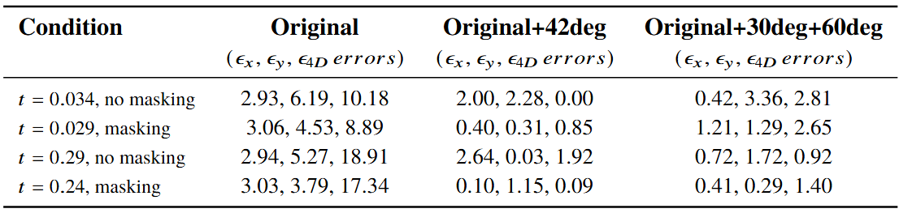
ADS Results Summary
Macroparticles : 50,000 / Total particles : 3$×{10}^{8}$ (fix.)(on Space Charge)
$$K=$$
• When the single ADS is conducted, I found the optimal scan angle to 42deg.
• The ADS method is well reconstructed, especially in the high coupled beam.
4

Slide 5
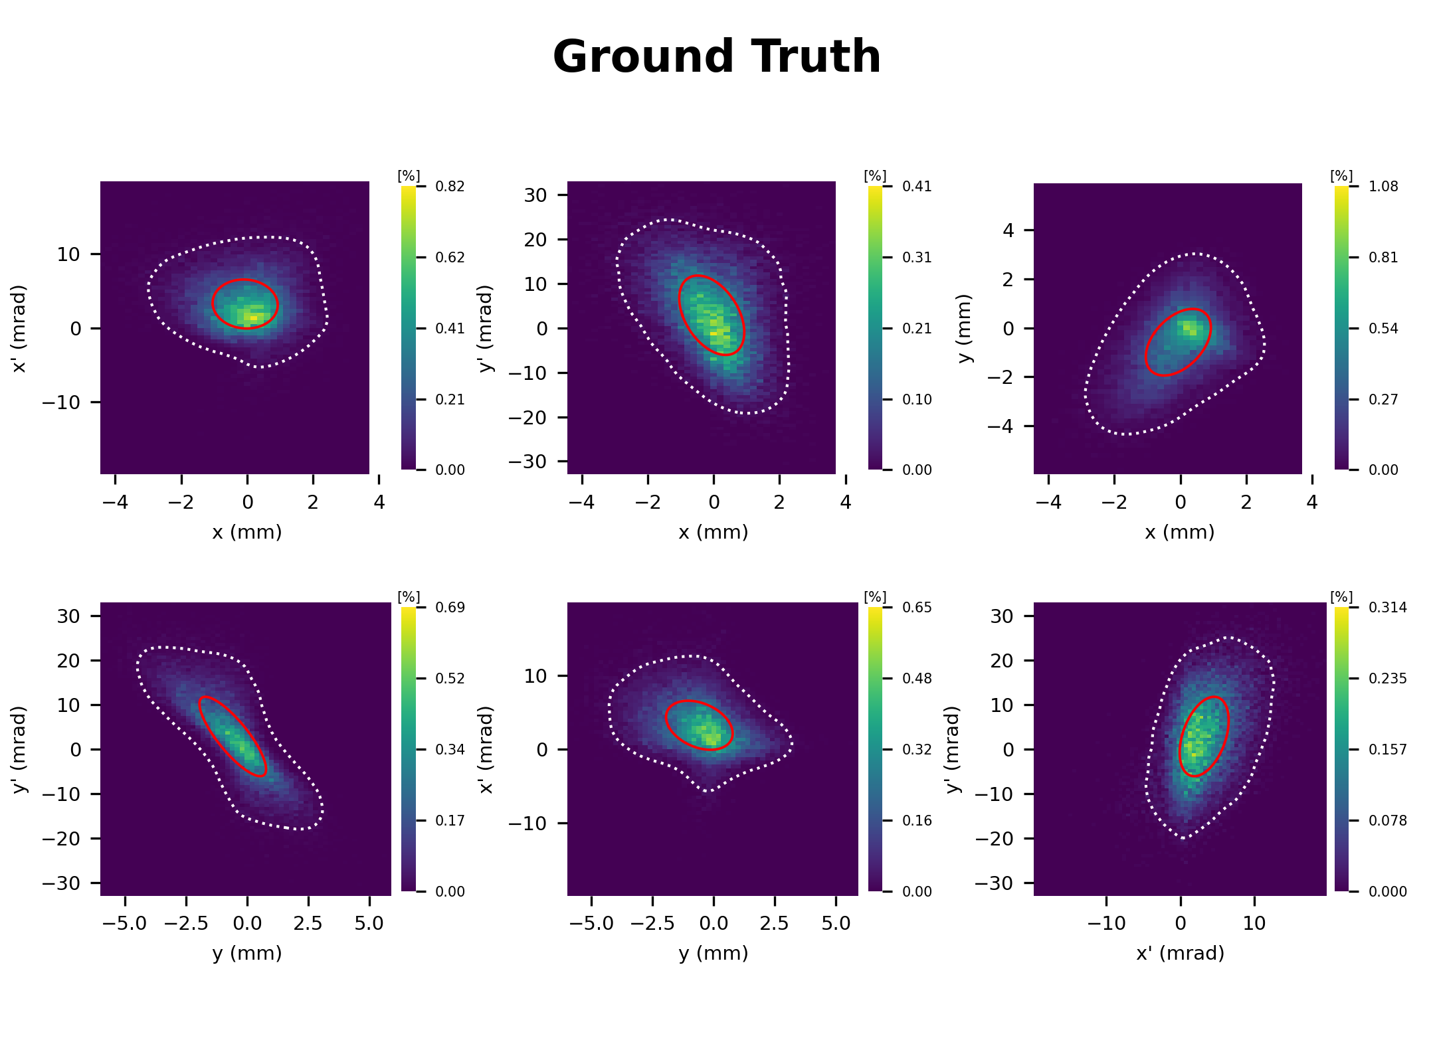
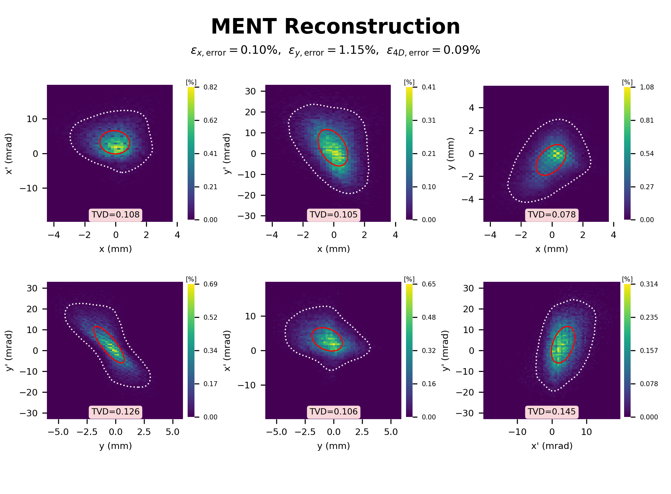

ADS Result Plots
Representative result : t=0.24, masking
$$K=$$
• Additional Diagonal Scan(42 degree)(30iter)
• Red line : rms emittance, white dotted line : 2 sigma line
5

Slide 6
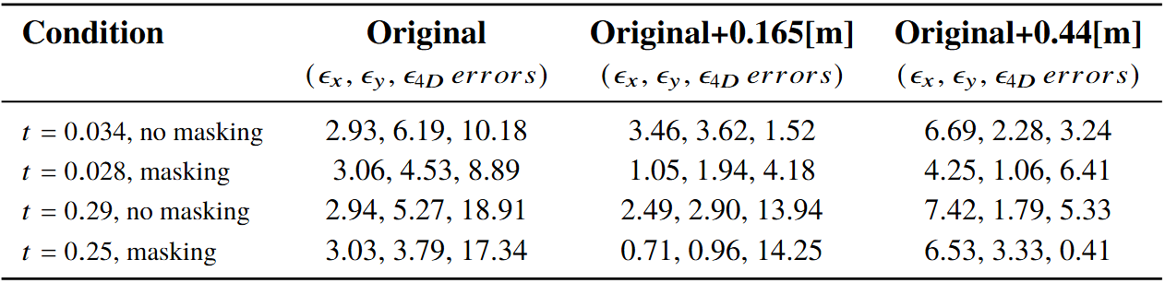
MSS Results Summary
Macroparticles : 50,000 / Total particles : 3$×{10}^{8}$ (fix.)(on Space Charge)
$$K=$$
• The reconstruction of MSS method is worse than that of the ADS method.
• The 4D emittance error decreased significantly, whereas the x and y emittance errors increased.
6

Slide 7
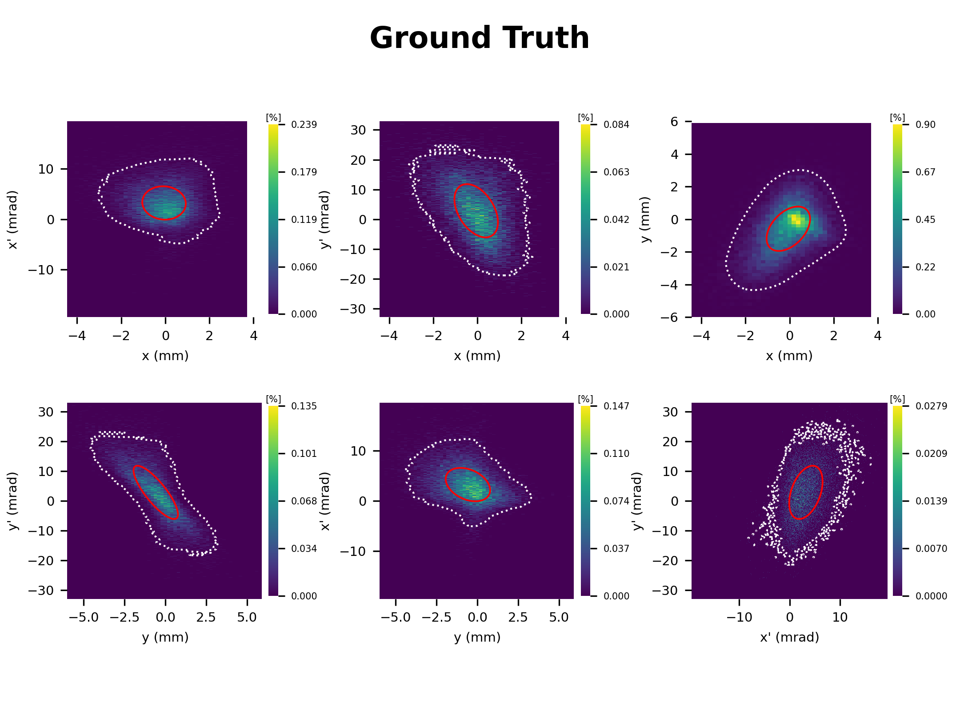
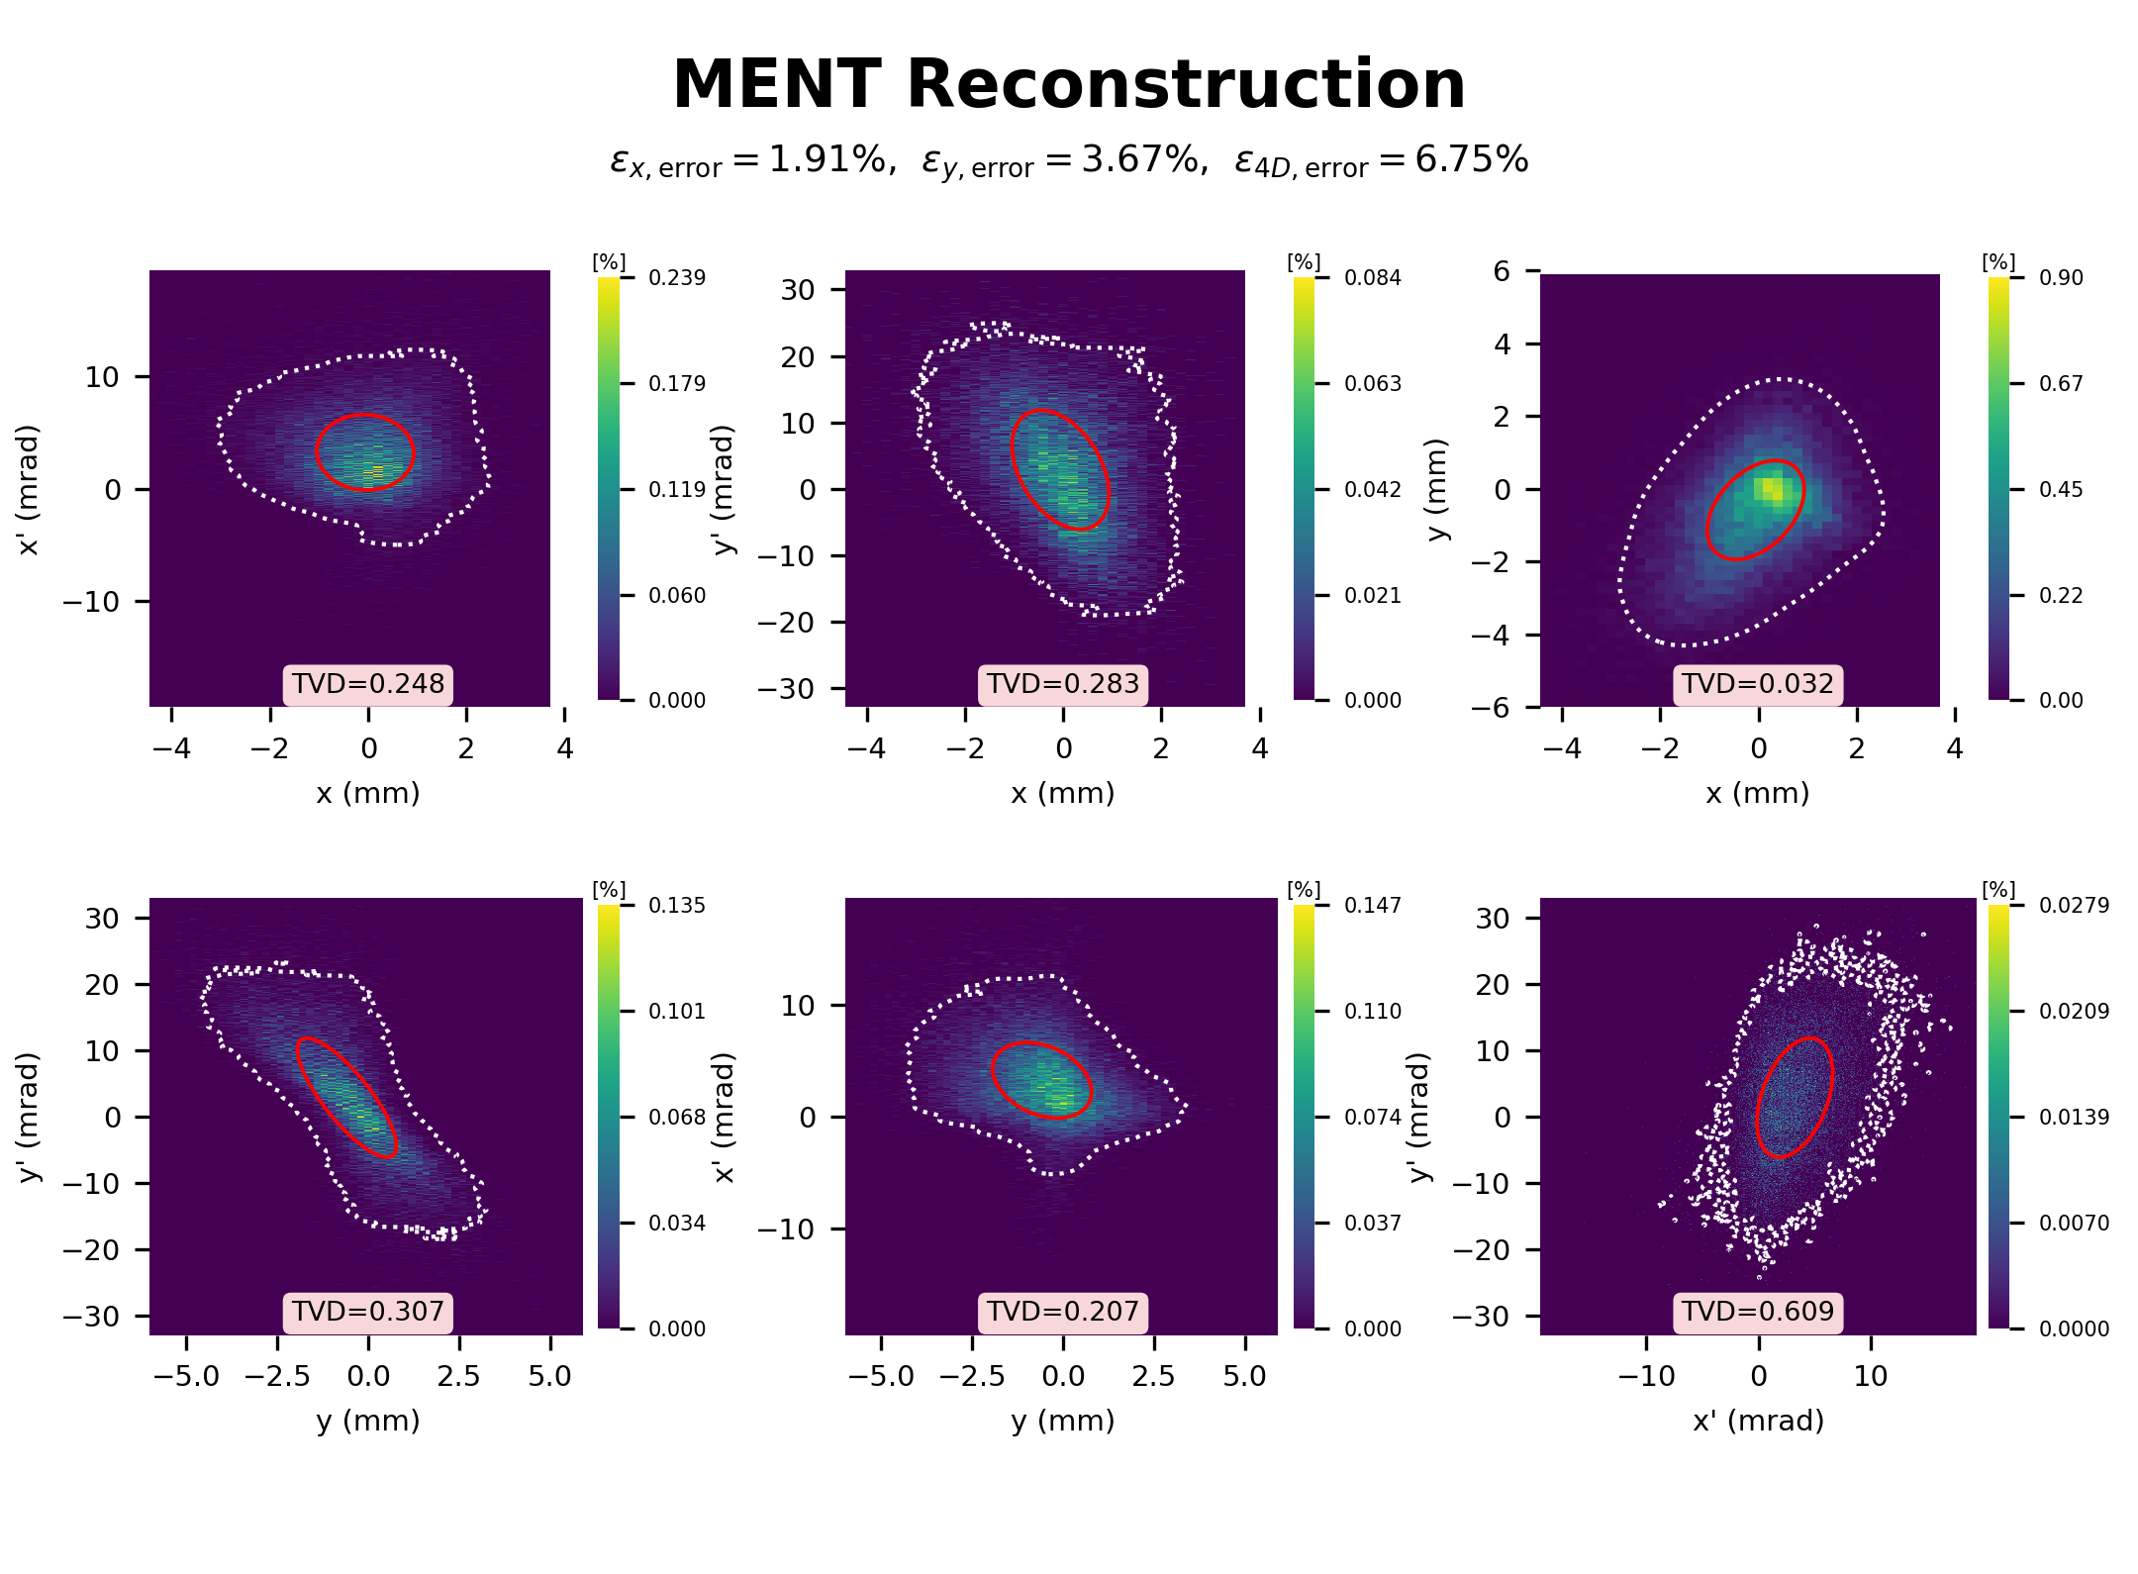
Back to the Original Scan
Macroparticles : 50,000 / Total particles : 3$×{10}^{8}$ (fix.)(on Space Charge)
$$K=$$
• Original Scan(with MENT)(analytical method) : [0.44m]
* t=0.24, masking
• The emittance errors are within 10%, which is reasonable, but the TVD values are very high.
7

Slide 8
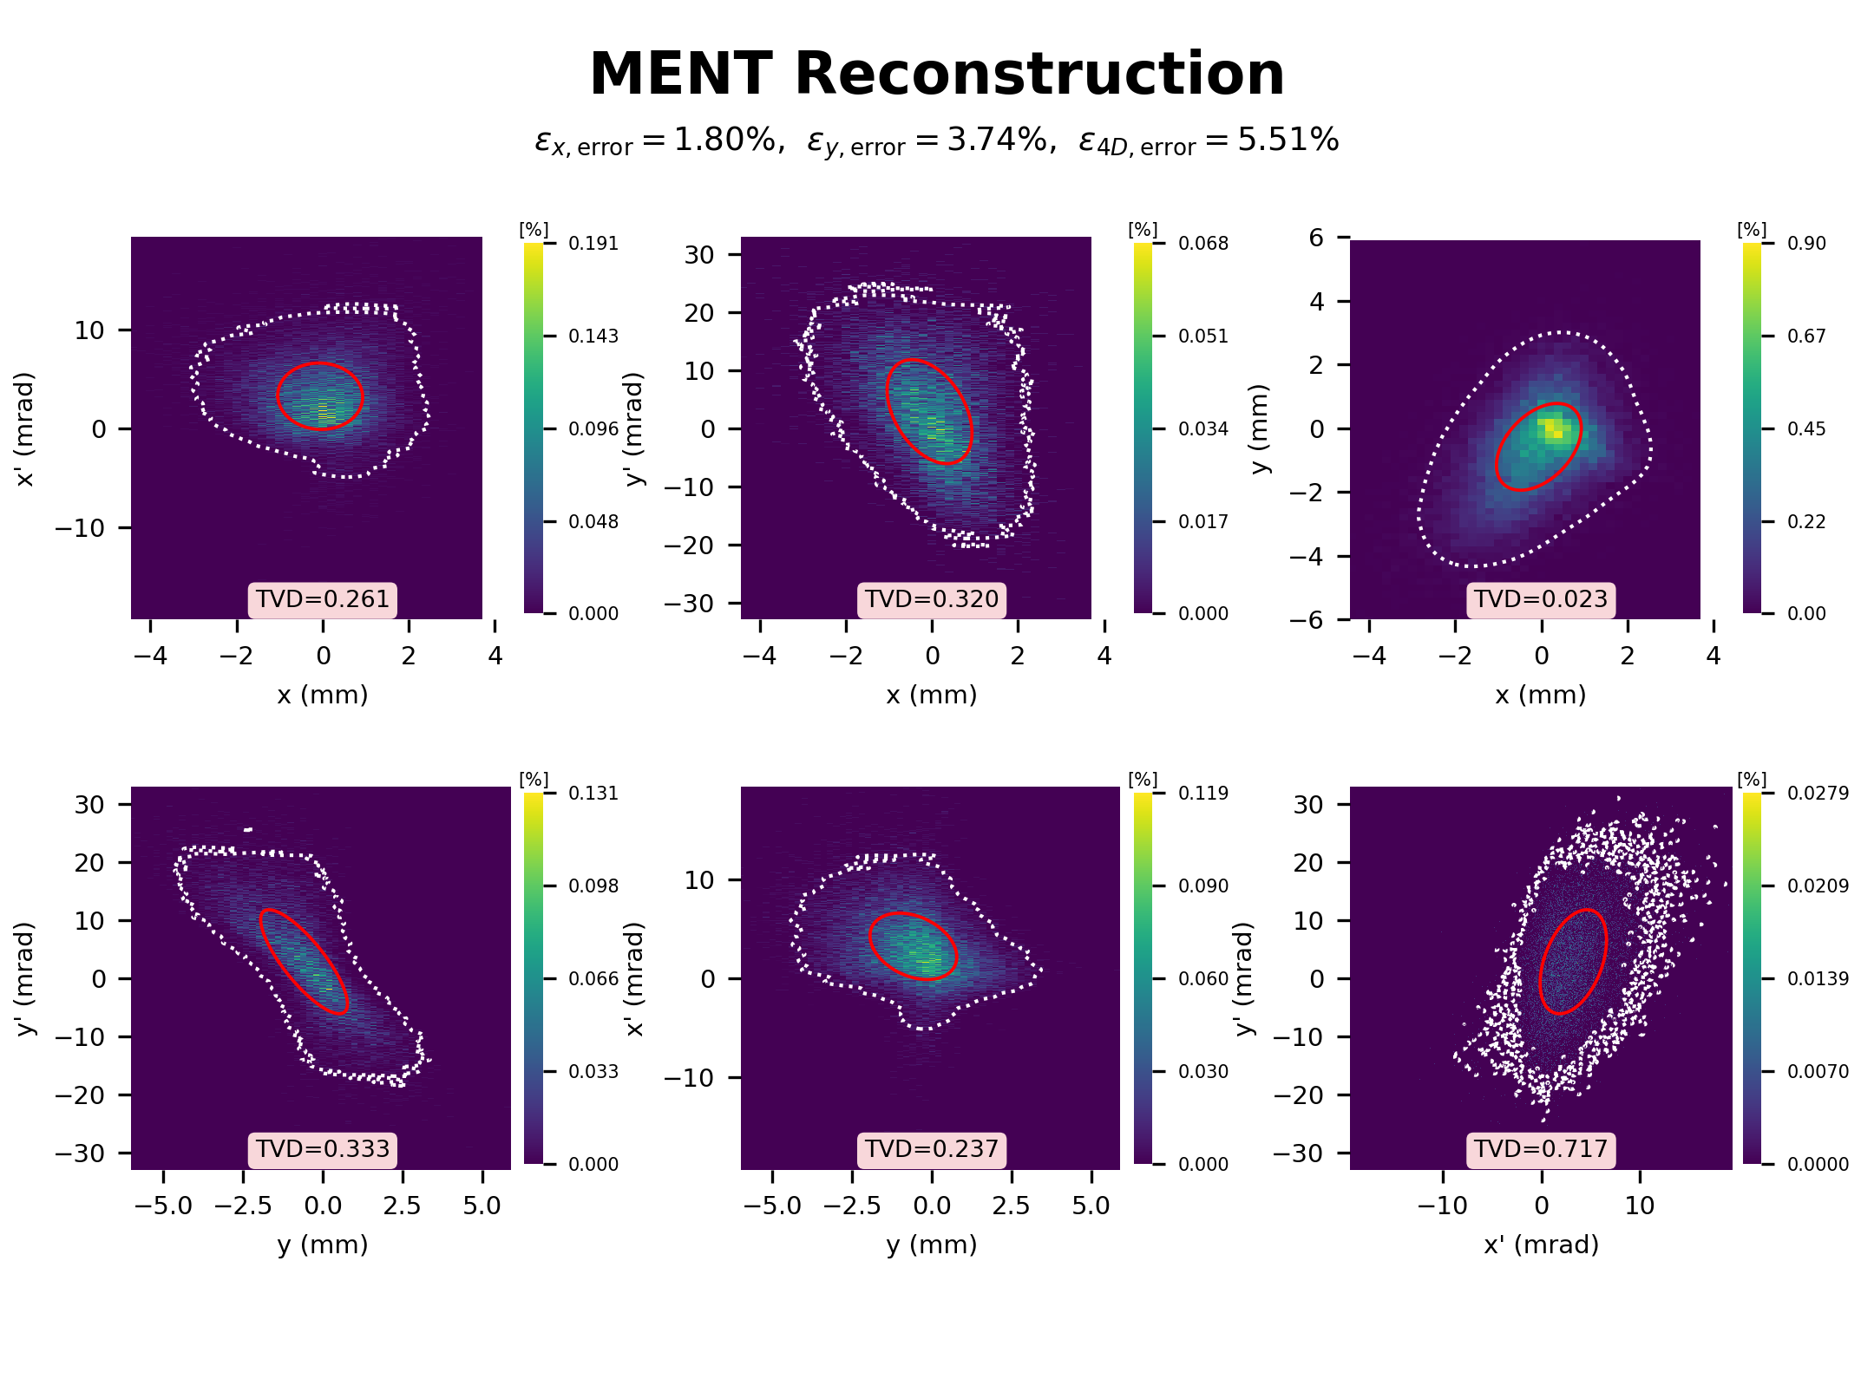
Back to the Original Scan
Macroparticles : 50,000 / Total particles : 3$×{10}^{8}$ (fix.)(on Space Charge)
$$K=$$
• Original Scan(with MENT)(analytical method) : [0.55m]
* t=0.24, masking
• As the L becomes longer, the emittance errors decrease, whereas the TVD values increase.
8

Slide 9
Summary(table)
$$K=$$
ADS
based-on 3variables
MSS
based-on 2variables
9

Slide 10
Summary & Conclusion
$$K=$$
• The ADS method is well reconstructed, especially in the high coupled beam.
- based-on 3 variables
- one scan
• The MSS method is worse than that of the ADS method.
- based-on 2 variables
- scans for each screen
• For the original scan with MENT, a longer L reduces the emittance errors but increases the TVD values.
- This study aims to evaluate not only the emittance but also the detailed phase space distribution.
=> The ADS is considered the more appropriate method
10

