Slide 1
Progress on BTS VPP
Brief update

Slide 2
Outline
1. Review
VPP Workflow
VPP Reconstruction Result
2. Reconstruction Performance under Different Quadrupole settings
Beam Conditions for Reconstruction Failure Cases
Reconstruction Result for the Failure Case
Distortion by Minimum-bit Process
Q7 (=QM3) Strength Scan Summary
3. Possible Limitation of the Current VPP Algorithm

Slide 3
1. Review: VPP Workflow
Slit Scan
Virtual Beamlet
Individual Threshold
$$Σ_{4D, corrected}$$
Slit-width Correction
$$Σ_{4D, uncorrected}$$

Slide 4
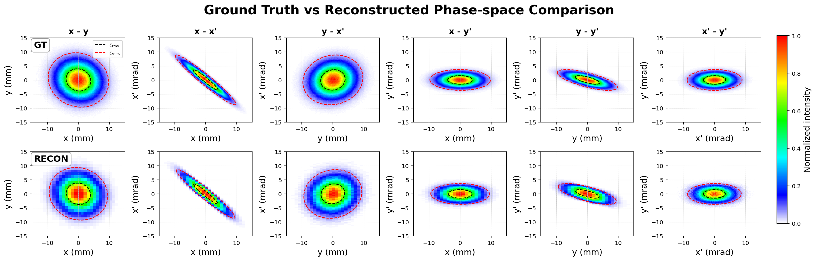
1. Review: Input Beam Matrix 1 :
Input beam matrix from experimental VPP reconstruction at the slit position
(KOMAC BTS, QM3 = 15 A)
 | Ground Truth | Reconstructed | Error
$$α_{x}$$ | 3.522 | 3.420 | 2.89%
$$β_{x}$$ $$[m/rad]$$ | 4.029 | 3.889 | 3.49%
$$α_{y}$$ | 0.981 | 0.954 | 2.71%
$$β_{y}$$ $$[m/rad]$$ | 3.661 | 3.485 | 4.80%
$$coupling t$$ | 0.0113 | 0.0109 | 2.99%
Threshold = 0.1 | Ground Truth | Reconstructed | Error
$$ε_{x}$$ $$[mm.mrad]$$ | 3.941 | 3.832 | 2.76%
$$ε_{y}$$ $$[mm.mrad]$$ | 4.266 | 4.187 | 1.85%
$$\sqrt{ε_{4D}}$$ $$[mm.mrad]$$ | 4.078 | 3.984 | 2.29%

Slide 5
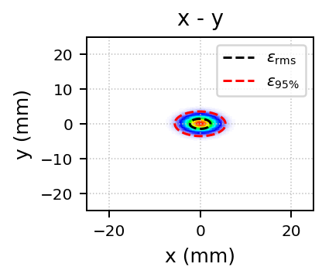
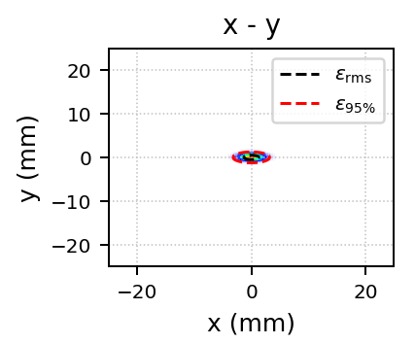
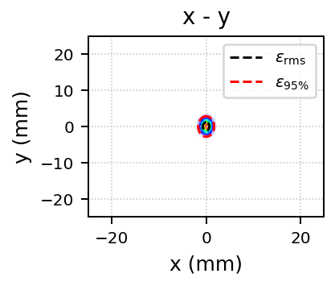
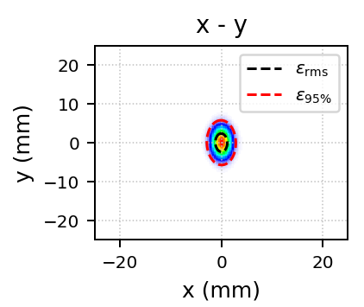
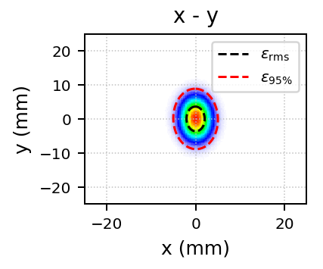
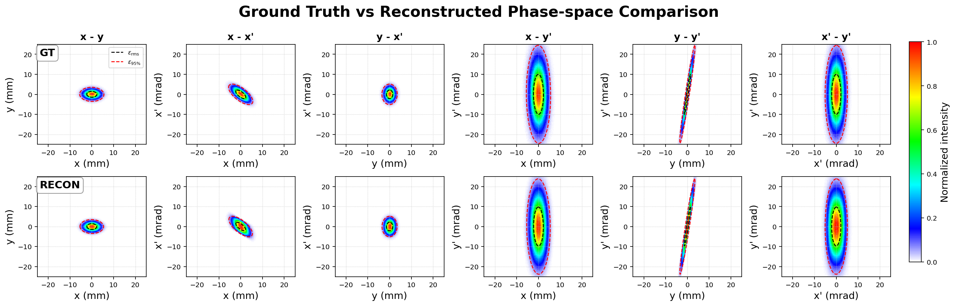
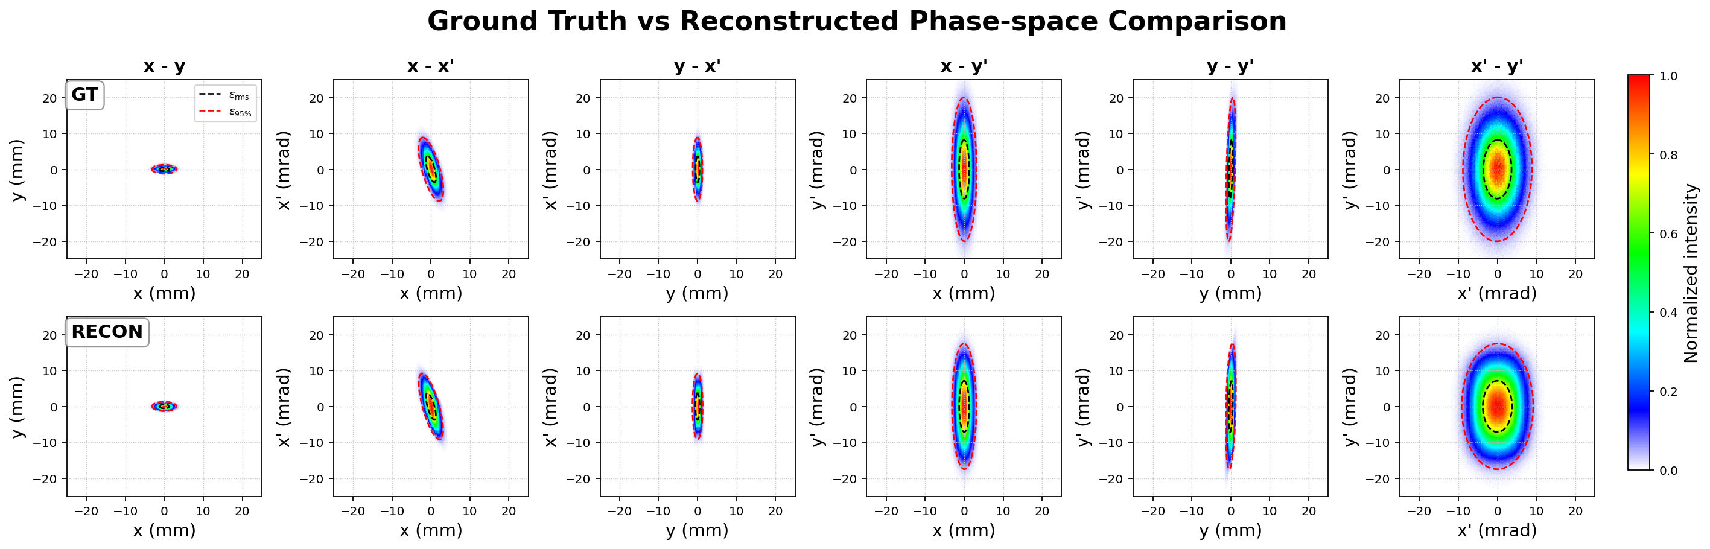
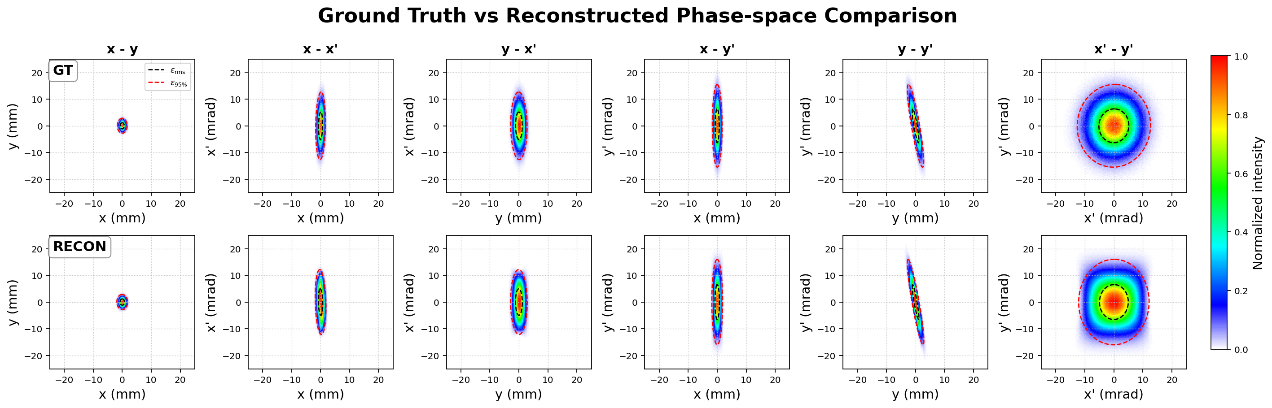
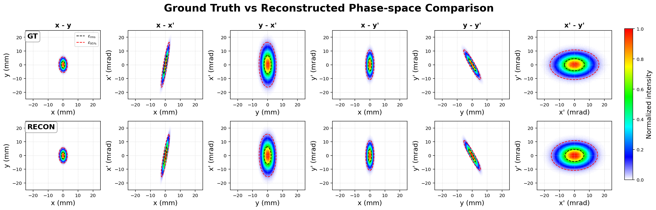
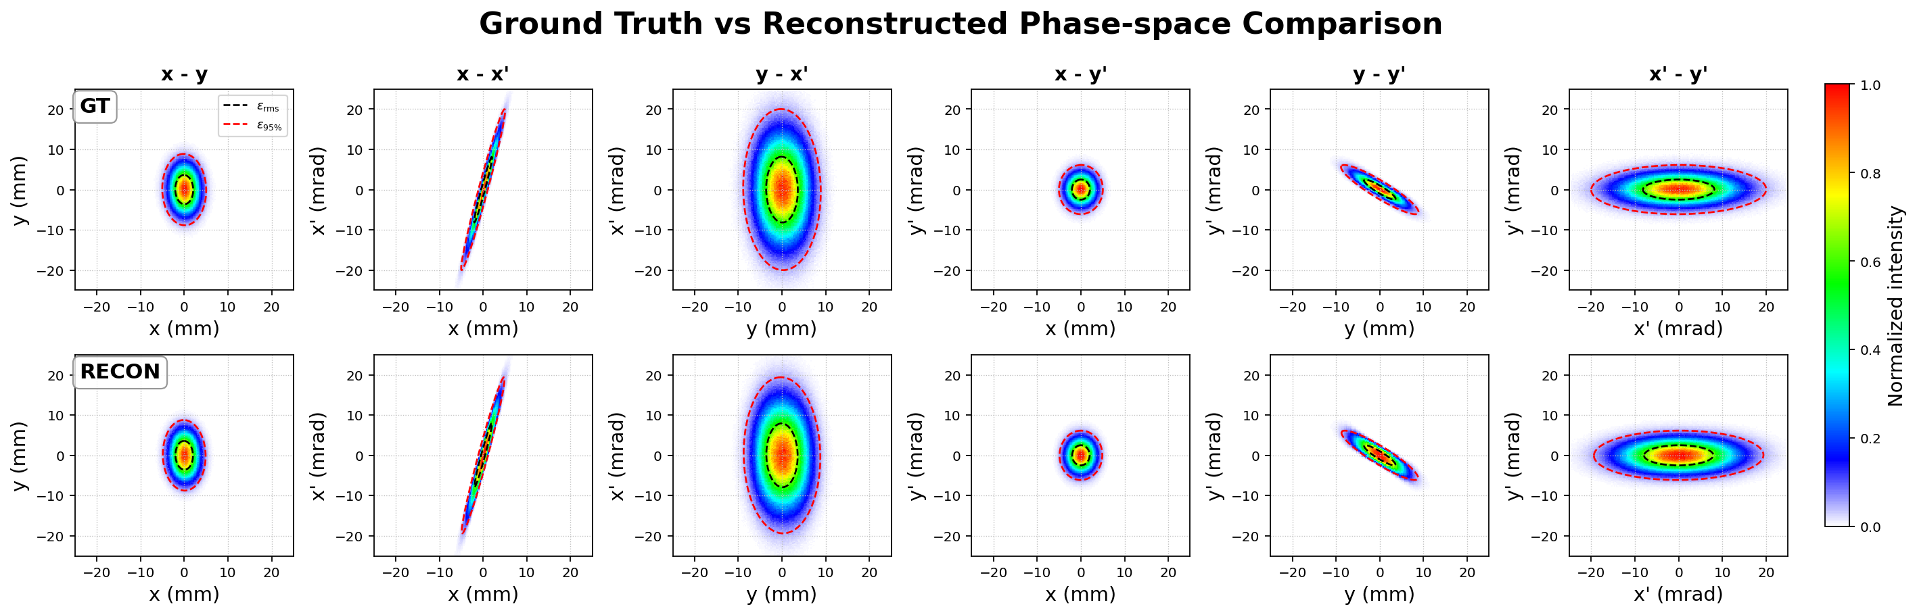
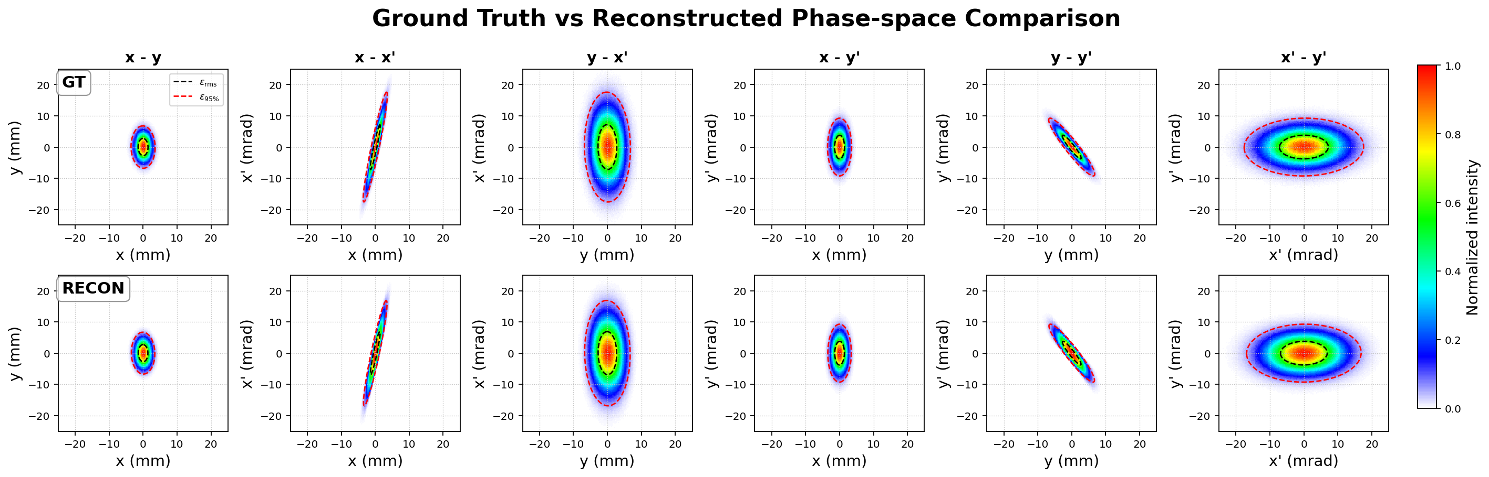
2-1. Beam Conditions for Reconstruction Failure Cases
Failure Case
-1.9 T/m
-1.6 T/m
-1.3 T/m
-1.0 T/m
-0.7 T/m
⬥ Slit-scan Conditions
Slit width = 0.2 mm
Scan step size = 0.2 mm
$$x−y$$
GT
$$x−x′$$
GT
⬥ Notable Beam Conditions
REC
Small transverse beam size that may not be sufficiently resolved by the slit-scan conditions.
Strong position-angle correlation in $x−x^{′}$ and $y−y′$.
$$y−y′$$
GT
REC

Slide 6

2-2. Reconstruction Result for the Failure Case
-1.35 T/m
 | GT | RECON | Error
$$ε_{x}$$ $$[mm.mrad]$$ | 3.541 | 3.729 | 5.31%
$$ε_{y}$$ $$[mm.mrad]$$ | 3.737 | 3.317 | -11.23%
$$\sqrt{ε_{4D}}$$ $$[mm.mrad]$$ | 3.635 | 3.515 | -3.30%
$$α_{x}$$ | 0.120 | 0.421 | 251.71%
$$β_{x}$$ $$[m/rad]$$ | 0.149 | 0.173 | 15.98%
$$α_{y}$$ | 1.400 | 1.844 | 31.81%
$$β_{y}$$ $$[m/rad]$$ | 0.250 | 0.312 | 24.68%
Although the emittance errors are relatively small, the Twiss parameter errors are large.
This indicates that the covariance structure is not accurately reconstructed.
The small emittance error may result from cancellation between beam matrix errors, giving a misleading impression of successful reconstruction.
$$Σ_{4D, error}$$
$$= \left(\begin{matrix}\begin{matrix}22.14\% & 270.39\% \\ 270.39\% & 5.39\%\end{matrix} & \begin{matrix}−302.61\% & −75.91\% \\ −44.63\% & −75.27\%\end{matrix} \\ \begin{matrix}−302.61\% & −44.63\% \\ −75.91\% & −75.27\%\end{matrix} & \begin{matrix}10.68\% & 17.00\% \\ 17.00\% & 5.93\%\end{matrix}\end{matrix}\right)$$

Slide 7
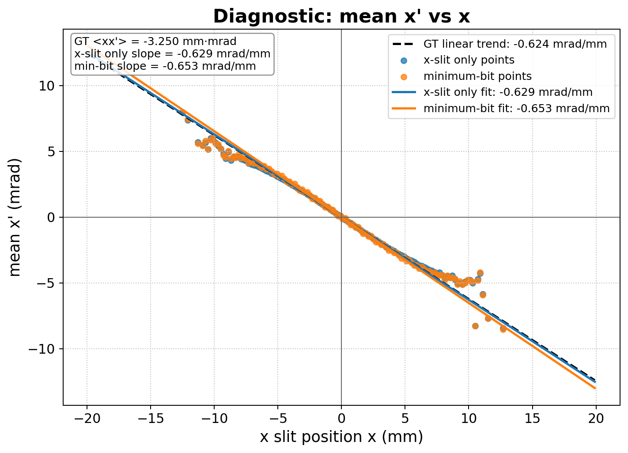
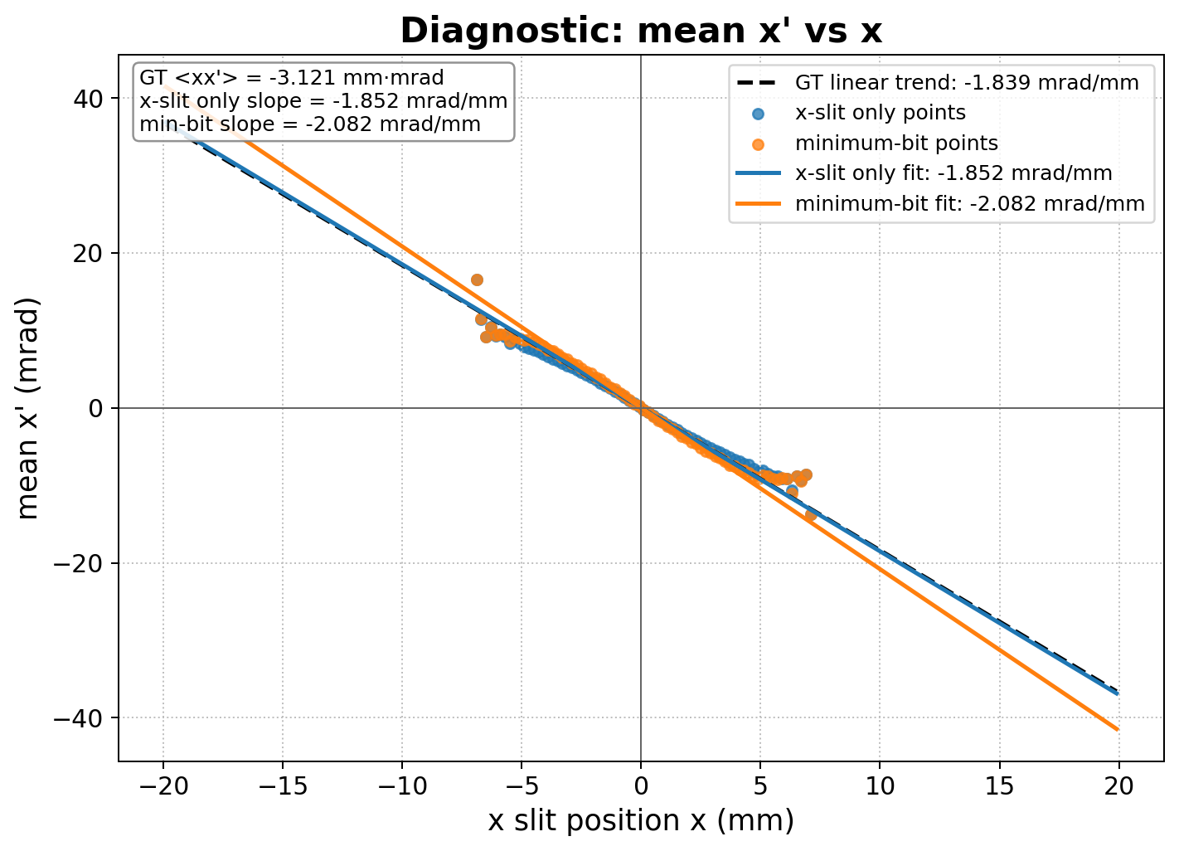
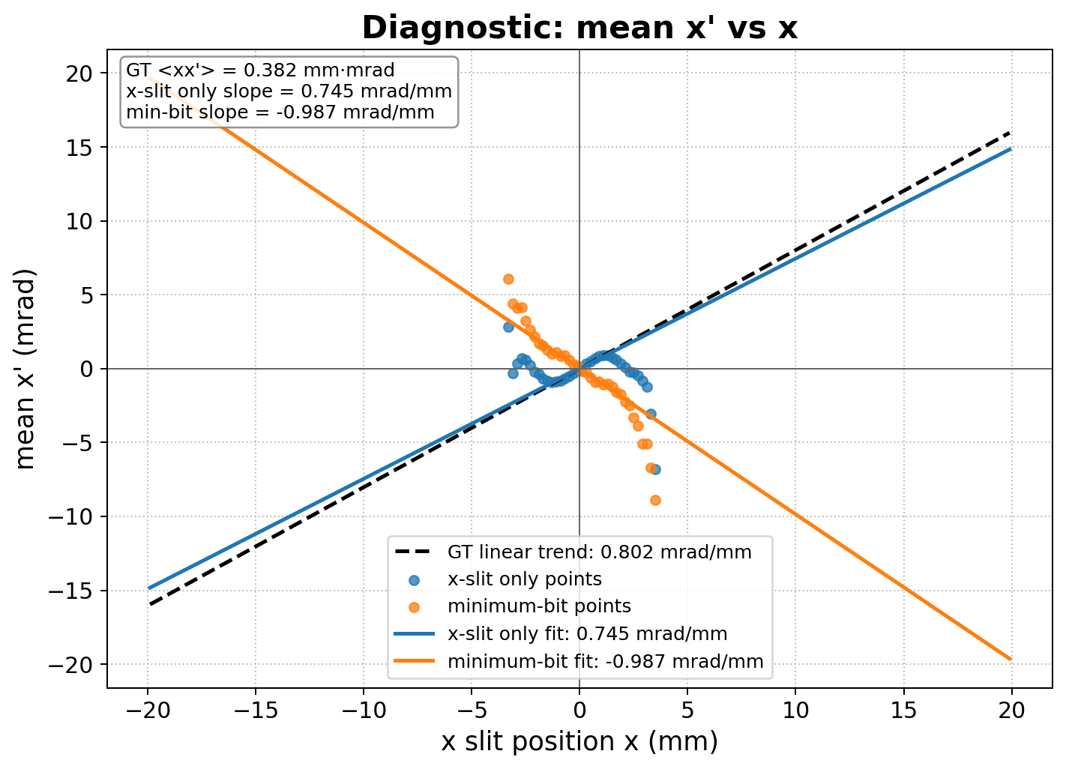
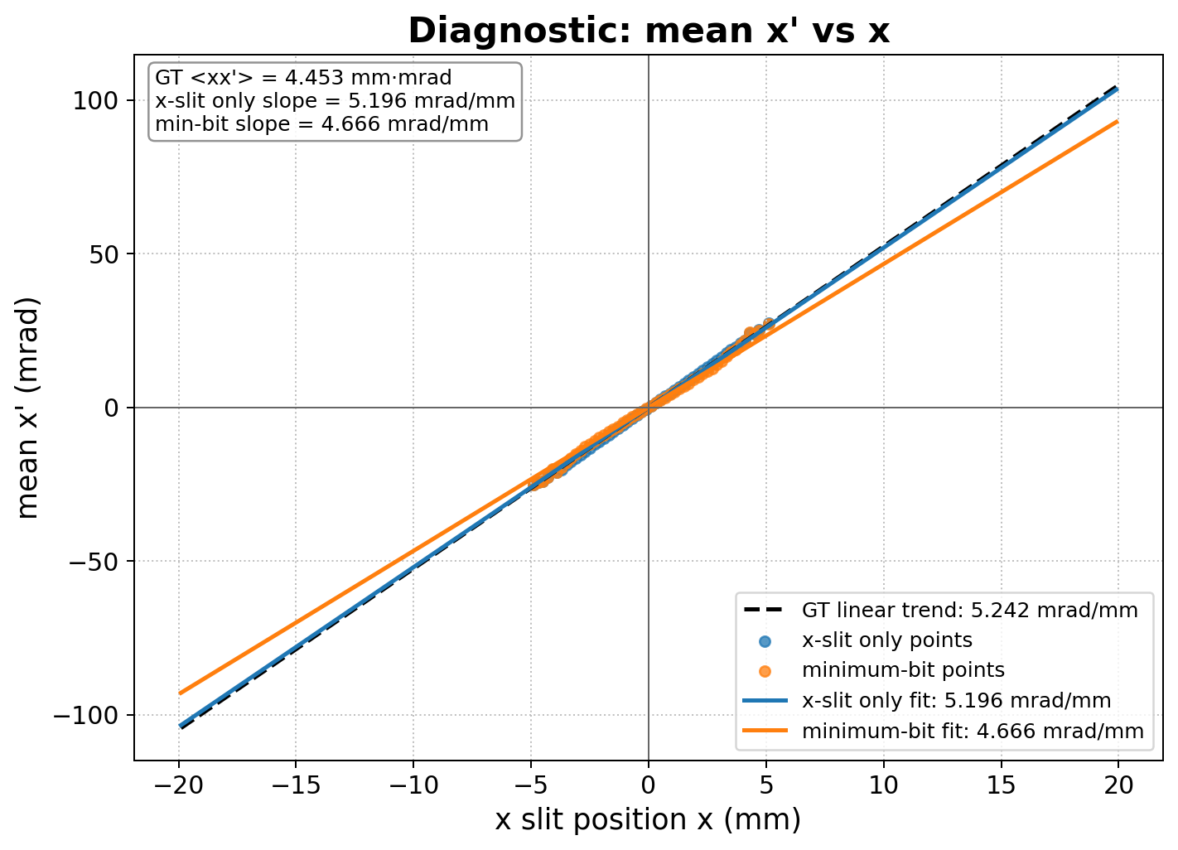
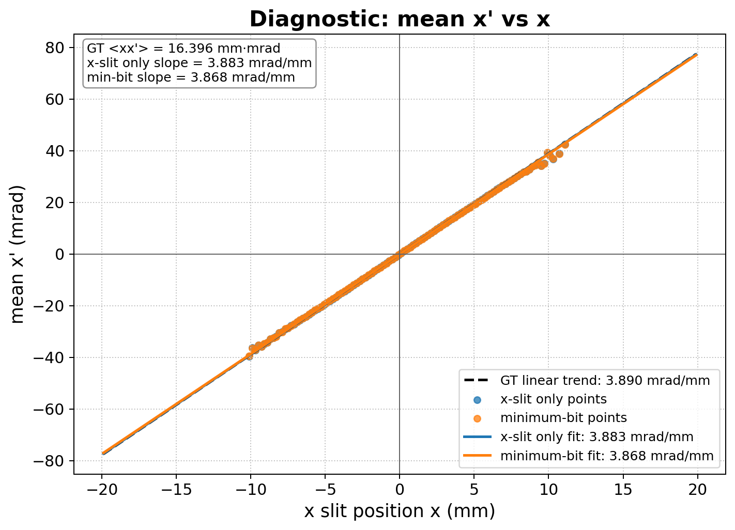
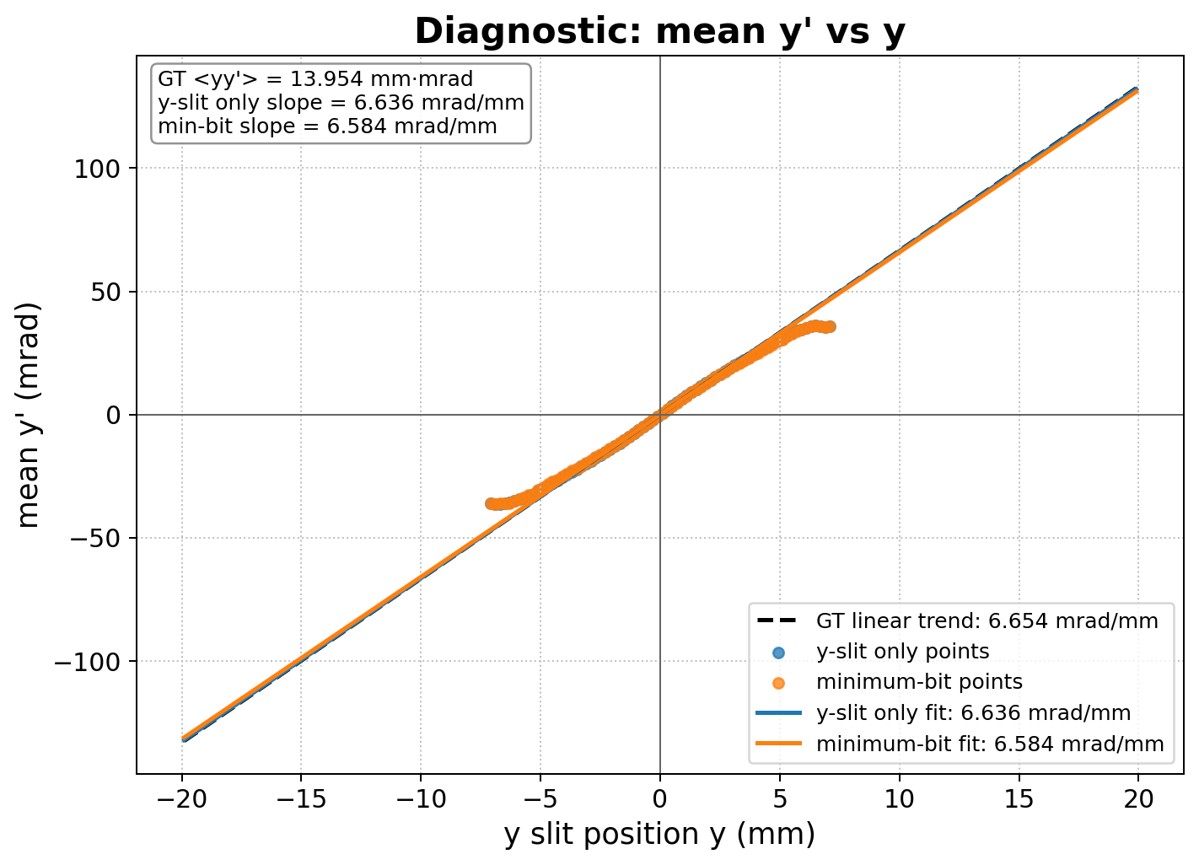
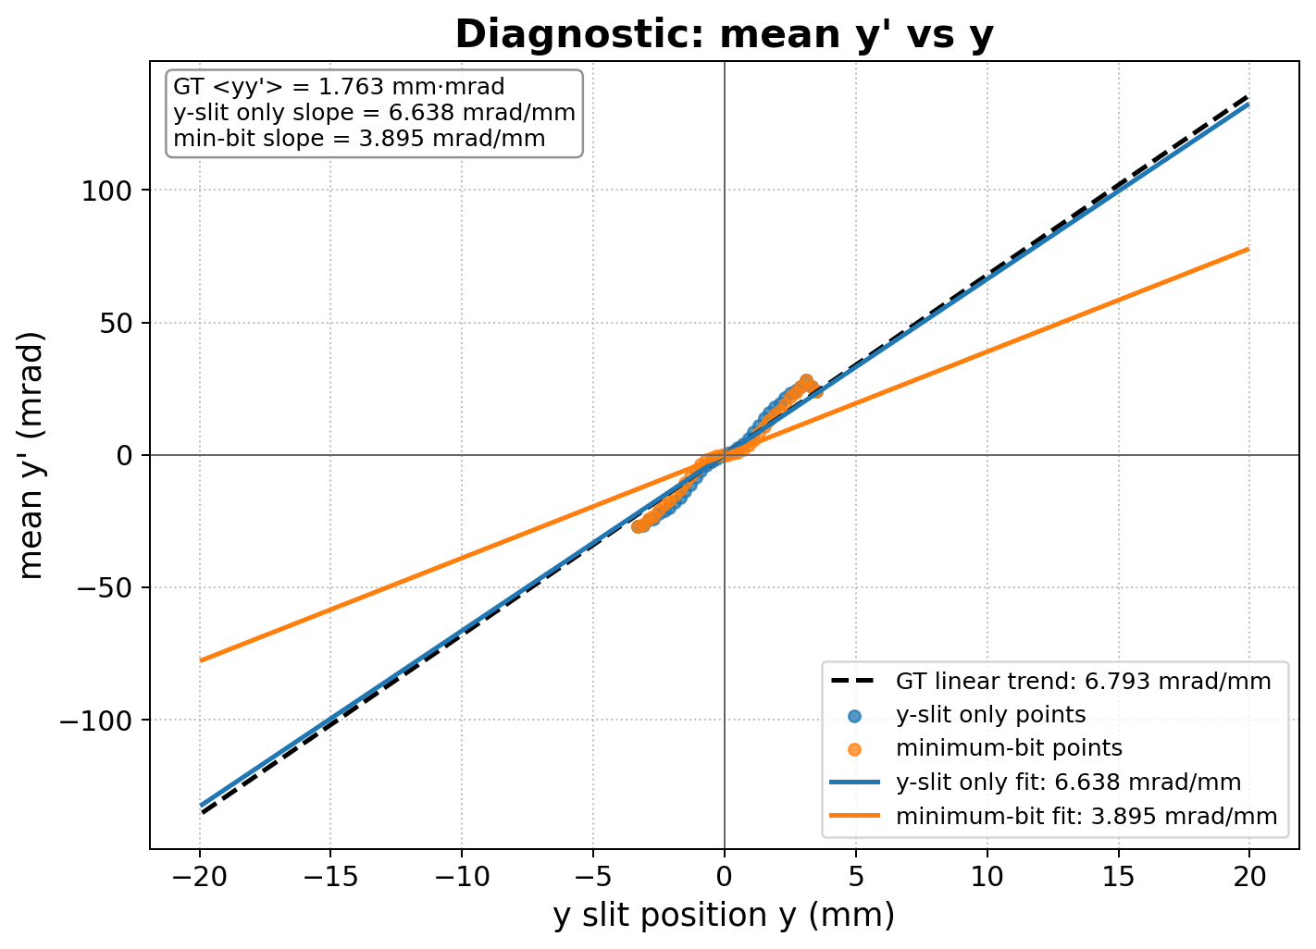
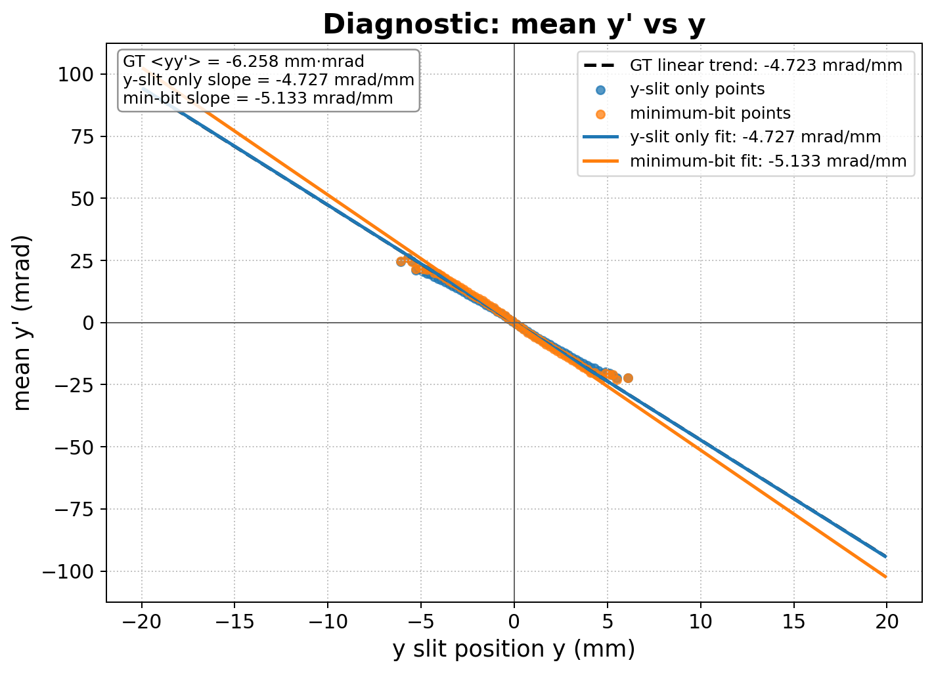
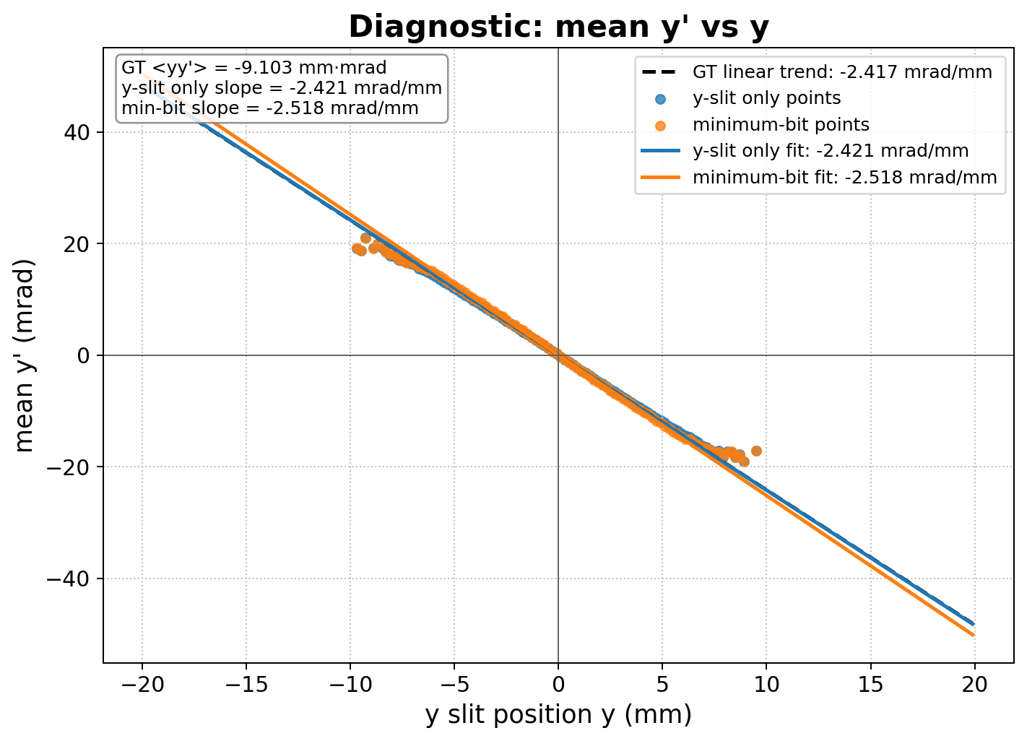
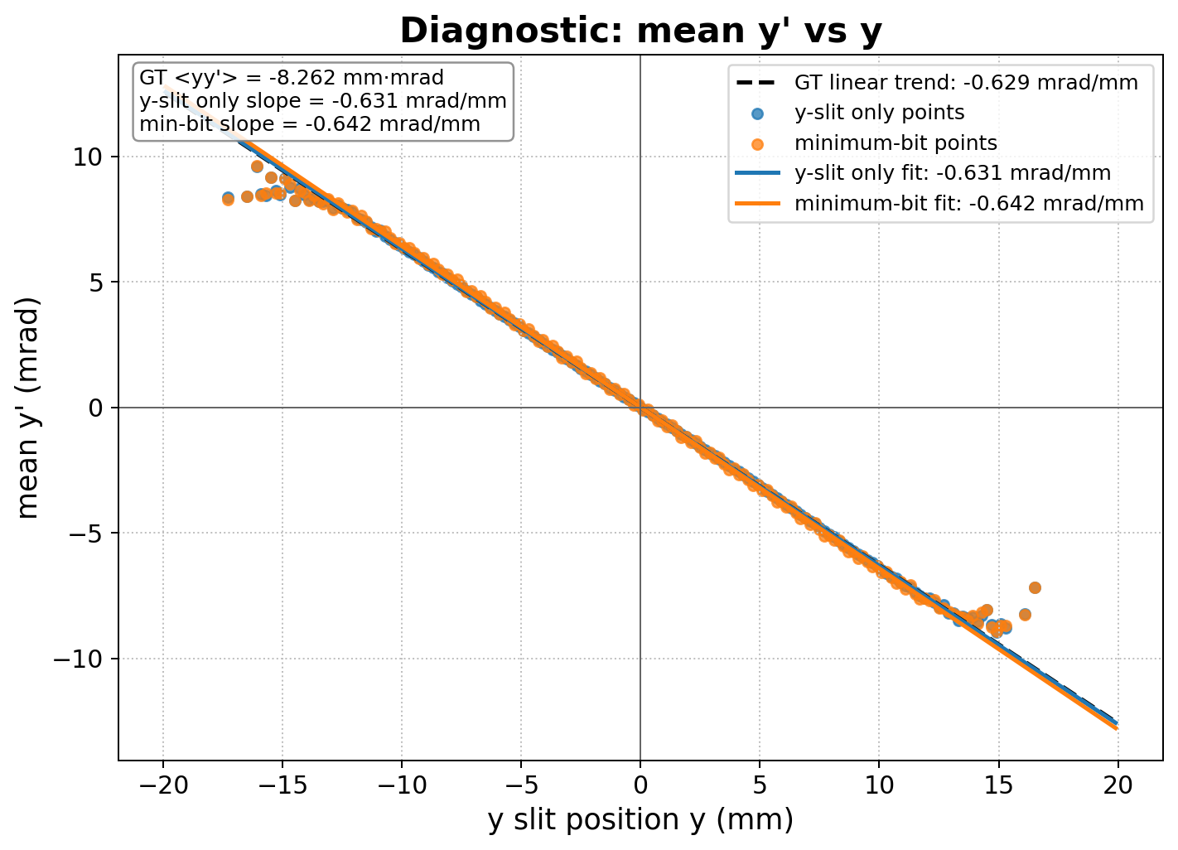
2-3. Distortion by Minimum-bit Process
Failure Case
-1.9 T/m
-1.6 T/m
-1.3 T/m
-1.0 T/m
-0.7 T/m
$x−\left\langle x^{′}\right\rangle$trend
$y−\left\langle y′\right\rangle$ trend
*Black dashed line : ground-truth trend
*Blue : trend from slit-scan data
*Orange : trend after minimum-bit process
: These diagnostic plots compare the mean-angle trends extracted from the original slit-scan distributions and from the virtual beamlet distributions reconstructed by the minimum-bit process.
⇒ The minimum-bit process does not explicitly preserve the original position-angle correlation.
⇒ In the failure-case conditions, this can strongly distort the virtual beamlet distributions, as shown by the large discrepancy between the slit-scan trend and the minimum-bit trend.
⇒ This distortion can lead to significant covariance reconstruction errors.

Slide 8
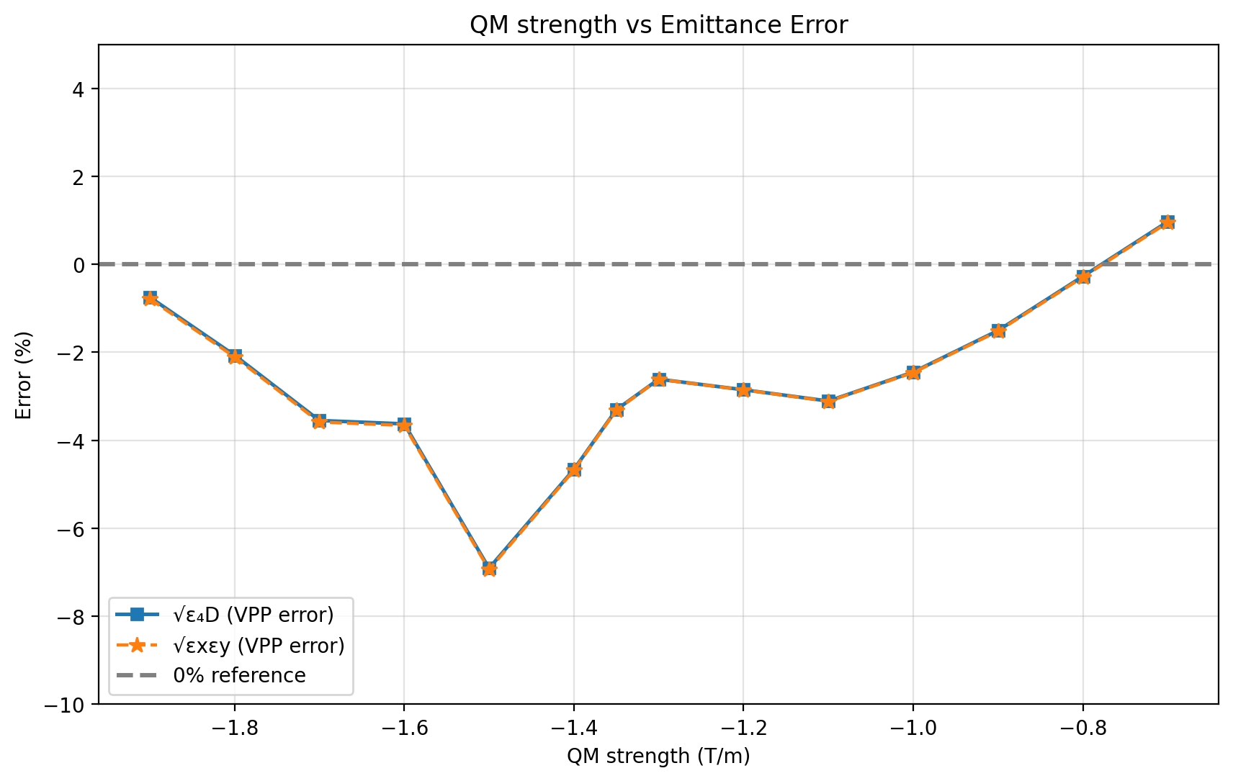
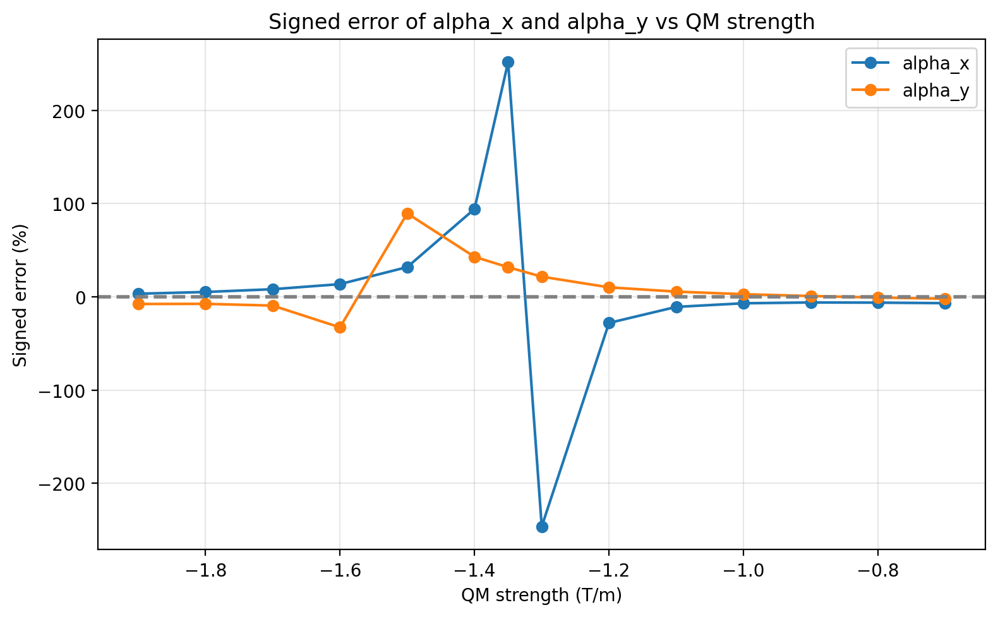
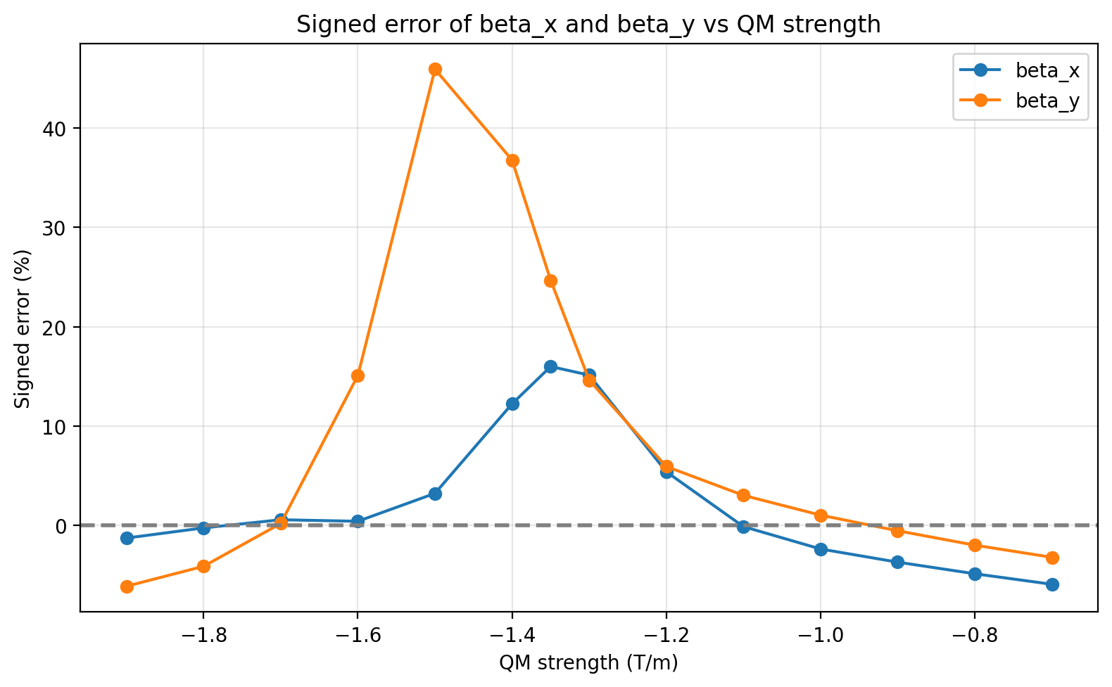
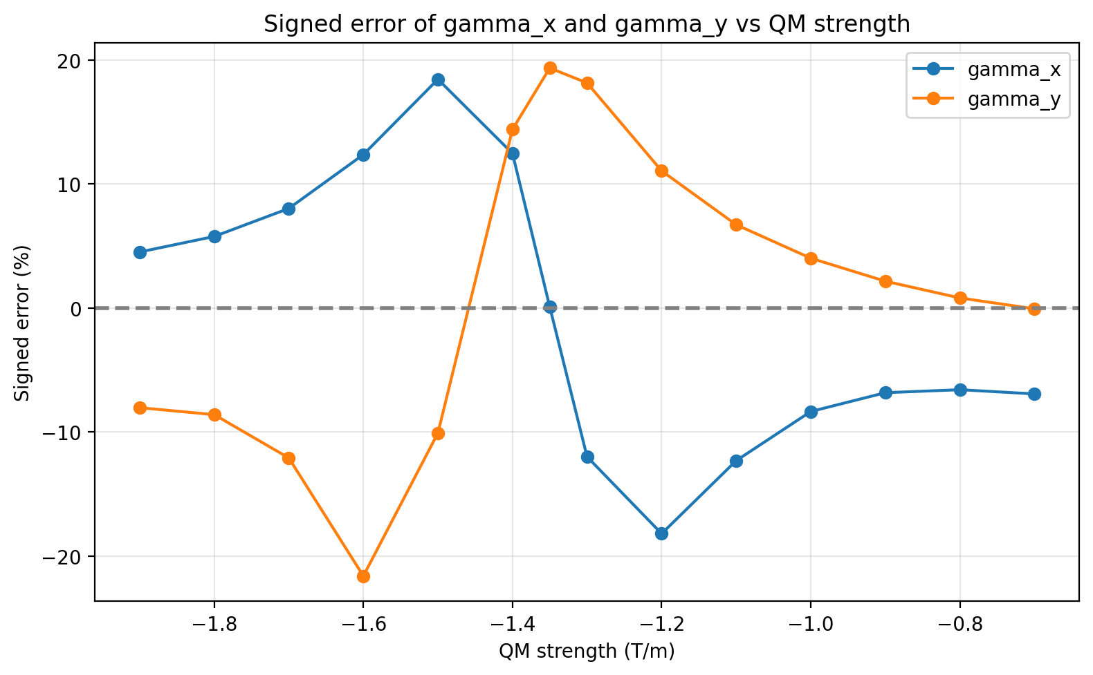
2-4. Q7 (=QM3) Strength Scan Summary
-1.9 T/m
-1.6 T/m
-1.3 T/m
-1.0 T/m
-0.7 T/m
Emittance Error
GT
REC
$α$ Error
GT
$β$ Error
REC
: The failure-case region shows relatively small emittance error, but large Twiss parameter errors.
⇒ Especially, the $α$ errors are large, which are directly related to the position-angle covariance terms, $\left\langle xx′\right\rangle$ and $\left\langle yy′\right\rangle$.
$γ$ Error

Slide 9
3. Possible Limitation of the Current VPP Algorithm
⬥ Summary of Observations
Failure-case beam conditions
Small transverse beam size & Strong position-angle correlation.
Minimum-bit process
Can distort the original slit-scan information.
Reconstruction result
Small emittance error but large Twiss/covariance errors.
Q7 (=QM3) strength scan
Error increases near the failure-case region, i.e., under failure-case beam conditions.
⬥ Working Interpretation
The current VPP algorithm may not be robust when the beam is strongly position-angle correlated and/or insufficiently resolved by the slit-scan conditions.
In this case, emittance alone is not a sufficient indicator of reconstruction accuracy.
⇒ Further studies are needed to separate the effects of beam correlation and slit-scan resolution.

Slide 10
Thank you
for your attention

