Slide 1

2026-07-16, ZOOM
26.07.16
-updates
DAON LEE
2026 The Beam Diagnostics and Tomography Study

Slide 2
Outline
Ⅰ. Discussion Points
- Diagonal slit width & issue of diagonal scan spacing
- Using GPU for iterative recon.
- The issue of 45 degree
Ⅱ. Reconstruction with Additional Diagonal Scan(ADS)
- Comparison of different angle scans
Ⅲ. Summary & Discussion

Slide 3















Additional Diagonal Scan(ADS) Set-up
In X-suite
$$=$$
• Additional Diagonal Scan
Slit position
Screen position
* Previous scan set-up
x-y coordi.
$$y$$
(x$scan$)
u-v coordi.
$$ρ(x_{i},x_{f}y_{f})$$
$$u$$
$$v$$
(v$scan$)
(u$scan$)
$$ρ(v_{i},x_{f}y_{f})$$
$$ρ(u_{i},x_{f}y_{f})$$
44deg
x-y coordi.
Just one coordinates system(x-y)
0.2mm
Two coordinates system
(x-y) & (u-v)
$$x$$
($y scan$)
$$ρ(y_{i},x_{f}y_{f})$$
0.2mm
Diagonal angle = $θ$
1. Slit spacing : at 30&60 scan, it has different slit width and spacing.
2. We don’t have appropriate GPUs to compute macro=total case.
3. 45 scan : In x-y plane, it has a large TVD.
$$∆y_{i}=∆v_{i}\left|cos⁡θ\right|$$
3

Slide 4
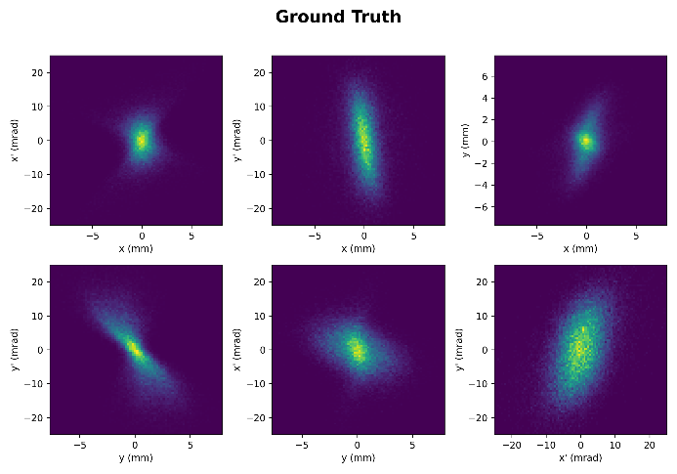
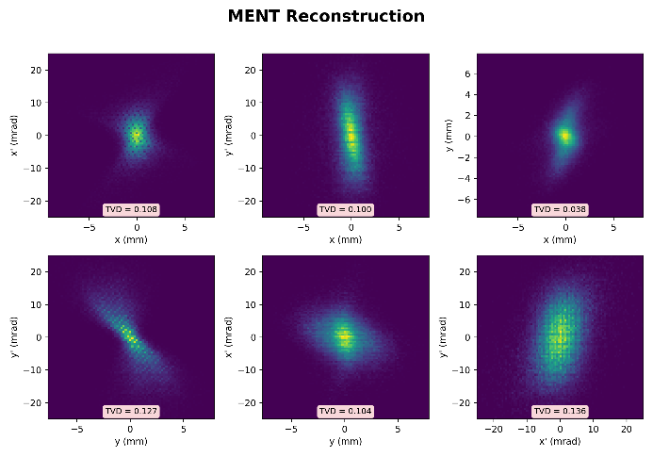
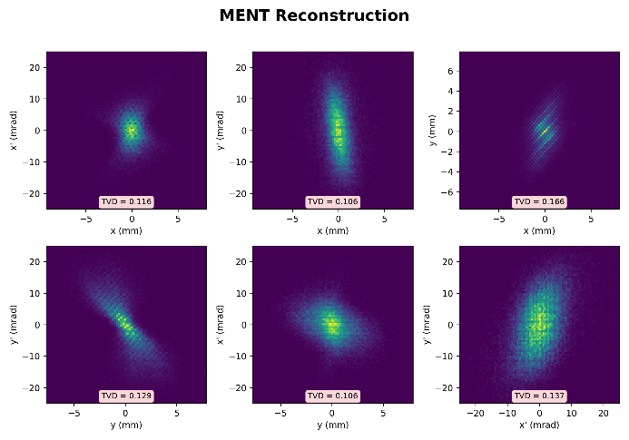
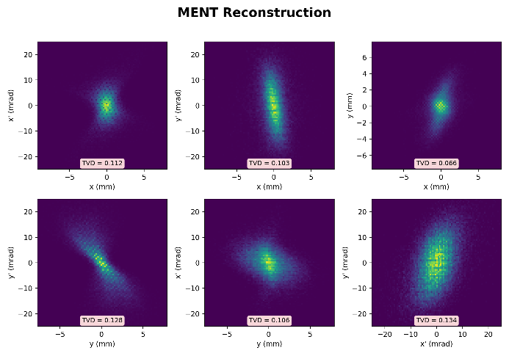




ADS Results (previous results)
Macroparticles : 50,000 / Total particles : 300M (t=0.25)
$$K=$$
• Original Scan
• Additional Diagonal Scan(45 degree)(10iter)
• Additional Diagonal Scan(42 degree)(10iter)
0.116
0.166
0.112
0.127
0.136
0.127
0.137
0.128
0.134
$$ε_{x} error :2.68\%$$
$$ε_{y} error :4.93\%$$
$$ε_{4D} error :14.86\%$$
$$ε_{x} error :4.73\%$$
$$ε_{y} error :1.82\%$$
$$ε_{4D} error :5.07\%$$
$$ε_{x} error :2.69\%$$
$$ε_{y} error :0.15\%$$
$$ε_{4D} error :2.02\%$$
4

Slide 5
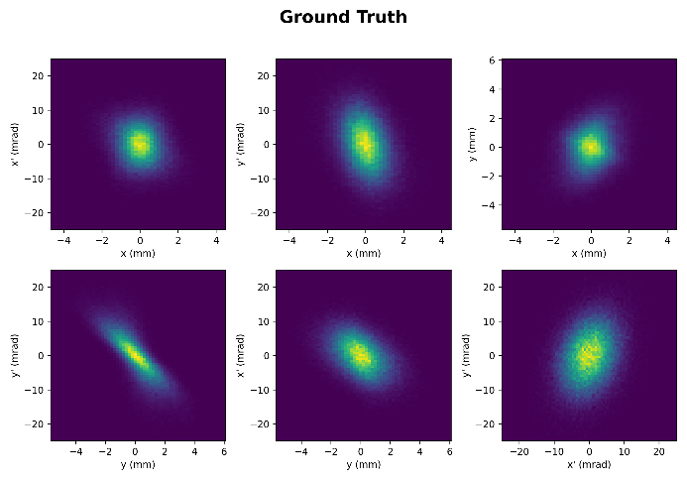
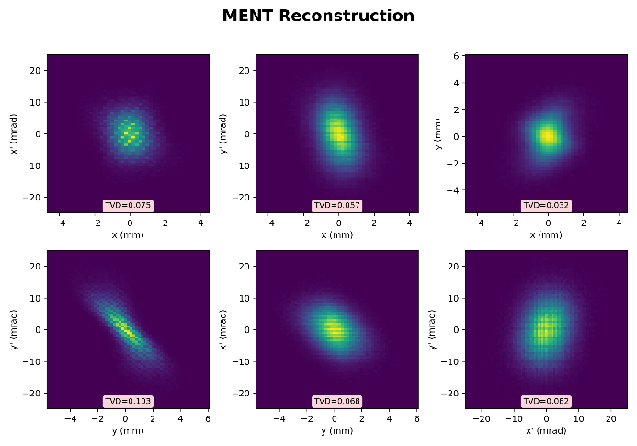
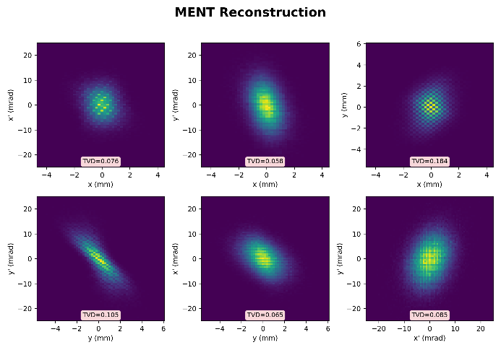







ADS Reconstruction Results
Macroparticles : 100,000 / Total particles : 100M (t=0.19)
$$K=$$
• Original Scan
• ADS(45 degree)(50iter)
• ADS(42 degree)(50iter)
• ADS(30,60 degree)(50iter)
x-y scan(0.2mm) + 45(0.2828mm/*)
x-y scan(0.2mm) + 42(0.2691mm/*)
x-y scan(0.2mm) + 30/60(0.2309mm*/0.4mm*)
0.184
$$ε_{x} error :1.16\%$$
$$ε_{y} error :2.27\%$$
$$ε_{4D} error :6.82\%$$
$$ε_{x} error :2.37\%$$
$$ε_{y} error :1.65\%$$
$$ε_{4D} error :2.68\%$$
$$ε_{x} error :1.32\%$$
$$ε_{y} error :0.65\%$$
$$ε_{4D} error :0.73\%$$
$$ε_{x} error :0.09\%$$
$$ε_{y} error :0.06\%$$
$$ε_{4D} error :0.84\%$$
5

Slide 6
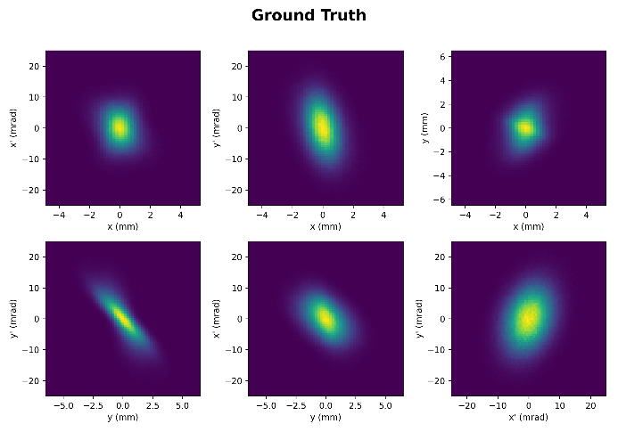
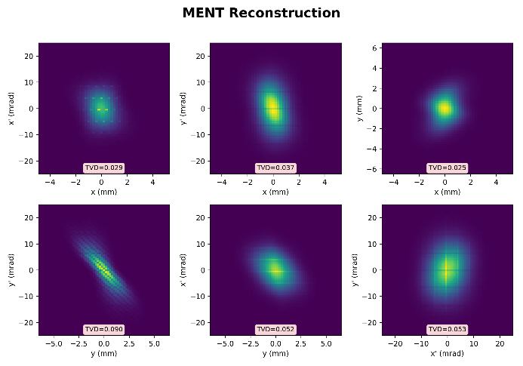
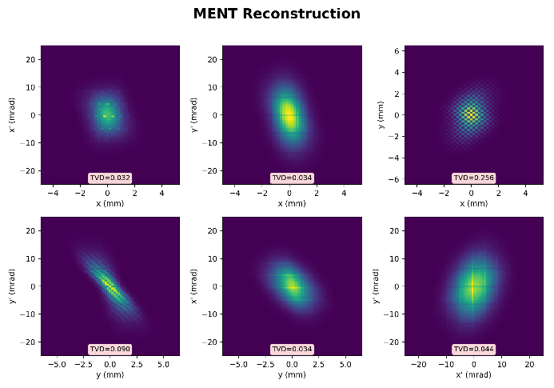
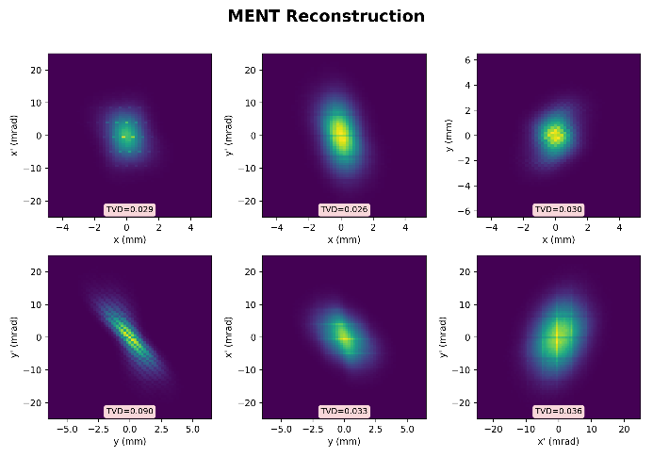
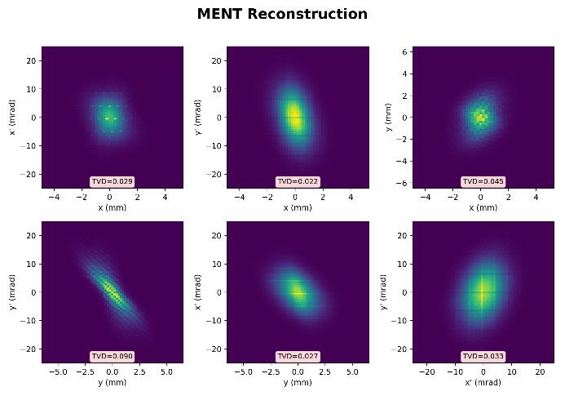




ADS Reconstruction Results
Macroparticles : 1M / Total particles : 100M (t=0.19)
$$K=$$
• Original Scan
• ADS(45 degree)(50iter)
• ADS(42 degree)(50iter)
• ADS(30,60 degree)(50iter)
x-y scan(0.2mm) + 45(0.2828mm/*)
x-y scan(0.2mm) + 42(0.2691mm/*)
x-y scan(0.2mm) + 30/60(0.2309mm*/0.4mm*)
0.256
$$ε_{x} error :1.14\%$$
$$ε_{y} error :2.33\%$$
$$ε_{4D} error :7.07\%$$
$$ε_{x} error :0.19\%$$
$$ε_{y} error :1.15\%$$
$$ε_{4D} error :2.46\%$$
$$ε_{x} error :0.47\%$$
$$ε_{y} error :1.38\%$$
$$ε_{4D} error :2.81\%$$
$$ε_{x} error :0.72\%$$
$$ε_{y} error :1.47\%$$
$$ε_{4D} error :3.05\%$$
6

Slide 7
Summary & Discussion
• Changing the diagonal slit width and spacing(now these are same)
• In x-y plane, 45 scan still has a large TVD.
(And multi-screen scan is being coded…)
1. Change the screen resolution(to reduce vacancies)
(I am not sure how to accurately verify to what extent the reconstruction using MENT is valid)
2. Put two different slit plates
3. Should I stop working on ADS at this point and try the multi-screen method?

