Slide 1
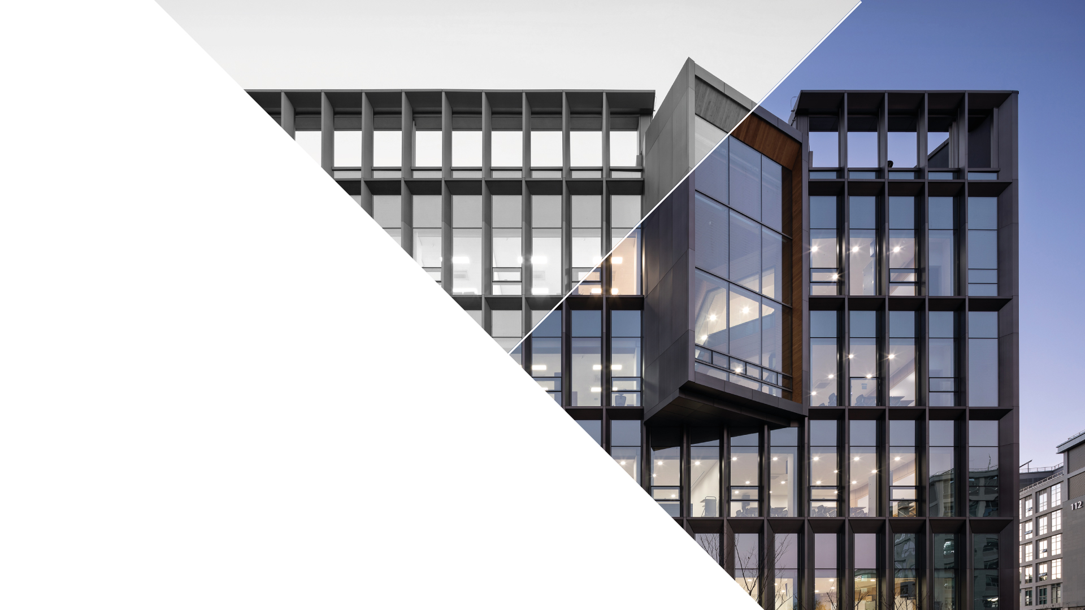

Status Report
July 24, 2026
Soyeon Kim
CONTACT
Department of Physics
4th Natural Science Building 108
https://physics.unist.ac.kr/

Slide 2

Contents
2
Active energy compression
Injection into PLS-II storage ring
Future plans

Slide 3
3
Active energy compression

Slide 4
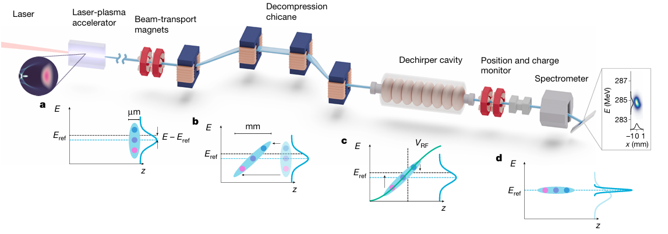
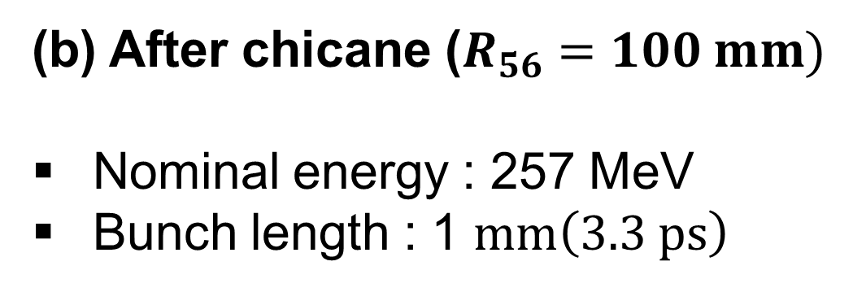
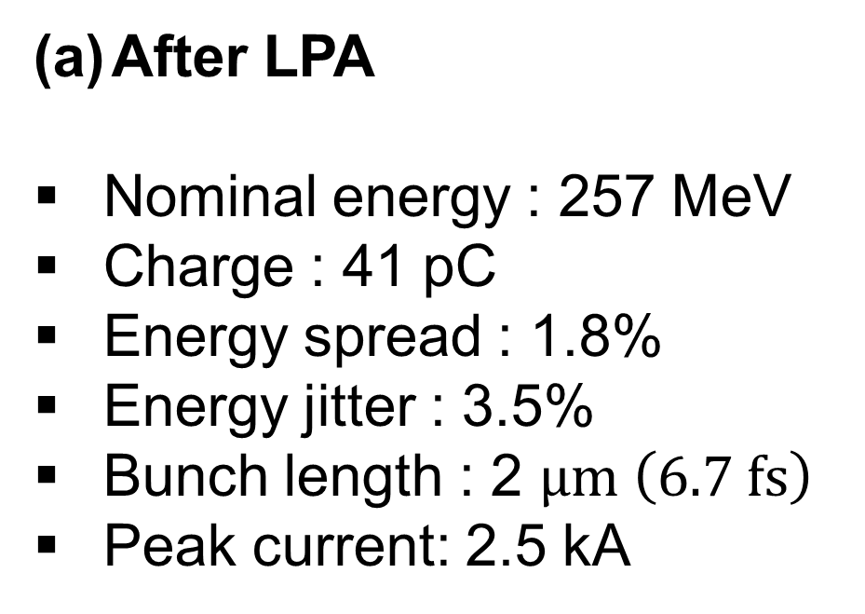
Active energy compression of a laser-plasma electron beam
4
After LPA
Nominal energy : 257 MeV
Charge : 41 pC
Energy spread : 1.8%
Energy jitter : 3.5%
Bunch length : 2 $μm \left(6.7 fs\right)$
Peak current: 2.5 kA
(b) After chicane ($R_{56}=100 mm)$
Nominal energy : 257 MeV
Bunch length : 1 $mm\left(3.3 ps\right)$
(c) RF cavity parameter
S-band cavity (2.998 GHz), 5-m long structure
Klystron generates 20 MV peak RF power
RF pulse is compressed by a SLED cavity -> Final RF power: 80 MV
Used RF Voltage: 45.4 MV

Slide 5
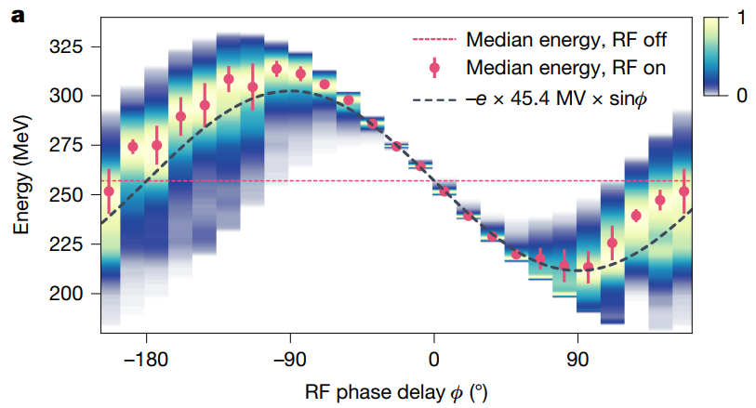
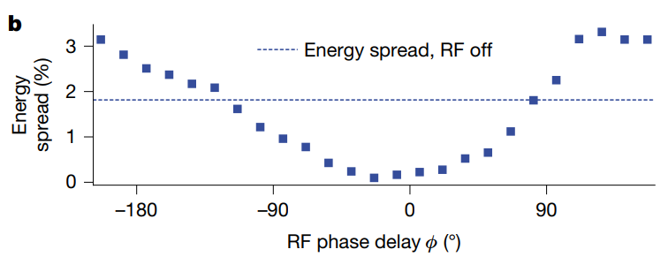
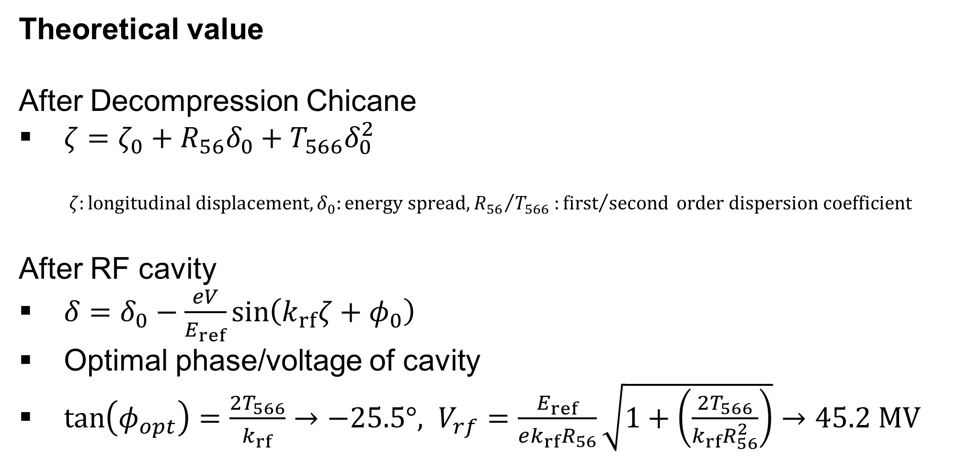
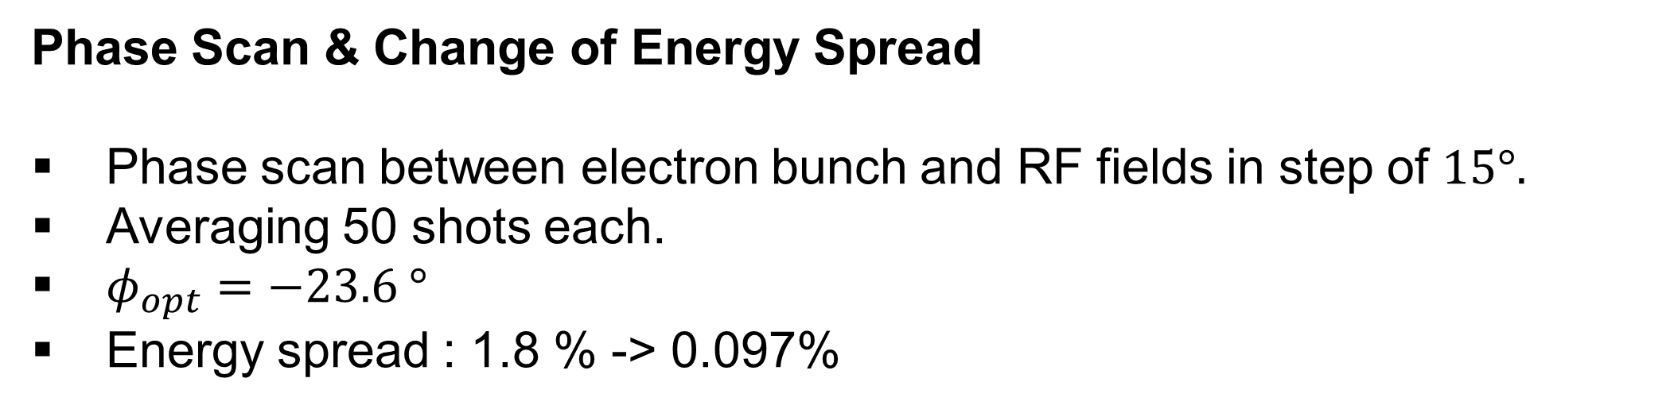
Active energy compression of a laser-plasma electron beam
5
Phase Scan & Change of Energy Spread
Phase scan between electron bunch and RF fields in step of $15°.$
Averaging 50 shots each.
$φ_{opt}=−23.6 °$
Energy spread : 1.8 % -> 0.097%
Theoretical value
After Decompression Chicane
$ζ=ζ_{0}+R_{56}δ_{0}+T_{566}δ_{0}^{2}$
$$ζ:longitudinal displacement, δ_{0}:energy spread,{R_{56}}/{T_{566}}:{first}/{second} order dispersion coefficient$$
After RF cavity
$δ=δ_{0}−\frac{eV}{E_{ref}}\sin\left(k_{rf}ζ+φ_{0}\right)$
Optimal phase/voltage of cavity
$\tan\left(φ_{opt}\right)=\frac{2T_{566}}{k_{rf}}→−25.5°, V_{rf}=\frac{E_{ref}}{ek_{rf}R_{56}}\sqrt{1+\left(\frac{2T_{566}}{k_{rf}R_{56}^{2}}\right)}→45.2 MV$

Slide 6
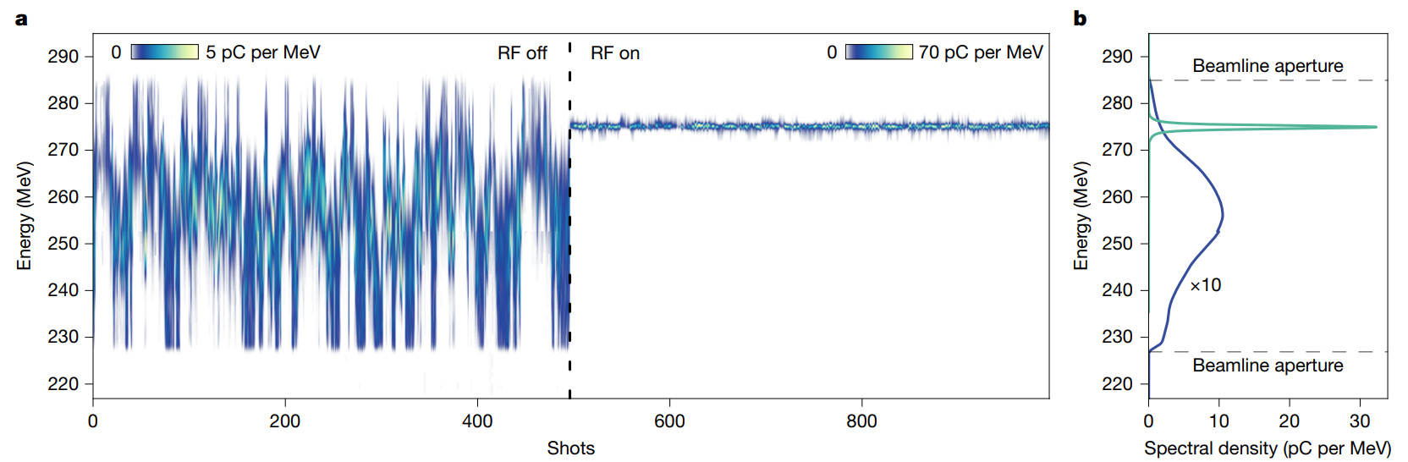
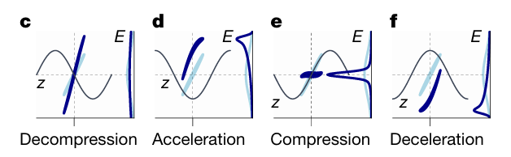
Change of energy jitter & Spectral density
6
RF OFF
Energy jitter: 3.5%
Beam median energy: 257 MeV
RF ON
Energy jitter: 0.048%
Beam median energy: 275 MeV
Why did the beam energy increase from 257 MeV to 275 MeV?
The RF cavity was used primarily for energy compression, but operating at the optimal phase for minimum energy spread resulted in additional net acceleration of the beam centroid.

Slide 7
Summary
7
Conclusions
Reduced the energy spread and energy jitter of LPA-generated electron beams to a level previously achievable only with large RF-based accelerators.
This technology enables practical application as a compact particle storage ring injector or for other industrial and medical applications.
Suggests that adopting X-band RF technology could enable scaling to GeV-level beam energies without significantly increasing the system footprint.

Slide 8
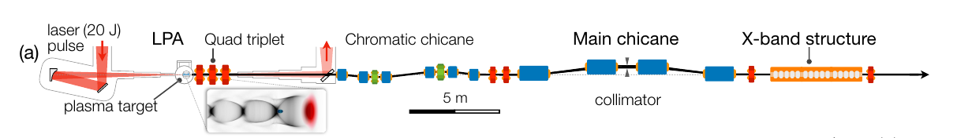
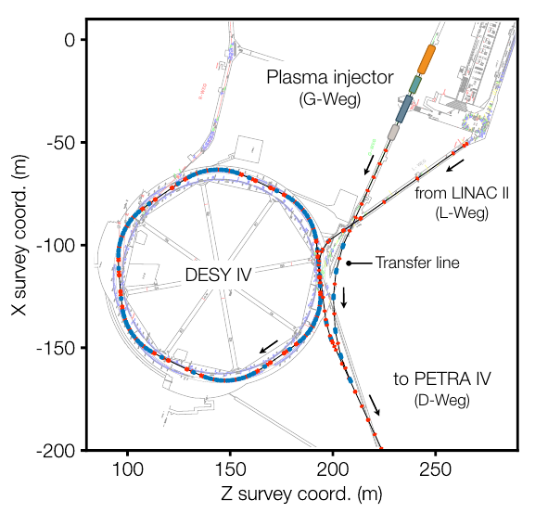
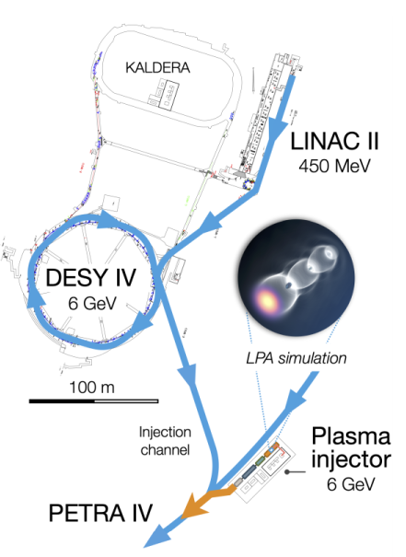
PETRA IV in DESY
8

Slide 9
9
Injection for PLS-II storage ring

Slide 10
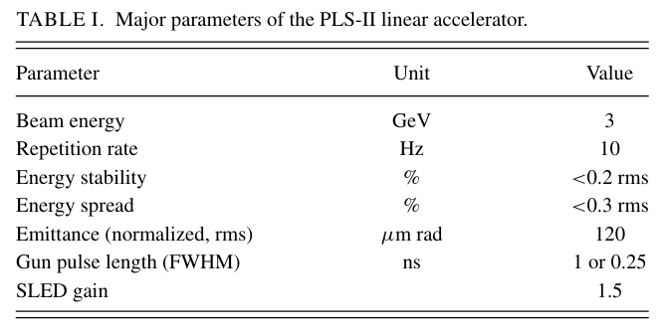
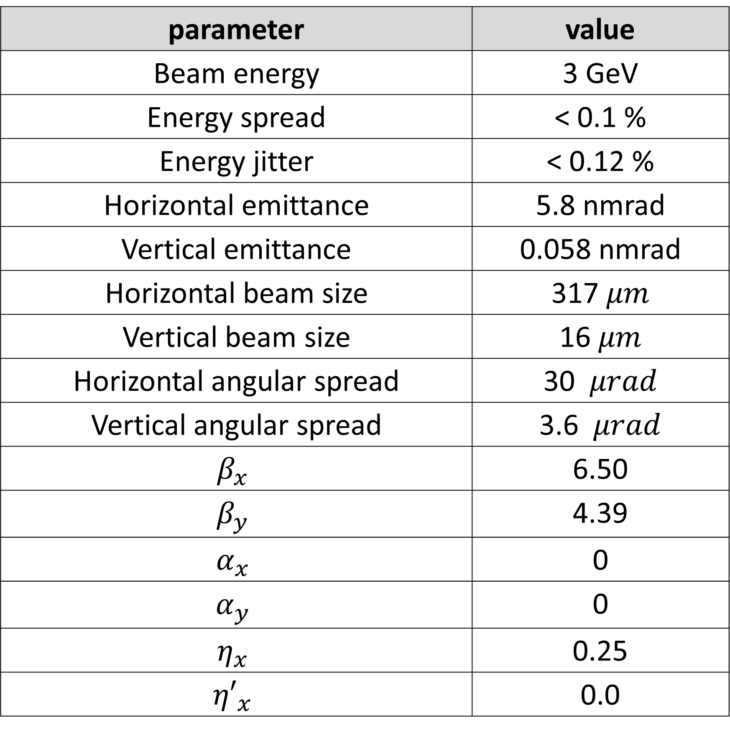
Injection for PLS-II Storage Ring
10
Storage Ring (long straight line)
Fixed parameters
parameter | value
Beam energy | 3 GeV
Energy spread | < 0.1 %
Energy jitter | < 0.12 %
Horizontal emittance | 5.8 nmrad
Vertical emittance | 0.058 nmrad
Horizontal beam size | 317 $μm$
Vertical beam size | 16 $μm$
Horizontal angular spread | 30 $μrad$
Vertical angular spread | 3.6 $μrad$
$$β_{x}$$ | 6.50
$$β_{y}$$ | 4.39
$$α_{x}$$ | 0
$$α_{y}$$ | 0
$$η_{x}$$ | 0.25
$${η′}_{x}$$ | 0.0
parameter | value
Distance btw B2 ~ B3 | 20 cm
Drift | 10 cm
The length of quadrupoles | 50 cm
The length of dipoles in Main Chicane | 1.5 m
The length of Rf cavities | 5m
RF frequency | 12 GHz
The length of dipoles in BTL | 50 cm
Variables
The strength of Dipoles & Quads. , Distance btw magnets, Distance btw B1~B2 & B3~B4, The bending angle of dipoles in main chicane, RF phase

Slide 11
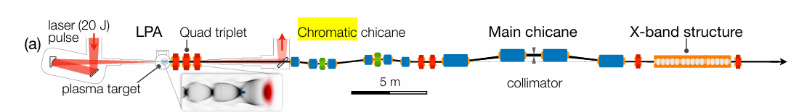
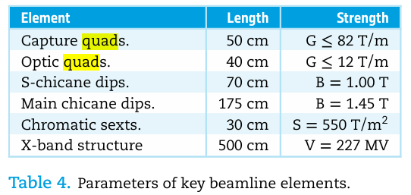
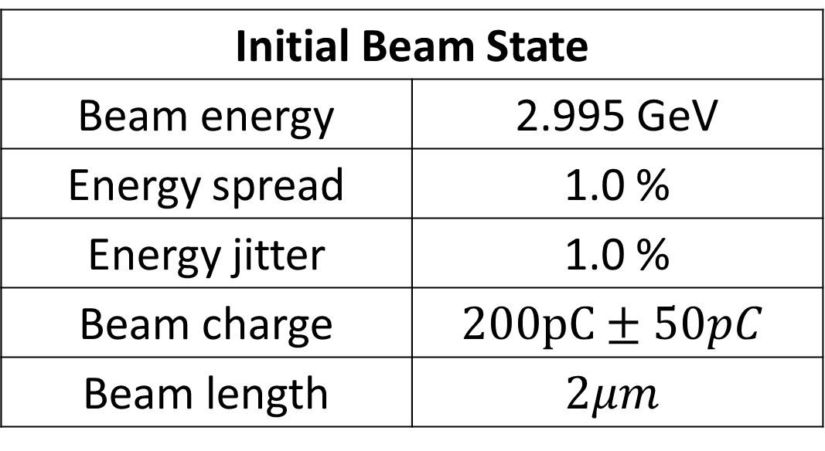
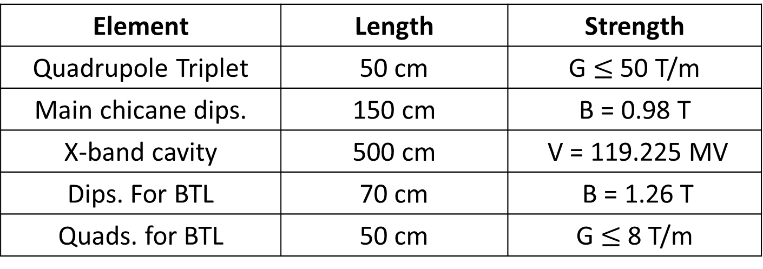
Injection for PLS-II Storage Ring
11
Parameters of key beamline elements
Initial Beam State
Beam energy | 2.995 GeV
Energy spread | 1.0 %
Energy jitter | 1.0 %
Beam charge | $$200pC±50pC$$
Beam length | $$2μm$$
Element | Length | Strength
Quadrupole Triplet | 50 cm | G $≤$ 50 T/m
Main chicane dips. | 150 cm | B = 0.98 T
X-band cavity | 500 cm | V = 119.225 MV
Dips. For BTL | 70 cm | B = 1.26 T
Quads. for BTL | 50 cm | G $≤$ 8 T/m
To minimize angular spread
B2
B3
To eliminate the energy chirp
Drift: 0.1m
QF1
QD1
QF2
B1
B4
Using X-band cavity, <5m
QF3
B5
QD3
B6
QF4
B7
QD4
LPA
RF Cavity
RF frequency: 12 GHz
To stretch the bunch length
WATCH
WATCH
WATCH
WATCH
WATCH
To injection into storage ring DA

Slide 12
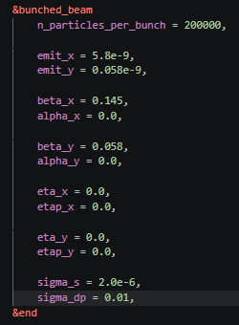
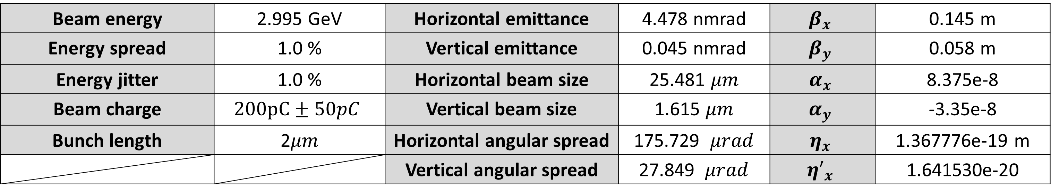
Initial Beam State (After LPA)
12
Beam energy | 2.995 GeV | Horizontal emittance | 4.478 nmrad | $$β_{x}$$ | 0.145 m
Energy spread | 1.0 % | Vertical emittance | 0.045 nmrad | $$β_{y}$$ | 0.058 m
Energy jitter | 1.0 % | Horizontal beam size | 25.481 $μm$ | $$α_{x}$$ | 8.375e-8
Beam charge | $$200pC±50pC$$ | Vertical beam size | 1.615 $μm$ | $$α_{y}$$ | -3.35e-8
Bunch length | 2$μm$ | Horizontal angular spread | 175.729 $μrad$ | $$η_{x}$$ | 1.367776e-19 m
 |  | Vertical angular spread | 27.849 $μrad$ | $${η′}_{x}$$ | 1.641530e-20
Drift: 0.1m
LPA
WATCH

Slide 13
Quad. Doublet for minimizing angular spread
13
Parameters of Quad. doublet
Length | 50 cm
DQ | 42 cm
QF1 | K 1= 5.3, G = 53 T/m
QD1 | K1 = -2.1, G = 21 T/m
Drift: 0.1m
QF1
QD1
LPA
WATCH
WATCH
WATCH

Slide 14
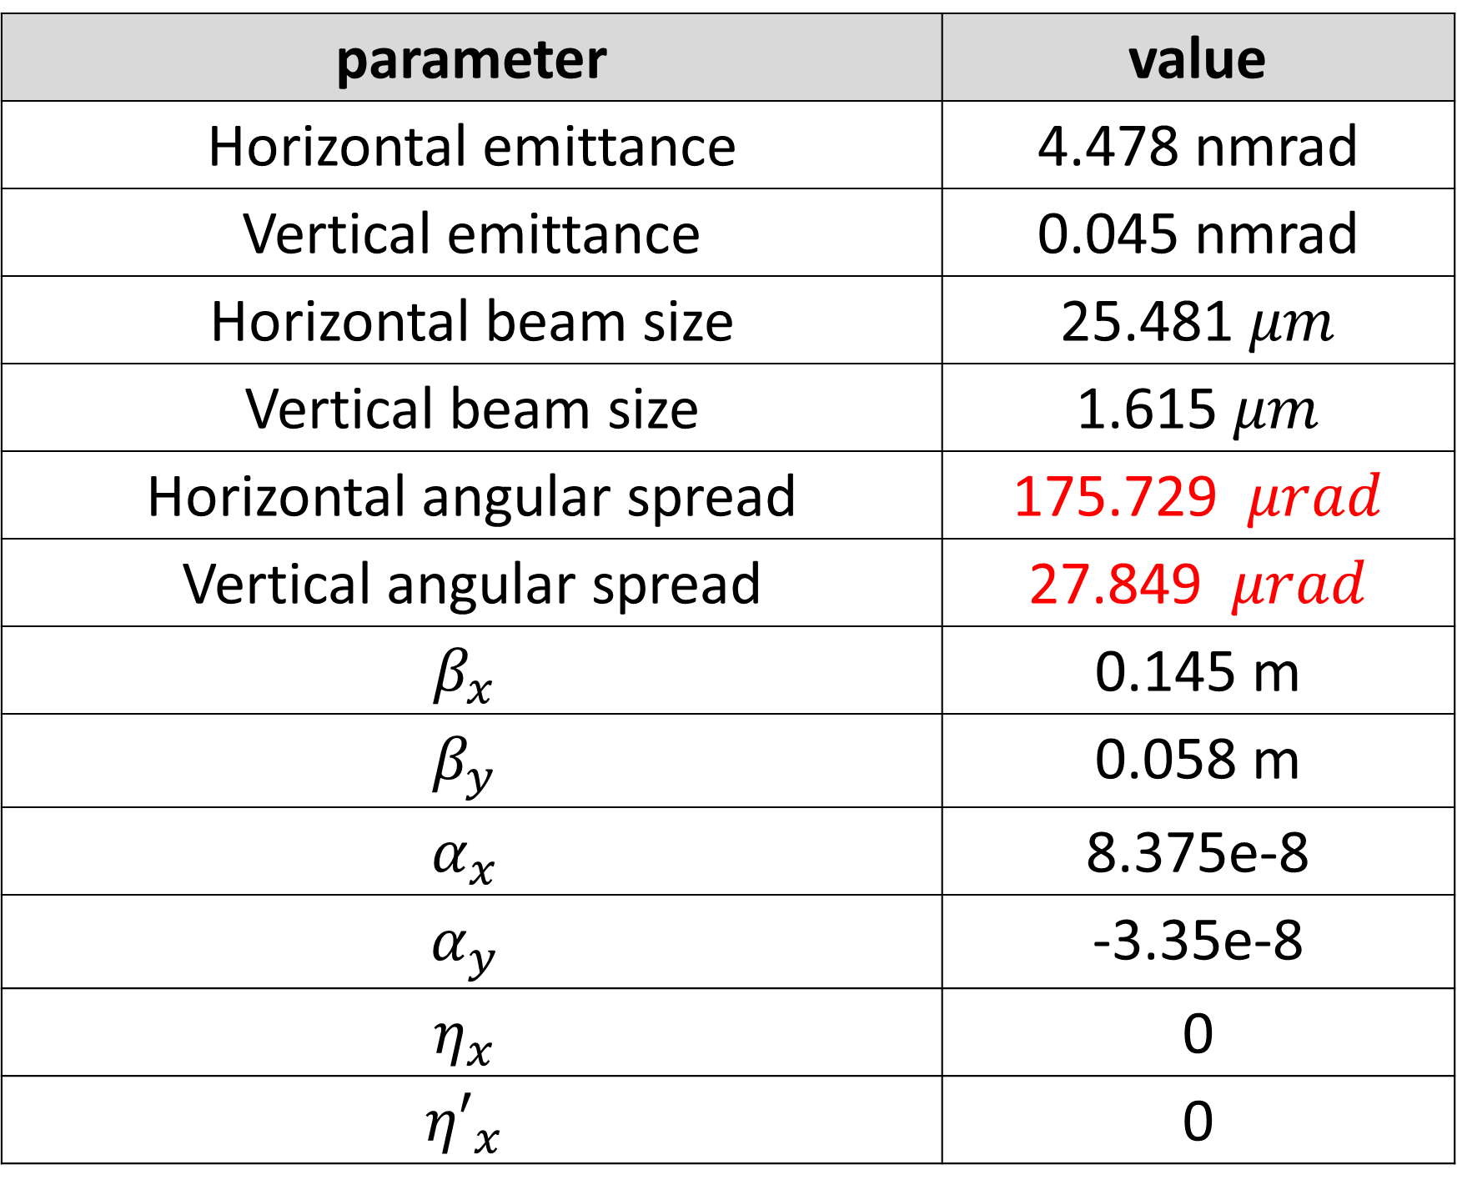

After first quadrupoles (Quad doublet)
14
After LPA
After first quadrupoles (Quad doublet)
parameter | value
Horizontal emittance | 4.478 nmrad
Vertical emittance | 0.045 nmrad
Horizontal beam size | 25.481 $μm$
Vertical beam size | 1.615 $μm$
Horizontal angular spread | 175.729 $μrad$
Vertical angular spread | 27.849 $μrad$
$$β_{x}$$ | 0.145 m
$$β_{y}$$ | 0.058 m
$$α_{x}$$ | 8.375e-8
$$α_{y}$$ | -3.35e-8
$$η_{x}$$ | 0
$${η′}_{x}$$ | 0
parameter | value
Horizontal emittance | 4.482 nmrad
Vertical emittance | 0.048 nmrad
Horizontal beam size | 184.350 $μm$
Vertical beam size | 55.700$μm$
Horizontal angular spread | 223.375 $μrad$
Vertical angular spread | 0.943 $μrad$
$$β_{x}$$ | 7.58 m
$$β_{y}$$ | 64 m
$$α_{x}$$ | -9.13
$$α_{y}$$ | -0.42
$$η_{x}$$ | 0.0
$${η′}_{x}$$ | 0.0

Slide 15
Quad. Triplet for minimizing angular spread
15
Parameters of Quad. triplet
Length | 50 cm
D12 | 30 cm
D23 | 30 cm
QF1 | K1= 4.0, G = 40 T/m
QD1 | K1 = -5.0, G = 50 T/m
QF2 | K1 = 2.1, G = 21 T/m
Drift: 0.1m
QF1
QD1
QF2
LPA
WATCH
WATCH
WATCH

Slide 16
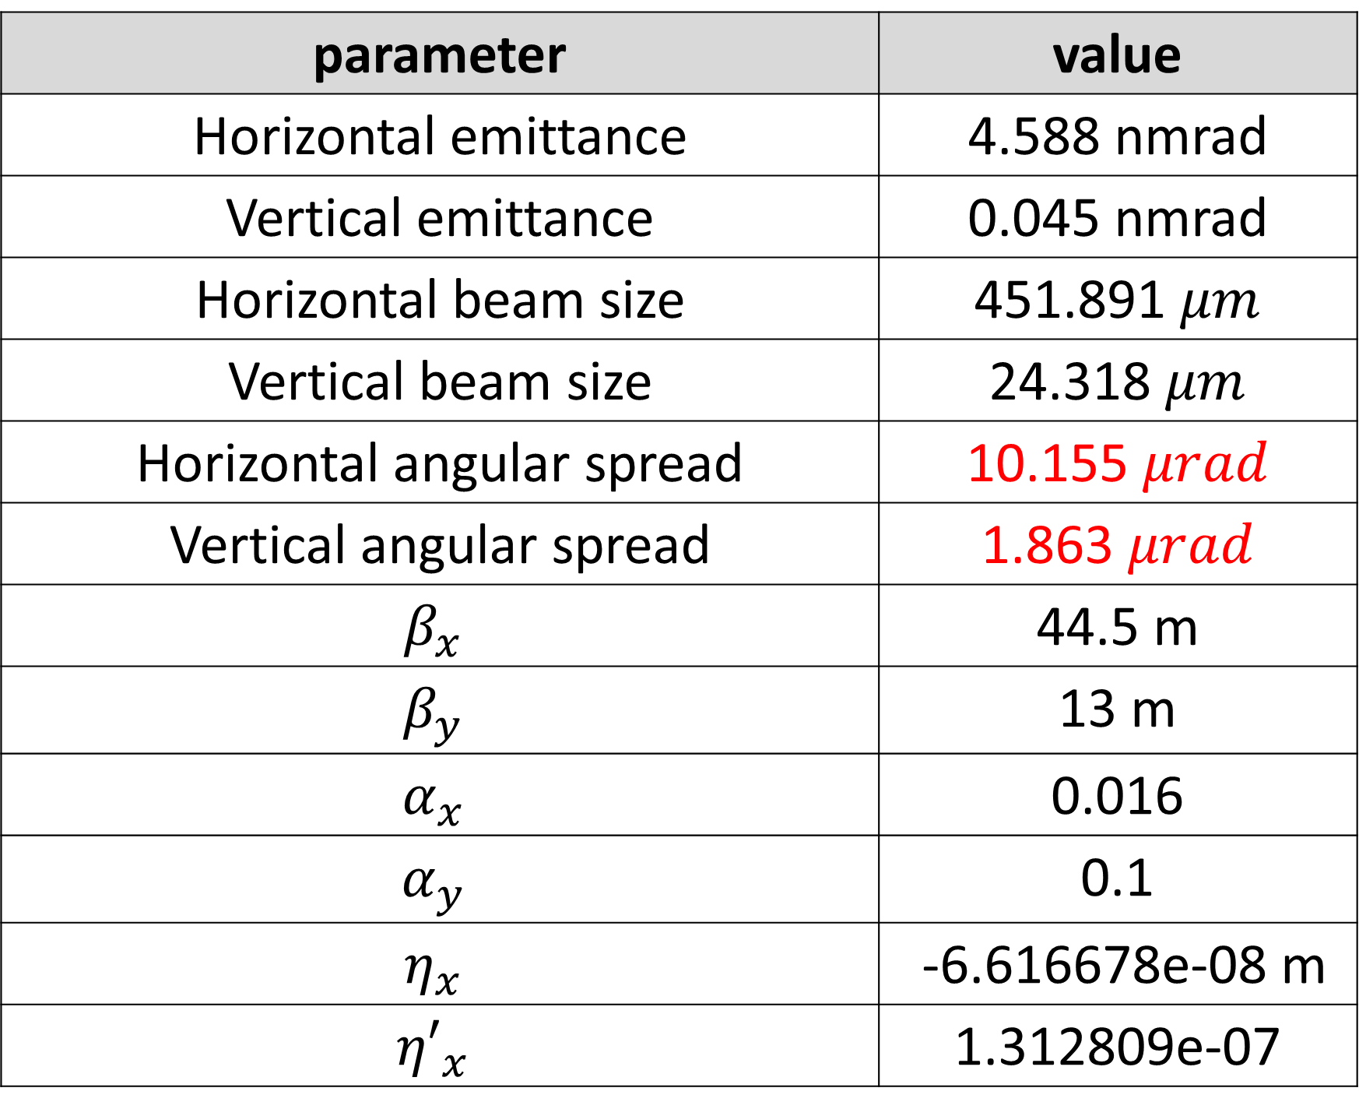
After first quadrupoles (Quad triplet)
16
After LPA
After first quadrupoles (Quad triplet)
parameter | value
Horizontal emittance | 4.478 nmrad
Vertical emittance | 0.045 nmrad
Horizontal beam size | 25.481 $μm$
Vertical beam size | 1.615 $μm$
Horizontal angular spread | 175.729 $μrad$
Vertical angular spread | 27.849 $μrad$
$$β_{x}$$ | 0.145 m
$$β_{y}$$ | 0.058 m
$$α_{x}$$ | 8.375e-8
$$α_{y}$$ | -3.35e-8
$$η_{x}$$ | 0
$${η′}_{x}$$ | 0
parameter | value
Horizontal emittance | 4.588 nmrad
Vertical emittance | 0.045 nmrad
Horizontal beam size | 451.891 $μm$
Vertical beam size | 24.318$μm$
Horizontal angular spread | 10.155 $μrad$
Vertical angular spread | 1.863 $μrad$
$$β_{x}$$ | 44.5 m
$$β_{y}$$ | 13 m
$$α_{x}$$ | 0.016
$$α_{y}$$ | 0.1
$$η_{x}$$ | -6.616678e-08 m
$${η′}_{x}$$ | 1.312809e-07

Slide 17
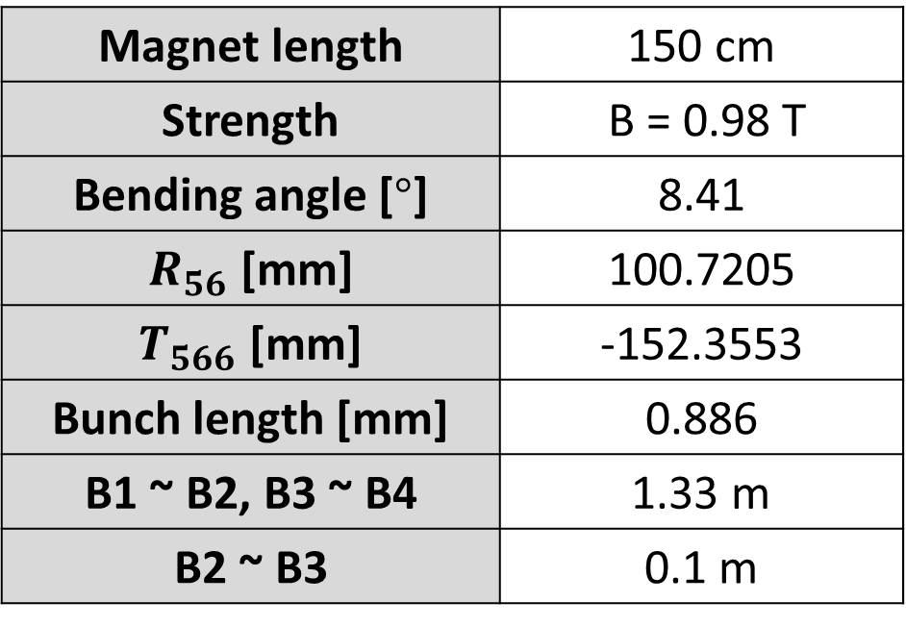
Magnetic Chicane for bunch lengthening
17
Parameters of Main Chicane
Magnet length | 150 cm
Strength | B = 0.98 T
Bending angle [$°$] | 8.41
$R_{56}$ [mm] | 100.7205
$T_{566}$ [mm] | -152.3553
Bunch length [mm] | 0.886
B1 ~ B2, B3 ~ B4 | 1.33 m
B2 ~ B3 | 0.1 m
B2
B3
Drift: 0.1m
QF1
QD1
QF2
B1
B4
LPA
WATCH
WATCH
WATCH

Slide 18
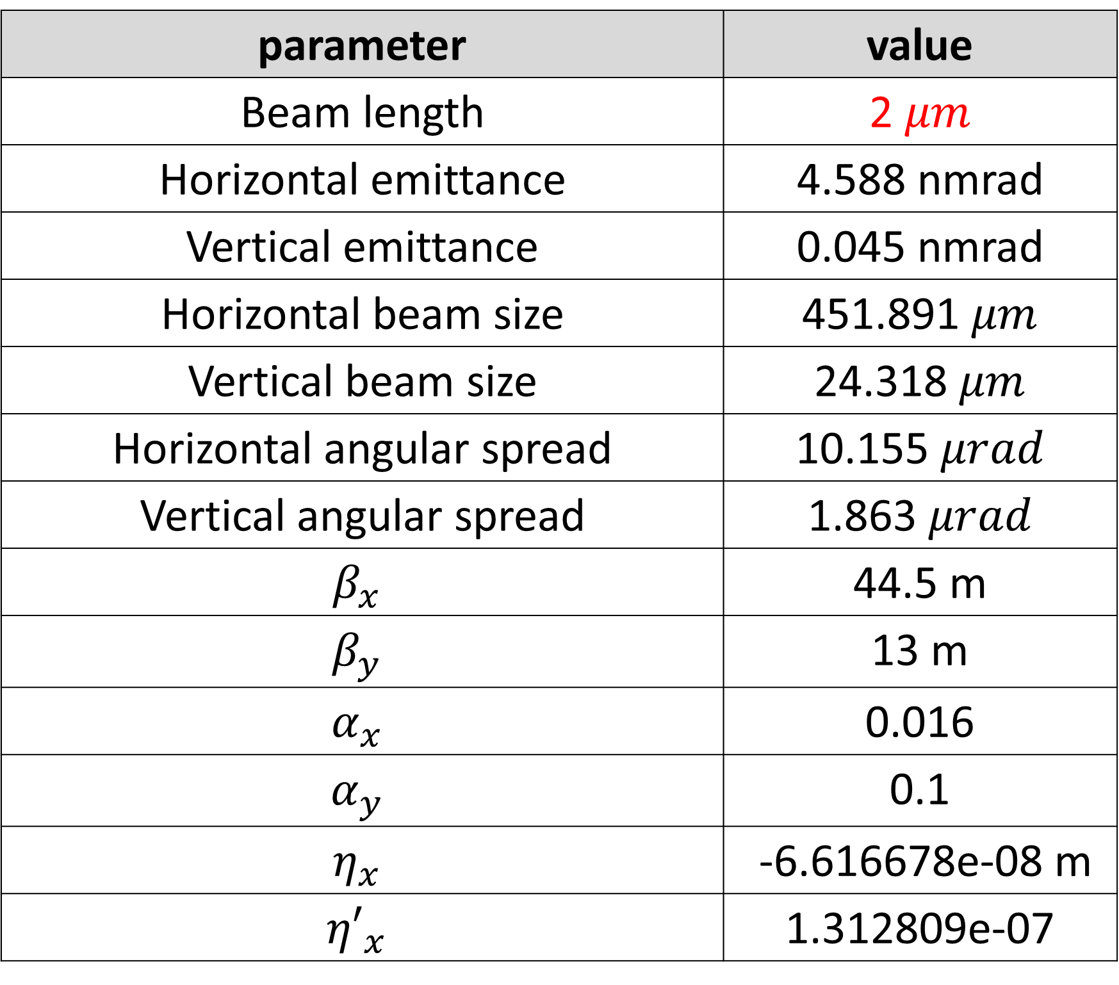
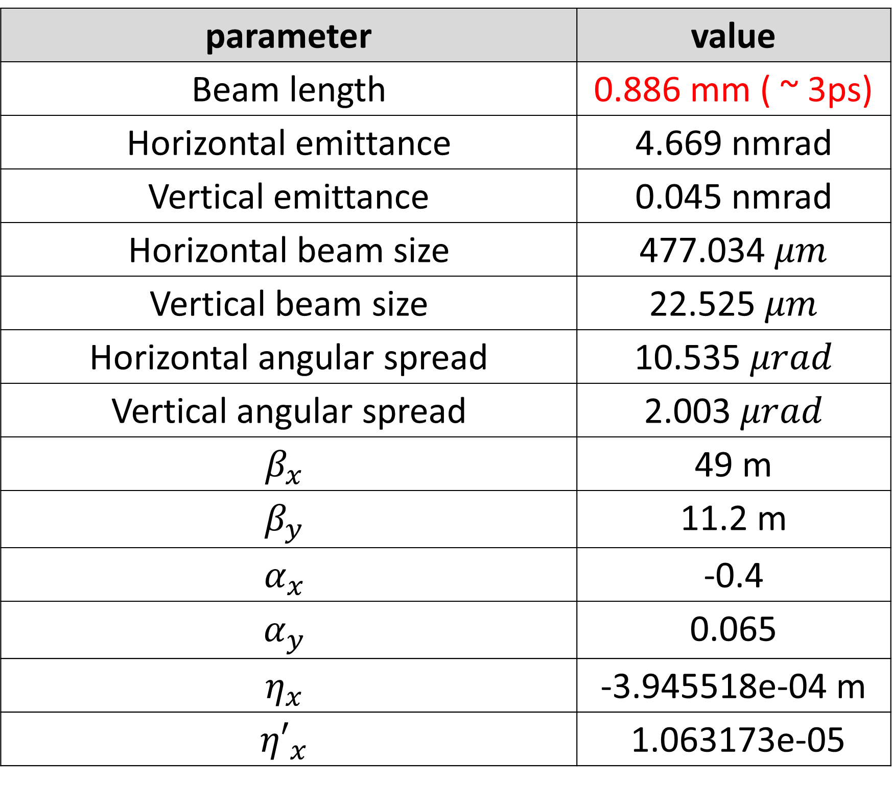
After Main Chicane
18
After first quadrupoles (Quad triplet)
After Main Chicane
parameter | value
Beam length | 2 $μm$
Horizontal emittance | 4.588 nmrad
Vertical emittance | 0.045 nmrad
Horizontal beam size | 451.891 $μm$
Vertical beam size | 24.318$μm$
Horizontal angular spread | 10.155 $μrad$
Vertical angular spread | 1.863 $μrad$
$$β_{x}$$ | 44.5 m
$$β_{y}$$ | 13 m
$$α_{x}$$ | 0.016
$$α_{y}$$ | 0.1
$$η_{x}$$ | -6.616678e-08 m
$${η′}_{x}$$ | 1.312809e-07
parameter | value
Beam length | 0.886 mm ( ~ 3ps)
Horizontal emittance | 4.669 nmrad
Vertical emittance | 0.045 nmrad
Horizontal beam size | 477.034 $μm$
Vertical beam size | 22.525 $μm$
Horizontal angular spread | 10.535 $μrad$
Vertical angular spread | 2.003 $μrad$
$$β_{x}$$ | 49 m
$$β_{y}$$ | 11.2 m
$$α_{x}$$ | -0.4
$$α_{y}$$ | 0.065
$$η_{x}$$ | -3.945518e-04 m
$${η′}_{x}$$ | 1.063173e-05

Slide 19
RF cavity for minimizing energy spread
19
RF cavity
RF voltage | 119.225 MV
RF frequency | 12 GHz
Cavity length | 5.0 m
B2
B3
Drift: 0.1m
QF1
QD1
QF2
B1
B4
Using X-band cavity, <5m
LPA
RF Cavity
RF frequency: 12 GHz
WATCH
WATCH
WATCH
WATCH

Slide 20
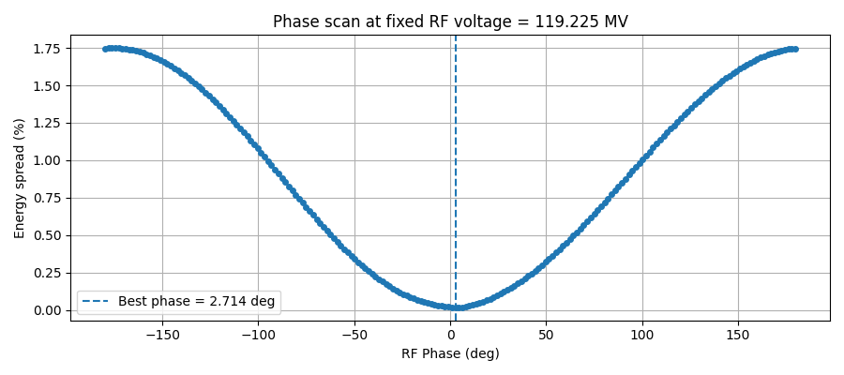
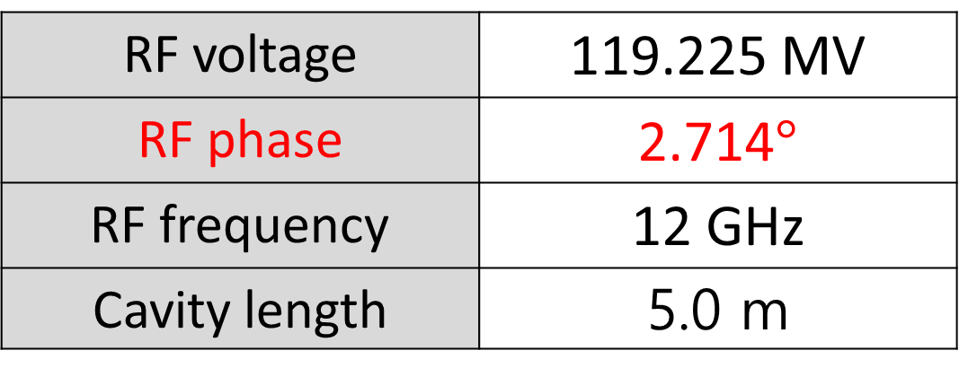
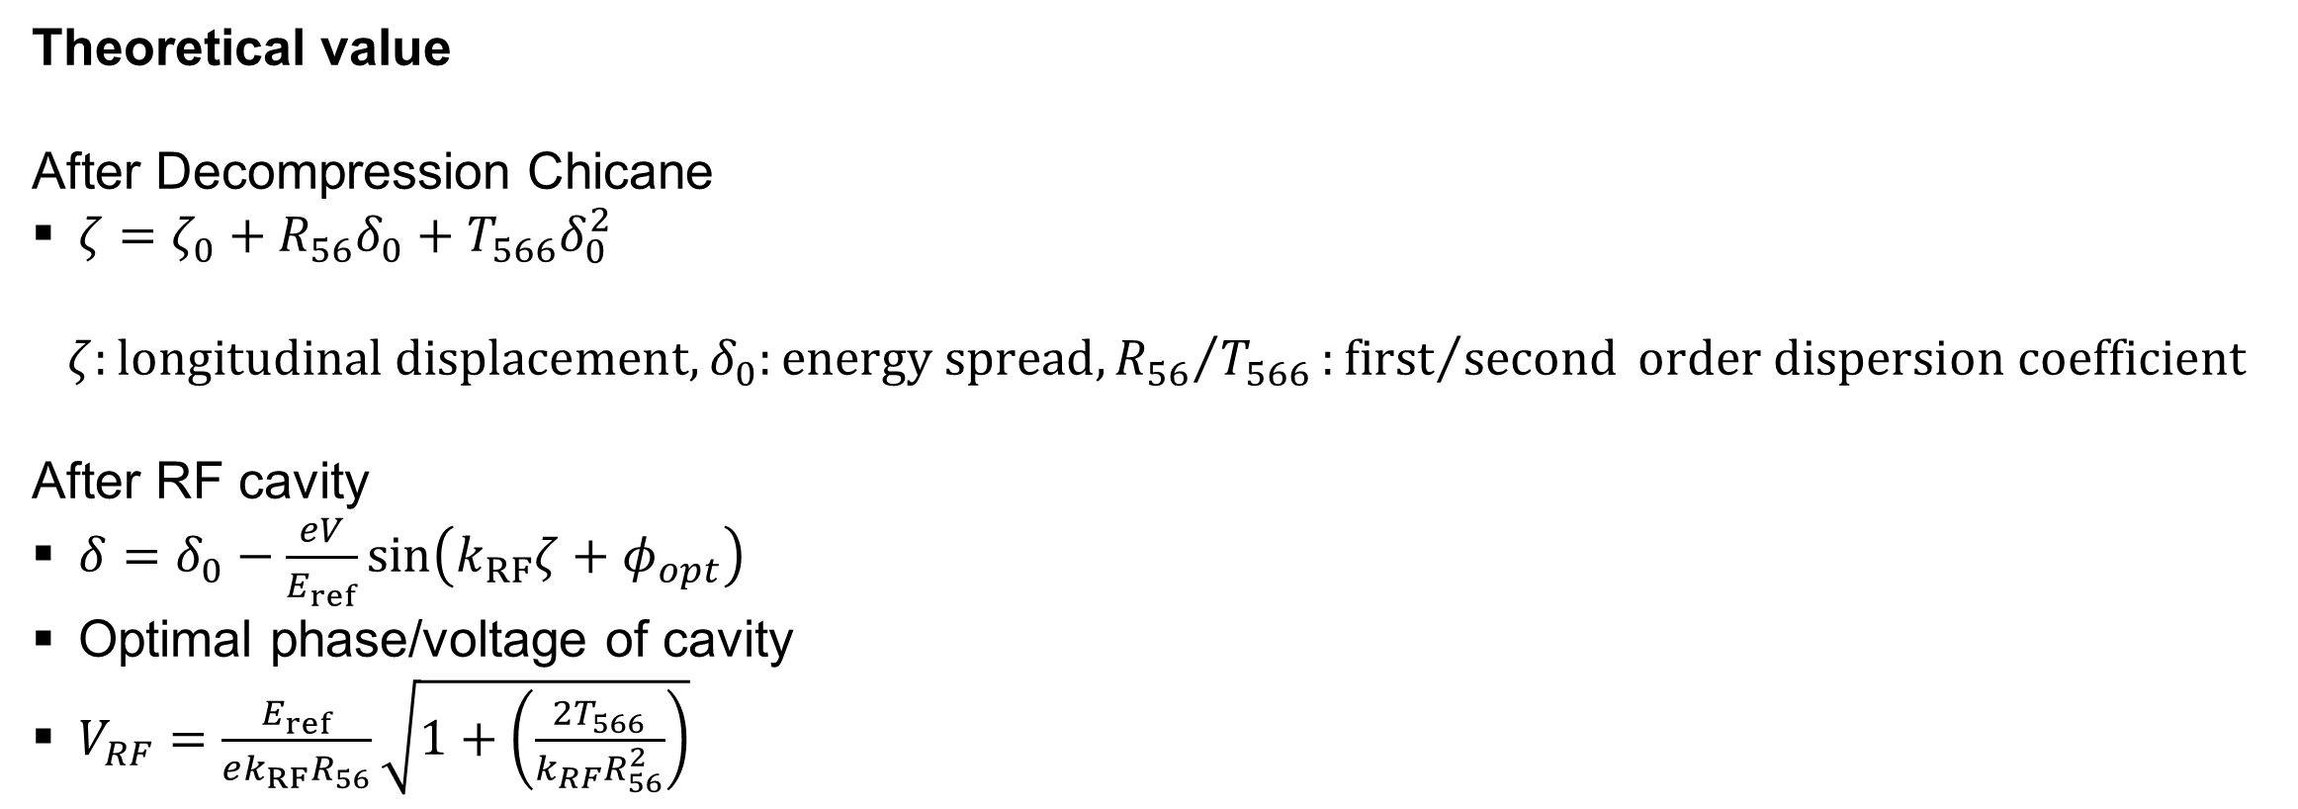
RF cavity for minimizing energy spread
18
Optimal RF phase scan
RF voltage | 119.225 MV
RF phase | 2.714$°$
RF frequency | 12 GHz
Cavity length | 5.0 m
Theoretical value
After Decompression Chicane
$ζ=ζ_{0}+R_{56}δ_{0}+T_{566}δ_{0}^{2}$
$$ζ:longitudinal displacement, δ_{0}:energy spread,{R_{56}}/{T_{566}}:{first}/{second} order dispersion coefficient$$
After RF cavity
$δ=δ_{0}−\frac{eV}{E_{ref}}\sin\left(k_{RF}ζ+φ_{opt}\right)$
Optimal phase/voltage of cavity
$V_{RF}=\frac{E_{ref}}{ek_{RF}R_{56}}\sqrt{1+\left(\frac{2T_{566}}{k_{RF}R_{56}^{2}}\right)}$

Slide 21
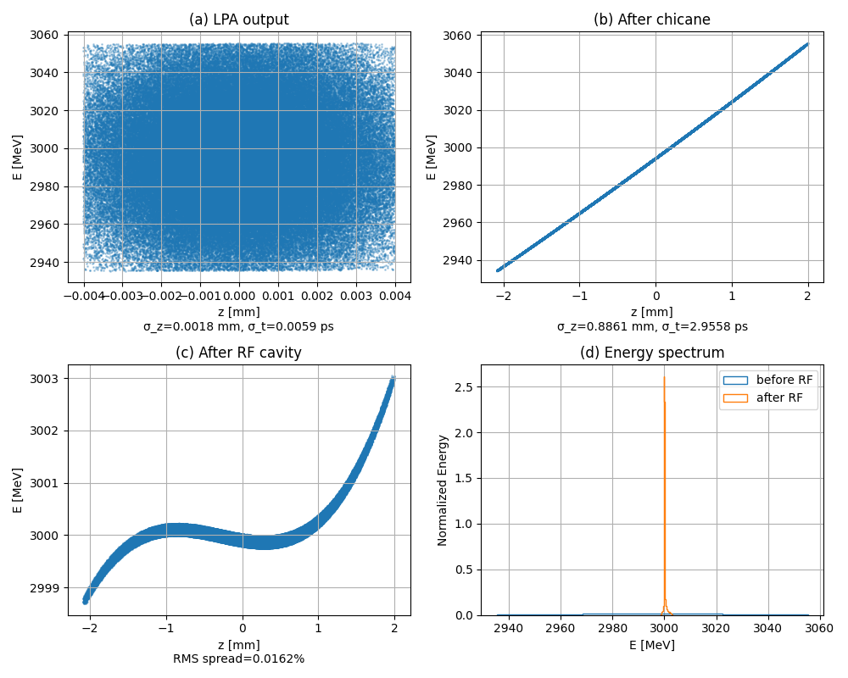

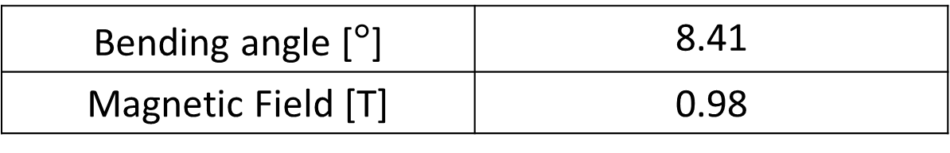
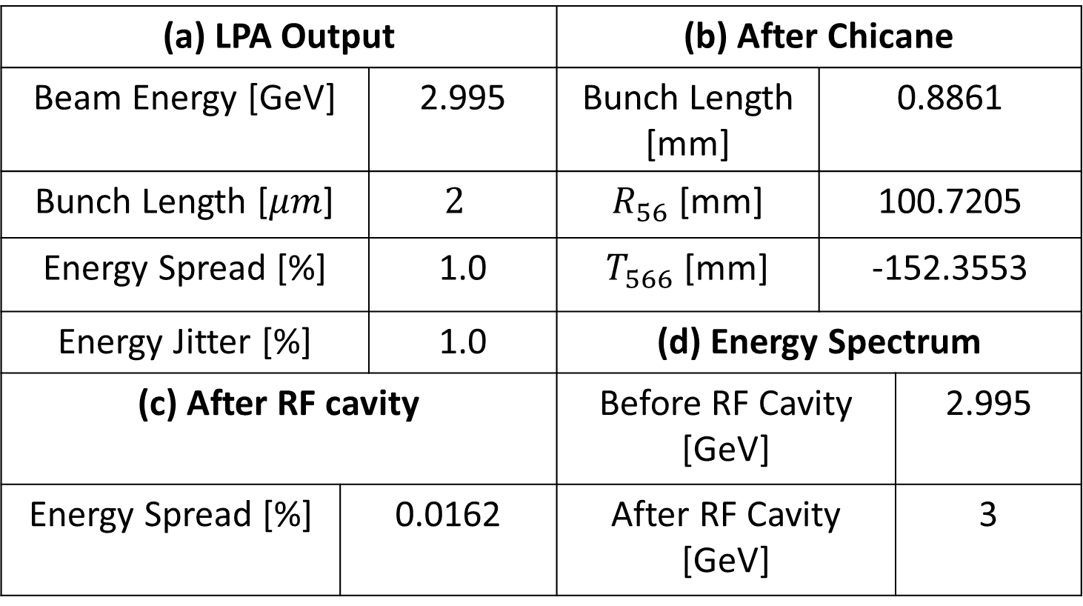
Graphs for each steps
20
Bending angle [$°$] | 8.41
Magnetic Field [T] | 0.98
(a) LPA Output |  |  | (b) After Chicane
Beam Energy [GeV] | 60 | 2.995 | Bunch Length [mm] | 0.8861
Bunch Length [$μm$] |  | $$2$$ | $R_{56}$ [mm] | 100.7205
Energy Spread [%] |  | 1.0 | $T_{566}$ [mm] | -152.3553
Energy Jitter [%] | 3.5 % | 1.0 | (d) Energy Spectrum
(c) After RF cavity |  |  | Before RF Cavity [GeV] |  | 2.995
Energy Spread [%] | 0.0162 |  | After RF Cavity [GeV] |  | 3
* Residual energy spread

Slide 22
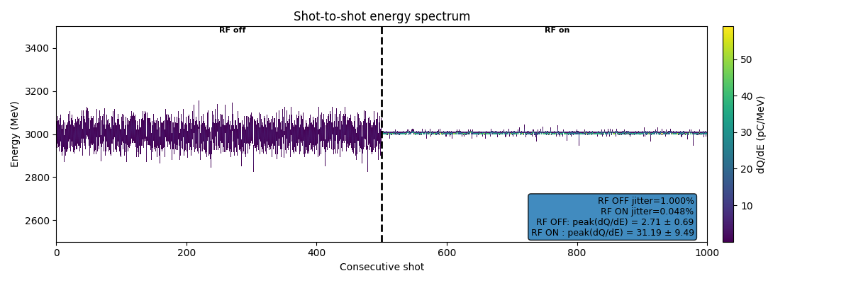
The change of energy jitter
21
RF OFF | 1.0 % | 2.71 pC/MeV
RF ON | 0.048 % | 31.19 pC/MeV

Slide 23
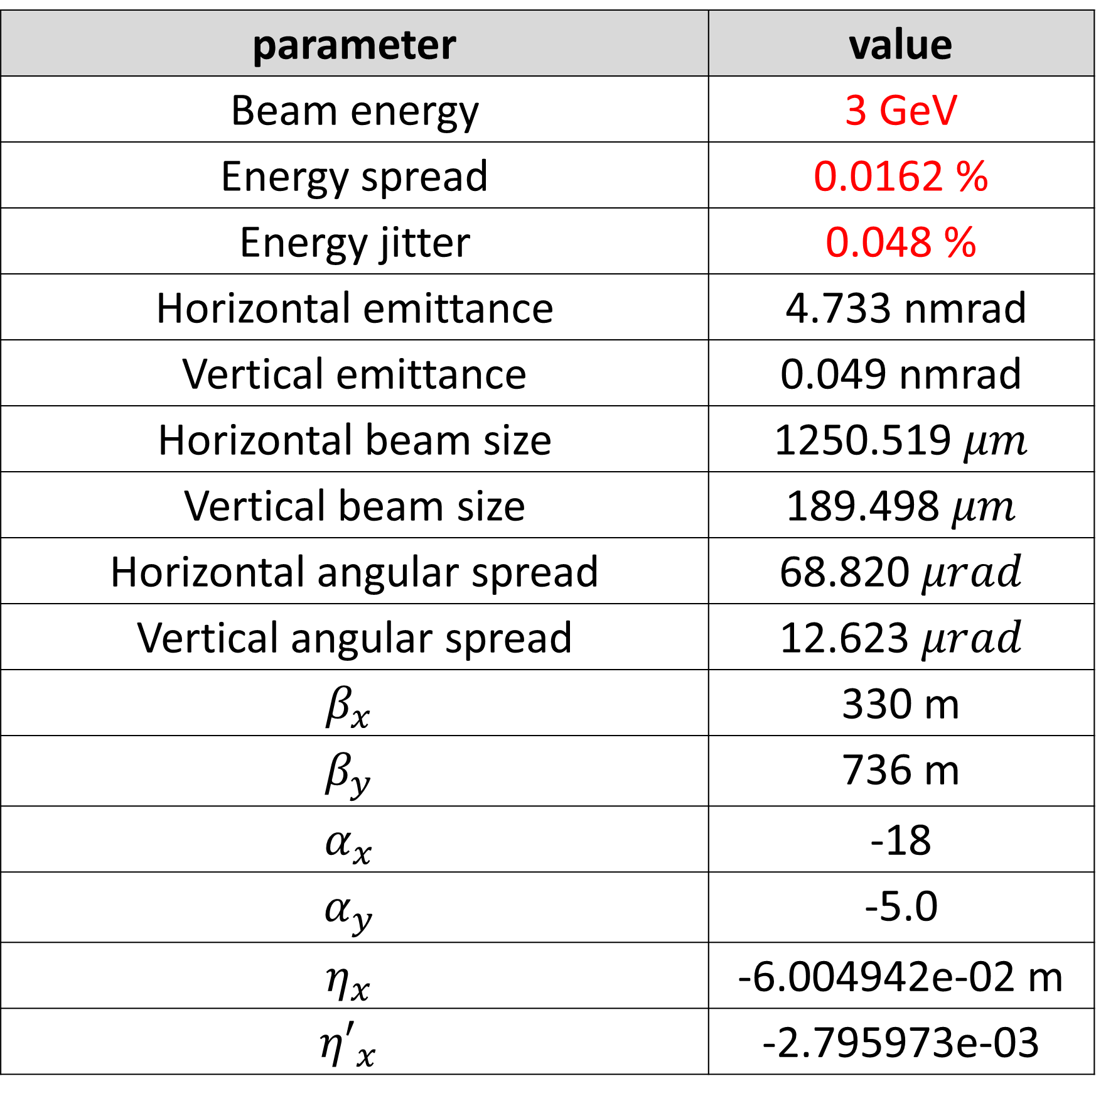
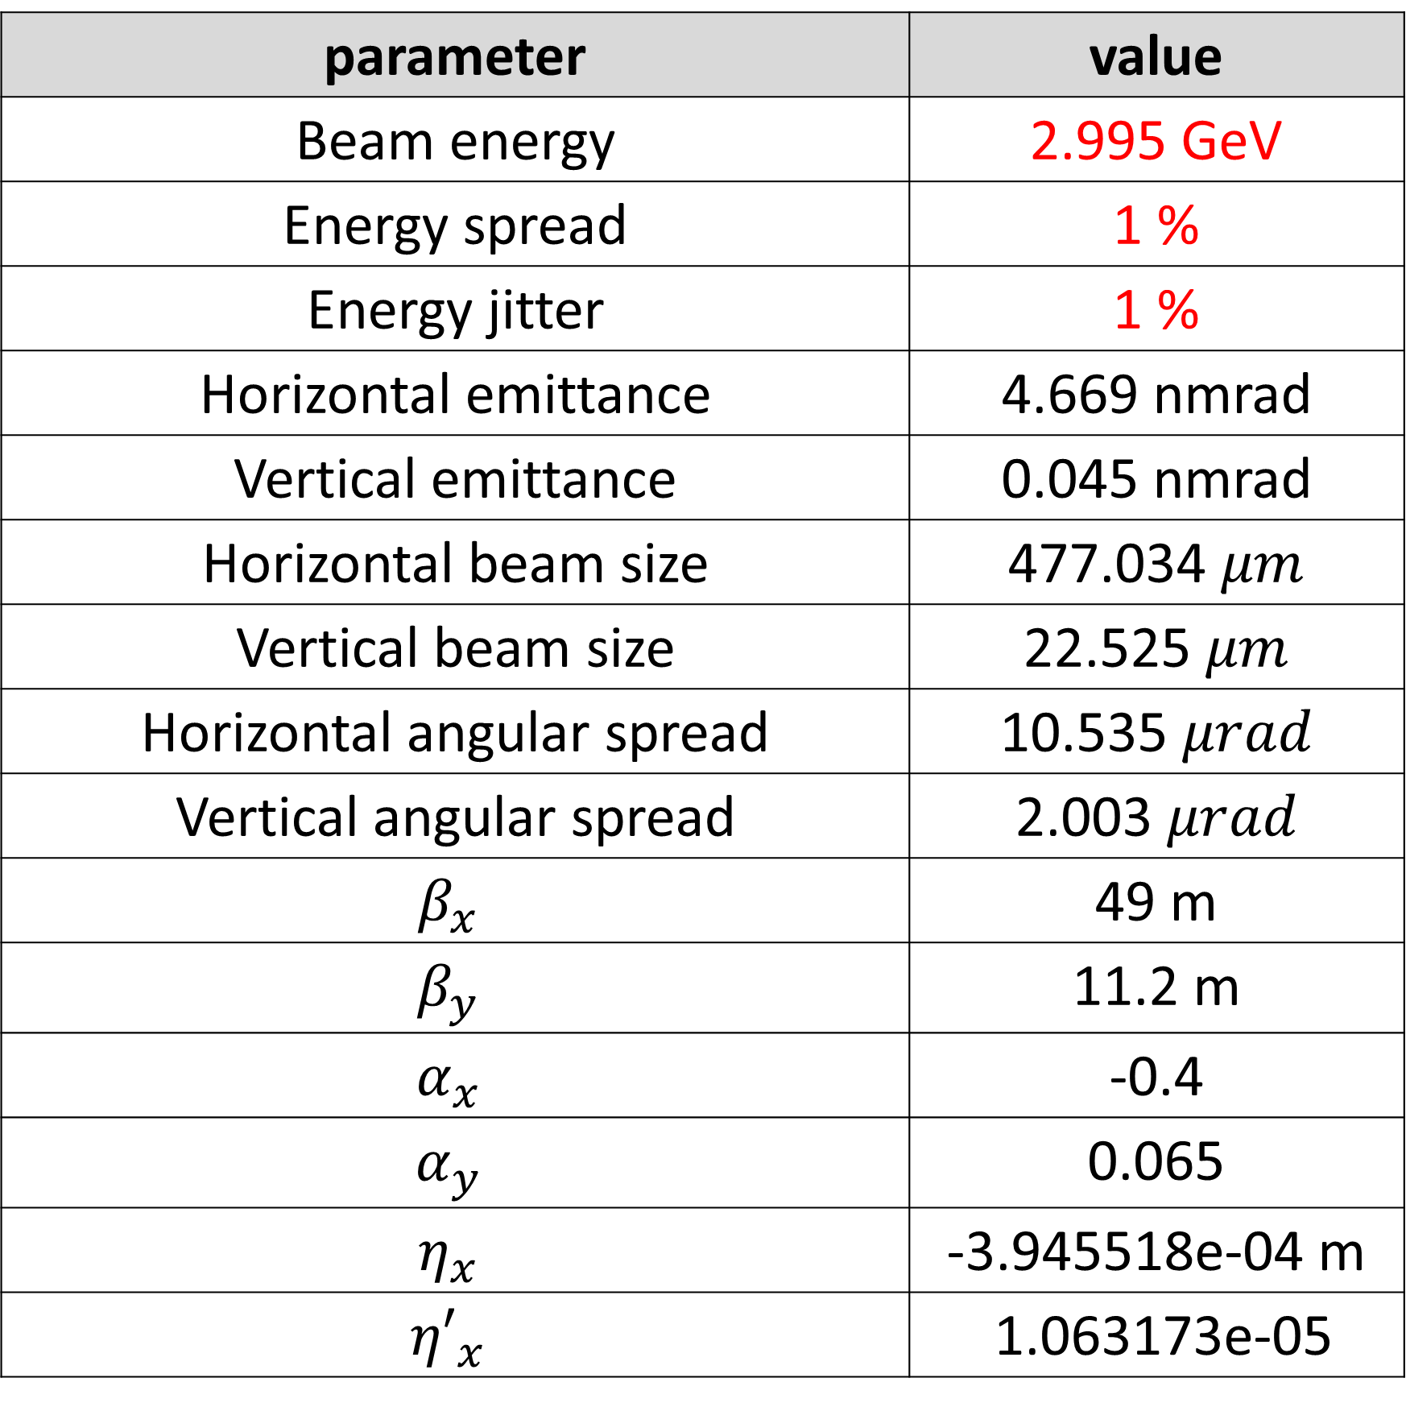
After RF cavity
After RF cavity
22
After Main Chicane
parameter | value
Beam energy | 2.995 GeV
Energy spread | 1 %
Energy jitter | 1 %
Horizontal emittance | 4.669 nmrad
Vertical emittance | 0.045 nmrad
Horizontal beam size | 477.034 $μm$
Vertical beam size | 22.525 $μm$
Horizontal angular spread | 10.535 $μrad$
Vertical angular spread | 2.003 $μrad$
$$β_{x}$$ | 49 m
$$β_{y}$$ | 11.2 m
$$α_{x}$$ | -0.4
$$α_{y}$$ | 0.065
$$η_{x}$$ | -3.945518e-04 m
$${η′}_{x}$$ | 1.063173e-05
parameter | value
Beam energy | 3 GeV
Energy spread | 0.0162 %
Energy jitter | 0.048 %
Horizontal emittance | 4.733 nmrad
Vertical emittance | 0.049 nmrad
Horizontal beam size | 1250.519 $μm$
Vertical beam size | 189.498 $μm$
Horizontal angular spread | 68.820 $μrad$
Vertical angular spread | 12.623 $μrad$
$$β_{x}$$ | 330 m
$$β_{y}$$ | 736 m
$$α_{x}$$ | -18
$$α_{y}$$ | -5.0
$$η_{x}$$ | -6.004942e-02 m
$${η′}_{x}$$ | -2.795973e-03

Slide 24
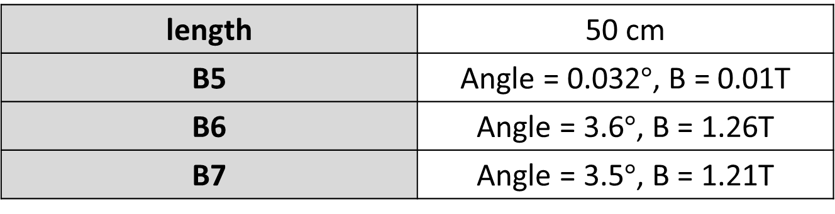
BTL for injection into the Dynamic Aperture
22
Parameters of Quadrupoles
Parameters of Dipoles
length | 50 cm
QF3 | K 1= 0.2, G = 2 T/m
QD3 | K 1= -0.8, G = 8 T/m
QF4 | K 1= 0.6, G = 6 T/m
QD4 | K 1= -0.1, G = 1 T/m
length | 50 cm
B5 | Angle = 0.032$°$, B = 0.01T
B6 | Angle = 3.6$°$, B = 1.26T
B7 | Angle = 3.5$°$, B = 1.21T
28.46 m
B2
B3
Drift: 0.1m
QF1
QD1
QF2
B1
B4
Using X-band cavity, <5m
QF3
B5
QD3
B6
QF4
B7
QD4
LPA
RF Cavity
RF frequency: 12 GHz
WATCH
WATCH
WATCH
WATCH
WATCH

Slide 25


After RF cavity
After BTL
23
parameter | value
Beam energy | 3 GeV
Energy spread | 0.0162 %
Energy jitter | 0.048 %
Horizontal emittance | 4.733 nmrad
Vertical emittance | 0.049 nmrad
Horizontal beam size | 1250.519 $μm$
Vertical beam size | 189.498 $μm$
Horizontal angular spread | 68.820 $μrad$
Vertical angular spread | 12.623 $μrad$
$$β_{x}$$ | 330 m
$$β_{y}$$ | 736 m
$$α_{x}$$ | -18
$$α_{y}$$ | -5.0
$$η_{x}$$ | -6.004942e-02 m
$${η′}_{x}$$ | -2.795973e-03
parameter | value
Beam energy | 3 GeV
Energy spread | 0.0171 %
Energy jitter | 0.048 %
Horizontal emittance | 12.940 nmrad
Vertical emittance | 0.045 nmrad
Horizontal beam size | 307.210 $μm$
Vertical beam size | 65.045 $μm$
Horizontal angular spread | 111.441 $μrad$
Vertical angular spread | 11.432 $μrad$
$$β_{x}$$ | 19.4 m
$$β_{y}$$ | 94 m
$$α_{x}$$ | 7.0
$$α_{y}$$ | -16
$$η_{x}$$ | 0.35 m
$${η′}_{x}$$ | 0.1

Slide 26
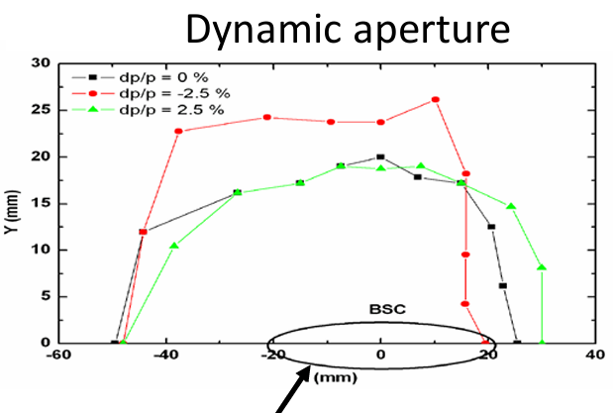
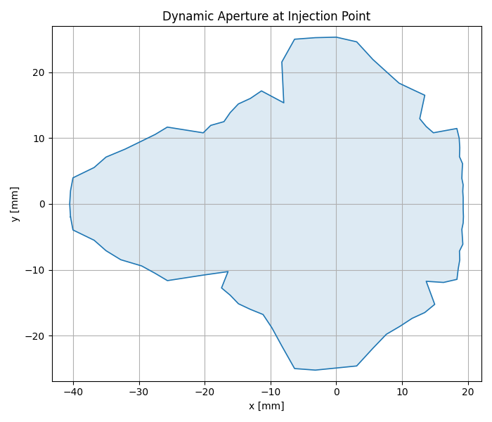
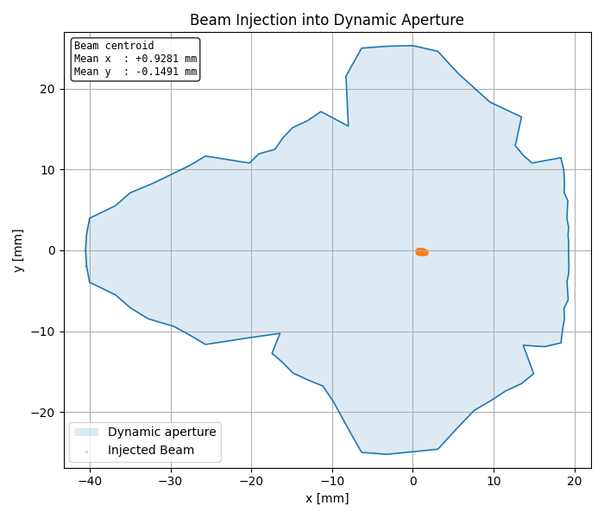
Dynamic Aperture at Injection point
24

Slide 27
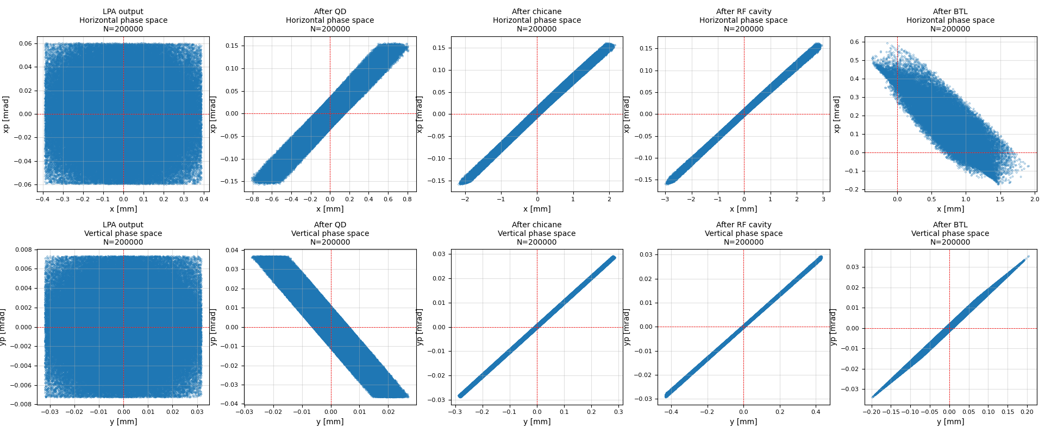
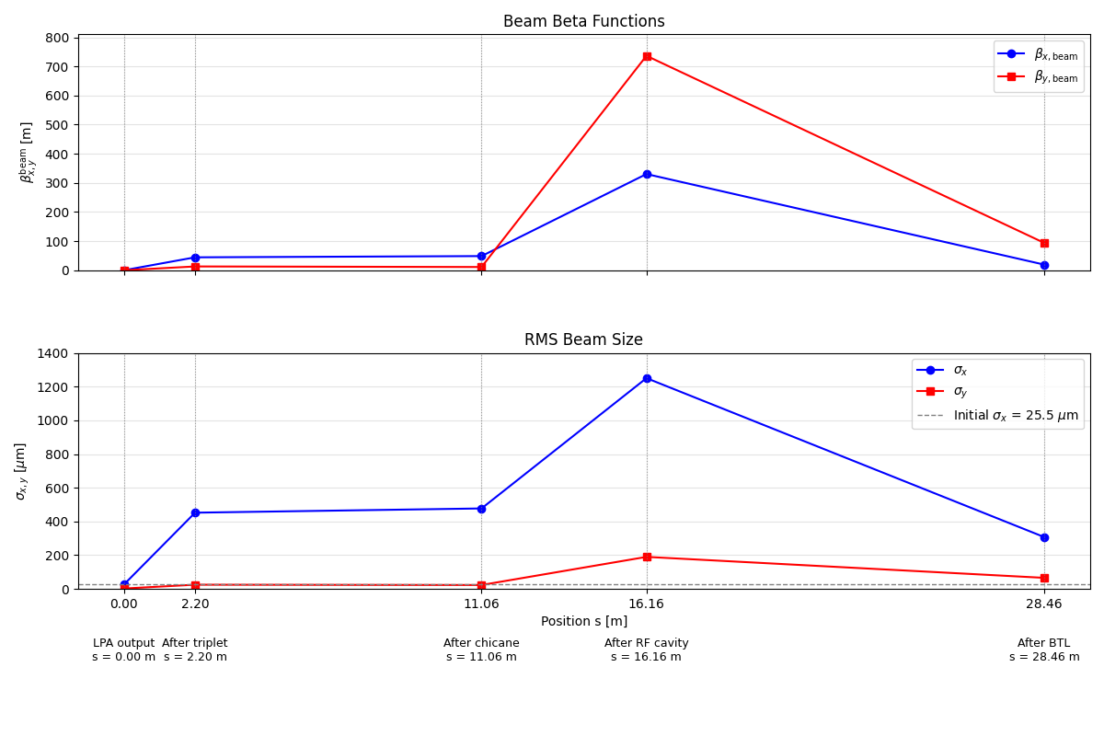
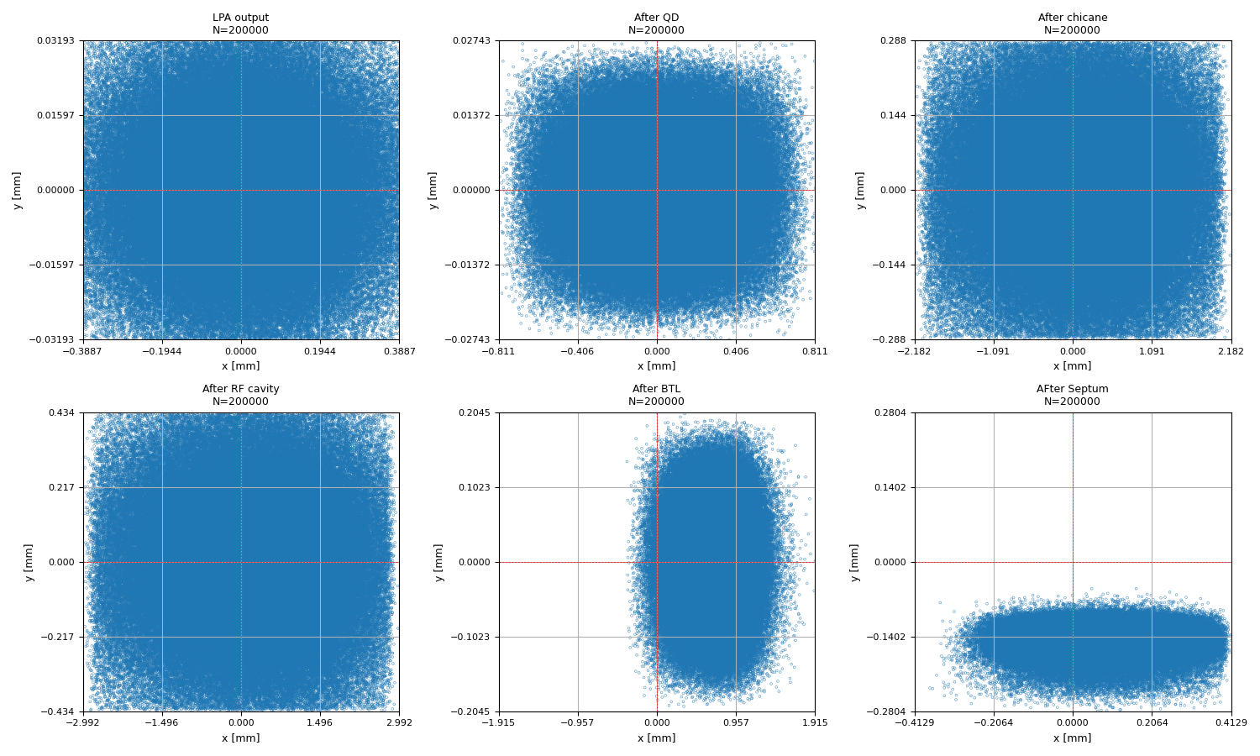
24

Slide 28
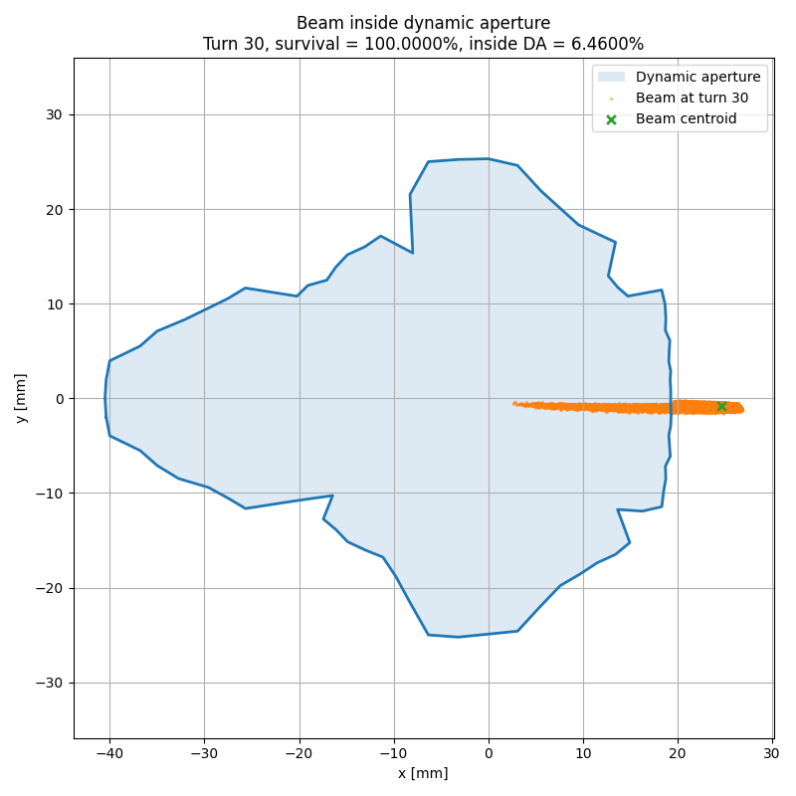
Future Plan..
25
2. Multi-turn tracking -> Injection efficiency

Slide 29
THANK YOU

Slide 30
Appendix - Calculation

Slide 31
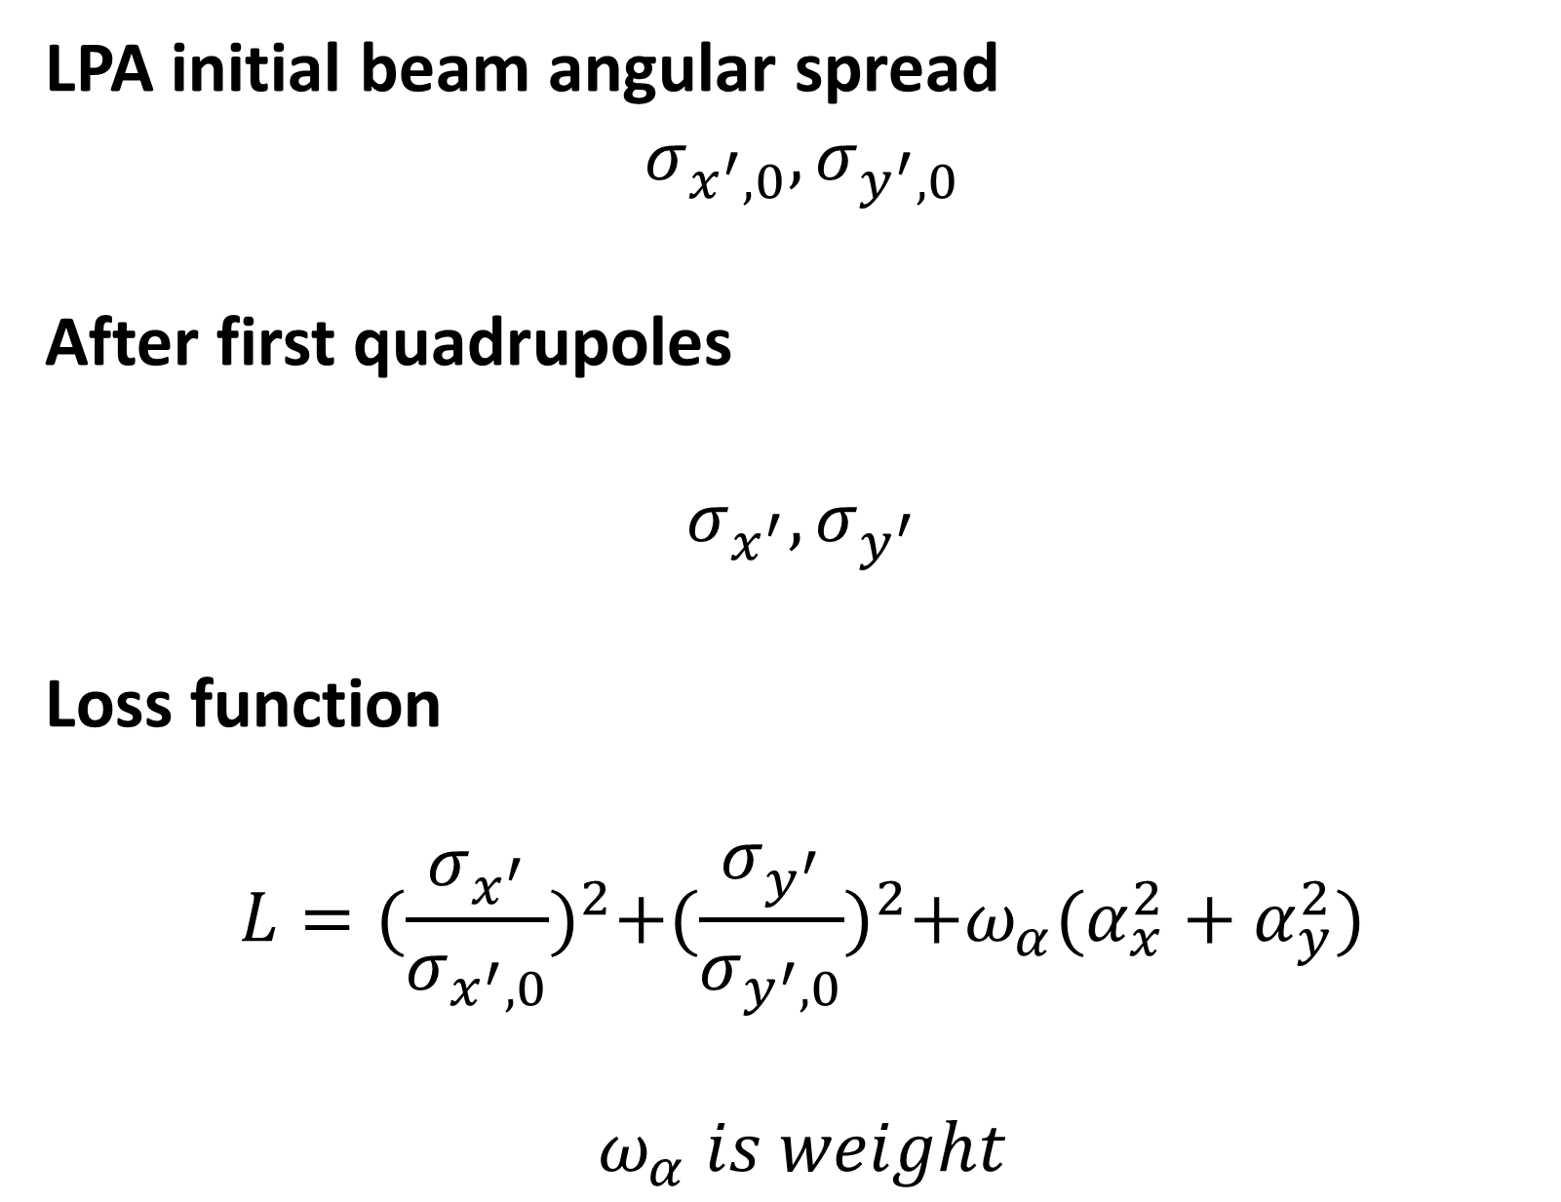
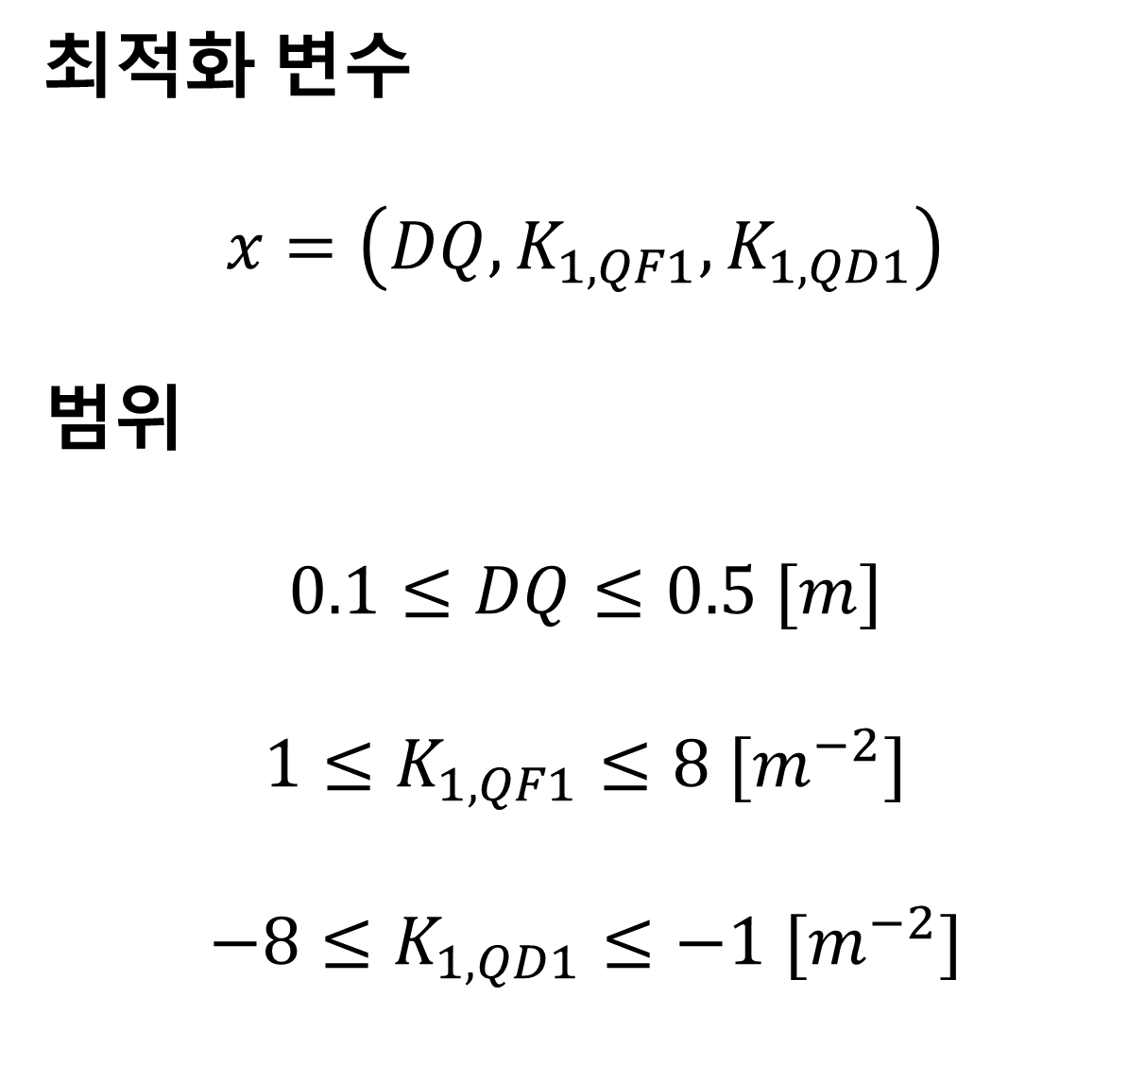
Optimization for 1st quadrupoles (Quadrupole Doublet)
최적화 변수
$$x=\left(DQ, K_{1, QF1},K_{1, QD1}\right)$$
범위
$$0.1≤DQ≤0.5 [m]$$
$$1≤K_{1, QF1}≤8 [m^{−2}]$$
$$−8≤K_{1, QD1}≤−1 [m^{−2}]$$
LPA initial beam angular spread
$$σ_{x^{′},0},σ_{y^{′},0}$$
After first quadrupoles
$$σ_{x^{′}},σ_{y^{′}}$$
Loss function
$$L={(\frac{σ_{x^{′}}}{σ_{x^{′},0}})}^{2}+{(\frac{σ_{y^{′}}}{σ_{y^{′},0}})}^{2}+ω_{α}(α_{x}^{2}+α_{y}^{2})$$
$$ω_{α} is weight$$
WATCH

Slide 32
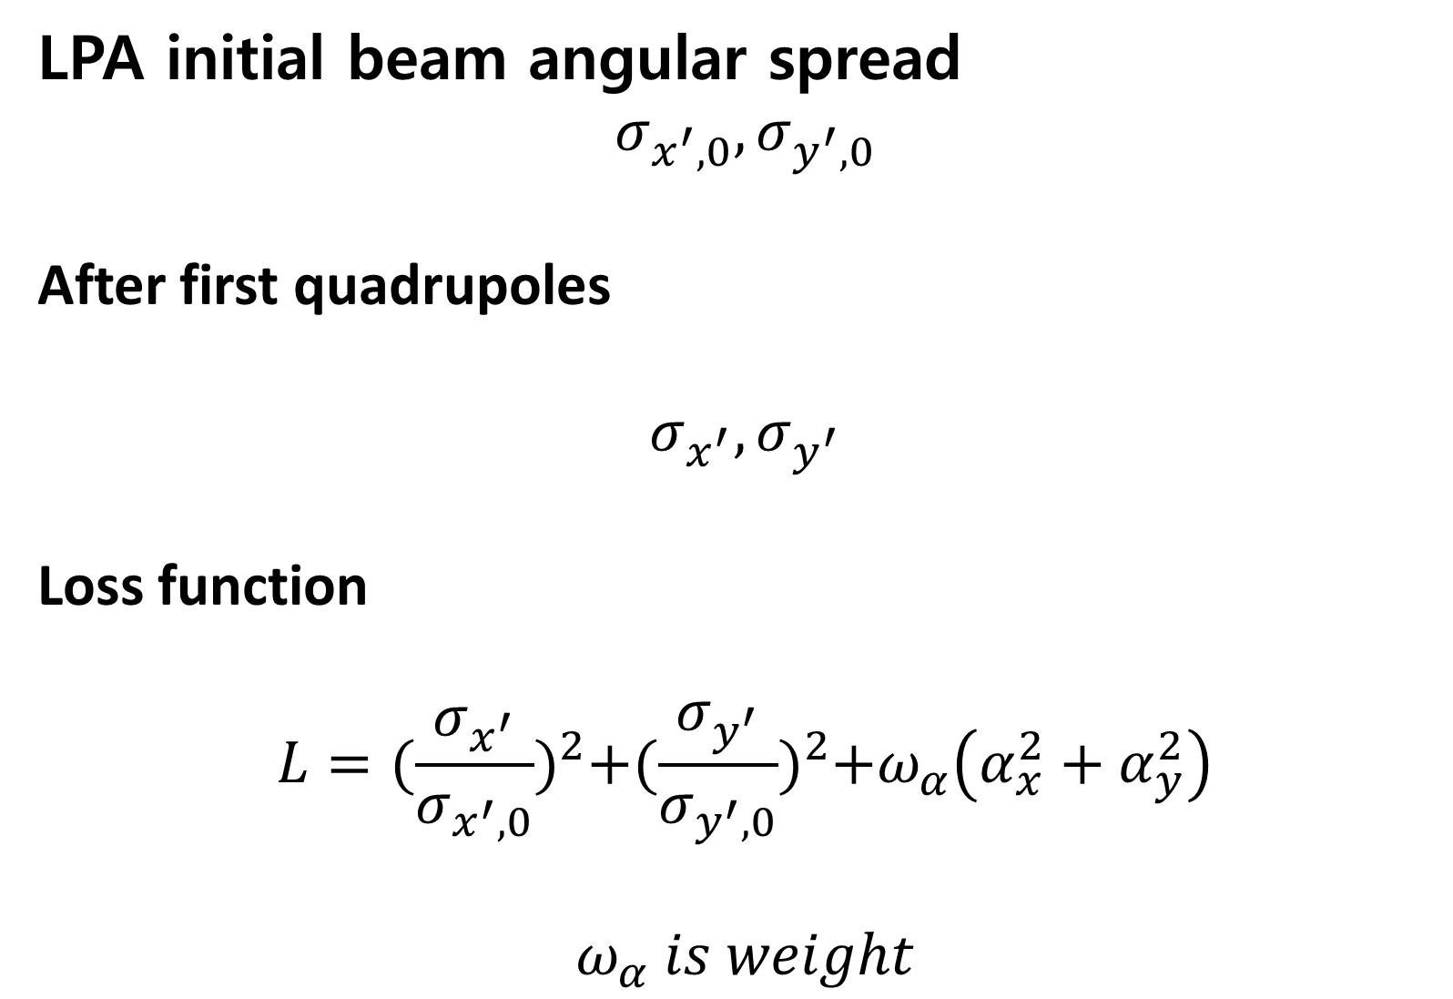

Optimization for 1st quadrupoles (Quad. Triplet)
최적화 변수
$$x=\left(D12, D23, K_{1, QF1},K_{1, QD1},K_{1, QF2}\right)$$
범위
$$0.05≤D12≤2.0 [m]$$
$$0.05≤D23≤2.0 [m]$$
$$0≤K_{1, QF1}≤8 [m^{−2}]$$
$$−8≤K_{1, QD1}≤0 [m^{−2}]$$
$$0≤K_{1, QF2}≤8 [m^{−2}]$$
LPA initial beam angular spread
$$σ_{x^{′},0},σ_{y^{′},0}$$
After first quadrupoles
$$σ_{x^{′}},σ_{y^{′}}$$
Loss function
$$L={(\frac{σ_{x^{′}}}{σ_{x^{′},0}})}^{2}+{(\frac{σ_{y^{′}}}{σ_{y^{′},0}})}^{2}+ω_{α}\left(α_{x}^{2}+α_{y}^{2}\right)$$
$$ω_{α} is weight$$
WATCH

Slide 33

Optimization for Main Chicane
최적화 변수
$$x=\left(DSEP, C_ANGLE\right)$$
범위
$$0.5≤DSEP≤2.0 [m]$$
$$8≤C_{ANGLE}≤20[°]$$
Objective function
$$f\left(DSEP, C_{ANGLE}\right)=|R_{56}\left(DSEP,C_{ANGLE}\right)−0.1m|$$
WATCH

Slide 34
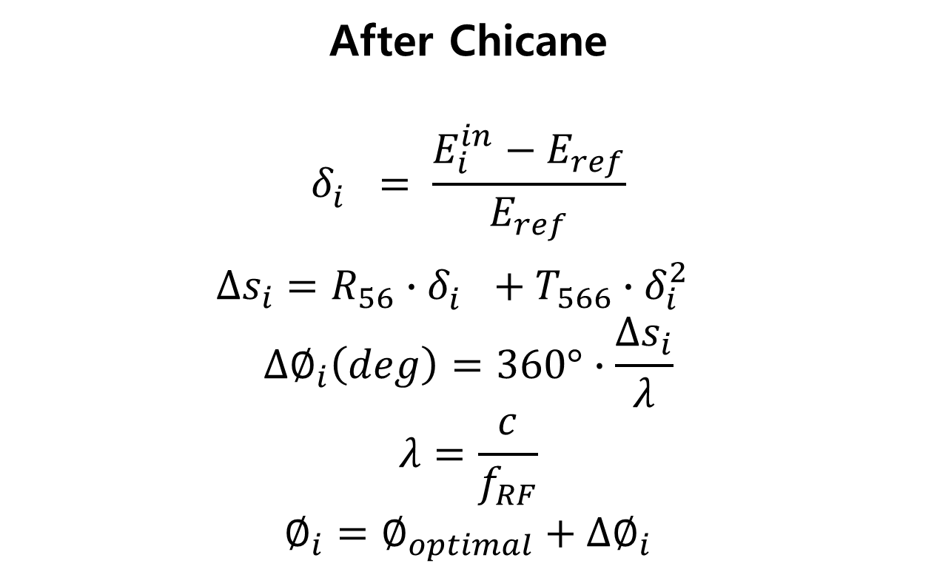
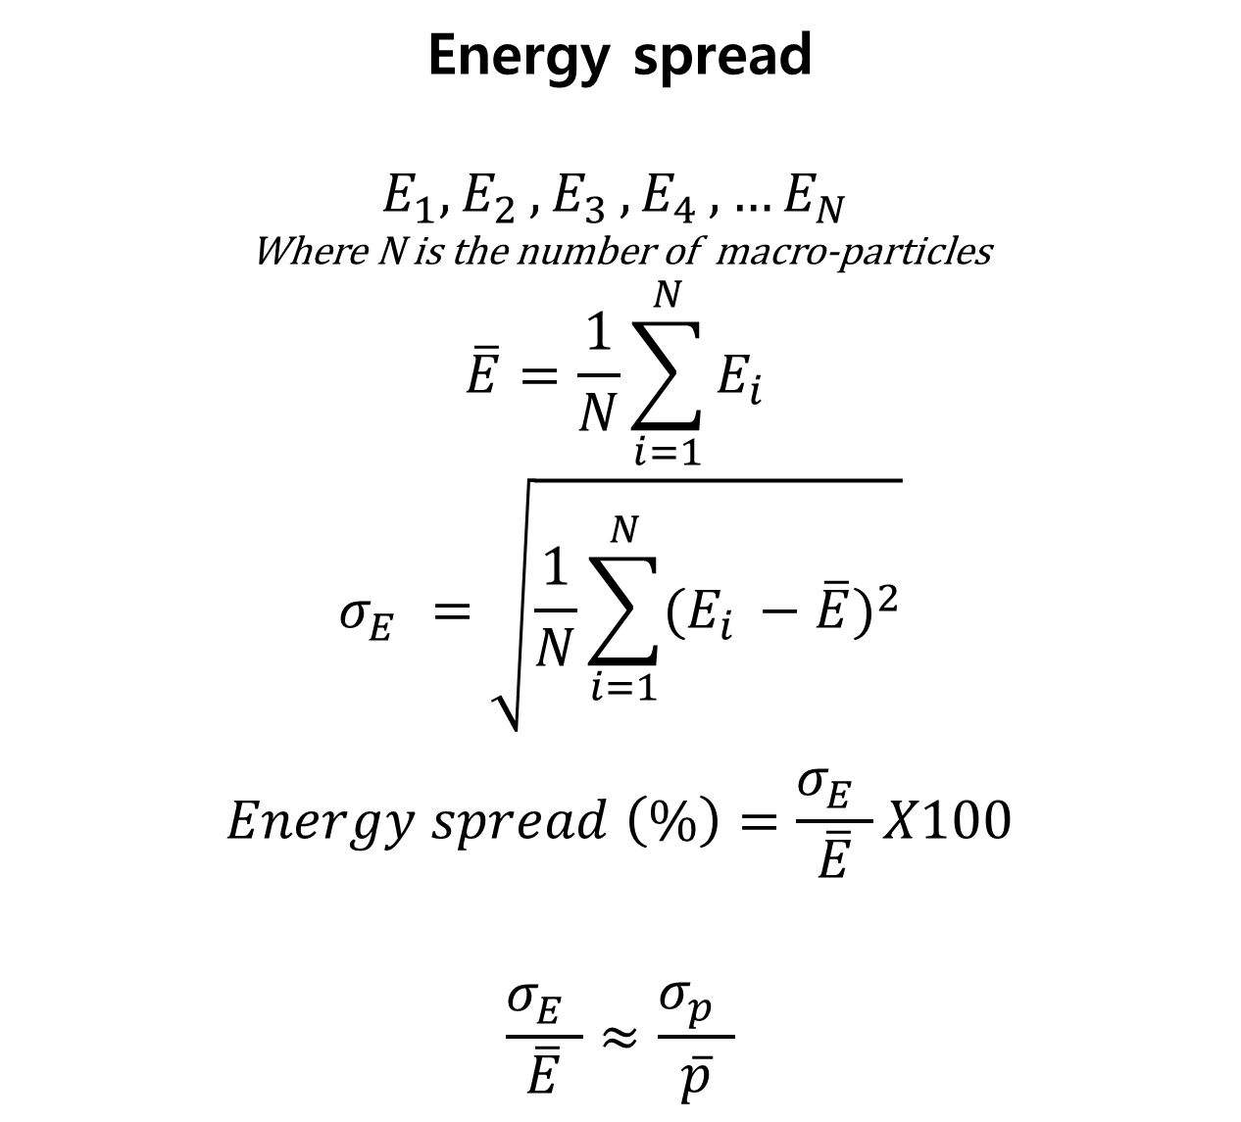

Calculation of energy spread and jitter (RMS)
Energy spread
$$E_{1},E_{2 }, E_{3 }, E_{4 }, …E_{N }$$
Where N is the number of macro-particles
$$\overline{E}=\frac{1}{N}\sum_{i=1}^{N}{E_{i }}$$
$$σ_{E}^{}=\sqrt{\frac{1}{N}\sum_{i=1}^{N}{{(E_{i }−\overline{E})}^{2}}}$$
$$Energy spread \left(\%\right)=\frac{σ_{E}^{}}{\overline{E}}X100$$
$$\frac{σ_{E}^{}}{\overline{E}}≈\frac{σ_{p}^{}}{\overline{p}}$$
After Chicane
$$δ_{i}^{}= \frac{E_{i}^{in}−E_{ref}}{E_{ref}}$$
$$∆s_{i}=R_{56}∙δ_{i}^{}+T_{566}∙{δ_{i}^{2}}^{}$$
$$∆∅_{i}\left(deg\right)=360°∙\frac{∆s_{i}}{λ}$$
$$λ=\frac{c}{f_{RF}}$$
$$∅_{i}=∅_{optimal}+∆∅_{i}$$
Energy jitter
$$E_{1},E_{2 }, E_{3 }, E_{4 }, …E_{M }$$
Where M is the number of shots
$$<E>=\frac{1}{M}\sum_{j=1}^{M}{E_{j }}$$
$$σ_{shot}^{}=\sqrt{\frac{1}{M}\sum_{j=1}^{M}{{(E_{j }−\overline{E})}^{2}}}$$
$$Energy jitter \left(\%\right)=\frac{σ_{shot}^{}}{<E>}X100$$

