Slide 1
Machine learning-based calibration and surrogate modeling of the photoinjector at PAL-XFEL
2026/07/24
Won Jang
POSTECH

Slide 2
Outline
Introduction for PAL-XFEL injector
Calibrate simulation model by Bayesian optimization(BO)
Define input/output parameters
BO method
3. Future work

Slide 3
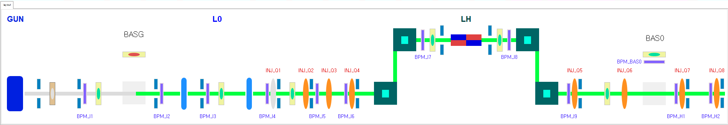
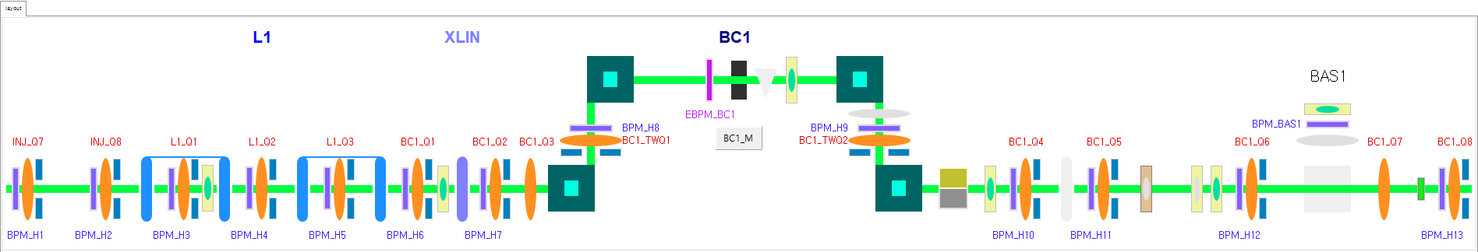
PAL-XFEL injector

Slide 4
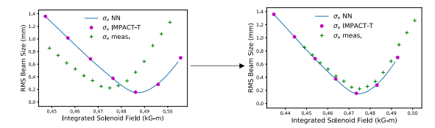
Surrogate model for PAL-XFEL injector
Purpose:
Calibrate the simulation and make surrogate models
(automated approach)
Advantage
-Improved prediction accuracy
-Same workflow can be reused for different machine settings
Work plan
Calibrate model by Bayesian optimization(BO)
Evaluate the model performance and refine the input parameters to improve better surrogate model
A. Edelen and X. Huang, “Machine Learning for Design and Control of Particle Accelerators: A Look Backward and Forward,” Annual Review of Nuclear and Particle Science, vol. 74, pp. 557–581, 2024. doi:10.1146/annurev-nucl-121423-100719.

Slide 5
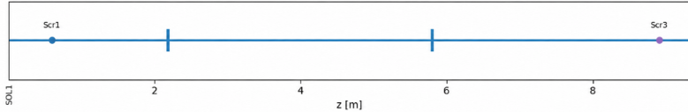
Calibrate simulation model by Bayesian optimization(BO)
Goal: Identify the input setting that minimizes the difference between simulation and target by using BO.
1. Target/Reference
2. Initial Candidate Input settings.
3. Simulate Model(IMPACT-T)
4. Get Simulated Outputs
(emittance, beam size, energy…)
Target(what we want to know)
Gun RF phase
Solenoid current offset
Initial beam distribution
.
.
.
We only know the result of simulation(IMPACT-T) from these inputs.
Iterate until the target is matched.
6. Bayesian Optimization
5. Discrepancy(Loss)
Compare simulated outputs with target results
6-1. Surrogate model
6-2. Acquisition function
6-3. Propose next settings
Gun RF
L0A(RF)
L0B(RF)
scr1
scr3
Gun solenoid

Slide 6
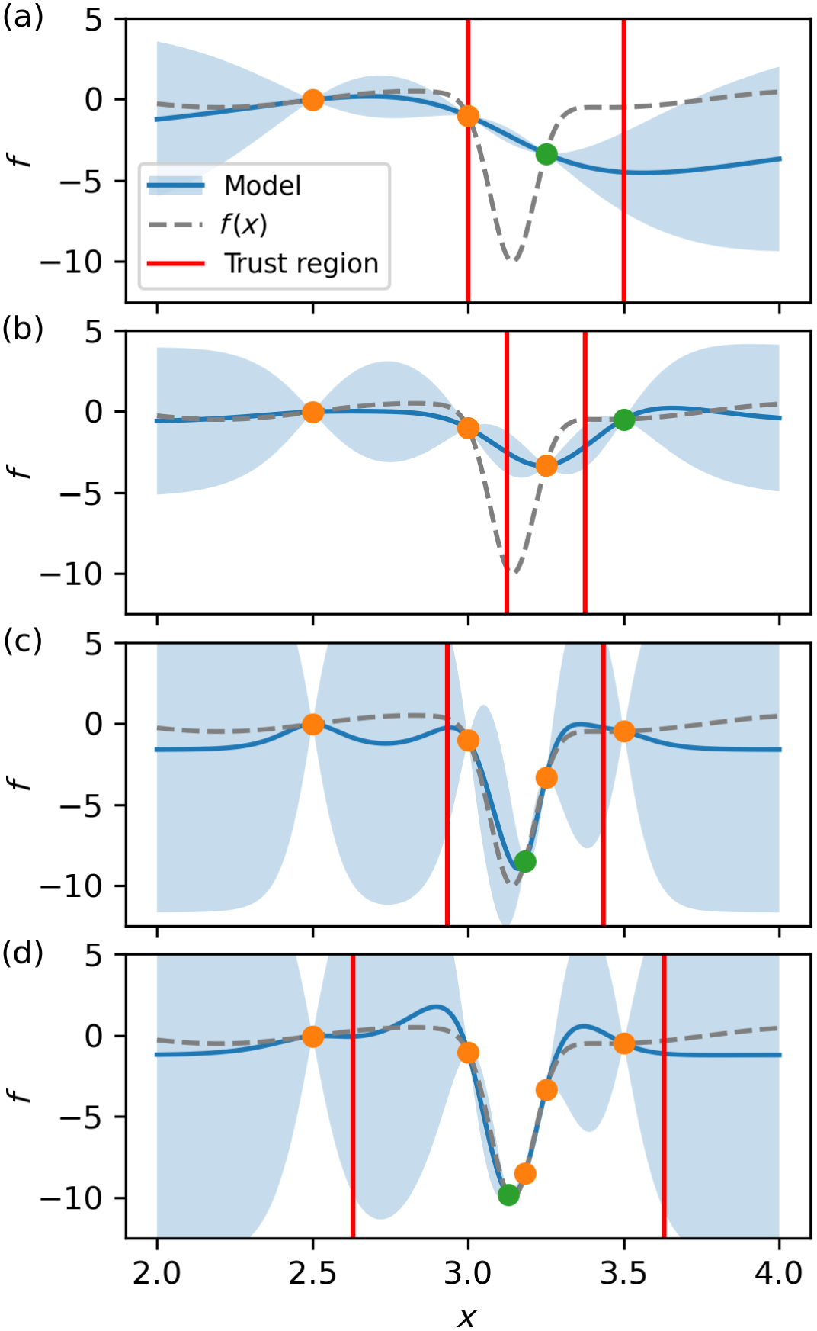
Trust-region Bayesian optimation(TurBO)
As optimization progresses, the size of the trust region changes based on the number of consecutive successes or failure
R. Roussel et al. Phys. Rev. Accel. Beams 27. (2024).

Slide 7
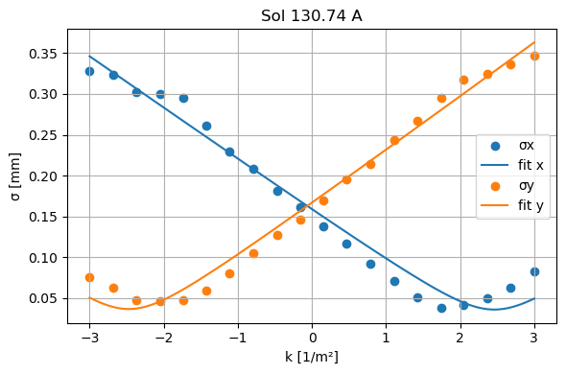
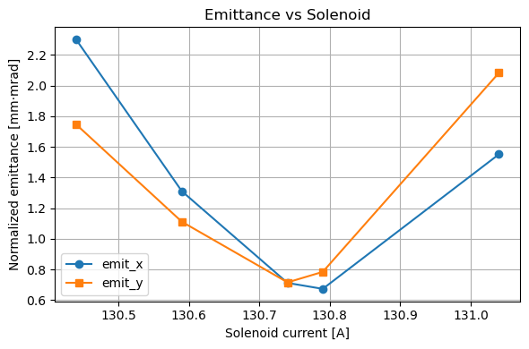
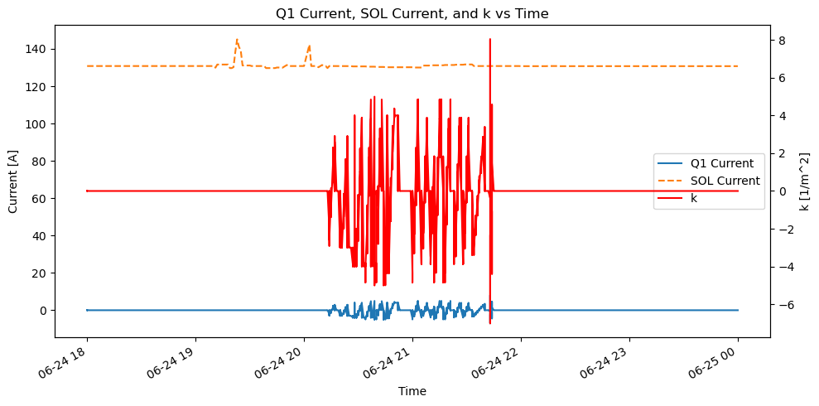
Define input/output parameters
What can we measure?
<After (Gun+L0A+L0B)>
Size(yag screen)
Emittance(Quad scan)
Energy(BAS0)
Gun RF
L0A(RF)
L0B(RF)
scr1
scr3
Gun solenoid
<After Gun>
Beam size(yag screen)
Energy(BASG)
Quad scan
Get beam size
Curve fitting

Slide 8
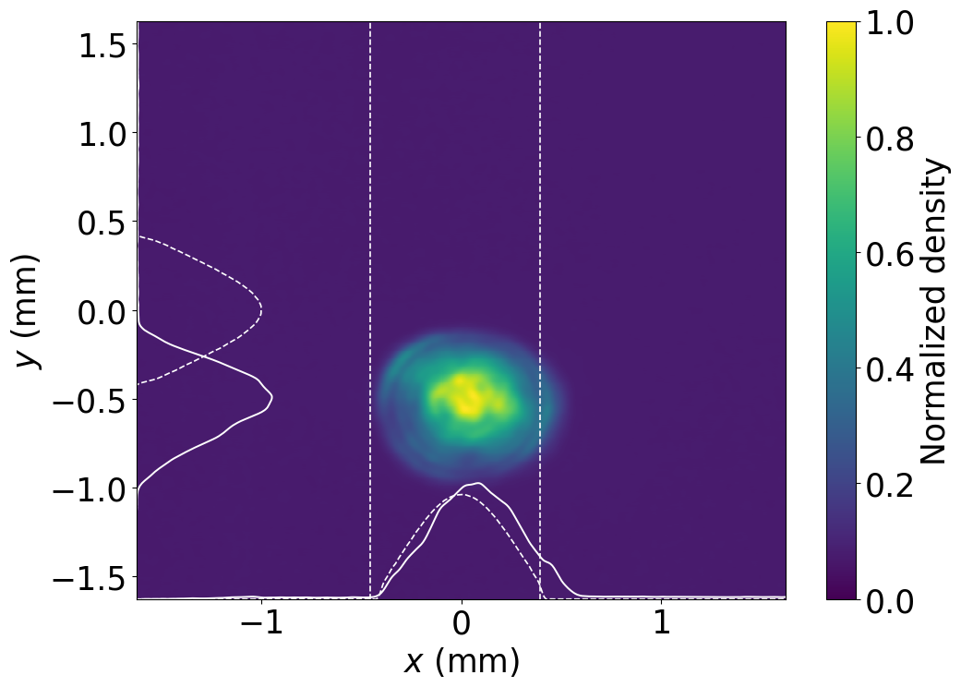
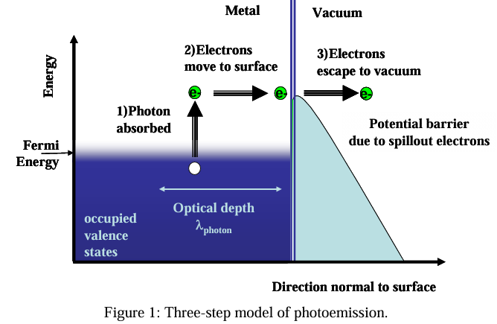
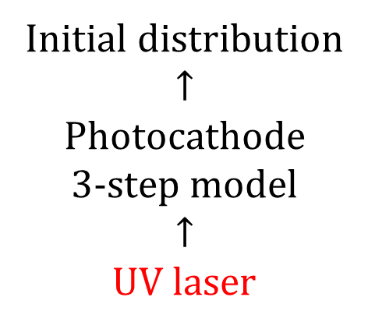
Define input parameters
Gun RF
L0A(RF)
L0B(RF)
scr1
scr3
Gun solenoid
UV distribution
Initial distribution
$$↑$$
Photocathode
3-step model
$$↑$$
UV laser

Slide 9
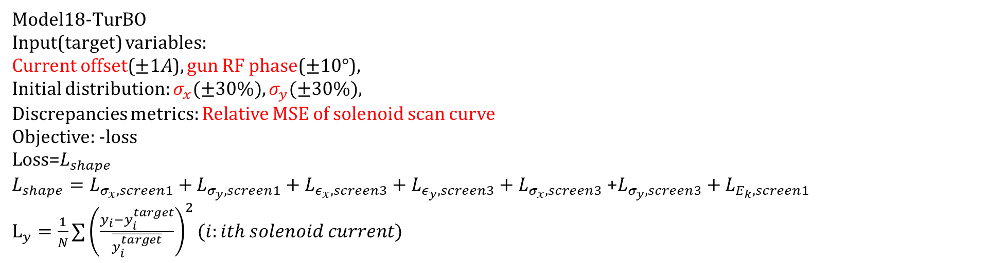
History of BO Trials conducted so far…
Model18-TurBO
Input(target) variables:
Current offset($±1A$), gun RF phase($±10°$),
Initial distribution: $σ_{x}(±30\%),σ_{y}(±30\%)$,
Discrepancies metrics: Relative MSE of solenoid scan curve
Objective: -loss
$\text{Loss}\text{=}L_{shape}$
$L_{shape}=L_{σ_{x},screen1}+L_{σ_{y},screen1}+L_{ε_{x},screen3}+L_{ε_{y},screen3}+L_{σ_{x},screen3} \text{+}L_{σ_{y},screen3}+L_{E_{k},screen1}$
$L_{y}=\frac{1}{N}∑{\left(\frac{y_{i}−y_{i}^{target}}{\overline{y_{i}^{target}}}\right)}^{2}(i:ith solenoid current)$

Slide 10
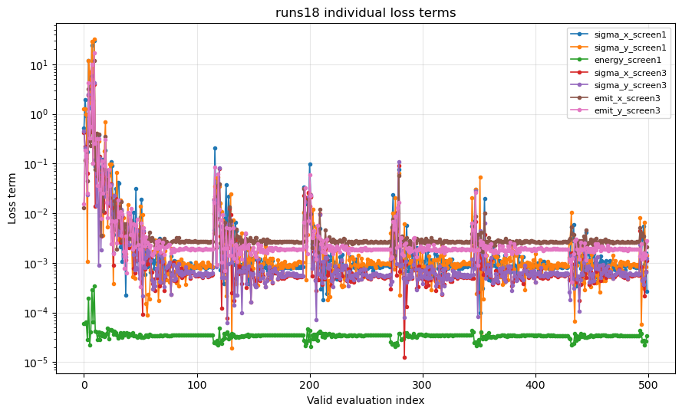
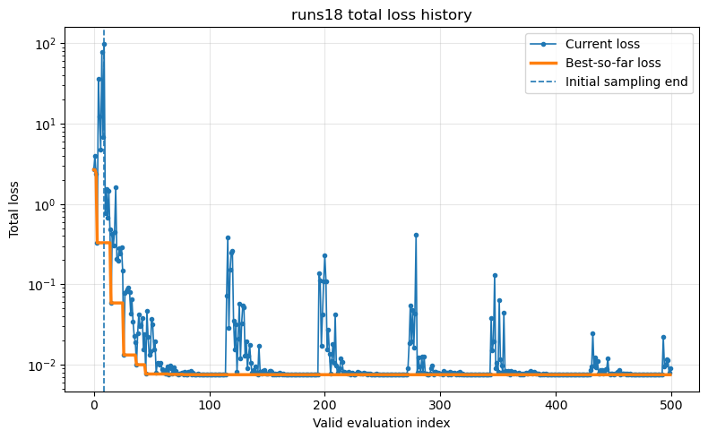
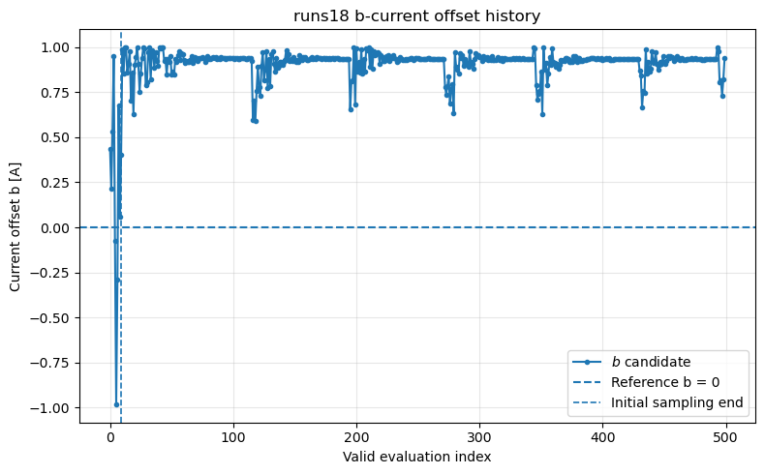
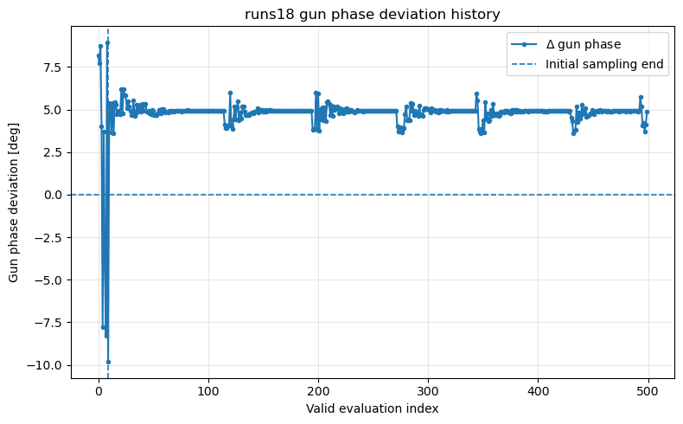
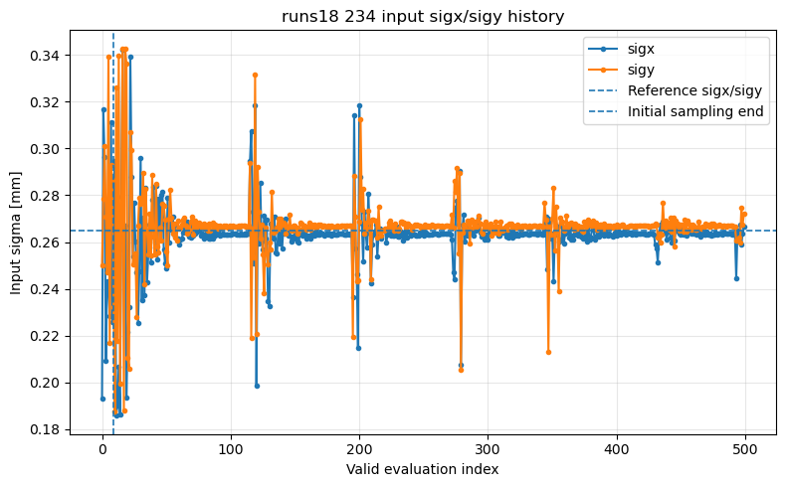

Slide 11
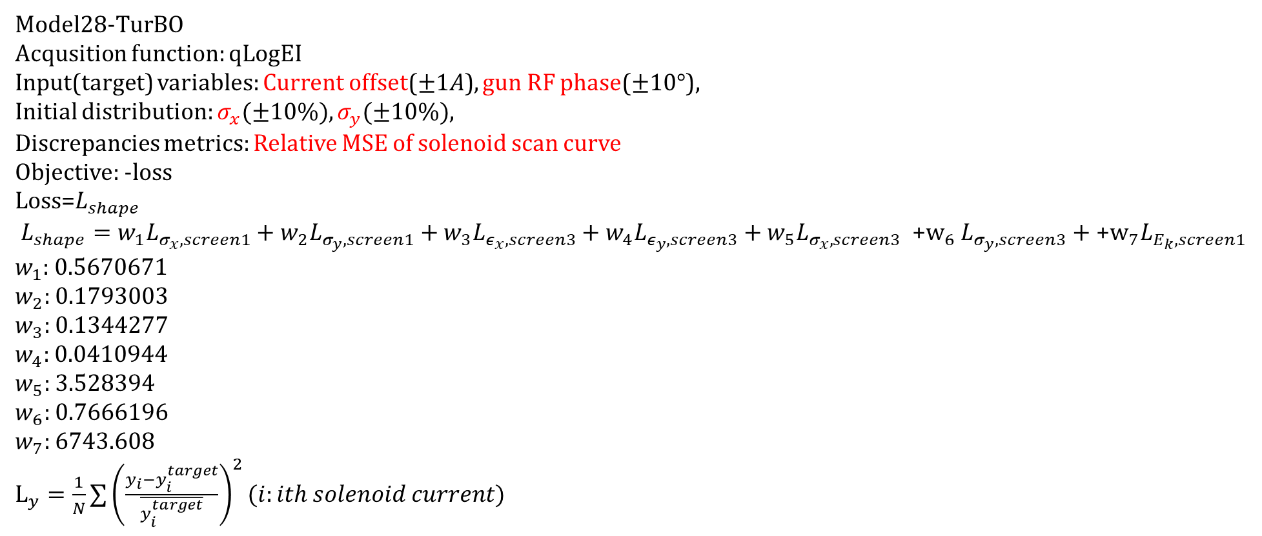
History of BO Trials conducted so far…
Model28-TurBO
Acqusition function: qLogEI
Input(target) variables: Current offset($±1A$), gun RF phase($±10°$),
Initial distribution: $σ_{x}(±10\%),σ_{y}(±10\%)$,
Discrepancies metrics: Relative MSE of solenoid scan curve
Objective: -loss
$\text{Loss}\text{=}L_{shape}$
$$L_{shape}=w_{1}L_{σ_{x},screen1}+w_{2}L_{σ_{y},screen1}+w_{3}L_{ε_{x},screen3}+w_{4}L_{ε_{y},screen3}+w_{5}L_{σ_{x},screen3} {\text{+}\text{w}}_{6}L_{σ_{y},screen3}+{\text{+}\text{w}}_{7}L_{E_{k},screen1}$$
$w_{1}$: 0.5670671
$w_{2}:$ 0.1793003
$w_{3}:$ 0.1344277
$w_{4}:$ 0.0410944
$w_{5}:$ 3.528394
$w_{6}:$ 0.7666196
$w_{7}:$ 6743.608
$L_{y}=\frac{1}{N}∑{\left(\frac{y_{i}−y_{i}^{target}}{\overline{y_{i}^{target}}}\right)}^{2}(i:ith solenoid current)$

Slide 12
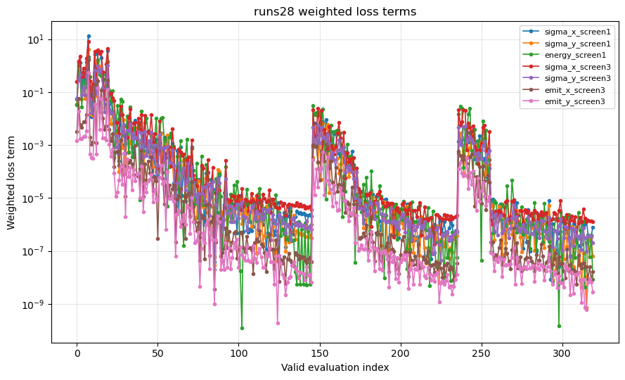
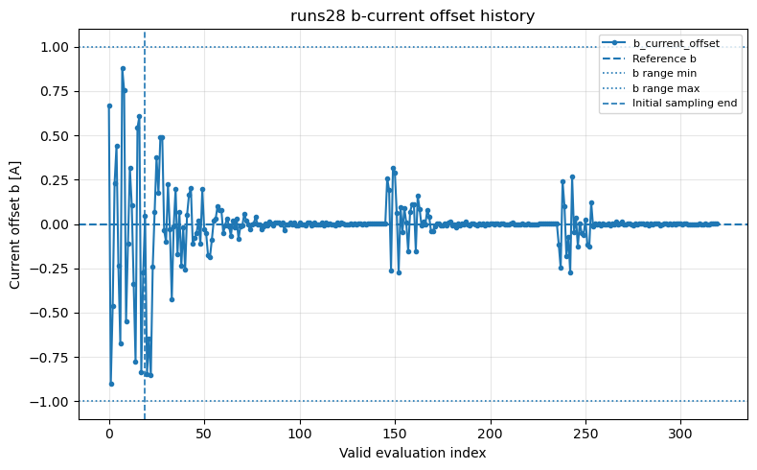
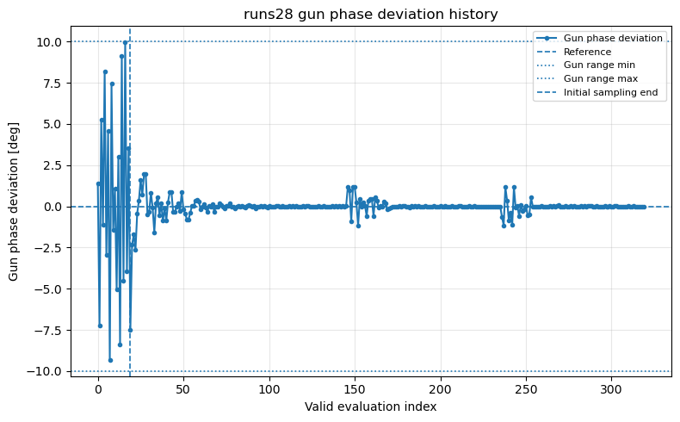
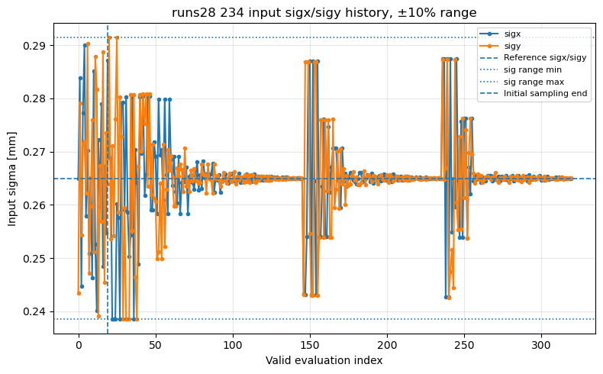
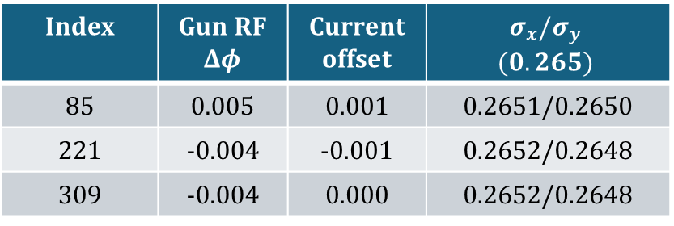
Index | Gun RF $Δφ$ | Current offset | $$σ_{x}/σ_{y}$$ $$(0.265)$$
85 | 0.005 | 0.001 | 0.2651/0.2650
221 | -0.004 | -0.001 | 0.2652/0.2648
309 | -0.004 | 0.000 | 0.2652/0.2648

Slide 13
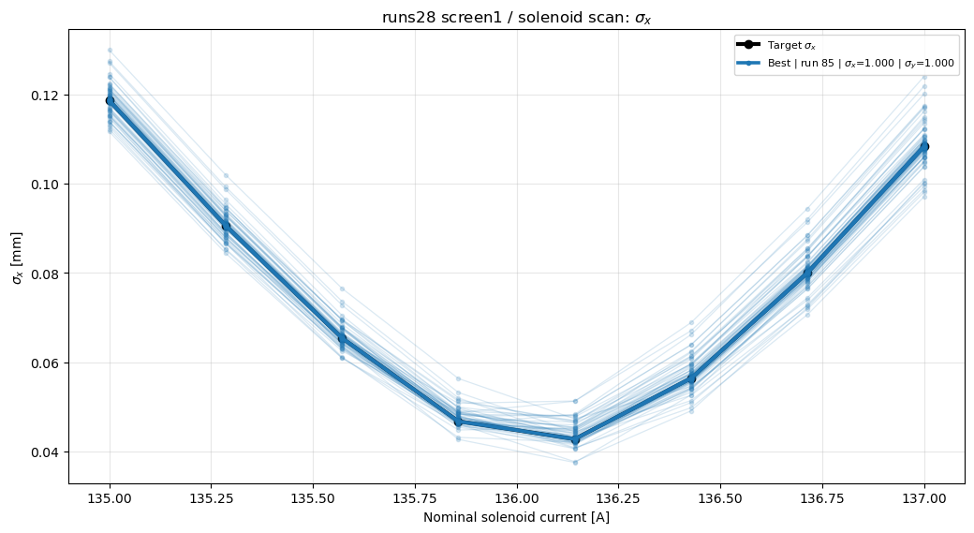
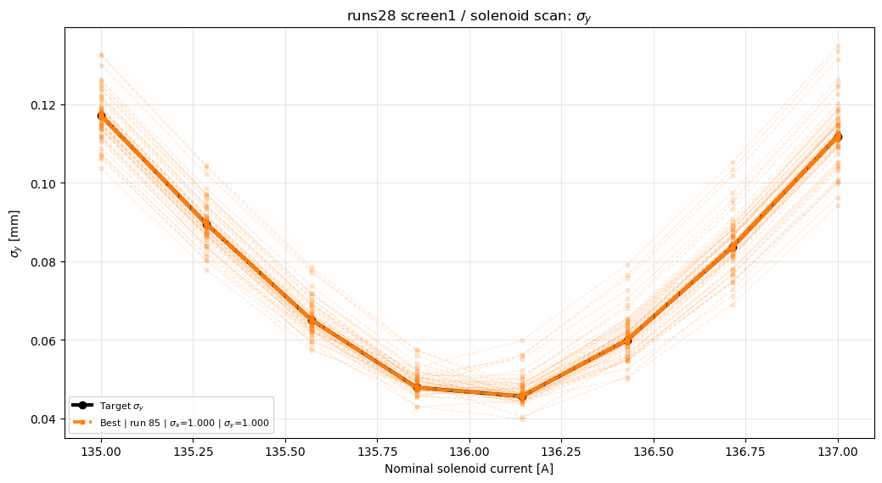
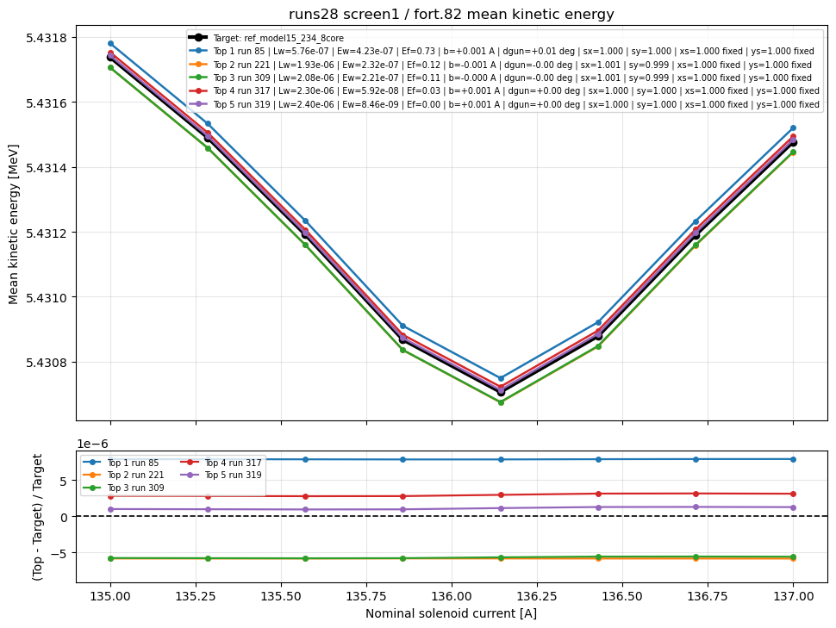
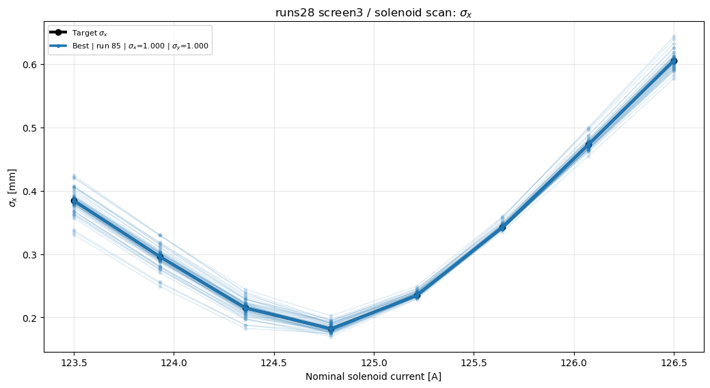
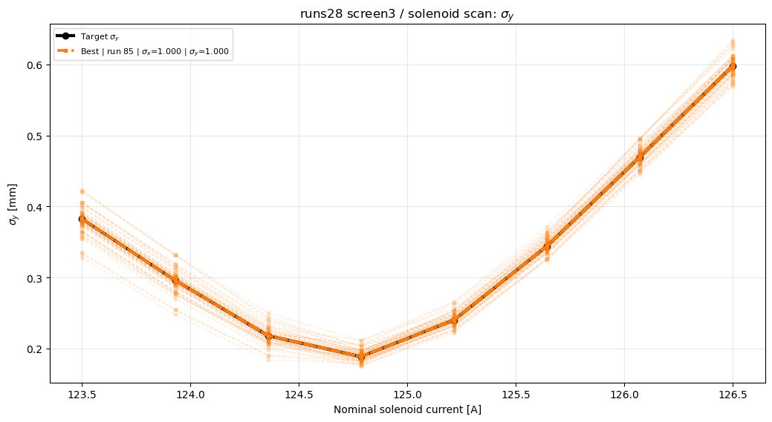
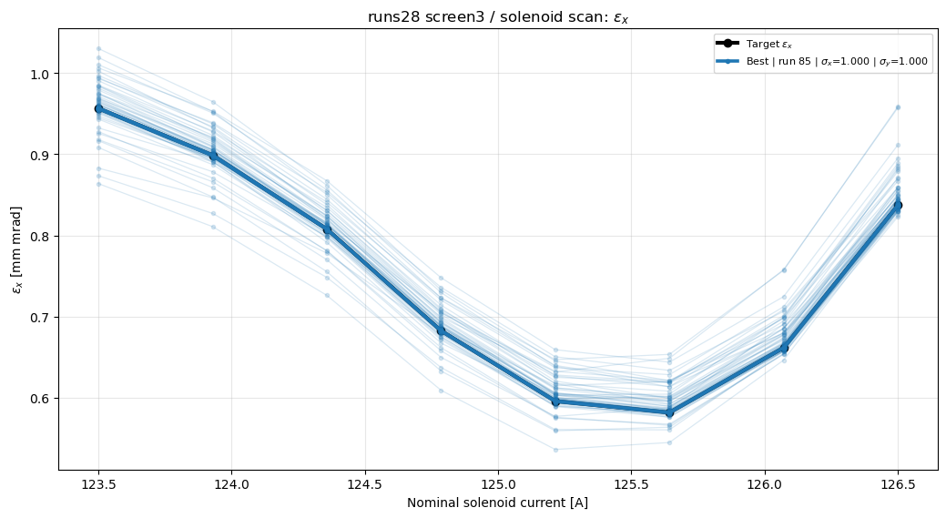
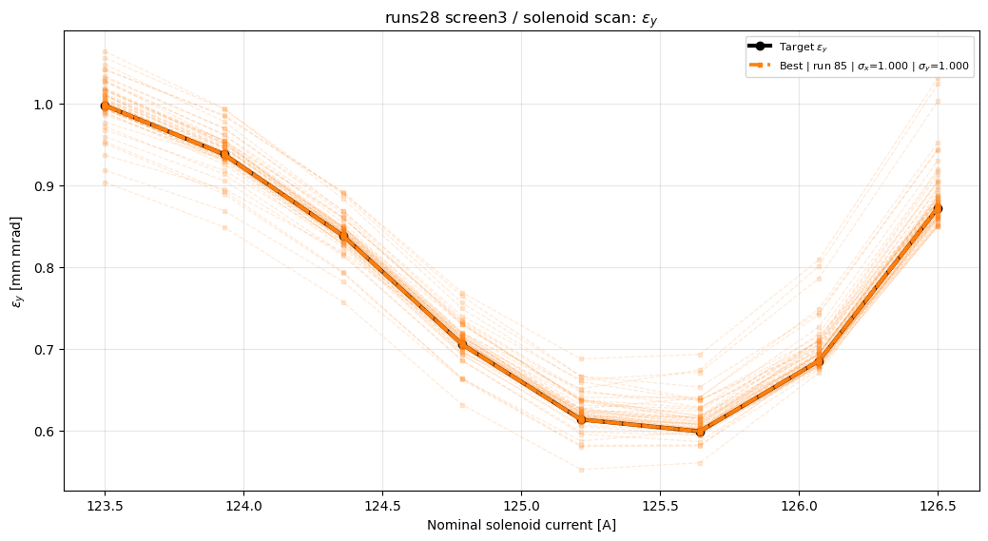

Slide 14
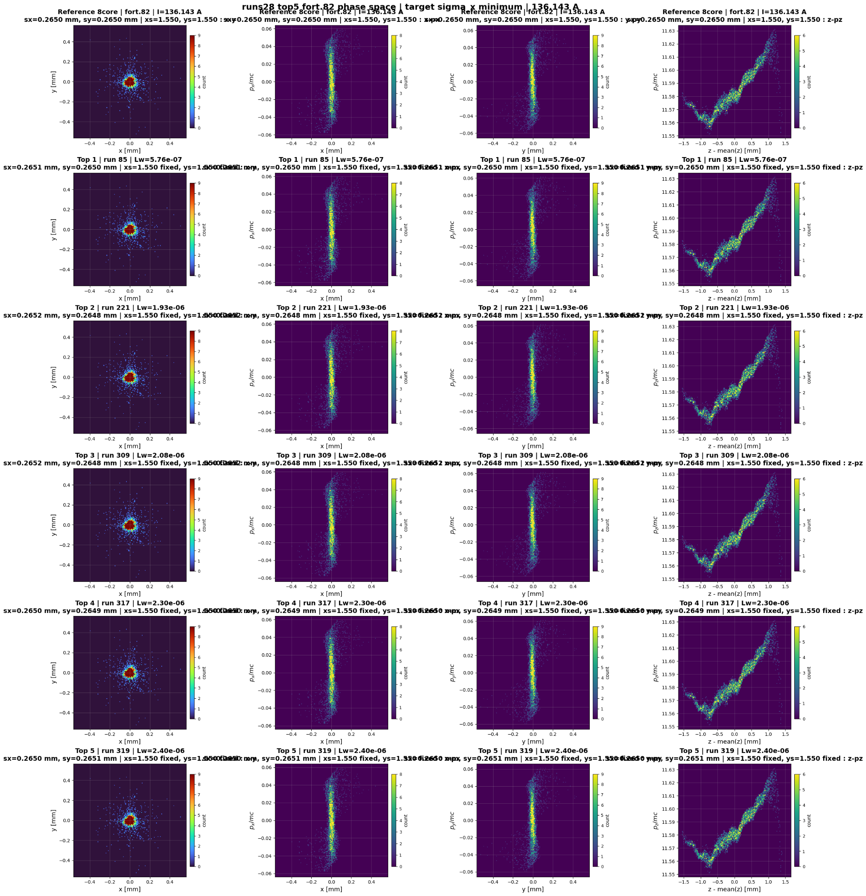
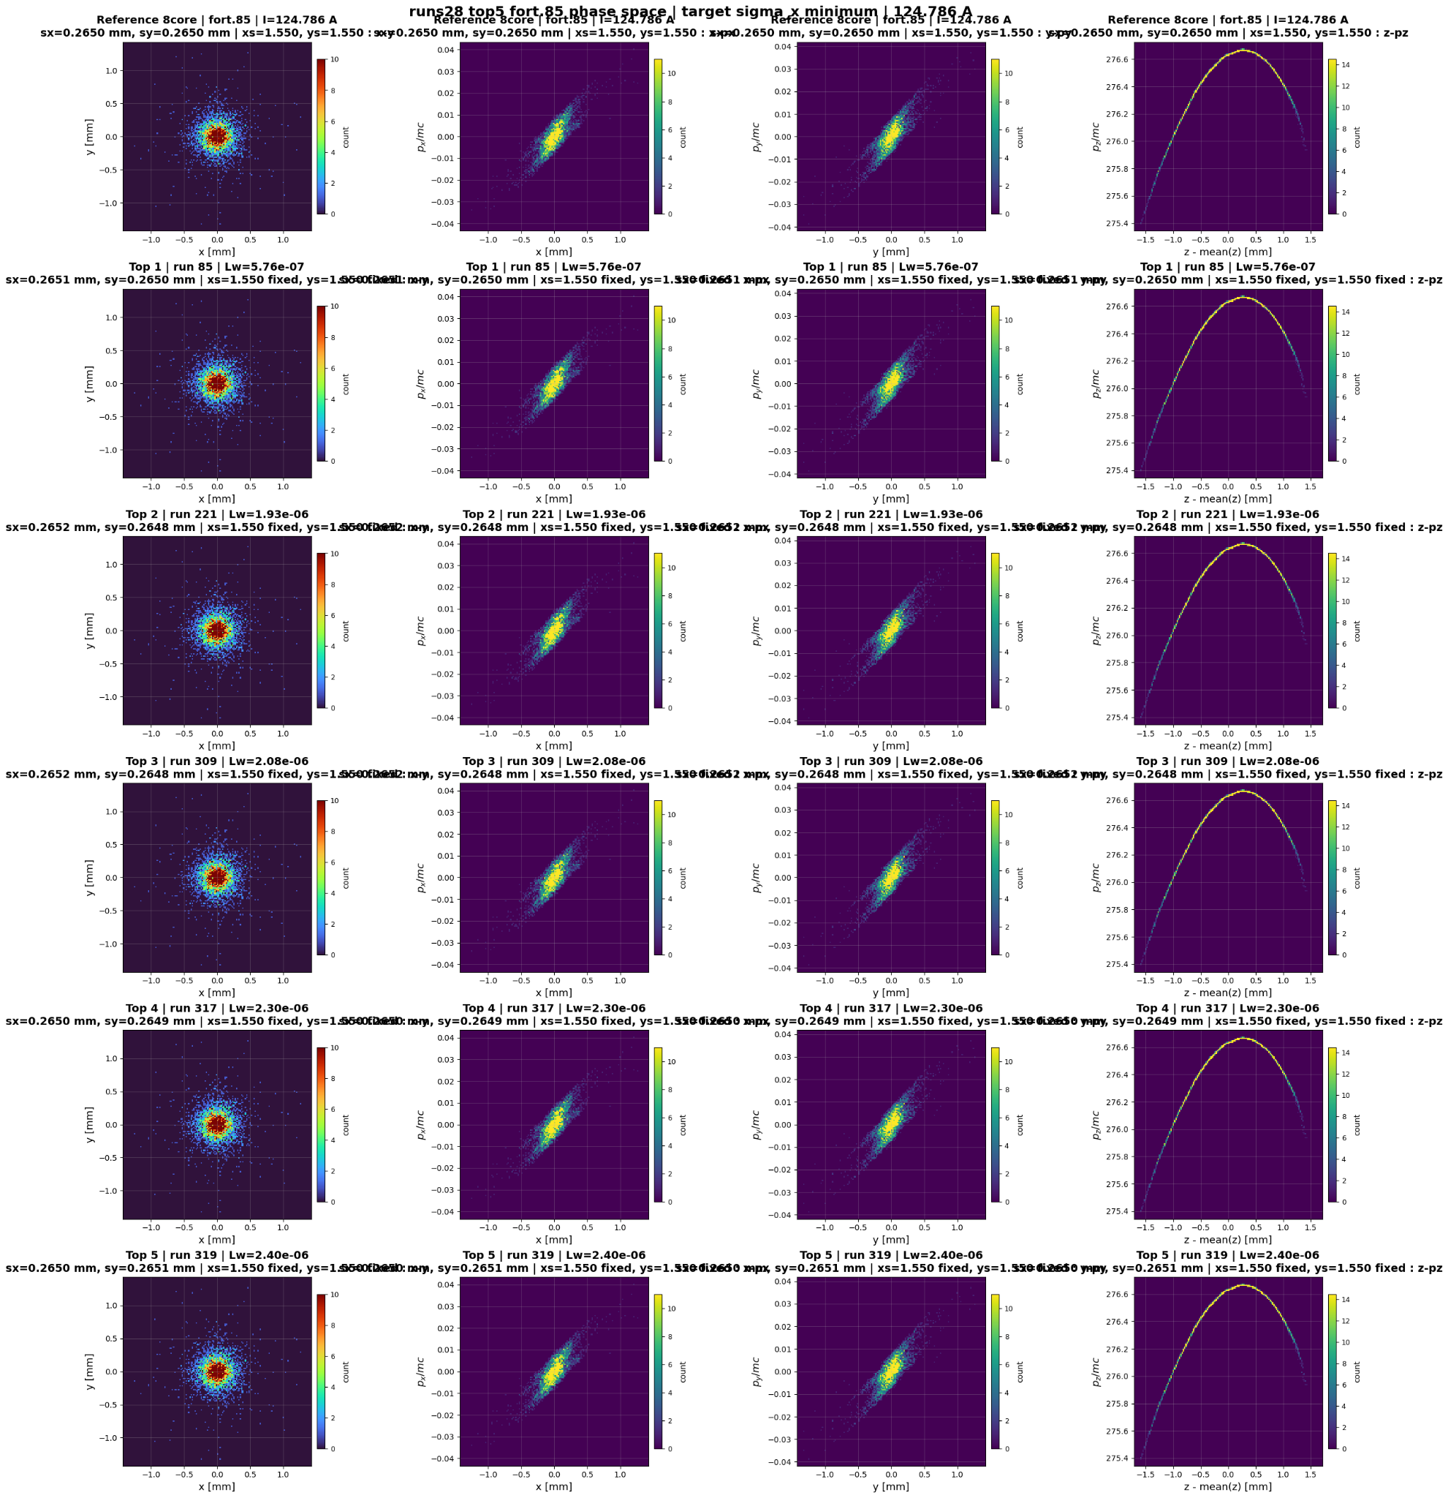

Slide 15
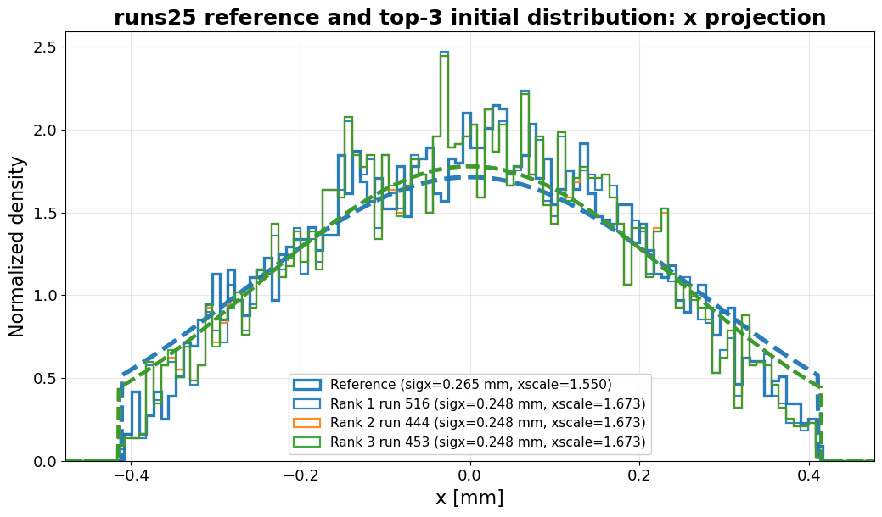
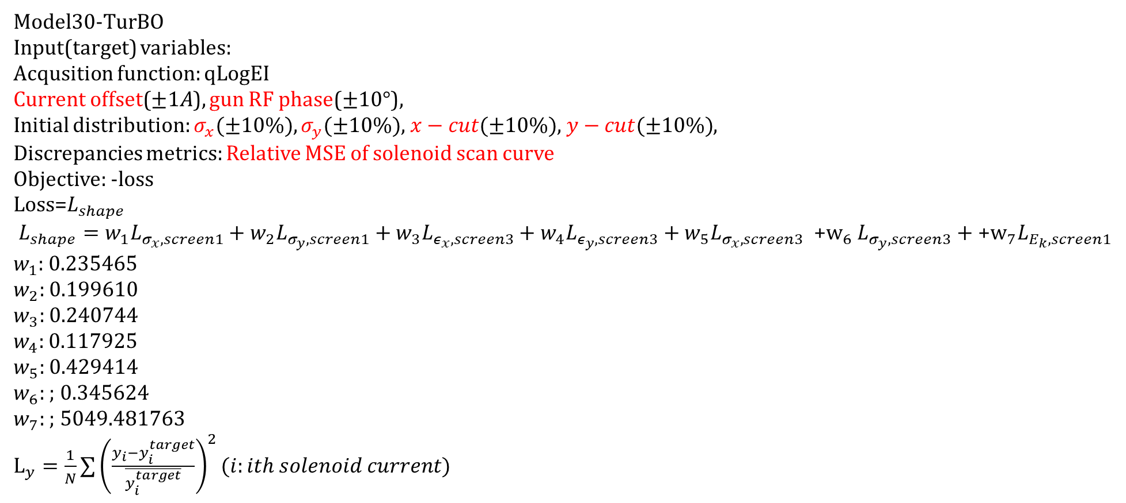
History of BO Trials conducted so far…
Model30-TurBO
Input(target) variables:
Acqusition function: qLogEI
Current offset($±1A$), gun RF phase($±10°$),
Initial distribution: $σ_{x}(±10\%),σ_{y}(±10\%)$, $x−cut(±10\%)$, $y−cut(±10\%)$,
Discrepancies metrics: Relative MSE of solenoid scan curve
Objective: -loss
$\text{Loss}\text{=}L_{shape}$
$$L_{shape}=w_{1}L_{σ_{x},screen1}+w_{2}L_{σ_{y},screen1}+w_{3}L_{ε_{x},screen3}+w_{4}L_{ε_{y},screen3}+w_{5}L_{σ_{x},screen3} {\text{+}\text{w}}_{6}L_{σ_{y},screen3}+{\text{+}\text{w}}_{7}L_{E_{k},screen1}$$
$w_{1}$: 0.235465
$w_{2}:$ 0.199610
$w_{3}:$ 0.240744
$w_{4}:$ 0.117925
$w_{5}:$ 0.429414
$w_{6}:$ ; 0.345624
$w_{7}:$ ; 5049.481763
$L_{y}=\frac{1}{N}∑{\left(\frac{y_{i}−y_{i}^{target}}{\overline{y_{i}^{target}}}\right)}^{2}(i:ith solenoid current)$

Slide 16
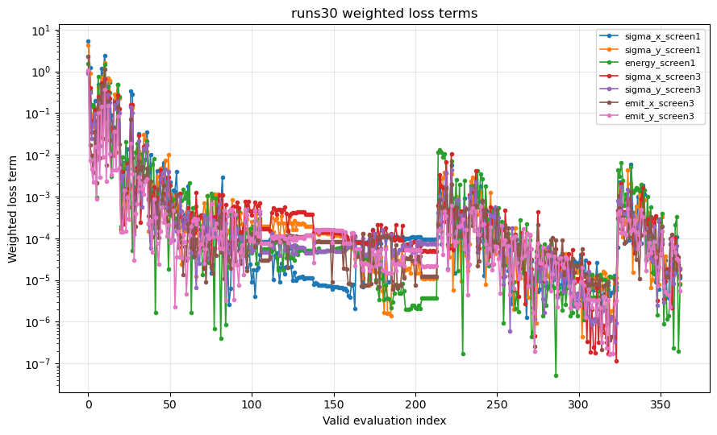
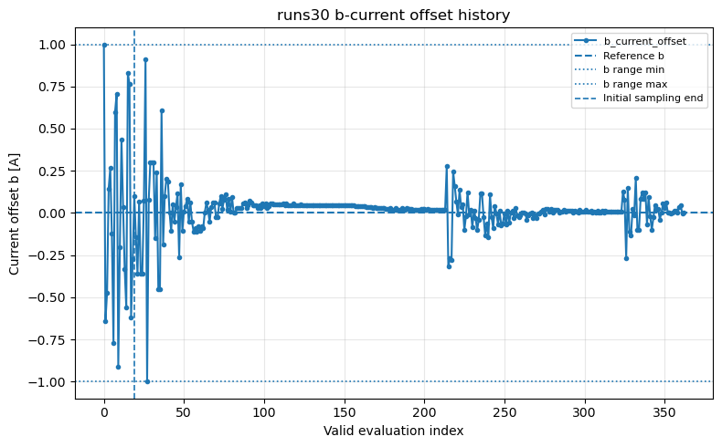
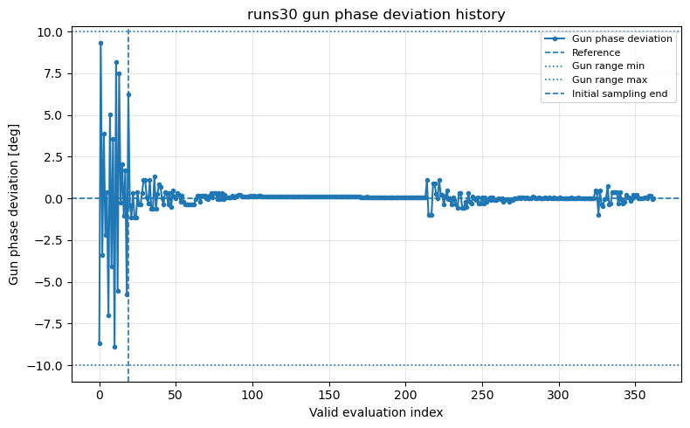
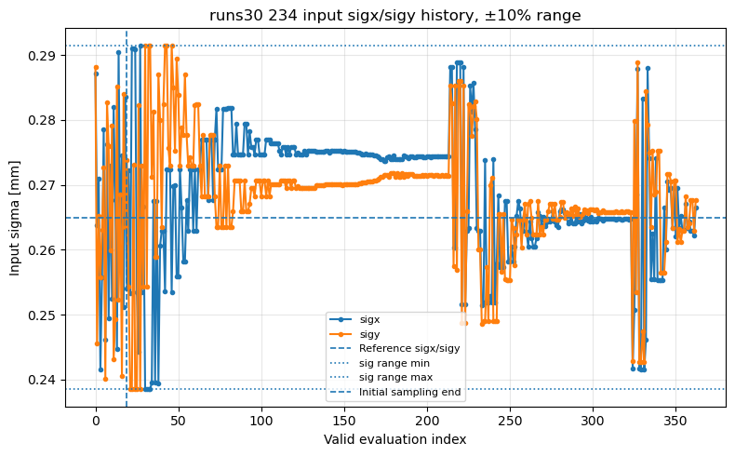
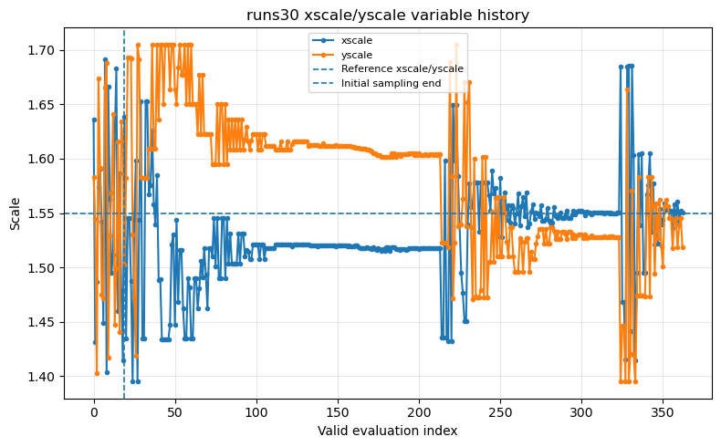
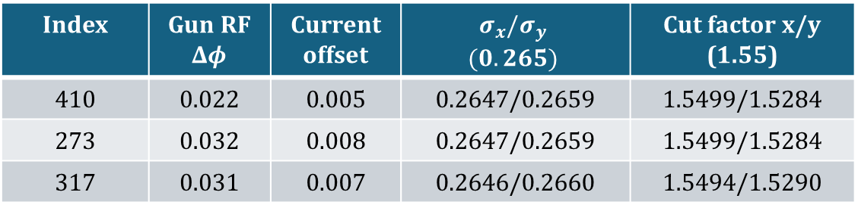
Index | Gun RF $Δφ$ | Current offset | $$σ_{x}/σ_{y}$$ $$(0.265)$$ | Cut factor x/y (1.55)
410 | 0.022 | 0.005 | 0.2647/0.2659 | 1.5499/1.5284
273 | 0.032 | 0.008 | 0.2647/0.2659 | 1.5499/1.5284
317 | 0.031 | 0.007 | 0.2646/0.2660 | 1.5494/1.5290

Slide 17
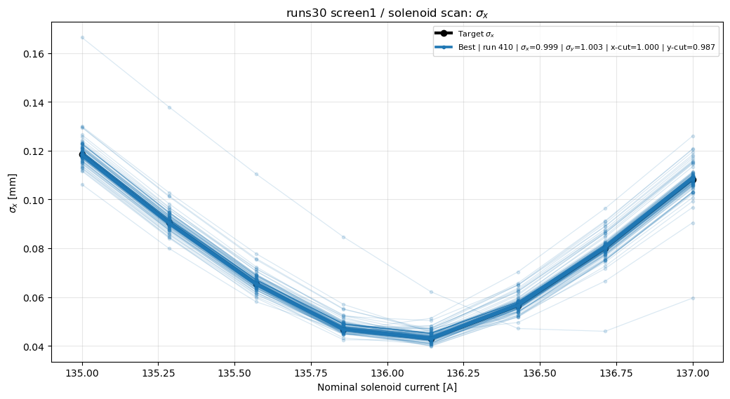
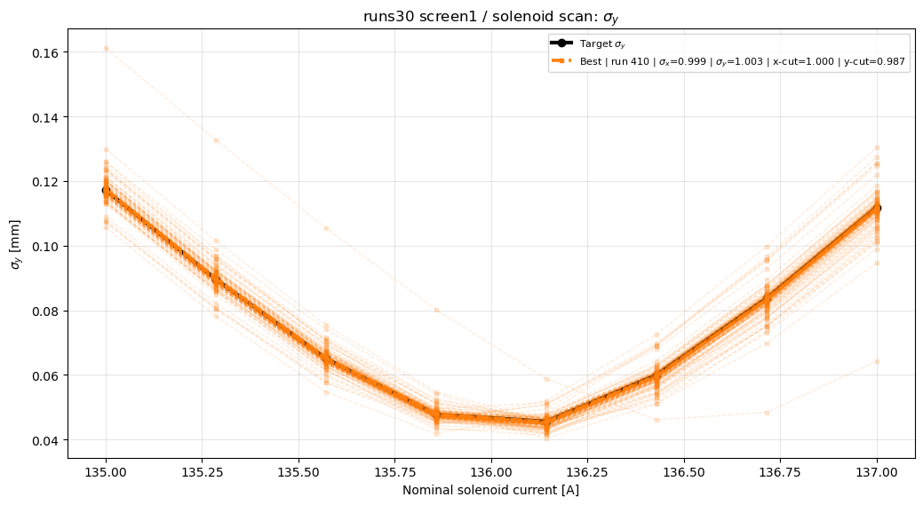
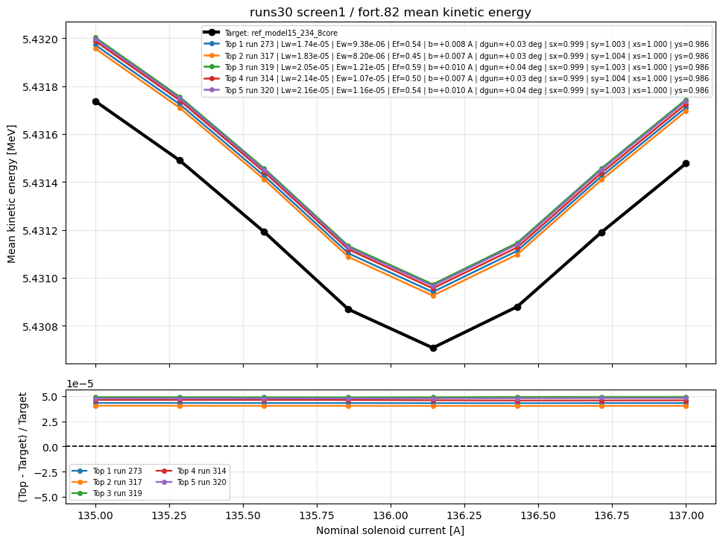
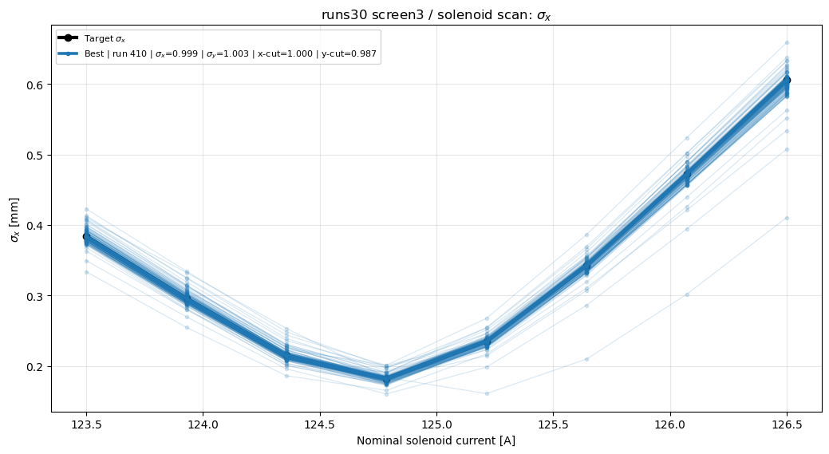
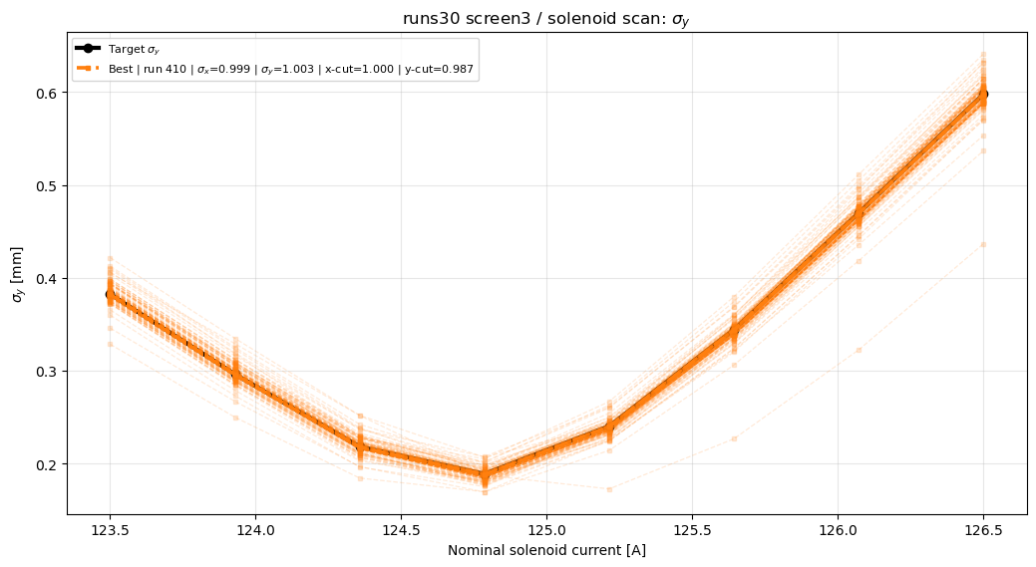
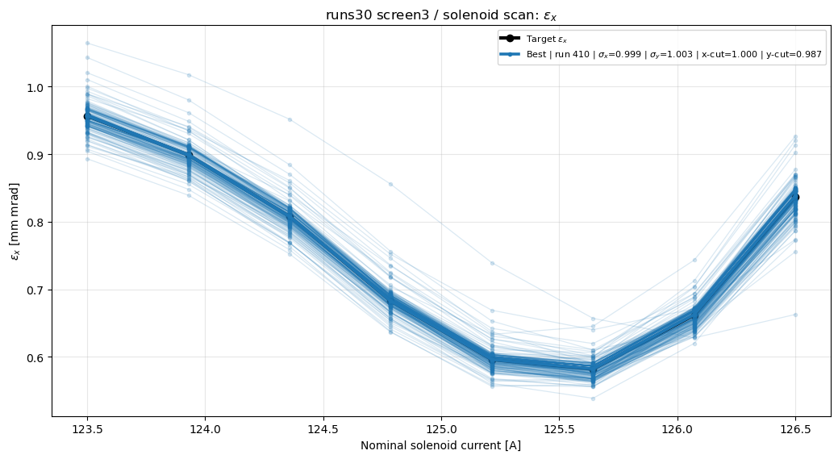
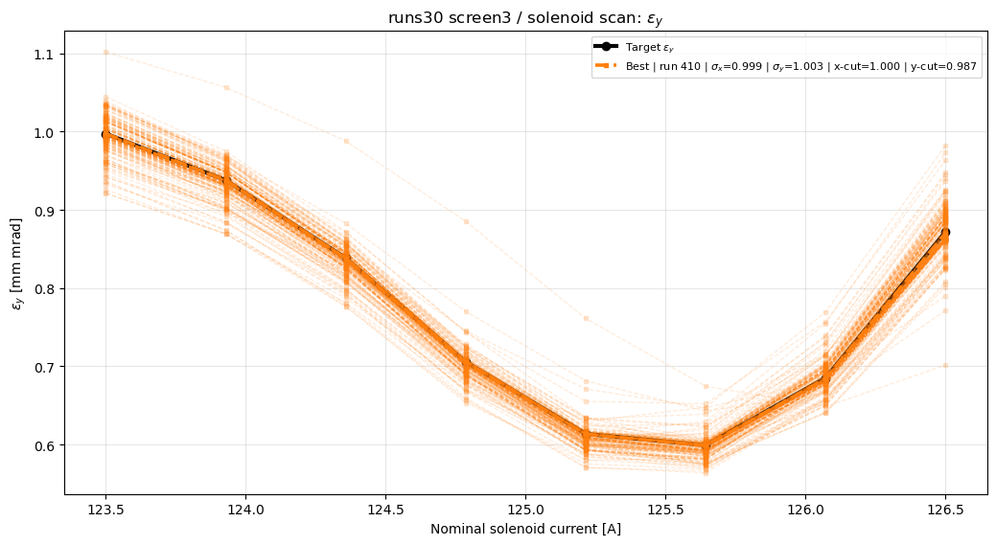

Slide 18
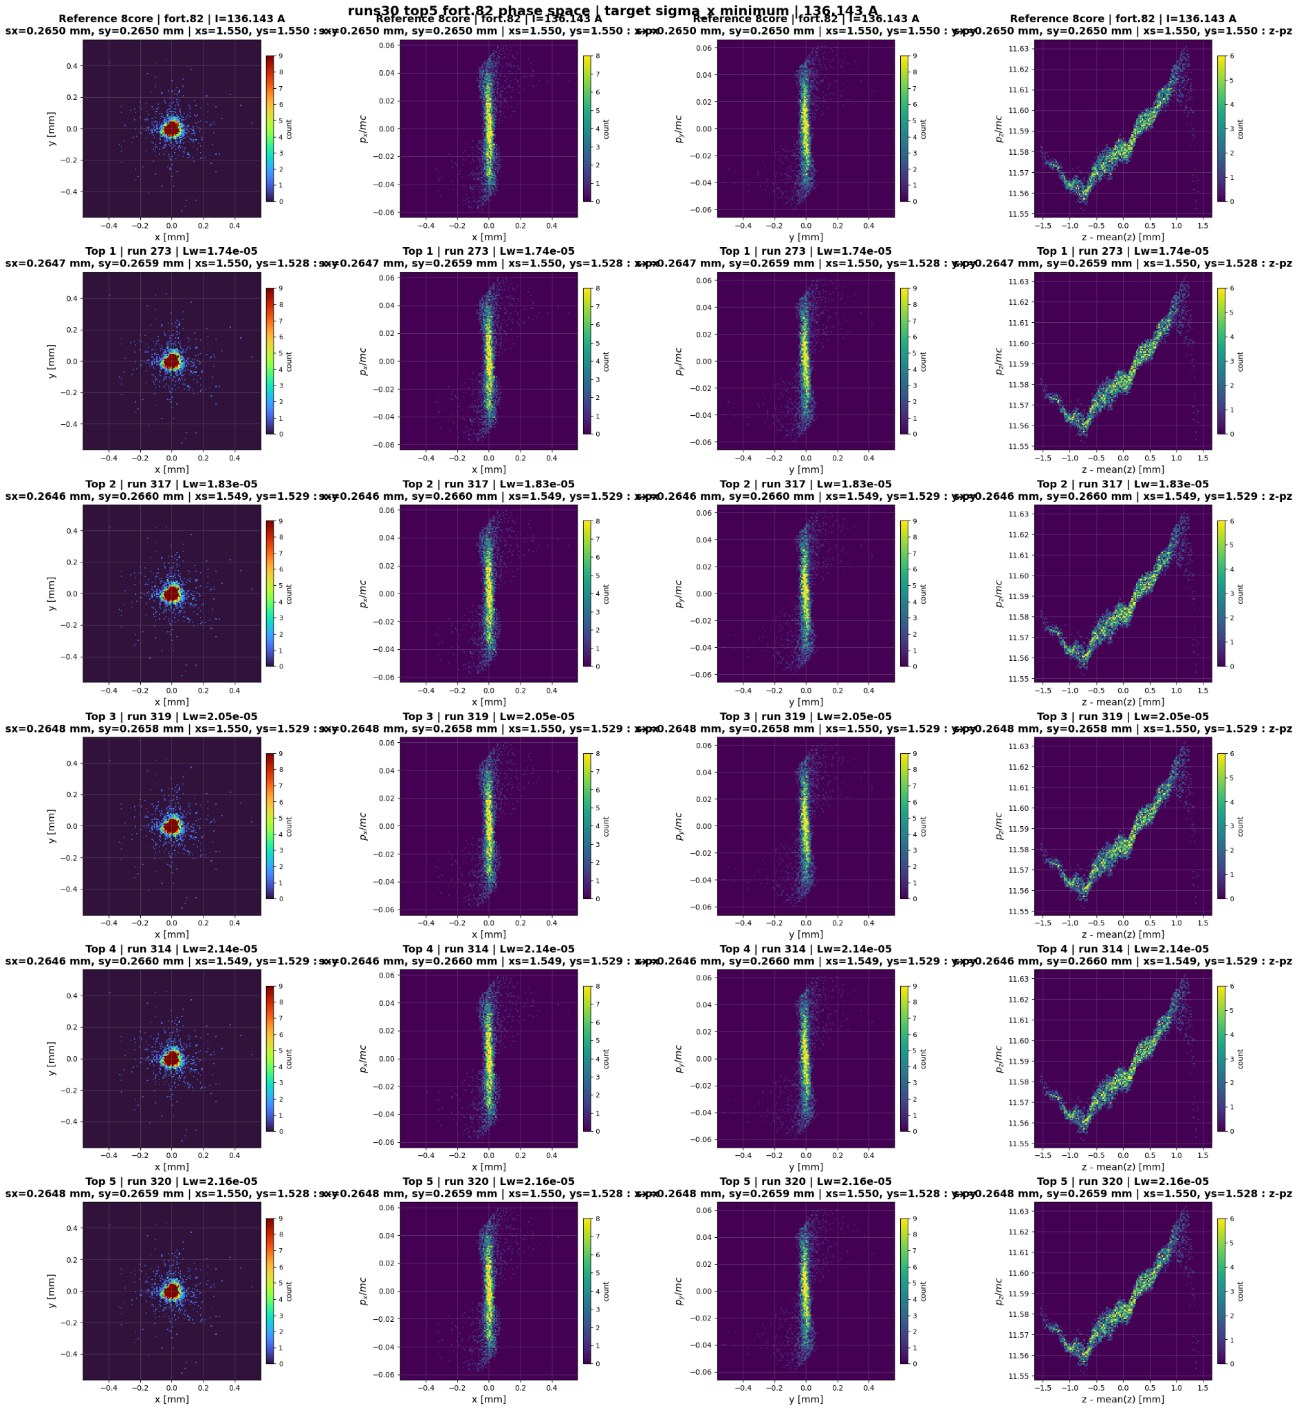
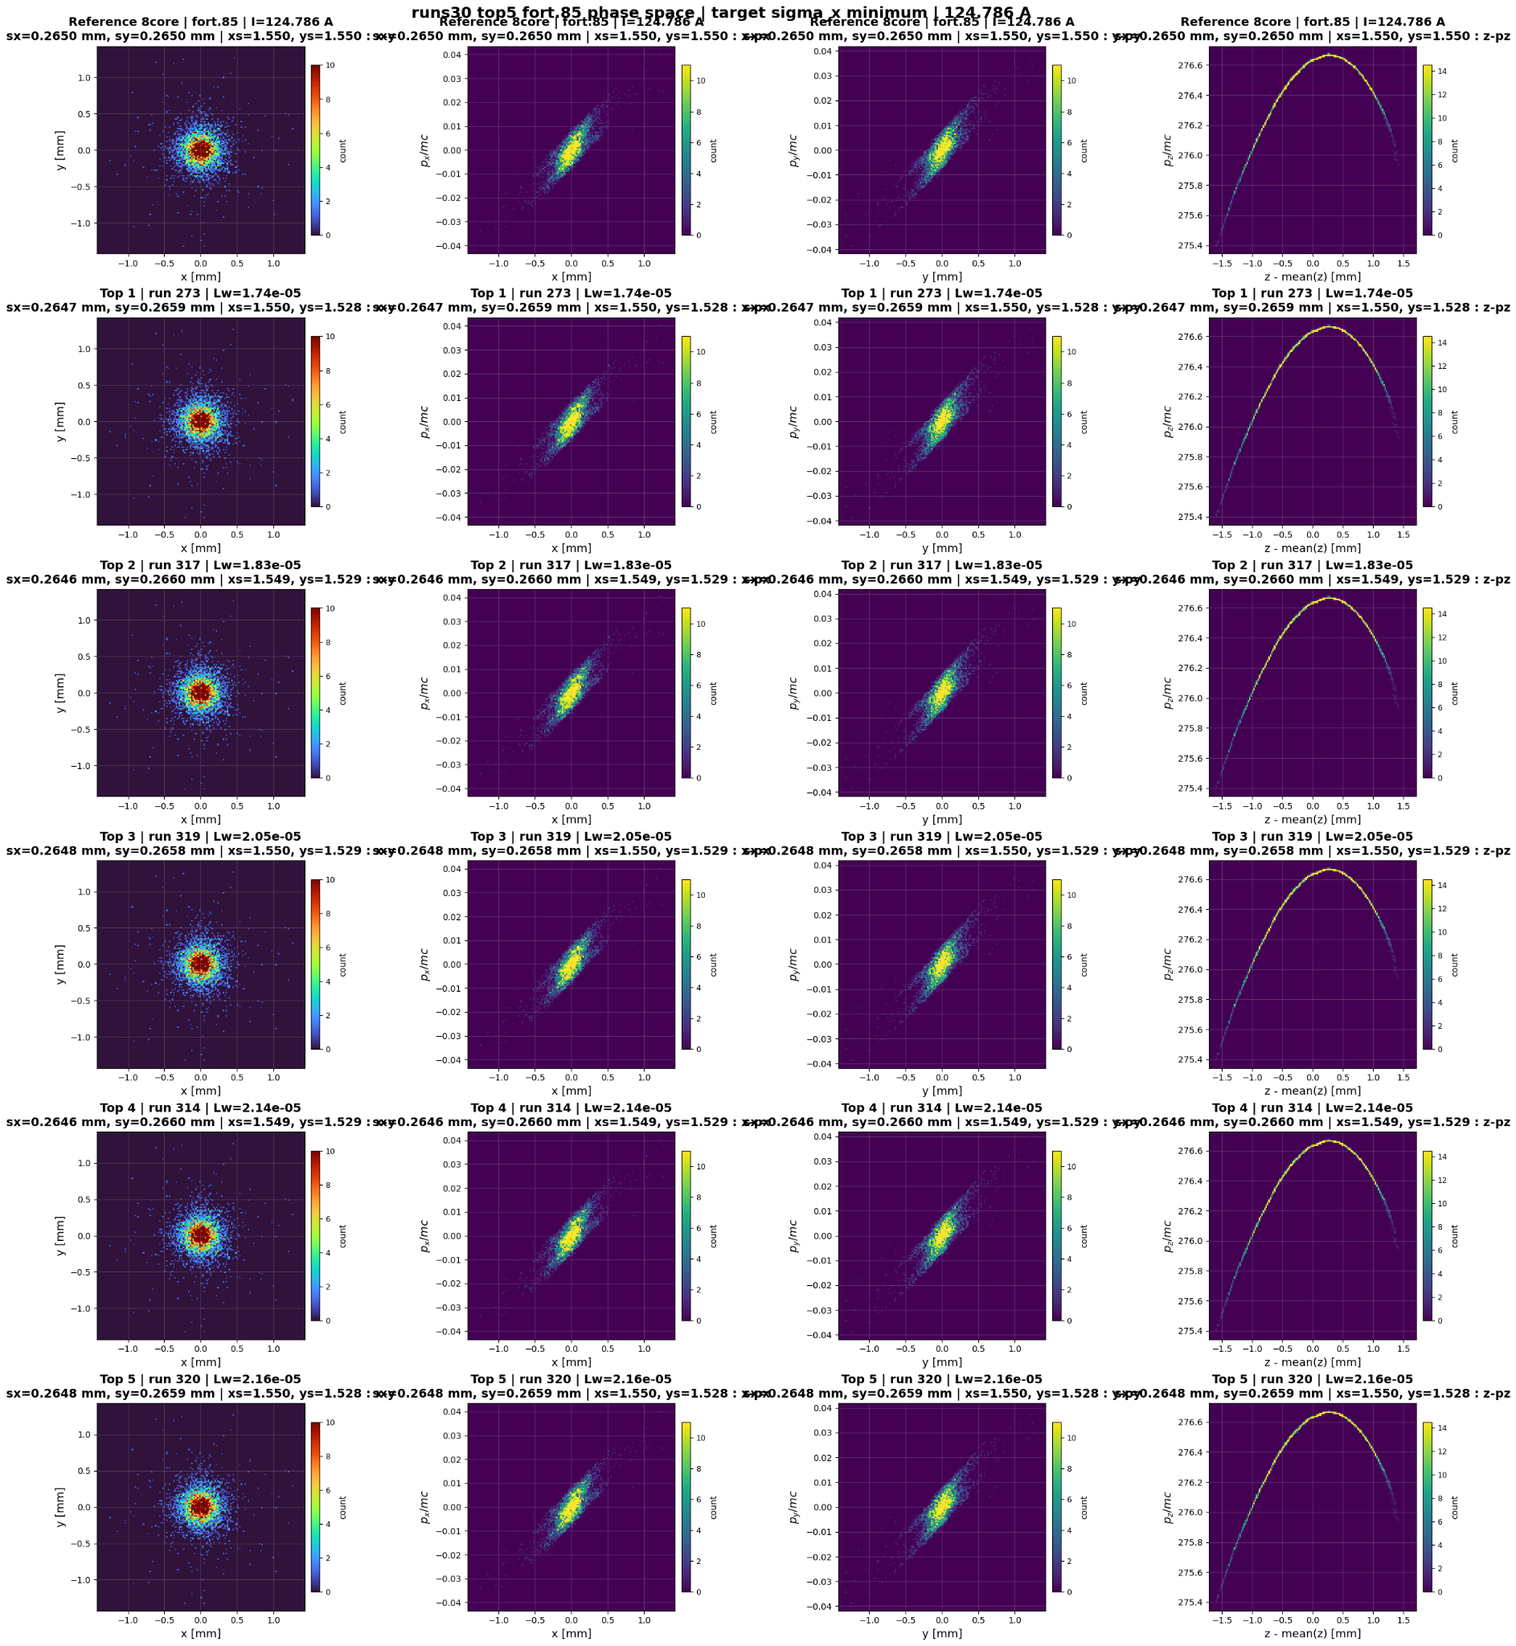

Slide 19
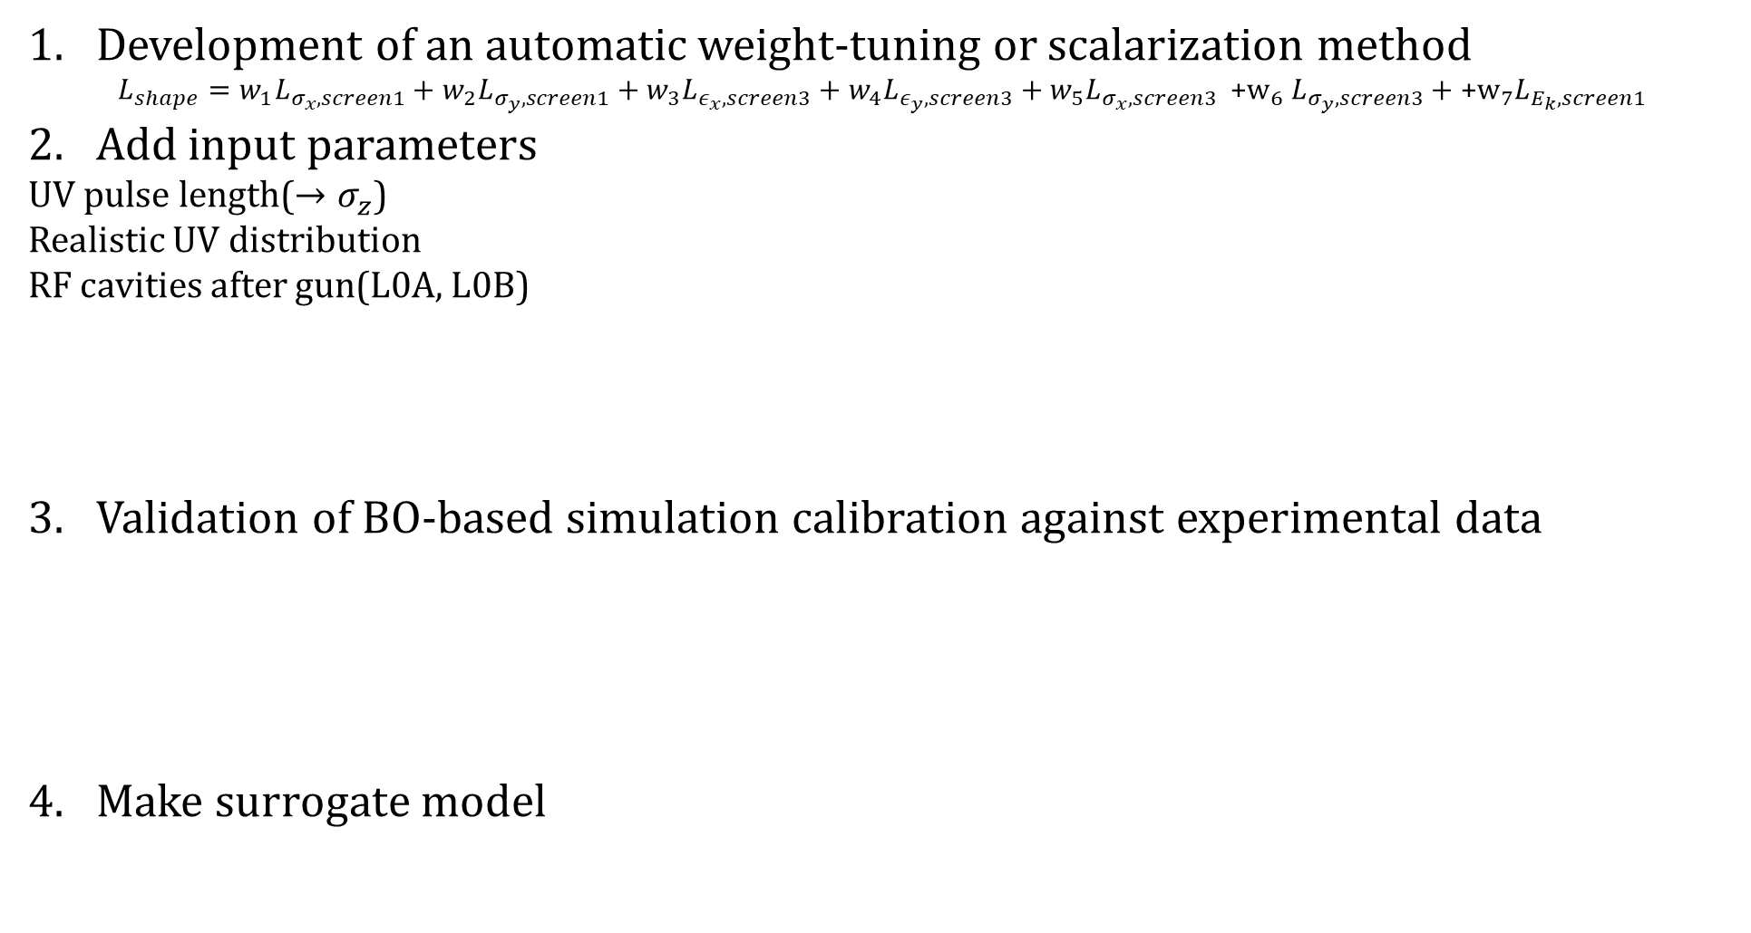
Future work
Development of an automatic weight-tuning or scalarization method
$$L_{shape}=w_{1}L_{σ_{x},screen1}+w_{2}L_{σ_{y},screen1}+w_{3}L_{ε_{x},screen3}+w_{4}L_{ε_{y},screen3}+w_{5}L_{σ_{x},screen3} {\text{+}\text{w}}_{6}L_{σ_{y},screen3}+{\text{+}\text{w}}_{7}L_{E_{k},screen1}$$
Add input parameters
UV pulse length($→σ_{z}$)
Realistic UV distribution
RF cavities after gun(L0A, L0B)
Validation of BO-based simulation calibration against experimental data
Make surrogate model
Gun RF
L0A(RF)
L0B(RF)
scr1
scr3
Gun solenoid

Slide 20

History of BO
Runs17: TS sampling으로 변경
runs18: xscale, yscale을 input variable에서 뺏음
Runs19: energy weight 250
Runs20: energy weight 2500
Runs21: dynamic weight
Runs22: runs21 upgrade
Runs23; runs18에서 loss 수렴할 때 기준으로 weight 변경
Weight($σ_{x,screen1}$; 0.5670671 $σ_{y,screen2}$; 0.1793003 $E_{k,screen1}$; 674.3608 $σ_{x,screen3}$; 3.528394 $σ_{y,screen3}$; 0.7666196 $ε_{x,screen3}$; 0.1344277 $ε_{y,screen3}$; 0.0410944)
Runs24: runs23에서 xyscale 추가
Runs25: runs24에서 energy loss weight 10배
Runs26: runs25에서 normalized 방식 각 obj별로 평균을 나누는 방식으로 바꿈
Runs27: xyscale빼고 진행
Runs28: runs27기반, ref lattice lossed particle 문제 수정, ts samplin에서 다시 qlogei,
Runs29: runs28에서 x/yscale 추가
Runs30:weight update해서 새롭게
Weight($σ_{x,screen1}$; 0.235465 $σ_{y,screen2}$; 0.199610 $E_{k,screen1}$; 5049.481763 $σ_{x,screen3}$; 0.429414 $σ_{y,screen3}$; 0.345624 $ε_{x,screen3}$; 0.240744 $ε_{y,screen3}$; 0.117925)
Runs31: 30에서 uv pulse length 추가
$$σ$$

