Slide 1
Emittance blow-up study via white noise for the Korea Light Source (KLS) storage ring
Junha Kim

Slide 2
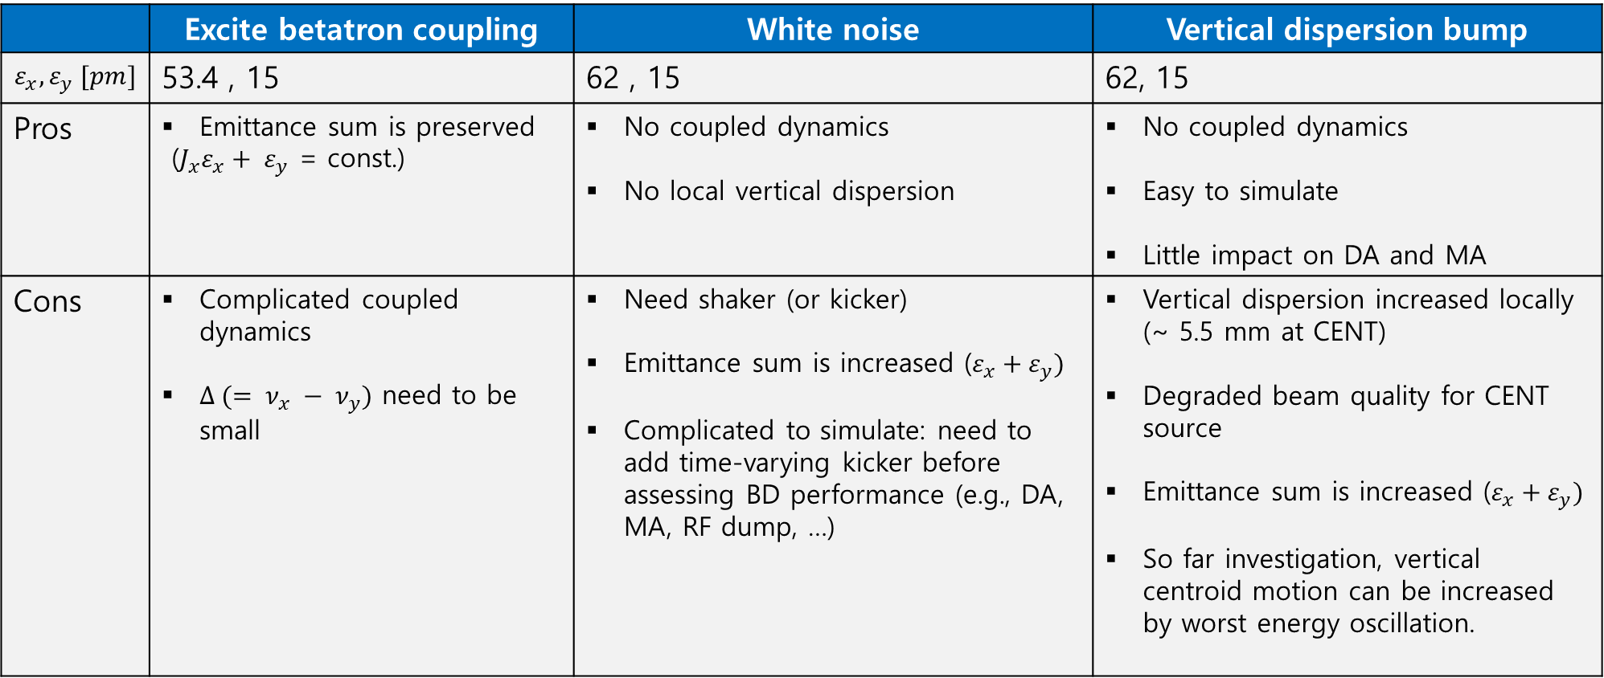
Vertical emittance blow-up methods
 | Excite betatron coupling | White noise | Vertical dispersion bump
$$ε_{x}, ε_{y} [pm]$$ | 53.4 , 15 | 62 , 15 | 62, 15
Pros | Emittance sum is preserved ($J_{x}ε_{x}+ ε_{y}$ = const.) | No coupled dynamics No local vertical dispersion | No coupled dynamics Easy to simulate Little impact on DA and MA
Cons | Complicated coupled dynamics $Δ (= ν_{x} − ν_{y})$ need to be small | Need shaker (or kicker) Emittance sum is increased ($ε_{x}+ε_{y})$ Complicated to simulate: need to add time-varying kicker before assessing BD performance (e.g., DA, MA, RF dump, …) | Vertical dispersion increased locally (~ 5.5 mm at CENT) Degraded beam quality for CENT source Emittance sum is increased ($ε_{x}+ε_{y})$ So far investigation, vertical centroid motion can be increased by worst energy oscillation.

Slide 3
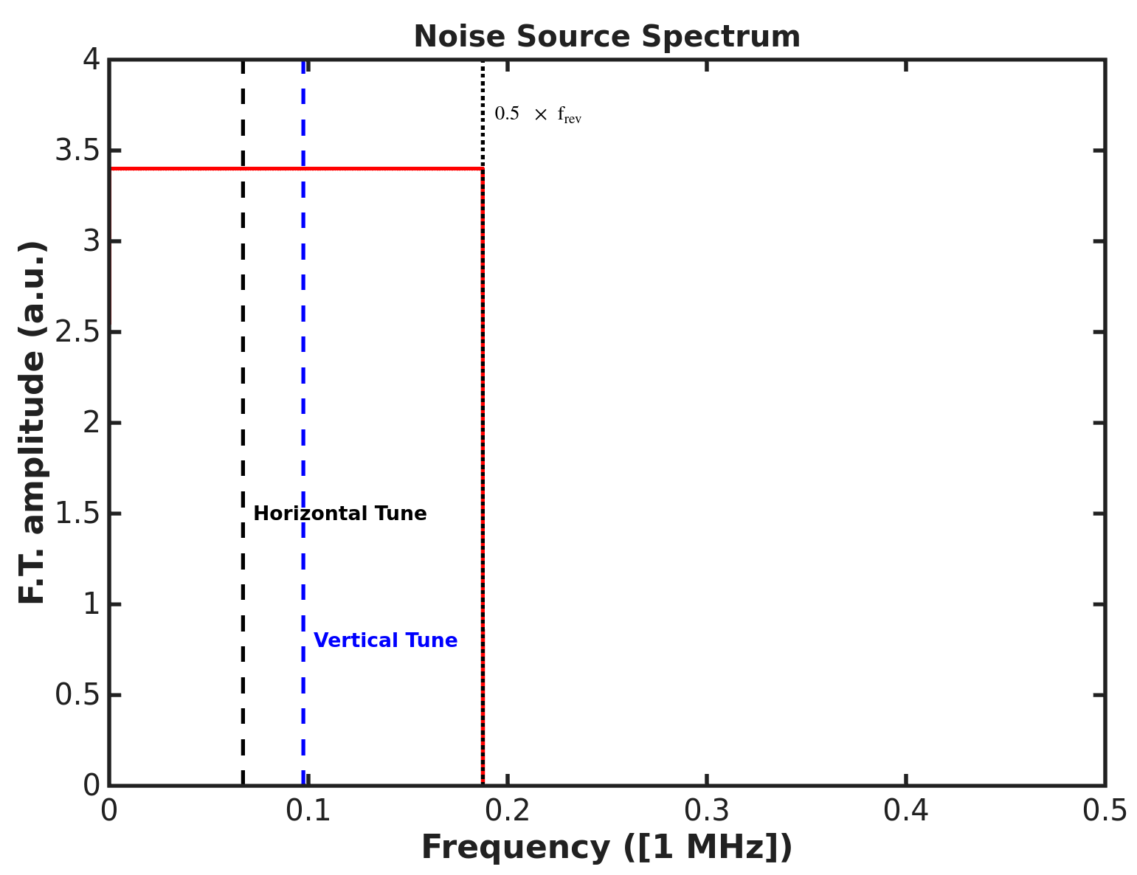

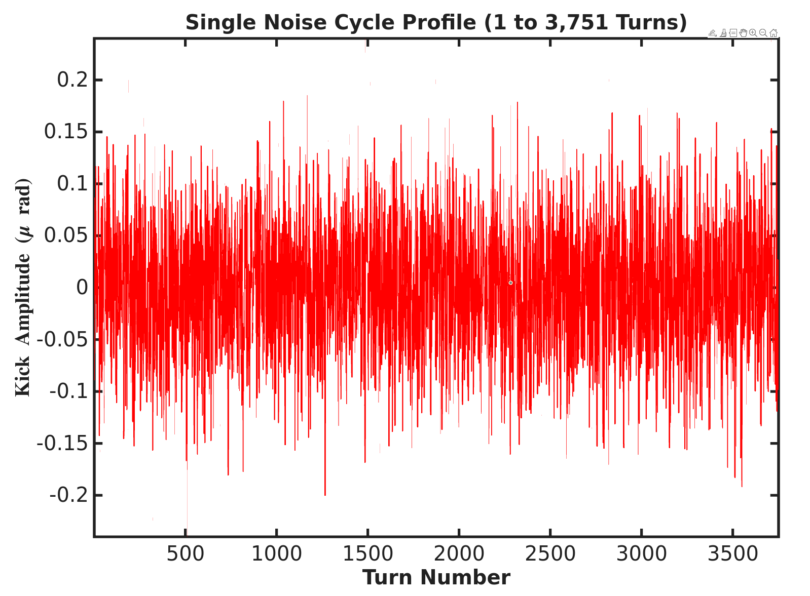
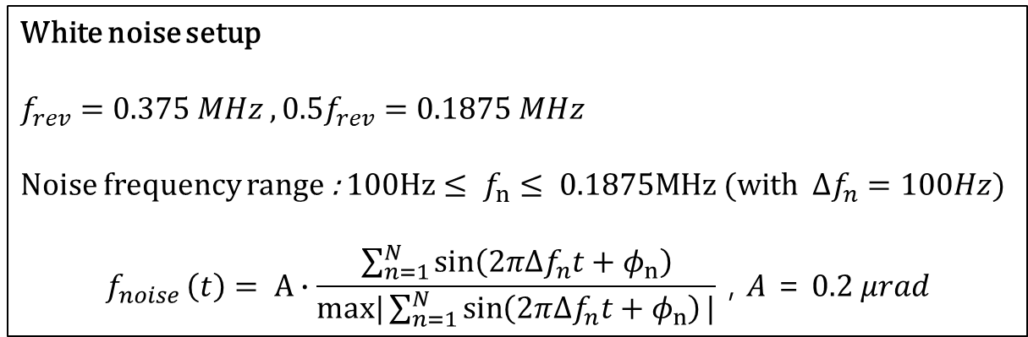
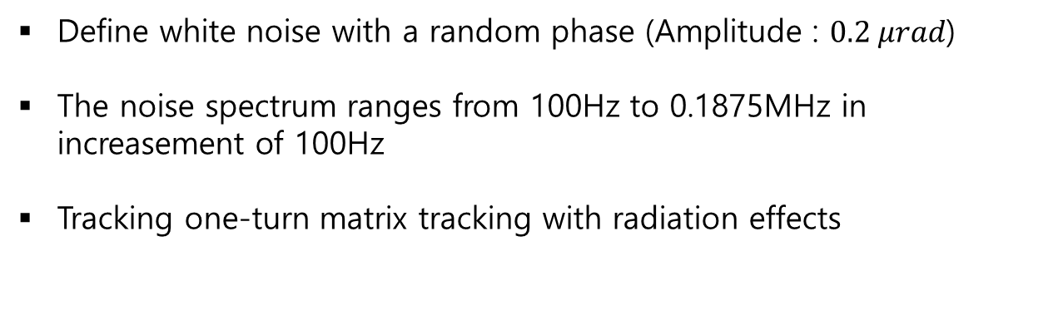
Korea-4GSR emittance blow up simulation setting
White noise setup
$$f_{rev}=0.375 MHz , 0.5f_{rev}=0.1875 MHz$$
Noise frequency range : $100Hz≤ f_{n}≤ 0.1875MHz (with Δf_{n}=100Hz$)
$$f_{noise }\left(t\right)= A∙\frac{\sum_{n=1}^{N}{\sin\left(2π{Δf}_{n}t+φ_{n}\right)}}{max|\sum_{n=1}^{N}{\sin\left(2π{Δf}_{n}t+φ_{n}\right)}|} \text{, }A\text{ = }0.2 μrad$$
Tracking setup
Number of turns : 100k
Number of particles : 10k
Using one-turn matrix
Initial beam distribution : matching with lattice
Define white noise with a random phase (Amplitude : $0.2 μrad$)
The noise spectrum ranges from 100Hz to 0.1875MHz in increasement of 100Hz
Tracking one-turn matrix tracking with radiation effects

Slide 4
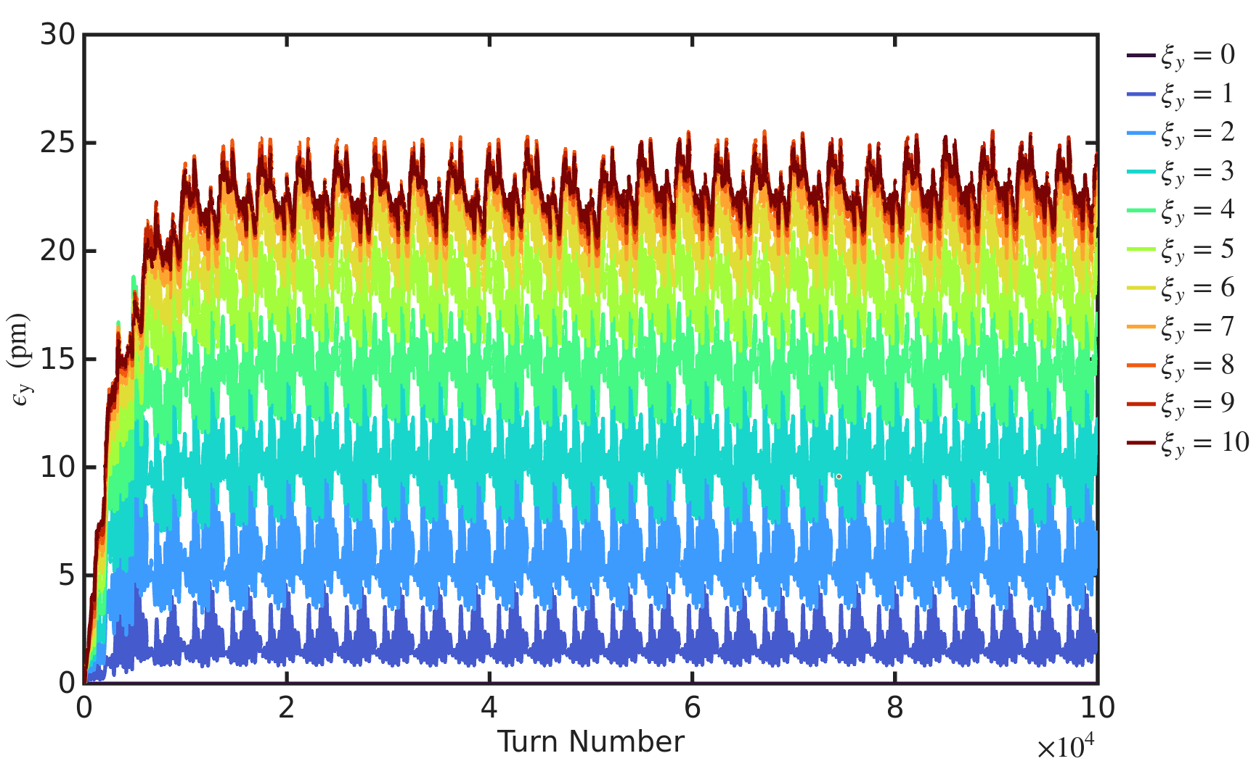
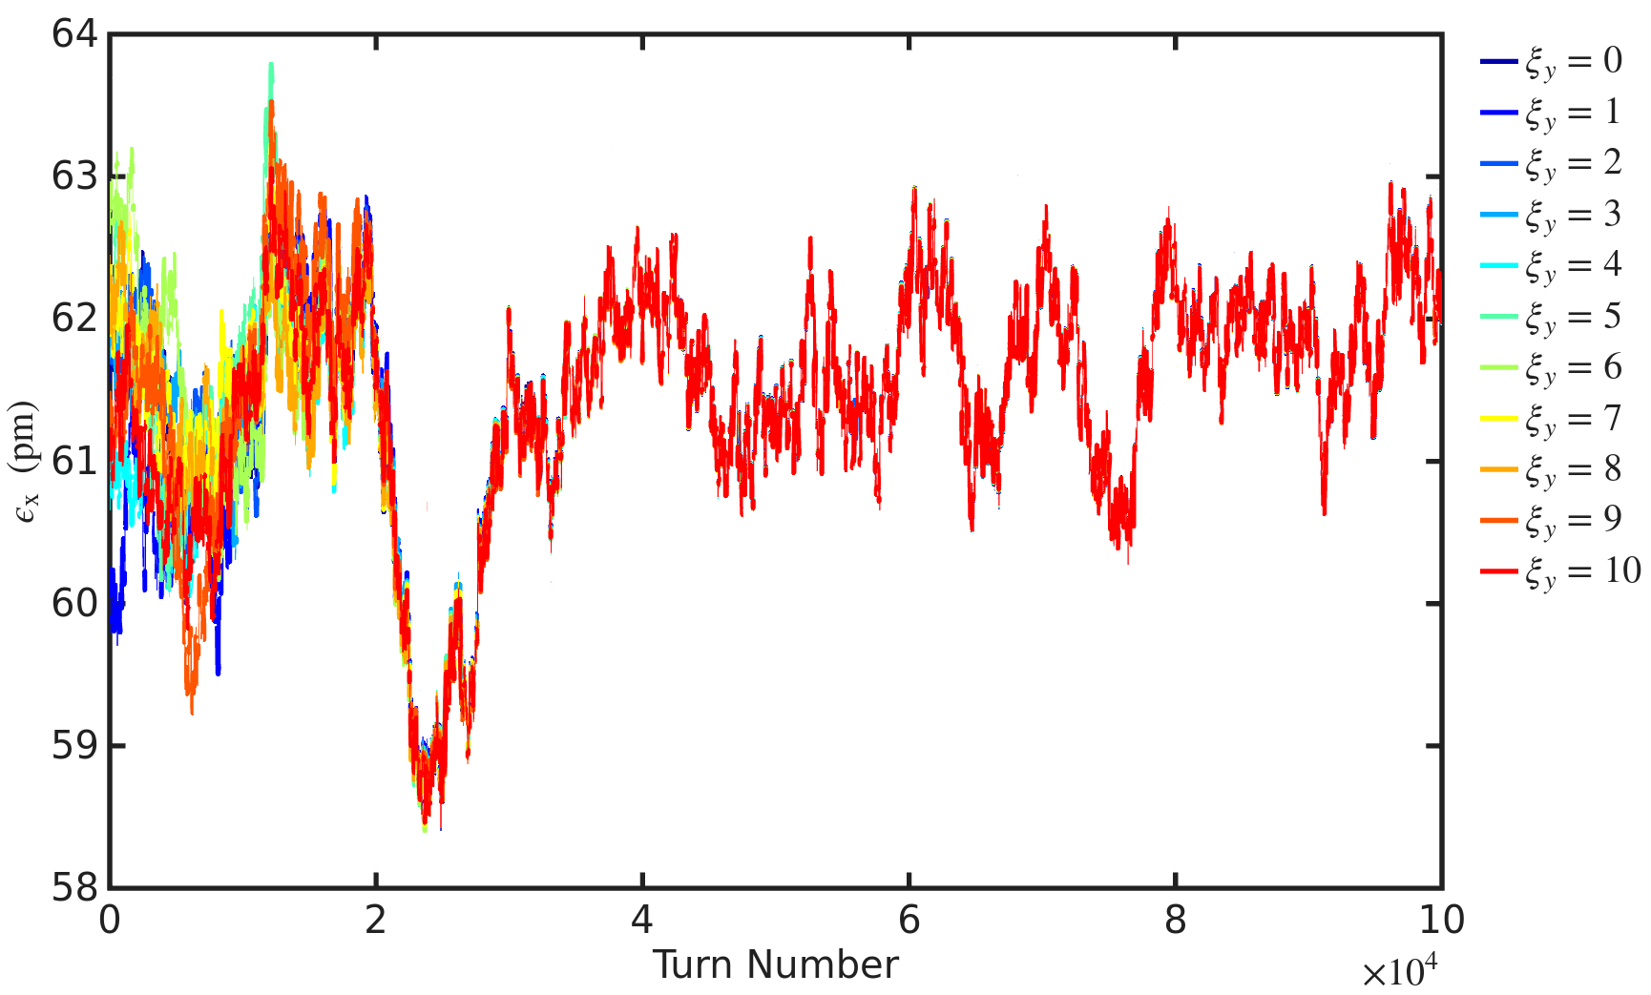
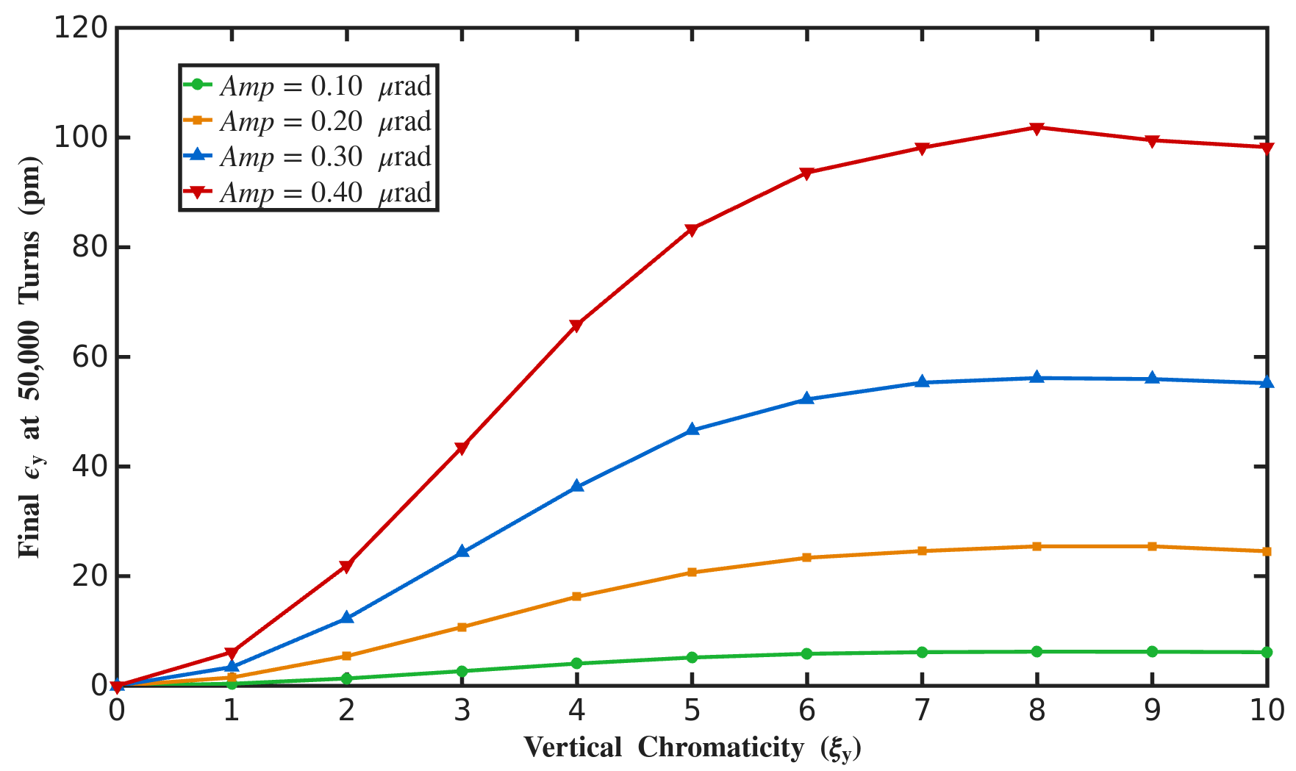
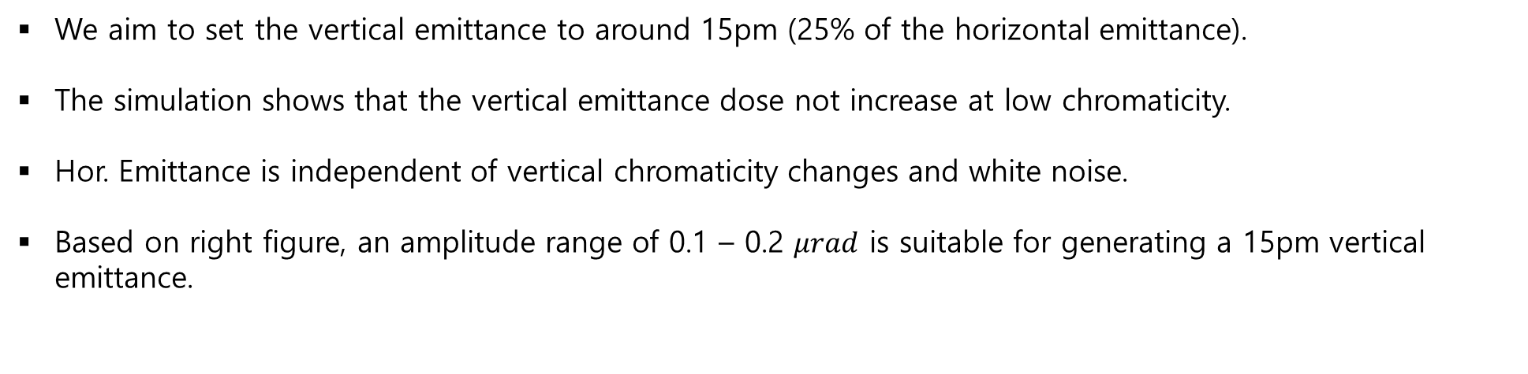
Simulation results
Vertical emittance vs. turn number
Horizontal emittance vs. turn number
Vertical emittance vs. vertical chromaticty
We aim to set the vertical emittance to around 15pm (25% of the horizontal emittance).
The simulation shows that the vertical emittance dose not increase at low chromaticity.
Hor. Emittance is independent of vertical chromaticity changes and white noise.
Based on right figure, an amplitude range of 0.1 – 0.2 $μrad$ is suitable for generating a 15pm vertical emittance.

Slide 5
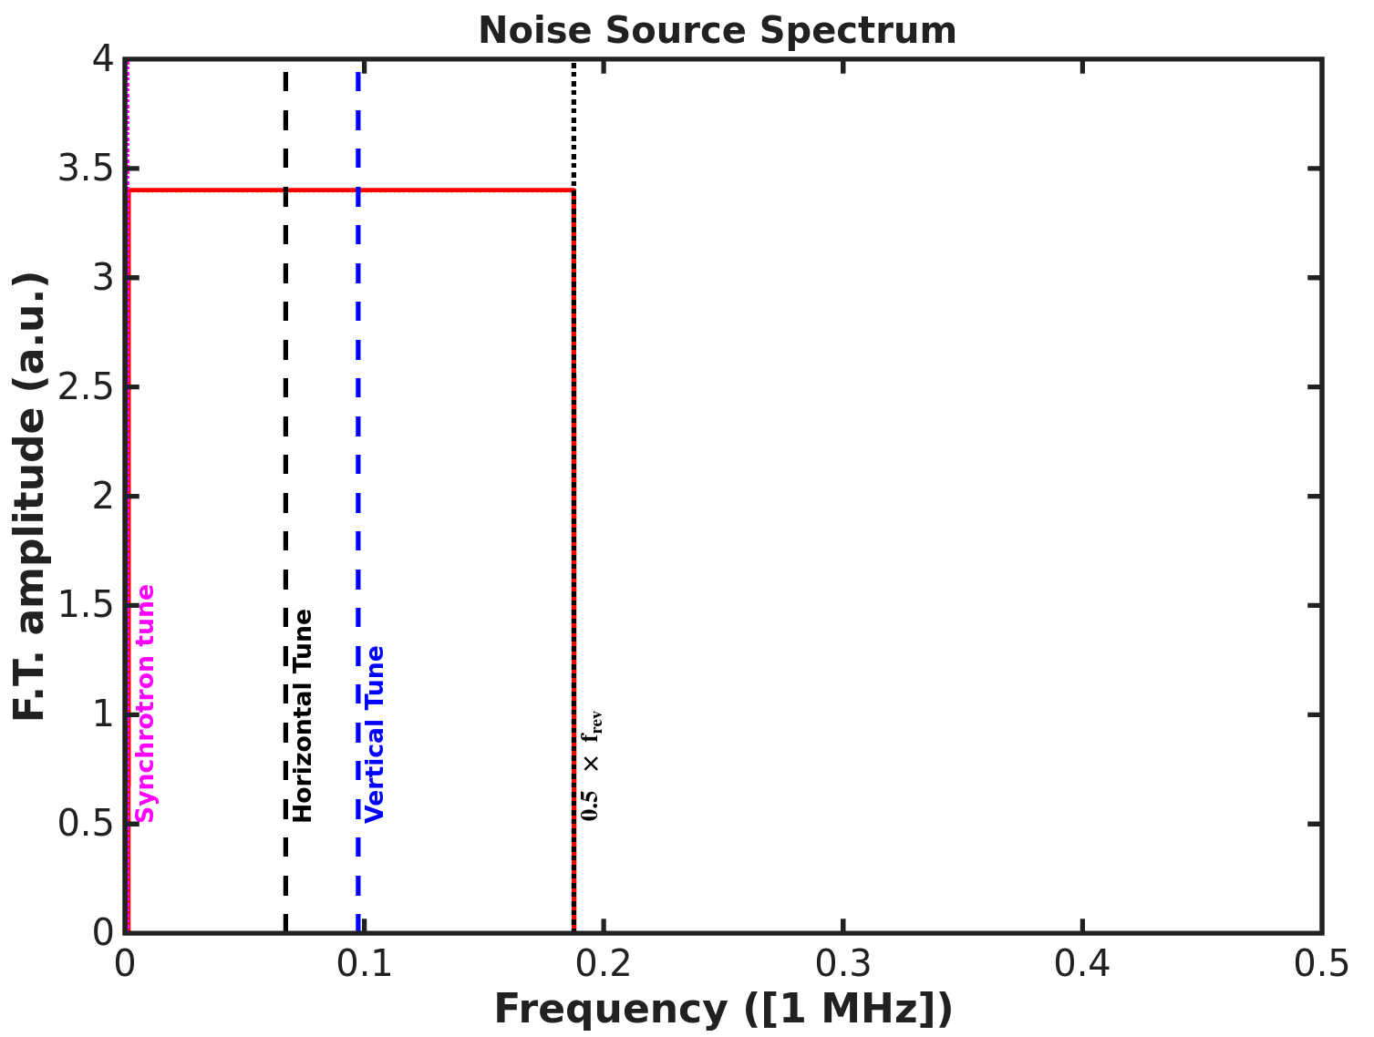
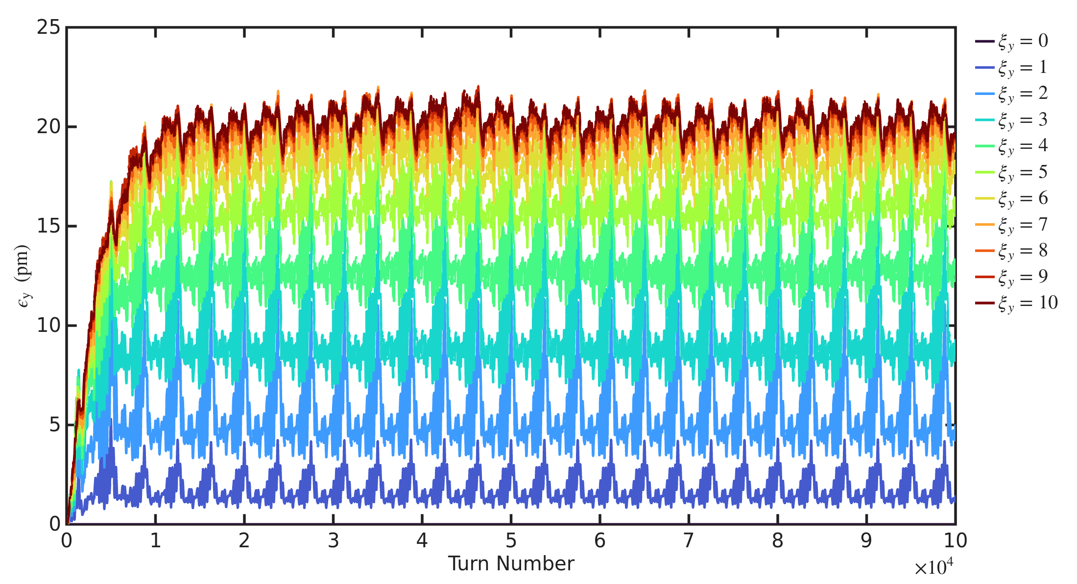
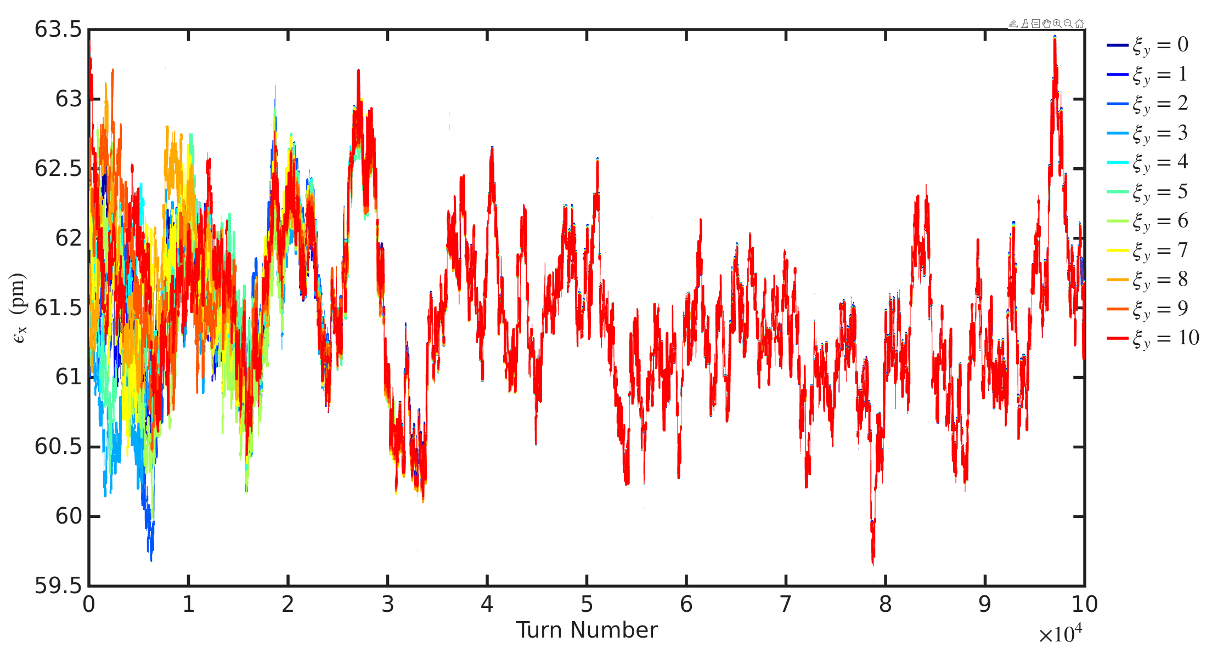
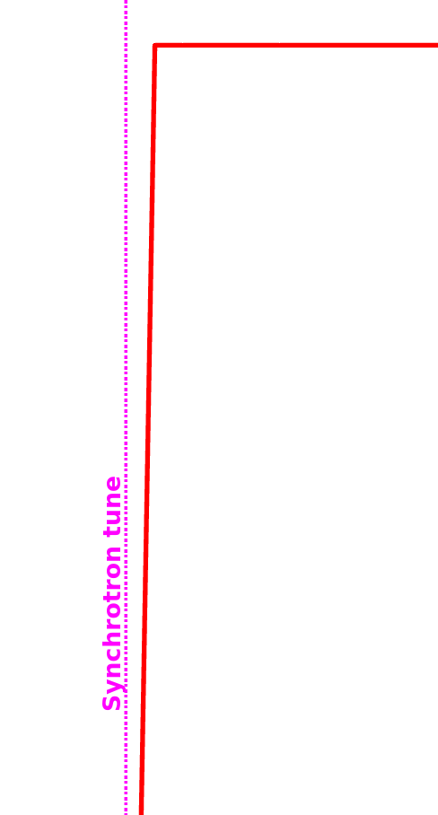
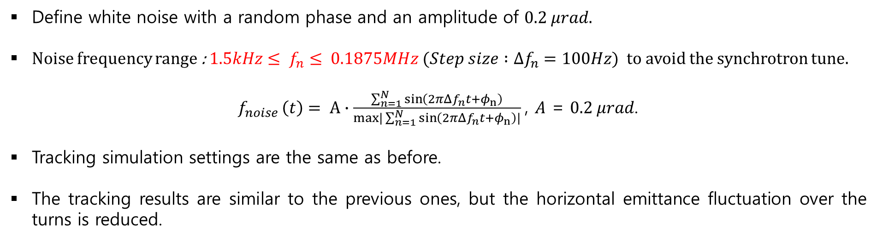
Korea-4GSR emittance blow up simulation settings and results
Define white noise with a random phase and an amplitude of $0.2 μrad.$
Noise frequency range : $1.5kHz≤ f_{n}≤ 0.1875MHz (Step size :Δf_{n}=100Hz$) to avoid the synchrotron tune.
$f_{noise }\left(t\right)= A∙\frac{\sum_{n=1}^{N}{\sin\left(2π{Δf}_{n}t+φ_{n}\right)}}{max|\sum_{n=1}^{N}{\sin\left(2π{Δf}_{n}t+φ_{n}\right)}|}$, $A$ = $0.2 μrad$.
Tracking simulation settings are the same as before.
The tracking results are similar to the previous ones, but the horizontal emittance fluctuation over the turns is reduced.

Slide 6
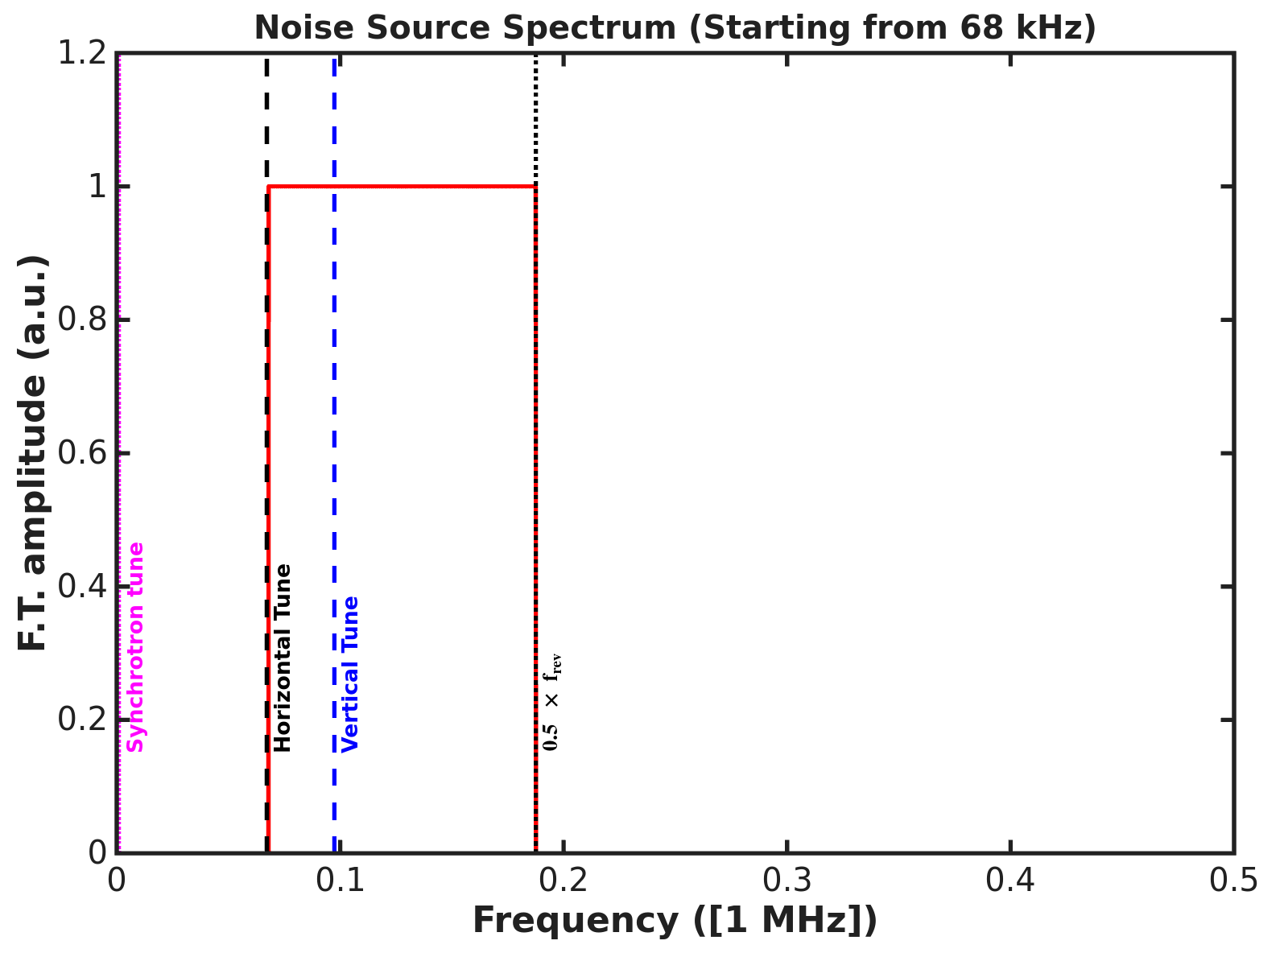
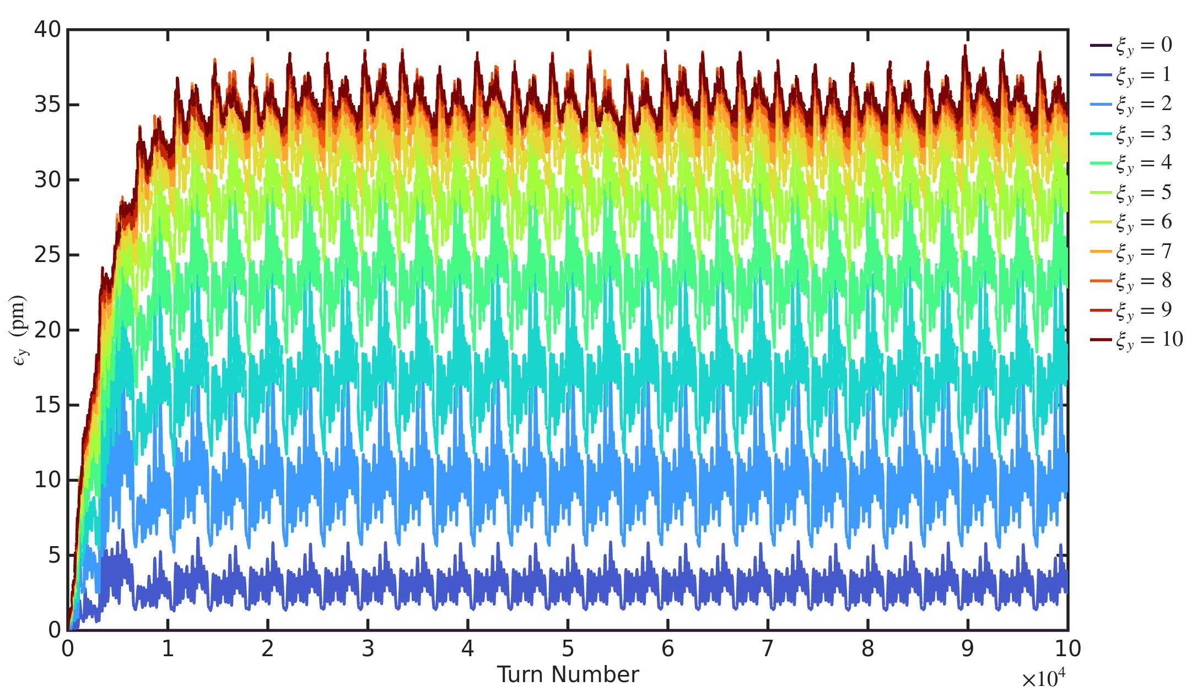
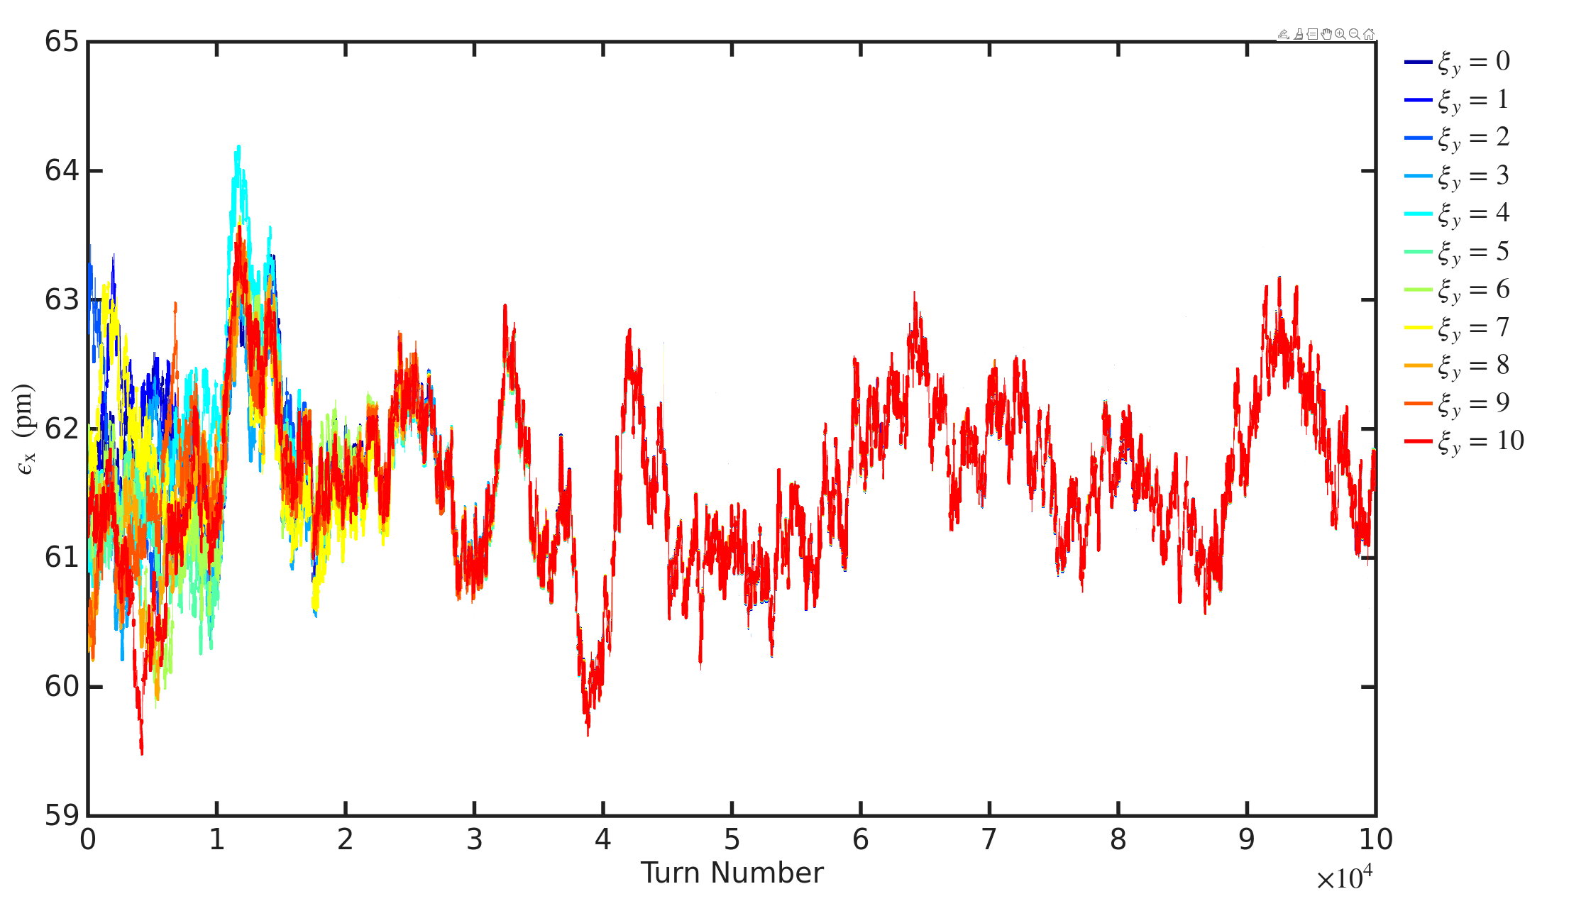
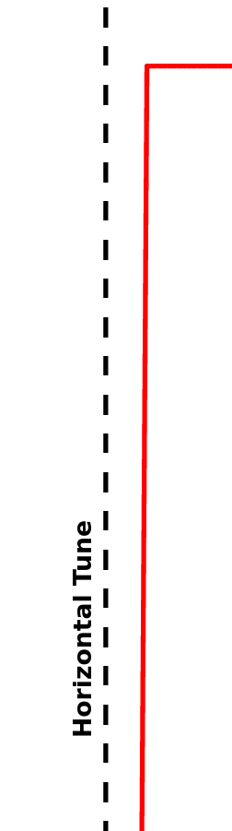
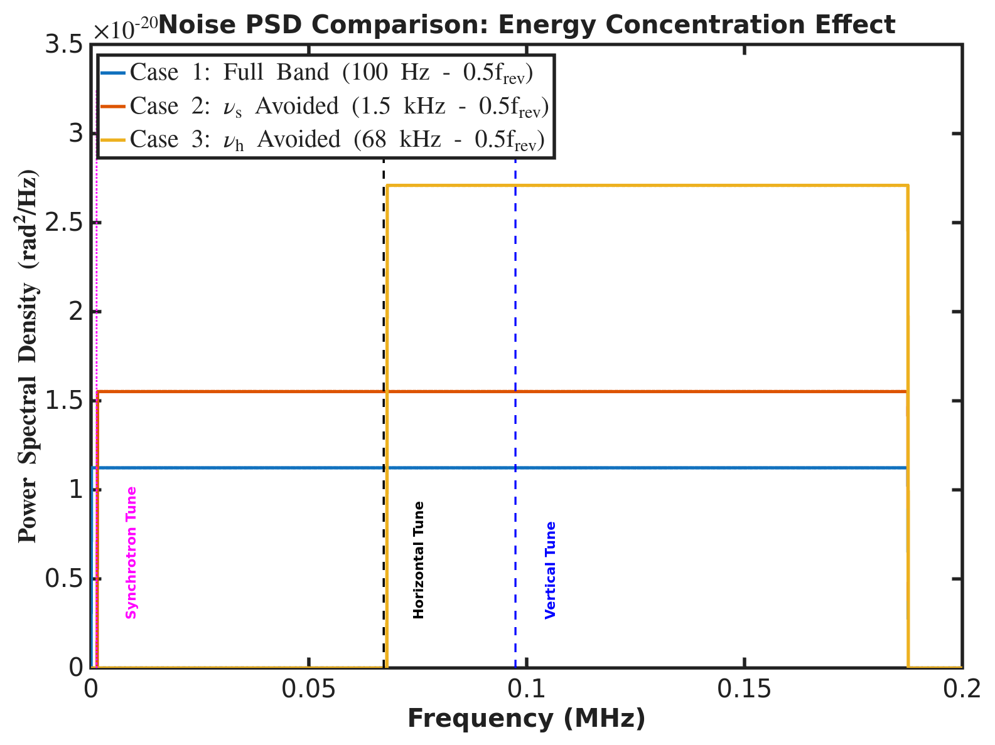
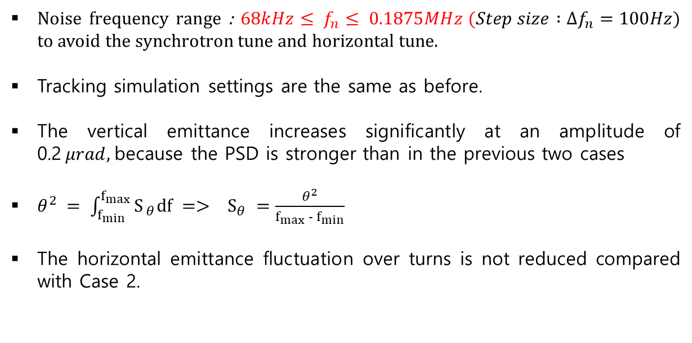
Korea-4GSR emittance blow up simulation settings and results
Noise frequency range : $68kHz≤ f_{n}≤ 0.1875MHz (Step size :Δf_{n}=100Hz$) to avoid the synchrotron tune and horizontal tune.
Tracking simulation settings are the same as before.
The vertical emittance increases significantly at an amplitude of 0.2$μrad,$because the PSD is stronger than in the previous two cases
$θ^{2} = \int_{f_{min}}^{f_{max}}{S_{ θ}df} => S_{θ} =\frac{θ^{2}}{f_{max} − f_{min}}$
The horizontal emittance fluctuation over turns is not reduced compared with Case 2.

Slide 7
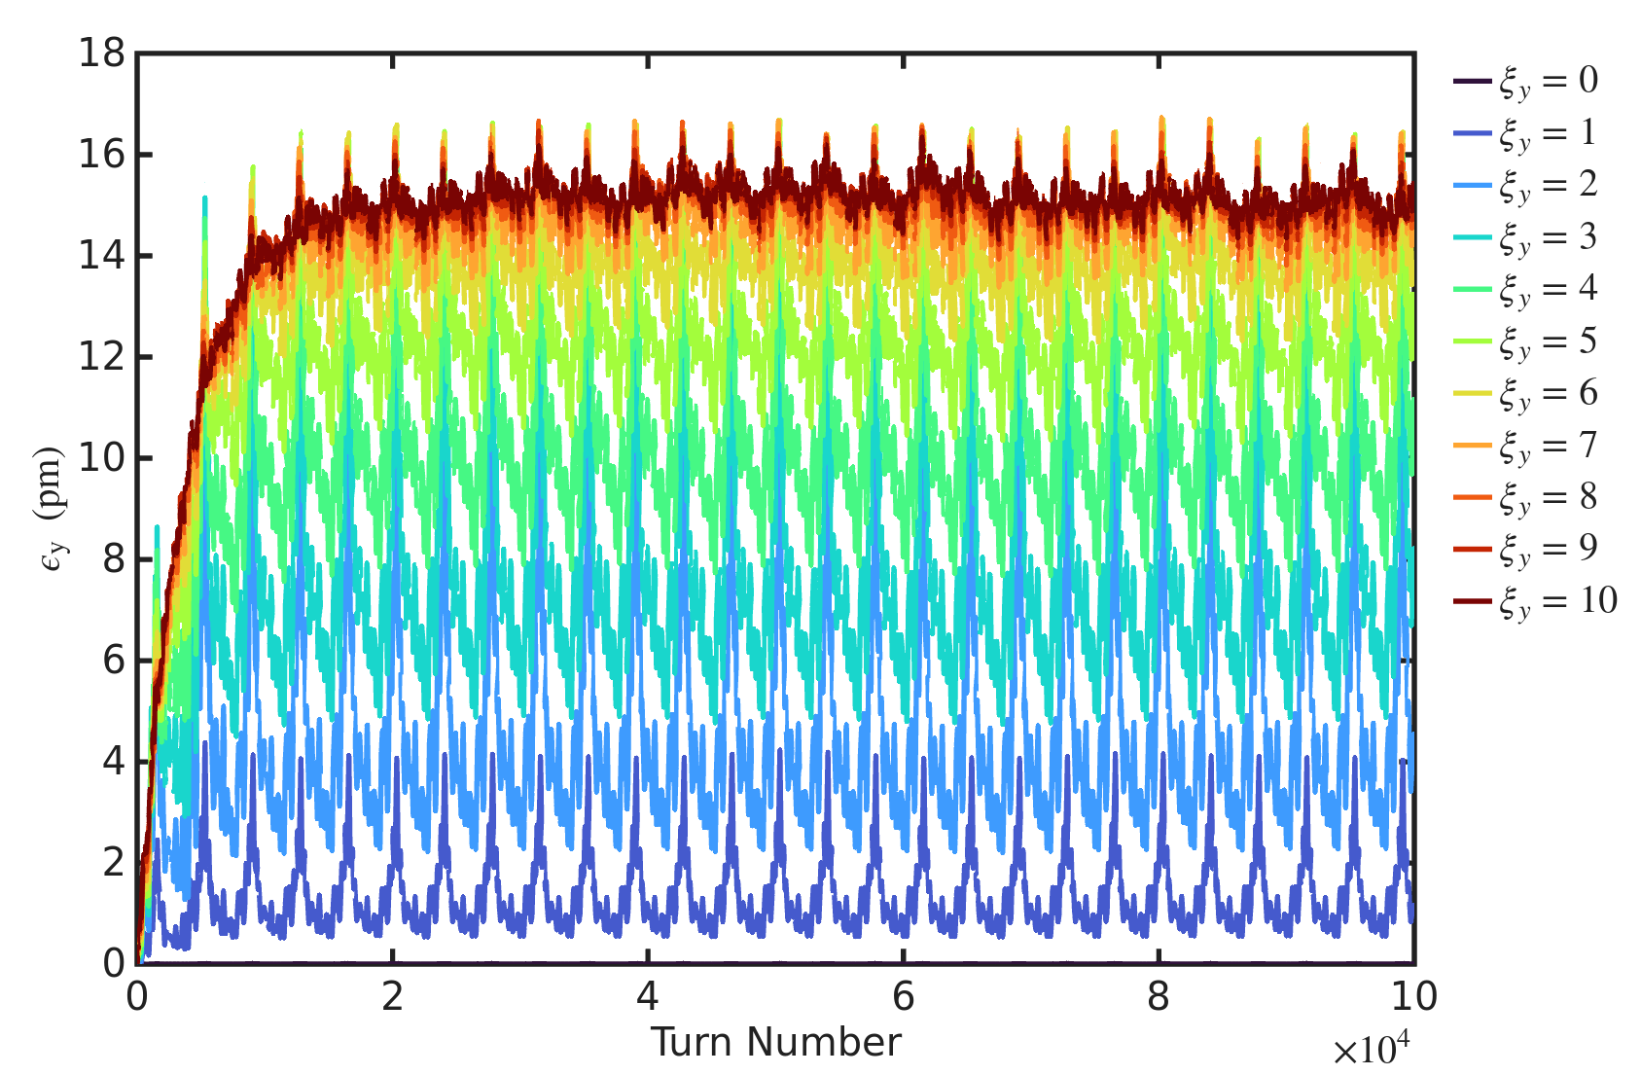
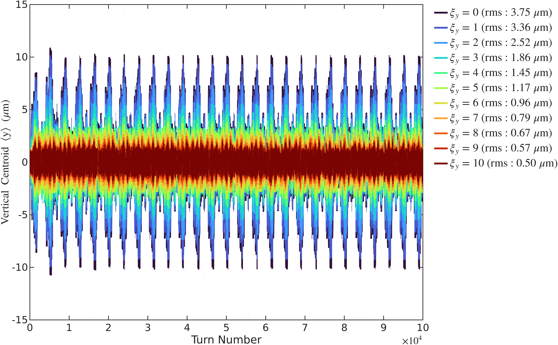
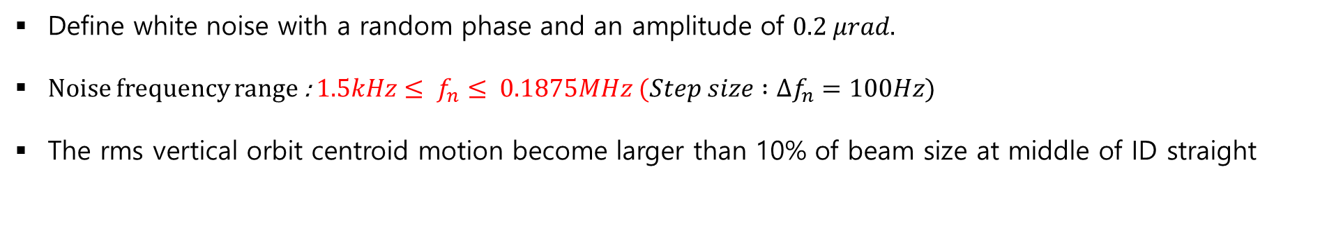
Korea-4GSR emittance blow up simulation settings and results
Results at middle of ID straight section ($ε_{y}=15pm$ ,Amp = 0.2$μrad$)
Define white noise with a random phase and an amplitude of $0.2 μrad.$
Noise frequency range : $1.5kHz≤ f_{n}≤ 0.1875MHz (Step size :Δf_{n}=100Hz$)
The rms vertical orbit centroid motion become larger than 10% of beam size at middle of ID straight

Slide 8
Korea-4GSR emittance blow up simulation settings and results
Results at middle of ID straight section ($ε_{y}=15pm$ ,Amp = 0.2$μrad$)
Define white noise with a random phase and an amplitude of $0.2 μrad.$
Noise frequency range : $1.5kHz≤ f_{n}≤ 0.1875MHz (Step size :Δf_{n}=100Hz$)
The rms vertical orbit centroid motion become larger than 10% of beam size at middle of ID straight

Slide 9
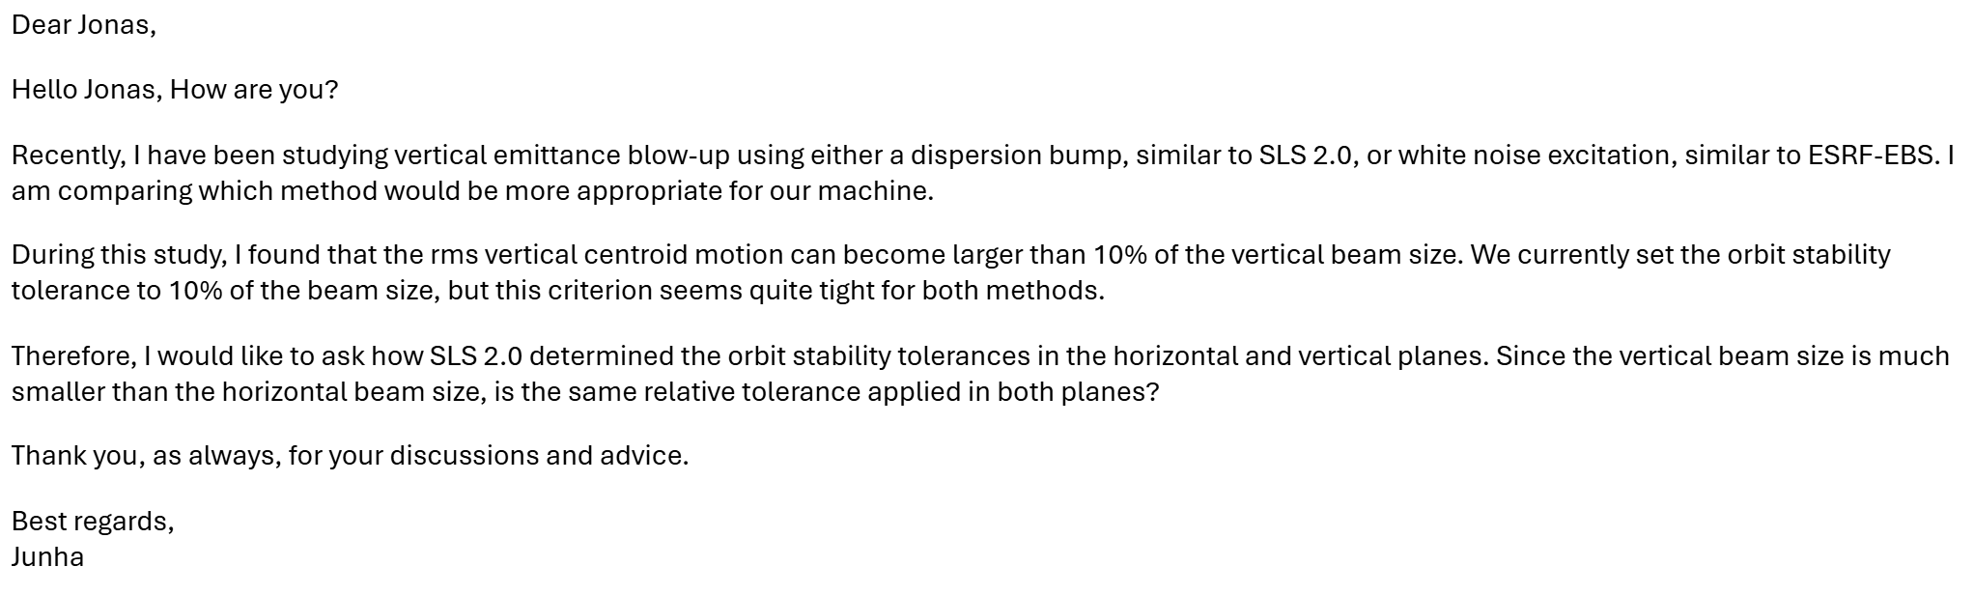
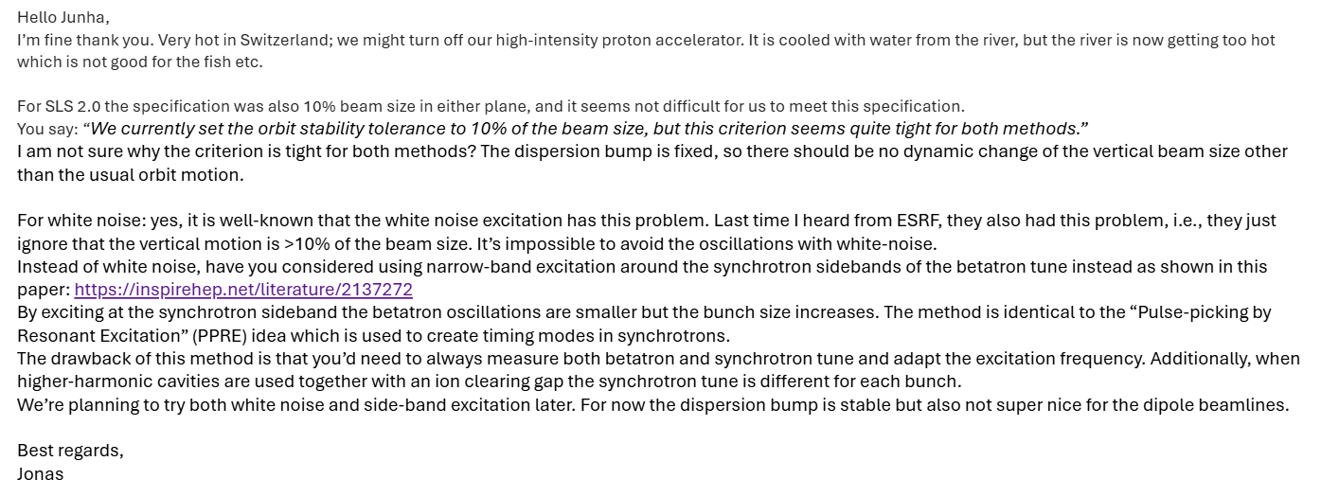
Discussion with Jonas

Slide 10
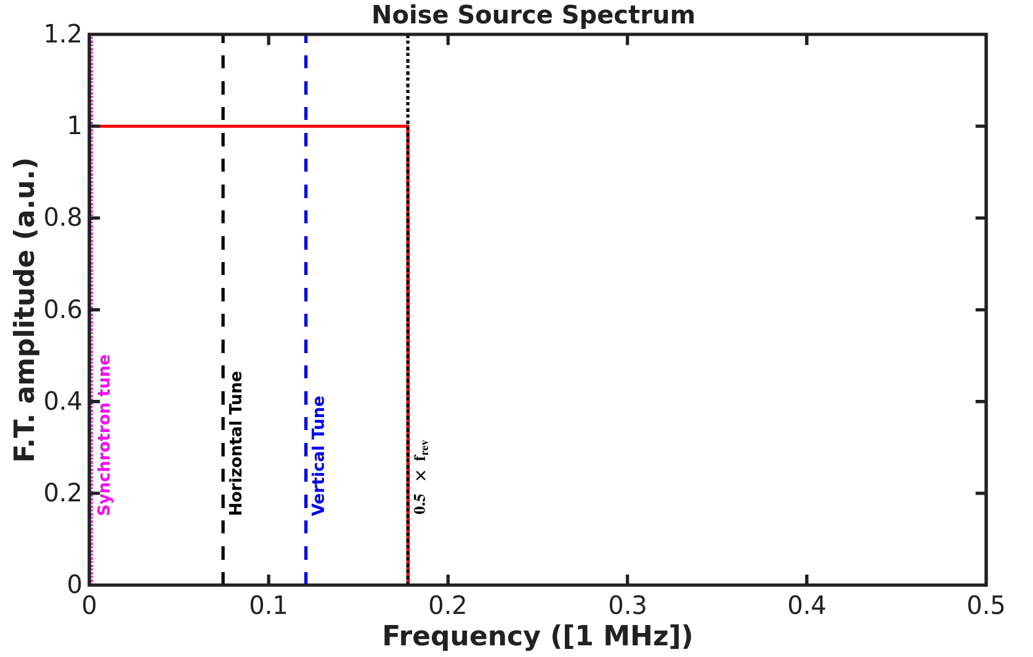
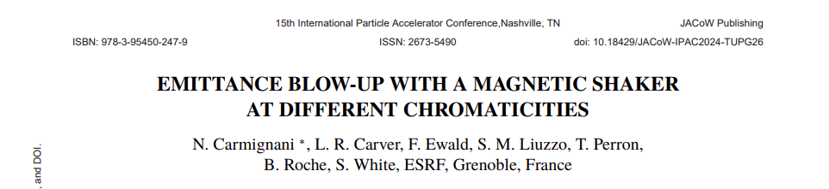
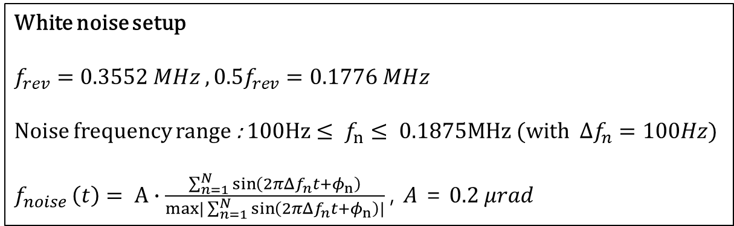
ESRF-EBS emittance blow up simulation settings
White noise setup
$$f_{rev}=0.3552 MHz , 0.5f_{rev}=0.1776 MHz$$
Noise frequency range : $100Hz≤ f_{n}≤ 0.1875MHz (with Δf_{n}=100Hz$)
$f_{noise }\left(t\right)= A∙\frac{\sum_{n=1}^{N}{\sin\left(2π{Δf}_{n}t+φ_{n}\right)}}{max|\sum_{n=1}^{N}{\sin\left(2π{Δf}_{n}t+φ_{n}\right)}|}$, $A$ = $0.2 μrad$
Tracking setup
Number of turns : 35k
Number of particles :10k
Using one-turn matrix
Initial beam distribution : matching with lattice
To validate our simulation results, we reproduced the ESRF-EBS simulation study following IPAC24 proceeding by N. Carmignani (“Emittance blow-up with a magnetic shaker at different chromaticities”).
The noise spectrum ranges from 100 Hz to 0.1776 MHz in increments of 100 Hz, consistent with the proceeding.
The tracking simulation settings are based on the proceeding paper.
The EBS.mat file from the AT website was used.

Slide 11
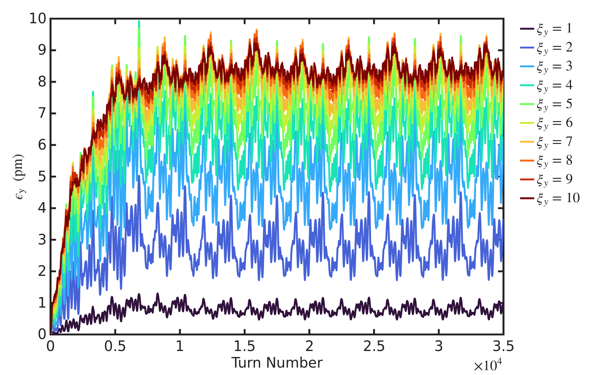
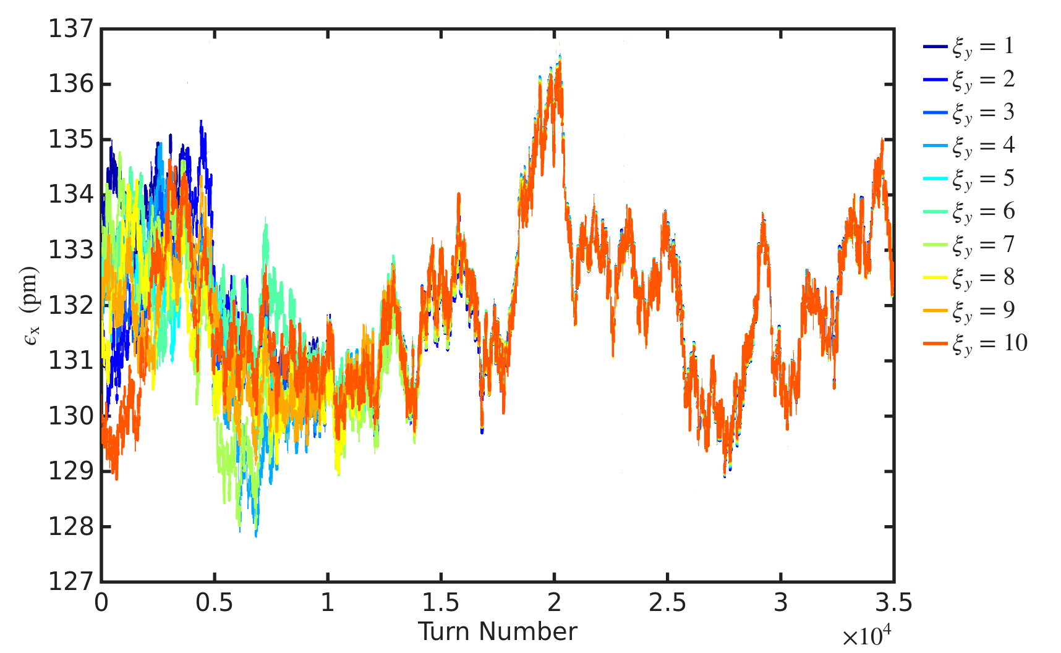
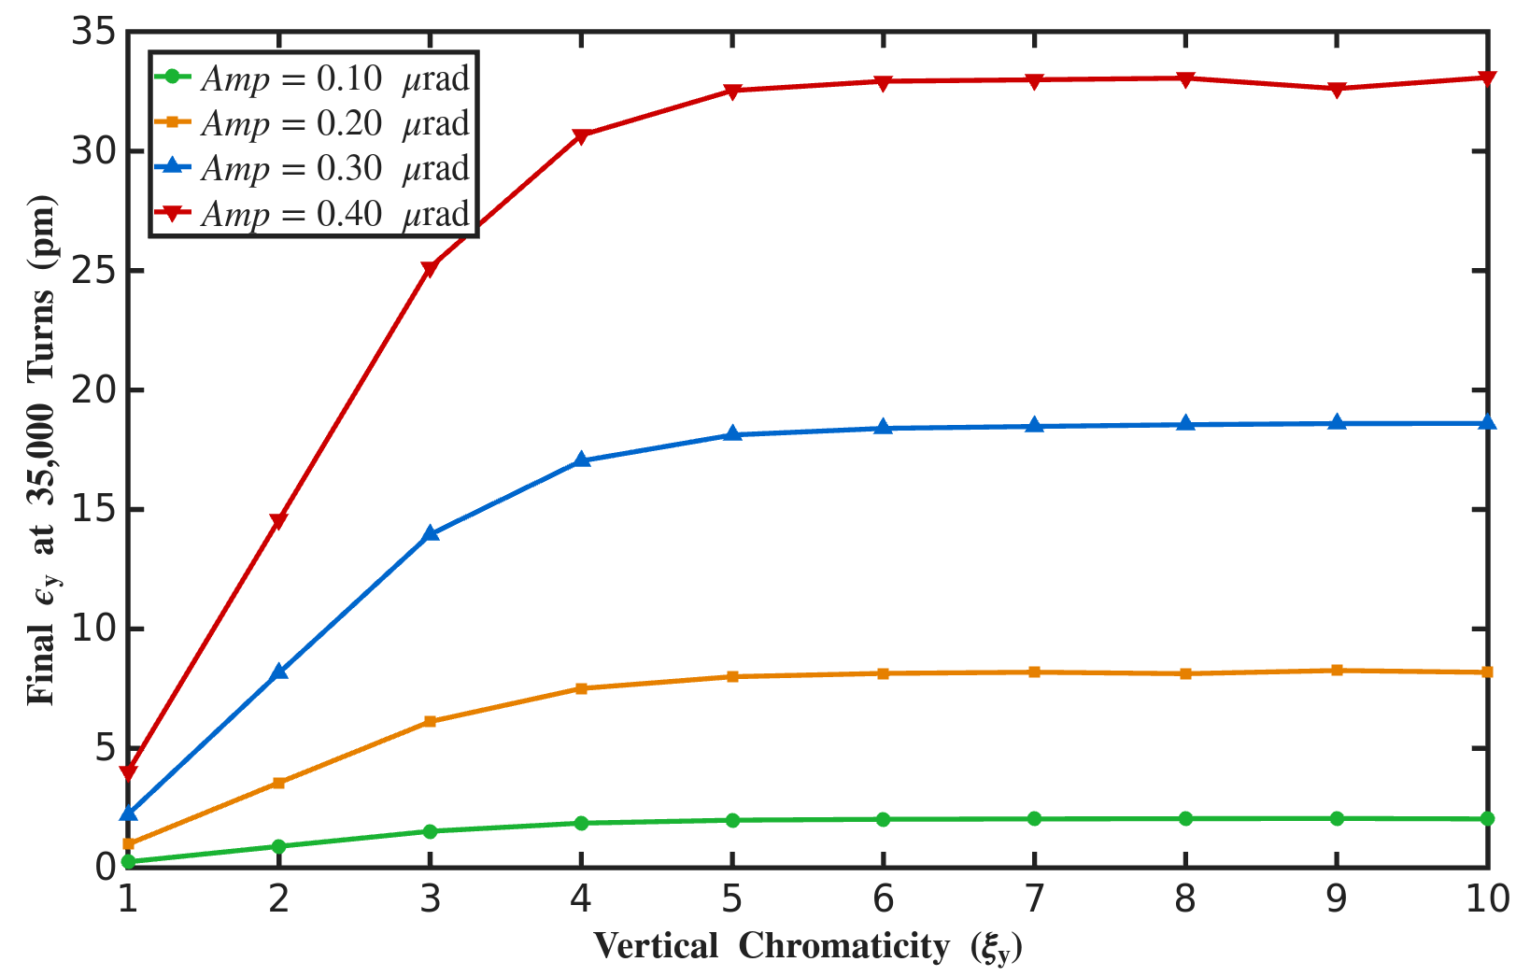
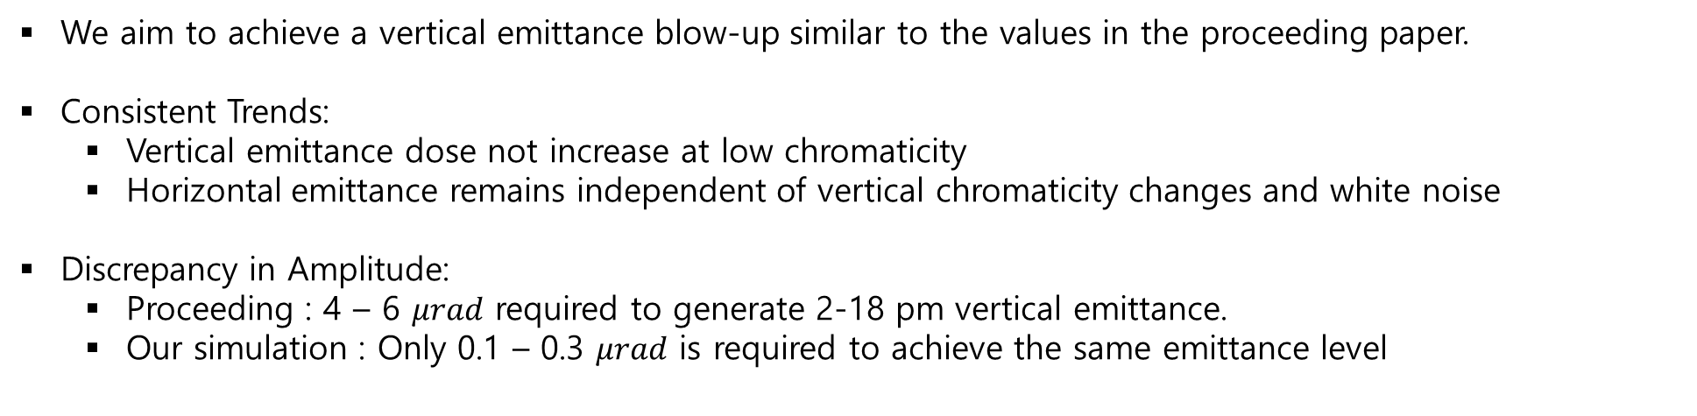
ESRF-EBS emittance blow up simulation results
We aim to achieve a vertical emittance blow-up similar to the values in the proceeding paper.
Consistent Trends:
  Vertical emittance dose not increase at low chromaticity
  Horizontal emittance remains independent of vertical chromaticity changes and white noise
Discrepancy in Amplitude:
  Proceeding : 4 – 6 $μrad$ required to generate 2-18 pm vertical emittance.
  Our simulation : Only 0.1 – 0.3 $μrad$ is required to achieve the same emittance level

Slide 12
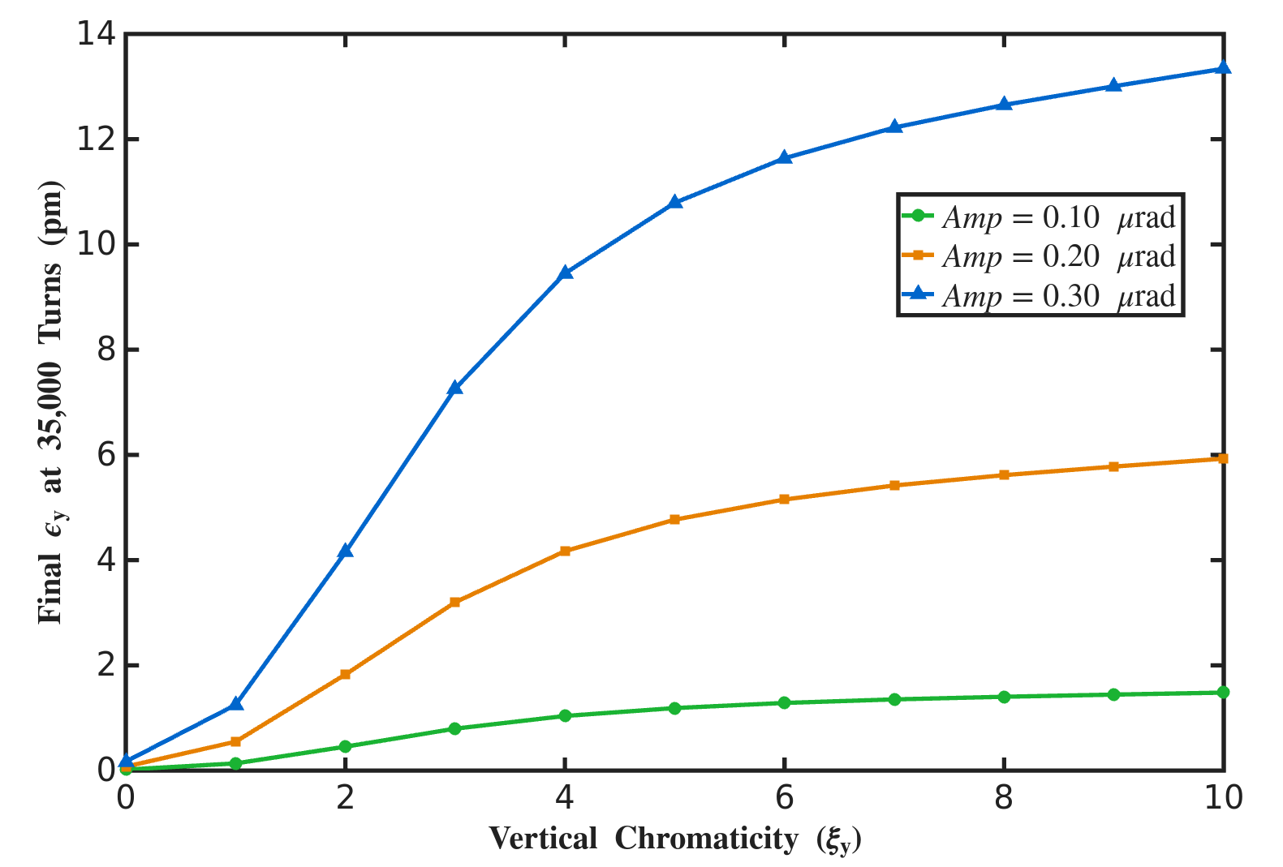
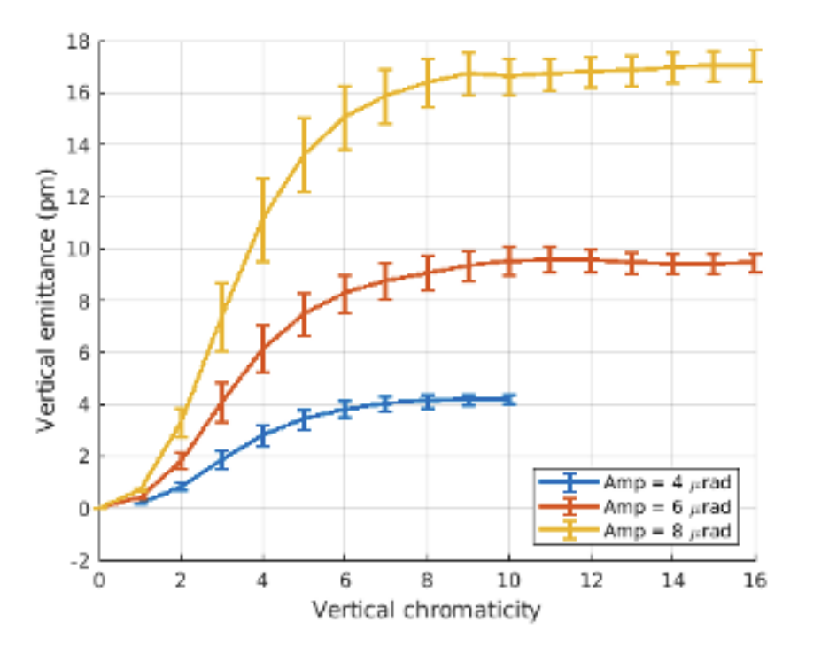
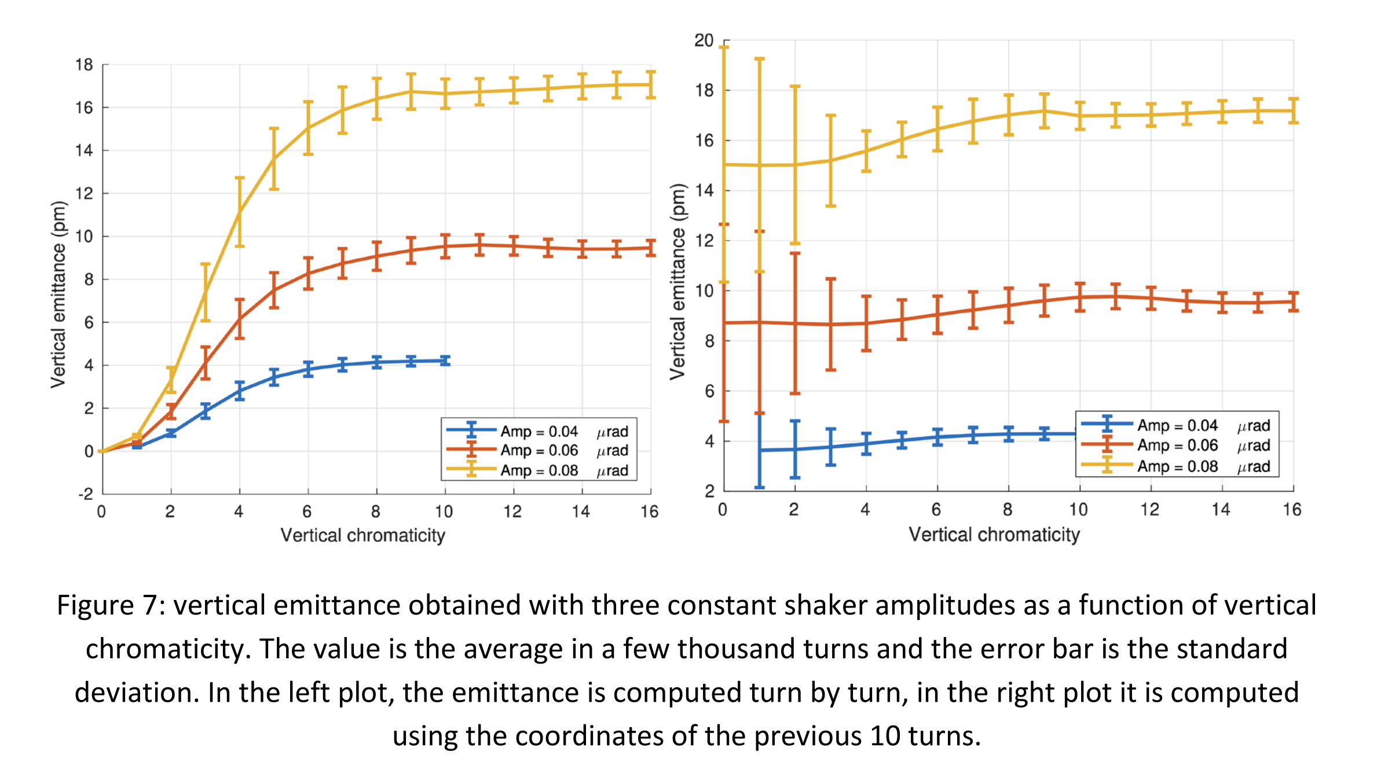
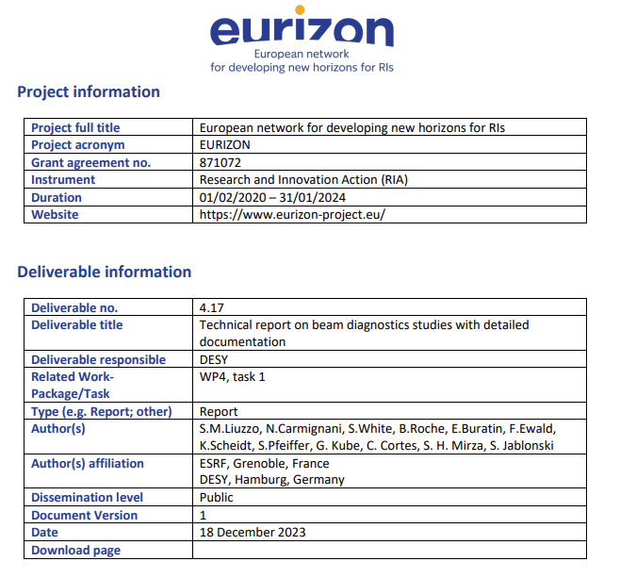
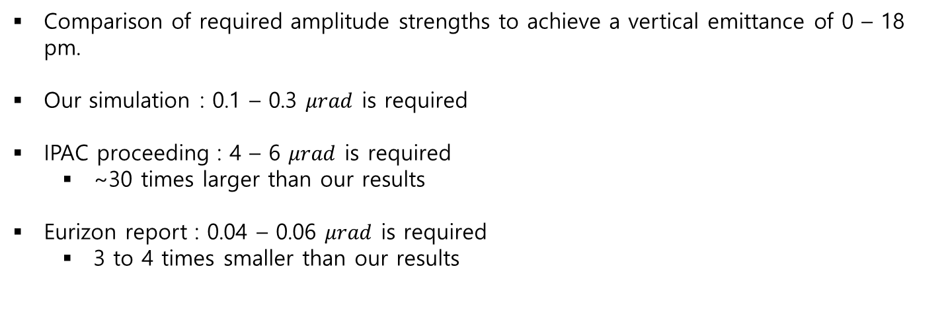
ESRF-EBS emittance blow up simulation results
Our simulation result
The proceeding result
The eurizon report result
Comparison of required amplitude strengths to achieve a vertical emittance of 0 – 18 pm.
Our simulation : 0.1 – 0.3 $μrad$ is required
IPAC proceeding : 4 – 6 $μrad$ is required
  ~30 times larger than our results
Eurizon report : 0.04 – 0.06 $μrad$ is required
  3 to 4 times smaller than our results

Slide 13
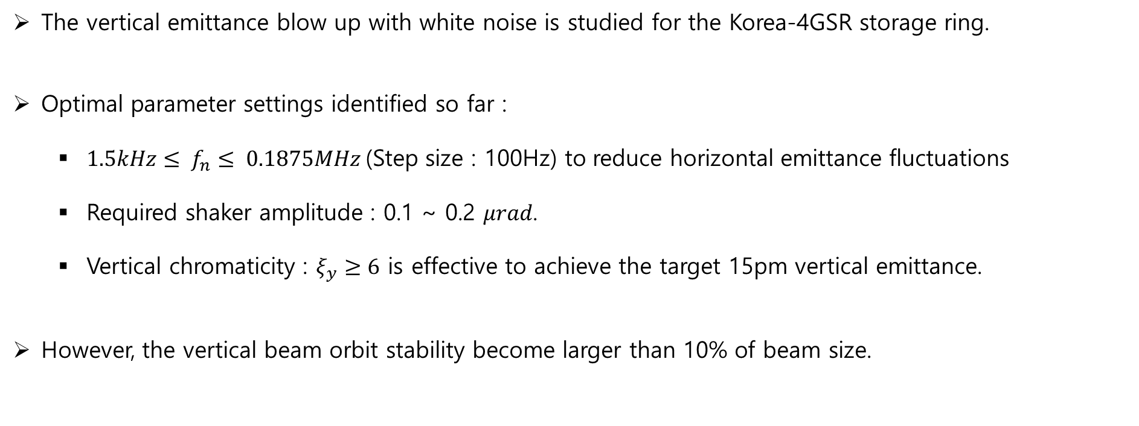
Summary
The vertical emittance blow up with white noise is studied for the Korea-4GSR storage ring.
Optimal parameter settings identified so far :
  $1.5kHz≤ f_{n}≤ 0.1875MHz$(Step size : 100Hz) to reduce horizontal emittance fluctuations
  Required shaker amplitude : 0.1 ~ 0.2 $μrad$.
  Vertical chromaticity : $ξ_{y}≥6$ is effective to achieve the target 15pm vertical emittance.
However, the vertical beam orbit stability become larger than 10% of beam size.

Slide 14
Thank you

Slide 15
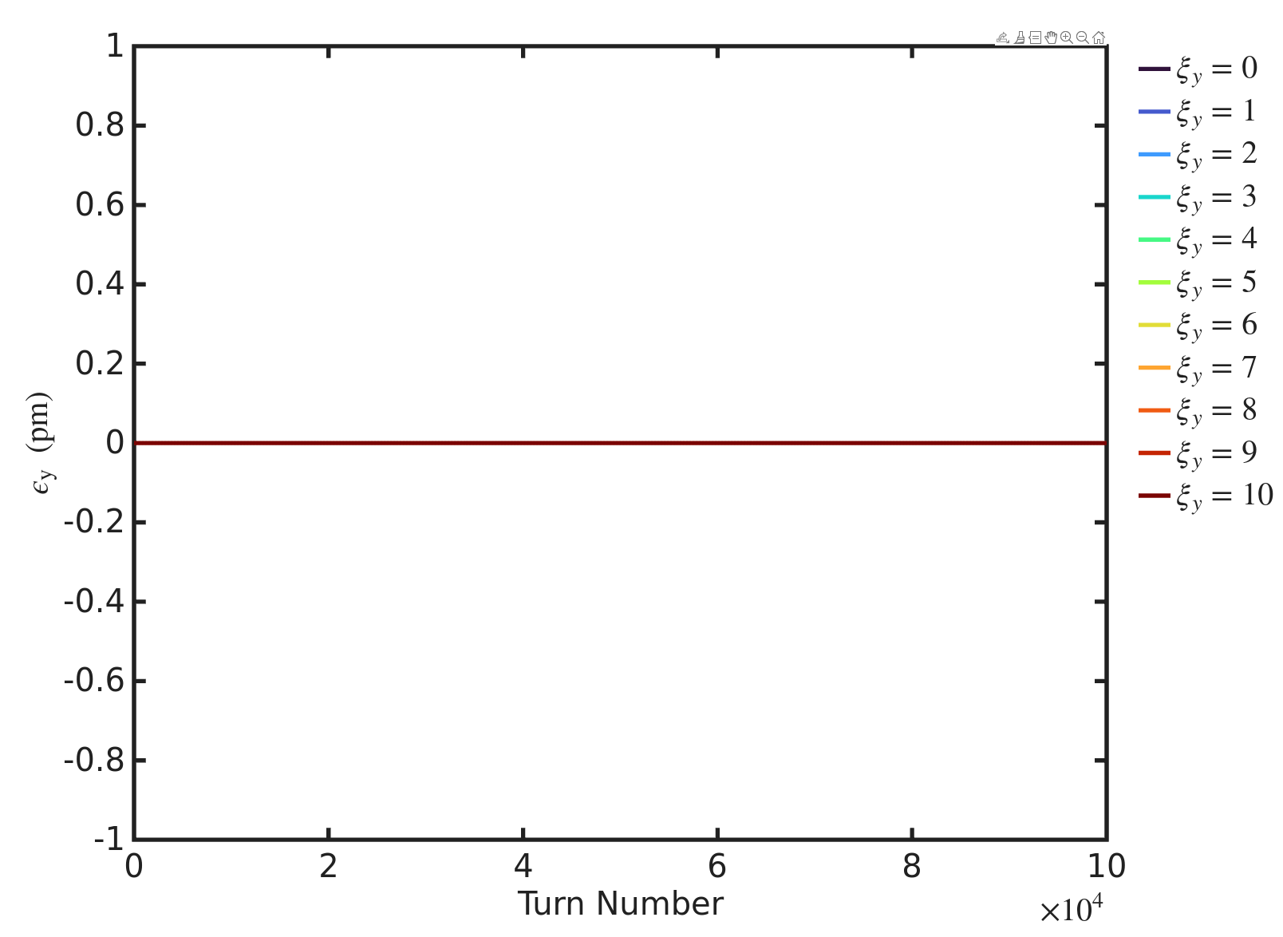
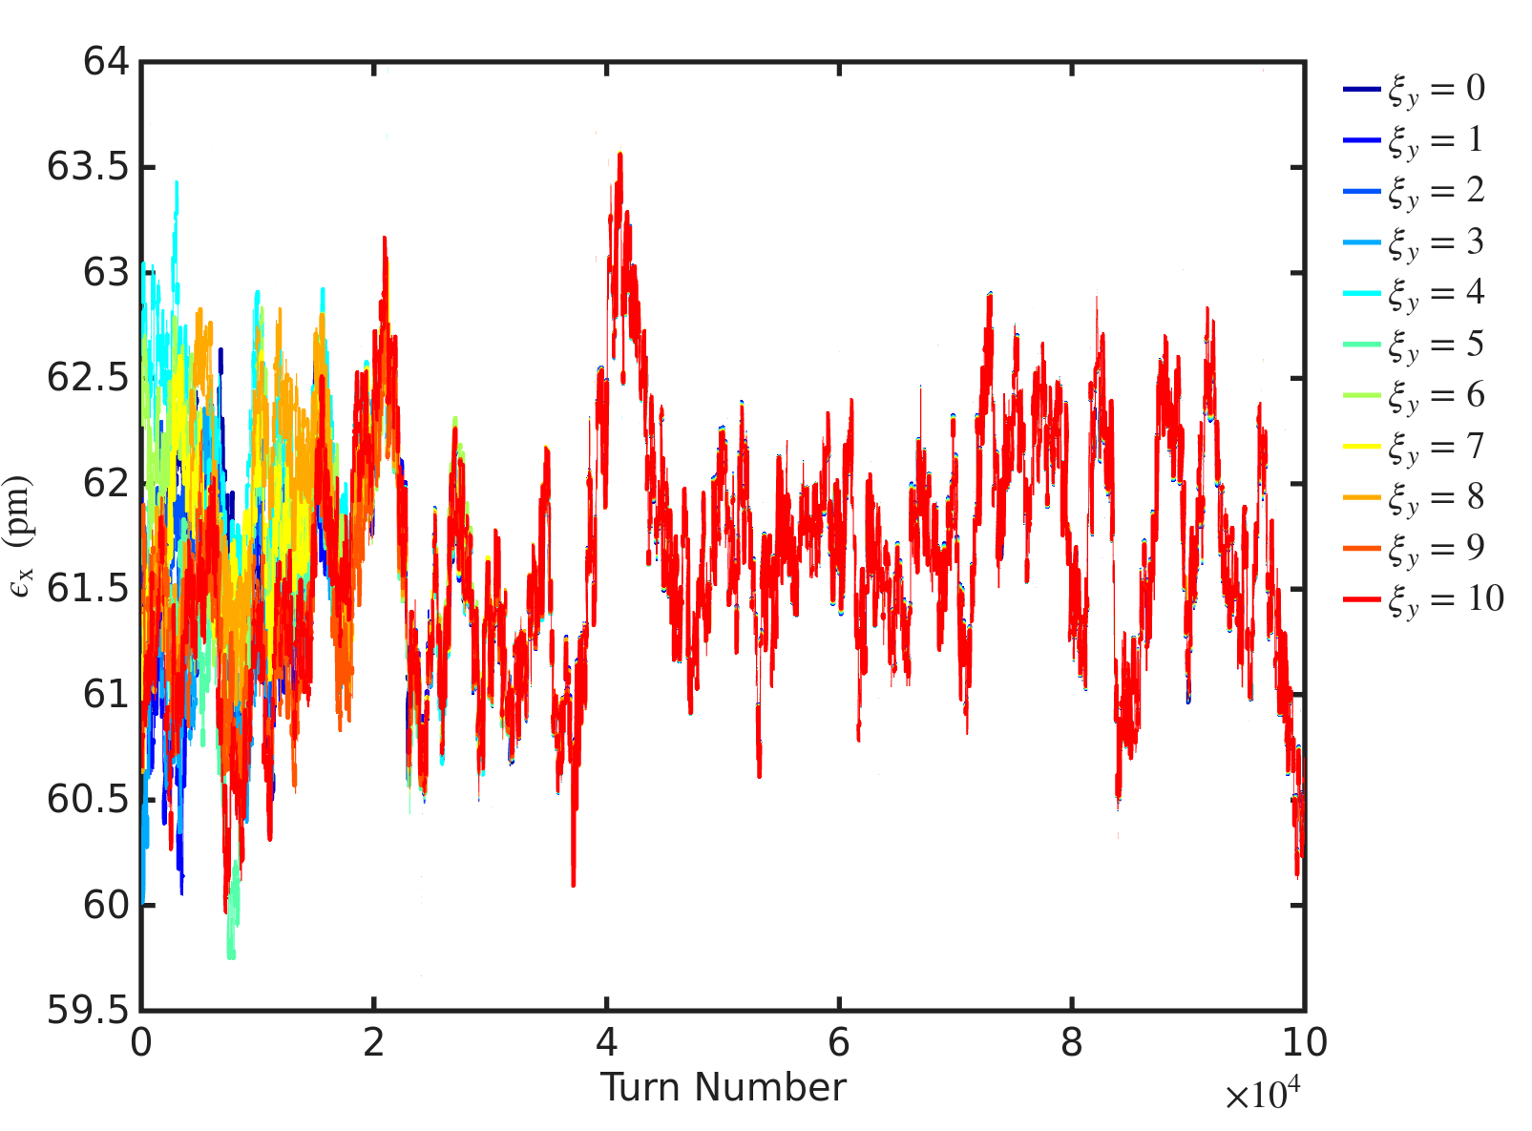


Vertical emittance vs. turn number
Horizontal emittance vs. turn number
Vertical emittance vs. vertical chrom
$$No white noise case$$
$$No white noise case$$

Slide 16
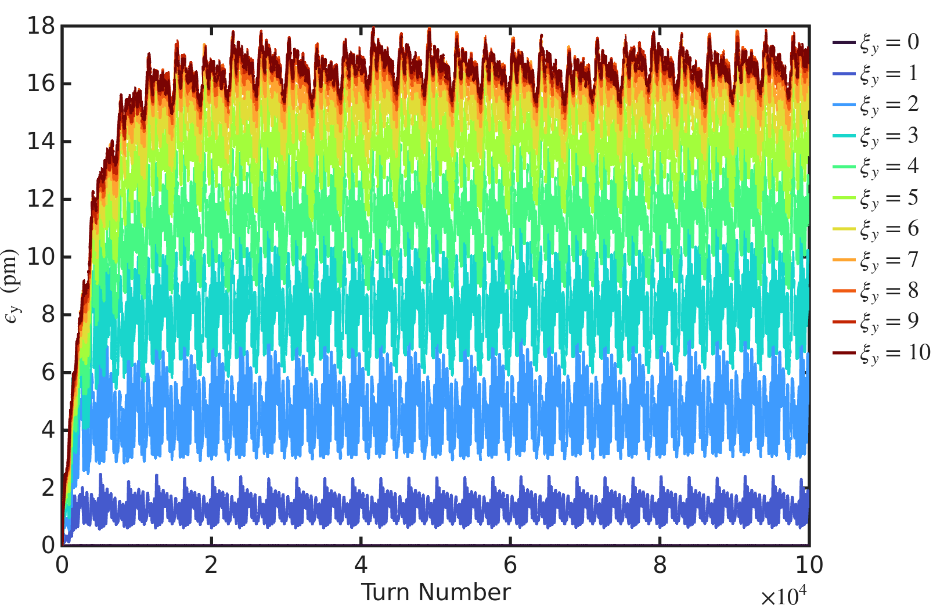
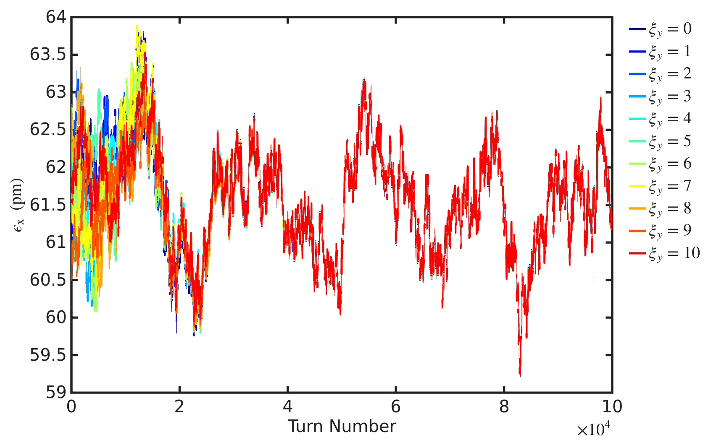


Results at middle of ID straight section
Results at middle of High beta straight sectioin
$β_{y}=2.84, ε_{y}=16.76 pm (ξ_{y}=10)$
$β_{y}=4.44, ε_{y}=25.63 pm (ξ_{y}=10)$

Slide 17
ESRF-EBS emittance blow up simulation settings
White noise setup
$$f_{rev}=0.3552 MHz , 0.5f_{rev}=0.1776 MHz$$
Noise frequency range : $100Hz≤ f_{n}≤ 0.1875MHz (with Δf_{n}=100Hz$)
$f_{noise }\left(t\right)= A∙\frac{\sum_{n=1}^{N}{\sin\left(2π{Δf}_{n}t+φ_{n}\right)}}{max|\sum_{n=1}^{N}{\sin\left(2π{Δf}_{n}t+φ_{n}\right)}|}$, $A$ = $0.2 μrad$
Tracking setup
Number of turns : 35k
Number of particles :10k
Using one-turn matrix
Initial beam distribution : matching with lattice
To validate our simulation results, we reproduced the ESRF-EBS simulation study following IPAC24 proceeding by N. Carmignani (“Emittance blow-up with a magnetic shaker at different chromaticities”).
The noise spectrum ranges from 100 Hz to 0.1776 MHz in increments of 100 Hz, consistent with the proceeding.
The tracking simulation settings are based on the proceeding paper.
The EBS.mat file from the AT website was used.

Slide 18
ESRF-EBS emittance blow up simulation results
We aim to achieve a vertical emittance blow-up similar to the values in the proceeding paper.
Consistent Trends:
  Vertical emittance dose not increase at low chromaticity
  Horizontal emittance remains independent of vertical chromaticity changes and white noise
Discrepancy in Amplitude:
  Proceeding : 4 – 6 $μrad$ required to generate 2-18 pm vertical emittance.
  Our simulation : Only 0.1 – 0.3 $μrad$ is required to achieve the same emittance level

Slide 19
ESRF-EBS emittance blow up simulation results
Our simulation result
The proceeding result
The eurizon report result
Comparison of required amplitude strengths to achieve a vertical emittance of 0 – 18 pm.
Our simulation : 0.1 – 0.3 $μrad$ is required
IPAC proceeding : 4 – 6 $μrad$ is required
  ~30 times larger than our results
Eurizon report : 0.04 – 0.06 $μrad$ is required
  3 to 4 times smaller than our results

