Slide 1
Group Meeting 260626
Minseo Jeong

Slide 2
UED Experiment
Restoration of beamline after blackout
Alignment of irises of UED beamline

Slide 3
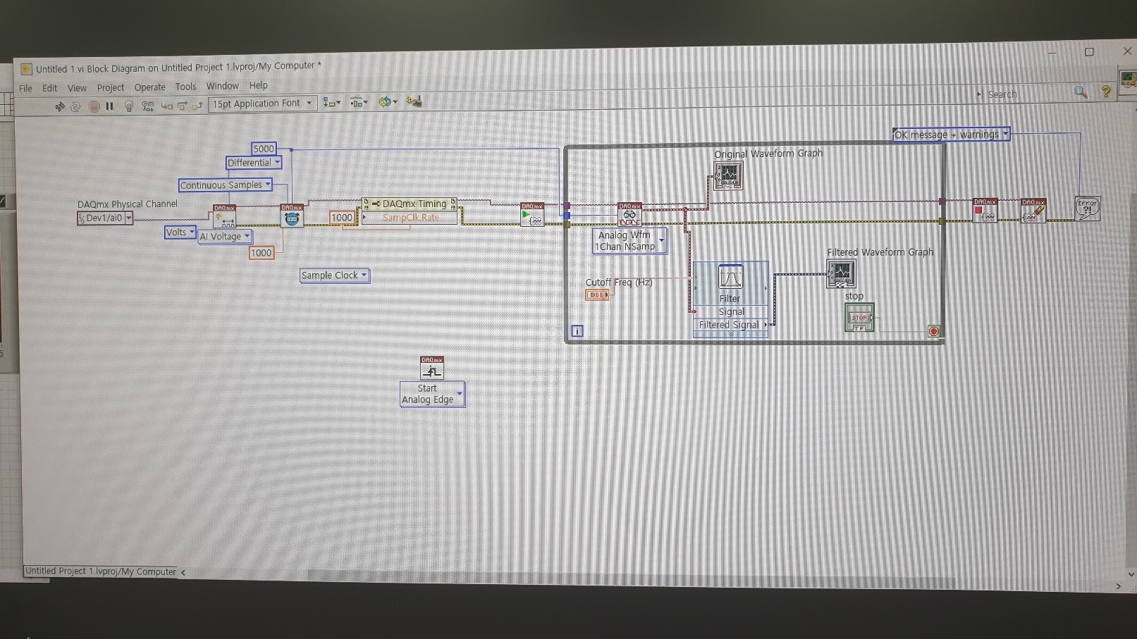
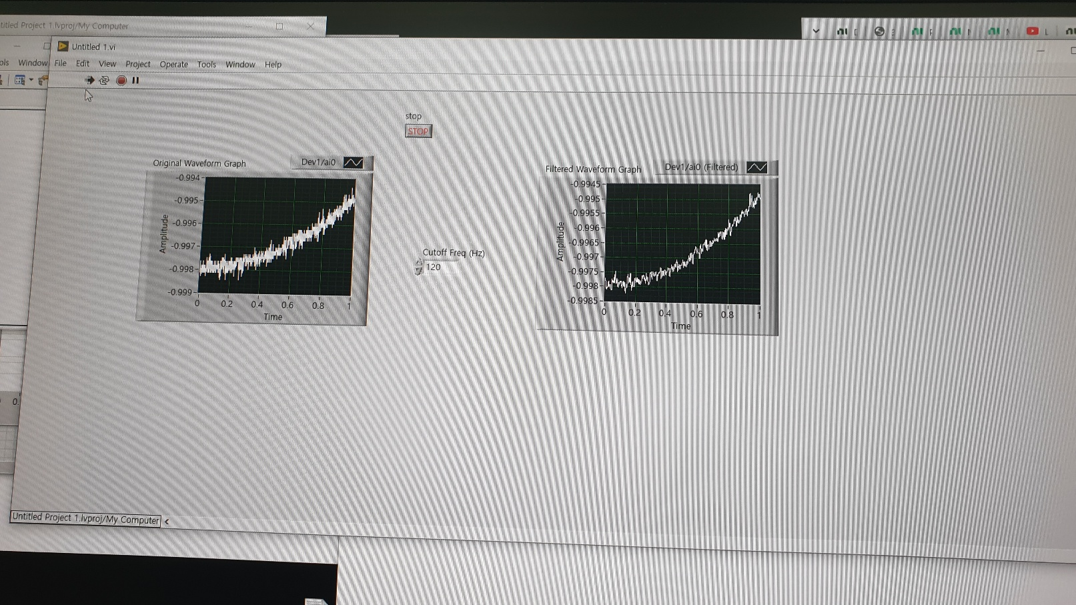
Laser Cross-correlation experiment
Initiation of cross-correlation experiment: end of July
Coding Labview program for experiment

Slide 4
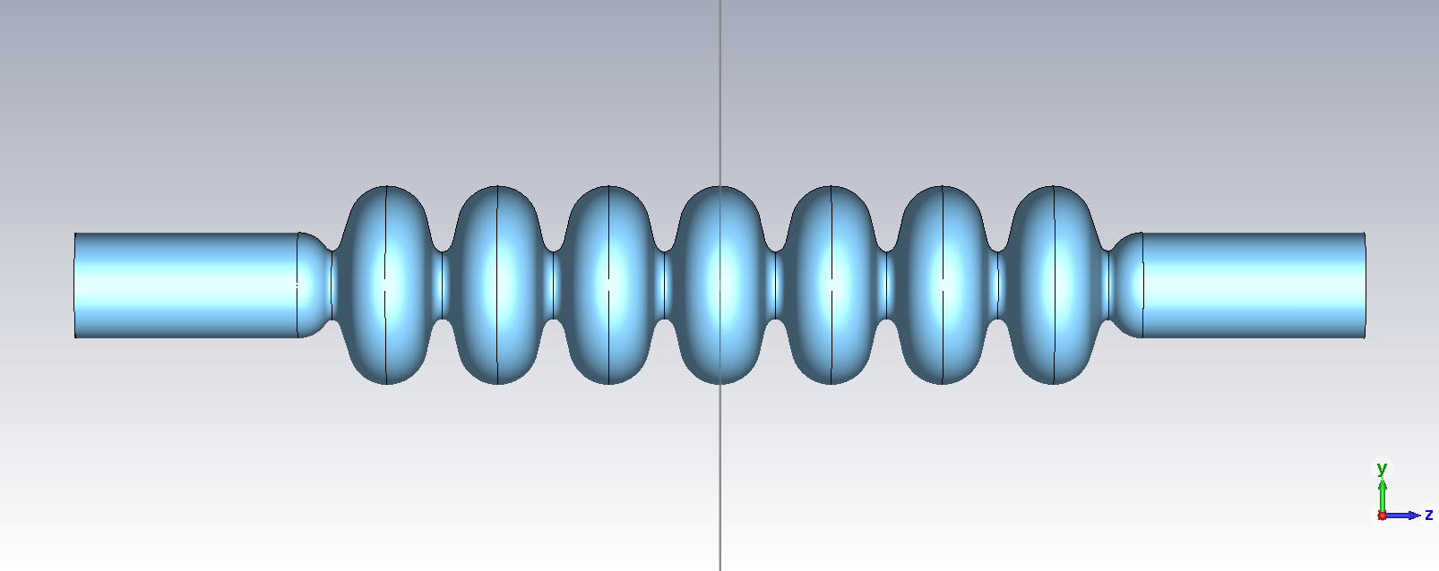
Design of SRF cavity
Optimization of FM performance
- Maximization of R/Q and field flatness
- Minimization of E_{pk}/E_{acc} and B_{pk}/E_{acc}

Slide 5
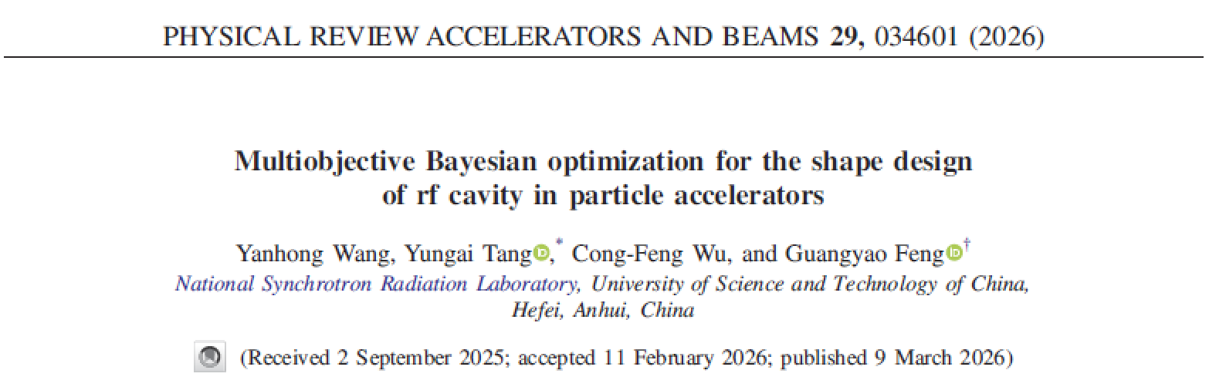
Optimization of Cavity by BO
Input parameter: dimensions of end cell and beam pipe
Constraint: L>A+a, B+b<R_{eq}-R_{i}, AU+aU<LU, BU+bU<R_{tube}-R_{i}, a²/b>6, frequency of FM=1300±1MHz

Slide 6
Optimization of Cavity by BO
Challenge: Typical acquisition function of MOBO is not suitable for equality constraint
Solution: Two-stage acquisition strategy

Slide 7
Optimization of Cavity by BO
1) Vector acquisition function with constraint
2) Finding Pareto front of vector acquisition function by MOGA
3) Calculation of scalar acquisition function for PF

Slide 8
Optimization of Cavity by BO

Slide 9
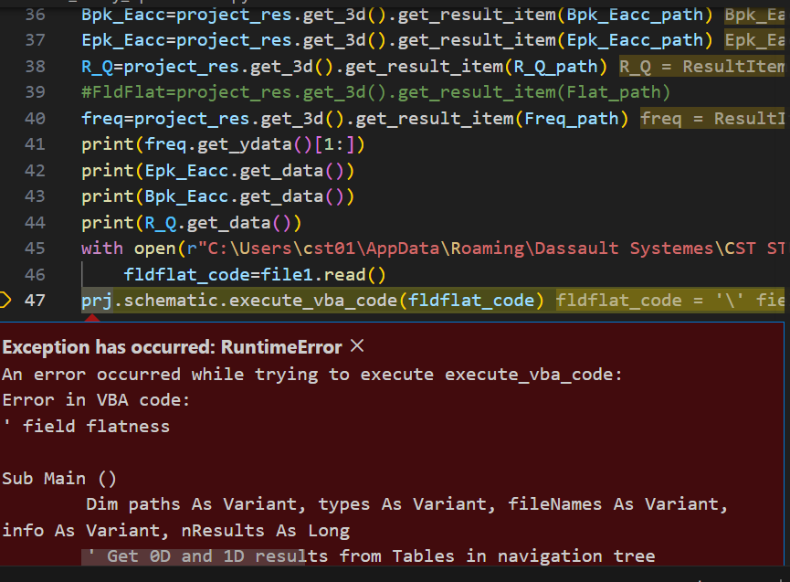
Current Status
Code for running CST with python(completed)
- Error occurred when running CST macro by python
Coding for constrained BO (in progress)

Slide 10
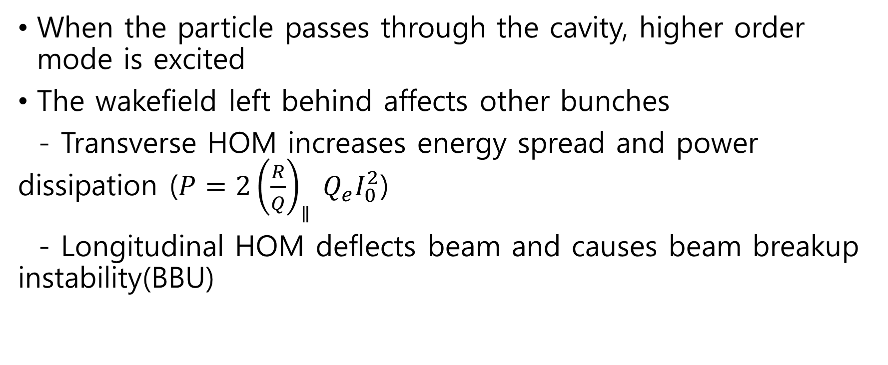
Higher Order Mode Damping
When the particle passes through the cavity, higher order mode is excited
The wakefield left behind affects other bunches
- Transverse HOM increases energy spread and power dissipation ($P=2{\left(\frac{R}{Q}\right)}_{∥} Q_{e}I_{0}^{2}$)
- Longitudinal HOM deflects beam and causes beam breakup instability(BBU)

Slide 11
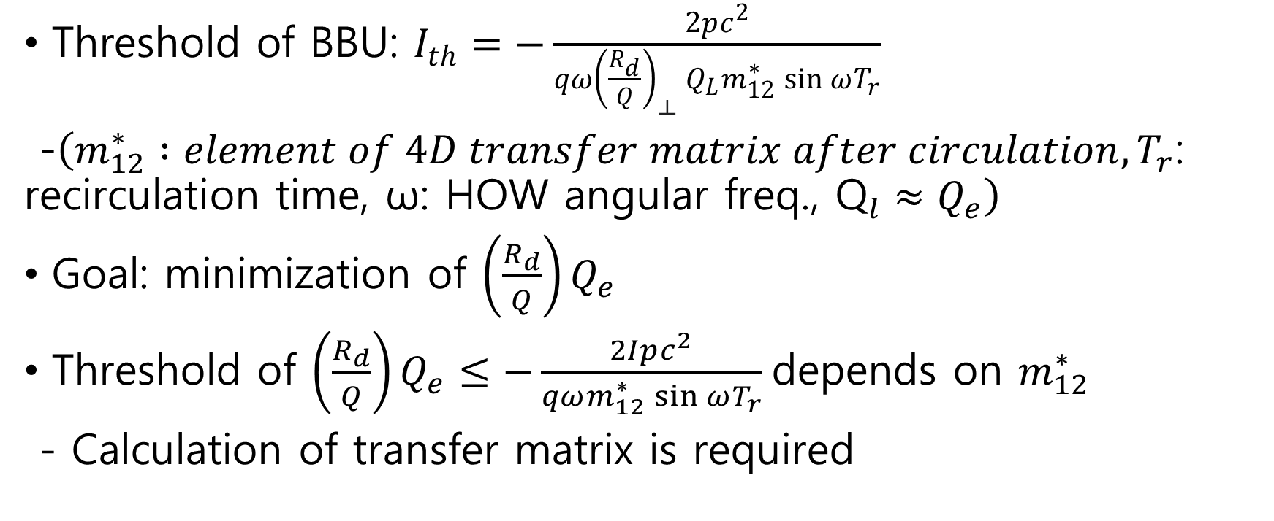
Higher Order Mode Damping
Threshold of BBU: $I_{th}=−\frac{2pc^{2}}{qω{\left(\frac{R_{d}}{Q}\right)}_{⟂} Q_{L}m_{12}^{∗}\sin{ωT_{r}}}$
-$\left(m_{12}^{∗} :element of 4D transfer matrix after circulation,T_{r}\text{: }\text{recirculation} \text{time}\text{, }\text{ω}\text{: }\text{HOW} \text{angular} \text{freq}\text{., }{\text{Q}}_{l}≈Q_{e}\right)$
Goal: minimization of $\left(\frac{R_{d}}{Q}\right)Q_{e}$
Threshold of $\left(\frac{R_{d}}{Q}\right)Q_{e}≤−\frac{2Ipc^{2}}{qωm_{12}^{∗}\sin{ωT_{r}}}$ depends on $m_{12}^{∗}$
- Calculation of transfer matrix is required

Slide 12
Research Plan
Optimization of cavity
- coding for constrained MOBO algorithm (by next week)
Completion of Labview code for cross-correlation experiment (by July)
UED simulation with high charge (~100pC)

