Slide 1
MENT&VPP
using the second moment as a constraint condition
Presenter：Liwen Liu
1

Slide 2
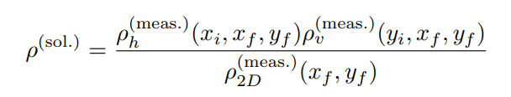
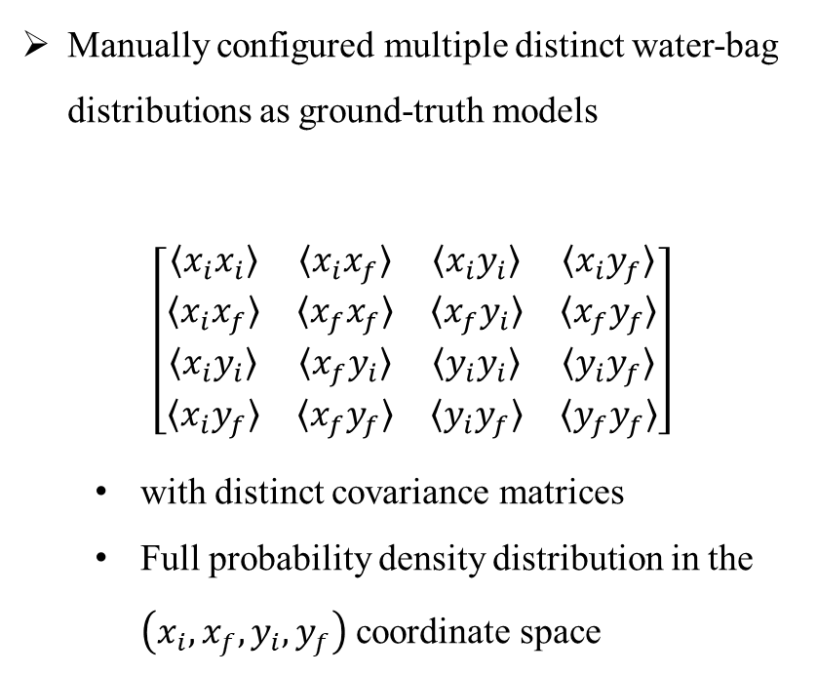
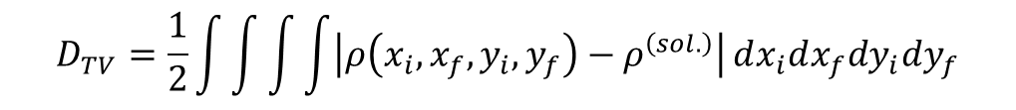
The reliability of the analytic formula was validated when reconstructing different distributions
Manually configured multiple distinct water-bag distributions as ground-truth models
$$\left[\begin{matrix}〈x_{i}x_{i}〉 & 〈x_{i}x_{f}〉 & 〈x_{i}y_{i}〉 & 〈x_{i}y_{f}〉 \\ 〈x_{i}x_{f}〉 & 〈x_{f}x_{f}〉 & 〈x_{f}y_{i}〉 & 〈x_{f}y_{f}〉 \\ 〈x_{i}y_{i}〉 & 〈x_{f}y_{i}〉 & 〈y_{i}y_{i}〉 & 〈y_{i}y_{f}〉 \\ 〈x_{i}y_{f}〉 & 〈x_{f}y_{f}〉 & 〈y_{i}y_{f}〉 & 〈y_{f}y_{f}〉\end{matrix}\right]$$
  with distinct covariance matrices
  Full probability density distribution in the $\left(x_{i},x_{f},y_{i},y_{f}\right)$coordinate space
Representing probability density distributions via computational grids
  （100，100，100，100）: 100 grid points per dimension
  （-8，8）: Range of [-8, 8] per dimension
$$D_{TV}=\frac{1}{2}\int{\int{\int{\int{\left|ρ\left(x_{i},x_{f},y_{i},y_{f}\right)−ρ^{\left(sol.\right)}\right|}}}}dx_{i}dx_{f}dy_{i}dy_{f}$$
2

Slide 3
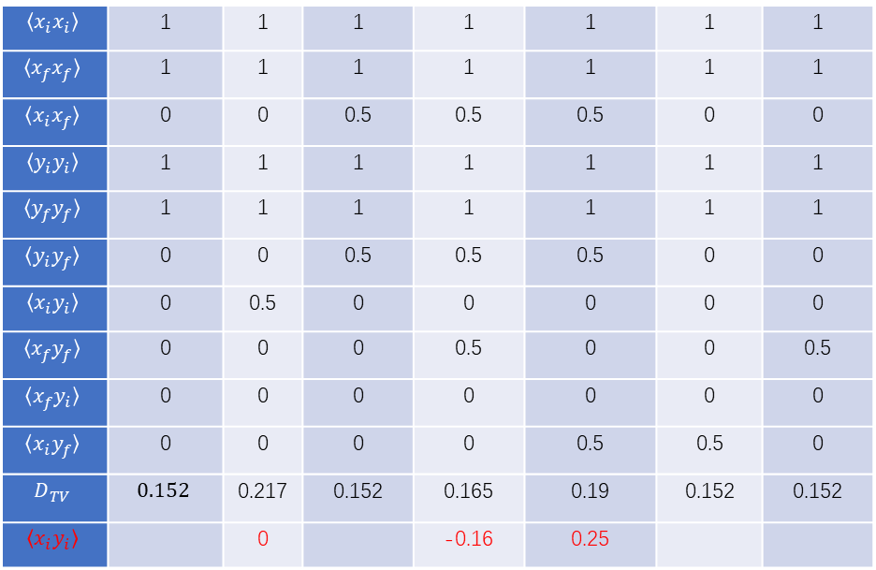
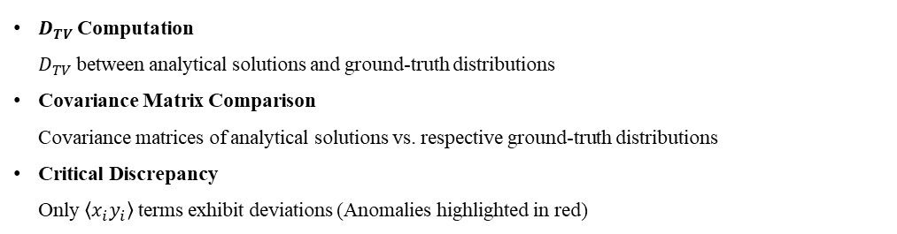
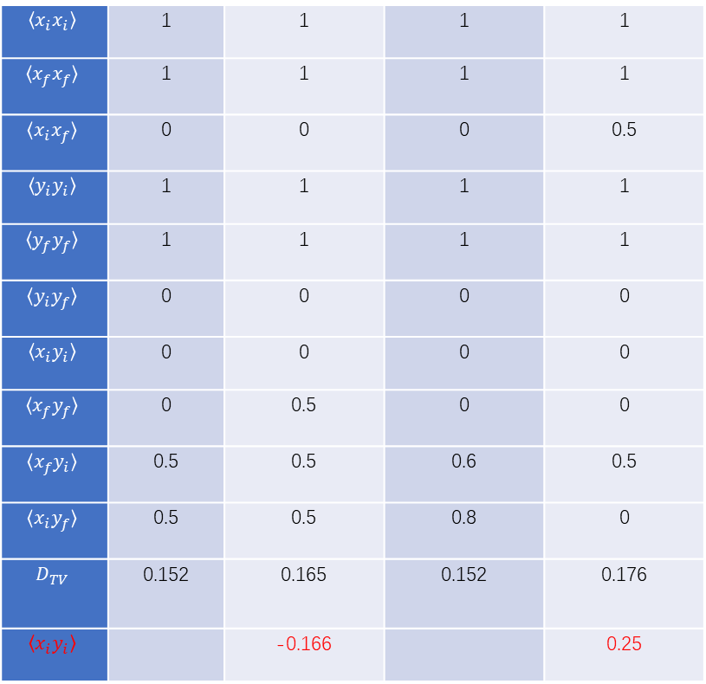
$$〈x_{i}x_{i}〉$$ | 1 | 1 | 1 | 1 | 1 | 1 | 1
$$〈x_{f}x_{f}〉$$ | 1 | 1 | 1 | 1 | 1 | 1 | 1
$$〈x_{i}x_{f}〉$$ | 0 | 0 | 0.5 | 0.5 | 0.5 | 0 | 0
$$〈y_{i}y_{i}〉$$ | 1 | 1 | 1 | 1 | 1 | 1 | 1
$$〈y_{f}y_{f}〉$$ | 1 | 1 | 1 | 1 | 1 | 1 | 1
$$〈y_{i}y_{f}〉$$ | 0 | 0 | 0.5 | 0.5 | 0.5 | 0 | 0
$$〈x_{i}y_{i}〉$$ | 0 | 0.5 | 0 | 0 | 0 | 0 | 0
$$〈x_{f}y_{f}〉$$ | 0 | 0 | 0 | 0.5 | 0 | 0 | 0.5
$$〈x_{f}y_{i}〉$$ | 0 | 0 | 0 | 0 | 0 | 0 | 0
$$〈x_{i}y_{f}〉$$ | 0 | 0 | 0 | 0 | 0.5 | 0.5 | 0
$$D_{TV}$$ | $$0.152$$ | 0.217 | 0.152 | 0.165 | 0.19 | 0.152 | 0.152
$$〈x_{i}y_{i}〉$$ |  | 0 |  | -0.16 | 0.25
$$〈x_{i}x_{i}〉$$ | 1 | 1 | 1 | 1
$$〈x_{f}x_{f}〉$$ | 1 | 1 | 1 | 1
$$〈x_{i}x_{f}〉$$ | 0 | 0 | 0 | 0.5
$$〈y_{i}y_{i}〉$$ | 1 | 1 | 1 | 1
$$〈y_{f}y_{f}〉$$ | 1 | 1 | 1 | 1
$$〈y_{i}y_{f}〉$$ | 0 | 0 | 0 | 0
$$〈x_{i}y_{i}〉$$ | 0 | 0 | 0 | 0
$$〈x_{f}y_{f}〉$$ | 0 | 0.5 | 0 | 0
$$〈x_{f}y_{i}〉$$ | 0.5 | 0.5 | 0.6 | 0.5
$$〈x_{i}y_{f}〉$$ | 0.5 | 0.5 | 0.8 | 0
$$D_{TV}$$ | 0.152 | 0.165 | 0.152 | 0.176
$$〈x_{i}y_{i}〉$$ |  | -0.166 |  | 0.25
$D_{TV}$Computation
$D_{TV}$between analytical solutions and ground-truth distributions
Covariance Matrix Comparison
Covariance matrices of analytical solutions vs. respective ground-truth distributions
Critical Discrepancy
Only $〈x_{i}y_{i}〉$terms exhibit deviations (Anomalies highlighted in red)

Slide 4
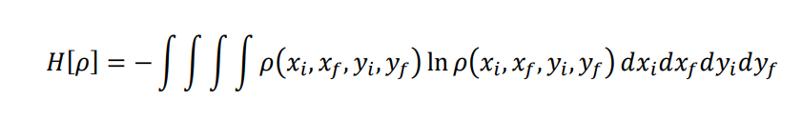
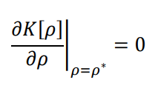
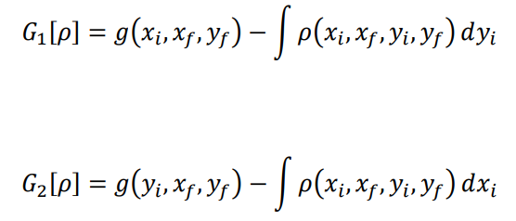
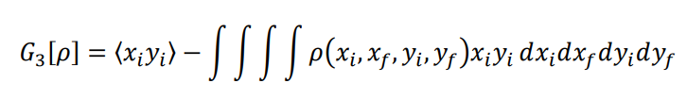
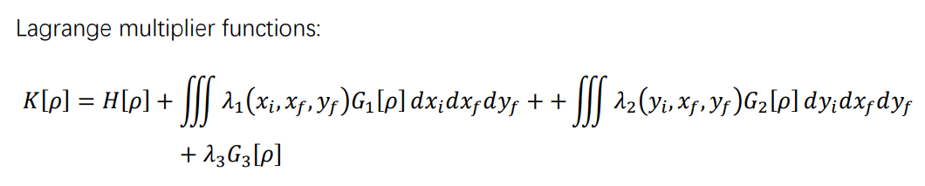


4D entropy:
Solution:
constraint condition:
$h_{1}、h_{2}$：tensor to be solved
$λ_{3}$:a scalar to be solved

Slide 5
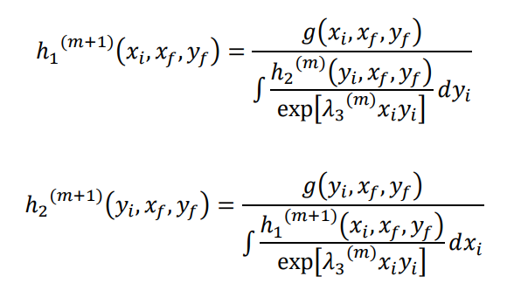
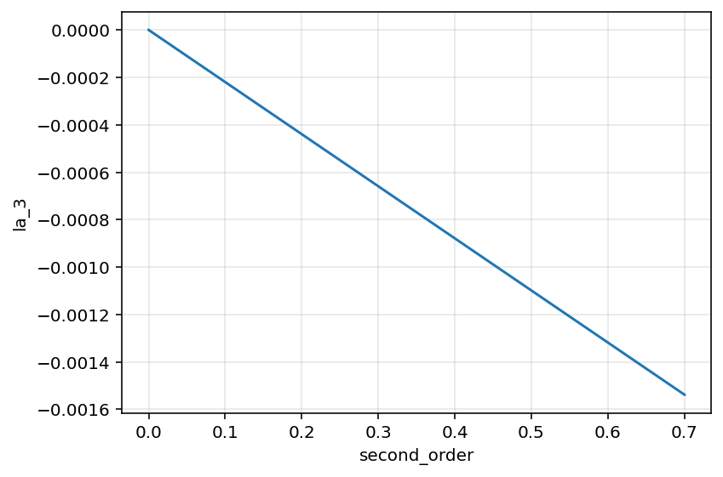
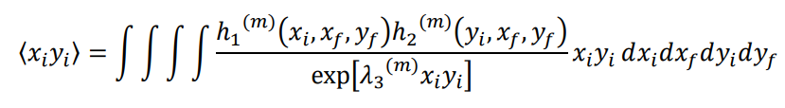
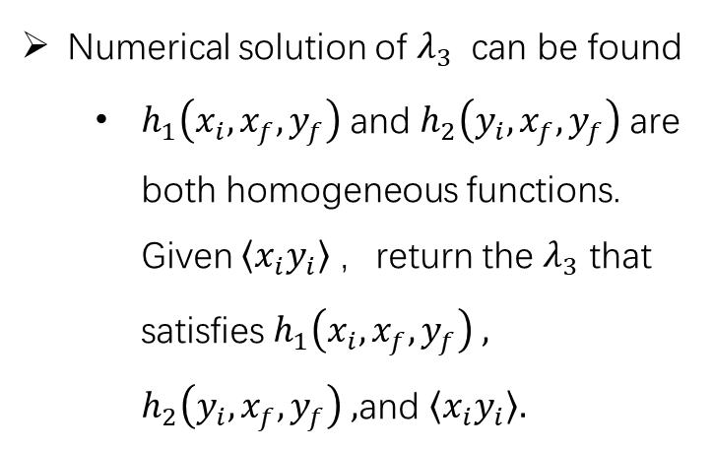
Numerical solution of $λ_{3}$ can be found
  $h_{1}\left(x_{i},x_{f},y_{f}\right)$and $h_{2}\left(y_{i},x_{f},y_{f}\right)$are both homogeneous functions. Given $\left\langle x_{i}y_{i}\right\rangle$，return the $λ_{3}$ that satisfies $h_{1}\left(x_{i},x_{f},y_{f}\right) ,$ $h_{2}\left(y_{i},x_{f},y_{f}\right) ,$and $\left\langle x_{i}y_{i}\right\rangle .$
Iterative solution：
The second-order moment lacks a closed-form expression, but I have verified that it can be solved using the bisection method.
Subsequent overall iterative testing is still required

