Slide 1
Virtual Pepper-Pot
Analysis Method
June 25, 2026

Slide 2
Outline
1. Virtual Beamlet Construction
Slit scan measurement & Minimum-bit principle
2. Review of Reconstruction Method
2D Gaussian fitting
1D Gaussian fitting
3. Fitting-Free Reconstruction Process
Using virtual beamlet distributions
Finite slit width correction
Individual virtual beamlet threshold
4. Simulation Results
Input beam matrix1
Input beam matrix2

Slide 3
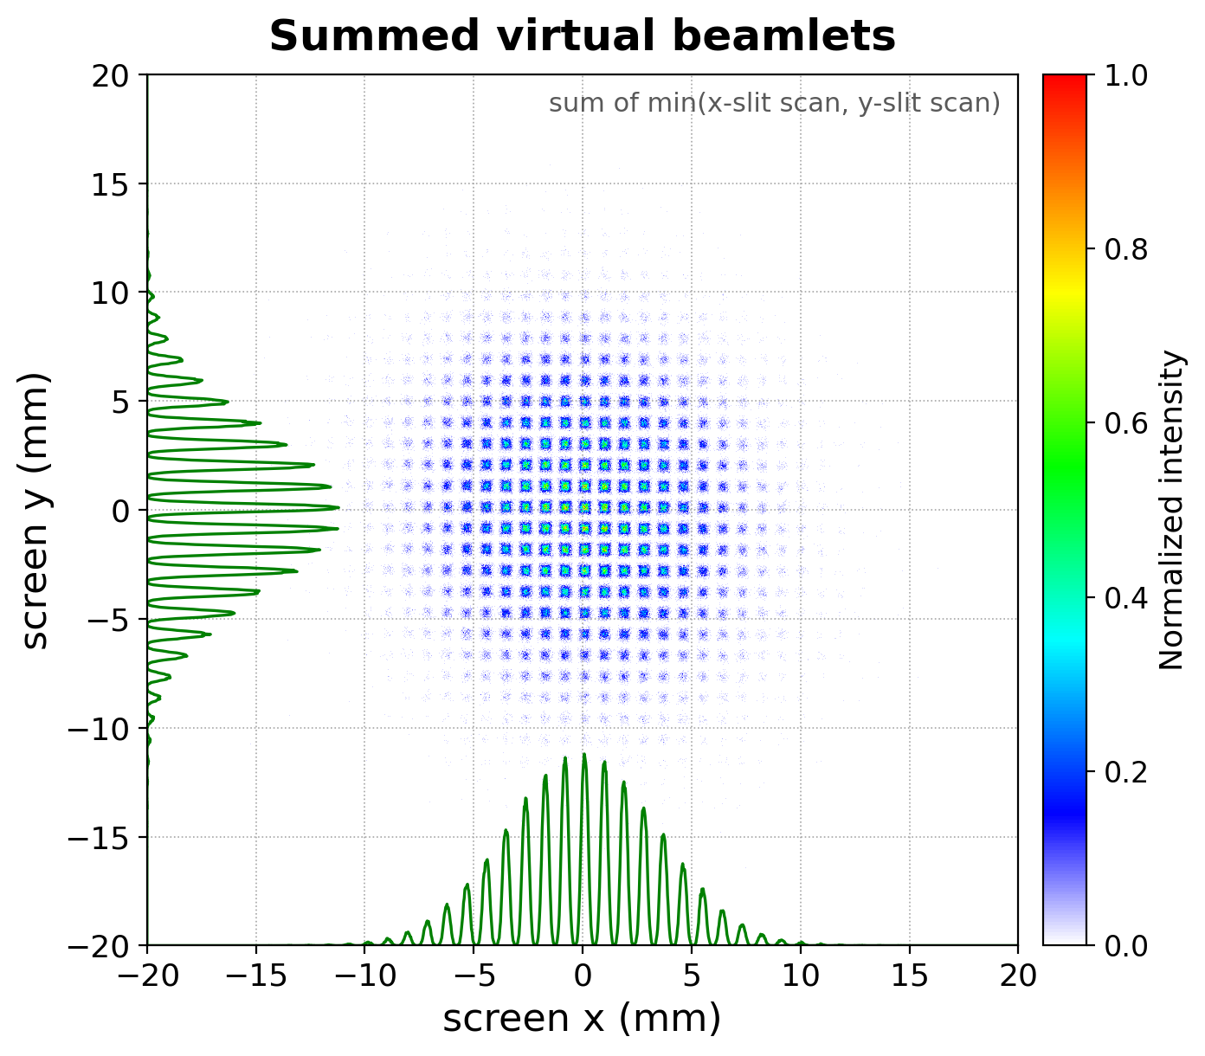
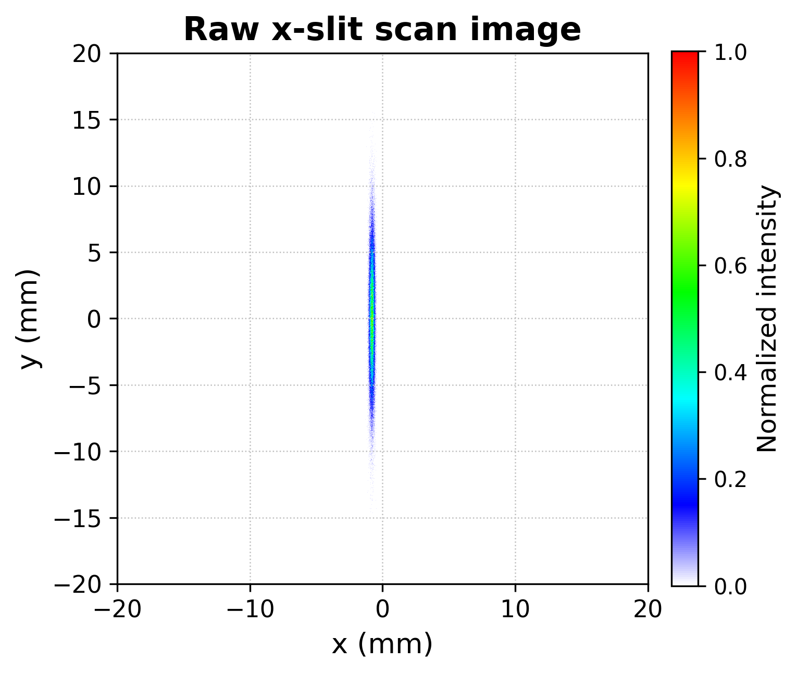
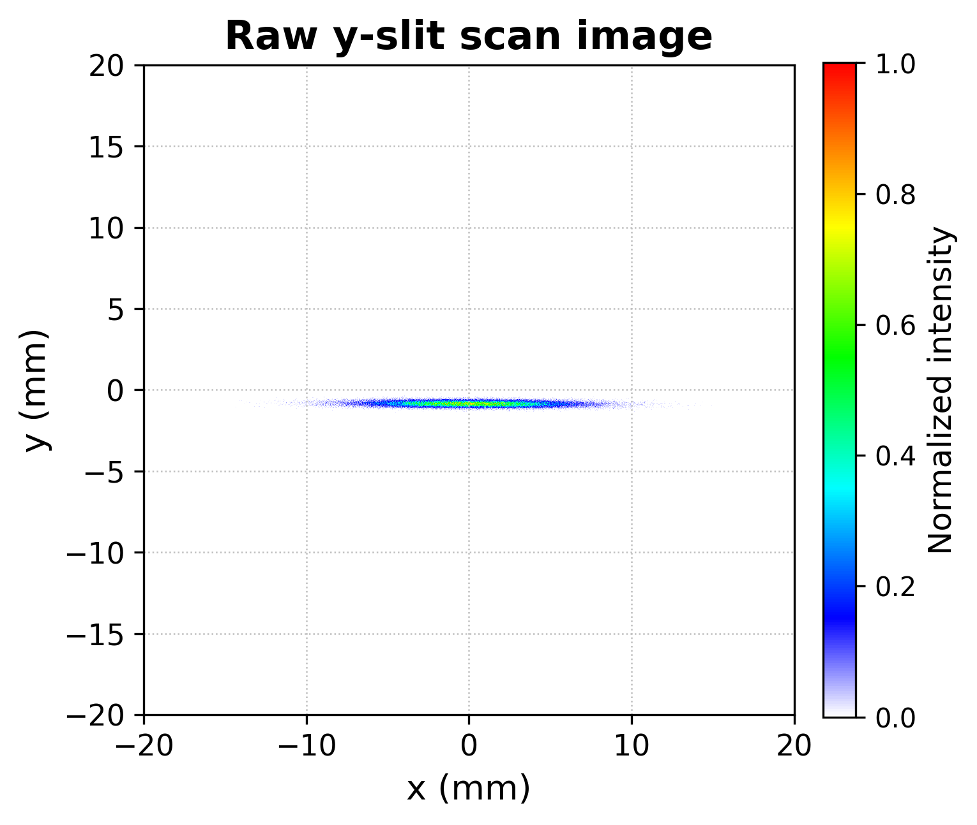
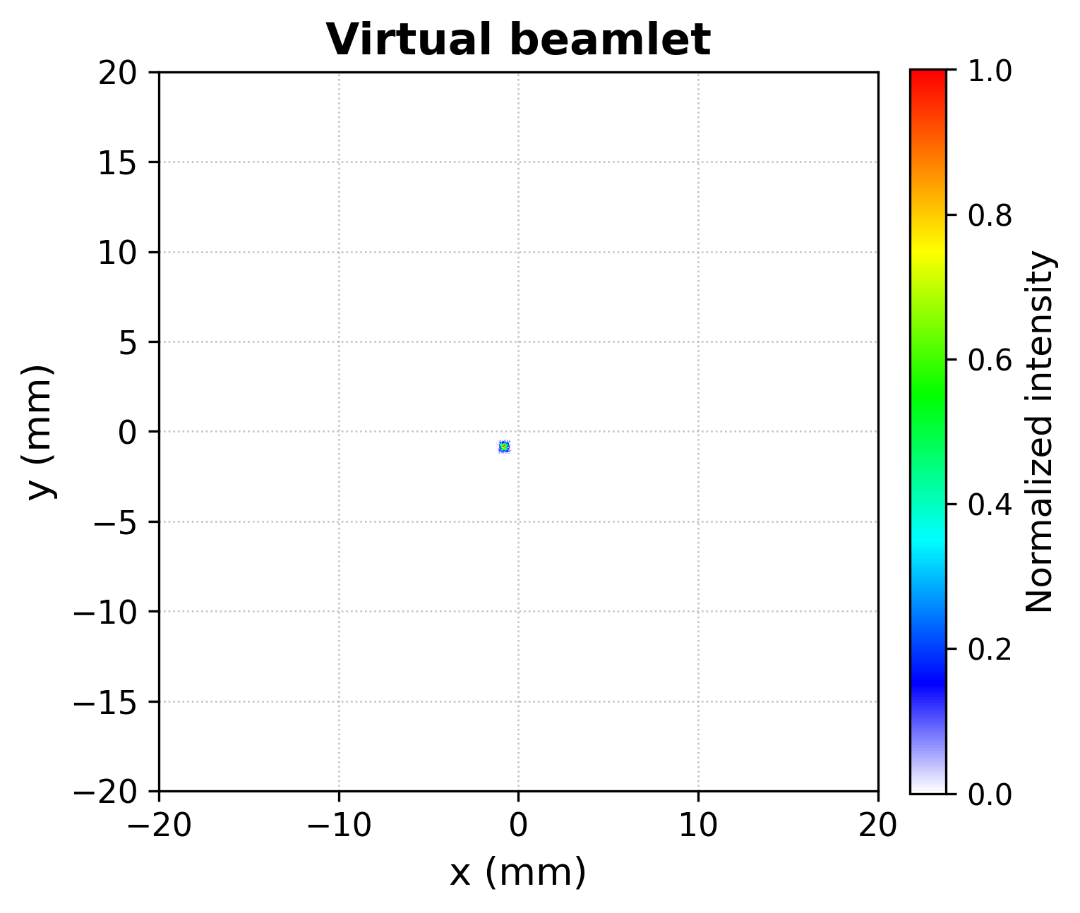
Measurement & Constructed Virtual Beamlet
$$I_{VPP}\left(n, m\right)=\min{(I_{n}^{h}, I_{m}^{v})}$$
Pepper Pot
Virtual Pepper Pot
: Beamlets are constructed by selecting the pixel-wise minimum intensity between horizontal and vertical slit scans to avoid overestimation.
Minimum-bit Process

Slide 4
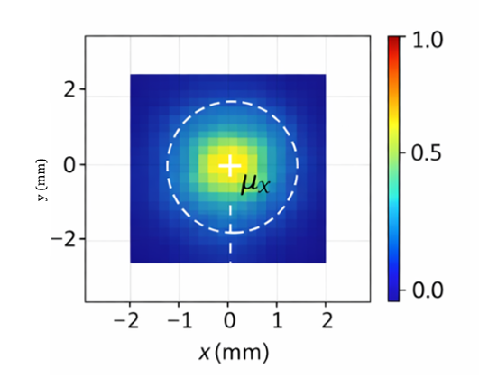
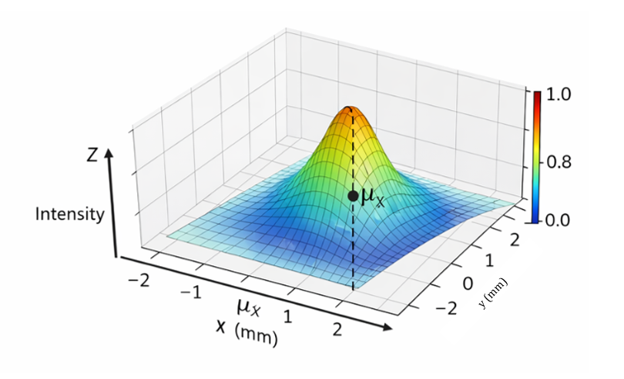
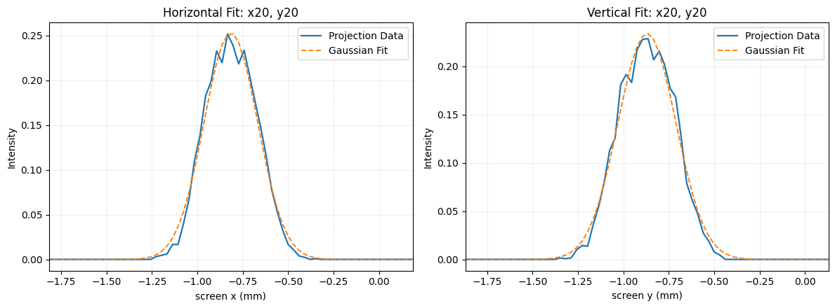


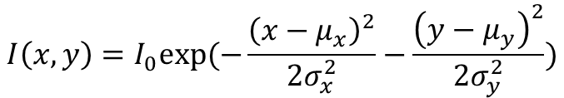




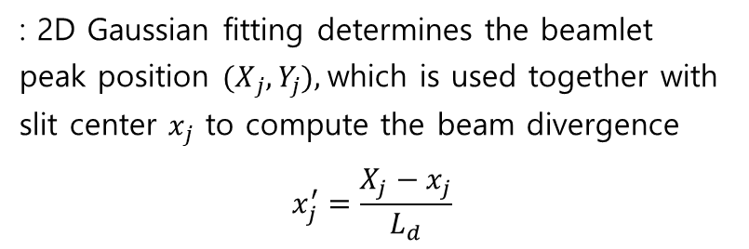
Before Reconstruction Process
Refer by “Characterization and benchmarking of complete 4D transverse phase space for high intensity ion beams using novel virtual pepper-pot technique” paper
2D Gaussian Fitting
1D Gaussian Fitting
, $μ_{y}$
, $μ_{y}$
$$I\left(x,y\right)=I_{0}exp⁡(−\frac{{\left(x−μ_{x}\right)}^{2}}{2σ_{x}^{2}}−\frac{{\left(y−μ_{y}\right)}^{2}}{2σ_{y}^{2}})$$
Each beamlet is projected onto the x- and y-axes, and then fitted with 1D Gaussian functions.
$${μ_{x}=X}_{j}$$
$${μ_{y}=Y}_{j}$$
$$I\left(x\right)=I_{0}exp⁡(−\frac{{\left(x−μ_{x}\right)}^{2}}{2σ_{x}^{2}})$$
: 2D Gaussian fitting determines the beamlet peak position ${(X}_{j},Y_{j}),$which is used together with slit center $x_{j}$ to compute the beam divergence
$$x_{j}^{′}=\frac{X_{j}−x_{j}}{L_{d}}$$
$$I\left(y\right)=I_{0}exp⁡(−\frac{{\left(y−μ_{y}\right)}^{2}}{2σ_{y}^{2}})$$
$${μ_{x}=X}_{j}$$
$${μ_{y}=Y}_{j}$$

Slide 5
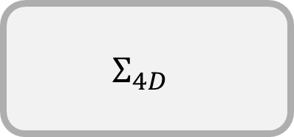
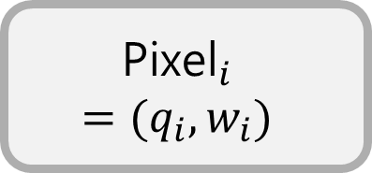
Fitting-Free Reconstruction Process
Virtual Beamlet
$${\text{Pixel}}_{i}$$
$$=(q_{i}, w_{i})$$
$$Σ_{4D}$$
Reconstruction
from
Virtual Beamlet Distributions
Same as Before

Slide 6


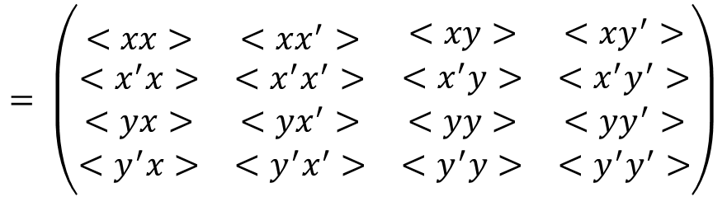


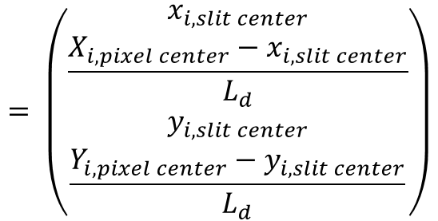
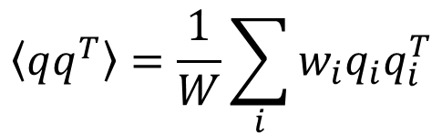
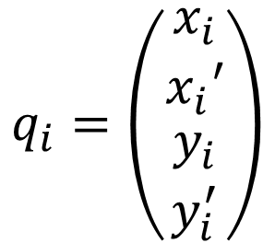
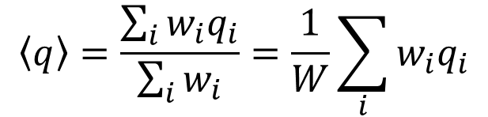
$${\text{Pixel}}_{i}$$
$$=(q_{i}, w_{i})$$
$$Σ_{4D}$$
$$\left\langle q\right\rangle =\frac{\sum_{i}{w_{i}q_{i}}}{\sum_{i}{w_{i}}}=\frac{1}{W}\sum_{i}{w_{i}q_{i}}$$
$$q_{i}=\left(\begin{matrix}\begin{matrix}x_{i} \\ x_{i}′\end{matrix} \\ \begin{matrix}y_{i} \\ y_{i}^{′}\end{matrix}\end{matrix}\right)$$
$$= \left(\begin{matrix}\begin{matrix}x_{i, slit center} \\ \frac{X_{i, pixel center}−x_{i, slit center}}{L_{d}}\end{matrix} \\ \begin{matrix}y_{i, slit center} \\ \frac{Y_{i, pixel center}−y_{i, slit center}}{L_{d}}\end{matrix}\end{matrix}\right)$$
$$\left\langle qq^{T}\right\rangle =\frac{1}{W}\sum_{i}{w_{i}q_{i}q_{i}^{T}}$$
$$Σ_{4D}= \left\langle qq^{T}\right\rangle −\left\langle q\right\rangle {\left\langle q\right\rangle }^{T}$$
$$= \left(\begin{matrix}\begin{matrix}<xx> & <xx^{′}> \\ <x^{′}x> & <x^{′}x^{′}>\end{matrix} & \begin{matrix}<xy> & <xy^{′}> \\ <x^{′}y> & <x^{′}y^{′}>\end{matrix} \\ \begin{matrix}<yx> & <yx^{′}> \\ <y^{′}x> & <y^{′}x^{′}>\end{matrix} & \begin{matrix}<yy> & <yy^{′}> \\ <y^{′}y> & <y^{′}y^{′}>\end{matrix}\end{matrix}\right)$$
$w_{i}$: pixel intensity

Slide 7

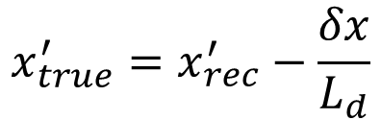



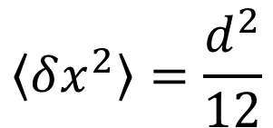

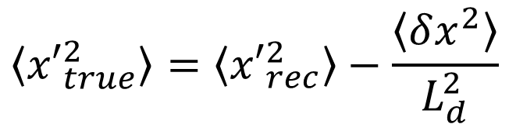



Finite Slit-Width Correction
Slit
$$x_{rec}≈x_{s}$$
$$x_{true}=x_{rec}+δx$$
$$δx$$
$$x_{true}^{′}=x_{rec}^{′}−\frac{δx}{L_{d}}$$
$$\left\langle x_{true}^{2}\right\rangle =\left\langle x_{rec}^{2}\right\rangle +\left\langle δx^{2}\right\rangle$$
$$x_{s}$$
$$x_{real}$$
$$\left\langle {x′}_{true}^{2}\right\rangle =\left\langle {x′}_{rec}^{2}\right\rangle −\frac{\left\langle δx^{2}\right\rangle }{L_{d}^{2}}$$
$$d$$
$$\left\langle x_{true}x_{true}^{′}\right\rangle =\left\langle x_{rec}x_{rec}^{′}\right\rangle$$
$$\left\langle δx^{2}\right\rangle =\frac{d^{2}}{12}$$
Slit moving

Slide 8
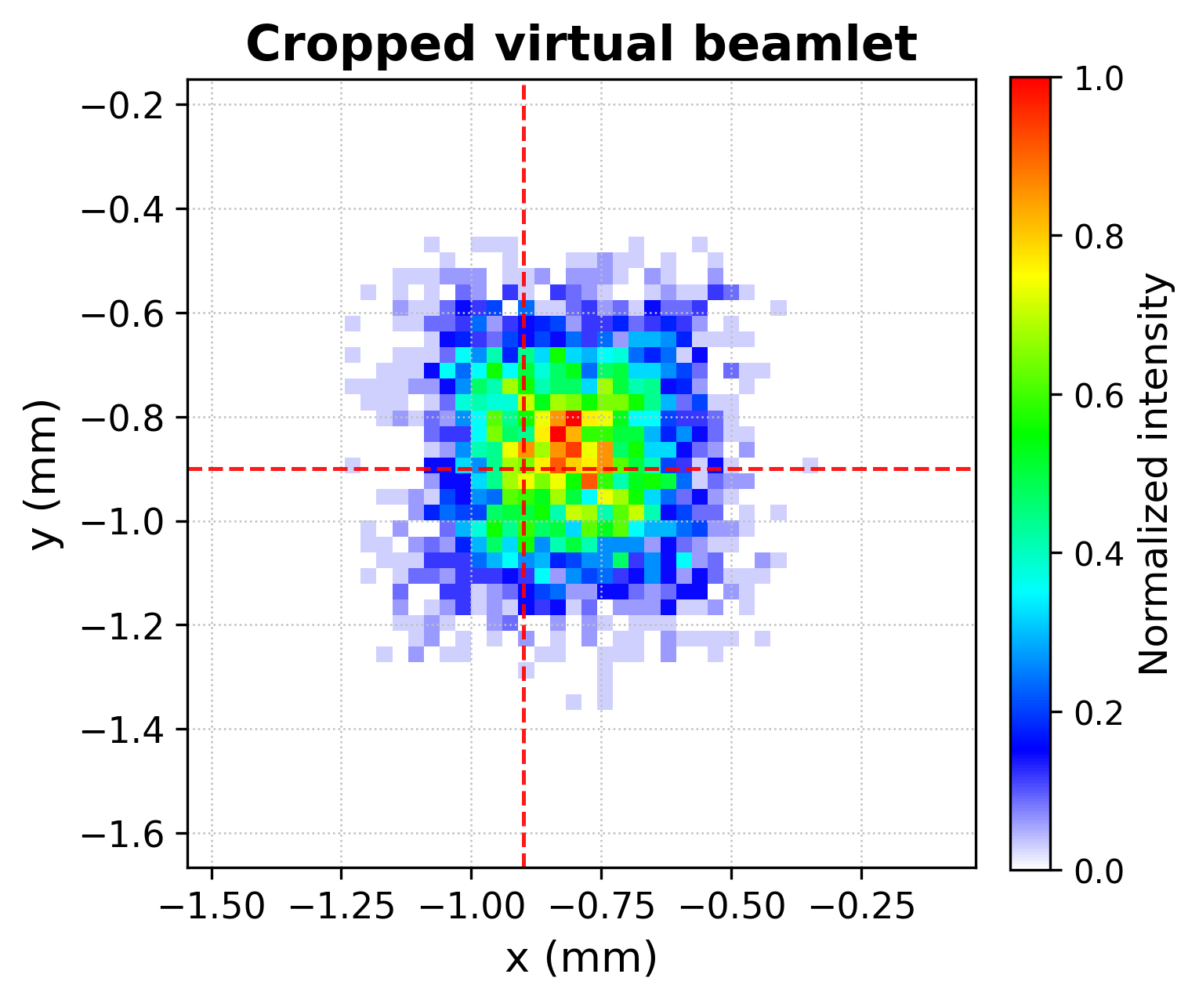
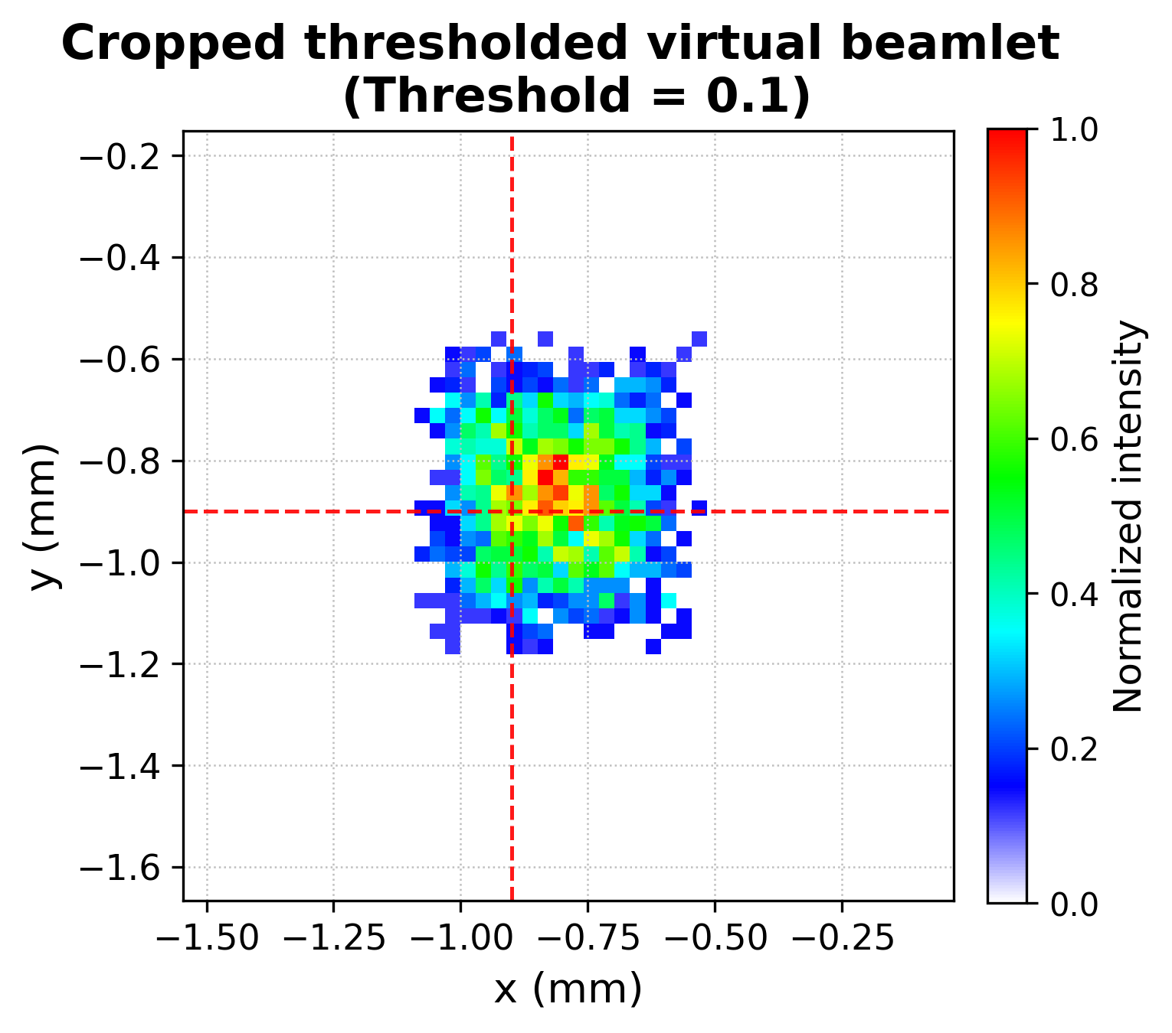
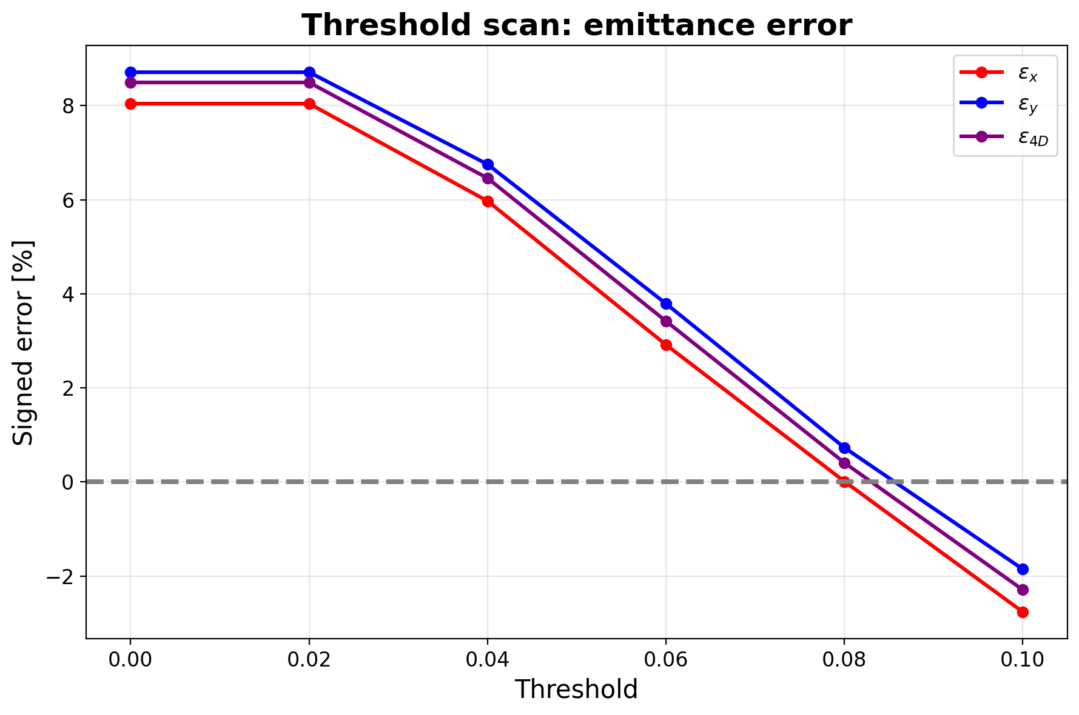
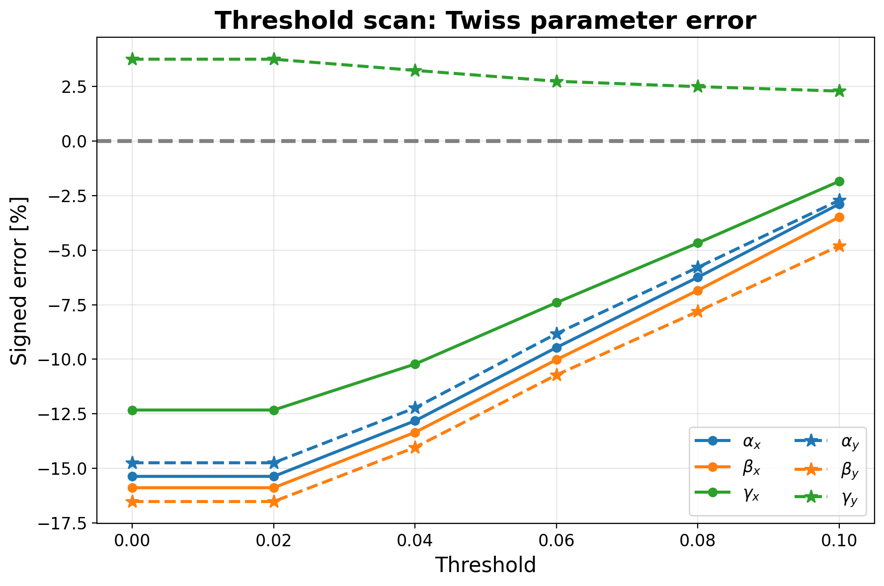


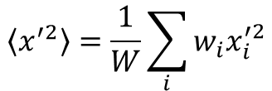
Individual Virtual Beamlet Threshold
Divergence contribution to the angular variance
$$\left\langle x^{′2}\right\rangle =\frac{1}{W}\sum_{i}{w_{i}x_{i}^{′2}}$$
Individual Virtual Beamlet Threshold
$$T_{ij}=r∙max⁡(H_{ij}^{Beamlet})$$
Threshold scan
$$H_{ij,p}^{thr}=0, if H_{ij,p}^{Beamlet}<T_{ij}$$
*Threshold = r

Slide 9
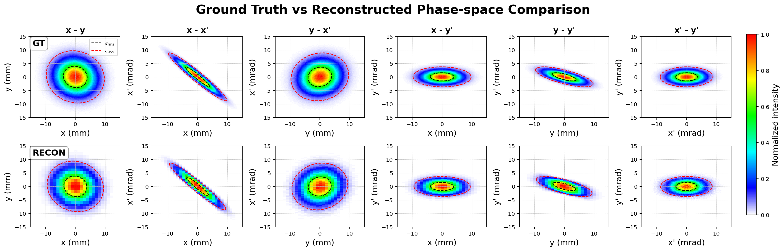
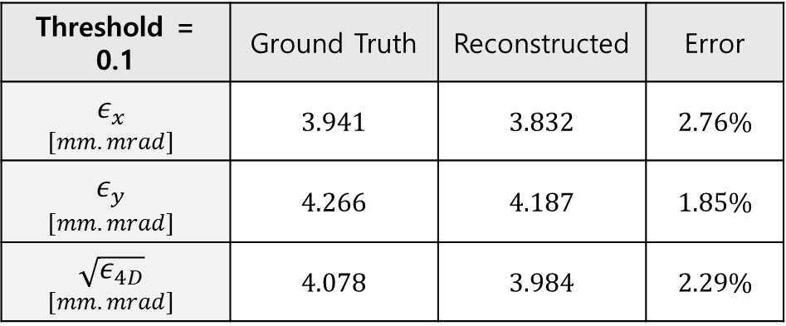
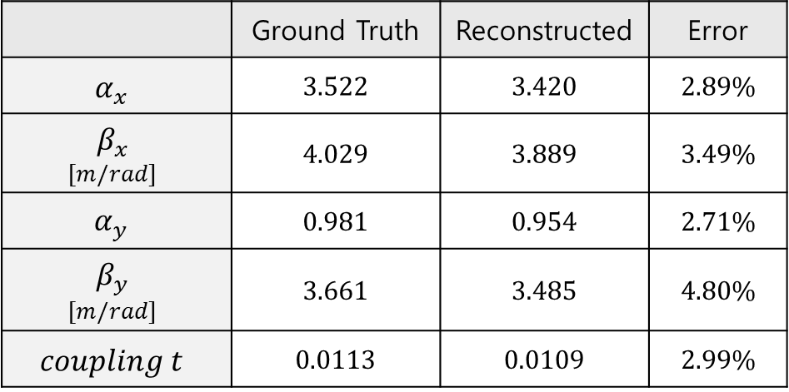
Simulation Results – Matrix1:
Input beam matrix from experimental VPP reconstruction at the slit position
(KOMAC BTS, QM3 = 15 A)
 | Ground Truth | Reconstructed | Error
$$α_{x}$$ | 3.522 | 3.420 | 2.89%
$$β_{x}$$ $$[m/rad]$$ | 4.029 | 3.889 | 3.49%
$$α_{y}$$ | 0.981 | 0.954 | 2.71%
$$β_{y}$$ $$[m/rad]$$ | 3.661 | 3.485 | 4.80%
$$coupling t$$ | 0.0113 | 0.0109 | 2.99%
Threshold = 0.1 | Ground Truth | Reconstructed | Error
$$ε_{x}$$ $$[mm.mrad]$$ | 3.941 | 3.832 | 2.76%
$$ε_{y}$$ $$[mm.mrad]$$ | 4.266 | 4.187 | 1.85%
$$\sqrt{ε_{4D}}$$ $$[mm.mrad]$$ | 4.078 | 3.984 | 2.29%

Slide 10
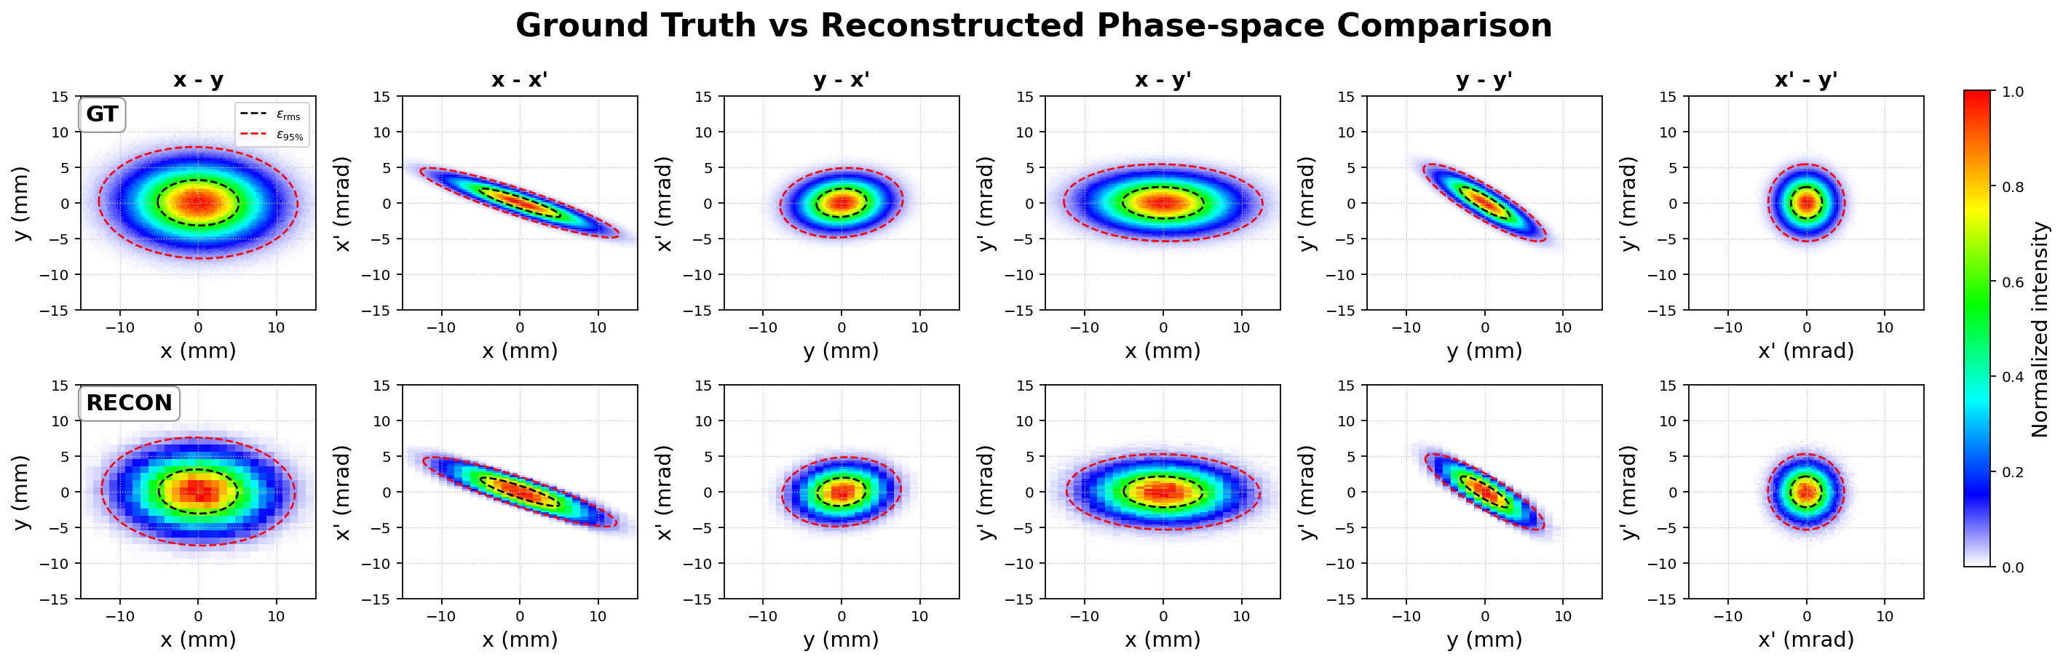
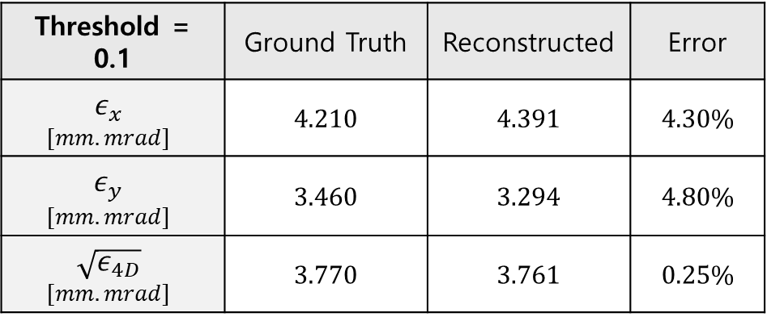
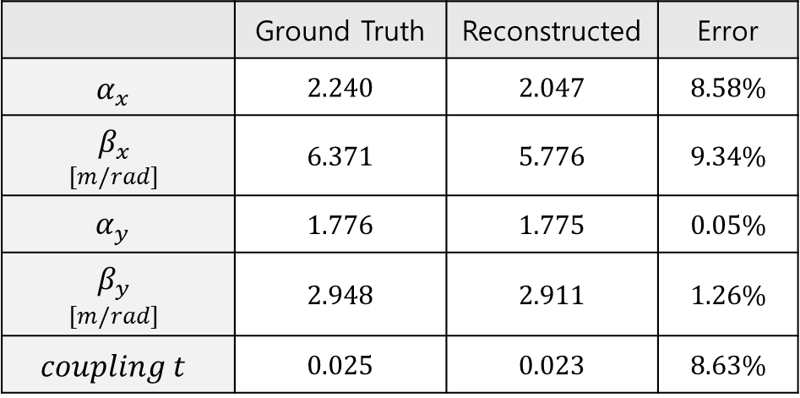
Simulation Results – Matrix2:
Input beam matrix from experimental VPP reconstruction at the slit position
(KOMAC BTS, QM3 = 20 A)
 | Ground Truth | Reconstructed | Error
$$α_{x}$$ | 2.240 | 2.047 | 8.58%
$$β_{x}$$ $$[m/rad]$$ | 6.371 | 5.776 | 9.34%
$$α_{y}$$ | 1.776 | 1.775 | 0.05%
$$β_{y}$$ $$[m/rad]$$ | 2.948 | 2.911 | 1.26%
$$coupling t$$ | 0.025 | 0.023 | 8.63%
Threshold = 0.1 | Ground Truth | Reconstructed | Error
$$ε_{x}$$ $$[mm.mrad]$$ | 4.210 | 4.391 | 4.30%
$$ε_{y}$$ $$[mm.mrad]$$ | 3.460 | 3.294 | 4.80%
$$\sqrt{ε_{4D}}$$ $$[mm.mrad]$$ | 3.770 | 3.761 | 0.25%

Slide 11
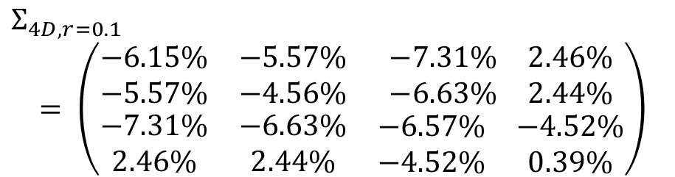
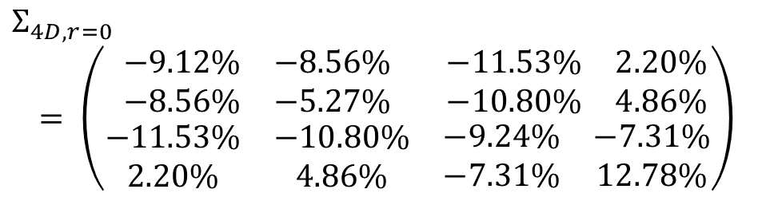
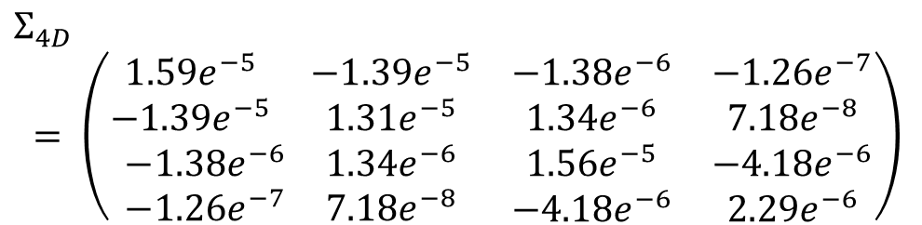
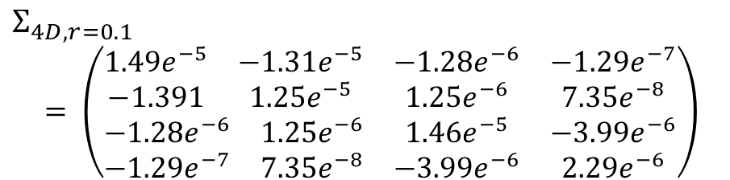
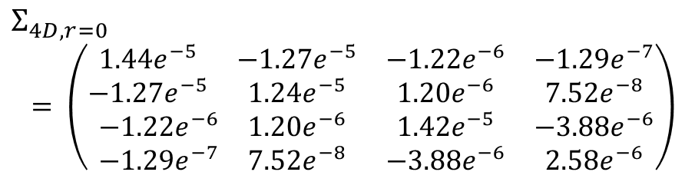
Appendix A. Threshold
Input Beam Matrix1
$$Σ_{4D}$$
$$= \left(\begin{matrix}\begin{matrix}1.59e^{−5} & −1.39e^{−5} \\ −1.39e^{−5} & 1.31e^{−5}\end{matrix} & \begin{matrix}−1.38e^{−6} & −1.26e^{−7} \\ 1.34e^{−6} & 7.18e^{−8}\end{matrix} \\ \begin{matrix}−1.38e^{−6} & 1.34e^{−6} \\ −1.26e^{−7} & 7.18e^{−8}\end{matrix} & \begin{matrix}1.56e^{−5} & −4.18e^{−6} \\ −4.18e^{−6} & 2.29e^{−6}\end{matrix}\end{matrix}\right)$$
Before threshold
After threshold
$$Σ_{4D, r=0}$$
$$= \left(\begin{matrix}\begin{matrix}1.44e^{−5} & −1.27e^{−5} \\ −1.27e^{−5} & 1.24e^{−5}\end{matrix} & \begin{matrix}−1.22e^{−6} & −1.29e^{−7} \\ 1.20e^{−6} & 7.52e^{−8}\end{matrix} \\ \begin{matrix}−1.22e^{−6} & 1.20e^{−6} \\ −1.29e^{−7} & 7.52e^{−8}\end{matrix} & \begin{matrix}1.42e^{−5} & −3.88e^{−6} \\ −3.88e^{−6} & 2.58e^{−6}\end{matrix}\end{matrix}\right)$$
$$Σ_{4D, r=0.1}$$
$$= \left(\begin{matrix}\begin{matrix}1.49e^{−5} & −1.31e^{−5} \\ −1.391 & 1.25e^{−5}\end{matrix} & \begin{matrix}−1.28e^{−6} & −1.29e^{−7} \\ 1.25e^{−6} & 7.35e^{−8}\end{matrix} \\ \begin{matrix}−1.28e^{−6} & 1.25e^{−6} \\ −1.29e^{−7} & 7.35e^{−8}\end{matrix} & \begin{matrix}1.46e^{−5} & −3.99e^{−6} \\ −3.99e^{−6} & 2.29e^{−6}\end{matrix}\end{matrix}\right)$$
$$Σ_{4D, r=0}$$
$$= \left(\begin{matrix}\begin{matrix}−9.12\% & −8.56\% \\ −8.56\% & −5.27\%\end{matrix} & \begin{matrix}−11.53\% & 2.20\% \\ −10.80\% & 4.86\%\end{matrix} \\ \begin{matrix}−11.53\% & −10.80\% \\ 2.20\% & 4.86\%\end{matrix} & \begin{matrix}−9.24\% & −7.31\% \\ −7.31\% & 12.78\%\end{matrix}\end{matrix}\right)$$
$$Σ_{4D, r=0.1}$$
$$= \left(\begin{matrix}\begin{matrix}−6.15\% & −5.57\% \\ −5.57\% & −4.56\%\end{matrix} & \begin{matrix}−7.31\% & 2.46\% \\ −6.63\% & 2.44\%\end{matrix} \\ \begin{matrix}−7.31\% & −6.63\% \\ 2.46\% & 2.44\%\end{matrix} & \begin{matrix}−6.57\% & −4.52\% \\ −4.52\% & 0.39\%\end{matrix}\end{matrix}\right)$$

