Slide 1
2026-06-25, ZOOM
26.06.25
-updates
DAON LEE
2026 The Beam Diagnostics and Tomography Study

Slide 2
Outline
Ⅰ. Introduction
- Additional diagonal scan set-up
Ⅱ. Reconstruction with Additional Diagonal Scan(ADS)
- Comparison of different angle scans
Ⅲ. Conclusion
Ⅵ. Questions

Slide 3


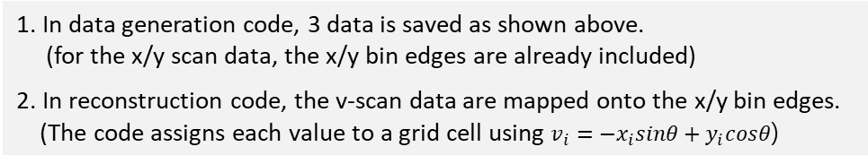














Additional Diagonal Scan Set-up
In X-suite
$$=$$
• Additional Diagonal Scan
$$y$$
For transformation,
(x$scan$)
$\left(\begin{matrix}u_{i} \\ v_{i}\end{matrix}\right)=\left(\begin{matrix}cosθ & sinθ \\ −sinθ & cosθ\end{matrix}\right)\left(\begin{matrix}x_{i} \\ y_{i}\end{matrix}\right)$.
$$ρ(x_{i},x_{f}y_{f})$$
$$u$$
$$v$$
(u$scan$)
(v$scan$)
$$ρ(u_{i},x_{f}y_{f})$$
$$ρ(v_{i},x_{f}y_{f})$$
In 44deg. additional scan, we obtain 3 data.
44deg
$$ρ(x_{i},x_{f}y_{f})$$
$$ρ(y_{i},x_{f}y_{f})$$
$$ρ(v_{i},x_{f}y_{f})$$
$$v_{i}=−x_{i}sinθ+y_{i}cosθ$$
The key point is how we assign the bins for the v-scan. So, in my code,
$$x$$
($y scan$)
$$ρ(y_{i},x_{f}y_{f})$$
1. In data generation code, 3 data is saved as shown above.
(for the x/y scan data, the x/y bin edges are already included)
2. In reconstruction code, the v-scan data are mapped onto the x/y bin edges.
(The code assigns each value to a grid cell using $v_{i}=−x_{i}sinθ+y_{i}cosθ$)
3

Slide 4
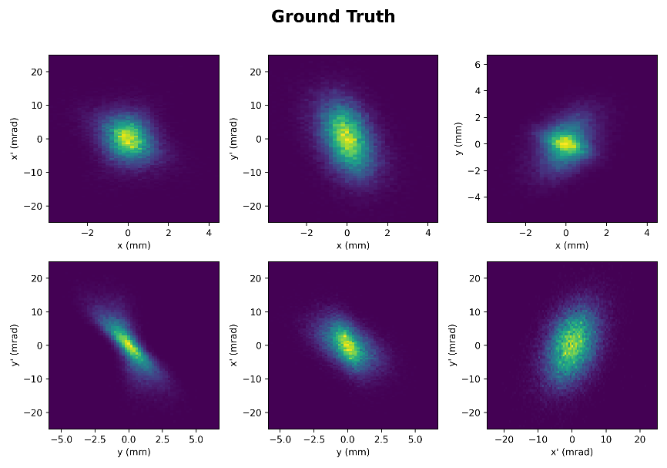
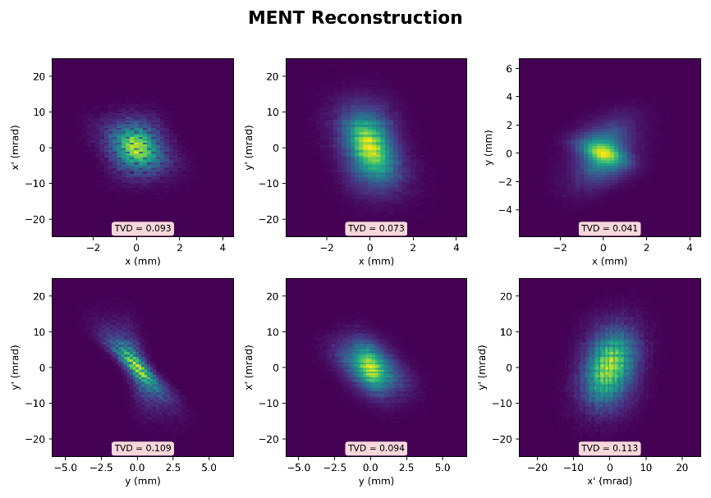
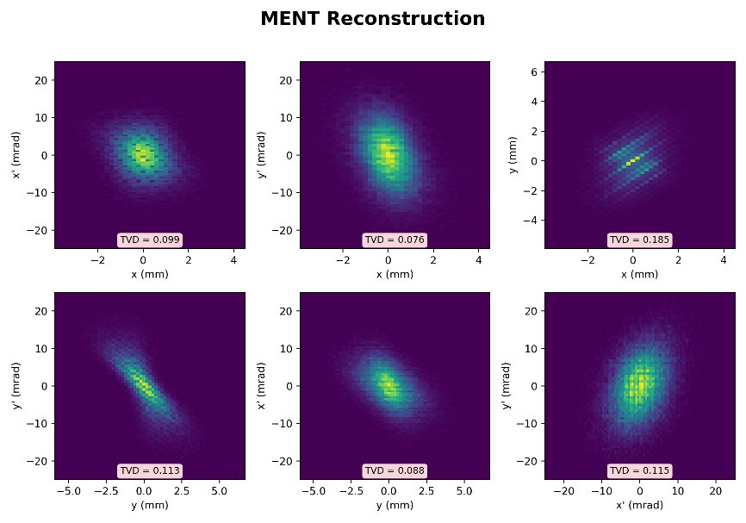



Additional Diagonal Scan
Macroparticles : 50,000 / Total particles : 100M (t=0.25)
$$K=$$
• VPP Original Scan(analytic)
$$ε_{x} error :1.43\%$$
$$ε_{y} error :2.60\%$$
$$ε_{4D} error :9.82\%$$
0.109
0.113
• Additional Diagonal Scan
(50iter)
0.185
$$ε_{x} error :4.17\%$$
$$ε_{y} error :4.12\%$$
$$ε_{4D} error :5.60\%$$
45deg
0.113
0.115
4

Slide 5
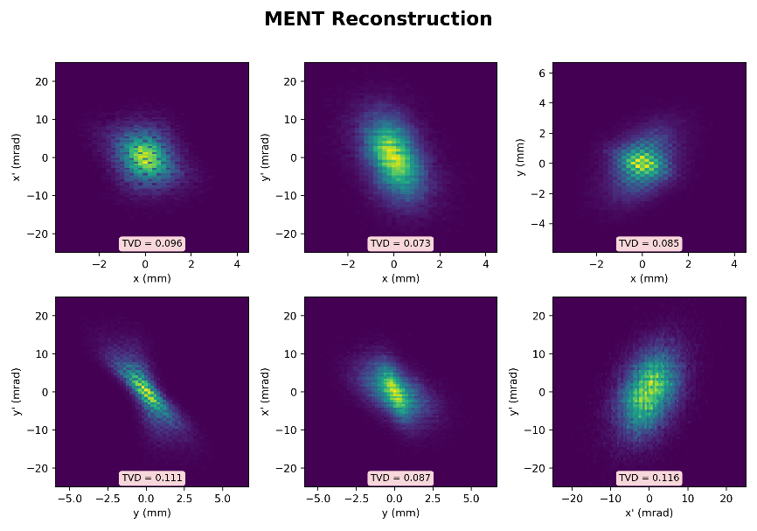



Additional Diagonal Scan
Macroparticles : 50,000 / Total particles : 100M (t=0.25)
$$K=$$
• Additional Diagonal Scan
(50iter)
$$ε_{x} error :1.23\%$$
$$ε_{y} error :2.10\%$$
$$ε_{4D} error :3.42\%$$
44deg
0.111
0.116
• Additional Diagonal Scan
(50iter)
$$ε_{x} error :1.51\%$$
$$ε_{y} error :1.80\%$$
$$ε_{4D} error :1.86\%$$
42deg
0.112
0.116
5

Slide 6


Additional Diagonal Scan
Macroparticles : 50,000 / Total particles : 100M (t=0.25)
$$K=$$
• Additional Diagonal Scan
(50iter)
60deg
$$ε_{x} error :2.58\%$$
$$ε_{y} error :2.72\%$$
$$ε_{4D} error :3.89\%$$
30deg
0.112
0.116
6

Slide 7
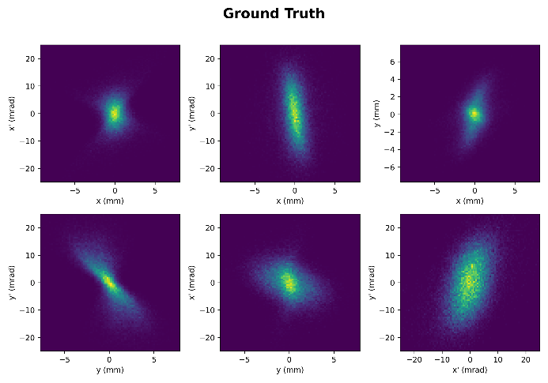
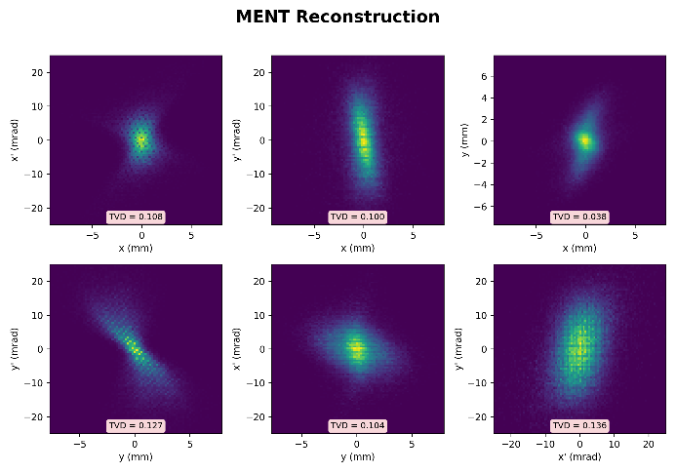
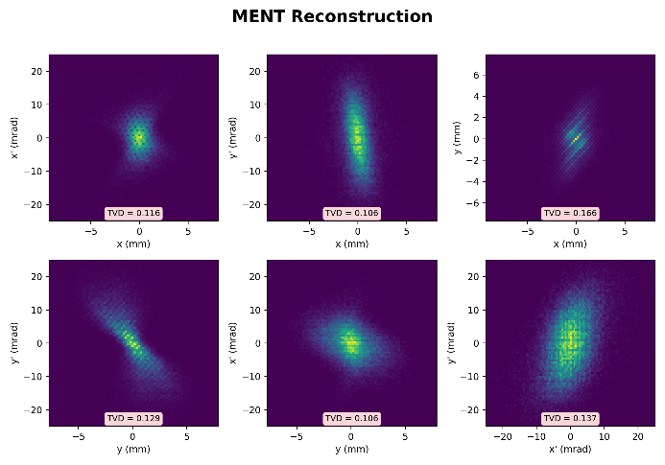
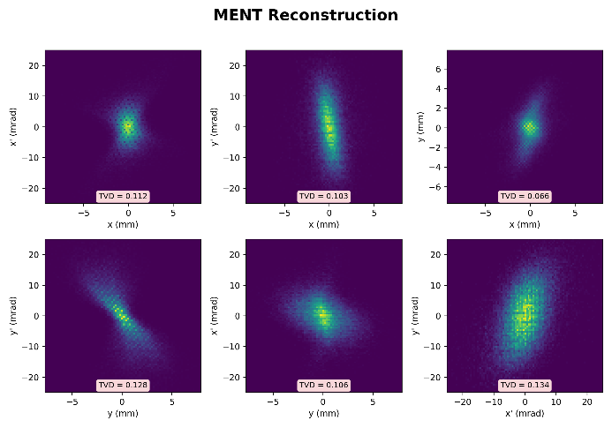



Additional Diagonal Scan
Macroparticles : 50,000 / Total particles : 300M (t=0.25)
$$K=$$
• Original Scan
• Additional Diagonal Scan(45 degree)(10iter)
• Additional Diagonal Scan(42 degree)(10iter)
0.116
0.166
0.112
0.127
0.136
0.127
0.137
0.128
0.134
$$ε_{x} error :2.68\%$$
$$ε_{y} error :4.93\%$$
$$ε_{4D} error :14.86\%$$
$$ε_{x} error :4.73\%$$
$$ε_{y} error :1.82\%$$
$$ε_{4D} error :5.07\%$$
$$ε_{x} error :2.69\%$$
$$ε_{y} error :0.15\%$$
$$ε_{4D} error :2.02\%$$
7

Slide 8
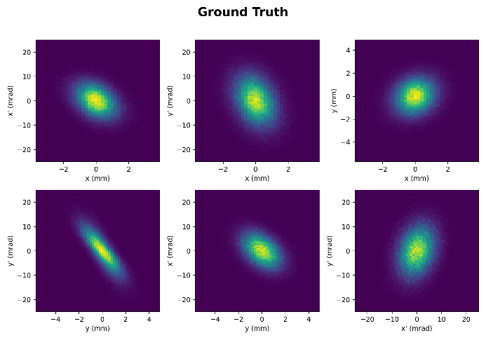
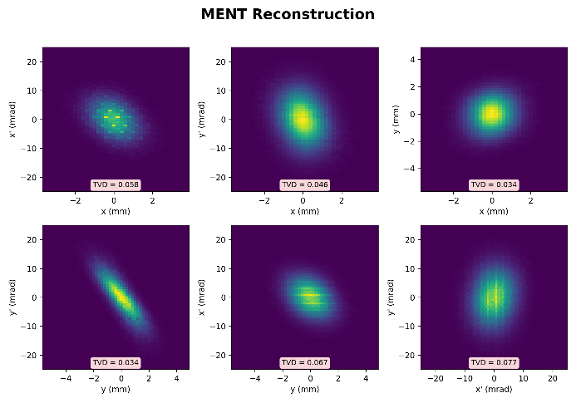
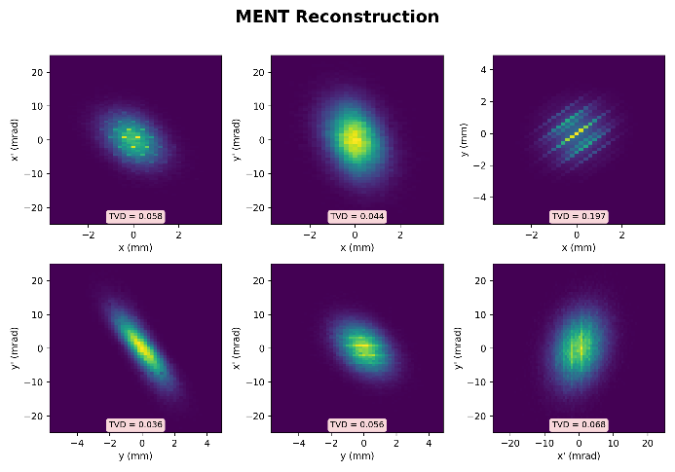

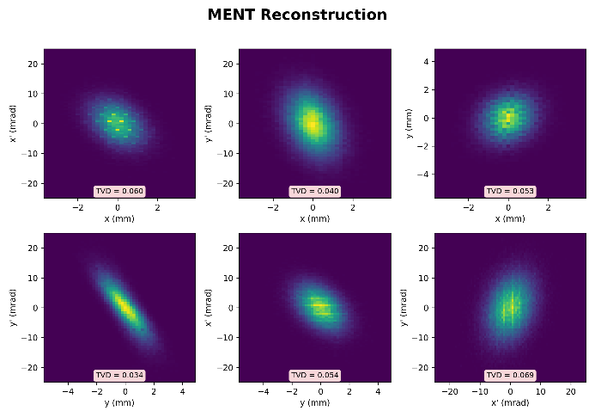




Additional Diagonal Scan
Macroparticles : 100,000 / Total particles : 30M (t=0.24)
$$K=$$
• Original Scan
• ADS(45 degree)(50iter)
• ADS(42 degree)(50iter)
• ADS(30,60 degree)(50iter)
0.197
$$ε_{x} error :0.76\%$$
$$ε_{y} error :0.83\%$$
$$ε_{4D} error :4.26\%$$
$$ε_{x} error :2.25\%$$
$$ε_{y} error :2.30\%$$
$$ε_{4D} error :2.91\%$$
$$ε_{x} error :0.82\%$$
$$ε_{y} error :1.08\%$$
$$ε_{4D} error :0.96\%$$
$$ε_{x} error :0.07\%$$
$$ε_{y} error :0.54\%$$
$$ε_{4D} error :0.06\%$$
8

Slide 9
Conclusion
• When we performed an additional 45 deg. scan, the x-y plane showed a large TVD.
(and we need to optimize scan angle)
• We need appropriate TVD threshold or another comparison methods.

Slide 10




Questions
1. About Liwen’s case,
2. About Binghui’s method,
How does she optimize the appropriate scan angle?
+3. Wang’s e-mail : I am studying Wang’s results and my results
(Briefly)
In my case, ${\tilde{ρ}}_{3D}\left(x_{i},x_{f},y_{f}\right)=\frac{H[i,f_{x},f_{y}]}{∆x_{i}∆x_{f}(f_{x})∆y_{f}(f_{y})}$

Slide 11



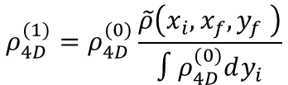






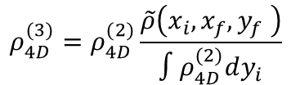
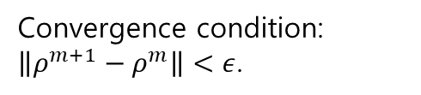
The MENT Method in Code
Gauss-Seidel iterative method
$$ρ_{1},ρ_{2}⋯=constraints$$
$$M=∫ρ dx_{1/2} : marginal$$
$$ρ^{(0)}=gaussian distribution$$
$$Gauss−Seidel.$$
$$if we have two constraints[\tilde{ρ}\left(x_{i},x_{f},y_{f} \right), \tilde{ρ}(y_{i},x_{f},y_{f})]$$
$R= \frac{\tilde{ρ}\left(x_{i},x_{f},y_{f} \right)}{∫ρ_{4D}^{(0)}dy_{i}}$
$$ρ_{4D}^{(1)}=ρ_{4D}^{(0)}\frac{\tilde{ρ}\left(x_{i},x_{f},y_{f} \right)}{∫ρ_{4D}^{(0)}dy_{i}}$$
$$ρ_{4D}^{(3)}=ρ_{4D}^{(2)}\frac{\tilde{ρ}\left(x_{i},x_{f},y_{f} \right)}{∫ρ_{4D}^{(2)}dy_{i}}$$
$$⟹$$
$$⋯$$
Convergence condition:
$\left\|ρ^{m+1}−ρ^{m}\right\|<ε$.
$$ρ_{4D}^{(2)}=ρ_{4D}^{(1)}\frac{\tilde{ρ}(y_{i},x_{f},y_{f})}{∫ρ_{4D}^{(1)}dx_{i}}$$
$$ρ_{4D}^{(4)}=ρ_{4D}^{(3)}\frac{\tilde{ρ}(y_{i},x_{f},y_{f})}{∫ρ_{4D}^{(3)}dx_{i}}$$
11

