Slide 1
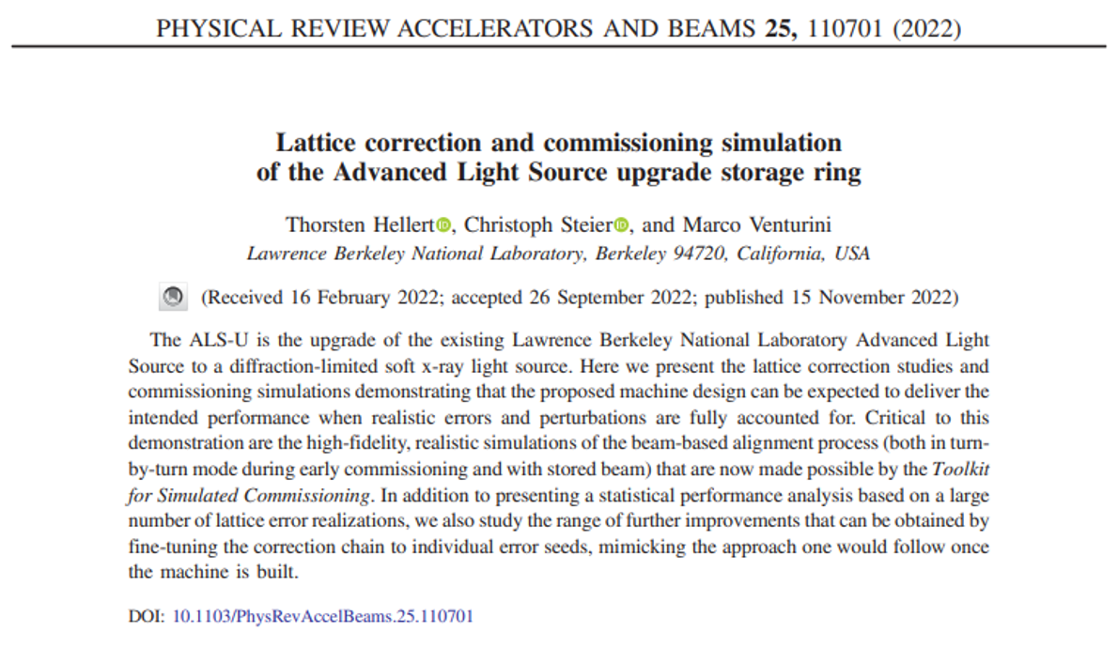
Lattice correction and commissioning simulation of the Advanced Light Source upgrade storage ring
2026-06-19, Pohang, South Korea
Young Min Park
^{53rd JKPS Meeting}
Division of Advanced Nuclear Engineering (DANE), POSTECH

Slide 2
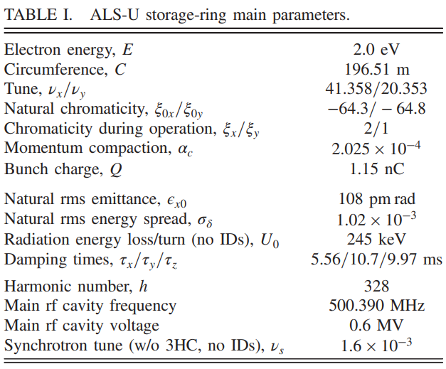
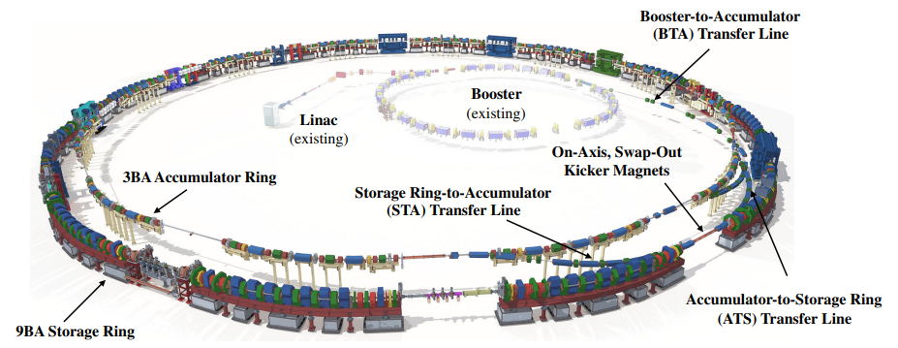
Introduction
ALS-U
Major items:
2 GeV, high-brightness storage ring fed by a new full-energy accumulator ring and transfer lines in the existing ALS storage ring tunnel.
However, strong sextupole and quadrupole magnets make the ALS-U storage ring highly sensitive to lattice errors.
Also, low beam energy (2 GeV) also increases the impact of insertion device perturbations
Paper goals:
Demonstrate realistic lattice error correction and commissioning strategies that can
recover the required beam quality, aperture, and lifetime of the ALS-U storage ring.
2

Slide 3
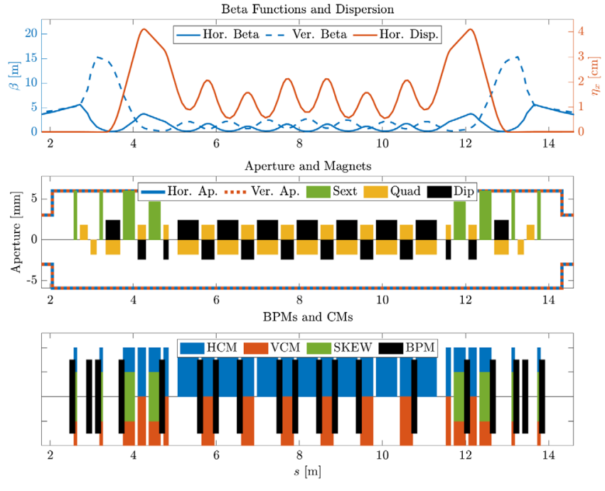
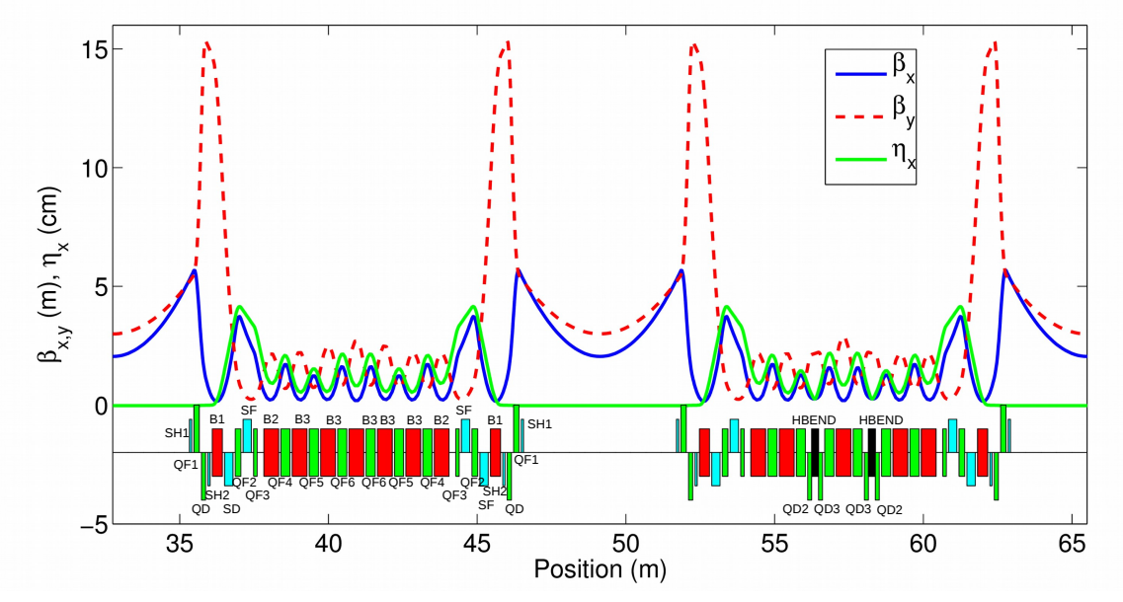
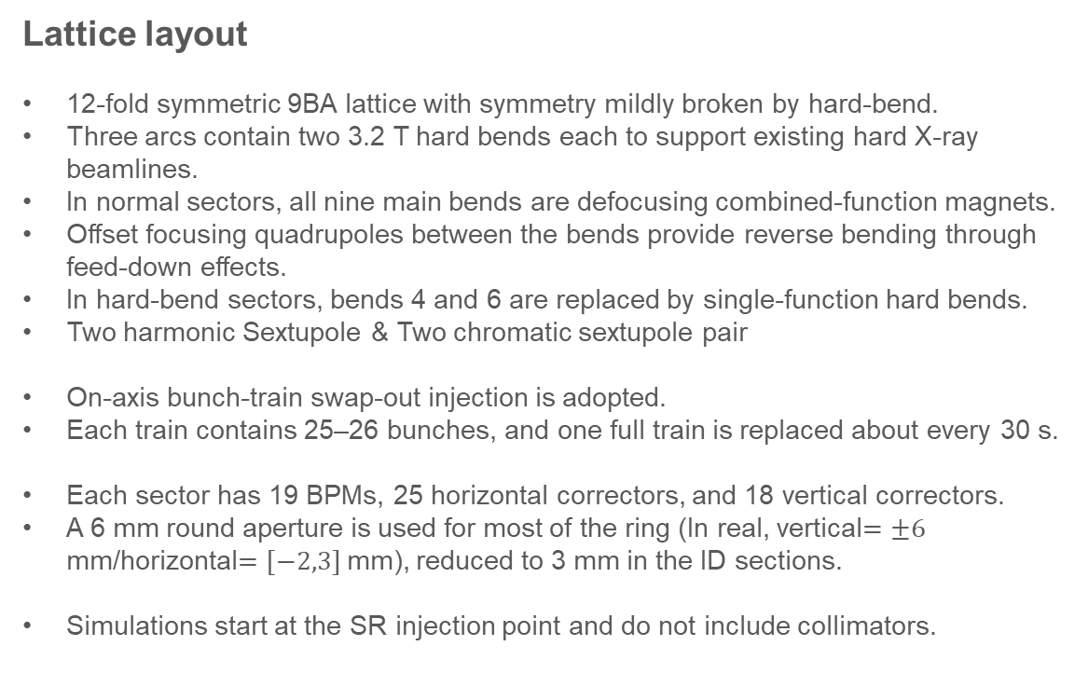
Lattice layout
Lattice layout
12-fold symmetric 9BA lattice with symmetry mildly broken by hard-bend.
Three arcs contain two 3.2 T hard bends each to support existing hard X-ray beamlines.
In normal sectors, all nine main bends are defocusing combined-function magnets.
Offset focusing quadrupoles between the bends provide reverse bending through feed-down effects.
In hard-bend sectors, bends 4 and 6 are replaced by single-function hard bends.
Two harmonic Sextupole & Two chromatic sextupole pair
On-axis bunch-train swap-out injection is adopted.
Each train contains 25–26 bunches, and one full train is replaced about every 30 s.
Each sector has 19 BPMs, 25 horizontal correctors, and 18 vertical correctors.
A 6 mm round aperture is used for most of the ring (In real, vertical$=±6$ mm/horizontal$=[−2,3]$ mm), reduced to 3 mm in the ID sections.
Simulations start at the SR injection point and do not include collimators.
3

Slide 4
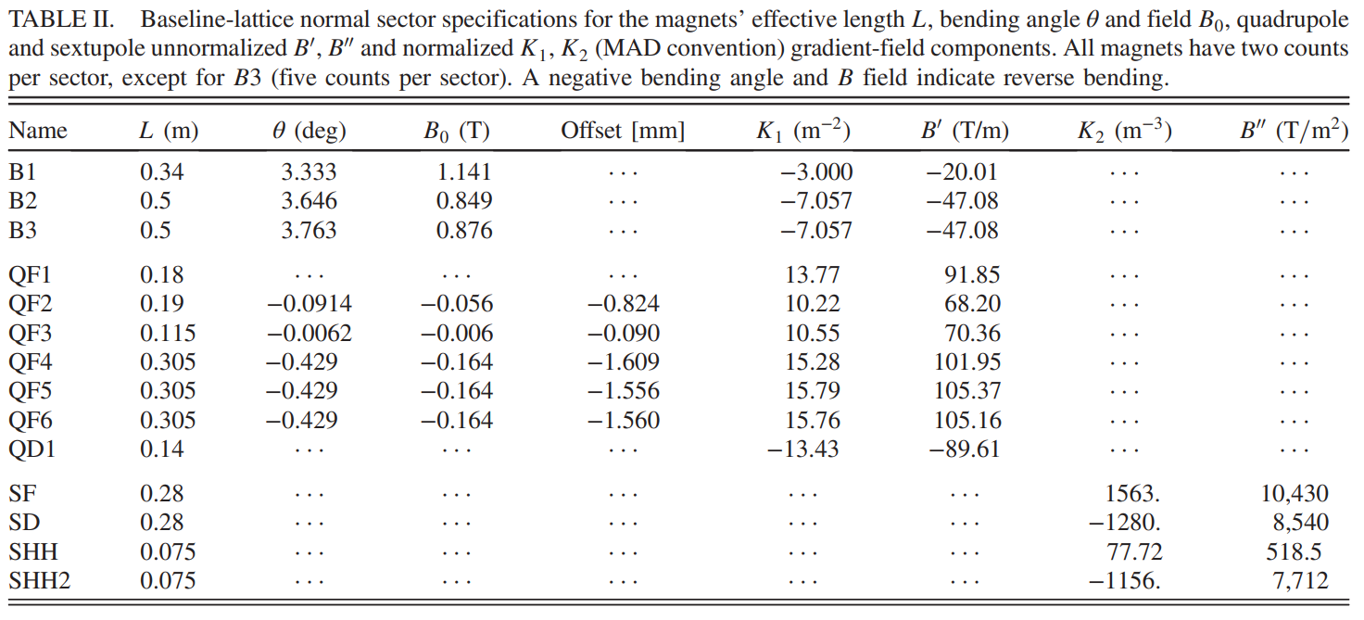
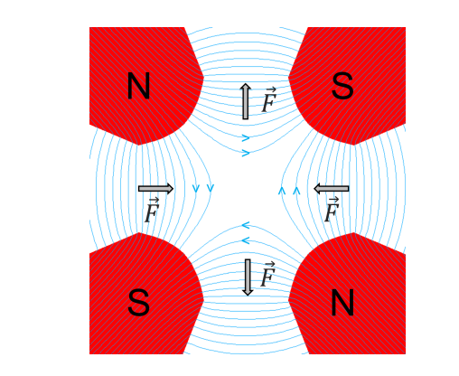
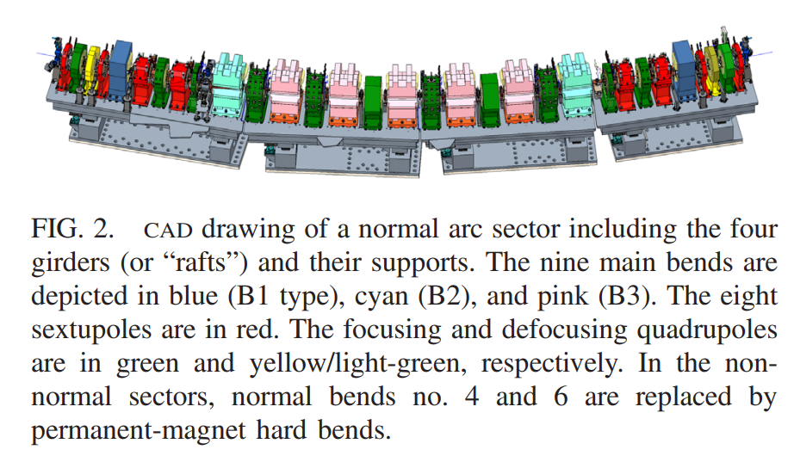
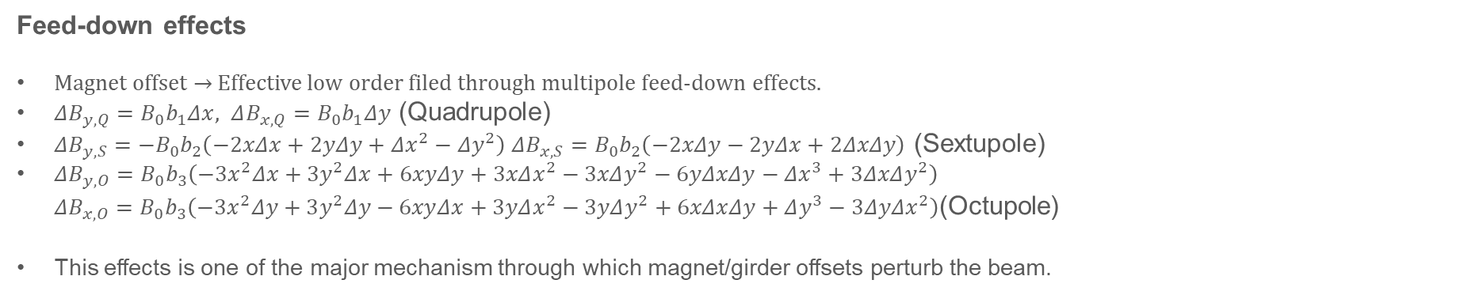
Lattice layout
Quadrupole feed-down effects
Offset
Feed-down effects
Magnet offset $→$ Effective low order filed through multipole feed-down effects.
$ΔB_{y,Q}=B_{0}b_{1}Δx, ΔB_{x,Q}=B_{0}b_{1}Δy$ (Quadrupole)
$ΔB_{y,S}=−B_{0}b_{2}\left(−2xΔx+2yΔy+Δx^{2}−Δy^{2}\right) ΔB_{x,S}=B_{0}b_{2}\left(−2xΔy−2yΔx+2ΔxΔy\right)$ (Sextupole)
$ΔB_{y,O}=B_{0}b_{3}\left(−3x^{2}Δx+3y^{2}Δx+6xyΔy+3xΔx^{2}−3xΔy^{2}−6yΔxΔy−Δx^{3}+3ΔxΔy^{2}\right)$
$ΔB_{x,O}=B_{0}b_{3}\left(−3x^{2}Δy+3y^{2}Δy−6xyΔx+3yΔx^{2}−3yΔy^{2}+6xΔxΔy+Δy^{3}−3ΔyΔx^{2}\right)$(Octupole)
This effects is one of the major mechanism through which magnet/girder offsets perturb the beam.
4

Slide 5
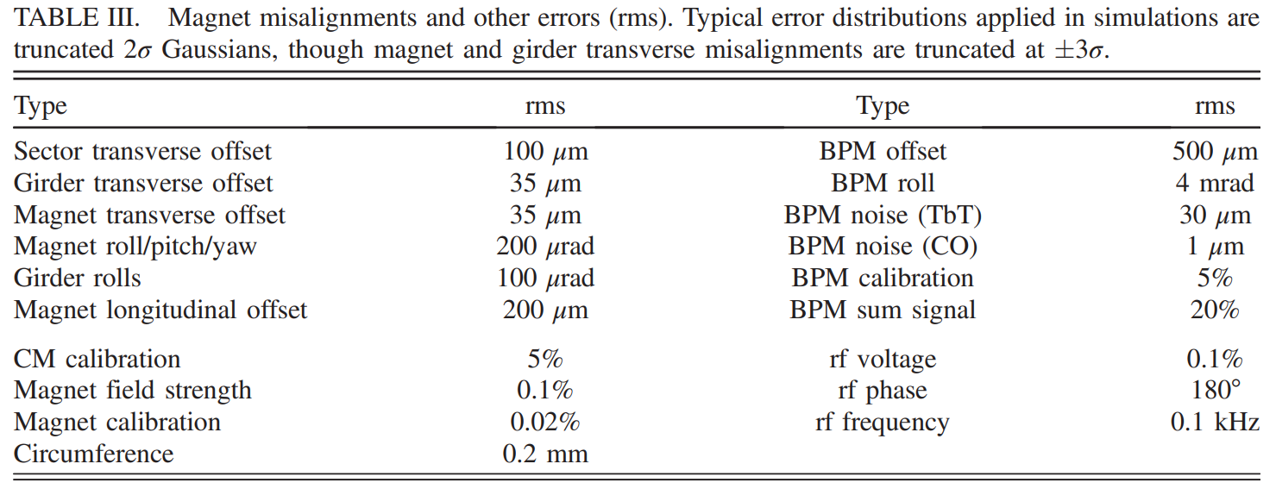
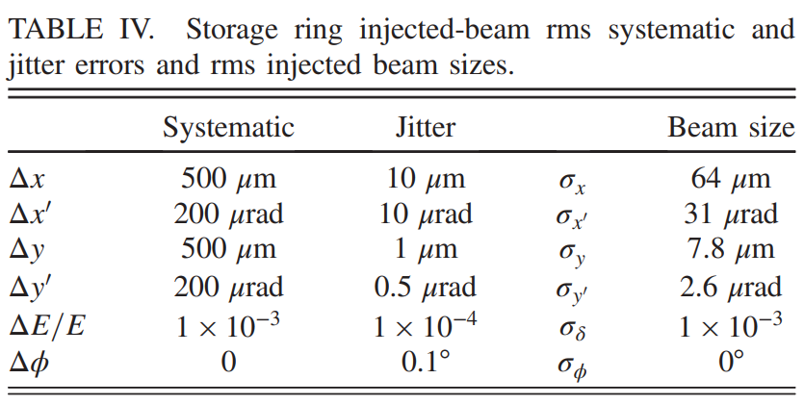
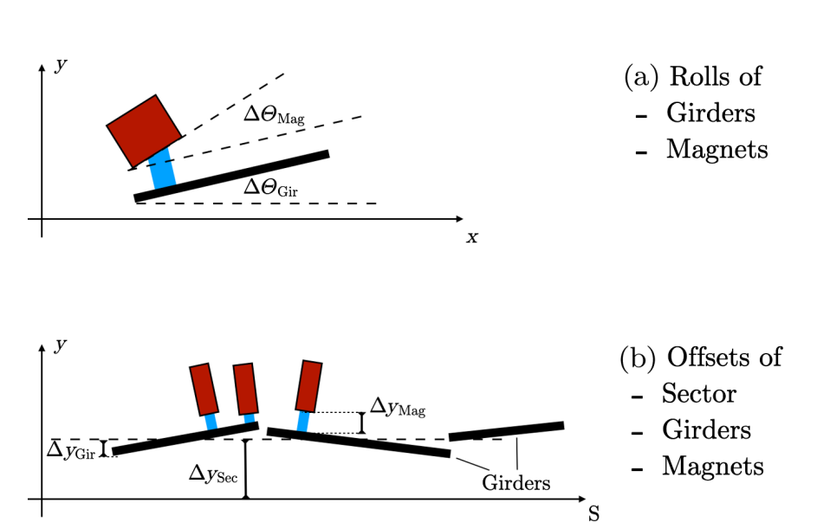
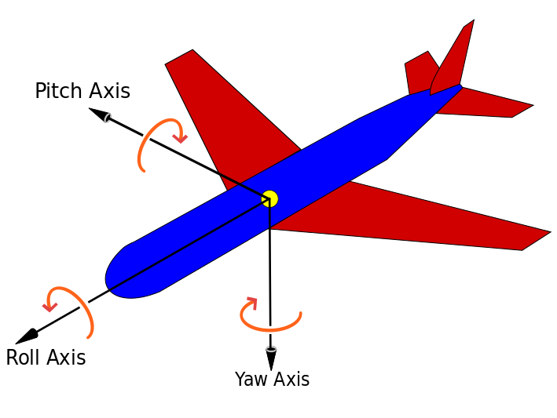
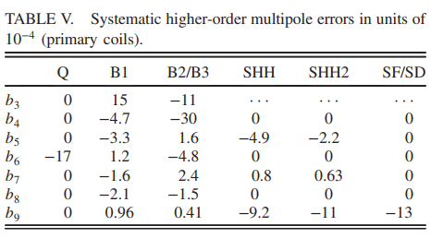
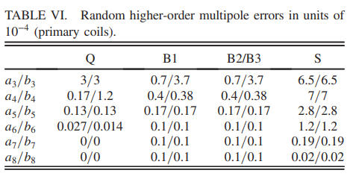
Lattice errors
Error sources
TbT: Single charge 0.4 nC (design value: 1.15 nC )
CO: Stored beam current 50 mA (design value: 500 mA)
: Transverse lattice errors
: Longitudinal lattice errors
: Diagnostics and correction system errors
Fixed error in one seed
Shot by shot jitter
Higher order multipole error
5

Slide 6
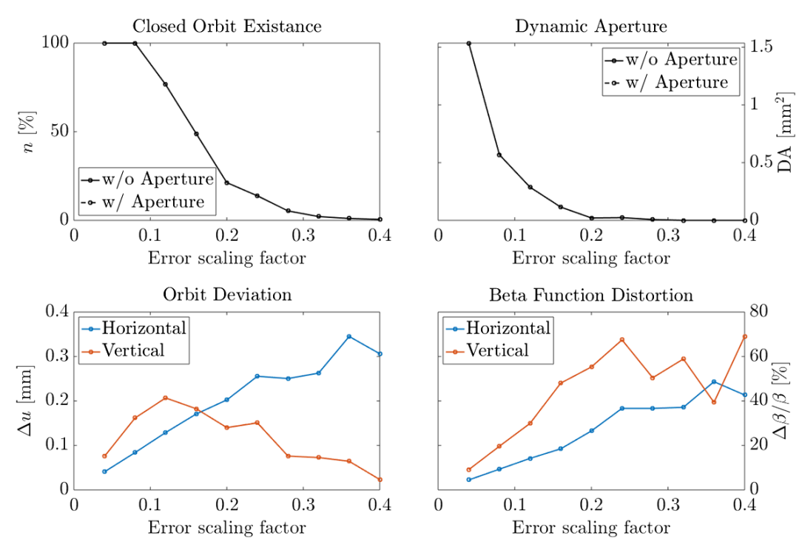
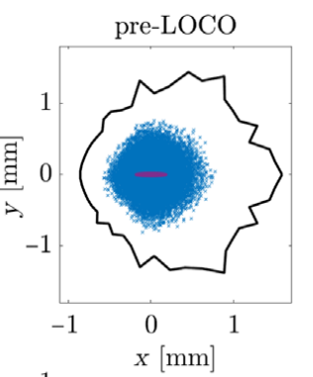
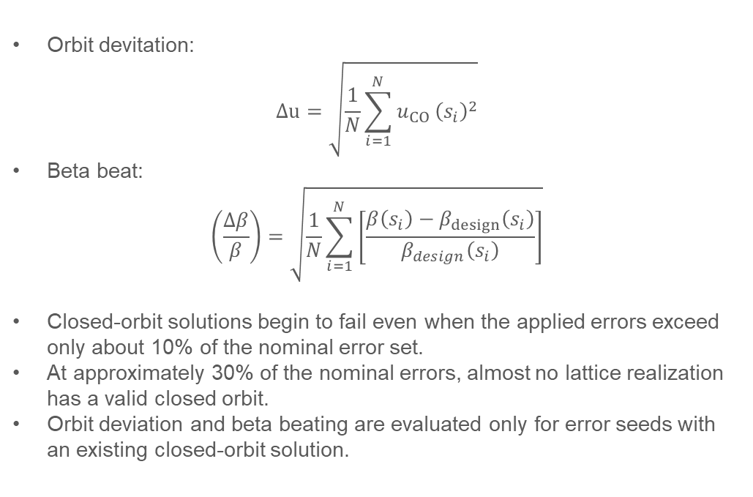
Uncorrected lattice performance
Lattice properties
Orbit devitation:
$$Δu=\sqrt{\frac{1}{N}\sum_{i=1}^{N}{u_{CO}}{\left(s_{i}\right)}^{2}}$$
Beta beat:
$$\left(\frac{Δβ}{β}\right)=\sqrt{\frac{1}{N}\sum_{i=1}^{N}{\left[\frac{β\left(s_{i}\right)−β_{design}\left(s_{i}\right)}{β_{design}\left(s_{i}\right)}\right]}}$$
Closed-orbit solutions begin to fail even when the applied errors exceed only about 10% of the nominal error set.
At approximately 30% of the nominal errors, almost no lattice realization has a valid closed orbit.
Orbit deviation and beta beating are evaluated only for error seeds with an existing closed-orbit solution.
Dynamic aperture
(Black: Original,
Dots: with errors,
Red: Injected beam)
6

Slide 7
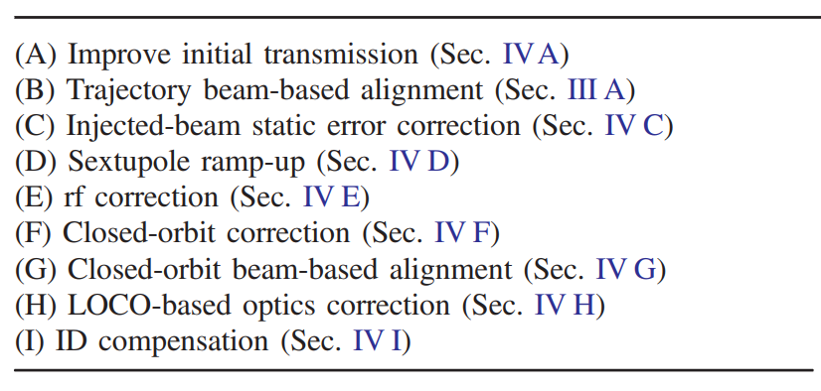
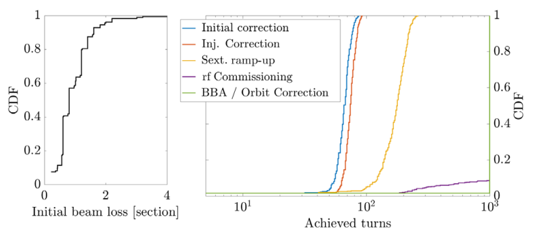
Correction chain
Simulation conditions
500 lattice error realizations
Gaussian-distributed errors with ±2σ truncation
Injected bunch represented by 200 macroparticles
6D Gaussian beam distribution with ±3σ truncation
Initial RF cavities and sextupoles switched off
Dynamic aperture evaluated by 4D on-momentum tracking
Tracking length: ~1000 turns
Synchrotron radiation included
Nominal setting for Touschek lifetime calculation
Bunch charge : 1.15 nC
Bunch length: 4× natural rms with harmonic cavities
In this simulation
Bunch charge : 0.3 nC
Bunch length: Nominal bunch length without harmonic cavities
Correction sequence
2 Iteration
3 Iteration
Day 1 of commissioning
Correction results
7

Slide 8
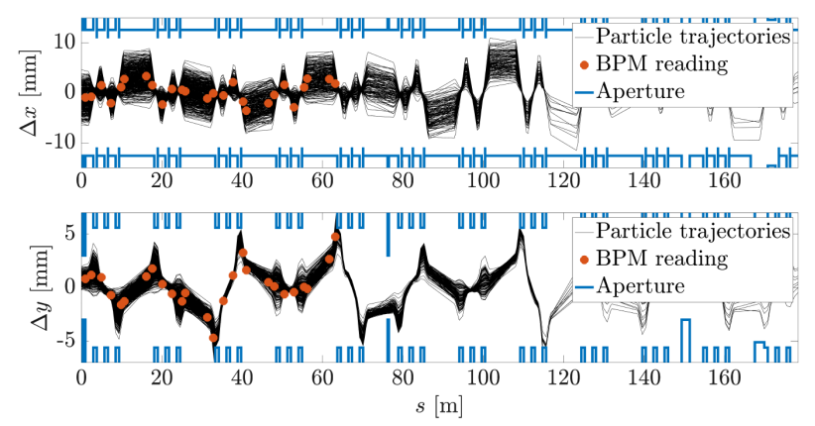
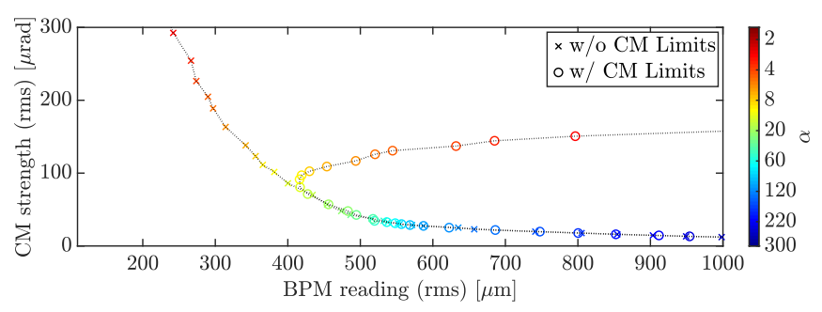
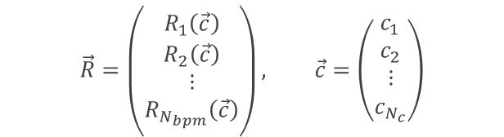
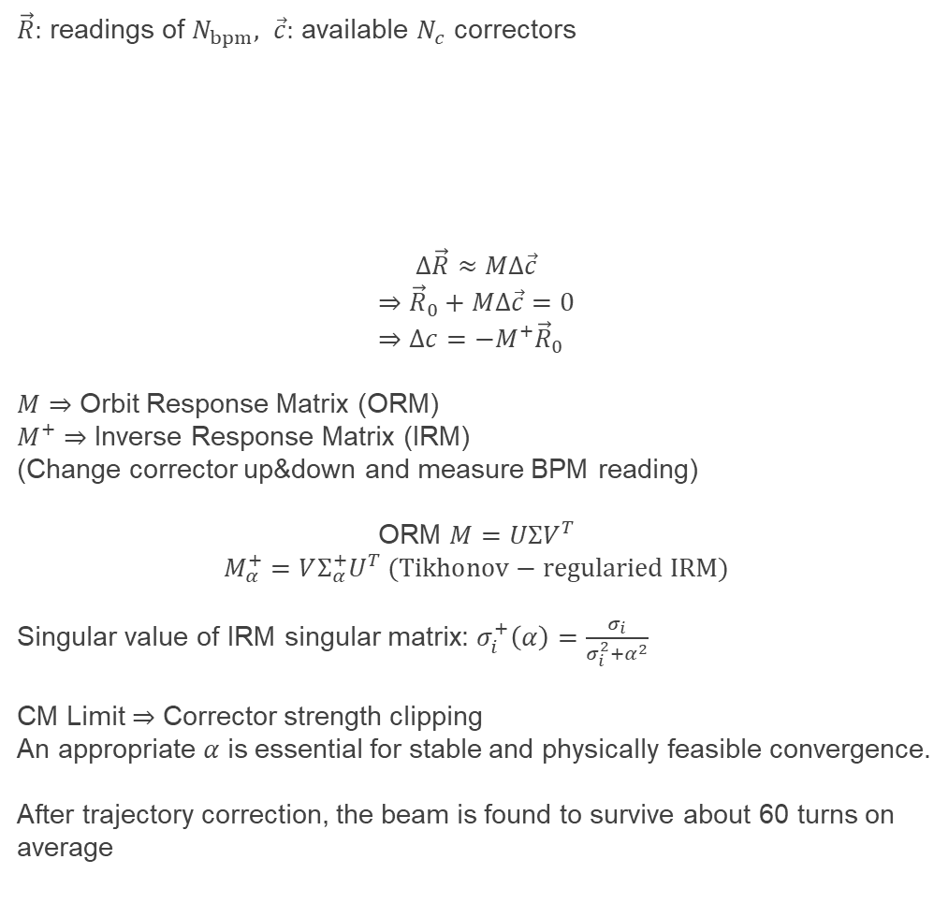
Initial transmission
Trajectory correction (ALS-U AR)
(Same as closed-orbit correction)
$\vec{R}:$ readings of $N_{bpm}, \vec{c}:$ available $N_{c}$ correctors
$$Δ\vec{R}≈MΔ\vec{c}$$
$$⇒{\vec{R}}_{0}+MΔ\vec{c}=0 \\ ⇒Δc=−M^{+}{\vec{R}}_{0}$$
$M⇒$ Orbit Response Matrix (ORM)
$M^{+}⇒$ Inverse Response Matrix (IRM)
(Change corrector up&down and measure BPM reading)
ORM $M=UΣV^{T}$
$$M_{α}^{+}=VΣ_{α}^{+}U^{T} (Tikhonov−regularied IRM)$$
Singular value of IRM singular matrix: $σ_{i}^{+}\left(α\right)=\frac{σ_{i}}{σ_{i}^{2}+α^{2}}$
CM Limit $⇒$ Corrector strength clipping
An appropriate $α$ is essential for stable and physically feasible convergence.
After trajectory correction, the beam is found to survive about 60 turns on average
$$\vec{R}=\left(\begin{matrix}R_{1}\left(\vec{c}\right) \\ R_{2}\left(\vec{c}\right) \\ ⋮ \\ R_{N_{bpm}}\left(\vec{c}\right)\end{matrix}\right), \vec{c}=\left(\begin{matrix}c_{1} \\ c_{2} \\ ⋮ \\ c_{N_{c}}\end{matrix}\right)$$
Vertical aperture hit
8

Slide 9
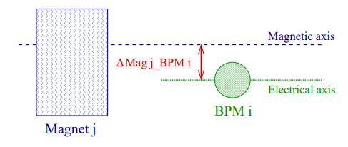
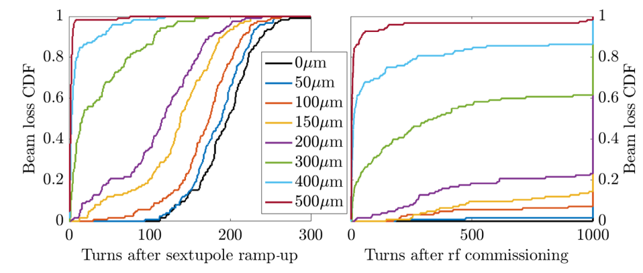
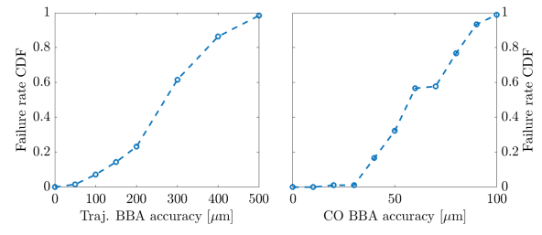
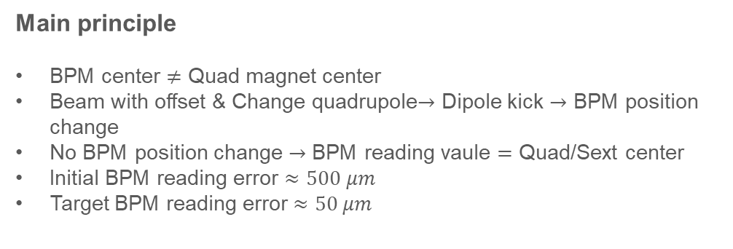
Trajectory BBA
Trajectory BBA
Main principle
BPM center $≠$ Quad magnet center
Beam with offset & Change quadrupole$→$ Dipole kick $→$ BPM position change
No BPM position change $→$ BPM reading vaule $=$ Quad/Sext center
Initial BPM reading error $≈500 μm$
Target BPM reading error $≈50 μm$
Effects of BBA
BPM reading error
9

Slide 10
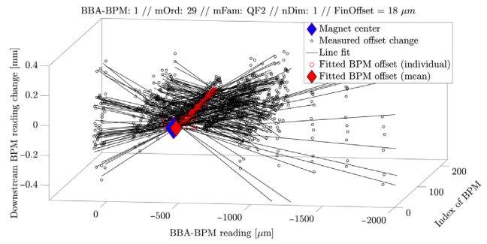
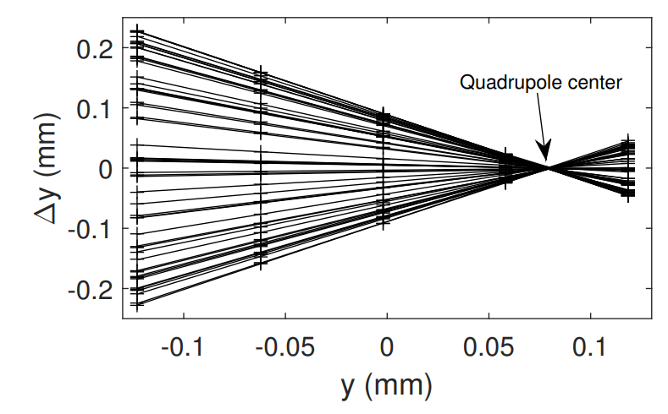
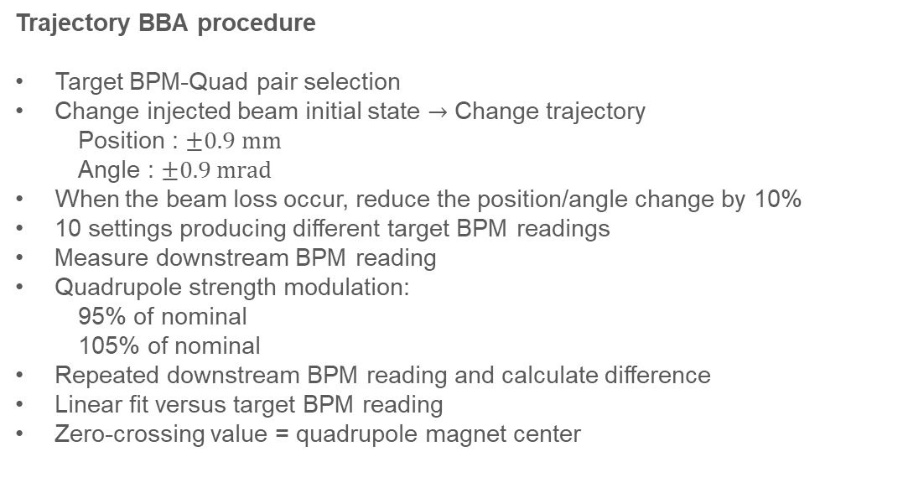
Trajectory BBA
Trajectory BBA
Trajectory BBA procedure
Target BPM-Quad pair selection
Change injected beam initial state $→$ Change trajectory
Position : $±0.9 mm$
Angle : $±0.9 mrad$
When the beam loss occur, reduce the position/angle change by 10%
10 settings producing different target BPM readings
Measure downstream BPM reading
Quadrupole strength modulation:
95% of nominal
105% of nominal
Repeated downstream BPM reading and calculate difference
Linear fit versus target BPM reading
Zero-crossing value = quadrupole magnet center
10

Slide 11
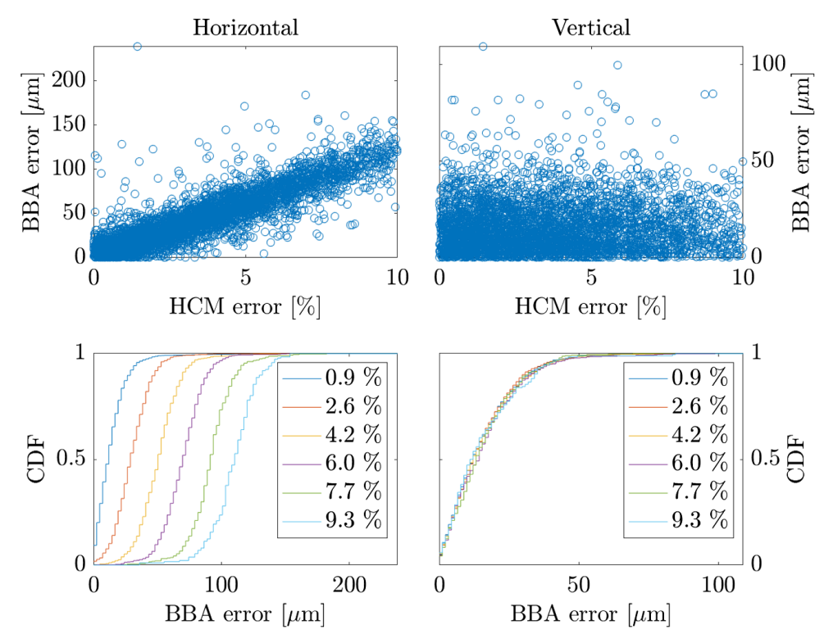
Trajectory BBA
BBA with combined function magnet
Trajectory BBA procedure
Quadrupole strength varied by ±5% during BBA
Strength variation also changes the bending angle
HCM adjusted simultaneously to restore the nominal bending angle
HCM calibration error → residual dipole kick→ horizontal BBA error
Sensitivity: 11.5 μm BBA error per 1% HCM calibration error
Accurate HCM calibration required for <30 μm rms BBA accuracy
Negligible impact on vertical BBA
11

Slide 12
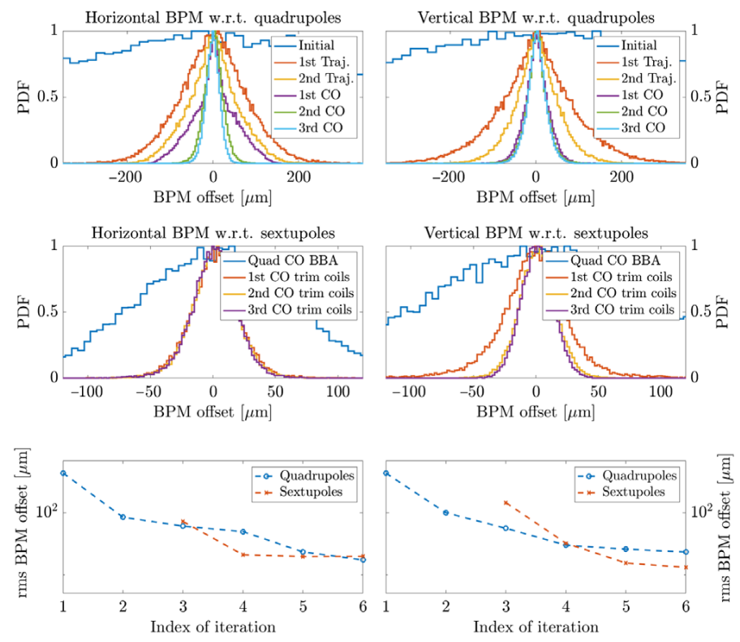
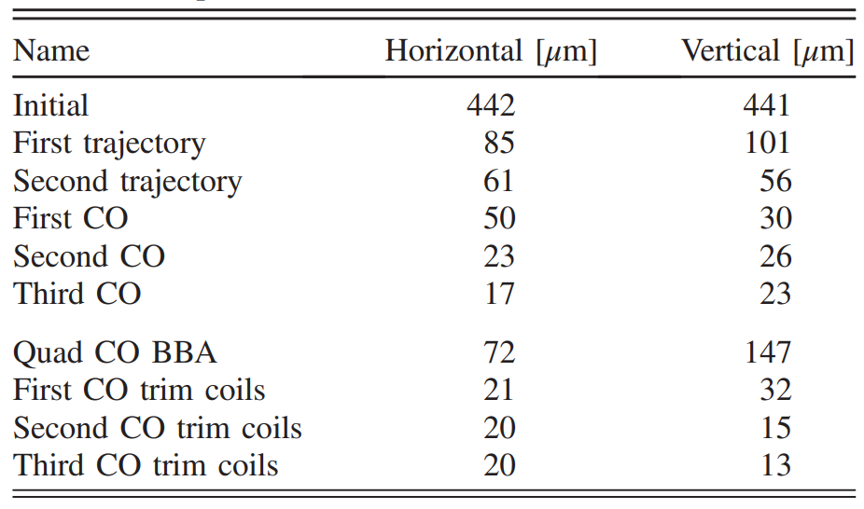
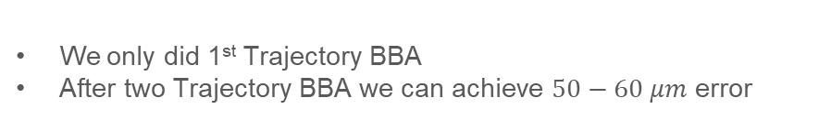
Trajectory BBA
BBA result
: Quad
: Sext
We only did 1st Trajectory BBA
After two Trajectory BBA we can achieve $50−60 μm$ error
12

Slide 13
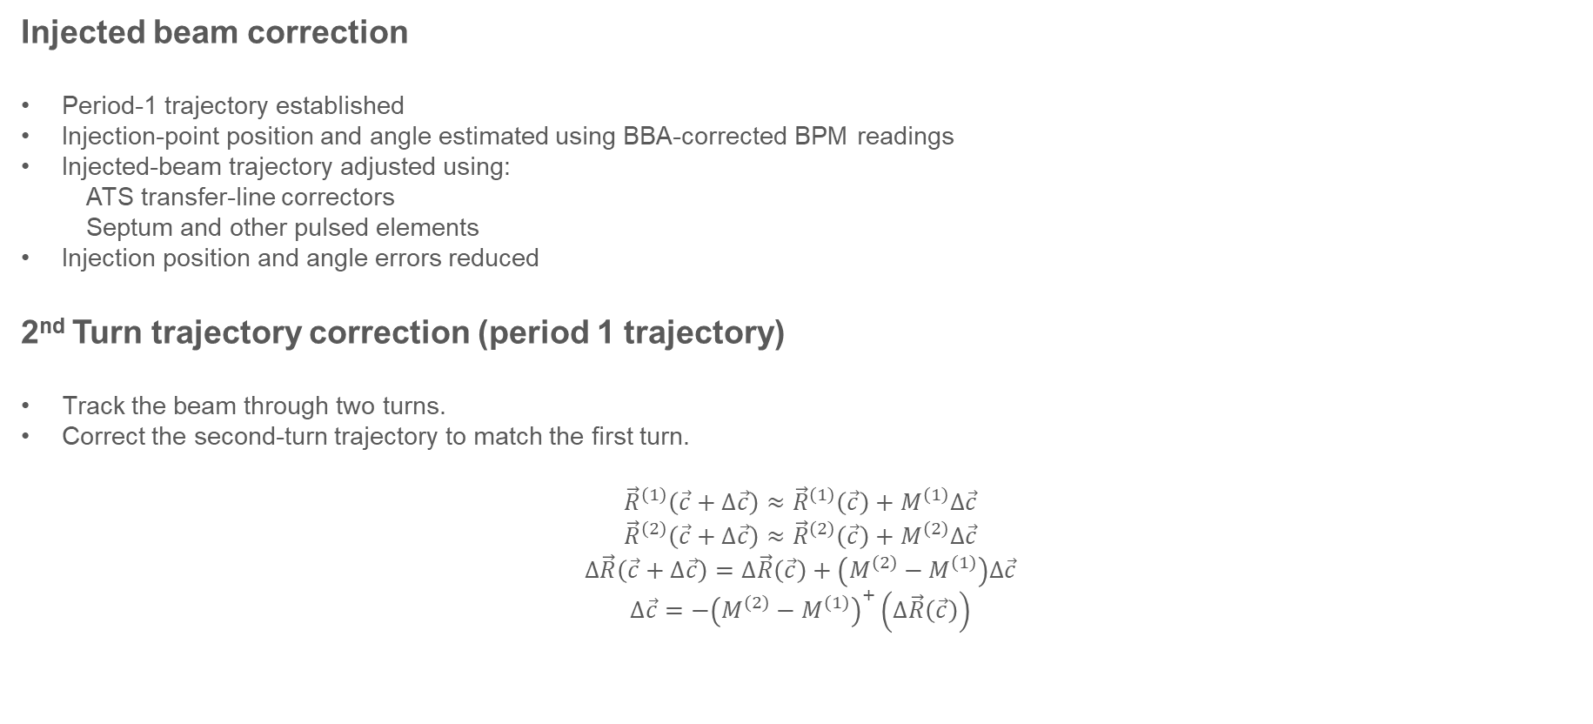
Injected beam static error correction
Injected beam correction
Period-1 trajectory established
Injection-point position and angle estimated using BBA-corrected BPM readings
Injected-beam trajectory adjusted using:
ATS transfer-line correctors
Septum and other pulsed elements
Injection position and angle errors reduced
2nd Turn trajectory correction (period 1 trajectory)
Track the beam through two turns.
Correct the second-turn trajectory to match the first turn.
$${\vec{R}}^{\left(1\right)}\left(\vec{c}+Δ\vec{c}\right)≈{\vec{R}}^{\left(1\right)}\left(\vec{c}\right)+M^{\left(1\right)}Δ\vec{c}$$
$${\vec{R}}^{\left(2\right)}\left(\vec{c}+Δ\vec{c}\right)≈{\vec{R}}^{\left(2\right)}\left(\vec{c}\right)+M^{\left(2\right)}Δ\vec{c}$$
$$Δ\vec{R}\left(\vec{c}+Δ\vec{c}\right)=Δ\vec{R}\left(\vec{c}\right)+\left(M^{\left(2\right)}−M^{\left(1\right)}\right)Δ\vec{c}$$
$$Δ\vec{c}=−{\left(M^{\left(2\right)}−M^{\left(1\right)}\right)}^{+}\left(Δ\vec{R}\left(\vec{c}\right)\right)$$
Now we are here!!
13

Slide 14
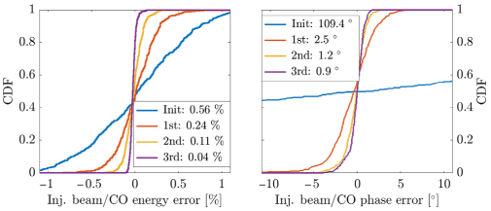

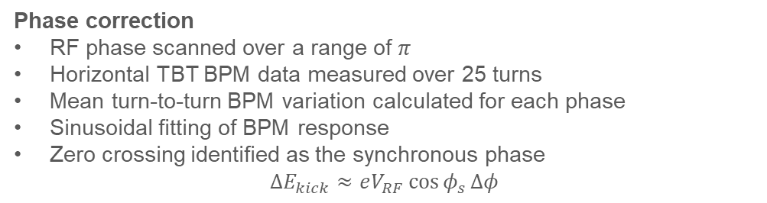
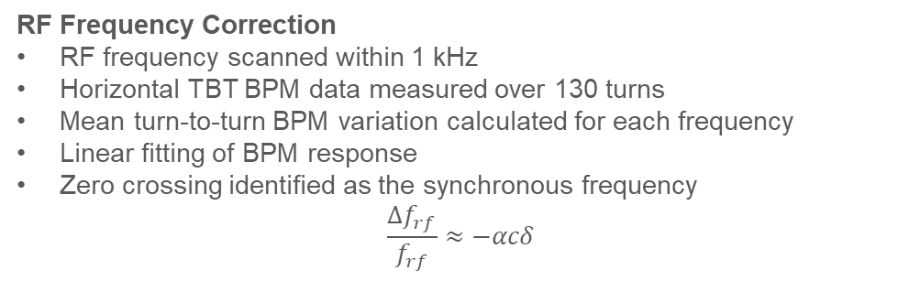
Sextupole ramp-up & RF commisioning
Sextupole ramp-up
RF off $→$ Beam energy loss and $δ=\frac{Δp}{p_{0}}$ increase
No sextupole strength $→$ Large natural chromaticity $\frac{dν_{x}}{dδ}$ $→$ Large tune shift & Cross integer resonance $→$ Limit beam transmission
Increase sextupole strength in 10% steps and apply trajectory feedback.
RF commisioning
After Sextupole ramp-up & RF commissioning,
stored beam maintained for at least 1000 turns
Phase correction
RF phase scanned over a range of $π$
Horizontal TBT BPM data measured over 25 turns
Mean turn-to-turn BPM variation calculated for each phase
Sinusoidal fitting of BPM response
Zero crossing identified as the synchronous phase
$$ΔE_{kick}≈eV_{RF}\cos{φ_{s}}Δφ$$
RF Frequency Correction
RF frequency scanned within 1 kHz
Horizontal TBT BPM data measured over 130 turns
Mean turn-to-turn BPM variation calculated for each frequency
Linear fitting of BPM response
Zero crossing identified as the synchronous frequency
$$\frac{Δf_{rf}}{f_{rf}}≈−αcδ$$
14

Slide 15
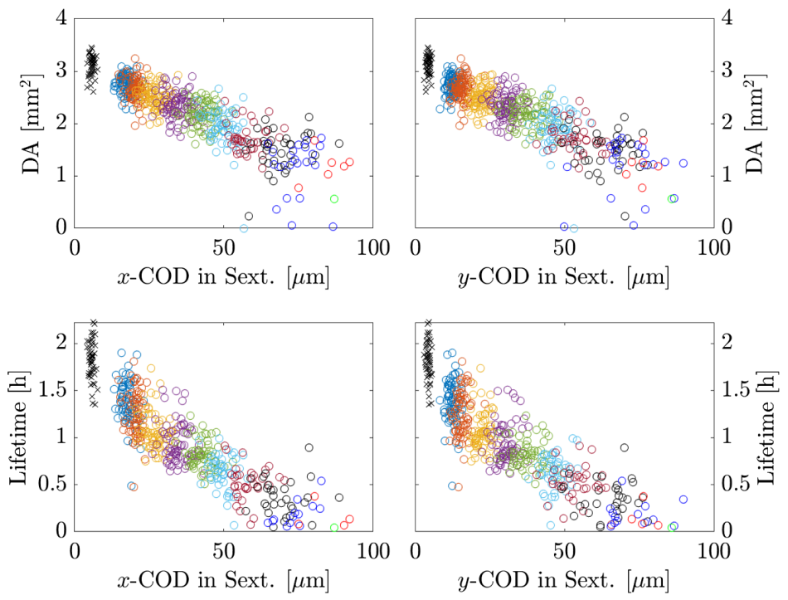
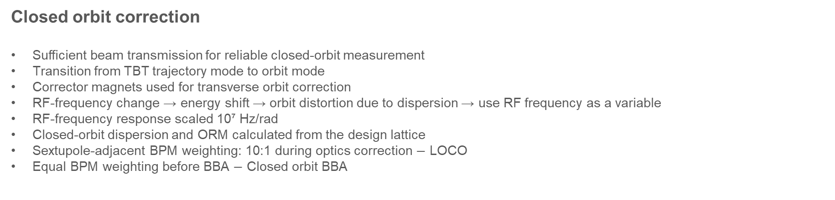
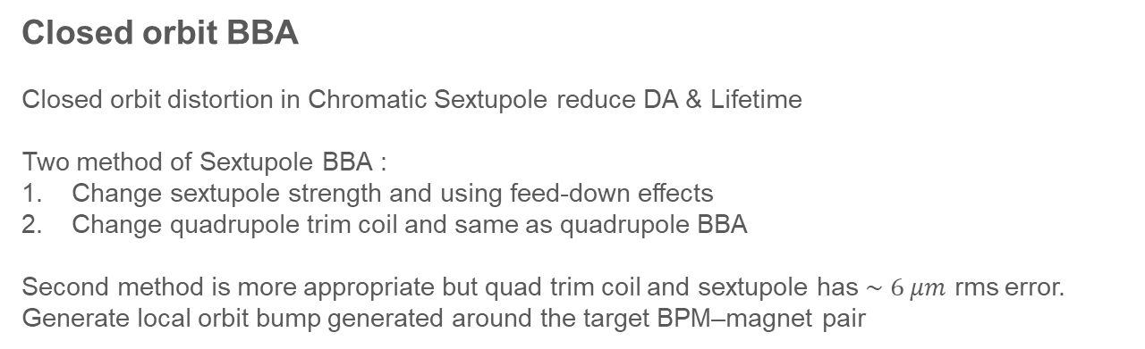
Closed orbit correction & BBA
Closed orbit correction
Sufficient beam transmission for reliable closed-orbit measurement
Transition from TBT trajectory mode to orbit mode
Corrector magnets used for transverse orbit correction
RF-frequency change → energy shift → orbit distortion due to dispersion → use RF frequency as a variable
RF-frequency response scaled 10⁷ Hz/rad
Closed-orbit dispersion and ORM calculated from the design lattice
Sextupole-adjacent BPM weighting: 10:1 during optics correction $−$ LOCO
Equal BPM weighting before BBA $−$ Closed orbit BBA
Closed orbit BBA
Closed orbit distortion in Chromatic Sextupole reduce DA & Lifetime
Two method of Sextupole BBA :
Change sextupole strength and using feed-down effects
Change quadrupole trim coil and same as quadrupole BBA
Second method is more appropriate but quad trim coil and sextupole has $\sim 6 μm$ rms error.
Generate local orbit bump generated around the target BPM–magnet pair
15

Slide 16
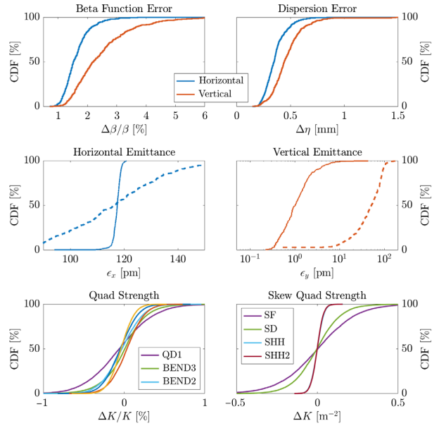
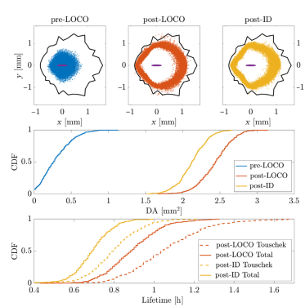
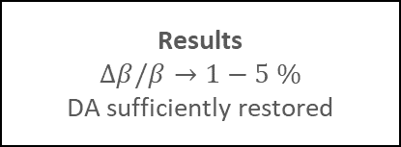
LOCO
LOCO
Correction of the actual machine optics toward the ideal lattice
Nine sequential LOCO steps
Closed-orbit correction after each LOCO step
ORM Measurement
226 BPMs and 294/216 correctors
RF frequency variation of 1.5 kHz for dispersion measurement
Dispersion weighting factor: 5 in both planes
Step 1
QF1/QD1 as fitting parameter
Diagonal ORM only
Step 2
QF4/QF5/QF6 family added
Step 3
All skew quad added
Correct Dispersion & Off diagonal ORM
Step 4
Chromaticity correction using chromatic sextupole
repeated every LOCO step
Step 5
Exclude Qaud gradients
BPM and CM calibration factor
Step 6-7
1-4 LOCO steps repeated
Step 8-9
B2&B3 Quad gradient
Final refinement of linear optics
Results
$$Δβ/β→1−5 \%$$
DA sufficiently restored
16

Slide 17
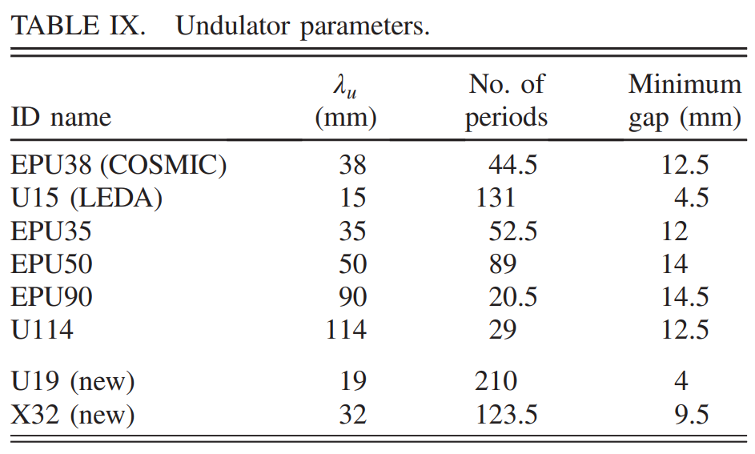
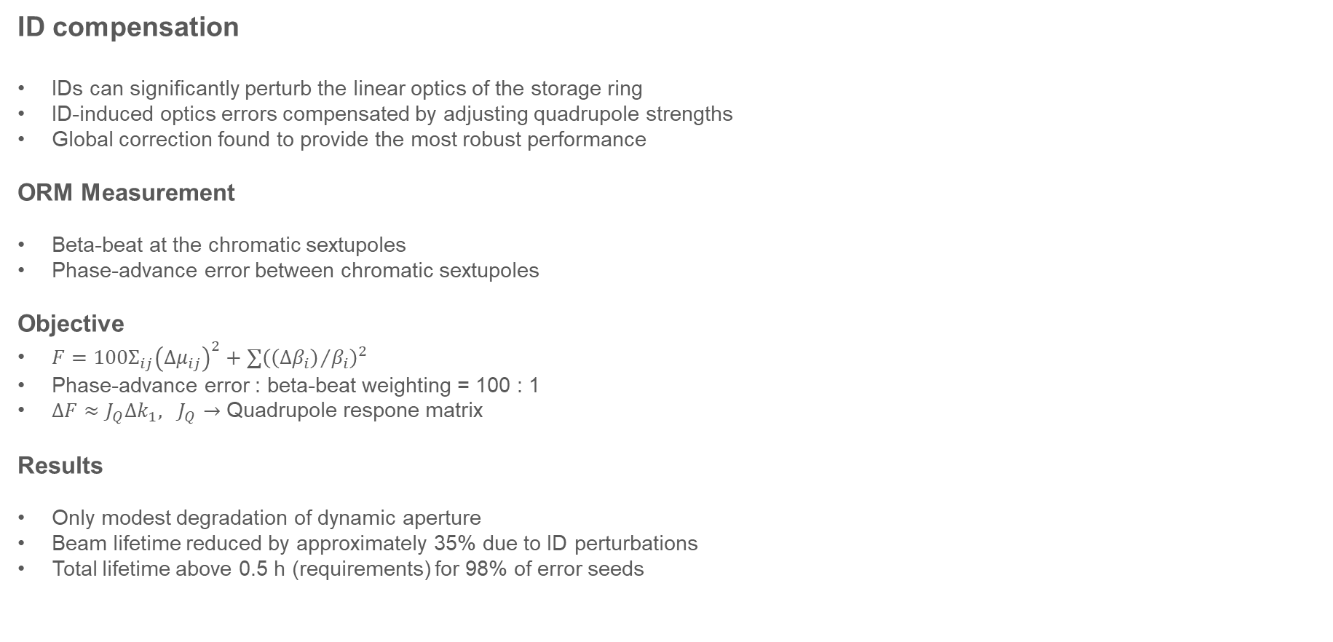
ID compensation
ID compensation
IDs can significantly perturb the linear optics of the storage ring
ID-induced optics errors compensated by adjusting quadrupole strengths
Global correction found to provide the most robust performance
ORM Measurement
Beta-beat at the chromatic sextupoles
Phase-advance error between chromatic sextupoles
Objective
$F=100Σ_{ij}{\left(Δμ_{ij}\right)}^{2}+∑{\left({\left(Δβ_{i}\right)}/{β_{i}}\right)}^{2}$
Phase-advance error : beta-beat weighting = 100 : 1
$ΔF≈J_{Q}Δk_{1}, J_{Q}→$ Quadrupole respone matrix
Results
Only modest degradation of dynamic aperture
Beam lifetime reduced by approximately 35% due to ID perturbations
Total lifetime above 0.5 h (requirements) for 98% of error seeds
17

Slide 18
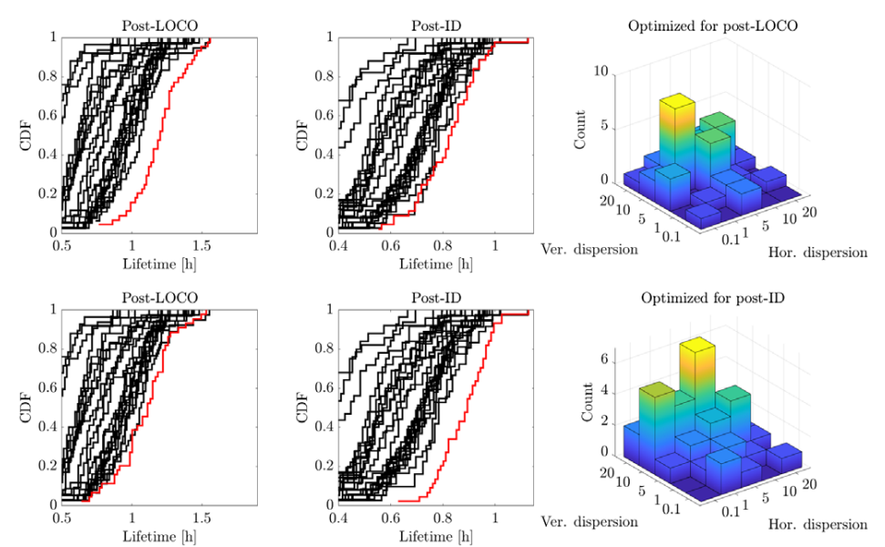

Fine tuning
Fine tuning for Touscheck lifetime optimization
The optimum correction parameters can differ for each error seed.
Touschek lifetime optimized by scanning the LOCO dispersion weights.
Additional optimization performed by scanning harmonic sextupole strengths.
LOCO Dispersion weight scan
Horizontal and vertical dispersion weights varied from 0.1 to 20.
The weights determine the relative importance of dispersion in the LOCO fitting.
Optimal weights differed among error seeds and changed after ID insertion.
Individual optimization improved the lifetime by approximately 10%.
Harmonic Sextupole Scan
SHH and SHH2 strengths scanned over a 6 × 8 grid.
Orbit, tune, and chromaticity corrected at each grid point.
The sextupole setting maximizing the Touschek lifetime selected for each seed.
Average lifetime increased by an additional 6 min, reaching 0.97 h.
18

Slide 19
Conclusion
Developed a start-to-finish commissioning simulation for the ALS-U storage ring with realistic machine errors and correction procedures.
Demonstrated that minimizing closed-orbit deviations in sextupoles is essential for preserving dynamic aperture and beam lifetime.
Established a robust BBA procedure, reducing BPM-to-sextupole offsets to ≤20 μm.
Achieved the design beam-lifetime requirement of ≥0.5 h through linear-optics correction and ID compensation.
Further performance improvement is possible by optimizing LOCO parameters and harmonic sextupole strengths for the actual machine-error configuration.
19

Slide 20
Thank you for your attention!
20

