Slide 1
Interference of diffraction and transition radiation and its application as a beam divergence diagnostic
2026. 06. 12
Jang Won

Slide 2
Contents
Transition radiation
-Introduction
-General formula
-OTRI(Optical transition radiation interferometry)
2. ODR
3. Total radiation for ODTRI system
4. Fitting procedure
5. Results
6. Conclusion

Slide 3
Transition Radiation

Slide 4
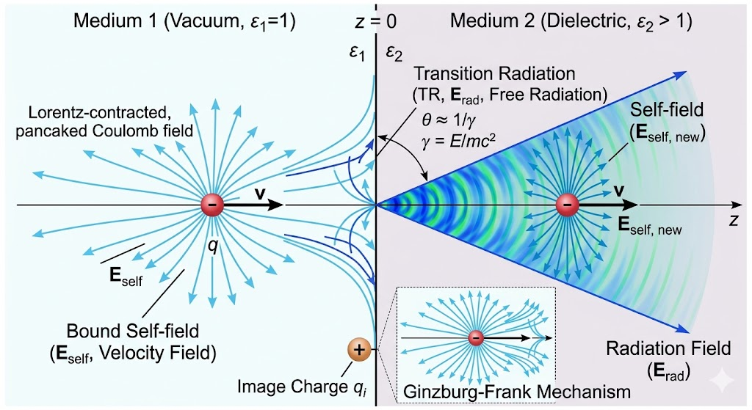

Slide 5
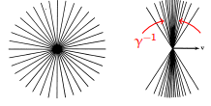
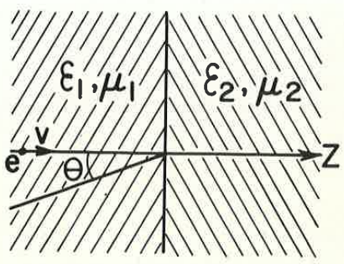
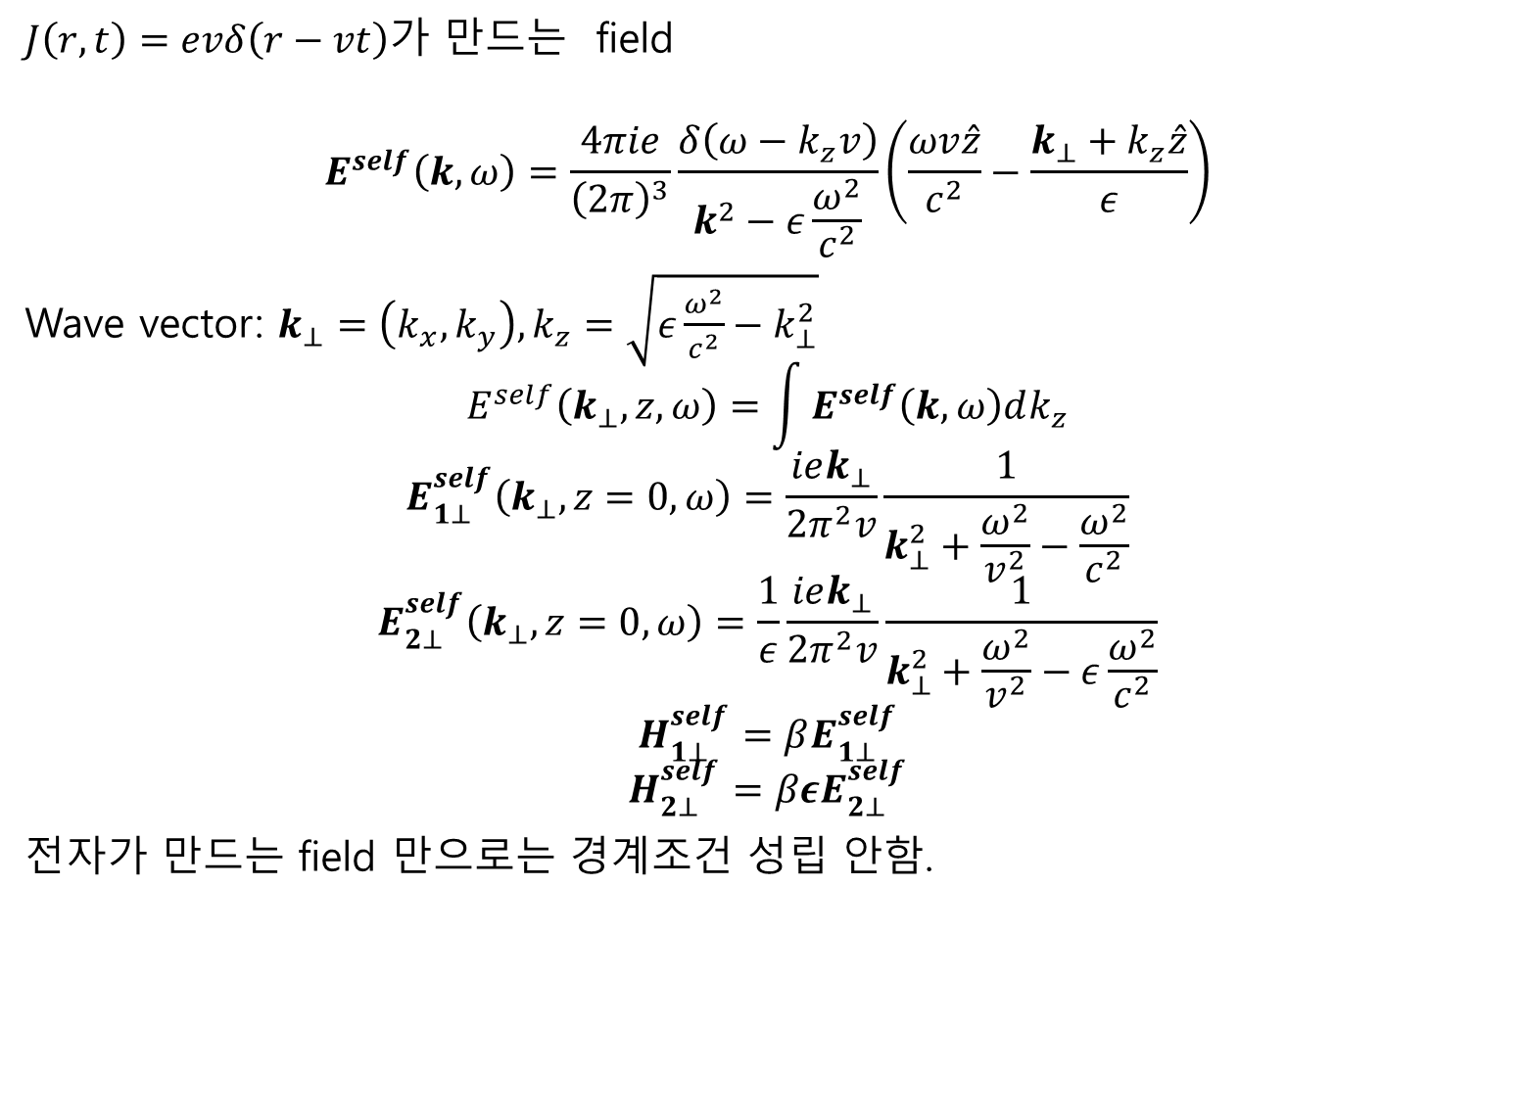
$J\left(r,t\right)=evδ\left(r−vt\right)$가 만드는 field
$$E^{self}\left(k,ω\right)=\frac{4πie}{{\left(2π\right)}^{3}}\frac{δ\left(ω−k_{z}v\right)}{k^{2}−ε\frac{ω^{2}}{c^{2}}}\left(\frac{ωv\hat{z}}{c^{2}}−\frac{k_{⊥}+k_{z}\hat{z}}{ε}\right)$$
Wave vector: $k_{⊥}=\left(k_{x},k_{y}\right), k_{z}=\sqrt{ε\frac{ω^{2}}{c^{2}}−k_{⊥}^{2}}$
$$E^{self}\left(k_{⊥},z,ω\right)=\int_{ }^{ }{E^{self}\left(k,ω\right)dk_{z}}$$
$$E_{1⊥}^{self}\left(k_{⊥},z=0,ω\right)=\frac{iek_{⊥}}{2π^{2}v}\frac{1}{k_{⊥}^{2}+\frac{ω^{2}}{v^{2}}−\frac{ω^{2}}{c^{2}}}$$
$$E_{2⊥}^{self}\left(k_{⊥},z=0,ω\right)=\frac{1}{ε}\frac{iek_{⊥}}{2π^{2}v}\frac{1}{k_{⊥}^{2}+\frac{ω^{2}}{v^{2}}−ε\frac{ω^{2}}{c^{2}}}$$
$$H_{1⊥}^{self}=βE_{1⊥}^{self}$$
$$H_{2⊥}^{self}=βεE_{2⊥}^{self}$$
전자가 만드는 field 만으로는 경계조건 성립 안함.

Slide 6
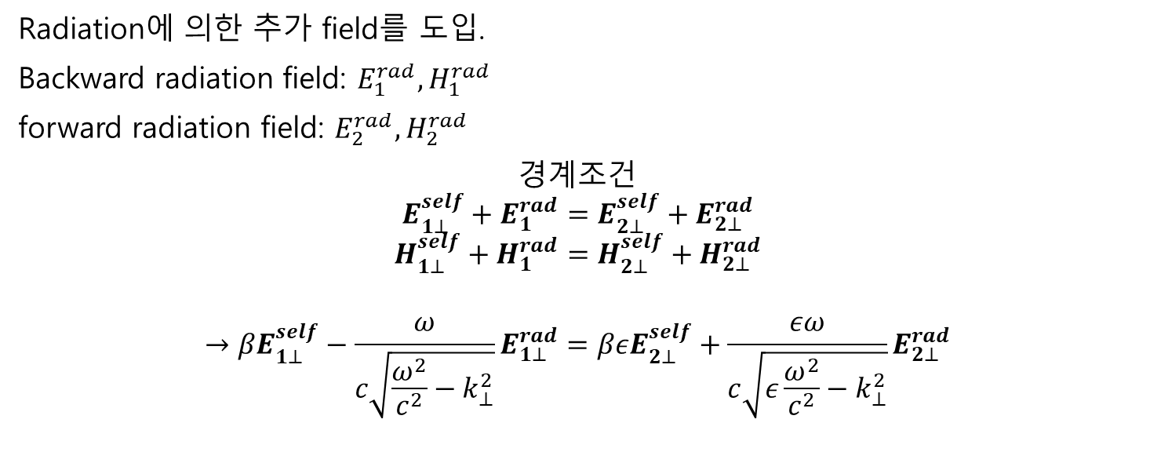
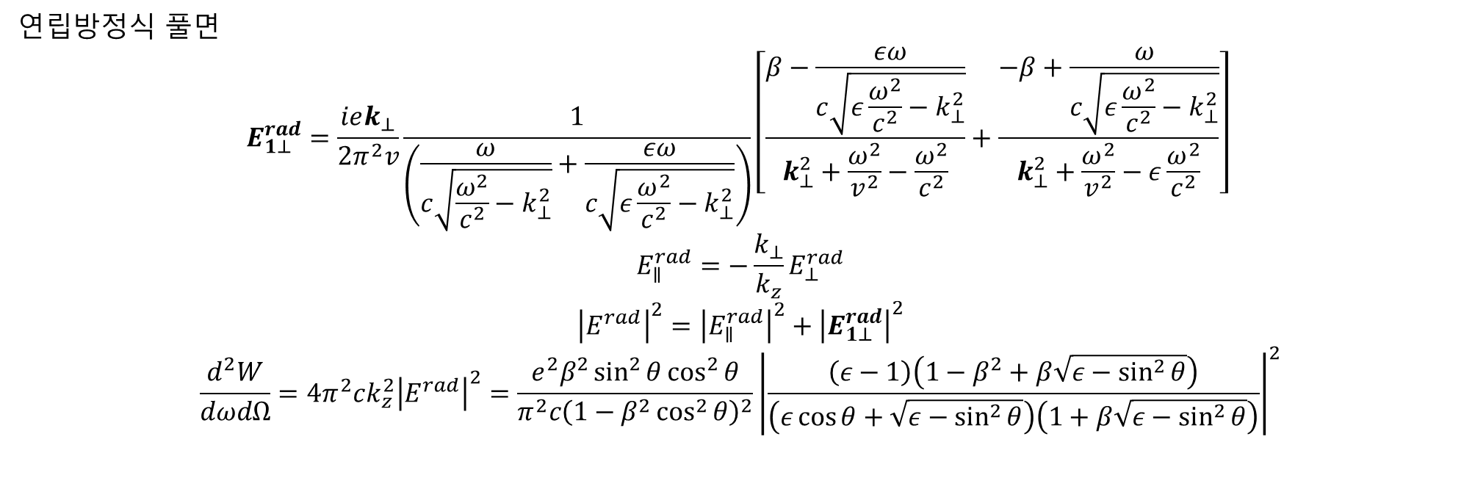
Radiation에 의한 추가 field를 도입.
Backward radiation field: $E_{1}^{rad},H_{1}^{rad}$
forward radiation field: $E_{2}^{rad},H_{2}^{rad}$
경계조건
$$E_{1⊥}^{self}+E_{1}^{rad}=E_{2⊥}^{self}+E_{2⊥}^{rad}$$
$$H_{1⊥}^{self}+H_{1}^{rad}=H_{2⊥}^{self}+H_{2⊥}^{rad}$$
$$→βE_{1⊥}^{self}−\frac{ω}{c\sqrt{\frac{ω^{2}}{c^{2}}−k_{⊥}^{2}}}E_{1⊥}^{rad}=βεE_{2⊥}^{self}+\frac{εω}{c\sqrt{ε\frac{ω^{2}}{c^{2}}−k_{⊥}^{2}}}E_{2⊥}^{rad}$$
연립방정식 풀면
$$E_{1⊥}^{rad}=\frac{iek_{⊥}}{2π^{2}v}\frac{1}{\left(\frac{ω}{c\sqrt{\frac{ω^{2}}{c^{2}}−k_{⊥}^{2}}}+\frac{εω}{c\sqrt{ε\frac{ω^{2}}{c^{2}}−k_{⊥}^{2}}}\right)}\left[\frac{β−\frac{εω}{c\sqrt{ε\frac{ω^{2}}{c^{2}}−k_{⊥}^{2}}}}{k_{⊥}^{2}+\frac{ω^{2}}{v^{2}}−\frac{ω^{2}}{c^{2}}}+\frac{−β+\frac{ω}{c\sqrt{ε\frac{ω^{2}}{c^{2}}−k_{⊥}^{2}}}}{k_{⊥}^{2}+\frac{ω^{2}}{v^{2}}−ε\frac{ω^{2}}{c^{2}}}\right]$$
$$E_{∥}^{rad}=−\frac{k_{⊥}}{k_{z}}E_{⊥}^{rad}$$
$${\left|E^{rad}\right|}^{2}={\left|E_{∥}^{rad}\right|}^{2}+{\left|E_{1⊥}^{rad}\right|}^{2}$$
$$\frac{d^{2}W}{dωdΩ}=4π^{2}ck_{z}^{2}{\left|E^{rad}\right|}^{2}=\frac{e^{2}β^{2}\sin^{2}{θ}\cos^{2}{θ}}{π^{2}c{\left(1−β^{2}\cos^{2}{θ}\right)}^{2}}{\left|\frac{\left(ε−1\right)\left(1−β^{2}+β\sqrt{ε−\sin^{2}{θ}}\right)}{\left(ε\cos{θ}+\sqrt{ε−\sin^{2}{θ}}\right)\left(1+β\sqrt{ε−\sin^{2}{θ}}\right)}\right|}^{2}$$

Slide 7
General formula
(Ginzburg-frank formula)

Slide 8
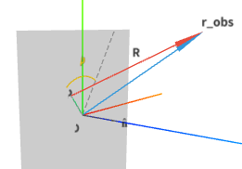
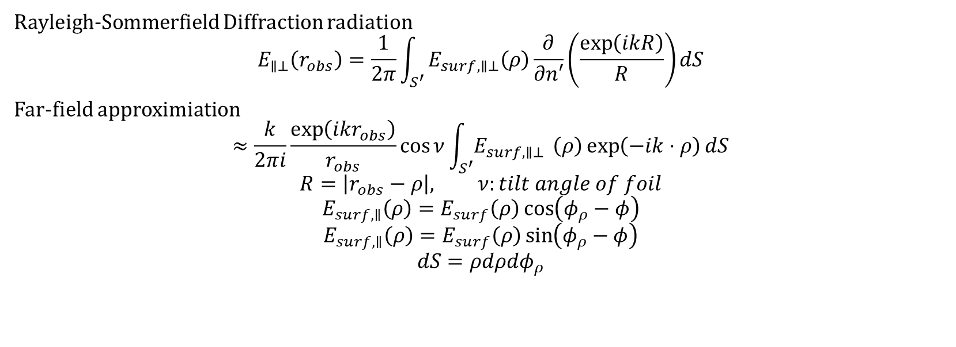

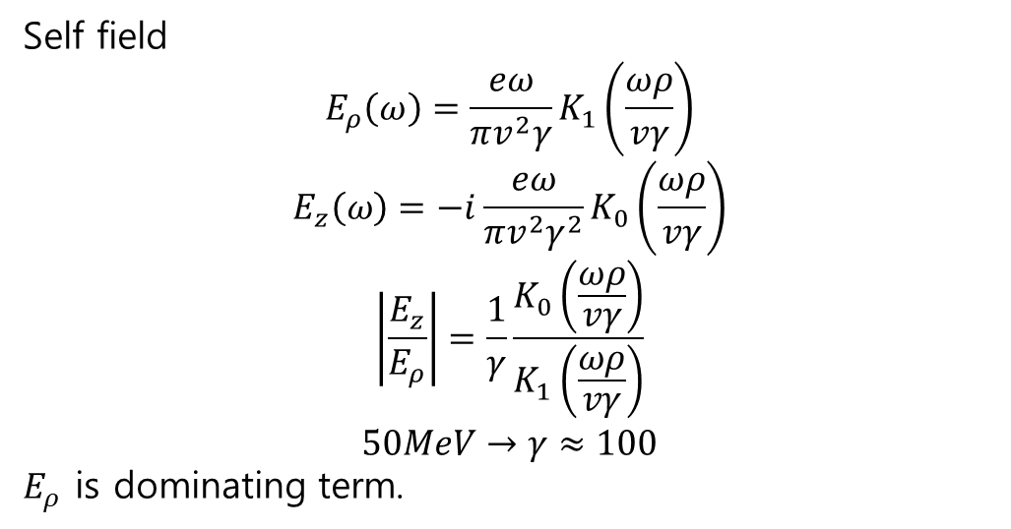
Self field
$$E_{ρ}\left(ω\right)=\frac{eω}{πv^{2}γ}K_{1}\left(\frac{ωρ}{vγ}\right)$$
$$E_{z}\left(ω\right)=−i\frac{eω}{πv^{2}γ^{2}}K_{0}\left(\frac{ωρ}{vγ}\right)$$
$$\left|\frac{E_{z}}{E_{ρ}}\right|=\frac{1}{γ}\frac{K_{0}\left(\frac{ωρ}{vγ}\right)}{K_{1}\left(\frac{ωρ}{vγ}\right)}$$
$$50MeV→γ≈100$$
$E_{ρ}$ is dominating term.
$$φ_{ρ}−φ$$
Rayleigh-Sommerfield Diffraction radiation
$$E_{∥⊥}\left(r_{obs}\right)=\frac{1}{2π}\int_{S^{′}}^{ }{E_{surf,∥⊥}\left(ρ\right)\frac{∂}{∂n′}\left(\frac{\exp\left(ikR\right)}{R}\right)dS}$$
Far-field approximiation
$$≈\frac{k}{2πi}\frac{\exp\left(ikr_{obs}\right)}{r_{obs}}\cos{ν}\int_{S^{′}}^{ }{E_{surf,∥⊥ }\left(ρ\right)\exp\left(−ik⋅ρ\right)dS}$$
$$R=\left|r_{obs}−ρ\right|, ν:tilt angle of foil$$
$$E_{surf,∥}\left(ρ\right)=E_{surf}\left(ρ\right)\cos\left(φ_{ρ}−φ\right)$$
$$E_{surf,∥}\left(ρ\right)=E_{surf}\left(ρ\right)\sin\left(φ_{ρ}−φ\right)$$
$$dS=ρdρdφ_{ρ}$$

Slide 9
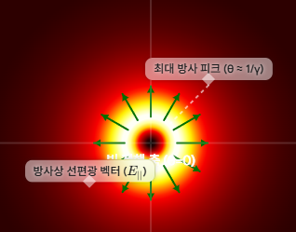
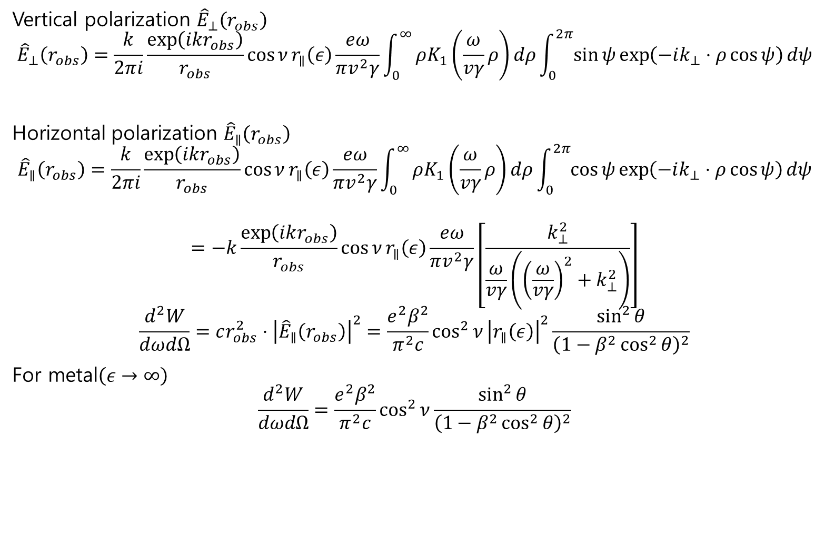

Infinite screen(transition radiation)
Vertical polarization ${\hat{E}}_{⊥}\left(r_{obs}\right)$
$${\hat{E}}_{⊥}\left(r_{obs}\right)=\frac{k}{2πi}\frac{\exp\left(ikr_{obs}\right)}{r_{obs}}\cos{ν}r_{∥}\left(ε\right)\frac{eω}{πv^{2}γ}\int_{0}^{∞}{ρK_{1}\left(\frac{ω}{vγ}ρ\right)dρ}\int_{0}^{2π}{\sin{ψ}\exp\left(−ik_{⊥}⋅ρ\cos{ψ}\right)dψ}$$
Horizontal polarization ${\hat{E}}_{∥}\left(r_{obs}\right)$
$${\hat{E}}_{∥}\left(r_{obs}\right)=\frac{k}{2πi}\frac{\exp\left(ikr_{obs}\right)}{r_{obs}}\cos{ν}r_{∥}\left(ε\right)\frac{eω}{πv^{2}γ}\int_{0}^{∞}{ρK_{1}\left(\frac{ω}{vγ}ρ\right)dρ}\int_{0}^{2π}{\cos{ψ}\exp\left(−ik_{⊥}⋅ρ\cos{ψ}\right)dψ}$$
$$=−k\frac{\exp\left(ikr_{obs}\right)}{r_{obs}}\cos{ν}r_{∥}\left(ε\right)\frac{eω}{πv^{2}γ}\left[\frac{k_{⊥}^{2}}{\frac{ω}{vγ}\left({\left(\frac{ω}{vγ}\right)}^{2}+k_{⊥}^{2}\right)}\right]$$
$$\frac{d^{2}W}{dωdΩ}=cr_{obs}^{2}⋅{\left|{\hat{E}}_{∥}\left(r_{obs}\right)\right|}^{2}=\frac{e^{2}β^{2}}{π^{2}c}\cos^{2}{ν}{\left|r_{∥}\left(ε\right)\right|}^{2}\frac{\sin^{2}{θ}}{{\left(1−β^{2}\cos^{2}{θ}\right)}^{2}}$$
For metal$\left(ε→∞\right)$
$$\frac{d^{2}W}{dωdΩ}=\frac{e^{2}β^{2}}{π^{2}c}\cos^{2}{ν}\frac{\sin^{2}{θ}}{{\left(1−β^{2}\cos^{2}{θ}\right)}^{2}}$$
$$=0$$
Notes:
X-ray 영역에서는 flat 하지 않음

Slide 10
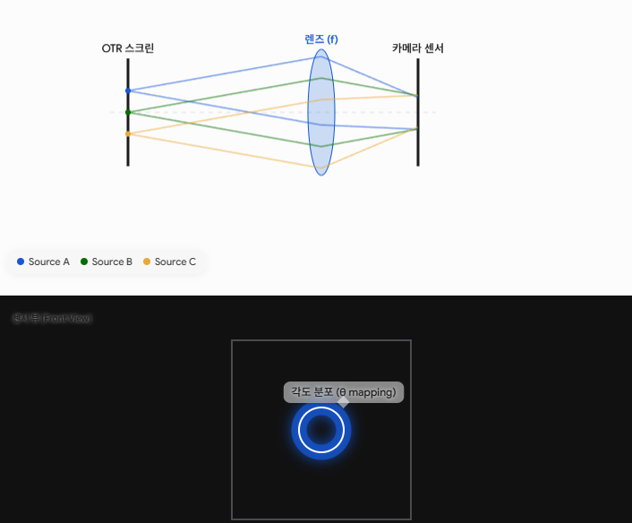
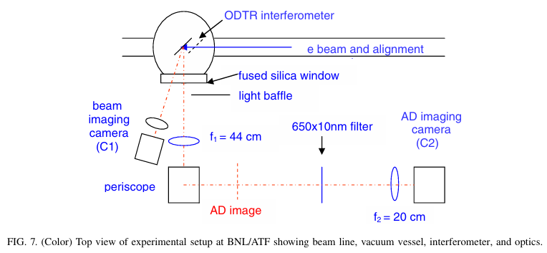
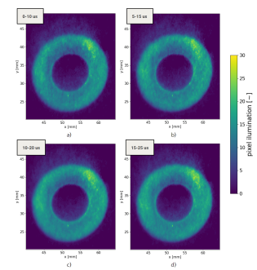
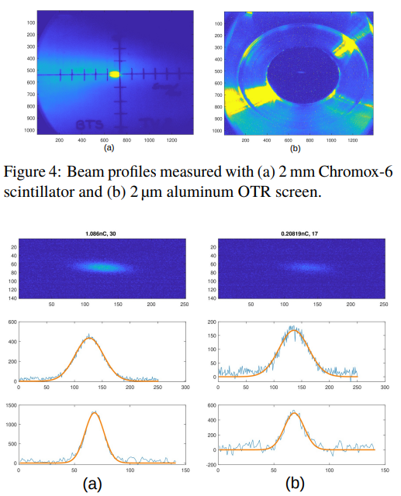
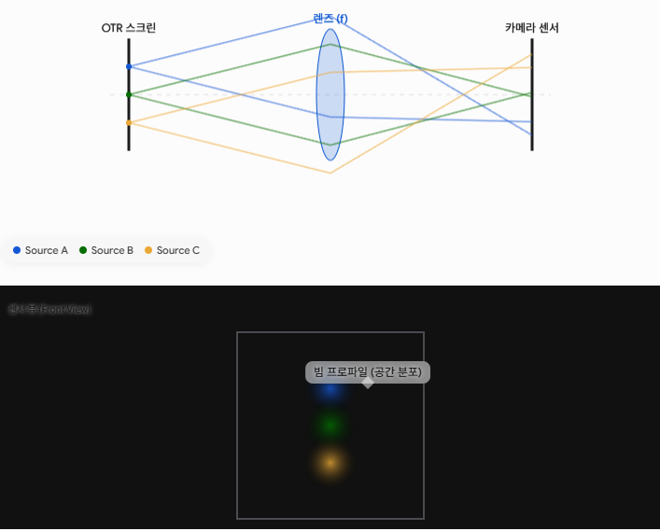
Notes:
Lens에 따라서 profile을 확인할 수도, angular distribution을 볼 수도 있음

Slide 11
OTRI
(optical transition radiation interferometry)

Slide 12
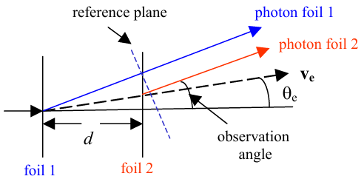
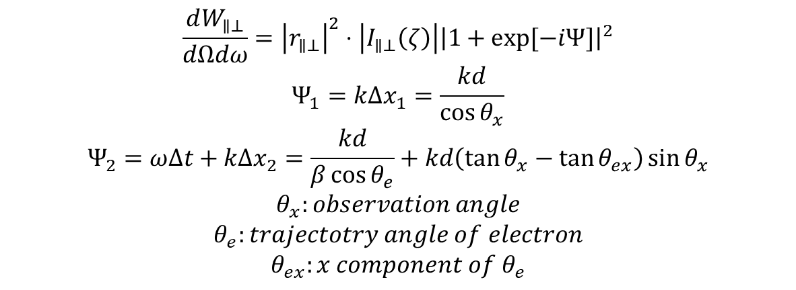
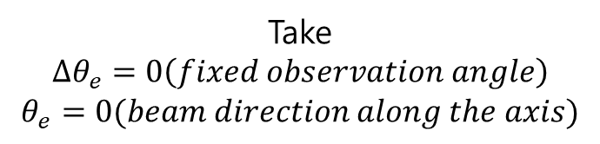
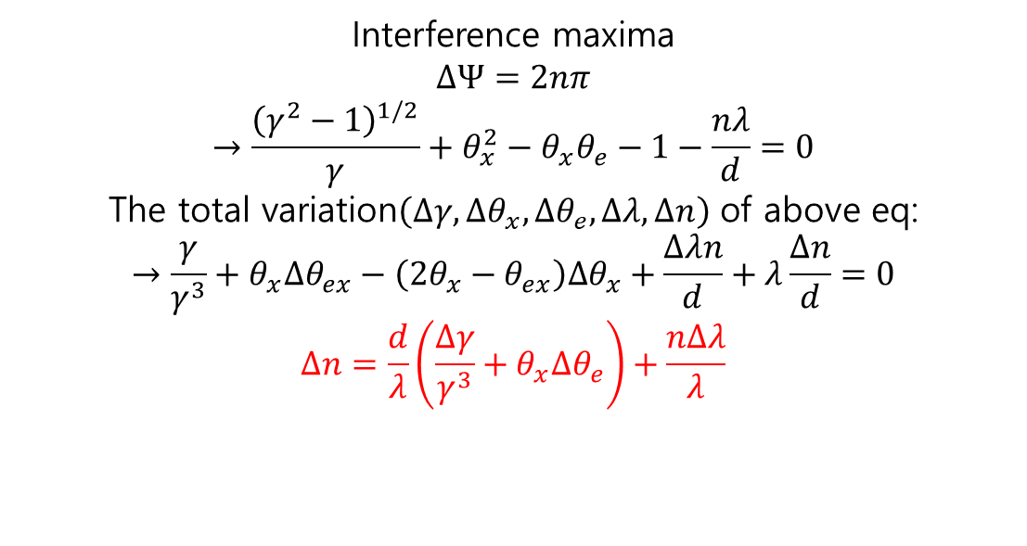
$$\frac{dW_{∥⊥}}{dΩdω}={\left|r_{∥⊥}\right|}^{2}⋅\left|I_{∥⊥}\left(ζ\right)\right|{\left|1+\exp{[−iΨ]}\right|}^{2}$$
$$Ψ_{1}=kΔx_{1}=\frac{kd}{\cos{θ_{x}}}$$
$$Ψ_{2}=ωΔt+kΔx_{2}=\frac{kd}{β\cos{θ_{e}}}+kd\left(\tan{θ_{x}}−\tan{θ_{ex}}\right)\sin{θ_{x}}$$
$$θ_{x}:observation angle$$
$$θ_{e}:trajectotry angle of electron$$
$$θ_{ex}:x component of θ_{e}$$
Interference maxima
$$ΔΨ=2nπ$$
$$→\frac{{\left(γ^{2}−1\right)}^{1/2}}{γ}+θ_{x}^{2}−θ_{x}θ_{e}−1−\frac{nλ}{d}=0$$
The total variation$\left(Δγ,Δθ_{x},Δθ_{e},Δλ,Δn\right)$ of above eq:
$$→\frac{γ}{γ^{3}}+θ_{x}Δθ_{ex}−\left(2θ_{x}−θ_{ex}\right)Δθ_{x}+\frac{Δλn}{d}+λ\frac{Δn}{d}=0$$
$$Δn=\frac{d}{λ}\left(\frac{Δγ}{γ^{3}}+θ_{x}Δθ_{e}\right)+\frac{nΔλ}{λ}$$
Take
$$Δθ_{e}=0\left(fixed observation angle\right)$$
$$θ_{e}=0(beam direction along the axis)$$

Slide 13
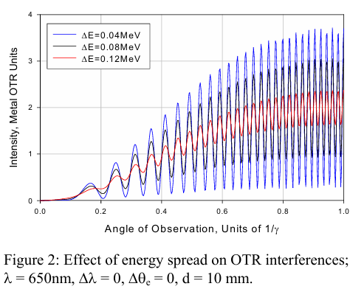
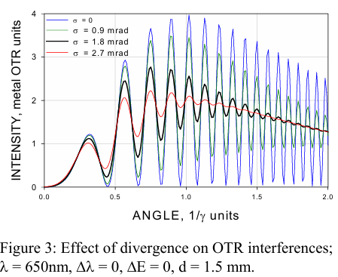
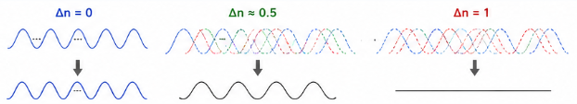
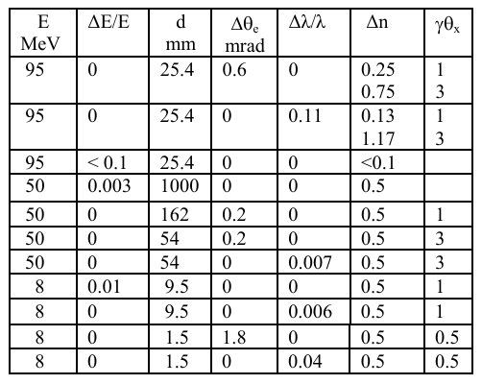
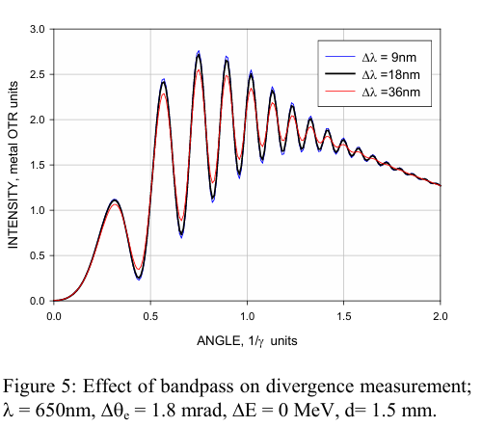
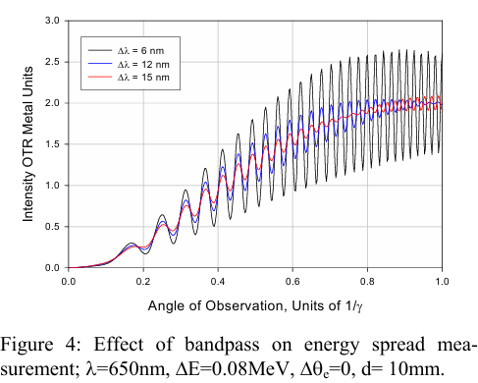
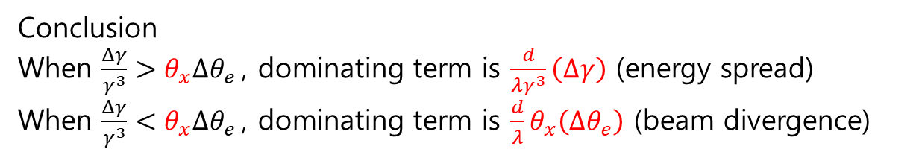
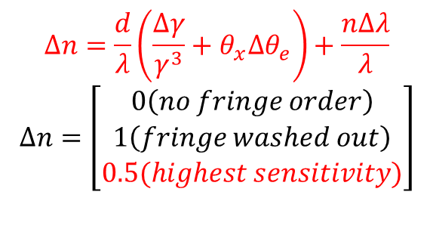

$$Δn=\frac{d}{λ}\left(\frac{Δγ}{γ^{3}}+θ_{x}Δθ_{e}\right)+\frac{nΔλ}{λ}$$
$$Δn=\left[\begin{aligned}0\left(no fringe order\right) \\ 1\left(fringe washed out\right) \\ 0.5(highest sensitivity)\end{aligned}\right]$$
Conclusion
When $\frac{Δγ}{γ^{3}}>θ_{x}Δθ_{e}$, dominating term is $\frac{d}{λγ^{3}}\left(Δγ\right)$ (energy spread)
When $\frac{Δγ}{γ^{3}}<θ_{x}Δθ_{e}$, dominating term is $\frac{d}{λ}θ_{x}\left(Δθ_{e}\right)$ (beam divergence)
Both measurement have to satisfy:
$$Δλ↓,\frac{d}{λ}↑\left(\frac{nΔλ}{λ}↓\right)$$

Slide 14
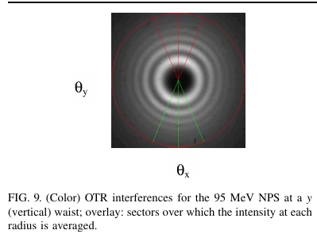
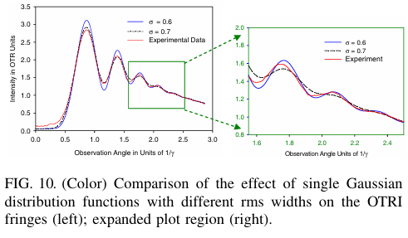
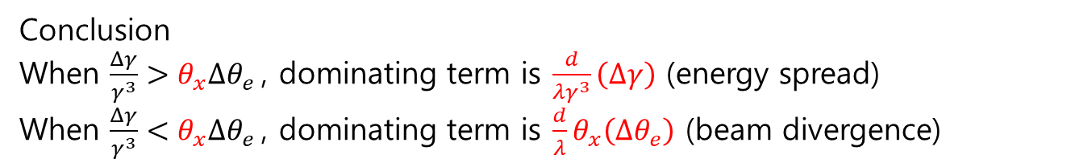
Conclusion
When $\frac{Δγ}{γ^{3}}>θ_{x}Δθ_{e}$, dominating term is $\frac{d}{λγ^{3}}\left(Δγ\right)$ (energy spread)
When $\frac{Δγ}{γ^{3}}<θ_{x}Δθ_{e}$, dominating term is $\frac{d}{λ}θ_{x}\left(Δθ_{e}\right)$ (beam divergence)

Slide 15
ODR
(optical diffraction radiation)

Slide 16
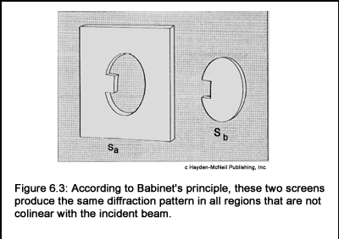
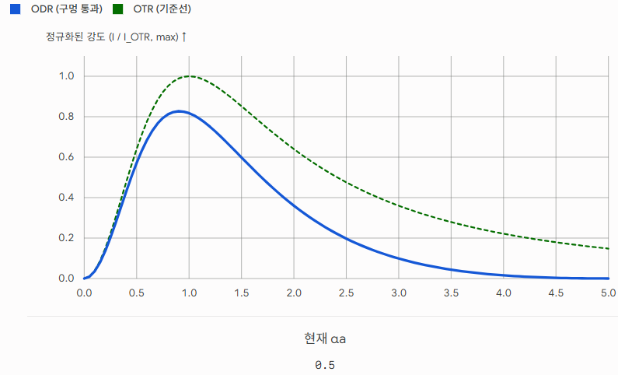
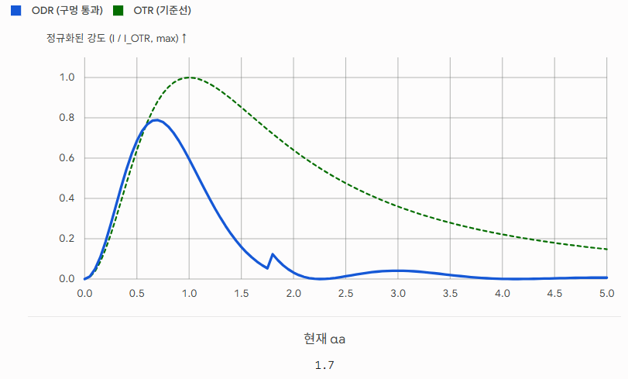
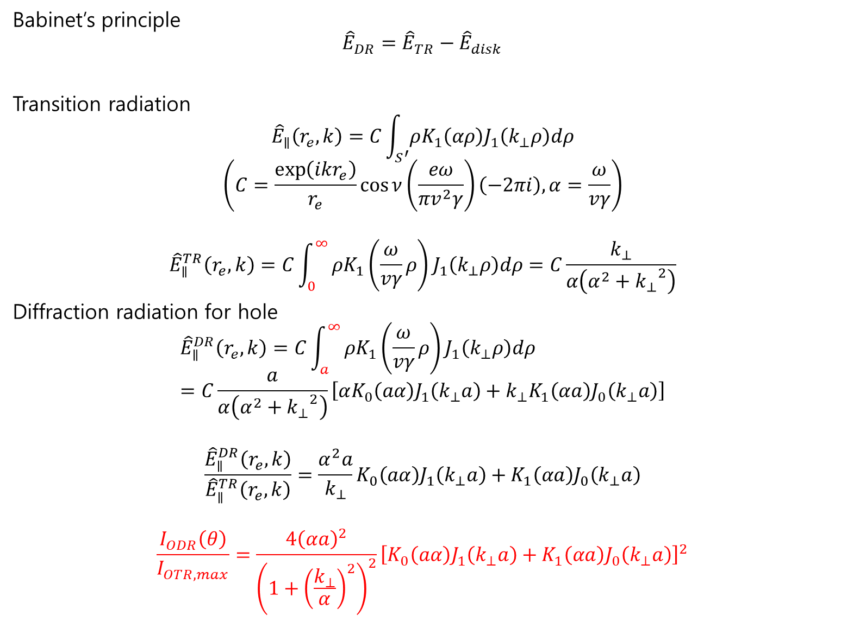
Babinet’s principle
$${\hat{E}}_{DR}={\hat{E}}_{TR}−{\hat{E}}_{disk}$$
Transition radiation
$${\hat{E}}_{∥}\left(r_{e},k\right)=C\int_{S^{′}}^{ }{ρK_{1}\left(αρ\right)J_{1}\left(k_{⊥}ρ\right)dρ}$$
$$\left(C=\frac{\exp\left(ikr_{e}\right)}{r_{e}}\cos{ν}（\frac{eω}{πv^{2}γ}）\left(−2πi\right), α=\frac{ω}{vγ}\right)$$
$${\hat{E}}_{∥}^{TR}\left(r_{e},k\right)=C\int_{0}^{∞}{ρK_{1}\left(\frac{ω}{vγ}ρ\right)J_{1}\left(k_{⊥}ρ\right)dρ}=C\frac{k_{⊥}}{α\left(α^{2}+{k_{⊥}}^{2}\right)}$$
Diffraction radiation for hole
$${\hat{E}}_{∥}^{DR}\left(r_{e},k\right)=C\int_{a}^{∞}{ρK_{1}\left(\frac{ω}{vγ}ρ\right)J_{1}\left(k_{⊥}ρ\right)dρ}=C\frac{a}{α\left(α^{2}+{k_{⊥}}^{2}\right)}\left[αK_{0}\left(aα\right)J_{1}\left(k_{⊥}a\right)+k_{⊥}K_{1}\left(αa\right)J_{0}\left(k_{⊥}a\right)\right]$$
$$\frac{{\hat{E}}_{∥}^{DR}\left(r_{e},k\right)}{{\hat{E}}_{∥}^{TR}\left(r_{e},k\right)}=\frac{α^{2}a}{k_{⊥}}K_{0}\left(aα\right)J_{1}\left(k_{⊥}a\right)+K_{1}\left(αa\right)J_{0}\left(k_{⊥}a\right)$$
$$\frac{I_{ODR}\left(θ\right)}{I_{OTR,max}}=\frac{4{\left(αa\right)}^{2}}{{\left(1+{\left(\frac{k_{⊥}}{α}\right)}^{2}\right)}^{2}}{\left[K_{0}\left(aα\right)J_{1}\left(k_{⊥}a\right)+K_{1}\left(αa\right)J_{0}\left(k_{⊥}a\right)\right]}^{2}$$

Slide 17
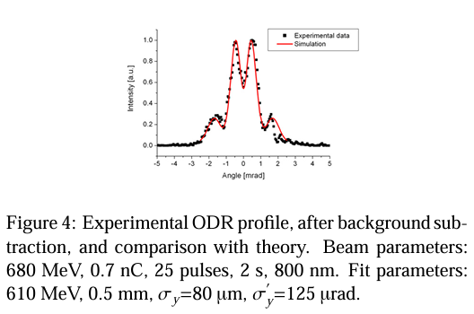
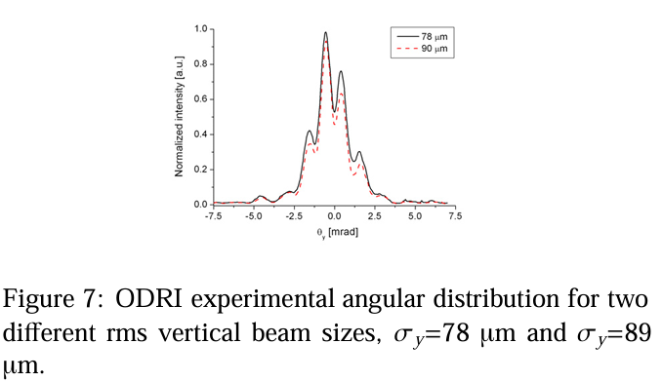
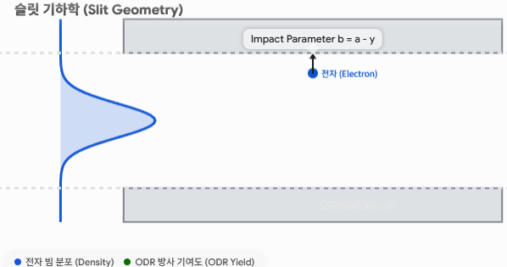
E. Chiadroni, M. Castellano, A. Cianchi, K. Honkavaara, and G. Kube, "Optical Diffraction Radiation Interferometry as Electron Transverse Diagnostics," in Proceedings of DIPAC09, Basel, Switzerland (2009), pp. 151–154.
Slit aperture: 0.5mm
Notes:
Beam size가 impact parameter에 영향을 주기 떄문에 스펙트럼 변함

Slide 18
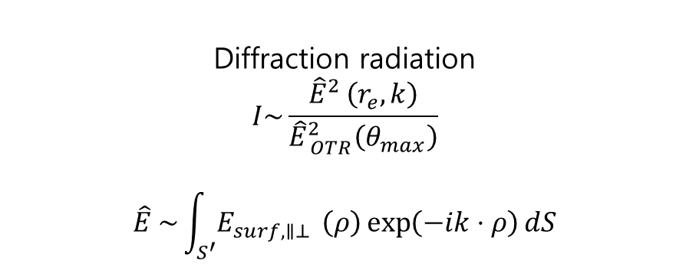
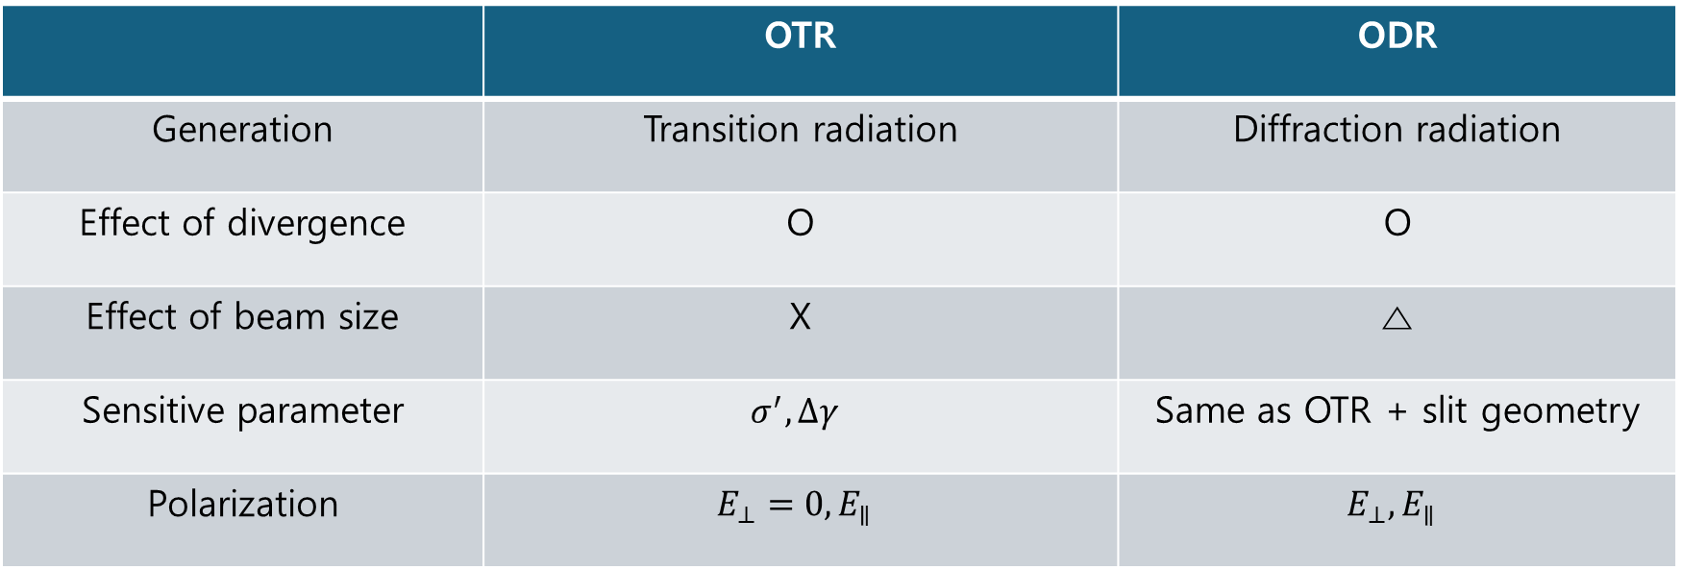

 | OTR | ODR
Generation | Transition radiation | Diffraction radiation
Effect of divergence | O | O
Effect of beam size | X | △
Sensitive parameter | $$σ^{′},Δγ$$ | Same as OTR + slit geometry
Polarization | $$E_{⊥}=0, E_{∥}$$ | $$E_{⊥}, E_{∥}$$
Diffraction radiation
$$I\sim \frac{{\hat{E}}_{ }^{2 }\left(r_{e},k\right)}{{\hat{E}}_{ OTR}^{2}\left(θ_{max}\right)}$$
$${\hat{E}}_{ }^{ }\sim \int_{S^{′}}^{ }{E_{surf,∥⊥ }\left(ρ\right)\exp\left(−ik⋅ρ\right)dS}$$
Transition radiation
$$I=\frac{e^{2}β^{2}}{π^{2}c}\cos^{2}{ν}\frac{\sin^{2}{θ}}{{\left(1−β^{2}\cos^{2}{θ}\right)}^{2}}$$

Slide 19
Total radiation with two foil
(convolutions)

Slide 20
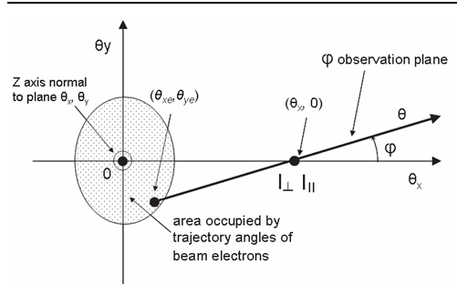
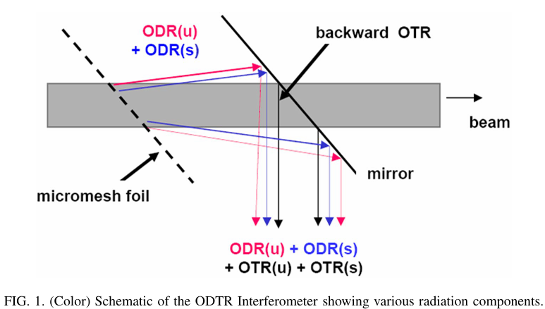
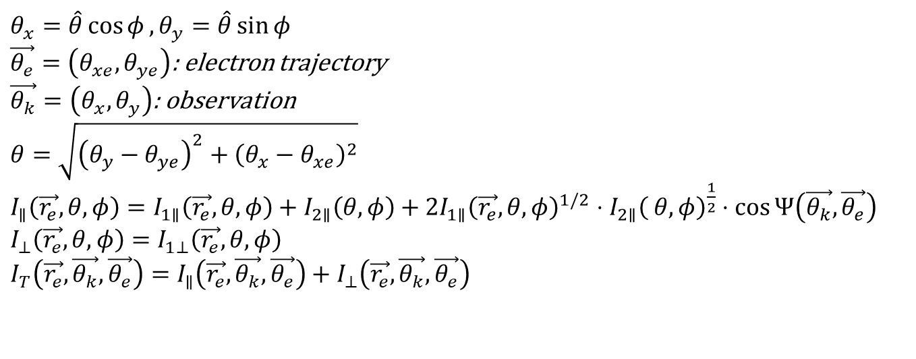
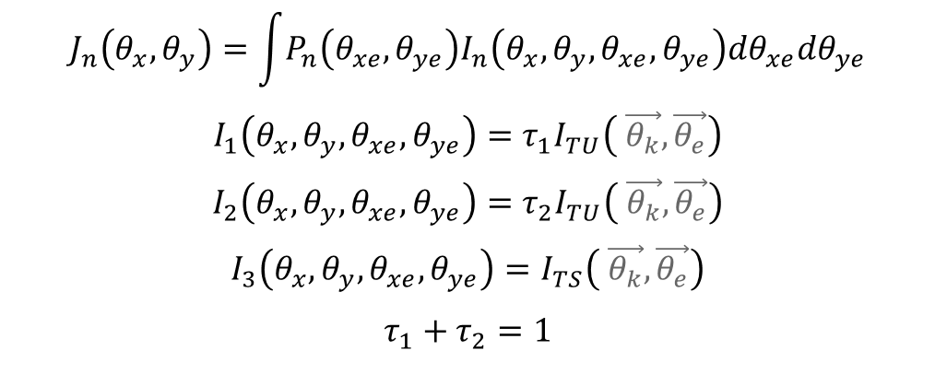
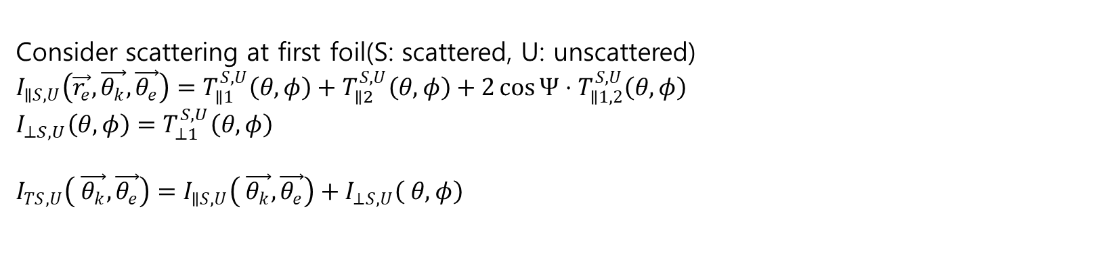
$θ_{x}=\hat{θ}\cos{φ}, θ_{y}=\hat{θ}\sin{φ}$
$\vec{θ_{e}}=\left(θ_{xe},θ_{ye}\right)$: electron trajectory
$\vec{θ_{k}}=\left(θ_{x},θ_{y}\right)$: observation
$θ=\sqrt{{\left(θ_{y}−θ_{ye}\right)}^{2}+{\left(θ_{x}−θ_{xe}\right)}^{2}}$
$I_{∥}\left(\vec{r_{e}}, θ,φ\right)=I_{1∥}\left(\vec{r_{e}}, θ,φ\right)+I_{2∥}\left(θ,φ\right)+2I_{1∥}{\left(\vec{r_{e}}, θ,φ\right)}^{1/2}⋅I_{2∥}{\left( θ,φ\right)}^{\frac{1}{2}}⋅\cos{Ψ\left(\vec{θ_{k}},\vec{θ_{e}}\right)}$
$I_{⊥}\left(\vec{r_{e}}, θ,φ\right)=I_{1⊥}\left(\vec{r_{e}}, θ,φ\right)$
$I_{T}\left(\vec{r_{e}}, \vec{θ_{k}},\vec{θ_{e}}\right)=I_{∥}\left(\vec{r_{e}}, \vec{θ_{k}},\vec{θ_{e}}\right)+I_{⊥}\left(\vec{r_{e}}, \vec{θ_{k}},\vec{θ_{e}}\right)$
Consider scattering at first foil(S: scattered, U: unscattered)
$I_{∥S,U}\left(\vec{r_{e}}, \vec{θ_{k}},\vec{θ_{e}}\right)=T_{∥1}^{S,U}\left(θ,φ\right)+T_{∥2}^{S,U}\left(θ,φ\right)+2\cos{Ψ}⋅T_{∥1,2}^{S,U}\left(θ,φ\right)$
$I_{⊥S,U}\left(θ,φ\right)=T_{⊥1}^{S,U}\left(θ,φ\right)$
$I_{TS,U}\left( \vec{θ_{k}},\vec{θ_{e}}\right)=I_{∥S,U}\left( \vec{θ_{k}},\vec{θ_{e}}\right)+I_{⊥S,U}\left( θ,φ\right)$
$$J_{n}\left(θ_{x},θ_{y}\right)=\int{P_{n}\left(θ_{xe},θ_{ye}\right)I_{n}\left(θ_{x},θ_{y},θ_{xe},θ_{ye}\right)dθ_{xe}dθ_{ye}}$$
$$I_{1}\left(θ_{x},θ_{y},θ_{xe},θ_{ye}\right)=τ_{1}I_{TU}\left( \vec{θ_{k}},\vec{θ_{e}}\right)$$
$$I_{2}\left(θ_{x},θ_{y},θ_{xe},θ_{ye}\right)=τ_{2}I_{TU}\left( \vec{θ_{k}},\vec{θ_{e}}\right)$$
$$I_{3}\left(θ_{x},θ_{y},θ_{xe},θ_{ye}\right)=I_{TS}\left( \vec{θ_{k}},\vec{θ_{e}}\right)$$
$$τ_{1}+τ_{2}=1$$
Mesh period 12.7um
Hole size 8um~15um

Slide 21
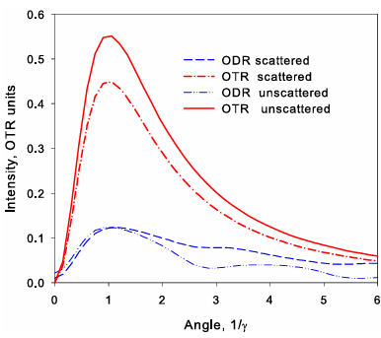
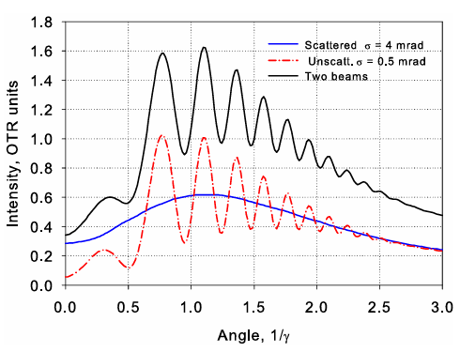
 | Radiated from | Pattern | Coherency
Unscattered | Mesh | Sharp | ODR<->OTR
Scattered | Wire | Noisy, background | X

Slide 22
Data fitting procedure

Slide 23
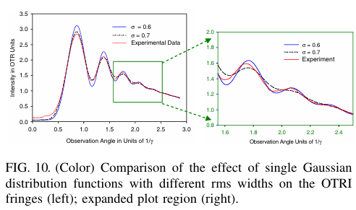
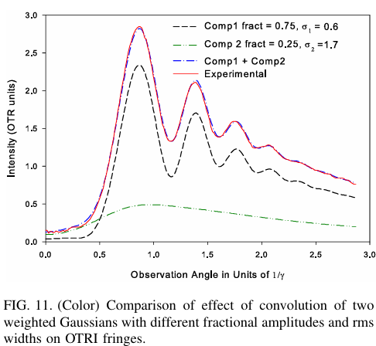
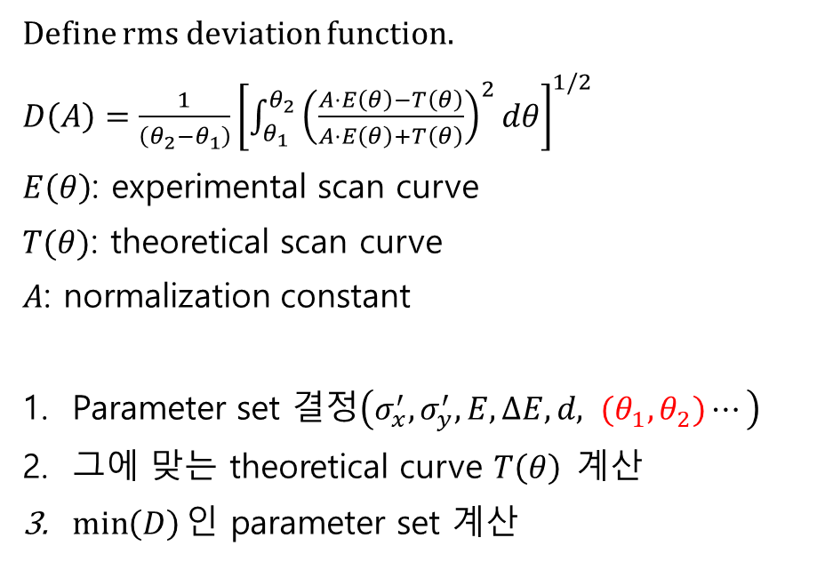

Define rms deviation function.
$D\left(A\right)=\frac{1}{\left(θ_{2}−θ_{1}\right)}{\left[\int_{θ_{1}}^{θ_{2}}{{\left(\frac{A⋅E\left(θ\right)−T\left(θ\right)}{A⋅E\left(θ\right)+T\left(θ\right)}\right)}^{2}dθ}\right]}^{1/2}$
$E\left(θ\right)$: experimental scan curve
$T(θ)$: theoretical scan curve
$A$: normalization constant
Parameter set 결정$\left(σ_{x}^{′}, σ_{y}^{′}, E, ΔE, d, {(θ}_{1},θ_{2})⋯\right)$
그에 맞는 theoretical curve $T\left(θ\right)$계산
$\min\left(D\right)인$ parameter set 계산
$σ^{′}=0.7mrad$이 모든 fringe는 더 잘 맞음.
그러나, $\frac{1.5}{γ}$인 영역에서는 $σ^{′}=0.6mrad$인 경우가 더 잘 맞는다.
두번째 가우시안 도입.
(core + halo)
ODTRI에서는 scattered radiation을
나타내기 위해 세번째 가우시안 도입

Slide 24
Measurement

Slide 25





NPS
 | NPS
Energy spread$\left(\frac{ΔE}{E}\right)$ | 0.05
Beam divergence$\left(γσ′\right)$ | 0.10
Notes:
Odtri와 otri의 결과가 거의 비슷함

Slide 26




ATF
 | ATF
Energy spread$\left(\frac{ΔE}{E}\right)$ | ~0.005
Beam divergence$\left(γσ′\right)$ | ~0.05
Notes:
Odtri가 otri보다 fringe수가 더 많음.
ODTRI의 visibilit는 첫 번째 foil에서의 scattering에 의해 영향을 받지 않기 때문이다.
Otri에서는 scatterin에 의해 지워졌던 고차 fring들이 odtri에서는 잘 나옴.

Slide 27
Conclusion
1. Beam divergence obtained through two methods, OTRI and ODTRI.
The two methods produced nearly identical results because ODTRI and OTRI are affected by the same physical effect. Also, the simulation and fitting procedures are correct.
2. ODTRI is valid diagnostic technique for measuring beam divergence regardless of beam conditions.
3. ODTRI can overcome the lower limit on measurable divergence in conventional OTRI caused by scattering in the first foil.

Slide 28

G. L. Orlandi, “Beam transverse size effects on the transition radiation energy spectrum,” in Proceedings of EPAC08 (European Particle Accelerator Conference, Genoa, Italy, 2008), Paper TUPC074, pp. 1221–1223

