Slide 1

2026-06-12, Pohang, South Korea
Reconstruction from VPP with MENT
& Study of Transient Beam Loading
DAON LEE
2026 The Beam Diagnostics and Dynamics Study
(Room 310)

Slide 2
Outline
Ⅰ. Tomography
- Overview of the Tomography
- The single-optics based reconstruction
- RMS envelope equation
Ⅱ. Transient Beam Loading
- Overview of the transient beam loading
- Comparison of rms bunch lengths : Theoretical vs. Tracking
Ⅲ. Summary

Slide 3
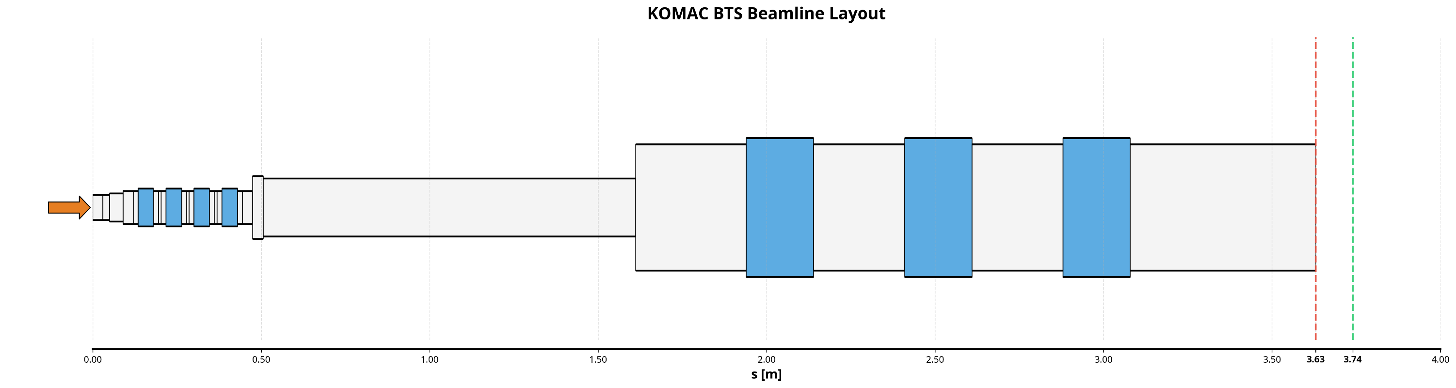
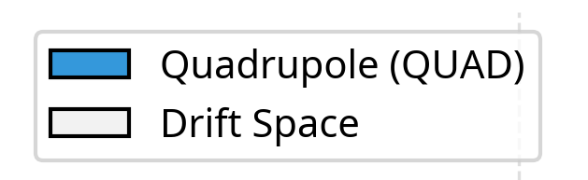



Overview of the Tomography
KOMAC BTS(Beam Test Stand) implementation in x-suite
(slit)
(screen)
Beam parameters
Simulation set-up
Energy
1 MeV
Slit width, Slit step(continuous scan)
0.2mm
N total, macro
3,000,000 -> 3e+8 / 300,000 -> 50,000
Distance L
0.11m
$ε_{x/y, rms}$
0.16 [π mm·mrad]
Screen resolution
30$μm$
rms bunch length
1.141820 mm
Recon. method
Numerical / +Analytic
$σ_{δ}$ (Δp/p)
0.507123 %
Framework
X-suite
3

Slide 4
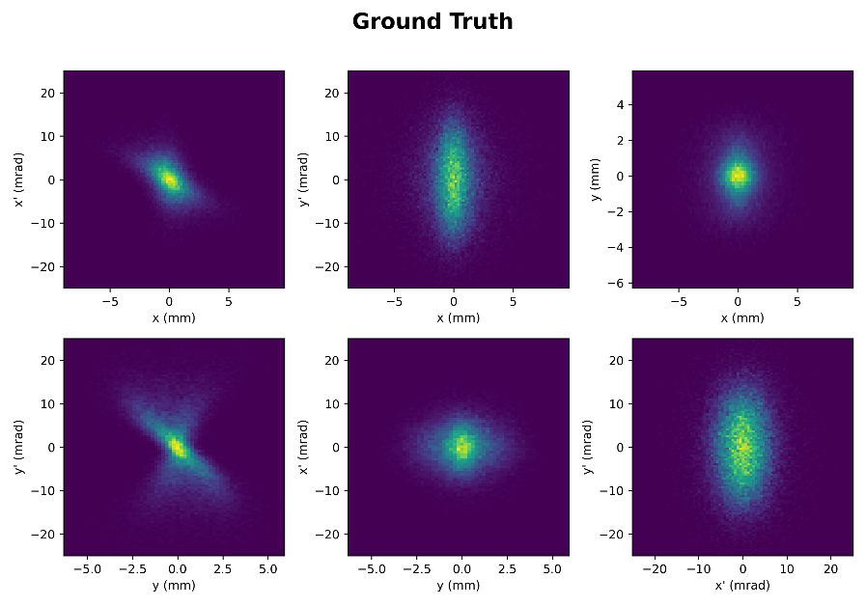
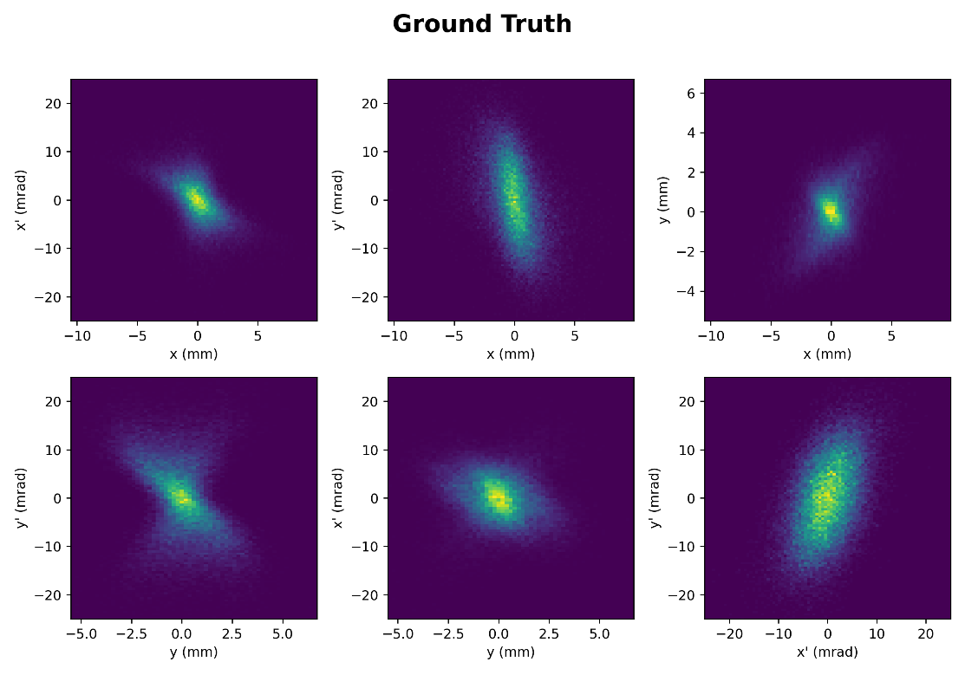
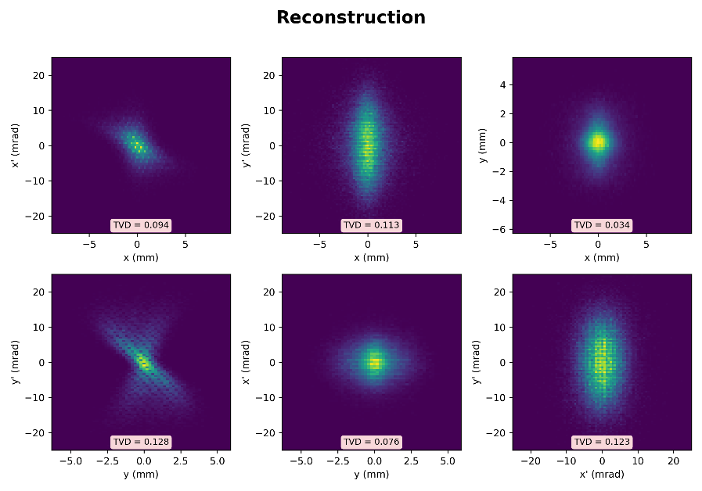
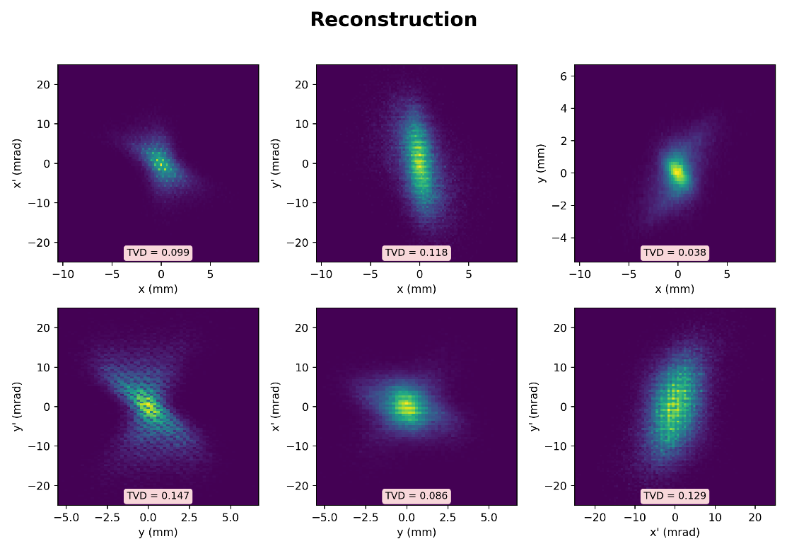



Reconstruction
Space-charge / Analytic reconstruction / Coupling
$$K=$$
• Phase space distribution
• Phase space distribution
Coupling factor(t) : 0.25
$$ε_{x} error=3.82\%$$
$$ε_{y} error=2.47\%$$
$$ε_{4D} error=6.39\%$$
$$ε_{x} error=3.80\%$$
$$ε_{y} error=2.10\%$$
$$ε_{4D} error=9.38\%$$
Previous Numerical method
- total time : 3m 33.48s
Analytic method
- total time : 3m 10.99s
TVDs are same.
0.113
0.118
Analytic method
- total time : 4m 44.12s
0.128
0.123
0.147
0.129
4

Slide 5
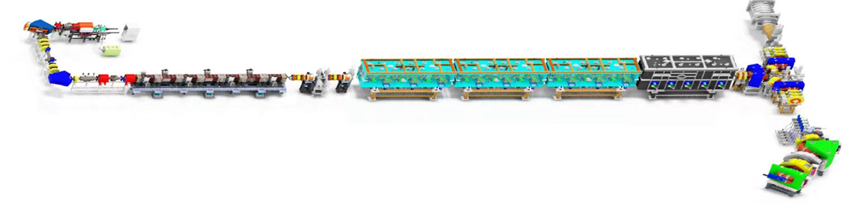
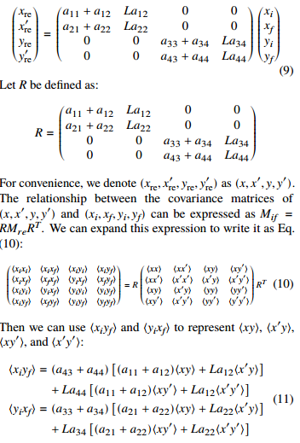
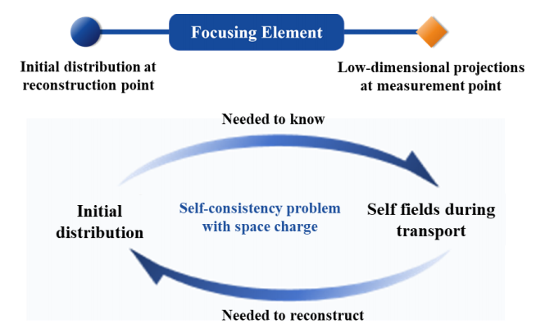

Previous Discussion
Single-optics / Space charge & emittance -dominated
Single-optics-based reconstruction
$$K=$$
1
Multi-optics
rms envelope equation
2
Space charge-dominated(beamlets)
5

Slide 6
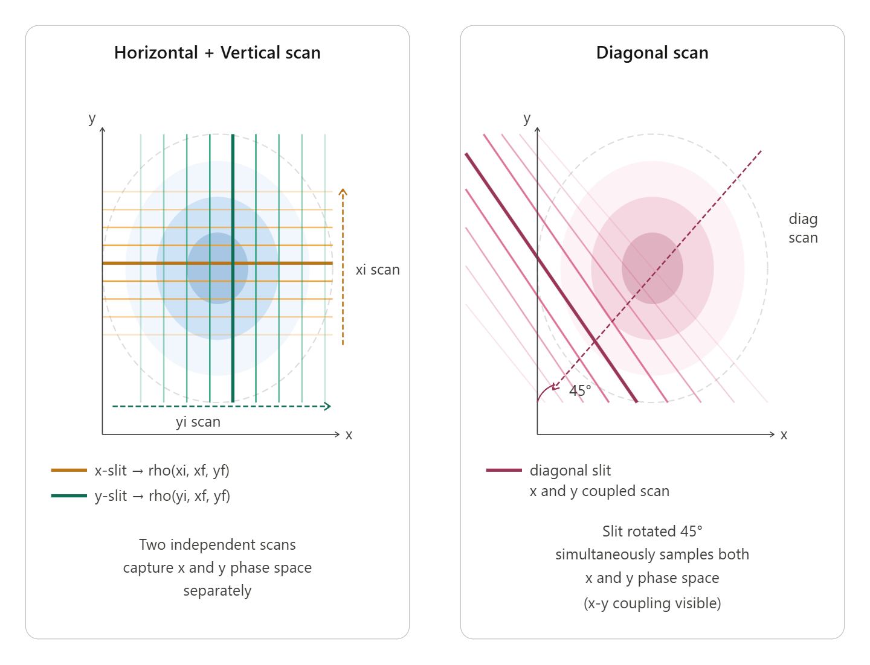


Single-optics-based Reconstruction
Diagonal scan / Multi-screen scan
• Additional diagonal scan
• Multiple screen distance
Progress made, but resolving a coordinate alignment issue(coding) in the iterative density update.
$$+$$
Time-consuming issue
L1
L2
In my view, this is easier than adding mechanical angle scans and simplifies data processing as no coordinate transformation is needed.
fixed
fixed
$$⋯$$
Additional longitudinal space needed
(screen1)
(slit)
(screen2)
RECON.
6

Slide 7
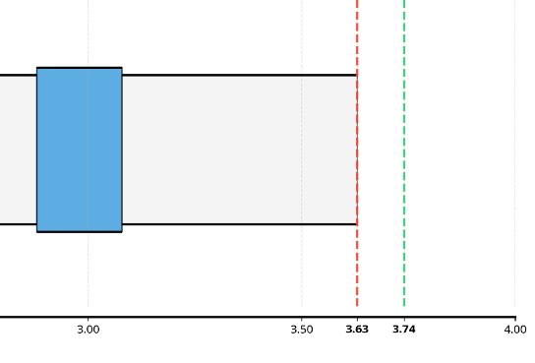
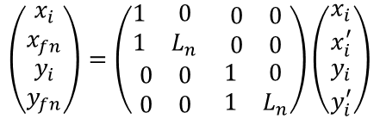









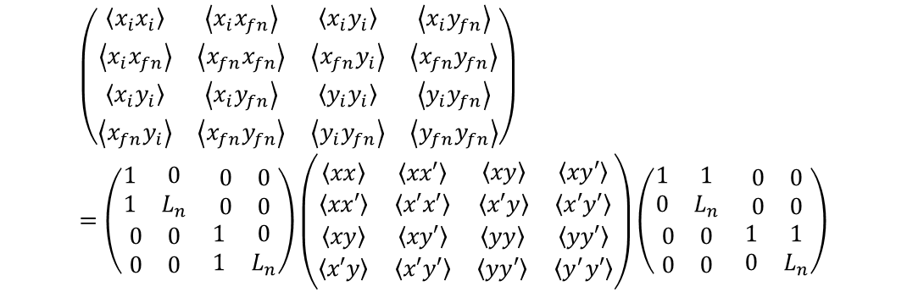




Multi-screen Scan
Single-optics
$$K=$$
$$K=$$
RECON.
$$X_{1}=R_{n}X_{0}$$
L1
L2
$x_{i}, x_{f}$
$$x_{i}^{re}, {x′}_{i}^{re}$$
$$\left(\begin{matrix}\begin{matrix}x_{i} \\ x_{fn}\end{matrix} \\ \begin{matrix}y_{i} \\ y_{fn}\end{matrix}\end{matrix}\right)=\left(\begin{matrix}\begin{matrix}1 & 0 \\ 1 & L_{n}\end{matrix} & \begin{matrix}0 & 0 \\ 0 & 0\end{matrix} \\ \begin{matrix}0 & 0 \\ 0 & 0\end{matrix} & \begin{matrix}1 & 0 \\ 1 & L_{n}\end{matrix}\end{matrix}\right)\left(\begin{matrix}\begin{matrix}x_{i} \\ x_{i}^{′}\end{matrix} \\ \begin{matrix}y_{i} \\ y_{i}^{′}\end{matrix}\end{matrix}\right)$$
$ρ(x_{i}, x_{f})$
$$⇒$$
$$B_{1}=R_{n}B_{0}R_{n}^{T}$$
$$≡R_{n}$$
$ρ(x_{i}^{re}, {x′}_{i}^{re})$
$$\left(\begin{matrix}\begin{matrix}\left\langle x_{i}x_{i}\right\rangle & \left\langle x_{i}x_{fn}\right\rangle \\ \left\langle x_{i}x_{fn}\right\rangle & \left\langle x_{fn}x_{fn}\right\rangle \end{matrix} & \begin{matrix}\left\langle x_{i}y_{i}\right\rangle & \left\langle x_{i}y_{fn}\right\rangle \\ \left\langle x_{fn}y_{i}\right\rangle & \left\langle x_{fn}y_{fn}\right\rangle \end{matrix} \\ \begin{matrix}\left\langle x_{i}y_{i}\right\rangle & \left\langle x_{i}y_{fn}\right\rangle \\ \left\langle x_{fn}y_{i}\right\rangle & \left\langle x_{fn}y_{fn}\right\rangle \end{matrix} & \begin{matrix}\left\langle y_{i}y_{i}\right\rangle & \left\langle y_{i}y_{fn}\right\rangle \\ \left\langle y_{i}y_{fn}\right\rangle & \left\langle y_{fn}y_{fn}\right\rangle \end{matrix}\end{matrix}\right) =\left(\begin{matrix}\begin{matrix}1 & 0 \\ 1 & L_{n}\end{matrix} & \begin{matrix}0 & 0 \\ 0 & 0\end{matrix} \\ \begin{matrix}0 & 0 \\ 0 & 0\end{matrix} & \begin{matrix}1 & 0 \\ 1 & L_{n}\end{matrix}\end{matrix}\right)\left(\begin{matrix}\begin{matrix}\left\langle xx\right\rangle & \left\langle xx′\right\rangle \\ \left\langle xx′\right\rangle & \left\langle x′x′\right\rangle \end{matrix} & \begin{matrix}\left\langle xy\right\rangle & \left\langle xy′\right\rangle \\ \left\langle x′y\right\rangle & \left\langle x′y′\right\rangle \end{matrix} \\ \begin{matrix}\left\langle xy\right\rangle & \left\langle xy′\right\rangle \\ \left\langle x′y\right\rangle & \left\langle x′y′\right\rangle \end{matrix} & \begin{matrix}\left\langle yy\right\rangle & \left\langle yy′\right\rangle \\ \left\langle yy′\right\rangle & \left\langle y^{′}y′\right\rangle \end{matrix}\end{matrix}\right)\left(\begin{matrix}\begin{matrix}1 & 1 \\ 0 & L_{n}\end{matrix} & \begin{matrix}0 & 0 \\ 0 & 0\end{matrix} \\ \begin{matrix}0 & 0 \\ 0 & 0\end{matrix} & \begin{matrix}1 & 1 \\ 0 & L_{n}\end{matrix}\end{matrix}\right)$$
Unknown : $\left\langle xy\right\rangle , \left\langle xy′\right\rangle , \left\langle x′y\right\rangle , \left\langle x′y′\right\rangle$
$$\left\langle x_{i}y_{fn}\right\rangle =\left\langle xy\right\rangle +L_{n}\left\langle xy′\right\rangle$$
$$\left\langle x_{fn}y_{i}\right\rangle =\left\langle xy\right\rangle +L_{n}\left\langle x^{′}y\right\rangle$$
$$\left\langle x_{fn}y_{fn}\right\rangle =\left\langle xy\right\rangle +L_{n}\left\langle xy′\right\rangle +L_{n}\left\langle x^{′}y\right\rangle +L_{n}^{2}\left\langle x′y′\right\rangle$$
It is possible to solve.
7

Slide 8













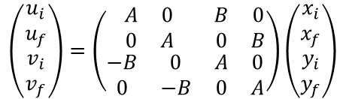

Diagonal Scan
Single-optics
$$K=$$
In diagonal scan
$$\left(\begin{matrix}\begin{matrix}u_{i} \\ u_{f}\end{matrix} \\ \begin{matrix}v_{i} \\ v_{f}\end{matrix}\end{matrix}\right)=\left(\begin{matrix}\begin{matrix}A & 0 \\ 0 & A\end{matrix} & \begin{matrix}B & 0 \\ 0 & B\end{matrix} \\ \begin{matrix}−B & 0 \\ 0 & −B\end{matrix} & \begin{matrix}A & 0 \\ 0 & A\end{matrix}\end{matrix}\right)\left(\begin{matrix}\begin{matrix}x_{i} \\ x_{f}\end{matrix} \\ \begin{matrix}y_{i} \\ y_{f}\end{matrix}\end{matrix}\right)$$
$$\left(\begin{matrix}\begin{matrix}x_{i} \\ x_{f}\end{matrix} \\ \begin{matrix}y_{i} \\ y_{f}\end{matrix}\end{matrix}\right)=\left(\begin{matrix}\begin{matrix}1 & 0 \\ 1 & L\end{matrix} & \begin{matrix}0 & 0 \\ 0 & 0\end{matrix} \\ \begin{matrix}0 & 0 \\ 0 & 0\end{matrix} & \begin{matrix}1 & 0 \\ 1 & L\end{matrix}\end{matrix}\right)\left(\begin{matrix}\begin{matrix}x_{i} \\ x_{i}^{′}\end{matrix} \\ \begin{matrix}y_{i} \\ y_{i}^{′}\end{matrix}\end{matrix}\right)$$
$$←$$
$$\begin{matrix}\cos{θ}≜A \\ \sin{θ}≜B\end{matrix}$$
$$\left(\begin{matrix}\begin{matrix}u_{i} \\ u_{f}\end{matrix} \\ \begin{matrix}v_{i} \\ v_{f}\end{matrix}\end{matrix}\right)=$$
$$\left(\begin{matrix}\begin{matrix}x_{i} \\ x_{i}^{′}\end{matrix} \\ \begin{matrix}y_{i} \\ y_{i}^{′}\end{matrix}\end{matrix}\right)$$
$${X′}_{1}={R′}_{n}X_{0}$$
$u_{i}, u_{f}$
$$x_{i}^{re}, {x′}_{i}^{re}$$
$$⇒$$
$${B′}_{1}={R′}_{n}B_{0}{R′}_{n}^{T}$$
$$≡{R′}_{n}$$
Unknown : $\left\langle xy\right\rangle , \left\langle xy′\right\rangle , \left\langle x′y\right\rangle , \left\langle x′y′\right\rangle$
$$\left\langle u_{i}v_{f}\right\rangle =−\left\langle xx\right\rangle AB−\left\langle xx^{′}\right\rangle ABL+\left\langle yy\right\rangle AB+\left\langle yy^{′}\right\rangle ABL+\left\langle xy\right\rangle \left[A^{2}−B^{2}\right]+\left\langle xy′\right\rangle L\left[A^{2}−B^{2}\right]$$
$$\left\langle u_{f}v_{i}\right\rangle =−\left\langle xx\right\rangle AB−\left\langle xx^{′}\right\rangle ABL+\left\langle yy\right\rangle AB+\left\langle yy^{′}\right\rangle ABL+\left\langle xy\right\rangle \left[A^{2}−B^{2}\right]+\left\langle x′y\right\rangle L\left[A^{2}−B^{2}\right]$$
$$\left\langle u_{f}v_{f}\right\rangle =−\left\langle xx\right\rangle AB−2\left\langle xx^{′}\right\rangle ABL−\left\langle x^{′}x^{′}\right\rangle ABL^{2}+\left\langle yy\right\rangle AB+\left\langle yy^{′}\right\rangle ABL+\left\langle y^{′}y^{′}\right\rangle ABL^{2}$$
$$+\left\langle xy\right\rangle \left[A^{2}−B^{2}\right]+\left\langle xy′\right\rangle L\left[A^{2}−B^{2}\right]+\left\langle x′y\right\rangle L\left[A^{2}−B^{2}\right]+\left\langle x′y′\right\rangle L^{2}\left[A^{2}−B^{2}\right]$$
It is possible to solve.
& It does not work at 45 degree.
8

Slide 9












Measurement Distortions
Space-charge/emittance
Space-charge ratio comparison
• RMS Envelope equation(kapchincky-Vladimirsky eq.)
Number of particles for bunch
* Generalized perveance
$$\hat{I}=\frac{qNβc}{\sqrt{2π}σ_{z}}$$
$$σ_{x}^{′′}+k_{x}\left(s\right)σ_{x}−\frac{K}{2(σ_{x}+σ_{y})}−\frac{ε_{x}^{2}}{σ_{x}^{3}}=0$$
Bunch peak current
For gaussian bunch:
$$K=\frac{\hat{I}}{I_{0}}\frac{2}{β^{3}γ^{3}}\left(1−γ^{2}f_{e}\right)$$
Charge-Neutralization factor
$$I_{0}=\frac{4πε_{0}mc^{3}}{q}$$
Characteristic current:
$$σ_{y}^{′′}+k_{y}\left(s\right)σ_{y}−\frac{K}{2(σ_{x}+σ_{y})}−\frac{ε_{y}^{2}}{σ_{y}^{3}}=0$$
$β, γ$ – relativistic factor
Characteristic current
Classical particle radius:
$$r_{p}=\frac{q^{2}}{4πε_{0}mc^{2}}$$
focusing
space-charge
emittance
For proton : 1.535e-18m
Supposes $f_{e}=0$,
Space-charge dominated:
$$\frac{Kσ_{1}^{3}}{2\left(σ_{1}+σ_{2}\right)ε_{1}^{2}}≫1$$
$$∴ K=\frac{2r_{p}N}{β^{2}γ^{3}\sqrt{2π}σ_{z}}$$
Emittance dominated:
$$\frac{Kσ_{1}^{3}}{2\left(σ_{1}+σ_{2}\right)ε_{1}^{2}}≪1$$
$$∴ K=\left(5.57418544e−16\right)\frac{N}{σ_{z}}$$
1
SC/focusing ratio(at 7th quadrupole; the lowest magnetic field strength)
2
SC/emit. ratio(just before slit, original bunch)
3
SC/emit. ratio(just after slit, beamlets)
9

Slide 10
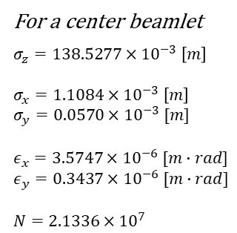



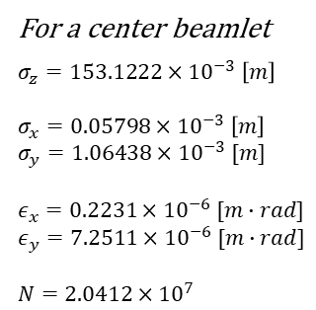






SC/Emittance-dominated
Beamlets
3
SC/emit. ratio(just after slit, beamlets)
1) Horizontal Scan
For a center beamlet
$σ_{z}=153.1222×{10}^{−3} \left[m\right]$
$σ_{x}=0.05798×{10}^{−3} \left[m\right]$
$σ_{y}=1.06438×{10}^{−3} [m]$
$ε_{x}=0.2231×{10}^{−6} [m∙rad]$
$ε_{y}=7.2511×{10}^{−6} [m∙rad]$
$N=2.0412×{10}^{7}$
1-i) Horizontal
Chosen a center scan
$$\frac{K_{H}σ_{x}^{3}}{2\left(σ_{x}+σ_{y}\right)ε_{x}^{2}}≈3.344×{10}^{−4}≪1$$
$$∴emittance−dominated$$
X=0
1-ii) Vertical
$$\frac{K_{H}σ_{y}^{3}}{2\left(σ_{x}+σ_{y}\right)ε_{y}^{2}}≈1.906×{10}^{−3}≪1$$
$$∴ K_{H}≈1.917×{10}^{−7}$$
$$∴emittance−dominated$$
2) Vertical Scan
For a center beamlet
$σ_{z}=138.5277×{10}^{−3} \left[m\right]$
$σ_{x}=1.1084×{10}^{−3} \left[m\right]$
$σ_{y}=0.0570×{10}^{−3} [m]$
$ε_{x}=3.5747×{10}^{−6} [m∙rad]$
$ε_{y}=0.3437×{10}^{−6} [m∙rad]$
$N=2.1336×{10}^{7}$
2-i) Horizontal
Chosen a center scan
$$\frac{K_{V}σ_{x}^{3}}{2\left(σ_{x}+σ_{y}\right)ε_{x}^{2}}≈1.01×{10}^{−2}<1$$
y=0
$$∴emittance−dominated$$
2-ii) Vertical
$$\frac{K_{V}σ_{y}^{3}}{2\left(σ_{x}+σ_{y}\right)ε_{y}^{2}}≈1.490×{10}^{−4}≪1$$
$$∴ K_{V}≈2.215×{10}^{−7}$$
$$∴emittance−dominated$$
10

Slide 11
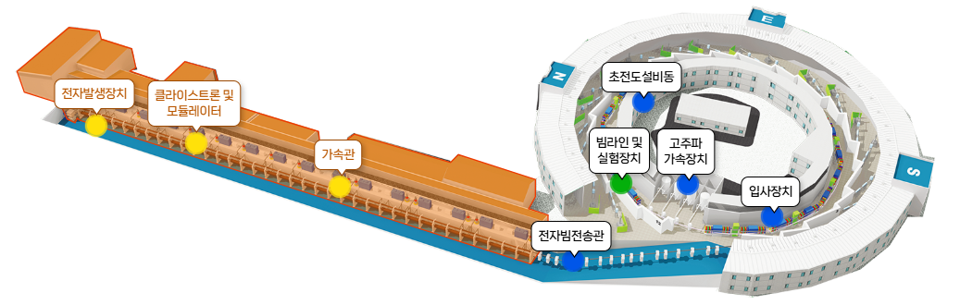


Overview of the Transient Beam Loading
PLS-Ⅱ
Beam parameters
Simulation set-up
Energy, Total current
3 GeV, 300 mA
Circumference
281.82 m
Bunch N, macro
300 / 10,000
RF frequency
499.9732 MHz
$ε_{x/y, rms}$
5.8/0.058 [nm·rad]
Harmonic number
470
rms bunch length
22 ps
$Q_{L}$, R/Q
145,000 / 89 Ω
$σ_{δ}$ (Δp/p), $α_{c}$
0.105 %, 0.0013
Framework
mbtrack2
11

Slide 12
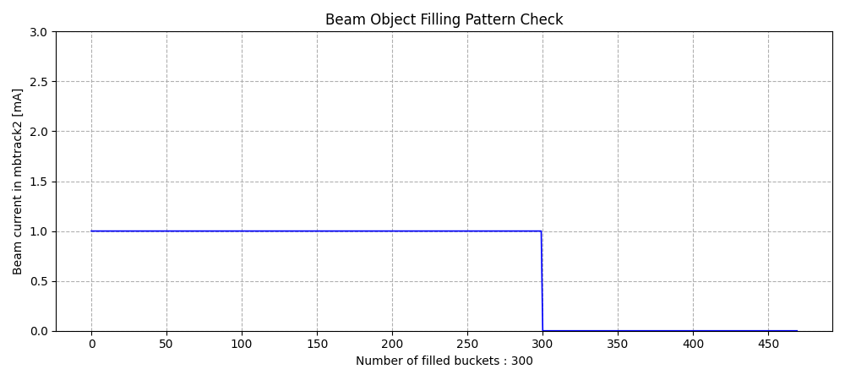
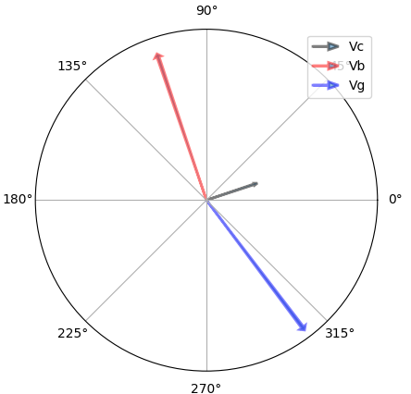
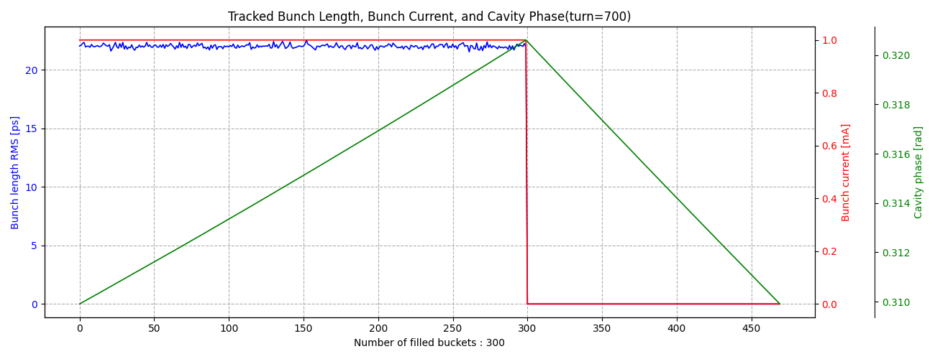
Uniform Fill Pattern
Without camshaft bunch
Theoretical rms bunch length
- 14.26ps
Analytic method
- 21.94ps
12

Slide 13
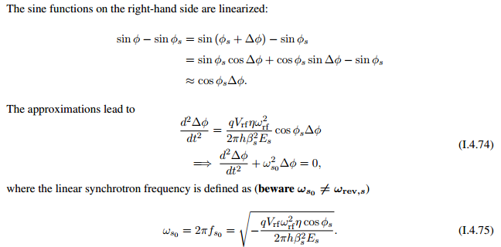
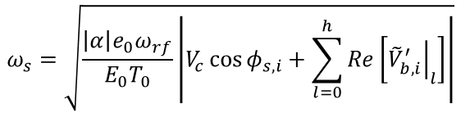



Comparison of RMS Bunch Lengths
Uniform fill pattern
• The bunch length can be calculated from the energy spread.
Theoretical rms bunch length
- 14.26ps
Analytic method
- 21.94ps
The angular frequency of incoherent synchrotron oscillation
$$σ_{τ,i}=\frac{α}{ω_{s}}σ_{e}$$
$$ω_{s}=\sqrt{\frac{\left|α\right|e_{0}ω_{rf}}{E_{0}T_{0}}\left|V_{c}\cos{φ_{s,i}}+\sum_{l=0}^{h}{Re\left[{\left.{\tilde{V}}_{b,i}^{′}\right|}_{l}\right]}\right|}$$
Use of the first derivative at $φ_{s}$ for $ω_{s}$ calculation
By beam loading
$$\left(V\left(φ_{s}\right)=V_{c}\sin{φ_{s}}=U_{0}\right)$$
$ω_{s} ↑$ -> Reduction in bunch length
$ω_{s} ↓$ -> Increased bunch length
$$∆φ=Acos(ω_{s0}+θ)$$
13

Slide 14
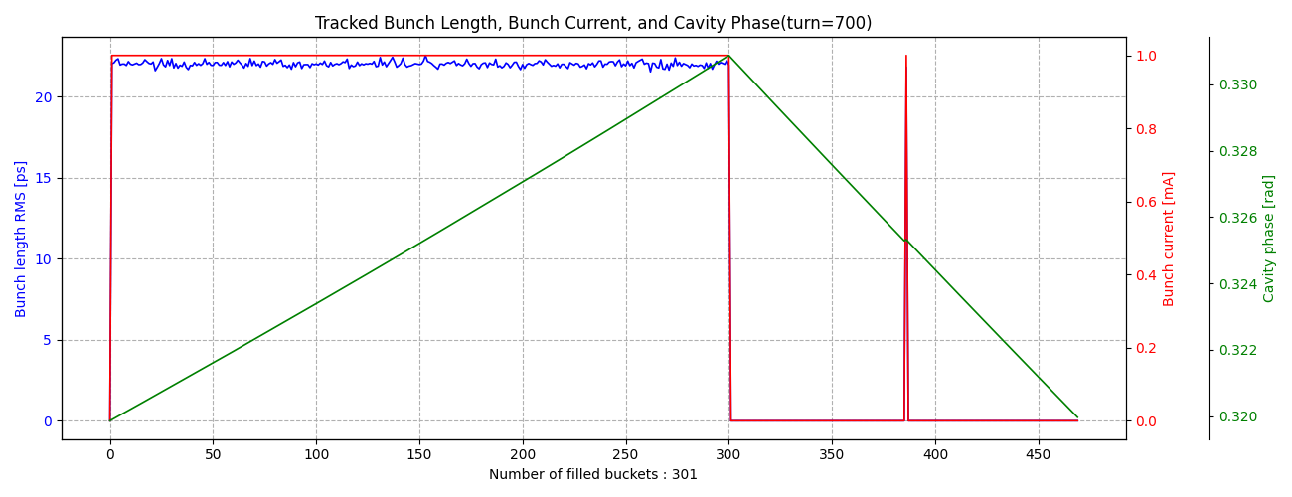
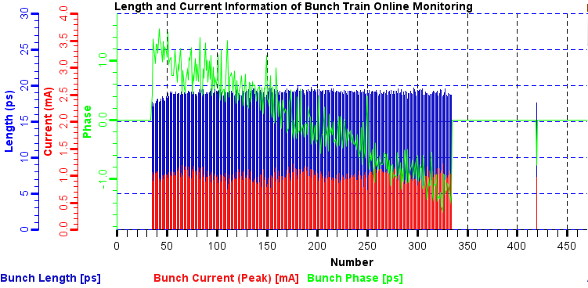
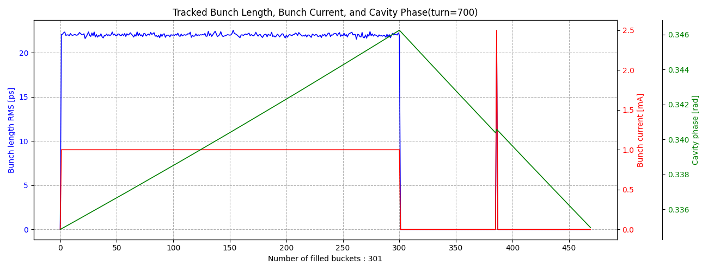
Uniform Fill Pattern
With camshaft bunch
14

Slide 15
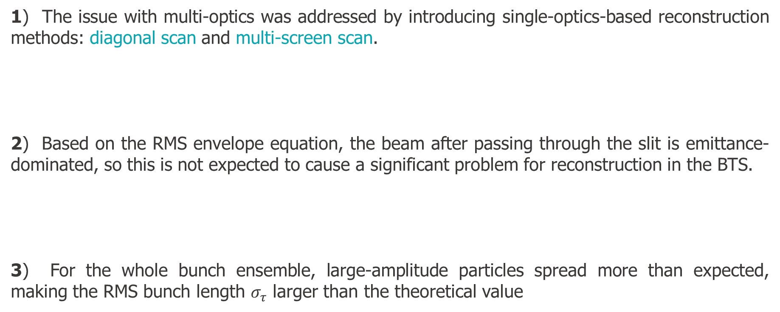
Summary
1) The issue with multi-optics was addressed by introducing single-optics-based reconstruction methods: diagonal scan and multi-screen scan.
2) Based on the RMS envelope equation, the beam after passing through the slit is emittance-dominated, so this is not expected to cause a significant problem for reconstruction in the BTS.
3) For the whole bunch ensemble, large-amplitude particles spread more than expected, making the RMS bunch length $σ_{τ}$ larger than the theoretical value
15

Slide 16
Thank you !

