Slide 1
MENT&VPP
testing reconstructed analytic solutions
Presenter：Liwen Liu
1

Slide 2
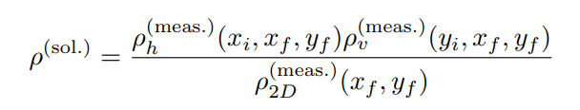
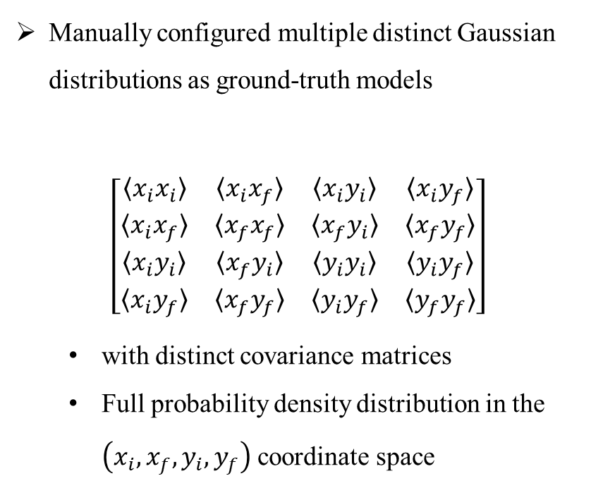
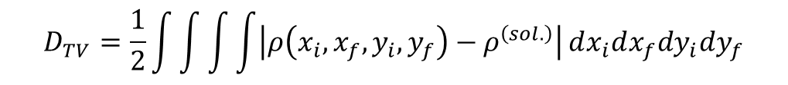
The reliability of the analytic formula was validated when reconstructing different distributions
Manually configured multiple distinct Gaussian distributions as ground-truth models
$$\left[\begin{matrix}〈x_{i}x_{i}〉 & 〈x_{i}x_{f}〉 & 〈x_{i}y_{i}〉 & 〈x_{i}y_{f}〉 \\ 〈x_{i}x_{f}〉 & 〈x_{f}x_{f}〉 & 〈x_{f}y_{i}〉 & 〈x_{f}y_{f}〉 \\ 〈x_{i}y_{i}〉 & 〈x_{f}y_{i}〉 & 〈y_{i}y_{i}〉 & 〈y_{i}y_{f}〉 \\ 〈x_{i}y_{f}〉 & 〈x_{f}y_{f}〉 & 〈y_{i}y_{f}〉 & 〈y_{f}y_{f}〉\end{matrix}\right]$$
  with distinct covariance matrices
  Full probability density distribution in the $\left(x_{i},x_{f},y_{i},y_{f}\right)$coordinate space
Representing probability density distributions via computational grids
  （40，40，40，40）: 40 grid points per dimension
  （-8，8）: Range of [-8, 8] per dimension
$$D_{TV}=\frac{1}{2}\int{\int{\int{\int{\left|ρ\left(x_{i},x_{f},y_{i},y_{f}\right)−ρ^{\left(sol.\right)}\right|}}}}dx_{i}dx_{f}dy_{i}dy_{f}$$
2

Slide 3
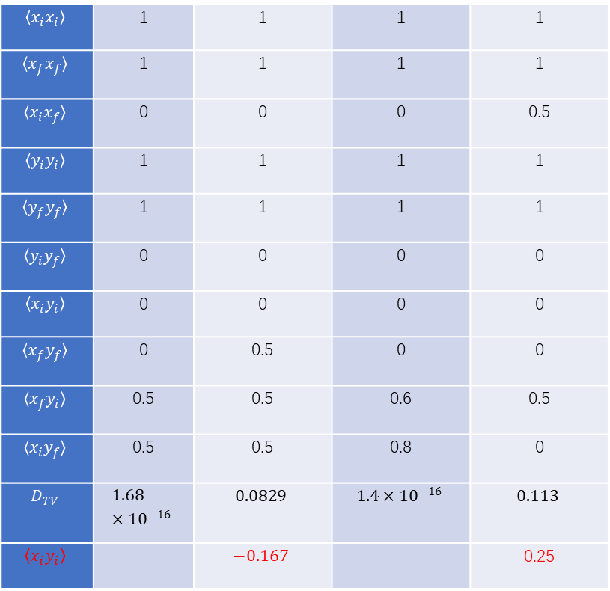
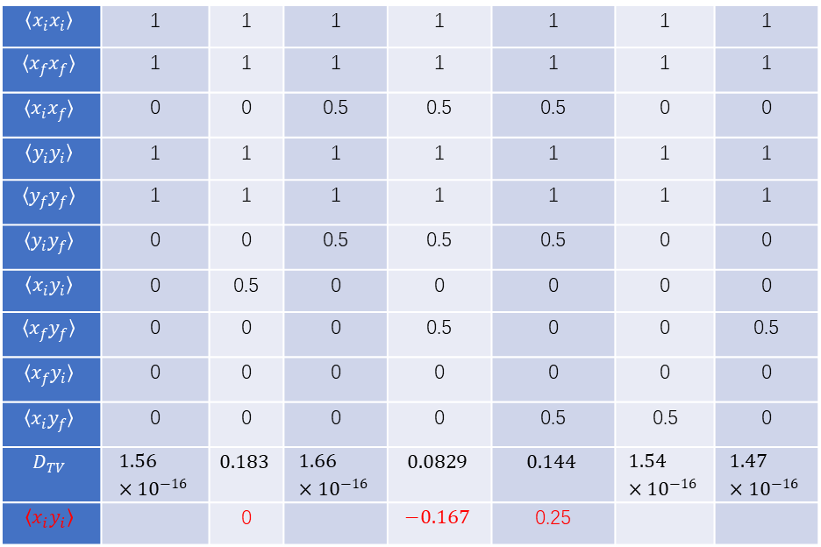
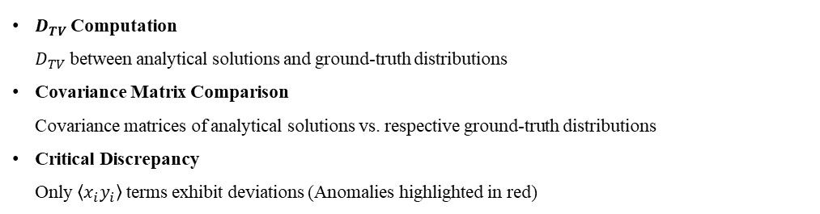
$$〈x_{i}x_{i}〉$$ | 1 | 1 | 1 | 1 | 1 | 1 | 1
$$〈x_{f}x_{f}〉$$ | 1 | 1 | 1 | 1 | 1 | 1 | 1
$$〈x_{i}x_{f}〉$$ | 0 | 0 | 0.5 | 0.5 | 0.5 | 0 | 0
$$〈y_{i}y_{i}〉$$ | 1 | 1 | 1 | 1 | 1 | 1 | 1
$$〈y_{f}y_{f}〉$$ | 1 | 1 | 1 | 1 | 1 | 1 | 1
$$〈y_{i}y_{f}〉$$ | 0 | 0 | 0.5 | 0.5 | 0.5 | 0 | 0
$$〈x_{i}y_{i}〉$$ | 0 | 0.5 | 0 | 0 | 0 | 0 | 0
$$〈x_{f}y_{f}〉$$ | 0 | 0 | 0 | 0.5 | 0 | 0 | 0.5
$$〈x_{f}y_{i}〉$$ | 0 | 0 | 0 | 0 | 0 | 0 | 0
$$〈x_{i}y_{f}〉$$ | 0 | 0 | 0 | 0 | 0.5 | 0.5 | 0
$$D_{TV}$$ | $$1.56×{10}^{−16}$$ | $$0.183$$ | $$1.66×{10}^{−16}$$ | $$0.0829$$ | $$0.144$$ | $$1.54×{10}^{−16}$$ | $$1.47×{10}^{−16}$$
$$〈x_{i}y_{i}〉$$ |  | 0 |  | $$−0.167$$ | 0.25
$$〈x_{i}x_{i}〉$$ | 1 | 1 | 1 | 1
$$〈x_{f}x_{f}〉$$ | 1 | 1 | 1 | 1
$$〈x_{i}x_{f}〉$$ | 0 | 0 | 0 | 0.5
$$〈y_{i}y_{i}〉$$ | 1 | 1 | 1 | 1
$$〈y_{f}y_{f}〉$$ | 1 | 1 | 1 | 1
$$〈y_{i}y_{f}〉$$ | 0 | 0 | 0 | 0
$$〈x_{i}y_{i}〉$$ | 0 | 0 | 0 | 0
$$〈x_{f}y_{f}〉$$ | 0 | 0.5 | 0 | 0
$$〈x_{f}y_{i}〉$$ | 0.5 | 0.5 | 0.6 | 0.5
$$〈x_{i}y_{f}〉$$ | 0.5 | 0.5 | 0.8 | 0
$$D_{TV}$$ | $$1.68×{10}^{−16}$$ | $$0.0829$$ | $$1.4×{10}^{−16}$$ | $$0.113$$
$$〈x_{i}y_{i}〉$$ |  | $$−0.167$$ |  | 0.25
$D_{TV}$Computation
$D_{TV}$between analytical solutions and ground-truth distributions
Covariance Matrix Comparison
Covariance matrices of analytical solutions vs. respective ground-truth distributions
Critical Discrepancy
Only $〈x_{i}y_{i}〉$terms exhibit deviations (Anomalies highlighted in red)

Slide 4

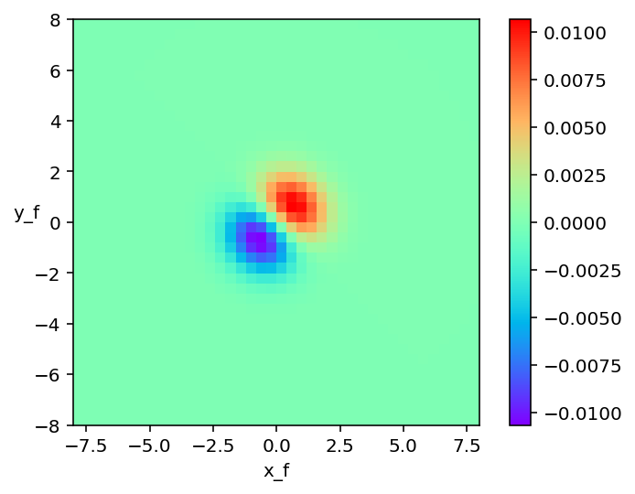

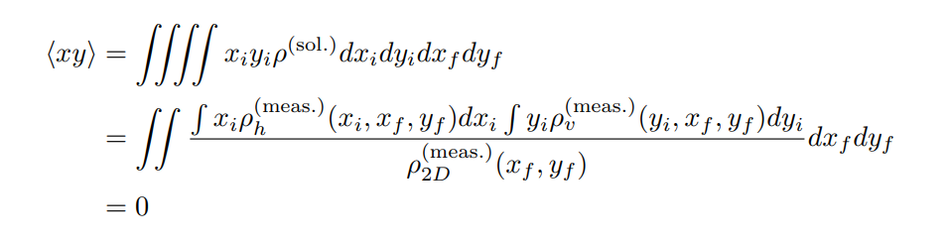

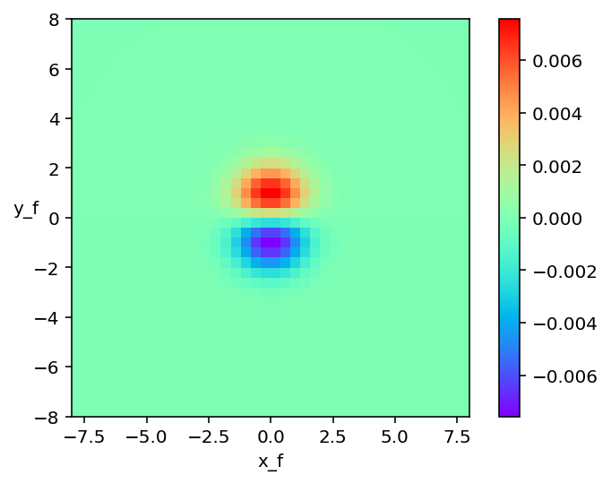
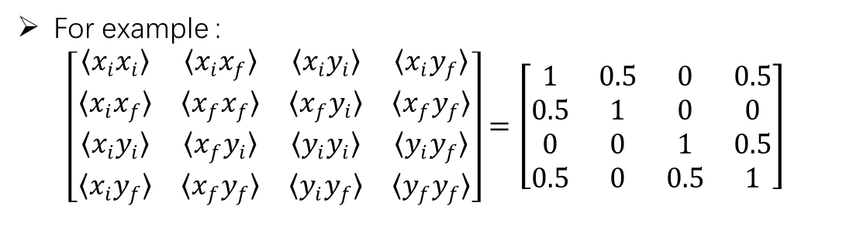
This shows some deviation from our prior assumptions
For example :
$$\left[\begin{matrix}〈x_{i}x_{i}〉 & 〈x_{i}x_{f}〉 & 〈x_{i}y_{i}〉 & 〈x_{i}y_{f}〉 \\ 〈x_{i}x_{f}〉 & 〈x_{f}x_{f}〉 & 〈x_{f}y_{i}〉 & 〈x_{f}y_{f}〉 \\ 〈x_{i}y_{i}〉 & 〈x_{f}y_{i}〉 & 〈y_{i}y_{i}〉 & 〈y_{i}y_{f}〉 \\ 〈x_{i}y_{f}〉 & 〈x_{f}y_{f}〉 & 〈y_{i}y_{f}〉 & 〈y_{f}y_{f}〉\end{matrix}\right]=\left[\begin{matrix}1 & 0.5 & 0 & 0.5 \\ 0.5 & 1 & 0 & 0 \\ 0 & 0 & 1 & 0.5 \\ 0.5 & 0 & 0.5 & 1\end{matrix}\right]$$

Slide 5
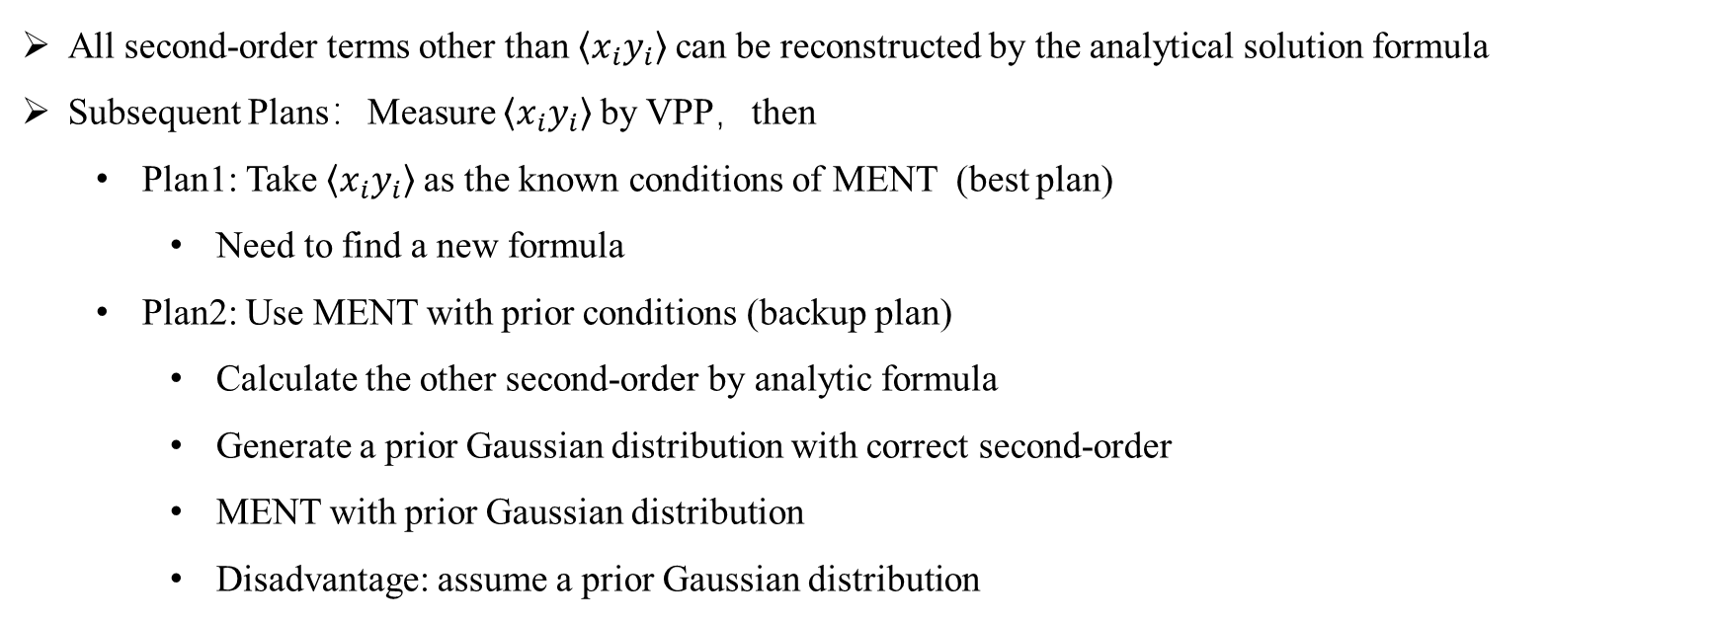
All second-order terms other than $〈x_{i}y_{i}〉$can be reconstructed by the analytical solution formula
Subsequent Plans：Measure $〈x_{i}y_{i}〉$by VPP，then
  Plan1: Take $〈x_{i}y_{i}〉$as the known conditions of MENT (best plan)
    Need to find a new formula
  Plan2: Use MENT with prior conditions (backup plan)
    Calculate the other second-order by analytic formula
    Generate a prior Gaussian distribution with correct second-order
    MENT with prior Gaussian distribution
    Disadvantage: assume a prior Gaussian distribution

