Slide 1
Brief Update
2026.06.04
Jiyoung Choi
*Please refer to the slide notes for details

Slide 2
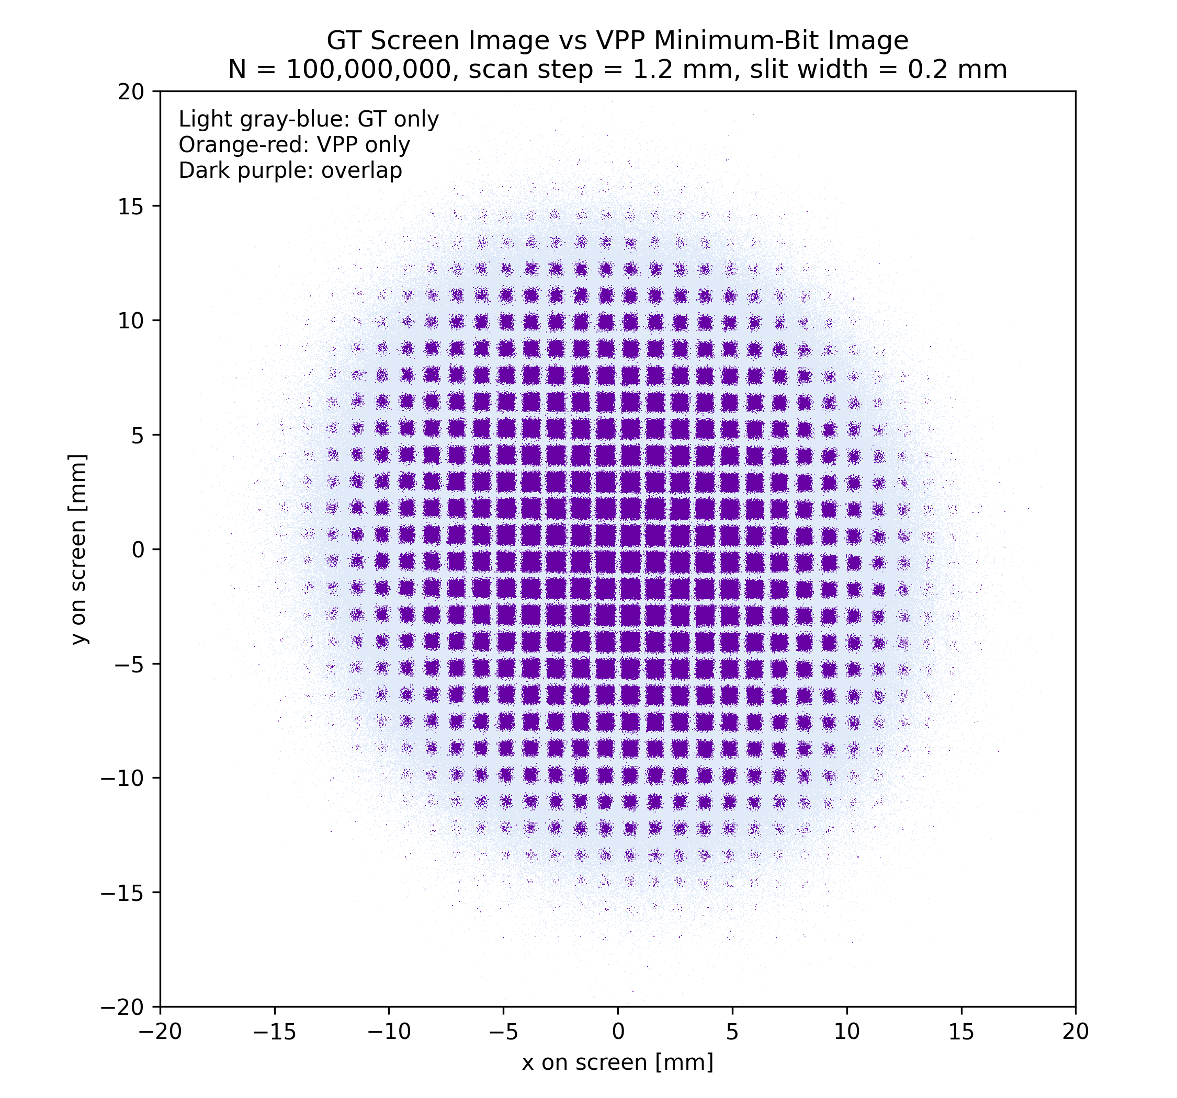
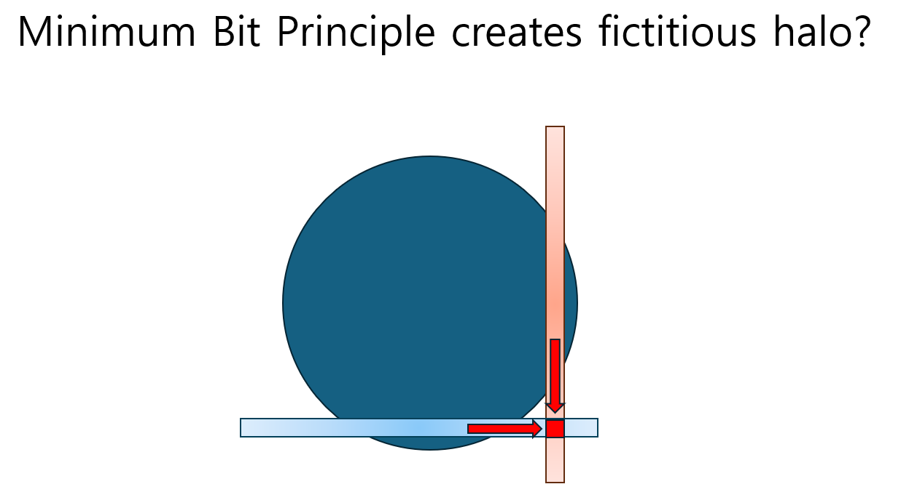
Simple Test: Fictitious Halo Beamlet
Screen GT & VPP Beamlets Overlay
Prof. Jonathan Wong comment
Result: VPP only bin = 0
Notes:
This slide shows a simple check to see whether the Minimum Bit Principle creates fictitious halo beamlets.
Prof. Jonathan commented that the Minimum Bit Principle might artificially generate halo-like beamlets. To check this, I compared the Ground Truth(GT) screen image with the constructed VPP beamlets image on the screen.
In the overlay plot, the GT-only bins, VPP-only bins, and overlapped bins were separated by color. It is hard to check the color. Although it may be difficult to verify by color, VPP-only bins are not visible in the plot. Also, I check the number, VPP-only bins, was zero. This means that, in this test condition, the Minimum Bit Principle did not create additional fictitious beamlets outside the GT screen distribution.
Therefore, at least for this simple test, I did not observe artificial halo beamlets generated by the Minimum Bit Principle.

Slide 3
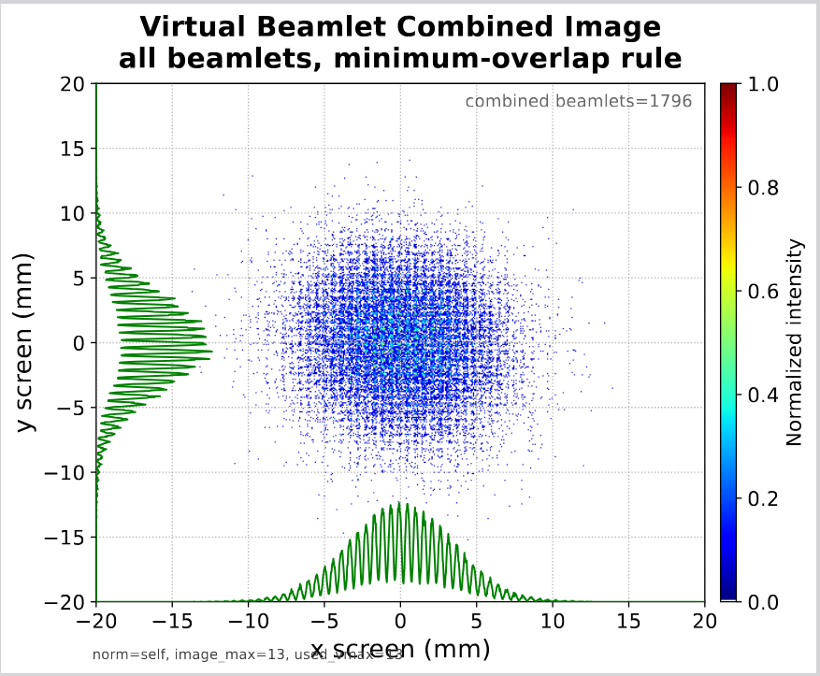
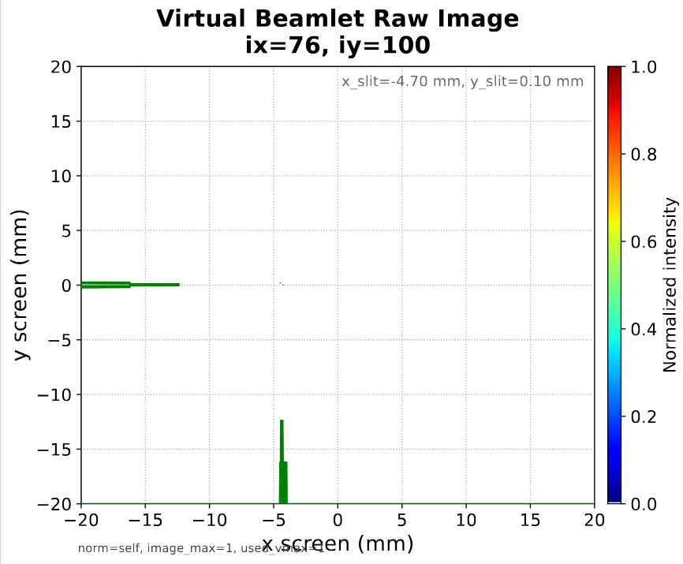
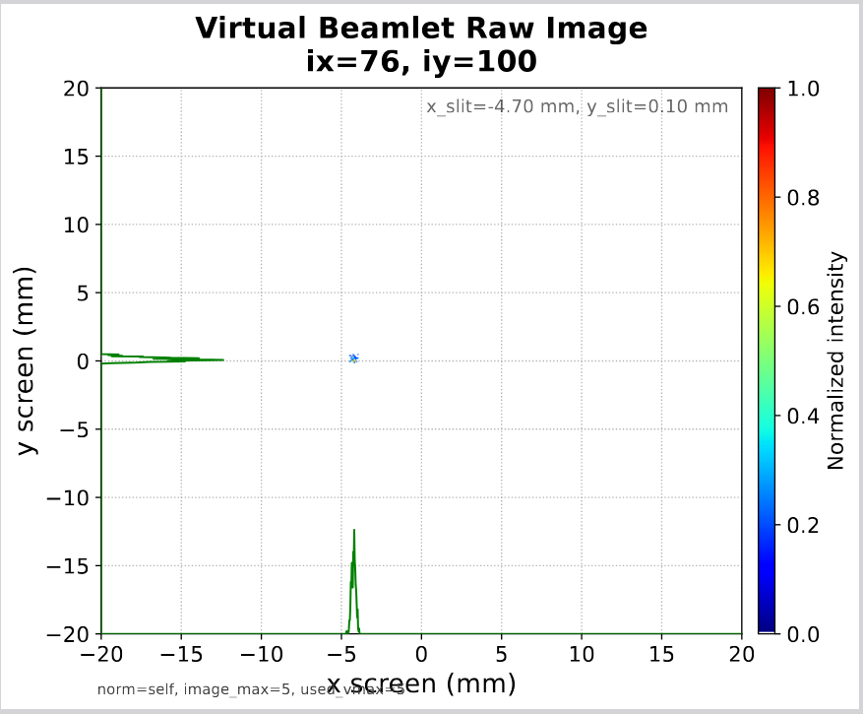
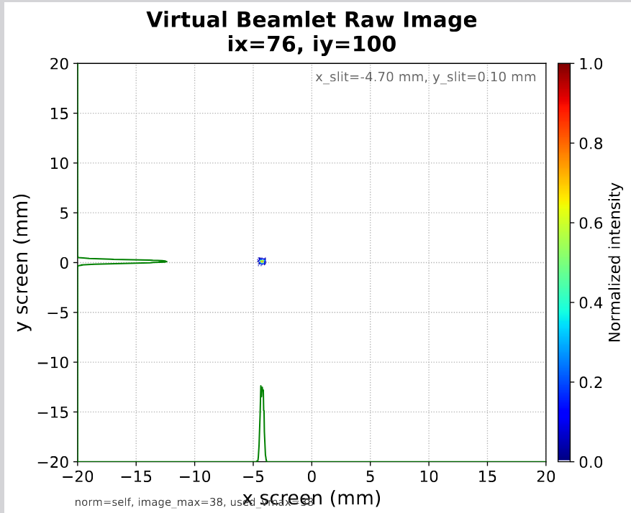
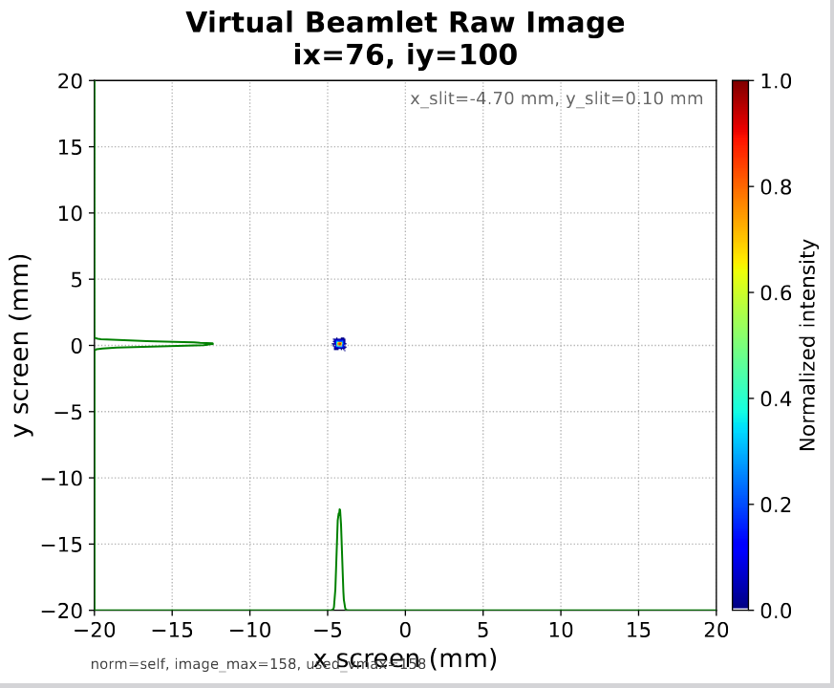
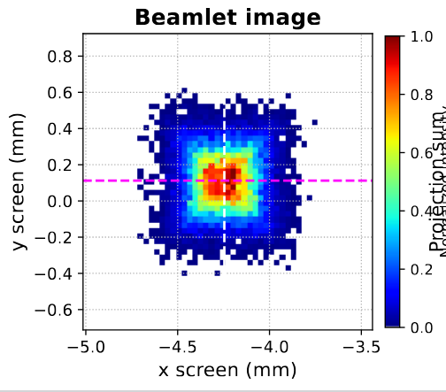
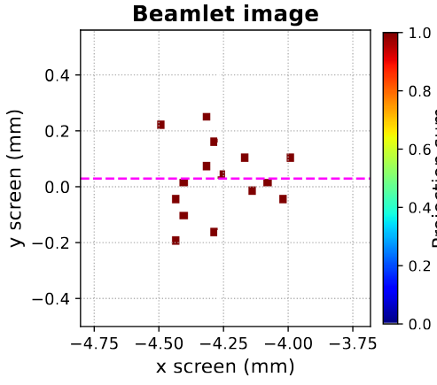
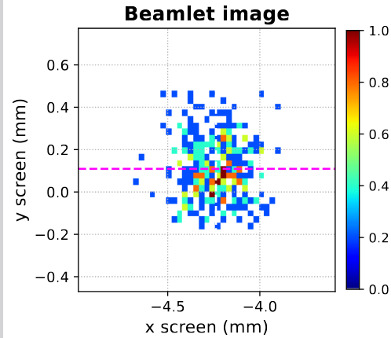
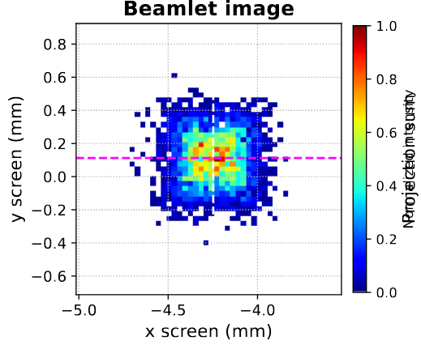
Notes:
Dr. Cosgun pointed out two possible factors.
The first one is the RMS beamlet size. From the previous results, the beamlets with a larger number of macroparticles, such as 10M, 50M or 100M, seemed to show larger RMS beamlet sizes. This could naturally increase the reconstructed emittance values.
The second possible factor is the uncertainty of instability of the projected beamlet peaks. Especially in low-statistics cases, such as 0.1M macroparticles, some of the 1D projected beamlet profiles appeared to have multiple peaks. This could affect the Gaussian fitting procedure and may introduce uncertainty in the extracted beamlet center and size.
Based on these comments, I tried to check whether the RMS beamlet size contribution could be related to the macroparticle dependent reconstruction error.

Slide 4
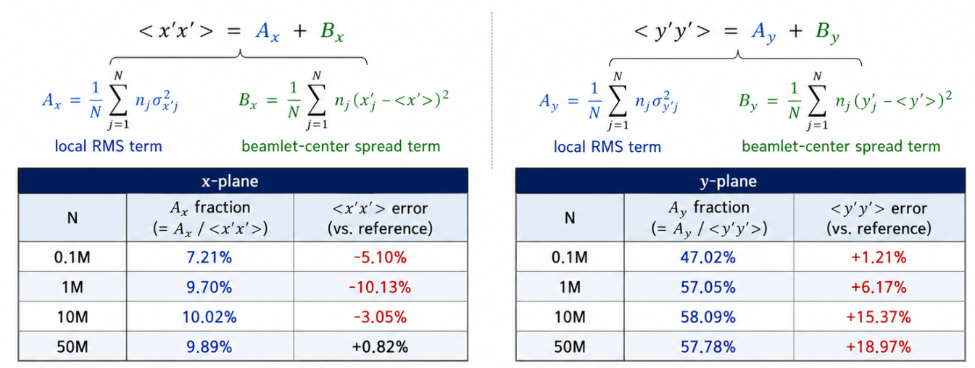
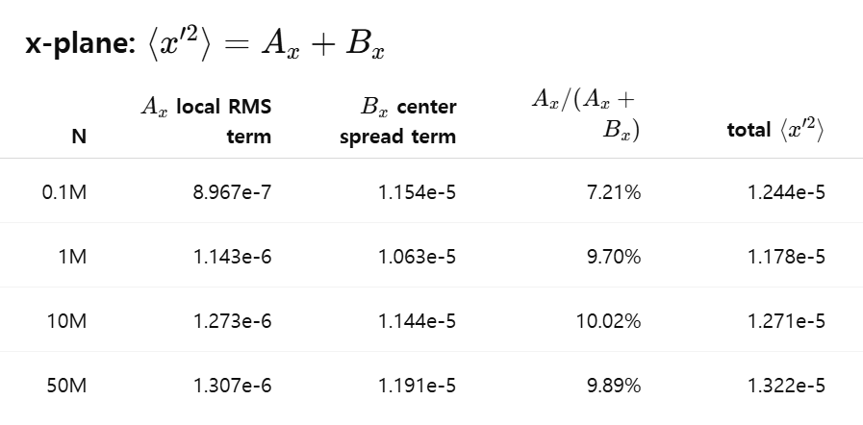
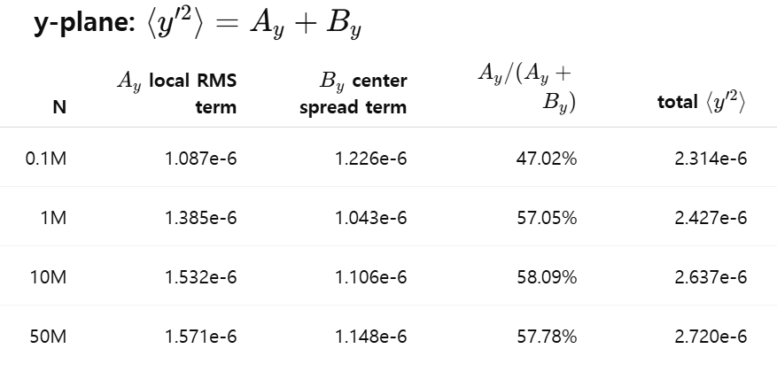
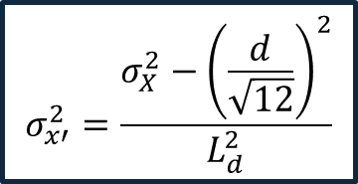
Mode0: COM + moment RMS beamlet size
0.2mm scan step
$$σ_{x′}^{2}=\frac{σ_{X}^{2}−{\left(\frac{d}{\sqrt{12}}\right)}^{2}}{L_{d}^{2}}$$
Notes:
This slide show the decomposition of the angular variance terms, <x’x’> and <y’y’>, for the COM-based reconstruction with a 0.2 mm scan step. Since I have not yet fully finalized a stable extraction method for the beamlet peak position and RMS beamlet size, I used the COM-based method as the current baseline.
Each angular variance term is separated into two contributions: the ‘local RMS term’ and the ‘beamlet-center spread term’.
In the x-plane, the local RMS term is relatively small compared with the beamlet-center spread term, so the trend is not very clear at this stage.
In the y-plane, however, the local RMS term accounts for about half or more of <y’y’>. Also, as the number of macroparticles increases, the local RMS term tends to increase. This suggests that the increase in <y’y’> error may be related to the increase in the local RMS beamlet size contribution.
Therefore, this result supports the possibility that the beamlet RMS size can affect the reconstructed vertical angular variance and, consequently, the vertical emittance.

