Slide 1
# of Macroparticle Dependence in VPP
May. 11, 2026
Jiyoung Choi

Slide 2
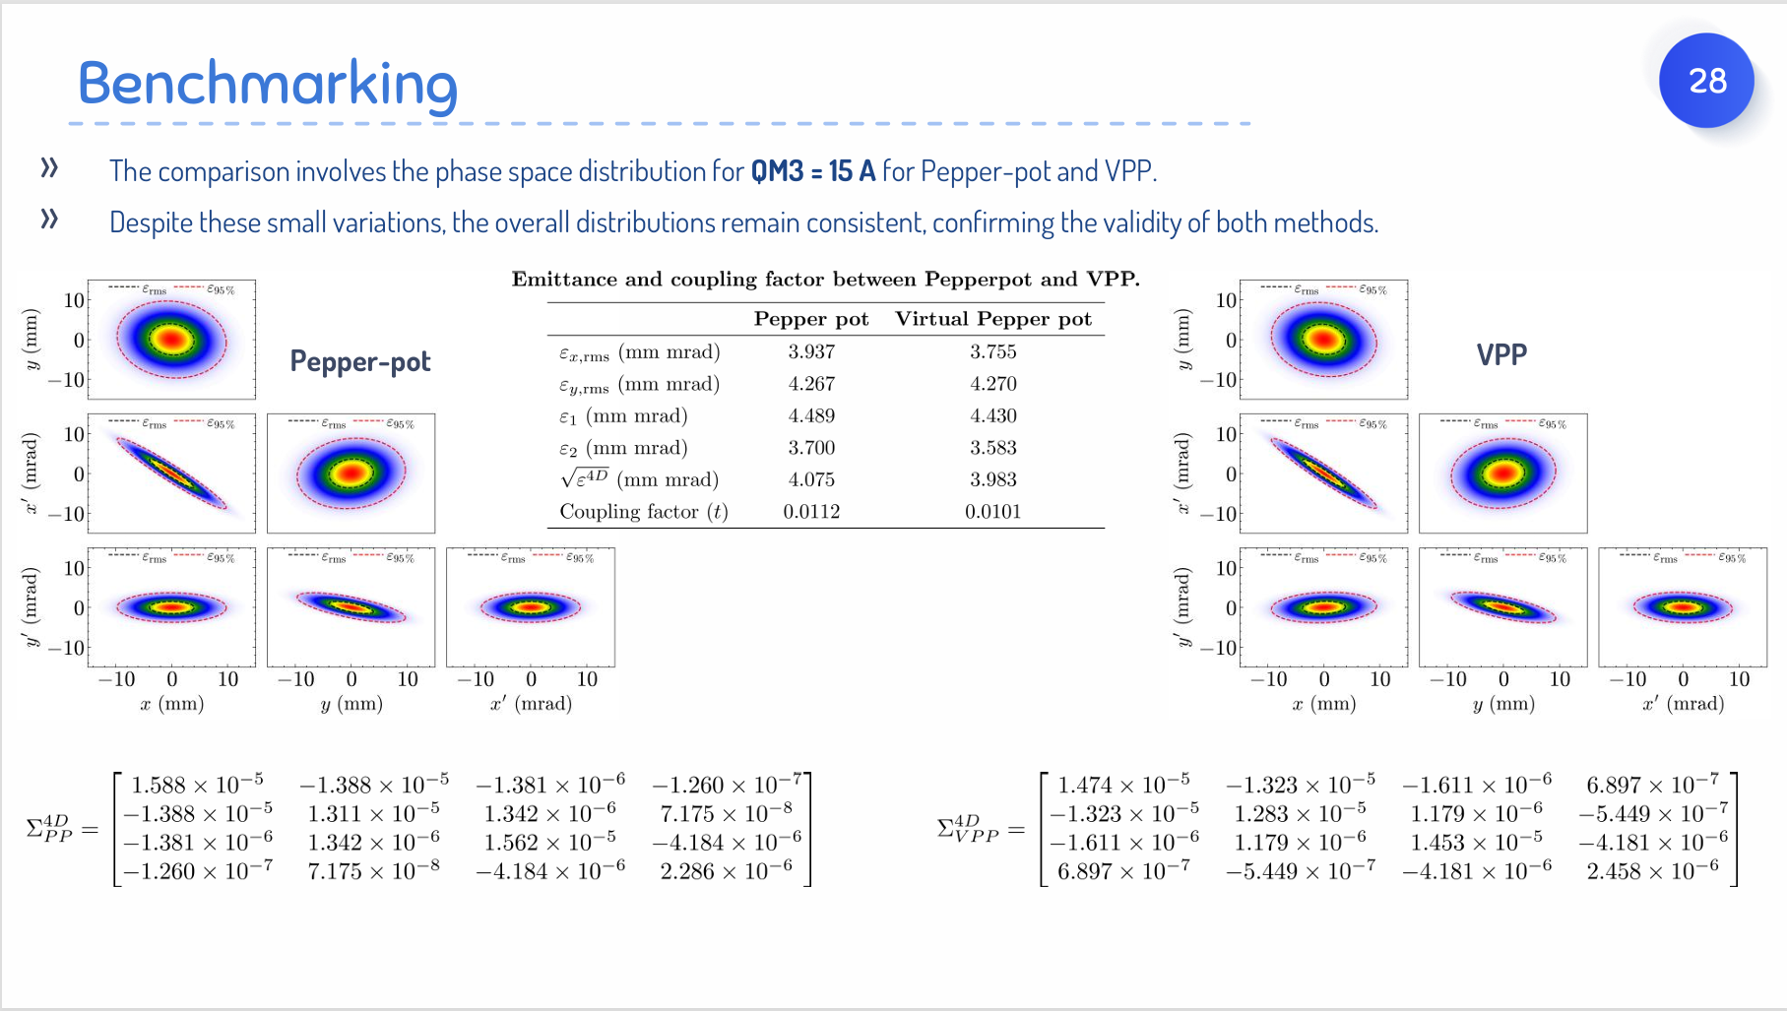
Case3

Slide 3
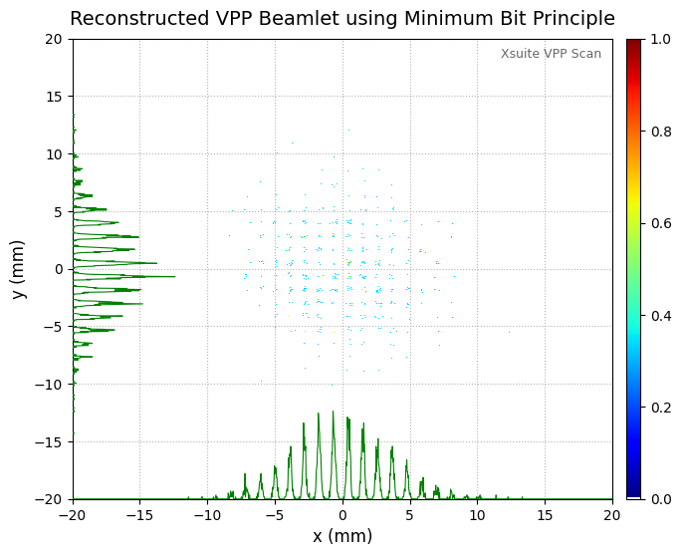
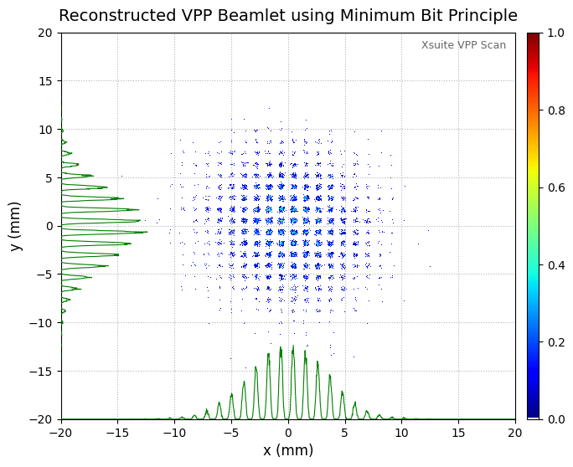
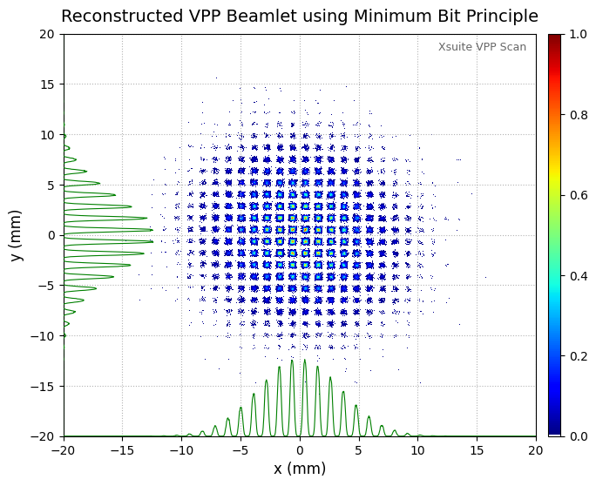
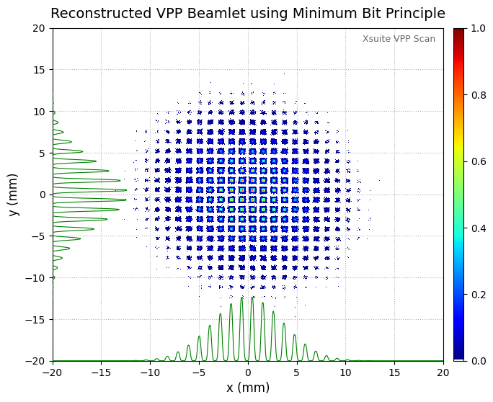
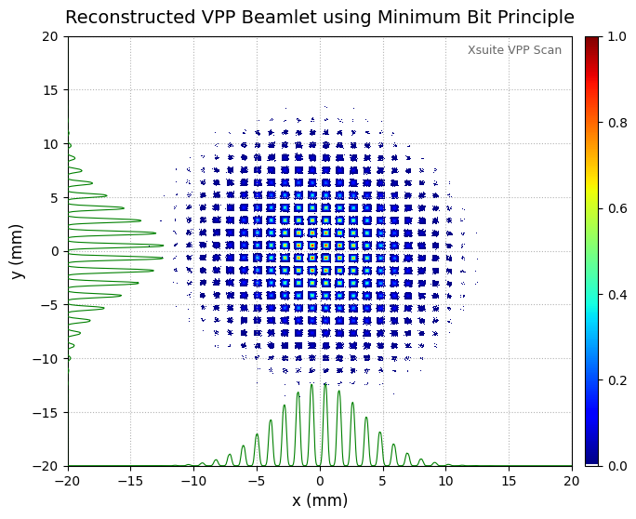
Effect of changing the # of Xsuite macroparticles on the Virtual Beamlets (Screen)
0.1M
1M
10M
50M
100M
*Please ignore the color differences between the plots as the intensity between the plots has not been normalized.

Slide 4
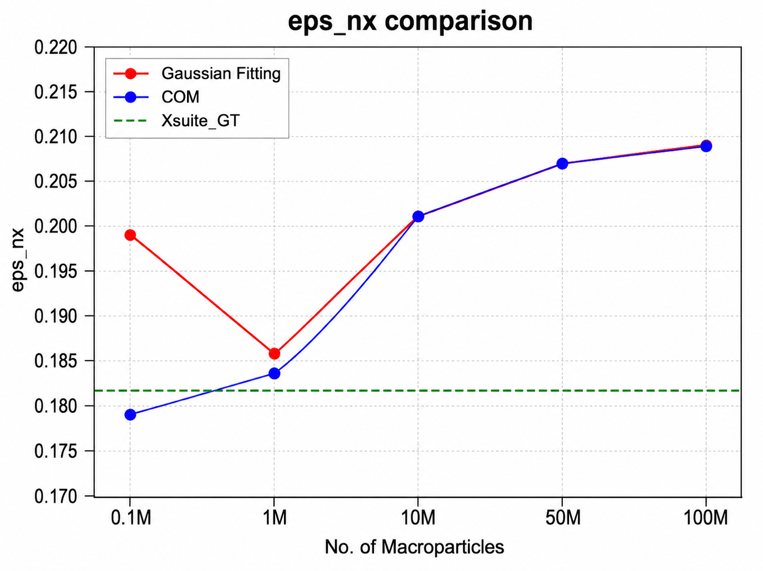
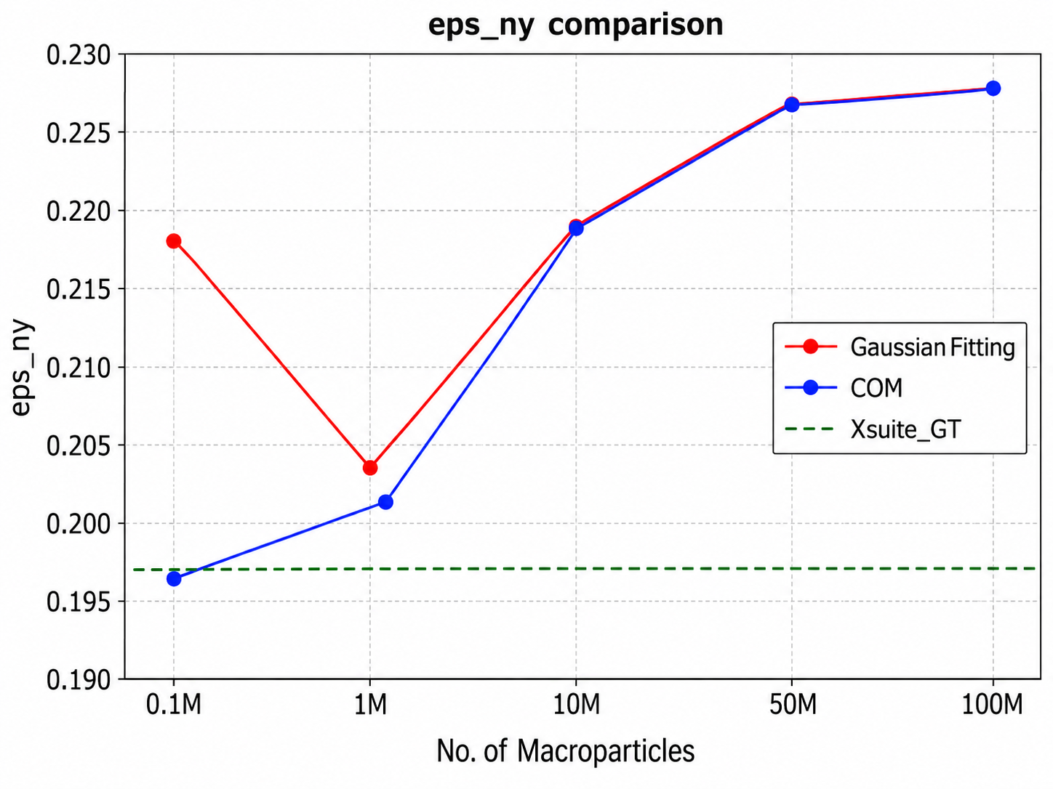
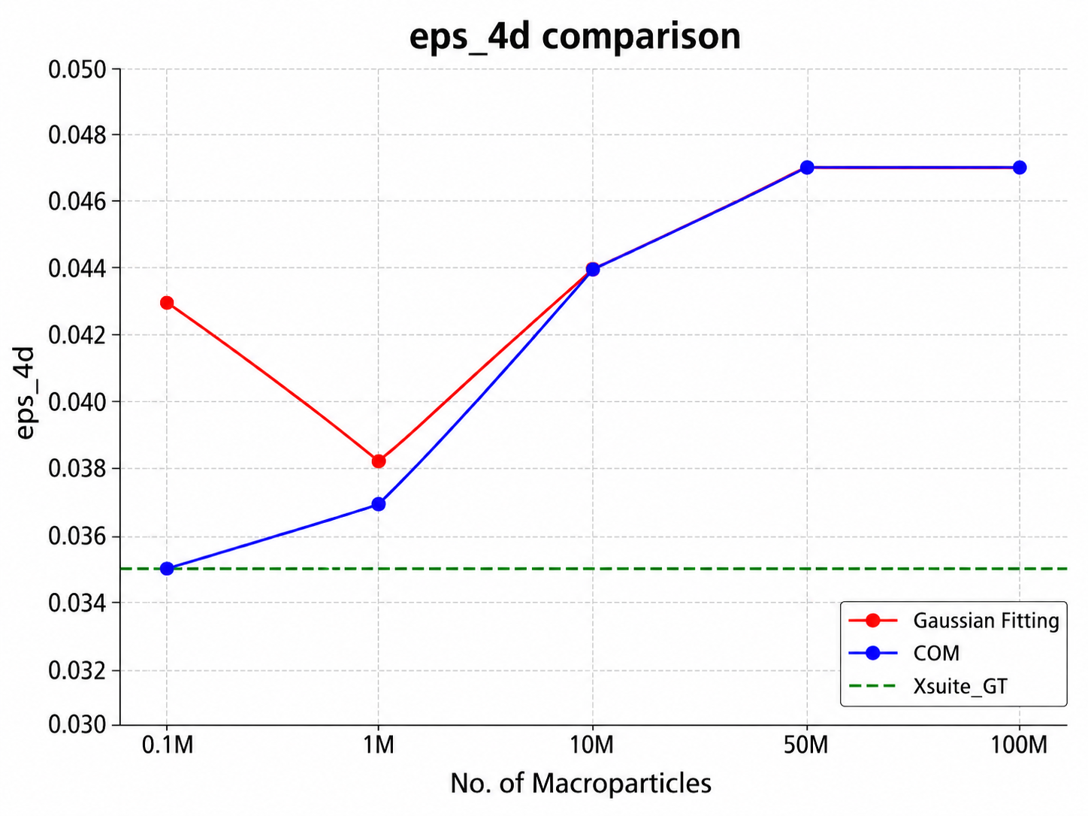
Effect of changing the # of Xsuite macroparticles on the emittance values

