Slide 1
2026-05-27,
Question[3]
-update
DAON LEE
2026 The Beam Diagnostics and Tomography Study

Slide 2
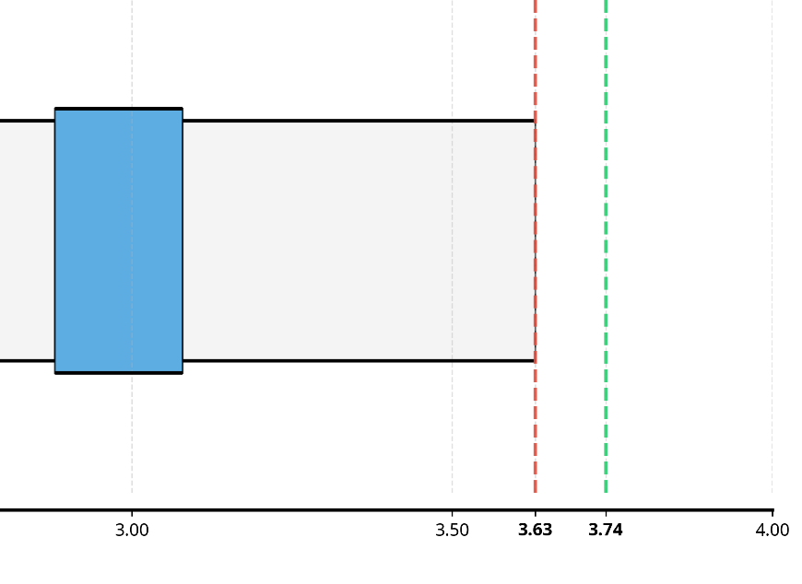
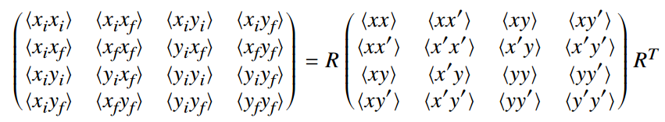


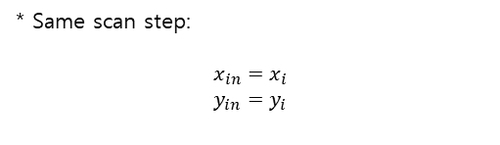



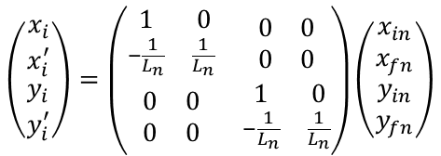



Question[3]
Multi-screen scan method
• Multi-screen distance(two another distance; L1, L2)
L1
L2
$$\left(\begin{matrix}\begin{matrix}x_{i} \\ x_{i}^{′}\end{matrix} \\ \begin{matrix}y_{i} \\ y_{i}^{′}\end{matrix}\end{matrix}\right)=\left(\begin{matrix}\begin{matrix}1 & 0 \\ −\frac{1}{L_{n}} & \frac{1}{L_{n}}\end{matrix} & \begin{matrix}0 & 0 \\ 0 & 0\end{matrix} \\ \begin{matrix}0 & 0 \\ 0 & 0\end{matrix} & \begin{matrix}1 & 0 \\ −\frac{1}{L_{n}} & \frac{1}{L_{n}}\end{matrix}\end{matrix}\right)\left(\begin{matrix}\begin{matrix}x_{in} \\ x_{fn}\end{matrix} \\ \begin{matrix}y_{in} \\ y_{fn}\end{matrix}\end{matrix}\right)$$
Previous result
$$x_{i}, y_{i}$$
$$=R_{n}$$
* Same scan step:
$$x_{in}=x_{i}$$
$$y_{in}=y_{i}$$
$$x_{fn}, y_{fn}$$
RECON.
$$\left\langle x_{i}y_{fn}\right\rangle =\frac{\left\langle xy′\right\rangle }{L_{n}}−\frac{\left\langle xy\right\rangle }{L_{n}}$$
Unknown : $\left\langle xy\right\rangle , \left\langle xy′\right\rangle , \left\langle x′y\right\rangle , \left\langle x′y′\right\rangle$
$$⇒$$
$$\left\langle y_{i}x_{fn}\right\rangle =\frac{\left\langle x′y\right\rangle }{L_{n}}−\frac{\left\langle xy\right\rangle }{L_{n}}$$
It is possible to solve.
$$\left\langle x_{fn}y_{fn}\right\rangle =\frac{\left\langle xy\right\rangle }{L_{n}^{2}}−\frac{\left\langle xy^{′}\right\rangle }{L_{n}^{2}}−\frac{\left\langle x′y\right\rangle }{L_{n}^{2}}+\frac{\left\langle x′y′\right\rangle }{L_{n}^{2}}$$
2

Slide 3
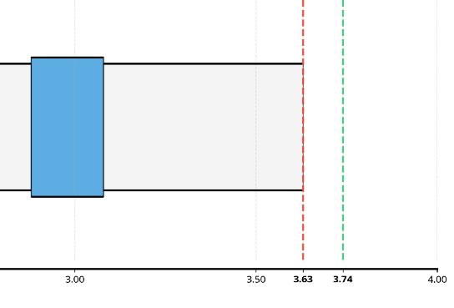
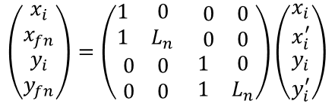


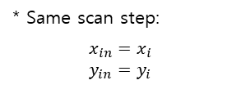

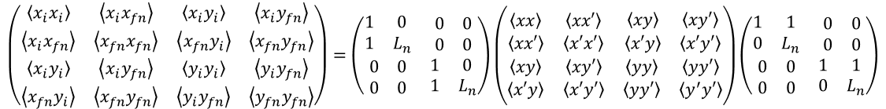








Question[3]
Multi-screen scan method
$$\left(\begin{matrix}\begin{matrix}x_{i} \\ x_{i}^{′}\end{matrix} \\ \begin{matrix}y_{i} \\ y_{i}^{′}\end{matrix}\end{matrix}\right)=\left(\begin{matrix}\begin{matrix}1 & 0 \\ −\frac{1}{L_{n}} & \frac{1}{L_{n}}\end{matrix} & \begin{matrix}0 & 0 \\ 0 & 0\end{matrix} \\ \begin{matrix}0 & 0 \\ 0 & 0\end{matrix} & \begin{matrix}1 & 0 \\ −\frac{1}{L_{n}} & \frac{1}{L_{n}}\end{matrix}\end{matrix}\right)\left(\begin{matrix}\begin{matrix}x_{in} \\ x_{fn}\end{matrix} \\ \begin{matrix}y_{in} \\ y_{fn}\end{matrix}\end{matrix}\right)$$
* Same scan step:
$$x_{in}=x_{i}$$
$$y_{in}=y_{i}$$
$$=R_{n}$$
Problem
In my case,
L1
L2
[1] KLAUS WILLE, The Physics of Particle Accelerators p.85
$$\left(\begin{matrix}\begin{matrix}x_{i} \\ x_{fn}\end{matrix} \\ \begin{matrix}y_{i} \\ y_{fn}\end{matrix}\end{matrix}\right)=\left(\begin{matrix}\begin{matrix}1 & 0 \\ 1 & L_{n}\end{matrix} & \begin{matrix}0 & 0 \\ 0 & 0\end{matrix} \\ \begin{matrix}0 & 0 \\ 0 & 0\end{matrix} & \begin{matrix}1 & 0 \\ 1 & L_{n}\end{matrix}\end{matrix}\right)\left(\begin{matrix}\begin{matrix}x_{i} \\ x_{i}^{′}\end{matrix} \\ \begin{matrix}y_{i} \\ y_{i}^{′}\end{matrix}\end{matrix}\right)$$
$$X_{1}={R′}_{n}X_{0}$$
$$⇒$$
i, f
re-i, re_i’
i, f
$$⇒$$
$$B_{1}={R′}_{n}B_{0}{R′}_{n}^{T}$$
$$≡{R′}_{n}$$
$$\left(\begin{matrix}\begin{matrix}\left\langle x_{i}x_{i}\right\rangle & \left\langle x_{i}x_{fn}\right\rangle \\ \left\langle x_{i}x_{fn}\right\rangle & \left\langle x_{fn}x_{fn}\right\rangle \end{matrix} & \begin{matrix}\left\langle x_{i}y_{i}\right\rangle & \left\langle x_{i}y_{fn}\right\rangle \\ \left\langle x_{fn}y_{i}\right\rangle & \left\langle x_{fn}y_{fn}\right\rangle \end{matrix} \\ \begin{matrix}\left\langle x_{i}y_{i}\right\rangle & \left\langle x_{i}y_{fn}\right\rangle \\ \left\langle x_{fn}y_{i}\right\rangle & \left\langle x_{fn}y_{fn}\right\rangle \end{matrix} & \begin{matrix}\left\langle y_{i}y_{i}\right\rangle & \left\langle y_{i}y_{fn}\right\rangle \\ \left\langle y_{i}y_{fn}\right\rangle & \left\langle y_{fn}y_{fn}\right\rangle \end{matrix}\end{matrix}\right)=\left(\begin{matrix}\begin{matrix}1 & 0 \\ 1 & L_{n}\end{matrix} & \begin{matrix}0 & 0 \\ 0 & 0\end{matrix} \\ \begin{matrix}0 & 0 \\ 0 & 0\end{matrix} & \begin{matrix}1 & 0 \\ 1 & L_{n}\end{matrix}\end{matrix}\right)\left(\begin{matrix}\begin{matrix}\left\langle xx\right\rangle & \left\langle xx′\right\rangle \\ \left\langle xx′\right\rangle & \left\langle x′x′\right\rangle \end{matrix} & \begin{matrix}\left\langle xy\right\rangle & \left\langle xy′\right\rangle \\ \left\langle x′y\right\rangle & \left\langle x′y′\right\rangle \end{matrix} \\ \begin{matrix}\left\langle xy\right\rangle & \left\langle xy′\right\rangle \\ \left\langle x′y\right\rangle & \left\langle x′y′\right\rangle \end{matrix} & \begin{matrix}\left\langle yy\right\rangle & \left\langle yy′\right\rangle \\ \left\langle yy′\right\rangle & \left\langle y^{′}y′\right\rangle \end{matrix}\end{matrix}\right)\left(\begin{matrix}\begin{matrix}1 & 1 \\ 0 & L_{n}\end{matrix} & \begin{matrix}0 & 0 \\ 0 & 0\end{matrix} \\ \begin{matrix}0 & 0 \\ 0 & 0\end{matrix} & \begin{matrix}1 & 1 \\ 0 & L_{n}\end{matrix}\end{matrix}\right)$$
RECON.
$$⇒$$
re-i, re_i’
$$\left\langle x_{i}y_{fn}\right\rangle =\left\langle xy\right\rangle +\frac{\left\langle xy′\right\rangle }{L_{n}}$$
$$⇒$$
Unknown : $\left\langle xy\right\rangle , \left\langle xy′\right\rangle , \left\langle x′y\right\rangle , \left\langle x′y′\right\rangle$
$$\left\langle x_{fn}y_{i}\right\rangle =\left\langle xy\right\rangle +\left\langle x^{′}y\right\rangle L_{n}$$
It is possible to solve.
$$\left\langle x_{fn}y_{fn}\right\rangle =\left\langle xy\right\rangle +\frac{\left\langle xy^{′}\right\rangle }{L_{n}}+\left\langle x′y\right\rangle L_{n}+\left\langle x′y′\right\rangle$$
3

Slide 4
