Slide 1
2026-05-10~13,
Questions
-update
DAON LEE
2026 The Beam Diagnostics and Tomography Study

Slide 2












Question[2]
Space-charge/emittance
Space-charge ratio comparison
• RMS Envelop equation(kapchincky-Vladimirsky eq.)
Number of particles for bunch
* Generalized perveance
$$\hat{I}=\frac{qNβc}{\sqrt{2π}σ_{z}}$$
$$σ_{x}^{′′}+k_{x}\left(s\right)σ_{x}−\frac{K}{2(σ_{x}+σ_{y})}−\frac{ε_{x}^{2}}{σ_{x}^{3}}=0$$
Bunch peak current
For gaussian bunch:
$$K=\frac{\hat{I}}{I_{0}}\frac{2}{β^{3}γ^{3}}\left(1−γ^{2}f_{e}\right)$$
Charge-Neutralization factor
$$I_{0}=\frac{4πε_{0}mc^{3}}{q}$$
Characteristic current:
$$σ_{y}^{′′}+k_{y}\left(s\right)σ_{y}−\frac{K}{2(σ_{x}+σ_{y})}−\frac{ε_{y}^{2}}{σ_{y}^{3}}=0$$
$β, γ$ – relativistic factor
Characteristic current
Classical particle radius:
$$r_{p}=\frac{q^{2}}{4πε_{0}mc^{2}}$$
focusing
space-charge
emittance
[1] Theory and Design of Charged particle Beam p.325
Supposes $f_{e}=0$,
[2] Multiparticle Dynamics with Space Charge Ch.9 p.298
Space-charge dominated:
$$\frac{Kσ_{1}^{3}}{2\left(σ_{1}+σ_{2}\right)ε_{1}^{2}}≫1$$
$$∴ K=\frac{2r_{p}N}{β^{2}γ^{3}\sqrt{2π}σ_{z}}$$
Emittance dominated:
$$\frac{Kσ_{1}^{3}}{2\left(σ_{1}+σ_{2}\right)ε_{1}^{2}}≪1$$
$$∴ K=\left(5.57418544e−16\right)\frac{N}{σ_{z}}$$
[2] Multiparticle Dynamics with Space Charge Ch.9 p.298
1
SC/focusing ratio(at 7th quadrupole; the lowest magnetic field strength)
2
SC/emit. ratio(just before slit, original bunch)
3
SC/emit. ratio(just after slit, beamlets)
2

Slide 3
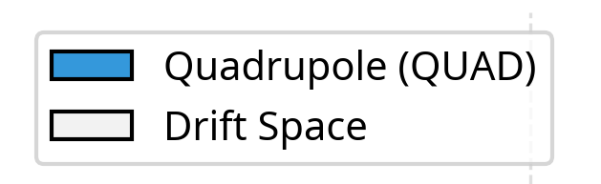
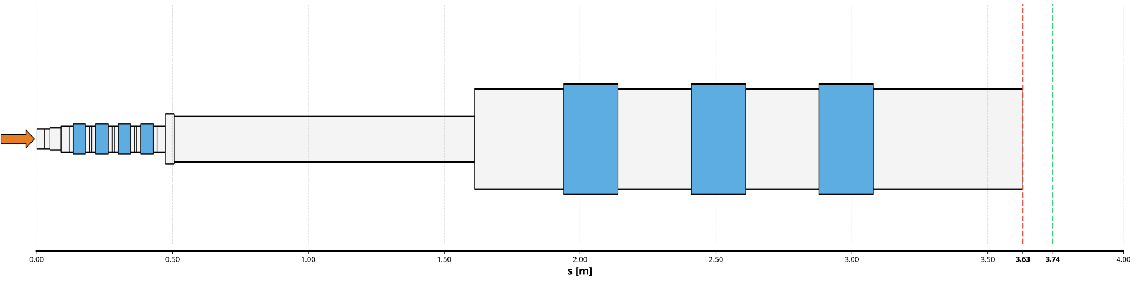





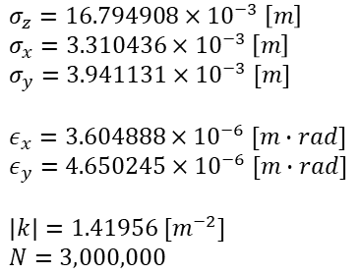

Question[2]
Space-charge/emittance
1
SC/focusing ratio(at 7th quadrupole; the lowest magnetic field strength)
Here
i) Horizontal
$σ_{z}=16.794908×{10}^{−3} \left[m\right]$
$σ_{x}=3.310436×{10}^{−3} \left[m\right]$
$σ_{y}=3.941131×{10}^{−3} [m]$
$ε_{x}=3.604888×{10}^{−6} [m∙rad]$
$ε_{y}=4.650245×{10}^{−6} [m∙rad]$
$\left|k\right|=1.41956 [m^{−2}]$
$N=3,000,000$
+ emittance/focusing ratio
$$\frac{K}{2σ_{x}\left(σ_{x}+σ_{y}\right)\left|k\right|}≈0.0015≪1$$
$$\frac{ε_{x}^{2}}{σ_{x}^{3}\left|k\right|}≈0.00025≪1$$
$$∴SC≪focusing$$
$$∴emittance≪focusing$$
ii) Vertical
$$\frac{K}{2σ_{y}\left(σ_{x}+σ_{y}\right)\left|k\right|}≈0.0019≪1$$
$$∴ K≈9.96×{10}^{−8}$$
$$∴SC≪focusing$$
3

Slide 4

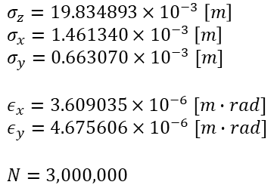



Question[2]
Space-charge/emittance
2
SC/emit. ratio(just before slit, original bunch)
$σ_{z}=19.834893×{10}^{−3} \left[m\right]$
$σ_{x}=1.461340×{10}^{−3} \left[m\right]$
$σ_{y}=0.663070×{10}^{−3} [m]$
$ε_{x}=3.609035×{10}^{−6} [m∙rad]$
$ε_{y}=4.675606×{10}^{−6} [m∙rad]$
$N=3,000,000$
i) Horizontal
$$\frac{Kσ_{x}^{3}}{2\left(σ_{x}+σ_{y}\right)ε_{x}^{2}}≈0.0047≪1$$
$$∴emittance−dominated$$
ii) Vertical
$$∴ K≈8.4×{10}^{−8}$$
$$\frac{Kσ_{y}^{3}}{2\left(σ_{x}+σ_{y}\right)ε_{y}^{2}}≈0.00026≪1$$
$$∴emittance−dominated$$
4

Slide 5
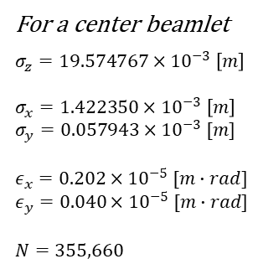



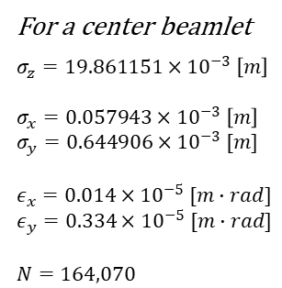





Question[2]
Space-charge/emittance
3
SC/emit. ratio(just after slit, beamlets)
1) Horizontal Scan
For a center beamlet
$σ_{z}=19.861151×{10}^{−3} \left[m\right]$
$σ_{x}=0.057943×{10}^{−3} \left[m\right]$
$σ_{y}=0.644906×{10}^{−3} [m]$
$ε_{x}=0.014×{10}^{−5} [m∙rad]$
$ε_{y}=0.334×{10}^{−5} [m∙rad]$
$N=164,070$
1-i) Horizontal
Chosen a center scan
$$\frac{K_{H}σ_{x}^{3}}{2\left(σ_{x}+σ_{y}\right)ε_{x}^{2}}≈0.325×{10}^{−4}≪1$$
$$∴emittance−dominated$$
X=0
1-ii) Vertical
$$\frac{Kσ_{y}^{3}}{2\left(σ_{x}+σ_{y}\right)ε_{y}^{2}}≈0.787×{10}^{−4}≪1$$
$$∴ K≈4.6×{10}^{−9}$$
$$∴emittance−dominated$$
2) Vertical Scan
For a center beamlet
$σ_{z}=19.574767×{10}^{−3} \left[m\right]$
$σ_{x}=1.422350×{10}^{−3} \left[m\right]$
$σ_{y}=0.057943×{10}^{−3} [m]$
$ε_{x}=0.202×{10}^{−5} [m∙rad]$
$ε_{y}=0.040×{10}^{−5} [m∙rad]$
$N=355,660$
2-i) Horizontal
Chosen a center scan
$$\frac{K_{V}σ_{x}^{3}}{2\left(σ_{x}+σ_{y}\right)ε_{x}^{2}}≈0.0024≪1$$
y=0
$$∴emittance−dominated$$
2-ii) Vertical
$$\frac{Kσ_{y}^{3}}{2\left(σ_{x}+σ_{y}\right)ε_{y}^{2}}≈0.4×{10}^{−5}≪1$$
$$∴ K≈1.0×{10}^{−8}$$
$$∴emittance−dominated$$
5

Slide 6
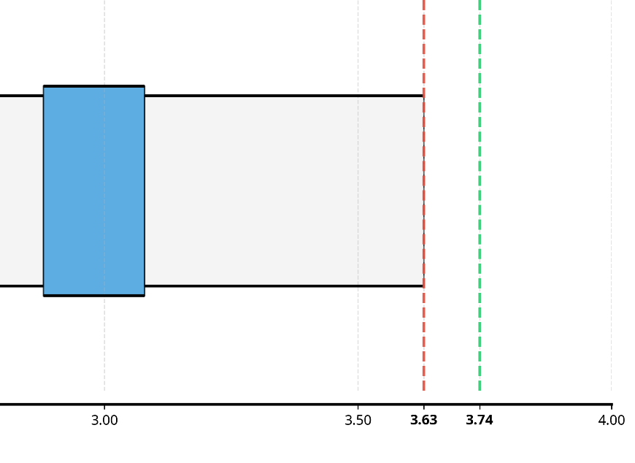
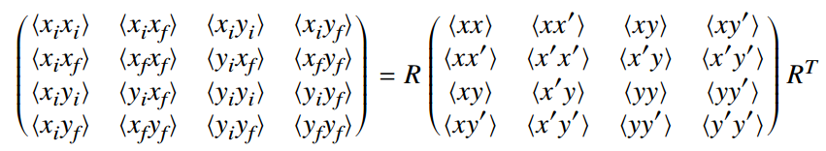


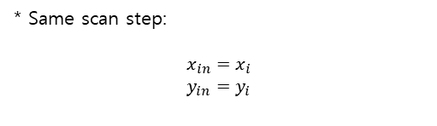



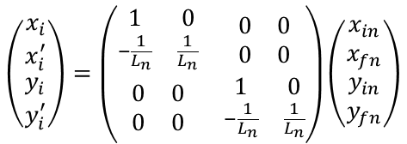



Question[3]
Multi-screen scan method
• Multi-screen distance(two another distance; L1, L2)
L1
L2
$$\left(\begin{matrix}\begin{matrix}x_{i} \\ x_{i}^{′}\end{matrix} \\ \begin{matrix}y_{i} \\ y_{i}^{′}\end{matrix}\end{matrix}\right)=\left(\begin{matrix}\begin{matrix}1 & 0 \\ −\frac{1}{L_{n}} & \frac{1}{L_{n}}\end{matrix} & \begin{matrix}0 & 0 \\ 0 & 0\end{matrix} \\ \begin{matrix}0 & 0 \\ 0 & 0\end{matrix} & \begin{matrix}1 & 0 \\ −\frac{1}{L_{n}} & \frac{1}{L_{n}}\end{matrix}\end{matrix}\right)\left(\begin{matrix}\begin{matrix}x_{in} \\ x_{fn}\end{matrix} \\ \begin{matrix}y_{in} \\ y_{fn}\end{matrix}\end{matrix}\right)$$
$$x_{i}, y_{i}$$
$$=R_{n}$$
* Same scan step:
$$x_{in}=x_{i}$$
$$y_{in}=y_{i}$$
$$x_{fn}, y_{fn}$$
RECON.
$$\left\langle x_{i}y_{fn}\right\rangle =\frac{\left\langle xy′\right\rangle }{L_{n}}−\frac{\left\langle xy\right\rangle }{L_{n}}$$
Unknown : $\left\langle xy\right\rangle , \left\langle xy′\right\rangle , \left\langle x′y\right\rangle , \left\langle x′y′\right\rangle$
$$⇒$$
$$\left\langle y_{i}x_{fn}\right\rangle =\frac{\left\langle x′y\right\rangle }{L_{n}}−\frac{\left\langle xy\right\rangle }{L_{n}}$$
It is possible to solve.
$$\left\langle x_{fn}y_{fn}\right\rangle =\frac{\left\langle xy\right\rangle }{L_{n}^{2}}−\frac{\left\langle xy^{′}\right\rangle }{L_{n}^{2}}−\frac{\left\langle x′y\right\rangle }{L_{n}^{2}}+\frac{\left\langle x′y′\right\rangle }{L_{n}^{2}}$$
6

Slide 7
And…
1. question 1(for coding) -> ongoing
2. question 3 – for diagonal method calculation -> ongoing
7

