Slide 1
Virtual Pepper-Pot

Slide 2
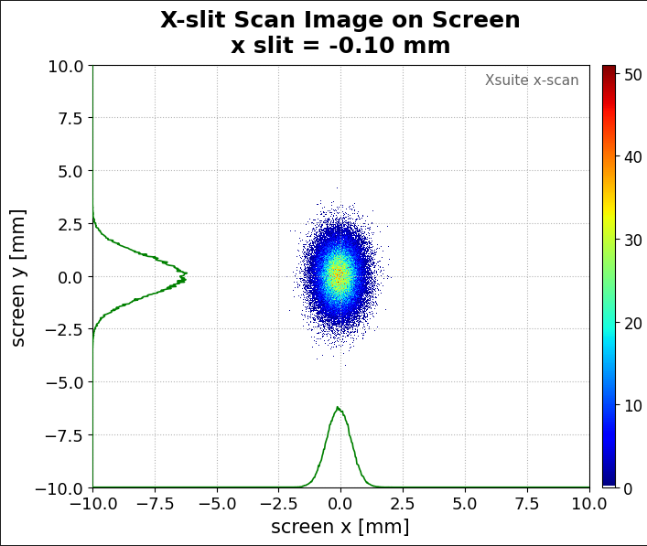
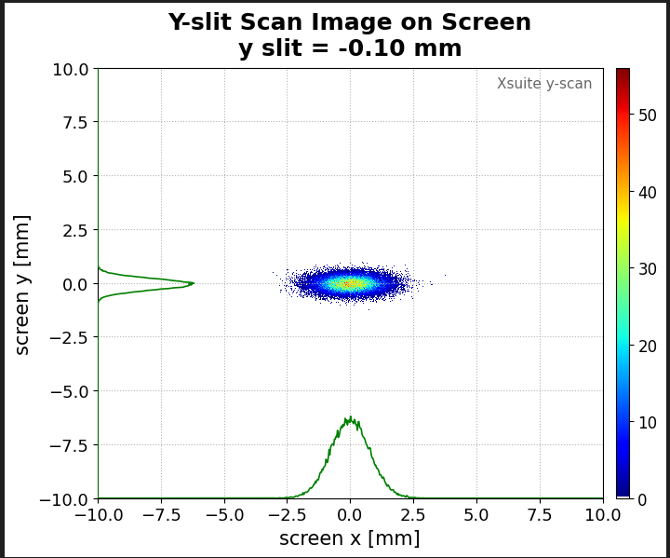
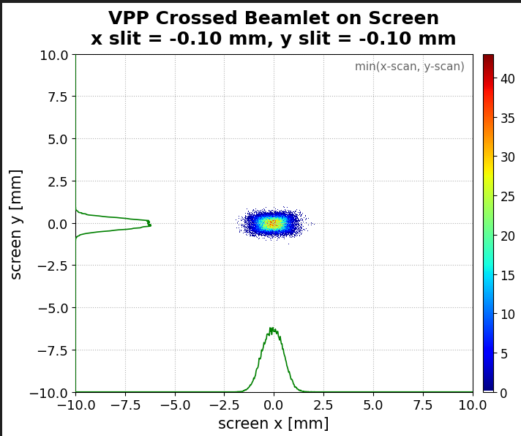

Review
VPP – Minimum Bit Principle
$$I_{VPP}\left(n, m\right)=\min{(I_{n}^{h}, I_{m}^{v})}$$
Minimum (X-slit Scan Image, Y-slit Scan Image)
=
Virtual Beamlet

Slide 3
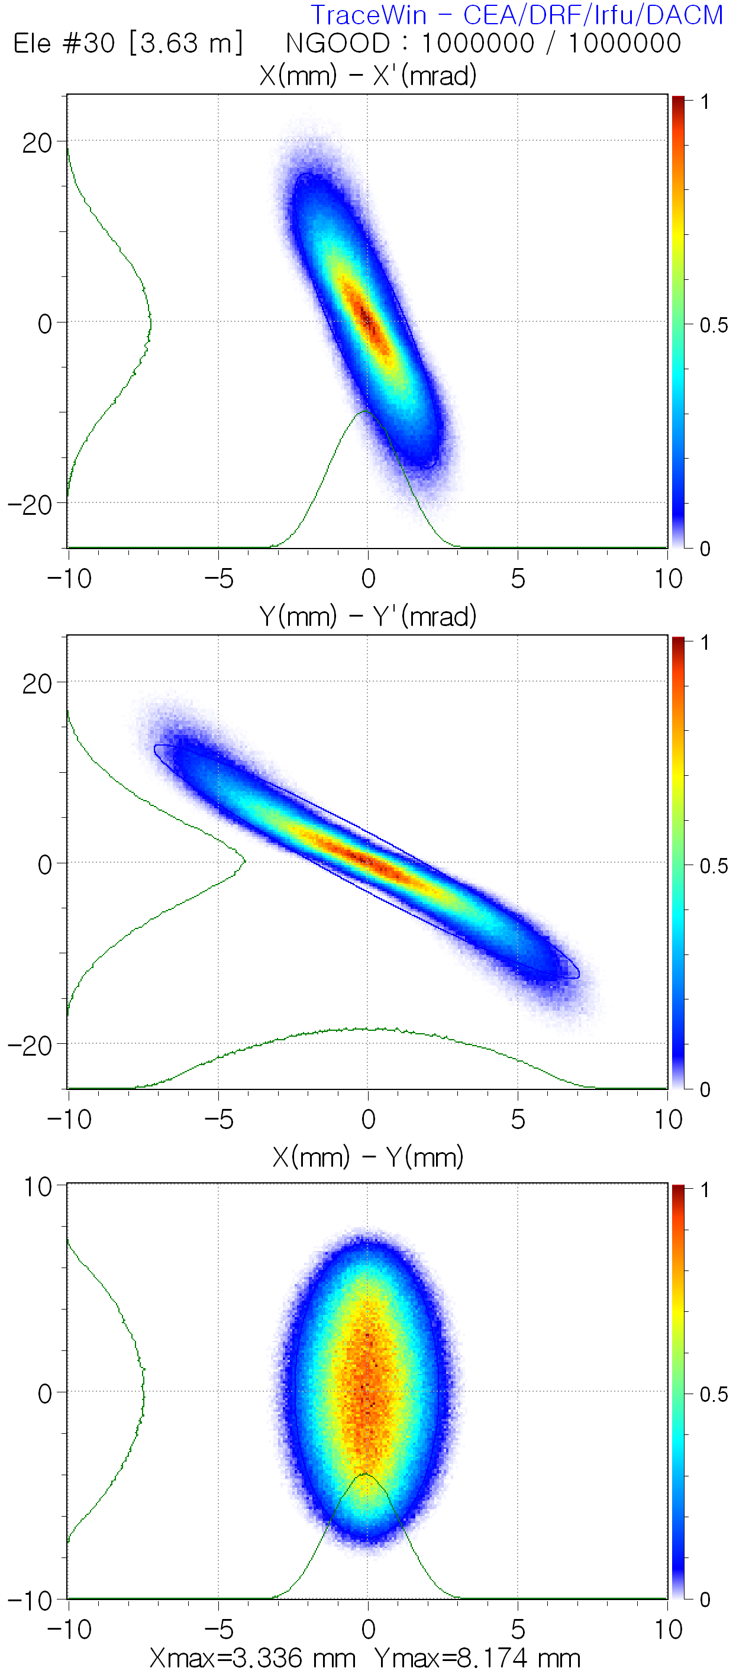
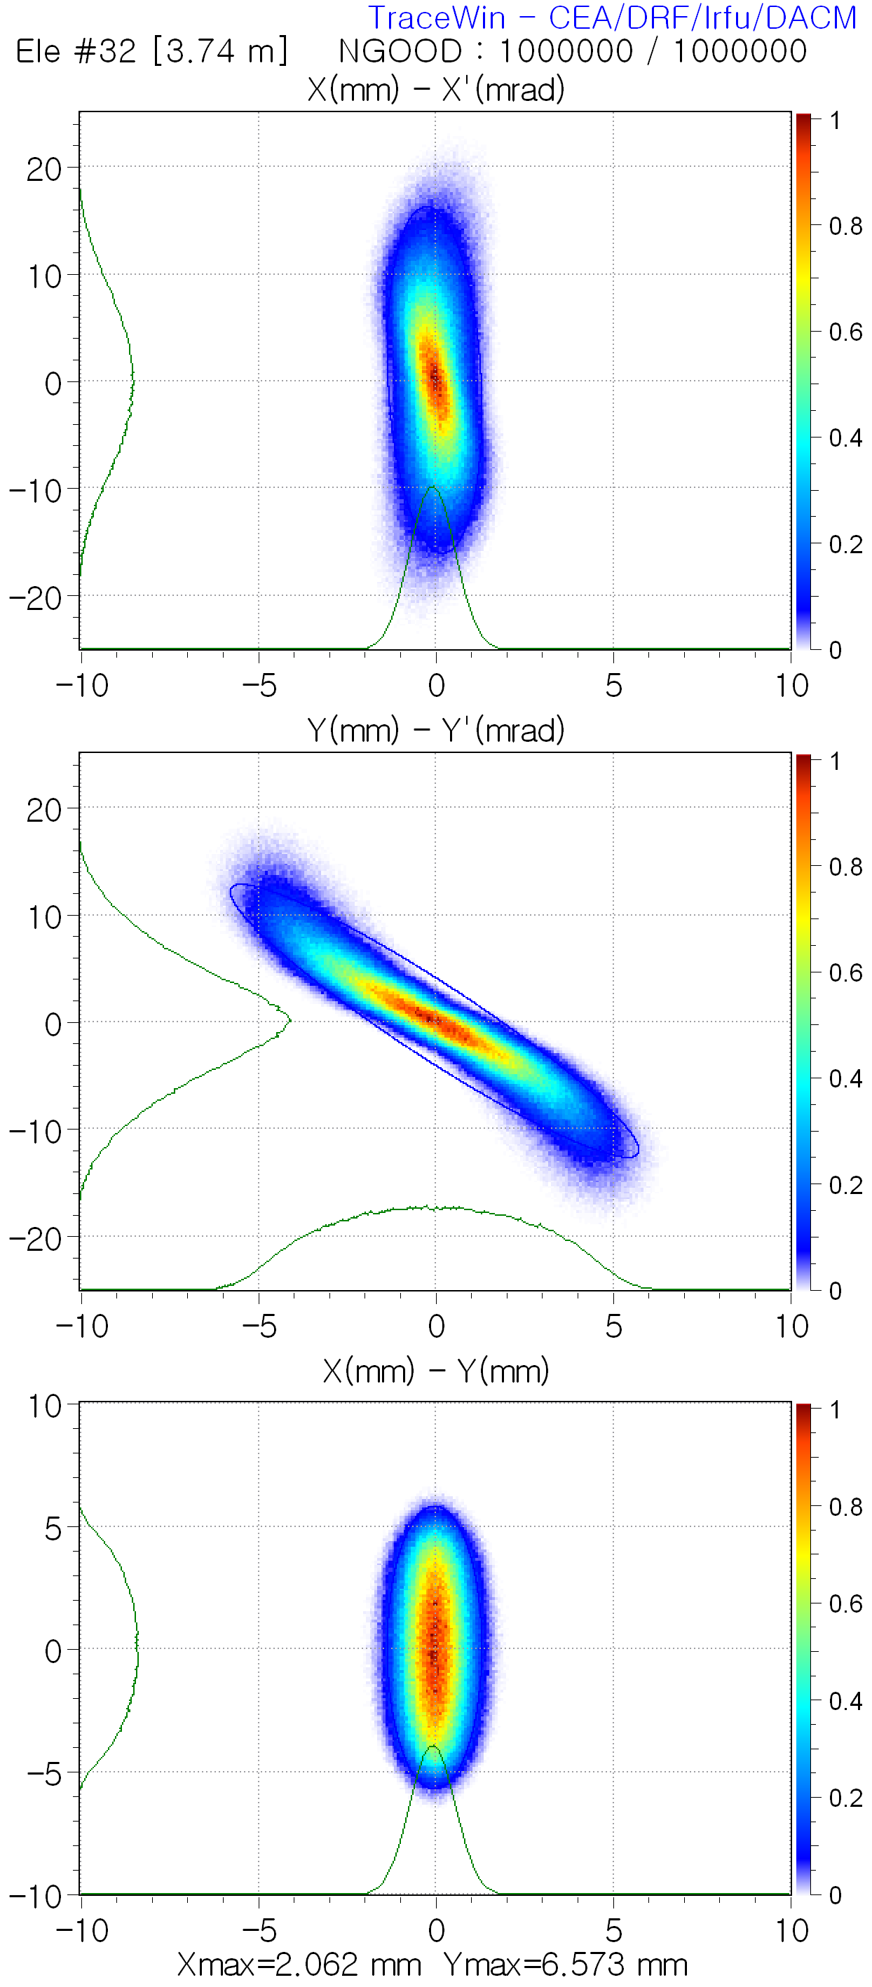
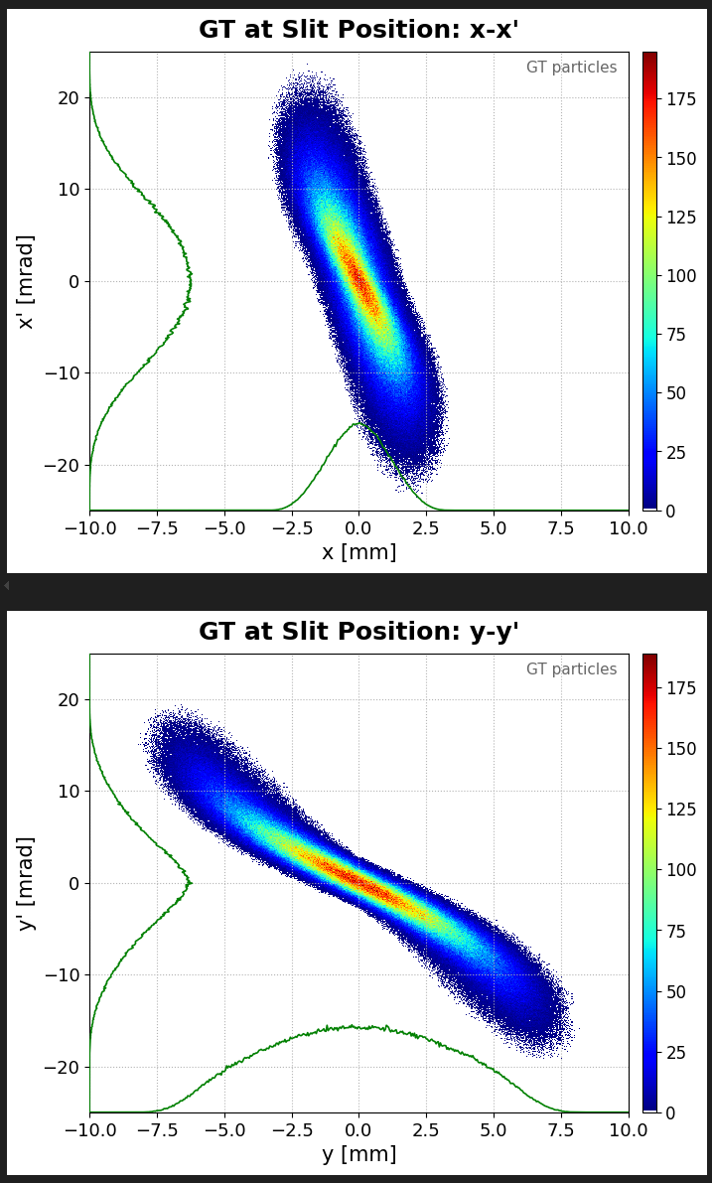
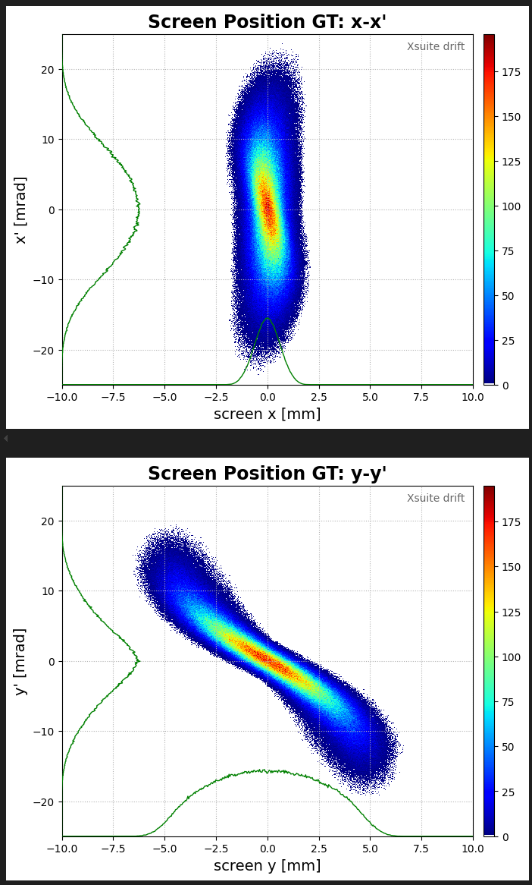
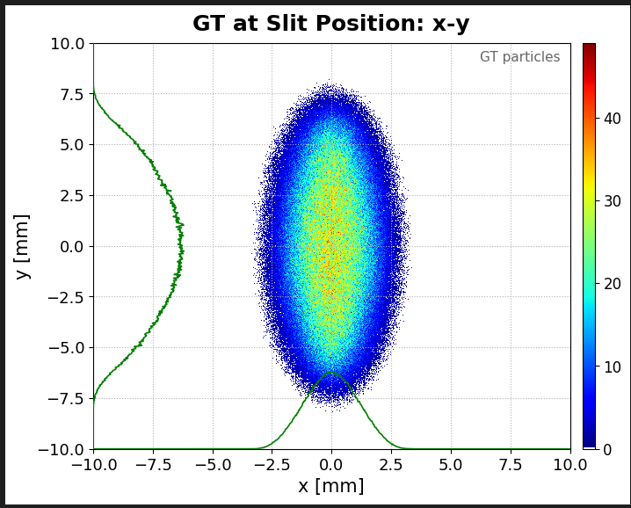
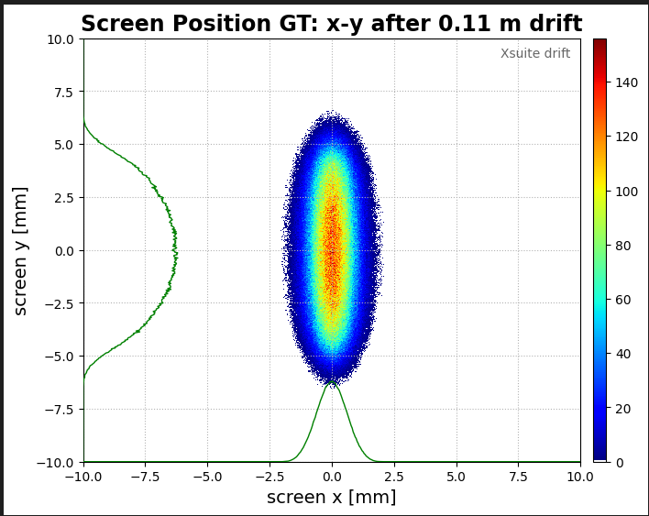
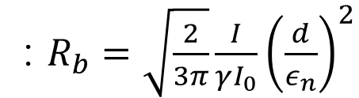

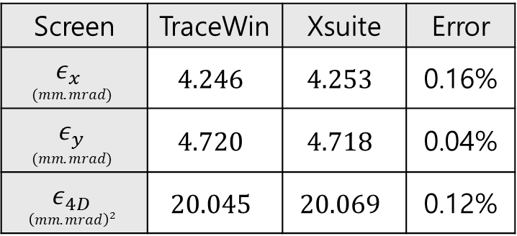
Tracking: Full lattice $→$ Slit to Screen
Space-charge dominance ratio for the beamlets
: $R_{b}=\sqrt{\frac{2}{3π}}\frac{I}{γI_{0}}{\left(\frac{d}{ε_{n}}\right)}^{2}$
$R_{b}≪1$ means that the beamlets are emittance dominated. ⇒${ R}_{b}=0.00018$
TraceWin: Full Tracking
Xsuite: Slit to Screen
Screen | TraceWin | Xsuite | Error
$$ε_{x}$$ $$(mm.mrad)$$ | $$4.246$$ | $$4.253$$ | 0.16%
$$ε_{y}$$ $$(mm.mrad)$$ | $$4.720$$ | $$4.718$$ | 0.04%
$$ε_{4D}$$ $${\left(mm.mrad\right)}^{2}$$ | $$20.045$$ | $$20.069$$ | 0.12%
Xsuite input beam distribution is generated from a TraceWin slit position file
Slit
Screen
Slit
Screen

Slide 4
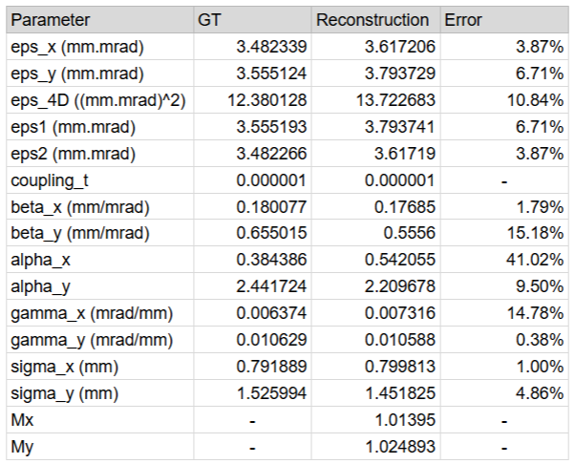
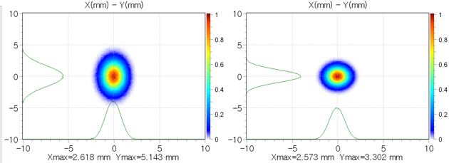
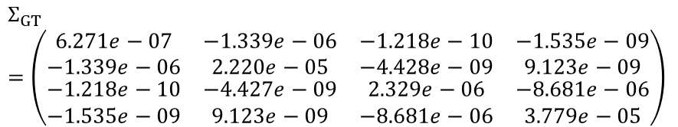
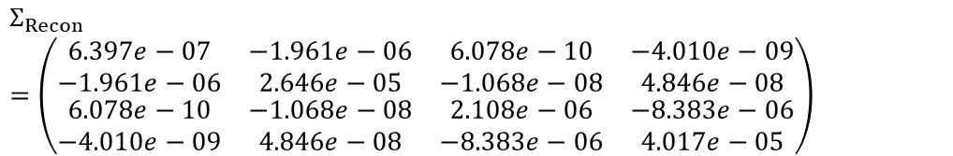
0mA & 10mA VPP Recon for Compare with MENT
0mA (No Space Charge Effect)
# of Macroparticle: 1,000,000
* M = 1 : Matched beam
$$Σ_{GT}=\left(\begin{matrix}\begin{matrix}6.271e−07 & −1.339e−06 \\ −1.339e−06 & 2.220e−05\end{matrix} & \begin{matrix}−1.218e−10 & −1.535e−09 \\ −4.428e−09 & 9.123e−09\end{matrix} \\ \begin{matrix}−1.218e−10 & −4.427e−09 \\ −1.535e−09 & 9.123e−09\end{matrix} & \begin{matrix}2.329e−06 & −8.681e−06 \\ −8.681e−06 & 3.779e−05\end{matrix}\end{matrix}\right)$$
$$Σ_{Recon}$$
$$=\left(\begin{matrix}\begin{matrix}6.397e−07 & −1.961e−06 \\ −1.961e−06 & 2.646e−05\end{matrix} & \begin{matrix}6.078e−10 & −4.010e−09 \\ −1.068e−08 & 4.846e−08\end{matrix} \\ \begin{matrix}6.078e−10 & −1.068e−08 \\ −4.010e−09 & 4.846e−08\end{matrix} & \begin{matrix}2.108e−06 & −8.383e−06 \\ −8.383e−06 & 4.017e−05\end{matrix}\end{matrix}\right)$$

Slide 5
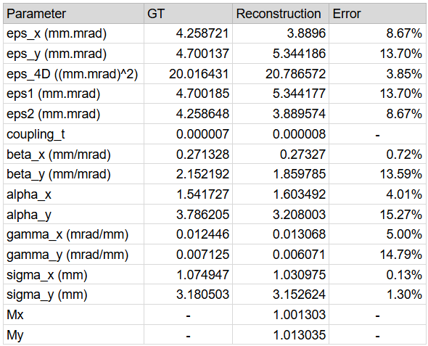
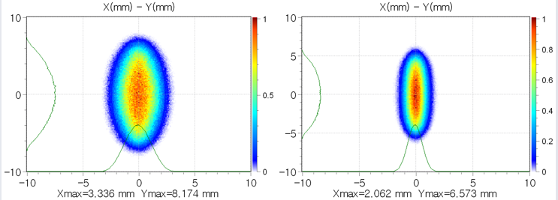
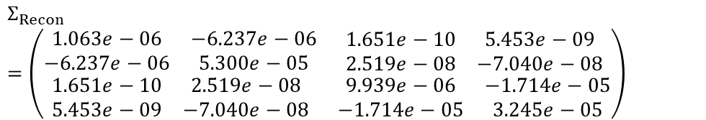
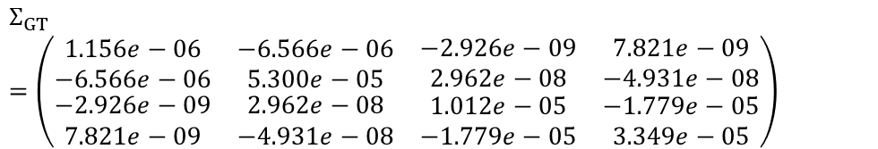
10mA (Space Charge Effect)
# of Macroparticle: 100,000
$$Σ_{GT}$$
$$=\left(\begin{matrix}\begin{matrix}1.156e−06 & −6.566e−06 \\ −6.566e−06 & 5.300e−05\end{matrix} & \begin{matrix}−2.926e−09 & 7.821e−09 \\ 2.962e−08 & −4.931e−08\end{matrix} \\ \begin{matrix}−2.926e−09 & 2.962e−08 \\ 7.821e−09 & −4.931e−08\end{matrix} & \begin{matrix}1.012e−05 & −1.779e−05 \\ −1.779e−05 & 3.349e−05\end{matrix}\end{matrix}\right)$$
$$Σ_{Recon}$$
$$=\left(\begin{matrix}\begin{matrix}1.063e−06 & −6.237e−06 \\ −6.237e−06 & 5.300e−05\end{matrix} & \begin{matrix}1.651e−10 & 5.453e−09 \\ 2.519e−08 & −7.040e−08\end{matrix} \\ \begin{matrix}1.651e−10 & 2.519e−08 \\ 5.453e−09 & −7.040e−08\end{matrix} & \begin{matrix}9.939e−06 & −1.714e−05 \\ −1.714e−05 & 3.245e−05\end{matrix}\end{matrix}\right)$$

Slide 6
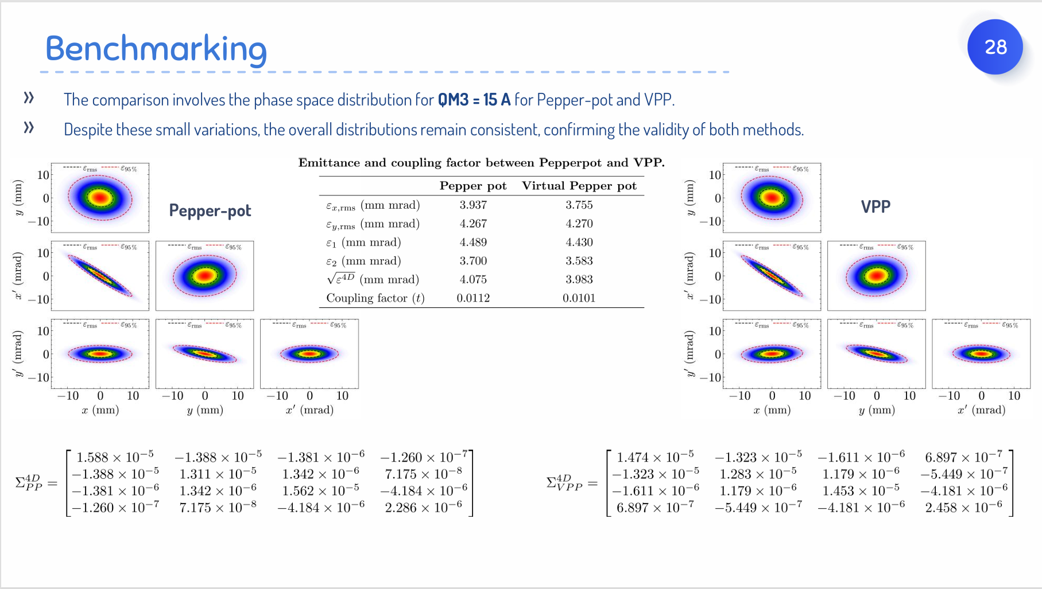
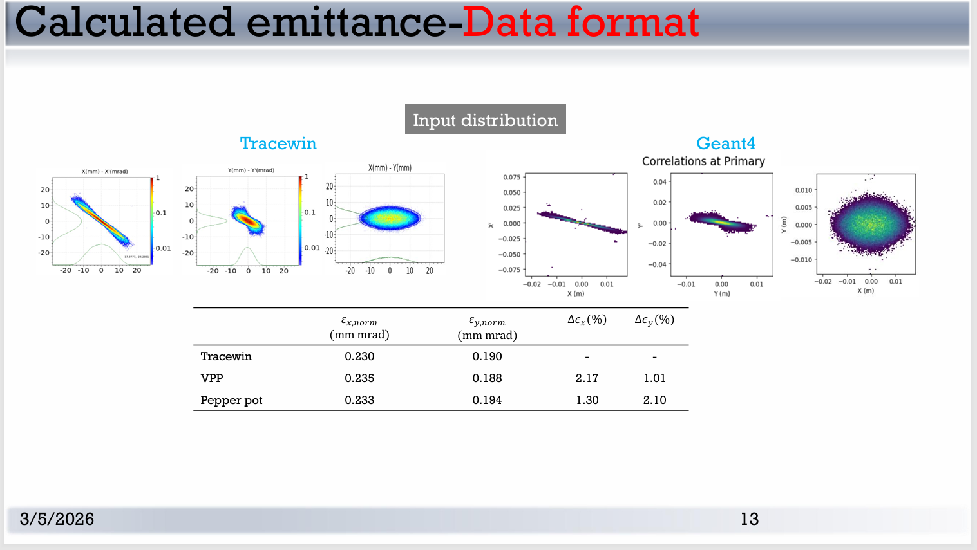
Case Study
Case1
Case2
0mA (No Space Charge Effect)
10mA (Space Charge Effect)
Case3
Case4

Slide 7
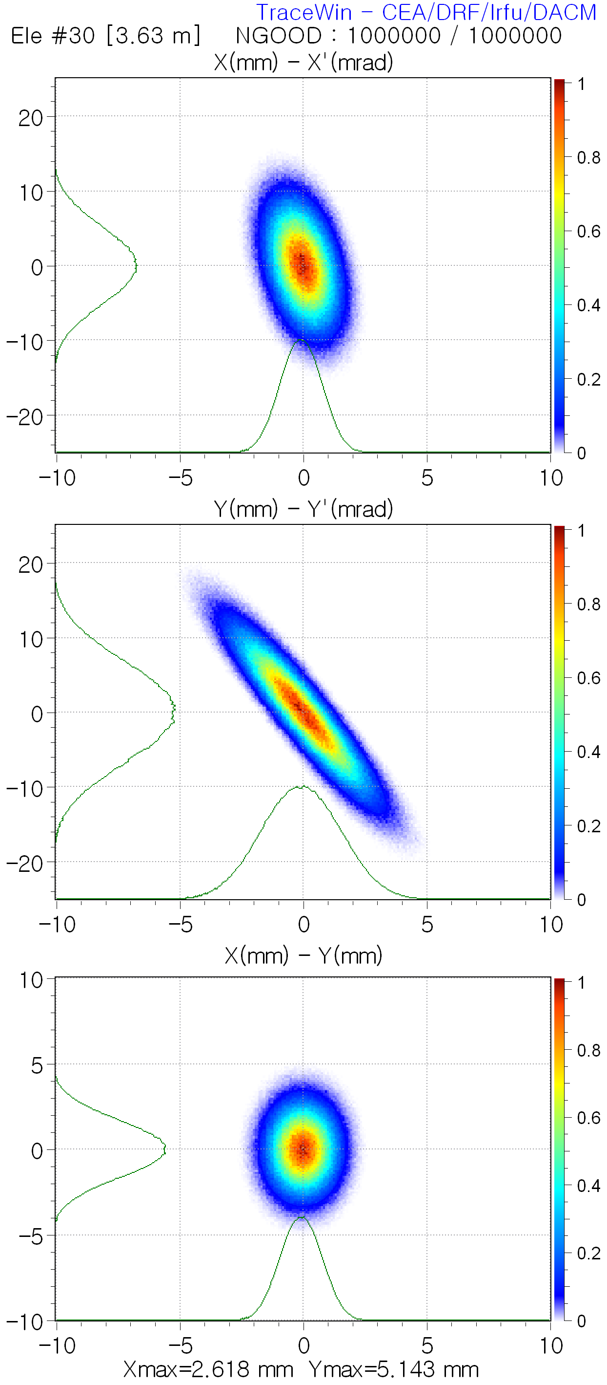
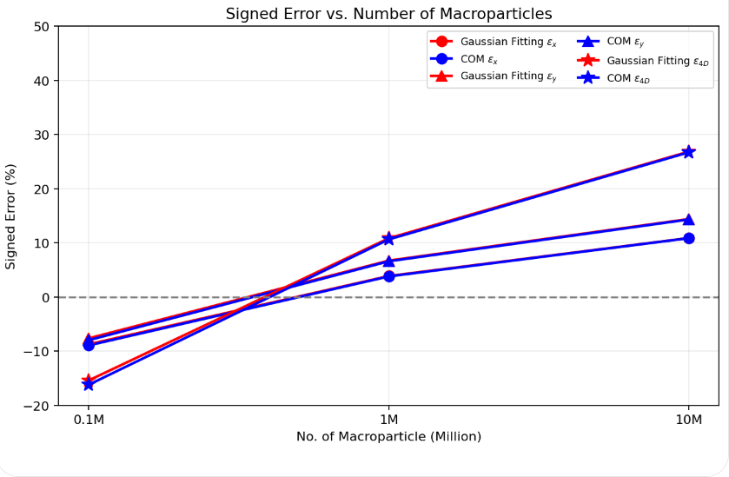
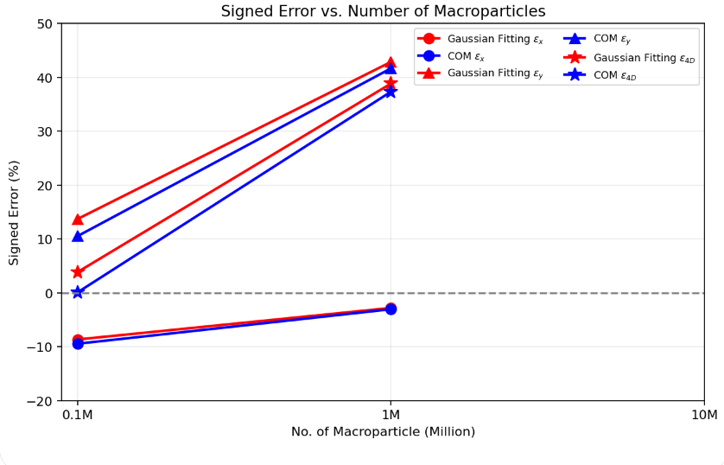
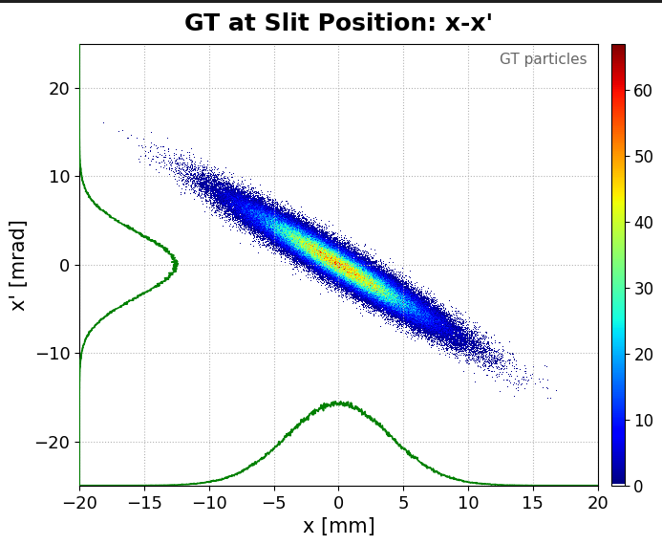
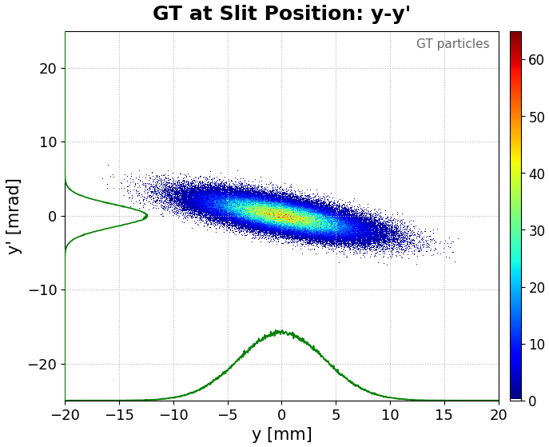
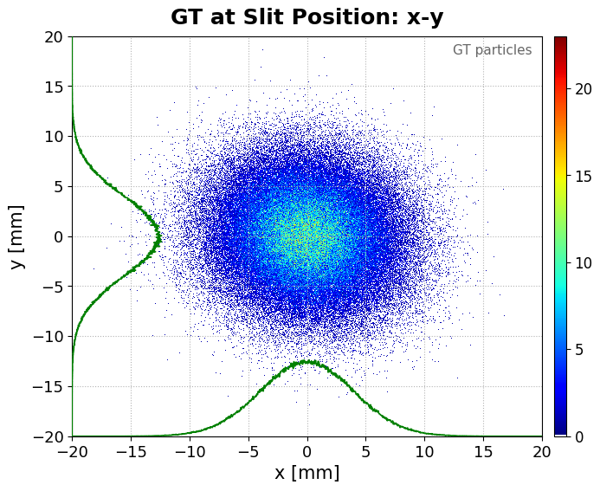
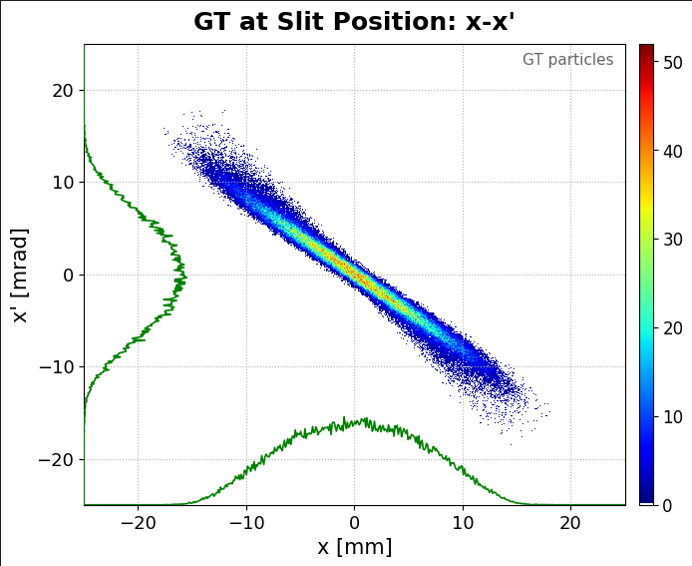
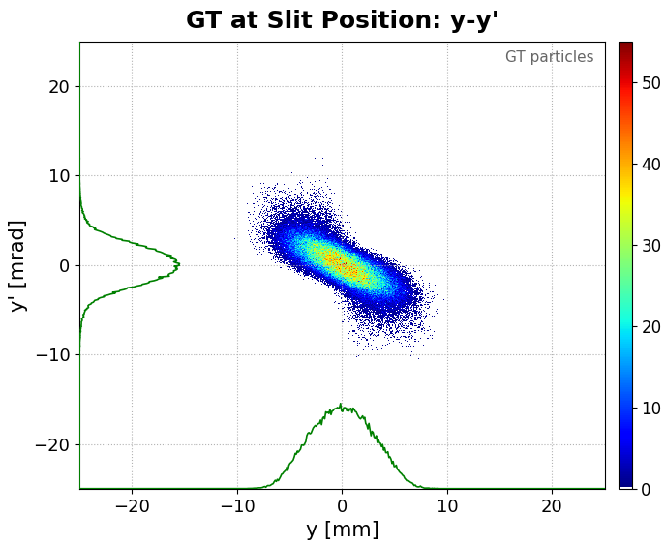
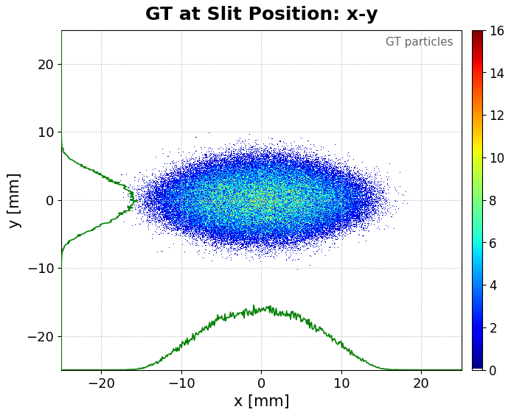
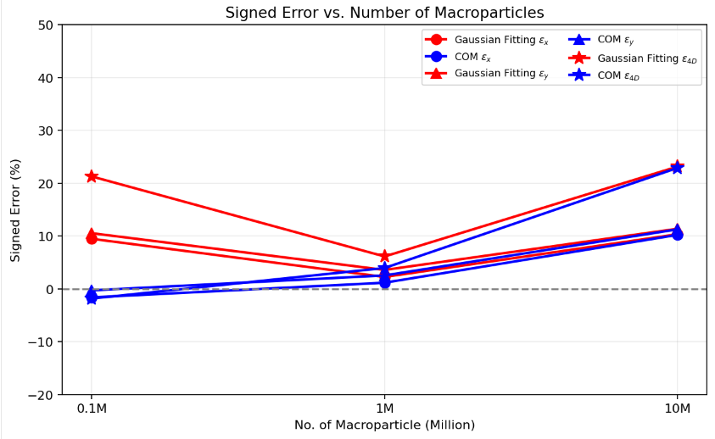
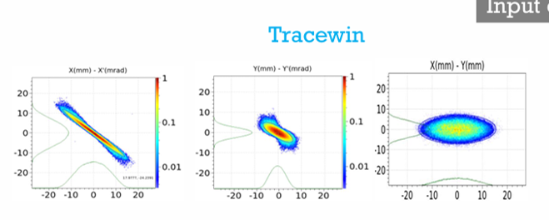
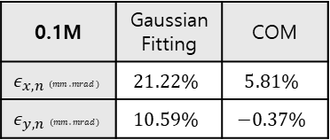
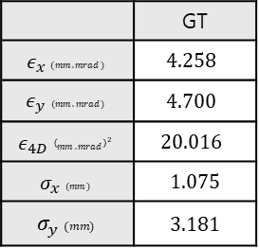
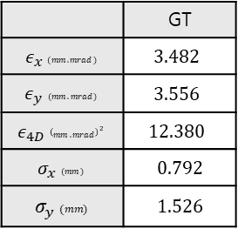
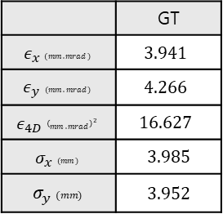
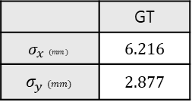
Case1
Case2
 | GT
$$ε_{x} (mm.mrad)$$ | $$3.482$$
$$ε_{y} (mm.mrad)$$ | $$3.556$$
$$ε_{4D} {\left(mm.mrad\right)}^{2}$$ | $$12.380$$
$$σ_{x} (mm)$$ | 0.792
$$σ_{y} (mm)$$ | 1.526
 | GT
$$ε_{x} (mm.mrad)$$ | $$4.258$$
$$ε_{y} (mm.mrad)$$ | $$4.700$$
$$ε_{4D} {\left(mm.mrad\right)}^{2}$$ | $$20.016$$
$$σ_{x} (mm)$$ | 1.075
$$σ_{y} (mm)$$ | 3.181
Case3
Case4
 | GT
$$ε_{x} (mm.mrad)$$ | $$3.941$$
$$ε_{y} (mm.mrad)$$ | $$4.266$$
$$ε_{4D} {\left(mm.mrad\right)}^{2}$$ | $$16.627$$
$$σ_{x} (mm)$$ | 3.985
$$σ_{y} (mm)$$ | 3.952
0.1M | Gaussian Fitting | COM
$$ε_{x,n} (mm.mrad)$$ | $$21.22\%$$ | $$5.81\%$$
$$ε_{y,n} (mm.mrad)$$ | $$10.59\%$$ | $$−0.37\%$$
 | GT
$$σ_{x} (mm)$$ | 6.216
$$σ_{y} (mm)$$ | 2.877
by Dr. Emre Cosgun

Slide 8
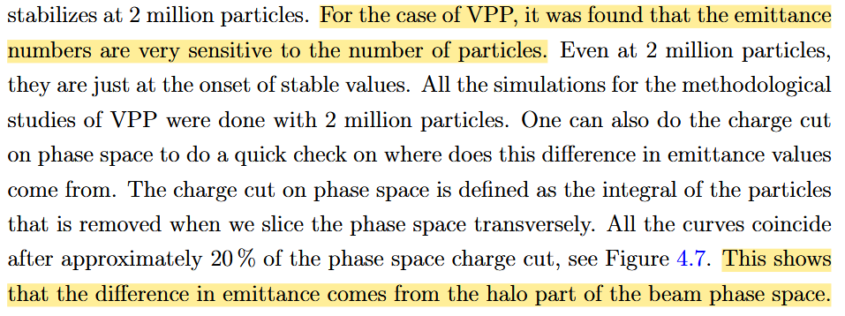
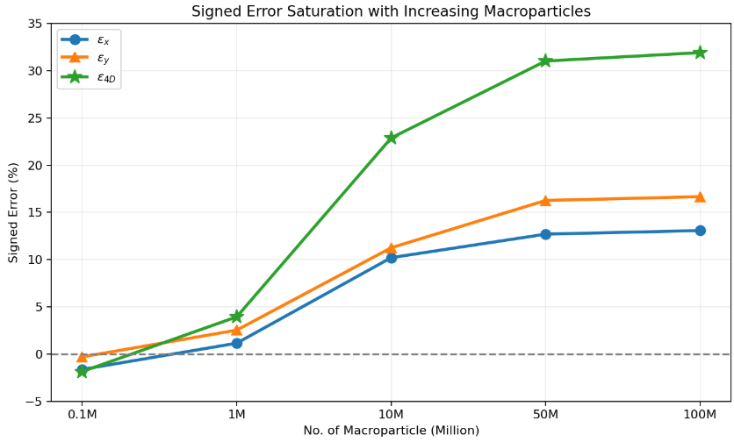
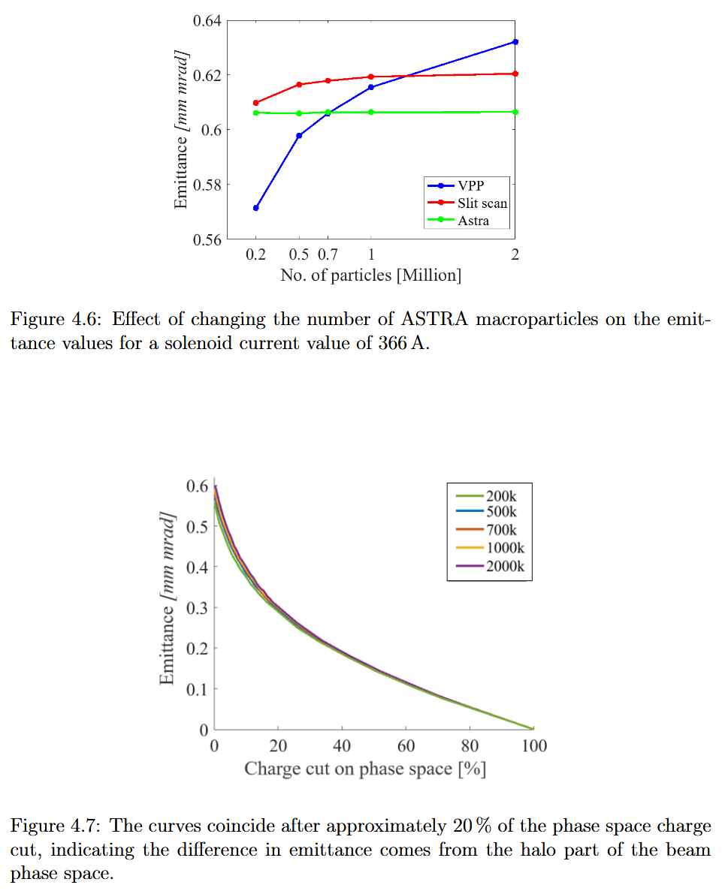
PITZ
Check with Case1

Slide 9
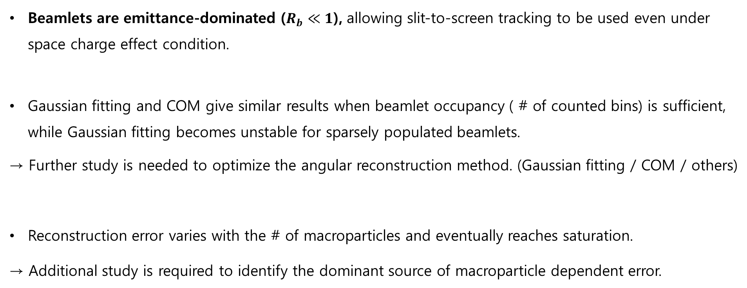
Conclusion
Beamlets are emittance-dominated ($R_{b}≪1$), allowing slit-to-screen tracking to be used even under space charge effect condition.
Gaussian fitting and COM give similar results when beamlet occupancy ( # of counted bins) is sufficient, while Gaussian fitting becomes unstable for sparsely populated beamlets.
→ Further study is needed to optimize the angular reconstruction method. (Gaussian fitting / COM / others)
Reconstruction error varies with the # of macroparticles and eventually reaches saturation.
→ Additional study is required to identify the dominant source of macroparticle dependent error.

Slide 10
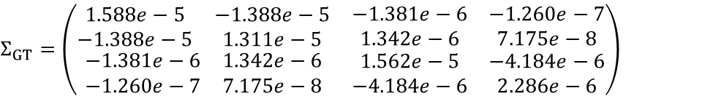

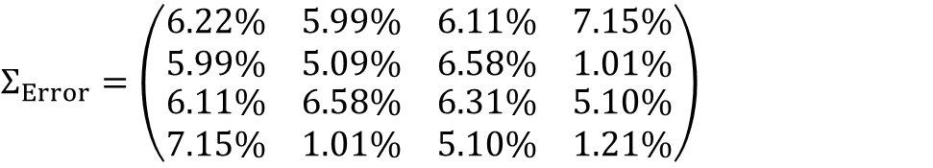
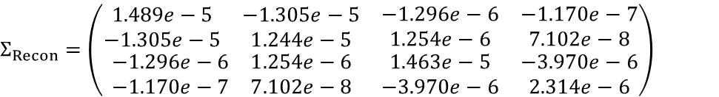
Addition – coupling term
Emittance errors are below 2%
Twiss parameter errors are below 6%
 | GT | Recon
$$coupling t$$ | $$0.011$$ | $$0.010$$
$$Σ_{GT}=\left(\begin{matrix}\begin{matrix}1.588e−5 & −1.388e−5 \\ −1.388e−5 & 1.311e−5\end{matrix} & \begin{matrix}−1.381e−6 & −1.260e−7 \\ 1.342e−6 & 7.175e−8\end{matrix} \\ \begin{matrix}−1.381e−6 & 1.342e−6 \\ −1.260e−7 & 7.175e−8\end{matrix} & \begin{matrix}1.562e−5 & −4.184e−6 \\ −4.184e−6 & 2.286e−6\end{matrix}\end{matrix}\right)$$
$$Σ_{Recon}=\left(\begin{matrix}\begin{matrix}1.489e−5 & −1.305e−5 \\ −1.305e−5 & 1.244e−5\end{matrix} & \begin{matrix}−1.296e−6 & −1.170e−7 \\ 1.254e−6 & 7.102e−8\end{matrix} \\ \begin{matrix}−1.296e−6 & 1.254e−6 \\ −1.170e−7 & 7.102e−8\end{matrix} & \begin{matrix}1.463e−5 & −3.970e−6 \\ −3.970e−6 & 2.314e−6\end{matrix}\end{matrix}\right)$$
$$Σ_{Error}=\left(\begin{matrix}\begin{matrix}6.22\% & 5.99\% \\ 5.99\% & 5.09\%\end{matrix} & \begin{matrix}6.11\% & 7.15\% \\ 6.58\% & 1.01\%\end{matrix} \\ \begin{matrix}6.11\% & 6.58\% \\ 7.15\% & 1.01\%\end{matrix} & \begin{matrix}6.31\% & 5.10\% \\ 5.10\% & 1.21\%\end{matrix}\end{matrix}\right)$$

