Slide 1

2026-05-07, ZOOM, 3 p.m. Korea
Full 4D Reconstruction-
-MENT(Progress Check)
DAON LEE
2026 The Beam Diagnostics and Tomography Study
(ZOOM Meeting: 1st Tomography Meeting)

Slide 2
Outline
Ⅰ. Previous Story
- The KOMAC Beam test stand(BTS) layout : Problem1&2
Ⅱ. Recently Updated Results(Problem1)
- Space-charge effect
- Analytic method
Ⅲ. Ongoing process(Problem2)
- Multi-optics reconstruction
Ⅵ. Next Step
- Single-optics reconstruction

Slide 3
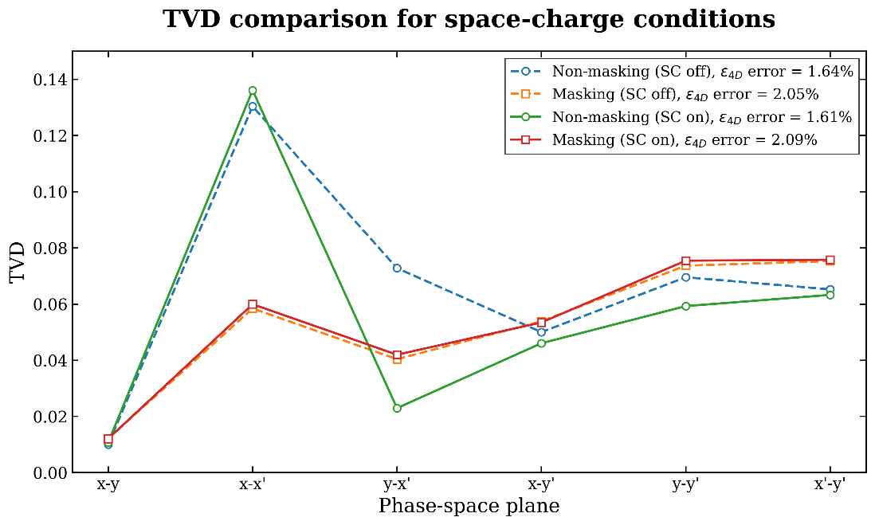
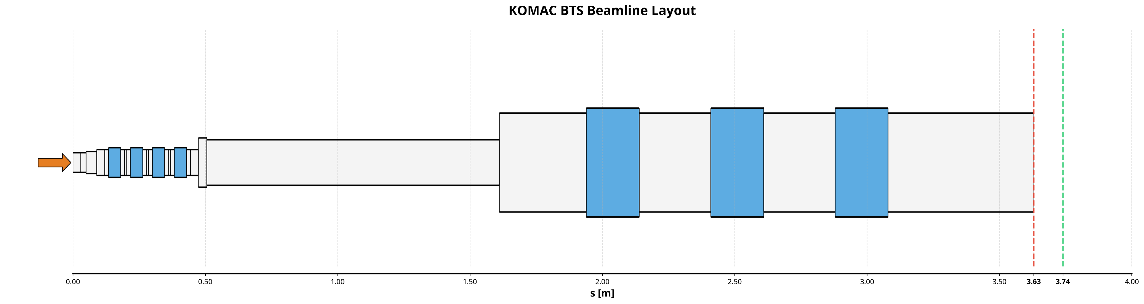
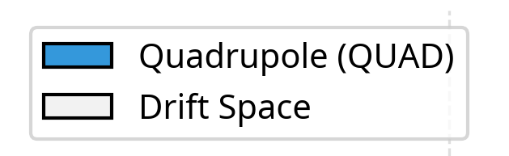
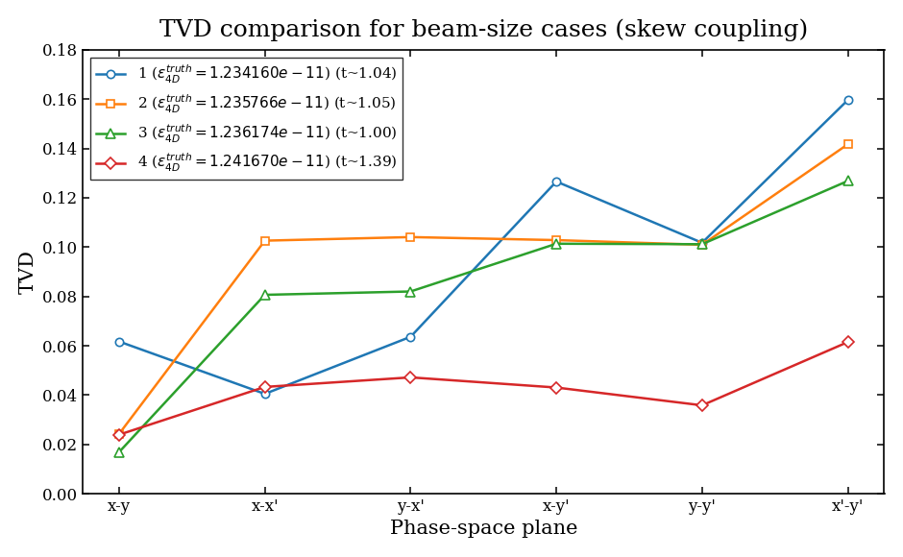





Previous Story
KOMAC BTS(Beam Test Stand) implementation in x-suite
Problem1 : space-charge –> code update & increase number of particles!
Problem2 : round beam –> multi-optics reconstruction!
(slit)
(screen)
$$resoluotion :50μm$$
Beam parameters
Simulation set-up
Energy
1 MeV
Slit width, Slit step(continuous scan)
0.2mm
N total
3,000,000
Distance L
0.11m
$ε_{x/y, rms}$
0.16 [π mm·mrad]
Screen resolution
30$μm$
$$σ_{x}=0.48mm$$
$$σ_{y}=0.44mm$$
rms bunch length
1.141820 mm
Recon. method
Numerical
$σ_{δ}$ (Δp/p)
0.507123 %
Framework
X-suite
3

Slide 4
Simulation Updates
KOMAC BTS(Beam Test Stand) implementation in x-suite
(slit)
(screen)
Beam parameters
Simulation set-up
Energy
1 MeV
Slit width, Slit step(continuous scan)
0.2mm
N total, macro
3,000,000 -> 3e+8 / 300,000 -> 50,000
Distance L
0.11m
$ε_{x/y, rms}$
0.16 [π mm·mrad]
Screen resolution
30$μm$
rms bunch length
1.141820 mm
Recon. method
Numerical / +Analytic
$σ_{δ}$ (Δp/p)
0.507123 %
Framework
X-suite
4

Slide 5
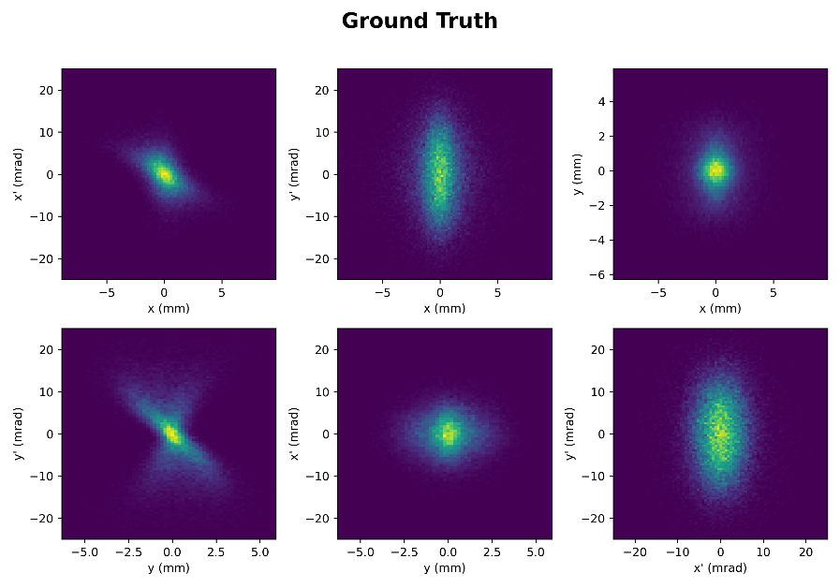
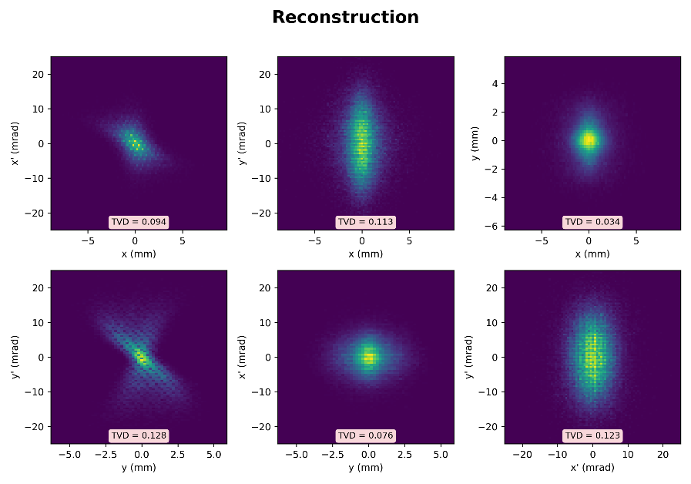



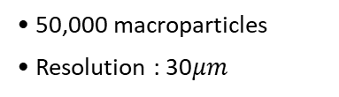


Effect of Space-Charge on Reconstruction
Space-charge / Analytic reconstruction
$$K=$$
Scan condition
• Phase space distribution
• Continuous scan
• Drift length : 0.11m
• 50,000 macroparticles
• Resolution : 30$μm$
$$ε_{x} error=3.82\%$$
$$ε_{y} error=2.47\%$$
$$ε_{4D} error=6.39\%$$
Key point
How put some proper space charge effect? & A comparison of Numerical and Analytic method.
Space-charge mode(in X-suite)
• RMS Envelop equation
Previous Numerical method
- total time : 3m 33.48s
Analytic method
- total time : 3m 10.99s
TVDs are same.
$$σ^{′′}+k\left(s\right)σ−\frac{K}{2σ}−\frac{ε^{2}}{σ^{3}}=0$$
$$K=\frac{2r_{p}N}{β^{2}γ^{3}\sqrt{2π}σ_{z}}$$
focusing
SC
Previous : space charge < focusing
total particle 3e+6 - > 3e+8
$$\frac{K}{2kσ^{2}}=9.2\%$$
5

Slide 6
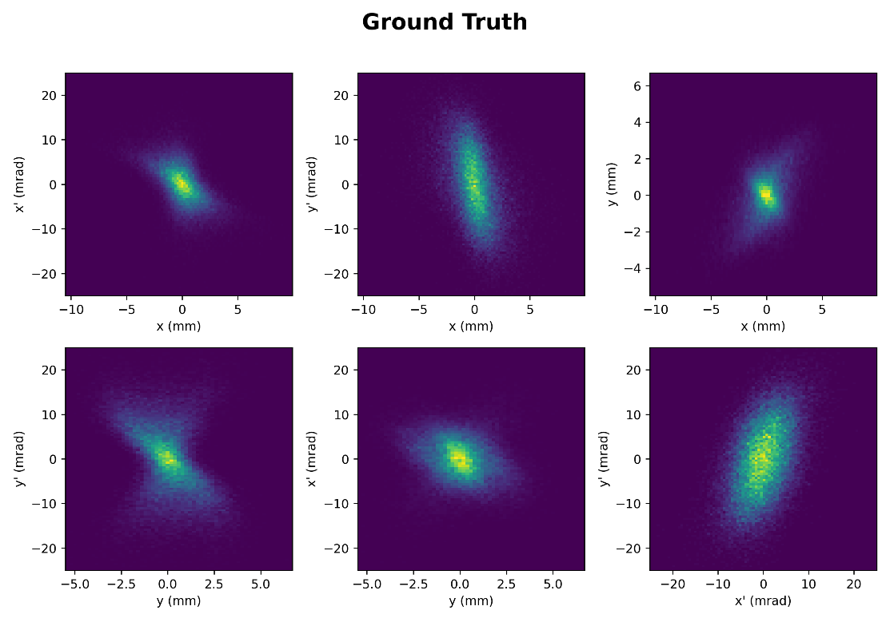
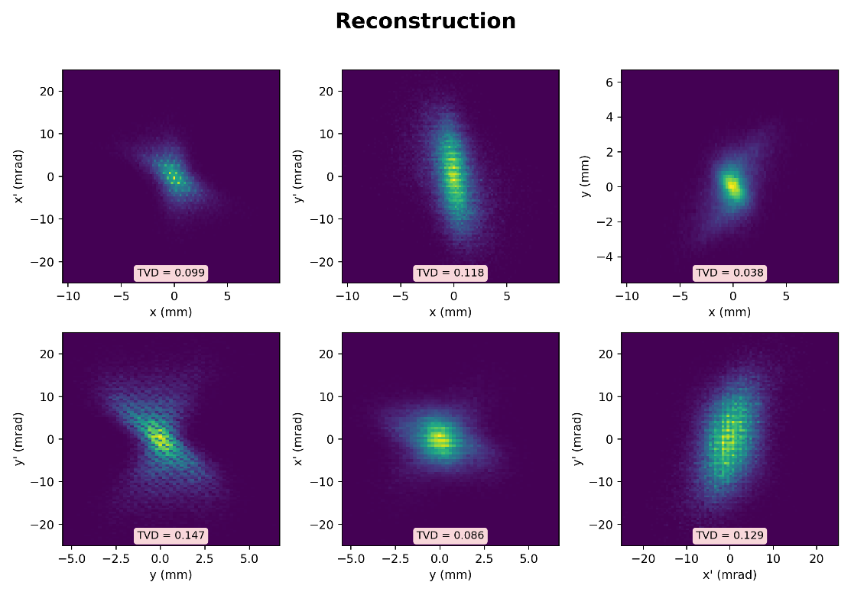


Effect of Space-Charge & Coupling
Analytic reconstruction
$$K=$$
• Phase space distribution
Coupling factor(t) : 0.25
$$ε_{x} error=3.80\%$$
$$ε_{y} error=2.10\%$$
$$ε_{4D} error=9.38\%$$
Analytic method
- total time : 4m 44.12s
6

Slide 7





Multi-optics-based Reconstruction
Angular data sets
RECON.
(slit)
(screen)
1. Two 3D data sets -> First RECON(at slit) 4D -> compute 4D density at red RECON. point -> iterative method(now ongoing)
2. Two 3D data sets( ex) 2 sets – four 3D density data) -> compute 3D density at red RECON. point -> iterative method
Analytic method
Numerical method
xi, yf, yf
xi, yi, yf, yf
xi, yi, yf, yf
xi, yi, yf, yf
yi, yf, yf
$$×n$$
$$×n$$
$$×n$$
Numerical method
xi, yf, yf
xi, yf, yf
yi, yf, yf
yi, yf, yf
xi, yi, yf, yf
$$×n$$
$$×n$$
7

Slide 8
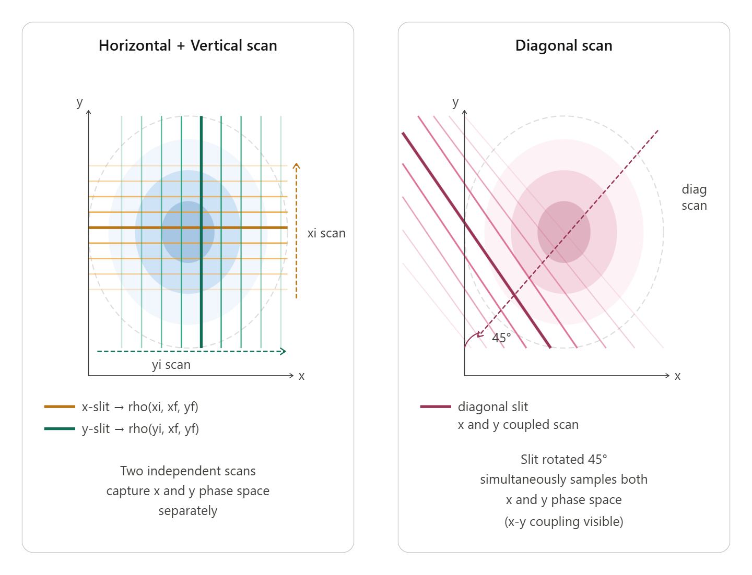


Next Step
Single-optics-based reconstruction
• Additional diagonal scan
• Multiple screen distance(additional angular data sets)
Progress made, but resolving a coordinate alignment issue(coding) in the iterative density update.
$$+$$
L1
L2
In my view, this is easier than adding mechanical angle scans and simplifies data processing as no coordinate transformation is needed.
fixed
fixed
$$⋯$$
(screen1)
(slit)
(screen2)
RECON.
8

Slide 9
Thank you !

