Slide 1
SLS-IPAC Organize
2026-05-29, Pohang, South Korea
Young Min Park
Division of Advanced Nuclear Engineering (DANE), POSTECH

Slide 2
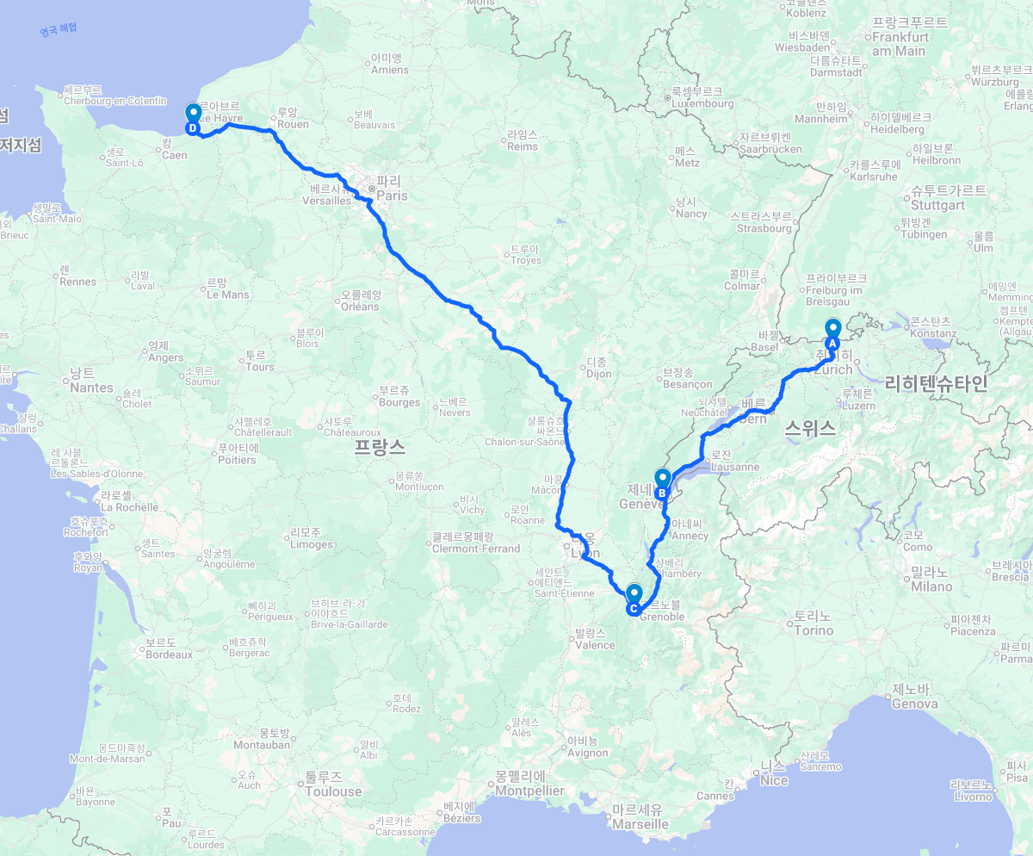
Schedule
SLS-II (2026-05-02 ~ 2026-05-14)
  Machine study at SLS-II
  ADTS measurement with low chromaticity (Mon.)
  Apple-X ID characterization (Tue.)
  Round beam and dissonance injection (Thu/Sun.)
  RF noise level measurement (Mon/Thu.)
  SLS-II Ring tour (Wed.)
  Bunch length with HHC measurement (Thu.)
  Booster emittance exchange (Fri.)
CERN (2026-05-14)
  CERN Tour
  SC(Synchronous Cyclotron)
  ATLAS (A Toroidal LHC ApparatuS)
  Control room (PS,SPS,LHC)
  LEIR (Low Energy Ion Ring)
ESRF-EBS (2026-05-15)
  ESRF Tour
  Control room & Injection
  Ring tour
IPAC (2026-05-15 ~ 2026-05-22)
2

Slide 3
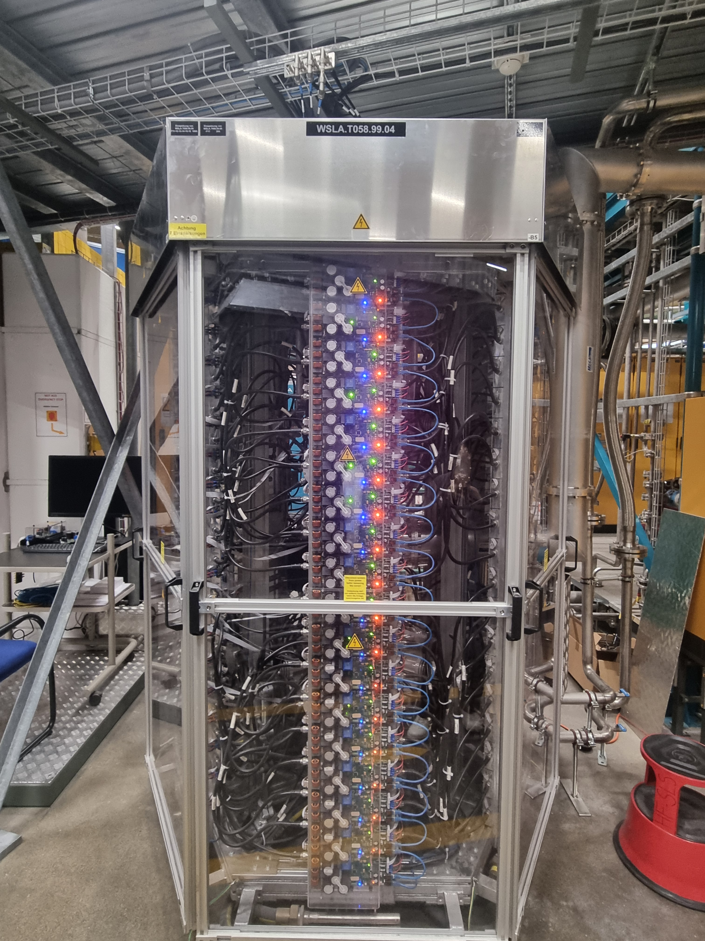
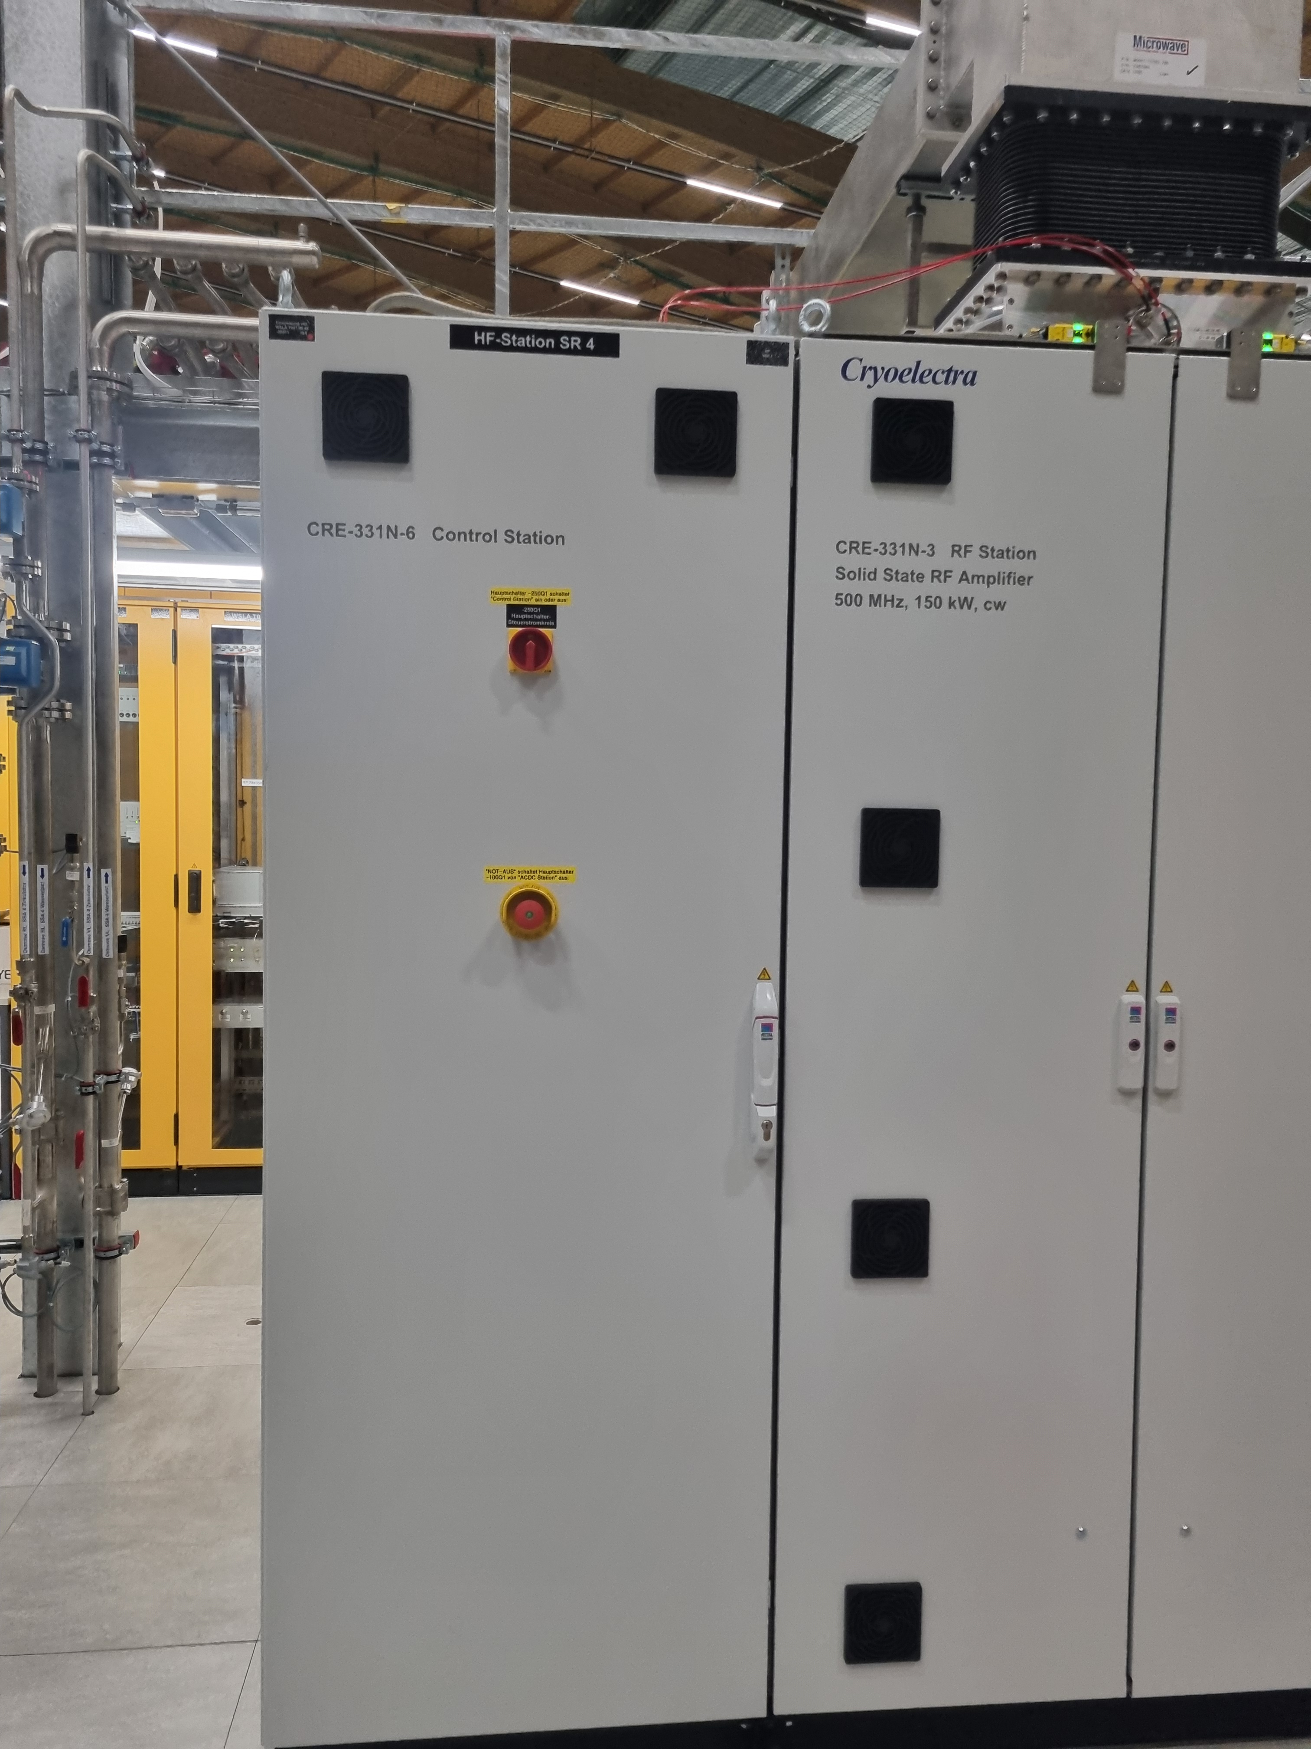
SLS Tour
SSA
SSA
SSA generate 150 kW/500 MHz rf for storage ring main cavity.
Much stable than general Klystron & modulator.
The SSA is built from many individual amplifier modules, almost like a “Christmas tree”.
One advantage of this modular design is that a faulty module can be hot-swapped and replaced individually.
3

Slide 4
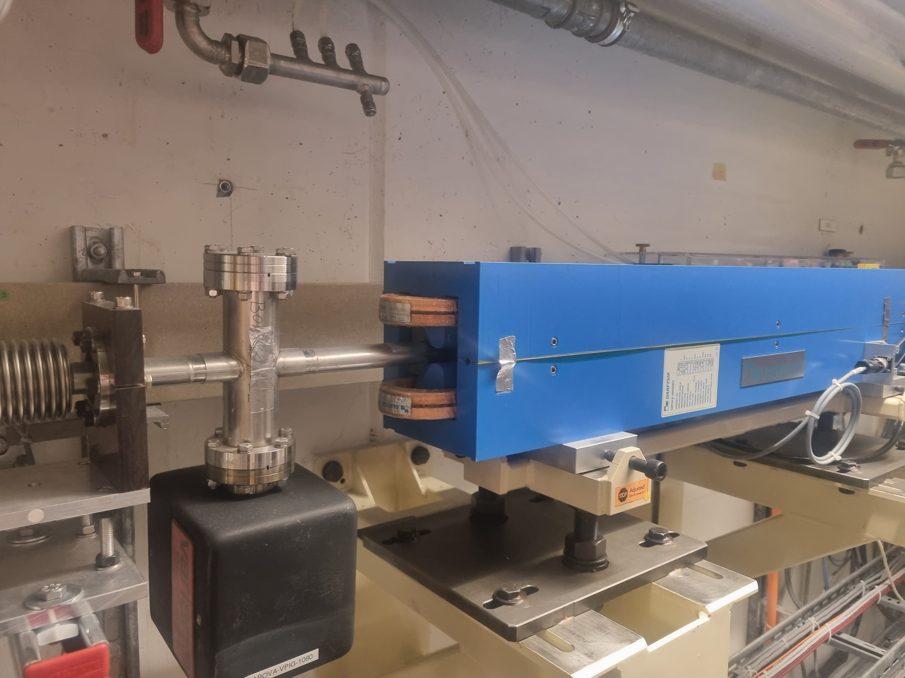
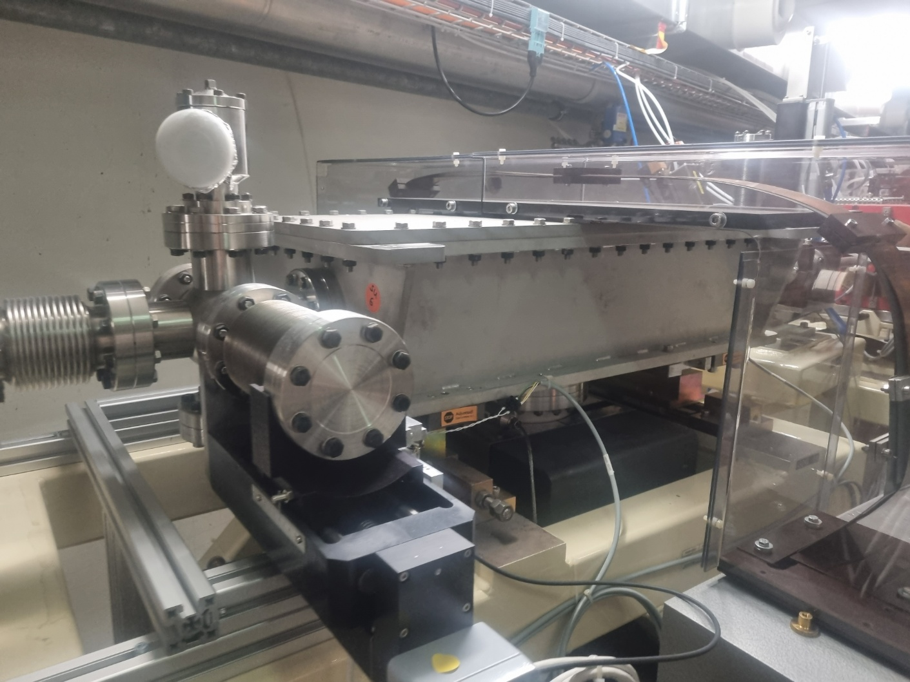
SLS Tour
Booster Ring
Extraction septum
Bend with trimmed
Quad/Sext
Simple FODO cell/ 160 ms ramp/ 3 Hz injection
Bending ramp = Quad ramp = Sextupole ramp (Same mps)
Additional Quad/Sext to match tune/chromaticity
4

Slide 5
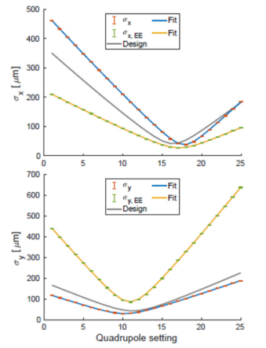
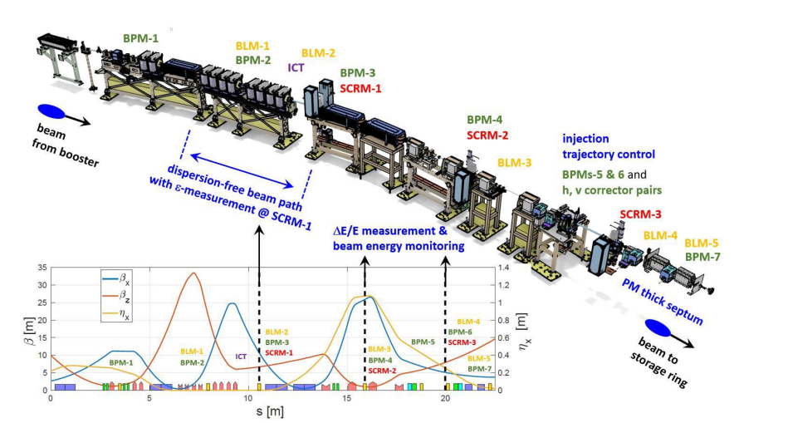
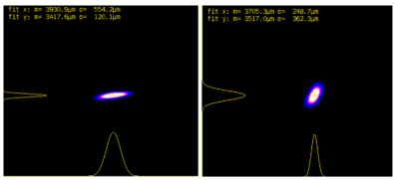
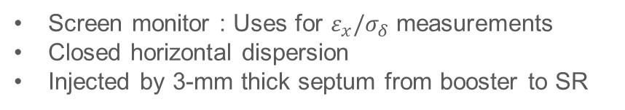
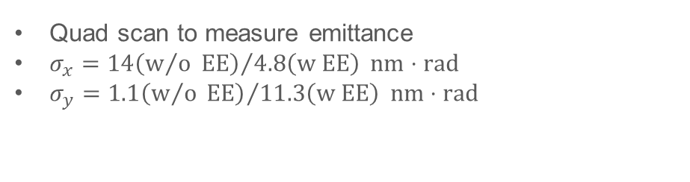
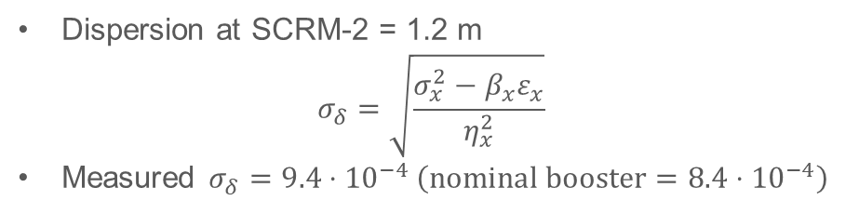
SLS Tour
BRTL (Booster to Ring Transfer Line)
Emittance measurement
Without and with
emittance exchange (EE)
Quad scan to measure emittance
$σ_{x}={14\left(w/o EE\right)}/{4.8\left(w EE\right)} nm⋅rad$
$σ_{y}={1.1\left(w/o EE\right)}/{11.3\left(w EE\right)} nm⋅rad$
Screen monitor : Uses for $ε_{x}/σ_{δ}$ measurements
Closed horizontal dispersion
Injected by 3-mm thick septum from booster to SR
Energy spread measurement
Dispersion at SCRM-2 = 1.2 m
$$σ_{δ}=\sqrt{\frac{σ_{x}^{2}−β_{x}ε_{x}}{η_{x}^{2}}}$$
Measured $σ_{δ}=9.4⋅{10}^{−4} \left(nominal booster=8.4⋅{10}^{−4}\right)$
5

Slide 6
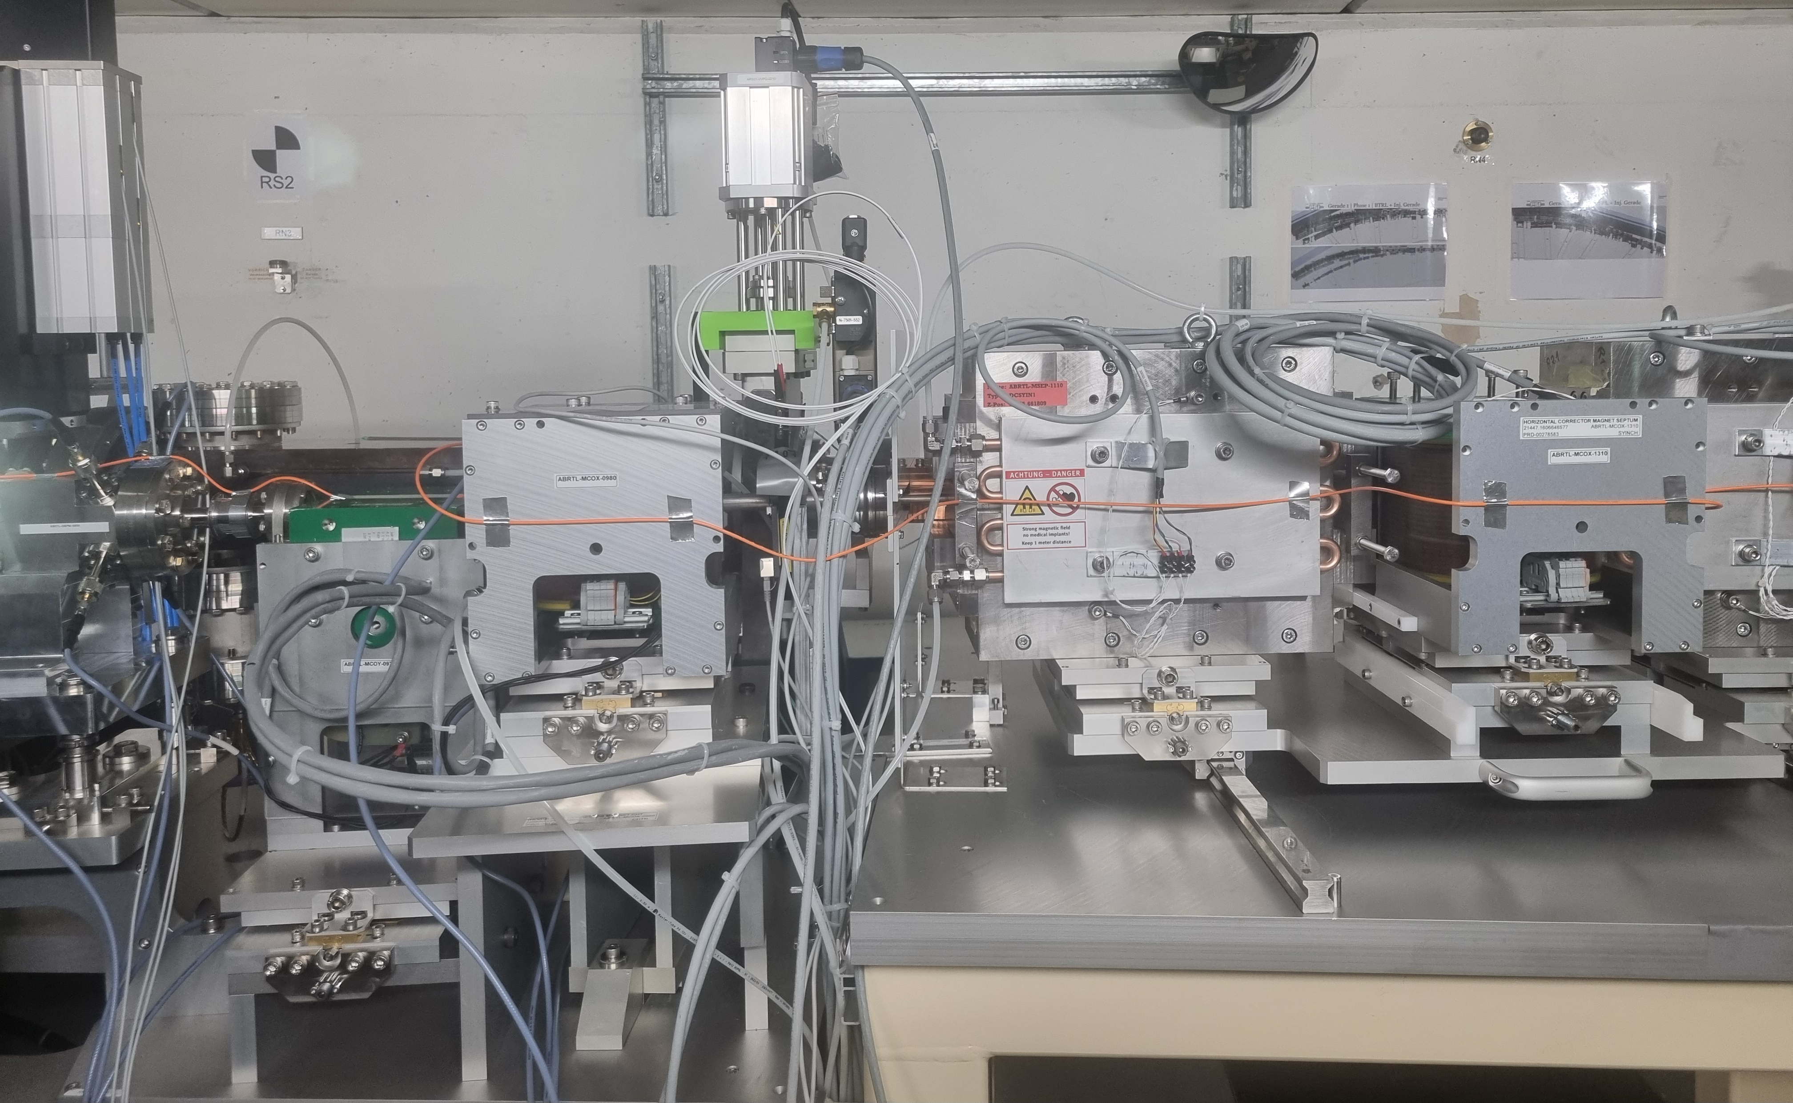
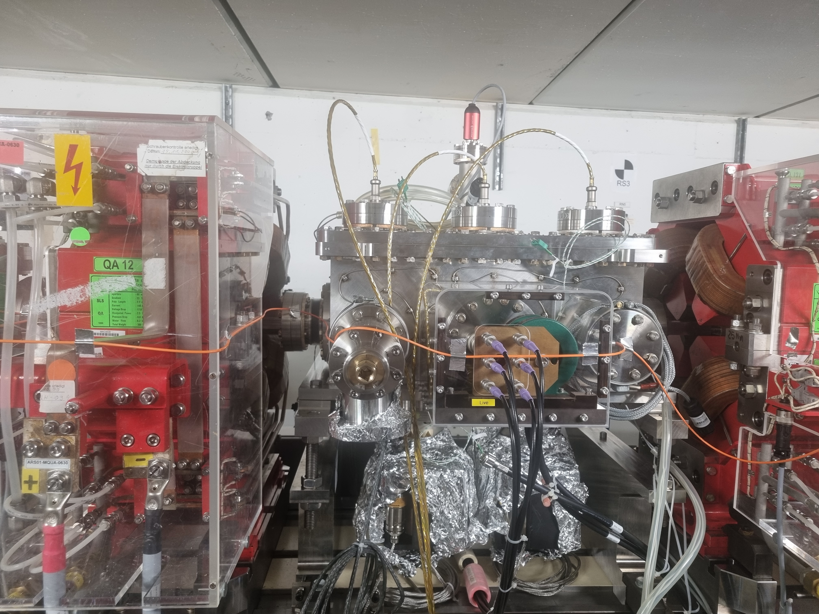
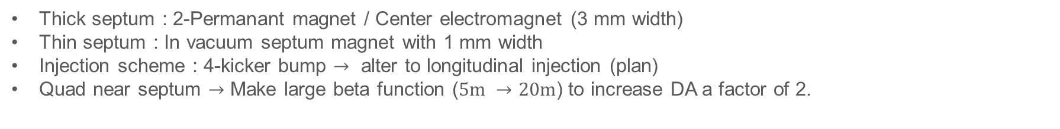
SLS Tour
Ring injection
3mm thick septum
1mm thin septum
Thick septum : 2-Permanant magnet / Center electromagnet (3 mm width)
Thin septum : In vacuum septum magnet with 1 mm width
Injection scheme : 4-kicker bump $→$ alter to longitudinal injection (plan)
Quad near septum $→$ Make large beta function ($5m →20m$) to increase DA a factor of 2.
6

Slide 7
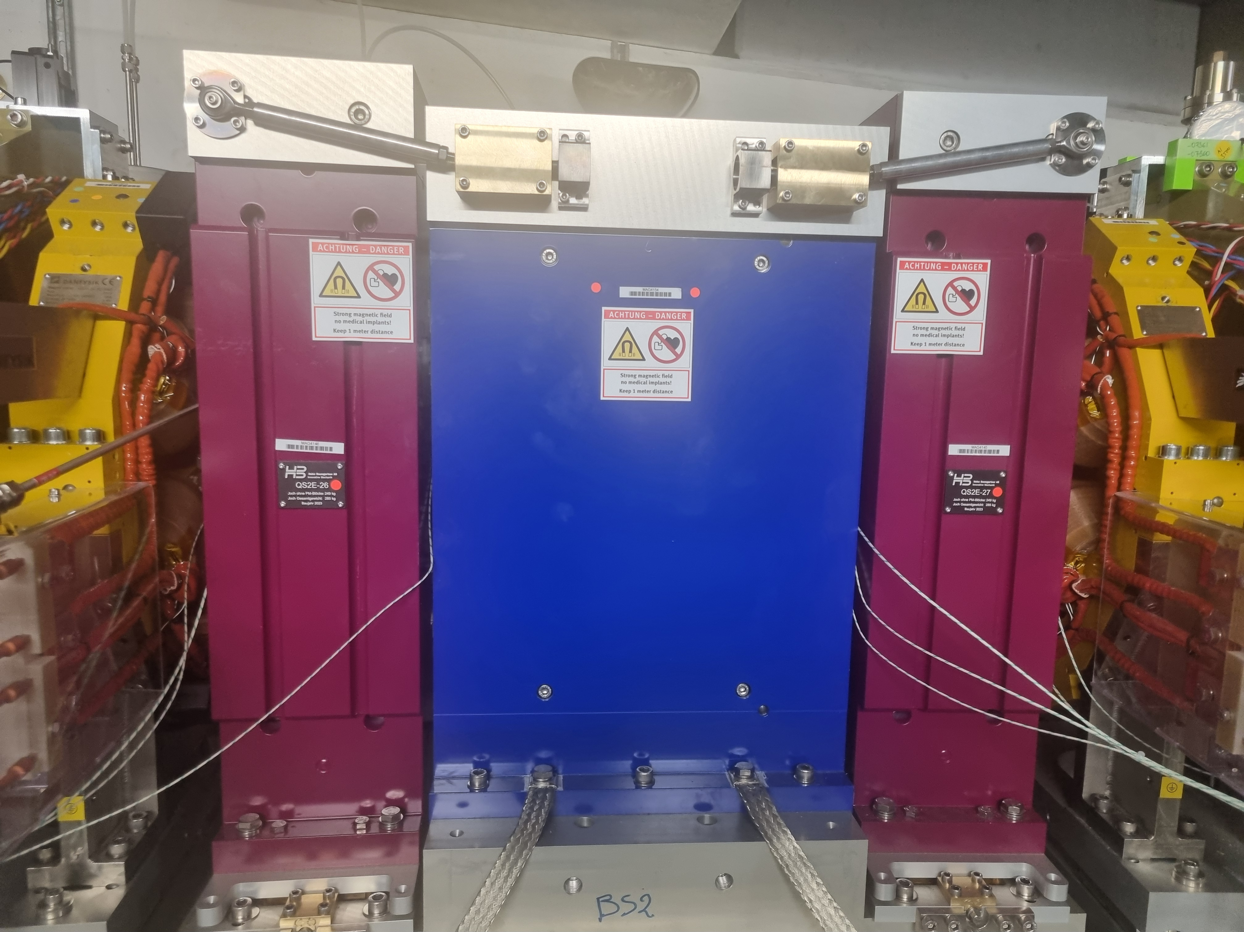
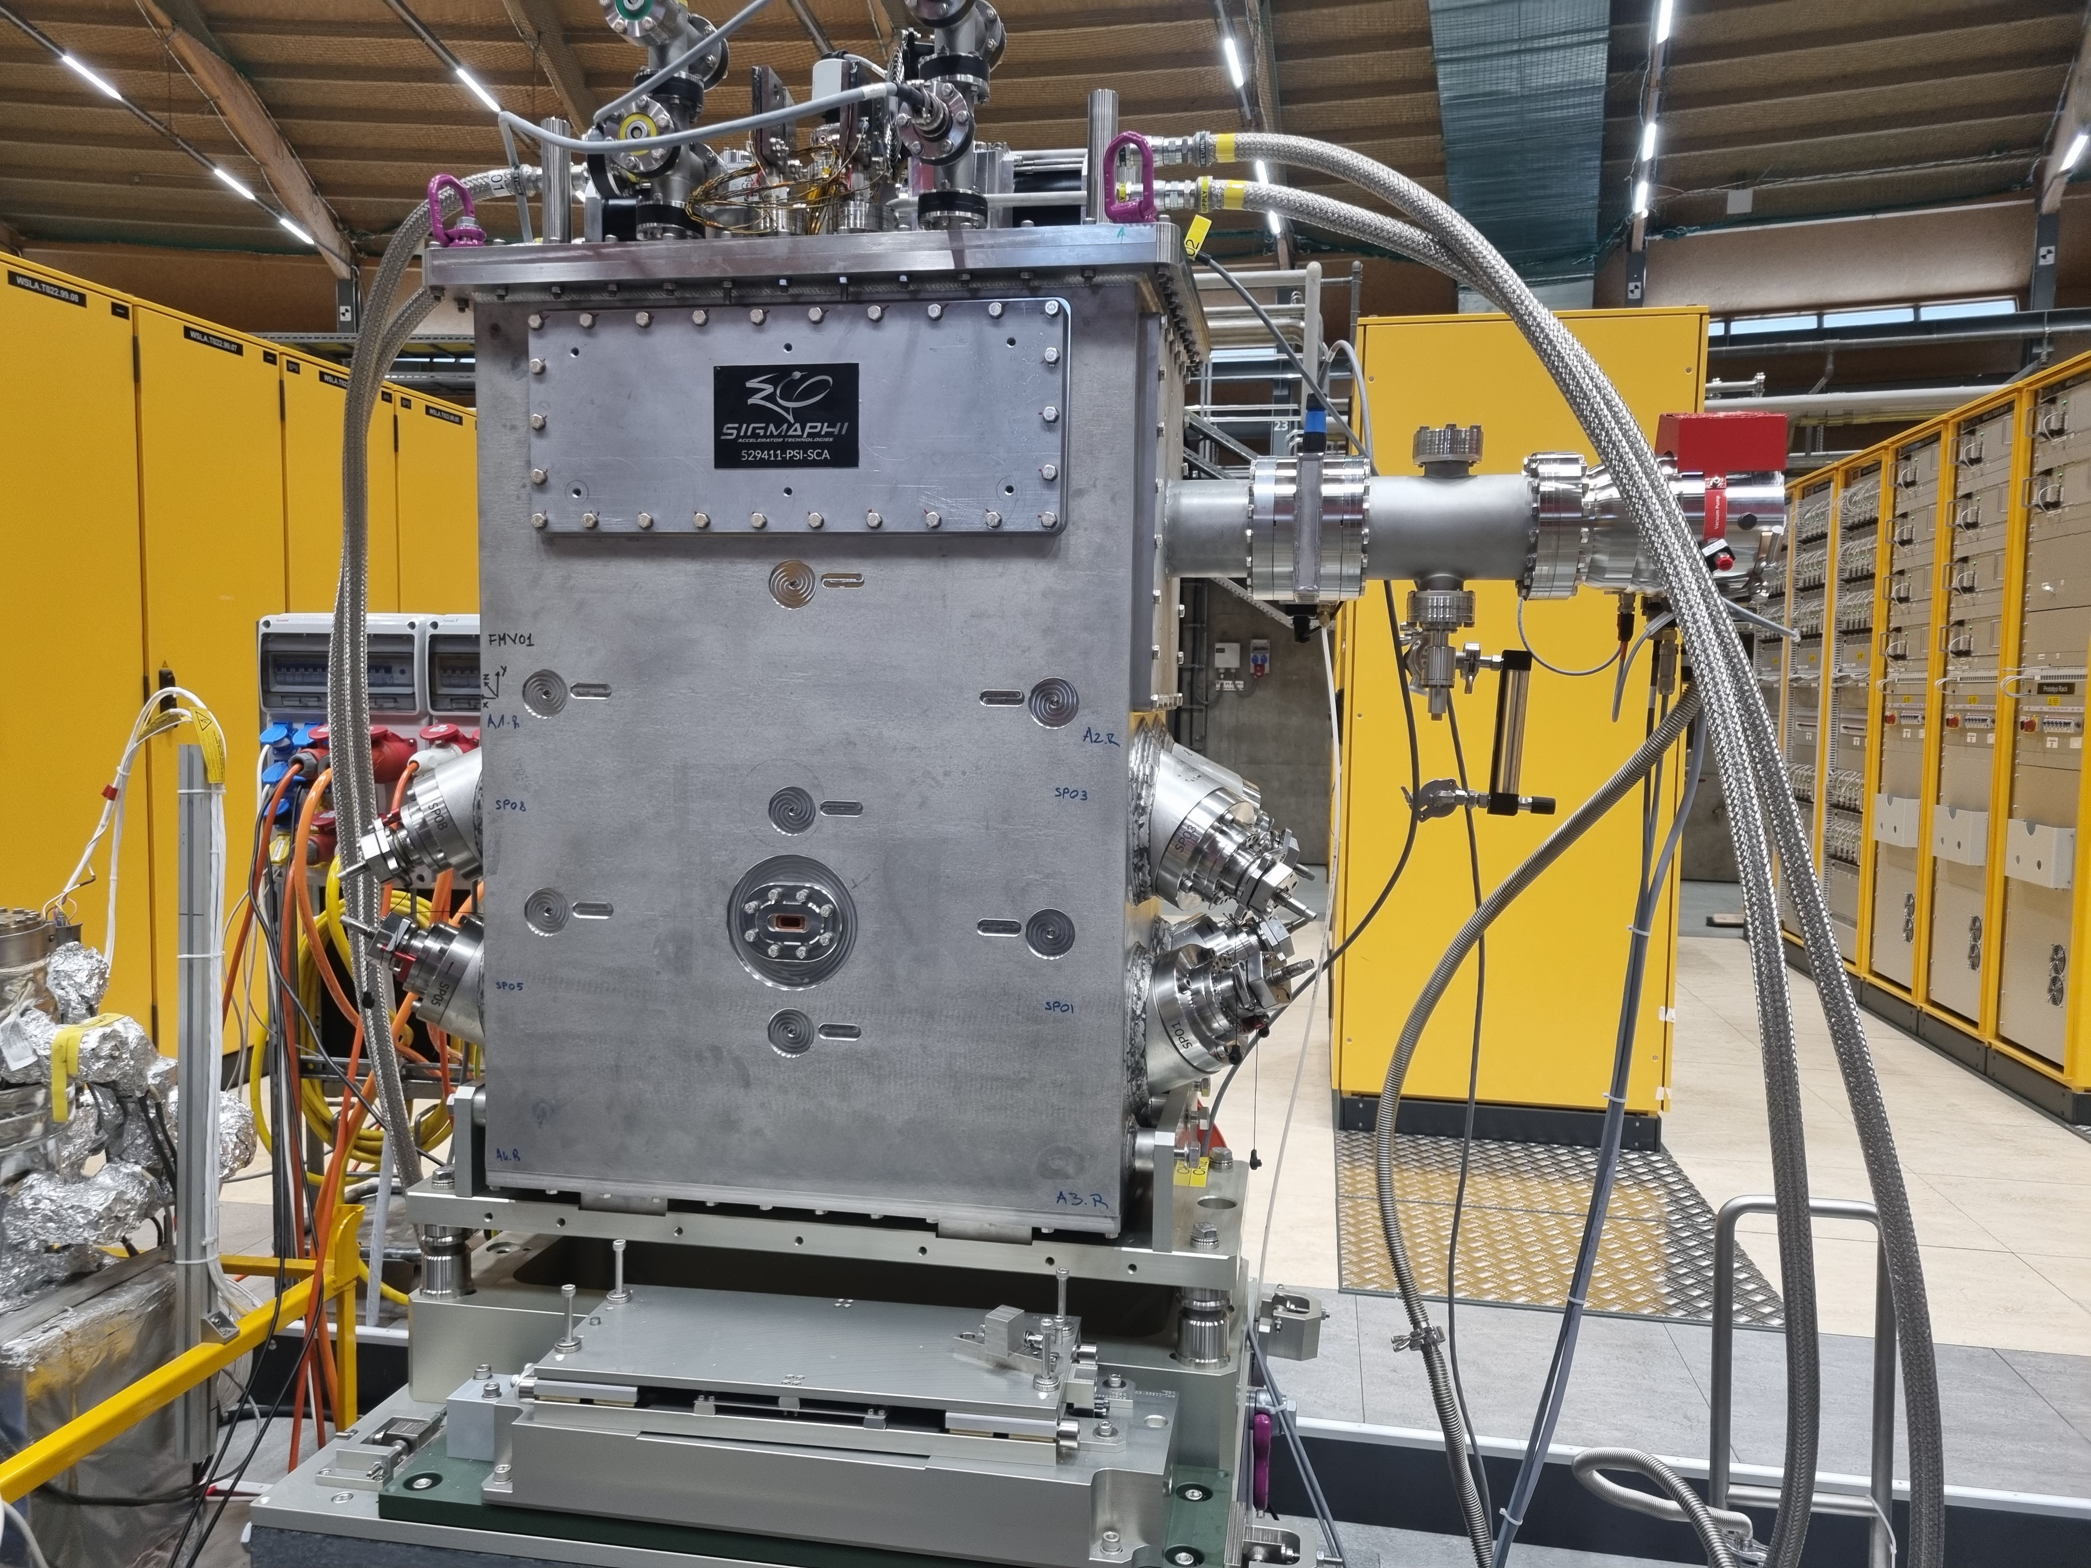
SLS Tour
Superbend magnet (Current)
(Plan to install - Superconducting)
2 T superbend magnet in operation
Purple: combined-function magnets (dipole + quadrupole)
Blue center magnet: pure dipole
LGB applied → maximum magnetic field at the center
A superconducting superbend magnet with a field of up to 5 T is currently under testing.
It is planned to replace the existing 2 T superbend magnet after the test campaign.
7

Slide 8
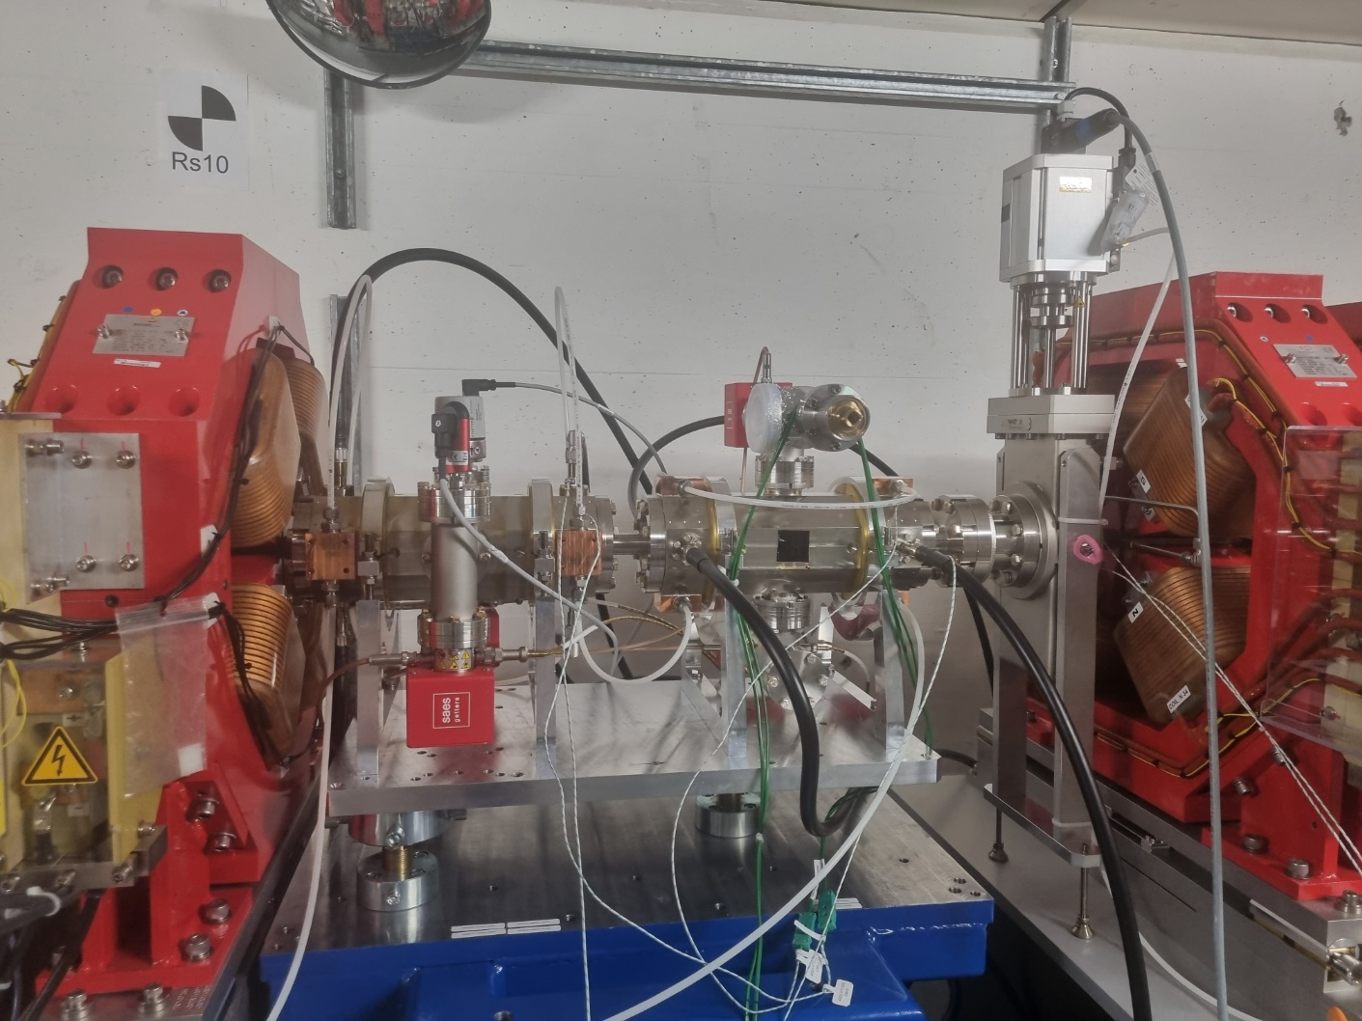
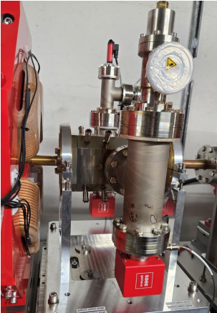
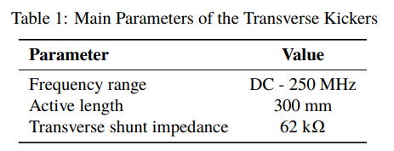
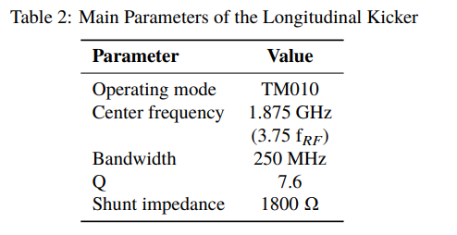
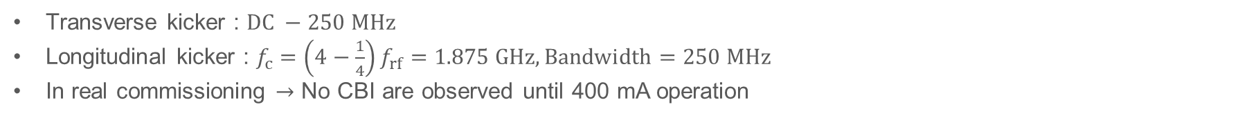
SLS Tour
Bunch by Bunch Feedback
Transverse kickers
Longitudinal kickers
Transverse kicker : $DC −250 MHz$
Longitudinal kicker : $f_{c}=\left(4−\frac{1}{4}\right)f_{rf}=1.875 GHz, Bandwidth=250 MHz$
In real commissioning $→$ No CBI are observed until 400 mA operation
8

Slide 9
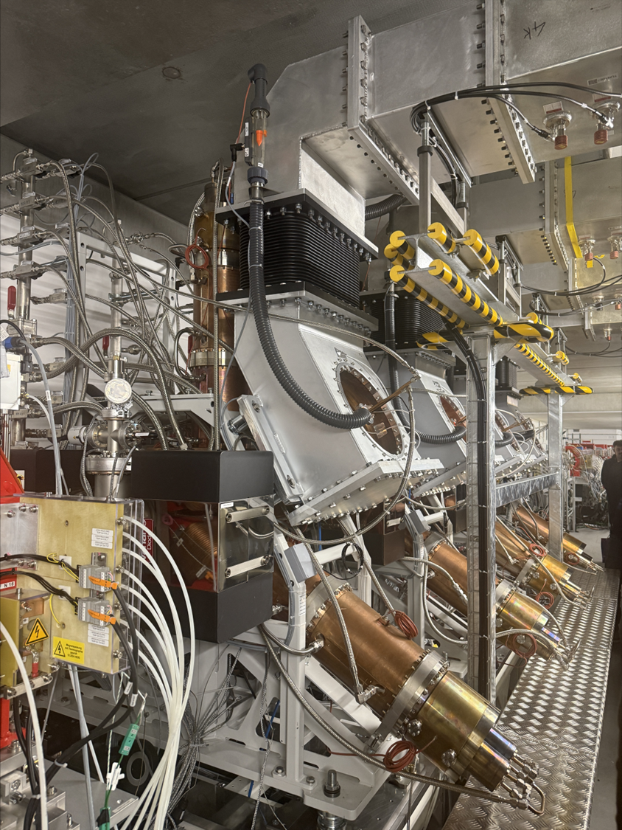
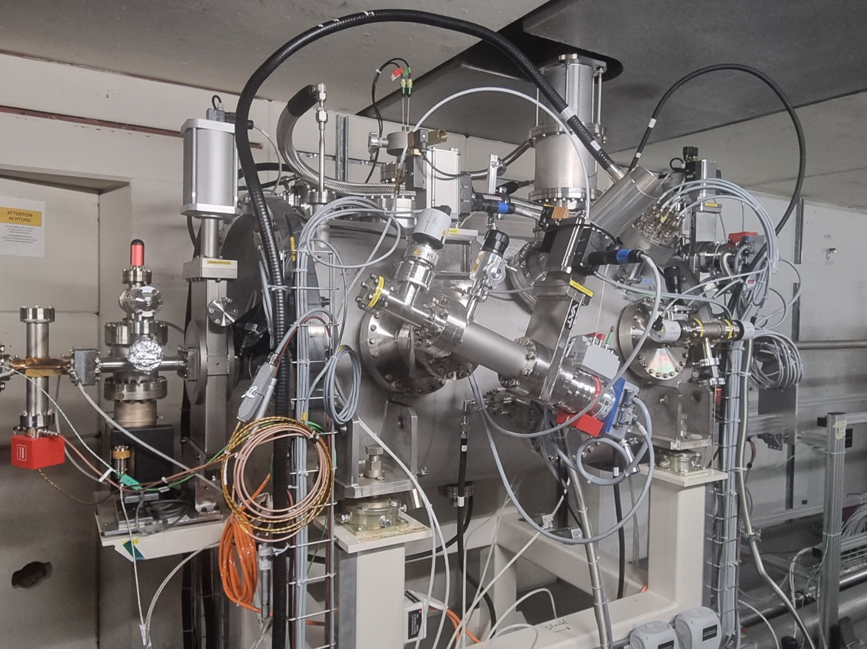
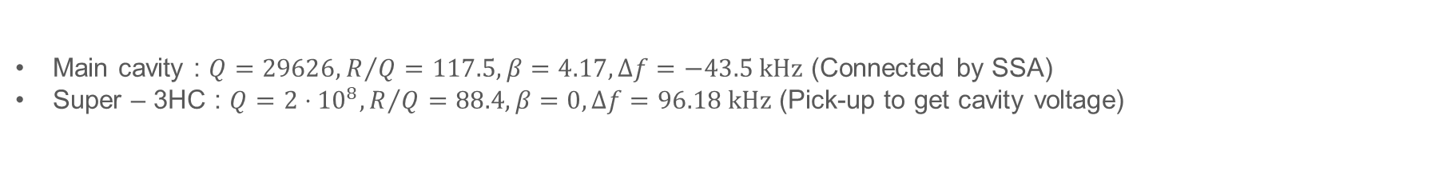
SLS Tour
Harmonic Cavity
Main HOM-damped cavity
Super – 3HC
Main cavity : $Q=29626,R/Q=117.5, β=4.17,Δf=−43.5 kHz$ (Connected by SSA)
Super – 3HC : $Q=2⋅{10}^{8},R/Q=88.4, β=0, Δf=96.18 kHz$ (Pick-up to get cavity voltage)
9

Slide 10
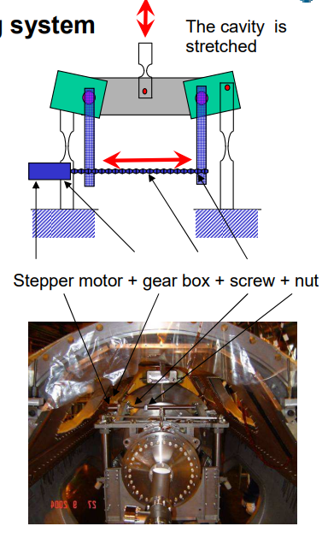
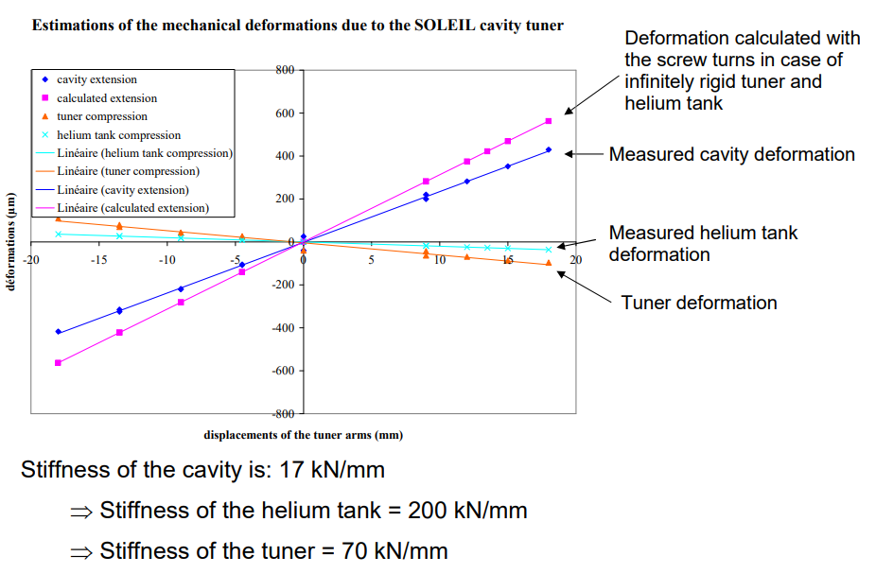
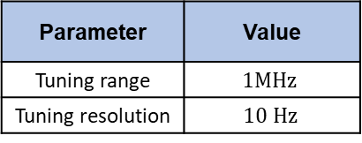
SLS Tour
Harmonic Cavity Tuner
Parameter | Value
Tuning range | $$1MHz$$
Tuning resolution | $$10 Hz$$
10

Slide 11
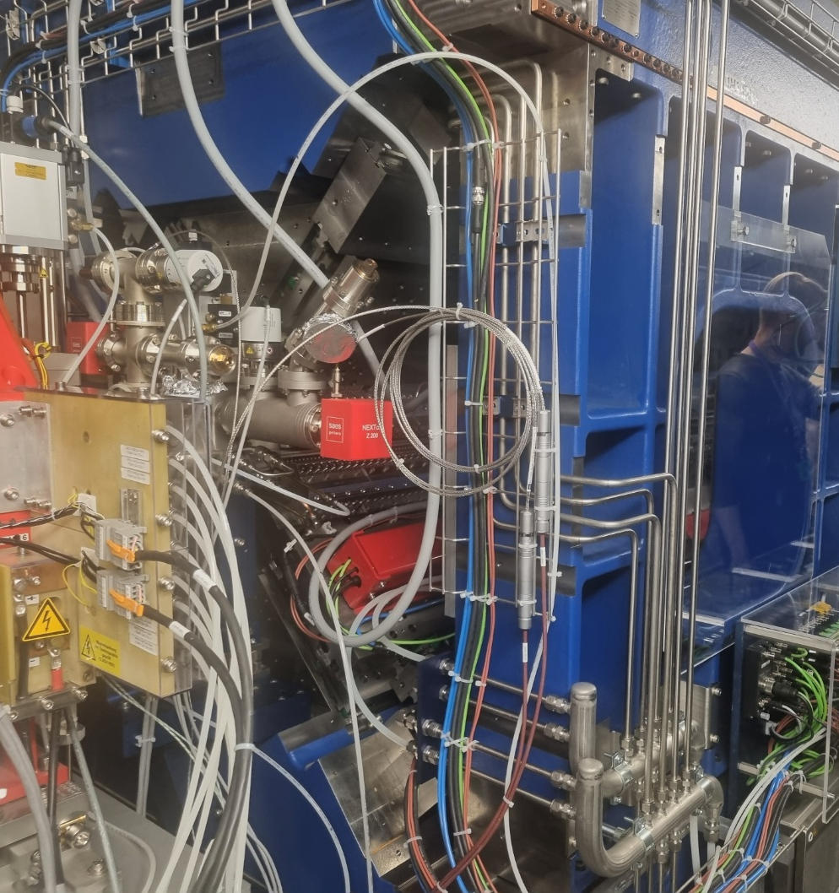
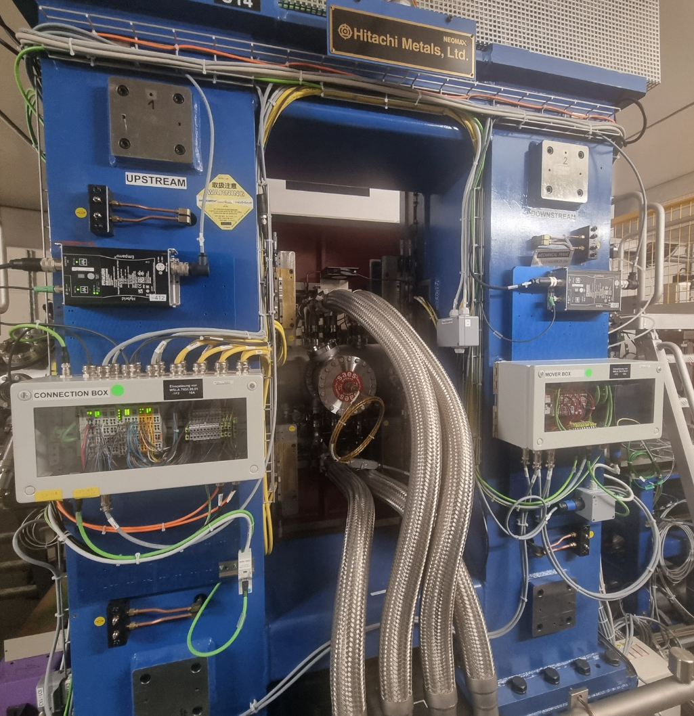
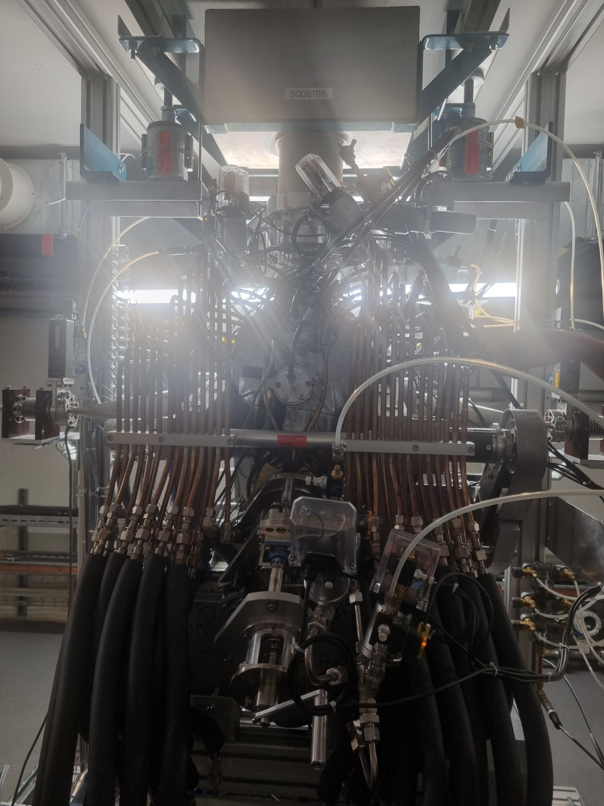
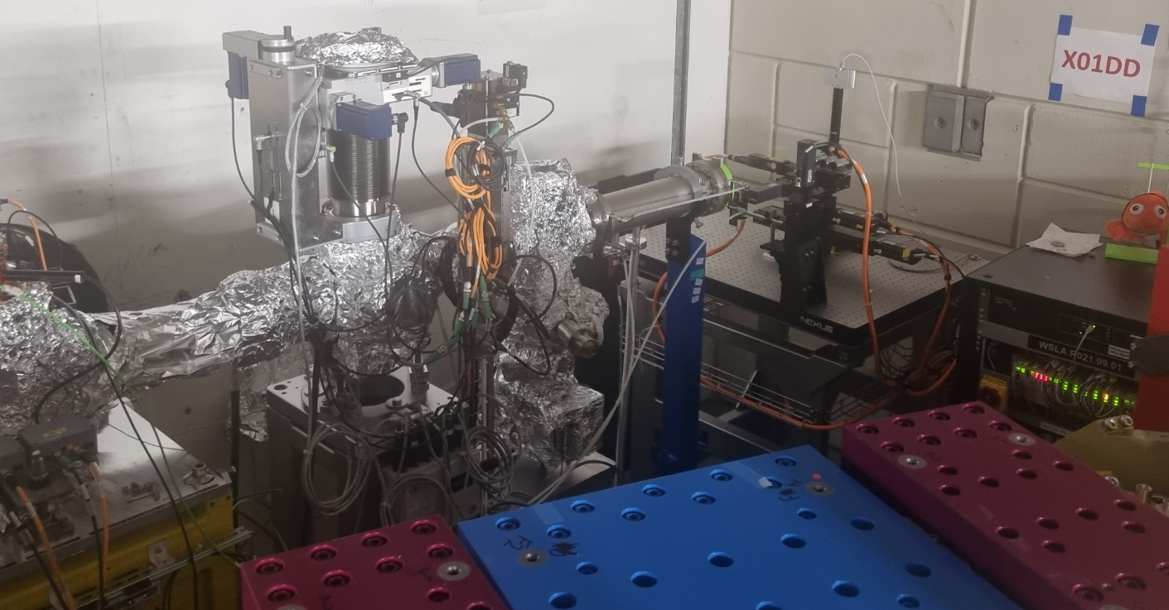
SLS Tour
Others
Undulators
Booster cavity
Diagnostic beamline
11

Slide 12
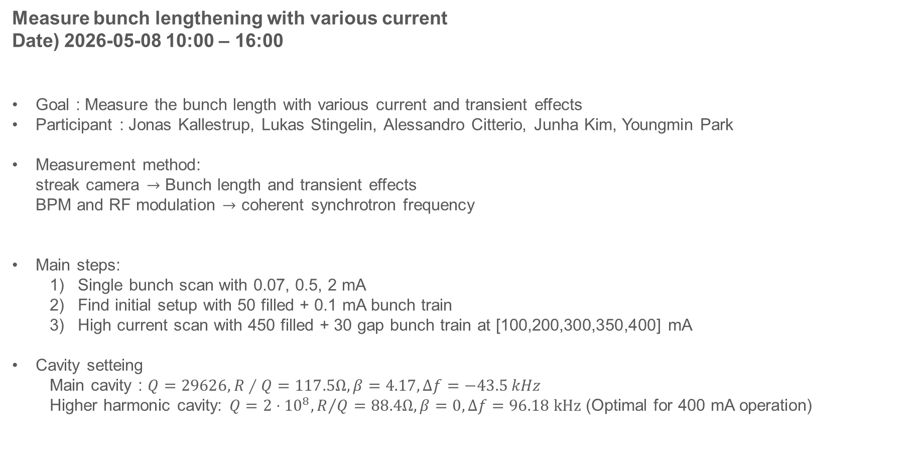
Bunch lengthening with HHC
Measure bunch lengthening with various current
Date) 2026-05-08 10:00 – 16:00
Goal : Measure the bunch length with various current and transient effects
Participant : Jonas Kallestrup, Lukas Stingelin, Alessandro Citterio, Junha Kim, Youngmin Park
Measurement method:
streak camera $→$ Bunch length and transient effects
BPM and RF modulation $→$ coherent synchrotron frequency
Main steps:
  Single bunch scan with 0.07, 0.5, 2 mA
  Find initial setup with 50 filled + 0.1 mA bunch train
  High current scan with 450 filled + 30 gap bunch train at [100,200,300,350,400] mA
Cavity setteing
  Main cavity : $Q=29626,R∕Q=117.5Ω, β=4.17,Δf=−43.5 kHz$
  Higher harmonic cavity: $Q=2⋅{10}^{8},R/Q=88.4Ω, β=0, Δf=96.18 kHz$ (Optimal for 400 mA operation)
12

Slide 13
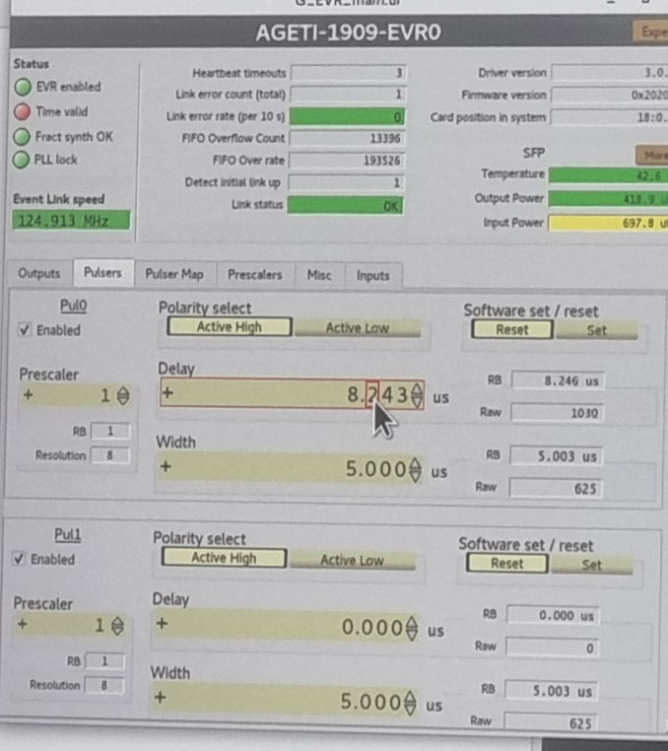
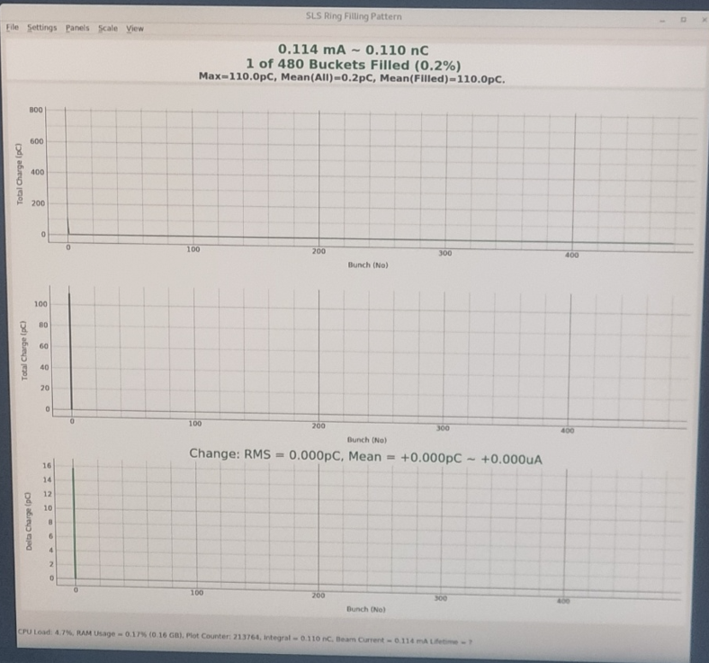
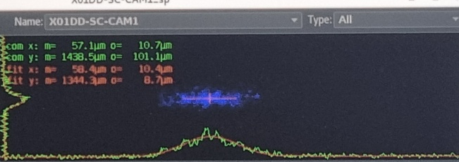
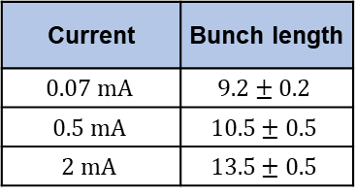
Bunch lengthening with HHC
Single bunch scan
Streak camera (Unit $μm→ps$)
Current | Bunch length
$$0.07 mA$$ | $$9.2±0.2$$
$$0.5 mA$$ | $$10.5±0.5$$
$$2 mA$$ | $$13.5±0.5$$
Theorical value = 8.97 ps
Control pulse delay to
find 0th bunch position
Filling pattern monitor
Bunch length increased with single-bunch current.
This effect is likely due to potential-well distortion induced by wake field, rather than HHC bunch lengthening.
13

Slide 14
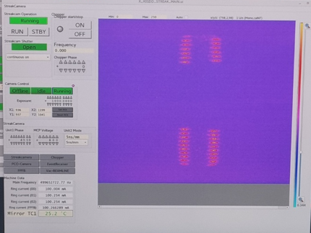
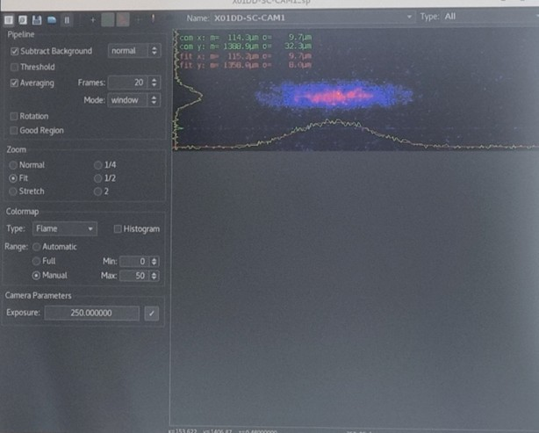
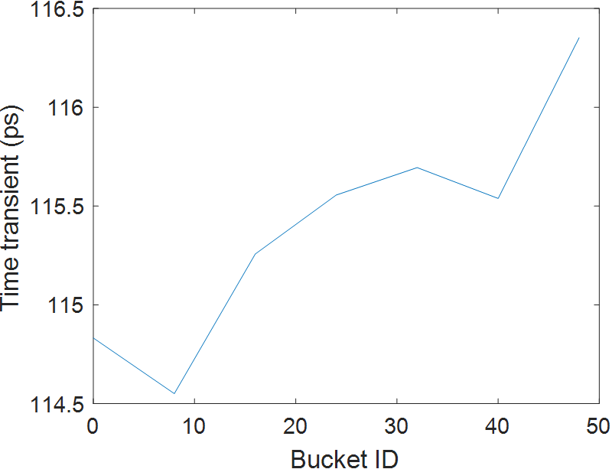
Bunch lengthening with HHC
50 Filled bunch measure(Total 5 mA)
Transient
0th
Bunch length
Change delay
1st
2nd
For the 50-filled-bucket case, the single-bunch current was about 0.1 mA.
Bunch-by-bunch measurements were performed every 8 buckets.
The measured bunch length was approximately 9.4 ps, similar to the 0.07 mA single-bunch case.
This indicates that the total current of 5 mA was too low to produce a noticeable HHC-induced bunch lengthening.
14

Slide 15
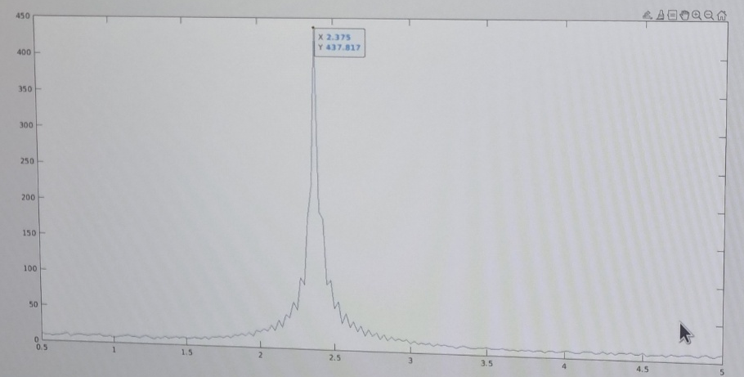
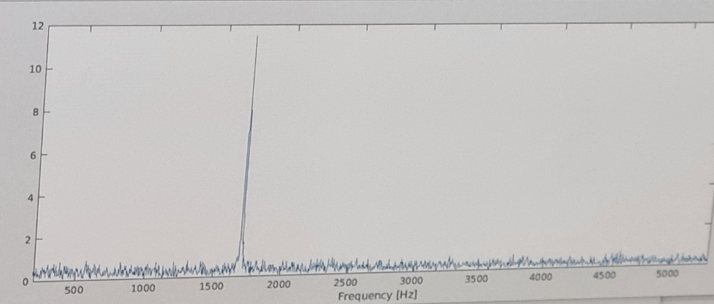
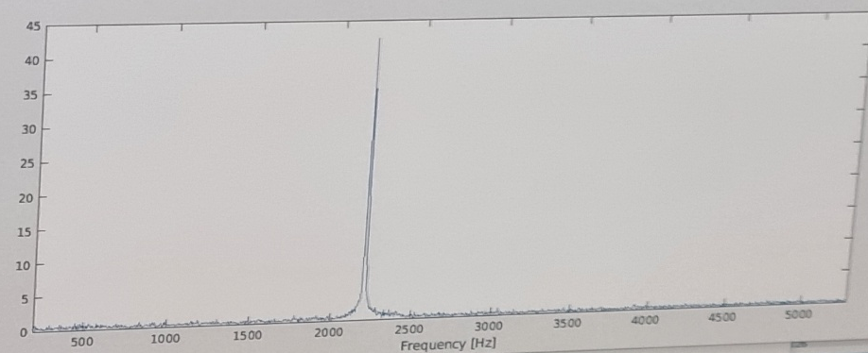
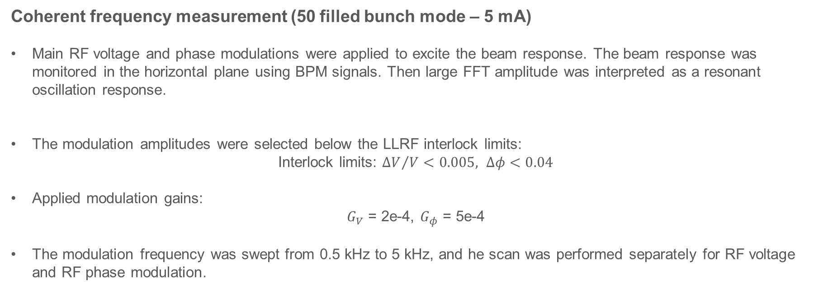

Bunch lengthening with HHC
Coherent frequency measurement (50 filled bunch mode – 5 mA)
Main RF voltage and phase modulations were applied to excite the beam response. The beam response was monitored in the horizontal plane using BPM signals. Then large FFT amplitude was interpreted as a resonant oscillation response.
The modulation amplitudes were selected below the LLRF interlock limits:
Interlock limits: ${ΔV}/V<0.005, Δφ<0.04$
Applied modulation gains:
$G_{V}$ = 2e-4, $G_{φ}$ = 5e-4
The modulation frequency was swept from 0.5 kHz to 5 kHz, and he scan was performed separately for RF voltage and RF phase modulation.
Theory value = $2.248 kHz$
15

Slide 16
Bunch lengthening with HHC
High current scan with 450 filled + 30 gap bunch train at [100,200,300,350,400] mA
Some error
At 350 mA, the expected bunch length was about 18–20 ps.
However, the measured bunch length was significantly longer and became comparable to the 400 mA case.
This additional lengthening is likely due to potential-well distortion, since the single-bunch current is about 0.78 mA.
At 400 mA, the operating point was close to the flat-potential condition.
A strong transient effect was observed along the bunch train under this condition.
16

Slide 17
Bunch lengthening with HHC
Compare with theory
The measured bunch lengths were slightly longer than the theoretical prediction.
However, the overall transient trend was reproduced reasonably well.
In particular, the similar bunch length level observed at 350–400 mA was also consistent with the theoretical tendency.
The systematic increase in the measured bunch length is likely due to additional potential-well distortion.
As discussed earlier, the single-bunch current is already high enough to induce wake-field-driven bunch lengthening.
17

Slide 18
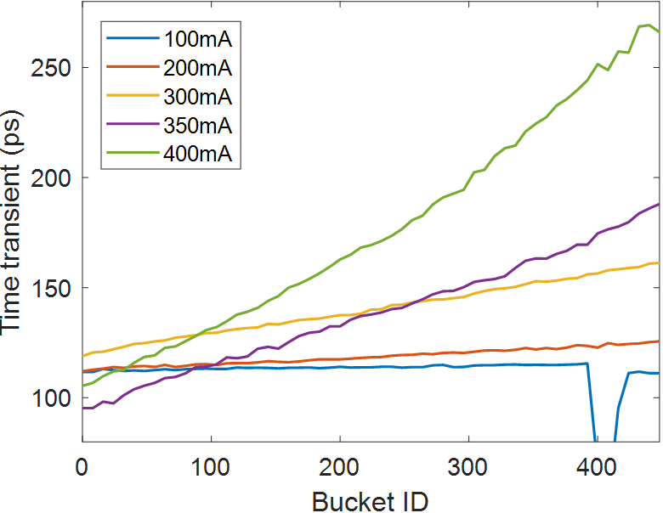
Bunch lengthening with HHC
Compare with theory
The measured centroid transient showed a similar trend to the theoretical prediction.
The transient amplitude was also comparable between measurement and theory.
At 400 mA, the measured centroid shift was about 160 ps, and he theoretical result showed about 150 ps
At 350 mA, the measured centroid shift was about 85 ps and the theoretical result showed about 75 ps
The measured centroid transient is reasonably consistent with the theoretical prediction.
18

Slide 19
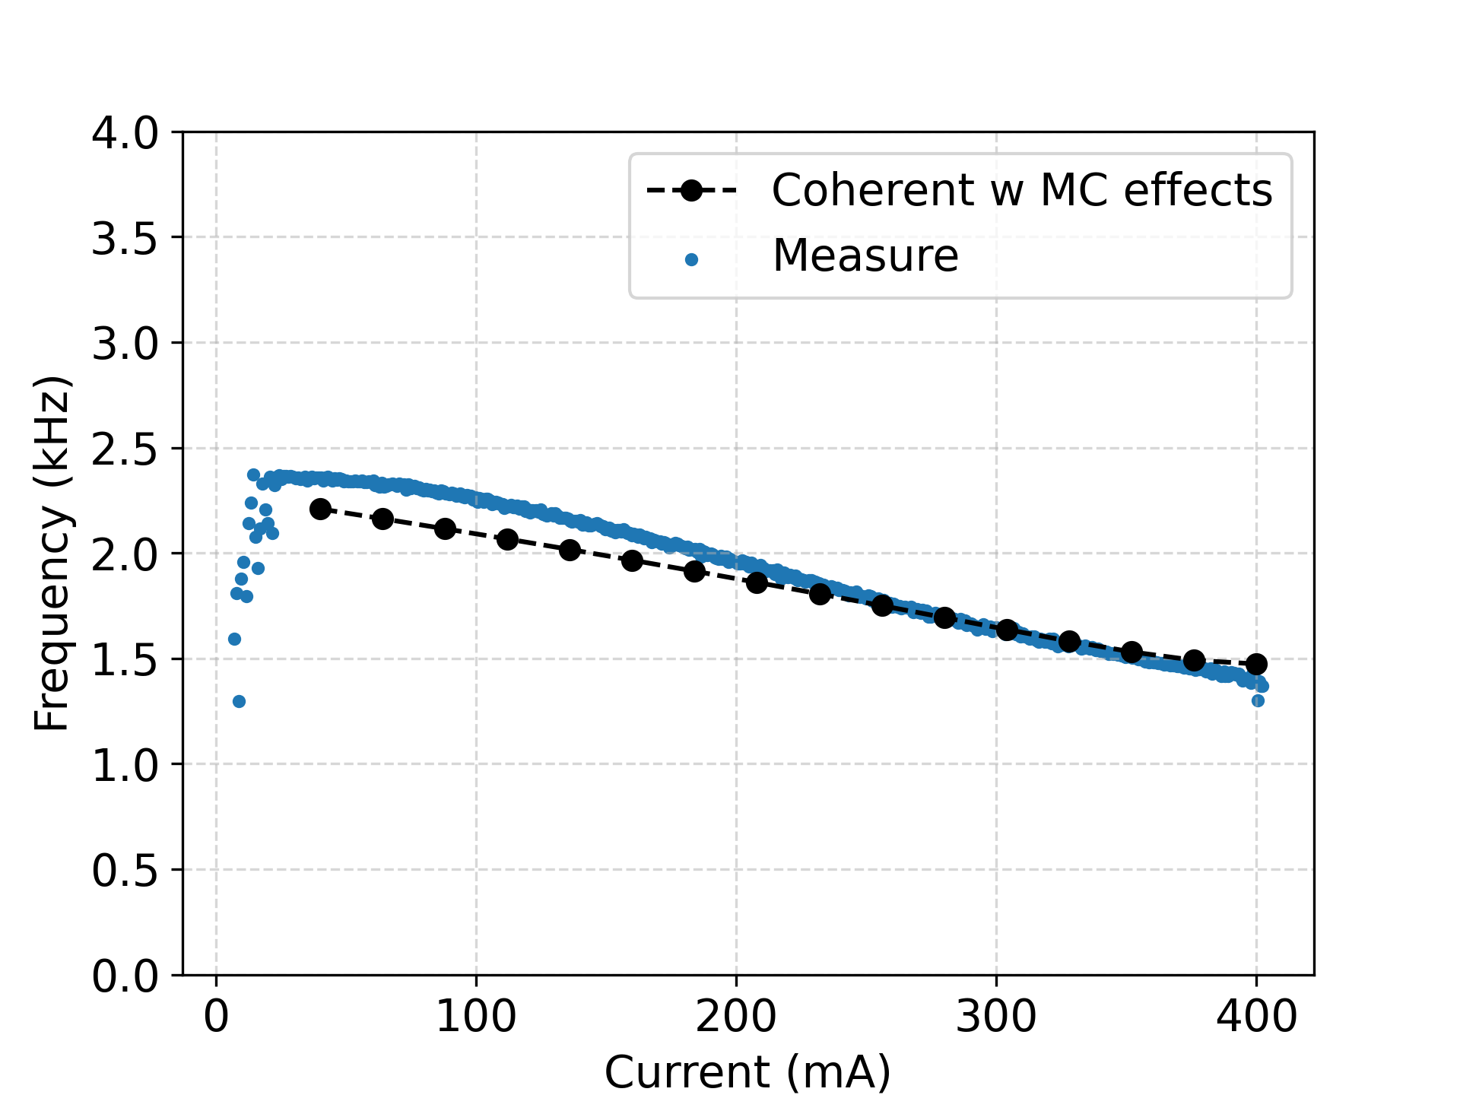
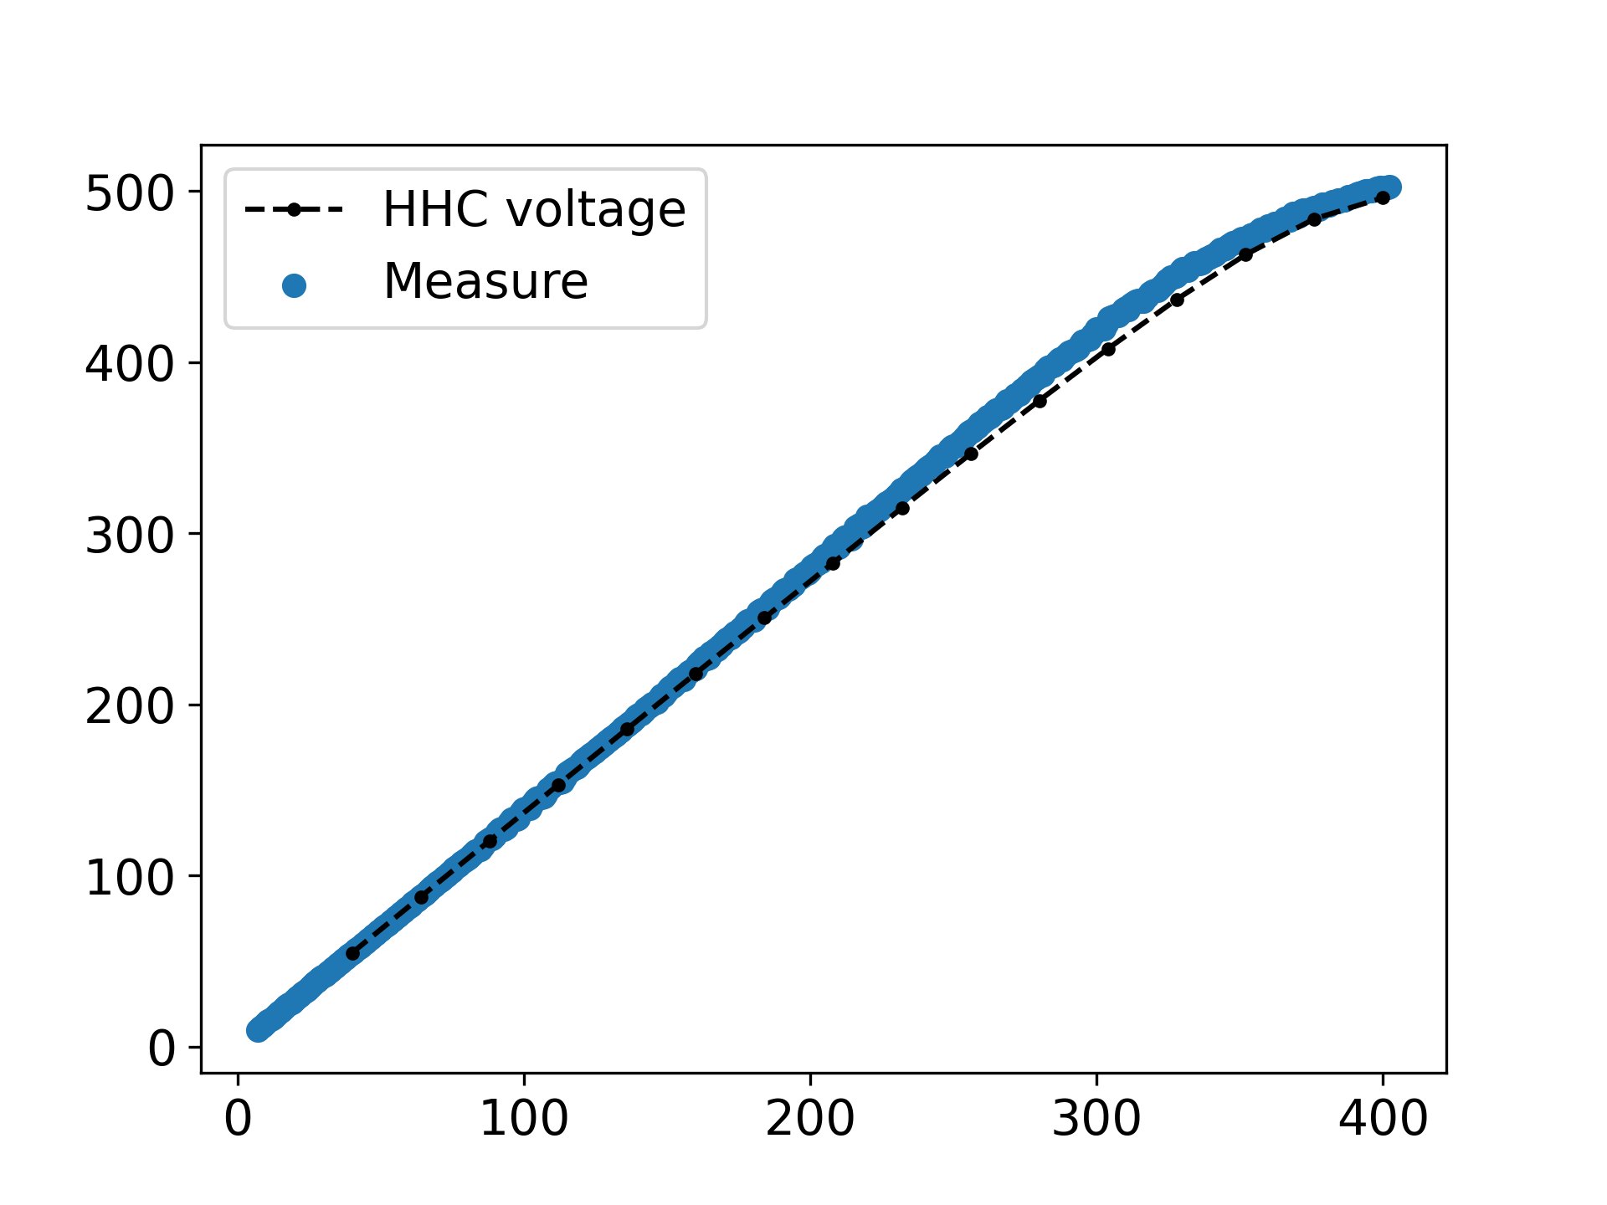
Bunch lengthening with HHC
6th order Characteristic equation & Measurement of synchrotron frequency
HHC Voltage (kV)
Current (mA)
6th-order characteristic function including main cavity and HHC impedances
HHC voltage calculated self-consistently at each beam current
Good overall agreement with measured vlaues
Small frequency deviation appears at low current, but similar values are reproduced
19

Slide 20
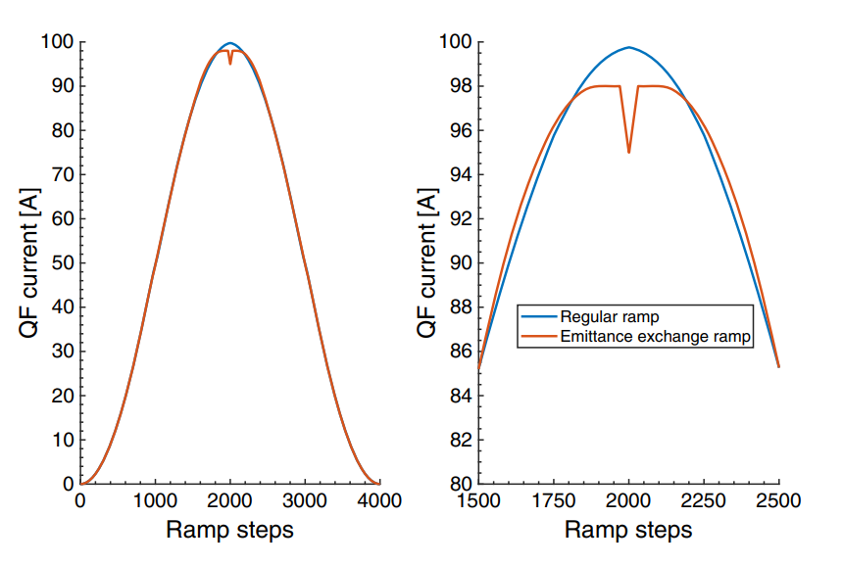
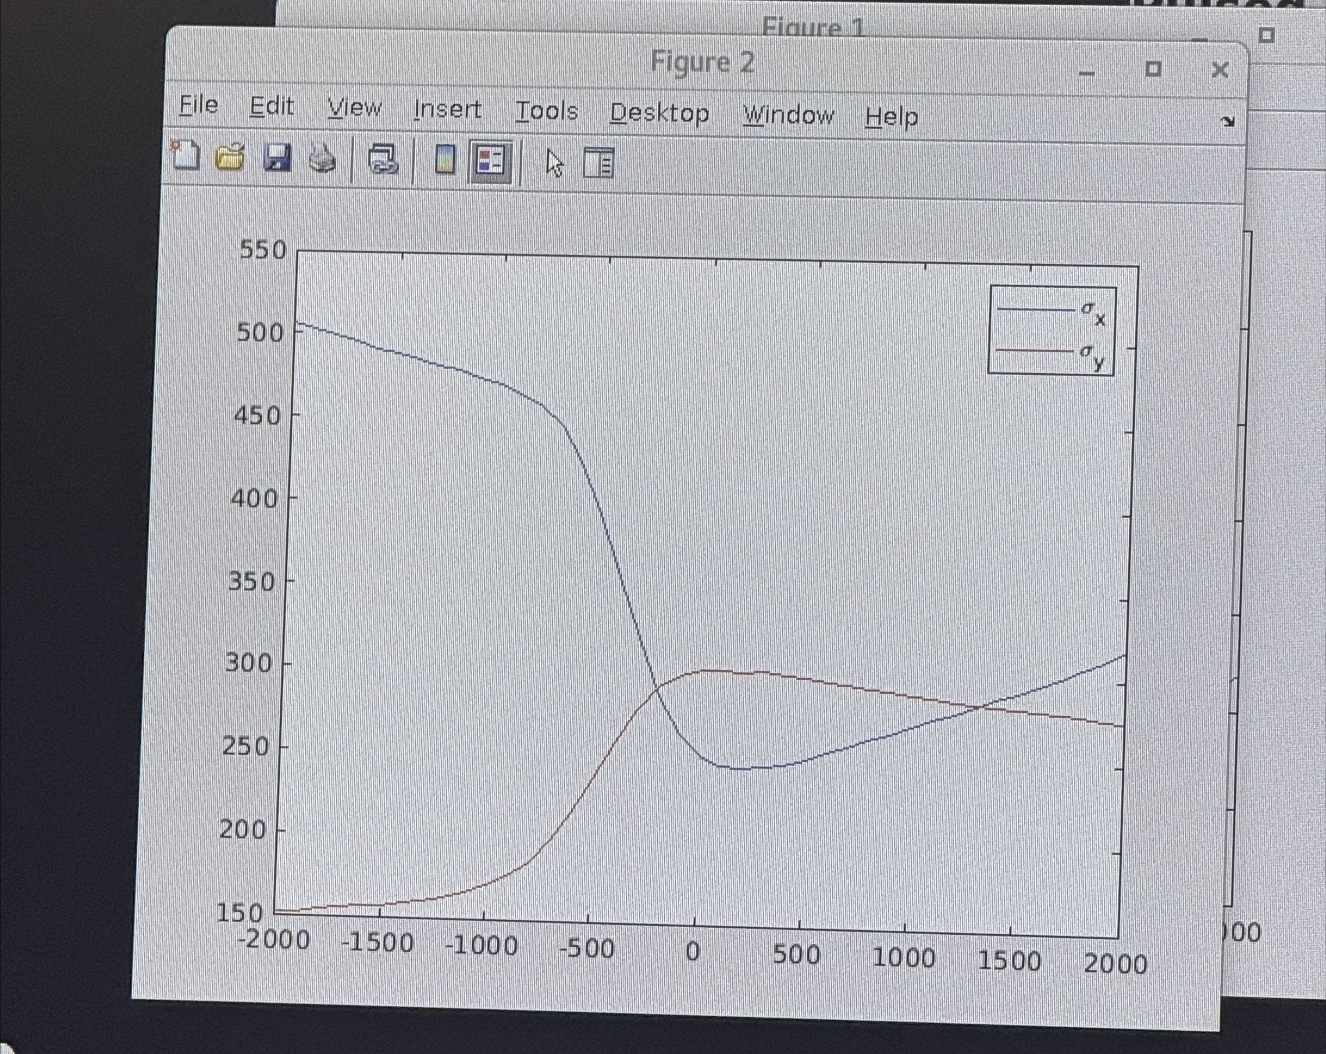
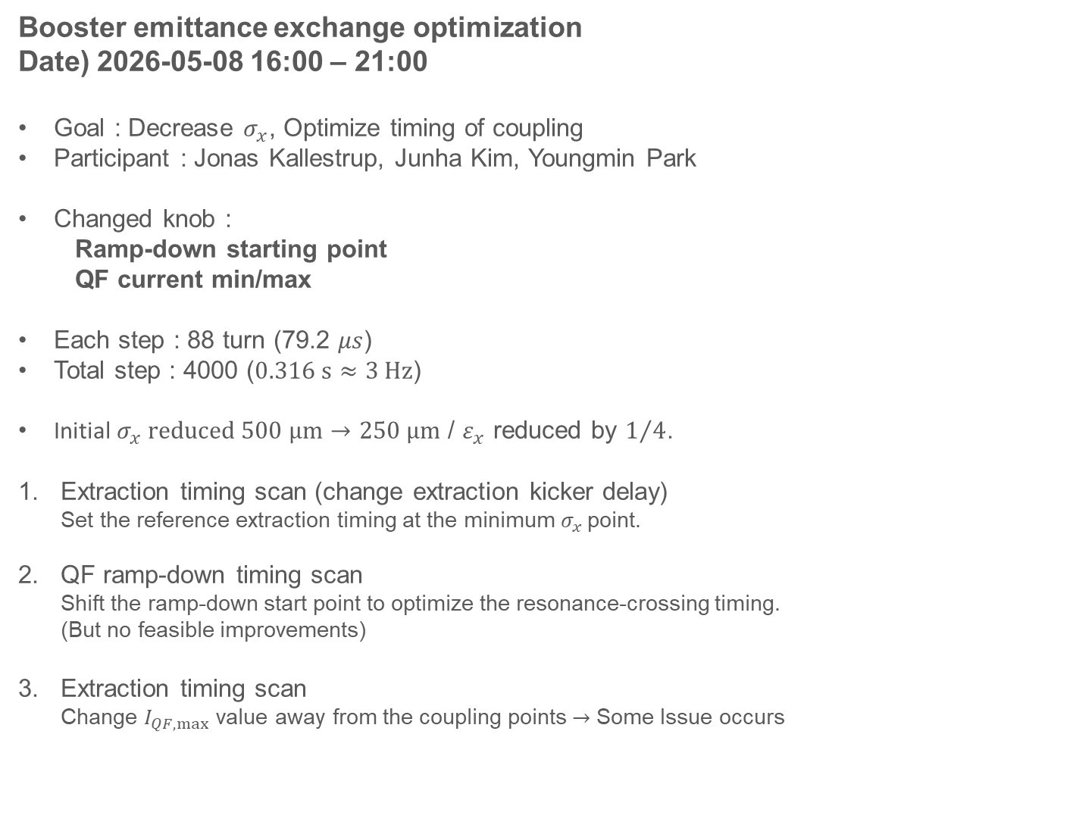
Booster Emittance Exchange
Booster emittance exchange optimization
Date) 2026-05-08 16:00 – 21:00
Goal : Decrease $σ_{x}$, Optimize timing of coupling
Participant : Jonas Kallestrup, Junha Kim, Youngmin Park
Changed knob :
Ramp-down starting point
QF current min/max
Each step : 88 turn (79.2 $μs$)
Total step : 4000 ($0.316 s≈3 Hz$)
Initial $σ_{x} reduced 500 μm→250 μm$ / $ε_{x}$ reduced by $1/4$.
Extraction timing scan (change extraction kicker delay)
Set the reference extraction timing at the minimum $σ_{x}$ point.
QF ramp-down timing scan
Shift the ramp-down start point to optimize the resonance-crossing timing.
(But no feasible improvements)
Extraction timing scan
Change $I_{QF,max}$ value away from the coupling points $→$ Some Issue occurs
Coupling minimized
Extraction
Exchange occurs
due to ramp-down
Emittance recover
due to radiation properties
20

Slide 21
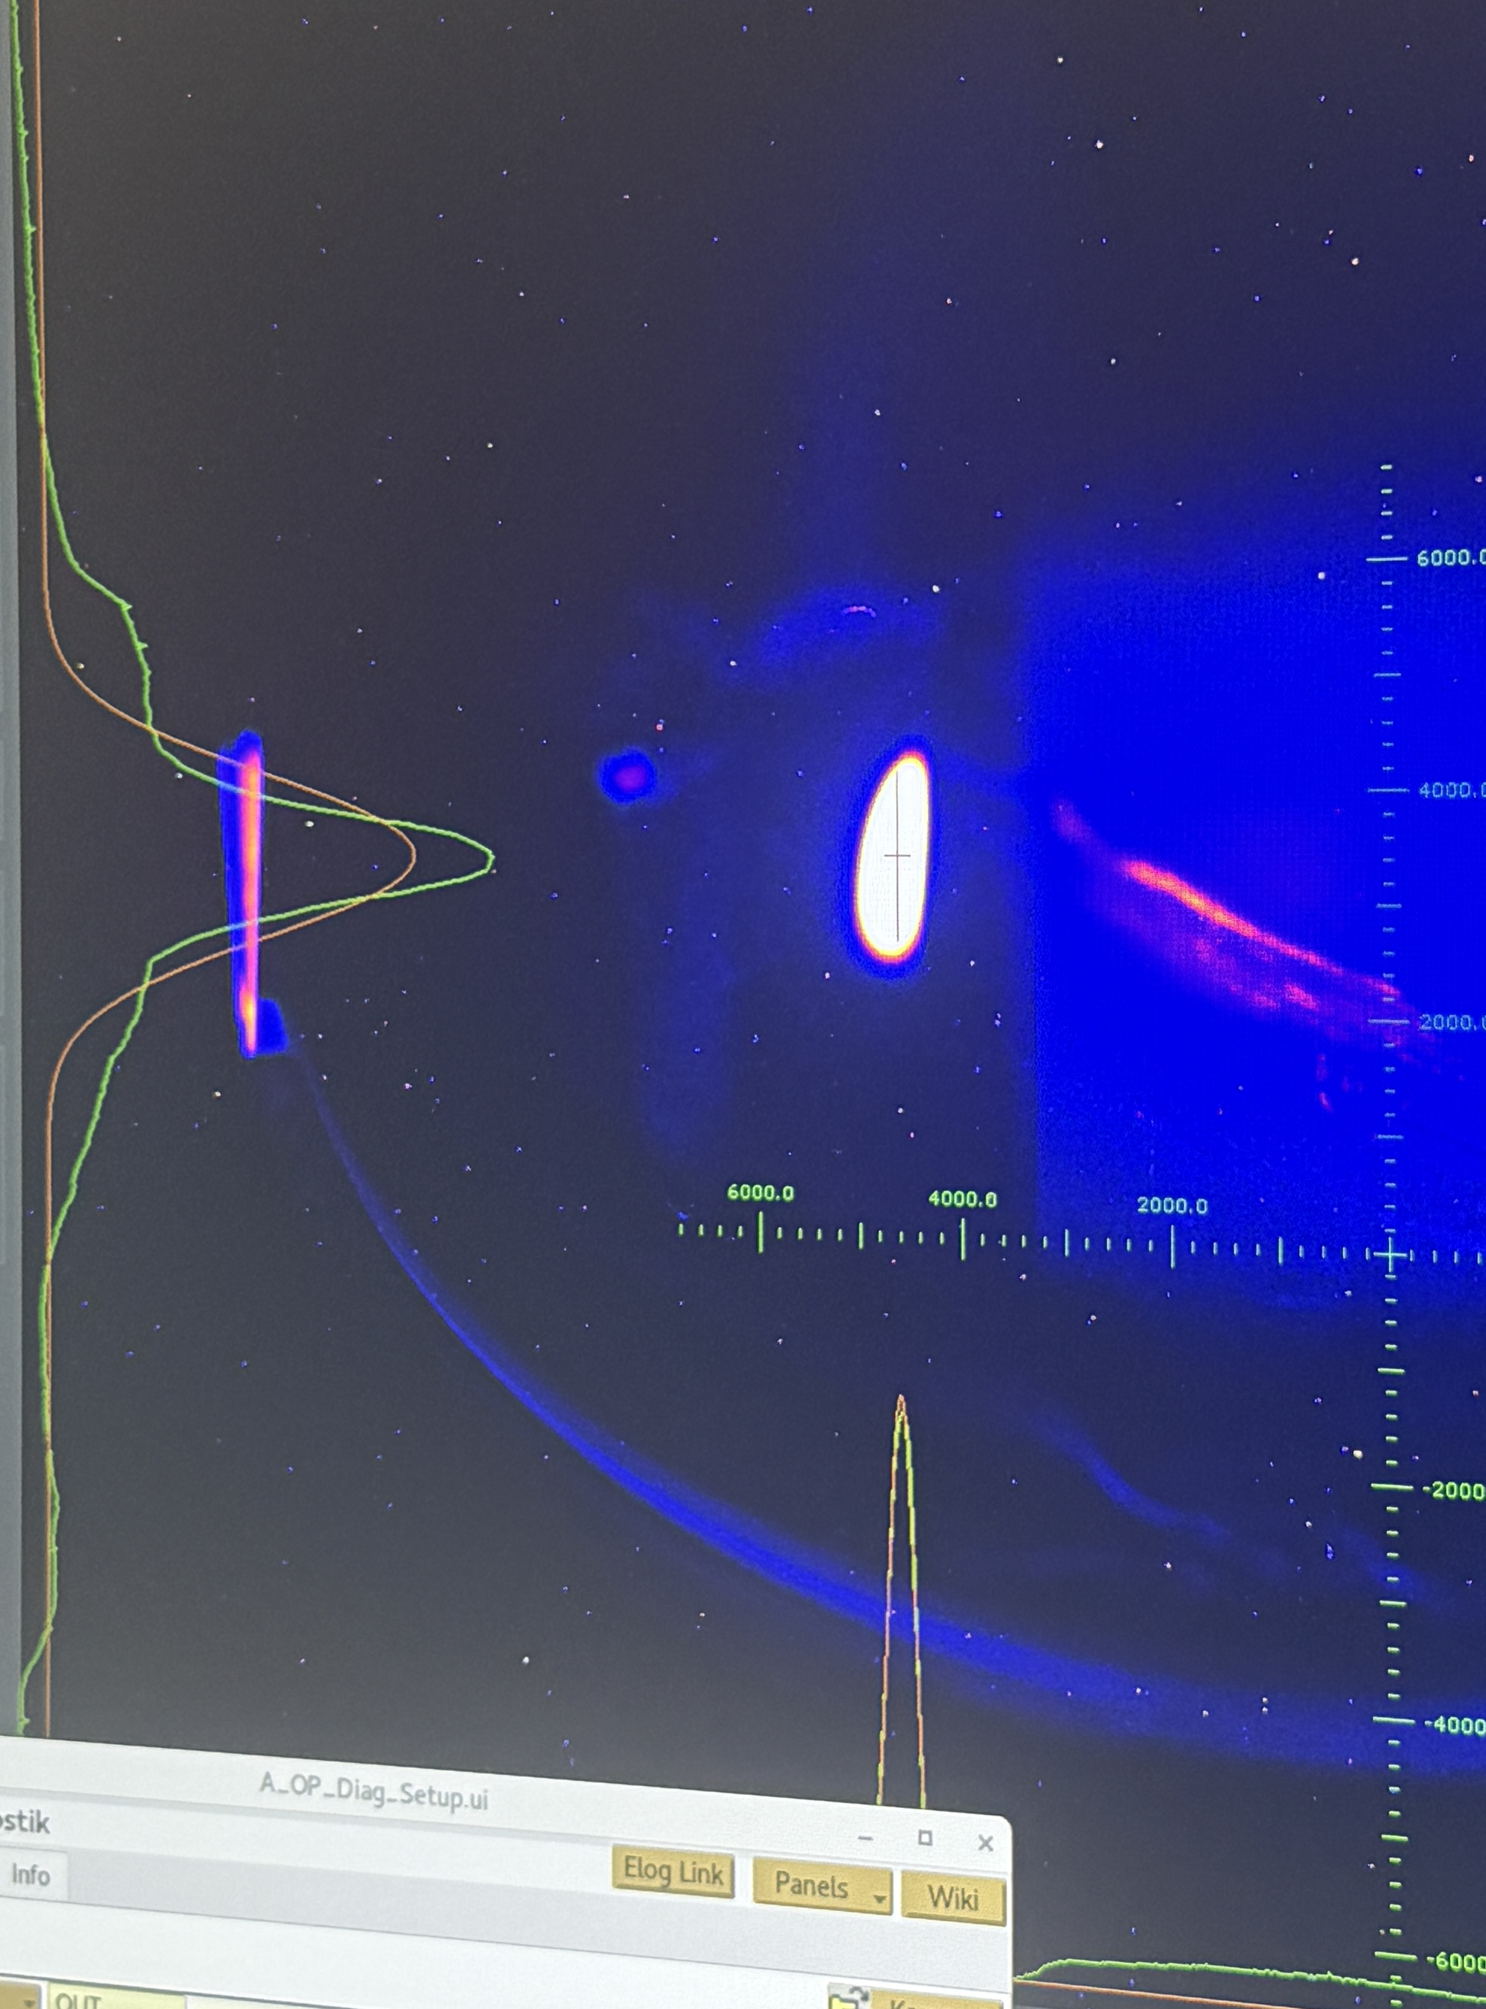
Booster Emittance Exchange
Booster emittance exchange optimization
Date) 2025-05-08 17:00 – 21:00
Beam loss occurred at several QF settings
clipped beam profiles suggested possible septum/aperture scraping.
The likely cause was a change in the extraction optics due to the tune shift induced by the QF variation.
Extraction kicker and BRTL quadrupoles were adjusted to recover beam centering and injection.
Stable injection was not recovered, and the experiment was stopped.
Beam loss by septum
21

Slide 22



CERN Tour
Date) 2026-05-14 11:00 – 18:00
SynchroCyclotron(SC)
Operate 1957 – 1990’s, 600 MeV circular accelerator
$$ω_{c}=\frac{qB}{γm}→ω_{c} becomes lower$$
After 1964: SC mainly used for nuclear physics due to PS (Proton Synchrotron)
22

Slide 23



CERN Tour
Date) 2026-05-14 11:00 – 18:00
ATLAS (A Toroidal LHC ApparatuS)
Purpose
Study particles produced in high-energy proton–proton collisions
Test the Standard Model and search for new physics
Structure
Large cylindrical detector surrounding the collision point
Built with several layers, each measuring different particle properties
Detectors
Inner Detector: tracks charged particles
Calorimeters: measure particle energy
Muon Spectrometer: detects muons
Magnets: bend charged particles to measure momentum
Achievements
Played a key role in the Higgs boson discovery in 2012
Continues precision measurements and searches for new particles
23

Slide 24




CERN Tour
Date) 2026-05-14 11:00 – 18:00
CERN control room
Central control room for CERN’s accelerator complex
Organized into four main operation panels:
  PS and injector chain
  SPS
  LHC
  Cryogenic system
Operators monitor and control beam operation, machine status, and cryogenic conditions from this room
24

Slide 25

CERN Tour
Date) 2026-05-14 11:00 – 18:00
Injection
Extraction
LEIR (Low Energy Ion Ring)
Accumulates low-energy ion beams from Linac 3
Converts long ion pulses into short, dense bunches
Accelerates the ions before transfer to the PS
Used as part of the ion injector chain:
Linac 3 → LEIR → PS → SPS → LHC
Operation history
Converted from the LEAR (Low Energy Antiproton Ring)
LEAR operation ended in 1996
First beam observed in October 2005
25

Slide 26


IPAC SSMB
Date) 2026-05-15 ~ 2026-05-22
Dr. Deng !!
26

Slide 27


IPAC SSMB
Longitudinal Weak Focusing
Date) 2026-05-15 ~ 2026-05-22
Longitudinal Strong Focusing
Don’t need
Isochronous condition!!
27

Slide 28
Thank you for your attention!
28

Slide 29



6th Order characteristic equation
HHC
Main cav
Beam-cavity coupled motion
$$G\left(s\right)+\frac{N_{1}}{D_{1}\left(s\right)}+\frac{N_{2}\left(s\right)}{D_{2}\left(s\right)}=0$$
$$where s=jΩ, G\left(s\right)=s^{2}+ω_{s}^{2},D_{1}\left(s\right)=s^{2}+\frac{2}{T_{f}}s+d_{0},D_{2}\left(s\right)=s^{2}+\frac{2}{T_{f2}}s+d_{2},$$
$$d_{2}=\frac{1+\tan^{2}{ψ_{2}}}{T_{f2}^{2}},N_{1}=\frac{2mAω_{rf}\tan{ψ}}{T_{f}^{2}},N_{2}\left(s\right)=\frac{A_{2}}{T_{f2}^{2}}\left(−2T_{f2}s^{2}−2s+2ω_{rf}\tan{ψ_{2}}\right)$$
29

