Slide 1


Paper Review
Design and implementation of
accelerator control monitoring system
51st Speaker
류연찬
05, JUN 2026

Slide 2
Paper Review
OUTLINE
Chosen Reason & Introduction
System design
Software development
  Metric monitoring
  Log monitoring
  EPICS control system real-time monitoring
ACMS vs Phoebus alarm
Conclusion and Discussion

Slide 3
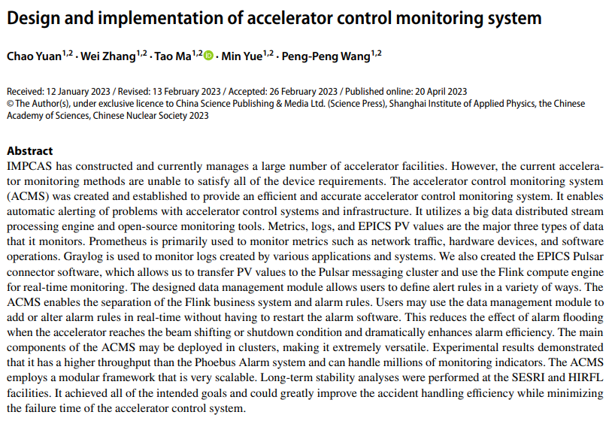
Paper Review
Chosen Reason & Introduction
선정 이유 : 가속기 제어의 학술적 의의
데이터 “값”이 아닌 “데이터” 자체를 스터디
Introduction (기존의 문제점)
ALH – based on old x11/Motif architecture
Phoebus – based on XML. Can be rigid
when monitoring many PVs
CERN, SuperKEKB also developed
own Monitoring System
Contribution of this paper
Monitoring Metrics, Logs and EPICS PVs
ACMS(Accelerator Control Monitor System)
for integrated monitoring and alarm system

Slide 4
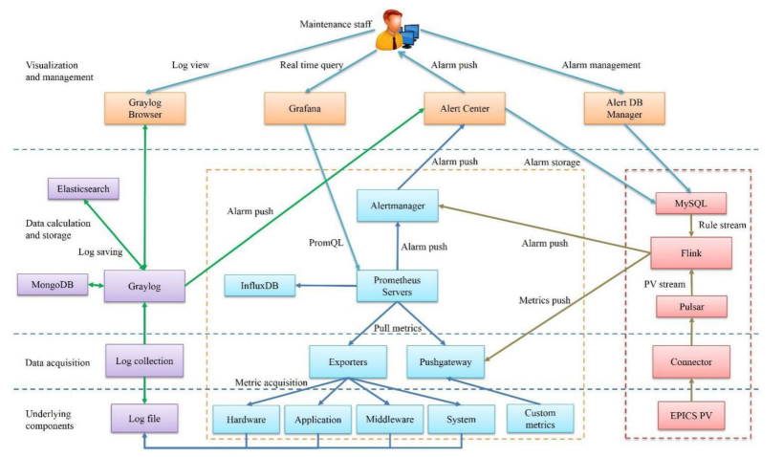
Paper Review
2. System design
Logs : Graylog / Metric – Prometheus / PV – Flink
Four layers Architecture
  Component, acquisition, storage and Visual
  Alert Center for alarm delivery and management
Advantages of ACMS
Improved scalability and stability
Integration of open-source tools
Logs
Metrics
PV
Overall Architecture of ACMS

Slide 5
Paper Review
3.1 Metric monitoring (1/3) – Control System
What is metrics
  Metrics are numerical data collected over time
  Such as Network traffic, CPU/Memory usage, DISK I/O
  Help identify the cause of system slowdown of failure
Virtual Machiane(VM) : Prometheus Server
  Prometheus Server : Requests metric queries using HTTP
  Grafana : Visualizes metrics received from Prometheus on a dashboard
Raspberry Pi(RPi) : node exporter & EPICS IOC(Input Output Controller)
  node_exporter : Exporters RPi status as metrics
  IOC : EPICS IOC. Control Device
Device
  Field Layer Device
VM
Grafana
EPICS
Prome. Server
query metric
response
RPi
node
exporter
IOC
Device
Test bench

Slide 6
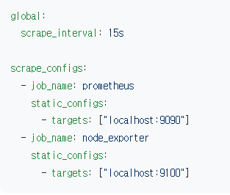
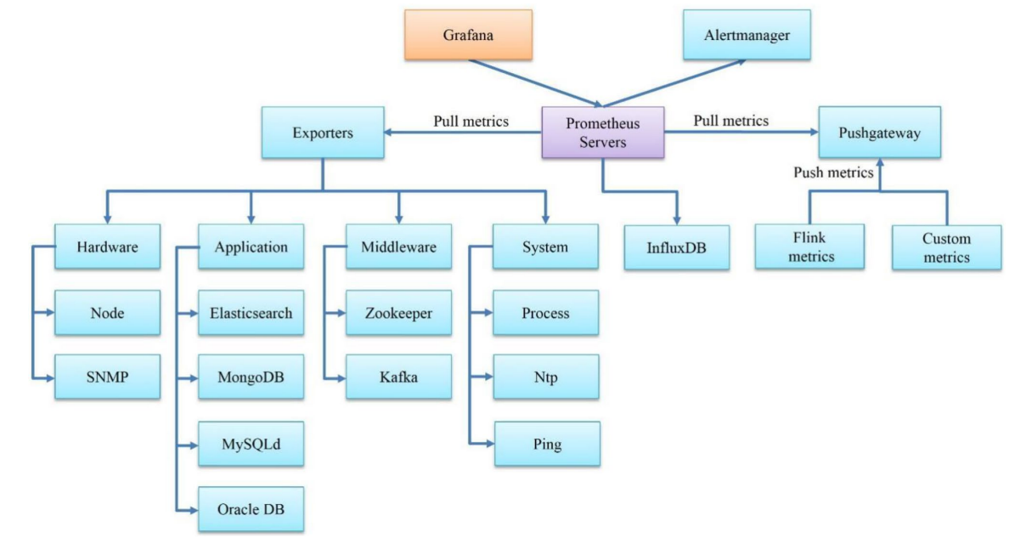
Paper Review
Scrape 시간
3.1 Metric monitoring (2/3)
Scrape 종류
VM Prometheus
Prometheus Server
  Collects and stores exposed metric data
  Pulls metrics from exporters at regular scrape intervals
  Uses HTTP-based metric collection
  Uses PromQL for data queries and alarm rules
  Uses InfluxDB for long-term data storage
  Uses Grafana for visualization
RPi node_exporter
[“192.168.50.10:9100”]
Prometheus Server
설정파일 예시
Grafana 관계도

Slide 7
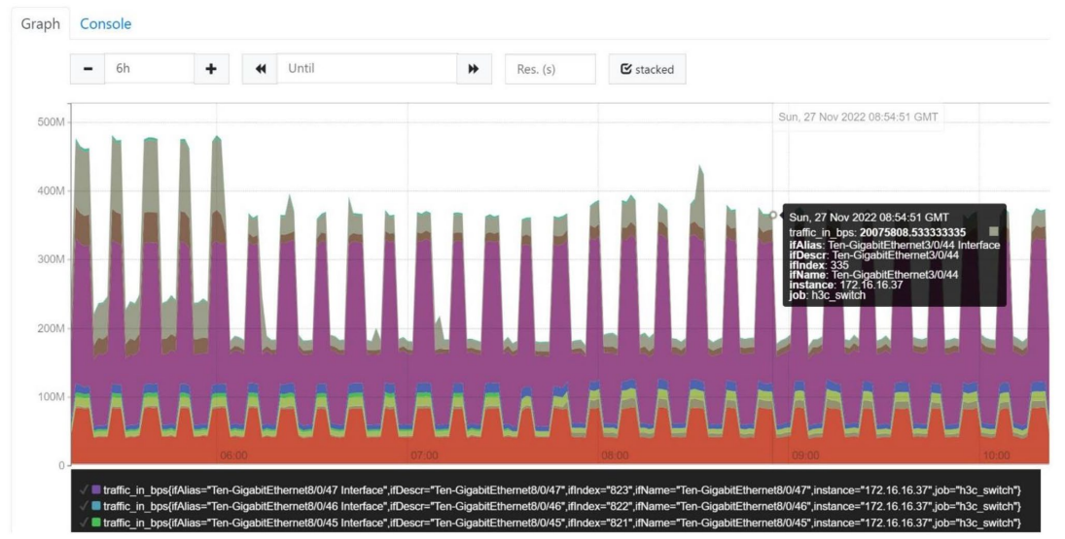
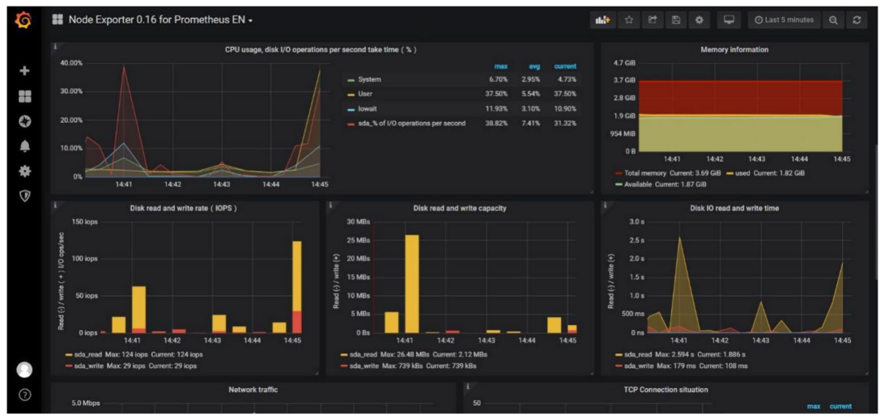
Paper Review
3.1 Metric monitoring (3/3)
IOC Server Monitoring
SNMP monitoring
network traffic

Slide 8
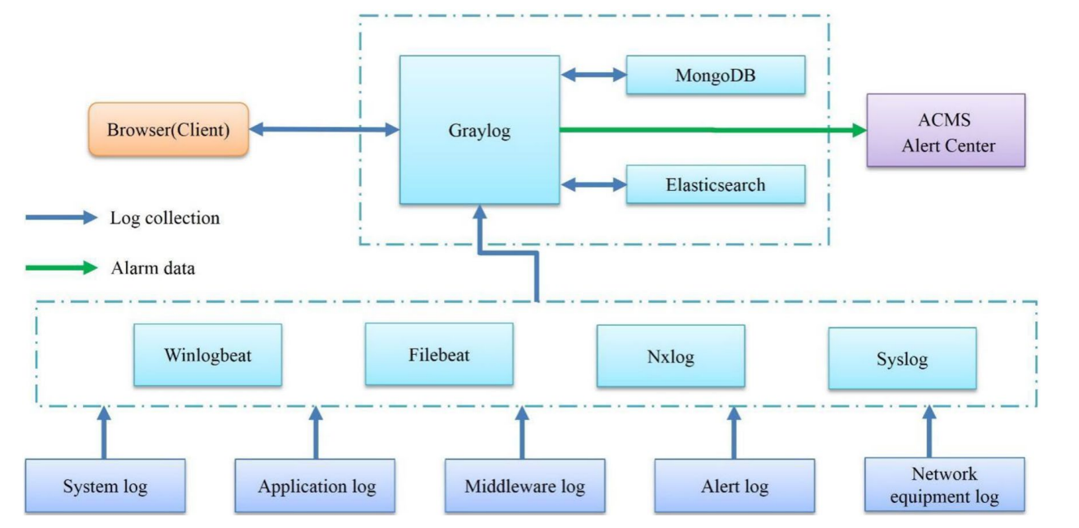
Paper Review
3.2 Log monitoring (1/2)
Graylog based log monitoring
Three layers : Underlying data source / data collection / core processing
Core processing
  Graylog : Provide web and external interface
  MongoDB : Stores Graylog’s alarm configuration
  Elasticsearch : Store and search log data
Data collection
  Syslog : Collects log from network devices
  Filebeat/Nxlog : Collects log from server or program
Underlying data source
Core Processing
Data collection
Underlying
data source
Graylog 관계도

Slide 9
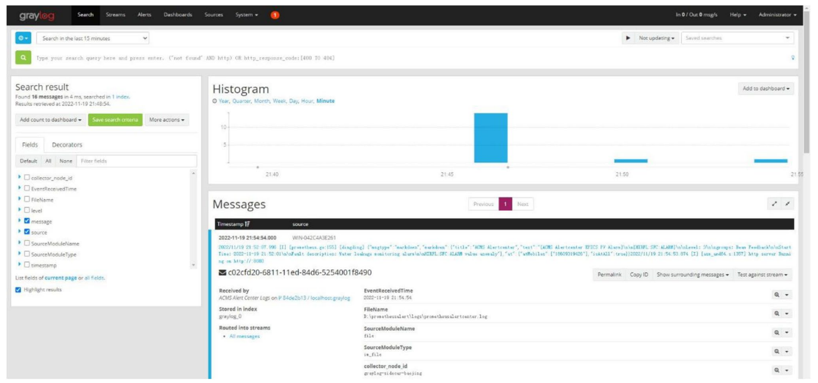
Paper Review
3.2 Log monitoring (2/2)
Graylog view alarm log historical data
Graylog view

Slide 10
Paper Review
3.3 EPICS control system (1/2)
Major | Minor | Minor | Major
303 mA | 301 mA | 299 mA | 297 mA
PV Monitoring and Alarms based on Pulsar and Flink
Conventional Alarm Monitoring
  EPICS IOC generates alarm states such as MINOR or MAJOR
  Phoebus Alarm displays and manages these PV alarm states
  XML-based alarm configuration can be rigid for large numbers of PVs
EPICS Pulsar Connector (PV to Streaming)
  MySQL : Store alarm rules
  Pulsar : Delivers PV JSON messages as stream
  (pvname, value, pvtime)
  Flink : Reads and compares PV values with rules from MySQL
  Generates alarm message when rules are matched
Example of Conventional Alarm
Slice of Image
(Left) XML Structure
(Right) JSON Structure
<Beam Status>
<Current>300.2</Current>
<Energy>3.01</Energy>
</Beam Status>
{
“Current” : 300.2
“Energy” : 3.01
}

Slide 11
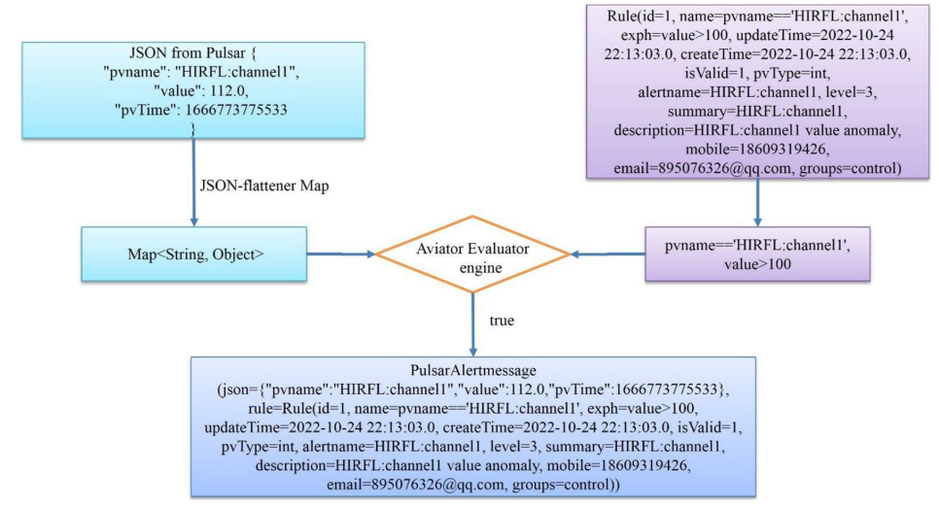
Paper Review
3.3.1 Alarm rule matching
Aviator Evaluator (Java based expression evaluation engine)
  Compares PV data from Pulsar with alarm rules stored in MySQL
  Generates an alarm message when the PV name and value satisfy the rule
Advantages of this system
  Alarm rules can be managed
  in a DBMS (DataBase Management System)
  Rule changes can be applied
  without restarting
Aviator Evaluator 흐름도

Slide 12
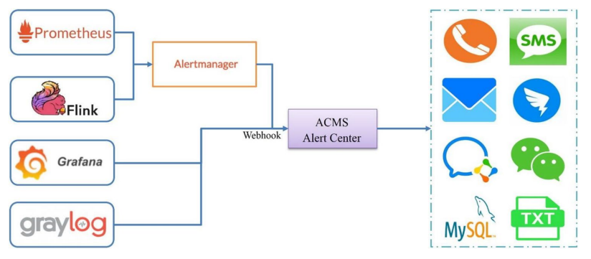
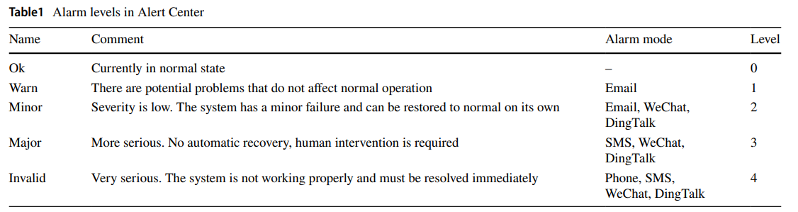
Paper Review
3.3.2 Alarm module design (1/2)
ACMS Alert Center
  Developed using Beego framework and MVC(Model View Controller) design pattern
  Receives alarm information and forwards it to users
Alarm flood Reduction and Alarm Management
  Single fault can generate many secondary alarms. and difficult to identify root cause
  Grouping : Combine related alarms into one notification
  Silence : Temporarily mutes selected alarms
  Inhibition : Suppresses repeated alarms
Alert Center 모식도

Slide 13
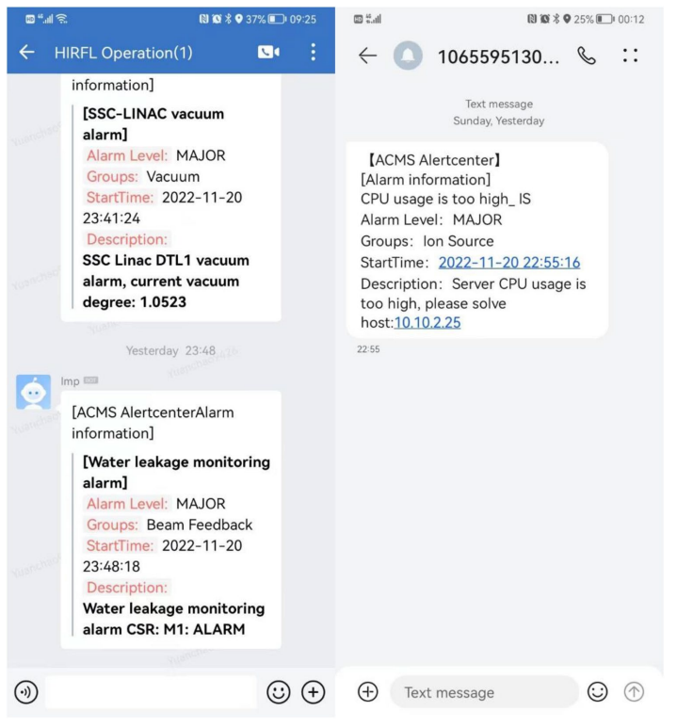
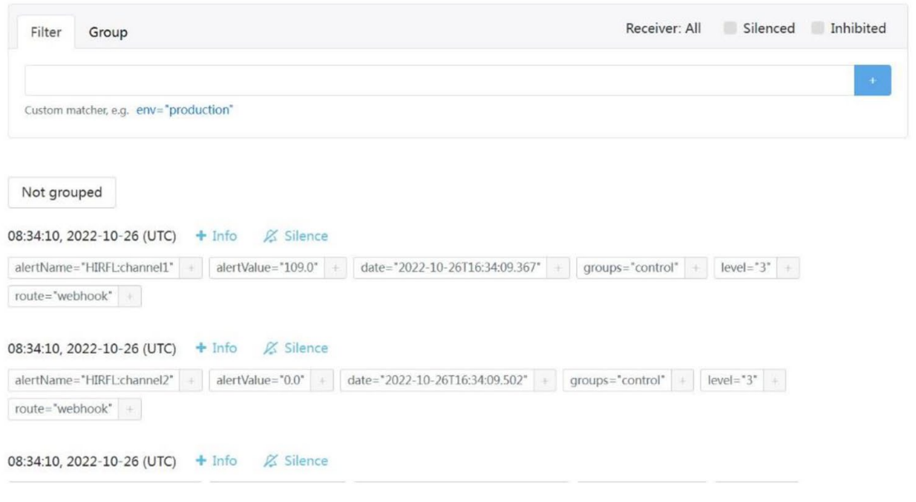
Paper Review
3.3.2 Alarm module design (2/2)
Alertmanager & messages
Alertmanager
Message

Slide 14
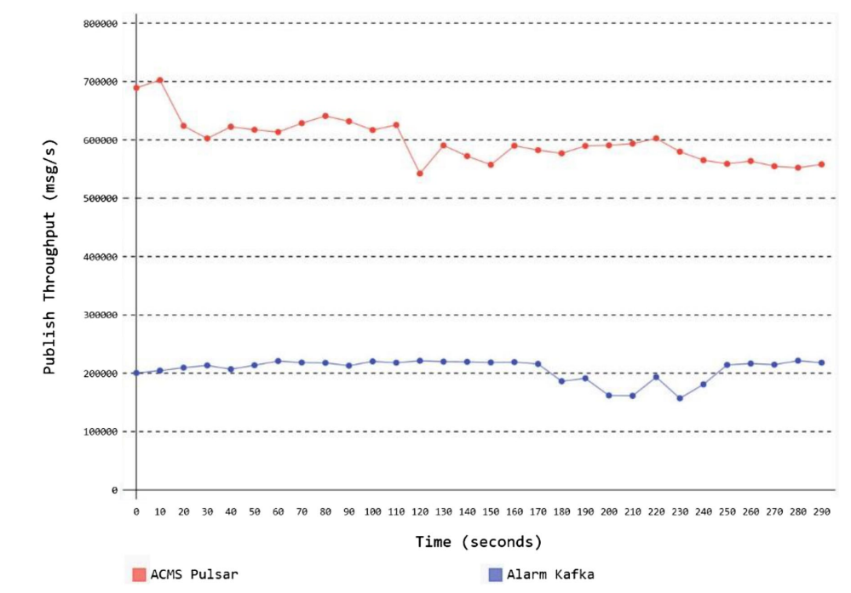
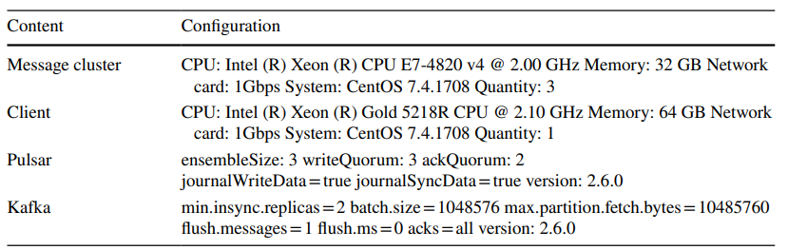
Paper Review
ACMS vs Phoebus alarm
Pulsar vs Kafka Thtoughput
  OpenMessaging benchmark를 이용해 throughput 접근
  ACMS : 600,000 msg/s
  Phoebus Alarm 220,000 msg/s
Operational Use case
  Applied to HIRFL and SESRI
  SESRI sent 38,202 alarms since December 2019
처리량 결과물
실험에 사용된 HW/SW

Slide 15
Paper Review
Conclusion and Discussion
알람서비스가 포함된 SW 통합시스템
  metric, log, EPICS PV를 모니터링하며 알림시스템 구축
  기존 Phoebus 방식보다 처리량도 높고,
  PV는 stream으로 처리하기에 운영도 편리
Discussion Theme
  이용, 운영 관점에서는 효과적인데, 전자빔에 대한 기여?
  Promethues, Graylog 각각 단일 모듈로는 학술적 의의?

Slide 16
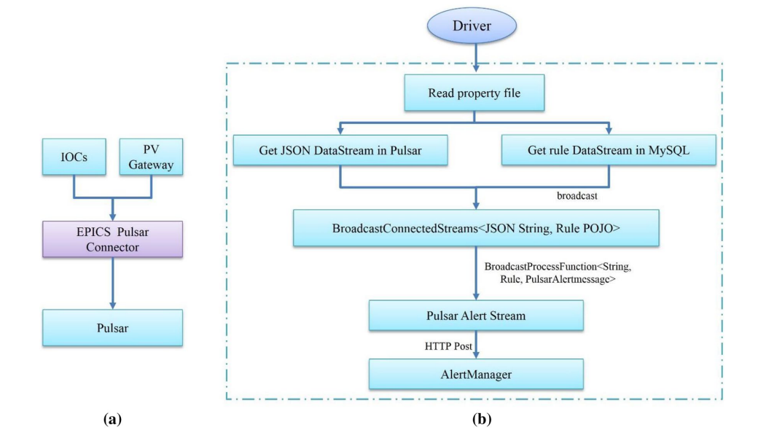
Paper Review
Backup Slide
[개인적인 추정 – MySQL 채택이유]
규칙변경시 Pulsar Cluster에 Broadcast 목표
오픈소스면서 DBMS중 사용량이 많아서?
CDC(Change Data Capture)등의 모듈도 다양
Flink Service
  AlertManager에 알람할 데이터 송신
Serializable item을 Stream data로 변환 및 연결
  MySQL과 Pulsar, Flink의 설정파일 로드
  MySQL의 알람규칙 stream은 CDC 모듈로 확인
  Pulsar 데이터가 stream으로 확인
  규칙과 Pulsar 데이터를 연결
JSON
{“pvname”:”gateway:load”,”value”:0.38,”pvTime”:16677…}
Topic
persistent ://HIRFL-CS/hirflgatewayioc/hirflcs

