Slide 1
Group Meeting 260522
Minseo Jeong

Slide 2
UED Experiment & Laser Cross-correlation experiment
Solenoid align(completed)
UV laser align (in progress)
Purchase for laser cross correlation experiment (arrival in July)

Slide 3
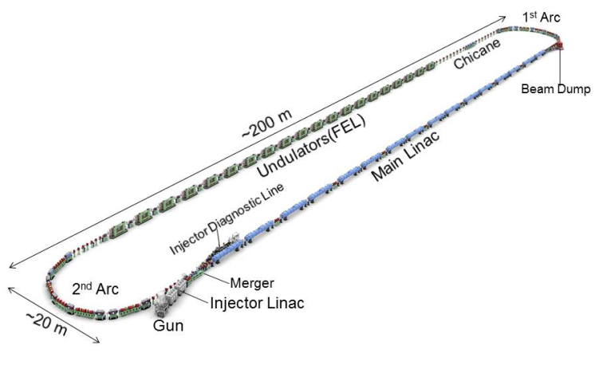
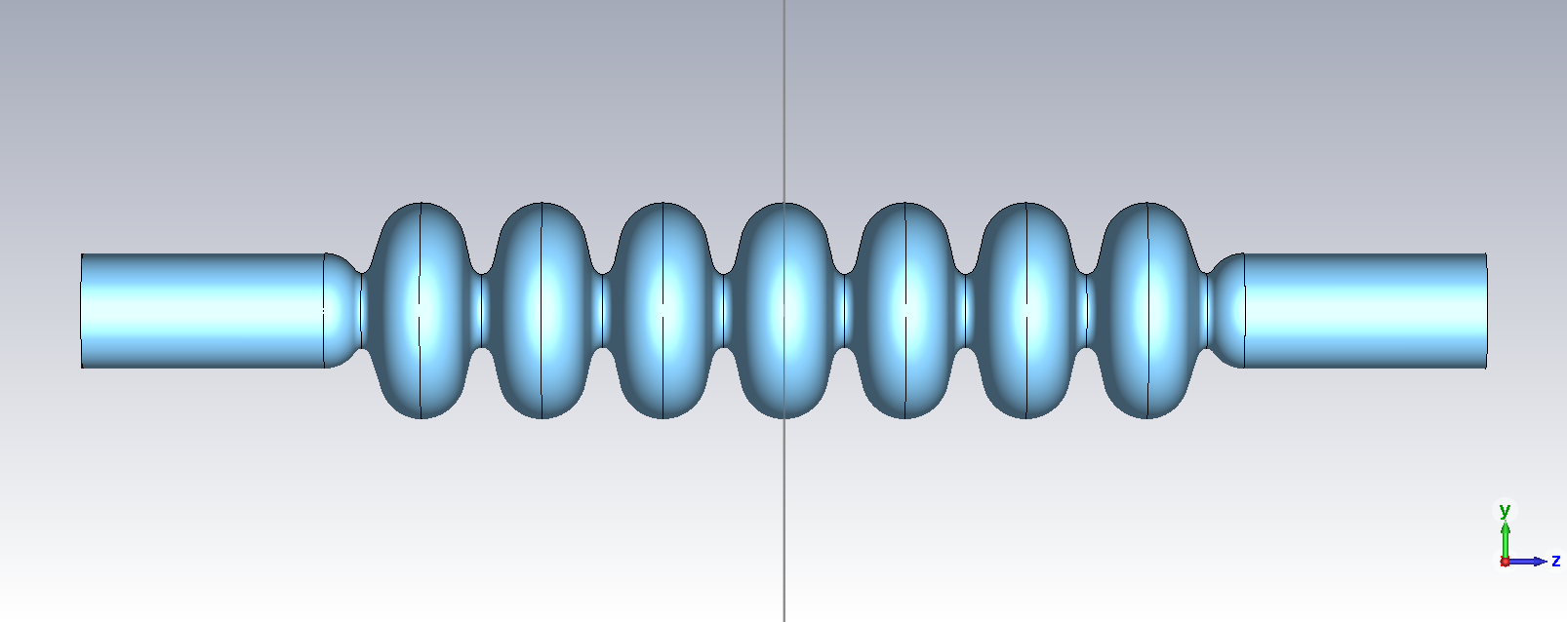
SRF Cavity for EUV-ERL

Slide 4
Research Plan
2026년
추진내용 | 월별 추진 일정 |  |  |  |  |  |  |  |  |  |  |  |  |  |  |  |  |  |  |  |  |  |  |  | 방법
 | 1 |  | 2 |  | 3 |  | 4 |  | 5 |  | 6 |  | 7 |  | 8 |  | 9 |  | 10 |  | 11 |  | 12
EUV-FEL 용 초전도 cavity 관련 조사 |  |  |  |  |  |  |  |  |  |  |  |  |  |  |  |  |  |  |  |  |  |  |  |  | 문헌 조사 및 전문가 자문
주요 이론 검증 및 시뮬레이션 재현 |  |  |  |  |  |  |  |  |  |  |  |  |  |  |  |  |  |  |  |  |  |  |  |  | 논문 연구 및 EM 시뮬레이션 tool 활용
Cavity 기본 형상 설계 |  |  |  |  |  |  |  |  |  |  |  |  |  |  |  |  |  |  |  |  |  |  |  |  | EM 시뮬레이션 tool 및 최적화 기법 활용
HOM 커플러 물리 설계 |  |  |  |  |  |  |  |  |  |  |  |  |  |  |  |  |  |  |  |  |  |  |  |  | EM 시뮬레이션 tool 및 최적화 기법 활용
FPC 물리 설계 |  |  |  |  |  |  |  |  |  |  |  |  |  |  |  |  |  |  |  |  |  |  |  |  | EM 시뮬레이션 tool 및 최적화 기법 활용
설계 개선 및 최적화, 보고서 작성 |  |  |  |  |  |  |  |  |  |  |  |  |  |  |  |  |  |  |  |  |  |  |  |  | 전체 가속기 개념 설계 과제 및 업체와 협업

Slide 5
SRF Cavity in EUV-ERL(KEK)
Based on TESLA 1.3GHz cavity
End Cell A
End Cell B
Cavity Parameters | KEK-EUV | TESLA
Frequency (MHz) | 1300 | 1300
R/Q (Ω) | 1009 | 1020
Ep/Eacc | 2.0 | 2.06
Hp/Eacc (mT/(MV/m)) | 4.23 | 4.26
TESLA Center Cell
Φ100 mm BP
Φ110 mm BP
HOM
HOM Damper

Slide 6
SRF Cavity in EUV-ERL(China)
7-cell cavity based on cavity in TESLA 1.3GHz cavity
Cavity Parameters | KEK-EUV | TESLA
Frequency (MHz) | 1300 | 1300
R/Q (Ω) | 784.8 | 790
Ep/Eacc | 2.03 | 2.16
Hp/Eacc (mT/(MV/m)) | 4.23 | 4.27

Slide 7
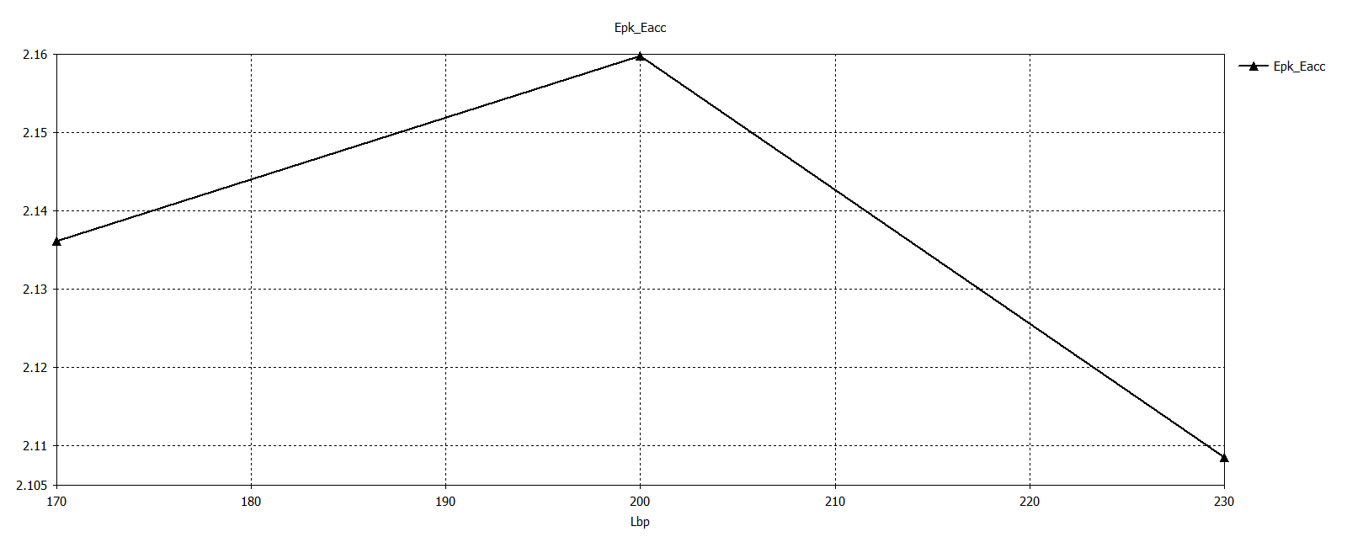
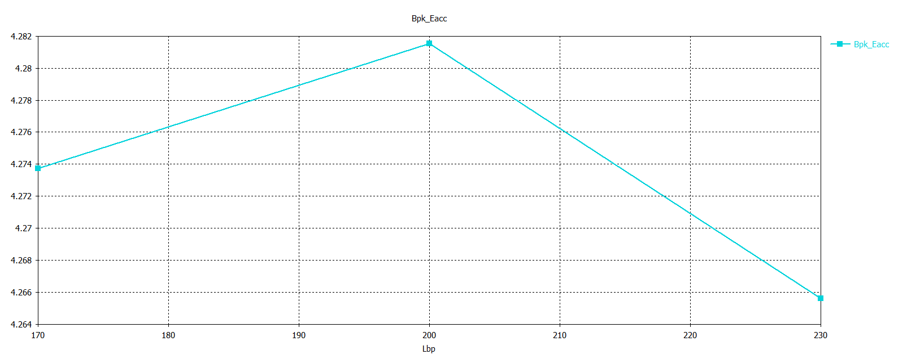
SRF Cavity in EUV-ERL(China)

Slide 8
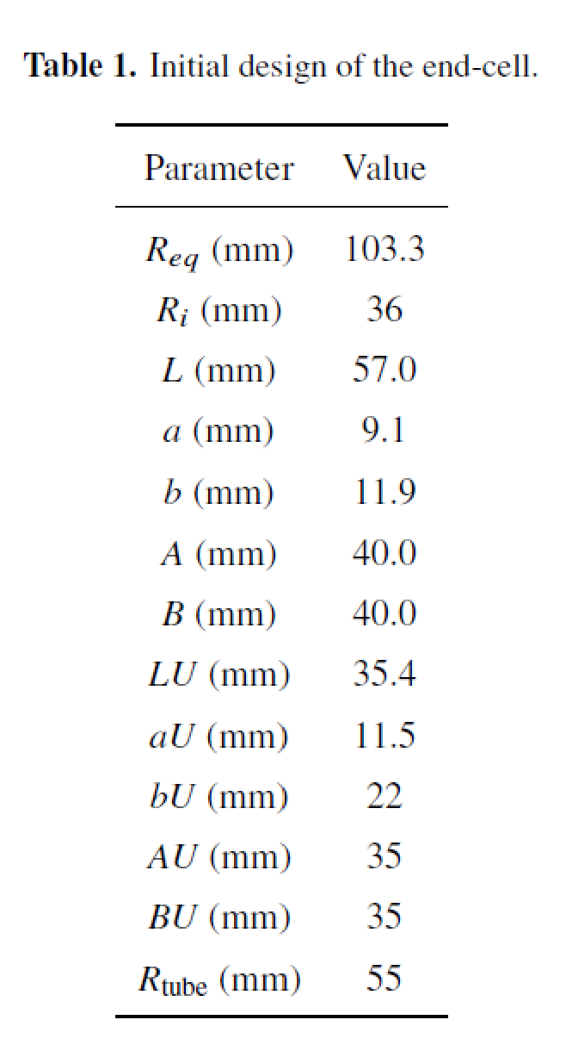
SRF Cavity in EUV-ERL(China)

Slide 9
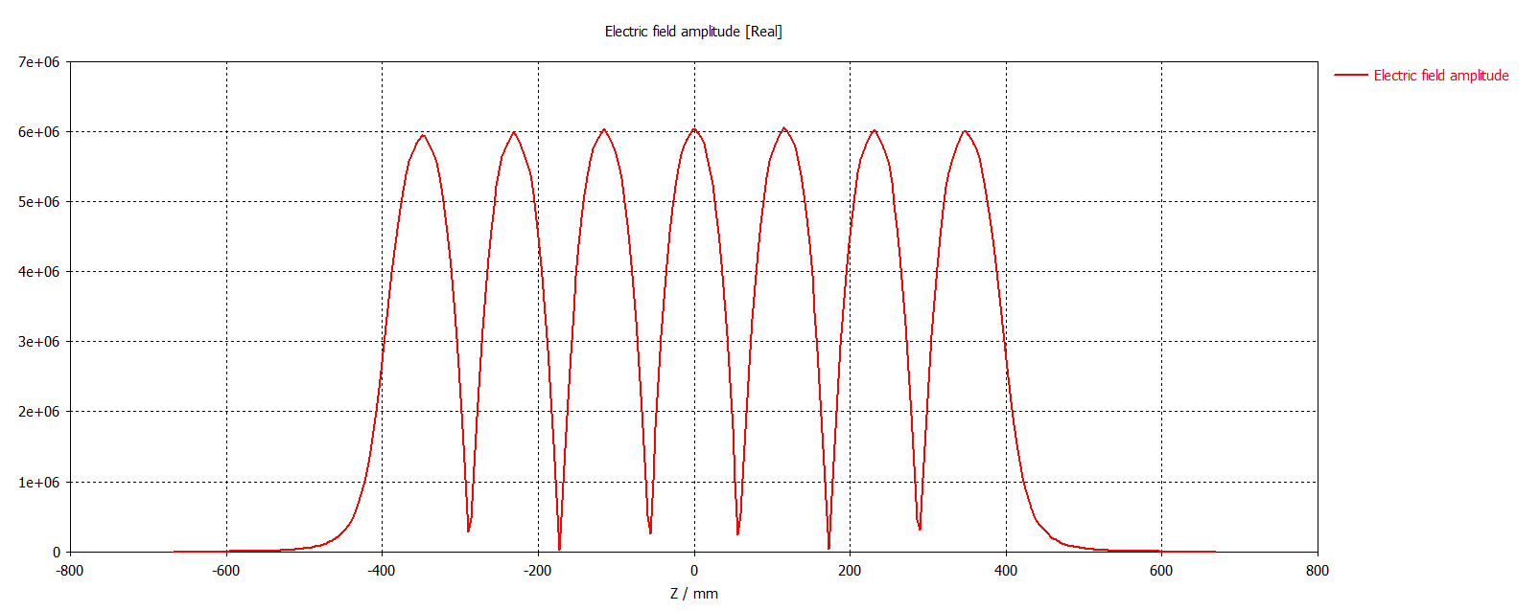
SRF Cavity in EUV-ERL(China)
7-cell cavity based on cavity in TESLA 1.3GHz cavity
Field flatness : 98.04%
Field flatness : 98.33%
X. Guo, J. Instrum. (2025)

Slide 10
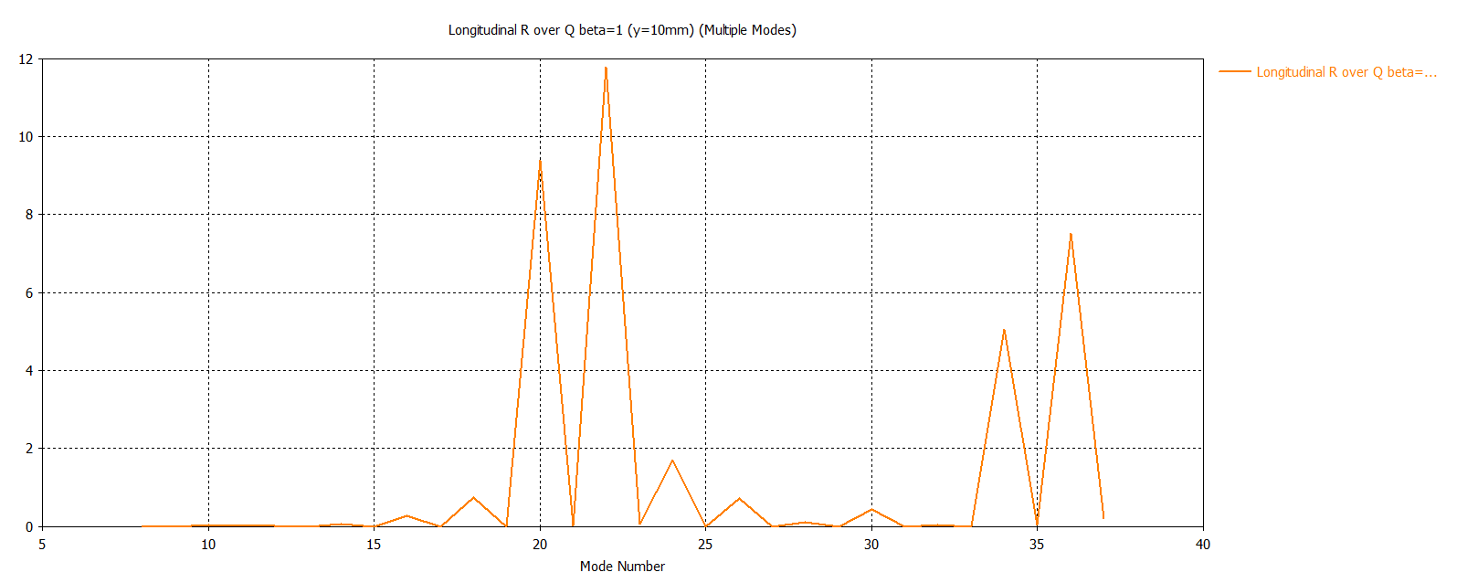
Higher Order Mode Damping
Calculation of external Q factor of HOM is required

Slide 11
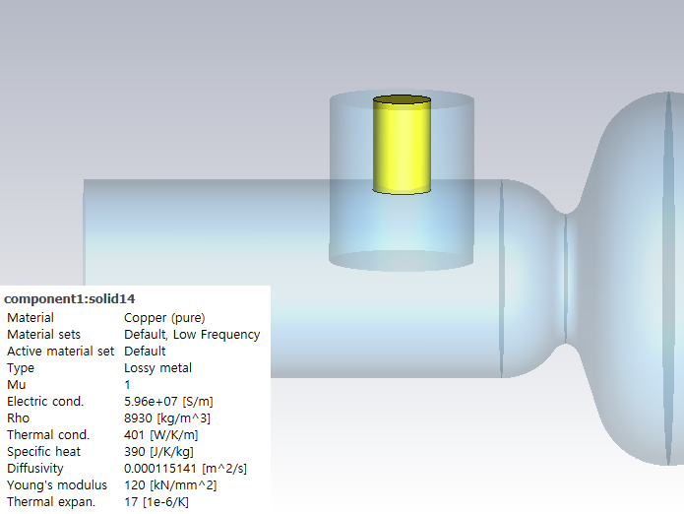
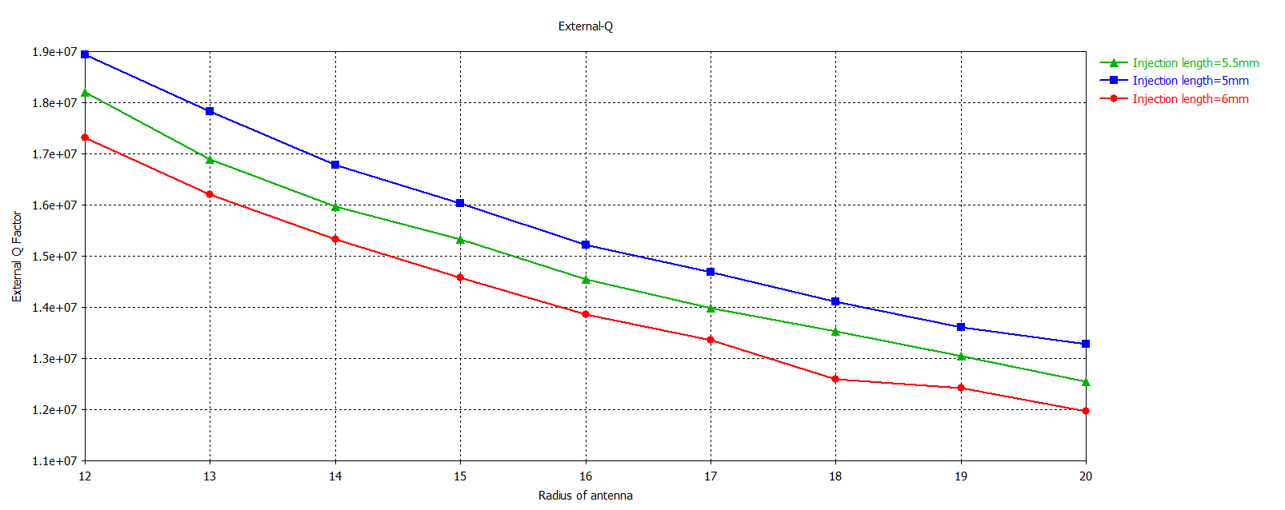

Fundamental Power Coupler
Goal: setting external quality factor by $Q_{e}=\frac{f_{0}}{2∆f}$
Position, injection length, and tip geometry of antenna should be optimized
X. Guo, J. Instrum. (2025)

Slide 12
Fundamental Mode Coupler
Using single coupler can break symmetry
- compensation stub should be introduced on the opposite side of the main couple

Slide 13
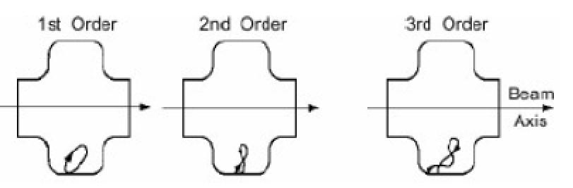
Multipacting
Multipacting : an electron multiplication based on resonance breakdown phenomenon inside RF cavity
- drain the energy stored in the cavity
For elliptical cell, MP occurs usually in equator region

Slide 14
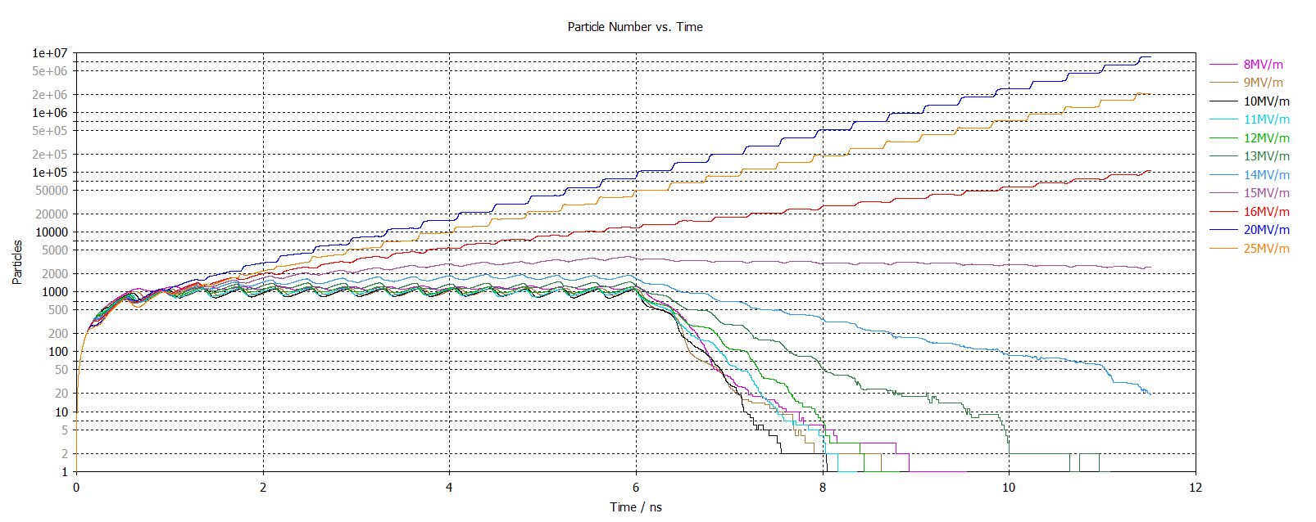
Multipacting Simulation (TESLA center cell)
Primary emission energy: 3eV
Emission angle: 45°
X. Guo, J. Instrum. (2025)

Slide 15
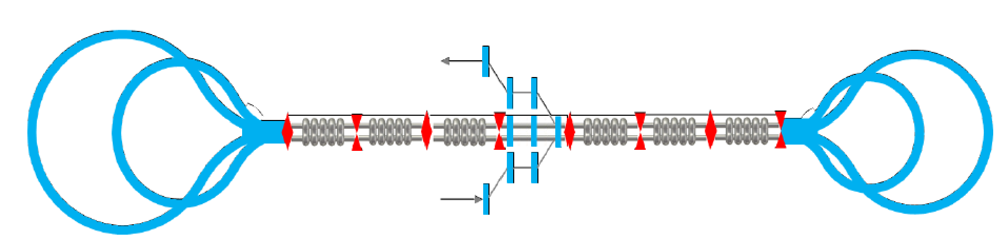
Dual axis cavity
Allows energy recovery of parallel beams, accelerating/decelerating along different axes
It can shorten length of linac

Slide 16
Research Plan
Design of cavity
- minimization of E_{pk}/E_{acc} and B_{pk}/E_{acc,} maximization of flatness of field, and lower HOM impedance
- by optimization algorithm(MOGA, MOBO)

