Slide 1
Differentiable Models for Control of Complex Physical
Systems: A Case Study in Laser Pulse Shape
Minseo Jeong

Slide 2
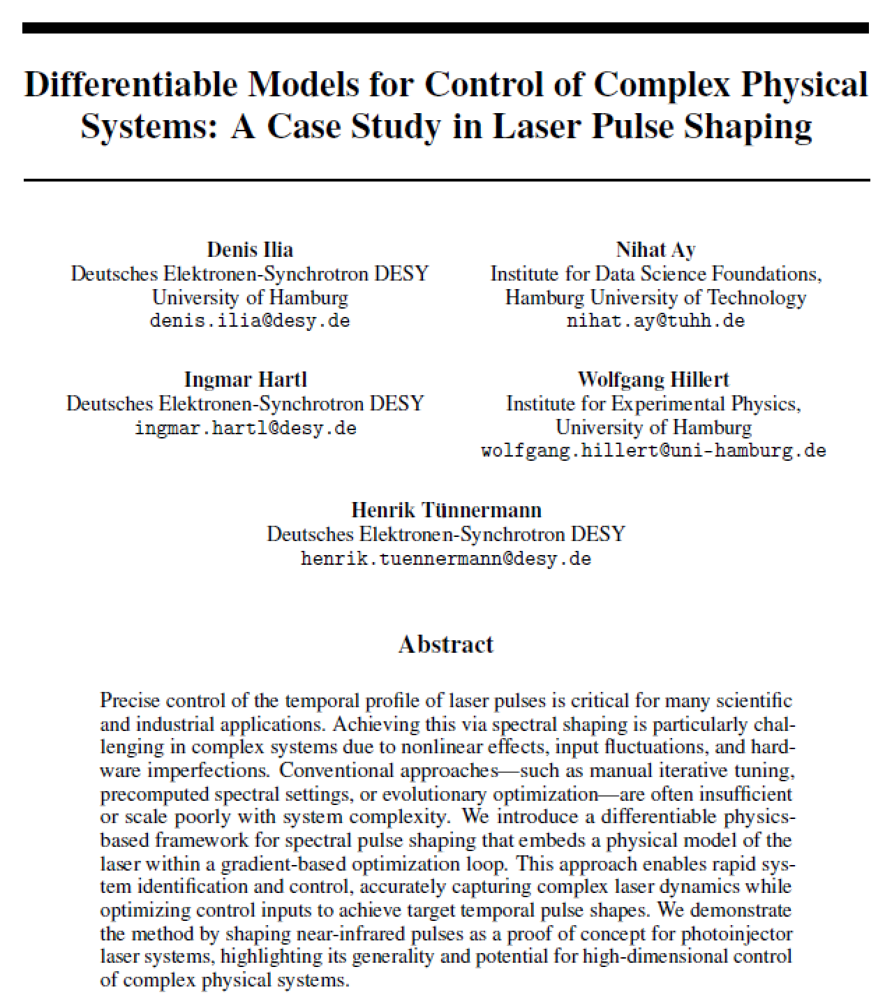

Slide 3
Introduction
Free electron laser(FEL): a device in which an electron beam and a beam of electromagnetic wave colinearly travel through an undulator generates amplified, coherent radiations.
Temporal laser shaping improves electron beam quality (e.g. emittance)

Slide 4
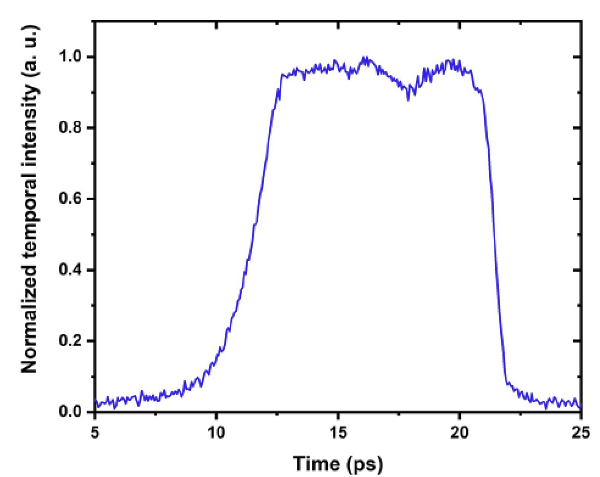
Temporal Shaping of Photoinjector Laser
Shape of photoinjector laser pulse is a key factor that determines phase space of electron bunch, thereby influencing emittance or stability
FERMILAB(2007)
PITZ(2012)
SwissFEL(2021)

Slide 5
Temporal Shaping of Photoinjector Laser
Shaping ultrashort laser pulse in time domain is not possible due to bad modulator resolution(ns scale)
To shape ultrashort laser pulse, spectral shaping techniques are used
~
~

Slide 6
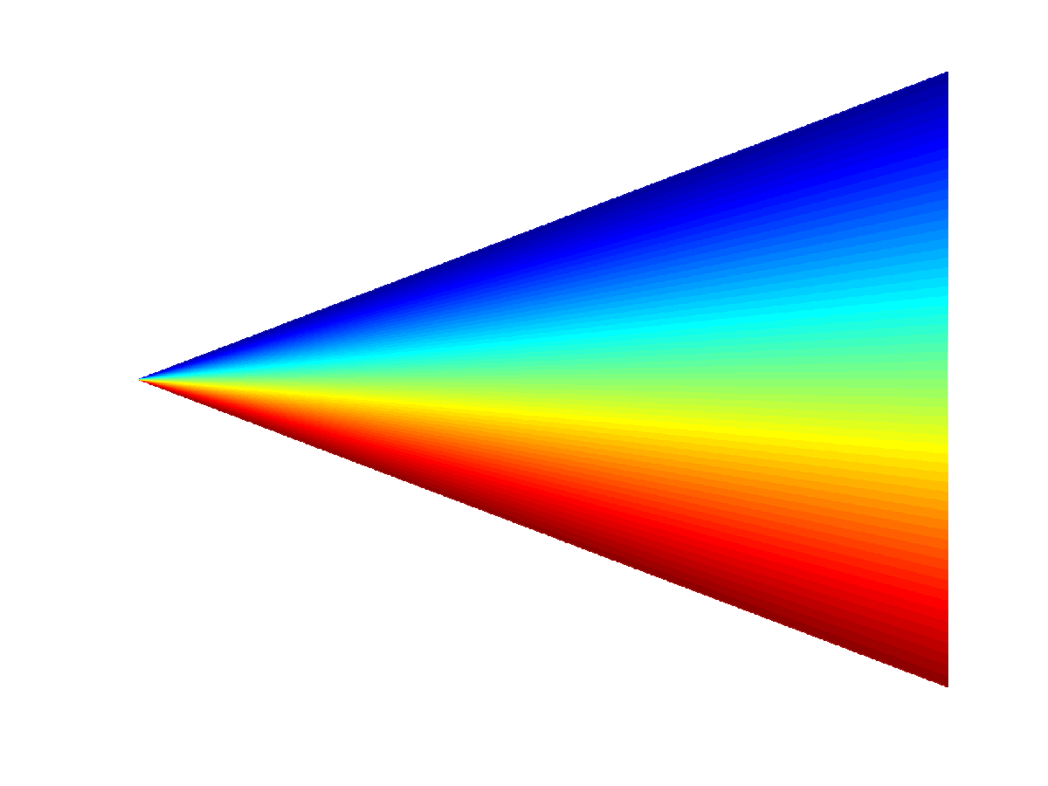
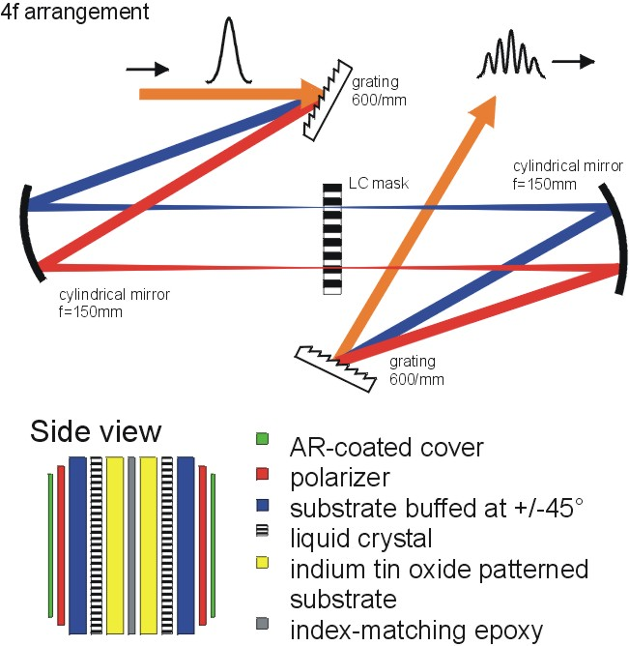
Temporal Shaping of Photoinjector Laser
Spatial light modulator(SLM): modulates both amplitude and phase of the spectrum with liquid crystal mask
Amplitude mask
Transmission = t(x) = t(λ)
Phase mask
Phase delay = ϕ(x) = ϕ(λ)
Dead Space
Pixel
Grating
Grating
f
f
f
f
f
f
$${\tilde{E}}_{out}\left(λ\right)=H\left(λ\right){\tilde{E}}_{in}\left(λ\right)=t\left(λ\right)e^{iφ\left(λ\right)}{\tilde{E}}_{in}\left(λ\right)$$

Slide 7
Setup of Photoinjector Laser in EuXFEL
Yb:YAG fiber laser(1030nm→257.5nm, 1 ps to 20 ps, few μJ at max 4.5MHz(UV))

Slide 8
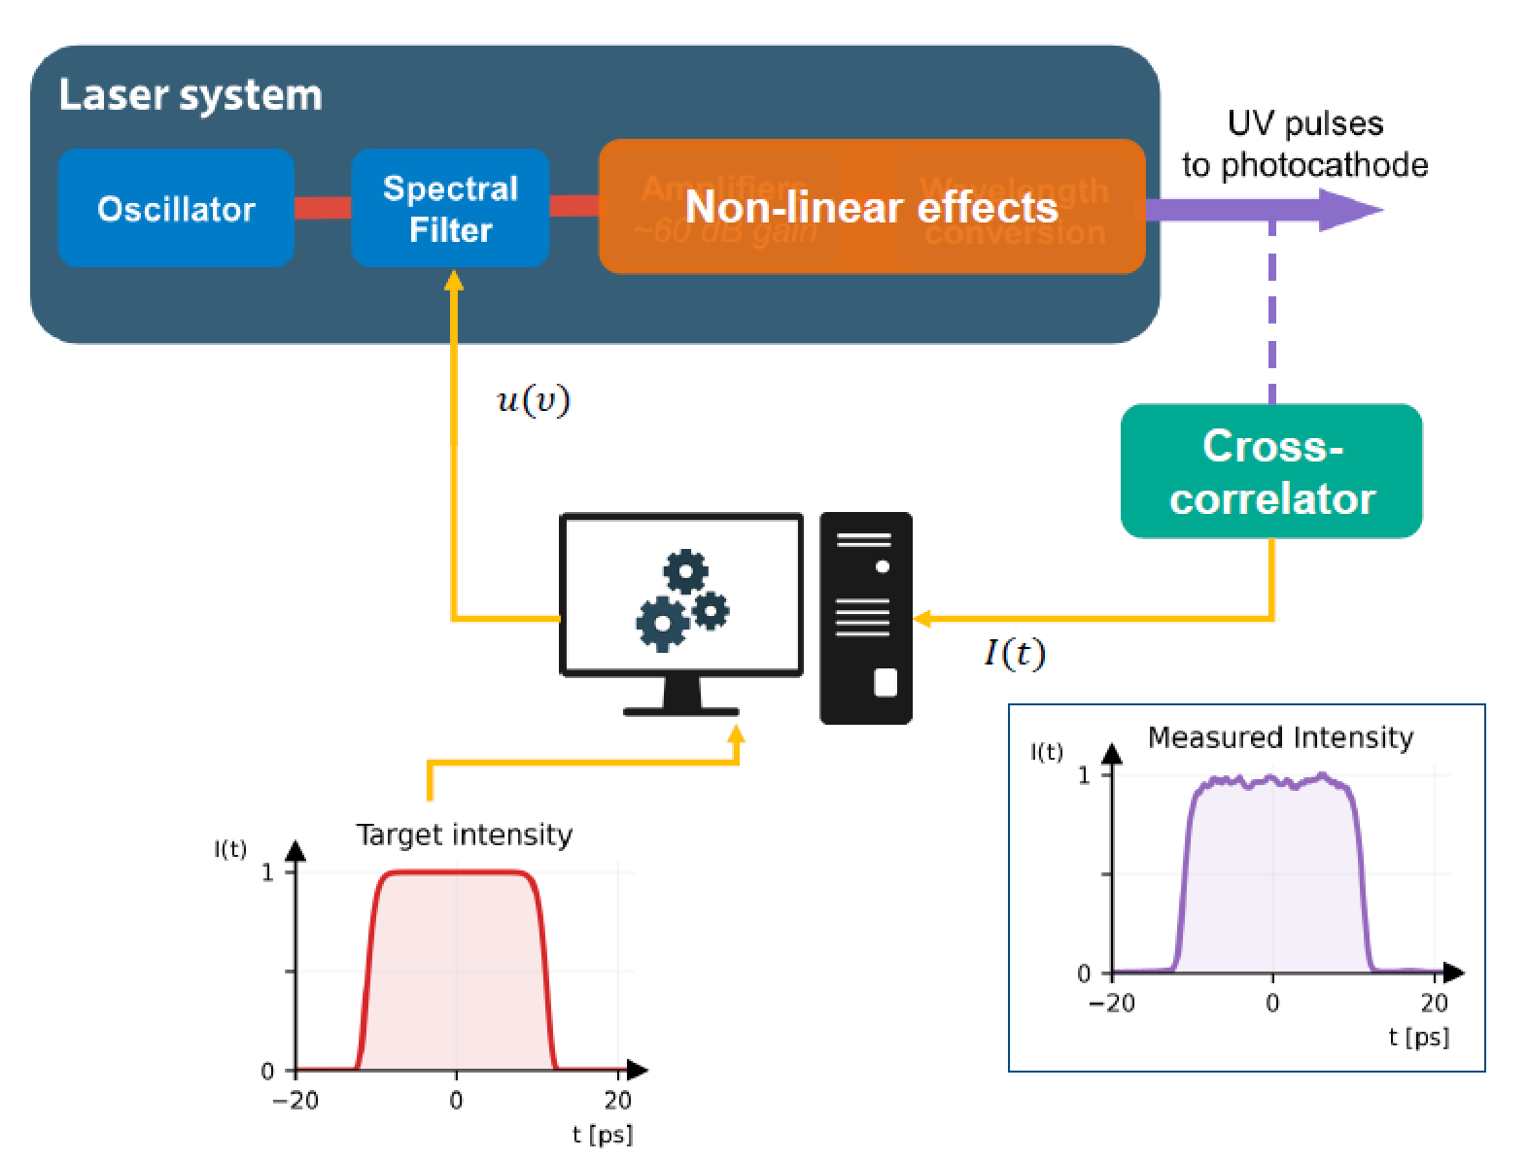
Setup of Photoinjector Laser in EuXFEL

Slide 9
Temporal Shaping of Photoinjector Laser
Goal: finding the SLM filter u* for targeted pulse y*
Due to costly measurement and high dimension of control input, black-box optimization (e.g. evolutionary algorithm or Bayesian optimization) cannot be used
For pulse shaping, differentiable models are applied

Slide 10
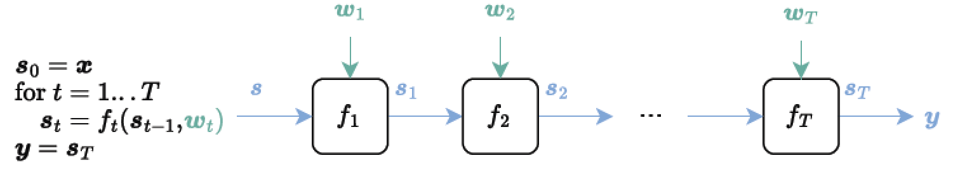
Differentiable Model
Differentiable programming: programming paradigm in which computer programs can be differentiated end-to-end
- gradient-based optimization of parameters in the program

Slide 11
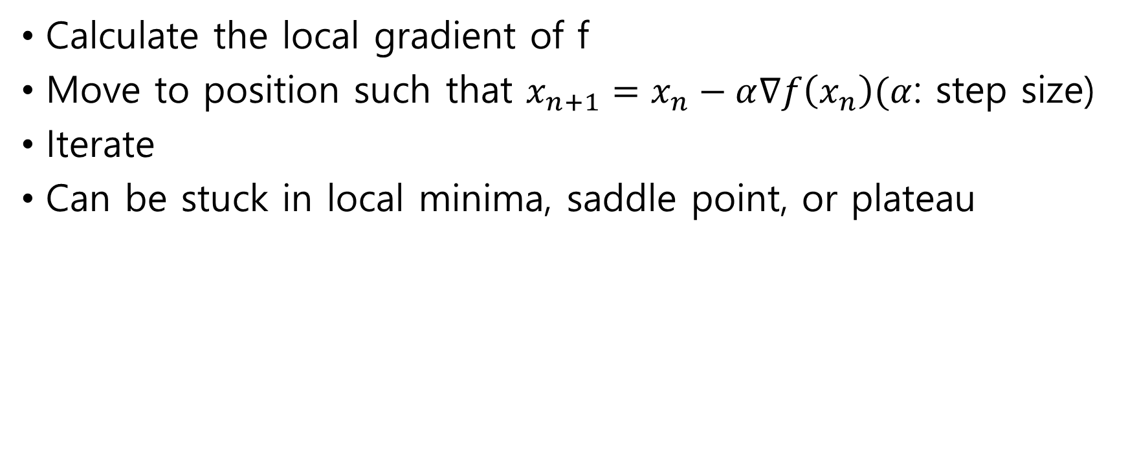
Gradient-based Optimization
Calculate the local gradient of f
Move to position such that $x_{n+1}=x_{n}−α∇f\left(x_{n}\right)(α$: step size)
Iterate
Can be stuck in local minima, saddle point, or plateau

Slide 12
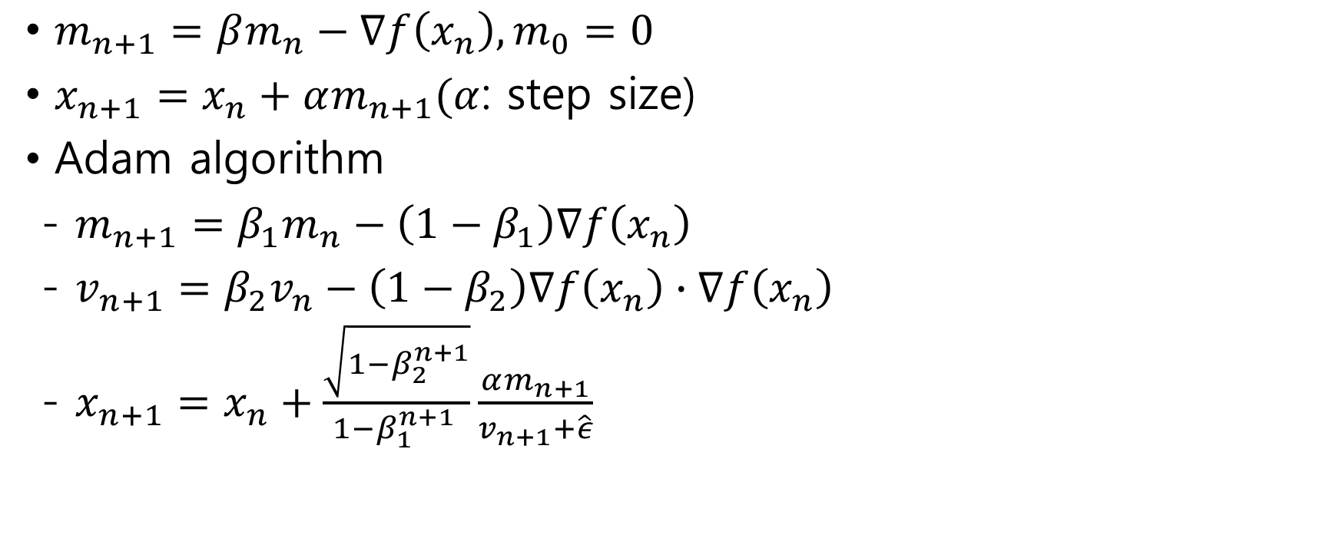
Gradient-based Optimization with Momentum
β=0
$m_{n+1}=βm_{n}−∇f\left(x_{n}\right), m_{0}=0$
$x_{n+1}=x_{n}+αm_{n+1}(α$: step size)
Adam algorithm
- $m_{n+1}=β_{1}m_{n}−\left(1−β_{1}\right)∇f\left(x_{n}\right)$
- $v_{n+1}=β_{2}v_{n}−\left(1−β_{2}\right)∇f\left(x_{n}\right)∙∇f\left(x_{n}\right)$
- $x_{n+1}=x_{n}+\frac{\sqrt{1−β_{2}^{n+1}}}{1−β_{1}^{n+1 }}\frac{αm_{n+1}}{v_{n+1}+\hat{ε}}$
β=0.85

Slide 13
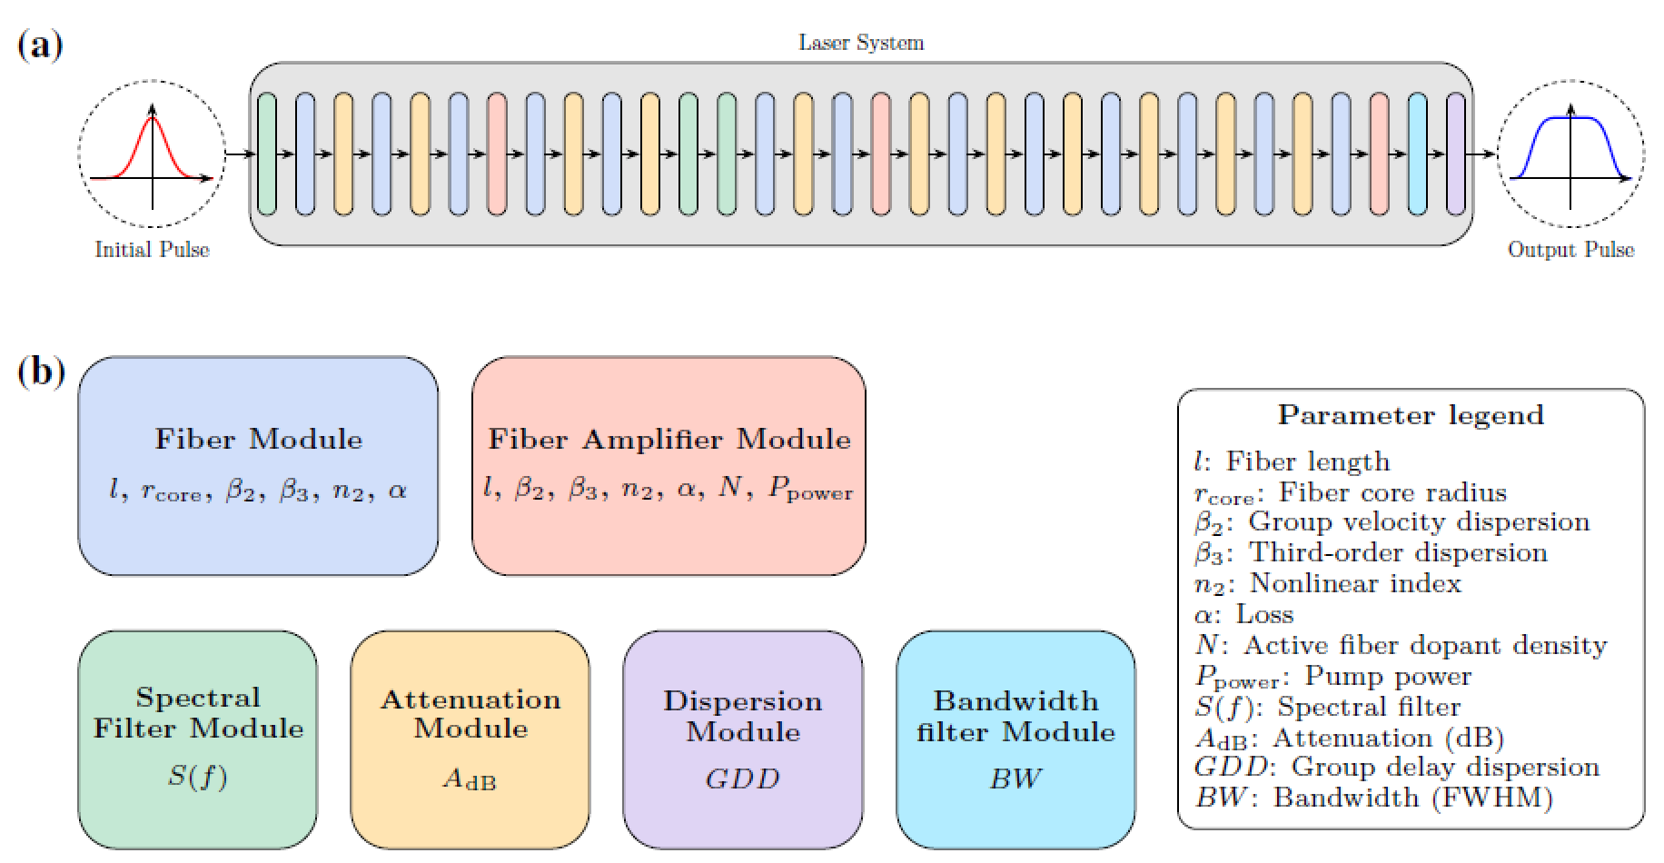
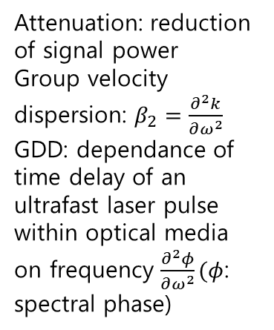
Setup of Photoinjector Laser in EuXFEL
Differentiable module
Attenuation: reduction of signal power
Group velocity dispersion: $β_{2}=\frac{∂^{2}k}{∂ω^{2}}$
GDD: dependance of time delay of an ultrafast laser pulse within optical media on frequency $\frac{∂^{2}φ}{∂ω^{2}}(φ$: spectral phase)
Notes:
GVD: estimate the amount of chirp that will be imposed on a pulse of light

Slide 14
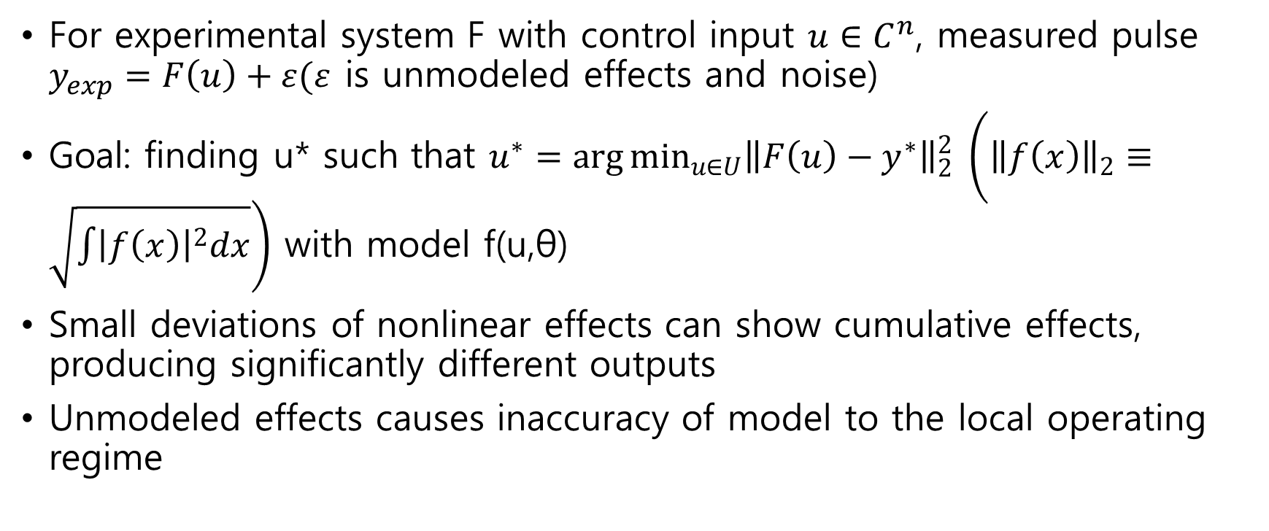
Control problem
For experimental system F with control input $u∈C^{n}$, measured pulse $y_{exp}=F\left(u\right)+ε(ε$ is unmodeled effects and noise)
Goal: finding u* such that $u^{∗}=\arg{\min_{u∈U}{{\left\|F\left(u\right)−y^{∗}\right\|}_{2}^{2}}} \left({\left\|f\left(x\right)\right\|}_{2}≡\sqrt{\int{{\left|f\left(x\right)\right|}^{2}dx}}\right)$ with model f(u,θ)
Small deviations of nonlinear effects can show cumulative effects, producing significantly different outputs
Unmodeled effects causes inaccuracy of model to the local operating regime

Slide 15
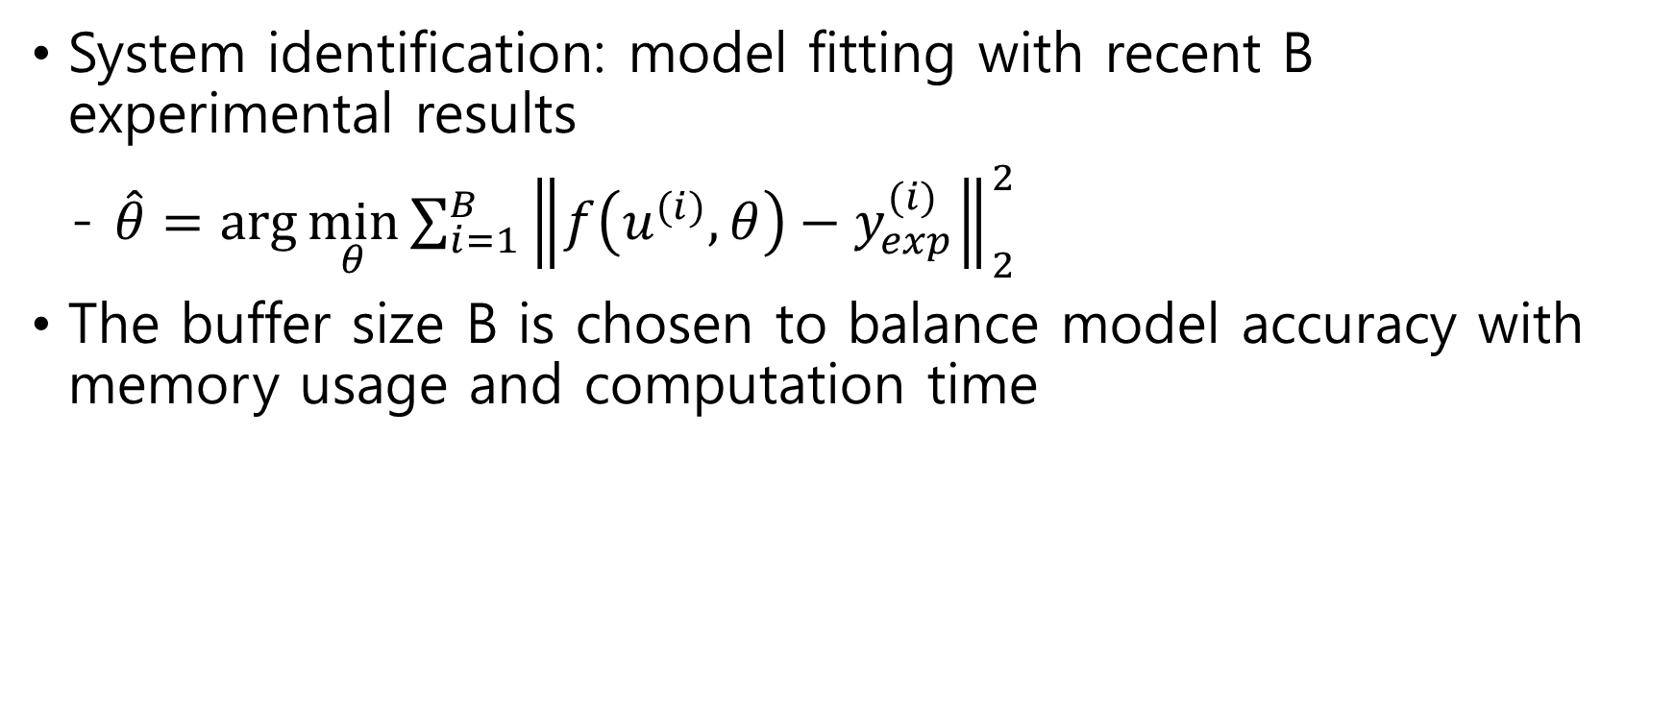
Control Problem
System identification: model fitting with recent B experimental results
- $\hat{θ}=\arg{\min_{θ}{\sum_{i=1}^{B}{{\left\|f\left(u^{(i)},θ\right)−y_{exp}^{(i)}\right\|}_{2}^{2}}}}$
The buffer size B is chosen to balance model accuracy with memory usage and computation time

Slide 16
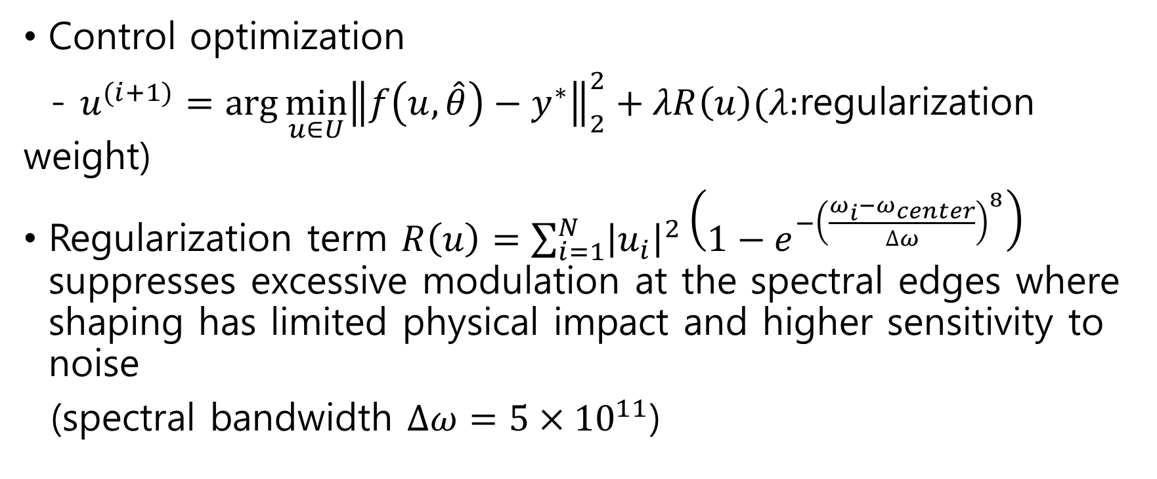
Control Problem
Control optimization
- $u^{(i+1)}=\arg{\min_{u∈U}{{\left\|f\left(u,\hat{θ}\right)−y^{∗}\right\|}_{2}^{2}}}+λR\left(u\right)(λ:$regularization weight)
Regularization term $R\left(u\right)=\sum_{i=1}^{N}{{\left|u_{i}\right|}^{2}\left(1−e^{−{\left(\frac{ω_{i}−ω_{center}}{∆ω}\right)}^{8}}\right)}$ suppresses excessive modulation at the spectral edges where shaping has limited physical impact and higher sensitivity to noise
(spectral bandwidth $∆ω=5×{10}^{11}$)

Slide 17
Control Problem
Adaptive algorithm

Slide 18
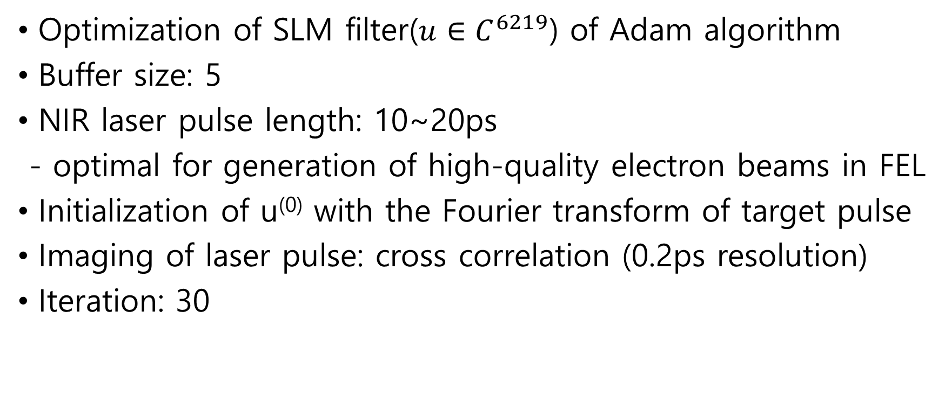
Experimental Setup
Optimization of SLM filter($u∈C^{6219}$) of Adam algorithm
Buffer size: 5
NIR laser pulse length: 10~20ps
- optimal for generation of high-quality electron beams in FEL
Initialization of u⁽⁰⁾ with the Fourier transform of target pulse
Imaging of laser pulse: cross correlation (0.2ps resolution)
Iteration: 30
E(t)
Slow
detector
Unknown pulse
E_{g}(t–τ)
Reference pulse
Lens
Delay

Slide 19
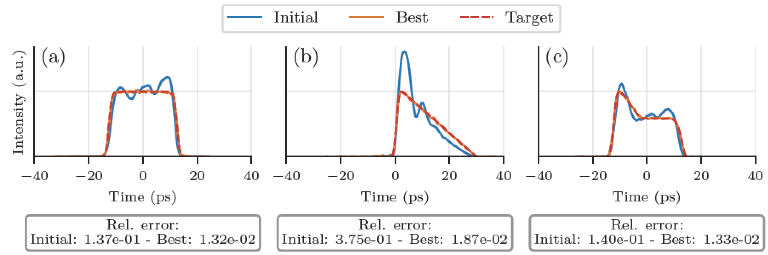
Result

Slide 20
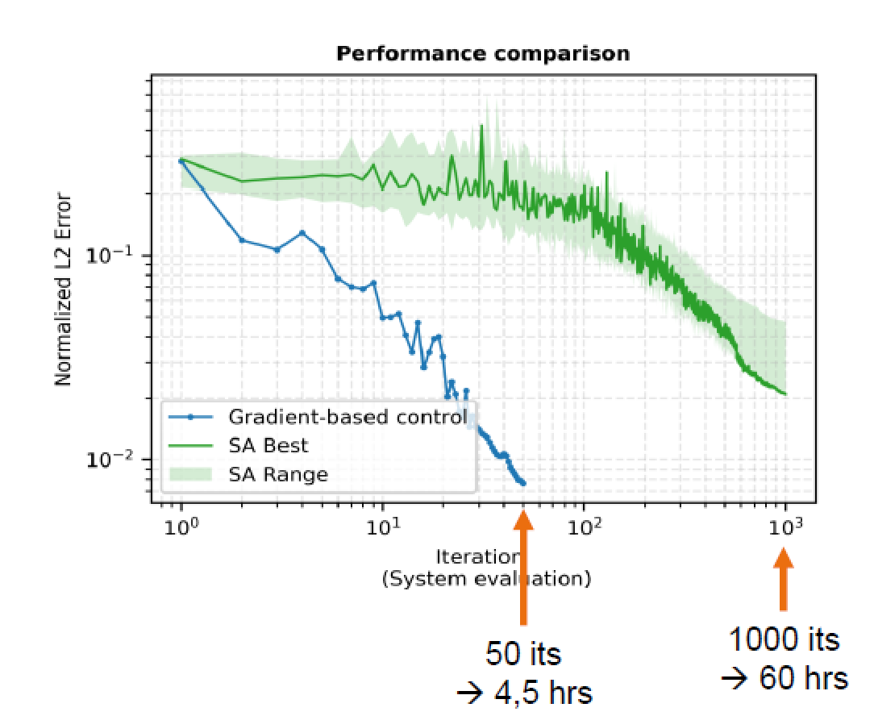
Discussion
Optimization with differentiable model is more sample-efficient than other methods
Convergence is sensitive to initial condition
Tuning of hyperparameters including learning rates, regularization weights, and buffer size B is required
- by digital twin of the physical system

Slide 21
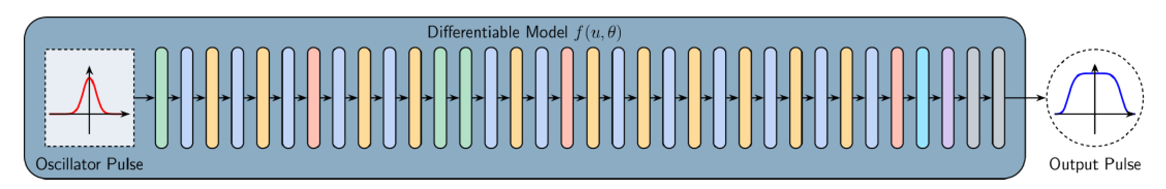
Discussion
Due to high nonlinearity of frequency conversion, fourth harmonic generation was excluded in the paper
- included in 2026
Future plan: Integration with EuXFEL operations

Slide 22
Appendix
OSC: Oscillstor, SA: saturable absorber; POL: polarizer; STR: passive fiber stetcher ISO: isolator; YDFA: pm-Yb:fiber amplifier; CMP: transmission grating compressor; Yb:YAG: Yb:YAG amplifier; AOM: acousto-optical modulator; ATT: attenuator; FHG: Forth harmonic gemeration;

