Slide 1
Lab meeting
2026. 05. 08 –
나창선

Slide 2
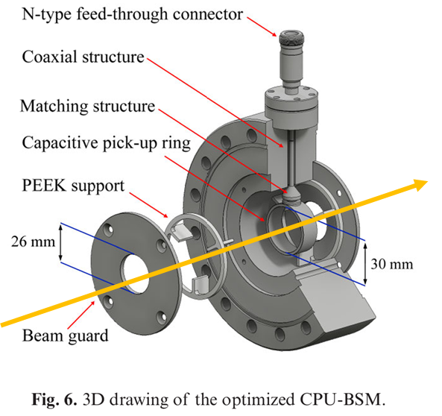
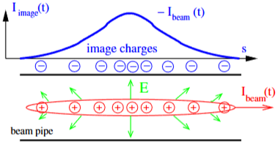
Background – Image charge
Forck et al., Beam Position Monitors.

Slide 3
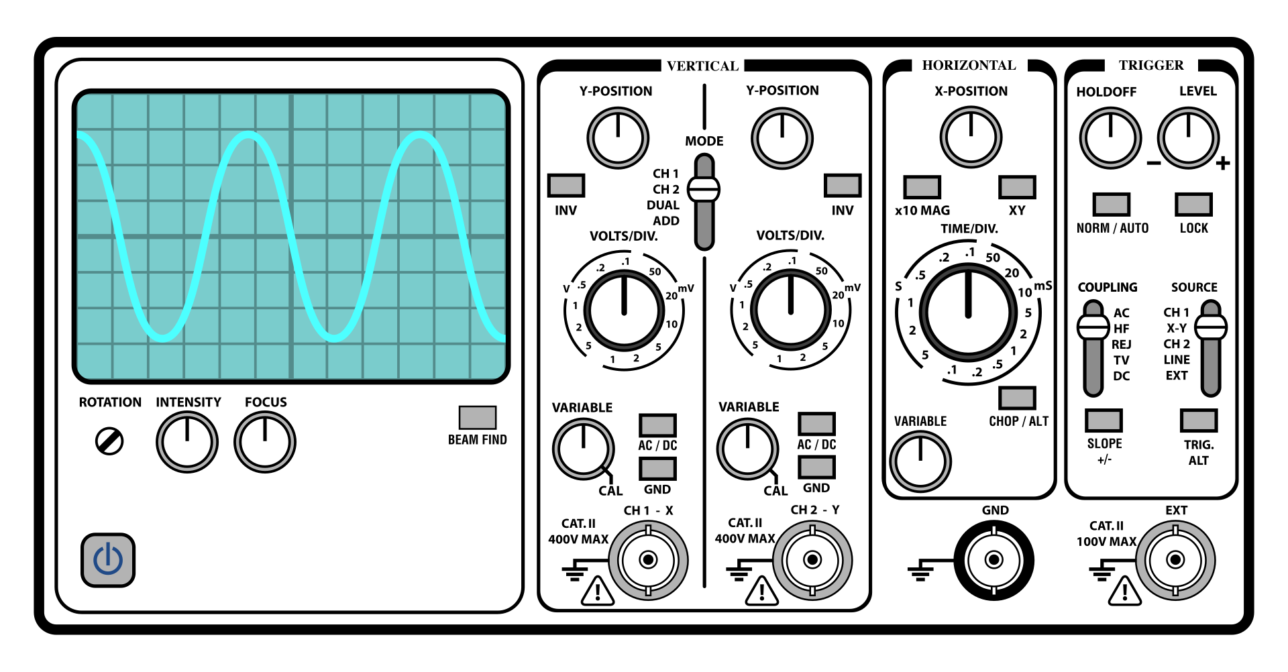
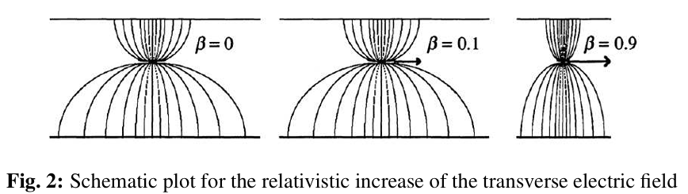
Background – Impedance Matching, Reconstruction
Impedance
matching
Minimize reflection and waveform distortion
Impedance matching
The pick-up signal is transmitted through a coaxial line.
Impedance mismatch causes signal reflection.
Reflected signals can produce ringing and waveform distortion.
Match the characteristic impedance of the pick-up structure.
Reconstruction algorithm
Low-β beams have longitudinal electric-field spread.
The measured signal can be broader than the original bunch shape.
Reconstruction is required to recover the bunch profile.
Matched case
Mismatched case
wikipedia:Impedance_matching
Forck et al., Beam Position Monitors.

Slide 4
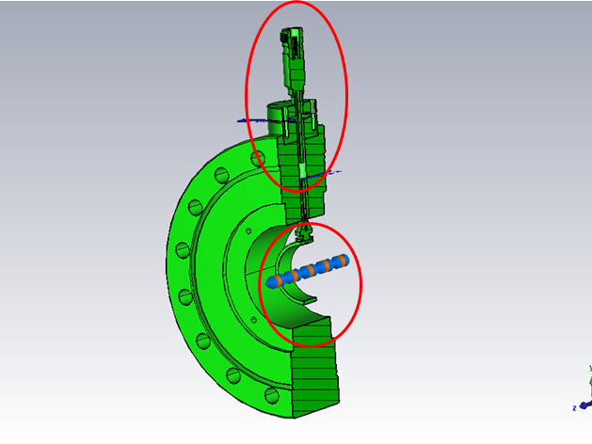
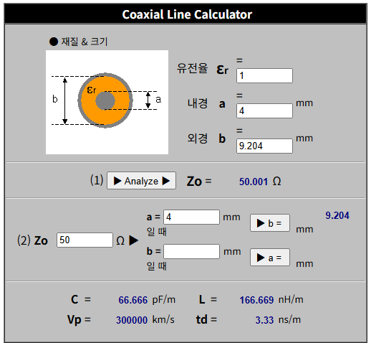
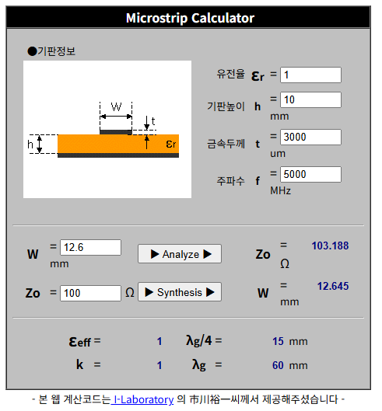
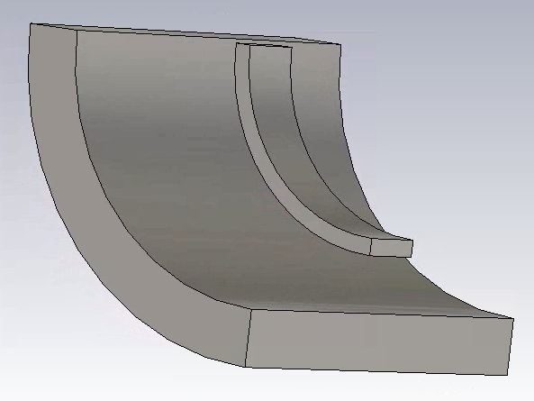
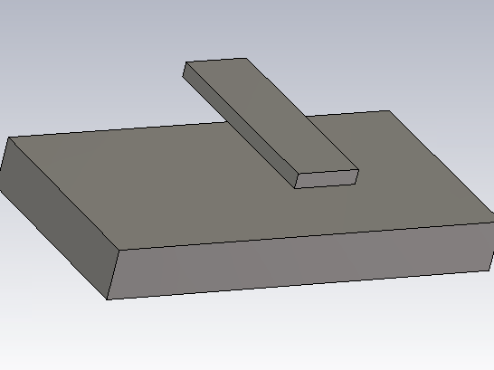
Impedance Matching
Signal Transmission Structure of CPU-BSM
Main signal path:
Pick-up ring → coaxial line → oscilloscope
Coaxial line:
conventional coaxial geometry
Pick-up ring:
curved microstrip-like structure
RF design house

Slide 5
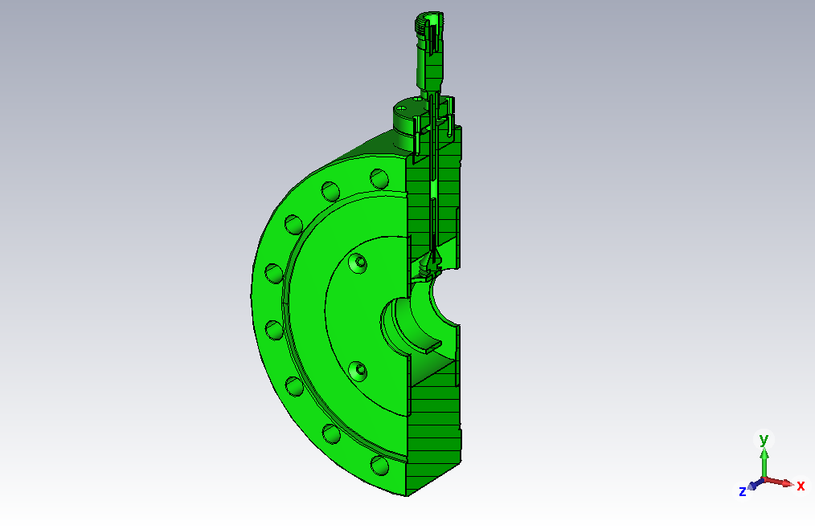
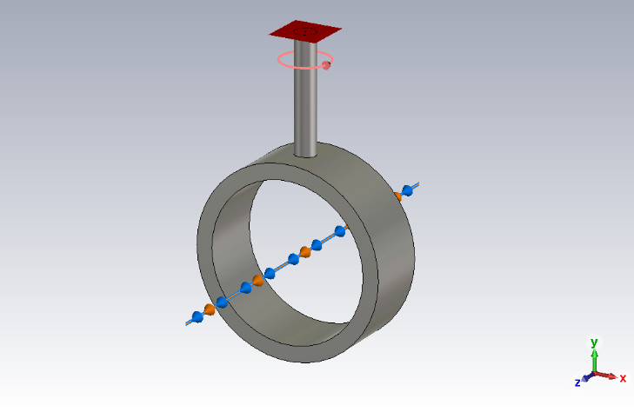
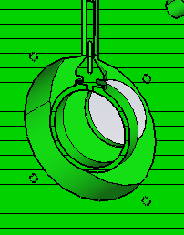
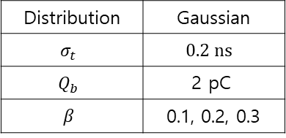
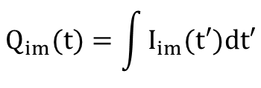


Reference vs Basic
Reference
Basic
Basic model includes:
- pick-up ring
- coaxial line
- cavity
Matching structures were not included in the basic model.
The basic model was compared with the reference response.
Distribution | Gaussian
$$σ_{t}$$ | $$0.\text{2} \text{ns}$$
$$Q_{b}$$ | $$\text{2 }\text{pC}$$
$$β$$ | 0.1, 0.2, 0.3
$$I(t)=\frac{dQ(t)}{dt}$$
$$I_{im}(t)=\frac{dQ_{im}(t)}{dt}$$
$$Q_{im}(t)=\int{I_{im}(t′)dt′}$$

Slide 6
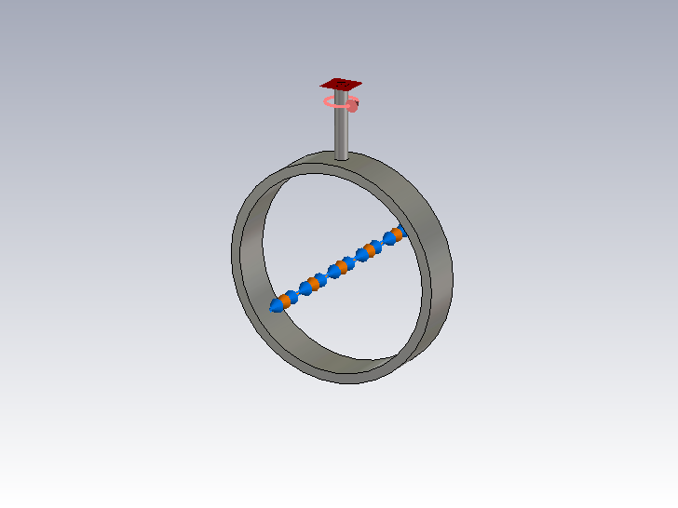
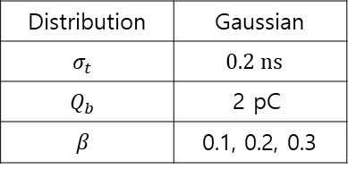
30 mm vs 60 mm
D=30 mm
D=60 mm
As the aperture increased, the distance between the beam and pick-up ring increased.
The current signal amplitude decreased for the larger aperture.
The normalized waveform became slightly broader.
Distribution | Gaussian
$$σ_{t}$$ | $$0.\text{2} \text{ns}$$
$$Q_{b}$$ | $$\text{2 }\text{pC}$$
$$β$$ | 0.1, 0.2, 0.3
w | 12.6 mm
t | 3 mm
h | 10 mm

Slide 7
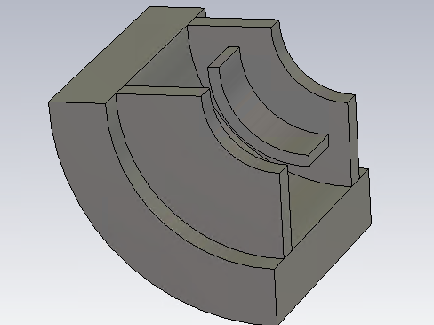
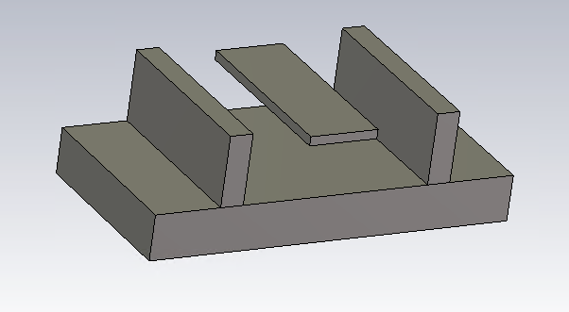
Impedance Matching - Beam Guard
Beam guard is required to protect the pick-up ring from direct beam loss.
With beam guard, the pick-up ring is no longer a simple microstrip geometry.
Standard microstrip formulas are not directly applicable.

Slide 8
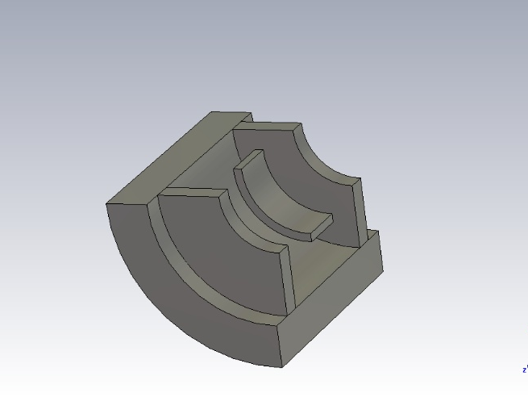
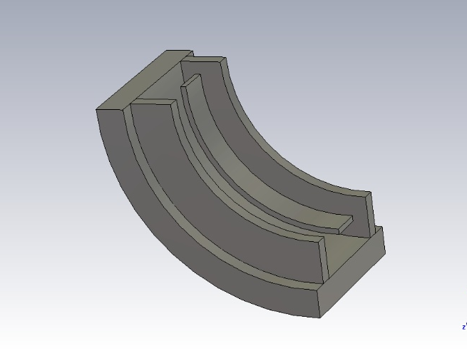
Impedance Matching – Aperture
Straight
Aperture Effect on Characteristic Impedance
The pick-up ring is a curved microstrip-like structure.
Larger aperture → different curvature
In a curved ring, the inner and outer edges have different path lengths.
Characteristic impedance changes with aperture

Slide 9
Summary
In the basic model, only the pick-up ring, coaxial line, and cavity were included.
→ Without matching structures, ringing was observed.
As the aperture increased:
  Current intensity decreased.
  The normalized signal became broader.
Beam guard was added for pick-up ring protection,
and characteristic impedance optimization was performed.
In the curved pick-up ring simulation, characteristic impedance changed with aperture.
→ Straight microstrip estimation should be corrected by aperture-dependent CST simulation.

Slide 10
Future Work
Impedance Matching
  Design pick-up ring and coax matching structure
  Perform full assembly simulation
Reconstruction Algorithm
  Apply reconstruction algorithm to large-aperture CPU-BSM
  Evaluate applicability to proton accelerator.
Tomography

Slide 11
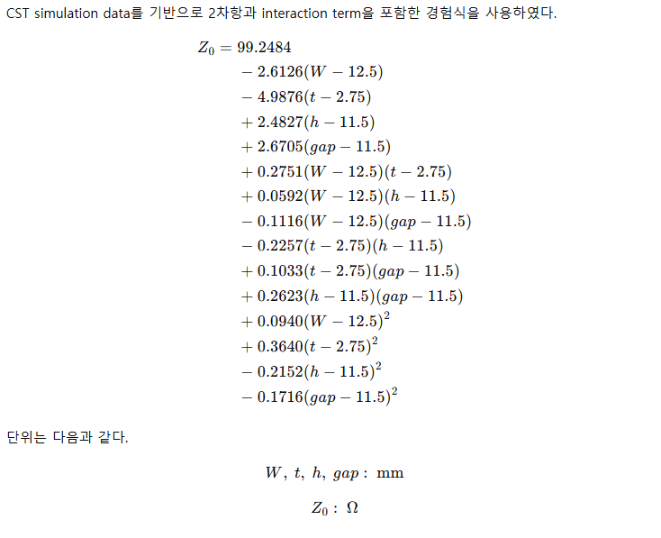
Appendix

Slide 12
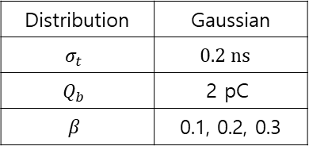
Reference vs basic vs beamguard
Distribution | Gaussian
$$σ_{t}$$ | $$0.\text{2} \text{ns}$$
$$Q_{b}$$ | $$\text{2 }\text{pC}$$
$$β$$ | 0.1, 0.2, 0.3
w | 12.6 mm
t | 2
h | 11
h_wall | 15
gap | 12.7
Reference
Basic v1
Beamguard v1

Slide 13
v1(w=12.645,h=10) 과 비교 v2(D=70mm,w=15,h=11.5)
Pick-up ring의 폭을 늘리고 임피던스 매칭을 진행함.
Current의 Intensity가 증가했음.
Sigma_t = 0.2 ns
Beta = 0.2
Sigma_t = 0.1 ns
Beta = 0.3

Slide 14
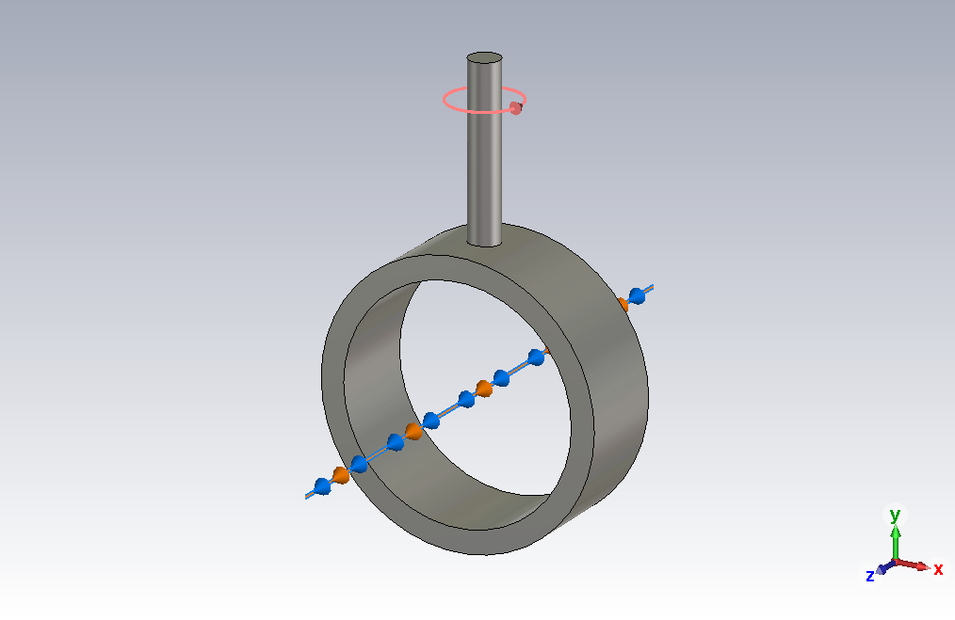
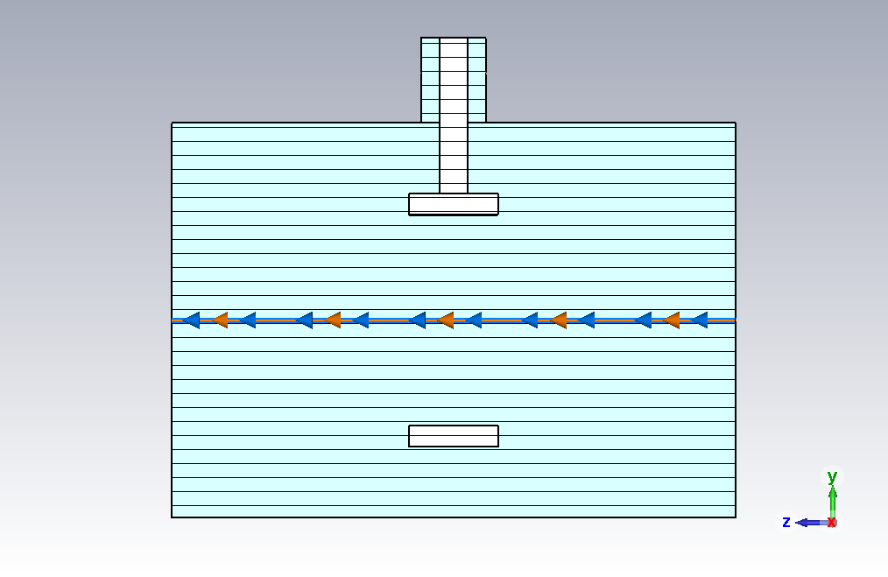
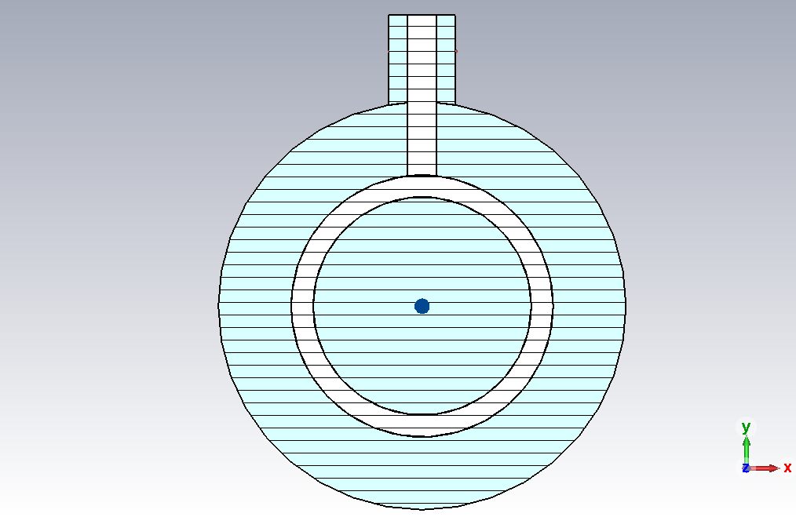

Appendix - Parameter
w
t
h
전체
측면
ring_out
coax_in
pipe_in
coax_out
ring_in
정면
상단

Slide 15
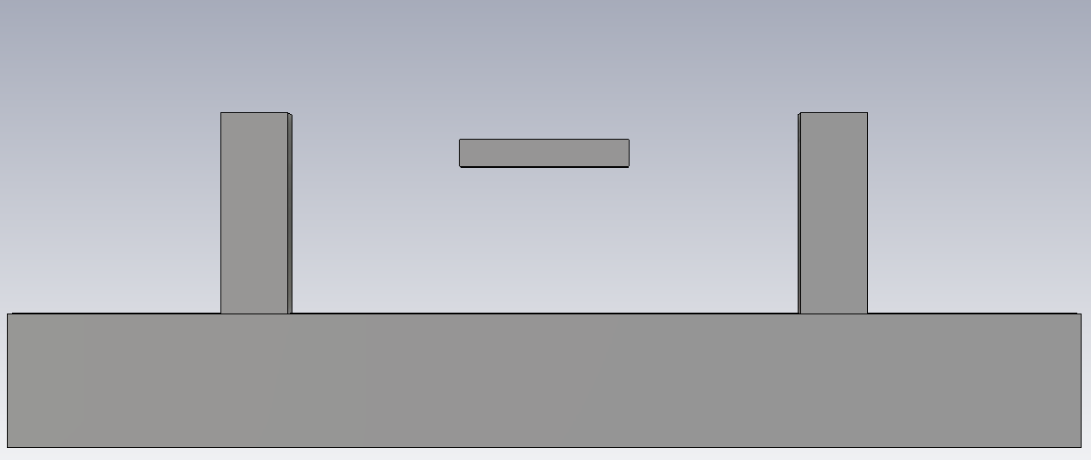
Appendix - Parameter
t_wall
w
gap
t
h_wall
h

Slide 16
Analytical estimate: 100.151 Ω
CST simulation: 111.546 Ω

