Slide 1
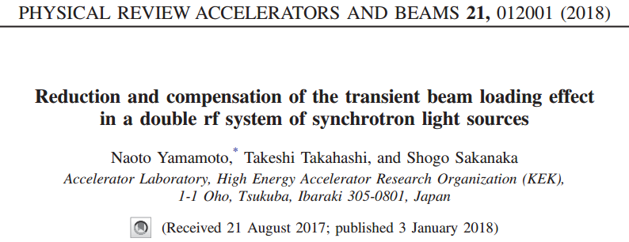


2026-04-24, Pohang, South Korea
$${\text{48}}^{th}$$
DAON LEE
2026 JKPS(Journal Klub of Pohang Scientist)
(과학관, JKPS)

Slide 2
Outline
Ⅰ. Introduction
Ⅱ. Transient Beam Loading
Ⅲ. Simulation
Ⅵ. Compensation
Ⅴ. Summary
Ⅵ. Follow-up Study

Slide 3
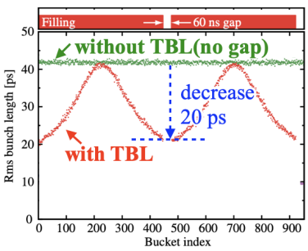
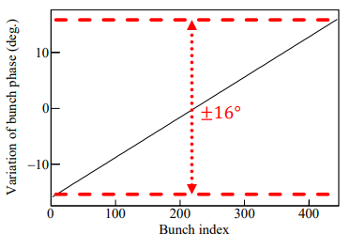
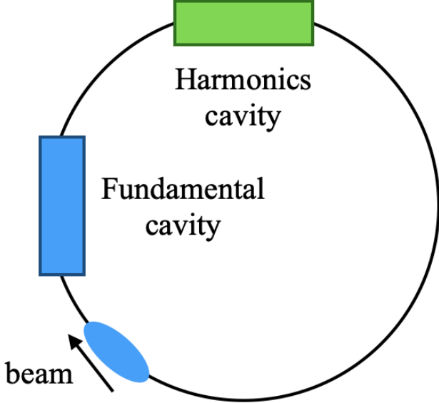

Introduction
Transient Beam Loading(TBL) effect in the ultra-low emittance ring
● Bunch lengthening is effective to achieve mitigation of the intra-beam scattering(IBS) and sufficient Touschek lifetime.
● The TBL affects the performance of the bunch lengthening.
● They estimated the TBL effect using a semi-analytical method with compensation.
$$Double RF system$$
3

Slide 4
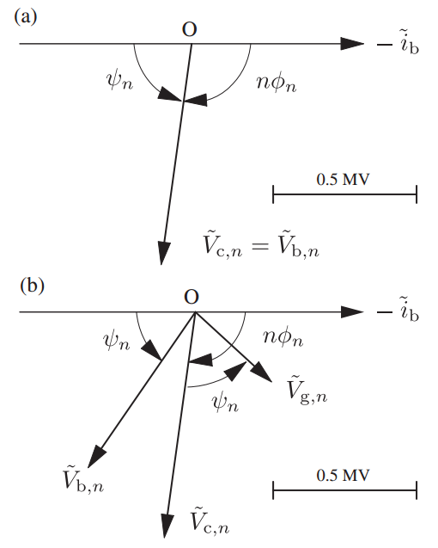
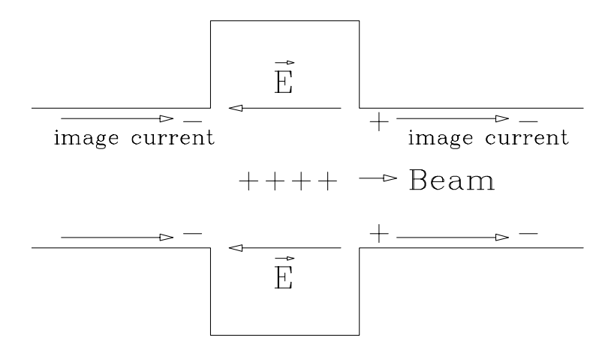
Beam Loading
Beam loading
• The Beam Loading :
- When a beam passes through an RF cavity, it excites the electromagnetic fields inside the cavity, much like a klystron or other RF source does. This excitation of the cavity by the beam is referred to as beam loading.
4

Slide 5
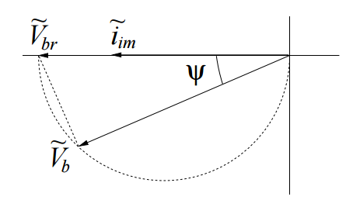
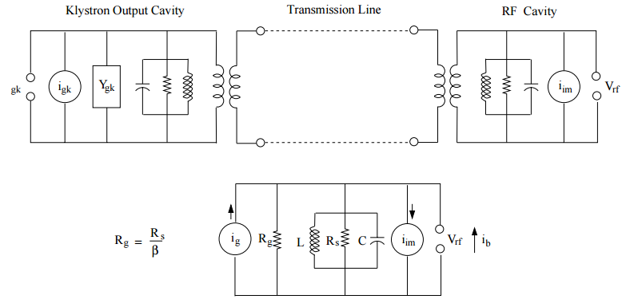



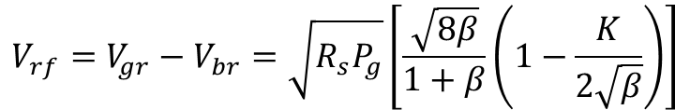





Equivalent Circuit
Energy conservation / Superposition principle
$$ω_{r}=\frac{1}{\sqrt{LC}}$$
$$ω_{rf}$$
$$Z_{cav}=R_{L}cosψe^{jψ}$$
$$beam image current$$
$${\tilde{V}}_{b}={\tilde{i}}_{im}R_{L}cosψe^{jψ}$$
$$V_{b}=V_{br}R_{L}cosψ$$
$$cavity shunt impedance$$
$$V_{rf}=V_{gr}−V_{br}=\sqrt{R_{s}P_{g}}\left[\frac{\sqrt{8β}}{1+β}\left(1−\frac{K}{2\sqrt{β}}\right)\right]$$
Very high in SC cavity
-> crucial beam loading effect
$ex) i_{gk}=12i_{g}$ in Fermilab
5

Slide 6
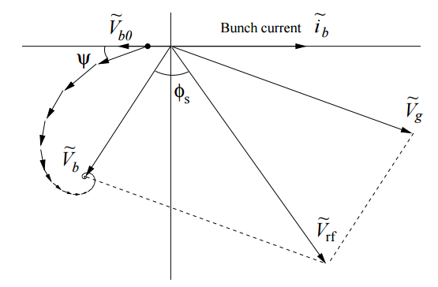


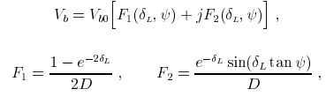
Transient Beam Loading
Transient beam loading / from transient to steady-state
• The Transient Beam Loading :
- Due to bunch spacing, cavity filling time, detuning, and loaded Q, the cavity voltage seen by each bunch can vary.
6

Slide 7
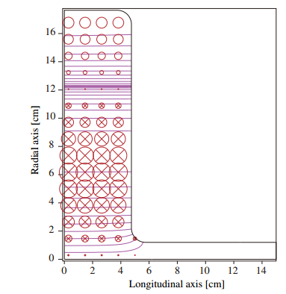
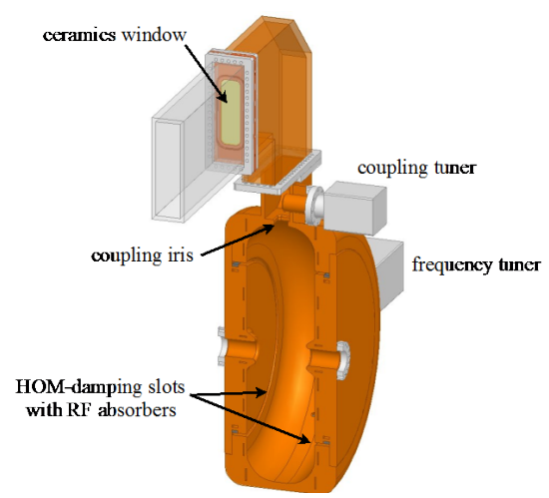

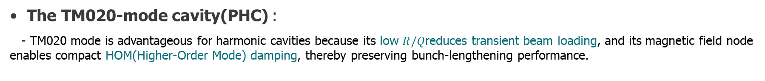
Double RF System
Five main RF cavity & five passive harmonic cavity(PHC)
• The TM020-mode cavity(PHC) :
- TM020 mode is advantageous for harmonic cavities because its low $R/Q$reduces transient beam loading, and its magnetic field node enables compact HOM(Higher-Order Mode) damping, thereby preserving bunch-lengthening performance.
$$Double RF system$$
7

Slide 8
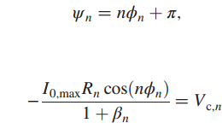


Double RF System
Five main RF cavity & five passive harmonic cavity(PHC)
• Operation :
- If the main RF slope is canceled by a third-harmonic cavity to achieve bunch lengthening, the longitudinal focusing force around the synchronous phase becomes very weak or nearly vanishes. As a result, even small fluctuations in the harmonic cavity voltage caused by bunch gaps can lead to significant changes in both the bunch position and the bunch length.
$$Double RF system$$
$$optimize power, satisfy Robinson^{′}s stabilty criteria$$
$$optimize power:reflected power$$
8

Slide 9
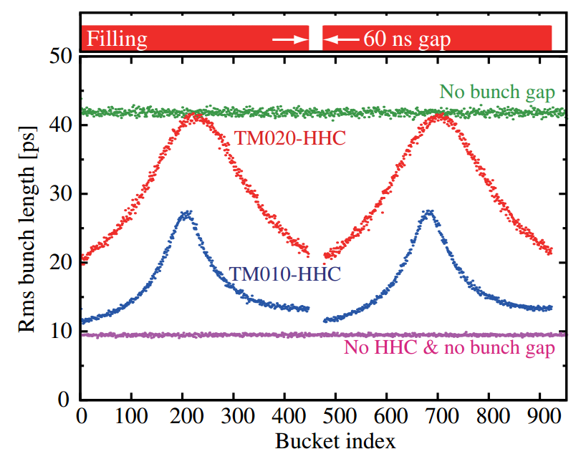


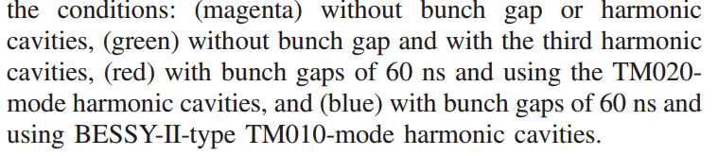
Simulation
1. Tracking simulation
• Tracking simulation : (1,000 macro-particles per bunch/total 10e+6 macros)
- These simulations demonstrated that the TM020-mode cavities are very effective for lengthening bunches when the bunch gaps are introduced.
9

Slide 10
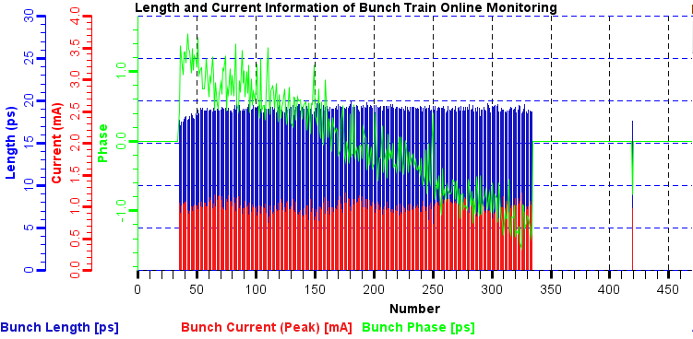
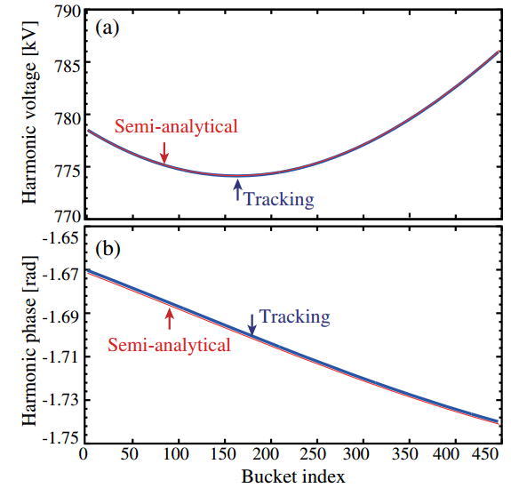

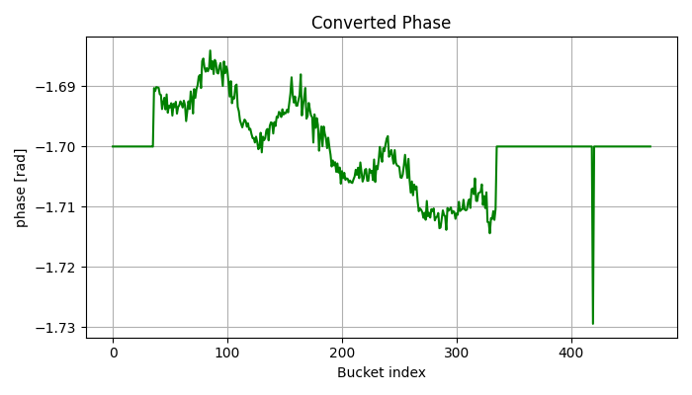


Simulation
Evaluation of bunch lengthening : 2. Semi-analytical calculation simulation
• Semi-analytical calculation simulation :
- This approach also allows us to estimate the bunch lengths quickly while the tracking simulation takes a long time.
10

Slide 11

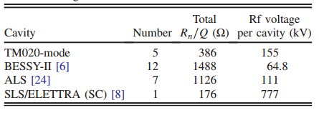
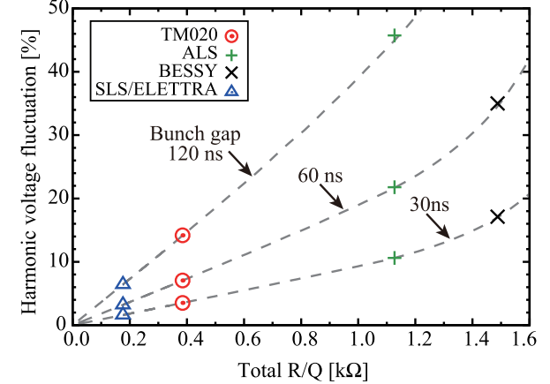


Simulation
Estimation of the transient rf voltage
• The voltage fluctuation :
- By applying the semi-analytical method, they estimated the voltage fluctuations due to bunch gaps in various harmonic cavities.
$$just geometric factor of the cavity$$
11

Slide 12
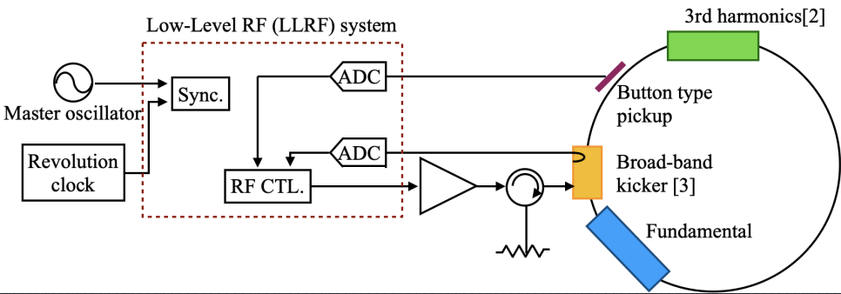







Compensation
The feed-forward Low-level rf(LLRF) compensation
• The feed-forward LLRF compensation :
- The half bandwidth of the compensation was chosen to be 1.1 MHz, which was approximately the same as the repetition frequency of the bunch trains.
$$bunch phase data$$
①
$$adjust fill pattern$$
③
②
$$read bunch phase$$
12

Slide 13
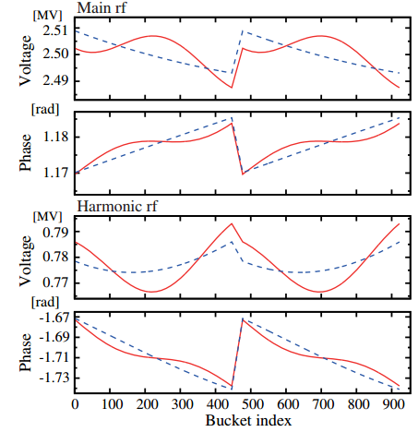
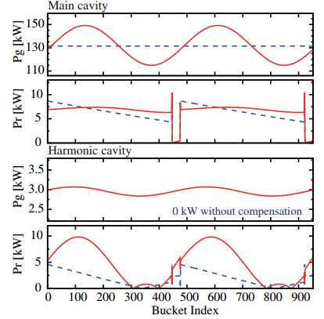
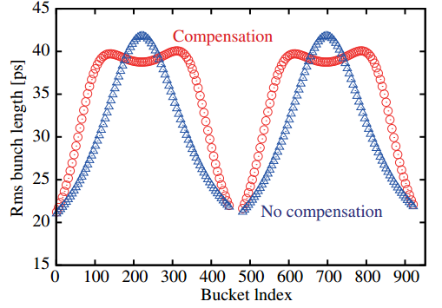





Compensation
The feed-forward LLRF compensation on Main & Harmonic cavities
⒜ Feed-forward 1.1MHz :
$$from 31.ps to 34.9ps(ave.)$$
-> All well good
$$Main :from 131 kW to 149kW$$
$$Harmonic :from 0 to\sim 3kW$$
⒝ Feed-forward 2.1MHz :
- we need to determine the bandwidth considering the required power and the performance.
$$from 31.ps to 37.4ps(ave.)$$
$$Main :from 131 kW to 158kW$$
13

Slide 14
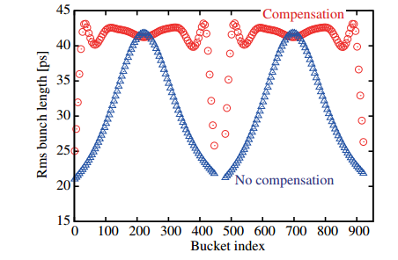

Compensation
The feed-forward LLRF compensation on separate rf cavities
• Feed-forward 3.MHz :
- The cavity voltage required for this compensation was ∼45 kV, while the peak generator power was ∼50 kW. Both of them are technically feasible.
$$from 31.ps to 40.9ps(ave.)$$
14

Slide 15
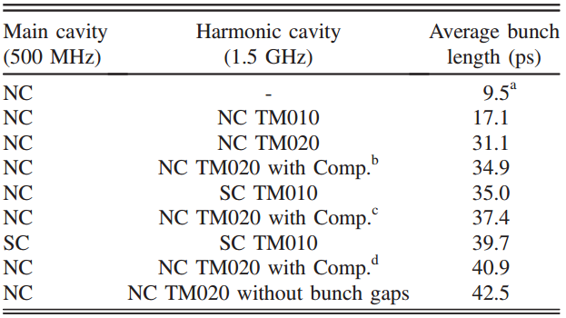


Discussion
The superconducting cavities
• Two KEKB-type SC cavities :
- With these cavities, the voltage fluctuation was estimated to be 0.4% p-p.
$$from 31.ps to 39.7ps(ave.)$$
$3.2\% p$-$p$
15

Slide 16
Summary
• For next-generation light sources, we investigated the transient beam loading effect, which affects bunch lengthening, using semi-analytical simulations.
• They proposed a normal-conducting double RF system based on a 1.5 GHz TM020-mode harmonic cavity with feed-forward LLRF compensation using a separate RF cavity, and the simulation results demonstrated improved performance.
16

Slide 17
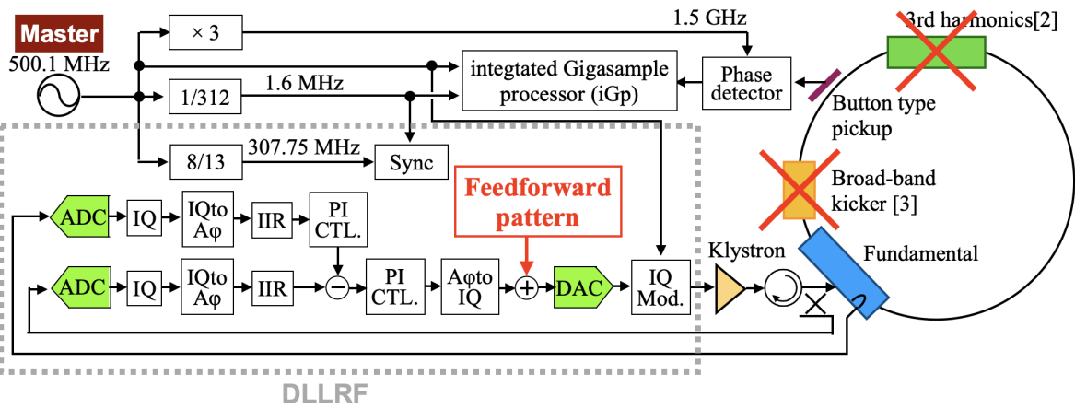
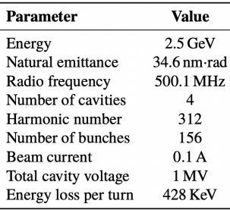
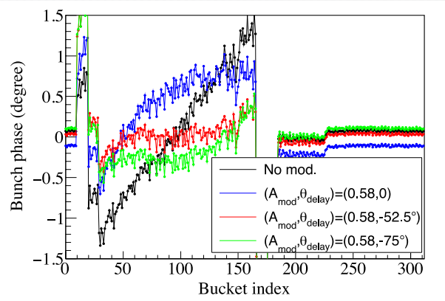
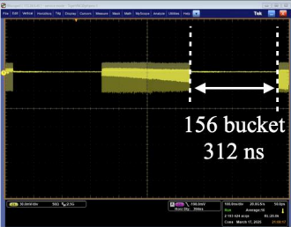
Follow-up Study
17

Slide 18
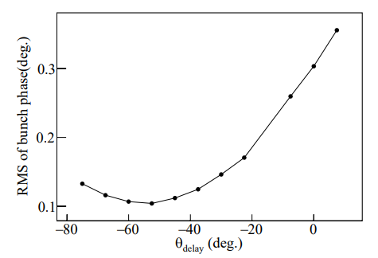
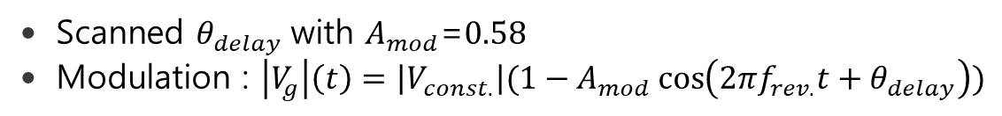
Follow-up Study
• $\text{Scanned} θ_{delay} \text{with} A_{mod}\text{=}0.58$
• $\text{Modulation}\text{ :}$ $\left|V_{g}\right|\left(t\right)=\left|V_{const.}\right|(1−A_{mod}\cos\left(2πf_{rev.}t+θ_{delay}\right))$
RMS of bunch phase within
40 and 150 buckets
With $θ_{delay}$ = −52.5°, variation in the bunch phase was mitigated from ±1.5° to ±0.4°
18

Slide 19
Thank you !

Slide 20




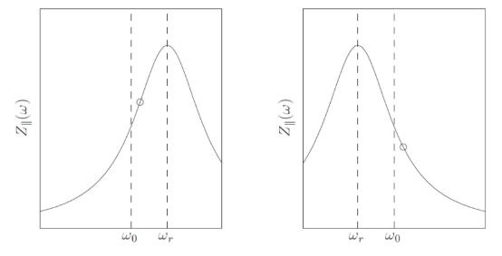



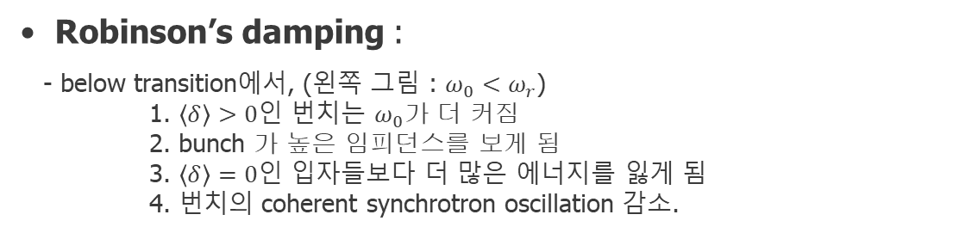
Appendix A
Robinson instability criteria
The Robinson instability is a longitudinal coupled-bunch instability driven by the interaction of the beam with the impedance of accelerating cavities
• In low intensity : (beam loading voltage의 perturbation을 무시 가능한 경우)
(rf voltage phasor ${\tilde{V}}_{rf}$가 거의 변하지 않음)
- 이 경우 보통의 phase stability condition으로 돌아감.
• In high intensity :
- beam loading voltage phasor가 추가로 생겨 원래의 rf voltage가 섭동. 이때 안정되지 위해서는 추가 가속성분이 restoring force를 깨지 않아야함.
• Robinson’s damping :
- below transition에서, (왼쪽 그림 : $ω_{0}<ω_{r}$)
1. $\left\langle δ\right\rangle >0$인 번치는 $ω_{0}$가 더 커짐
2. bunch 가 높은 임피던스를 보게 됨
3. $\left\langle δ\right\rangle =0$인 입자들보다 더 많은 에너지를 잃게 됨
4. 번치의 coherent synchrotron oscillation 감소.
Robinson instability는 번치의 주파수 변동이 어느쪽 slope에 걸리느냐로 결정
20

