Slide 1


2026. 04. 17, Pohang, S. Korea.
${47}^{th}$ JKPS
Mode-zero Robinson instability in the presence of passive superconducting harmonic cavities(PSHC)
Department of Physics, POSTECH
Boseong Kwon

Slide 2
Intro

Slide 3
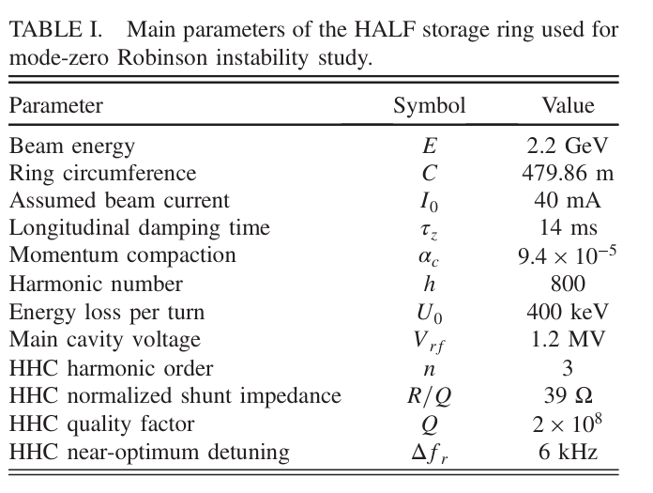
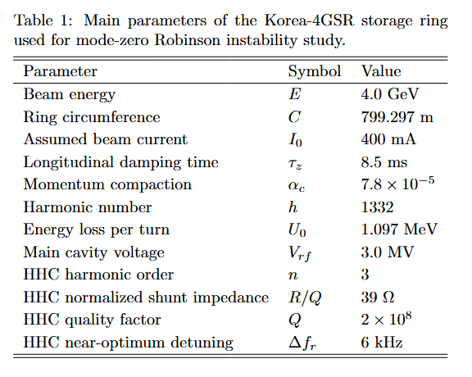
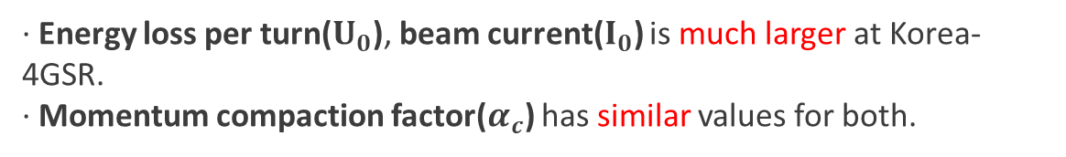
Parameters
Korea-4GSR vs. HALF
· Energy loss per turn($U_{0}$), beam current($I_{0}$) is much larger at Korea-4GSR.
· Momentum compaction factor($α_{c}$) has similar values for both.

Slide 4
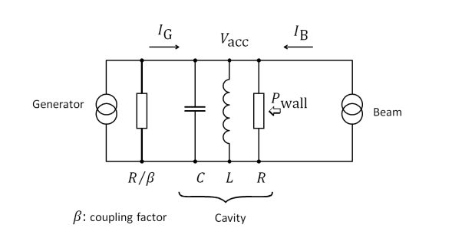
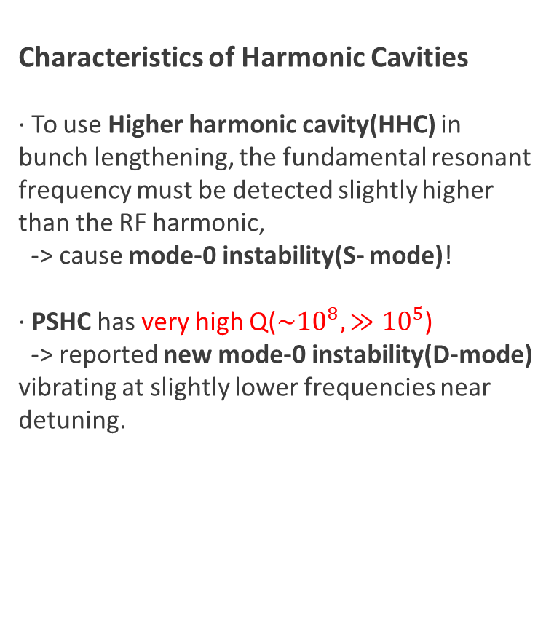
Cavity Structure
Characteristics of Harmonic Cavities
· To use Higher harmonic cavity(HHC) in bunch lengthening, the fundamental resonant frequency must be detected slightly higher than the RF harmonic,
-> cause mode-0 instability(S- mode)!
· PSHC has very high Q($\sim {10}^{8}, ≫{10}^{5}$)
-> reported new mode‑0 instability(D-mode) vibrating at slightly lower frequencies near detuning.
Goals: D-mode analysis, figure out the matter in which parameters

Slide 5
Passive vs. Active Harmonic Cavity
Passive Cavity
· Principle: No external source, using wake field made by beam-induced voltage.
· Principle: Use additional RF source(ex. Klystron), provide power directly. Able to control voltage and phase in detail.
Active Cavity
Both case can control beam quality(lifetime, length), produce harmonic wake field!

Slide 6
Method & Verification

Slide 7
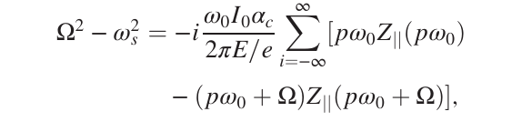
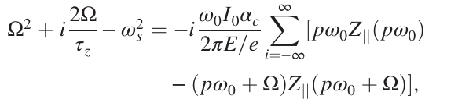

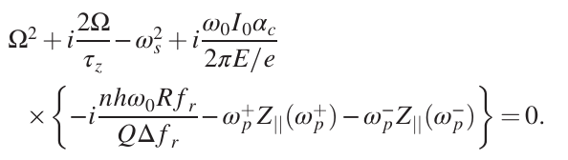
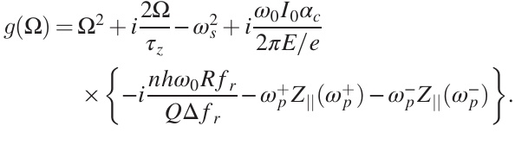


Mode-0 Instability
Derivation of frequency relation expressions
External damping effect
· Resonance angular frequency
Where, $Δf_{r}$ is detuning frequency.
Find $Ω=(Ω_{r0},Ω_{i0}) s.t. g(Ω_{r0}+iΩ_{i0})=0$

Slide 8
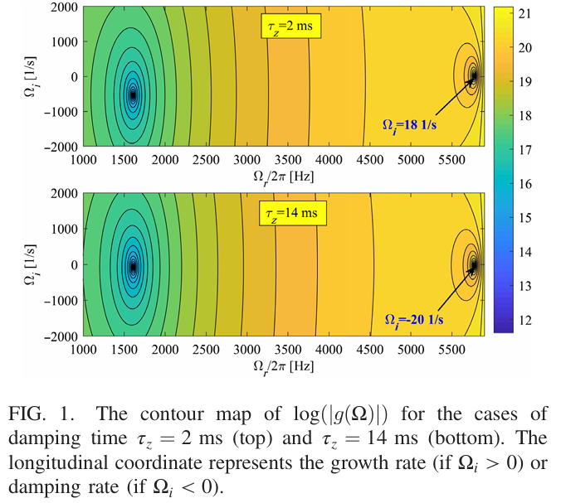

Mode-0 Instability
Definition of S-mode & D-mode
S- mode
D- mode
· There are always 2 local minimum of $g(Ω)$.
Solution 1: Near $Ω_{r}≈ω_{s}$ (S-mode, synchrotron mode)
Solution 2: Near $Ω_{r}≈2πΔf_{r}$ (D-mode, detuning mode)

Slide 9
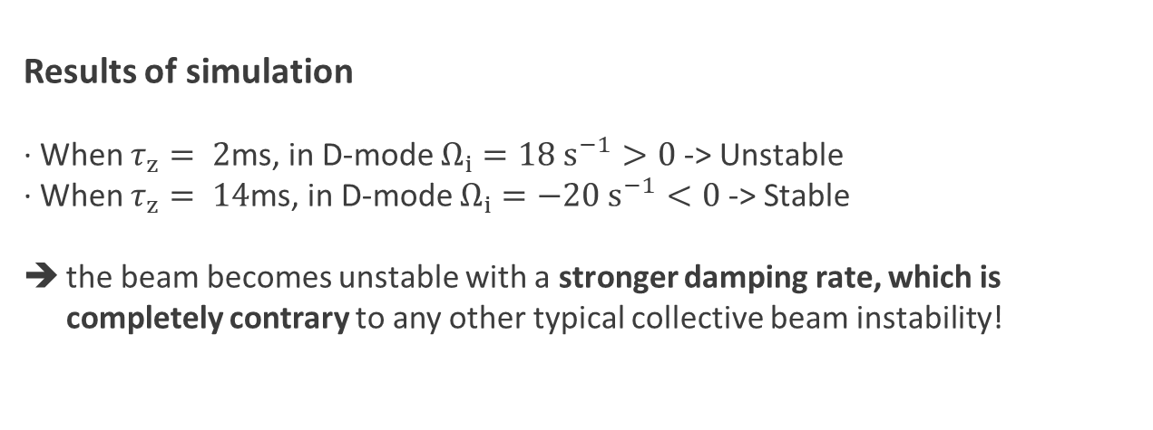
Mode-0 Instability
Results of simulation
· When $τ_{z}= 2$ms, in D-mode $Ω_{i}=18 s^{−1}>0$ -> Unstable
· When $τ_{z}= 14$ms, in D-mode $Ω_{i}=−20 s^{−1}<0$ -> Stable
the beam becomes unstable with a stronger damping rate, which is completely contrary to any other typical collective beam instability!

Slide 10

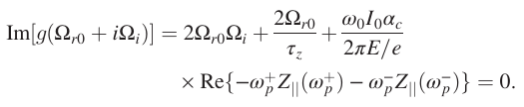
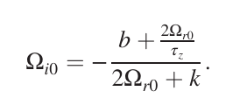
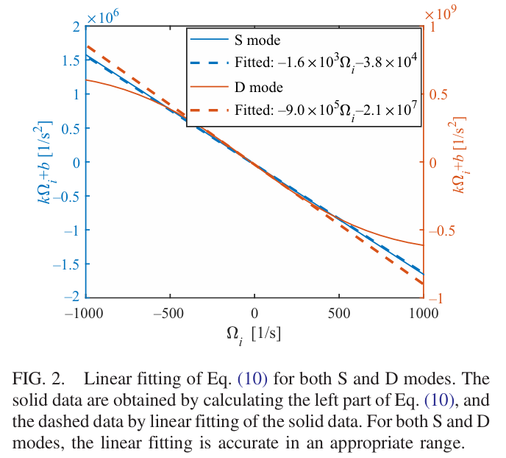
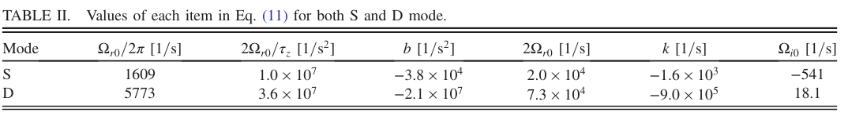

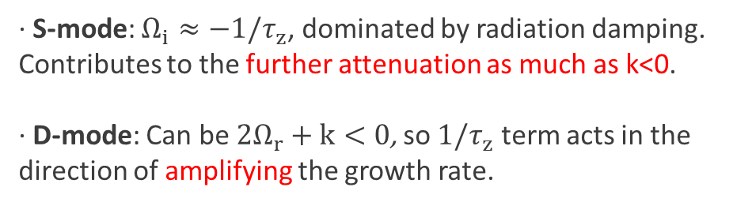
Mode-0 Instability
Analytic approximation about D-mode
· When $g(Ω)= 0 ⇒ Im[g(Ω)] = 0$,
· k and b are coefficients fitted using that the impedance term is almost linear for $Ω_{i}$, Fig. 2 shows how well it approximates S‑ mode and D‑ mode, respectively.
· S-mode: $Ω_{i}≈−1/τ_{z}$, dominated by radiation damping. Contributes to the further attenuation as much as k<0.
· D-mode: Can be $2Ω_{r}+k<0$, so $1/τ_{z}$ term acts in the direction of amplifying the growth rate.

Slide 11
Parameter dependency

Slide 12
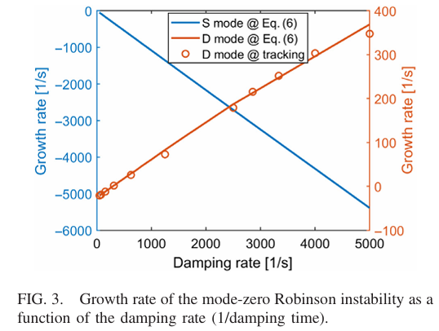


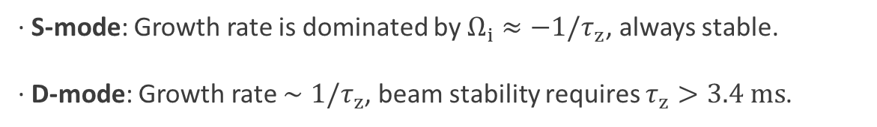
Damping Time($τ_{z}$)
Growth rate vs. Damping rate
$$∼300$$
· S-mode: Growth rate is dominated by $Ω_{i}≈−1/τ_{z}$, always stable.
· D-mode: Growth rate $∼1/τ_{z}$, beam stability requires $τ_{z}>3.4 ms$.

Slide 13
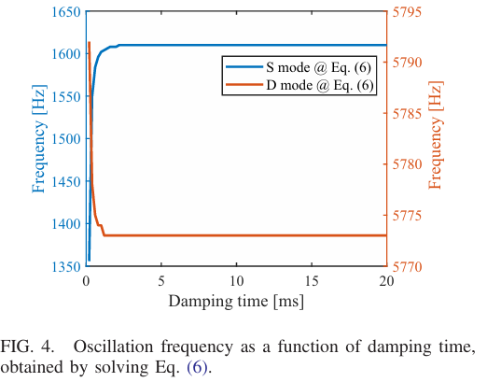
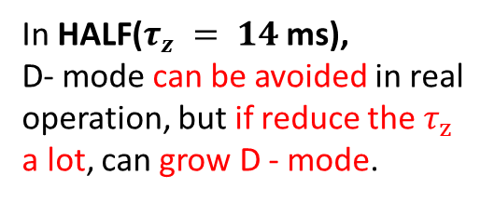
Damping Time($τ_{z}$)
Oscillation frequency vs. Damping time
In HALF($τ_{z} = 14$ms), D‑ mode can be avoided in real operation, but if reduce the $τ_{z}$ a lot, can grow D ‑ mode.
· In most sections, the frequencies of the two modes S and D are hardly affected by the decay time, with only a slight shift of less than 1 ms.

Slide 14
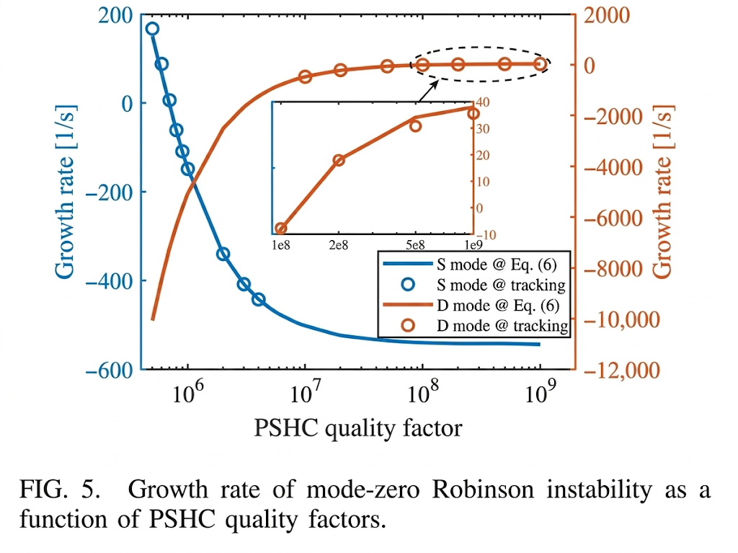


Quality Factor(Q)
Growth rate vs. Quality factor($2×{10}^{5}<Q<{10}^{9}$)
Best Q(${10}^{6}<Q<{10}^{7}$)!
· Small Q: suppress the D-mode instability, but may enhance the S-mode instability.
· High Q: the D-mode instability only occurs.
· Such as PSHC with a coupler to extract beam power, the D-mode instability is not expected to occur.

Slide 15
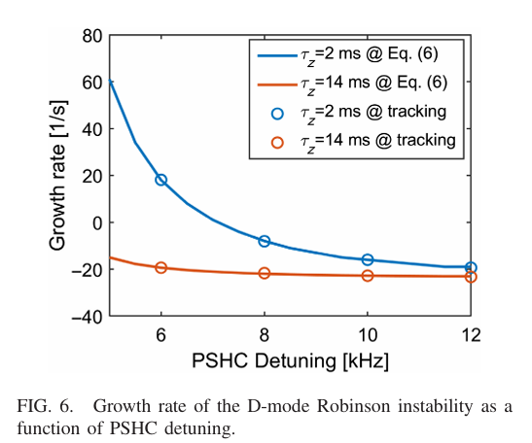

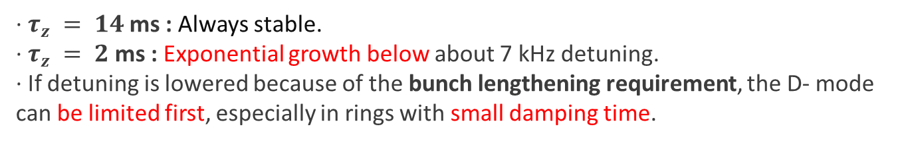

Detuning Frequency($∆f_{r}$)
Growth rate vs. Detuning frequency(5 - 12$kHz$)
· $τ_{z} = 14$ms : Always stable.
· $τ_{z} = 2$ms : Exponential growth below about 7 kHz detuning.
· If detuning is lowered because of the bunch lengthening requirement, the D‑ mode can be limited first, especially in rings with small damping time.

Slide 16
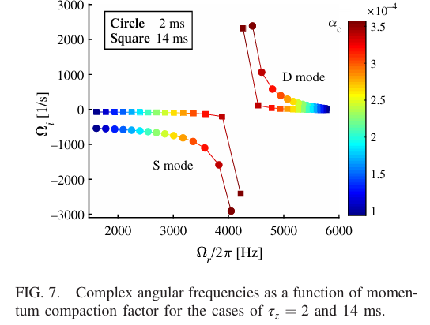


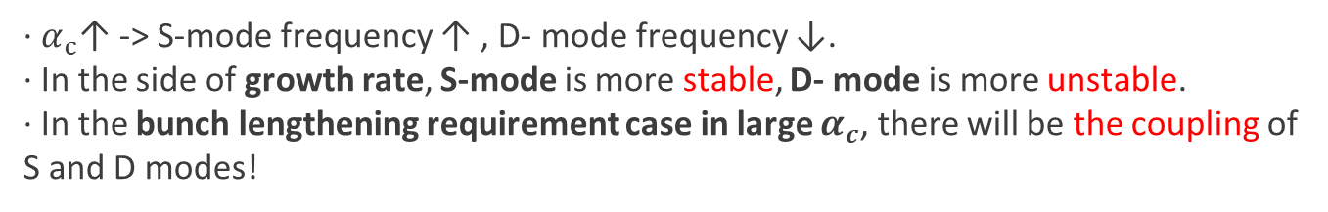

Momentum Compaction Factor($α_{c}$)
Complex frequencies vs. Momentum compaction factor($α_{c0} to 4α_{c0}$)
$$α_{c0}=9.4×{10}^{−5}$$
· $α_{c}$↑ -> S-mode frequency ↑ , D- mode frequency ↓.
· In the side of growth rate, S-mode is more stable, D- mode is more unstable.
· In the bunch lengthening requirement case in large $α_{c}$, there will be the coupling of S and D modes!

Slide 17
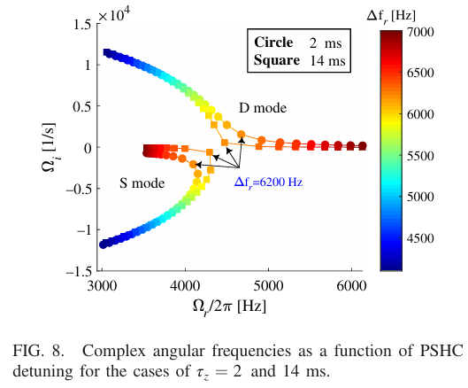
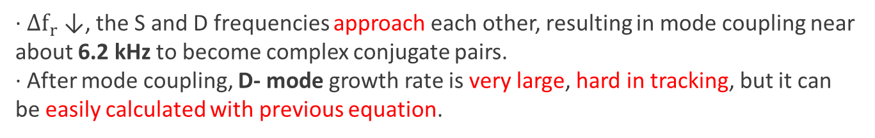

Coupling of S and D Modes
Complex frequencies vs. Detuning frequency(In $4α_{c0}$, 4- 7$kHz$)
· $∆f_{r}$ ↓, the S and D frequencies approach each other, resulting in mode coupling near about 6.2 kHz to become complex conjugate pairs.
· After mode coupling, D‑ mode growth rate is very large, hard in tracking, but it can be easily calculated with previous equation.

Slide 18
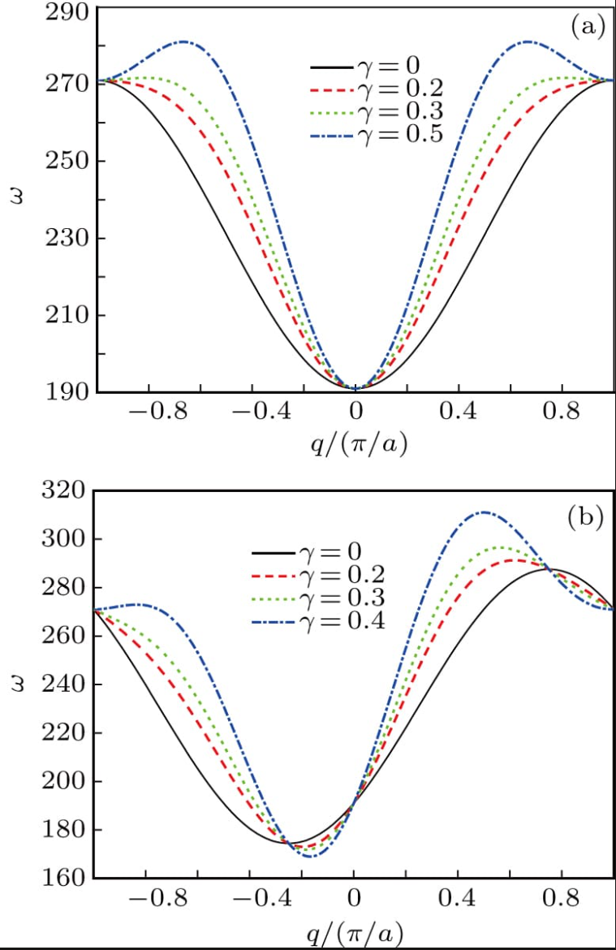
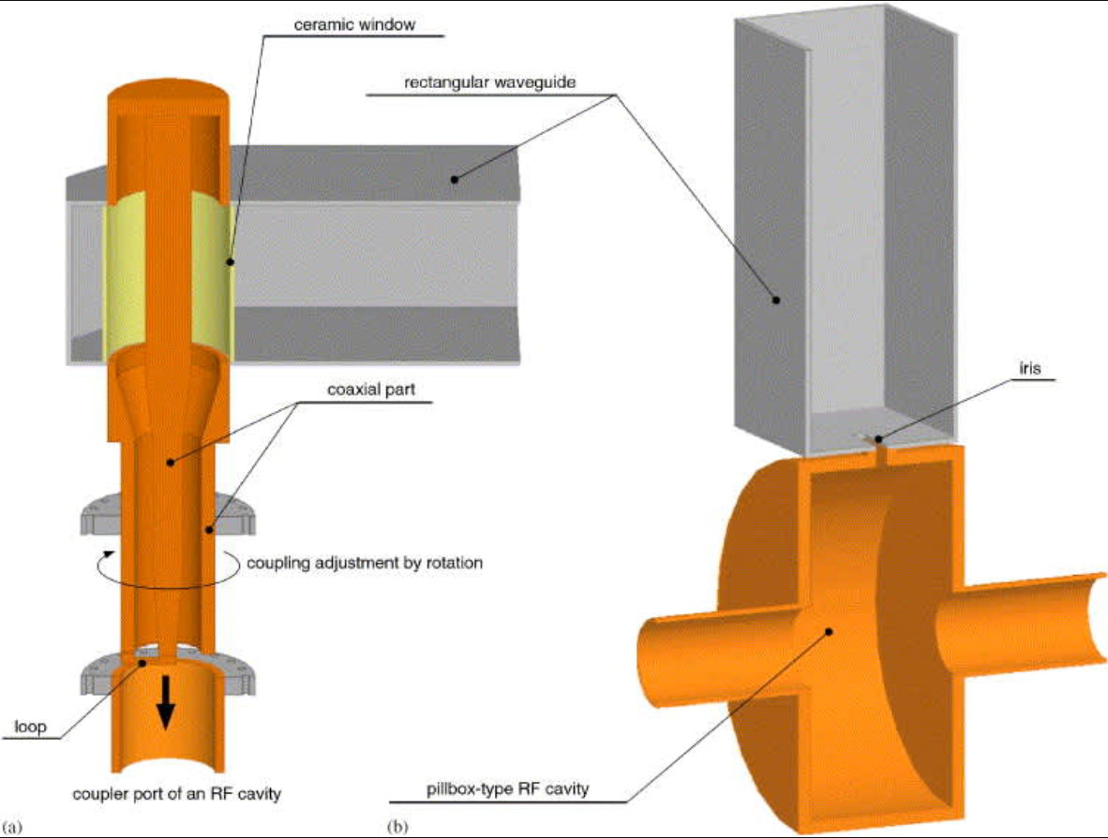
Main Cavity Affects
Main cavity fundamental mode
· Main cavity fundamental mode: Representative resonant mode in which the RF cavity responds most strongly at the lowest resonant frequency.
Can affect synchrotron frequency by giving the beam an additional RF voltage!
· This effect is more pronounced in the S-mode than in the D-mode.

Slide 19
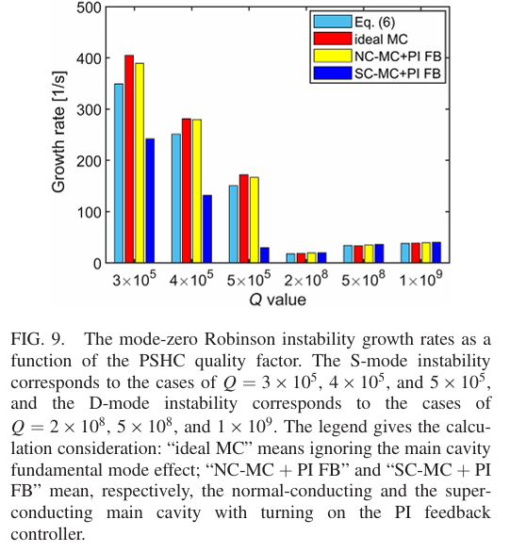
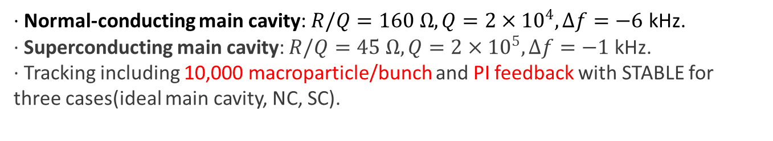
Main Cavity Affects
Tracking setup
· Normal-conducting main cavity: $R/Q=160 Ω,Q=2×{10}^{4},Δf=−6$ kHz.
· Superconducting main cavity: $R/Q=45 Ω,Q=2×{10}^{5},Δf=−1$ kHz.
· Tracking including 10,000 macroparticle/bunch and PI feedback with STABLE for three cases(ideal main cavity, NC, SC).
Results
· D‑ mode: Almost independent, decided by passive superconducting harmonic cavity's own characteristics.
· S ‑ mode: noticeably reduced with SC main cavity, and little change with NC main cavity.

Slide 20
Application

Slide 21
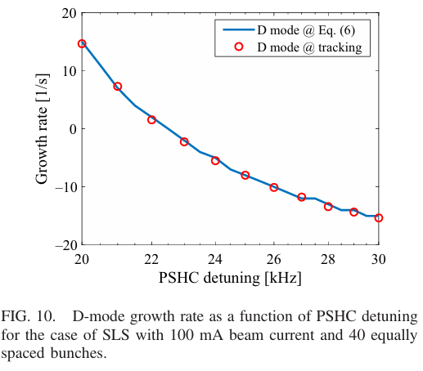


SLS(Swiss Light Source)
D- mode growth rate vs. Detuning
· Below Figure, applying tracking with Eq. (6) in SLS (100 mA, 40 bunch fill), D-mode critical detuning is about 22.5 kHz, consistent with the experiment result(23.6kHz).
· It is naturally explained not by dipole–quadrupole coupling alone, but by D‑ mode Robinson instability!
$$∼22.5$$

Slide 22
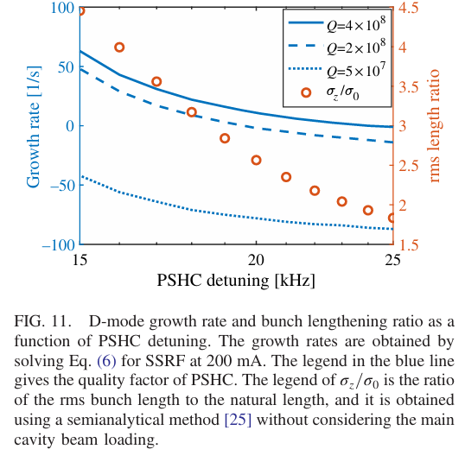

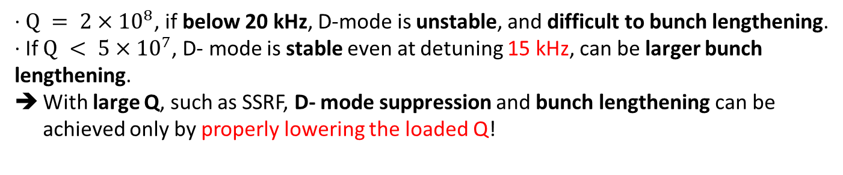
SSRF(Shanghai Synchrotron Radiation Facility)
D- mode growth rate, rms length ratio($σ_{z}/σ_{0}$) vs. Detuning
· $Q = 2×{10}^{8}$, if below 20 kHz, D-mode is unstable, and difficult to bunch lengthening.
· If $Q < 5×{10}^{7}$, D‑ mode is stable even at detuning 15 kHz, can be larger bunch lengthening.
With large Q, such as SSRF, D‑ mode suppression and bunch lengthening can be achieved only by properly lowering the loaded Q!
SSRF (200 mA, $τ_{z} = 3.5$ms)

Slide 23
Results

Slide 24
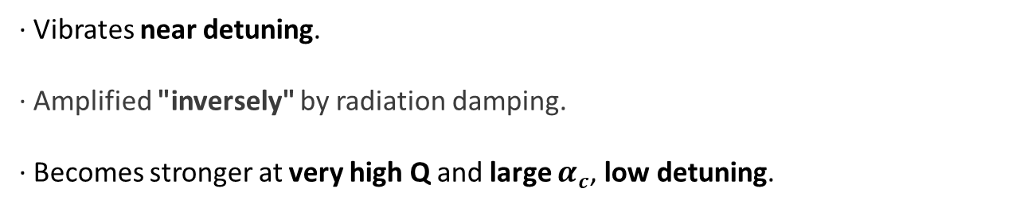
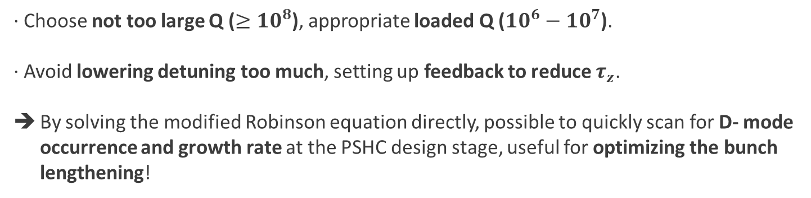
Results
Characteristics of D-mode
· Vibrates near detuning.
· Amplified "inversely" by radiation damping.
· Becomes stronger at very high Q and large $α_{c}$, low detuning.
D-mode suppression
· Choose not too large Q ($≥{10}^{8}$), appropriate loaded Q (${10}^{6}−{10}^{7}$).
· Avoid lowering detuning too much, setting up feedback to reduce $τ_{z}$.
By solving the modified Robinson equation directly, possible to quickly scan for D- mode occurrence and growth rate at the PSHC design stage, useful for optimizing the bunch lengthening!

Slide 25
Thank you!

