Slide 1

2026-04-03, Pohang, South Korea
Transverse Phase Space Reconstruction
On VPP via MENT
DAON LEE
2026 The Beam Diagnostics and Tomography Study
(Room 310, Division of Advanced Nuclear Engineering)

Slide 2
Outline
Ⅰ. Introduction
- The Maximum entropy theory(MENT)
- The KOMAC Beam test stand(BTS) layout
Ⅱ. 4D-Reconstruction with VPP Data via MENT
- Reconstruction : Main parameters
- Reconstruction results
Ⅲ. Conclusion

Slide 3
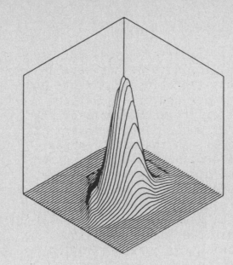
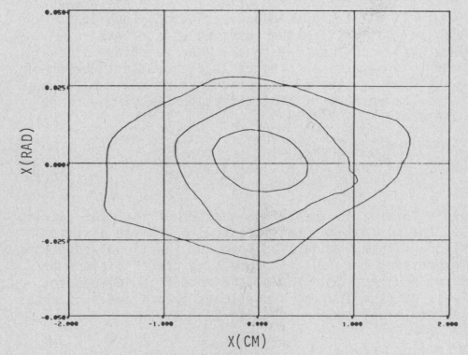
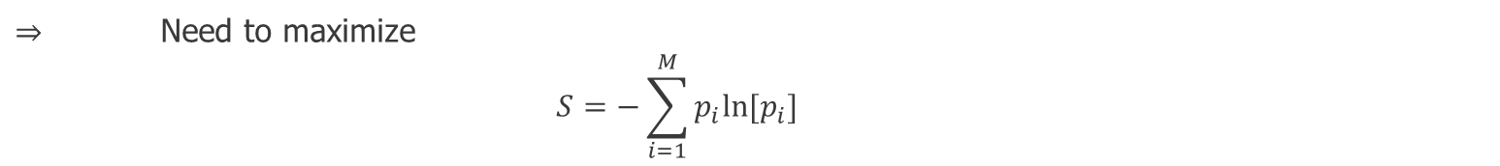

Introduction
- Maximum entropy theory(MENT) -
Q. How should we assign a pdf when ‘testable information’ is available?
A. Jaynes(1957) has suggested that we should make the assignment by using the principle of maximum entropy.
That is, we should choose that pdf which has the most entropy S while satisfying all the available constraints.
$⇒$ Need to maximize
    $$S=−\sum_{i=1}^{M}{p_{i}ln⁡[p_{i}]}$$
$$S\left[ρ\right]=−⨌ρ_{4D}\ln{ρ_{4D}}dxdx^{′}dydy′$$
(isometric display of MENT solution)
(contour plot of MENT solution)
3

Slide 4
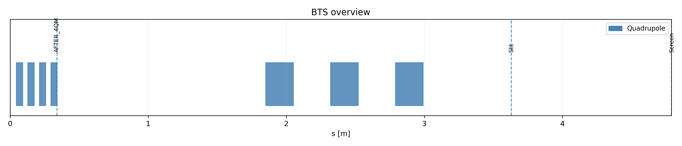
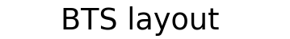


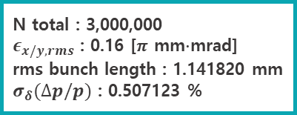

Introduction
- KOMAC BTS(Beam Test Stand) implementation in x-suite -
proton
Drift = 0.11m
1 MeV
$$(x_{i},y_{i})$$
$$(x_{f},y_{f})$$
N total : 3,000,000
$ε_{x/y,rms}$ : 0.16 [$π$ mm$∙$mrad]
rms bunch length : 1.141820 mm
$σ_{δ}(∆p/p)$ : 0.507123 %
Recon
resolution : 50 $μ$m
slit width : 0.2 mm
slit step : 0.2 mm
4

Slide 5
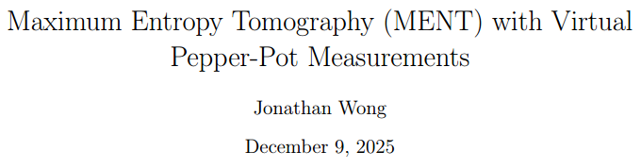



4D-Reconstruction with VPP Data via MENT
- New reconstruction scheme with MENT -
$$ρ\left(x_{i},x_{i}^{′},y_{i},y_{i}^{′}\right)=ρ\left(x_{i},\frac{x_{f}−x_{i}}{L},y_{i},\frac{y_{f}−y_{i}}{L},\right)=L^{2}\tilde{ρ}(x_{i},x_{f},y_{i},y_{f})$$
Horizontal scan:
$$ρ_{h}^{\left(meas.\right)}\left(x_{i},x_{f},y_{f}\right)=∫\tilde{ρ}\left(x_{i},x_{f},y_{i},y_{f}\right)dy_{i}$$
$${\tilde{ρ}}_{3D}\left(x_{i},x_{f},y_{f}\right)=\frac{H[i,f_{x},f_{y}]}{∆x_{i}∆x_{f}(f_{x})∆y_{f}(f_{y})}$$
Vertical scan:
$$ρ_{v}^{\left(meas.\right)}\left(y_{i},x_{f},y_{f}\right)=∫\tilde{ρ}\left(x_{i},x_{f},y_{i},y_{f}\right)dx_{i}$$
5

Slide 6
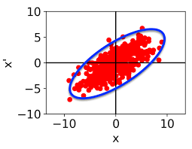


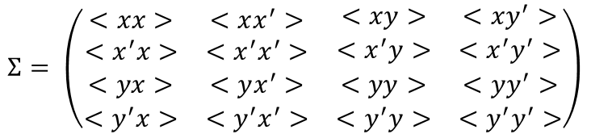

MENT Method
- Reconstruction parameters -
• $4D emittance error$
$$Σ= \left(\begin{matrix}\begin{matrix}<xx> & <xx^{′}> \\ <x^{′}x> & <x^{′}x^{′}>\end{matrix} & \begin{matrix}<xy> & <xy^{′}> \\ <x^{′}y> & <x^{′}y^{′}>\end{matrix} \\ \begin{matrix}<yx> & <yx^{′}> \\ <y^{′}x> & <y^{′}x^{′}>\end{matrix} & \begin{matrix}<yy> & <yy^{′}> \\ <y^{′}y> & <y^{′}y^{′}>\end{matrix}\end{matrix}\right)$$
$$ε_{4D}=\sqrt{detΣ}$$
• $Total variable distance\left(tvd\right) : \text{density}\text{-}\text{based} \text{index}$
$$TVD\left(P,Q\right)=\frac{1}{2}\sum{\left|P_{i}−Q_{i}\right|}$$
SIM : macroparticle, screen resolution
TVD : coupling, non-gaussian structure(masking), space charge effect
6

Slide 7
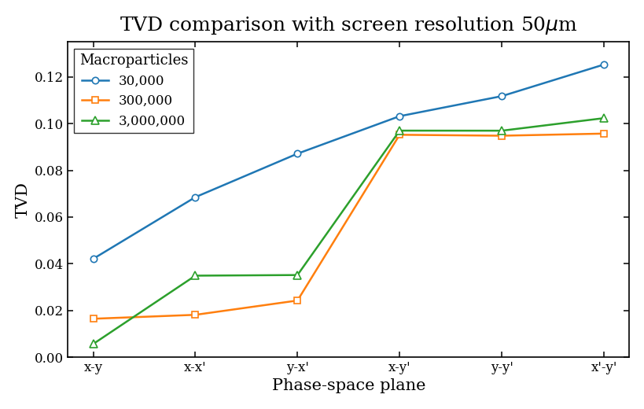
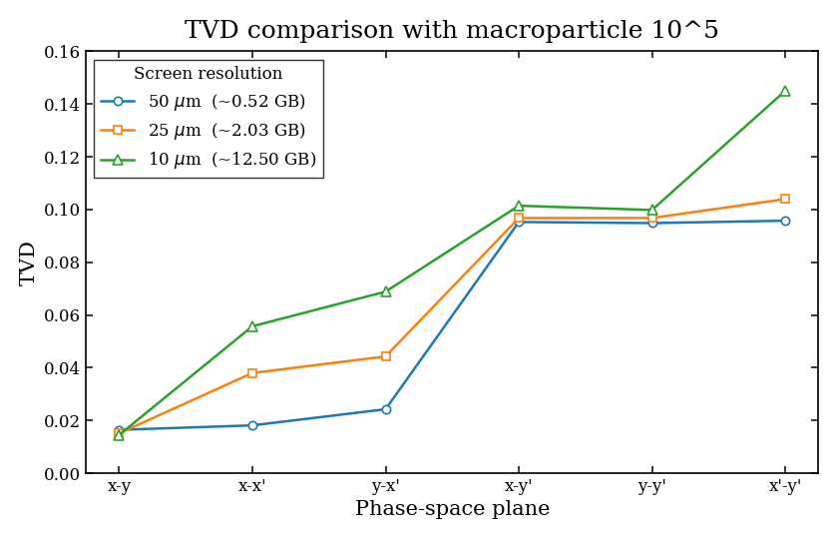


MENT Method
- Simulation variables -
• $Macroparticle number$
• $Screen resolution$
7

Slide 8
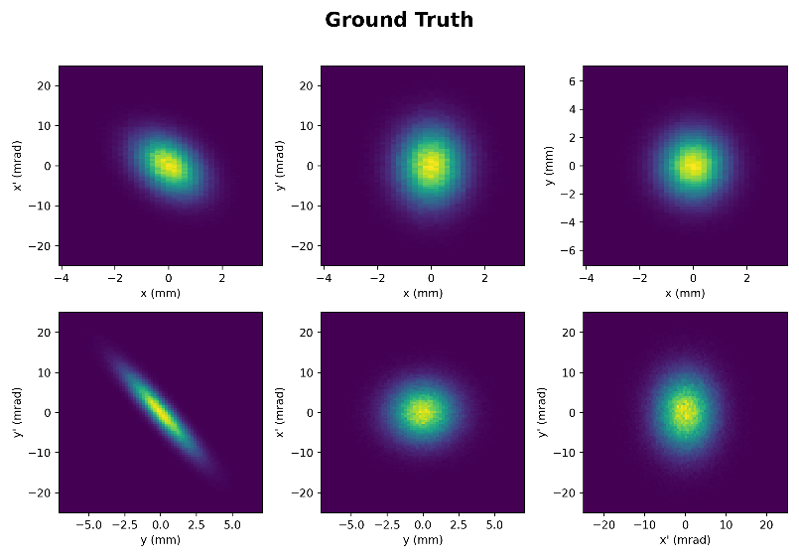
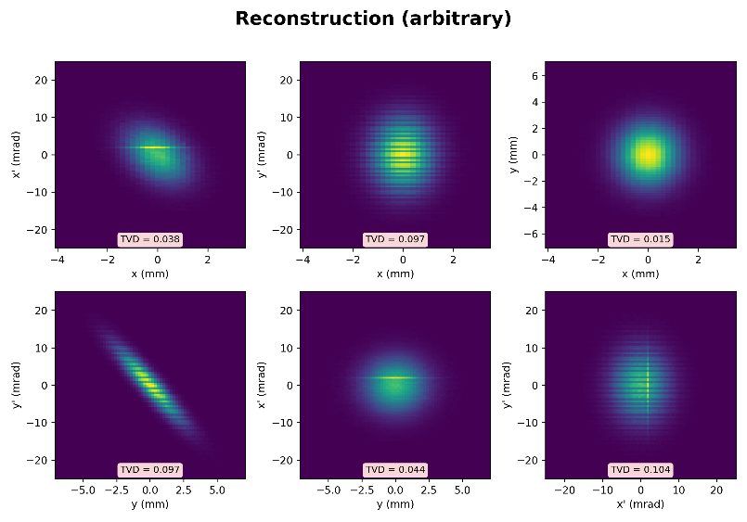
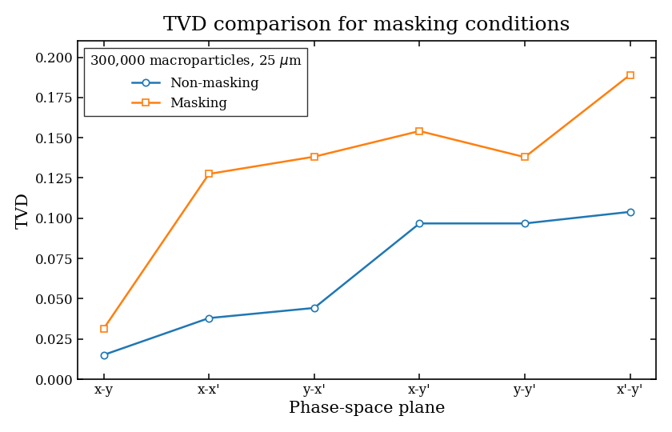
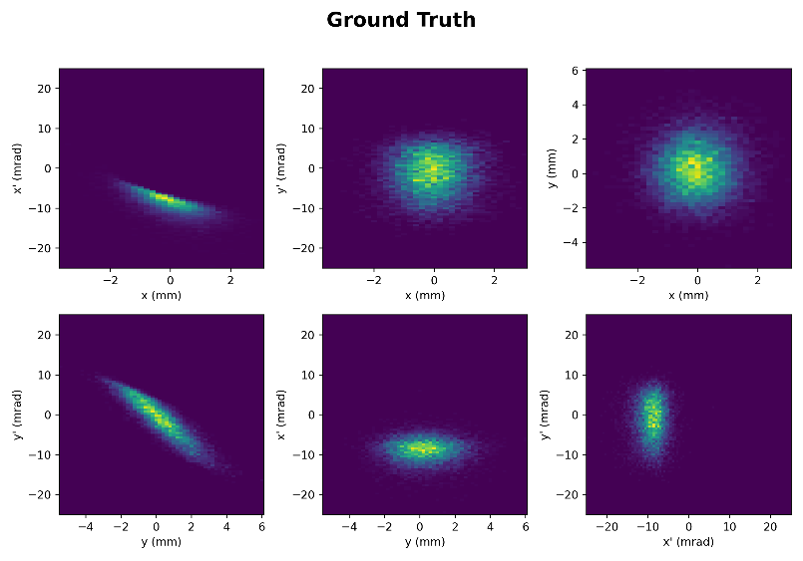
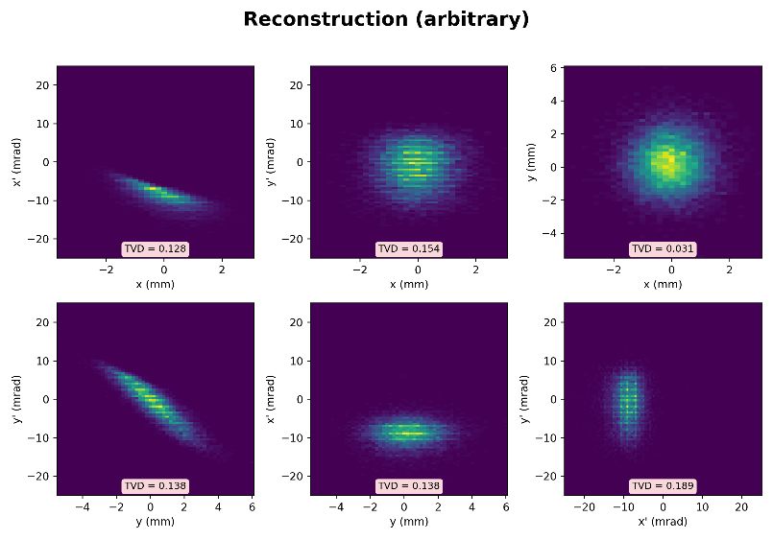

Reconstruction Result 1
- Non coupling, Non space charge -
• $Continuous scan(slit :0.2mm)$
8

Slide 9
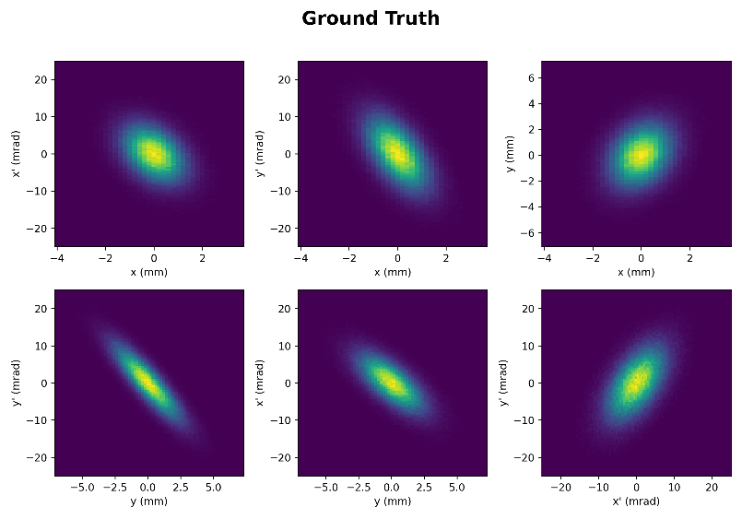
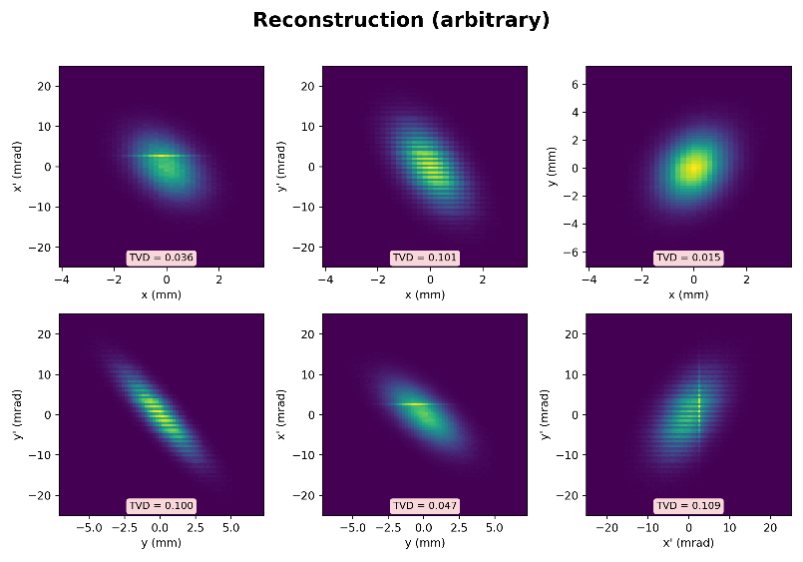
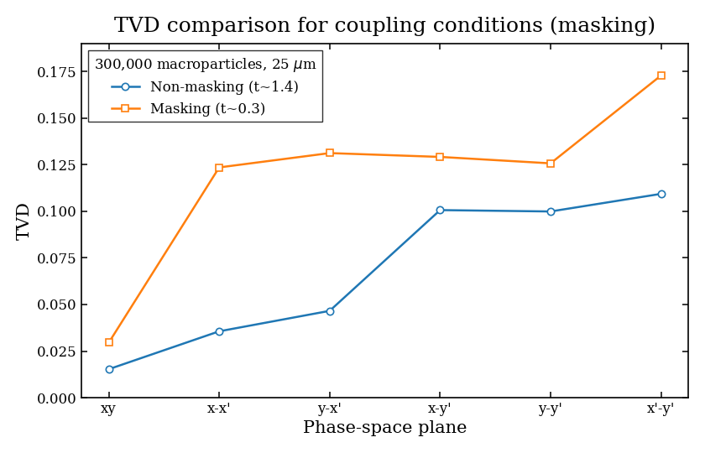
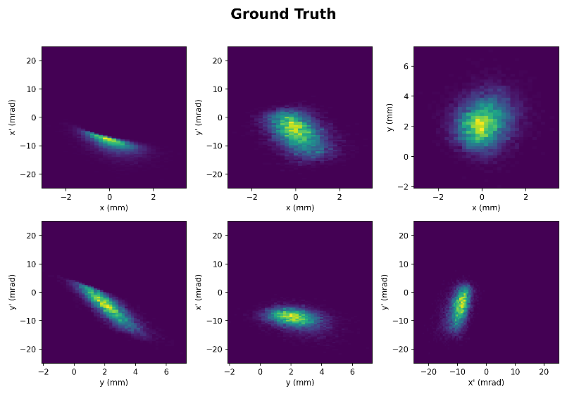
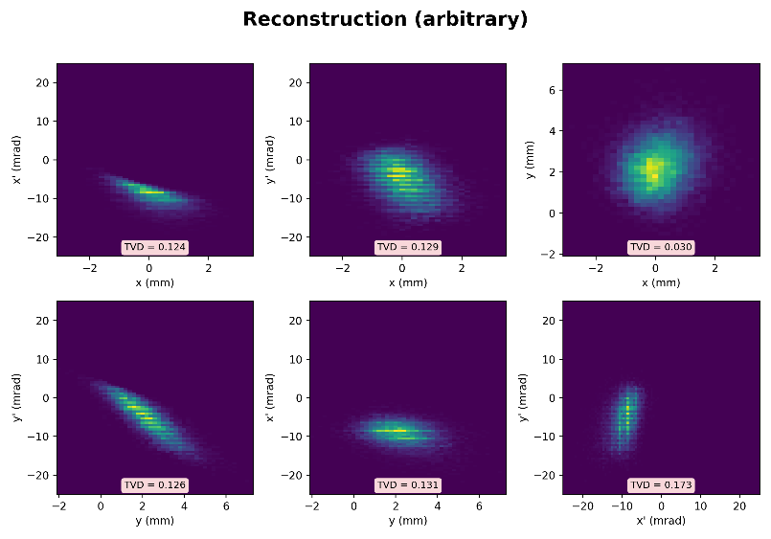
Reconstruction Result 2-1
- Non space charge(bunch component adjustment) -
• $Continuous scan(slit :0.2mm)$
9

Slide 10
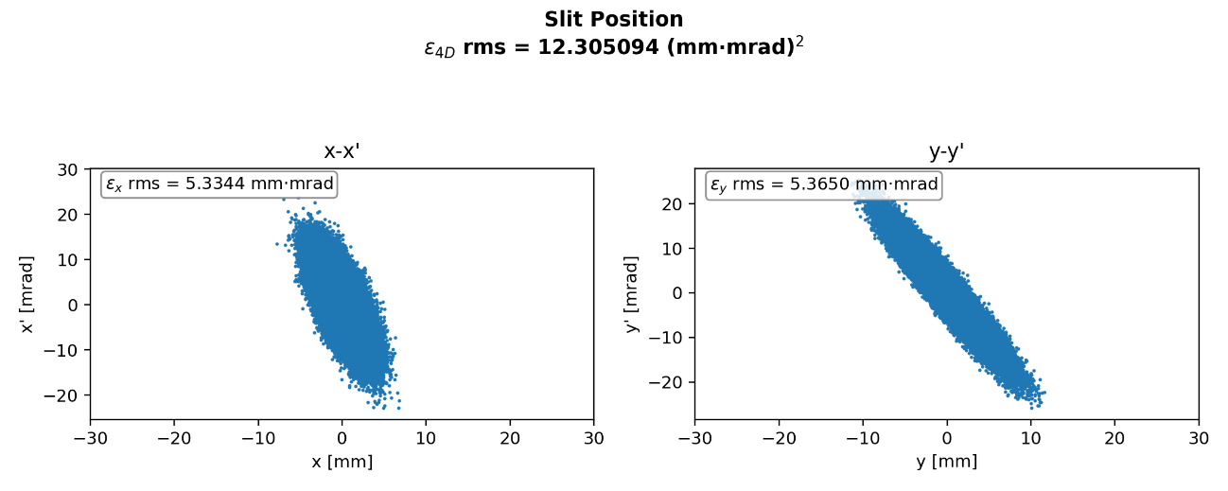
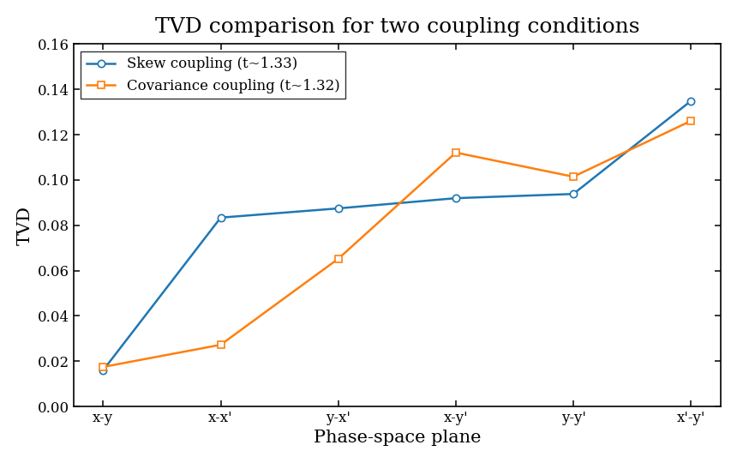
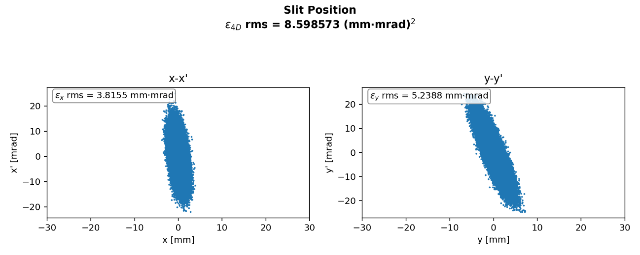


Reconstruction Result 2-2
- Non space charge(skew quadrupole) -
• $Problem !$
$⇒$ Beam Size at slit position !
10

Slide 11
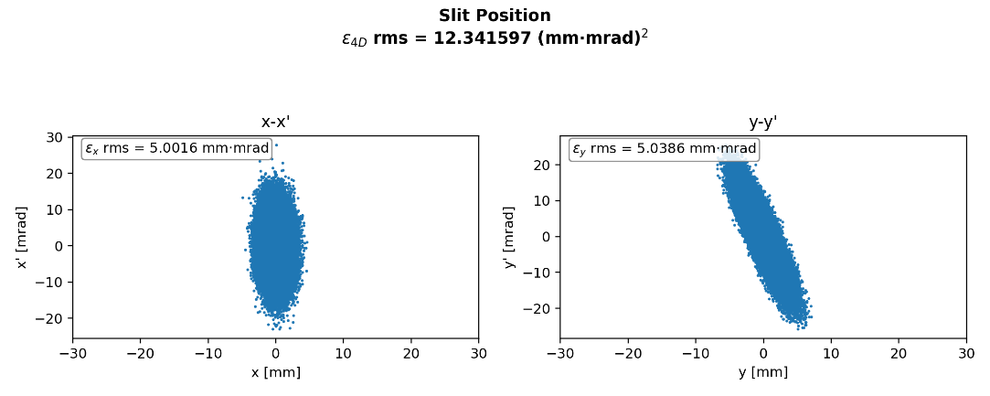
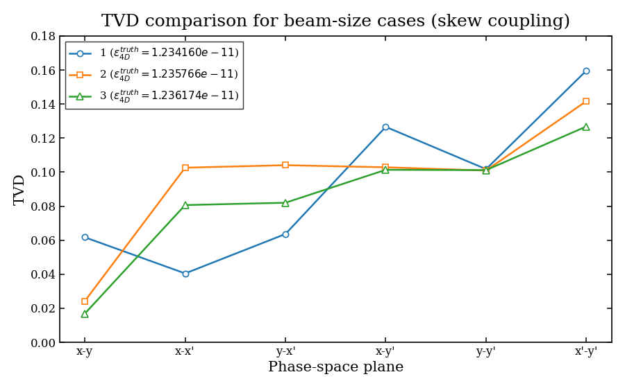
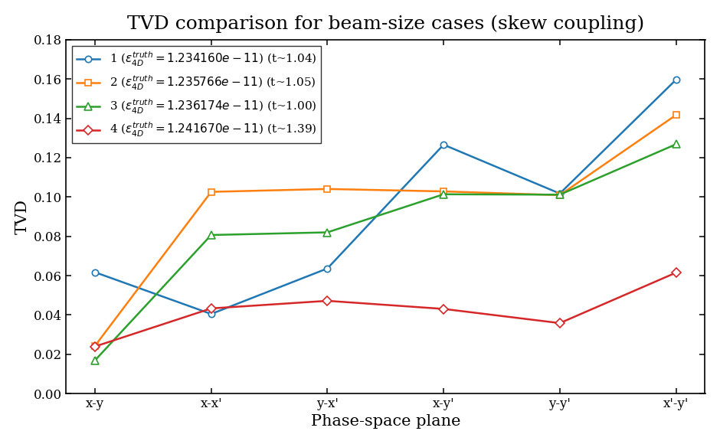
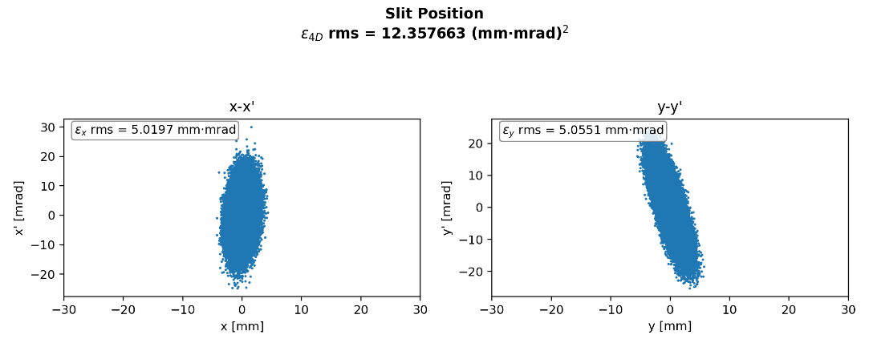
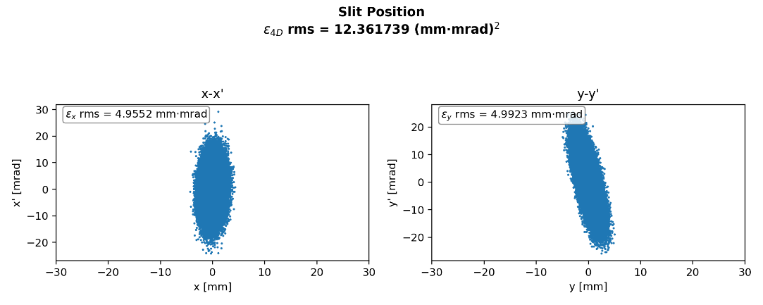






Optimize Beam Size
- At slit position -
• $resoluotion :50μm$
$$σ_{x}=0.96mm$$
$$σ_{y}=0.83mm$$
$$σ_{x}=0.55mm$$
$$σ_{y}=0.62mm$$
$$σ_{x}=0.48mm$$
$$σ_{y}=0.44mm$$
$$σ_{x}=0.48mm$$
$$σ_{y}=0.54mm$$
$⇒$ optimize QD conditions !
11

Slide 12
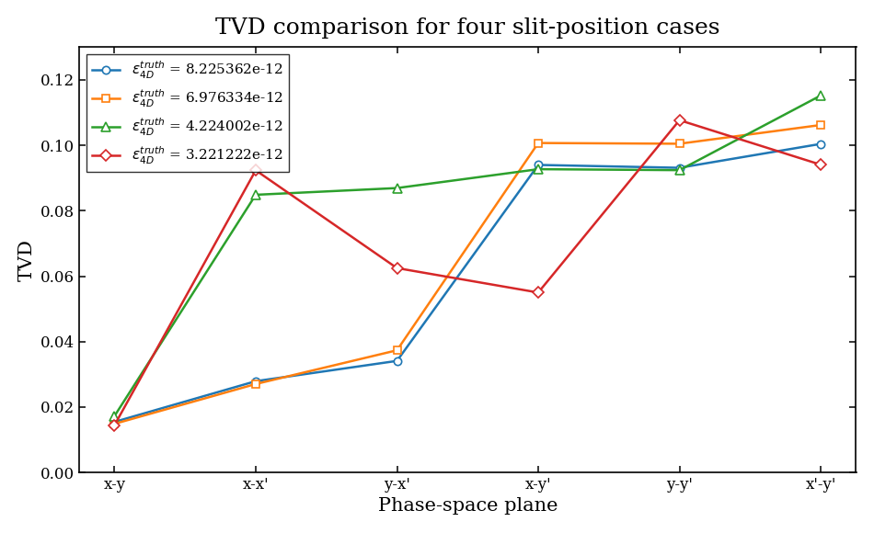
Reconstruction Result 3
- All effect on -
When space-charge effects are present, accurate beta functions at the slit position are not available, preventing reliable optimization of the QD settings.
12

Slide 13
Problem Solution
- About space charge effect -
Our research goal is to address space-charge effects!
Possible solutions :
(1) Machine learning is used to optimize the quadrupole strengths based on intermediate diagnostics data, such as BPM, to generate a round beam.
(2) Additional constraints are introduced by taking data with the slit and screen rotated by 45°.
13

Slide 14
Conclusion
1) The proposed method provides a simpler reconstruction process than VPP and allows direct observation of the beam distribution, including non-Gaussian structures.
2) It also requires less time than the double-slit method. Compared with the conventional double-slit approach, which relies on multiple quadrupole settings, this method achieves satisfactory reconstruction using data from a single quadrupole setting, for the round-beam case.
3) Space-charge effects still limit the reconstruction performance.
Possible solutions :
1. Use intermediate diagnostics data and machine learning to optimize the quadrupole strengths and generate a round beam.
2. Introduce additional constraints by rotating the slit and screen together by 45°.
(This scheme avoids the need for multiple quadrupole settings)
14

Slide 15
Thank you !

