Slide 1
Study of the Virtual Pepper Pot and Preliminary Application of the Differential Slit Method
03. Apr. 2026
Jiyoung Choi
POSTECH

Slide 2
Outline
1. Virtual Pepper Pot (VPP) study
Principle of VPP
Simulation conditions
2. Simulation results with conventional VPP
Large beam case
Small beam case
3. Preliminary application of the Differential Slit Method
Concept of the Differential Slit Method
Reconstruction result
Comparison with conventional VPP
4. Summary and Next steps

Slide 3
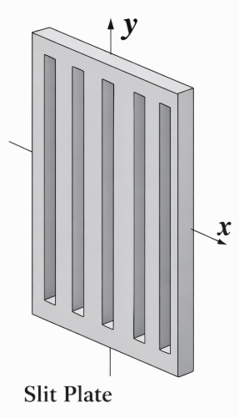
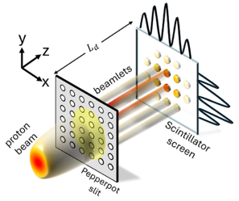
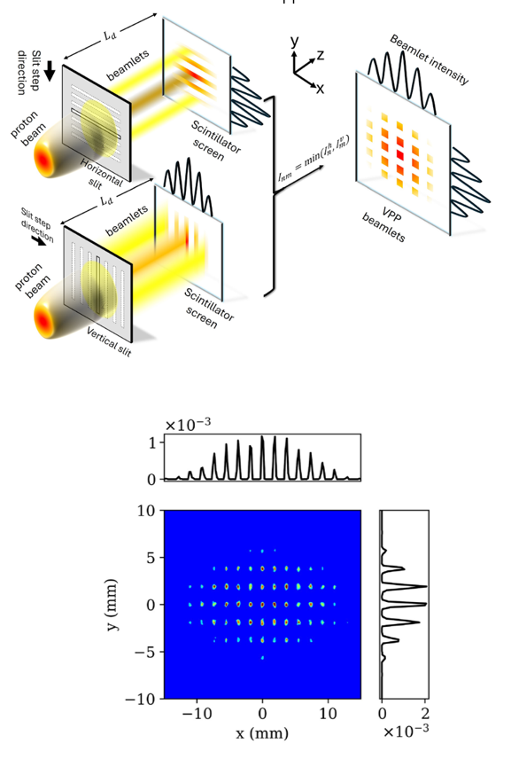
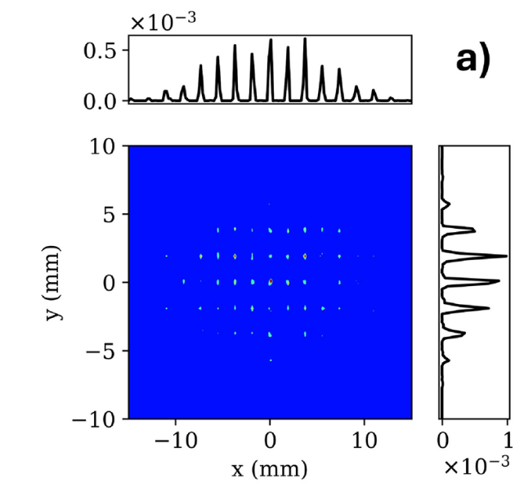
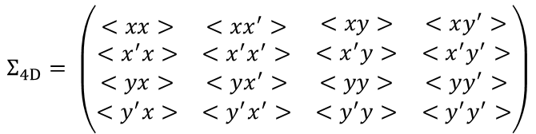

1. Principle of the Virtual Pepper Pot (VPP)
Motivation
Limitation of conventional measurements
Multi slit measurement
Pepper pot measurement
Virtual pepper pot method
2D phase space reconstruction
Full 4D phase space reconstruction
Full 4D phase space reconstruction
Avoids physical Pepper pot limitations
$$Σ_{x}=\left(\begin{matrix}<xx> & <xx^{′}> \\ <x^{′}x> & <x^{′}x^{′}>\end{matrix}\right)$$
Cannot provide coupling information
Resolution-Signal trade-off
$$Σ_{4D}= \left(\begin{matrix}\begin{matrix}<xx> & <xx^{′}> \\ <x^{′}x> & <x^{′}x^{′}>\end{matrix} & \begin{matrix}<xy> & <xy^{′}> \\ <x^{′}y> & <x^{′}y^{′}>\end{matrix} \\ \begin{matrix}<yx> & <yx^{′}> \\ <y^{′}x> & <y^{′}x^{′}>\end{matrix} & \begin{matrix}<yy> & <yy^{′}> \\ <y^{′}y> & <y^{′}y^{′}>\end{matrix}\end{matrix}\right)$$
Dense holes ↔ Beamlet overlap
Small apertures ↔ Reduced signal (Low SNR)

Slide 4
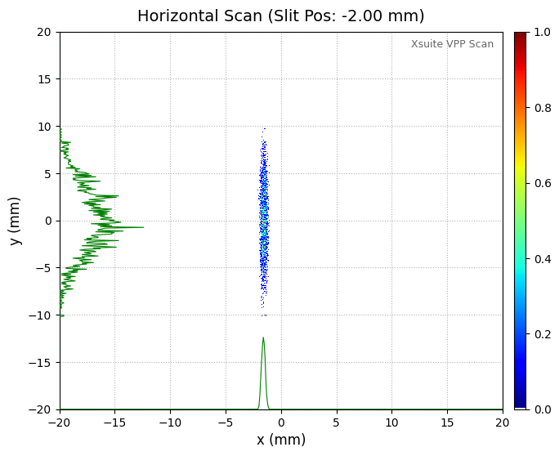
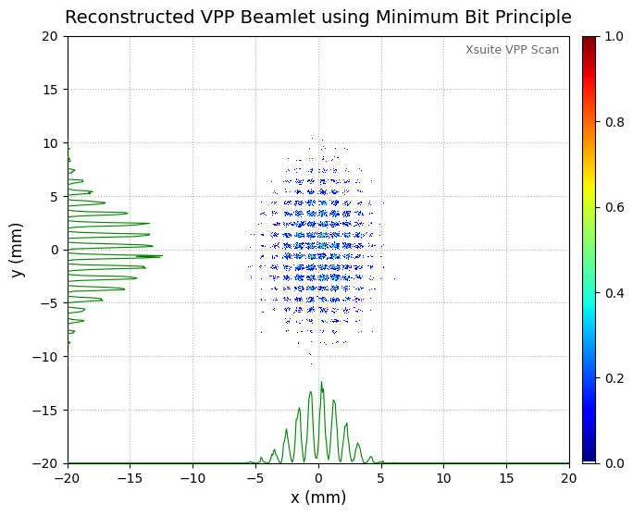
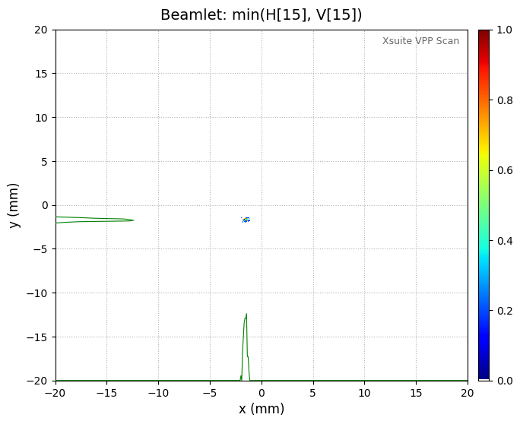
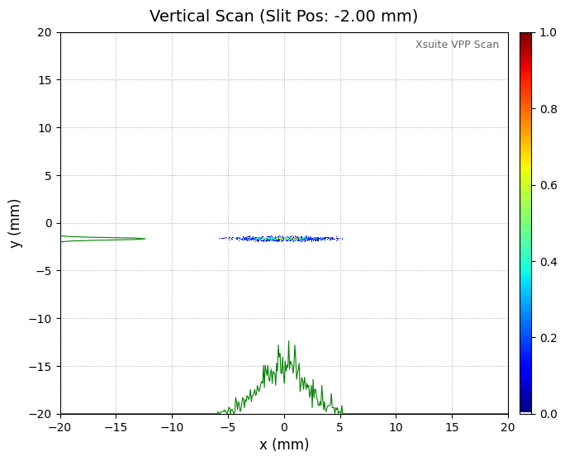
What is the Virtual Pepper-Pot (VPP)?
Full 4D phase space reconstruction
Generate pepper-pot like image using slit scan
Minimum Bit Principle
$$I_{VPP}\left(n,m\right)=\min{(I_{n}^{h}, I_{m}^{v})}$$
Measurement
Analysis
Virtual Pepper Pot
Slit Scan Measurement
Pepper -Pot

Slide 5
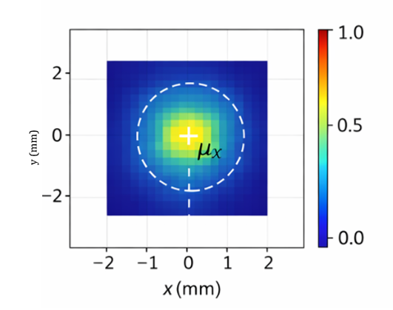
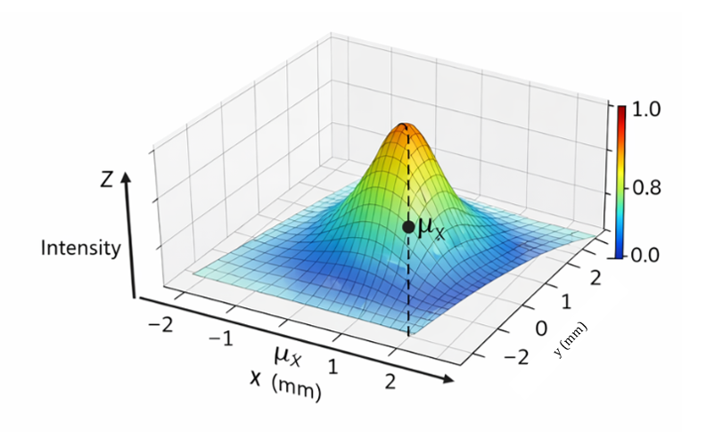
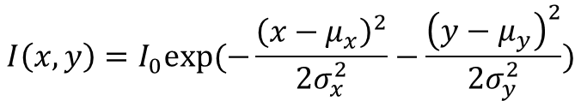




1) VPP Beamlet Image Processing
Minimum Bit Principle
$$I_{VPP}\left(n, m\right)=\min{(I_{n}^{h}, I_{m}^{v})}$$
Pepper Pot
Virtual Pepper Pot
: Beamlets are constructed by selecting the pixel-wise minimum intensity between horizontal and vertical slit scans to avoid overestimation.
2) Reconstruction process
2D Gaussian Fitting of each beamlets
, $μ_{y}$
, $μ_{y}$
$$I\left(x,y\right)=I_{0}exp⁡(−\frac{{\left(x−μ_{x}\right)}^{2}}{2σ_{x}^{2}}−\frac{{\left(y−μ_{y}\right)}^{2}}{2σ_{y}^{2}})$$
$$X_{j}=μ_{x}, Y_{j}=μ_{y}$$
: 2D Gaussian fitting determines the beamlet peak position ${(X}_{j},Y_{j}),$which is used together with slit center $x_{j}$ to compute the divergence $x_{j}^{′}=\frac{X_{j}−x_{j}}{L_{d}}$

Slide 6
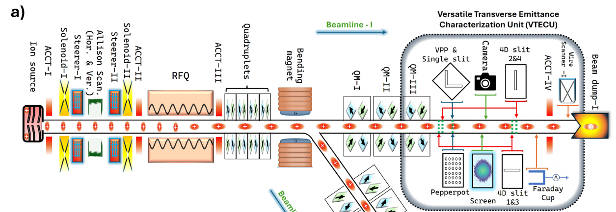
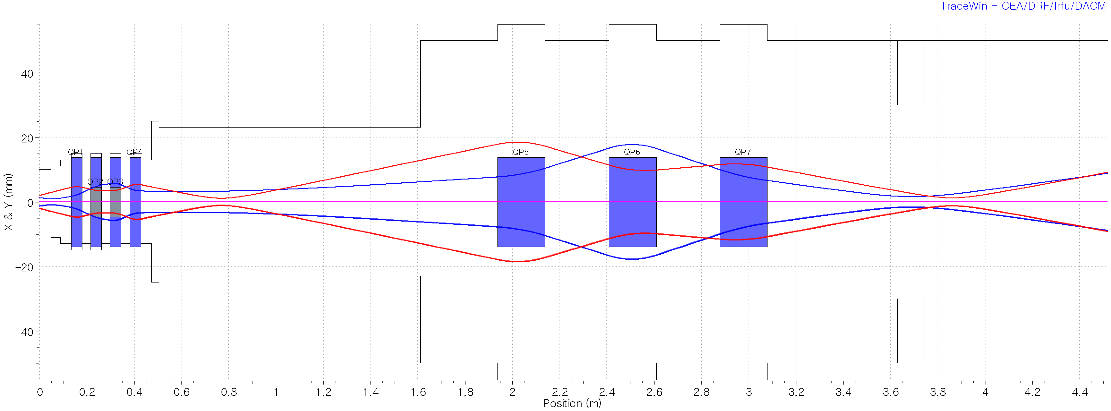
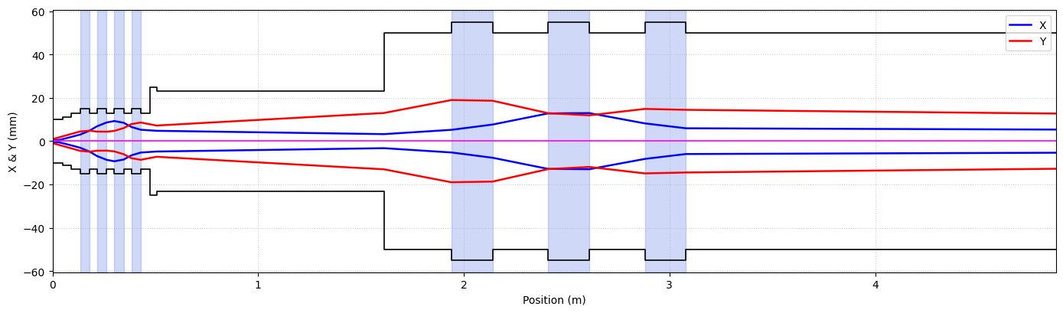

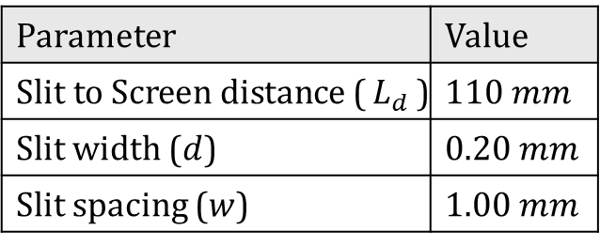


1. Simulation Setup
<KOMAC BTS Layout>
Parameter | Value
Slit to Screen distance ($L_{d}$) | $$110 mm$$
Slit width ($d$) | $$0.20 mm$$
Slit spacing ($w$) | $$1.00 mm$$
Slit
$$d$$
$$w$$
Slit moving
$$L_{d}$$
Slit
Screen

Slide 7
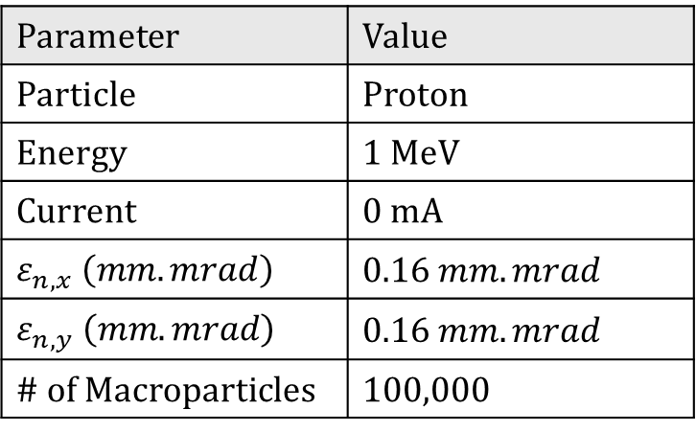
Input Beam (After RFQ)
Parameter | Value
Particle | Proton
Energy | 1 MeV
Current | 0 mA
$$ε_{n, x} \left(mm.mrad\right)$$ | $$0.16 mm.mrad$$
$$ε_{n, y} \left(mm.mrad\right)$$ | $$0.16 mm.mrad$$
# of Macroparticles | 100,000
Baseline verification with an uncoupled beam
Space Charge effect excluded
No x-y coupling in the input beam
Used to verify the basic VPP reconstruction procedure before extension to coupled beam case

Slide 8
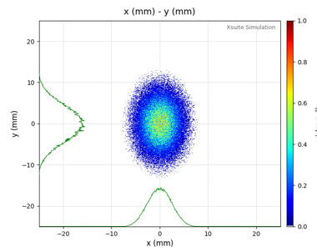
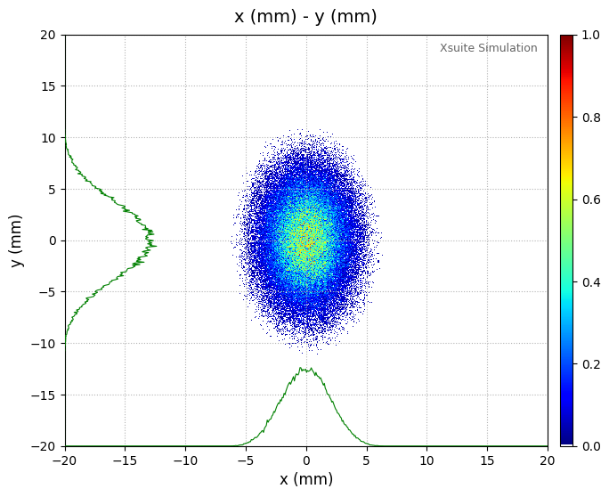
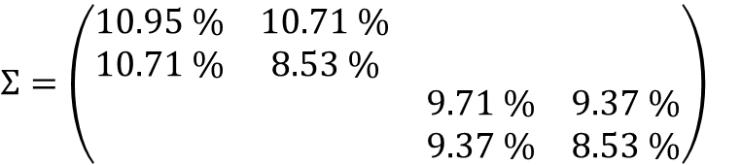
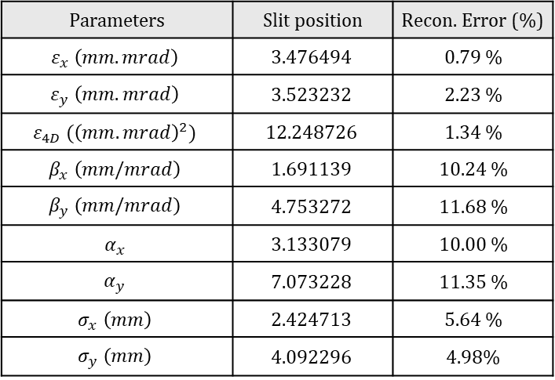
2. Conventional VPP Results
Large Beam Case
GT (Slit)
GT (Screen)
Parameters | Slit position | Recon. Error (%)
$$ε_{x} \left(mm.mrad\right)$$ | $$3.476494$$ | 0.79 %
$$ε_{y} \left(mm.mrad\right)$$ | $$3.523232$$ | 2.23 %
$$ε_{4D} ({\left(mm.mrad\right)}^{2})$$ | $$12.248726$$ | 1.34 %
$$β_{x} \left(mm/mrad\right)$$ | $$1.691139$$ | 10.24 %
$$β_{y} \left(mm/mrad\right)$$ | $$4.753272$$ | 11.68 %
$$α_{x}$$ | $$3.133079$$ | 10.00 %
$$α_{y}$$ | $$7.073228$$ | 11.35 %
$$σ_{x} \left(mm\right)$$ | $$2.424713$$ | 5.64 %
$$σ_{y} \left(mm\right)$$ | $$4.092296$$ | 4.98%
$$Σ=\left(\begin{matrix}\begin{matrix}10.95 \% & 10.71 \% \\ 10.71 \% & 8.53 \%\end{matrix} & \begin{matrix} & \\ & \end{matrix} \\ \begin{matrix} & \\ & \end{matrix} & \begin{matrix}9.71 \% & 9.37 \% \\ 9.37 \% & 8.53 \%\end{matrix}\end{matrix}\right)$$

Slide 9
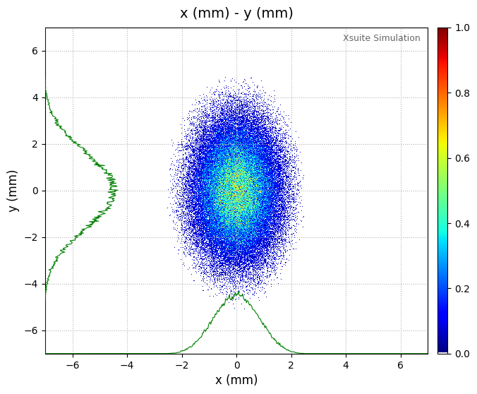
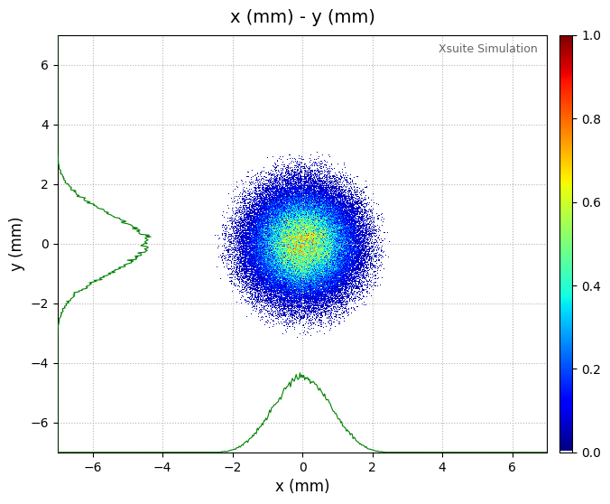
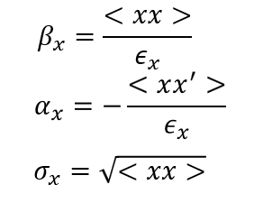
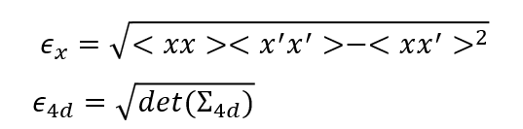
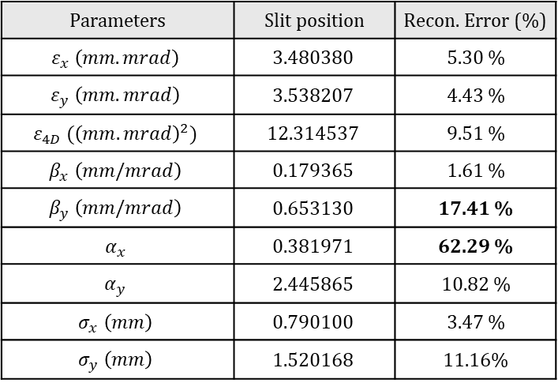
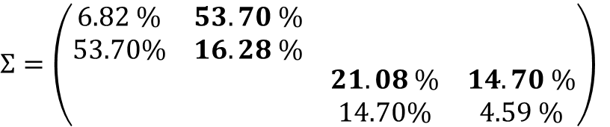
2. Conventional VPP Results
Small Beam Case
GT (Slit)
GT (Screen)
Parameters | Slit position | Recon. Error (%)
$$ε_{x} \left(mm.mrad\right)$$ | $$3.480380$$ | 5.30 %
$$ε_{y} \left(mm.mrad\right)$$ | $$3.538207$$ | 4.43 %
$$ε_{4D} ({\left(mm.mrad\right)}^{2})$$ | $$12.314537$$ | 9.51 %
$$β_{x} \left(mm/mrad\right)$$ | $$0.179365$$ | 1.61 %
$$β_{y} \left(mm/mrad\right)$$ | $$0.653130$$ | 17.41 %
$$α_{x}$$ | $$0.381971$$ | 62.29 %
$$α_{y}$$ | $$2.445865$$ | 10.82 %
$$σ_{x} \left(mm\right)$$ | $$0.790100$$ | 3.47 %
$$σ_{y} \left(mm\right)$$ | $$1.520168$$ | 11.16%
$$Σ=\left(\begin{matrix}\begin{matrix}6.82 \% & 53.70 \% \\ 53.70\% & 16.28 \%\end{matrix} & \begin{matrix} & \\ & \end{matrix} \\ \begin{matrix} & \\ & \end{matrix} & \begin{matrix}21.08 \% & 14.70 \% \\ 14.70\% & 4.59 \%\end{matrix}\end{matrix}\right)$$

Slide 10
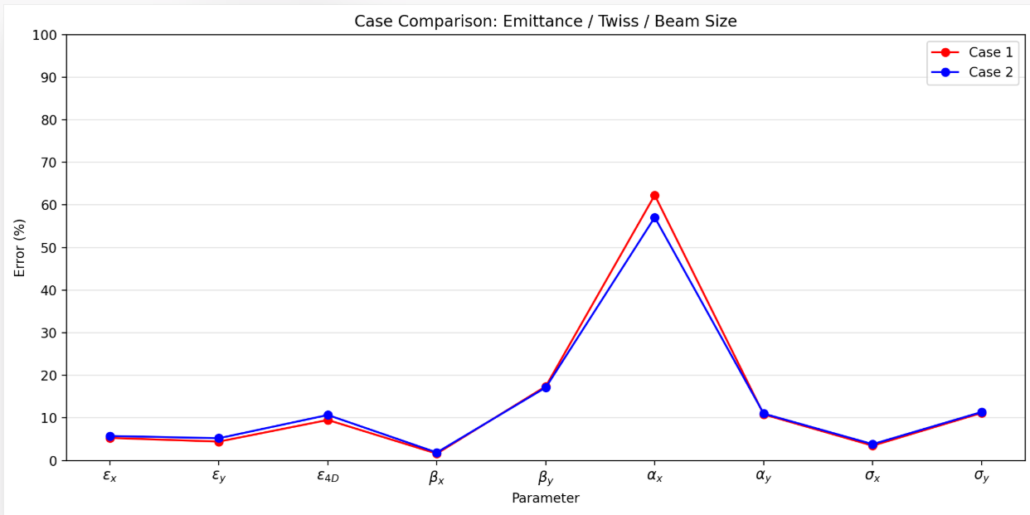
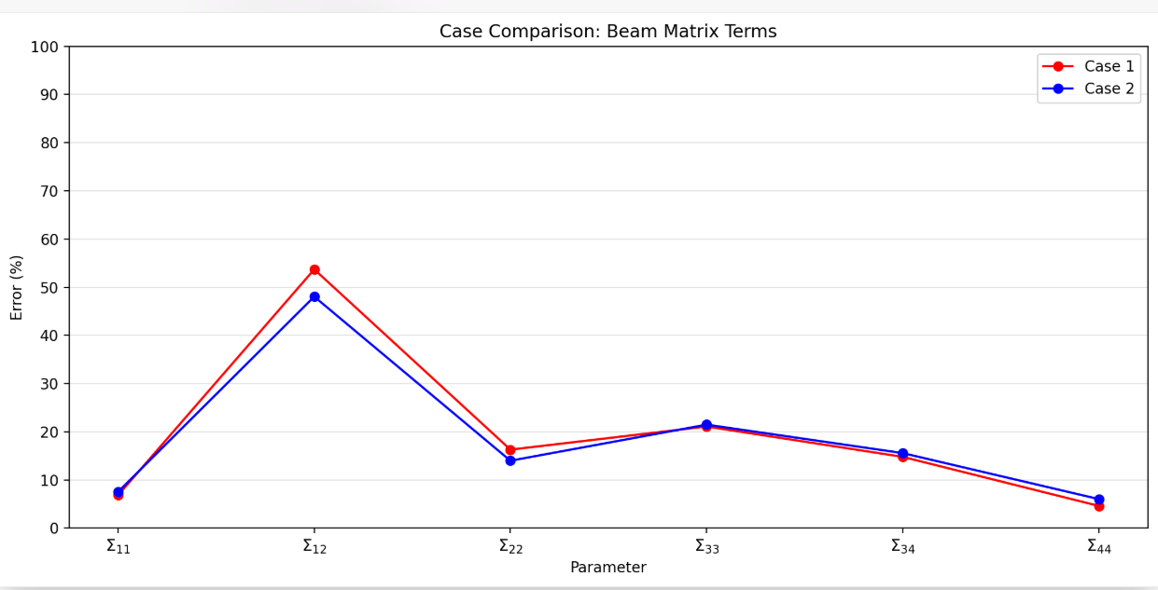
w
Virtual Pepper Pot의 screen data는 개별적으로 저장되므로 Beamlet의overlapping이 없음.
Case 1: Slit scan distance w = 1mm
Case 2: Slit scan distance w = 0mm
Beamlet 33 (4*9)
Beamlet 1008 (25*55)
1st
2nd

Slide 11
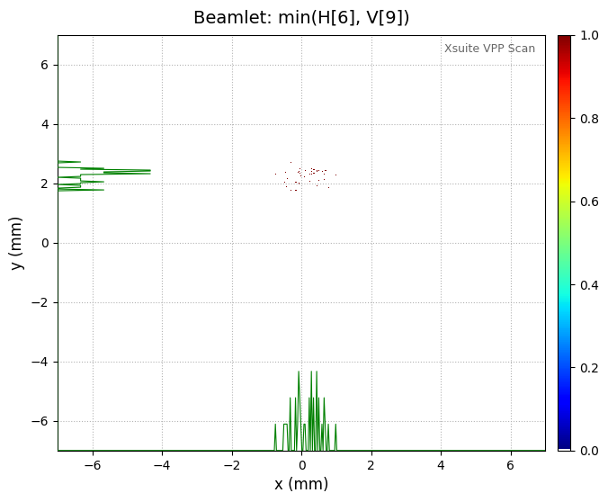
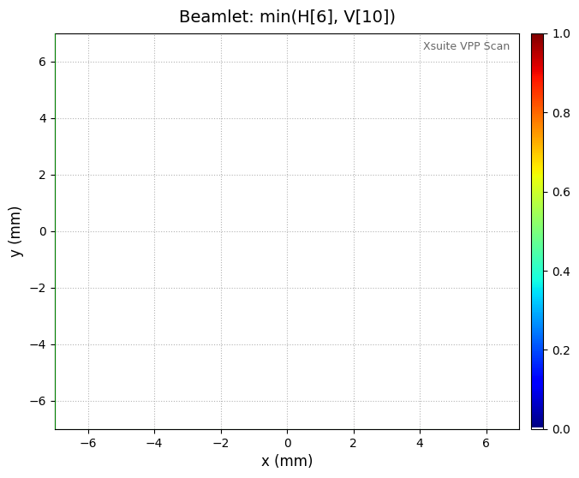
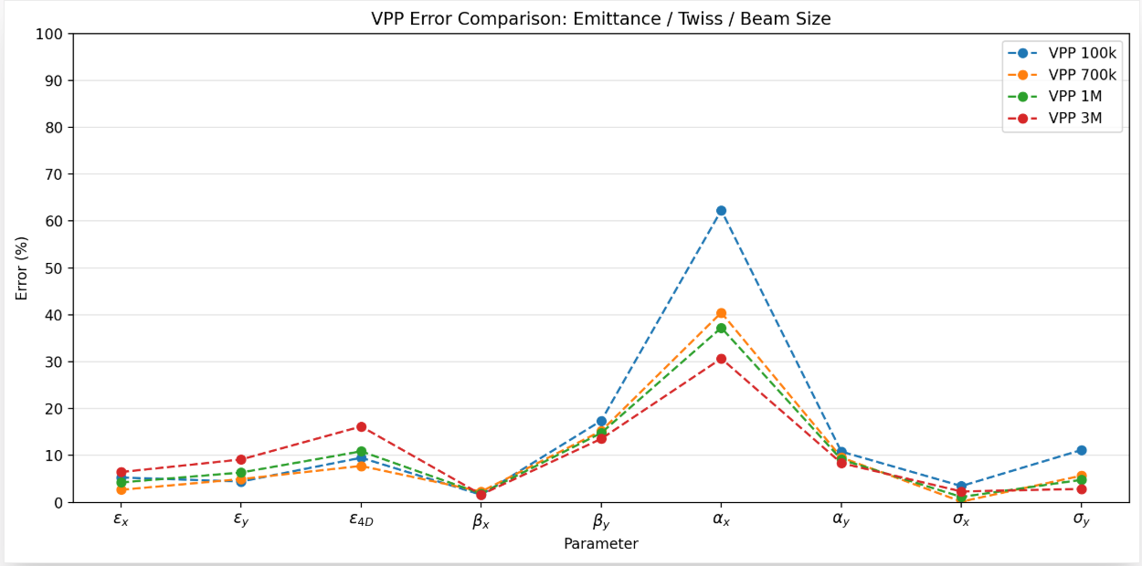
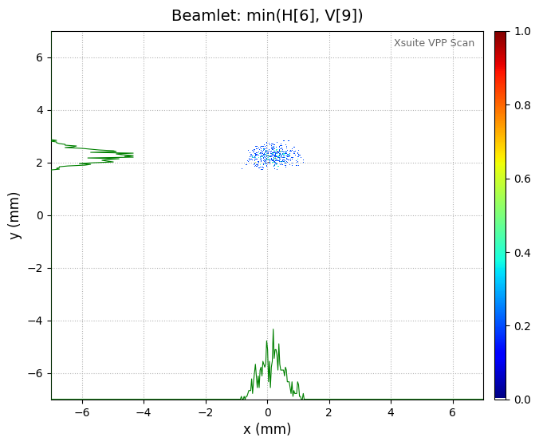
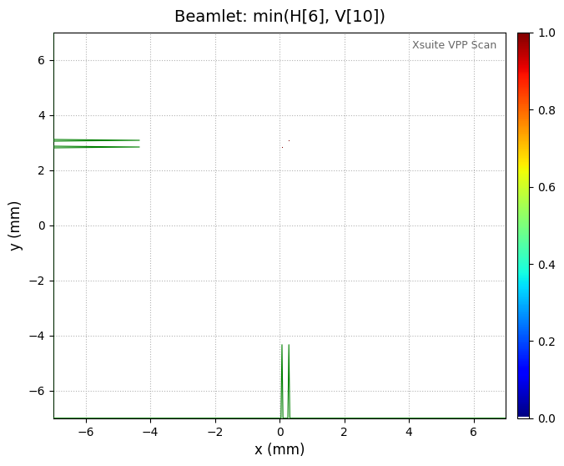
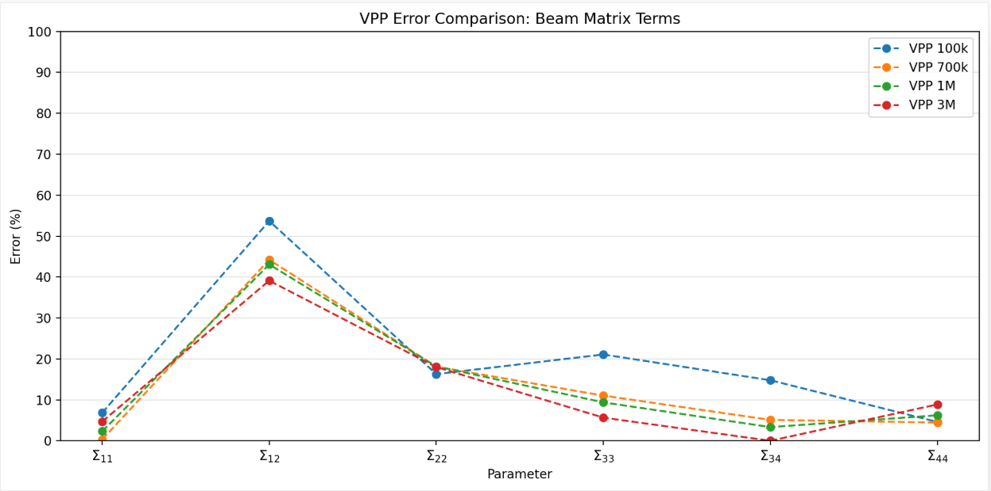
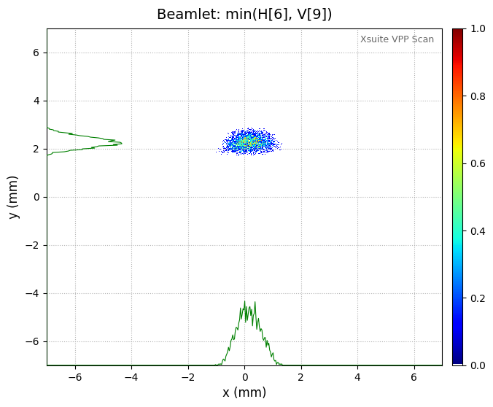
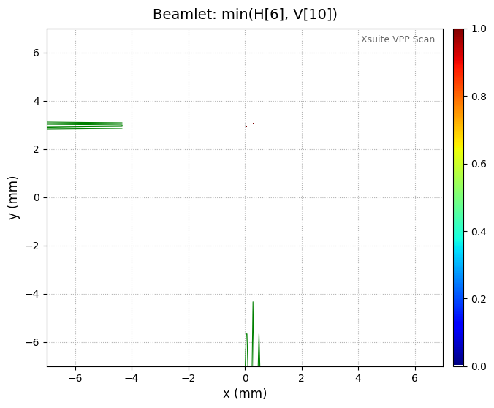
Case 1+: Slit scan distance w = 1mm | Change the # of Macroparticles
100k
700k
3M

Slide 12
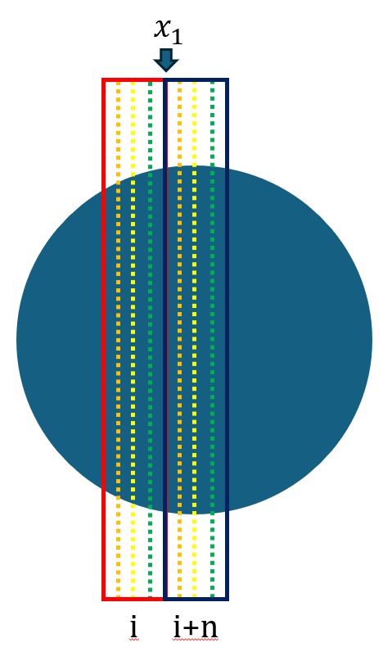












3. Differential Virtual Pepper Pot (DVPP)
What is the Differential Slit Method?
Slit
Limitation of Conventional VPP
Slit width에 의한 uncertainty 존재
$$d$$
$$(x_{j},y_{j})$$
$$w$$
$$2^{nd}$$
$$3^{rd}$$
$$1^{st}$$
$$4^{th}$$
i번째 scan data랑 i+n번째 scan data에 대한 minimum bit principle
$$x_{1}$$
scan
diff. process
diff. data
vpp. process
beamlet
$$x_{1}$$
$$x_{1}$$
$$y_{1}$$
$$(x_{1},y_{1})$$

Slide 13
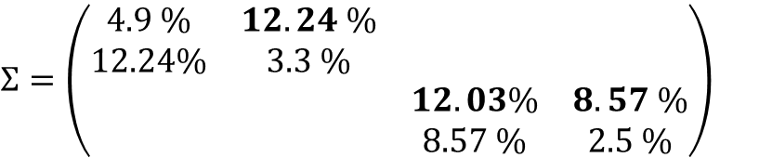
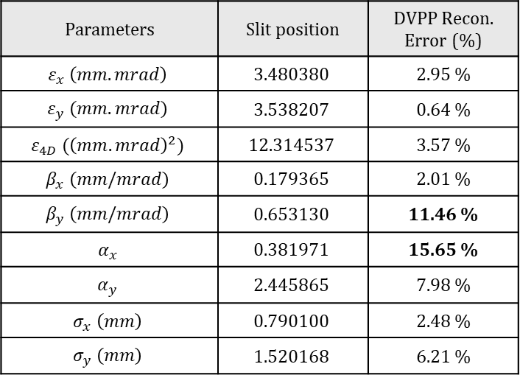
3. Results of DVPP
# of Macroparticles : 3M
Parameters | Slit position | DVPP Recon. Error (%)
$$ε_{x} \left(mm.mrad\right)$$ | $$3.480380$$ | 2.95 %
$$ε_{y} \left(mm.mrad\right)$$ | $$3.538207$$ | 0.64 %
$$ε_{4D} ({\left(mm.mrad\right)}^{2})$$ | $$12.314537$$ | 3.57 %
$$β_{x} \left(mm/mrad\right)$$ | $$0.179365$$ | 2.01 %
$$β_{y} \left(mm/mrad\right)$$ | $$0.653130$$ | 11.46 %
$$α_{x}$$ | $$0.381971$$ | 15.65 %
$$α_{y}$$ | $$2.445865$$ | 7.98 %
$$σ_{x} \left(mm\right)$$ | $$0.790100$$ | 2.48 %
$$σ_{y} \left(mm\right)$$ | $$1.520168$$ | 6.21 %
$$Σ=\left(\begin{matrix}\begin{matrix}4.9 \% & 12.24 \% \\ 12.24\% & 3.3 \%\end{matrix} & \begin{matrix} & \\ & \end{matrix} \\ \begin{matrix} & \\ & \end{matrix} & \begin{matrix}12.03\% & 8.57 \% \\ 8.57 \% & 2.5 \%\end{matrix}\end{matrix}\right)$$
DVPP는 2번의 minimum bit principle 과정을 거치기 때문에 더 많은 particle 수가 요구됨.

Slide 14
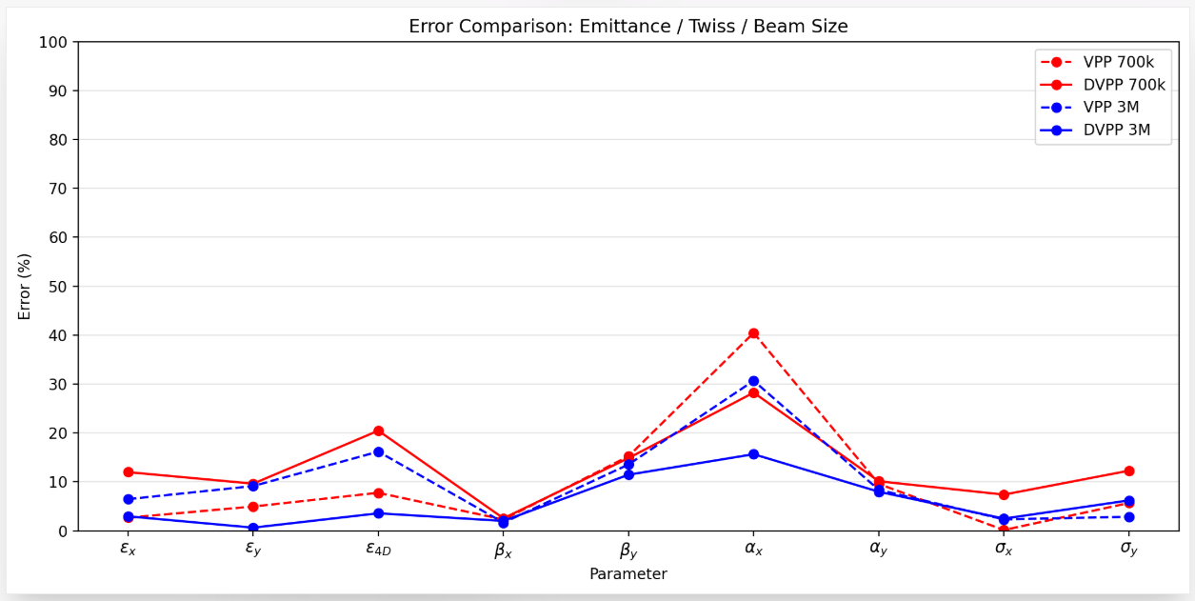
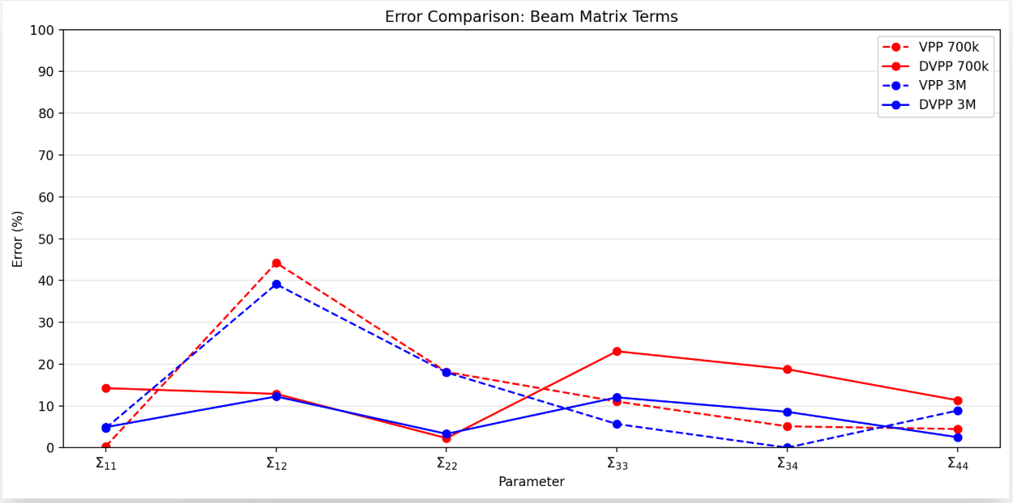
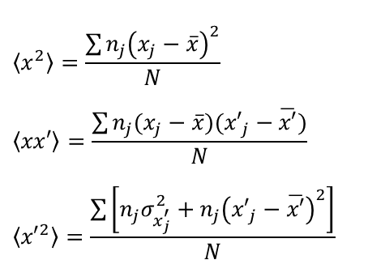
3. Compare with VPP
Two Way of Data Analysis for VPP & DVPP
Gaussian Fitting of Each Beamlets
Gaussian Fitting of Recon. Data
$$\left\langle x^{2}\right\rangle =\frac{\sum{n_{j}{\left(x_{j}−\overline{x}\right)}^{2}}}{N}$$
$$\left\langle xx′\right\rangle =\frac{\sum{n_{j}(x_{j}−\overline{x})({x′}_{j}−\overline{x′})}}{N}$$
$$\left\langle {x′}^{2}\right\rangle =\frac{\sum{\left[n_{j}σ_{x_{j}^{′}}^{2}+n_{j}{\left({x′}_{j}−\overline{x′}\right)}^{2}\right]}}{N}$$

Slide 15
4. Summary and Next Step
Summary
Baseline VPP verification was performed under idealized conditions without space charge or x–y coupling.
The conventional VPP method worked reasonably well for the relatively large-beam case.
In the small-beam case, the conventional VPP method showed relatively large errors, especially in divergence-related quantities.
The DVPP method showed improved reconstruction performance for the small-beam case.
Next Step
Further analysis is required to understand the simulation results, including the appropriate number of macroparticles and the limitations of the conventional VPP method.
Future studies will include space charge effects and coupled-beam cases.
More realistic DVPP simulations based on eLABs conditions will be carried out.

