Slide 1
Capacitive Pick-up Type Beam Shape monitor
2026. 03. 27 –
나창선

Slide 2
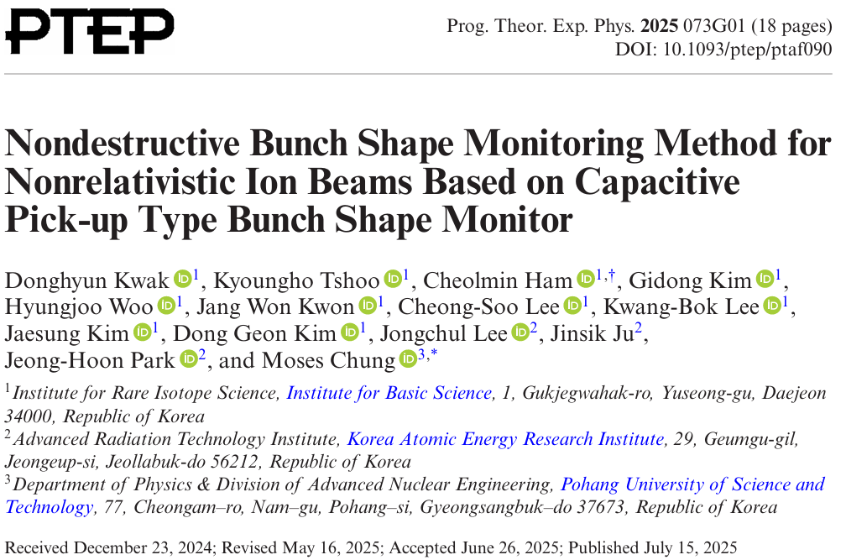

Slide 3
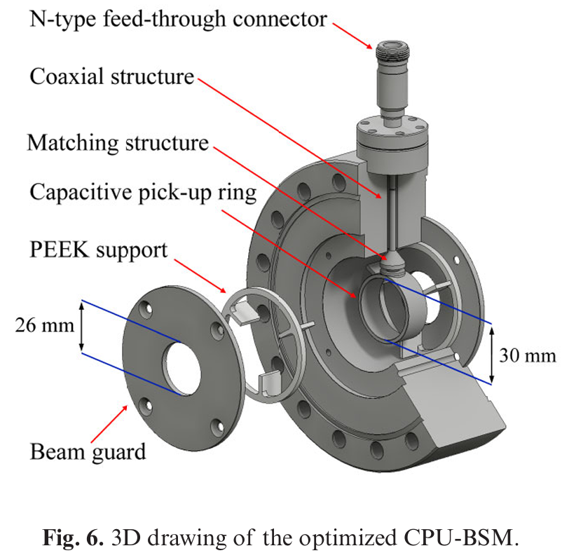
Capacitive Pick-up Type Beam Shape monitor (CPU-BSM)
A diagnostic device for measuring the longitudinal bunch shape of ion beams
The bunch shape is inferred from the induced signal measured by a capacitive pick-up
Non-destructive measurement
Simple structure and easy installation

Slide 4
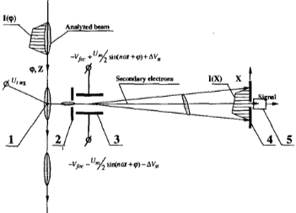
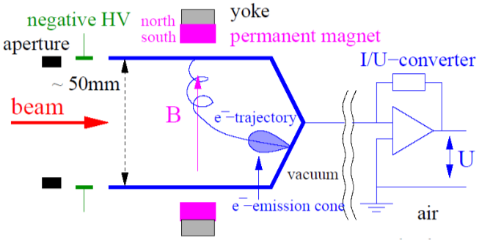
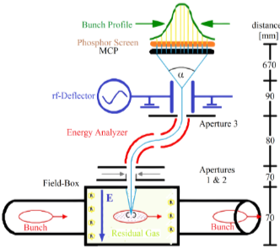
Conventional Bunch Shape Measurement Methods
A. Feschenko’s BSM (wire type)
Fast Faraday Cup
Feschenko, Bunch Shape Measurements, PAC 2001
특론: 빔진단, 고주파 및 초전도 기술
Measures the longitudinal bunch shape using secondary electrons emitted from a wire target.
Direct measurement of the beam current using a conductive cup. (destructive method)
Residual Gas BSM
Measures the bunch shape using secondary electrons generated by beam interaction with residual gas.
Zwicker et al., Non-invasive bunch shape monitor IBIC 2013

Slide 5
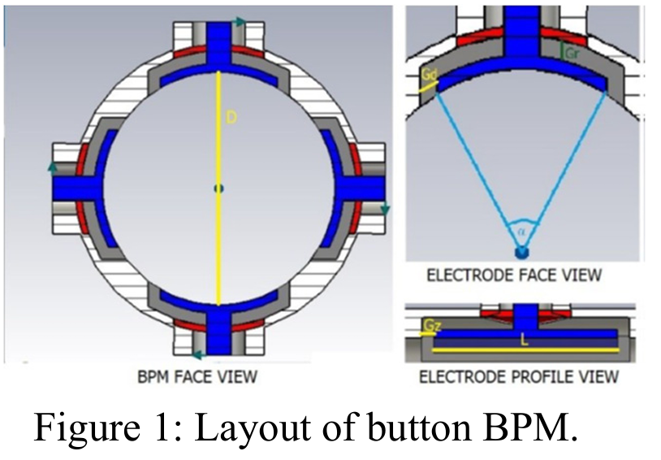
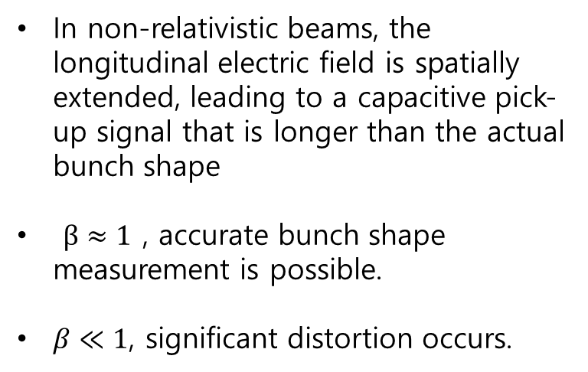
Pick-up Type BPM
In non-relativistic beams, the longitudinal electric field is spatially extended, leading to a capacitive pick-up signal that is longer than the actual bunch shape
$β≈1$ , accurate bunch shape measurement is possible.
$β≪1$, significant distortion occurs.
Abdillah et al., “Bunch measurements with BPM,” IPAC 2022

Slide 6
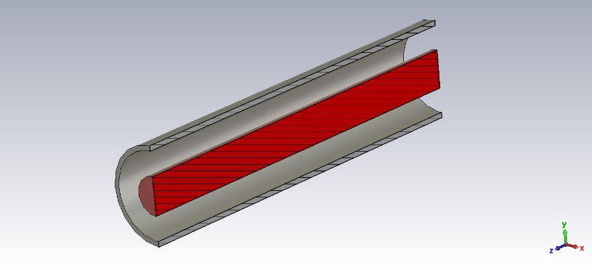
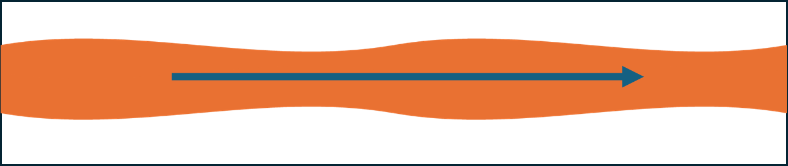
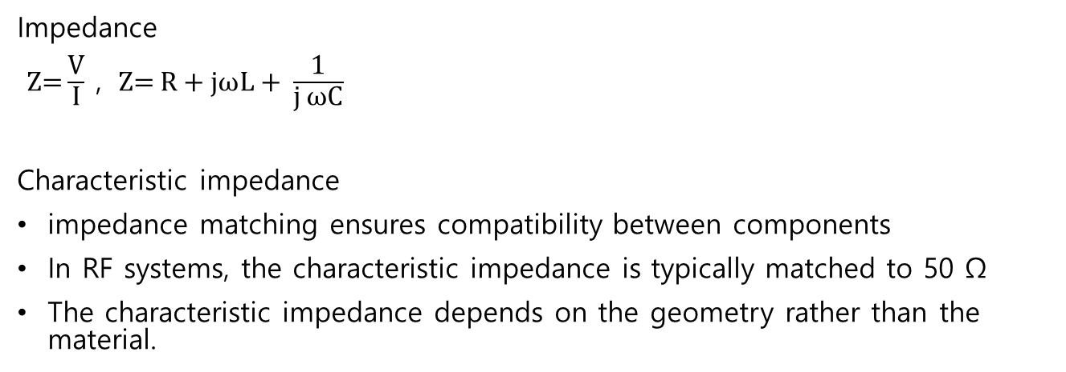
Impedance Matching
Impedance
$\text{Z}\text{=}\frac{\text{V}}{\text{I}}$ , $\text{Z}\text{=} \text{R}\text{ + }\text{jωL}\text{ + }\frac{\text{1}}{\text{j} \text{ωC}}$
Characteristic impedance
impedance matching ensures compatibility between components
In RF systems, the characteristic impedance is typically matched to 50 Ω
The characteristic impedance depends on the geometry rather than the material.

Slide 7
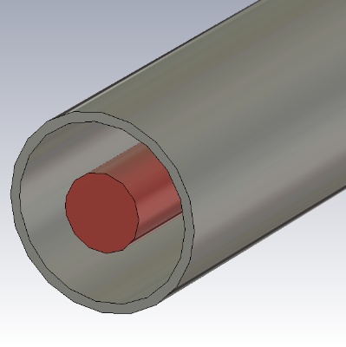
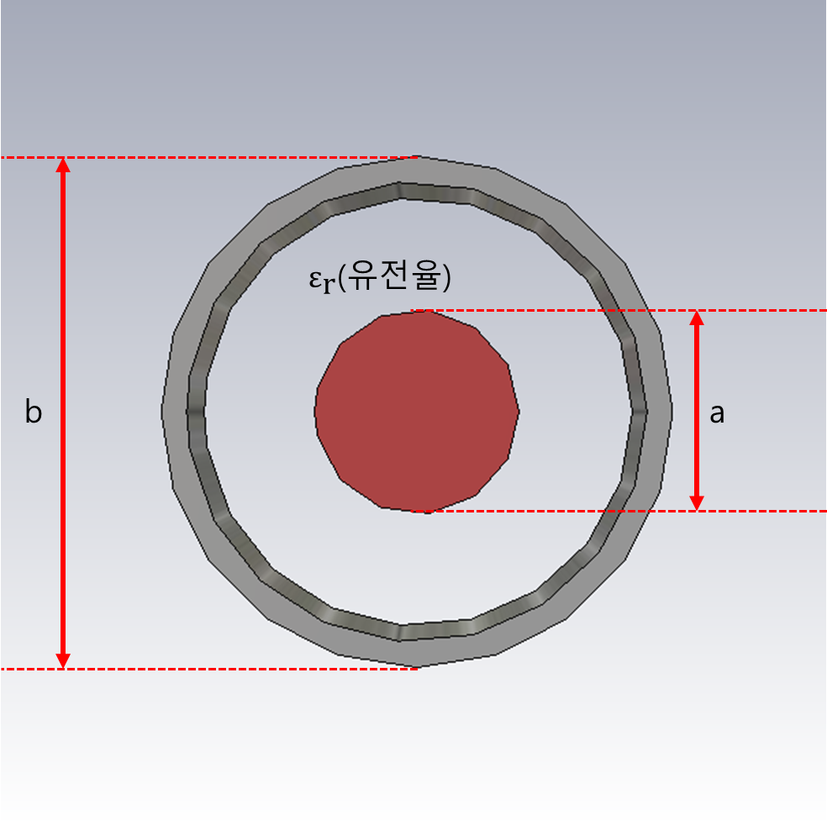
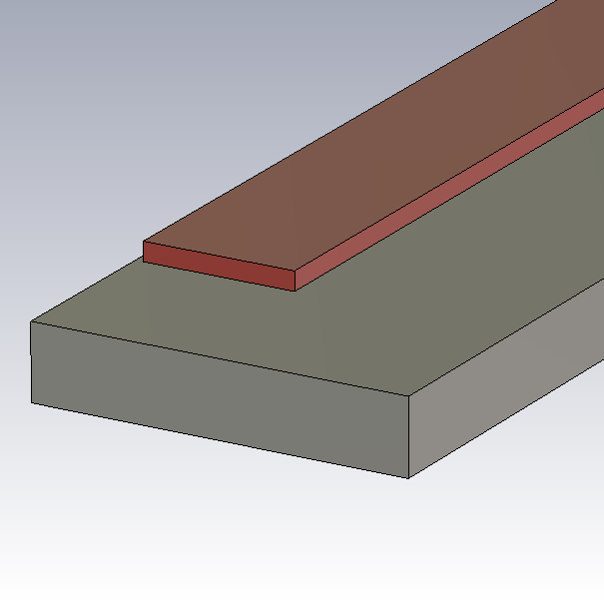
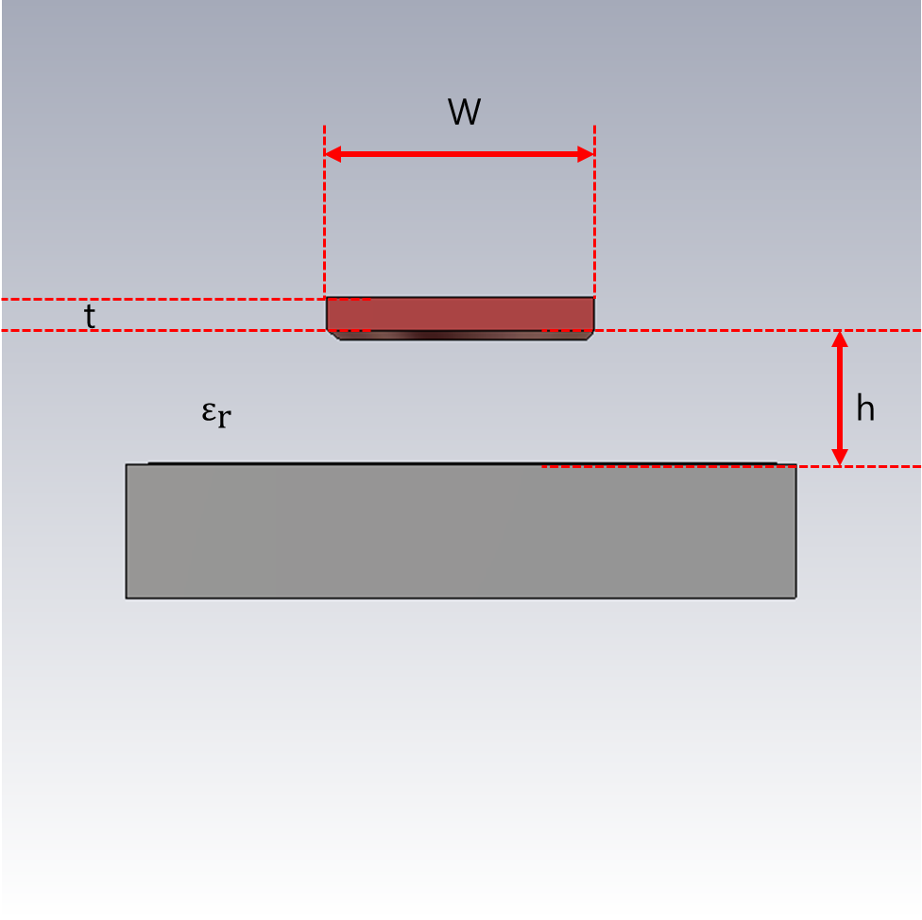
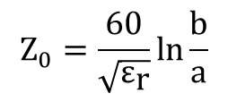
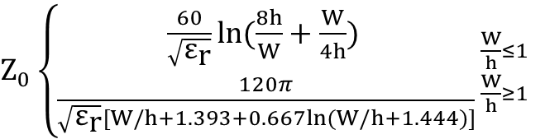
Impedance Matching – Characteristic Impedance
Coax
$$Z_{0}=\frac{60}{\sqrt{{\text{ε}}_{\text{r}}}}ln\frac{b}{a}$$
Microstrip
$Z_{0}\left\{\begin{aligned}\frac{60}{\sqrt{{\text{ε}}_{\text{r}}}}ln(\frac{8h}{W}+\frac{W}{4h}) \\ \frac{120π}{\sqrt{{\text{ε}}_{\text{r}}}[W/h+1.393+0.667ln(W/h+1.444)]}\end{aligned}{\frac{W}{h}≤1 \atop \frac{W}{h}≥1}\right.$

Slide 8
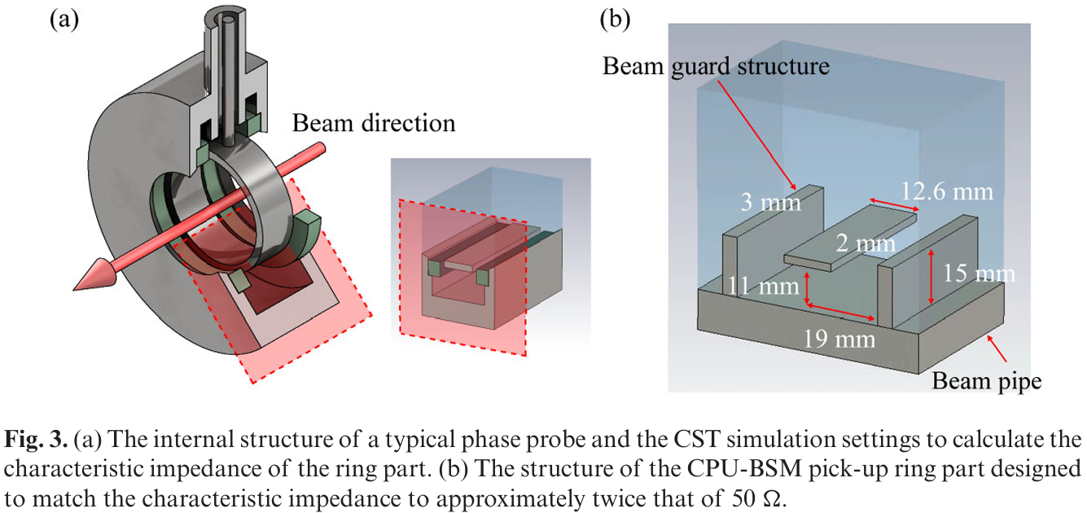
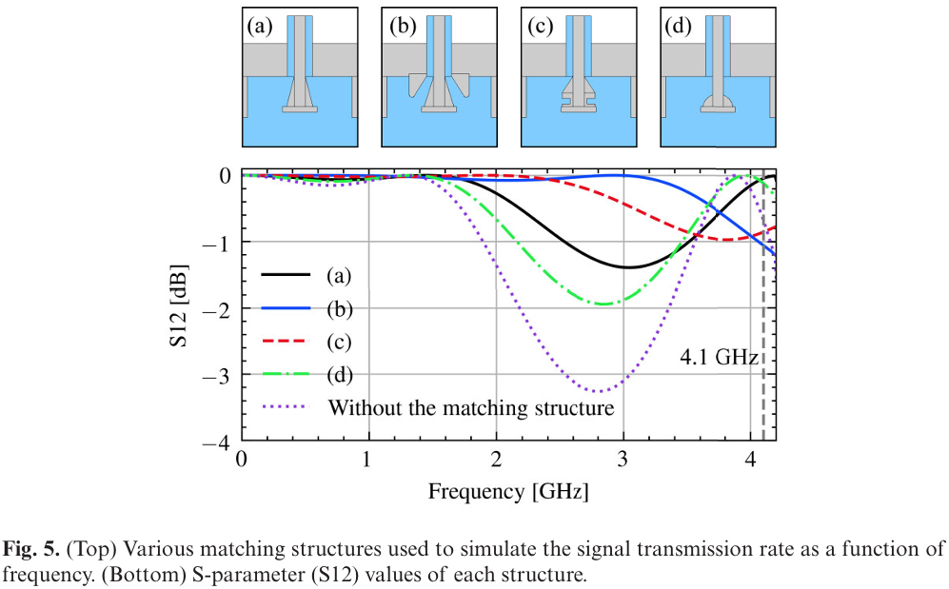

Impedance Matching
Beam guard
Due to the influence of the beam guard, standard microstrip-based impedance calculations cannot be directly applied
Evaluated using CST simulations.
Matching structure
Impedance matching between the pick-up ring and the coaxial structure
S-parameter
$S_{12}$: transmission coefficient between ports

Slide 9
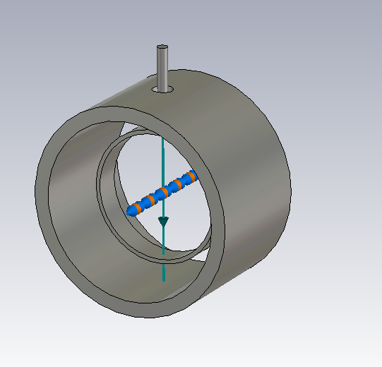
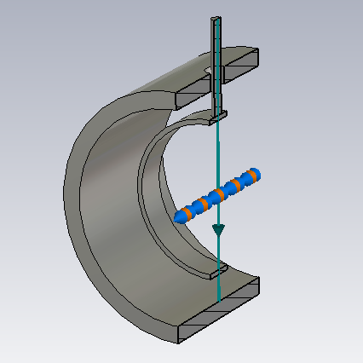
CST Simulation
Simulations were performed using a non-optimized structure.
The beam parameters were set to match those used in the reference study.
For β = 1, the measured signal closely follows the input distribution.
β decreases, the measured signal becomes increasingly broadened compared to the input bunch.

Slide 10
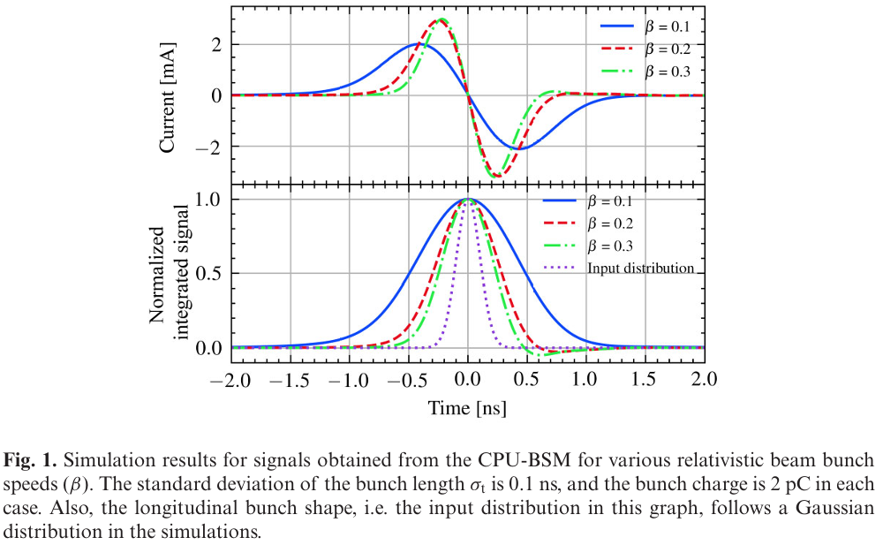
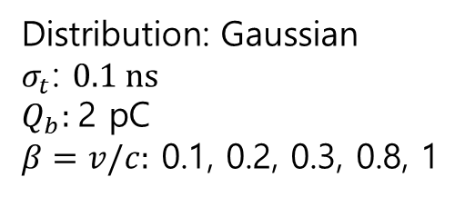
CST Simulation Result
Distribution: Gaussian
$σ_{t}$: $0.1 \text{ns}$
$$Q_{b}\text{: }\text{2 }\text{pC}$$
$β=v/c:$ 0.1, 0.2, 0.3, 0.8, 1
CST 설계 miss

Slide 11
CST Simulation Result

Slide 12
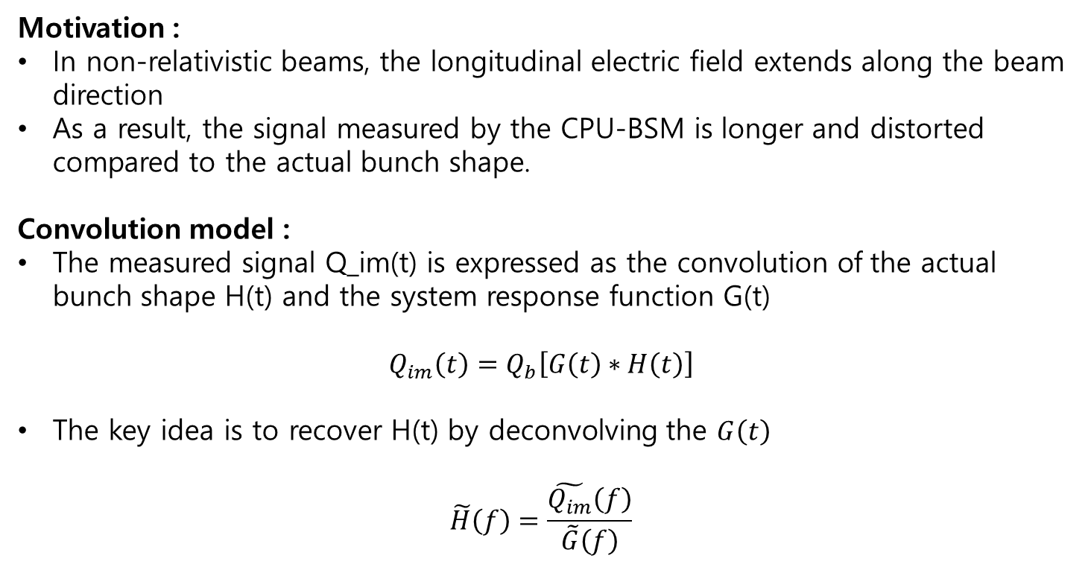
Reconstruction Algorithm
Motivation :
In non-relativistic beams, the longitudinal electric field extends along the beam direction
As a result, the signal measured by the CPU-BSM is longer and distorted compared to the actual bunch shape.
Convolution model :
The measured signal Q_im(t) is expressed as the convolution of the actual bunch shape H(t) and the system response function G(t)
$$Q_{im}\left(t\right)=Q_{b}\left[G\left(t\right)∗H\left(t\right)\right]$$
The key idea is to recover H(t) by deconvolving the $G\left(t\right)$
$$\tilde{H}\left(f\right)=\frac{\tilde{Q_{im}}\left(f\right)}{\tilde{G}\left(f\right)}$$

Slide 13
Summary
A non-destructive diagnostic device is required to measure the longitudinal bunch length of ion beam.
Capacitive pick-up type diagnostics are non-destructive, but the measured signal does not represent the actual bunch shape at low β.
The CPU-BSM improves signal transmission through impedance matching and structural optimization.
A reconstruction algorithm is used to recover the actual bunch shape from the distorted signal.
CST simulation results show the signal distortion and confirm its dependence on β
Future work.
Impedance matching using a coaxial structure (in progress).
Optimization of impedance for a larger-diameter CPU-BSM structure.
reconstruction algorithm for a larger-diameter CPU-BSM structure.

Slide 14
Appendix - CST simulation result

Slide 15
Appendix - CST simulation result

Slide 16
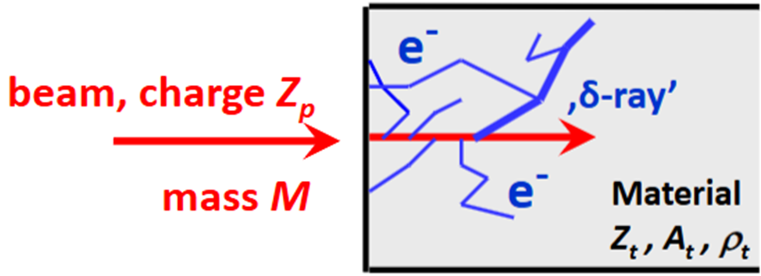
Appendix
Faraday cup
이온이 material에 부딪히면 에너지에 따라 침투 깊이가 달라지고 material에서 나오는 전자의 개수 도 달라짐

Slide 17
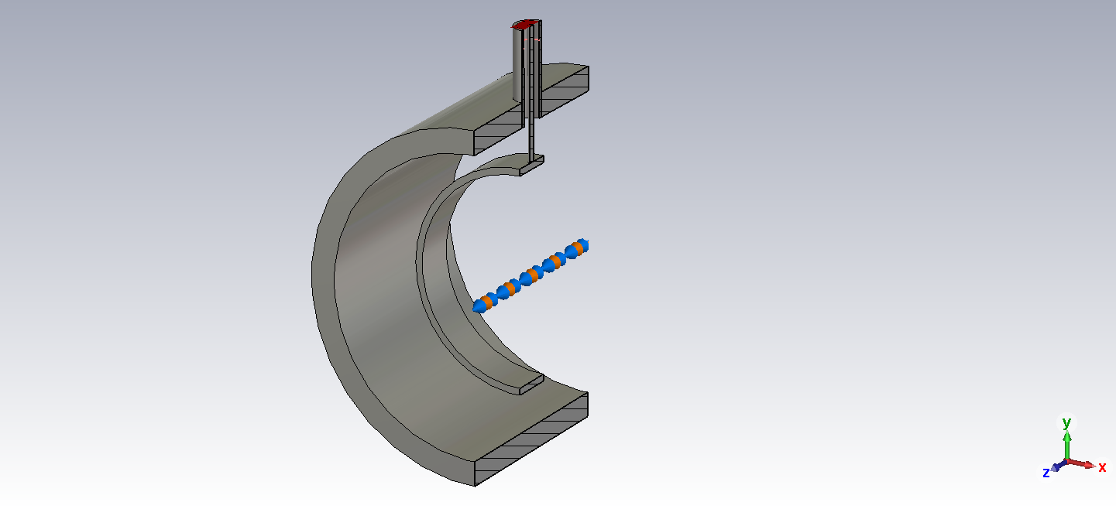
Appendix

Slide 18


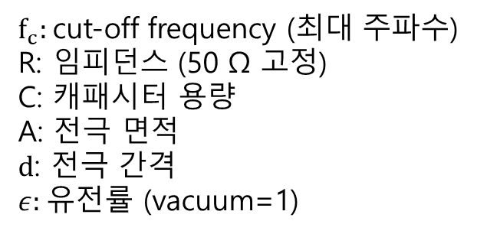
Appendix – frequency
$f_{c}:$cut-off frequency (최대 주파수)
R: 임피던스 (50 Ω 고정)
C: 캐패시터 용량
A: 전극 면적
$d$: 전극 간격
$ε:$유전률 (vacuum=1)

Slide 19
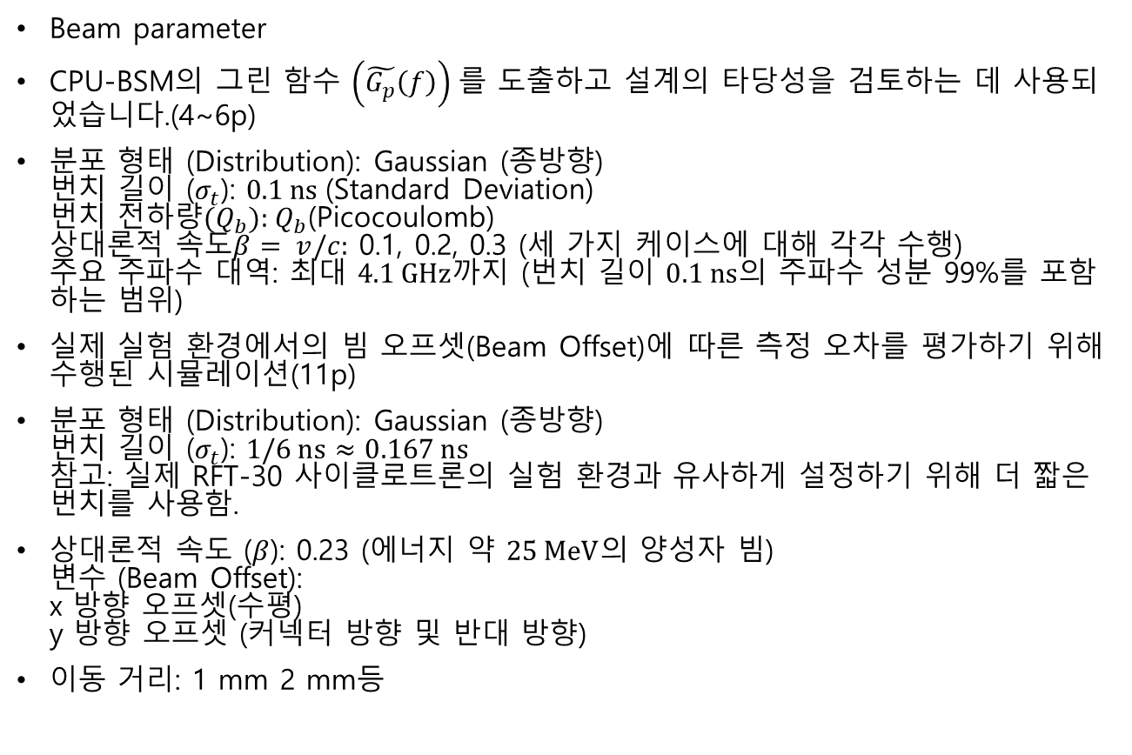
Beam parameter
CPU-BSM의 그린 함수 $\left(\tilde{G_{p}}\left(f\right)\right)$를 도출하고 설계의 타당성을 검토하는 데 사용되었습니다.(4~6p)
분포 형태 (Distribution): Gaussian (종방향)
번치 길이 ($σ_{t}$): $0.1 \text{ns}$(Standard Deviation)
번치 전하량${(Q}_{b})\text{: }Q_{b}$(Picocoulomb)
상대론적 속도$β= v/c:$ 0.1, 0.2, 0.3 (세 가지 케이스에 대해 각각 수행)
주요 주파수 대역: 최대 $4.1 \text{GHz}$까지 (번치 길이 $0.1 \text{ns}$의 주파수 성분 99%를 포함하는 범위)
실제 실험 환경에서의 빔 오프셋(Beam Offset)에 따른 측정 오차를 평가하기 위해 수행된 시뮬레이션(11p)
분포 형태 (Distribution): Gaussian (종방향)
번치 길이 ($σ_{t}$): $1/6 \text{ns}≈0.167 \text{ns}$
참고: 실제 RFT-30 사이클로트론의 실험 환경과 유사하게 설정하기 위해 더 짧은 번치를 사용함.
상대론적 속도 ($β$): 0.23 (에너지 약 $25 \text{MeV}$의 양성자 빔)
변수 (Beam Offset):
x 방향 오프셋(수평)
y 방향 오프셋 (커넥터 방향 및 반대 방향)
이동 거리: 1 mm 2 mm등

Slide 20


\

Slide 21
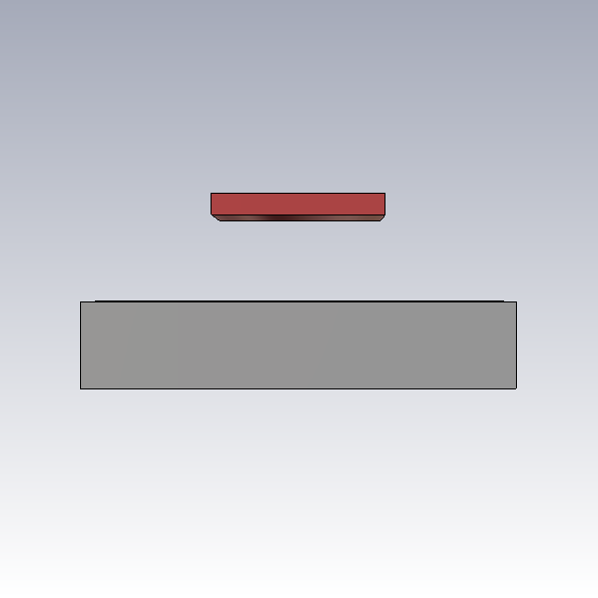

W
t
$${\text{ε}}_{\text{r}}$$
h

Slide 22
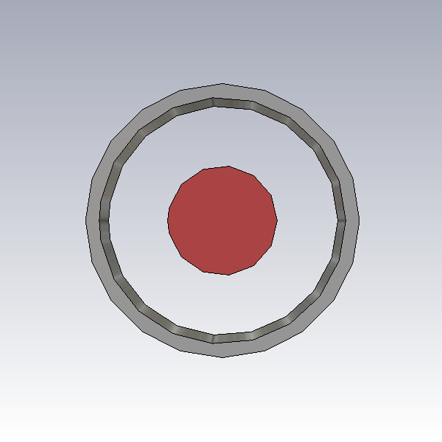

${\text{ε}}_{\text{r}}$(유전율)
b
a

