Slide 1
EUV INJECTION ORGANIZE
2026-03-27, Pohang, South Korea
Young Min Park
Division of Advanced Nuclear Engineering (DANE), POSTECH

Slide 2
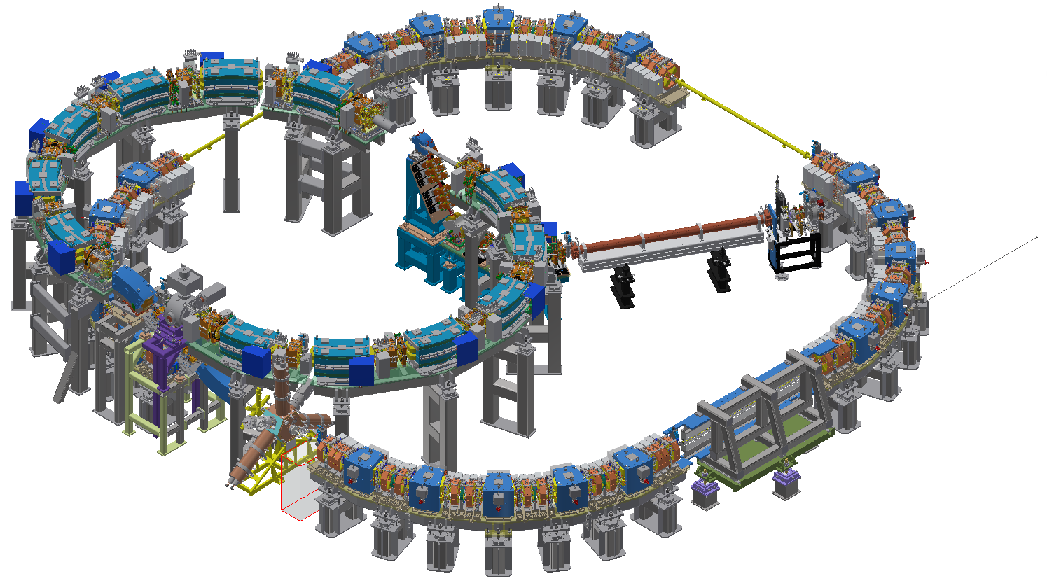
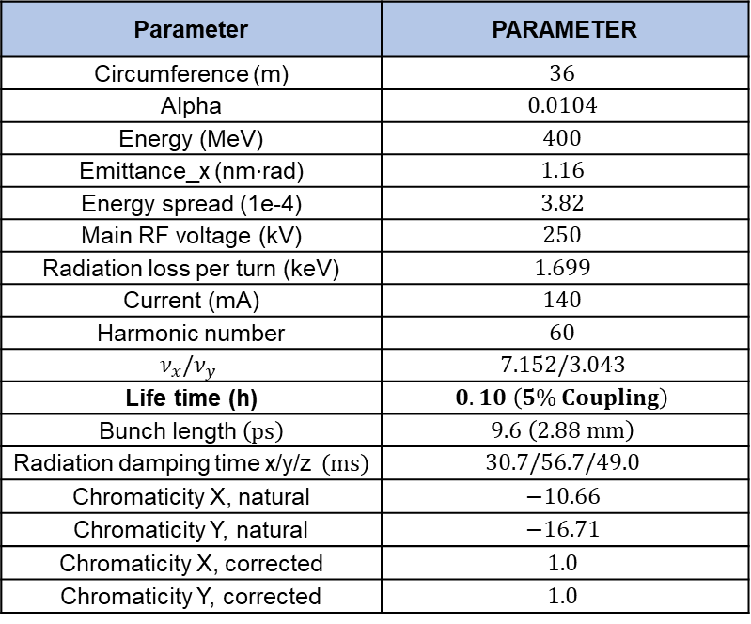
PAL-EUV
PAL-EUV storage ring
Parameter | PARAMETER
Circumference (m) | $$36$$
Alpha | $$0.0104$$
Energy (MeV) | $$400$$
Emittance_x (nm$⋅$rad) | $$1.16$$
Energy spread (1e-4) | $$3.82$$
Main RF voltage (kV) | $$250$$
Radiation loss per turn (keV) | $$1.699$$
Current (mA) | $$140$$
Harmonic number | $$60$$
$$ν_{x}/ν_{y}$$ | $$7.152/3.043$$
Life time (h) | $$0.10 \left(5\% Coupling\right)$$
Bunch length $\left(ps\right)$ | $$9.6 \left(2.88 mm\right)$$
Radiation damping time x/y/z $\left(ms\right)$ | $$30.7/56.7/49.0$$
Chromaticity X, natural | $$−10.66$$
Chromaticity Y, natural | $$−16.71$$
Chromaticity X, corrected | $$1.0$$
Chromaticity Y, corrected | $$1.0$$
LINAC: 20 MeV Photocathode Injector, Repetition rate 0.5 Hz, Pulse length 5 (3-6) ps
Booster: 20–400 MeV, Two-Cell Symmetric Lattice, Circumference 22.2 m
Storage Ring: 400 MeV, 5BA Lattice with Fixed-Gap Undulator and Nonlinear Kicker Injection
2

Slide 3
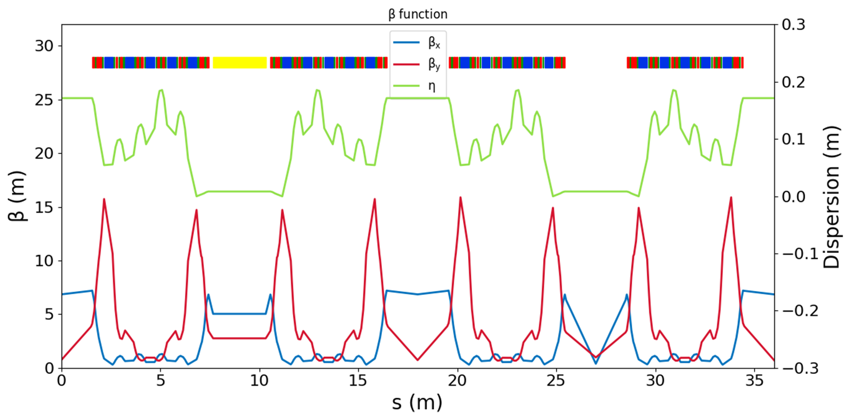
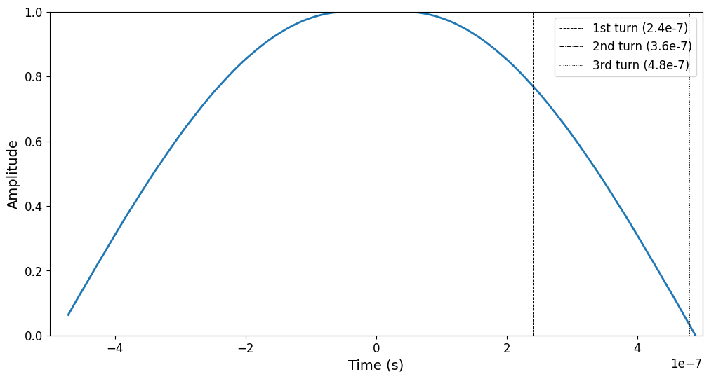
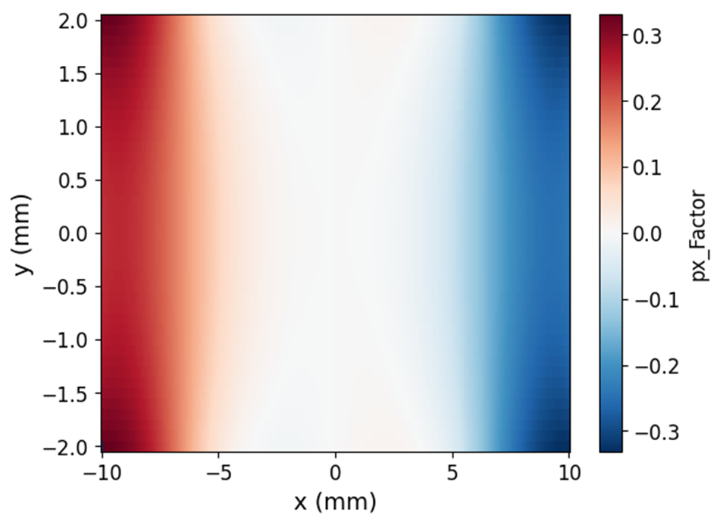
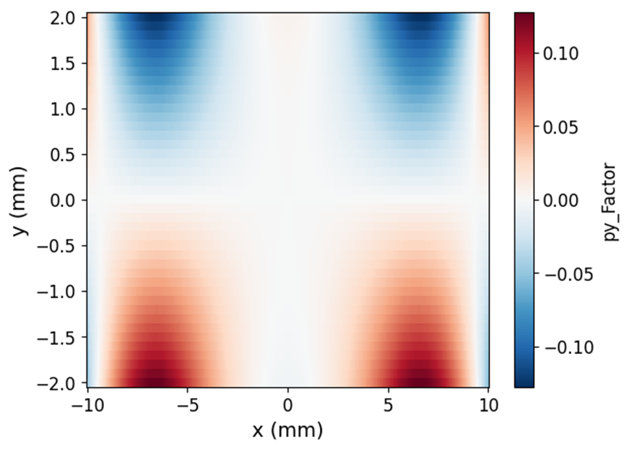
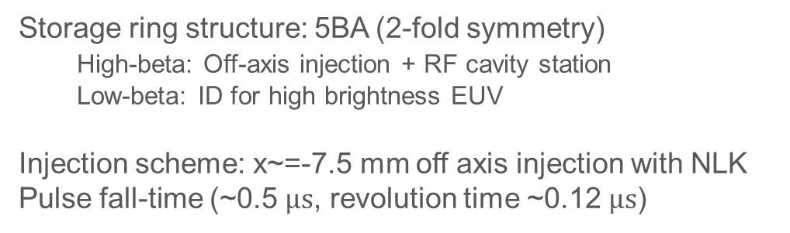
PAL-EUV
PAL-EUV Twiss
ELEGANT
NLK field
Storage ring structure: 5BA (2-fold symmetry)
High-beta: Off-axis injection + RF cavity station
Low-beta: ID for high brightness EUV
Injection scheme: x~=-7.5 mm off axis injection with NLK
Pulse fall-time (~0.5 $μs$, revolution time ~0.12 $μs$)
3

Slide 4
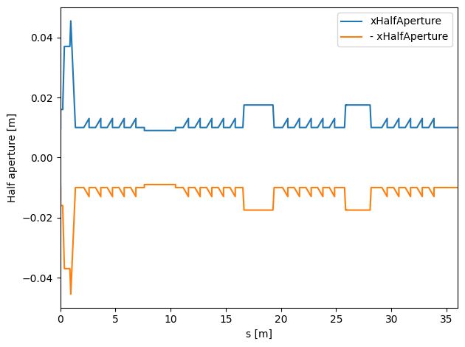
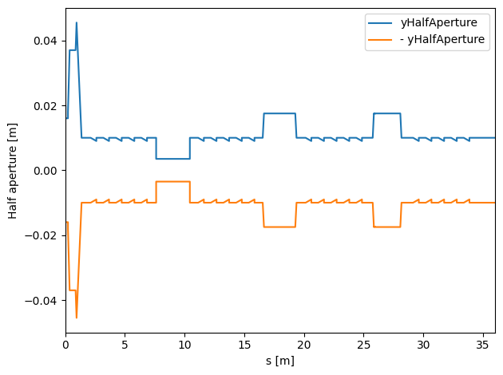
DA with real physical aperture
Physical Aperture
X-axis
Y-axis
Vacuum chamber $→$ $H×V$ ($±10$ mm)
Undulator $→$ Small y aperture ($±4$ mm)
…
4

Slide 5
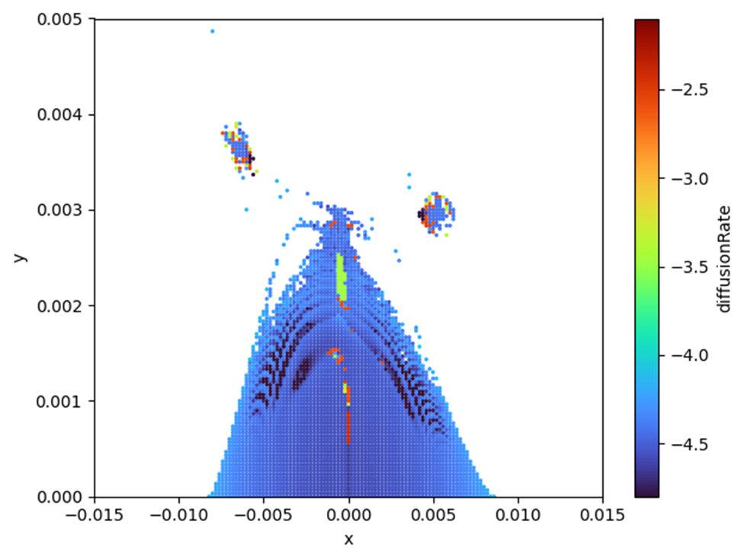
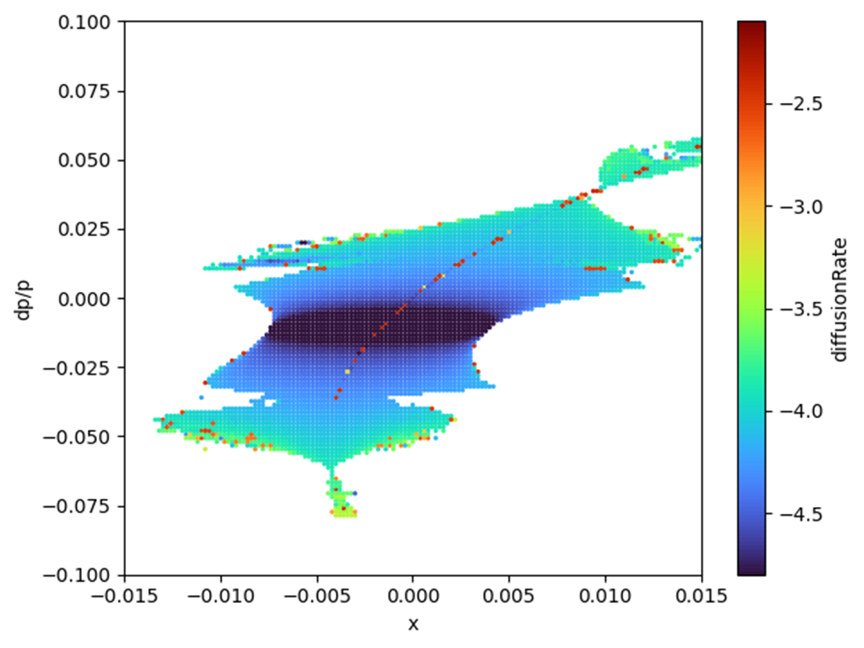
PAL-EUV
FMA analysis (w/o Physical aperture)/ DA analysis(w Physical aperture)
x vs y
x vs dp/p
5

Slide 6
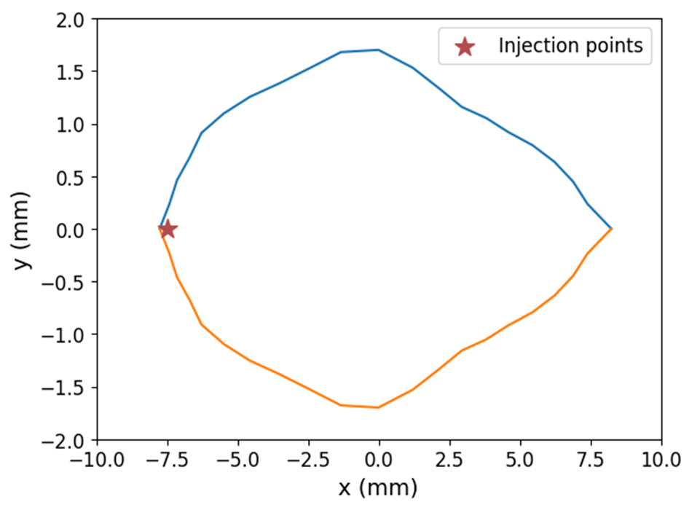
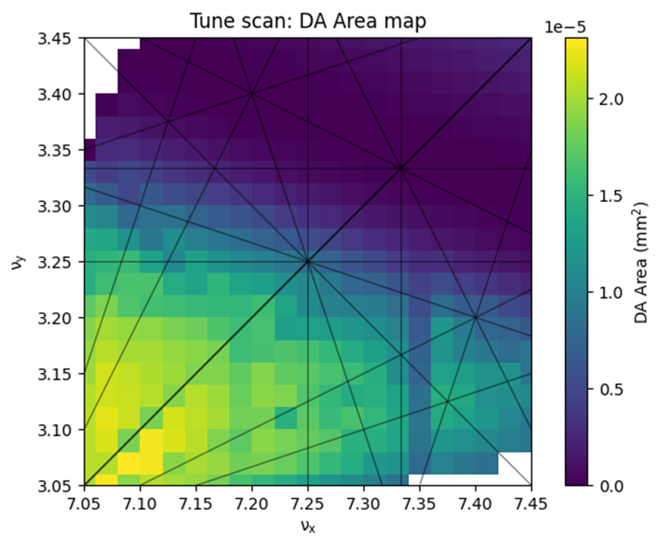
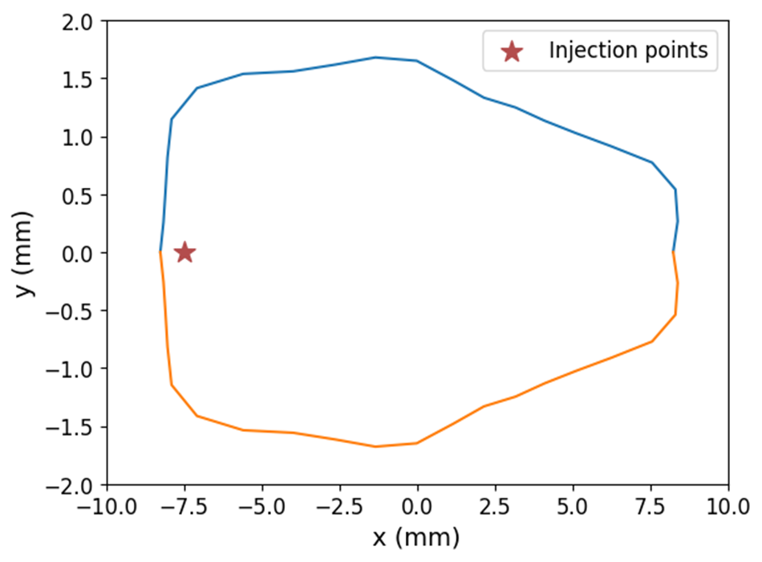
PAL-EUV
FMA analysis (w/o Physical aperture)/ DA analysis(w Physical aperture)
Original DA
Tune scan (total 14 Family)
Tune scan result
Quad | Original | Optimal
Q0 | 14.815 | 14.802
Q1 | -6.4 | -6.430
Q2 | 2.7 | 2.669
Q3A | 20.175 | 20.160
Q3B | 21.275 | 21.266
Q4A | 17.605 | 17.602
Q4B | 17.405 | 17.403
Q4C | 17.405 | 17.403
Q4D | 17.605 | 17.602
Q5A | 19.995 | 19.986
Q5B | 20.825 | 20.810
QUA | 7.776 | 7.738
QUB | -16.18 | -16.212
QUC | 23.74 | 23.729
New DA
6

Slide 7
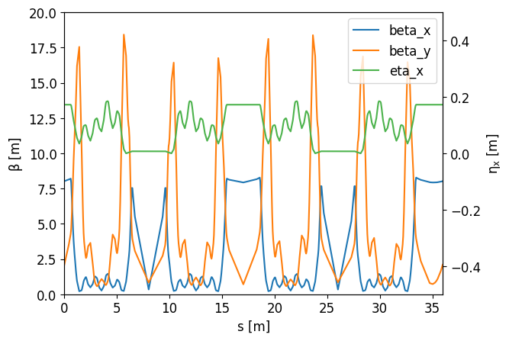
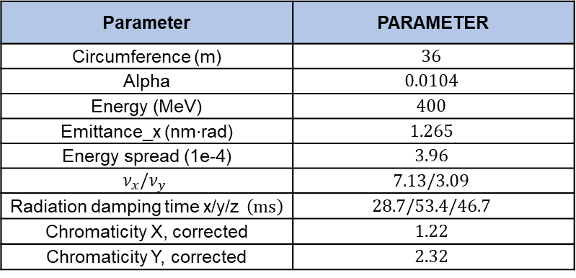
Optimal result
Parameter | PARAMETER
Circumference (m) | $$36$$
Alpha | $$0.0104$$
Energy (MeV) | $$400$$
Emittance_x (nm$⋅$rad) | $$1.265$$
Energy spread (1e-4) | $$3.96$$
$$ν_{x}/ν_{y}$$ | $$7.13/3.09$$
Radiation damping time x/y/z $\left(ms\right)$ | $$28.7/53.4/46.7$$
Chromaticity X, corrected | $$1.22$$
Chromaticity Y, corrected | $$2.32$$
$ν_{x}≈ν_{y}$, which may lead to a differential coupling resonance.
The emittance increases by ~10% compared to the original cell, because enhanced $η$ in the bending sections.
An error study is being carried out for the proposed lattice.
7

Slide 8
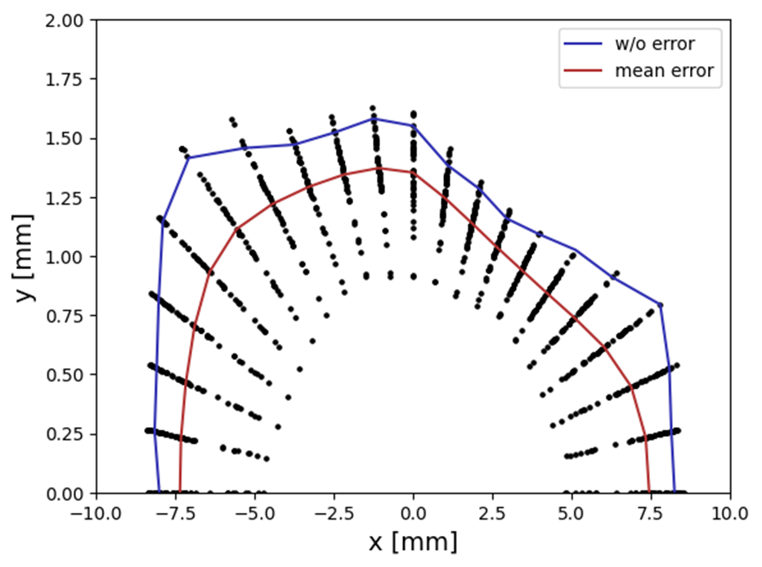
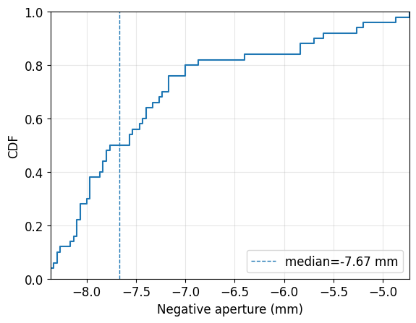
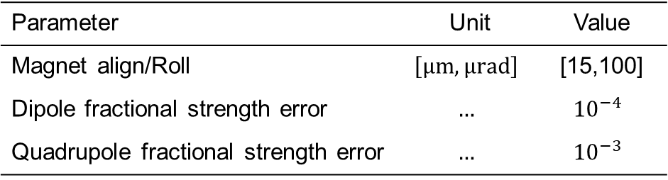
DA with error (Misalignment/Tilt/Strength)
Number of Error seed: 50
Parameter | Unit | Value
Magnet align/Roll | $$\left[μm,μrad\right]$$ | [15,100]
Dipole fractional strength error | $$…$$ | $${10}^{−4}$$
Quadrupole fractional strength error | $$…$$ | $${10}^{−3}$$
Error of Corrector & BPM x is neglected
(No correction)
Need to prepare an error-seed set tailored to PAL-EUV
For this error seed, an injection offset down to −7.5 mm appears feasible
Now change to injection simulations that explicitly include the NLK kick.
8

Slide 9
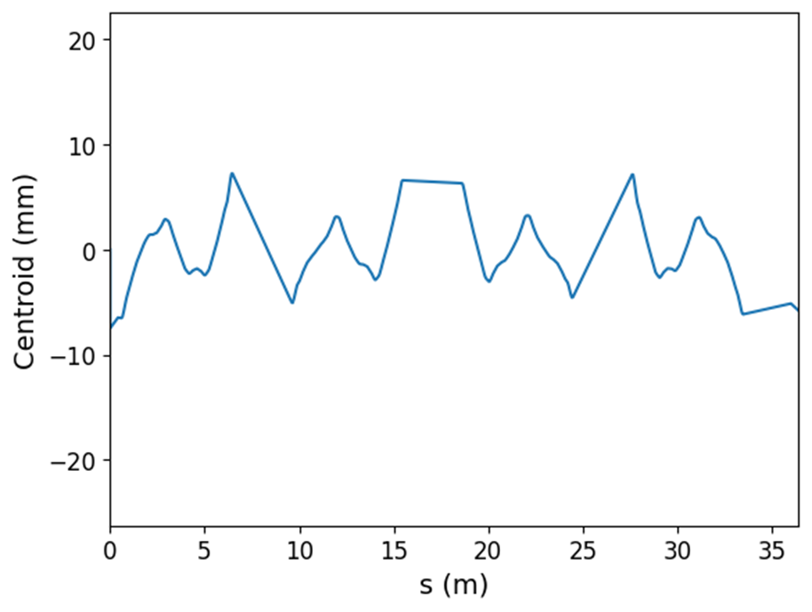
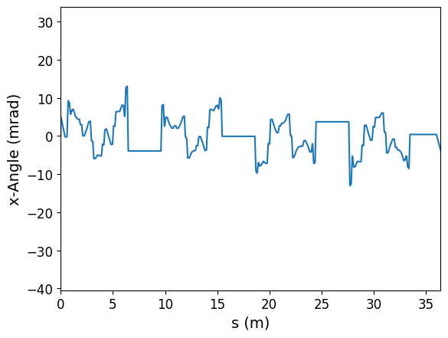
NLK injection
NLK injection study is ongoing — initial feasibility check as follows:
  Performed single-particle tracking to verify survival for an injected beam at −7.5 mm.
  The particle does not survive beyond ~4 turns in tracking
Main issue
After one turn, the particle shifts from −7.5 mm to around −6 mm.
At this location, it receives an additional negative NLK kick, resulting in approximately (𝑥,𝑥′)→(−6 mm,−5 mrad).
This trajectory hits the aperture and is lost.
Current mitigation strategy
Retune the NLK kick strength to leave a small residual 𝑥′ after the first injection.
Then remove 𝑥′ over the next 2 turns and conduct parameter scan on the kick strength.
2nd NLK end
2nd NLK end
1st NLK end
1st NLK end
9

Slide 10
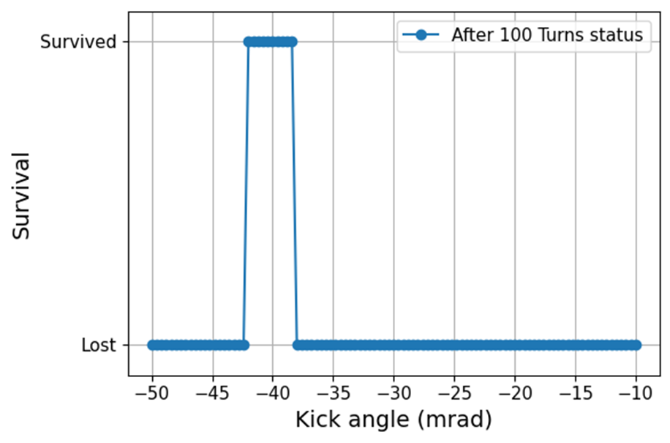
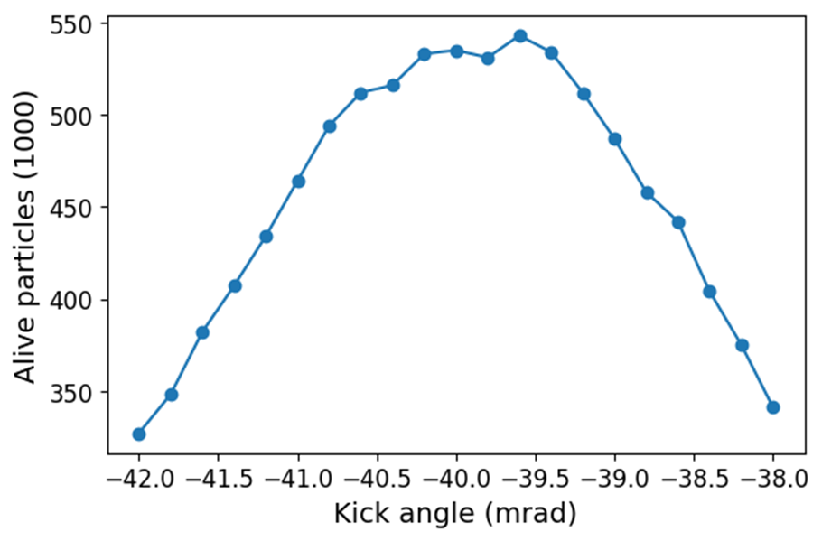
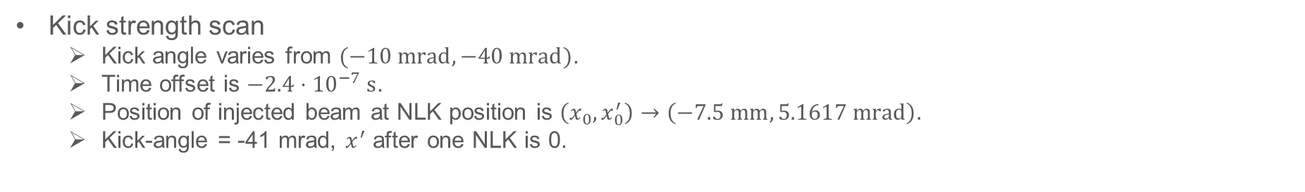
NLK injection
Kick strength scan
  Kick angle varies from $(−10 mrad,−40 mrad)$.
  Time offset is $−2.4⋅{10}^{−7} s$.
  Position of injected beam at NLK position is $\left(x_{0},x_{0}^{′}\right)→\left(−7.5 mm,5.1617 mrad\right).$
  Kick-angle = -41 mrad, $x^{′}$ after one NLK is 0.
Kick-angle: [-39 mard, -42 mrad]
Optimal kick-angle = -39.6 mrad
10

Slide 11
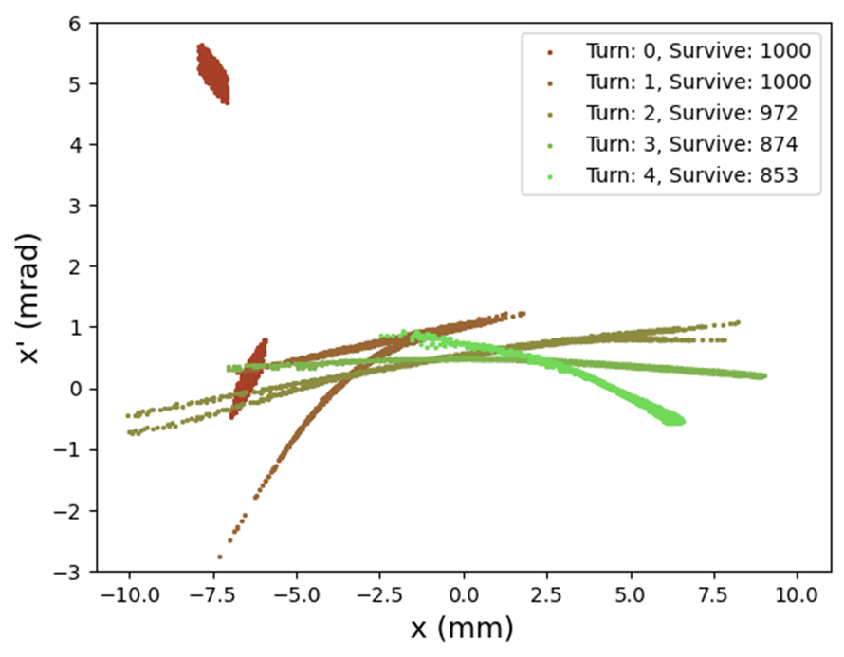
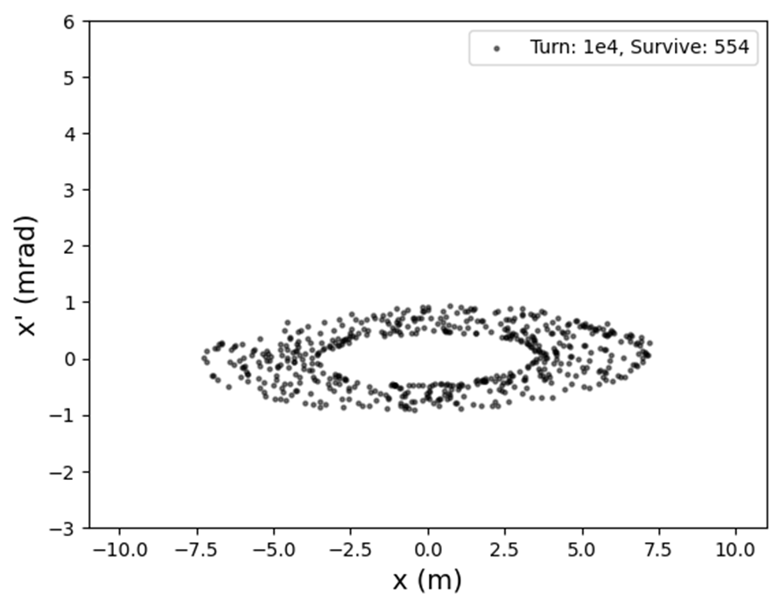
NLK injection
Injection result
0th turn
2nd turn
1st turn
11

Slide 12
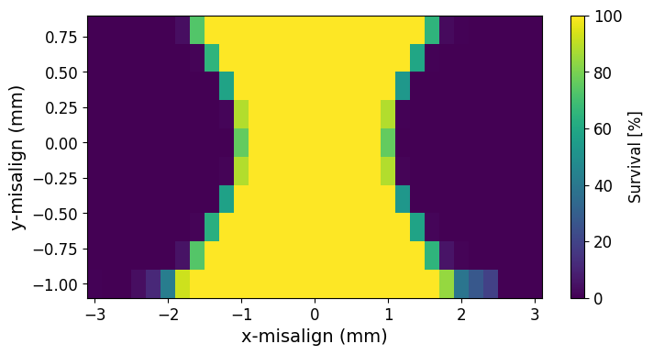

NLK main issue
Stored beam is lost when the NLK pulse is applied.
This suggests that the closed orbit at the NLK does not pass through the magnetic center.
Assuming a stabilized closed orbit after 1 s, we simulated stored-beam loss caused by NLK misalignment.
Simulation setting :
  $ε_{x}:1.23 nm⋅rad$
  NLK misalignment : [-3, 3] mm in x-y direction
  $Coupling=5\%$
  $Centroid=\left[0,0,0,0,0,0\right]$
  $Turn=10,$
  $Macroparticle=1000$
  $Time offset=−0.48 μs$
  $Kick angle=39.6 mrad$
  $Change \left[Dx,Dy\right] of NLK$
Results
Misalignment above ~1 mm can cause stored-beam loss.
Vertical misalignment has little effect on beam survival.
Mitigation: generate a local bump with correctors around the NLK.
12

Slide 13
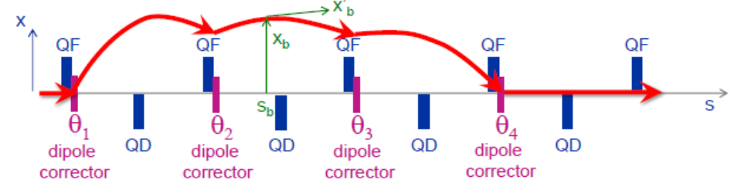
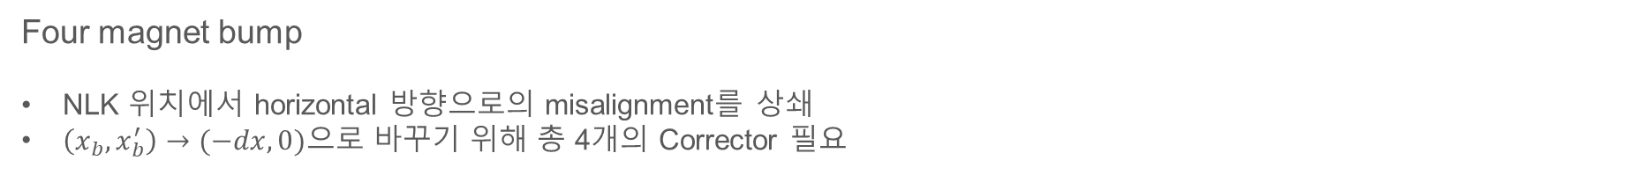
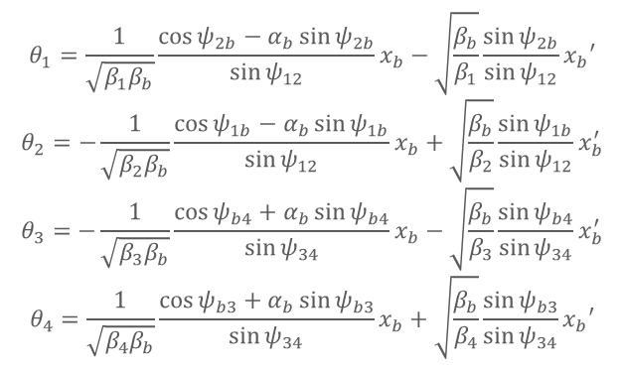
Local bump at NLK position
Four magnet bump
NLK 위치에서 horizontal 방향으로의 misalignment를 상쇄
$\left(x_{b},x_{b}^{′}\right)→(−dx,0)$으로 바꾸기 위해 총 4개의 Corrector 필요
$$θ_{1}=\frac{1}{\sqrt{β_{1}β_{b}}}\frac{\cos{ψ_{2b}−α_{b}\sin{ψ_{2b}}}}{\sin{ψ_{12}}}x_{b}−\sqrt{\frac{β_{b}}{β_{1}}}\frac{\sin{ψ_{2b}}}{\sin{ψ_{12}}}x_{b}′$$
$$θ_{2}=−\frac{1}{\sqrt{β_{2}β_{b}}}\frac{\cos{ψ_{1b}−α_{b}\sin{ψ_{1b}}}}{\sin{ψ_{12}}}x_{b}+\sqrt{\frac{β_{b}}{β_{2}}}\frac{\sin{ψ_{1b}}}{\sin{ψ_{12}}}x_{b}^{′}$$
$$θ_{3}=−\frac{1}{\sqrt{β_{3}β_{b}}}\frac{\cos{ψ_{b4}+α_{b}\sin{ψ_{b4}}}}{\sin{ψ_{34}}}x_{b}−\sqrt{\frac{β_{b}}{β_{3}}}\frac{\sin{ψ_{b4}}}{\sin{ψ_{34}}}x_{b}^{′}$$
$$θ_{4}=\frac{1}{\sqrt{β_{4}β_{b}}}\frac{\cos{ψ_{b3}+α_{b}\sin{ψ_{b3}}}}{\sin{ψ_{34}}}x_{b}+\sqrt{\frac{β_{b}}{β_{4}}}\frac{\sin{ψ_{b3}}}{\sin{ψ_{34}}}x_{b}′$$
13

Slide 14
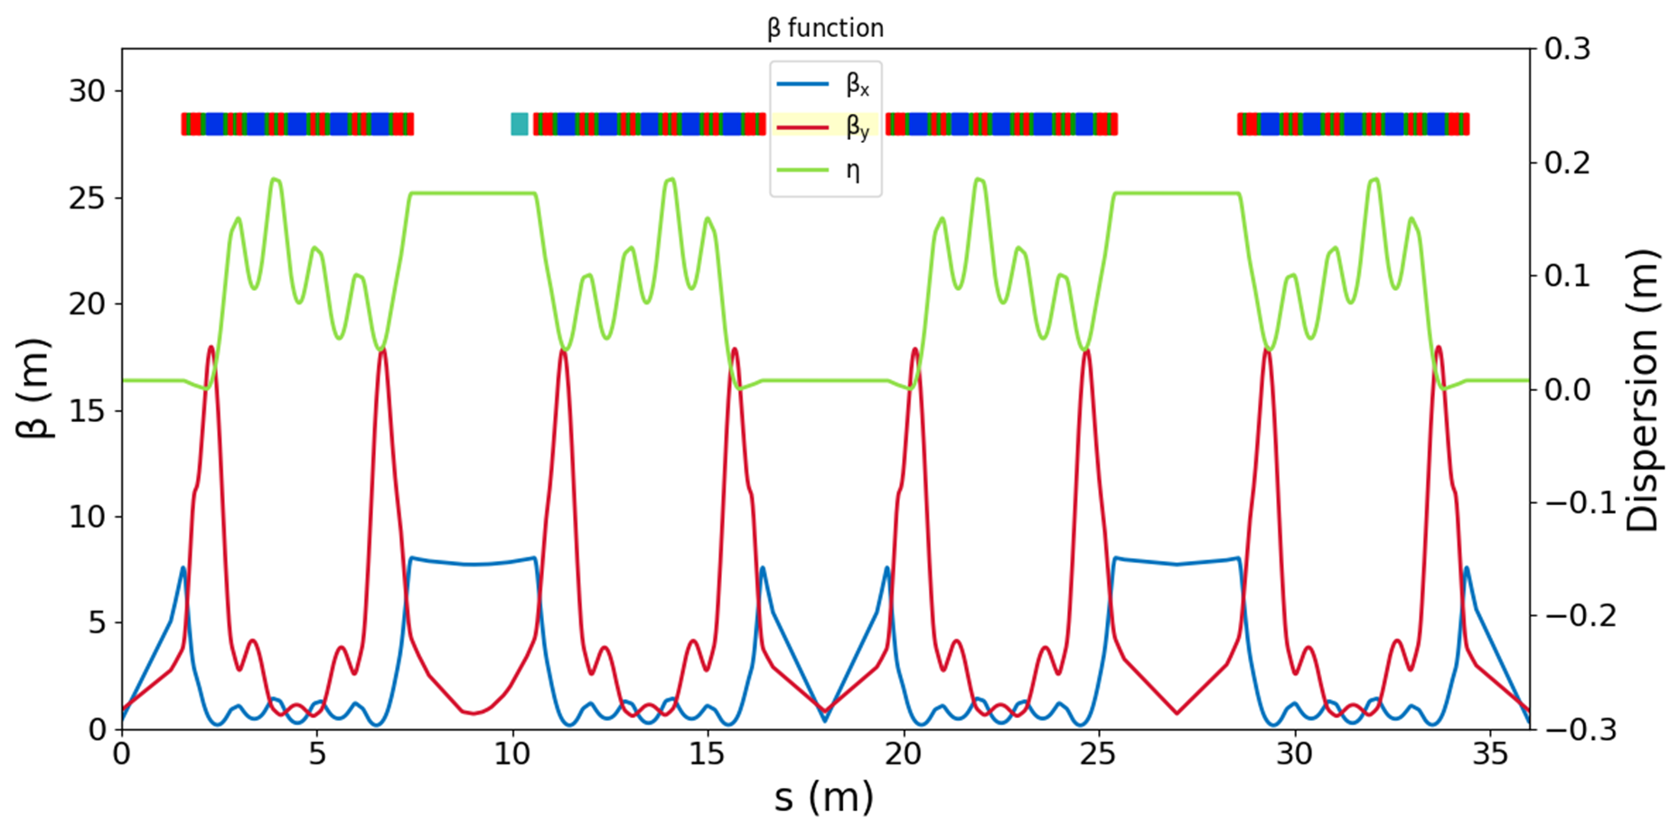
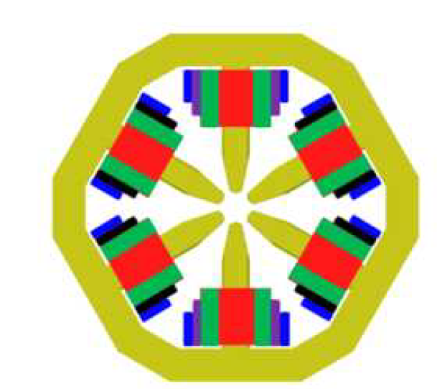
Local bump at NLK position
NLK로부터 가장 가까운 4개의 Corrector를 사용함
(Corrector는 Sextupole에 Trim 되어 있음)
NLK
EUV Sextupole
R_CH47
R_CH48
R_CH01
R_CH02
Skew Quad
Vertical Corrector
Horizontal Corrector
Element name | Value [mrad]
R_CH47 | 2.219
R_CH48 | -1.062
R_CH01 | -1.062
R_CH02 | 2.219
Sextupole
For 1 mm local bump
14

Slide 15
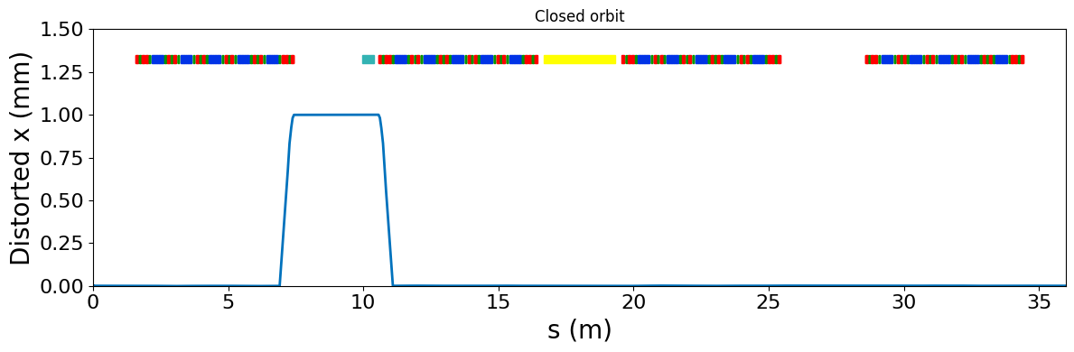
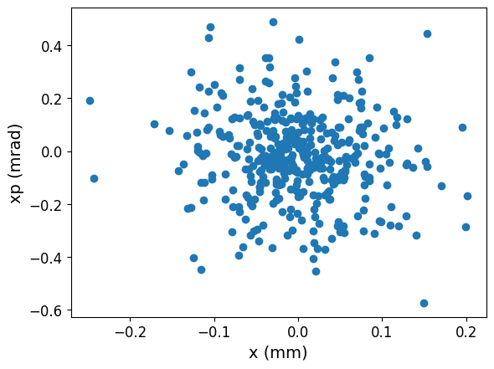
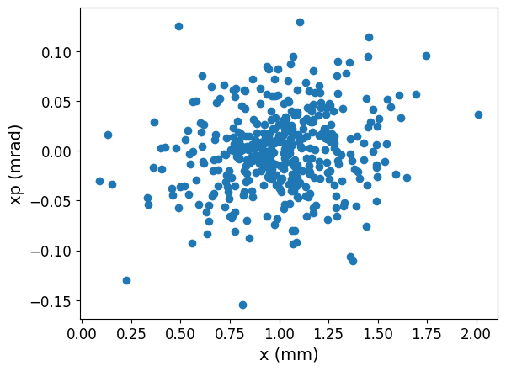

Simulation result
Simulation method
Set Correctors 47 and 02 to the theoretical kicks.
Adjust Correctors 48 and 01 so that the initial angle becomes x′ = 0.
If the local bump at the NLK differs from the target, rescale all corrector kicks.
Repeat until convergence (tol x = 1e-6, tol x′ = 1e-7).
Element name | Calculated value [mrad] | Simulation value [mard]
R_CH47 | 2.219 | 2.2190
R_CH48 | -1.062 | -1.0471
R_CH01 | -1.062 | -1.0471
R_CH02 | 2.219 | 2.2190
w/o local bump
w local bump
~ ${10}^{5}$ Turn
15

Slide 16
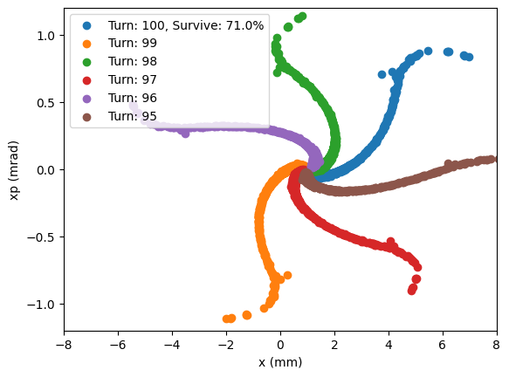
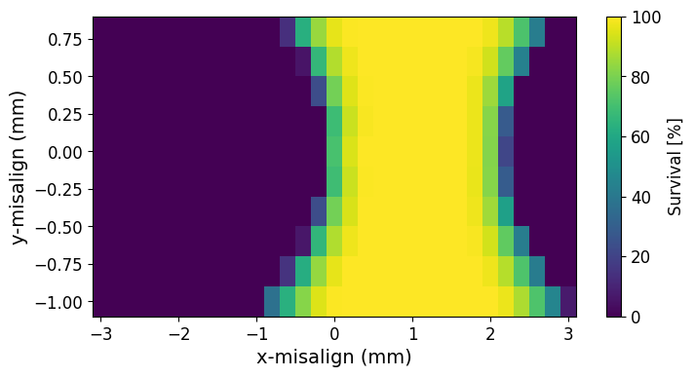
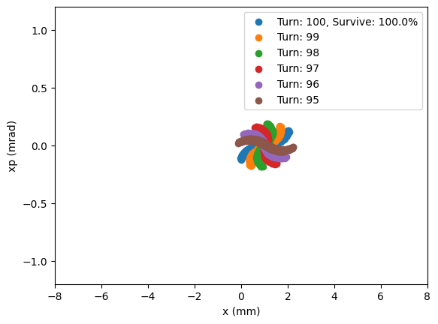
Local bump + NLK misalignment
Simulation method
1 mm local bump on + NLK on, assuming a stored beam
Local bump off + injection scheme, with kick-angle optimization (-30 to -50 mrad)
1 mm local bump on + injection scheme, with kick-angle optimization
1.
Misalignment = [0,0]
Misalignment = [1,0]
16

Slide 17
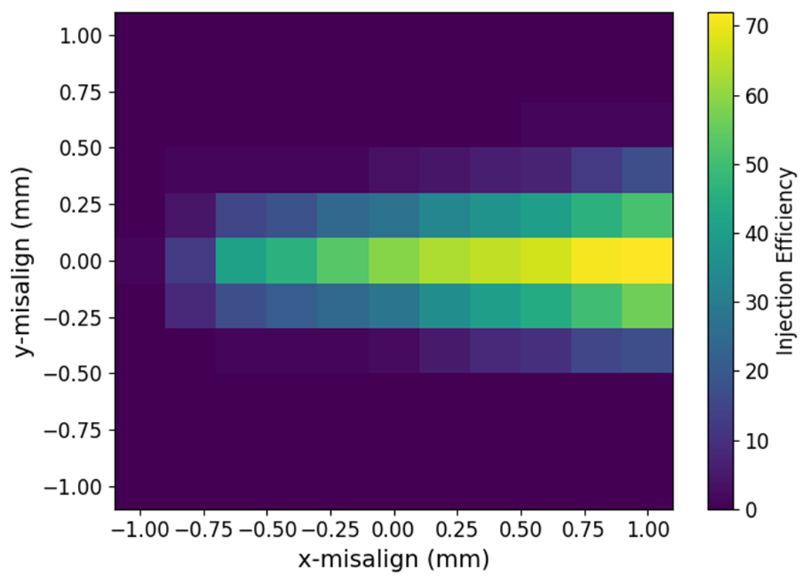
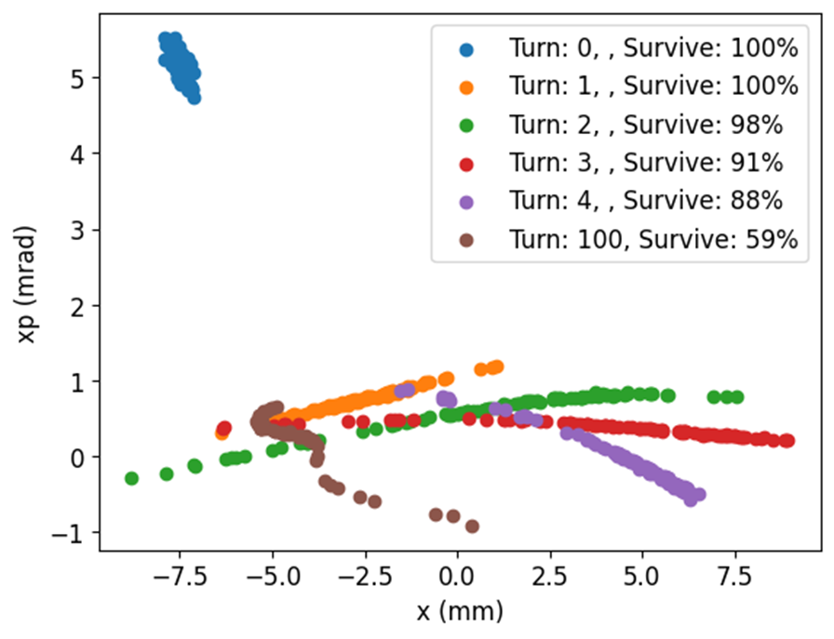
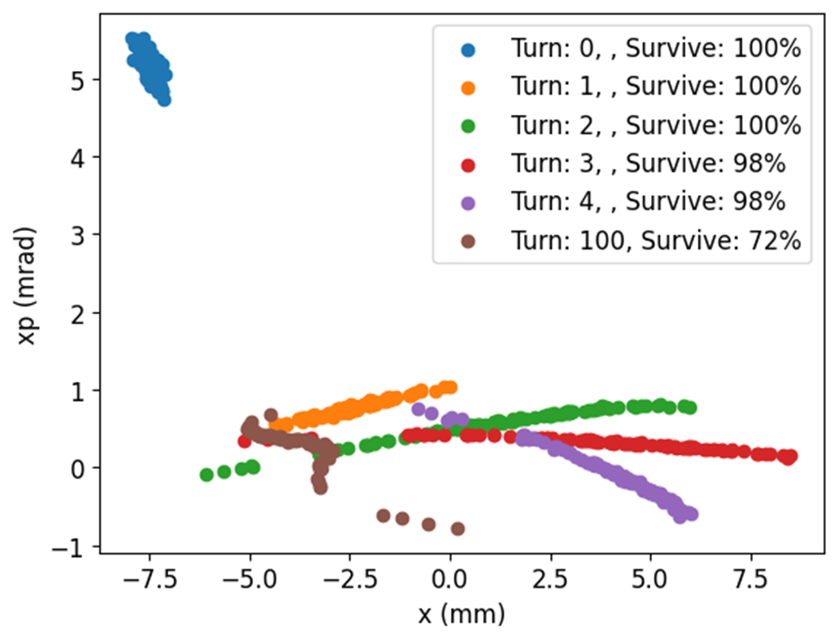
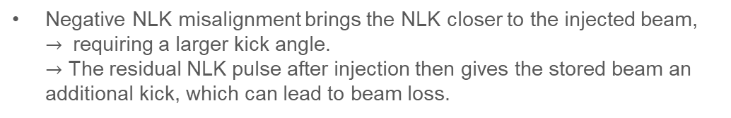
2nd simulation analysis
Local bump off + Injection scheme (Kick angle optimize)
Negative NLK misalignment brings the NLK closer to the injected beam,
$→$ requiring a larger kick angle.
$→$ The residual NLK pulse after injection then gives the stored beam an additional kick, which can lead to beam loss.
Misalignment = [0,0],
kick angle = 39.6 mrad
Misalignment = [1,0],
kick angle = 30.4 mrad
17

Slide 18
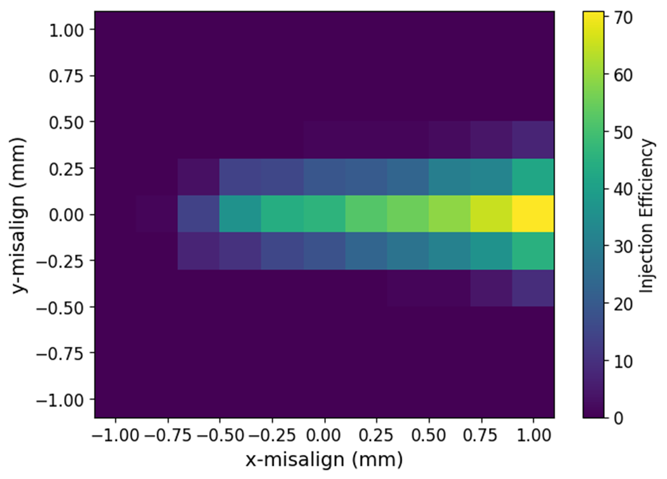
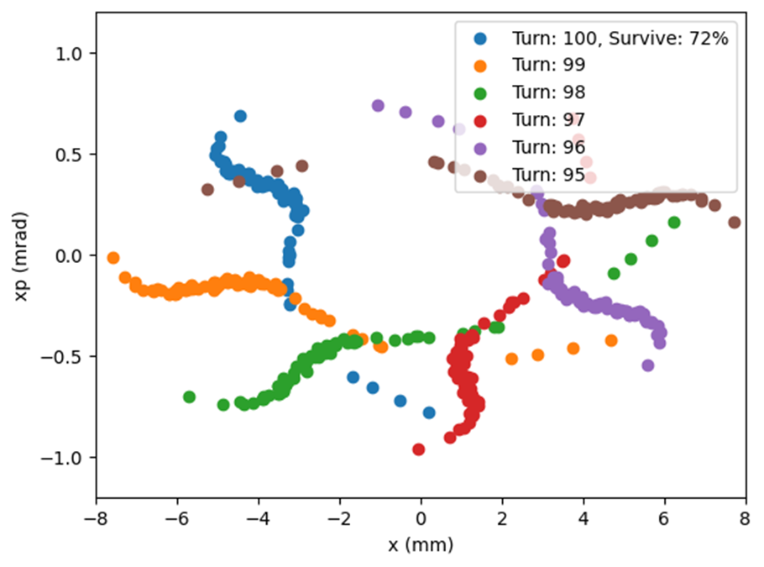
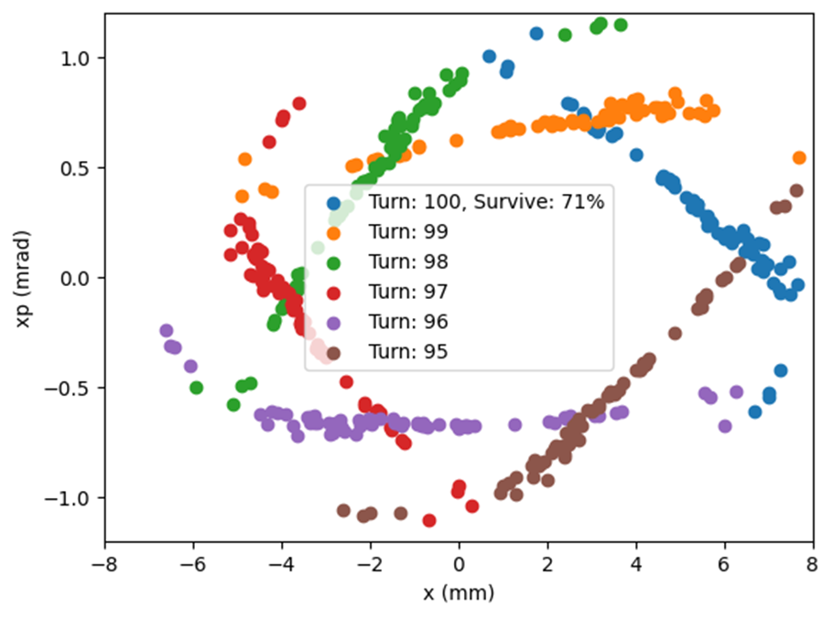
3nd simulation analysis
1 mm Local bump on + Injection scheme (Kick angle optimize)
Compared with the case without a local bump, the injection efficiency is slightly reduced, because the local bump increases the distance between the NLK and the injection trajectory.
• Bunch oscillation around the local bump (~1 mm) is also observed.
In actual commissioning, however, the exact optics functions are not known, so the practical implementation of this approach requires further consideration.
Local bump off, Kick angle=30.4 mrad
Local bump on, Kick angle=32.4 mrad
18

Slide 19
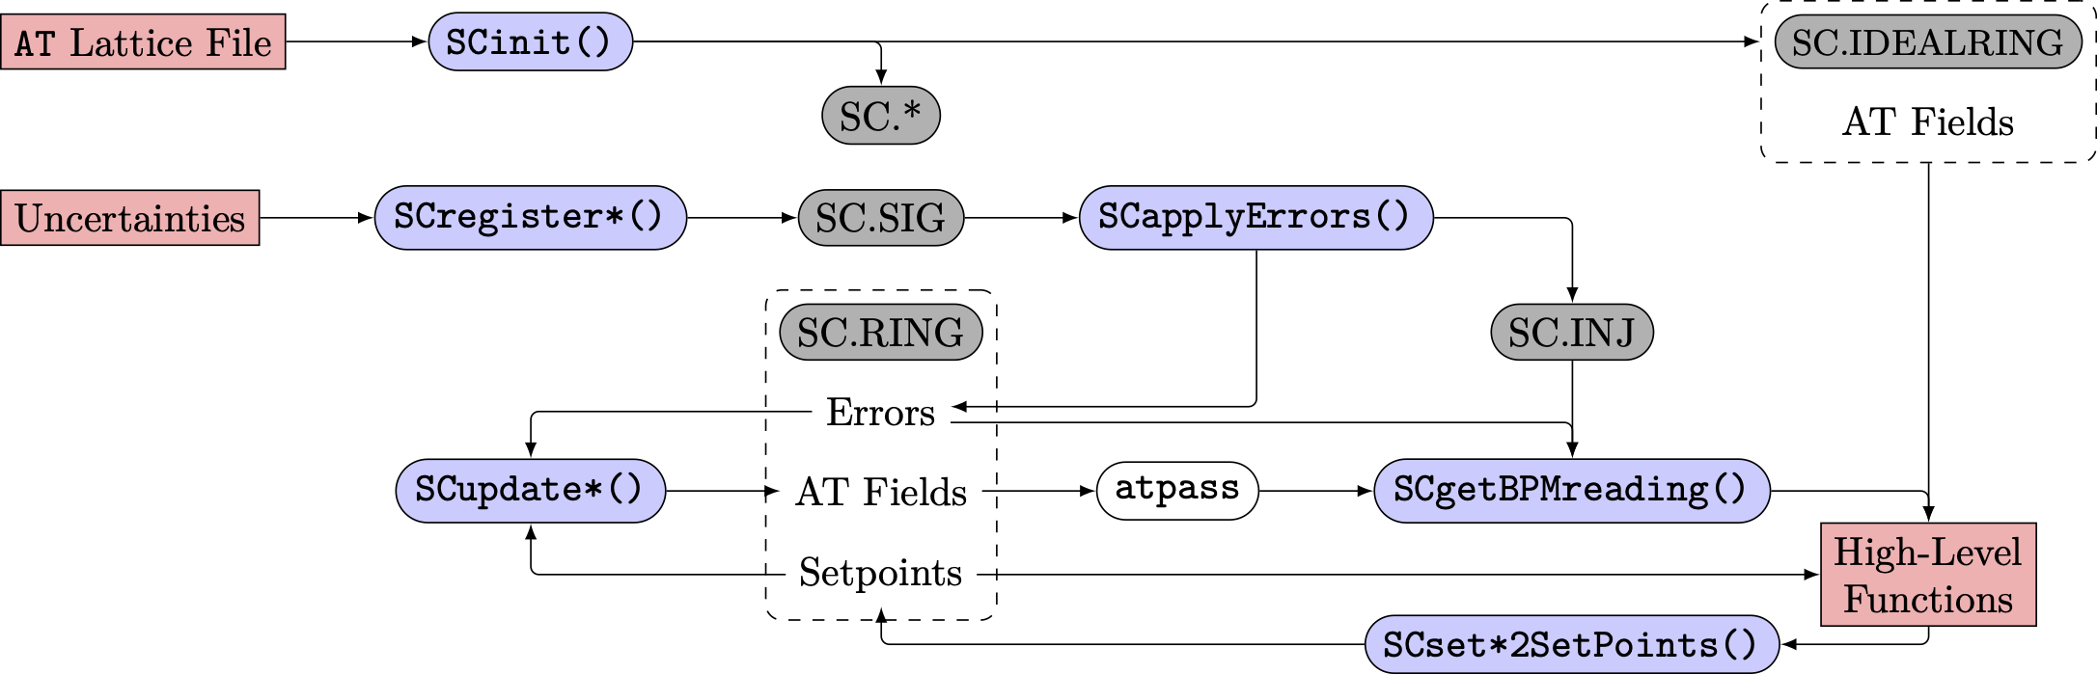
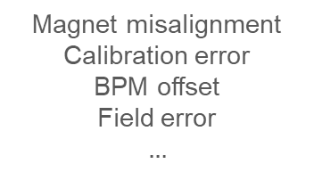
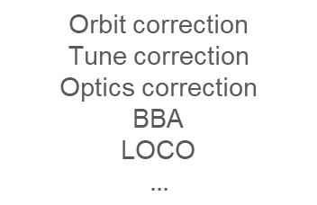
Commissioning Simulation Study
SC (Simulated Commissioning)
The full machine state cannot be known directly because of machine errors and limited diagnostics
Therefore, commissioning must rely on limited measurement data to recover the machine performance
SC is the simulation framework that reproduces realistic accelerator operation conditions
The SC toolbox separates physical machine parameters from operator control parameters and connects them through transfer functions
It creates a virtual machine with realistic errors and simulates measurement and correction procedures to test recovery of the target optics and beam performance
SC was originally developed in MATLAB
Goal
Development of a realistic PAL-EUV machine model using SC
Matching the simulation to measured machine data
Magnet misalignment
Calibration error
BPM offset
Field error
$$…$$
Orbit correction
Tune correction
Optics correction
BBA
LOCO
$$…$$
19

Slide 20
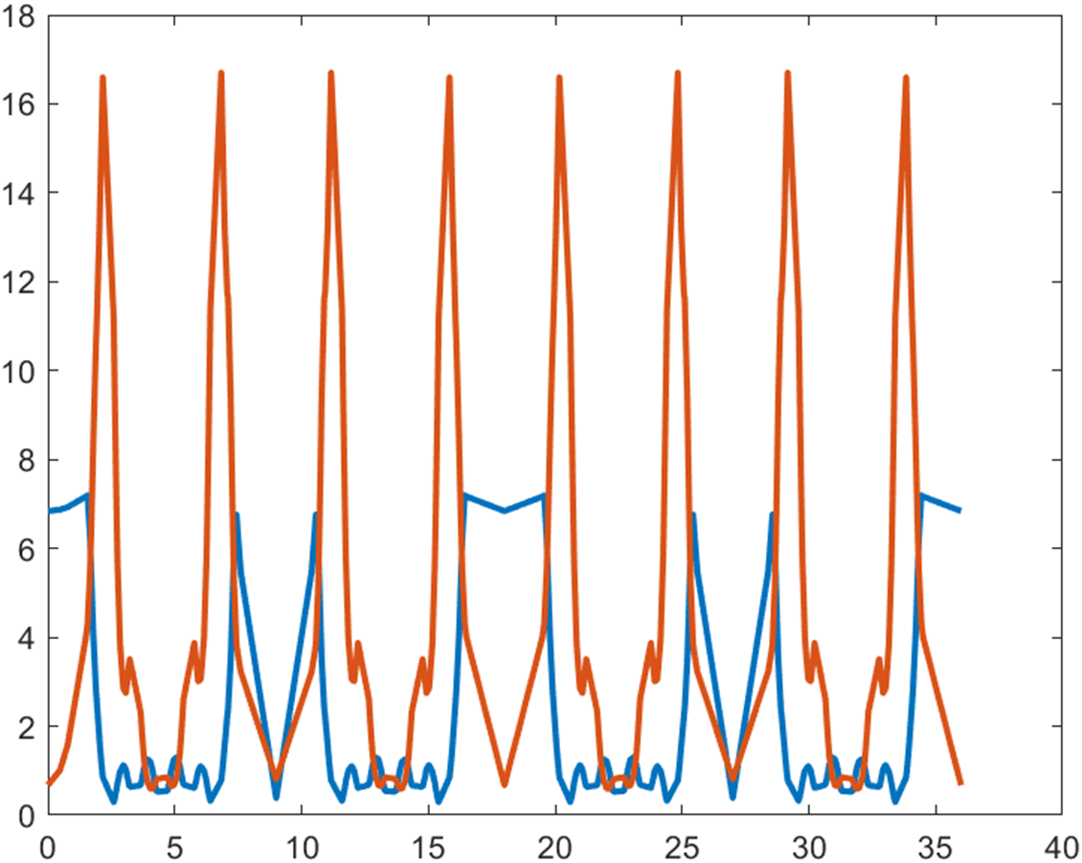




EUV SC test
Real commissioning status
Correction chain
Lattice registration
Apply random error
Turning off
RF & Sextupoles
Find 1-turn/
2-turn trajectory
Sextupole ramp-up in 10 steps
RF correction
(frequency & phase)
Orbit correction
Pseudo BBA
LOCO
Complete
Ideal lattice
Apply error
Trajectory correction
Orbit correction
LOCO
Further study needed
20

Slide 21
Summary
Characterization of the PAL-EUV lattice and DA optimization through simple tune scans
NLK injection study: a local bump is a possible solution, but accurate optics verification is required
Study of the SC: Tool for optics verification based on measured machine data
21

Slide 22
Thank you for your attention!
22

