Slide 1
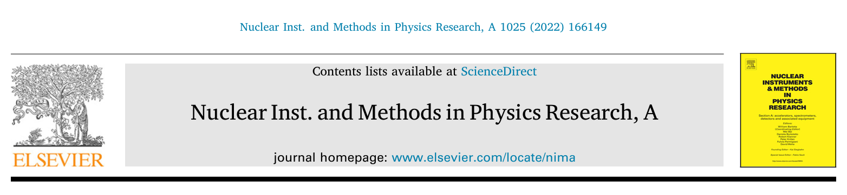
45th JKPS
Eliminating uncertainty of thermal emittance measurement in solenoid scans due to rf and solenoid fields overlap

Slide 2
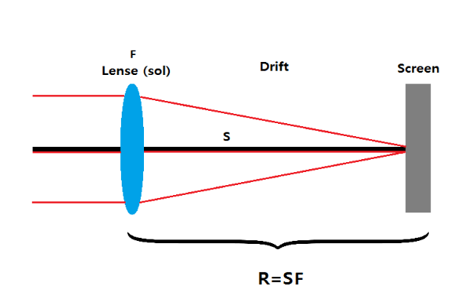
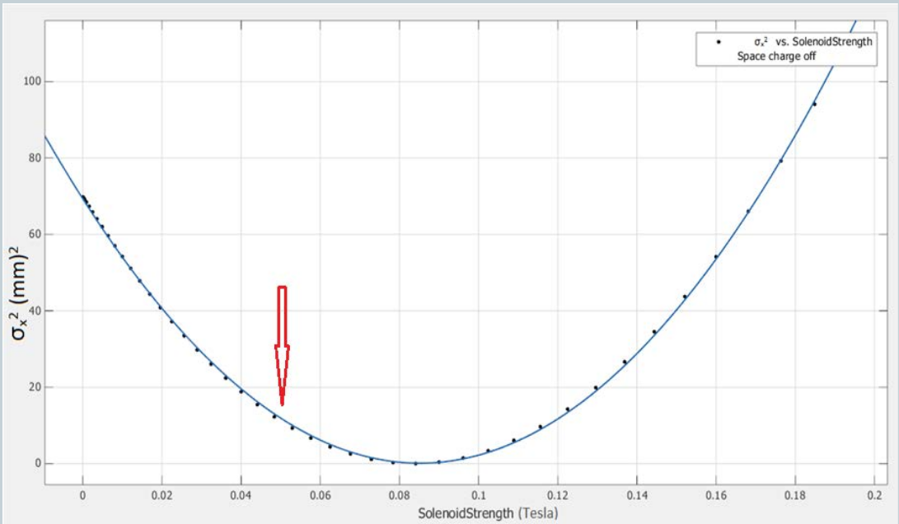
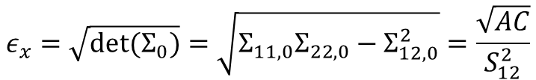
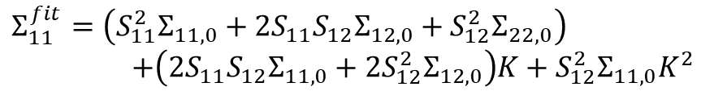


Solenoid Scan
Transfer Matrix Calculation
$Σ=RΣ_{0}R^{T}$,
$$R=\left(\begin{matrix}S_{11}+KS_{12} & S_{12} \\ S_{21}+KS_{22} & S_{22}\end{matrix}\right)$$
$$Σ_{11}^{fit}=\left(S_{11}^{2}Σ_{11,0}+2S_{11}S_{12}Σ_{12,0}+S_{12}^{2}Σ_{22,0}\right)$$
$$+\left(2S_{11}S_{12}Σ_{11,0}+2S_{12}^{2}Σ_{12,0}\right)K+S_{12}^{2}Σ_{11,0}K^{2}$$
Measurement – Parabolic Fitting
$$Σ_{11}^{scr}=A{\left(K−B\right)}^{2}+C=AK^{2}−2ABK+(C+AB^{2})$$
$$ε_{x}=\sqrt{det⁡(Σ_{0})}=\sqrt{Σ_{11,0}Σ_{22,0}−Σ_{12,0}^{2}}=\frac{\sqrt{AC}}{S_{12}^{2}}$$

Slide 3
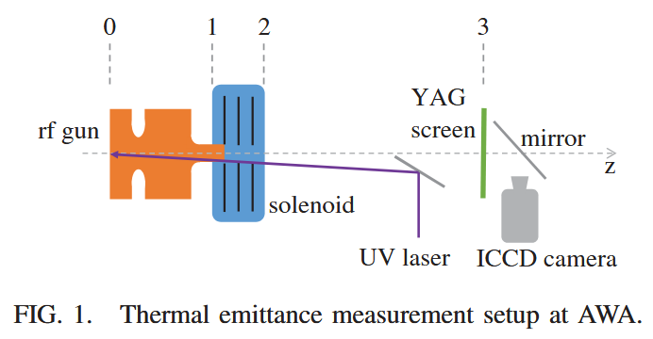
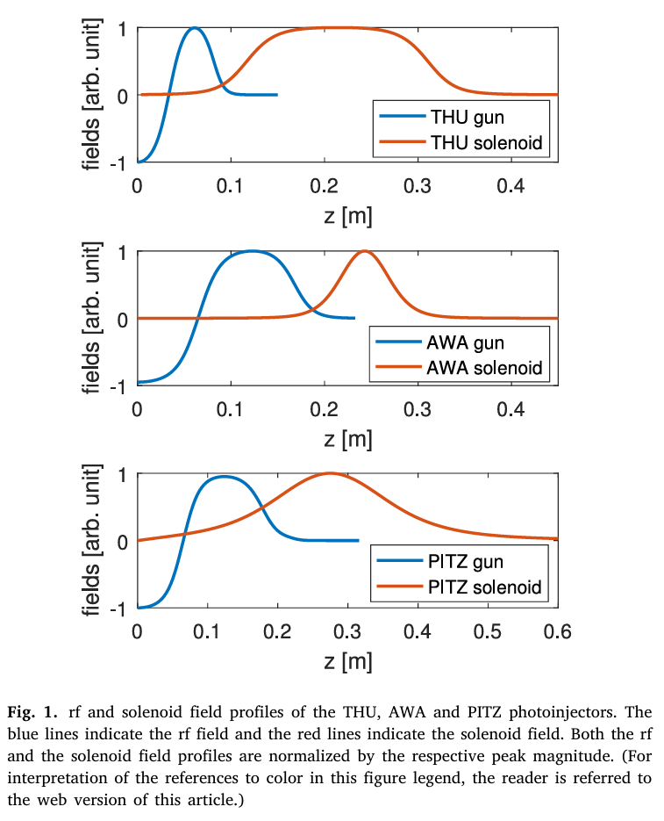
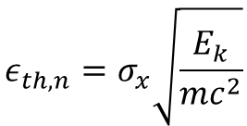
Thermal Emittance Measurement
Thermal Emittance (≈ Intrinsic Emittance)
$$ε_{th,n}=σ_{x}\sqrt{\frac{E_{k}}{mc^{2}}}$$
Minimum achievable emittance
Sources of Thermal Emittance Overestimation
Emittance Growth in Beam Transmission
Nonlinear space charge effects
RF effects
Optical aberrations
Error of Beam Size Measurement on Screen
Dim images due to the low energy
Inaccurate Knowledge of the Transfer Matrix
Non-ideal hard-edged solenoid field
RF field and solenoid field overlap

Slide 4
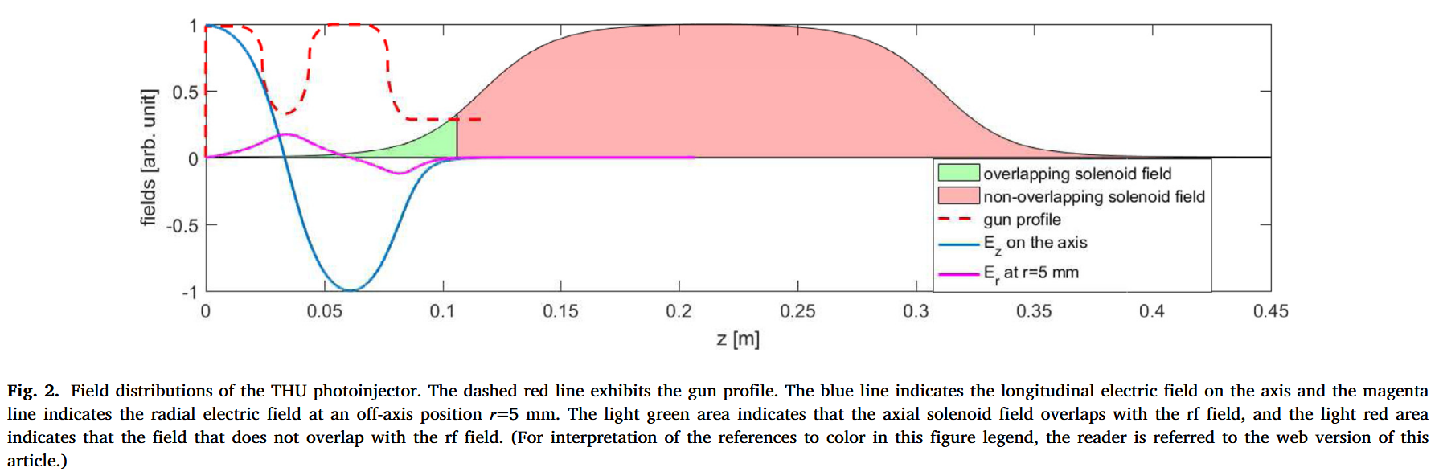





Modeling RF & Solenoid fields Overlap
1. Define overlap boundary $L_{sep}$
$$E_{z}\left(L_{sep}\right)=E_{0}×1\%$$
$$L_{sep}$$
2. Transverse force in RF field
Radial E-field $E_{r}$
Center iris
: Transverse force is negligible since for the $π$-mode the field $E_{z}(z)$ is anti-symmetric
Exit iris
: Total transverse force is an impulse given at the exit iris
Focal length $f_{g}=−\frac{2βγmc^{2}}{eE_{0}sinφ_{e}}$

Slide 5
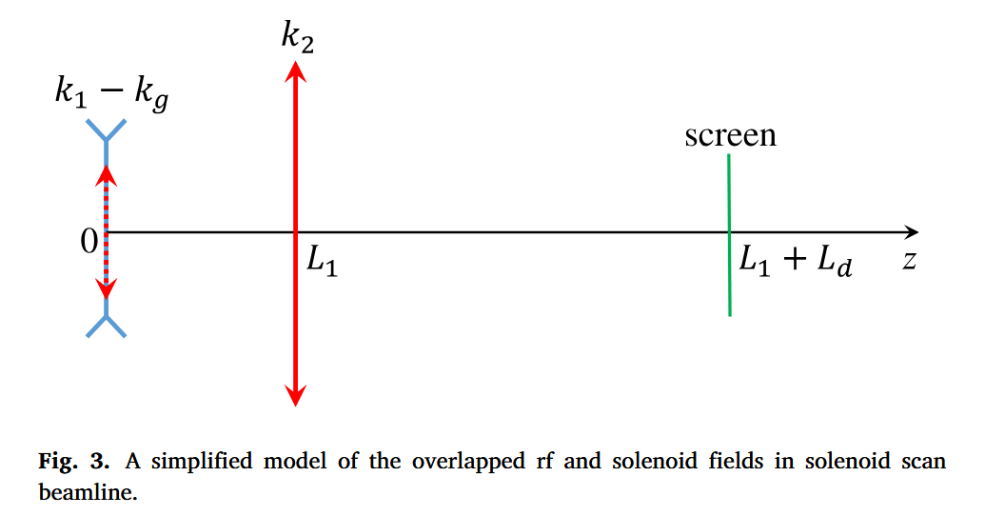


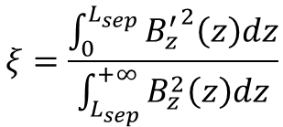


3. Const-momentum approximation
Purpose: preserve the geometric phase space (x, x’)
$x^{′}=\frac{p_{x}}{p_{z}}$,
$p_{z}\left(z\right)=p_{f}$, $p_{f}$: Beam momentum after the gun exit
Momentum-related equivalent field
$$B_{z}^{′}\left(z\right)=B_{z}\left(z\right)×\frac{p_{f}}{p_{z}\left(z\right)}$$
Ratio of the integral strength of the two parts of the solenoid
$$ξ=\frac{\int_{0}^{L_{sep}}{{B_{z}^{′}}^{2}\left(z\right)dz}}{\int_{L_{sep}}^{+∞}{B_{z}^{2}\left(z\right)dz}}$$
Gun exit
$$k_{1}=ξk_{2}$$

Slide 6


Deficiencies of the Conventional Methods
Method 1. Avoid the knowledge of the RF field
$$Minimize \left|σ_{scr}^{2}−σ_{fit}^{2}\right|$$
Theorical Function & Measurement Function without RF-solenoid fields overlap
$$M=\left[\begin{matrix}1 & L_{d} \\ 0 & 1\end{matrix}\right]\left[\begin{matrix}1 & 0 \\ −k_{2} & 1\end{matrix}\right]$$
$σ_{fit}^{2}=M_{11}^{2}<x_{fit}^{2}>+2M_{11}M_{12}<x_{fit}x_{fit}^{′}>+M_{12}^{2}<{x_{fit}^{′}}^{2}>$,
$$σ_{scr}^{2}=M_{11}^{2}<x_{0}^{2}>+2M_{11}M_{12}<x_{0}x_{0}^{′}>+M_{12}^{2}<{x_{0}^{′}}^{2}>$$
Analyze the overestimation of the thermal emittance
Measurement Function with RF-solenoid fields overlap
$$σ_{scr}^{2}=M_{11}^{2}<x_{0}^{2}>+2M_{11}M_{12}<x_{0}x_{0}^{′}>+M_{12}^{2}<{x_{0}^{′}}^{2}>$$

Slide 7






Analyze the overestimation of the thermal emittance
Assume initial condition
$Σ_{0}=\left[\begin{matrix}<x_{0}^{2}> & 0 \\ 0 & 0\end{matrix}\right]$, $ε_{0}=0$
$$M=\left[\begin{matrix}1 & L_{d} \\ 0 & 1\end{matrix}\right]\left[\begin{matrix}1 & 0 \\ −k_{2} & 1\end{matrix}\right]$$
Theorical Function
$σ_{fit}^{2}=M_{11}^{2}<x_{fit}^{2}>+2M_{11}M_{12}<x_{fit}x_{fit}^{′}>+M_{12}^{2}<{x_{fit}^{′}}^{2}>$,
Measurement Function with RF-solenoid fields overlap
drift
Solenoid Field
(Non-overlapping)
drift
RF Field
(Transverse force)
Solenoid Field
(Overlapping)
$R=\left[\begin{matrix}1 & L_{d} \\ 0 & 1\end{matrix}\right]\left[\begin{matrix}1 & 0 \\ −k_{2} & 1\end{matrix}\right]$ $\left[\begin{matrix}1 & L_{1} \\ 0 & 1\end{matrix}\right]\left[\begin{matrix}1 & 0 \\ k_{g} & 1\end{matrix}\right]\left[\begin{matrix}1 & 0 \\ −k_{1} & 1\end{matrix}\right]$
$$Σ=RΣ_{0}R^{T}$$
$$σ_{scr}^{2}=<x_{0}^{2}>×{\left[1−k_{2}L_{d}−\left(ξk_{2}−k_{g}\right)\left(L_{1}+L_{d}−k_{2}L_{1}L_{d}\right)\right]}^{2}$$
$σ_{scr}^{2}−σ_{fit}^{2}=p_{0}+p_{1}k_{2}+p_{2}k_{2}^{2}+p_{3}k_{2}^{3}+p_{4}k_{2}^{4}$, $p_{0}=p_{1}=p_{2}=p_{3}=p_{4}=0$
$$p_{3}=−2ξL_{1}L_{d}<x_{0}^{2}>(L_{d}+k_{g}L_{1}L_{d}+ξL_{1}+ξL_{d})≠0$$
$$p_{4}=ξ^{2}L_{1}^{2}L_{d}^{2}<x_{0}^{2}>≠0$$
$∴$ The error increases with the increase of $ξ$

Slide 8
Method 2. Using the beam dynamics simulation
Replace the transfer matrix calculation with start-to-end simulation
Beam size measurement results
Changing thermal emittance in simulation
Beam size
Simulation results
Matching between
measurement results and simulation results
Requires accurate knowledge of beamline parameters
Mismatch between simulation and the real beamline leads to uncertainties in the measured thermal emittance
Limitations
RF gun field profile
Distance between simulation and the real beamline

Slide 9







New Method
Theorical Function with RF-solenoid fields overlap
Equivalent Transfer Matrix $\tilde{R}$
drift
Solenoid Field
(Non-overlapping)
drift
RF Field
(Transverse force)
Solenoid Field
(Overlapping)
$R=\left[\begin{matrix}1 & L_{d} \\ 0 & 1\end{matrix}\right]\left[\begin{matrix}1 & 0 \\ −k_{2} & 1\end{matrix}\right]$ $\left[\begin{matrix}1 & L_{1} \\ 0 & 1\end{matrix}\right]\left[\begin{matrix}1 & 0 \\ k_{g} & 1\end{matrix}\right]\left[\begin{matrix}1 & 0 \\ −k_{1} & 1\end{matrix}\right]$
Unknown
$$R_{s1}R_{g}=R_{g}R_{s1}$$
drift
Solenoid Field
(Non-overlapping)
drift
Solenoid Field
(Overlapping)
RF Field
(Transverse force)
$R=\left[\begin{matrix}1 & L_{d} \\ 0 & 1\end{matrix}\right]\left[\begin{matrix}1 & 0 \\ −k_{2} & 1\end{matrix}\right]$ $\left[\begin{matrix}1 & L_{1} \\ 0 & 1\end{matrix}\right]\left[\begin{matrix}1 & 0 \\ −k_{1} & 1\end{matrix}\right]\left[\begin{matrix}1 & 0 \\ k_{g} & 1\end{matrix}\right]=\tilde{R}R_{g}$
$$\tilde{R}$$
$$R_{g}$$
Equivalent Initial Beam Matrix $\tilde{Σ}$
$$Σ=RΣ_{0}R^{T}=\tilde{R}R_{g}Σ_{0}{\left(\tilde{R}R_{g}\right)}^{T}=\tilde{R}{(R}_{g}Σ_{0}R_{g}^{T}){\tilde{R}}^{T}$$
$$\tilde{Σ}=\left[\begin{matrix}<x_{0}^{2}> & k_{g}<x_{0}^{2}> \\ k_{g}<x_{0}^{2}> & k_{g}^{2}<x_{0}^{2}>\end{matrix}\right]$$
$${∴σ}_{fit}^{2}={\tilde{R}}_{11}^{2}<x_{fit}^{2}>+2{\tilde{R}}_{11}{\tilde{R}}_{12}<x_{fit}x_{fit}^{′}>+{\tilde{R}}_{12}^{2}<{x_{fit}^{′}}^{2}>$$

Slide 10










Assume initial condition
$Σ_{0}=\left[\begin{matrix}<x_{0}^{2}> & 0 \\ 0 & 0\end{matrix}\right]$, $ε_{0}=0$
Theorical Function with RF-solenoid fields overlap
$$σ_{fit}^{2}={\tilde{R}}_{11}^{2}<x_{fit}^{2}>+2{\tilde{R}}_{11}{\tilde{R}}_{12}<x_{fit}x_{fit}^{′}>+{\tilde{R}}_{12}^{2}<{x_{fit}^{′}}^{2}>$$
Measurement Function with RF-solenoid fields overlap
$$σ_{scr}^{2}=<x_{0}^{2}>×{\left[1−k_{2}L_{d}−\left(ξk_{2}−k_{g}\right)\left(L_{1}+L_{d}−k_{2}L_{1}L_{d}\right)\right]}^{2}$$
$σ_{scr}^{2}−σ_{fit}^{2}=p_{0}+p_{1}k_{2}+p_{2}k_{2}^{2}+p_{3}k_{2}^{3}+p_{4}k_{2}^{4}$, $p_{0}=p_{1}=p_{2}=p_{3}=p_{4}=0$
$$p_{4}=ξ^{2}L_{1}^{2}L_{d}^{2}(<x_{0}^{2}>−<x_{fit}^{2}>)$$
$$p_{3}=2ξL_{1}^{2}L_{d}^{2}(<x_{fit}x_{fit}^{′}>{−k}_{g}<x_{0}^{2}>)$$
$$p_{2}=L_{1}^{2}L_{d}^{2}(k_{g}^{2}<x_{0}^{2}>−<{x_{fit}^{′}}^{2}>)$$
$${<x}_{fit}^{2}>=<x_{0}^{2}>$$
$$<x_{fit}x_{fit}^{′}>{=k}_{g}<x_{0}^{2}>$$
$$ε_{fit}=\sqrt{{<x}_{fit}^{2}><{x_{fit}^{′}}^{2}>−<x_{fit}x_{fit}^{′}>^{2}}=0=ε_{0}$$
$$<{x_{fit}^{′}}^{2}>=k_{g}^{2}<x_{0}^{2}>$$

Slide 11
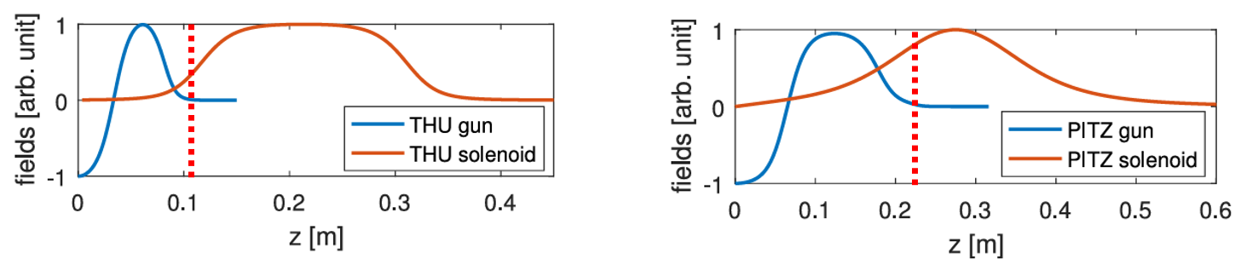
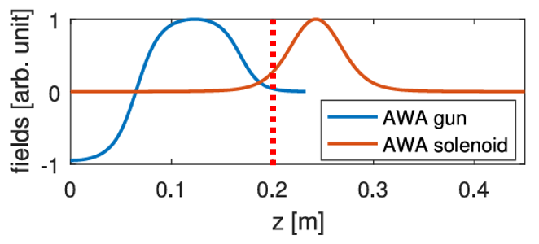
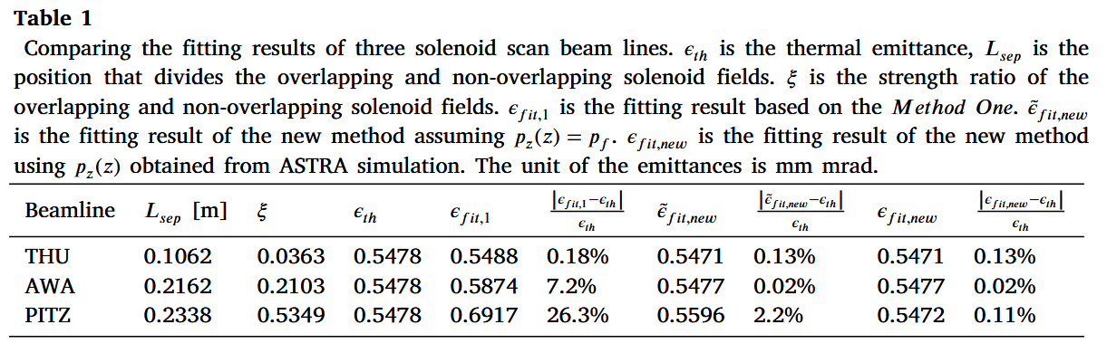
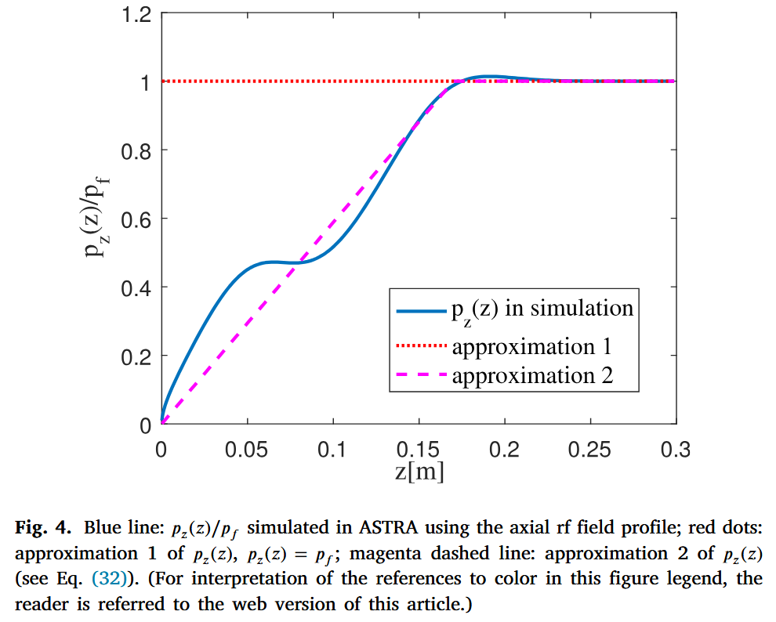




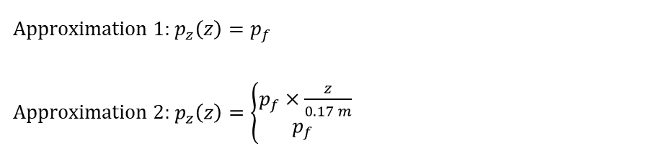
Simulation
Method one
New Method
($p_{z}\left(z\right)=p_{f}$)
New Method
($p_{z}\left(z\right)=ASTRA simulation field profile$)
Further study about $p_{z}\left(z\right)$ approximation in the PITZ beamline
$$p_{z}\left(z\right)=ASTRA simulation field profile$$
⇒ Error of the Thermal Emittance 0.11%
Approximation 1: $p_{z}\left(z\right)=p_{f}$
Approximation 2: $p_{z}\left(z\right)=\left\{\begin{aligned}p_{f}×\frac{z}{0.17 m} \\ p_{f} \end{aligned}\right.$
⇒ Error of the Thermal Emittance 2.2%
, $z<0.17 m$
⇒ Error of the Thermal Emittance 0.09%
, $z≥0.17 m$

Slide 12
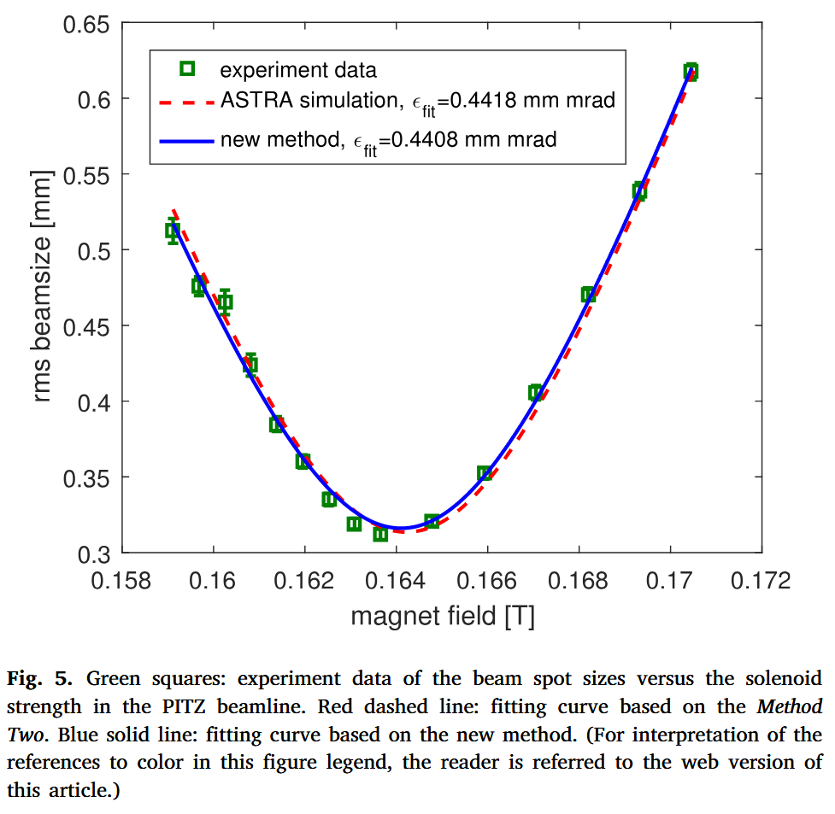
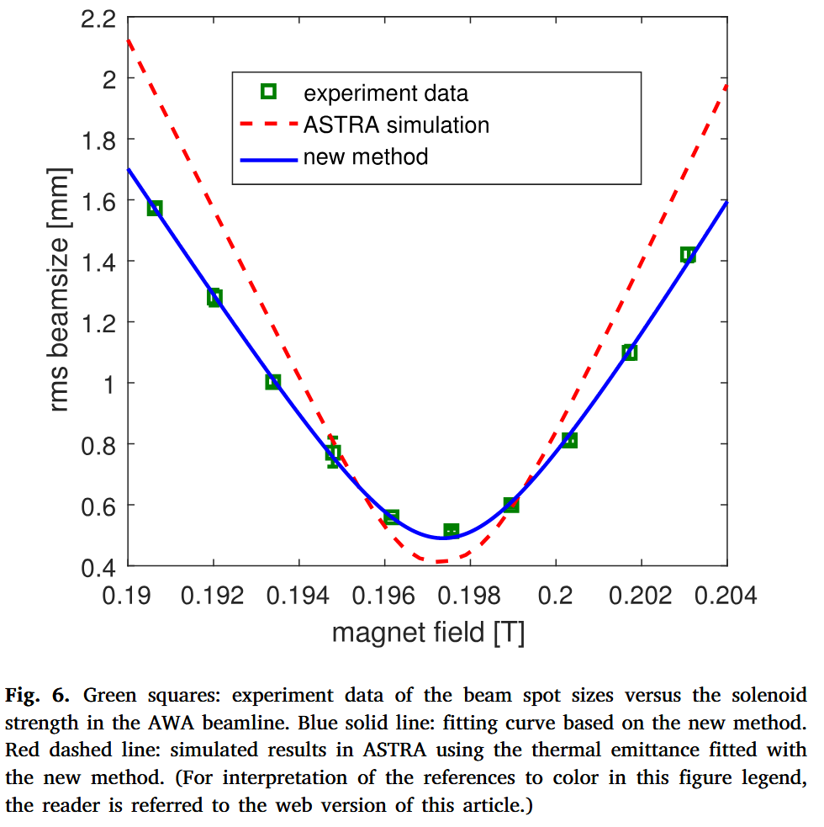
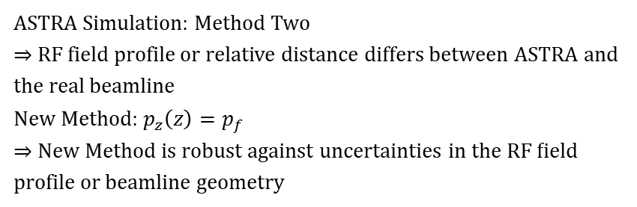
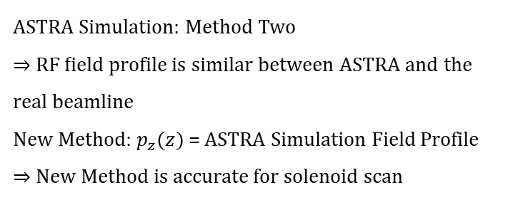
Experiments
PITZ beamline
AWA beamline
ASTRA Simulation: Method Two
⇒ RF field profile is similar between ASTRA and the real beamline
New Method: $p_{z}(z)$ = ASTRA Simulation Field Profile
⇒ New Method is accurate for solenoid scan
ASTRA Simulation: Method Two
⇒ RF field profile or relative distance differs between ASTRA and the real beamline
New Method: $p_{z}\left(z\right)=p_{f}$
⇒ New Method is robust against uncertainties in the RF field profile or beamline geometry

