Slide 1
Improving surrogate model accuracy for the LCLS-2 injector fronted using convolution neural networks and transfer learning
2026. 03. 05
Jang Won

Slide 2
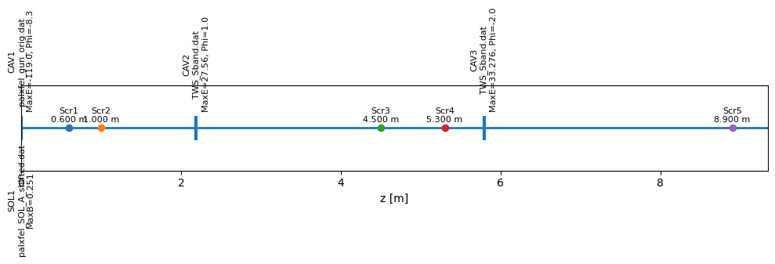
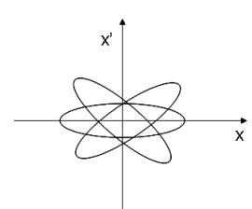
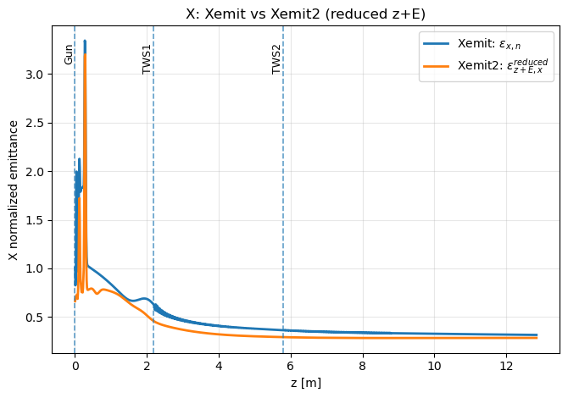
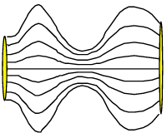
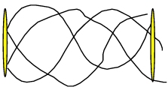
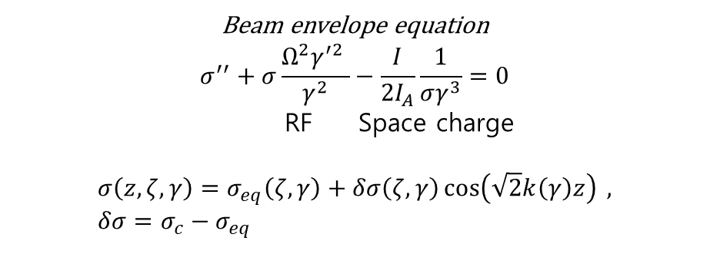
Common injector
Beam envelope equation
$$σ^{′′}+σ\frac{Ω^{2}γ^{′2} }{γ^{2}}−\frac{I}{2I_{A}}\frac{1}{σγ^{3}}=0$$
RF Space charge
$$σ\left(z,ζ,γ\right)=σ_{eq}\left(ζ,γ\right)+δσ\left(ζ,γ\right)\cos\left(\sqrt{2}k\left(γ\right)z\right) , δσ=σ_{c}−σ_{eq}$$
Quasi-laminar
region
Emittance dominated region
freezing

Slide 3
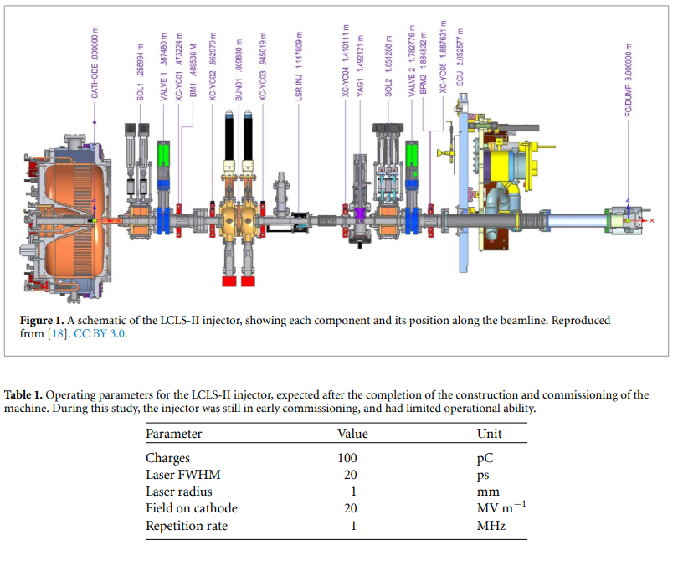
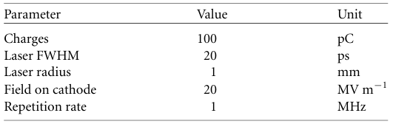
VCC
1~25pC in simulation
High repetition rate$→$limited field gradient $→$injected into buncher up to 750keV

Slide 4
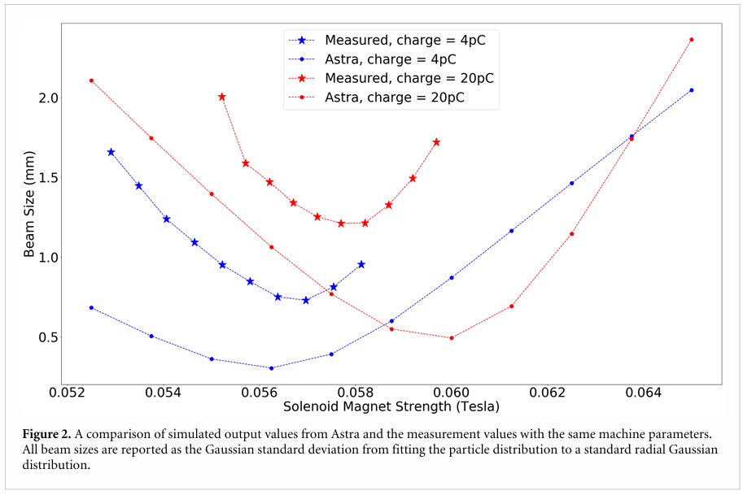
Expected error source:
Gun gradient, laser radius, focal point of solenoid
ASTRA input parameters: Charge, laser radius, gradient, solenoid strength

Slide 5
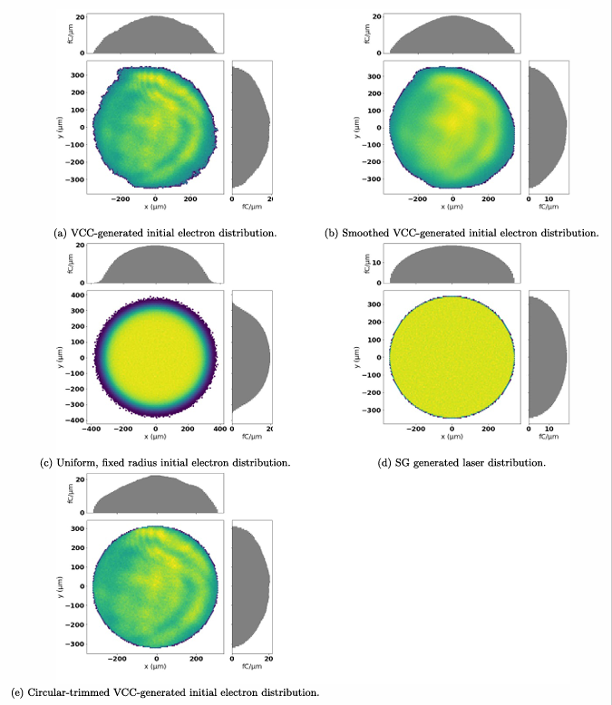
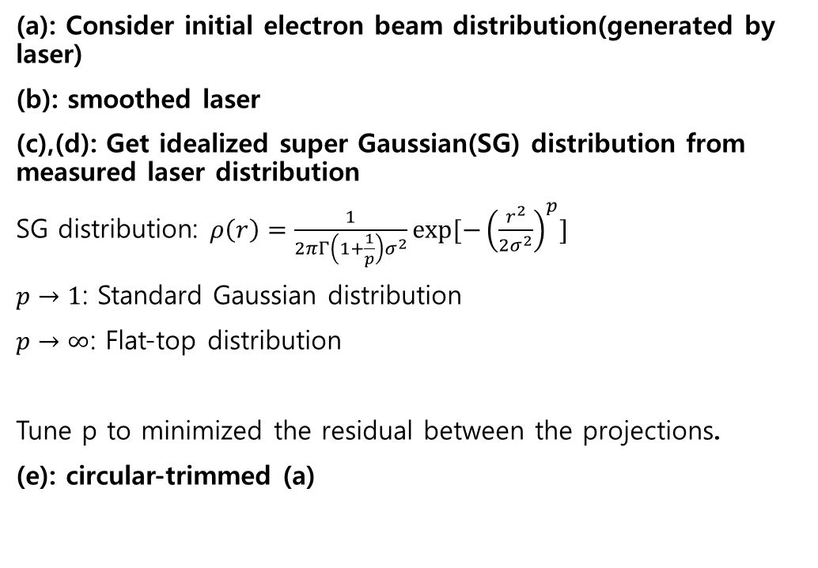
To minimize discrepancies…
(a): Consider initial electron beam distribution(generated by laser)
(b): smoothed laser
(c),(d): Get idealized super Gaussian(SG) distribution from measured laser distribution
SG distribution: $ρ\left(r\right)=\frac{1}{2πΓ\left(1+\frac{1}{p}\right)σ^{2}}\exp{[−{\left(\frac{r^{2}}{2σ^{2}}\right)}^{p}]}$
$p→1$: Standard Gaussian distribution
$p→∞$: Flat-top distribution
Tune p to minimized the residual between the projections.
(e): circular-trimmed (a)
Purpose
(b): sensitivity to the internal structure
(e): sensitivity to rough edge
Simulated by
LUME-Astra
Notes:
10000 macoparticle

Slide 6
VCC

Slide 7
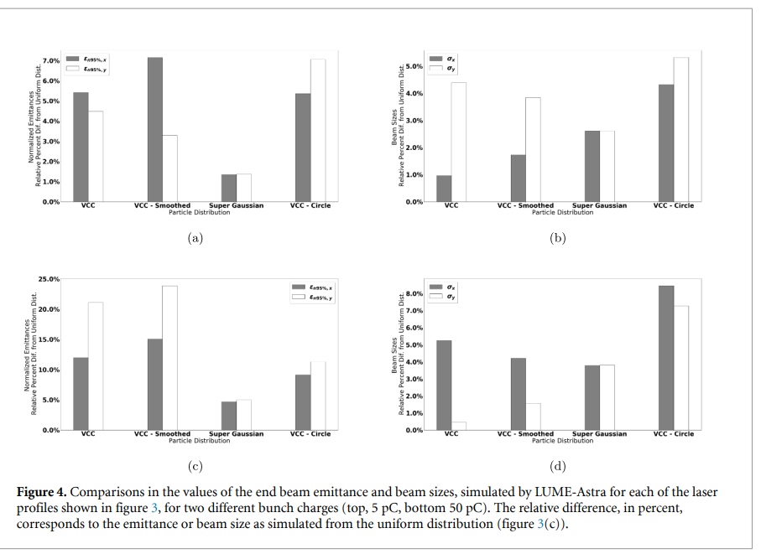
asymmetry of the VCC generated laser distributions
difference in each transverse direction(x,y)
These results suggest that using realistic laser profiles could result in simulated training data which is sufficiently different from that generated from idealized conditions
5pC

Slide 8
Research progress
Make and evaluate base surrogate model for simulation(ASTRA)
-Scalar model (consider idealized laser distribution)
-Vector model (consider real laser distribution)
2. Make new surrogate model by using transfer learning(TL) for measured data
-prototype
-measured data

Slide 9
Convolution neural network (CNN)

Slide 10
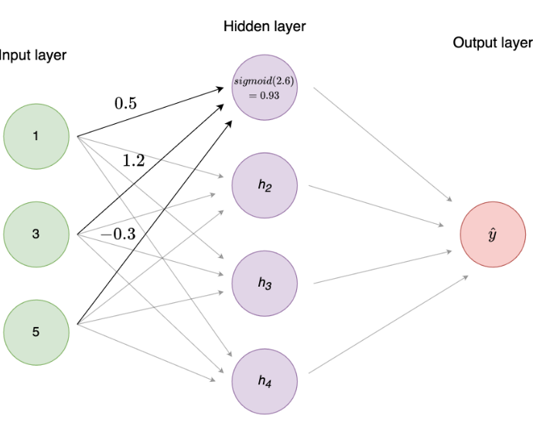
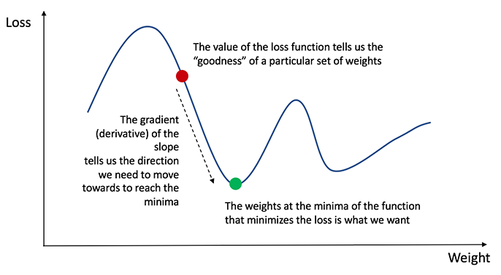
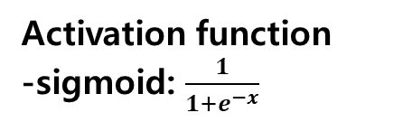
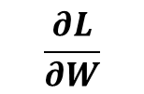
Understanding Neural network
x
y=wx+b
y
Loss function
Regression: MSE, MAE……
Classification: BCE, CCE…..
Purpose: minimize the loss function
weight
Activation function
-sigmoid: $\frac{1}{1+e^{−x}}$
$$\frac{∂L}{∂W}$$
Calculate Gradient descent
Weight update
EX) Optimizer: Gradient descent $W_{new}=W_{old}−α\frac{∂L}{∂W}, α:learning rate$

Slide 11
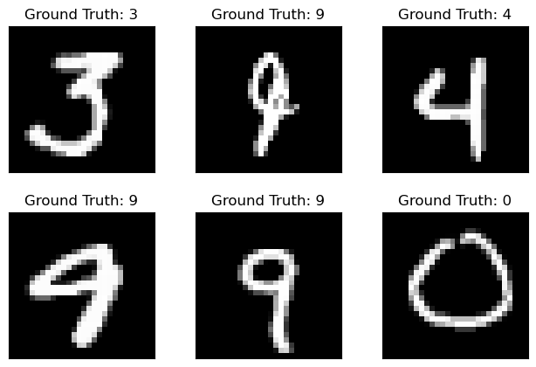
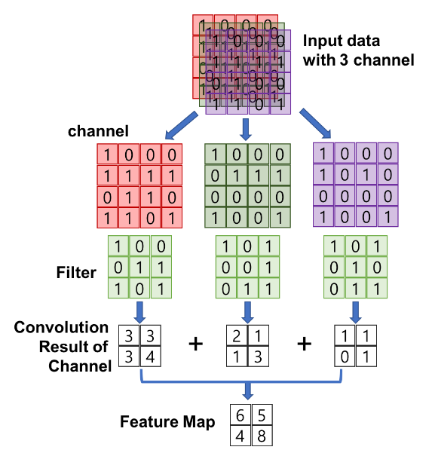
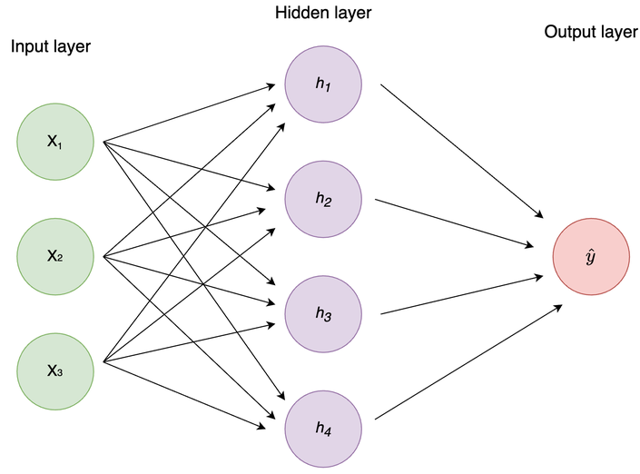
Convolution Neural network
Standard Neural network

Slide 12
A. Scalar model
Generated by standard ASTRA particle generator
입력으로 laser radius(레이저 반지름)만 제공 (레이저 이미지 사용 X)
랜덤 샘플링한 입력 변수:
laser radius
cathode cavity RF phase
beam charge
solenoid strength
각 샘플 구성:
(입력) 위 스칼라 값들
(출력) emittance, beam size 등 벌크(scalar) 빔 파라미터
B. 이미지 기반(CNN) 모델용 데이터
생성 방법: LUME-ASTRA로 시뮬레이션 생성
입력 레이저 분포를 2종으로 생성/사용
이상화 SG(super-Gaussian) 레이저 분포
실측 VCC 레이저 이미지 기반 분포
입력 설정값 샘플링: 레이저 프로파일(이미지) 하나당
2000개의 랜덤 input setting 포인트 생성 → ASTRA 시뮬레이션 수행
데이터 규모(시뮬레이션 샘플 수):
SG 기반 약 60,000 샘플
VCC 기반 약 70,000 샘플
출력(타깃):
YAG에서 측정될 것 같은 전자빔 횡단 분포(50×50 bin)
normalized emittance, beam size 등 스칼라 통계량
(추가로) 빔 분포의 **스칼라 extent(가로/세로 범위)**도 예측 대상에 포함
Frame work: TensorFlow, Keras
Loss function: Mean Squared Error (MSE) 최소화
Optimizer: Adam

Slide 13
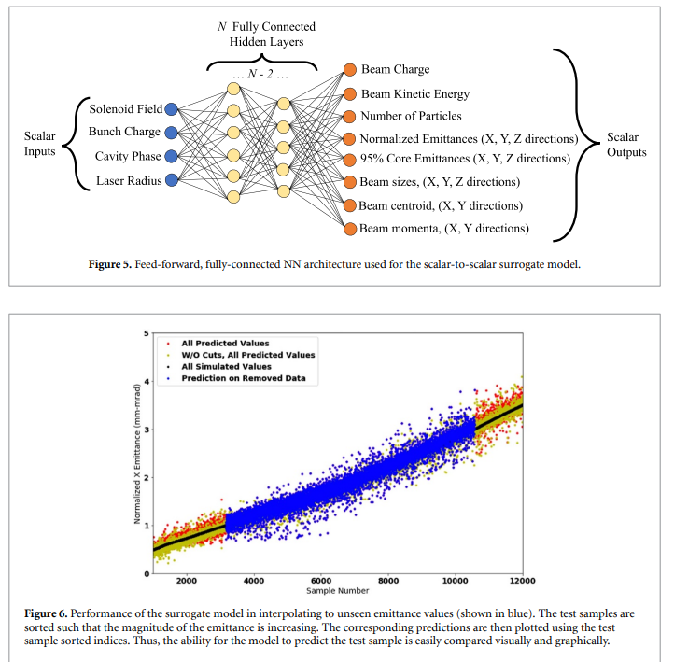
A. Scalar model
Initial electron beams are generated by standard ASTRA particle generator (idealized SG distribution)
Loss function: MSE
Optimizer: Adam

Slide 14
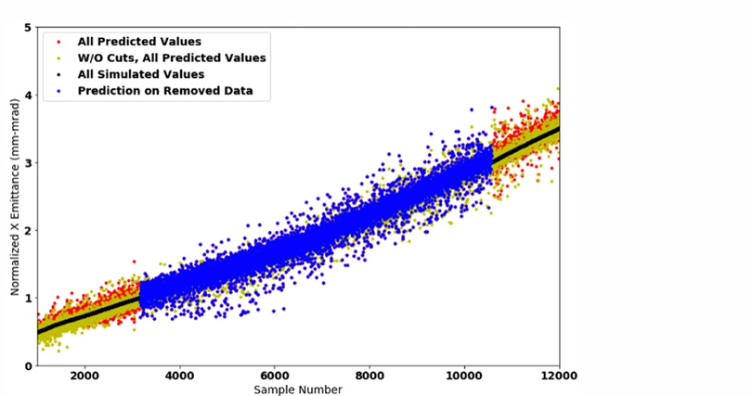
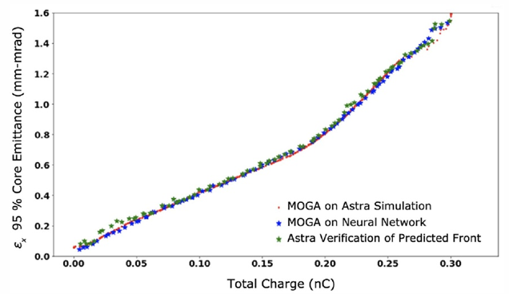
A. Scalar model
Initial electron beams are generated by standard ASTRA particle generator(idealized SG distribution)
Input -> ASTRA -> output->MOGA
Input -> NN -> output->MOGA
Input -> NN -> output->MOGA->……..
optimized input-> ASTRA
NN predictions were verified using ASTRA simulations.
Notes:
fig 6. 데이터 일부를 잘라서 예상값이 잘 들어맞는것을 확인했음
Fig 7. ASTRA/ surrogate model 각각에 대해 moga 수행하였고 같은 경향을 보이는것을 확인했음
세번 째 데이터는 surrogate model로 moga 수행, 생성된 predicted pareto front의 input paramete를 ASTRA에 다시 대입

Slide 15
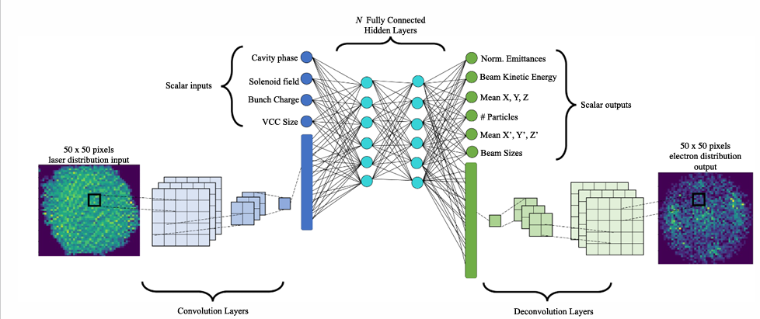
B. VCC image based model
Initial electron beams are generated by measured laser distribution(VCC image).
Loss function: MSE
Optimizer: Adam
encoder
decoder
Notes:
여기서 idealized SG laser distribution

Slide 16
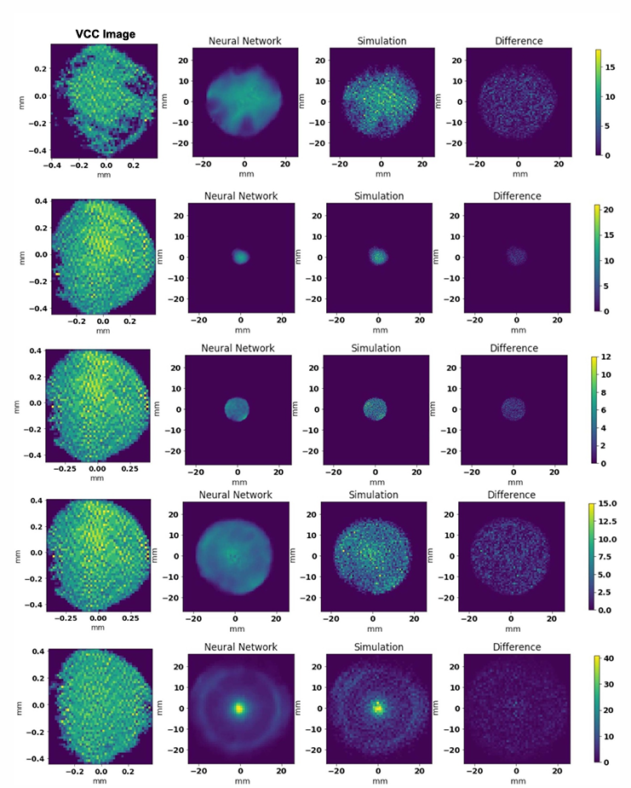
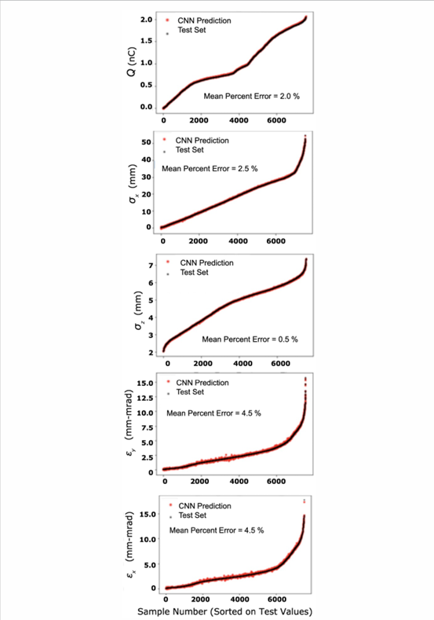
The surrogate model can play a role similar to that of a physics simulator. In addition, the computation time is significantly faster.

Slide 17
Summary
Issue:
The measured values do not agree well with the simulation results.
Final purpose:
Build the surrogate model predicting measured data.
Previous sections:
The ability of the basic surrogate model to reliably evaluate predictions form Astra simulations.
Next step:
Modify the basic surrogate model using transfer learning(TL) to better match the measured data. (Because of very little measured data)

Slide 18
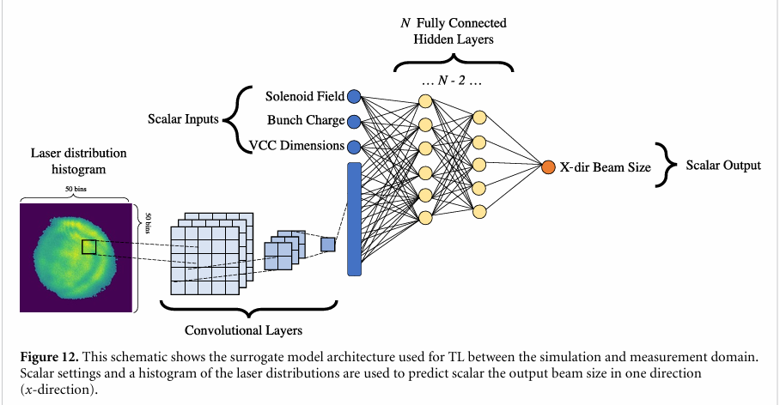
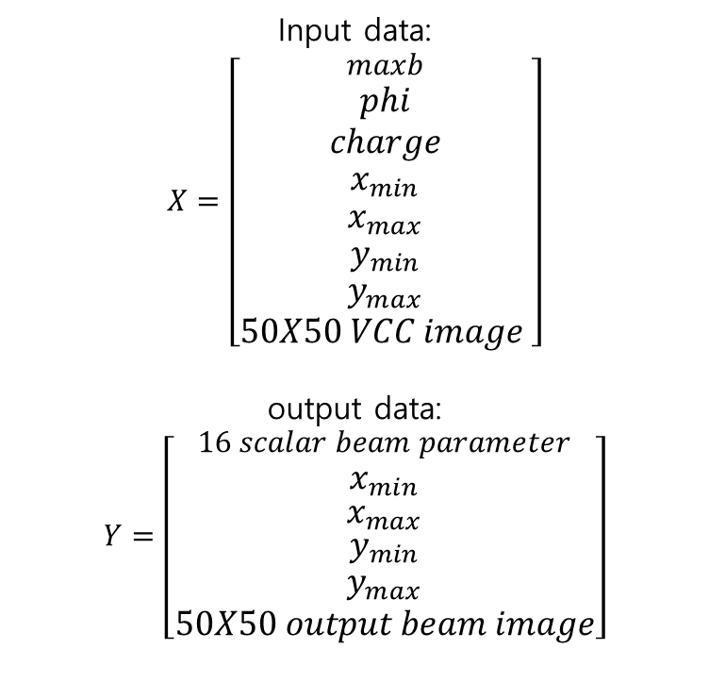
Input data:
$$X=\left[\begin{aligned}maxb \\ phi \\ charge \\ x_{min} \\ x_{max} \\ y_{min} \\ y_{max} \\ 50X50 VCC image \end{aligned}\right]$$
output data:
$$Y=\left[\begin{aligned}\begin{aligned}\begin{aligned}16 scalar beam parameter \\ x_{min}\end{aligned} \\ x_{max}\end{aligned} \\ y_{min} \\ y_{max} \\ 50X50 output beam image\end{aligned}\right]$$
Consider the size of image
end_core_emit_95percent_x,y,z
end_mean_kinetic_energy
End_mean_x,y,z
end_n_particle_loss
End_norm_emit_x,y,z
End_sigma_x,y,z,Xp,Yp,Zp
End_total_charge

Slide 19
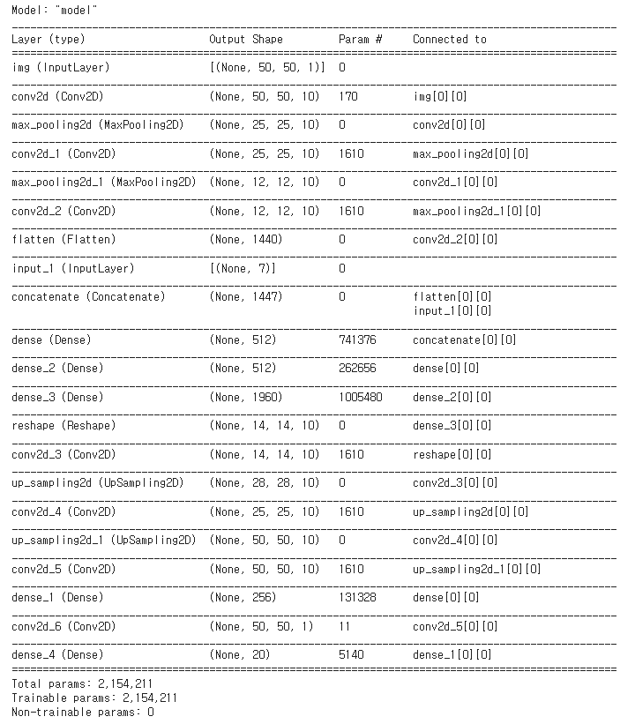
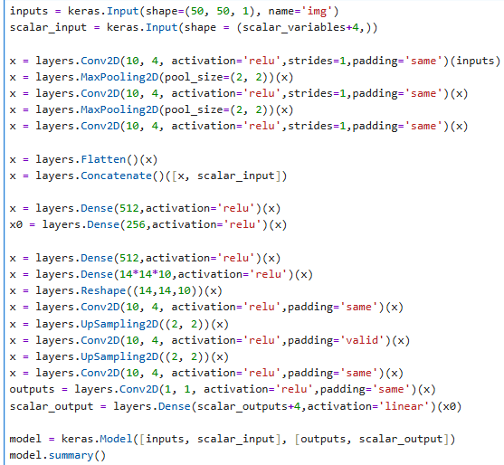
1. CNN encoder
2. Concatenate Image feature+scalar_input
3. Fully conentcion
(Standard NN)
4. Decoder
Notes:
x = layers.Conv2D(10, 4, activation='relu',strides=1,padding='same')(inputs) 커널 개수, 커널 사이즈, activation function, 이동 간격, padding 방식 same, full,……,
x = layers.MaxPooling2D(pool_size=(2, 2))(x) pool size 2x2, 최대값만 남김
x = layers.Flatten()(x) : scalar parmeter하고 합치려고
x = layers.Dense(512,activation='relu')(x) 커널 사이즈 1, fully connected
x = layers.UpSampling2D((2, 2))(x) 한 픽셀을 2x2 로 키움

Slide 20
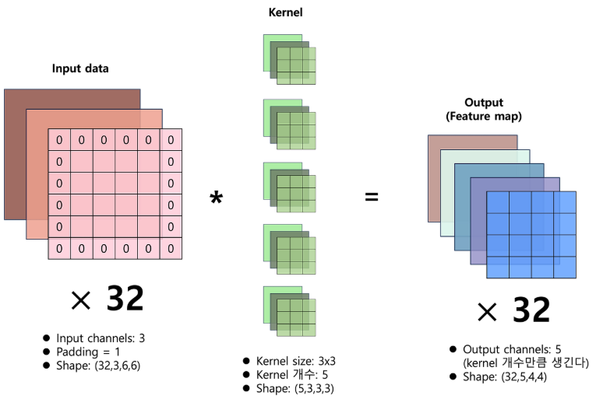
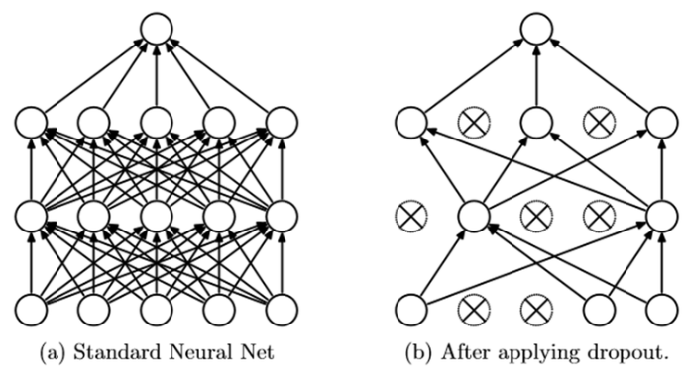
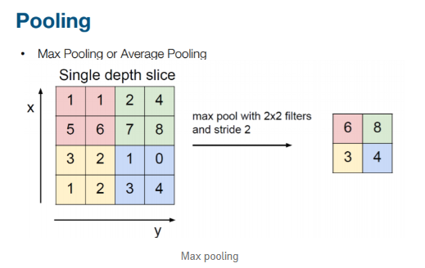
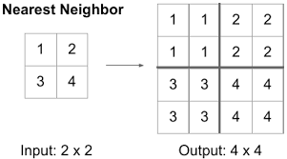
Conv2D
Drop out
Maxpooling
Upsampling
Notes:
x = layers.Conv2D(10, 4, activation='relu',strides=1,padding='same')(inputs) 커널 개수, 커널 사이즈, activation function, 이동 간격, padding 방식 same, full,……,
x = layers.MaxPooling2D(pool_size=(2, 2))(x) pool size 2x2, 최대값만 남김
x = layers.Flatten()(x) : scalar parmeter하고 합치려고
x = layers.Dense(512,activation='relu')(x) 커널 사이즈 1, fully connected
x = layers.UpSampling2D((2, 2))(x) 한 픽셀을 2x2 로 키움

Slide 21
Prototype
To confirm the TL model agree well with the ASTRA
Base model:
Input parameter: generated by SG Laser distribution
(Train the base until the MSE loss did not decrease over several training epochs)
Retrain model:
Input parameter: generated by VCC image based simulation
1. CNN encoder
2. Concatenate Image feature+scalar_input
3. Fully conentcion
(Standard NN)
Freeze
4. Decoder
+Dropout
Notes:
x = layers.Conv2D(10, 4, activation='relu',strides=1,padding='same')(inputs) 커널 개수, 커널 사이즈, activation function, 이동 간격, padding 방식 same, full,……,
x = layers.MaxPooling2D(pool_size=(2, 2))(x) pool size 2x2, 최대값만 남김
x = layers.Flatten()(x) : scalar parmeter하고 합치려고
x = layers.Dense(512,activation='relu')(x) 커널 사이즈 1, fully connected
x = layers.UpSampling2D((2, 2))(x) 한 픽셀을 2x2 로 키움

Slide 22
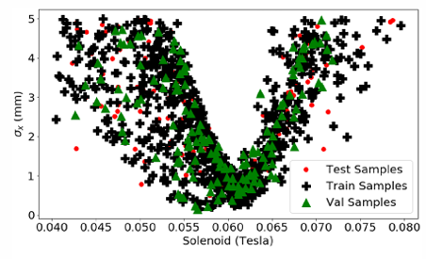
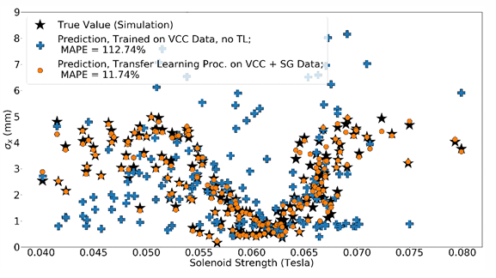
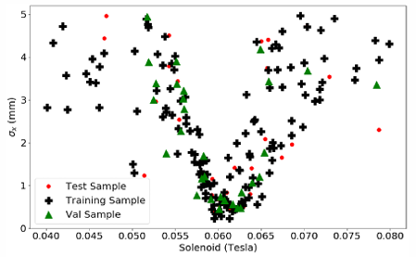
Prototype
Input samples
SG based train
Test: 700
Validation: 150
Test 151
Result
VCC based-simulation train
(repeat 5 times)
Test: 140
Validation: 30
Test 30
Notes:
True value도 시뮬레이션

Slide 23
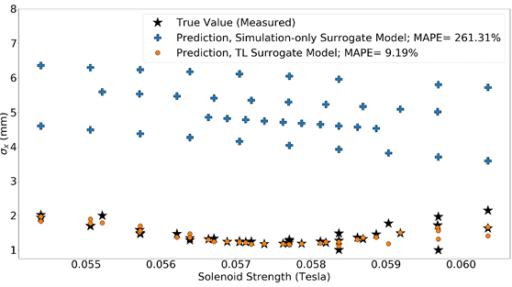
TL to measured data
Base model:
Inputs: generated by SG Laser distribution+ VCC image based simulation
(Train the base until the MSE loss did not decrease over several training epochs)
Retrain model:
Inputs: measured data
Prototype과 동일하게 학습했을 때
큰 systematic differences 존재
->더 많은 fully connected layer를 unfreeze
1. CNN encoder
2. Concatenate Image feature+scalar_input
3. Fully conentcion
(Standard NN)
4. Decoder
정확히 어디까지 freeze 시켰는지는 안나옴…..
Notes:
x = layers.Conv2D(10, 4, activation='relu',strides=1,padding='same')(inputs) 커널 개수, 커널 사이즈, activation function, 이동 간격, padding 방식 same, full,……,
x = layers.MaxPooling2D(pool_size=(2, 2))(x) pool size 2x2, 최대값만 남김
x = layers.Flatten()(x) : scalar parmeter하고 합치려고
x = layers.Dense(512,activation='relu')(x) 커널 사이즈 1, fully connected
x = layers.UpSampling2D((2, 2))(x) 한 픽셀을 2x2 로 키움

Slide 24
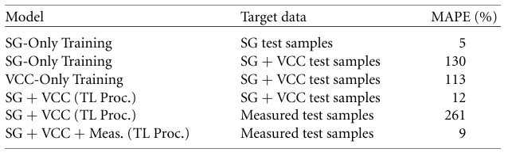
A scalar surrogate model based on simulation data was developed and shown to be effective for multi-objective optimization
Including VCC images in the training process improves the model’s ability to predict simulated beam.
Transfer learning from idealized SG simulations to VCC-based simulations enables the model to reproduce ASTRA simulation results for both ideal and realistic laser distribution.
Applying TL from simulation to measured data reduces error for measured beam parameter.
More fully connected layers are unfrozen during TL to measured data because systematic discrepancies exist between simulation and the real machine.
The earlier CNN layers are kept frozen since the spatial information in the VCC images remains valid features for accurate prediction.

