Slide 1

2026. 03. 06, Pohang, S. Korea.
CAPhE Lab Meeting
Beam dynamics and Instability study
Department of Physics, POSTECH
Boseong Kwon

Slide 2
Contents
1. Intro
2. Robinson Instability
- Theory
- Simulation
- Issues
3. (Strong) Head-Tail Instability
- Theory
- Simulation
- Issues
4. Summary & Plan

Slide 3
Intro

Slide 4
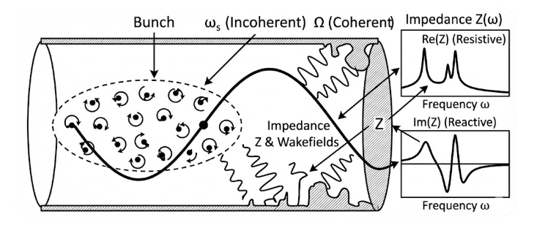
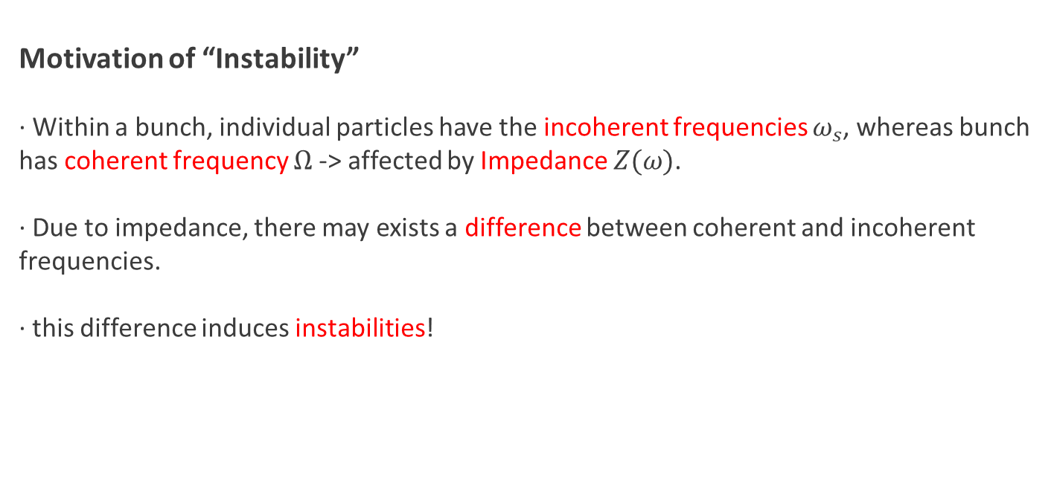
Basic Concepts of Instability
Motivation of “Instability”
· Within a bunch, individual particles have the incoherent frequencies $ω_{s}$, whereas bunch has coherent frequency $Ω$-> affected by Impedance $Z(ω)$.
· Due to impedance, there may exists a difference between coherent and incoherent frequencies.
· this difference induces instabilities!

Slide 5
Fundamental Mechanism of Instability
Longitudinal interaction
· Source: Beam intensity, Interference of structure
· Effects: Wake changes the phase and velocity of the particles, crushing or stretching the shape of the bunch back and forth. -> causes energy loss & gain!
· Results: Synchrotron tune, Energy spread
Transverse interaction
· Source: Beam displacement
· Effects: The preceding particles induce an asymmetric image current on the structure wall, resulting wake exerts a kick on the particles that follow.
· Results: Beam Emittance

Slide 6
Robinson Instability

Slide 7
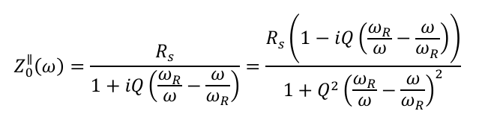
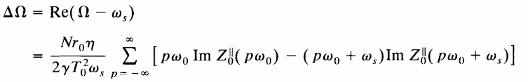
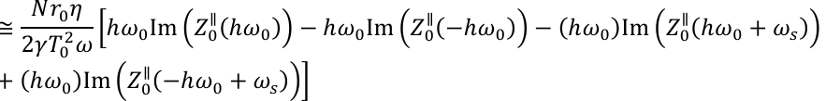





Robinson Instability
Theory
· Frequency difference(Complex) $Ω−ω_{s}$
-> Mode frequency shift(real part)
approximated equation($Δω≪ω_{R}/2Q)$
Growth rate(imaginary part)
approximated equation($Δω≪ω_{R}/2Q)$

Slide 8
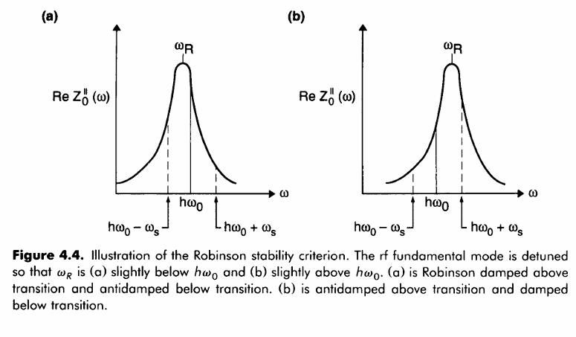


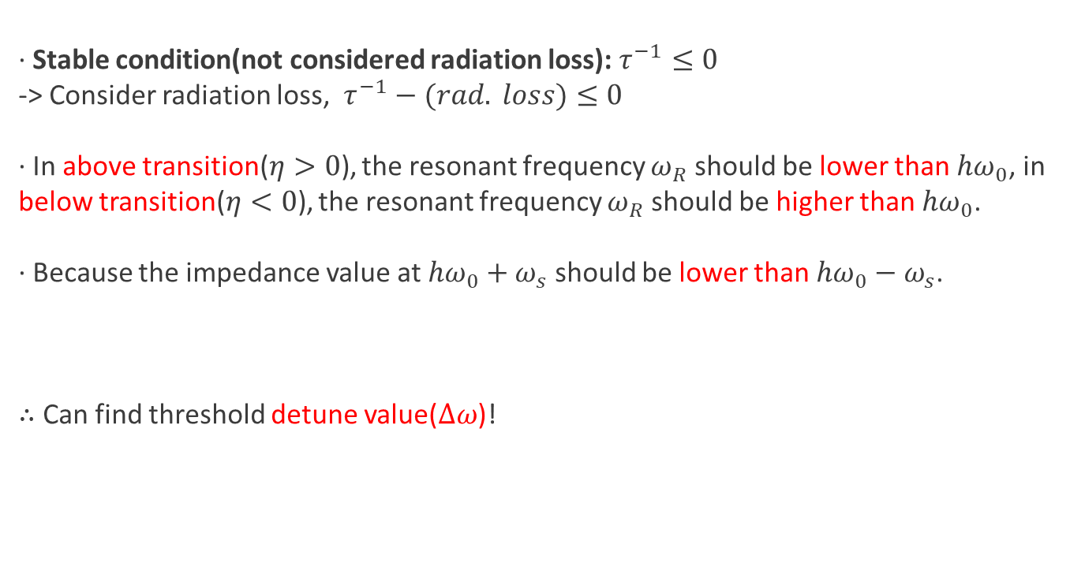
Robinson Instability
Robinson stability criterion
· Stable condition(not considered radiation loss): $τ^{−1}≤0$
-> Consider radiation loss, $τ^{−1}−(rad. loss)≤0$
· In above transition($η>0$), the resonant frequency $ω_{R}$ should be lower than $hω_{0}$, in below transition($η<0$), the resonant frequency $ω_{R}$ should be higher than $hω_{0}$.
· Because the impedance value at $hω_{0}+ω_{s}$ should be lower than $hω_{0}−ω_{s}$.
$∴$ Can find threshold detune value($Δω$)!
$$τ^{−1}$$
$$<0$$

Slide 9
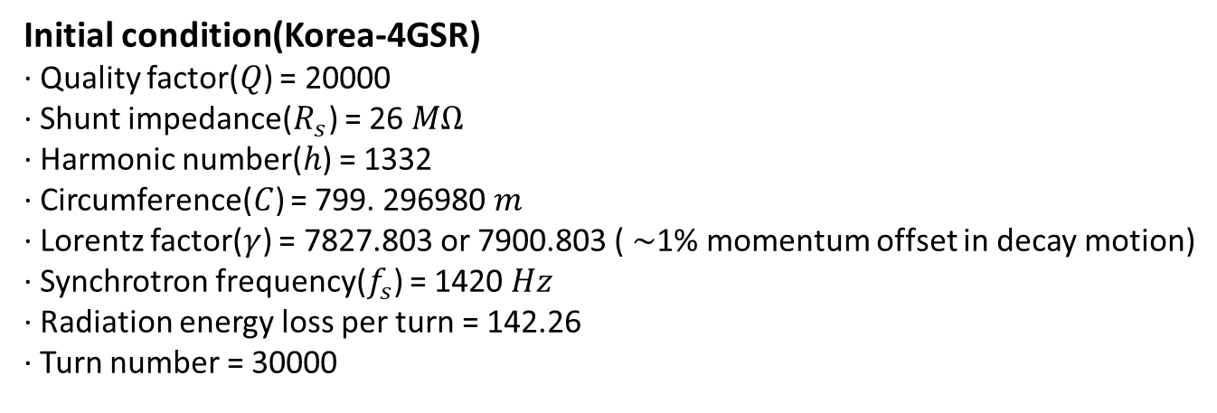
Simulations
Goals
Find the boundary detune between the growth oscillation and the decay oscillation
Find the growth rate of a single bunch according to the detune and compare it with a theoretical curve
Find the frequency shift of a single bunch according to the detune and compare it with a theoretical curve occurred issue!
Initial condition(Korea-4GSR)
· Quality factor($Q$) = 20000
· Shunt impedance($R_{s}$) = 26 $MΩ$
· Harmonic number($h$) = 1332
· Circumference($C$) = 799. 296980 $m$
· Lorentz factor($γ$) = 7827.803 or 7900.803 ( $\sim$1% momentum offset in decay motion)
· Synchrotron frequency($f_{s}$) = 1420 $Hz$
· Radiation energy loss per turn = 142.26
· Turn number = 30000

Slide 10
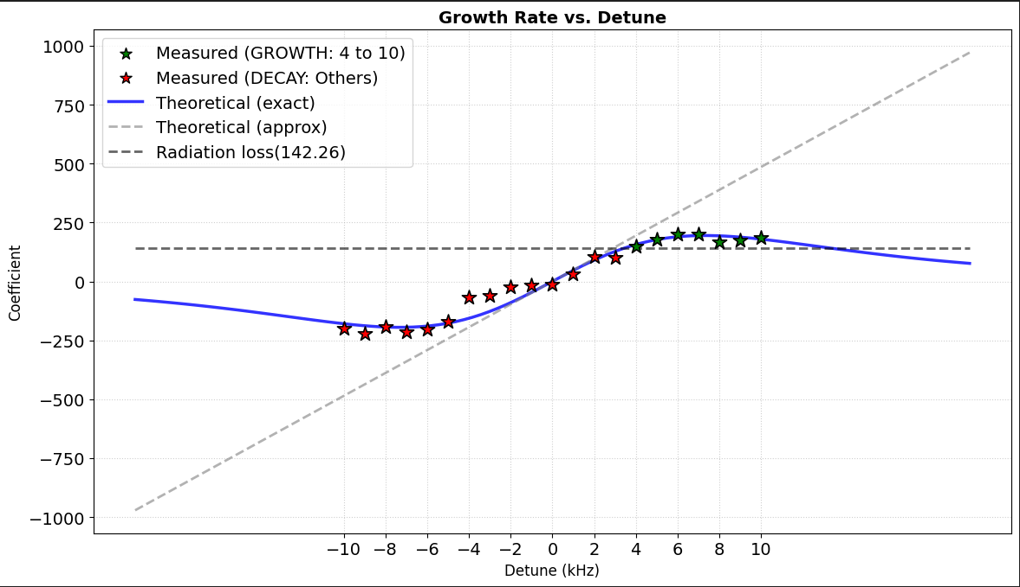
Simulations (Goal 1, 2)
Results
· By considering radiation loss, the boundary point appeared near 4kHz detune.
· The measured data fit their theoretical lines.

Slide 11
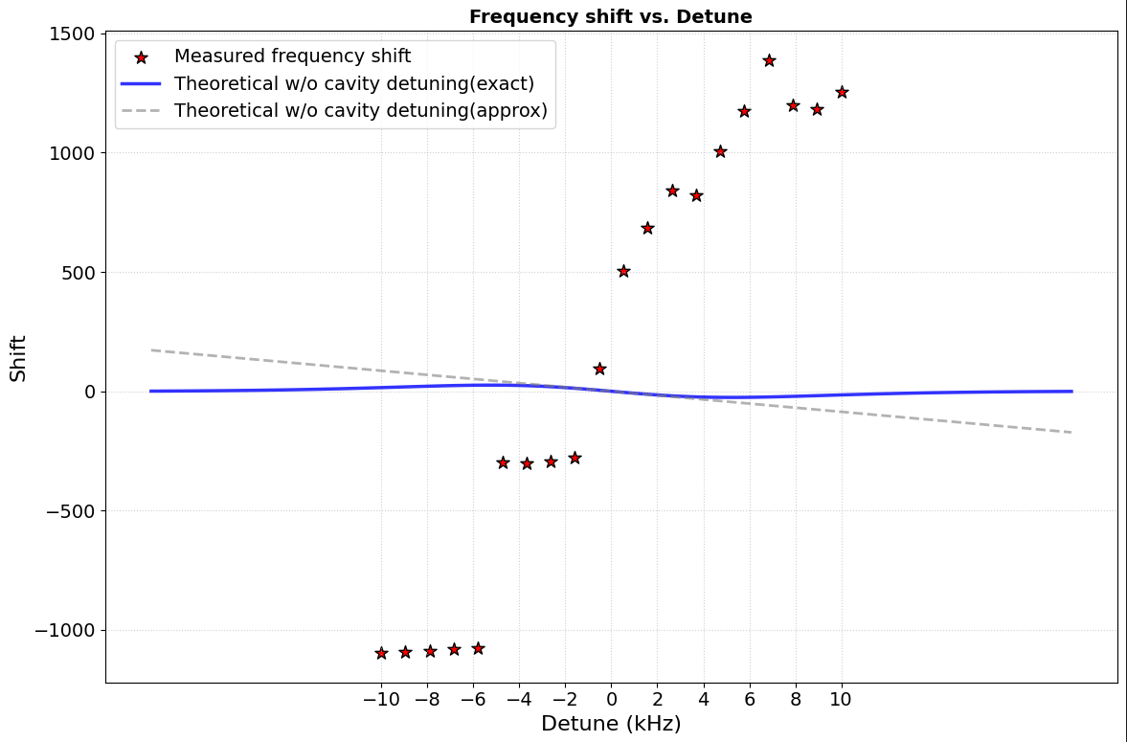
Simulations (Goal 3)
Results
· The measured data do not fit with theoretical lines!
Why?

Slide 12
Issues
Questions
Why did this phenomenon occur? ( = What additional factors should be considered?)
Then, What is the correct theoretical line?
How can we analyze physically?
· Find papers related this phenomenon…
Takaaki Yamaguchi et al., "Systematic study on the static Robinson instability in an electron storage ring," Physical Review Accelerators and Beams 26, no. 4 (April 2023): 044401,
S. Sakanaka et al., "Measurement of Coherent Synchrotron Frequencies under Conditions Close to the Robinson Limit at the Aichi Synchrotron Radiation Center," in Proceedings of the 15th International Particle Accelerator Conference (IPAC'24), Nashville, TN, USA (May 2024): 2209-2212,

Slide 13
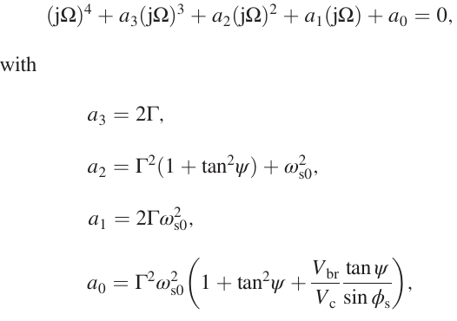

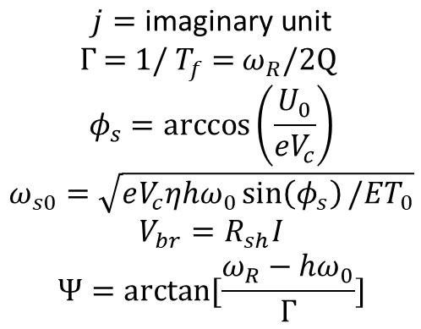
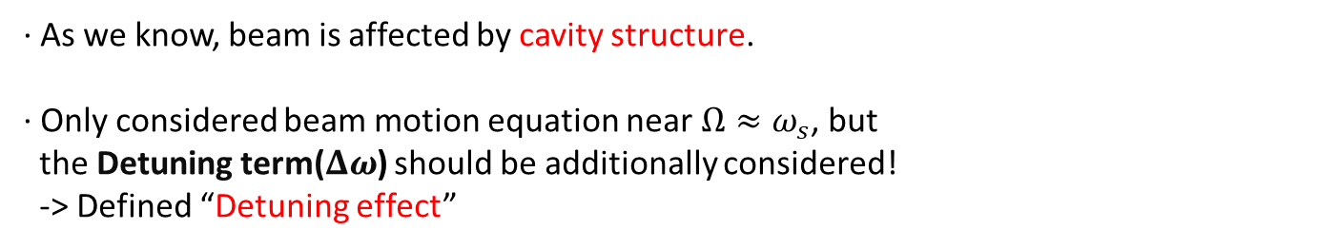
Issues
Standard $4^{th}$-Order Characteristic Equation
· As we know, beam is affected by cavity structure.
· Only considered beam motion equation near $Ω≈ω_{s}$, but
the Detuning term($Δω$) should be additionally considered!
-> Defined “Detuning effect”
$$j=\text{imaginary} \text{unit}$$
$$Γ\text{ = 1/ }T_{f}\text{ = }ω_{R}/2\text{Q}$$
$$φ_{s}=\arccos\left(\frac{U_{0}}{eV_{c}}\right)$$
$$ω_{s0}=\sqrt{eV_{c}ηhω_{0}\sin\left(φ_{s}\right)/ET_{0}}$$
$$V_{br}=R_{sh}I$$
$$Ψ=arctan⁡[\frac{ω_{R}−{hω}_{0}}{Γ}]$$
Can solve numerically by inserting above parameters!

Slide 14
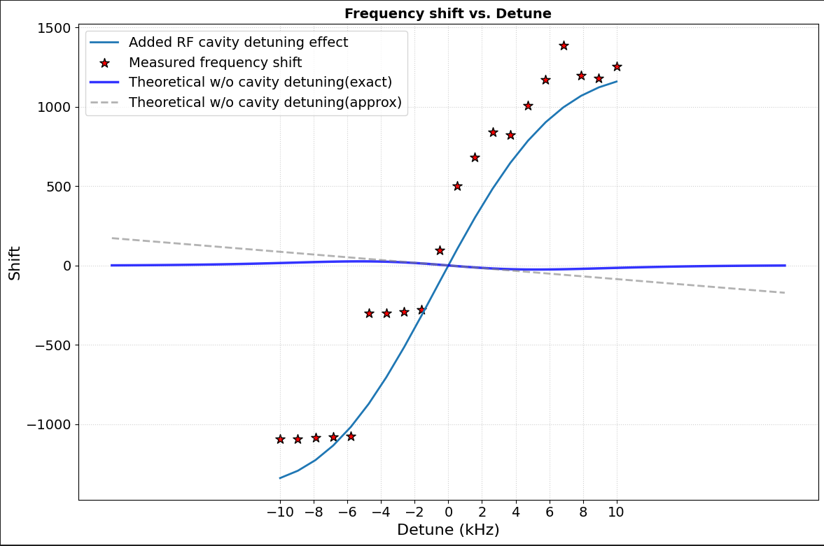
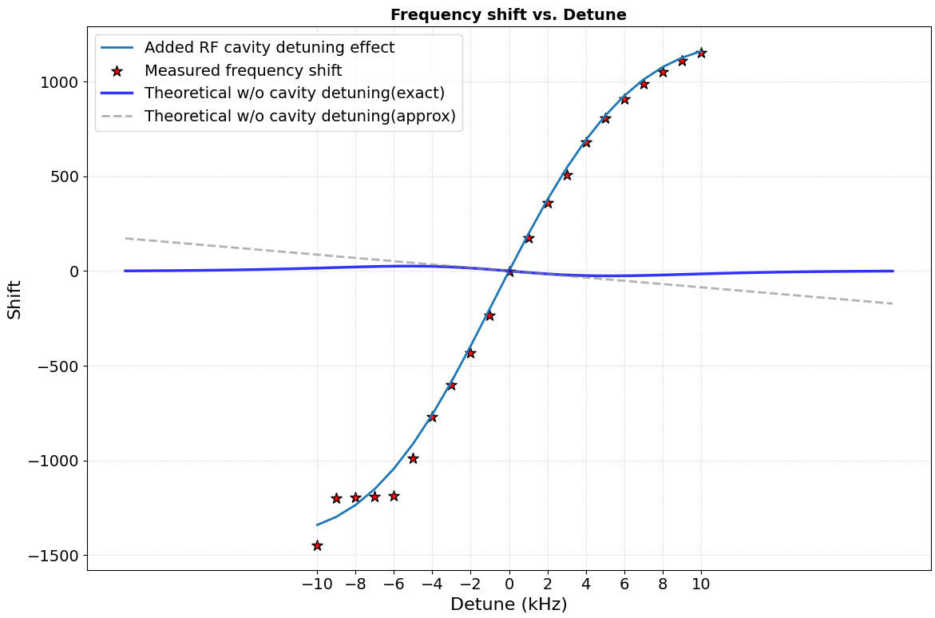
Simulation (Goal 3)
Results
Left is single-particle, right is multi-particle.
· The measured data fit detuning effect line.
· Confirmed that the multi-particle Bunch fits better than the single-particle Bunch!

Slide 15
Head-Tail Instability

Slide 16
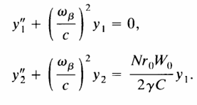


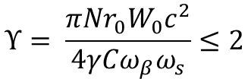
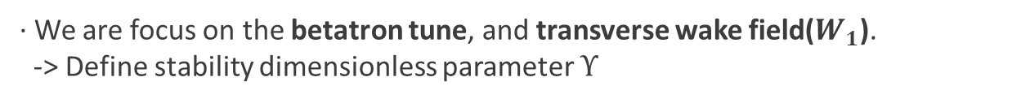
Strong Head-Tail Instability
Theory
· Treat the dipole beam, describe the equation of motion as leading particle($y_{1}$), following particle($y_{2}$).
· We are focus on the betatron tune, and transverse wake field($W_{1}$).
-> Define stability dimensionless parameter $Υ$
$$Υ= \frac{πNr_{0}W_{0}c^{2}}{4γCω_{β}ω_{s}}≤2$$
$$N_{th}= \frac{8γCω_{β}ω_{s}}{πr_{0}W_{0}c^{2}}$$
· Stable condition

Slide 17
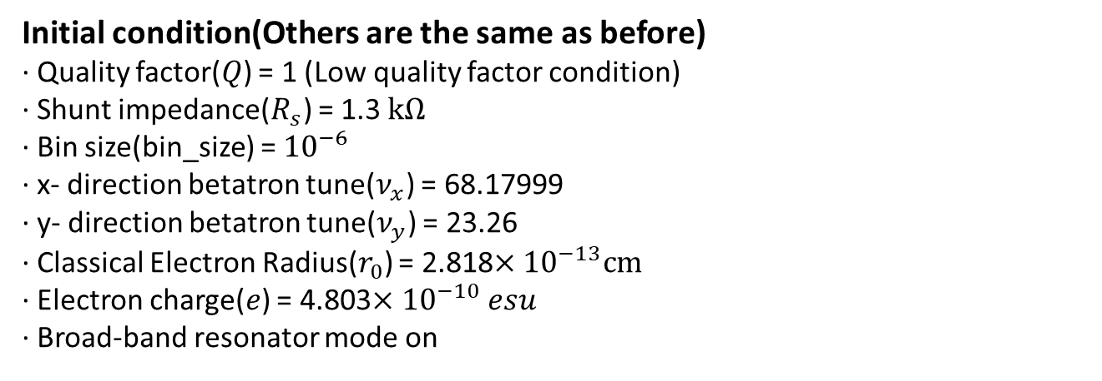
Simulations
Goals
Find the transverse wake field analytically
Find the threshold current of a multi bunch according to the current and compare it with a theoretical value occurred issue!
Initial condition(Others are the same as before)
· Quality factor($Q$) = 1 (Low quality factor condition)
· Shunt impedance($R_{s}$) = 1.3 $kΩ$
· Bin size(bin_size) = ${10}^{−6}$
· x- direction betatron tune($ν_{x}$) = 68.17999
· y- direction betatron tune($ν_{y}$) = 23.26
· Classical Electron Radius($r_{0}$) = 2.818$×{10}^{−13}cm$
· Electron charge($e$) = 4.803$×{10}^{−10} esu$
· Broad-band resonator mode on

Slide 18
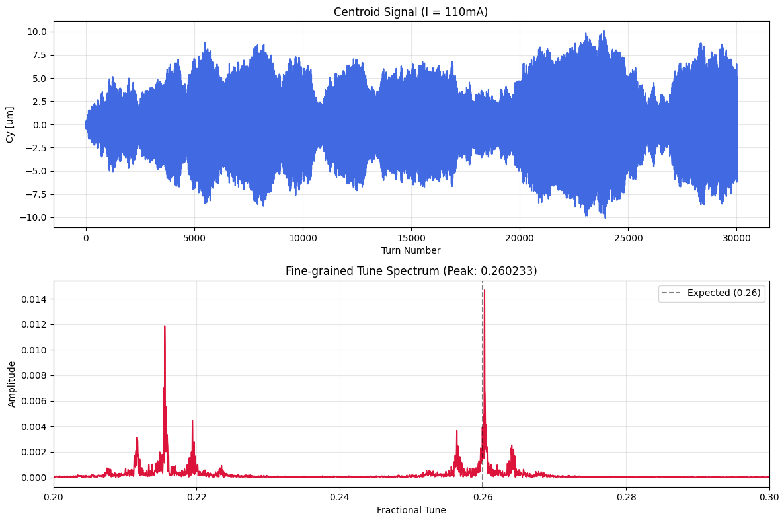
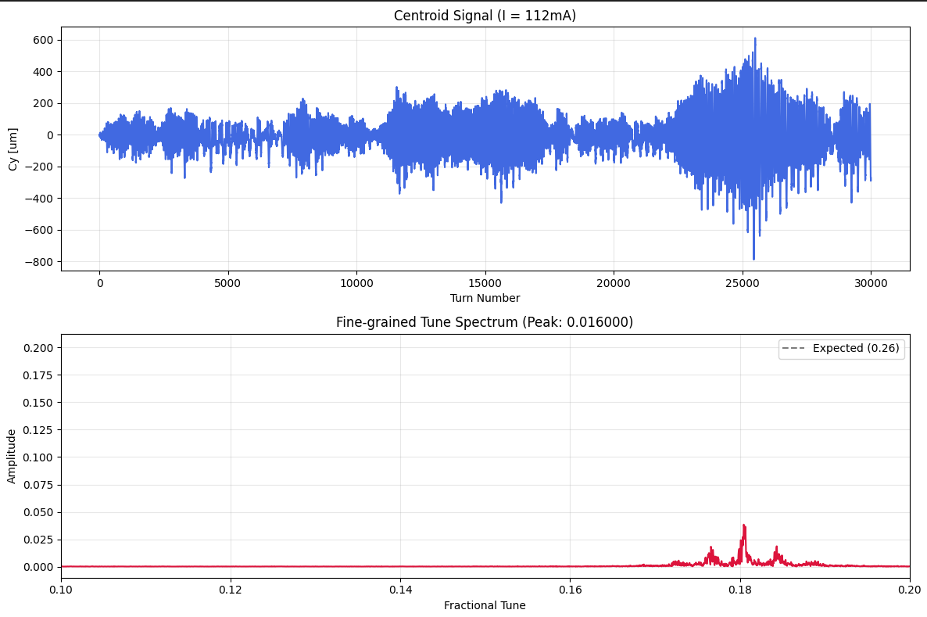
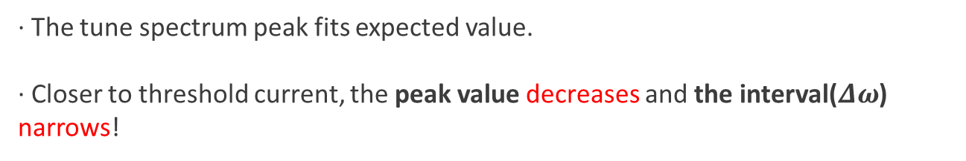
Simulation (Goal 3)
Results
· The tune spectrum peak fits expected value.
· Closer to threshold current, the peak value decreases and the interval($Δω$) narrows!

Slide 19
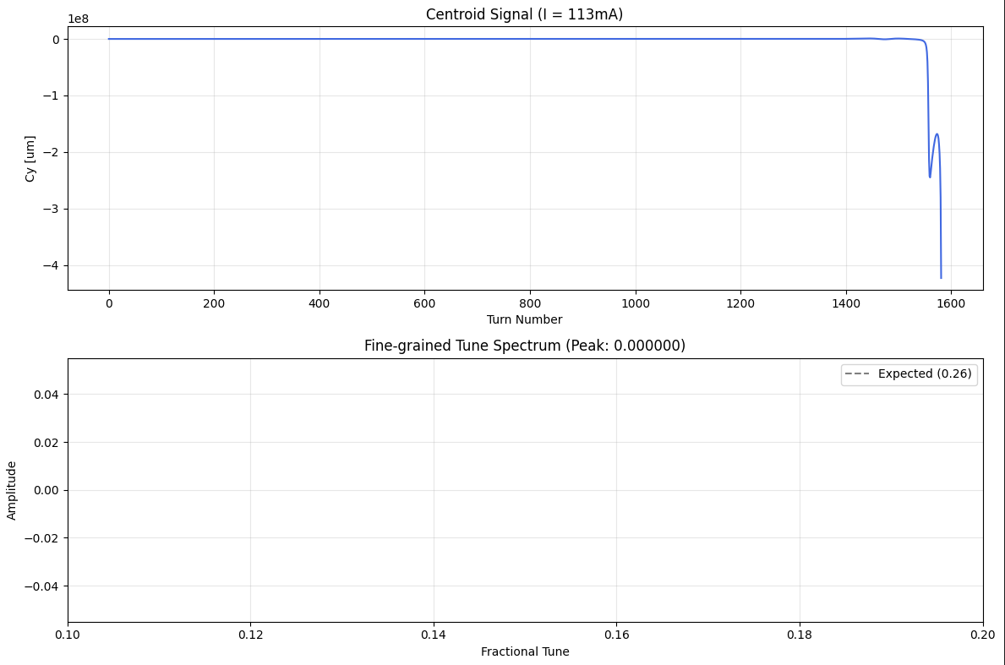
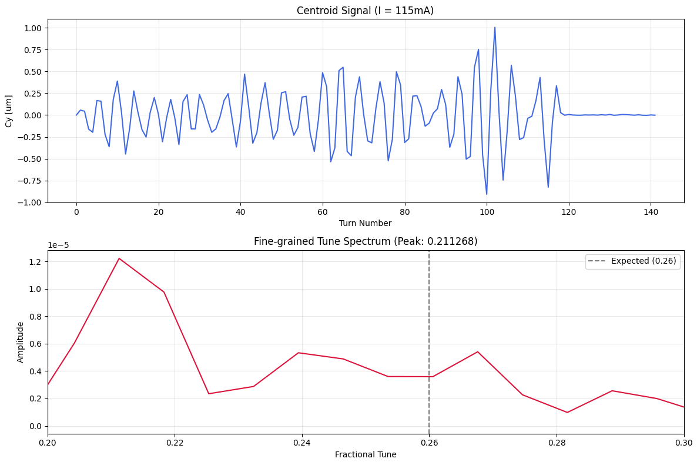
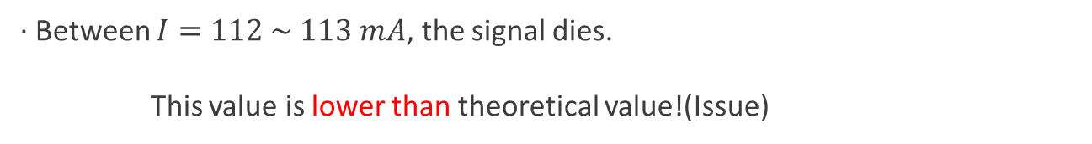
Simulation (Goal 3)
Results
· Between $I=112 \sim 113 mA$, the signal dies.
This value is lower than theoretical value!(Issue)

Slide 20
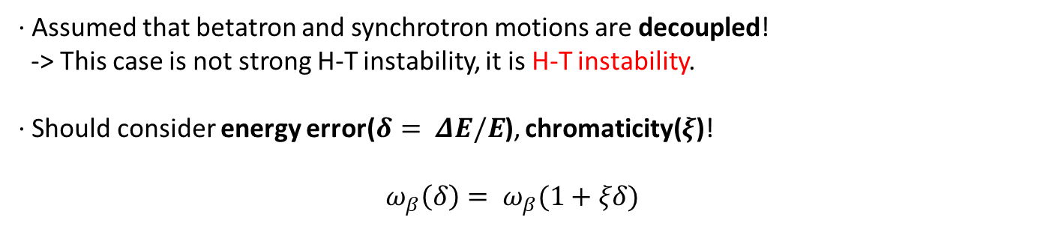

Issues
Why & How?
· Assumed that betatron and synchrotron motions are decoupled!
-> This case is not strong H-T instability, it is H-T instability.
· Should consider energy error($δ= ΔE/E$), chromaticity($ξ$)!
$ω_{β}\left(δ\right)= ω_{β}(1+ξδ)$
$$Υ → Υ(ξ)$$
Can solve numerically by inserting above parameters!

Slide 21
Summary & Plan

Slide 22
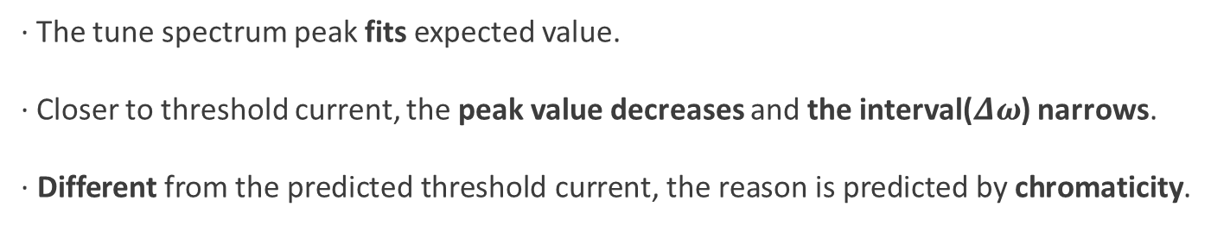
Summary
Robinson Instability
· The single-particle bunch tends to fit the theoretical growth rate curve.
· The single-particle bunch was not fit with the theoretical frequency shift curve.
· The frequency shift fits with the prediction considering the detuning effect, better multi-particle bunch than single-particle.
Head-Tail Instability
· The tune spectrum peak fits expected value.
· Closer to threshold current, the peak value decreases and the interval($Δω$) narrows.
· Different from the predicted threshold current, the reason is predicted by chromaticity.

Slide 23
Research Plan
Short-term plan
· Start Landau damping studying(Ch. 5 of Chao.).
· Make an abstract to register KPS meeting in April.
Long-term plan(~March.)
· Make an internal note with Ch. 5 of Chao.
· Prepare the presentation about KPS meeting in April.

Slide 24
Thank you!

Slide 25
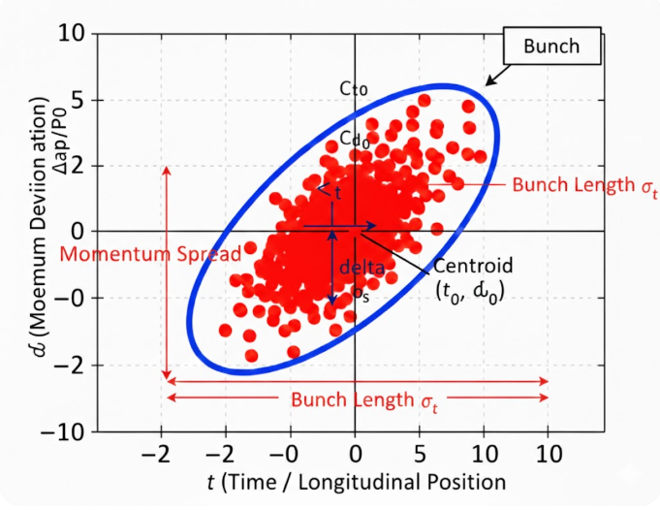
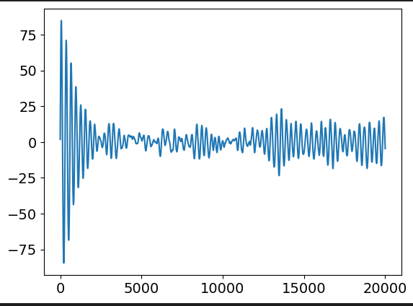
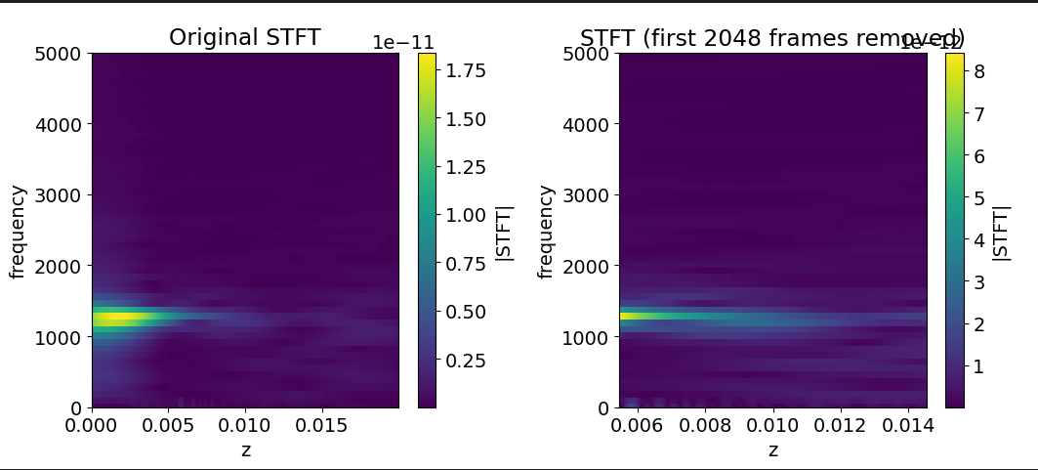
Appendix A. Simulations (Goal 1, 2)
Process of simulation
· Load SDDS file as .wpp0 and read centroid delta value(Cdelta).
· Perform Short Time Fourier Transform(STFT) in frequency domain.

Slide 26
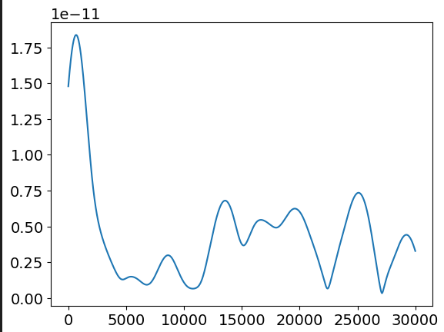
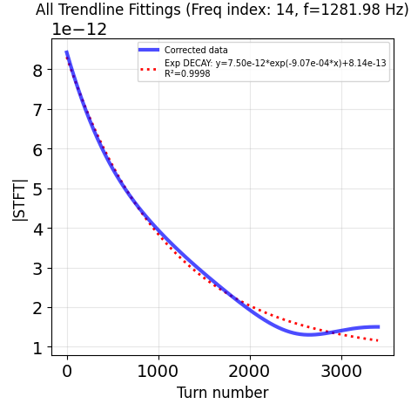
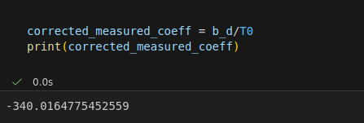

Appendix A. Simulations (Goal 1, 2)
Process of simulation
· Plot turn-signal graph and find exponential trendline.
· Read the coefficient of the exponential term( read $b$ if $y=Ae^{−bx}+C$)
-> to transform from z-axis to t-axis, divide $T_{0}=2π/ω_{0}=C/c$.

Slide 27
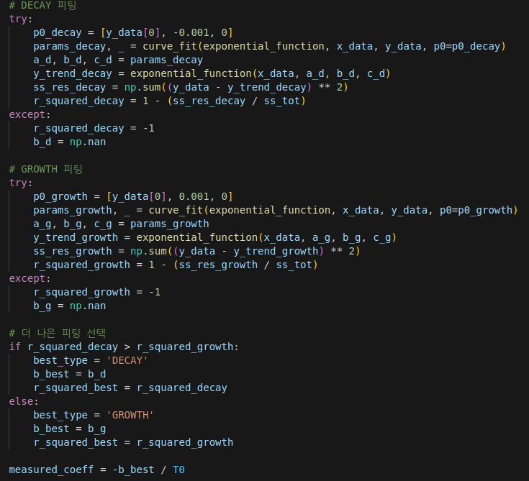
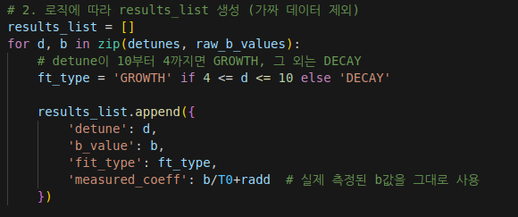
Appendix A. Simulations (Goal 1, 2)
Process of simulation
· Differentiate growth & decay case considering radiation loss.
· Plot theoretical(+ approximated) line and measured data scatter.

Slide 28
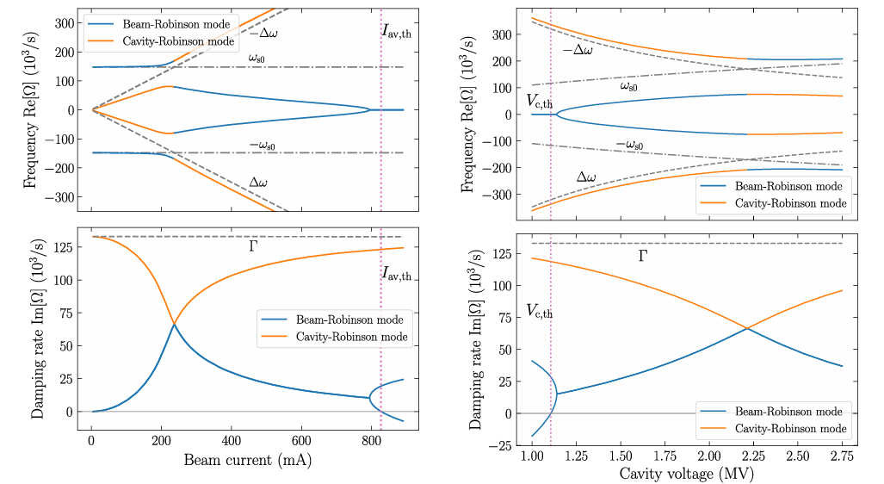
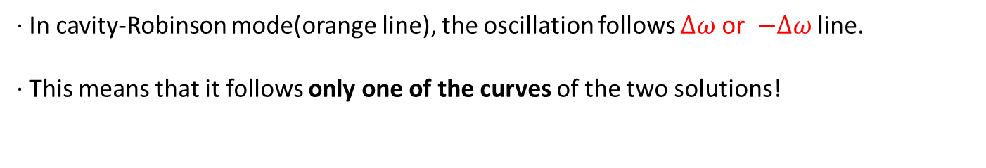
Appendix B. Issues
Expectation
· In cavity-Robinson mode(orange line), the oscillation follows $∆ω$ or $−∆ω$ line.
· This means that it follows only one of the curves of the two solutions!

Slide 29
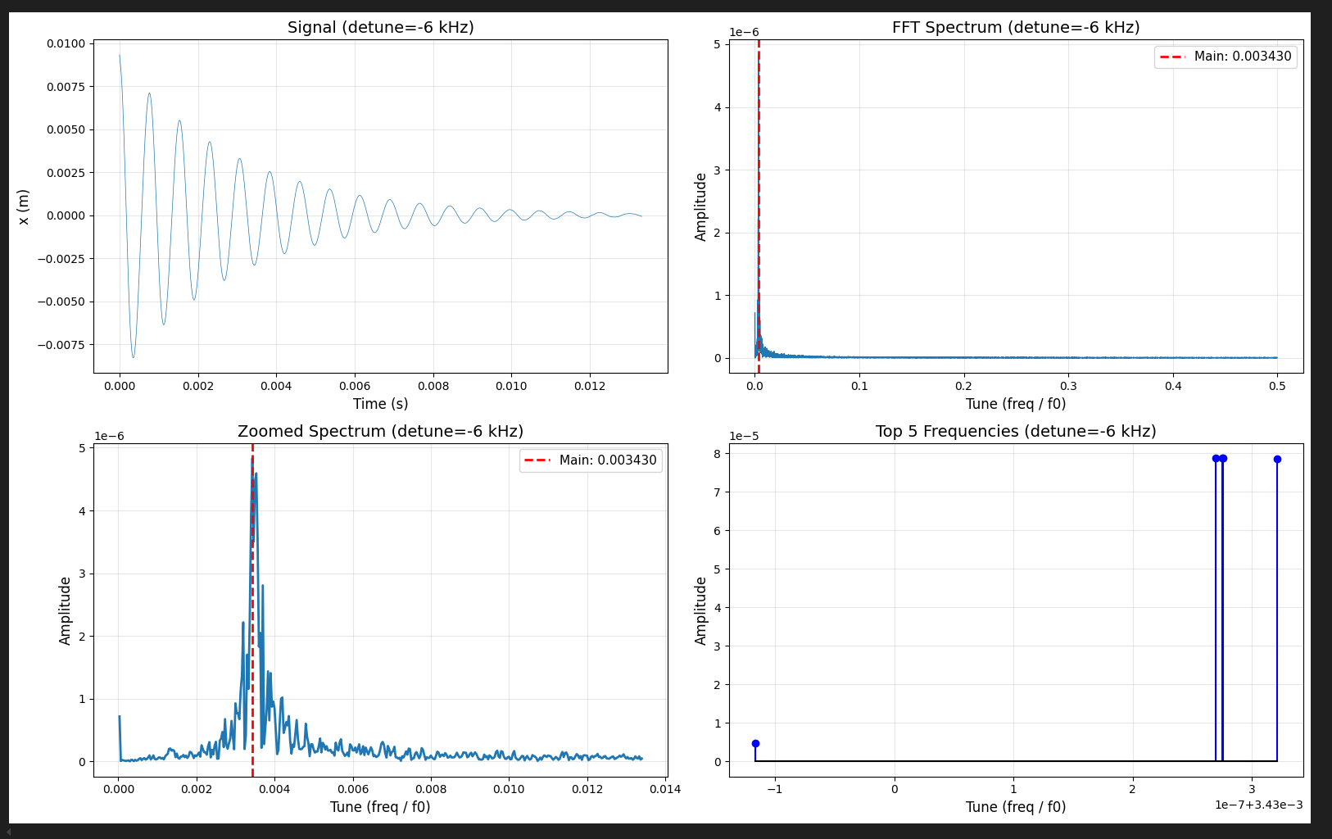
Appendix C. Simulations (Goal 3)
Process of simulation
· Repeat the previous process… but,
· Use NAFF algorithm(Numerical Analysis of Fundamental Frequencies)
-> 5 of the strongest frequencies can be searched!

Slide 30
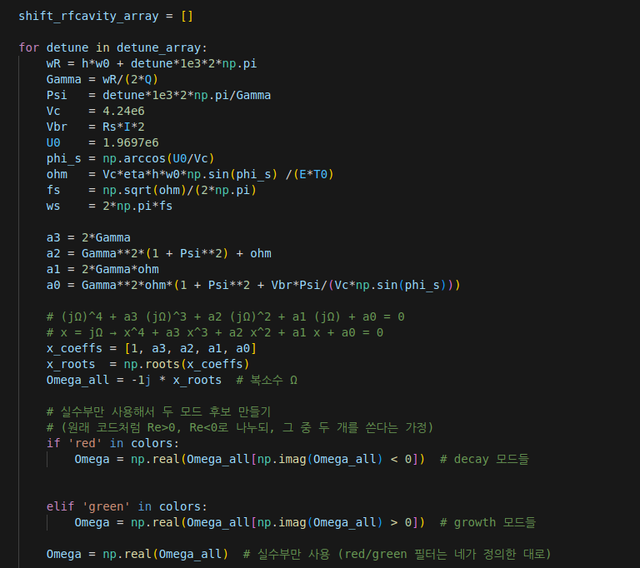
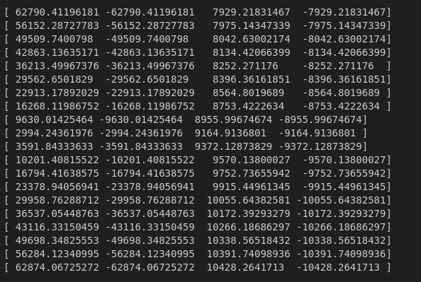

Appendix C. Simulation (Goal 3)
Process of simulation
· Solve the equation, save the solutions to a list.
· Choose the nearest solution to the synchrotron frequency($ω_{s}$).
(In above list, the 3rd components are.)

Slide 31
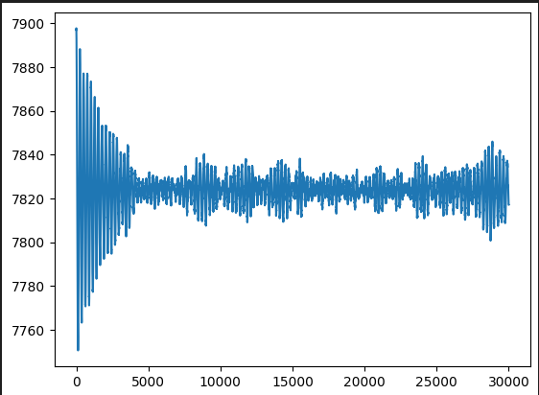
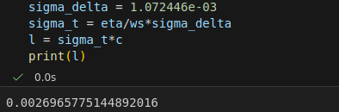
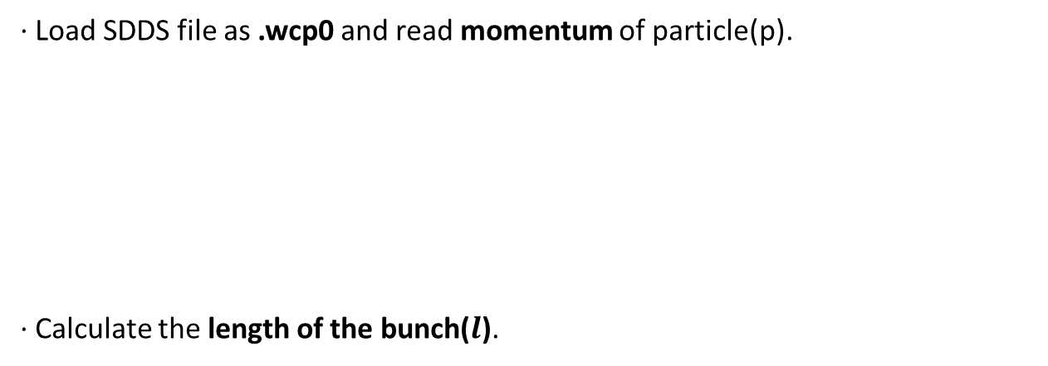
Appendix D. Simulations (Goal 1)
Process of simulation
· Load SDDS file as .wcp0 and read momentum of particle(p).
· Calculate the length of the bunch($l$).
$$l=2.7 mm$$

Slide 32


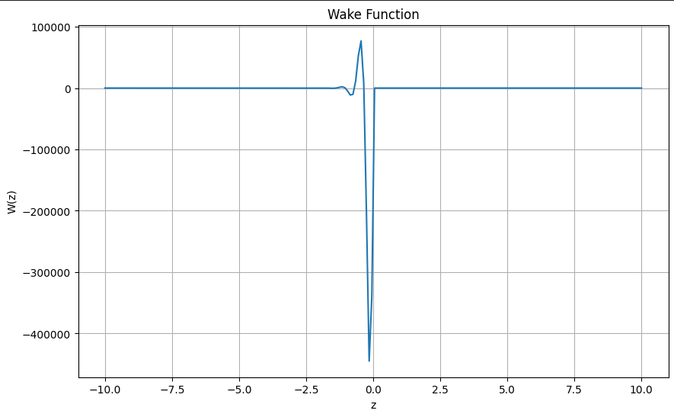
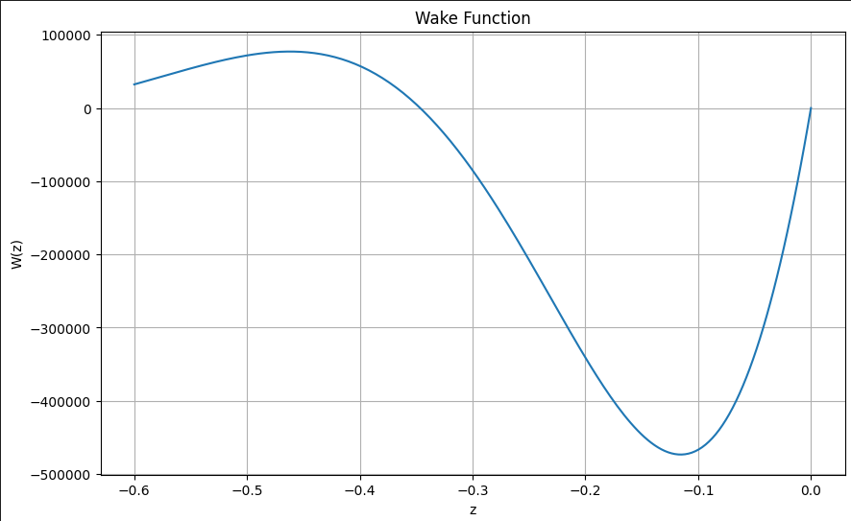
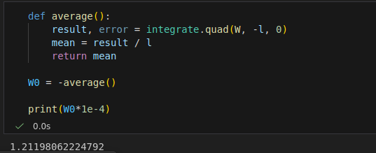


Appendix D. Simulations (Goal 1)
Process of simulation
· Calculate the transverse wake field using the below equation.
· Calculate $W_{0}$ defined as the $W_{1}$ average of the $−l<z<0$ section.
$$W_{0}=1.212 {cm}^{−2}$$

Slide 33
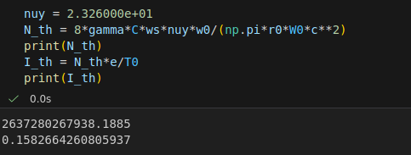



Appendix D. Simulations (Goal 2)
Process of simulation
· Calculate the threshold current using previous theory.
· Plot the signal of centroid and find the peak frequency using FFT.
$$N_{th}=2.64×{10}^{12}$$
$$I_{th}=158 mA$$

Slide 34
References
1] Ch. 4 of Physics of Collective Beam Instabilities in High Energy Accelerators, 1993, Alex Chao.
2] Formula of Wake Fields and Impedances, 2024, 박영민, 심치현, 박용운.
3] Robinson Instability in Circular Accelerators, 2025, 박영민, 박용운.
4] Systematic study on the static Robinson instability in an electron storage ring, 2023, Takaaki Yamaguchi 외 4명.
5] Stability of beam in Radiofrequency system, 1964, Kenneth. W. Robinson.
6] Measurement of Coherent Synchrotron Frequencies under conditions close to the Robinson Limit at the Aichi Synchrotron Radiation center, 2024, S. Sakanaka 외 5명.

