Slide 1
High-power EUV free-electron laser for future lithography
Minseo Jeong

Slide 2
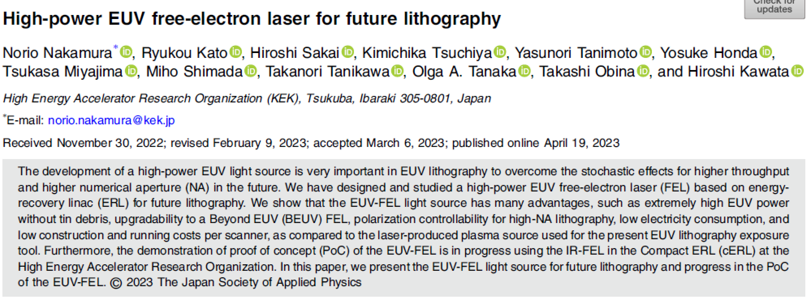

Slide 3
Index
Energy recovery linac(ERL)
EUV lithography
Setup of EUV-ERL
Proof of concept with cERL

Slide 4
Energy Recovery Linac
Energy recovery linac(ERL): recovers energy at linac by deceleration of used beam
Originally proposed for efficient e⁺/e⁻ collider(Tigner, 1965)
Demonstrated after development of reliable SRF linac(1987)

Slide 5
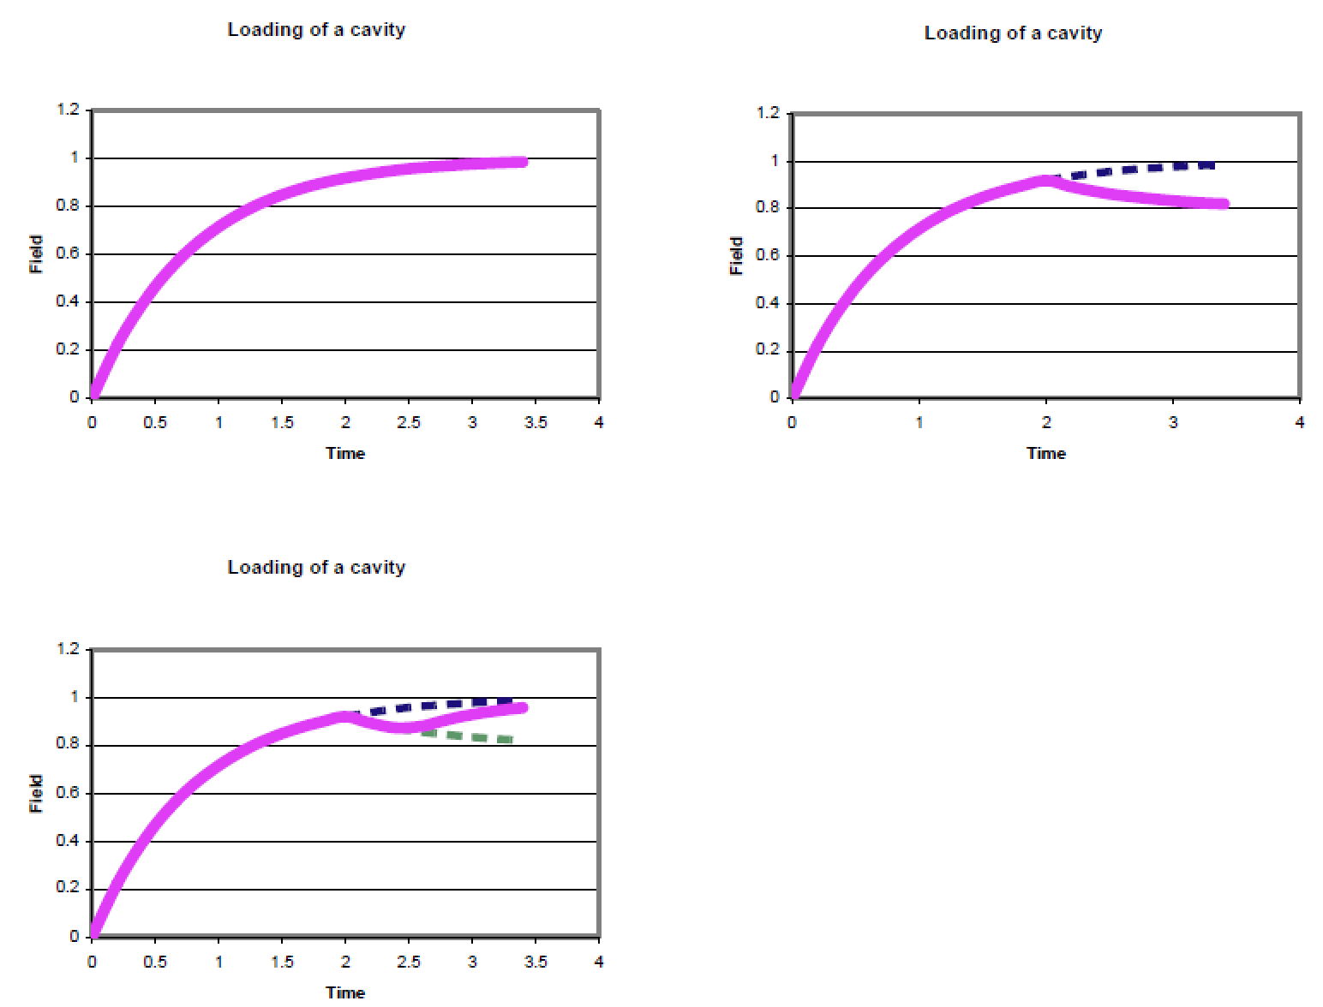
Energy Recovery Linac
Fields in a cavity. a) filling an empty cavity, b) an accelerated beam loads the cavity, c) a decelerated beam fills the cavity

Slide 6
Advantages of Energy Recovery Linac
High current/high beam power(~100mA @ GeV)
Flexible beamline
Short bunch
High energy efficiency

Slide 7
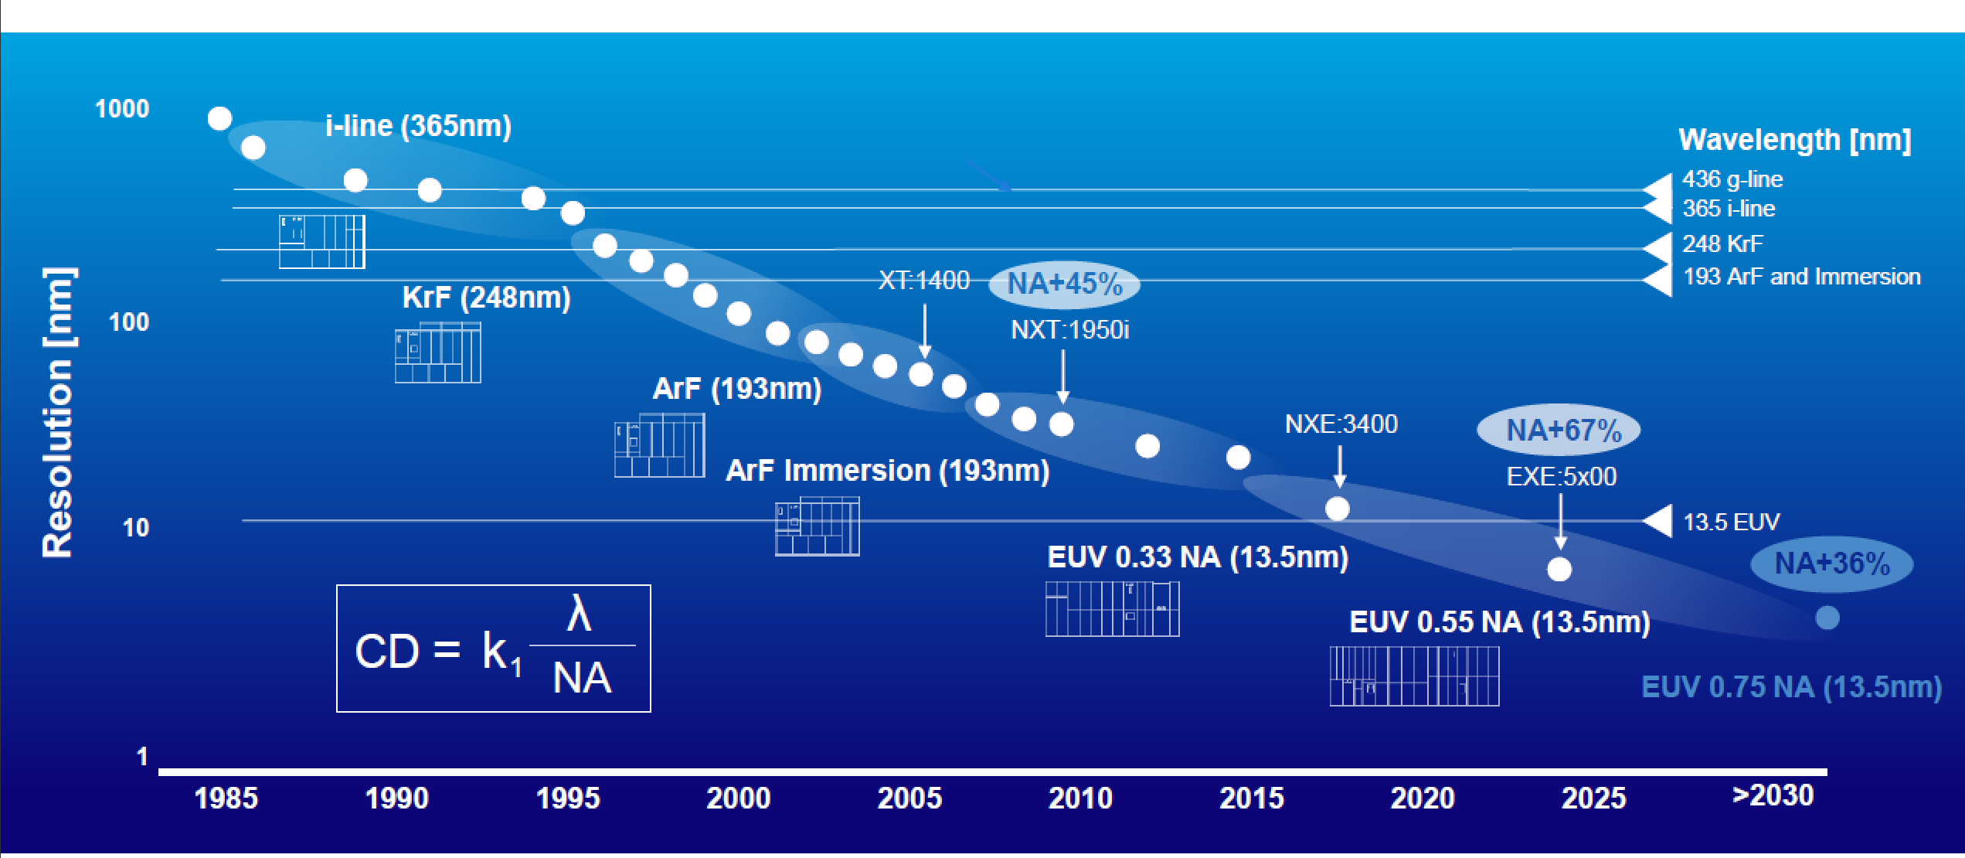
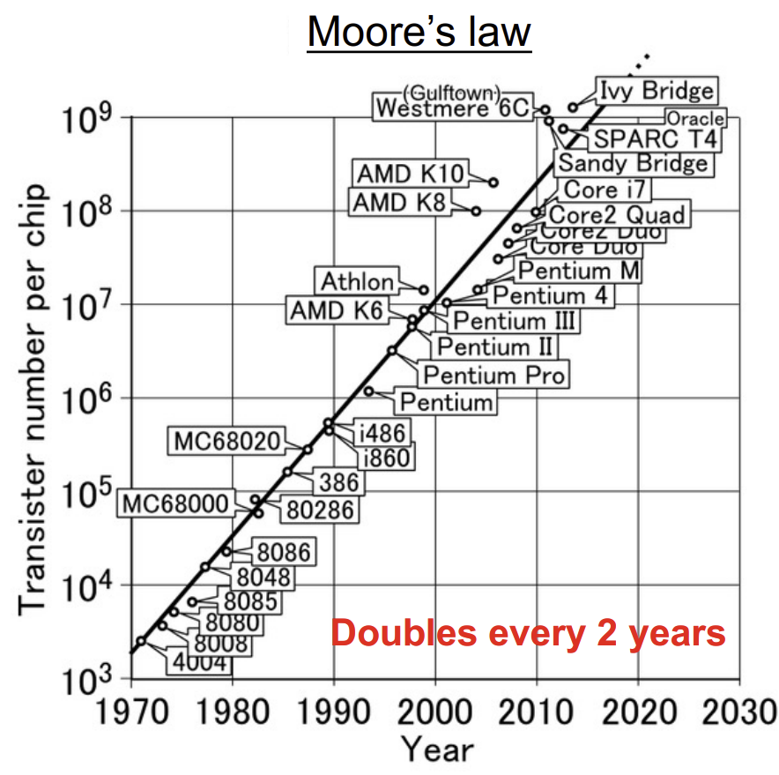

EUV Lithography
Photolithography: manufacturing process that involves using light to transfer a pattern onto a photoresist layer deposited on a silicon wafer
Resolution of lithography=$k_{1}\frac{λ}{NA}$
Numerical aperture(NA)= nsinθ<0.9
k₁= process parameter(0.25<k₁<1)
Notes:
NA: maximum range of angles over which the optical system can accept light

Slide 8
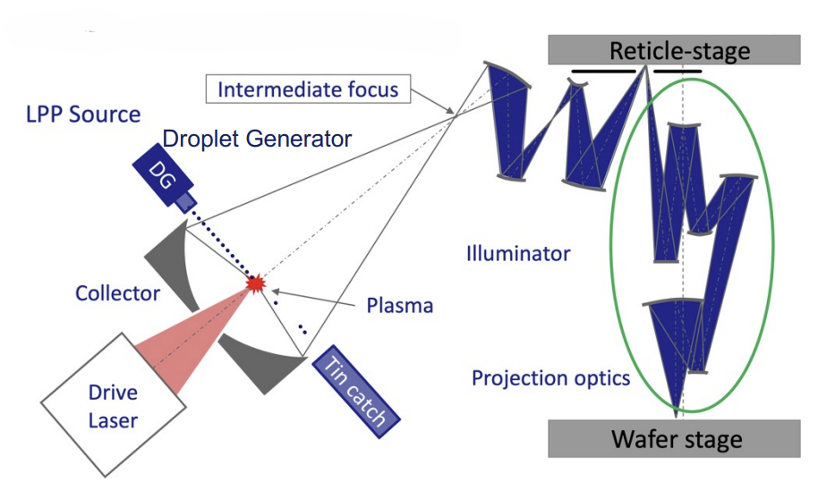
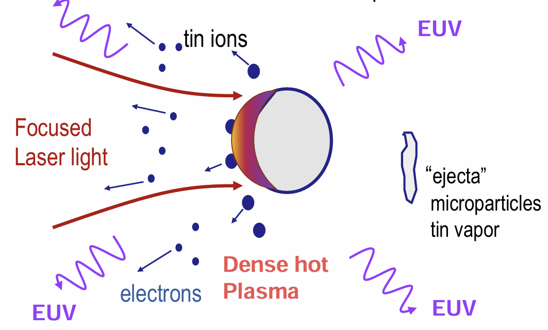
EUV Lithography
Current method for EUV light source: laser-produced plasma
Tin plasma generated by a CO2 drive laser and tin droplets generates EUV light
Contamination risk by tin debris

Slide 9
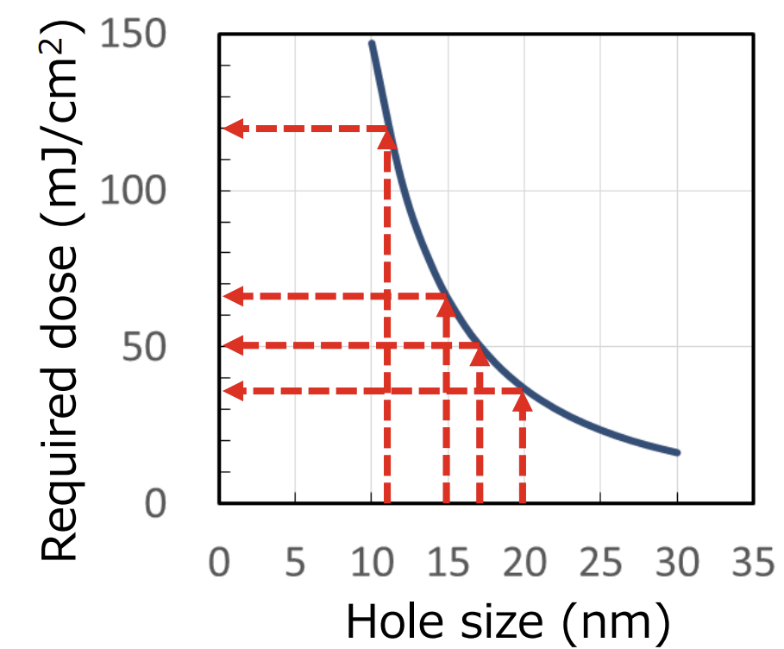
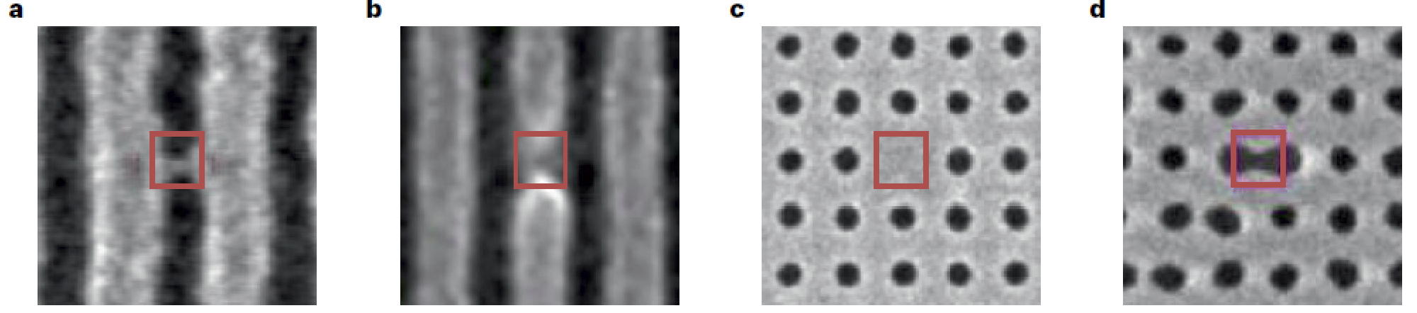
EUV Lithography
Stochastic effect happens during EUV lithography due to high photon energy
High EUV power required to mitigate
(1.5 kW for the 3 nm node, 2.8 kW for the 2 nm node)

Slide 10
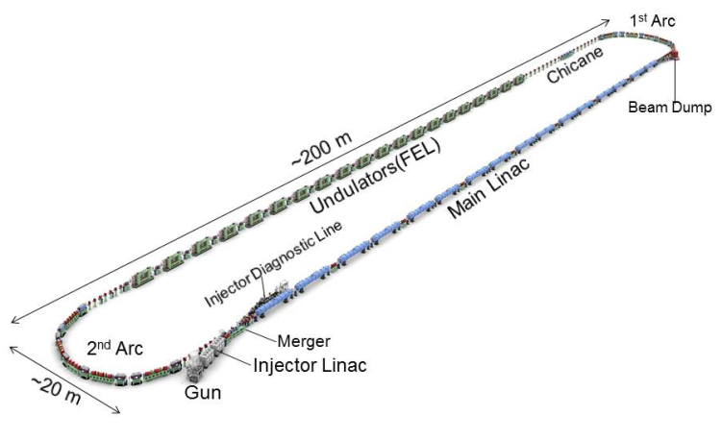
EUV-ERL
cERL-FEL Accelerator Parameters
Parameters | Target value
Wavelength | 13.5 nm
EUV Power | 10 kW
Bunch charge | 60 pC
Beam energy | 800 MeV
Repetition frequency | 162.5 MHz
Average current | 9.75 mA
Accelerating gradient | 12.5 MV/m
Number of cavities | 64

Slide 11
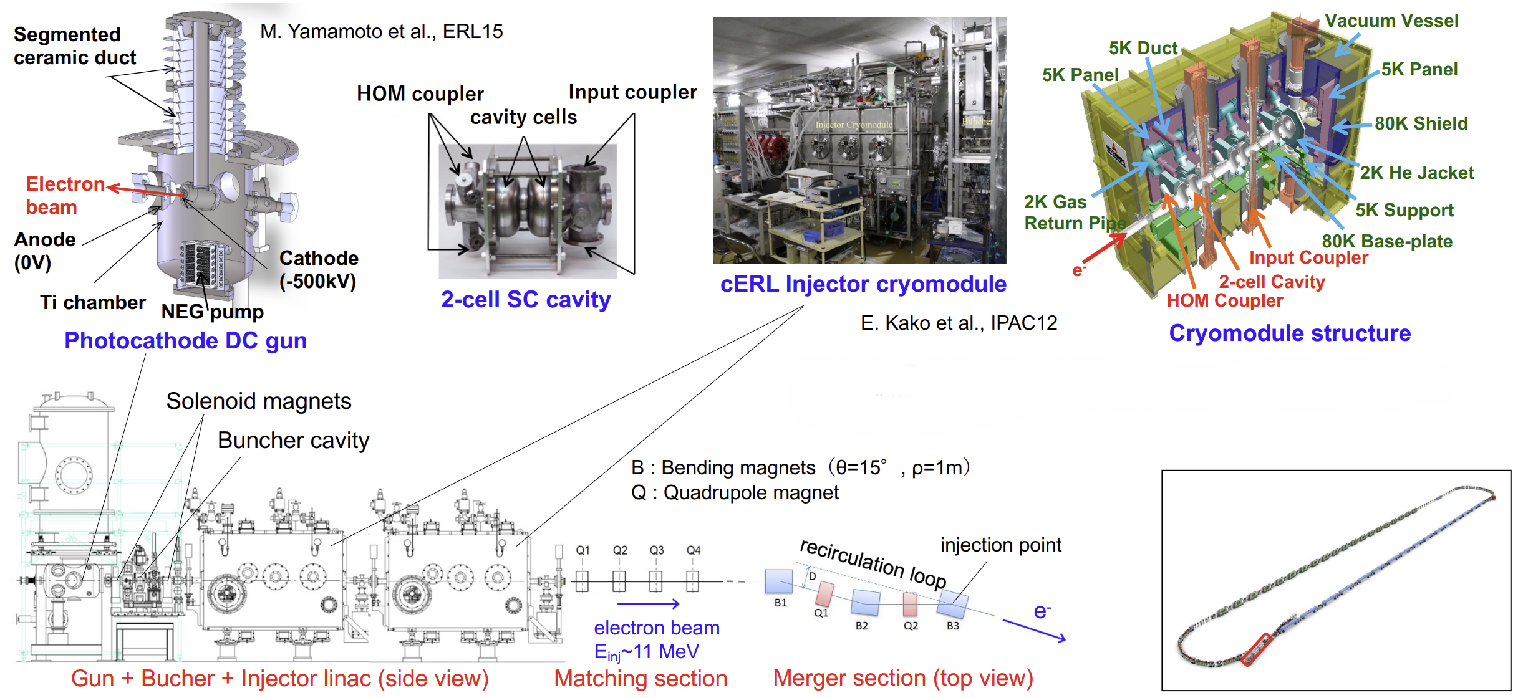
EUV-ERL
Injector: DC photogun(500kV) + 2 cryomodule w/ 3 2-cell SRF cavity

Slide 12
EUV-ERL
Linac: 16 cryomodules(64 9-cell cavities w/ gradient 12.5MV/m)
Quadrupole triplet is installed between every 2 cryomodules
Cells were optimized for minimization of E_{pk}/E_{acc} and B_{pk}/E_{acc,} flatness of field, and low Q factor of HOM
Cavity Parameters | KEK-EUV | TESLA
Frequency (MHz) | 1300 | 1300
Iris diameter (mm) | 70 | 70
R/Q (Ω) | 1009 | 1036
G (Ω) | 269 | 270
Ep/Eacc | 2.0 | 2.0
Hp/Eacc (mT/(MV/m)) | 4.23 | 4.26
BBU threshold(mA) | ~190 | ~80
End Cell A
End Cell B
TESLA Center Cell
Φ100 mm BP
Φ110 mm BP
HOM
HOM Damper
Notes:
field emission - E_{pk}/E_{acc}
thermal load/quench - B_{pk}/E_{acc}를 4.25mT/(MV/m

Slide 13
EUV ERL
Higher order mode(HOM) in the cavity can cause increase of energy spread(longitudinal) and beam breakup(BBU) instability(transverse)
Beam line absorber was used(AlN, 100W at 80K) for broadband HOM damping
Position of absorber in the cavity was optimized
Notes:
Heat load at cryomodule vs cost

Slide 14
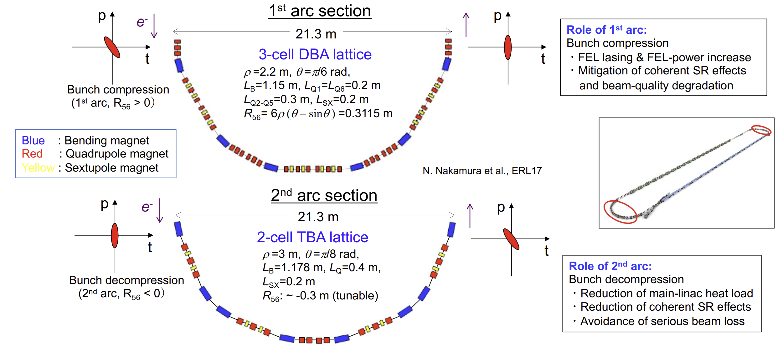
EUV-ERL
Arc

Slide 15
EUV-ERL
Beam parameter after 1st arc:
- normalized horizontal/vertical emittances: 2.0/ 0.9 mm·mrad
- bunch length: 39 fs(rms)
- energy spread: 0.1%

Slide 16
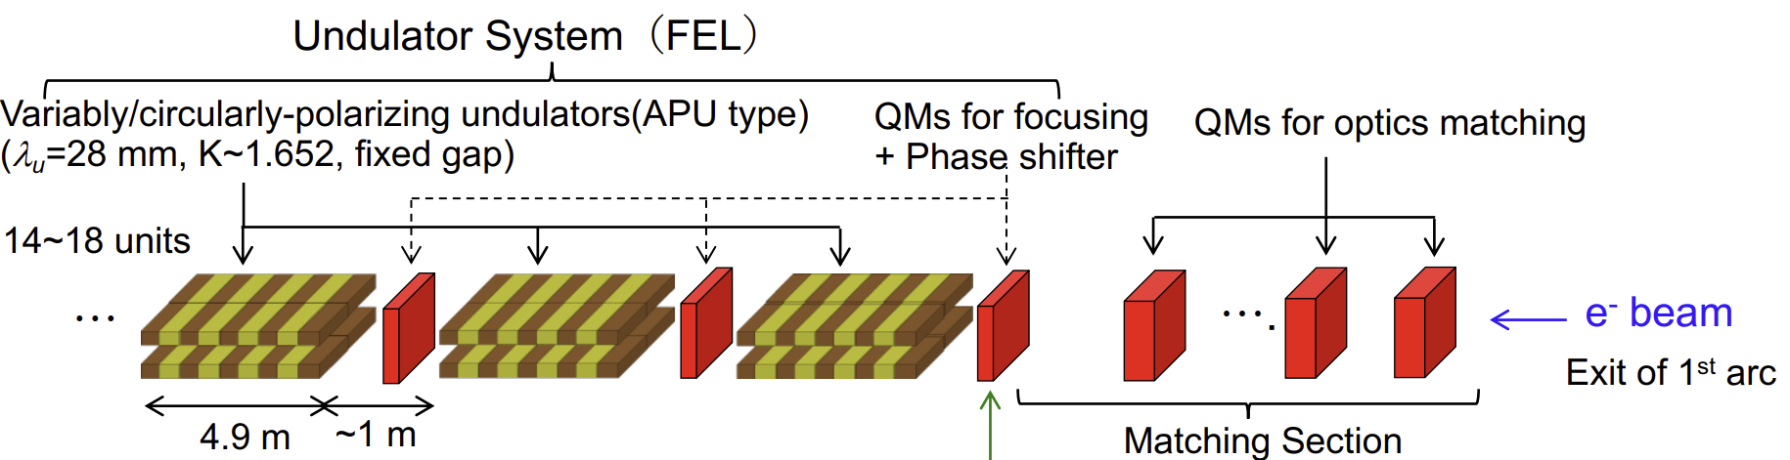
EUV-ERL
Undulator: 18 circular-polarizing (helical) undulators of 4.9m length

Slide 17
EUV-ERL
Optical beamline

Slide 18
Advantages of EUV-ERL
Generates high EUV power (>10 kW) without tin contamination on the Mo/Si mirror
Upgradable for shorter wavelength
Polarization controllable
Efficient(electricity and cost)

Slide 19

EUV-ERL
EUV-ERL beamline can be converted for BEUV(6.6~6.7nm) by increasing the beam energy by a factor of $\sqrt{2}\left(∵λ∝E_{beam}^{−2}\right)$
For multi-pass ERL, threshold of BBU can be decreased

Slide 20
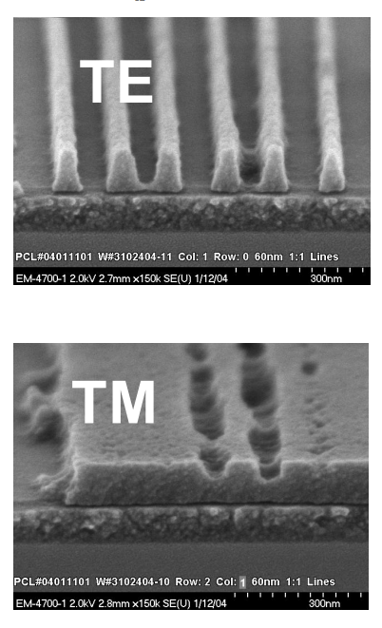

EUV-ERL
Polarization of EUV is important for better high NA operation
- p-pol:$I_{s}=2I_{0}\left\{1+\cos{2θ}\cos{\frac{4πn}{λ}x\sin{θ}}\right\}$
- s-pol:$I_{s}=2I_{0}\left\{1+\cos{\frac{4πn}{λ}x\sin{θ}}\right\}$
θ : the incident angle
n : the refractive index
TE(s-polarization)
TM(p-polarization)

Slide 21
EUV-ERL
Electricity consumption:
-EUV-FEL : ~7.0 MW/10-kW EUV ⇒ ~0.7 MW/1-kW EUV(or scanner)
-LPP : ~1.15 MW/500-W EUV(2025) ⇒ ~2.3 MW/1-kW EUV(or scanner)
Construction cost
-EUV-FEL : ~US$400M/10-kW EUV ⇒ ~US$40M/1-kW EUV(or scanner)
-LPP : ~US$20M/500-W EUV(2025) ⇒ ~US$40M/1-kW EUV(or scanner)
Running cost
-EUV-FEL : ~US$40M/10-kW EUV ⇒ ~US$4M/1-kW EUV(or scanner)
-LPP : ~US$15M/250-W EUV(2023) ⇒ ~US$60M/1-kW EUV(or scanner)
Item | Electric power [MW]
Refrigerator System | 3.2
RF Source | 1.3
Other Components | 1.0
Infrastructure | 1.5
Total | 7.0
Notes:
Infra: cooling-water system, an air-conditioning system, an illumination system, etc

Slide 22
PoC of ERL
cERL
Notes:
wl:10~20um

Slide 23
PoC of ERL
Linearly-polarizing adjustable phase undulators (APUs) with a period of 24 mm for cost reduction
Diagnostics: MCT (HgCdTe) detector, energy meter
Dump line
Radiation monitors

Slide 24
PoC of ERL
Burst mode for beam tuning →CW mode

Slide 25
PoC of ERL
FEL commissioning
The FEL energy of undulator 2 was lower than simulation due to space charge force

Slide 26
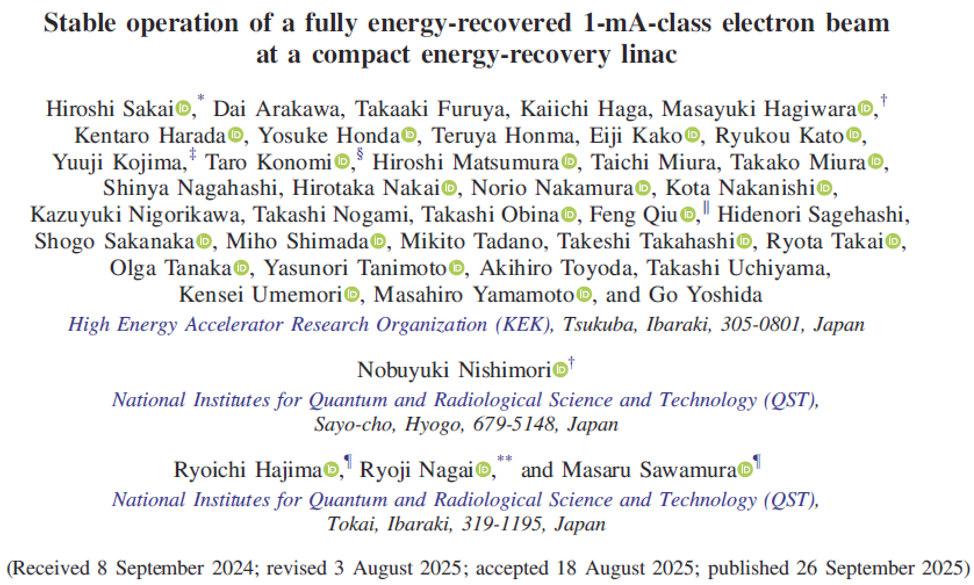
Future Plan
CW operation in 10mA
- upgrade of electron gun
Construction of cryomodule for main linac(~2027)

Slide 27
Summary
High-power EUV-ERL was developed for more powerful EUV light source
The EUV-ERL has many advantages in high EUV power, upgradability to BEUV, polarization control, and low electricity consumption and cost.
Generation of SASE-FEL emission at the cERL IR-FEL was achieved for PoC of the EUV-ERL.

