Slide 1

2026-02-27, Pohang, South Korea
Transverse Phase Space reconstruction
Study of VPP & MENT
DAON LEE
2026 The Beam Diagnostics and Tomography Study
(Room 310, Division of Advanced Nuclear Engineering)

Slide 2
Outline
Ⅰ. Introduction
Ⅱ. 4D-Reconstruction with VPP Data via MENT
- New reconstruction analysis with VPP data via MENT
- Data analysis: 3 variables vs. 2 variables
Ⅲ. Summary

Slide 3
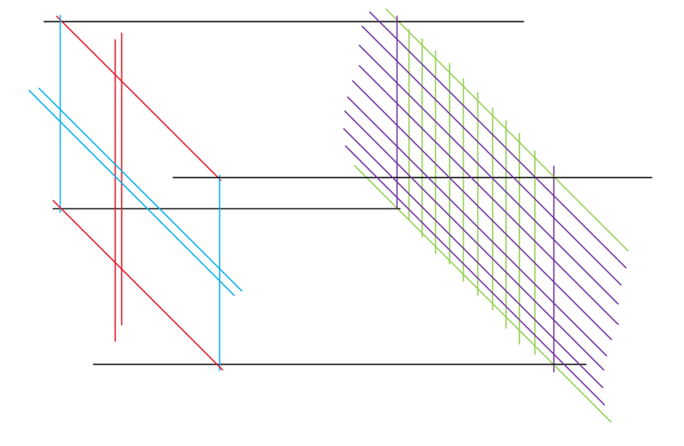
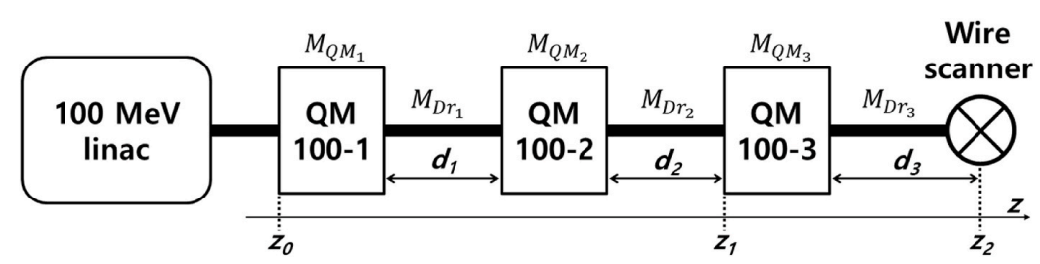
Introduction
- Tomography -
• The slit-based scan
- Need to be thin to define the beam position
- Must be thicker than the stopping range of the high-energy proton beam
• The QM method
- Effective for measuring the transverse emittance
- Can only provide the emittance and the Twiss parameters without offering detailed particle distribution(because it is based on Gaussian beam optics)(halo, non-Gaussian etc.)
$⟹$ To overcome this limitation, the tomography is introduced.
3

Slide 4
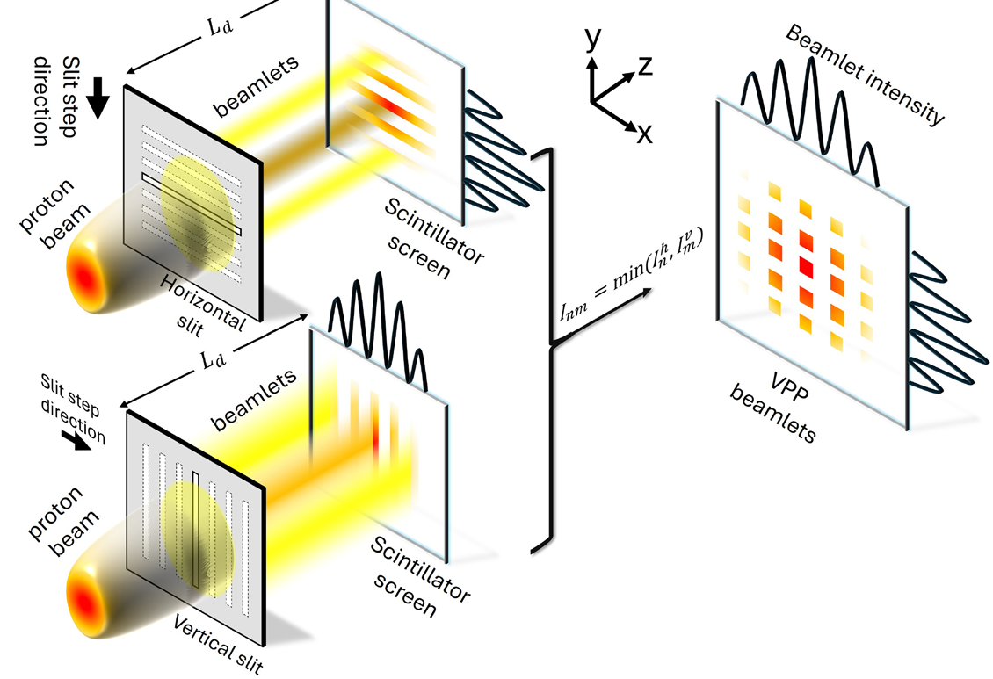
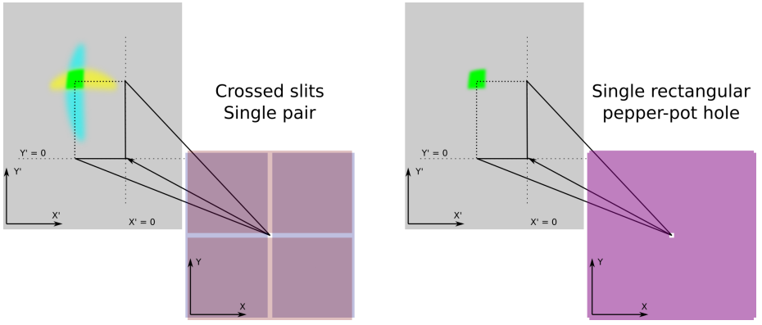

Virtual Pepper Pot(VPP)
- No physical pepper pot -
$I_{nm}=min⁡(I_{n}^{h}, I_{m}^{v})$ : minimum bit principle
4

Slide 5
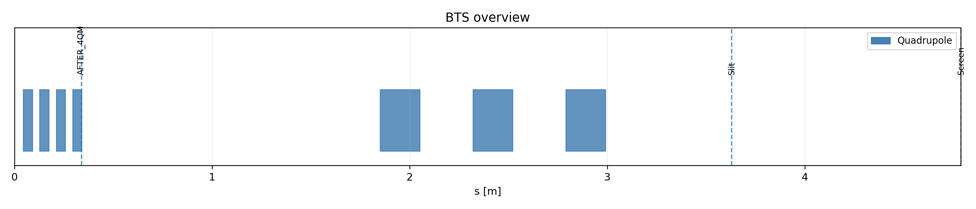
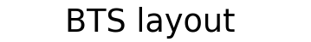


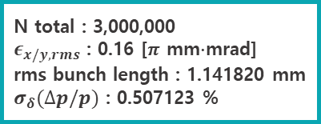

Introduction
- KOMAC BTS(Beam Test Stand) implementation in x-suite -
proton
Drift = 0.11m
1 MeV
$$(x_{i},y_{i})$$
$$(x_{f},y_{f})$$
N total : 3,000,000
$ε_{x/y,rms}$ : 0.16 [$π$ mm$∙$mrad]
rms bunch length : 1.141820 mm
$σ_{δ}(∆p/p)$ : 0.507123 %
Recon
resolution : 25 $μ$m
slit width : 0.1 mm
slit size : 0.25 mm
5

Slide 6
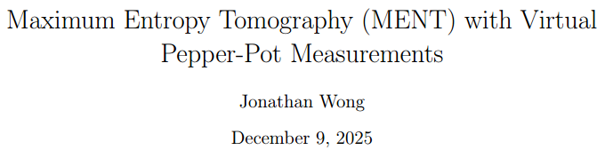



4D-Reconstruction with VPP Data via MENT
- New reconstruction scheme with MENT -
$$ρ\left(x_{i},x_{i}^{′},y_{i},y_{i}^{′}\right)=ρ\left(x_{i},\frac{x_{f}−x_{i}}{L},y_{i},\frac{y_{f}−y_{i}}{L},\right)=L^{2}\tilde{ρ}(x_{i},x_{f},y_{i},y_{f})$$
Horizontal scan:
$$ρ_{h}^{\left(meas.\right)}\left(x_{i},x_{f},y_{f}\right)=∫\tilde{ρ}\left(x_{i},x_{f},y_{i},y_{f}\right)dy_{i}$$
$${\tilde{ρ}}_{3D}\left(x_{i},x_{f},y_{f}\right)=\frac{H[i,f_{x},f_{y}]}{∆x_{i}∆x_{f}(f_{x})∆y_{f}(f_{y})}$$
Vertical scan:
$$ρ_{v}^{\left(meas.\right)}\left(y_{i},x_{f},y_{f}\right)=∫\tilde{ρ}\left(x_{i},x_{f},y_{i},y_{f}\right)dx_{i}$$
6

Slide 7
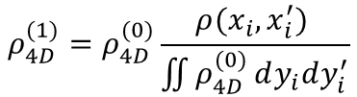


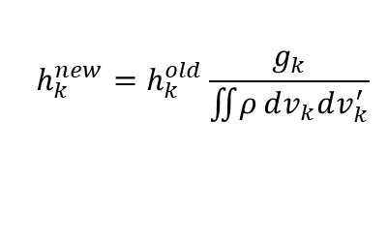


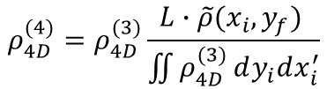


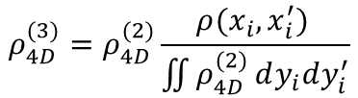

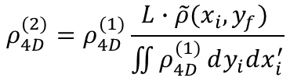
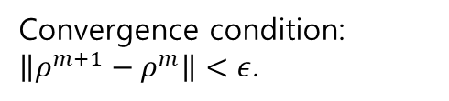
MENT Method
- Gauss-Seidel iterative method -
$$ρ^{∗}=C^{′}∙\exp\left(−\sum_{j=1}^{n}{λ_{j}\left(u_{j},u_{j}^{′}\right)}−1\right)≡C∙\prod_{j=1}^{n}{h_{j}\left(u_{j},u_{j}^{′}\right)}$$
$$ρ_{1},ρ_{2},ρ_{3}⋯=constraints$$
$$M=∫ρ dx_{1} or dx_{1}dx_{2} : marginal$$
$$ρ^{(0)}=gaussian distribution$$
$$Gauss−Seidel.$$
$$if we have two constraints[ρ\left(x_{i},x_{i}^{′}\right), \tilde{ρ}(x_{i},y_{f})]$$
$$h_{k}^{new}=h_{k}^{old}\frac{g_{k}}{\iint{ρ}dv_{k}dv_{k}^{′}}$$
$$ρ_{4D}^{(1)}=ρ_{4D}^{(0)}\frac{ρ(x_{i},x_{i}^{′}) }{\iint{ρ_{4D}^{(0)}}dy_{i}dy_{i}^{′}}$$
$$ρ_{4D}^{(3)}=ρ_{4D}^{(2)}\frac{ρ(x_{i},x_{i}^{′}) }{\iint{ρ_{4D}^{(2)}}dy_{i}dy_{i}^{′}}$$
$$⟹$$
$$⋯$$
Convergence condition:
$\left\|ρ^{m+1}−ρ^{m}\right\|<ε$.
$$ρ_{4D}^{(2)}=ρ_{4D}^{(1)}\frac{L∙\tilde{ρ}(x_{i},y_{f}) }{\iint{ρ_{4D}^{(1)}}dy_{i}dx_{i}^{′}}$$
$$ρ_{4D}^{(4)}=ρ_{4D}^{(3)}\frac{L∙\tilde{ρ}(x_{i},y_{f}) }{\iint{ρ_{4D}^{(3)}}dy_{i}dx_{i}^{′}}$$
7

Slide 8
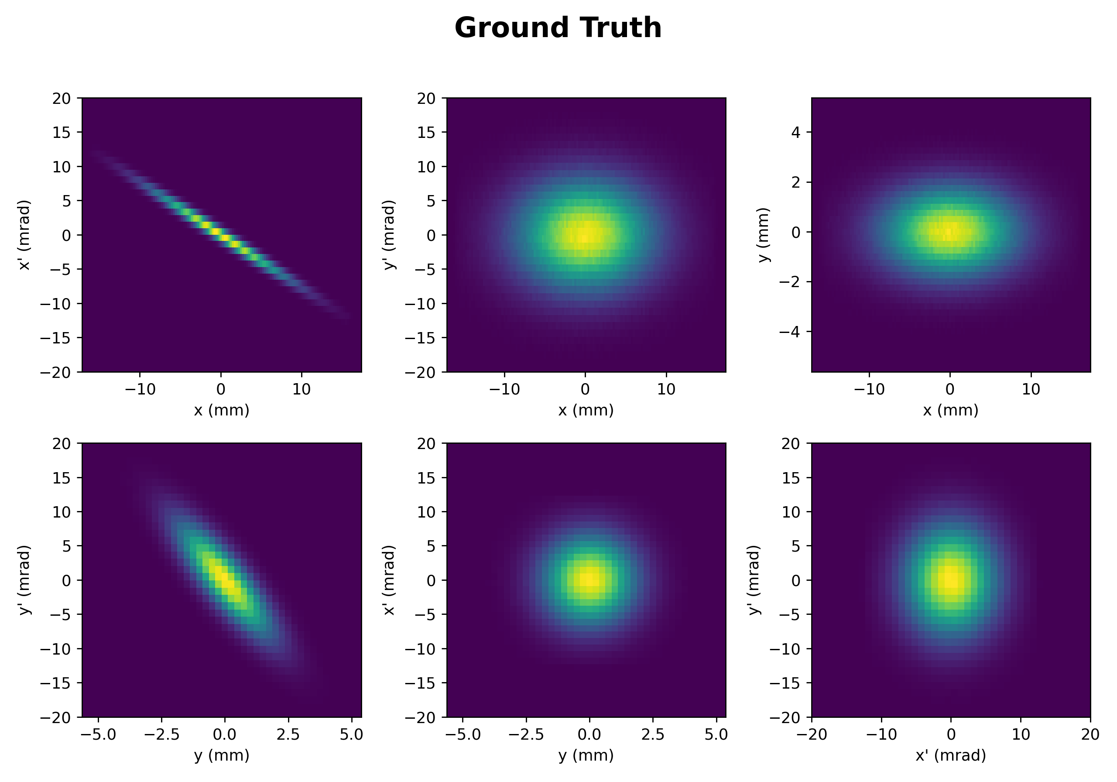
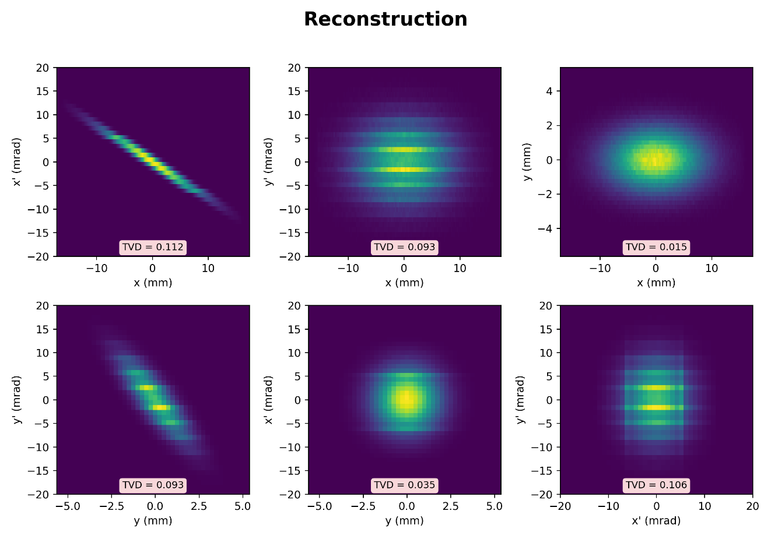



VPP Data Analysis
- 3 variables -
$${\tilde{ρ}}_{4D}^{(sol.)}=C_{1}h_{1}\left(x_{i},x_{f},y_{f}\right)h_{2}\left(y_{i},x_{f},y_{f}\right)$$
$${\tilde{ρ}}_{4D}^{(sol.)}=\frac{ρ_{h}^{\left(meas.\right)}\left(x_{i},x_{f},y_{f}\right)ρ_{v}^{\left(meas.\right)}\left(y_{i},x_{f},y_{f}\right)}{ρ_{2D}^{\left(meas.\right)}\left(x_{f},y_{f}\right)}$$
$$ρ\left(x_{i},x_{i}^{′},y_{i},y_{i}^{′}\right)=L^{2}\tilde{ρ}(x_{i},x_{f},y_{i},y_{f})$$
8

Slide 9

VPP Data Analysis
- Origin VPP method vs. 3 variables analysis -
• VPP
• 3 VAR.
- Unlike PP, which can fail when beamlets overlap, VPP can provide continuous measurements even in overlap regions.
- Because no pepper-pot grid needs to be fabricated, the processing workflow is faster.
- Coupling data limitation
$${\tilde{ρ}}_{4D}^{(sol.)}=\frac{ρ_{h}^{\left(meas.\right)}\left(x_{i},x_{f},y_{f}\right)ρ_{v}^{\left(meas.\right)}\left(y_{i},x_{f},y_{f}\right)}{ρ_{2D}^{\left(meas.\right)}\left(x_{f},y_{f}\right)}$$
$\left\langle x_{i}y_{i}\right\rangle =⨌x_{i}y_{i}ρ^{\left(sol\right)}dx_{i}dy_{i}dx_{f}dy_{f}$ & $\left\langle x_{i}\right\rangle =\left\langle y_{i}\right\rangle =0$
$$⟹ \left\langle x_{i}y_{i}\right\rangle =0$$
9

Slide 10


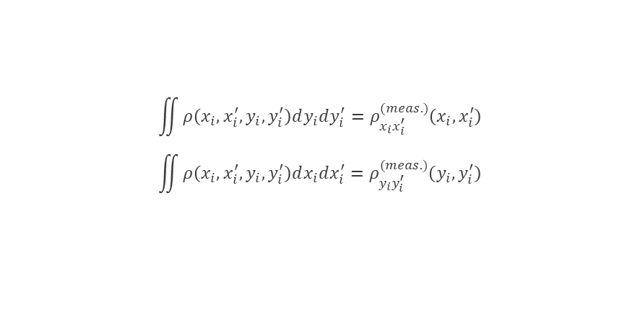
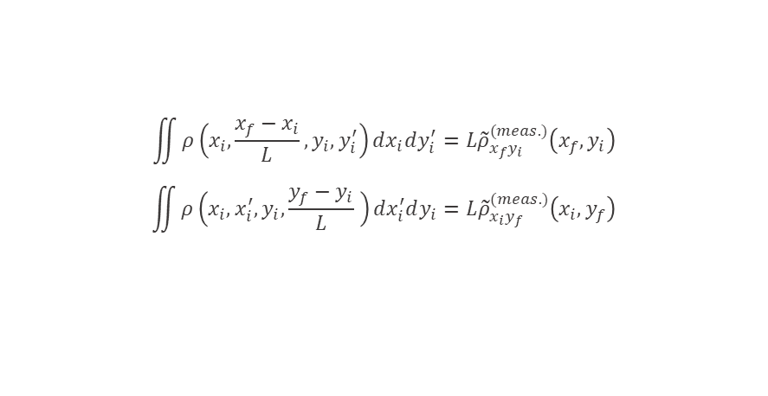
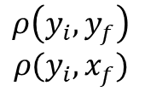
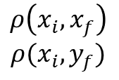
VPP Data Analysis
- 2 variables -
Parallel slits
Perpendicular slits
$$\iint{ρ\left(x_{i},x_{i}^{′},y_{i},y_{i}^{′}\right)dy_{i}dy_{i}^{′}}=ρ_{x_{i}x_{i}^{′}}^{(meas.)}\left(x_{i},x_{i}^{′}\right)$$
$$\iint{ρ\left(x_{i},x_{i}^{′},y_{i},y_{i}^{′}\right)dx_{i}dx_{i}^{′}}=ρ_{y_{i}y_{i}^{′}}^{(meas.)}\left(y_{i},y_{i}^{′}\right)$$
$$\iint{ρ\left(x_{i},\frac{x_{f}−x_{i}}{L},y_{i},y_{i}^{′}\right)dx_{i}dy_{i}^{′}}=L{\tilde{ρ}}_{x_{f}y_{i}}^{(meas.)}\left(x_{f},y_{i}\right)$$
$$\iint{ρ\left(x_{i},x_{i}^{′},y_{i},\frac{y_{f}−y_{i}}{L} \right)dx_{i}^{′}dy_{i}}=L{\tilde{ρ}}_{x_{i}y_{f}}^{(meas.)}\left(x_{i},y_{f}\right)$$
$$x^{′}, y^{′}binning vs. x_{f},y_{f} binning$$
$$ρ_{h}^{\left(meas.\right)}\left(x_{i},x_{f},y_{f}\right)$$
$$ρ\left(x_{i},x_{f}\right)$$
$$ρ(x_{i},y_{f})$$
$$ρ\left(y_{i},y_{f}\right)$$
$$ρ(y_{i},x_{f})$$
$$ρ_{v}^{\left(meas.\right)}\left(y_{i},x_{f},y_{f}\right)$$
Same as 3VAR.
10

Slide 11
Summary
1) 3변수 데이터로 MENT 복원을 했을 때, 커플링이 없는 빔에서는 복원이 잘 되었다.
2) 원래 VPP 방법은 커플링 정보를 포함하며 PP 방법에 비해 overlapping 구간에서 연속적인 측정이 가능하다. / 3변수 데이터 처리 방식은 커플링 정보는 포함하지 않지만 가상의 pepper pot 그리드를 생성하지 않기 때문에 복원 속도가 매우 빠르다.
3) 2변수 처리는 틸다 공간을 제외하곤 binning의 단위 차이로 인해 MENT 방법이 어렵다.
11

Slide 12
Thank you !

